Slide 1
Crash Course in Econometrics
ECON 380

Slide 2
What is Econometrics
What is Econometrics?
Defined as “an application of statistical methods to economic data in order to give empirical content to economic relationships.”
For instance, suppose that you are curious about the determinants of a high school students’ SAT scores.
You expect that the students’ SAT scores will depend on the number of hours that a student studies per week.

Slide 3
What is Econometrics
While there are countless other factors that can affect the students’ SAT scores, for now, let’s simplify the model to just the number of hours studied, $H$.
Then, we are assuming a “model” that states that the SAT score is some unknown function $f(⋅)$ of $H$.
$$SAT=f(H)$$
We can expect that as $H$ increases, SAT scores will also tend to increase.

Slide 4
Single-Variable Linear Regression
We can make an educated guess and assume that the “true” relationship between SAT scores and hours studied takes the following form.
$$SAT_{i}=β_{0}+β_{1}⋅H_{i}+ε_{i}$$
Where…
The left-hand side (SAT) is the dependent variable.
The variable(s) on the right-hand side are independent variables.
The term $ε$ represent the error terms.
The subscript $i$ indicates that the values are measured for individual $i$ in the dataset where $i=1,2,⋯,N$.

Slide 5
Single-Variable Linear Regression
We can make an educated guess and assume that the “true” relationship between SAT scores and hours studied takes the following form.
$$SAT_{i}=β_{0}+β_{1}⋅H_{i}+ε_{i}$$
Where…
$β_{0}$ represents the true baseline level of SAT scores that students are expected to earn when $H=0$.
$β_{1}$ represents the true effect of studying one extra hour on students’ SAT scores.
$$β_{1}=\frac{∂SAT_{i}}{∂H_{i}}$$

Slide 6
Single-Variable Linear Regression
Our goal would be to produce an estimate of $β_{1}$, the true parameter, which we label ${\hat{β}}_{1}$. (“beta-one hat”)
Actually, our goal would be to find all $\hat{β}$ so that we can estimate a students’ SAT scores $\hat{SAT}$ for any student given information about the hours they study.
$${\hat{SAT}}_{i}={\hat{β}}_{0}+{\hat{β}}_{1}⋅H_{i}$$
Based on our assumption about the true model, we estimate $β_{1}$ with “Ordinary Least Squares (OLS).”

Slide 7
Single-Variable Linear Regression
OLS aims to choose the $β$ values that minimize the squared sum of errors (SSE).
$$SSE=\sum_{i=1}^{N}{{\left(SAT_{i}−{\hat{SAT}}_{i}\right)}^{2}}$$
Let’s examine this a bit:
$SAT_{i}−{\hat{SAT}}_{i}$ is going to be the error of our estimates.
Not the $ε_{i}$ terms, but the distance between the students’ actual SAT score and our estimate ${\hat{SAT}}_{i}$.
Since the error can be both negative or positive, depending on the individual $i$, we take the squared value.

Slide 8
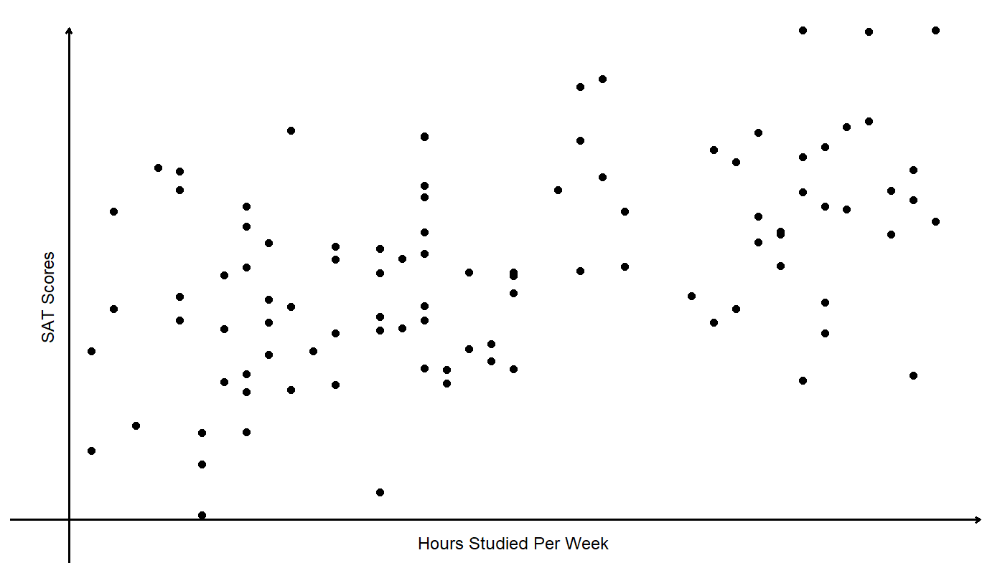
Single-Variable Linear Regression

Slide 9
Single-Variable Linear Regression
In terms of visualization, OLS is identical to “finding the straight line that minimizes the errors.”
Suppose we select a random line:
$${\hat{SAT}}_{i}=800+0⋅H_{i}$$
Here we are assuming that the number of hours that a student invests in preparing for the SAT has no effect on their expected scores.
Visually, it would look like…

Slide 10
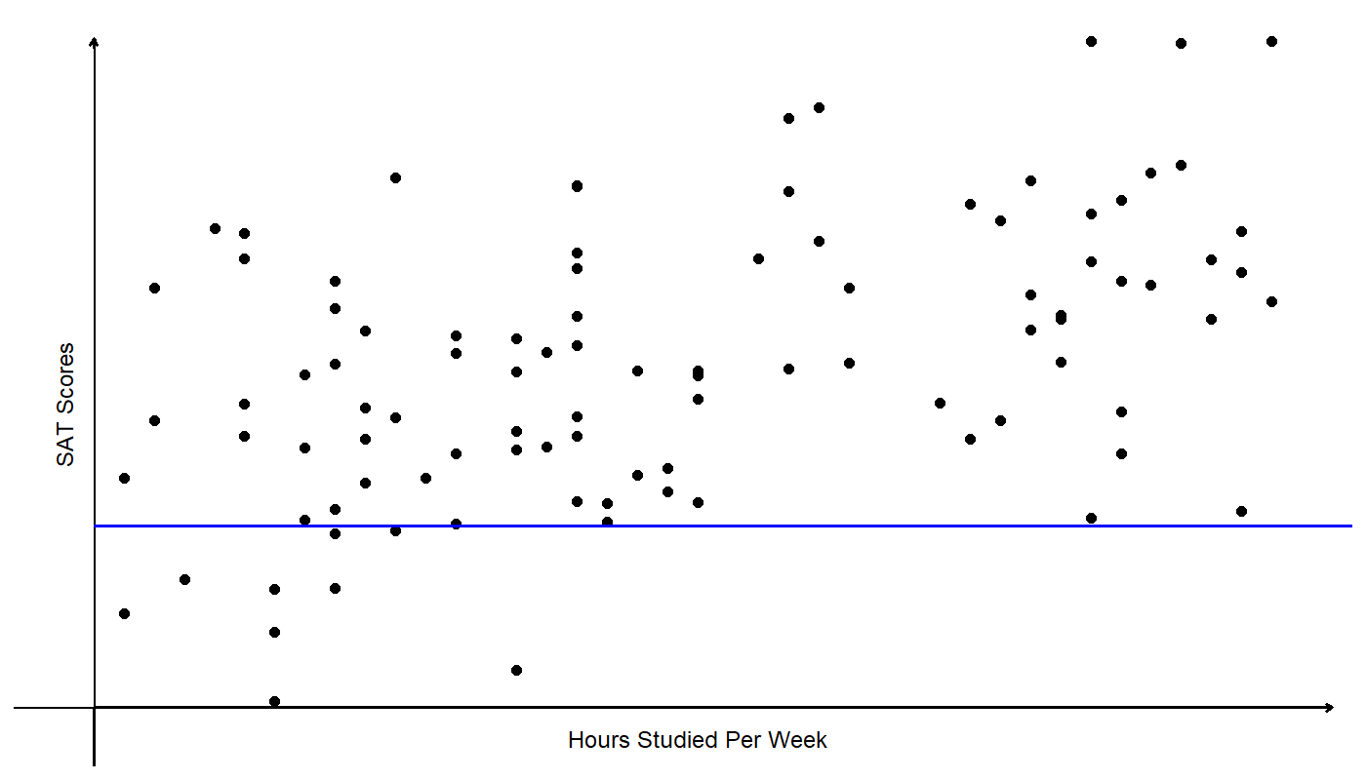
Single-Variable Linear Regression

Slide 11
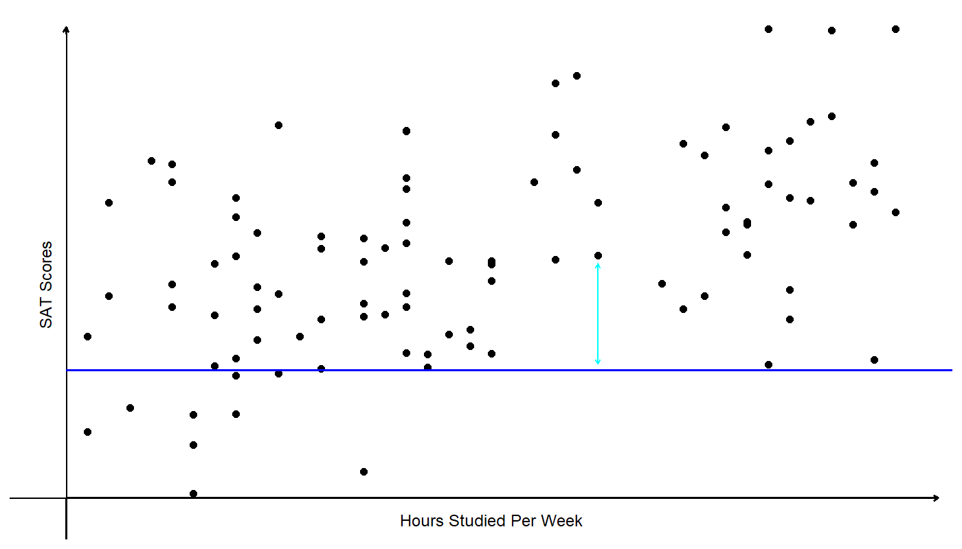
Single-Variable Linear Regression

Slide 12
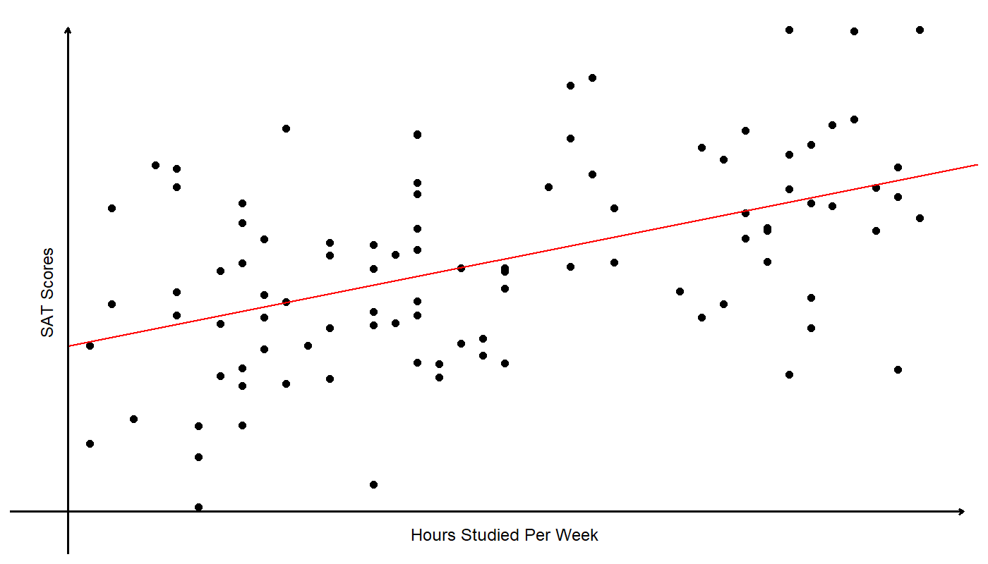
Single-Variable Linear Regression

Slide 13
Single-Variable Linear Regression
This is simply the best-fit line through the data.
The actual OLS estimates for this dataset yields:
$${\hat{SAT}}_{i}=878.81+9.94⋅H_{i}$$
Interpreting the results, we find that:
The SAT score for students who did not study at all is expected to be 878.81.
Students’ SAT scores are expected to increase by 9.94 points for every extra hour they spend a week studying.

Slide 14
Single-Variable Linear Regression
Without diving into the math and statistics, under certain conditions, we say that OLS is BLUE.
B: Best
L: Linear
U: Unbiased
E: Estimator
Here, “best” means that the estimator has the lowest variance of other linear estimators.
Unbiasedness is a term that we should discuss a bit further.

Slide 15
Unbiasedness
Unbiasedness in terms of estimators means that:
$$E\left[\hat{β}\right]=β$$
This means that on average, $\hat{β}$ will match the true $β$.
This does NOT mean that our estimate will always be equal to the true parameter, but “on average” it will.
So, this is a very nice property that we would want from a good estimator.

Slide 16
Unbiasedness
For OLS to be unbiased, we need our independent variables to be uncorrelated with the error term.
$$E\left[X⋅ε\right]=0$$
The error term may contain variables that influence the dependent variable (LHS), but we left out from the model.
Are there any variables that we left out?
If the answer is yes, and if the variable we left out is correlated with $H$, we have an “omitted variable bias.”

Slide 17
Unbiasedness and Omitted Variables
So, are there any variables other than $H$ that might affect students’ SAT scores?
What about the student’s familial income $I$?
Are students from wealthy families are more likely to spend more time studying?
Access to tutoring, better school districts, parental pressure, etc?
If so, $I$ is omitted from our model, so is included in $ε$, and:
$$E\left[H⋅ε\right]≠0$$

Slide 18
Unbiasedness and Omitted Variables
If we leave out familial income, $\hat{β}$ will be biased.
When we estimate the following model, ${\hat{β}}_{1}$ will end up picking up both effects of studying
$${\hat{SAT}}_{i}={\hat{β}}_{0}+{\hat{β}}_{1}⋅H_{i}$$
Since $I$ and $H$ are positively correlated, ${\hat{β}}_{1}$ will be biased, and it will overstate the impact of extra study hours.
How do we fix this problem?

Slide 19
Unbiasedness and Omitted Variables
We can simply add the omitted variable as “controls.”
$${\hat{SAT}}_{i}={\hat{β}}_{0}+{\hat{β}}_{1}⋅H_{i}+{\hat{β}}_{2}⋅I_{i}$$
$I$ is no longer missing, and the bias arising due to the omitted variable has been solved.
There are some issues that remain:
Can we ever be sure that there are no omitted variables?
Can we interpret $\hat{β}$ as “causal?”

Slide 20
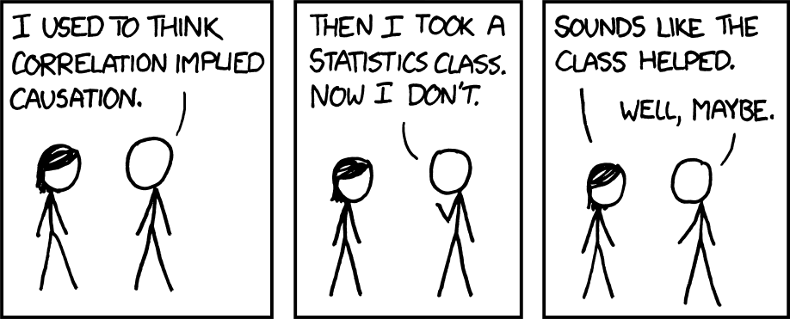
Correlation vs. Causation

Slide 21
Correlation vs. Causation
OLS, while powerful, is generally interpreted as retrieving correlation, but not necessarily causation.
That is, $\hat{β}$ is accurately interpreted as:
“A 1 unit increase in $X$ is associated with a $\hat{β}$ unit increase in $Y$.”
But why does causal structures matter?
Let’s look at a hypothetical scenario.

Slide 22
Simpson’s Paradox
Suppose you are the head of the CDC, and you are tasked with selecting the best treatment to some disease.
You have two options, treatment A and treatment B.
The data on mortality rates to this disease tells you that:
Treatment A: 16% mortality rate (240/1500)
Treatment B: 20% mortality rate (105/550)
Which treatment do you choose?

Slide 23
Simpson’s Paradox
Suppose that you are given more information on the patients’ conditions:
Which treatment would you choose now?
The answer will depend on the causal structure:
Treatment | Mild | Severe | Total
A | 15% 210/1400 | 30% 30/100 | 16% 240/1500
B | 10% 5/50 | 20% 100/500 | 19% 105/550

Slide 24
Simpson’s Paradox: Scenario 1
In scenario 1, let’s suppose that the patients’ condition influences the choice of treatment.
Doctors may decide to treat patients with mild symptoms with treatment A, and those with severe symptoms with treatment B.
C
T
Y

Slide 25
Simpson’s Paradox: Scenario 1
In scenario 1, it would be better off to choose B.
The higher mortality rate of 19% can be explained by the fact that B has been disproportionally given to patients with severe symptoms.
Treatment | Mild | Severe | Total
A | 15% 210/1400 | 30% 30/100 | 16% 240/1500
B | 10% 5/50 | 20% 100/500 | 19% 105/550

Slide 26
Simpson’s Paradox: Scenario 2
In scenario 2, let’s suppose that the treatment is the cause of the condition.
Suppose that treatment B is so scarce so that the waiting period is long, which can “cause” patients to transition from the mild to severe symptoms.
C
T
Y

Slide 27
Simpson’s Paradox: Scenario 2
In scenario 2, it would be better off to choose A.
Since the treatment is causing the symptoms to worsen, it is better off to choose the treatment that is readily available.
Treatment | Mild | Severe | Total
A | 15% 210/1400 | 30% 30/100 | 16% 240/1500
B | 10% 5/50 | 20% 100/500 | 19% 105/550

Slide 28
Correlation vs. Causation
Suppose that someone finds out that “owning a lighter is strongly correlated with the odds of suffering lung cancer.”
Would you be comfortable stating that “owing a lighter is the cause of increased risk of lung cancer”?
People who own a lighter are probably more likely to be smokers, and smoking is most likely the perpetrator of the increased risk of lung cancer.
Okay… so what DOES imply causation?

