Slide 1
Standards and Taxation
ECON 380

Slide 2
Pigouvian Policies
Pigouvian policies aim to force agents to internalize the external costs (and benefits) when there are no market mechanisms that can achieve this goal.
Examples include:
  Command and Control
  Emission Standards
  Taxation and Subsidies
Before jumping into these policies, we should try to build a framework to understand what is lost, and what can be gained.

Slide 3
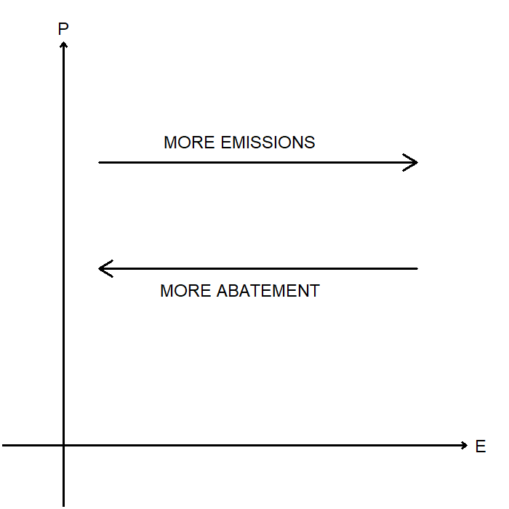
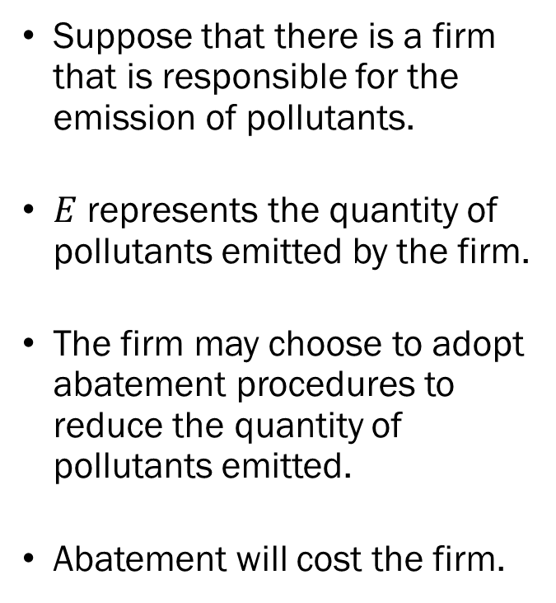
The Cost of Not Regulating
Suppose that there is a firm that is responsible for the emission of pollutants.
$E$ represents the quantity of pollutants emitted by the firm.
The firm may choose to adopt abatement procedures to reduce the quantity of pollutants emitted.
Abatement will cost the firm.

Slide 4
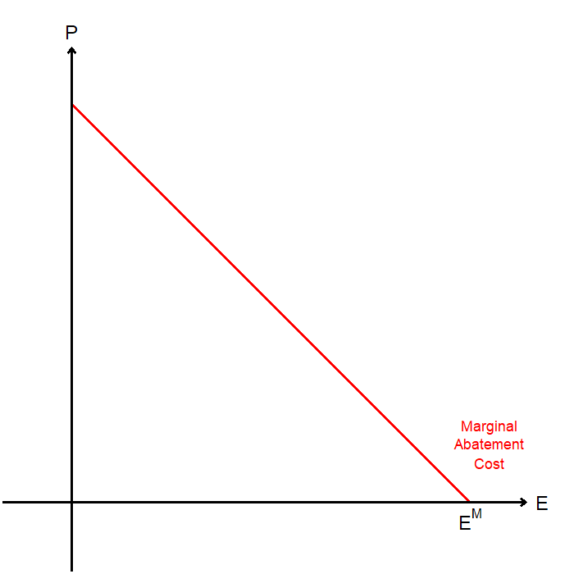
The Cost of Not Regulating
The Marginal Abatement Cost (MAC) curve informs us of the cost of abating the last unit of emissions.
Typically, the MAC curve is downward sloping.
It costs more to reduce emissions when the level of emissions are already lowered.

Slide 5
The Cost of Not Regulating
An alternate interpretation of MAC is that it is the Marginal Emissions Benefit of the firm.

Slide 6
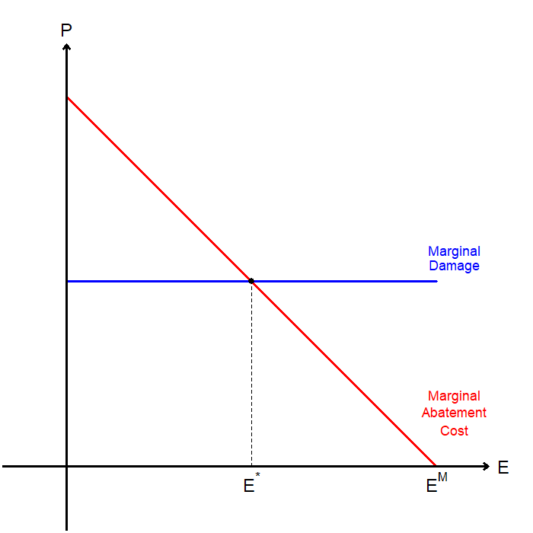
The Cost of Not Regulating
As a consequence of the firm emitting pollutants, there will be external costs imposed on the economy.
We represent this external cost using the Marginal Damage (MD) curve.
This MD curve is equivalent to the social marginal cost, as the private cost of emissions is zero.

Slide 7
The Cost of Not Regulating
Two ways to interpret how the model is set up:
MAC is the SMB of emissions, and MD is the SMC of emissions.
MAC is the SMC of abatement, and MD is the SMB of abatement

Slide 8
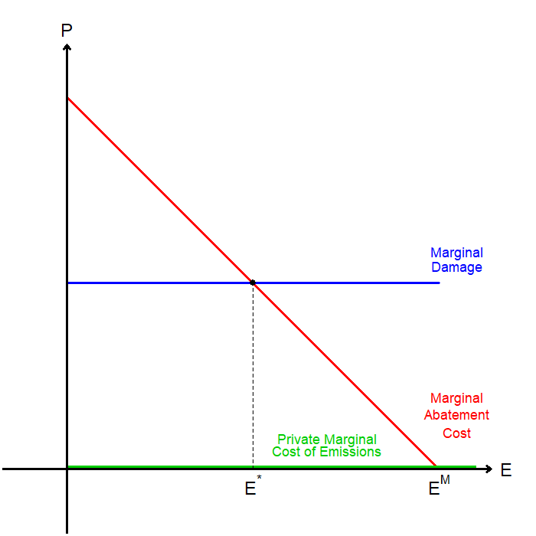
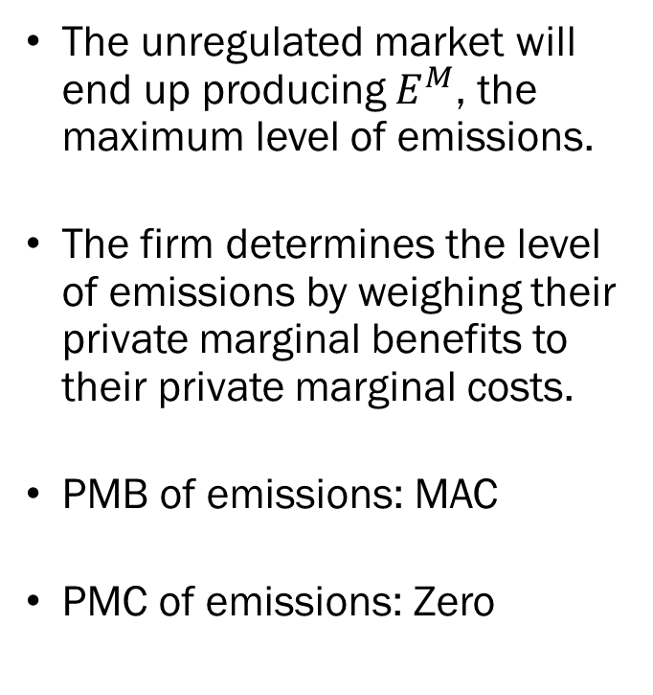
The Cost of Not Regulating
The unregulated market will end up producing $E^{M}$, the maximum level of emissions.
The firm determines the level of emissions by weighing their private marginal benefits to their private marginal costs.
PMB of emissions: MAC
PMC of emissions: Zero

Slide 9
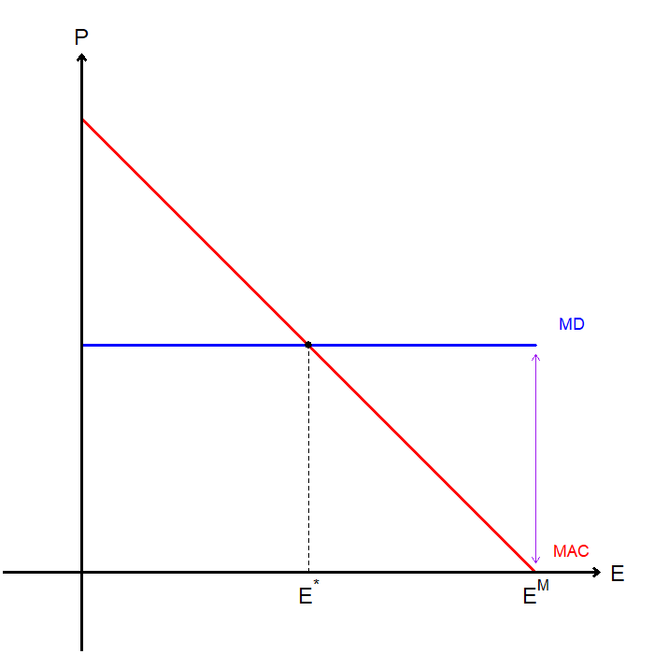
The Cost of Not Regulating
From the social planner’s point of view, this is clearly not an efficient allocation.
The victims will be willing to pay up to MD to entice the firm to reduce emissions.
For the first unit of abatement, the cost of abatement is lower than MD.

Slide 10
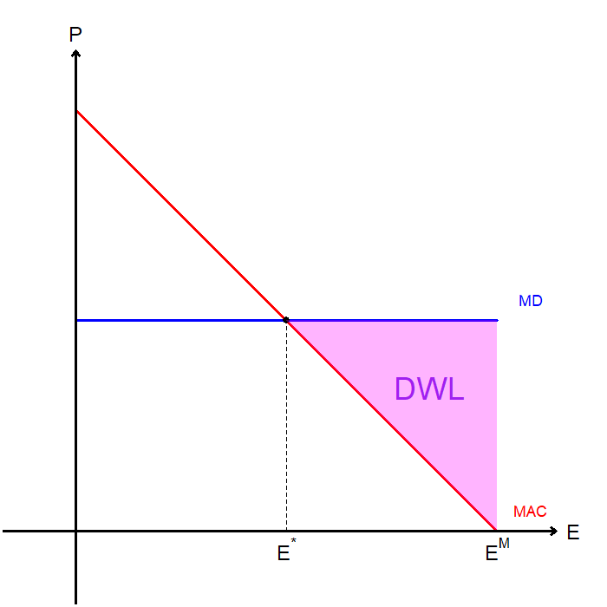
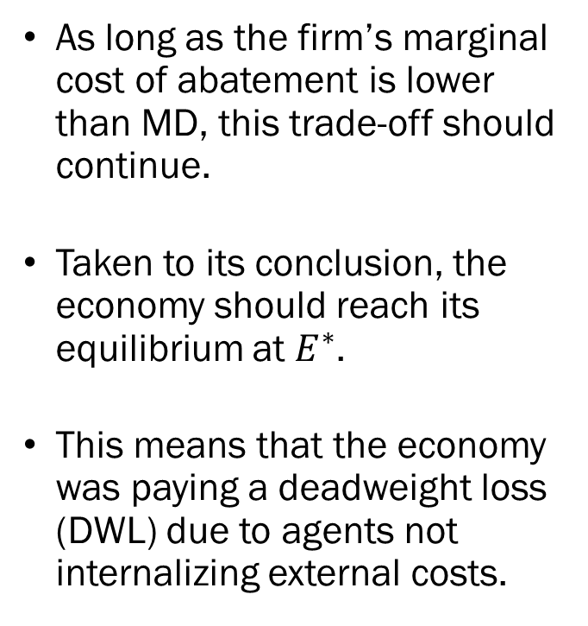
The Cost of Not Regulating
As long as the firm’s marginal cost of abatement is lower than MD, this trade-off should continue.
Taken to its conclusion, the economy should reach its equilibrium at $E^{∗}$.
This means that the economy was paying a deadweight loss (DWL) due to agents not internalizing external costs.

Slide 11
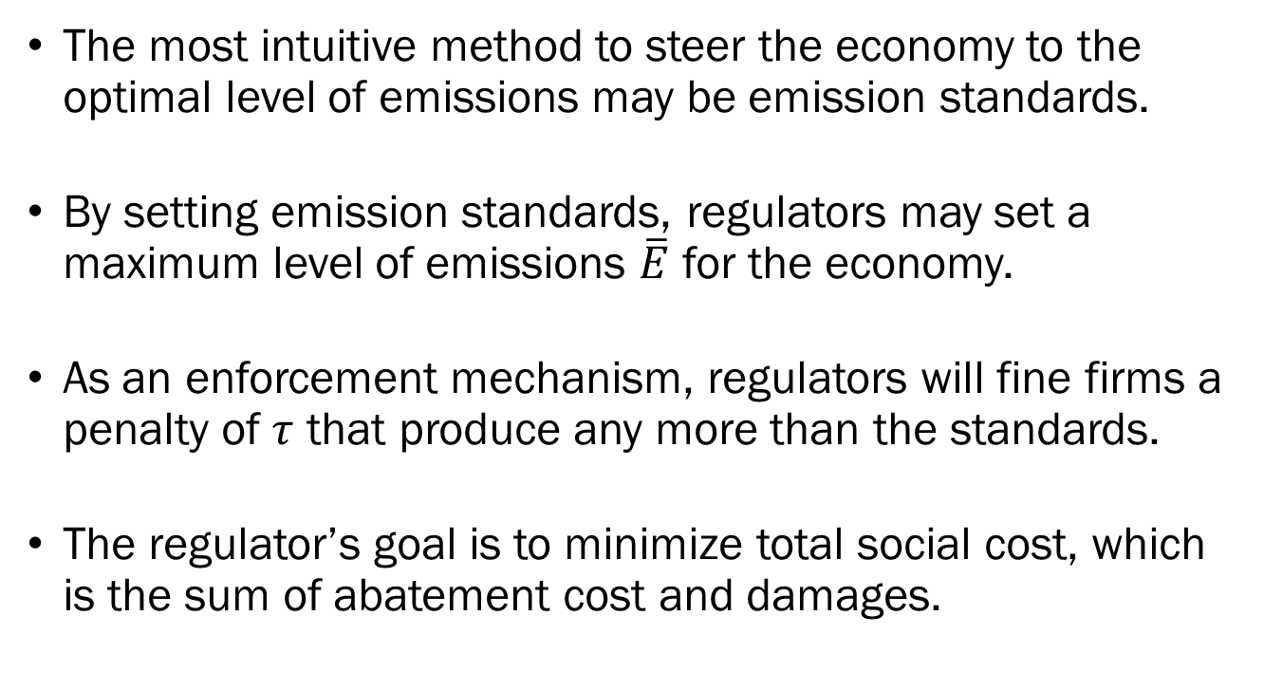
Emission Standards
The most intuitive method to steer the economy to the optimal level of emissions may be emission standards.
By setting emission standards, regulators may set a maximum level of emissions $\overline{E}$ for the economy.
As an enforcement mechanism, regulators will fine firms a penalty of $τ$ that produce any more than the standards.
The regulator’s goal is to minimize total social cost, which is the sum of abatement cost and damages.

Slide 12
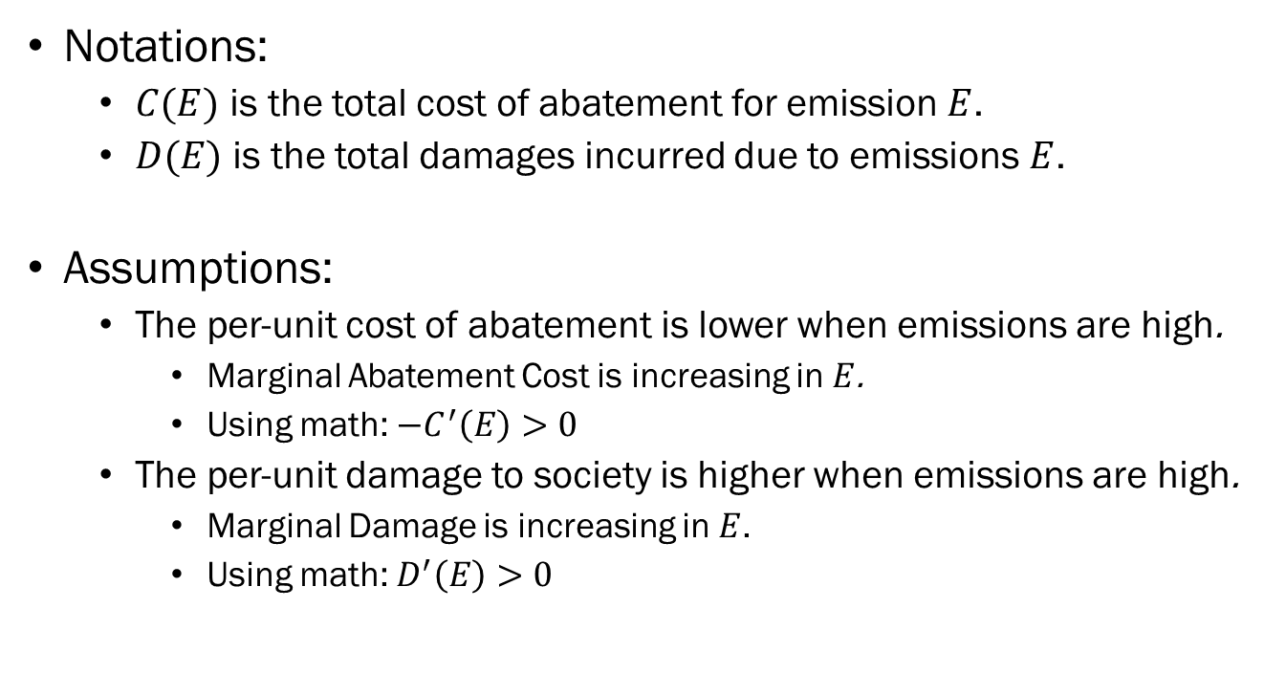
Emission Standards
Notations:
  $C(E)$ is the total cost of abatement for emission $E$.
  $D(E)$ is the total damages incurred due to emissions $E$.
Assumptions:
  The per-unit cost of abatement is lower when emissions are high.
    Marginal Abatement Cost is increasing in $E$.
    Using math: $−C^{′}\left(E\right)>0$
  The per-unit damage to society is higher when emissions are high.
    Marginal Damage is increasing in $E$.
    Using math: $D^{′}\left(E\right)>0$

Slide 13
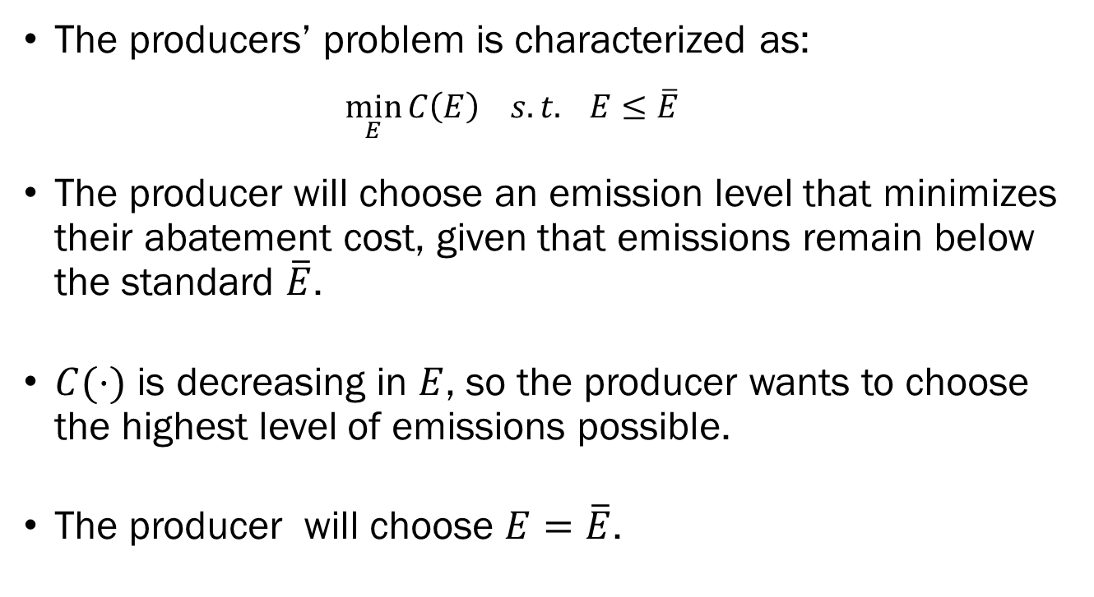
Emission Standards
The producers’ problem is characterized as:
  $$\min_{E}{C\left(E\right) s.t. E≤\overline{E}}$$
The producer will choose an emission level that minimizes their abatement cost, given that emissions remain below the standard $\overline{E}$.
$C(⋅)$ is decreasing in $E$, so the producer wants to choose the highest level of emissions possible.
The producer will choose $E=\overline{E}$.

Slide 14
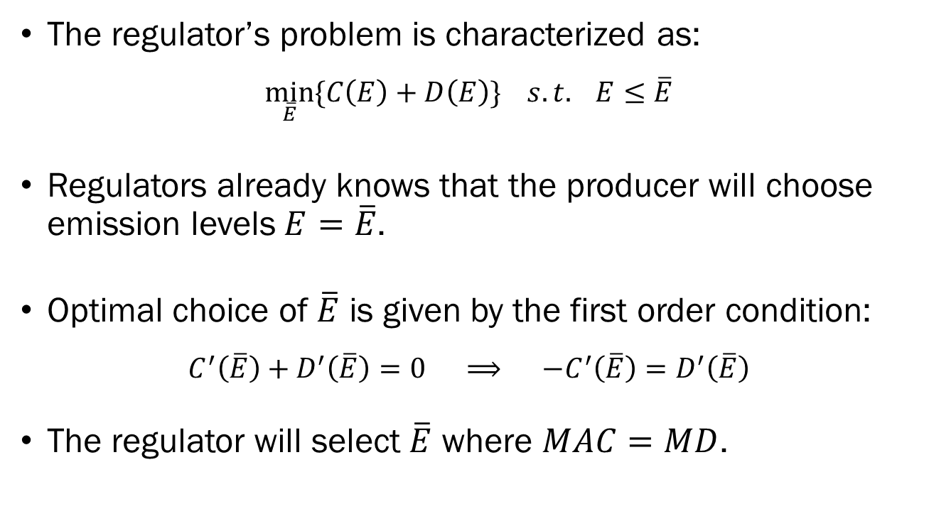
Emission Standards
The regulator’s problem is characterized as:
$$\min_{\overline{E}}{\{C\left(E\right)+D\left(E\right)\} s.t. E≤\overline{E}}$$
Regulators already knows that the producer will choose emission levels $E=\overline{E}$.
Optimal choice of $\overline{E}$ is given by the first order condition:
$$C^{′}\left(\overline{E}\right)+D^{′}\left(\overline{E}\right)=0 ⟹ −C^{′}\left(\overline{E}\right)=D^{′}\left(\overline{E}\right)$$
The regulator will select $\overline{E}$ where $MAC=MD$.

Slide 15
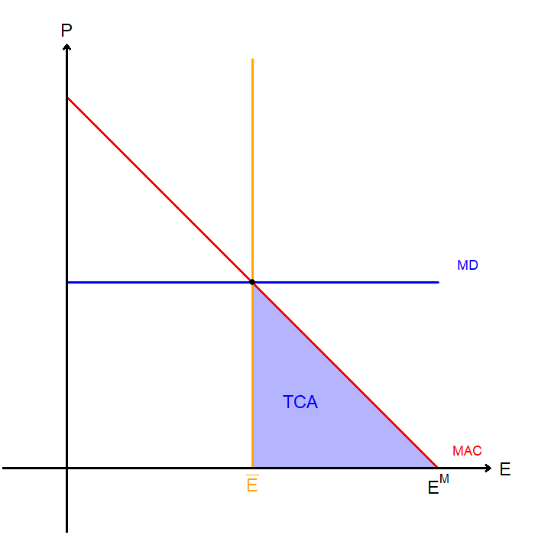
Emission Standards
Assuming that enforcement is binding, the firms’ total cost of abatement will be given by the blue triangle.
If the fine is large enough, firms will not emit above the standards, so the economy will be in an efficient state.
But in the real world, firms can always cheat.

Slide 16
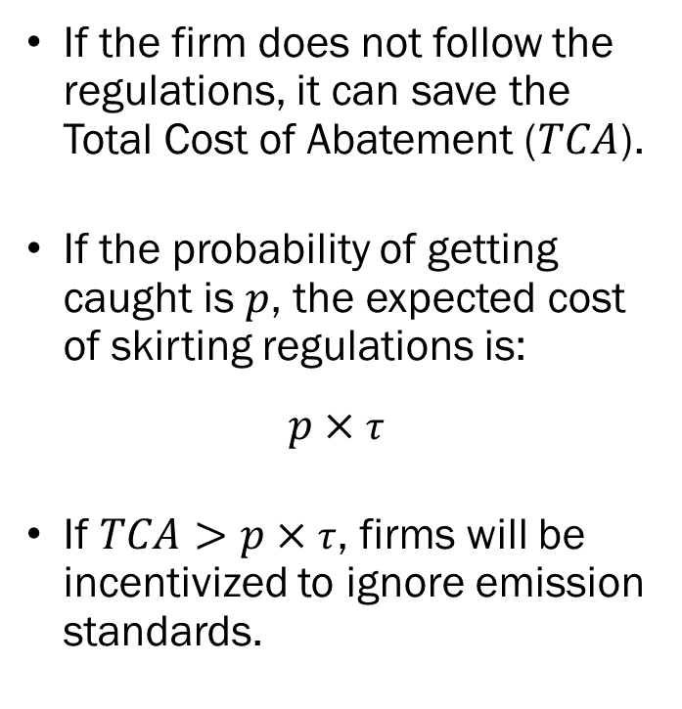
Emission Standards
If the firm does not follow the regulations, it can save the Total Cost of Abatement ($TCA$).
If the probability of getting caught is $p$, the expected cost of skirting regulations is:
$$p×τ$$
If $TCA>p×τ$, firms will be incentivized to ignore emission standards.

Slide 17
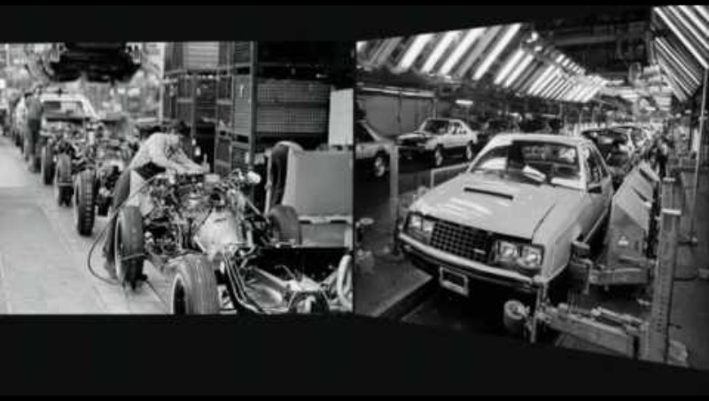
Clean Air Act of 1970

Slide 18
Command-and-Control Regulation
One method of recovering the lost social welfare is classified as “command-and-control” policies.
Command-and-control methods involve regulators mandating the adoption of certain emission control technologies.
Some example of command-and-control policies:
  Clean Air Act of 1970
  The establishment of the EPA
  Clean Water Act (1972).

Slide 19
Command-and-Control Regulation
Overall, command-and-control policies were cheap, and effective in preserving environmental quality, but...
Command and control regulations mandate the adoption of certain abatement tools.
  No incentives for polluters to go “above and beyond” the limit.
  Prohibits the development of more effective abatement technology.
Standards are set by regulators, who are typically government agencies, thus subject to political influence.

Slide 20

Political Influences

Slide 21
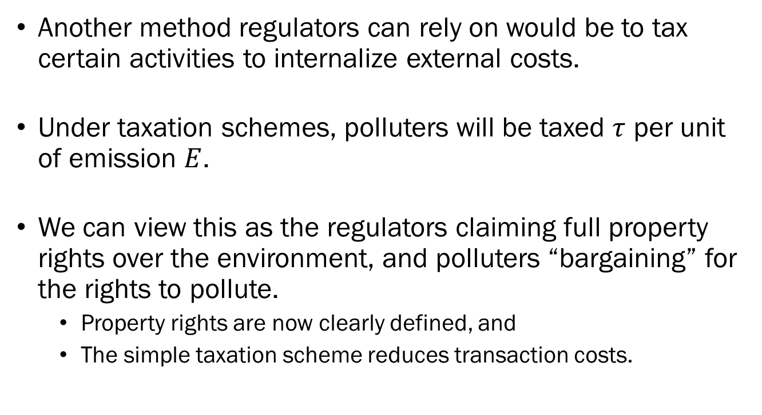
Taxation
Another method regulators can rely on would be to tax certain activities to internalize external costs.
Under taxation schemes, polluters will be taxed $τ$ per unit of emission $E$.
We can view this as the regulators claiming full property rights over the environment, and polluters “bargaining” for the rights to pollute.
  Property rights are now clearly defined, and
  The simple taxation scheme reduces transaction costs.

Slide 22
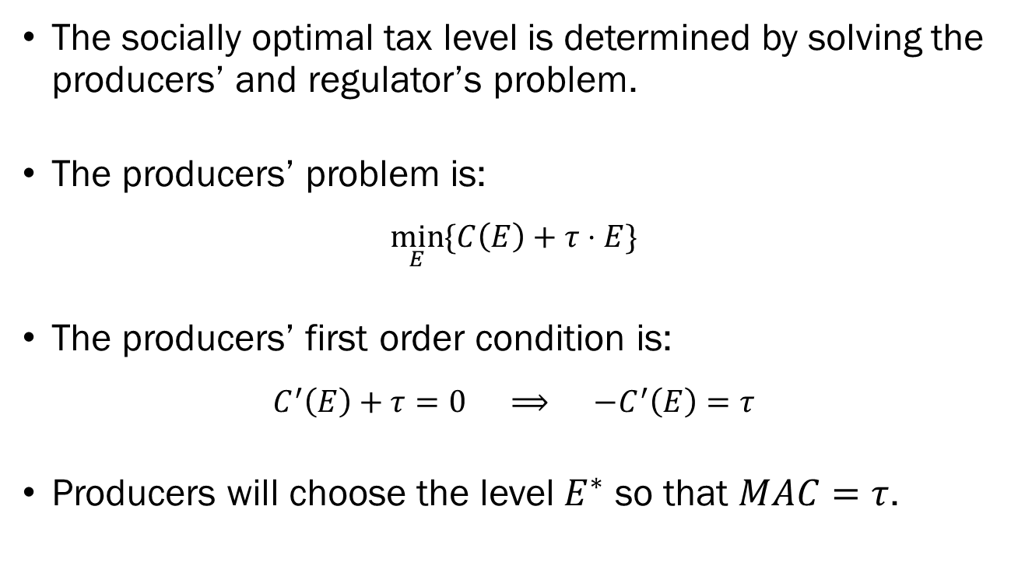
Taxation
The socially optimal tax level is determined by solving the producers’ and regulator’s problem.
The producers’ problem is:
$$\min_{E}{\{C\left(E\right)+τ⋅E\}}$$
The producers’ first order condition is:
$$C^{′}\left(E\right)+τ=0 ⟹ −C^{′}\left(E\right)=τ$$
Producers will choose the level $E^{∗}$ so that $MAC=τ$.

Slide 23
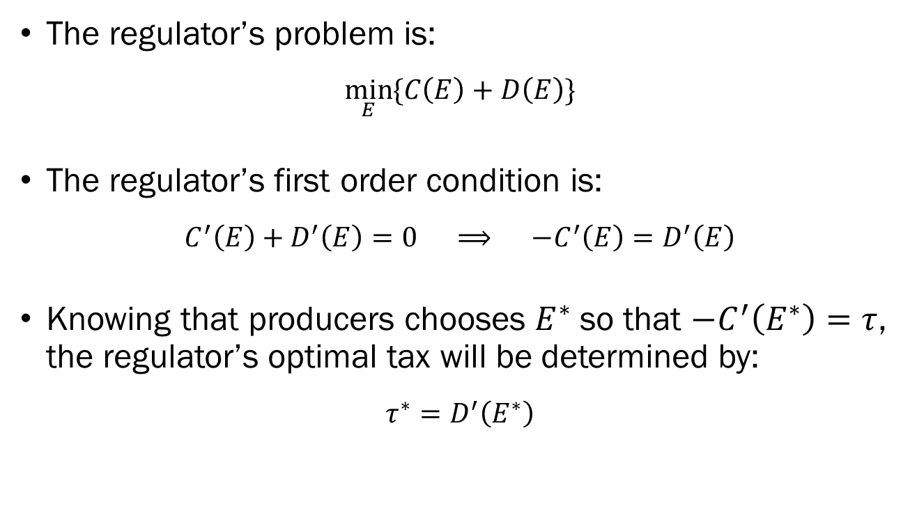
Taxation
The regulator’s problem is:
$$\min_{E}{\{C\left(E\right)+D\left(E\right)\}}$$
The regulator’s first order condition is:
$$C^{′}\left(E\right)+D^{′}\left(E\right)=0 ⟹ −C^{′}\left(E\right)=D^{′}\left(E\right)$$
Knowing that producers chooses $E^{∗}$ so that $−C^{′}\left(E^{∗}\right)=τ$, the regulator’s optimal tax will be determined by:
$$τ^{∗}=D^{′}\left(E^{∗}\right)$$

Slide 24
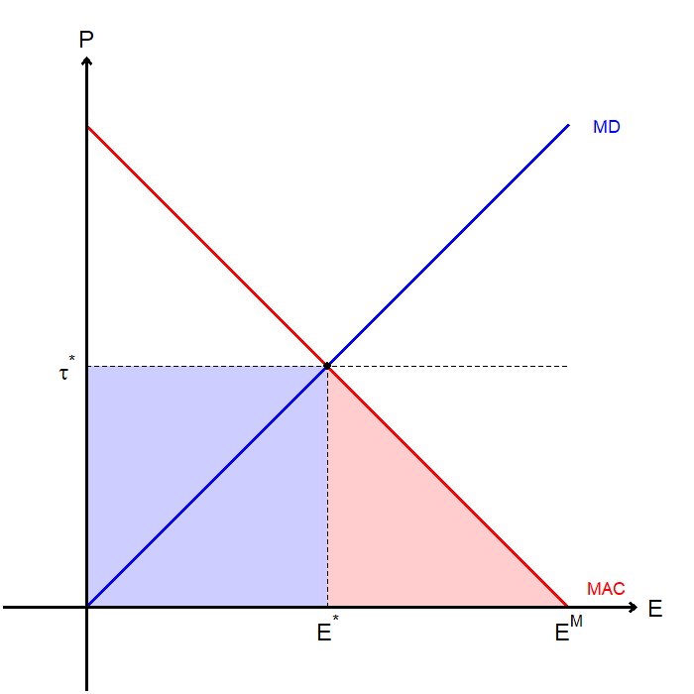
Taxation
The optimal tax is equal to the marginal damage at the societal optimal level of emission.
The producer must “pay” two “costs”:
  The tax based on emissions (blue box), and
  The cost of abatement (red triangle).

Slide 25
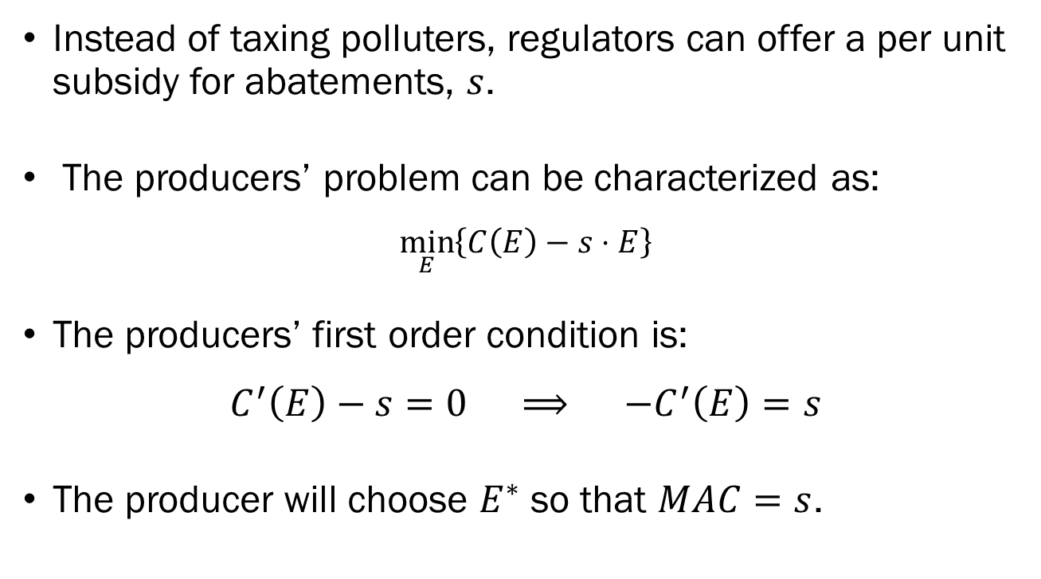
Subsidies
Instead of taxing polluters, regulators can offer a per unit subsidy for abatements, $s$.
The producers’ problem can be characterized as:
$$\min_{E}\left\{C\left(E\right)−s⋅E\right\}$$
The producers’ first order condition is:
$$C^{′}\left(E\right)−s=0 ⟹ −C^{′}\left(E\right)=s$$
The producer will choose $E^{∗}$ so that $MAC=s$.

Slide 26
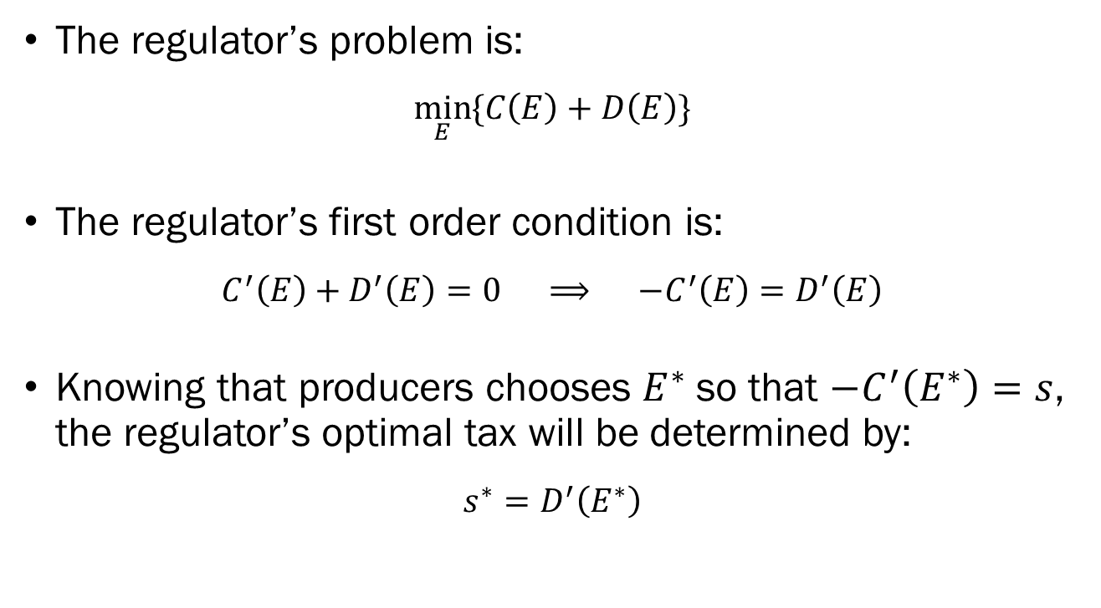
Subsidies
The regulator’s problem is:
$$\min_{E}{\{C\left(E\right)+D\left(E\right)\}}$$
The regulator’s first order condition is:
$$C^{′}\left(E\right)+D^{′}\left(E\right)=0 ⟹ −C^{′}\left(E\right)=D^{′}\left(E\right)$$
Knowing that producers chooses $E^{∗}$ so that $−C^{′}\left(E^{∗}\right)=s$, the regulator’s optimal tax will be determined by:
$$s^{∗}=D^{′}\left(E^{∗}\right)$$

Slide 27
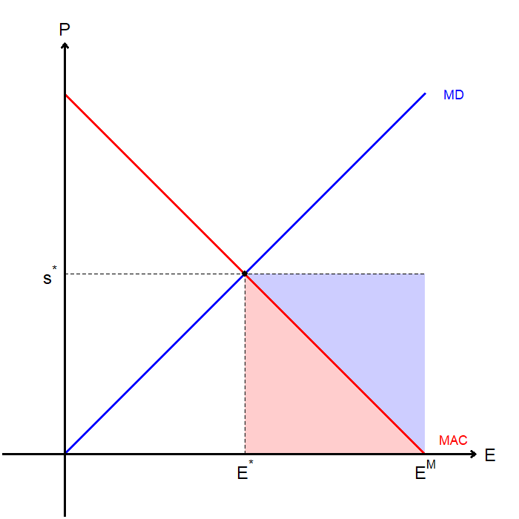
Subsidies
The optimal subsidy is equal to the marginal damage at the societal optimal level of emission.
The producer will end up:
  Paying the cost of abatement (red triangle)…
  But gaining subsidy revenue (red triangle + blue triangle).

Slide 28

Taxation and Standards

