Slide 1
Quiz #5 Review
ECON 301

Slide 2
How to Read Marks
Correct
Partially Correct
Incorrect

Slide 3
Quiz #5 “Recovery” Office Hours
https://calendly.com/brianhwpark
Venue: Rm. 248 Center for Science and Business
Dates: May 2nd – May 6th
Length: 30 Minutes per Session
Use the Whiteboard / Paper to correct your answers.

Slide 4
Problem 1. Definitions
Interest Rate Parity
  The difference in nominal interest rates between two countries is equal to the expected change in exchange rates between their currencies.
Nominal Exchange Rate
  The number of units of foreign currency that one unit of domestic currency can buy.
Real Exchange Rate
  The nominal exchange rate adjusted for differences in price levels between two countries.

Slide 5
Problem 1. Definitions
Net Exports
  Exports minus imports.
Marshall-Lerner Condition
  For a devaluation of a currency to improve its NX:
    Exports must increase enough, and
    Imports must decrease enough to balance out the increase in the price of imports.
Devaluation of Currencies
  A downward adjustment in the value of a country’s currency relative to another currency.

Slide 6
Problem 2.A.
A devaluation of the domestic currency alone is sufficient to decrease the trade deficit.
  FALSE
  Per the Marshall-Lerner condition, a devaluation of domestic currencies will lead to an improvement in the balance of trade if…
  Exports increase enough due to domestic goods being cheaper to foreign consumers, and
  Imports decrease enough to mitigate the increased price of imported goods.

Slide 7
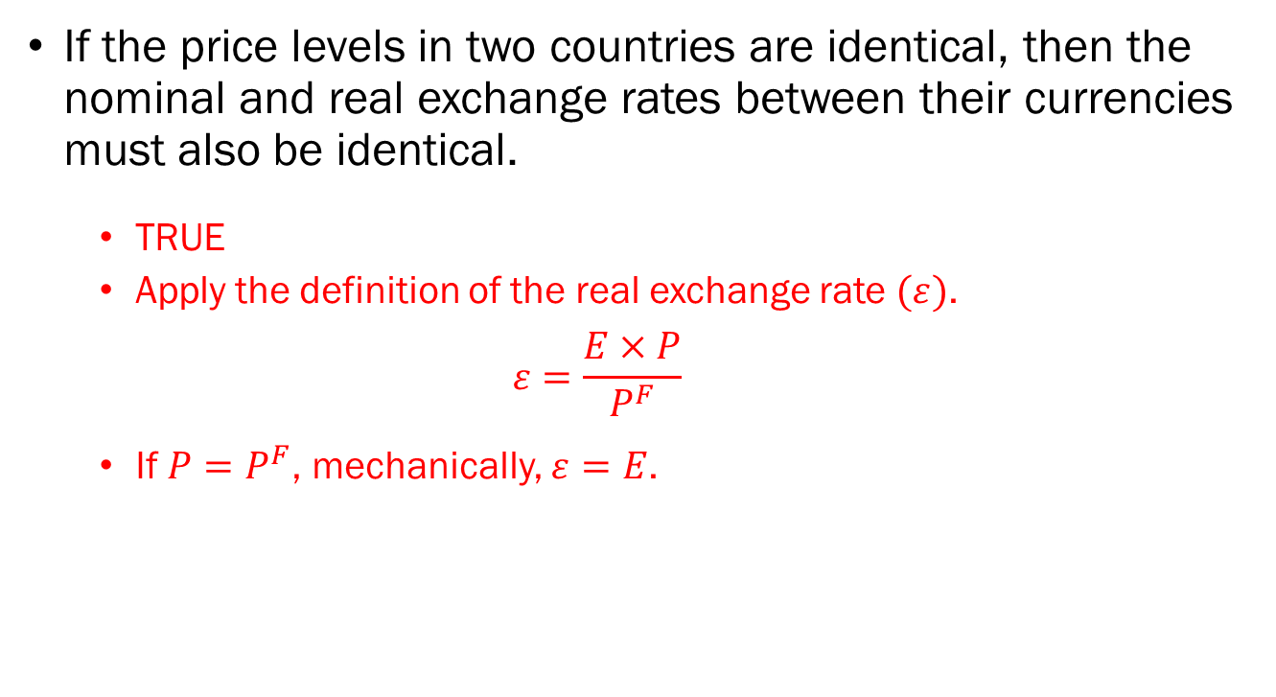
Problem 2.B.
If the price levels in two countries are identical, then the nominal and real exchange rates between their currencies must also be identical.
  TRUE
  Apply the definition of the real exchange rate $(ε)$.
  $$ε=\frac{E×P}{P^{F}}$$
  If $P=P^{F}$, mechanically, $ε=E$.

Slide 8
Problem 2.C.
If the domestic central bank adopts expansionary monetary policies, the country's currency is expected to appreciate.
  FALSE
  Expansionary monetary policy will drive domestic interest rates downward.
  All else equal, foreign assets are now more attractive to investors.
  Demand for domestic currencies fall, which pushes the domestic currency’s value downward.
  The domestic currency should depreciate.

Slide 9
Problem 2.D.
If a foreign trade partner's economy expands, domestic exports are likely to increase.
  TRUE
  Foreign consumers will increase their consumption.
  Part of this increased consumption will be directed towards foreign goods.
  Domestic producers can export more goods to satisfy this increased demand.

Slide 10
Problem 3.A.
If the investor allocates all of their investments into U.S. Treasury bonds which guarantee a 10% annual return, how much in U.S. dollar terms would the investor have by the end of the year?
  The investor starts off with $1,000.
  Investing in the asset with a 10% return, the investor will earn $1,100 at the end of the year.

Slide 11
Problem 3.B.
If the investor allocates all of their investments into Japanese bonds which guarantee a 20% annual return, how much in Japanese yen terms would the investor have by the end of the year?
  The investor starts off with $1,000.
  They exchange $1,000 for ¥100,000.
  The investment yields 20% return for ¥120,000.

Slide 12
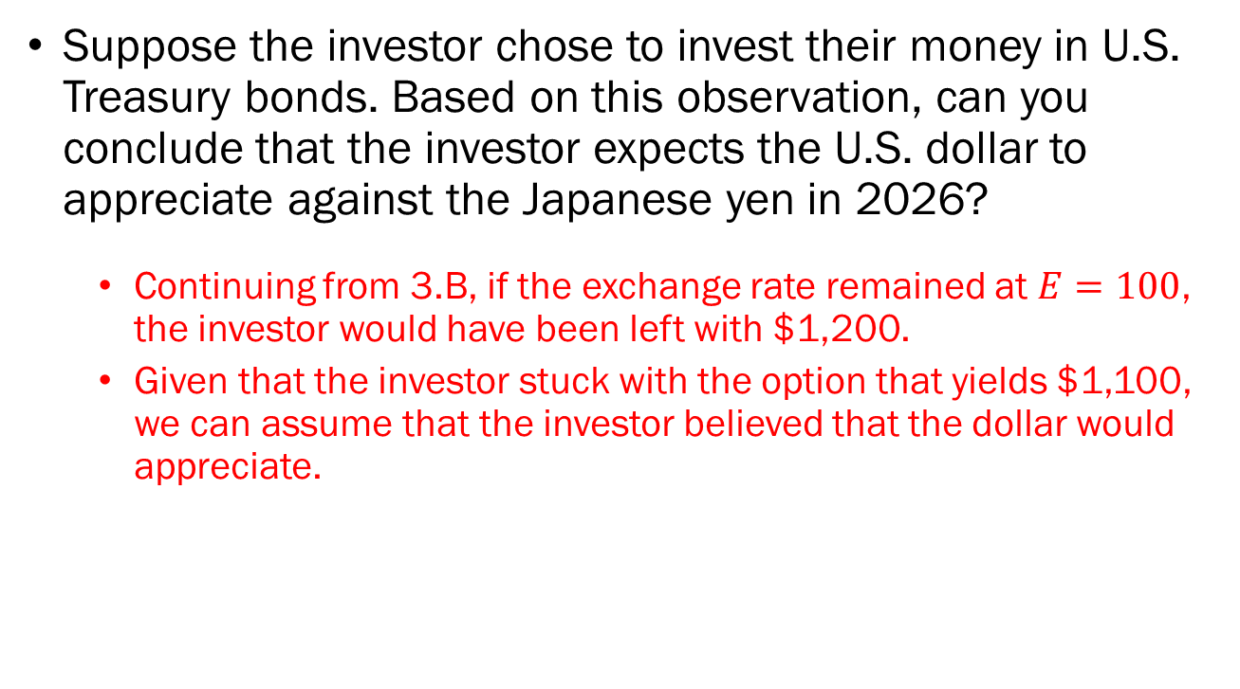
Problem 3.C.
Suppose the investor chose to invest their money in U.S. Treasury bonds. Based on this observation, can you conclude that the investor expects the U.S. dollar to appreciate against the Japanese yen in 2026?
  Continuing from 3.B, if the exchange rate remained at $E=100$, the investor would have been left with $1,200.
  Given that the investor stuck with the option that yields $1,100, we can assume that the investor believed that the dollar would appreciate.

Slide 13
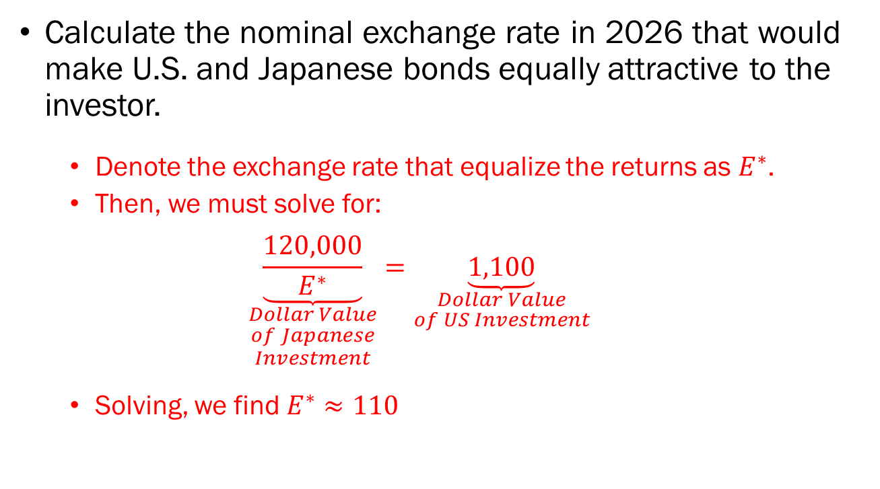
Problem 3.D.
Calculate the nominal exchange rate in 2026 that would make U.S. and Japanese bonds equally attractive to the investor.
  Denote the exchange rate that equalize the returns as $E^{∗}$.
  Then, we must solve for:
  $$\underset{\begin{aligned}Dollar Value \\ of Japanese \\ Investment\end{aligned}}{\underbrace{\frac{120,000}{E^{∗}}}}=\underset{\begin{aligned}Dollar Value \\ of US Investment\end{aligned}}{\underbrace{1,100}}$$
  Solving, we find $E^{∗}≈110$

Slide 14












Problem 4.A.
$$Interest$$
$$Parity$$
Domestic Interest Rate $i$
Domestic Interest Rate $i$
$$\overline{i}$$
$$LM$$
$$\overline{i}$$
$$IS^{′}$$
$$IS$$
$$Y^{′}$$
$$Y$$
Output, $Y$
$$E$$
Exchange Rate, $E$

Slide 15




Problem 4.B.
$$Interest$$
$$Parity$$
Domestic Interest Rate $i$
Domestic Interest Rate $i$
$$\overline{i}$$
$$LM$$
$$\overline{i}$$
$$\overline{i^{′}}$$
$$LM^{′}$$
$$\overline{i^{′}}$$
$$IS^{′}$$
$$IS$$
$$Y^{′}$$
$$Y$$
Output, $Y$
$$E^{′}$$
$$E$$
Exchange Rate, $E$

Slide 16
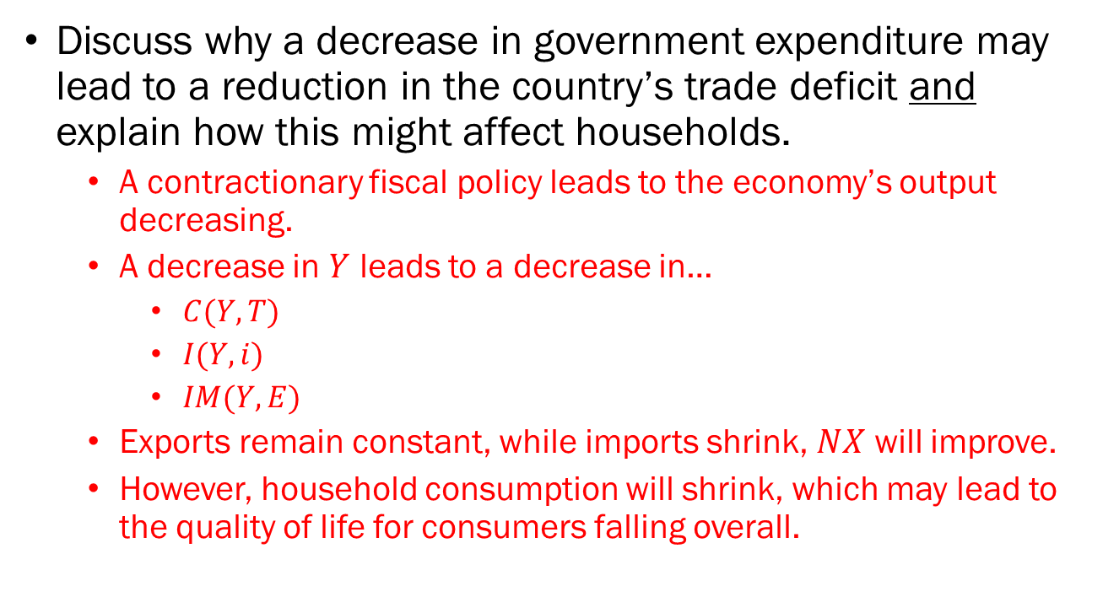
Problem 5.
Discuss why a decrease in government expenditure may lead to a reduction in the country’s trade deficit and explain how this might affect households.
  A contractionary fiscal policy leads to the economy’s output decreasing.
  A decrease in $Y$ leads to a decrease in…
    $C(Y,T)$
    $I(Y,i)$
    $IM(Y,E)$
  Exports remain constant, while imports shrink, $NX$ will improve.
  However, household consumption will shrink, which may lead to the quality of life for consumers falling overall.

