Slide 1
Quiz #4 Review
ECON 301

Slide 2
How to Read Marks
Correct
Partially Correct
Incorrect

Slide 3
Quiz #4 “Recovery” Office Hours
https://calendly.com/brianhwpark
Venue: Rm. 248 Center for Science and Business
Dates: TBD
Length: 30 Minutes per Session
Use the Whiteboard / Paper to correct your answers.

Slide 4
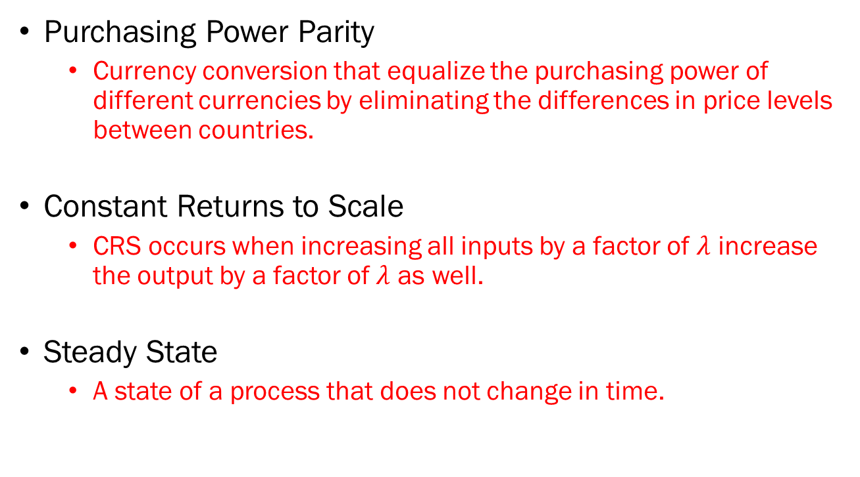
Problem 1. Definitions
Purchasing Power Parity
  Currency conversion that equalize the purchasing power of different currencies by eliminating the differences in price levels between countries.
Constant Returns to Scale
  CRS occurs when increasing all inputs by a factor of $λ$ increase the output by a factor of $λ$ as well.
Steady State
  A state of a process that does not change in time.

Slide 5
Problem 1. Definitions
Golden Rule Saving Rate
  The saving rate in an economy that maximizes its citizens’ consumption.
Effective Labor
  Labor input measured in efficiency units, controls for the productivity of each worker in the workforce.
Gini Coefficient
  A measure of income inequality in an economy, where 0 represents perfect equality, and 1 represents perfect inequality.

Slide 6
Problem 2.A.
An increase in the saving rate of an economy is sufficient to sustain a higher rate of long-run economic growth.
  FALSE
  An increase in the saving rate will increase the steady state level of output per worker, but it will not influence the long-run growth rate of the economy.
  Furthermore, increasing the saving rate beyond the golden rule saving rate will result in a decrease in the citizens’ welfare, following a decrease in consumption.

Slide 7
Problem 2.B.
All else equal, if the capital depreciation rate increases, the steady-state level of capital per worker will decrease.
  TRUE
  We will discuss this in more detail in Problem 3.

Slide 8
Problem 2.C.
Innovation and imitation contribute equally to technological progress in both developed and developing economies.
  FALSE
  Typically, developing economies exhibit a greater level of economic growth due to the relative ease of adopting imitation to catch-up.

Slide 9
Problem 2.D.
GDP per capita provides an accurate comparison of living standards across countries, regardless of cost-of-living differences.
  FALSE
  The GDP per capita of the United States is currently $82,769.41.
  If you earn this amount in Warren County IL, you should be relatively comfortable.
  If you earn this amount in San Francisco CA, you will have to make some compromises.

Slide 10










Problem 3.A.
$$δ_{0}\frac{K}{N}$$
$$δ_{1}\frac{K}{N}$$
$$Y/N$$
$$f\left(\frac{K}{N}\right)$$
$${\left(\frac{Y}{N}\right)}_{1}$$
$${\left(\frac{Y}{N}\right)}_{0}$$
$$sf\left(\frac{K}{N}\right)$$
$${\left(\frac{K}{N}\right)}_{0}$$
$${\left(\frac{K}{N}\right)}_{1}$$
$$K/N$$

Slide 11
Problem 3.B.
Briefly describe what happened to...
Capital per worker in the steady state:
  Capital per worker increases as a result of less capital depreciating over each period.
Output per worker in the steady state:
  Output per worker increases as a result of a higher level of capital per worker at the steady state.

Slide 12












Problem 4.A
COUNTRY A
$$δ\frac{K}{N}$$
COUNTRY B
$$δ\frac{K}{N}$$
$$Y/N$$
$$Y/N$$
$$f\left(\frac{K}{N}\right)$$
$$f\left(\frac{K}{N}\right)$$
$${\left(\frac{Y}{N}\right)}_{B}$$
$$s_{B}⋅f\left(\frac{K}{N}\right)$$
$${\left(\frac{Y}{N}\right)}_{A}$$
$$s_{A}⋅f\left(\frac{K}{N}\right)$$
$${\left(\frac{K}{N}\right)}_{A}$$
$$K/N$$
$${\left(\frac{K}{N}\right)}_{B}$$
$$K/N$$

Slide 13
Problem 4.B.
Discuss the differences in steady states between the two countries.
  The capital per worker, and output per worker are both greater in the country B, with the higher saving rate.
  However, whether country B’s citizens enjoy a better standard of living measured in consumption is ambiguous.

Slide 14
Problem 5.A.
Evaluate the following statement: “If the government’s goal is to foster long-run technological progress, it should fund research that is not of immediate use to the market, as such research may be underprovided if left solely to market forces.”
  No “correct conclusion” to this question.

