Slide 1
Quiz #3 Review
ECON 301

Slide 2
How to Read Marks
Correct
Partially Correct
Incorrect

Slide 3
Quiz #3 “Recovery” Office Hours
https://calendly.com/brianhwpark
Venue: Rm. 248 Center for Science and Business
Dates: TBD
Length: 30 Minutes per Session
Use the Whiteboard / Paper to correct your answers.

Slide 4
Problem 1. Definitions
Phillips Curve
  The Phillips Curve shows that inflation and unemployment have an inverse relationship.
Potential Output
  Level of output an economy produces when the unemployment rate matches the natural rate.
  Represents the theoretical equilibrium level of output that can be sustained without triggering runaway inflation.
Natural Rate of Unemployment
  The level of unemployment that exists when the labor market is in equilibrium in the medium run.

Slide 5
Problem 1. Definitions
Reservation Wage
  The lowest wage an individual is willing to accept for a job.
Efficiency Wage
  A theory that explains why employers may be willing to pay their workers above the equilibrium wage.
Real Wage
  Wages measured in terms of purchasing power.

Slide 6
Problem 2.A.
When the unemployment level in the economy is lower, wages tend to be high.
  TRUE
  When unemployment is low, it means that labor demand is relatively higher than labor supply.
  This makes it easier for workers to find alternate positions.
  Thus, workers’ bargaining power tends to be higher.
  Employers may be influenced to pay their workers a higher wage to retain their workforce.

Slide 7
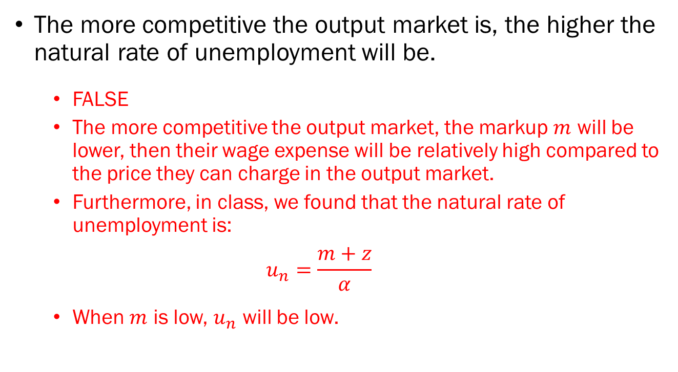
Problem 2.B.
The more competitive the output market is, the higher the natural rate of unemployment will be.
  FALSE
  The more competitive the output market, the markup $m$ will be lower, then their wage expense will be relatively high compared to the price they can charge in the output market.
  Furthermore, in class, we found that the natural rate of unemployment is:
  $$u_{n}=\frac{m+z}{α}$$
  When $m$ is low, $u_{n}$ will be low.

Slide 8
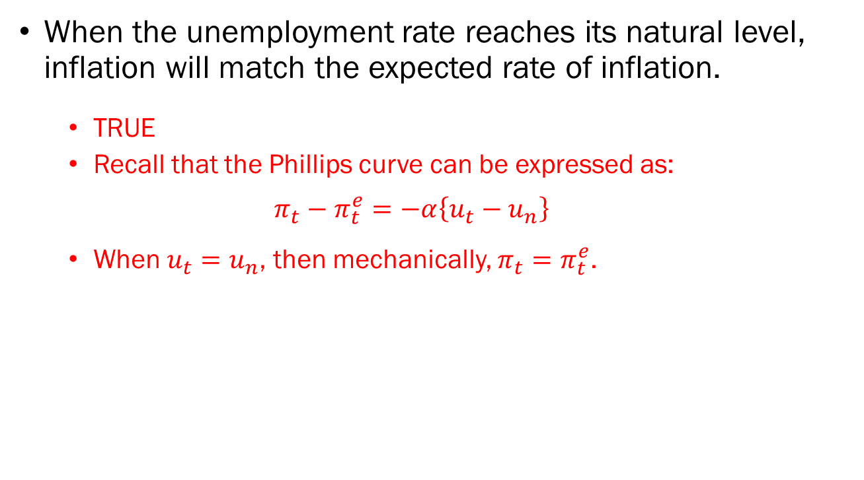
Problem 2.C.
When the unemployment rate reaches its natural level, inflation will match the expected rate of inflation.
  TRUE
  Recall that the Phillips curve can be expressed as:
  $$π_{t}−π_{t}^{e}=−α\left\{u_{t}−u_{n}\right\}$$
  When $u_{t}=u_{n}$, then mechanically, $π_{t}=π_{t}^{e}$.

Slide 9
Problem 2.D.
If the economy faces the zero lower bound, monetary policy can always restore full employment by lowering interest rates.
  FALSE
  If the economy is already facing the zero lower bound, monetary policy cannot always restore full employment simply by lowering interest rates, because it runs into a limit.

Slide 10










Problem 3.
$$r$$
$$r$$
$$A$$
$$LM$$
$$Y^{∗}$$
$$IS$$
$$π−\overline{π}$$
$$PC$$
Output
$$Y_{n}$$
$$π−π^{e}$$

Slide 11
Problem 3.A.
What types of monetary policy can the Federal Reserve implement to alleviate this imbalance?
  The Fed can conduct expansionary monetary policy to stimulate the economy so that output increases to match potential output.
  Examples include:
    Lowering interest rates, and/or
    Open Market Purchase, and/or
    Lowering the Required Reserve Rate.

Slide 12
Problem 3.B.
What types of fiscal policy can the government implement to alleviate this imbalance?
  The government can conduct expansionary fiscal policy to stimulate the economy so that output increases to match potential output.
  Examples include:
    Issuing tax reductions, and/or
    Increasing government expenditures.

Slide 13





Problem 3.C
$$r$$
$$r$$
$$A$$
$$LM$$
$$A^{′}$$
$$r^{′}$$
$$LM^{′}$$
$$IS$$
$$PC$$
$$π−\overline{π}$$
Output
$$Y_{n}$$
$$π−π^{e}$$

Slide 14


Problem 3.D
$$r$$
$$r$$
$$A$$
$$A^{′}$$
$$LM$$
$$r^{′}$$
$$IS$$
$$IS^{′}$$
$$PC$$
$$π−\overline{π}$$
Output
$$Y_{n}$$
$$π−π^{e}$$

