Slide 1
Quiz #1 Review
ECON 301

Slide 2
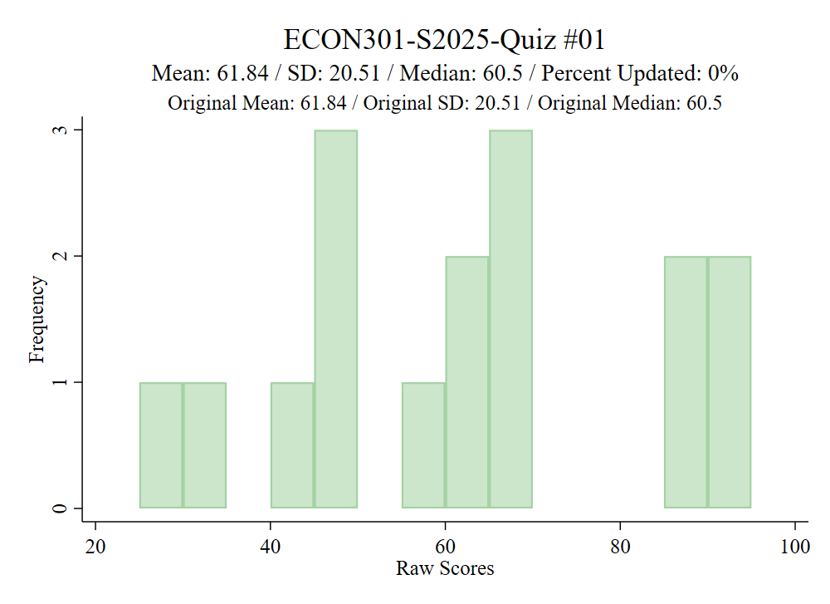
Grade Distribution

Slide 3
How to Read Marks
Correct
Partially Correct
Incorrect

Slide 4
Quiz #1 “Recovery” Office Hours
https://calendly.com/brianhwpark
Venue: Rm. 248 Center for Science and Business
Dates: Feb. 10th ~ Feb. 14th , 2025 (Monday ~ Friday)
Length: 30 Minutes per Session
Use the Whiteboard / Paper to correct your answers.

Slide 5
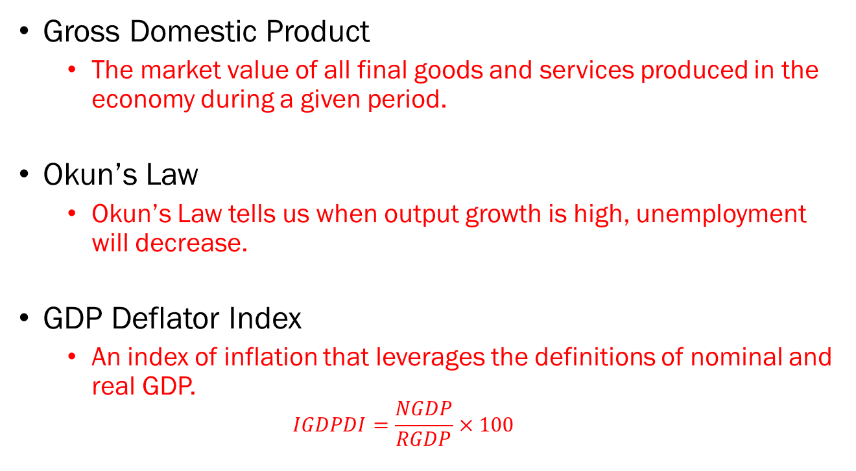
Problem 1. Definitions
Gross Domestic Product
  The market value of all final goods and services produced in the economy during a given period.
Okun’s Law
  Okun’s Law tells us when output growth is high, unemployment will decrease.
GDP Deflator Index
  An index of inflation that leverages the definitions of nominal and real GDP.
  $$IGDPDI=\frac{NGDP}{RGDP}×100$$

Slide 6
Problem 1. Definitions
Structural Unemployment
  Unemployment due to labor supply overwhelming labor demand. Often accompanied by structural shifts at the industry-level
Marginal Propensity to Consume
  The proportion of disposable income that a household spends as consumption.
Paradox of Thrift
  A phenomenon in which an economy saving too much ends up with lower levels of savings in the long run due to output falling as a result of dampened economic activity.

Slide 7
Problem 2.A.
The GDP of the U.S. includes all goods and services produced by U.S. citizens, regardless of where they live in the world.
  FALSE
  GDP is the market value of all final goods and services produced within an economy in a given period of time.
  “within an economy” means that it must be produced within the U.S. to be counted towards U.S. GDP.
  The production of U.S. citizens overseas will be counted in the U.S. GNP.

Slide 8
Problem 2.B.
If McDonald’s buys potatoes to make French fries, the purchase of those potatoes is included in GDP.
  FALSE
  GDP is the market value of all final goods and services produced within an economy in a given period of time.
  “final goods and services” means the value of the French fries will be included in GDP, not the potatoes sold to McDonalds.

Slide 9
Problem 2.C.
If the nominal GDP of a country increases while real GDP remains the same, the economy has likely experienced deflation.
  FALSE
  If the nominal GDP increases while real GDP remains stagnant, it means that the “growth” is most likely an illusion due to the current year’s prices increasing.
  Therefore, it is more likely that the economy has experienced inflation, not deflation.

Slide 10
Problem 2.D.
The Phillips Curve suggests that during periods of low unemployment, inflation tends to be lower.
  FALSE
  When unemployment is low, it most likely means that people are earning more money and consuming more goods and services.
  Under these conditions, it is more likely that prices will increase as a response to increased aggregate demand.
  So, when unemployment is low, inflation will tend to be high.

Slide 11
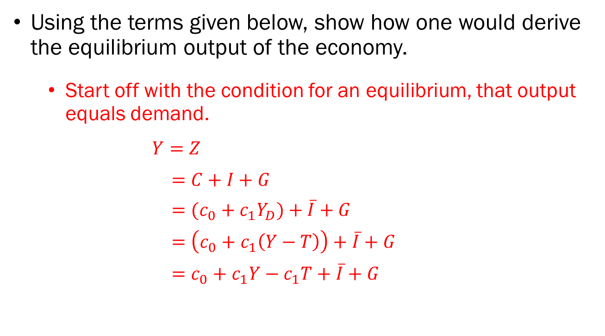
Problem 3.A.
Using the terms given below, show how one would derive the equilibrium output of the economy.
  Start off with the condition for an equilibrium, that output equals demand.
$Y=Z$
$=C+I+G$
$=(c_{0}+c_{1}Y_{D})+\overline{I}+G$
$=\left(c_{0}+c_{1}\left(Y−T\right)\right)+\overline{I}+G$
$=c_{0}+c_{1}Y−c_{1}T+\overline{I}+G$

Slide 12
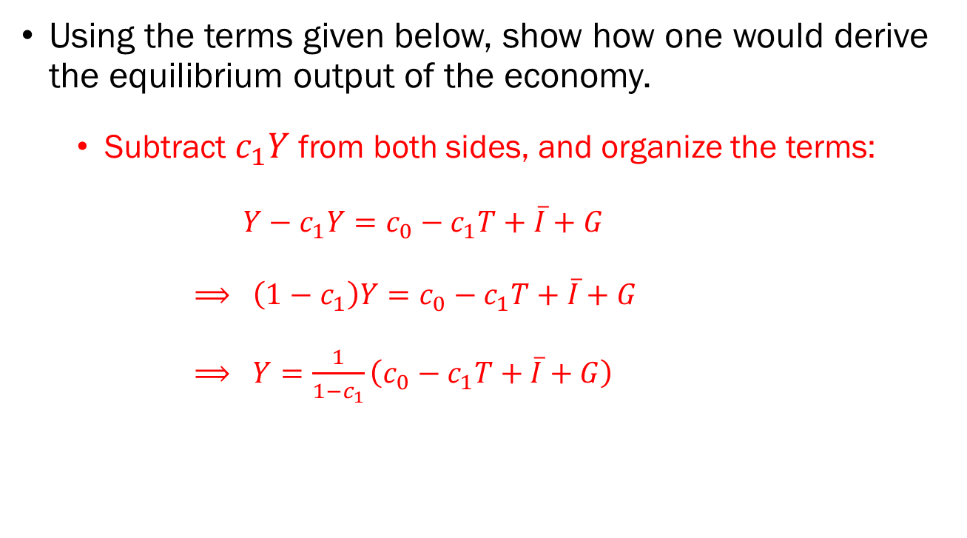
Problem 3.A. (Cont’d)
Using the terms given below, show how one would derive the equilibrium output of the economy.
  Subtract $c_{1}Y$ from both sides, and organize the terms:
$Y−c_{1}Y=c_{0}−c_{1}T+\overline{I}+G$
$⟹ \left(1−c_{1}\right)Y=c_{0}−c_{1}T+\overline{I}+G$
$⟹ Y=\frac{1}{1−c_{1}}\left(c_{0}−c_{1}T+\overline{I}+G\right)$

Slide 13






Problem 3.B.
In the following empty chart, plot and label the following elements.
Demand
$$Z=C+I+G$$
$$Y^{∗}$$
$$c_{0}+I+G$$
$$I+G$$
$$G$$
$$Y^{∗}$$
Output

Slide 14
Problem 4.A.
Discuss why a consumer may care more about inflation based on CPI, as compared to the inflation figures based on the GDP Deflator Index.
  The GDP Deflator Index is a measure of price levels based on ALL goods and services produced in an economy.
  There are many goods and services that typical consumers would not care about.
  Meanwhile, the CPI measures the price levels of a market basket of goods that a typical consumer is likely to consume regularly.
  So, a typical consumer would be more interested in inflation measured using CPI.

Slide 15
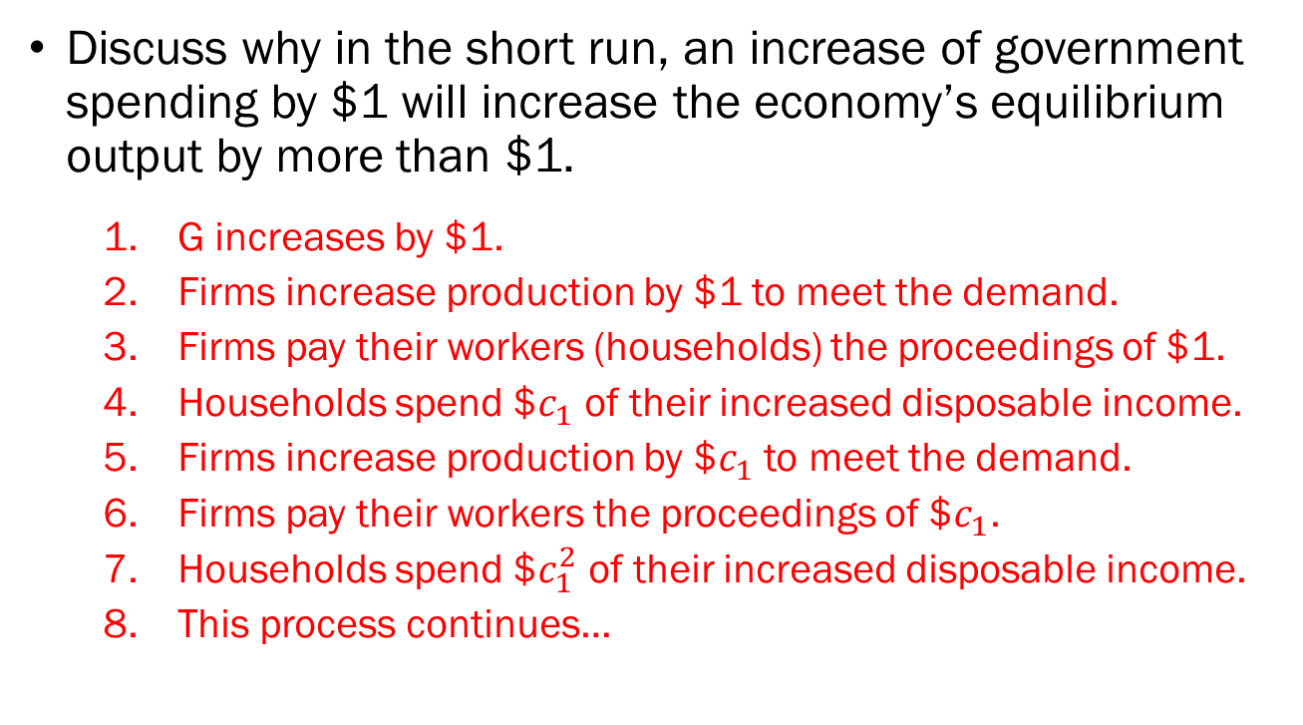
Problem 4.B.
Discuss why in the short run, an increase of government spending by $1 will increase the economy’s equilibrium output by more than $1.
  G increases by $1.
  Firms increase production by $1 to meet the demand.
  Firms pay their workers (households) the proceedings of $1.
  Households spend $$c_{1}$ of their increased disposable income.
  Firms increase production by $$c_{1}$ to meet the demand.
  Firms pay their workers the proceedings of $$c_{1}$.
  Households spend $$c_{1}^{2}$ of their increased disposable income.
  This process continues…

Slide 16
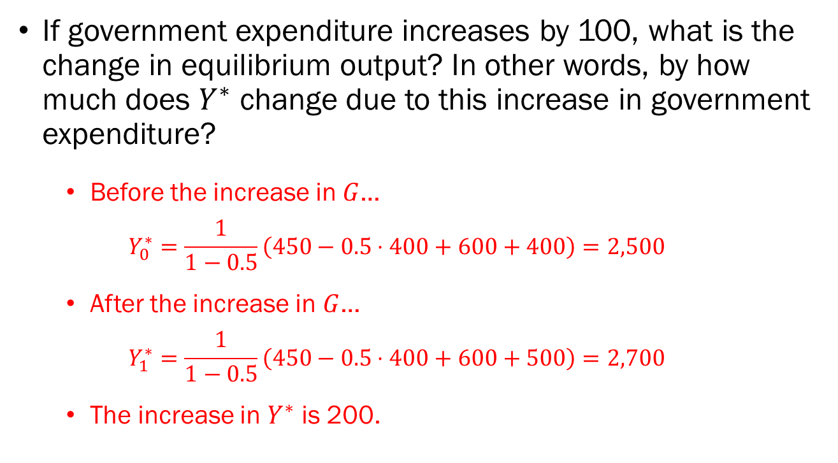
Problem 4.C.
If government expenditure increases by 100, what is the change in equilibrium output? In other words, by how much does $Y^{∗}$ change due to this increase in government expenditure?
  Before the increase in $G$…
  $$Y_{0}^{∗}=\frac{1}{1−0.5}\left(450−0.5⋅400+600+400\right)=2,500$$
  After the increase in $G$…
  $$Y_{1}^{∗}=\frac{1}{1−0.5}\left(450−0.5⋅400+600+500\right)=2,700$$
  The increase in $Y^{∗}$ is 200.

