Slide 1
Quiz #5 Review
ECON 301

Slide 2
Quiz #5 “Recovery” Office Hours
https://calendly.com/brianhwpark
Venue: Rm. 248 Center for Science and Business
Dates: Apr. 29th ~ May. 10th, 2024
Length: 30 Minutes per Session
Use the Whiteboard / Paper to correct your answers.
Recovery Rate: 50%

Slide 3
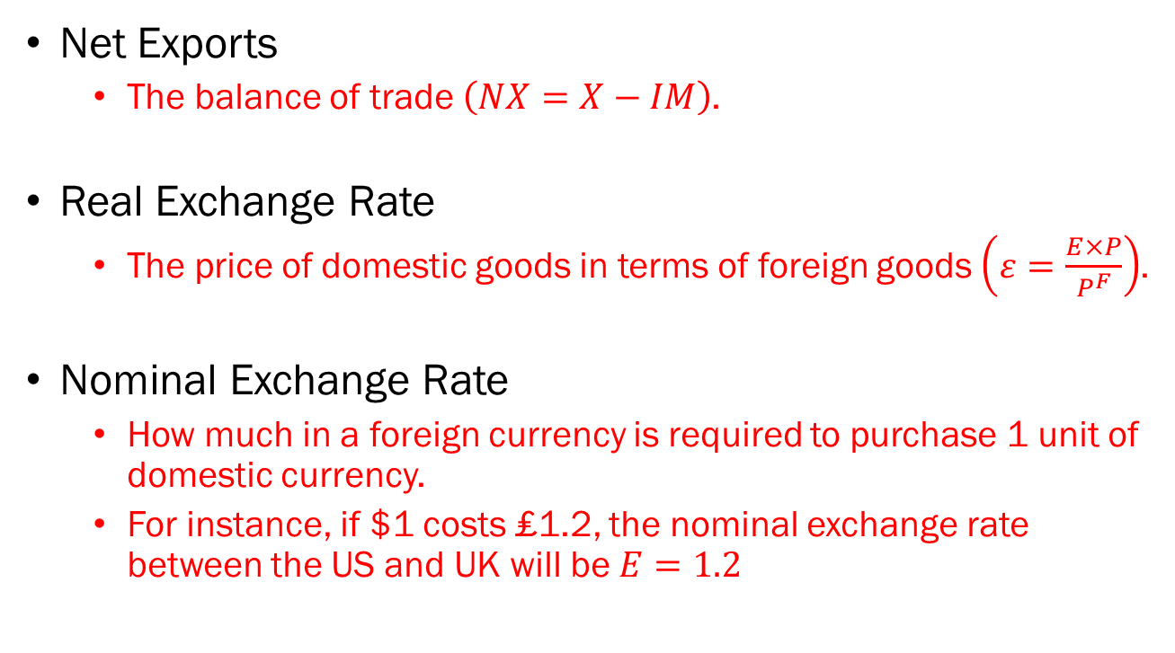
Problem 1. Definitions
Net Exports
  The balance of trade $\left(NX=X−IM\right)$.
Real Exchange Rate
  The price of domestic goods in terms of foreign goods $\left(ε=\frac{E×P}{P^{F}}\right)$.
Nominal Exchange Rate
  How much in a foreign currency is required to purchase 1 unit of domestic currency.
  For instance, if $1 costs ₤1.2, the nominal exchange rate between the US and UK will be $E=1.2$

Slide 4
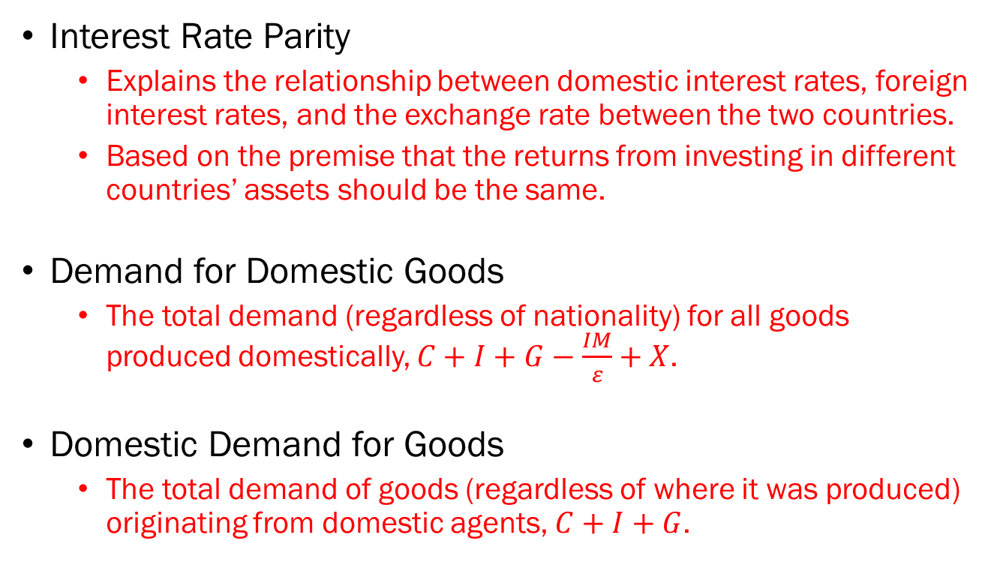
Problem 1. Definitions
Interest Rate Parity
  Explains the relationship between domestic interest rates, foreign interest rates, and the exchange rate between the two countries.
  Based on the premise that the returns from investing in different countries’ assets should be the same.
Demand for Domestic Goods
  The total demand (regardless of nationality) for all goods produced domestically, $C+I+G−\frac{IM}{ε}+X$.
Domestic Demand for Goods
  The total demand of goods (regardless of where it was produced) originating from domestic agents, $C+I+G$.

Slide 5
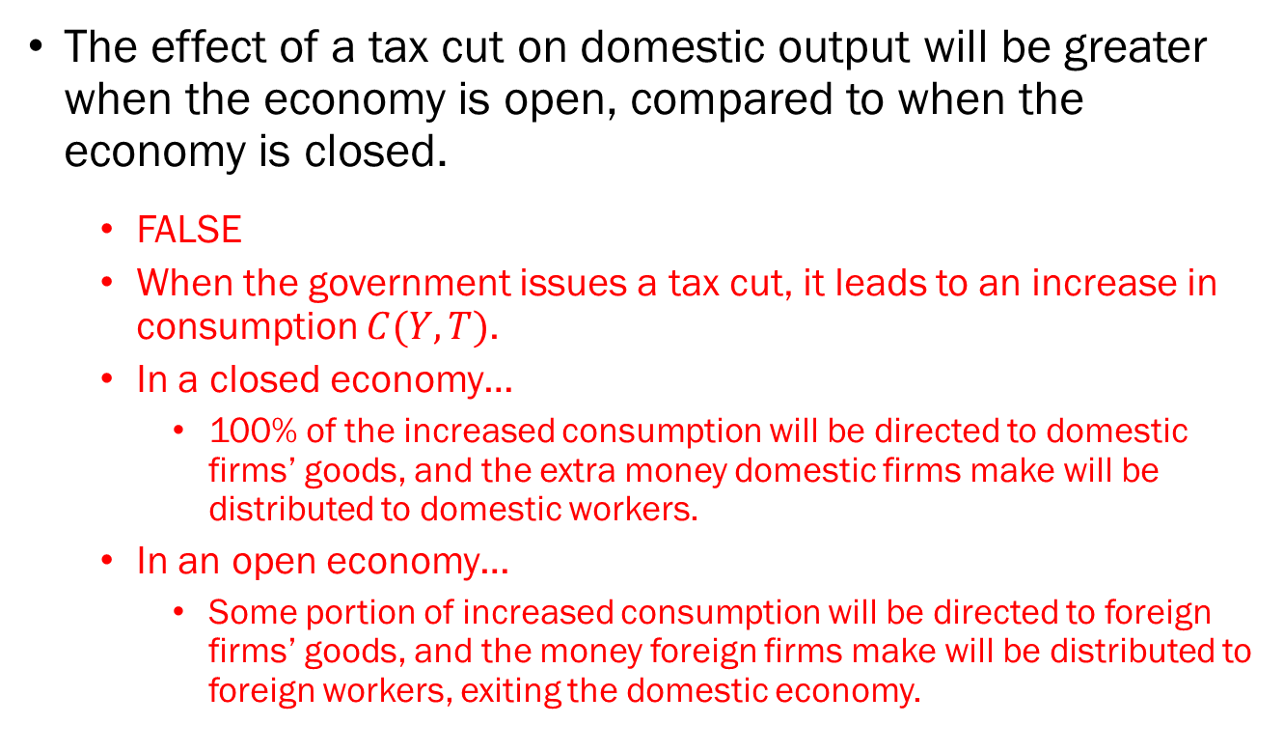
Problem 2.A.
The effect of a tax cut on domestic output will be greater when the economy is open, compared to when the economy is closed.
  FALSE
  When the government issues a tax cut, it leads to an increase in consumption $C(Y,T)$.
  In a closed economy…
    100% of the increased consumption will be directed to domestic firms’ goods, and the extra money domestic firms make will be distributed to domestic workers.
  In an open economy…
    Some portion of increased consumption will be directed to foreign firms’ goods, and the money foreign firms make will be distributed to foreign workers, exiting the domestic economy.

Slide 6
Problem 2.B.
Even when an economy's production matches its potential output, its net exports may not necessarily be zero.
  TRUE
  In our model, potential output is derived completely independent of foreign factors.
  Recall the Phillips curve, the Wage Setting, and Price Setting relations in the medium-run.

Slide 7
Problem 2.C.
If the amount of Euros required to purchase 1 US dollar changes from 1 to 1.2, we say that the US dollar has appreciated against the Euro.
  TRUE
  The change tells us that “more Euros are required to purchase one US dollar.”
  This means that the value of the US dollar increased.
  We call this an “appreciation.”

Slide 8
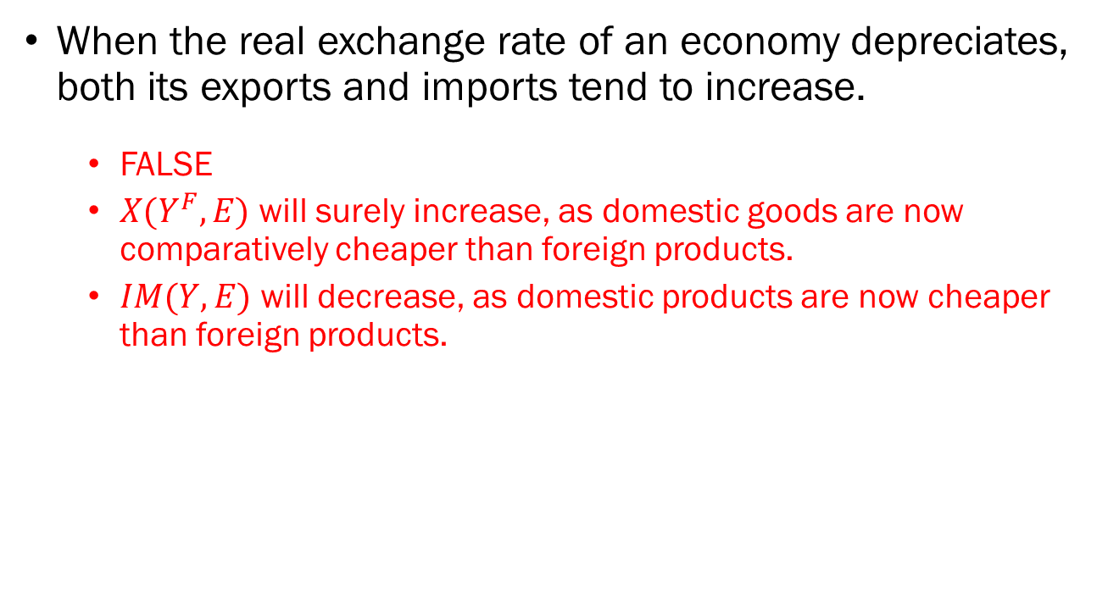
Problem 2.D.
When the real exchange rate of an economy depreciates, both its exports and imports tend to increase.
  FALSE
  $X(Y^{F},E)$ will surely increase, as domestic goods are now comparatively cheaper than foreign products.
  $IM(Y,E)$ will decrease, as domestic products are now cheaper than foreign products.

Slide 9
Problem 3.A.
If the investor invests their entire budget on US bonds that guarantee a 5% annual return, how much in US dollar ($) terms would the investor have at the end of the year?
  The US investor purchases $100 in US bonds.
  At the maturity, the investor collects $105.

Slide 10
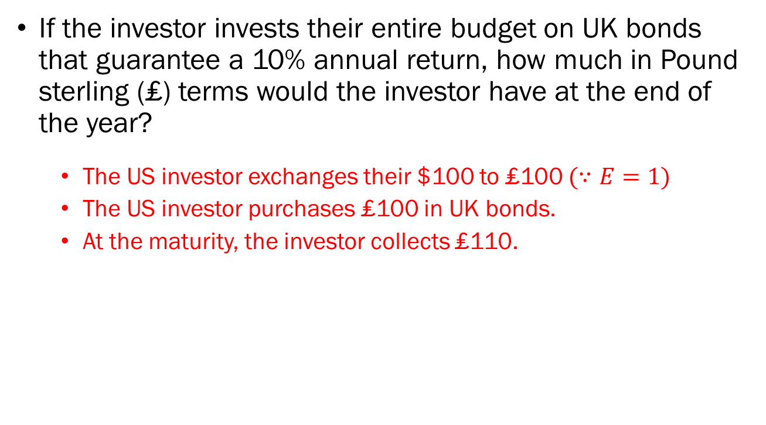
Problem 3.B.
If the investor invests their entire budget on UK bonds that guarantee a 10% annual return, how much in Pound sterling (₤) terms would the investor have at the end of the year?
  The US investor exchanges their $100 to ₤100 $(∵E=1)$
  The US investor purchases ₤100 in UK bonds.
  At the maturity, the investor collects ₤110.

Slide 11
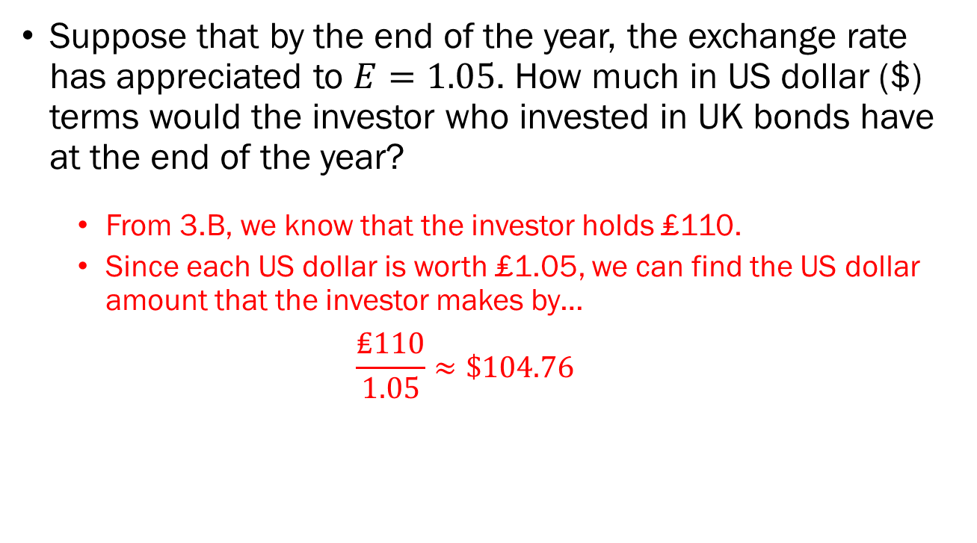
Problem 3.C.
Suppose that by the end of the year, the exchange rate has appreciated to $E=1.05$. How much in US dollar ($) terms would the investor who invested in UK bonds have at the end of the year?
  From 3.B, we know that the investor holds ₤110.
  Since each US dollar is worth ₤1.05, we can find the US dollar amount that the investor makes by…
  $$\frac{\text{₤110}}{1.05}≈\$104.76$$

Slide 12
Problem 3.D.
Based on your answers from 3.A. to 3.C., should the investor invest in the US bonds with a 5% annual return, or the UK bonds with a 10% annual return?
  From 3.A, we find that investing in US bonds will grow the initial budget of $100 to $105.
  From 3.B and 3.C, we find that investing in UK bonds will grow the initial budget of $100 to $104.76.
  Therefore, the US investor should invest in US bonds.

Slide 13
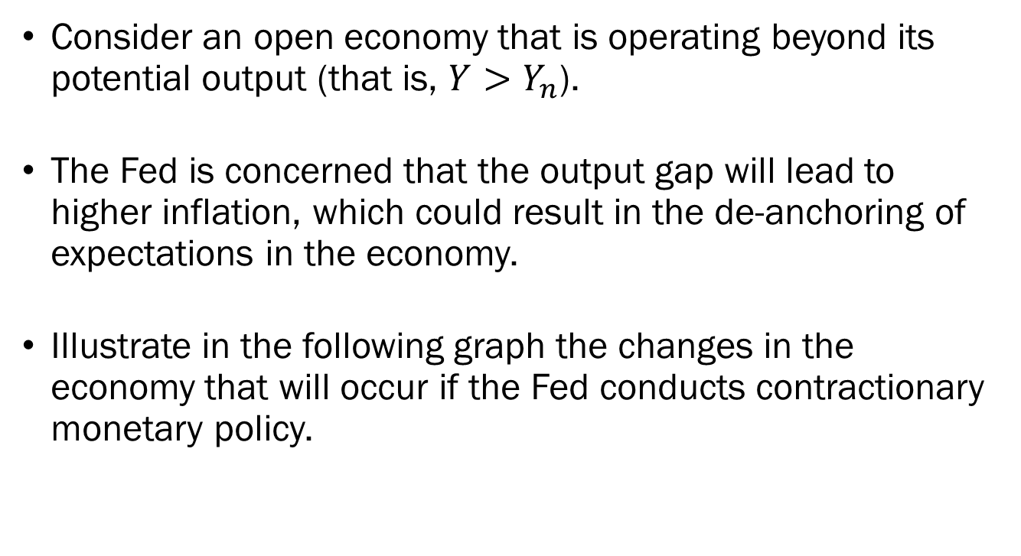
Problem 4.A.
Consider an open economy that is operating beyond its potential output (that is, $Y>Y_{n}$).
The Fed is concerned that the output gap will lead to higher inflation, which could result in the de-anchoring of expectations in the economy.
Illustrate in the following graph the changes in the economy that will occur if the Fed conducts contractionary monetary policy.

Slide 14















Problem 4.A.
$$Interest$$
$$Parity$$
Domestic Interest Rate $i$
Domestic Interest Rate $i$
$${\overline{i}}^{′}$$
$$LM^{′}$$
$${\overline{i}}^{′}$$
$$\overline{i}$$
$$LM$$
$$\overline{i}$$
$$IS$$
$$Y^{′}$$
$$Y$$
Output, $Y$
$$E$$
$$E^{′}$$
Exchange Rate, $E$

Slide 15
Problem 4.B.
Based on your answer from 4.A., what happens to the domestic interest rate?
  It will increase.
Based on your answer from 4.A., what happens to the nominal exchange rate?
  It will appreciate
Based on your answer from 4.A., what happens to the balance of trade?
  It will probably worsen (if the Marshall-Lerner conditions hold)

Slide 16
Problem 5.
Suppose that the economy is operating at the medium-run equilibrium, which happens to coincide with the balanced trade level of output.
Complete the following graph by illustrating the effect of a tax cut and explain its effect on the country's balance of trade.

Slide 17







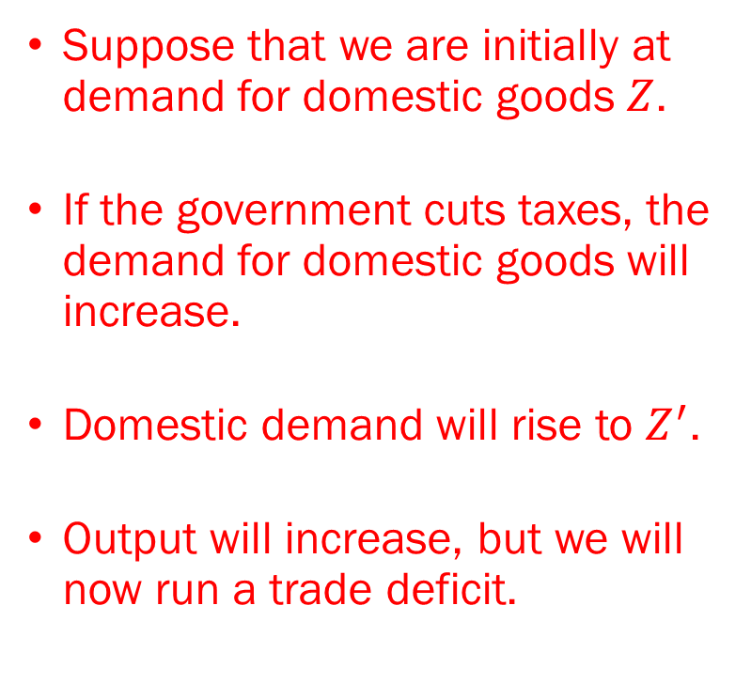
Problem 5.
Suppose that we are initially at demand for domestic goods $Z$.
If the government cuts taxes, the demand for domestic goods will increase.
Domestic demand will rise to $Z^{′}$.
Output will increase, but we will now run a trade deficit.
Demand
$$Z^{′}$$
$$Z$$
Output
$$Y^{∗}$$
$$Y^{∗′}$$
$$NX$$
$$Y_{TB}$$
Output
$$NX$$

