Slide 1
Quiz #4 Review
ECON 301

Slide 2
Quiz #4 “Recovery” Office Hours
https://calendly.com/brianhwpark
Venue: Rm. 248 Center for Science and Business
Dates: Apr. 10th ~ Apr. 19th, 2024
Length: 30 Minutes per Session
Use the Whiteboard / Paper to correct your answers.
Recovery Rate: 50%

Slide 3
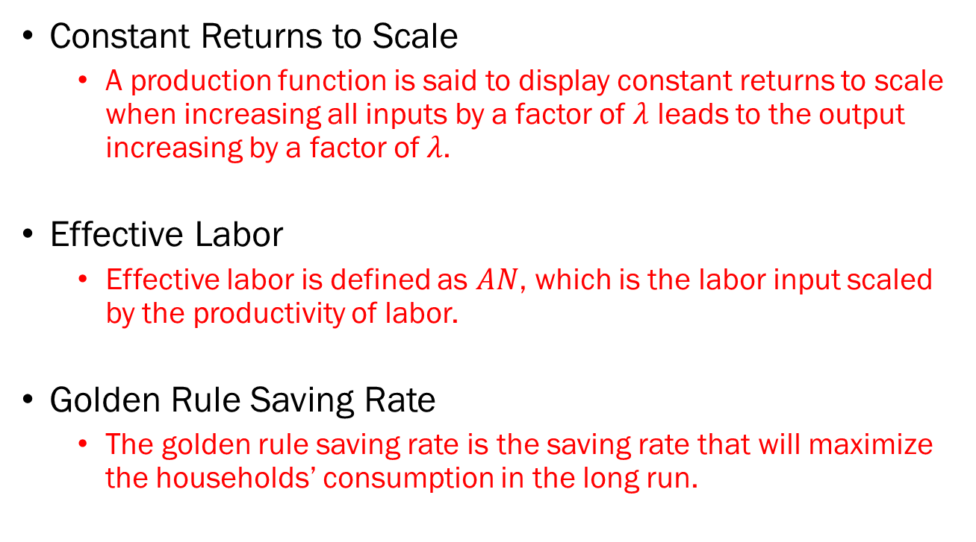
Problem 1. Definitions
Constant Returns to Scale
  A production function is said to display constant returns to scale when increasing all inputs by a factor of $λ$ leads to the output increasing by a factor of $λ$.
Effective Labor
  Effective labor is defined as $AN$, which is the labor input scaled by the productivity of labor.
Golden Rule Saving Rate
  The golden rule saving rate is the saving rate that will maximize the households’ consumption in the long run.

Slide 4
Problem 1. Definitions
Technological Progress
  Technological progress can mean many things, but in our context, it refers to an increase of the productivity of the economy.
Gini Coefficient
  A measure of the income inequality in the economy, where a smaller value means a more equal distribution of income.
Steady State
  When the economy reaches the steady state, the main variable of interest is kept constant.
  i.e., Output per effective labor is constant in the steady state.

Slide 5
Problem 2.A.
If an economy’s saving rate is increased, its growth rate will increase in the long run.
  FALSE
  An increase in the economy’s saving rate will not lead to a change in the economy’s growth rate.
  However, it may lead to a higher level of output per capita in the steady state.

Slide 6
Problem 2.B.
The accumulation of capital, whether physical or human, will not necessarily result in an increase in the growth rate of the economy over time.
  TRUE
  Essentially the same question as 2.A.
  Increased saving rates lead to higher levels of capital accumulation but does not lead to the increase in the long run growth rate.

Slide 7
Problem 2.C.
To compare the standards of living between any two countries, information on the US dollar value of real GDP per capita of each country will be sufficient.
  FALSE
  There are often massive differences in the cost of living between two countries, which are not reflected in the real GDP values.

Slide 8
Problem 2.D.
It can be harmful to technological progress if intellectual property rights are overly protected.
  TRUE
  Excessive protection of intellectual property will prohibit other researchers to build upon existing knowledge, which may slow down future R&D.

Slide 9
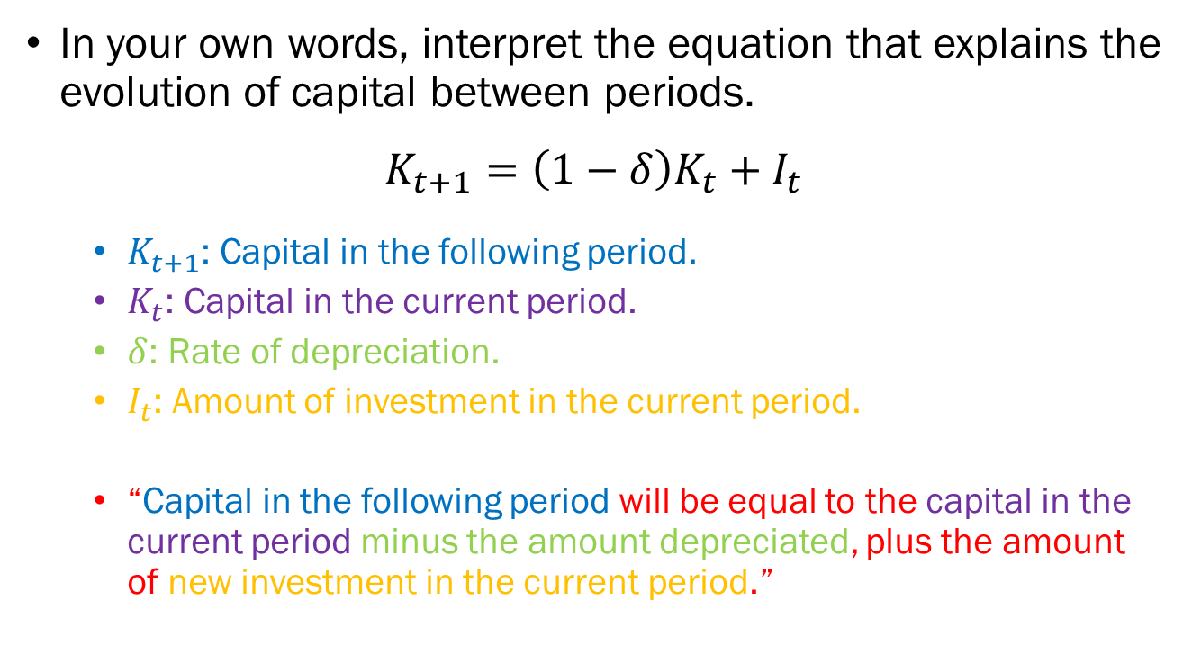
Problem 3.A.
In your own words, interpret the equation that explains the evolution of capital between periods.
$$K_{t+1}=\left(1−δ\right)K_{t}+I_{t}$$
  $K_{t+1}$: Capital in the following period.
  $K_{t}$: Capital in the current period.
  $δ$: Rate of depreciation.
  $I_{t}$: Amount of investment in the current period.
  “Capital in the following period will be equal to the capital in the current period minus the amount depreciated, plus the amount of new investment in the current period.”

Slide 10
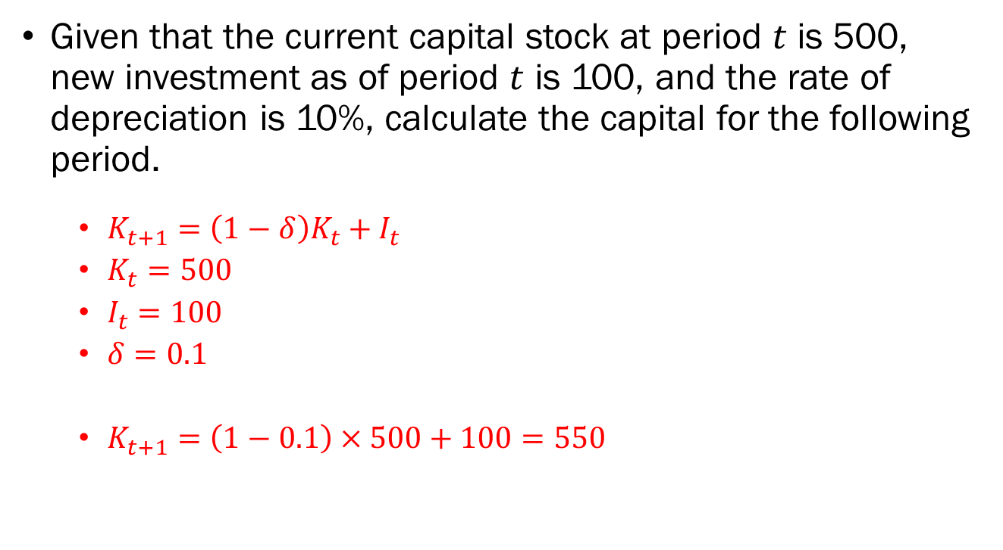
Problem 3.B.
Given that the current capital stock at period $t$ is 500, new investment as of period $t$ is 100, and the rate of depreciation is 10%, calculate the capital for the following period.
  $K_{t+1}=\left(1−δ\right)K_{t}+I_{t}$
  $K_{t}=500$
  $I_{t}=100$
  $δ=0.1$
  $K_{t+1}=\left(1−0.1\right)×500+100=550$

Slide 11
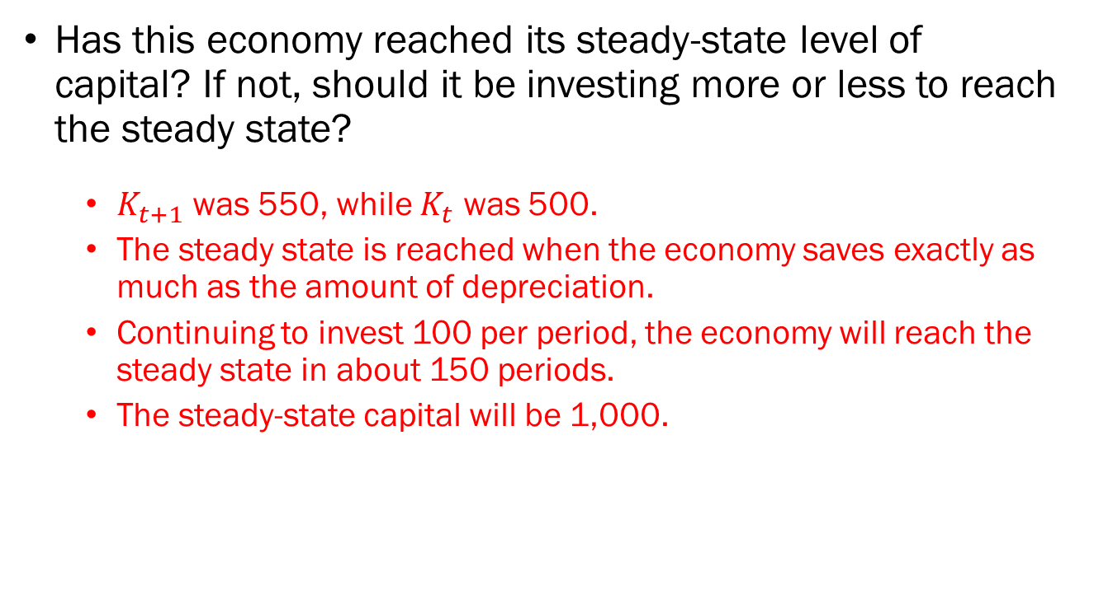
Problem 3.C.
Has this economy reached its steady-state level of capital? If not, should it be investing more or less to reach the steady state?
  $K_{t+1}$ was 550, while $K_{t}$ was 500.
  The steady state is reached when the economy saves exactly as much as the amount of depreciation.
  Continuing to invest 100 per period, the economy will reach the steady state in about 150 periods.
  The steady-state capital will be 1,000.

Slide 12





Problem 4.A.
Plot and label the graphs for the output, savings, and required investment.
$$(δ+g_{A}+g_{N})\frac{K}{AN}$$
$$Y/AN$$
Plot the per effective labor production function using the information given.
Multiply it by the saving rate to find the savings.
Then calculating the amount of investment required to keep capital per effective labor constant…
$$f\left(\frac{K}{AN}\right)$$
$$sf\left(\frac{K}{AN}\right)$$
$$K/AN$$

Slide 13


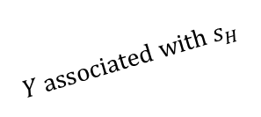
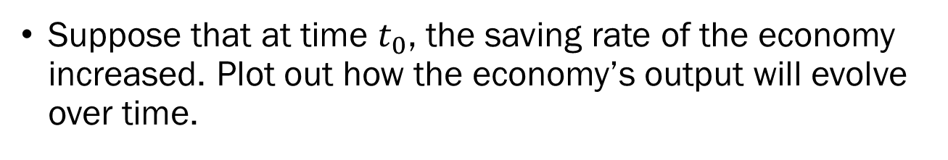
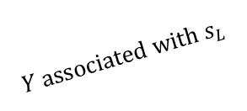


Problem 4.B.
Suppose that at time $t_{0}$, the saving rate of the economy increased. Plot out how the economy’s output will evolve over time.
The slopes of the growth paths (diagonal upward dotted lines) will be $g_{A}+g_{N}$.
$$log⁡(Y)$$
$$Y associated with s_{H}$$
$$Y associated with s_{L}$$
$$t_{0}$$
$$Time$$

Slide 14
Problem 5.
Explain why a 0% saving rate is not optimal
  A 0% saving rate will eventually lead to 0 output, which will lead to 0 consumption available for the households.
Explain why a 100% saving rate is not optimal
  A 100% saving rate will eventually lead to maximum output, but households will have no income left to consume, leading to 0 consumption.

Slide 15
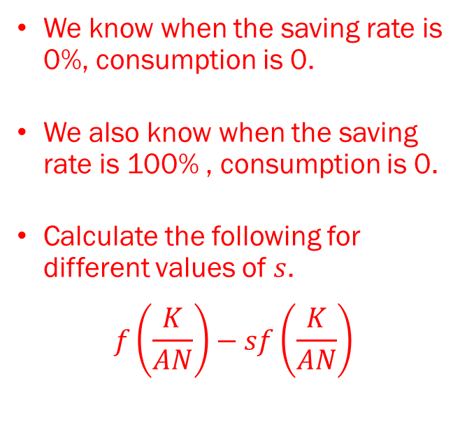






Problem 5.
How you would calculate the “best” saving rate.
$$C/N$$
We know when the saving rate is 0%, consumption is 0.
We also know when the saving rate is 100% , consumption is 0.
Calculate the following for different values of $s$.
$$f\left(\frac{K}{AN}\right)−sf\left(\frac{K}{AN}\right)$$
$$\frac{C^{MAX}}{N}$$
$$0$$
$$s_{G}$$
$$1$$
$$s$$

