Slide 1
Quiz #2 Review
ECON 301

Slide 3
Quiz #2 “Recovery” Office Hours
https://calendly.com/brianhwpark
Venue: Rm. 248 Center for Science and Business
Dates: Feb. 26th ~ Mar. 1st , 2024 (5 Days)
Length: 30 Minutes per Session
Use the Whiteboard / Paper to correct your answers.
Recovery Rate: 50%

Slide 4
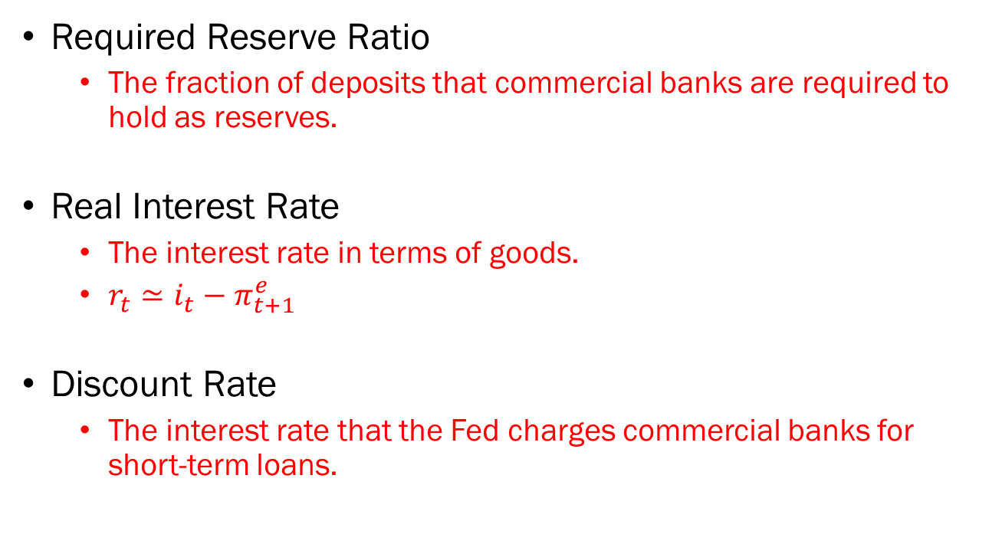
Problem 1. Definitions
Required Reserve Ratio
  The fraction of deposits that commercial banks are required to hold as reserves.
Real Interest Rate
  The interest rate in terms of goods.
  $r_{t}≃i_{t}−π_{t+1}^{e}$
Discount Rate
  The interest rate that the Fed charges commercial banks for short-term loans.

Slide 5
Problem 1. Definitions
Fiscal Policy
  The governments’ use of its own expenditures and taxation targeting to influence the economy.
Open Market Operations
  One of the Fed’s options on conducting monetary policy which involves the purchase or sale of securities, typically treasury bills.
Risk Premium
  The premium that financial intermediaries charge upon processing loans, which is typically based on the borrower’s probability of default.

Slide 6
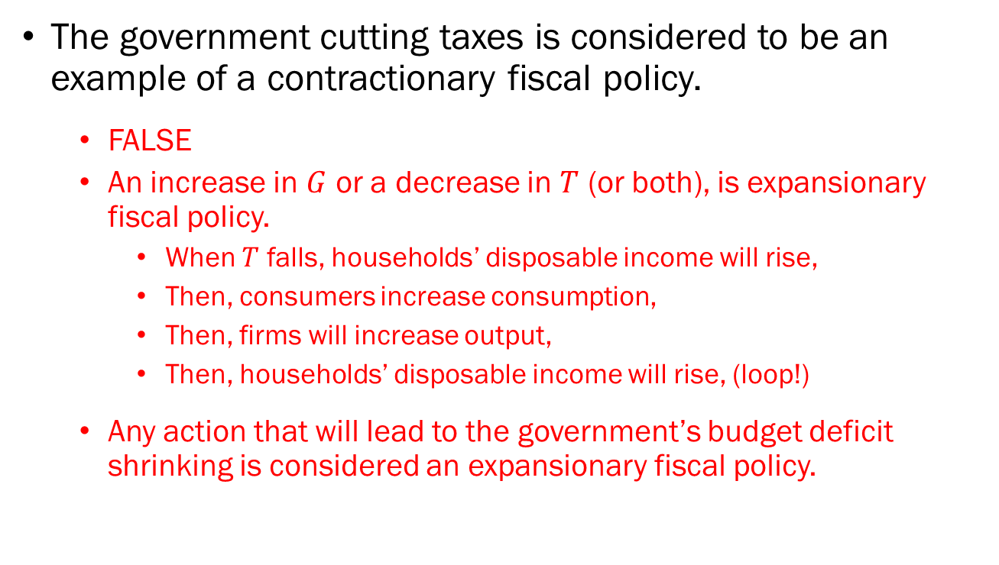
Problem 2.A.
The government cutting taxes is considered to be an example of a contractionary fiscal policy.
  FALSE
  An increase in $G$ or a decrease in $T$ (or both), is expansionary fiscal policy.
    When $T$ falls, households’ disposable income will rise,
    Then, consumers increase consumption,
    Then, firms will increase output,
    Then, households’ disposable income will rise, (loop!)
  Any action that will lead to the government’s budget deficit shrinking is considered an expansionary fiscal policy.

Slide 7
Problem 2.B.
The Fed raising interest rates is considered to be an example of an expansionary monetary policy.
  FALSE
  An expansion on the monetary base is considered an expansionary monetary policy.

Slide 8
Problem 2.C.
Bond prices and interest rates are negatively correlated.
  TRUE

Slide 9
Problem 2.D.
When households’ income increases, the demand for money will increase.
  TRUE

Slide 10


















Problem 3.A.
$$Y=Z$$
Demand
$$Z_{i=3\%}$$
Interest Rate
$$C$$
$$Z_{i=5\%}$$
$$7\%$$
$$Z_{i=7\%}$$
$$A$$
$$5\%$$
$$B$$
$$3\%$$
$$IS$$
$${45}^{°}$$
$$500$$
$$1000$$
$$1700$$
Output
$$500$$
$$1000$$
$$1700$$
Output

Slide 11
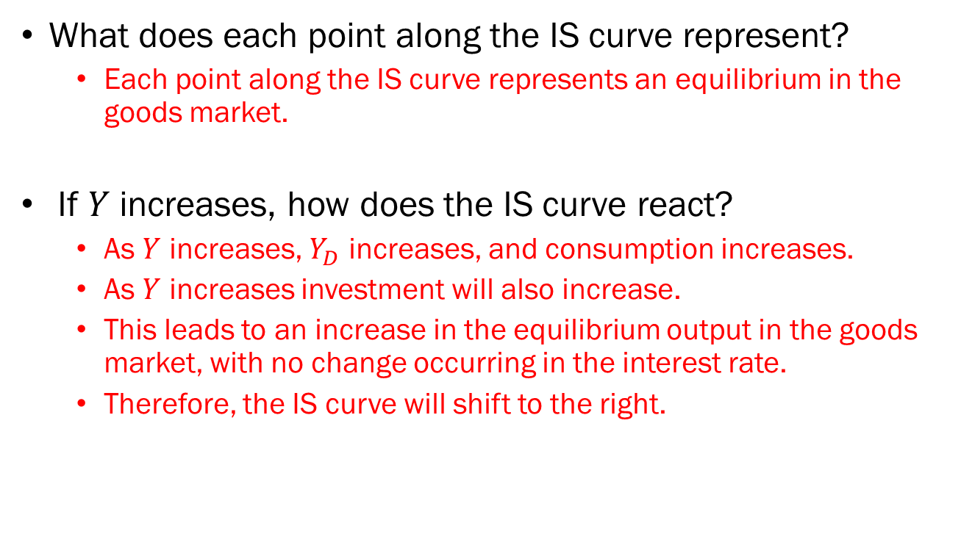
Problem 3.B.
What does each point along the IS curve represent?
  Each point along the IS curve represents an equilibrium in the goods market.
If $Y$ increases, how does the IS curve react?
  As $Y$ increases, $Y_{D}$ increases, and consumption increases.
  As $Y$ increases investment will also increase.
  This leads to an increase in the equilibrium output in the goods market, with no change occurring in the interest rate.
  Therefore, the IS curve will shift to the right.

Slide 12
Problem 4.A.
Money must serve three functions in the economy. List the three functions of money and provide a short explanation describing each function.
  Function #1: Medium of Exchange
    Money can be used as a method of payment when exchanging goods and services.
  Function #2: Store of Value
    Money can be used to preserve one’s purchasing power into the future.
  Function #3: Unit of Account
    Money is used as a yardstick to compare the value of different goods and services.

Slide 13
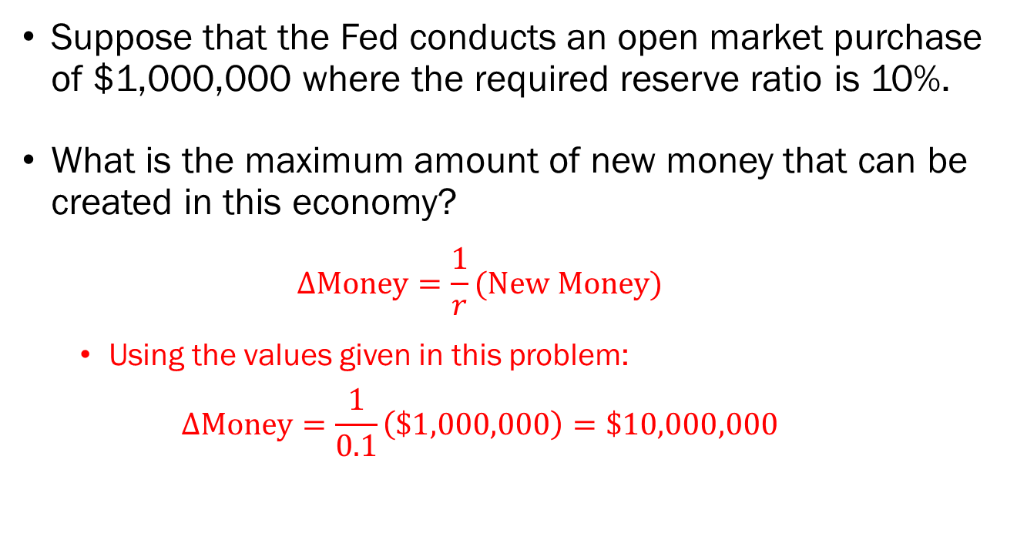
Problem 4.B.
Suppose that the Fed conducts an open market purchase of $1,000,000 where the required reserve ratio is 10%.
What is the maximum amount of new money that can be created in this economy?
  $$ΔMoney=\frac{1}{r}(New Money)$$
  Using the values given in this problem:
  $$ΔMoney=\frac{1}{0.1}\left(\$1,000,000\right)=\$10,000,000$$

Slide 14
Problem 4.B. (Continued)
Suppose that the Fed conducts an open market purchase of $1,000,000 where the required reserve ratio is 10%.
How can the Fed increase the amount of new money supplied in the economy without purchasing more bonds?
  By lowering the required reserve ratio, the Fed can increase the amount of new money produced in the economy.

Slide 15









Problem 5.A.
Real Interest Rate
$$A^{′}$$
$$A$$
$$LM$$
$$\overline{r}$$
$$0$$
$$Y^{∗′}$$
$$Y^{∗}$$
Output
$$IS$$
$$IS^{′}$$

Slide 16
Problem 5.B.
Suppose that an increase in the uncertainty regarding the economy caused a sharp increase of the risk premium assessed by financial intermediaries in the short run.
If you are the Chair of the Federal Reserve Board, and your goal is to allow the economy to return to the original state, how would you conduct monetary policy?
  Since output has decreased as a response to the increased uncertainty in the economy, the Fed should conduct expansionary monetary policy. This can be either…
    Lowering the Required Reserve Ratio, or
    Lowering the Key Interest Rates, or
    Conducting Open Market Purchases.

