Slide 1
Quiz #1 Review
ECON 301

Slide 2
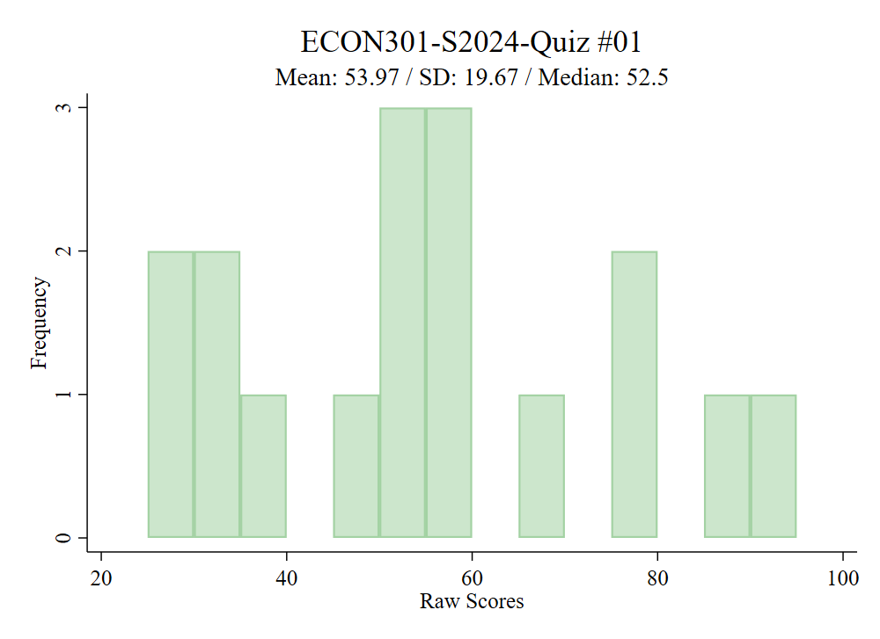

Slide 3
Quiz #1 “Recovery” Office Hours
https://calendly.com/brianhwpark
Venue: Rm. 248 Center for Science and Business
Dates: Feb. 12th ~ Feb. 16th , 2024
Length: 30 Minutes per Session
Use the Whiteboard / Paper to correct your answers.
Recovery Rate: 50%

Slide 4
Problem 1. Definitions
Gross Domestic Product
  The market value of all final goods and services produced in the economy during a given period.
Labor Force Participation Rate
  The ratio of people who are in the labor force to the number of civilian non-institutional population.
Marginal Propensity to Consume
  The proportion of disposable income that a household spends as consumption.

Slide 5
Problem 1. Definitions
Frictional Unemployment
  The type of unemployment that occurs due to the natural workings of the labor market; job search and matching.
Consumer Price Index
  The measure of the average change over time in the prices paid by consumers for a basket of consumer goods and services.
Intermediate Goods
  Goods that are used as factors of production in producing other final goods and services.

Slide 6
Problem 2.A.
An individual who willingly decides to be a full-time stay at home dad/mom will be classified as “unemployed” by the BLS.
  FALSE
  To be classified as unemployed, the individual must be:
    Above 16 years of age, and
    Are not employed, and
    Are currently available for work, and
    Have actively looked for work.
  Since this individual willingly decided to be a full-time stay at home dad/mom, they are not looking for work, and will not be classified as unemployed.

Slide 7
Problem 2.B.
If a Canadian citizen is employed by a factory in Texas which is owned by a Japanese auto manufacturer, their production will not be included in U.S. GDP.
  FALSE
  GDP does not discriminate on the basis of nationality, but only cares “where the production took place.” Since the production took place in Texas, this production will be included in U.S. GDP.

Slide 8

Problem 2.C.
In our simple model, households’ disposable income is defined as $Y−T$, which is output less taxes.
  TRUE

Slide 9
Problem 2.D.
The Philipps curve shows that unemployment and inflation are negatively correlated.
  TRUE

Slide 10
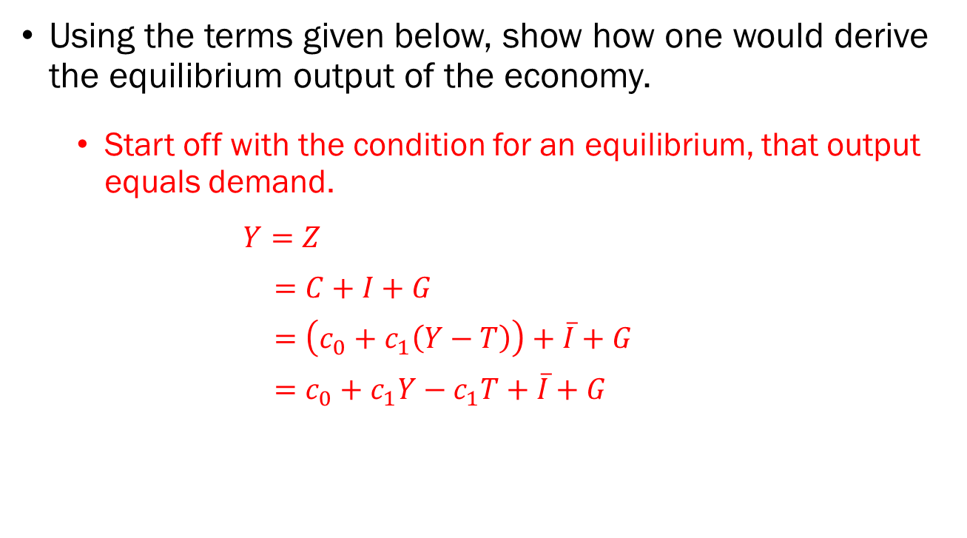
Problem 3.A.
Using the terms given below, show how one would derive the equilibrium output of the economy.
  Start off with the condition for an equilibrium, that output equals demand.
$Y=Z$
$=C+I+G$
$=\left(c_{0}+c_{1}\left(Y−T\right)\right)+\overline{I}+G$
$=c_{0}+c_{1}Y−c_{1}T+\overline{I}+G$

Slide 11
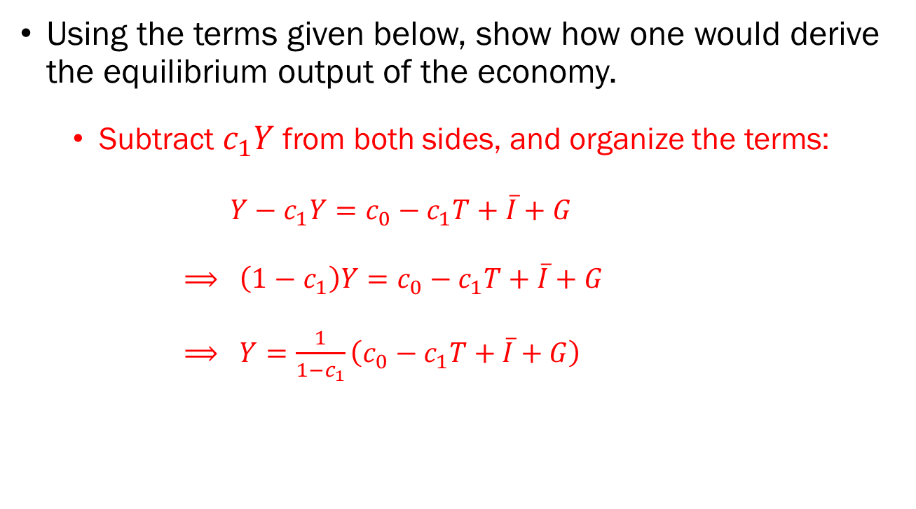
Problem 3.A. (Cont’d)
Using the terms given below, show how one would derive the equilibrium output of the economy.
  Subtract $c_{1}Y$ from both sides, and organize the terms:
$Y−c_{1}Y=c_{0}−c_{1}T+\overline{I}+G$
$⟹ \left(1−c_{1}\right)Y=c_{0}−c_{1}T+\overline{I}+G$
$⟹ Y=\frac{1}{1−c_{1}}\left(c_{0}−c_{1}T+\overline{I}+G\right)$

Slide 12
Problem 3.B.
Explain in your own words why a $1,000,000 increase in autonomous spending will lead to the equilibrium output increasing by more than $1,000,000.
  When autonomous spending increases by $1,000,000, this will lead to an excess demand in the economy.
  Firms in the economy will instantly react to this excess demand and increase output to fill the gap.
  The increased output translates to an increased income for households in the economy, which leads to increased demand.
  This increased demand will lead to an excess demand in the economy…

Slide 13
Problem 3.C.
In our model, any adjustments in the equilibrium level of output occurs instantly. Briefly discuss why this may not be true in the real world.
  In the real world, firms will not be able to “instantly” increase or decrease production to respond to excess demand or supply.

Slide 14
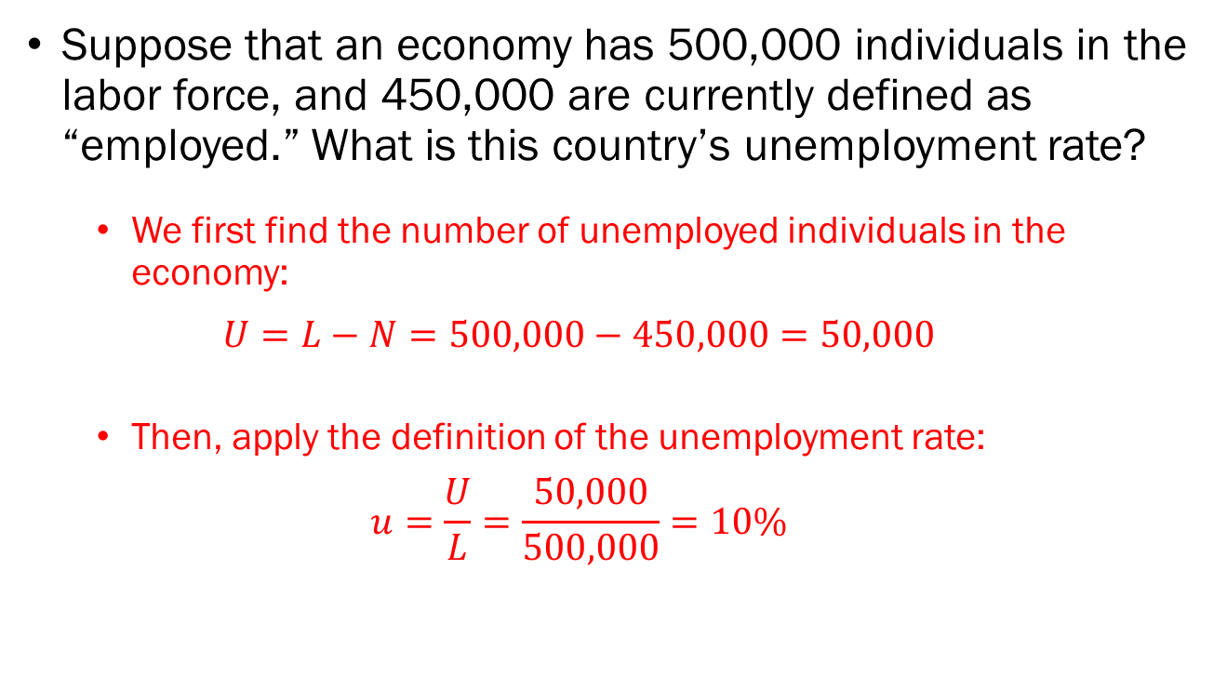
Problem 4.A.
Suppose that an economy has 500,000 individuals in the labor force, and 450,000 are currently defined as “employed.” What is this country’s unemployment rate?
  We first find the number of unemployed individuals in the economy:
  $$U=L−N=500,000−450,000=50,000$$
  Then, apply the definition of the unemployment rate:
  $$u=\frac{U}{L}=\frac{50,000}{500,000}=10\%$$

Slide 15
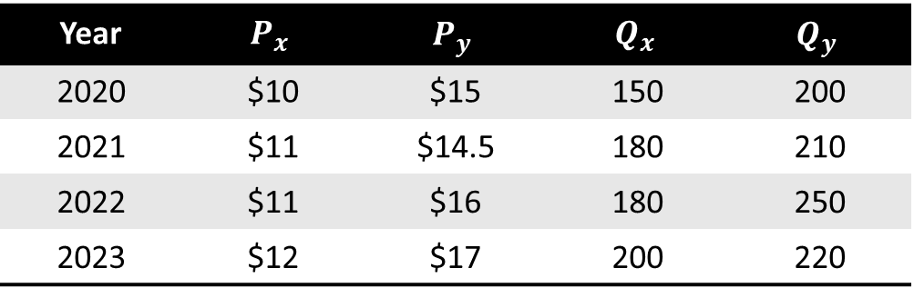

Problem 4.B.
Suppose that a country produces only two goods, good $x$ and good $y$. Calculate…
Nominal GDP for 2023.
  $$NGDP_{2023}=\$12×200+\$17×220=\$6,140$$
Year | $$P_{x}$$ | $$P_{y}$$ | $$Q_{x}$$ | $$Q_{y}$$
2020 | $10 | $15 | 150 | 200
2021 | $11 | $14.5 | 180 | 210
2022 | $11 | $16 | 180 | 250
2023 | $12 | $17 | 200 | 220

Slide 16

Problem 4.B.
Suppose that a country produces only two goods, good $x$ and good $y$. Calculate…
Real GDP for 2023 with 2020 as the base year.
  $$RGDP_{2023}^{2020}=\$10×200+\$15×220=\$5,300$$
Year | $$P_{x}$$ | $$P_{y}$$ | $$Q_{x}$$ | $$Q_{y}$$
2020 | $10 | $15 | 150 | 200
2021 | $11 | $14.5 | 180 | 210
2022 | $11 | $16 | 180 | 250
2023 | $12 | $17 | 200 | 220

Slide 17
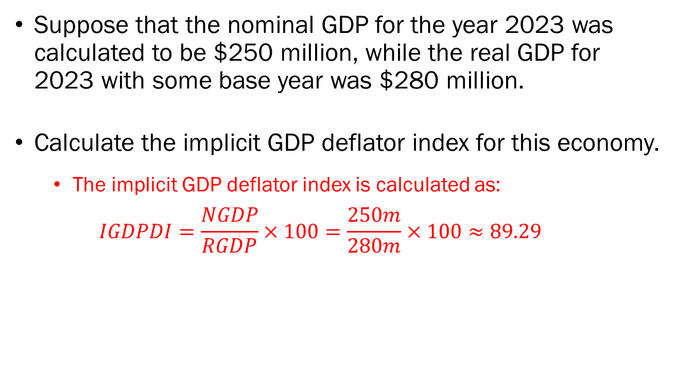
Problem 4.C.
Suppose that the nominal GDP for the year 2023 was calculated to be $250 million, while the real GDP for 2023 with some base year was $280 million.
Calculate the implicit GDP deflator index for this economy.
  The implicit GDP deflator index is calculated as:
  $$IGDPDI=\frac{NGDP}{RGDP}×100=\frac{250m}{280m}×100≈89.29$$

Slide 18
Problem 4.C. (Cont’d)
Suppose that the nominal GDP for the year 2023 was calculated to be $250 million, while the real GDP for 2023 with some base year was $280 million.
Discuss and explain whether the economy experienced inflation or deflation.
  Normalizing the price level of the economy at 100, the price level as of 2023 was 89.29, which implies that the economy experienced deflation between the base year and 2023.

