Slide 1
The Long Run:
Introduction to Growth
ECON 301

Slide 2
The Short and Medium Run vs. the Long Run
In the short run, changes in aggregate demand was the dominant force in determining equilibrium output.
In the medium run, conditions in the supply-side of the economy determined the equilibrium output.
In the short and medium runs, the changes in output we observe are largely “fluctuations.”

Slide 3
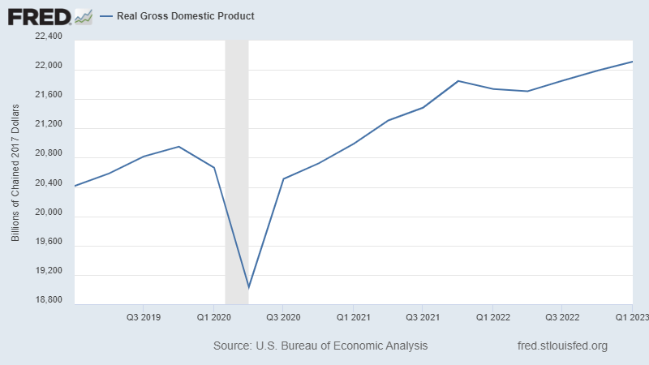
US Real GDP: 2019Q1 ~ 2023Q1

Slide 4
The Short and Medium Run vs. the Long Run
However, the impact of short-term fluctuations are drowned out in the long run.
In the long-run, it is no longer “fluctuations” that matters, but the trend of “growth.”
Growth is defined as the steady increase in aggregate output over time.

Slide 5
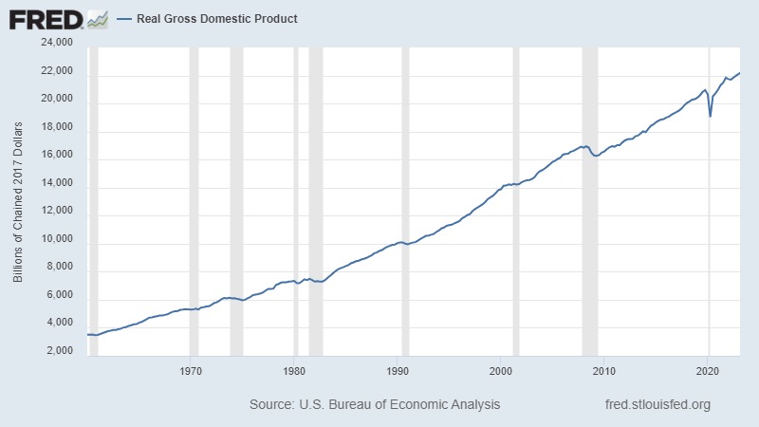
US Real GDP: 1960Q1 ~ 2023Q1

Slide 6
Why We Measure Growth
We care about growth of an economy, since we care about improvements of the standards of living in the country.
Comparing values over time, we can measure the change of the standards of living within a country.
Comparing the values between different countries, we can measure the differences in the standards of living between different countries.

Slide 7
Why We Measure Per Capita Output
As of 2022, the nominal GDP of…
  …India was $3.4 Trillion.
  …the United Kingdom was $3.1 Trillion.
Would it be fair to assume that the standards of living in India is similar to the standards of living in the UK?
The population in…
  …India was 1.4 billion, for a per capita output of $2,428
  …the UK was 67.3 million, for a per capita output of $50,520

Slide 8
Comparing GDP per Capita?
Simply comparing per capita GDP can be problematic.
First, we convert each country’s currency to US dollars to compare different country’s production.
However, exchange rates are often volatile, and can change drastically over time.
For instance, over 2020 to 2023…
  1 GBP traded for anywhere between 1 ~ 1.4 USD.
  1 USD traded for anywhere between 70 ~ 82 INR.

Slide 9
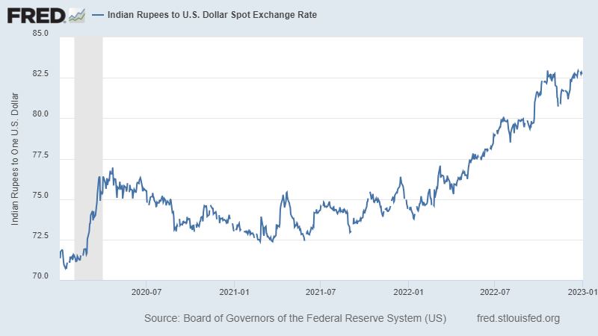
INR to USD Exchange Rates

Slide 10
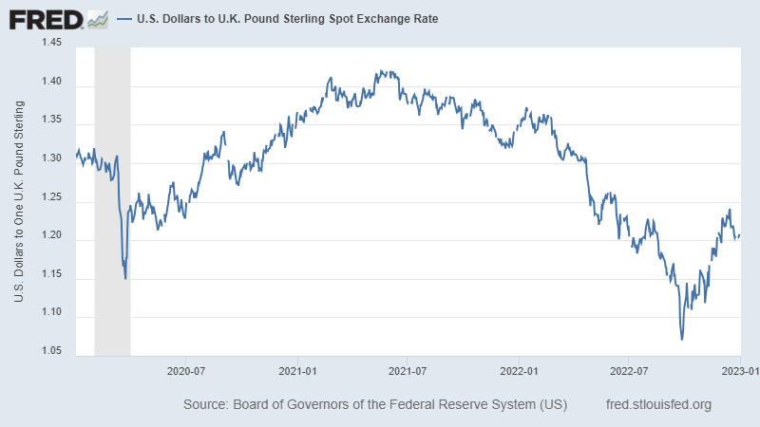
USD to GBP Exchange Rates

Slide 11
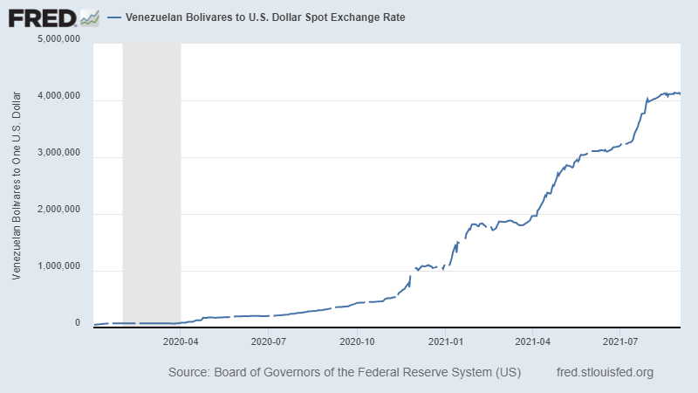
Extreme Cases of Fluctuations

Slide 12
Comparing GDP per Capita?
Second, there are massive differences in the cost of living across countries.
Recall that the GDP per capita of India was $2,428.
It would be incredibly difficult to live on $2,428 in the US, but many people in India live on this annual income.
Therefore, concluding that the standard of living in India is 21 times lower than the UK is not a fair comparison.
  $50,520/$2,428 is approximately 21.

Slide 13
Comparing Purchasing Power:
Purchasing Power Parity
The traditional method of comparing the purchasing power between countries uses Purchasing Power Parity (PPP) numbers.
Suppose that the typical household in the US spends $20,000 on food per year, where 1 bundle of food costs $10,000.
Also suppose that the typical household in India spends 300,000 INR on food per year, where the same bundle of food (as the US counterpart) costs 200,000 INR.

Slide 14
Comparing Purchasing Power:
Purchasing Power Parity
Assuming that $1 can be exchanged to 80 INR.
Translating the Indian households’ consumption to USD, we see that they spend $3,750 on food per year.
  300,000/80 is 3,750.
Does this truly mean that they can only afford 18.75% of what the typical US household can purchase?
  3,750/20,000 is 0.1875.
Not if we consider the amount of food each household can purchase!

Slide 15
Comparing Purchasing Power:
Purchasing Power Parity
The US household will be spending $20,000 in order to purchase 2 bundles of food.
Let’s calculate how much the household in India would spend to be at “parity” with the households in the US.
Indian households will purchase 1.5 bundles of food, which would cost $15,000 under US prices.
Taking the purchasing power in consideration, the difference is 75%, instead of 18.75%.
  15,000/20,000 is 0.75

Slide 16
Comparing Purchasing Power:
Purchasing Power Parity
One major problem with the PPP measure is that it assumes that the quality of the goods and services are uniform across borders.
Using our example, would the typical “food bundle” that a US consumer purchases identical in quality to that of the typical Indian consumer?
An alternative is to find some item that is identical in quality regardless of which country this item is produced and sold.

Slide 17
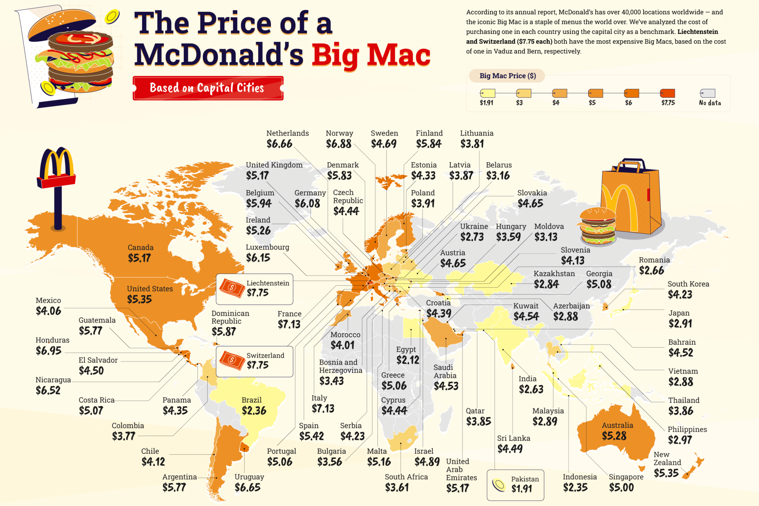
Comparing Purchasing Power:
The Big Mac Index

Slide 18
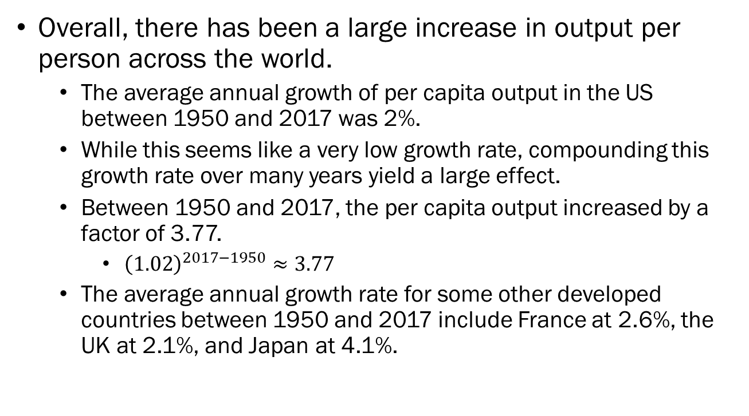
Facts about Growth
Overall, there has been a large increase in output per person across the world.
  The average annual growth of per capita output in the US between 1950 and 2017 was 2%.
  While this seems like a very low growth rate, compounding this growth rate over many years yield a large effect.
  Between 1950 and 2017, the per capita output increased by a factor of 3.77.
    ${\left(1.02\right)}^{2017−1950}≈3.77$
  The average annual growth rate for some other developed countries between 1950 and 2017 include France at 2.6%, the UK at 2.1%, and Japan at 4.1%.

Slide 19
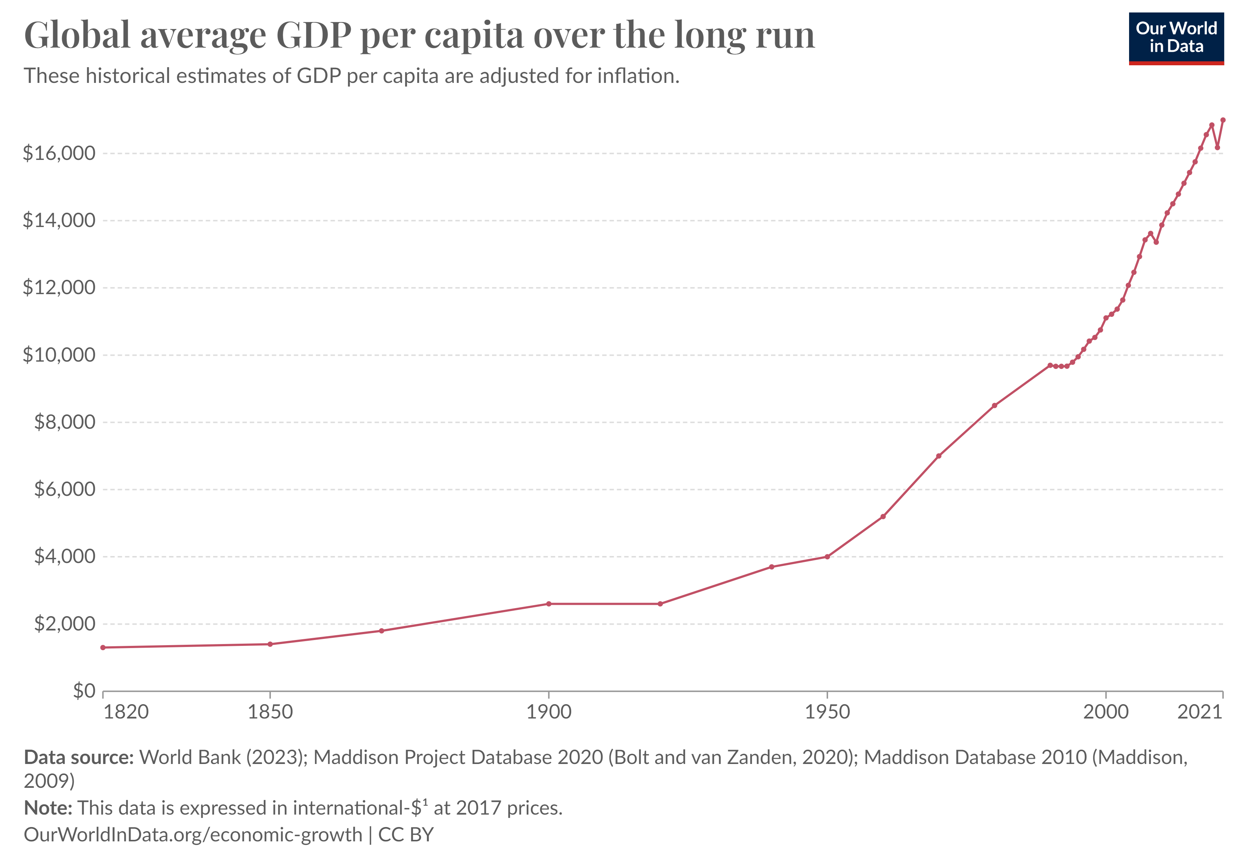

Slide 20
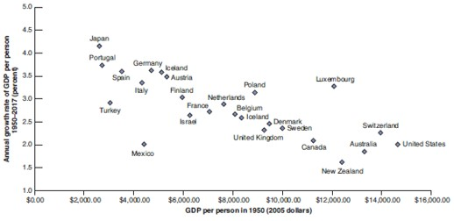
Facts about Growth
Meanwhile, there has been a convergence of output per capita across countries that are considered “developed.”
Countries which started off with a lower per capita output exhibited a higher rate of growth over time.

Slide 21
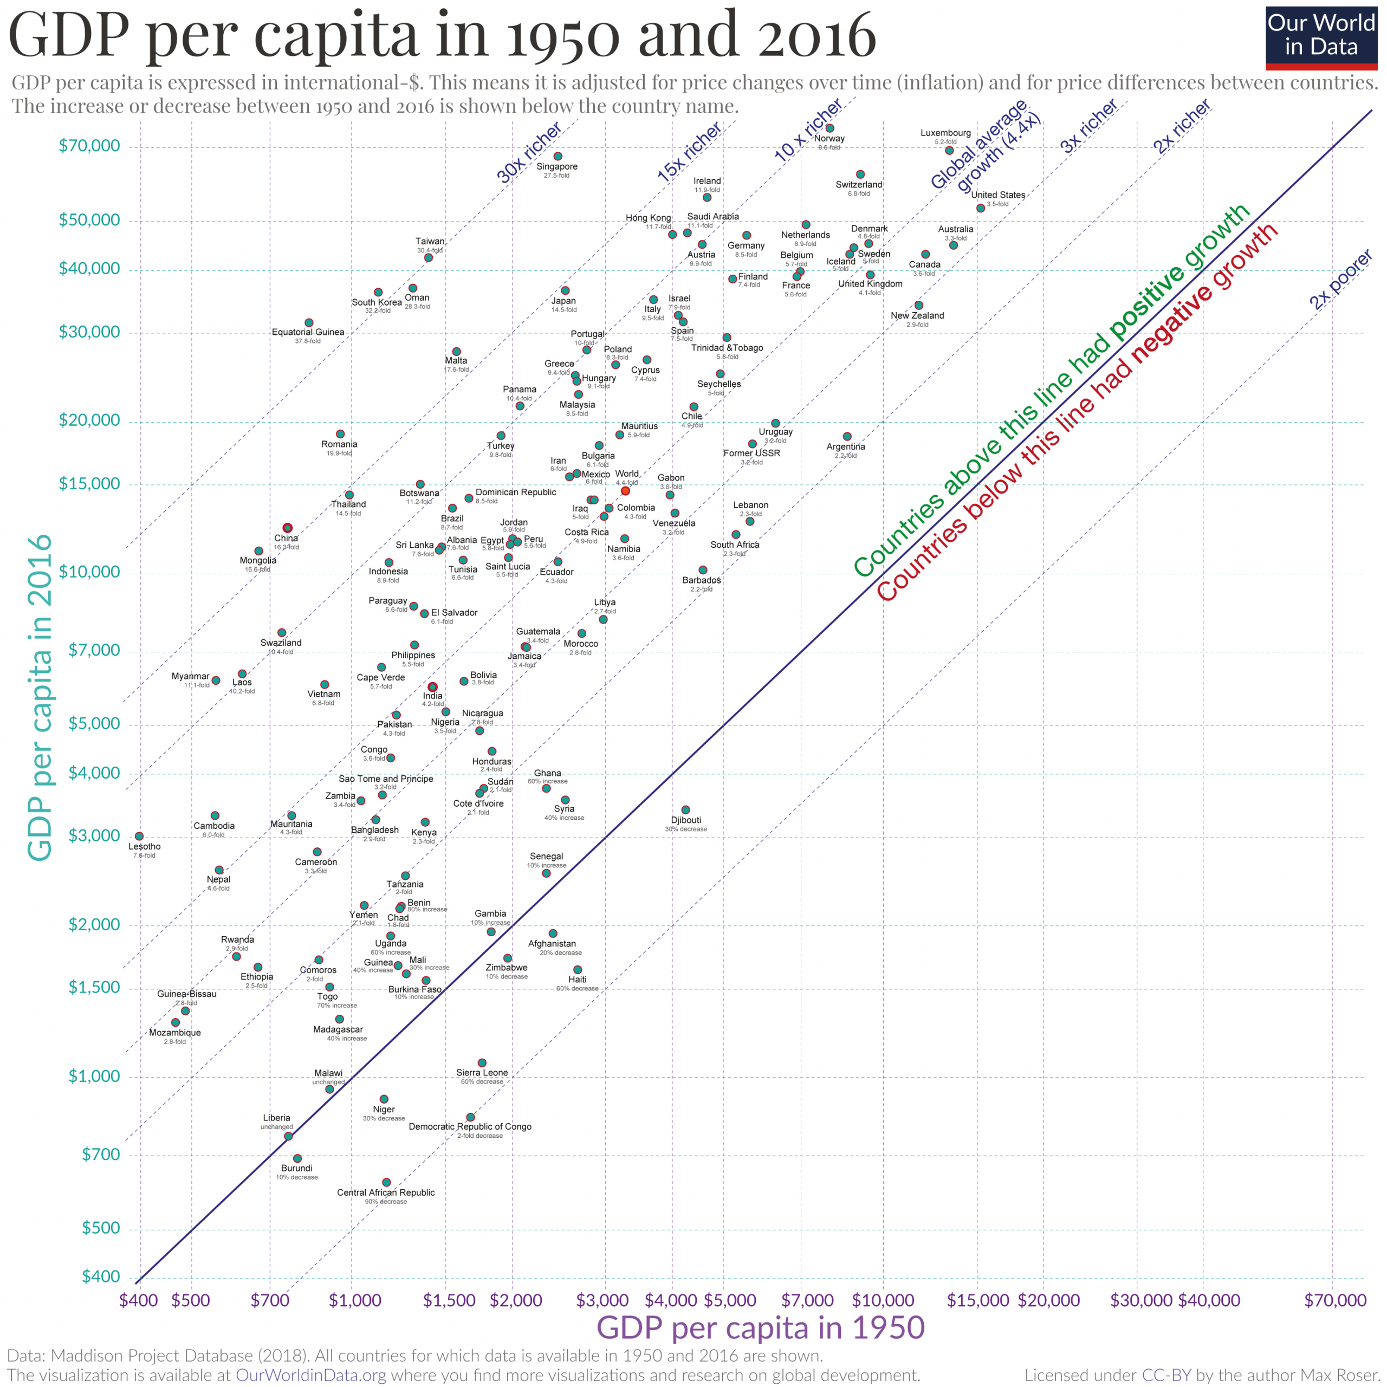

Slide 22
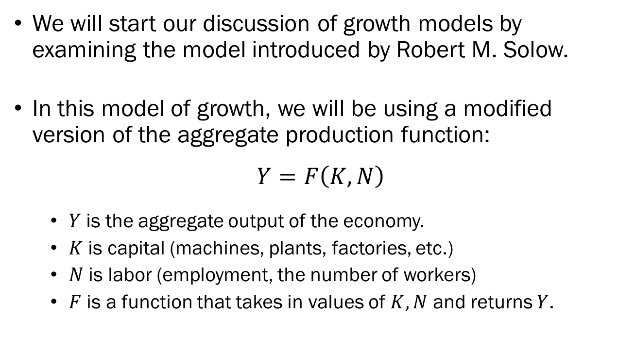
Groundwork for Growth Models
We will start our discussion of growth models by examining the model introduced by Robert M. Solow.
In this model of growth, we will be using a modified version of the aggregate production function:
$$Y=F\left(K,N\right)$$
  $Y$ is the aggregate output of the economy.
  $K$ is capital (machines, plants, factories, etc.)
  $N$ is labor (employment, the number of workers)
  $F$ is a function that takes in values of $K, N$ and returns $Y$.

Slide 23
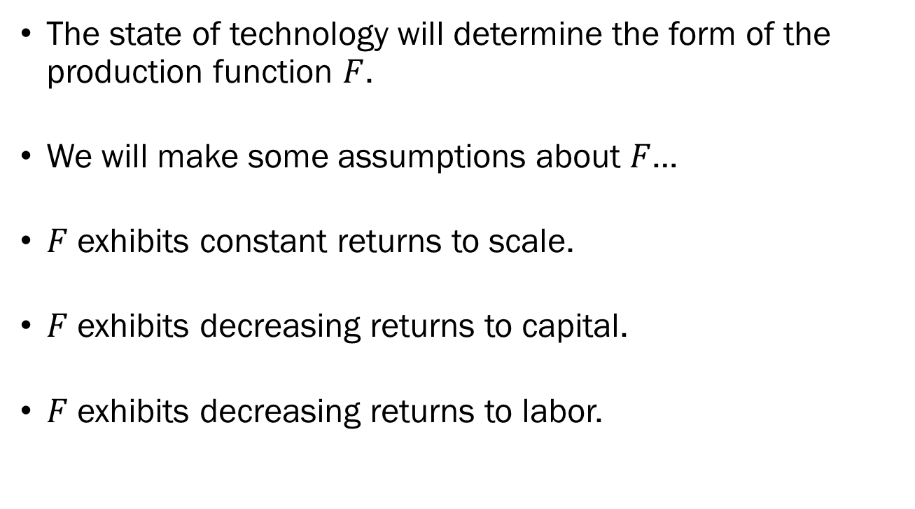
Groundwork for Growth Models
The state of technology will determine the form of the production function $F$.
We will make some assumptions about $F$…
$F$ exhibits constant returns to scale.
$F$ exhibits decreasing returns to capital.
$F$ exhibits decreasing returns to labor.

Slide 24
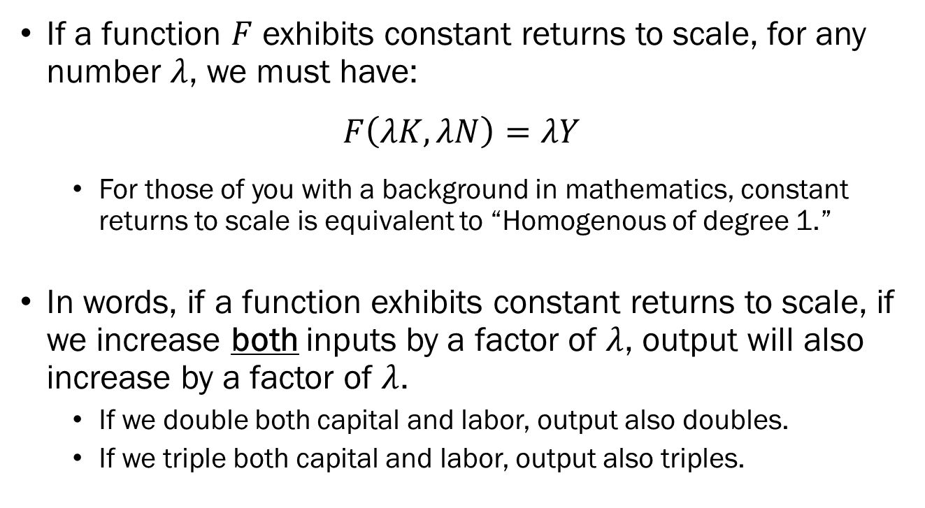
Constant Returns to Scale
If a function $F$ exhibits constant returns to scale, for any number $λ$, we must have:
$$F\left(λK,λN\right)=λY$$
  For those of you with a background in mathematics, constant returns to scale is equivalent to “Homogenous of degree 1.”
In words, if a function exhibits constant returns to scale, if we increase both inputs by a factor of $λ$, output will also increase by a factor of $λ$.
  If we double both capital and labor, output also doubles.
  If we triple both capital and labor, output also triples.

Slide 25
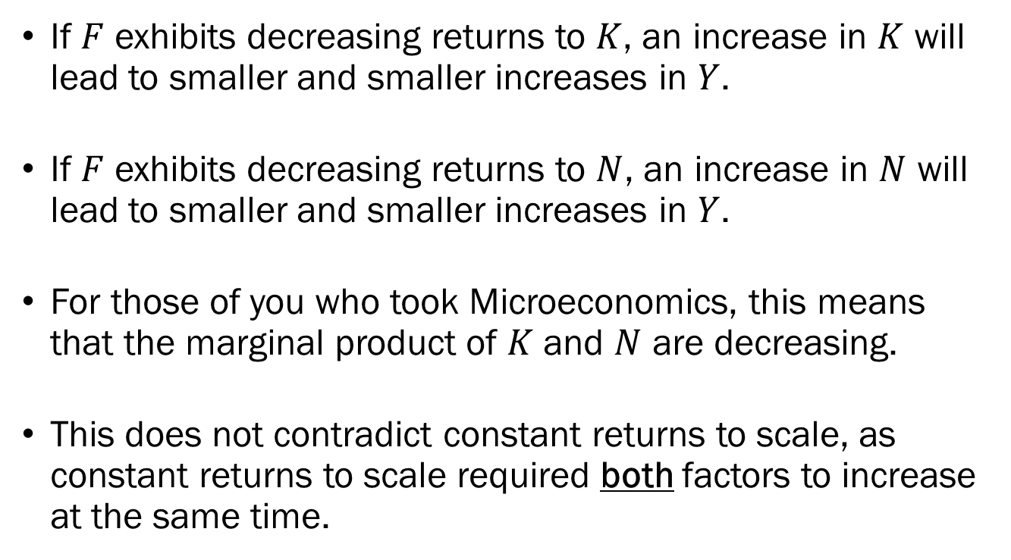
Decreasing Returns to Factors
If $F$ exhibits decreasing returns to $K$, an increase in $K$ will lead to smaller and smaller increases in $Y$.
If $F$ exhibits decreasing returns to $N$, an increase in $N$ will lead to smaller and smaller increases in $Y$.
For those of you who took Microeconomics, this means that the marginal product of $K$ and $N$ are decreasing.
This does not contradict constant returns to scale, as constant returns to scale required both factors to increase at the same time.

Slide 26
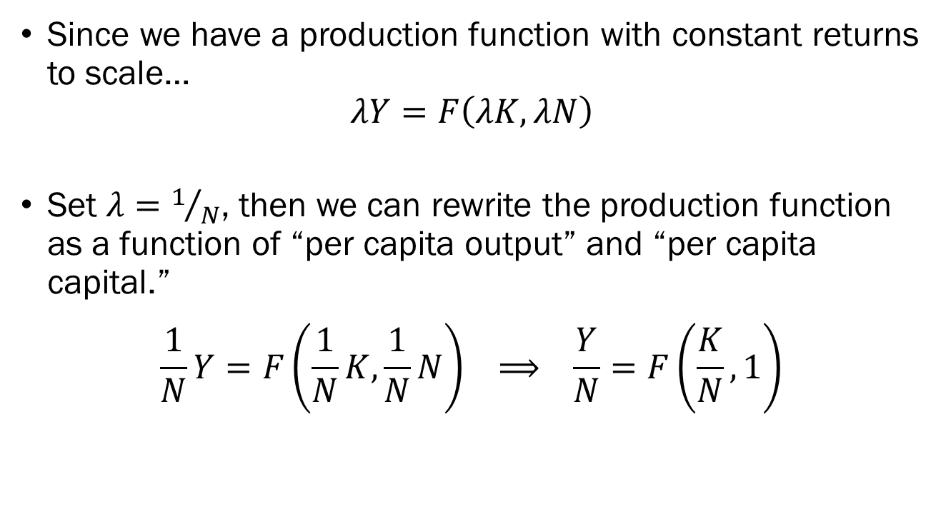
Groundwork for Growth Models
Since we have a production function with constant returns to scale…
$$λY=F\left(λK,λN\right)$$
Set $λ=1/N$, then we can rewrite the production function as a function of “per capita output” and “per capita capital.”
$$\frac{1}{N}Y=F\left(\frac{1}{N}K,\frac{1}{N}N\right) ⟹ \frac{Y}{N}=F\left(\frac{K}{N}, 1\right)$$

Slide 27



Groundwork for Growth Models
Plotting the relation, we have the following curve.
Given some ratio X of capital to labor in the economy…
The output per capita in the economy will be X’, determined by this graph.
$$Y/N$$
$F\left(\frac{K}{N},1\right)$’
X’
X
$$K/N$$

Slide 28
Groundwork for Growth Models
At point A, increasing capital to B produces an increase of output per capita from A’ to B’.
At point C, increasing capital to D produces a much smaller increase in output per capita.
Decreasing returns to capital / labor.
$$Y/N$$
D’
$F\left(\frac{K}{N},1\right)$’
C’
B’
A’
A
B
C
D
$$K/N$$

Slide 29

Groundwork for Growth Models
$F\left(\frac{K}{N},1\right)$’
If the state of technology improves, the production function will shift upward.
This means that given a certain capital to labor mix X in the economy…
  Under the old production function, you get A, but
  Under the new production function, you get B.
$$Y/N$$
B
$F\left(\frac{K}{N},1\right)$’
A
X
$$K/N$$

