Slide 1
The Medium Run:
The IS-LM-PC Framework
ECON 301

Slide 2

https://pollev.com/brianpark046

Slide 3
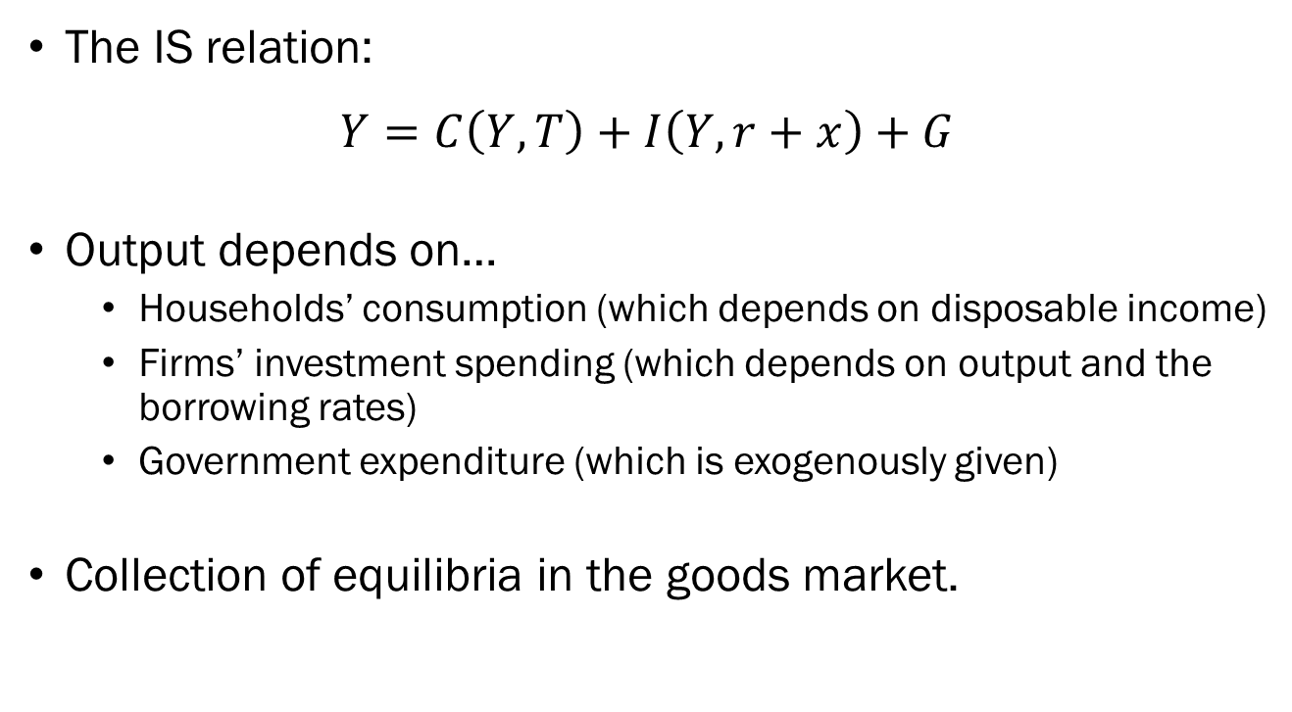
Recap of the IS-LM Framework
The IS relation:
$$Y=C\left(Y,T\right)+I\left(Y,r+x\right)+G$$
Output depends on…
  Households’ consumption (which depends on disposable income)
  Firms’ investment spending (which depends on output and the borrowing rates)
  Government expenditure (which is exogenously given)
Collection of equilibria in the goods market.

Slide 4
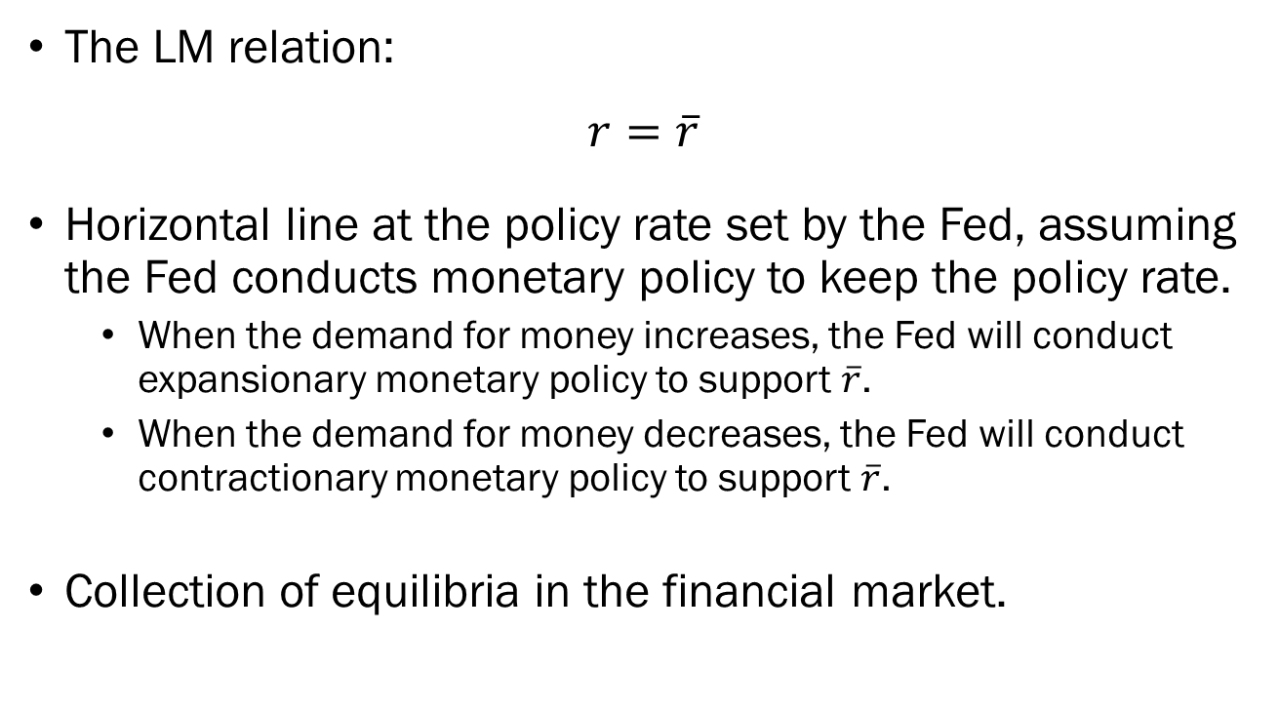
Recap of the IS-LM Framework
The LM relation:
$$r=\overline{r}$$
Horizontal line at the policy rate set by the Fed, assuming the Fed conducts monetary policy to keep the policy rate.
  When the demand for money increases, the Fed will conduct expansionary monetary policy to support $\overline{r}$.
  When the demand for money decreases, the Fed will conduct contractionary monetary policy to support $\overline{r}$.
Collection of equilibria in the financial market.

Slide 5






Recap of the IS-LM Framework
We found that the market for goods and the financial market are simultaneously in an equilibrium when the IS and LM curves intersect.
The Phillips curve will enter this relation, as in the medium run, output must converge towards the natural level of output.
Real Interest Rate
$$A$$
$$LM$$
$$\overline{r}$$
$$0$$
$$Y^{∗}$$
Output
$$IS$$

Slide 6
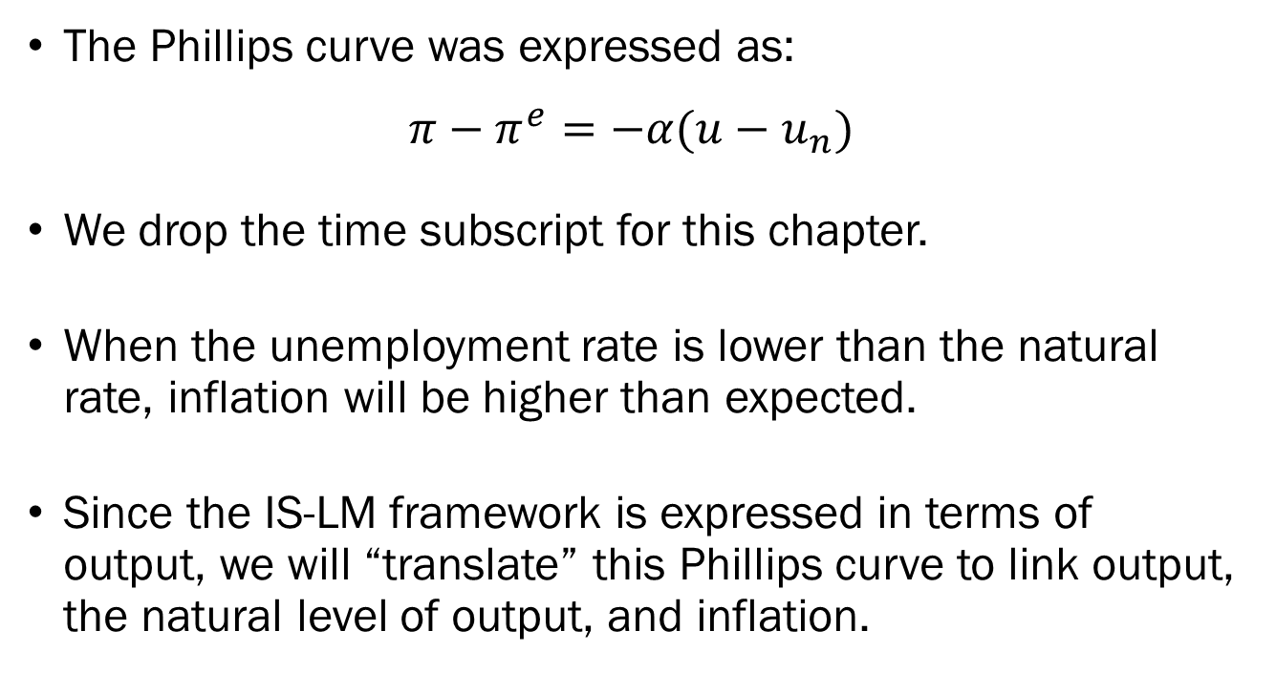
Preparing the Phillips Curve
The Phillips curve was expressed as:
$$π−π^{e}=−α(u−u_{n})$$
We drop the time subscript for this chapter.
When the unemployment rate is lower than the natural rate, inflation will be higher than expected.
Since the IS-LM framework is expressed in terms of output, we will “translate” this Phillips curve to link output, the natural level of output, and inflation.

Slide 7
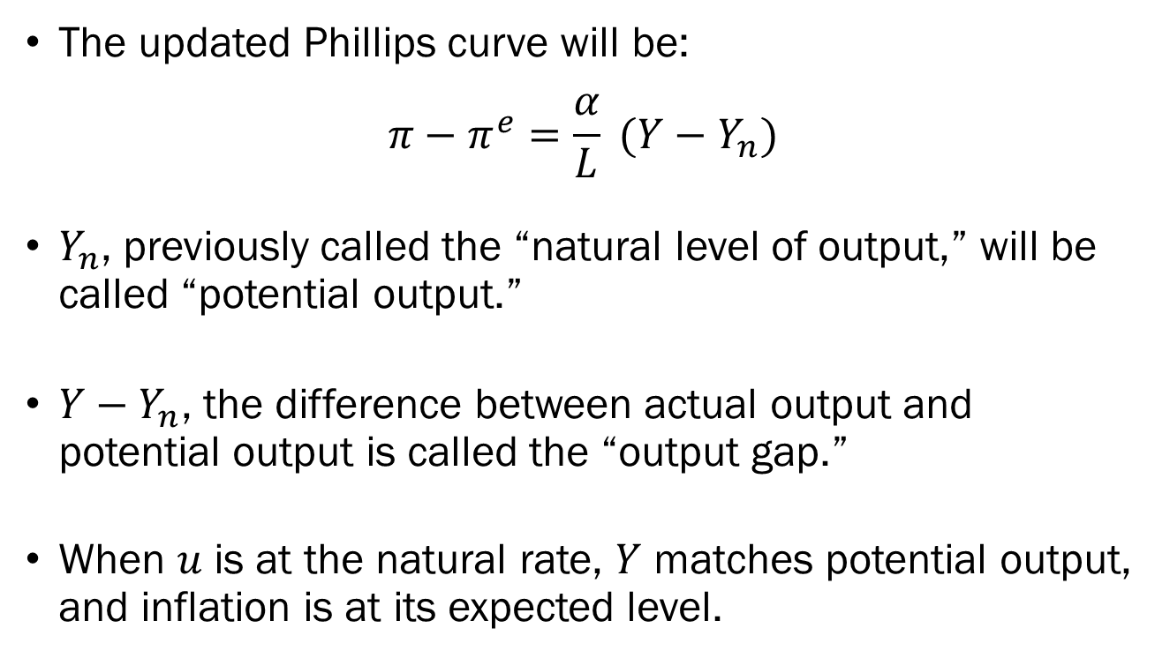
Preparing the Phillips Curve
The updated Phillips curve will be:
$$π−π^{e}=\frac{α}{L} (Y−Y_{n})$$
$Y_{n}$, previously called the “natural level of output,” will be called “potential output.”
$Y−Y_{n}$, the difference between actual output and potential output is called the “output gap.”
When $u$ is at the natural rate, $Y$ matches potential output, and inflation is at its expected level.

Slide 8
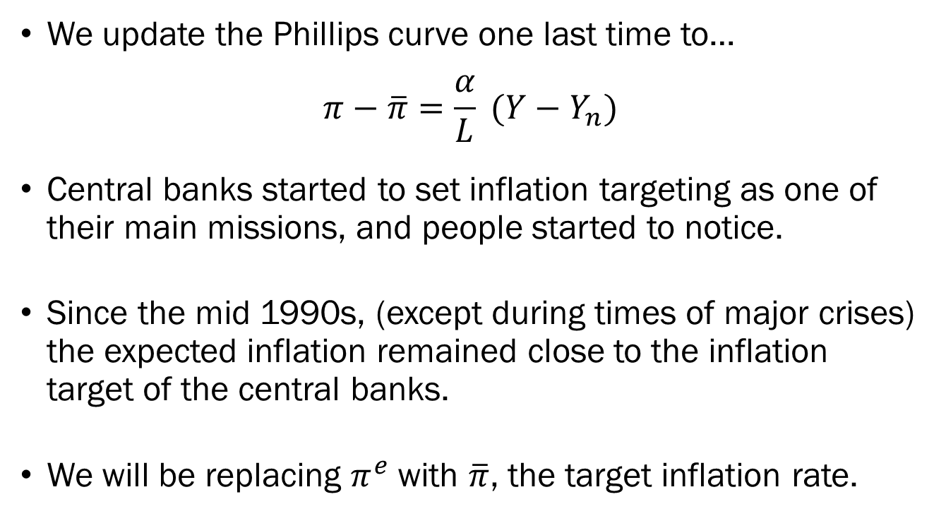
Preparing the Phillips Curve
We update the Phillips curve one last time to…
$$π−\overline{π}=\frac{α}{L} (Y−Y_{n})$$
Central banks started to set inflation targeting as one of their main missions, and people started to notice.
Since the mid 1990s, (except during times of major crises) the expected inflation remained close to the inflation target of the central banks.
We will be replacing $π^{e}$ with $\overline{π}$, the target inflation rate.

Slide 9


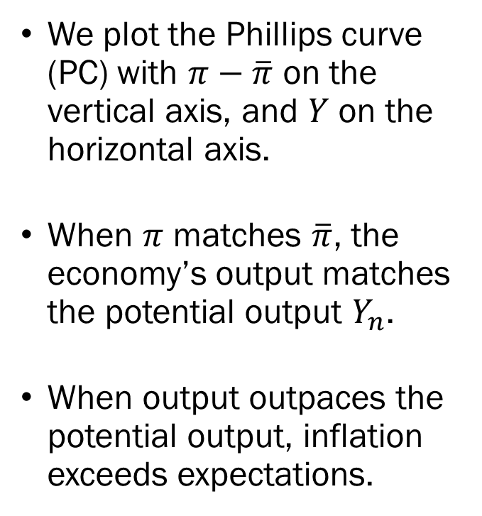


Preparing the Phillips Curve
We plot the Phillips curve (PC) with $π−\overline{π}$ on the vertical axis, and $Y$ on the horizontal axis.
When $π$ matches $\overline{π}$, the economy’s output matches the potential output $Y_{n}$.
When output outpaces the potential output, inflation exceeds expectations.
$$PC$$
Inflation Rate Minus Target
$π$-$\overline{π}$
$$0$$
Output
$$Y_{n}$$
$$Y$$

Slide 10
The IS-LM-PC Framework
The IS relation describes the equilibrium in the market for goods and services.
The LM relation describes the equilibrium in the financial market.
The IS-LM framework derives the real interest rate and the equilibrium output in the economy.
The PC relation links inflation, inflation target, potential output, and output.

Slide 11








The IS-LM-PC Framework
Suppose that the goods and financial markets are in equilibrium.
If we expand our model to include the Phillips curve, we can clearly see that this the output exceeds potential output.
This will lead to inflation outpacing the target rate.
$$r$$
$$A$$
$$LM$$
Output
$$Y$$
$$IS$$
$$PC$$
$$π−\overline{π}$$
$$A$$
$$Y_{n}$$
Output
$$Y$$

Slide 12


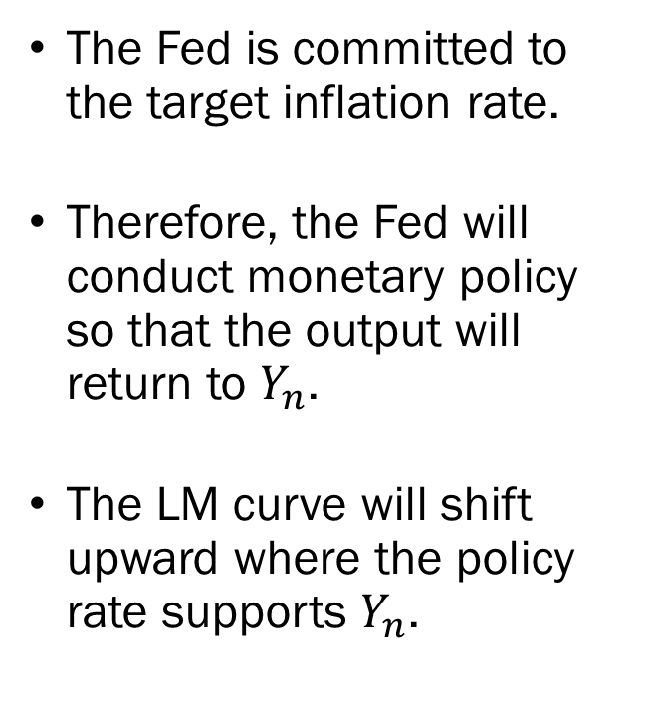


The IS-LM-PC Framework
$$A^{′}$$
The Fed is committed to the target inflation rate.
Therefore, the Fed will conduct monetary policy so that the output will return to $Y_{n}$.
The LM curve will shift upward where the policy rate supports $Y_{n}$.
$$r_{n}$$
$$LM^{′}$$
$$A$$
$$r$$
$$LM$$
Output
$$Y$$
$$IS$$
$$PC$$
$$π−\overline{π}$$
$$A$$
$$Y_{n}$$
Output
$$Y$$

Slide 13
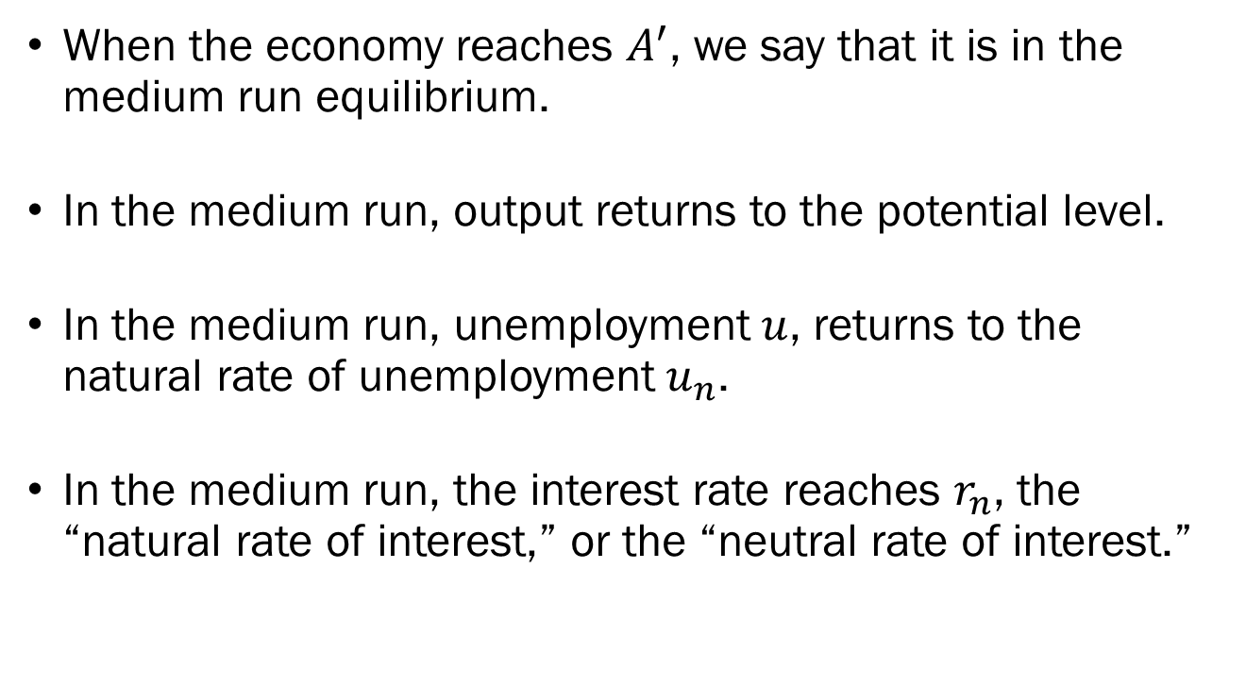
The Medium Run Equilibrium
When the economy reaches $A^{′}$, we say that it is in the medium run equilibrium.
In the medium run, output returns to the potential level.
In the medium run, unemployment $u$, returns to the natural rate of unemployment $u_{n}$.
In the medium run, the interest rate reaches $r_{n}$, the “natural rate of interest,” or the “neutral rate of interest.”

Slide 14
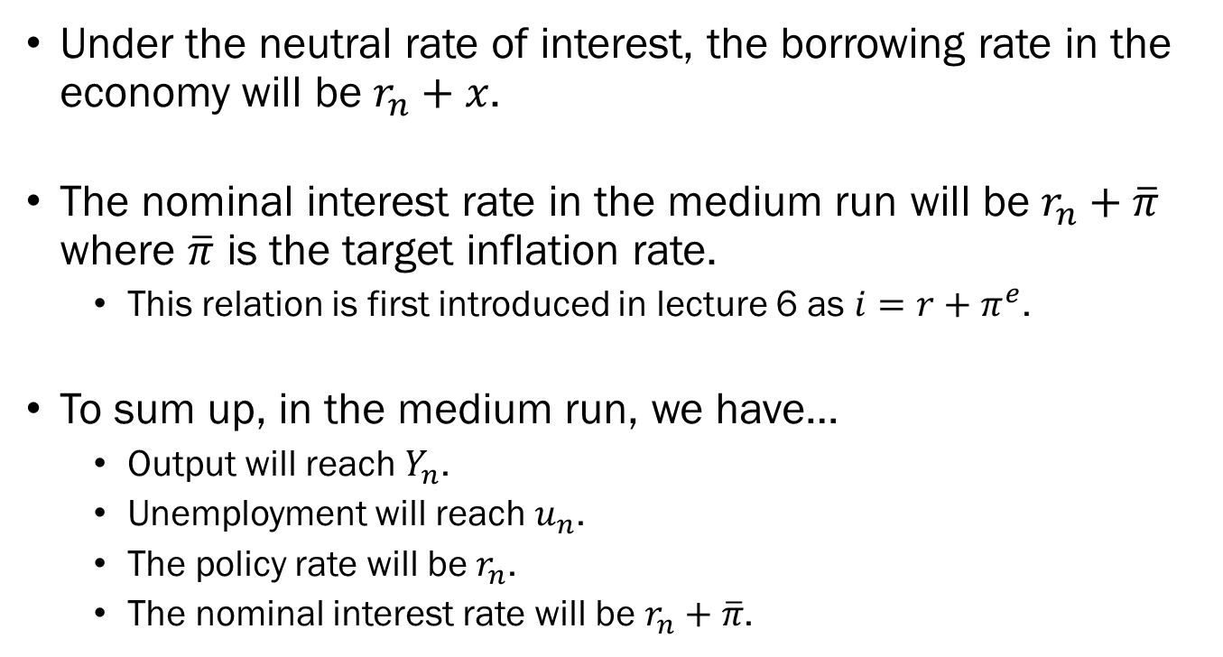
The Medium Run Equilibrium
Under the neutral rate of interest, the borrowing rate in the economy will be $r_{n}+x$.
The nominal interest rate in the medium run will be $r_{n}+\overline{π}$ where $\overline{π}$ is the target inflation rate.
  This relation is first introduced in lecture 6 as $i=r+π^{e}$.
To sum up, in the medium run, we have…
  Output will reach $Y_{n}$.
  Unemployment will reach $u_{n}$.
  The policy rate will be $r_{n}$.
  The nominal interest rate will be $r_{n}+\overline{π}$.

Slide 15
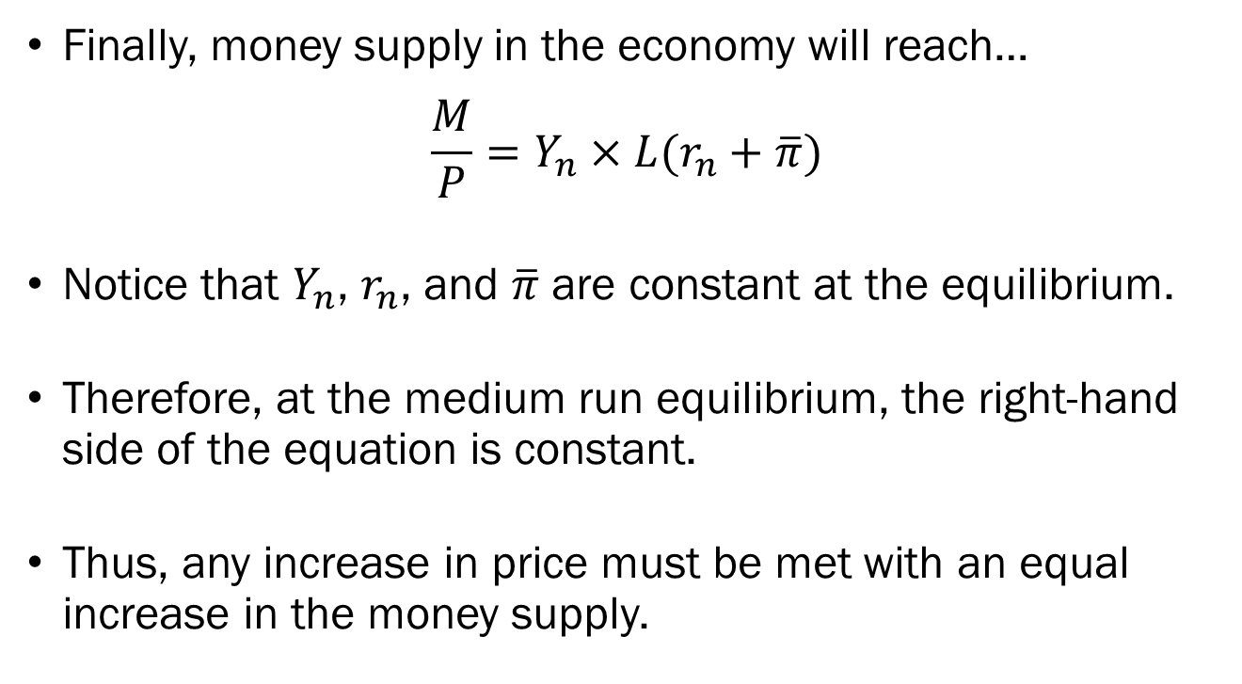
The Medium Run Equilibrium
Finally, money supply in the economy will reach…
$$\frac{M}{P}=Y_{n}×L(r_{n}+\overline{π})$$
Notice that $Y_{n}$, $r_{n}$, and $\overline{π}$ are constant at the equilibrium.
Therefore, at the medium run equilibrium, the right-hand side of the equation is constant.
Thus, any increase in price must be met with an equal increase in the money supply.

Slide 16
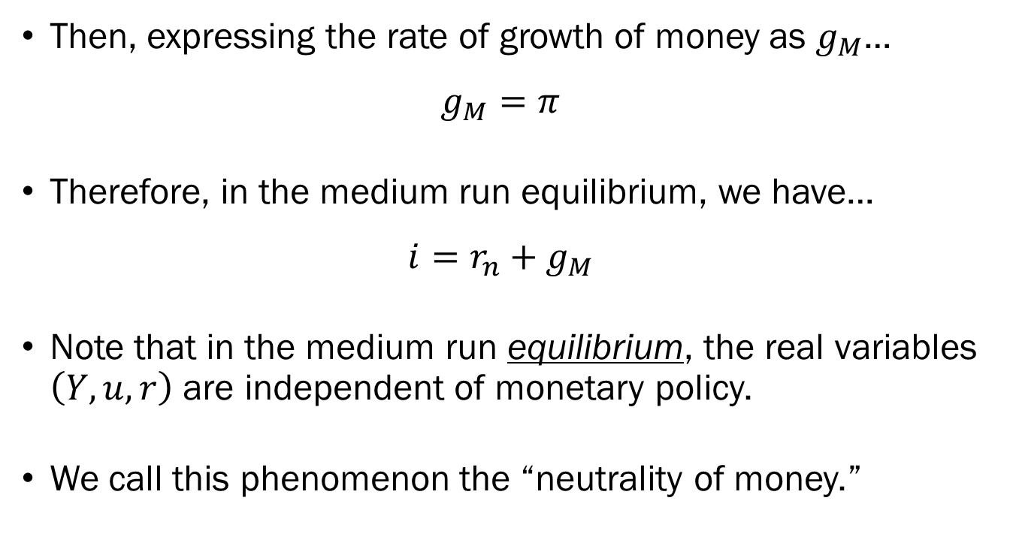
The Medium Run Equilibrium
Then, expressing the rate of growth of money as $g_{M}$…
$$g_{M}=π$$
Therefore, in the medium run equilibrium, we have…
$${i=r_{n}+g}_{M}$$
Note that in the medium run equilibrium, the real variables $\left(Y,u,r\right)$ are independent of monetary policy.
We call this phenomenon the “neutrality of money.”

Slide 17
Complications for Policymakers
While the model makes it look incredibly simplistic, there are real-world complications associated with execution.
First, it is difficult to accurately estimate the true value of potential output, as we rely on minute signals in the form of inflation rate.
Second, it takes a relatively long time for the economy to adjust to the new equilibrium.
If the Fed takes a drastic approach, the real interest rates and output will change too rapidly, which would cause its own problems.

Slide 18
Complications for Policymakers
If the Fed takes a slow and gradual approach, inflation will linger at a higher level for an extended period.
When inflation remains high, we may run into another case of “de-anchoring” of expectations.
This will lead to a costlier adjustment in the future.
Another related risk arises from the “zero lower bound” problem for monetary policy.

Slide 19








The Zero Lower Bound
Suppose that the economy is in a recession.
There is a negative output gap, and an inflation rate lower than the target rate.
Suppose that the Fed aims to push the economy back to the medium run equilibrium output.
$$r$$
$$A$$
$$LM$$
Output
$$Y$$
$$r_{n}$$
$$IS$$
$$PC$$
Output
$$Y$$
$$Y_{n}$$
$$π−\overline{π}$$
$$A$$

Slide 20
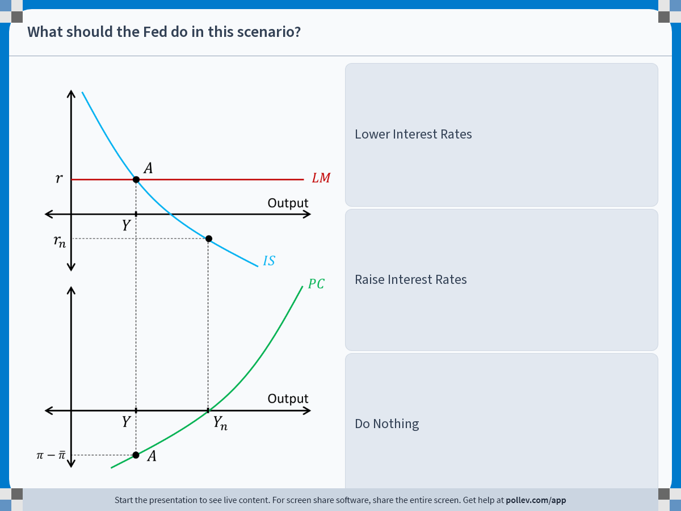
Notes:
Poll Title: Do not modify the notes in this section to avoid tampering with the Poll Everywhere activity.
More info at polleverywhere.com/support
What should the Fed do in this scenario?
https://www.polleverywhere.com/multiple_choice_polls/ndRFbRnG4iv6RTWvZ9yHR?display_state=instructions&activity_state=opened&state=opened&flow=Engagement&onscreen=persist

Slide 21
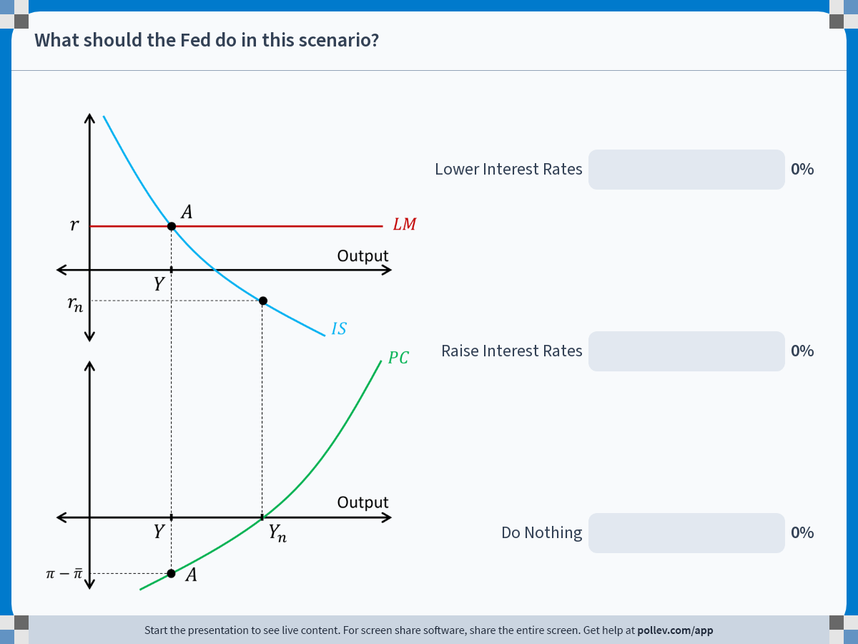
Notes:
Poll Title: Do not modify the notes in this section to avoid tampering with the Poll Everywhere activity.
More info at polleverywhere.com/support
What should the Fed do in this scenario?
https://www.polleverywhere.com/multiple_choice_polls/ndRFbRnG4iv6RTWvZ9yHR?display_state=chart&activity_state=closed&state=closed&flow=Engagement&onscreen=persist

Slide 22
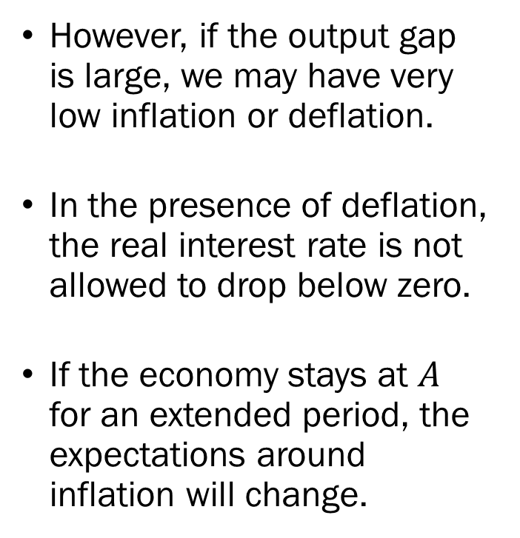
The Zero Lower Bound
However, if the output gap is large, we may have very low inflation or deflation.
In the presence of deflation, the real interest rate is not allowed to drop below zero.
If the economy stays at $A$ for an extended period, the expectations around inflation will change.
$$r$$
$$A$$
$$LM$$
Output
$$Y$$
$$r_{n}$$
$$IS$$
$$PC$$
Output
$$Y$$
$$Y_{n}$$
$$π−\overline{π}$$
$$A$$

Slide 23
The Zero Lower Bound
As expectations de-anchor, the rate of deflation will increase over time.
This will lead to a higher real interest rate, and output will fall accordingly.
The economy will fall into a “deflation trap,” or “deflation spiral.”
$$r$$
$$A$$
$$LM$$
Output
$$Y$$
$$r_{n}$$
$$IS$$
$$PC$$
Output
$$Y$$
$$Y_{n}$$
$$π−\overline{π}$$
$$A$$

Slide 24
Fiscal Policy in the Medium Run
Now suppose that the government wishes to reduce the budget deficit by increasing taxation.
We already discussed its consequences in the short run.
As a result of a tax hike, and the economy will reach an equilibrium with a lower output.
How would this play out in the medium run?

Slide 25






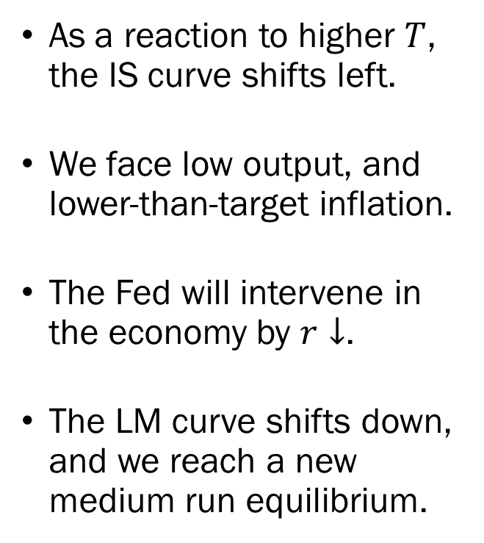







Fiscal Policy in the Medium Run
As a reaction to higher $T$, the IS curve shifts left.
We face low output, and lower-than-target inflation.
The Fed will intervene in the economy by $r↓$.
The LM curve shifts down, and we reach a new medium run equilibrium.
$$r_{n}$$
$$A^{′}$$
$$A$$
$$LM$$
$$r_{n}^{′}$$
$$A^{′′}$$
$$LM^{′}$$
$$Y^{′}$$
$$Y_{n}$$
$$IS^{′}$$
$$IS$$
$$PC$$
$$Y^{′}$$
$$A$$
Output
$$Y_{n}$$
$$π−\overline{π}$$
$$A^{′}$$

Slide 26
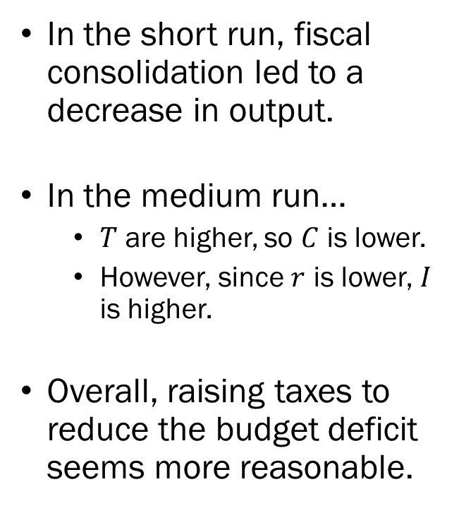
Fiscal Policy in the Medium Run
In the short run, fiscal consolidation led to a decrease in output.
In the medium run…
  $T$ are higher, so $C$ is lower.
  However, since $r$ is lower, $I$ is higher.
Overall, raising taxes to reduce the budget deficit seems more reasonable.
$$r_{n}$$
$$A^{′}$$
$$A$$
$$LM$$
$$r_{n}^{′}$$
$$A^{′′}$$
$$LM^{′}$$
$$Y^{′}$$
$$Y_{n}$$
$$IS^{′}$$
$$IS$$
$$PC$$
$$Y^{′}$$
$$A$$
Output
$$Y_{n}$$
$$π−\overline{π}$$
$$A^{′}$$

Slide 27
Fiscal Policy in the Medium Run
However, this assumes that the Fed will be willing and able to accommodate the changes in fiscal policy by utilizing monetary policy.
We have already examined one case where the Fed’s monetary policy will not be enough to adjust the economy back on track in the form of the zero lower bound.
This situation was on full display in the European Union during the Great Recession, where the nominal policy rates were at zero during a time of fiscal consolidation.

Slide 28
Changes in the Phillips Curve
Some changes in the economy can affect the natural rate of unemployment directly, shifting the Phillips curve itself.
For instance, suppose that the real prices of raw materials increased substantially.
This leads to an increase in the cost of production.
Assuming the firms aim to maintain profit margins, this will lead to an increase in the markup in the price setting relation.

Slide 29



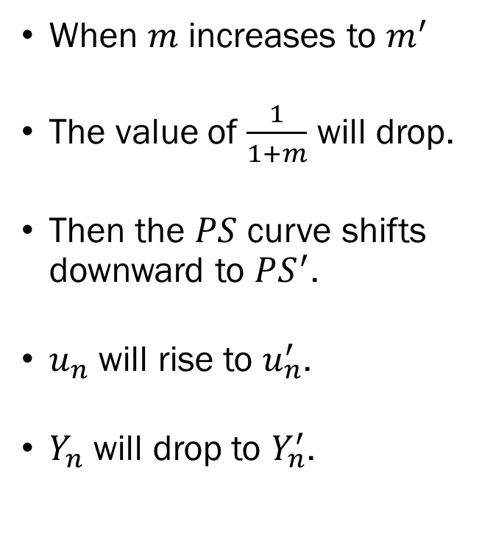






Changes in the Phillips Curve
When $m$ increases to $m^{′}$
The value of $\frac{1}{1+m}$ will drop.
Then the $PS$ curve shifts downward to $PS^{′}$.
$u_{n}$ will rise to $u_{n}^{′}$.
$Y_{n}$ will drop to $Y_{n}^{′}$.
Real Wage
$$\frac{1}{1+m}$$
$$A$$
$$PS$$
$$\frac{1}{1+m^{′}}$$
$$A^{′}$$
$$PS^{′}$$
$$WS$$
$$u_{n}$$
$$u_{n}^{′}$$
$$u$$

Slide 30





Changes in the Phillips Curve
Since the natural rate of unemployment increased in the economy, the Phillips curve will shift upward.
Initially, output will exceed the potential output.
The Fed will intervene to stabilize the economy.
$$r_{n}$$
$$A$$
$$LM$$
$$Y_{n}^{′}$$
$$Y_{n}$$
$$PC^{′}$$
$$IS$$
$$PC$$
$$A^{′}$$
$$π−\overline{π}$$
$$Y_{n}^{′}$$
$$A$$
Output
$$Y_{n}$$

Slide 31
Changes in the Phillips Curve
Assuming the IS curve does not shift for now…
If the Fed does not act…
  Output will continue to be lower than potential output.
  Inflation will continue to outpace the target rate.
  Expectations will de-anchor.
  Wage setters will expect higher inflation in the future.
  Inflation will keep increasing.
$$r_{n}$$
$$A$$
$$LM$$
$$Y_{n}^{′}$$
$$Y_{n}$$
$$PC^{′}$$
$$IS$$
$$PC$$
$$A^{′}$$
$$π−\overline{π}$$
$$Y_{n}^{′}$$
$$A$$
Output
$$Y_{n}$$

Slide 32


Changes in the Phillips Curve
$$r_{n}^{′}$$
$$A^{′′}$$
$$LM$$
As the Fed raises interest rates, the LM curve shifts upward.
During the adjustment along the IS curve, output will continue to fall, while inflation remains above the target.
Explains “stagflation,” stagnation + inflation.
$$r_{n}$$
$$A$$
$$LM$$
$$Y_{n}^{′}$$
$$Y_{n}$$
$$PC^{′}$$
$$IS$$
$$PC$$
$$A^{′}$$
$$π−\overline{π}$$
$$Y_{n}^{′}$$
$$A$$
Output
$$Y_{n}$$

Slide 33
Changes in the Phillips Curve
There are complications regarding this analysis as well.
First, would the IS curve remain constant while the price of raw materials increase substantially?
  If the IS curve also shifts to the left, the decrease in output will be observed in the short run and the medium run.
Also, if the price increase of raw materials is temporary in nature, the Fed will hesitate to intervene.
  Should the Fed trust that inflation will return to a reasonable level once the raw materials market returns to previous levels?
  Should the Fed still intervene to combat inflation to manage the economy’s expectations?

