Slide 1
The Short Run:
Financial Markets
ECON 301

Slide 2
Where this Fits In
Last week, we discussed how Economists define money, and examined how the Federal Reserve can control the supply of money in the economy.
Now we will discuss how money demand is determined in the economy, and how the principles of supply and demand can be applied to analyzing the financial market.
Once we wrap up the financial market, we will combine the goods market with the financial market to build a model of the overall economy in the short-run.

Slide 3
The Demand for Money
In this simple model, we assume that there are two asset classes
  Money: May be used in transactions but bears no interest.
  Bonds: Cannot be used in transactions but bears interest.
All households in the economy must determine their optimal holdings of money and bonds.
  When households tend to spend a large portion of their income, they would want to hold more money than bonds.
  When the interest rate is high, households would favor holding more bonds than money.

Slide 4

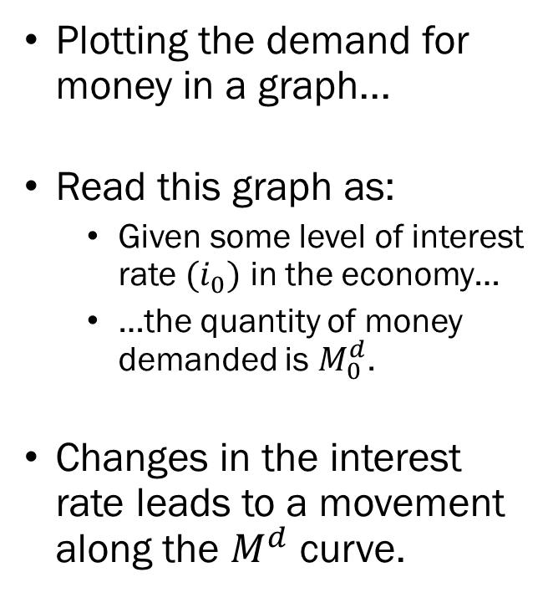


The Demand for Money
Plotting the demand for money in a graph...
Read this graph as:
  Given some level of interest rate $(i_{0})$ in the economy…
  …the quantity of money demanded is $M_{0}^{d}$.
Changes in the interest rate leads to a movement along the $M^{d}$ curve.
Interest Rate
$$i_{0}$$
$$M^{d}$$
$$M_{0}^{d}$$
Money

Slide 5

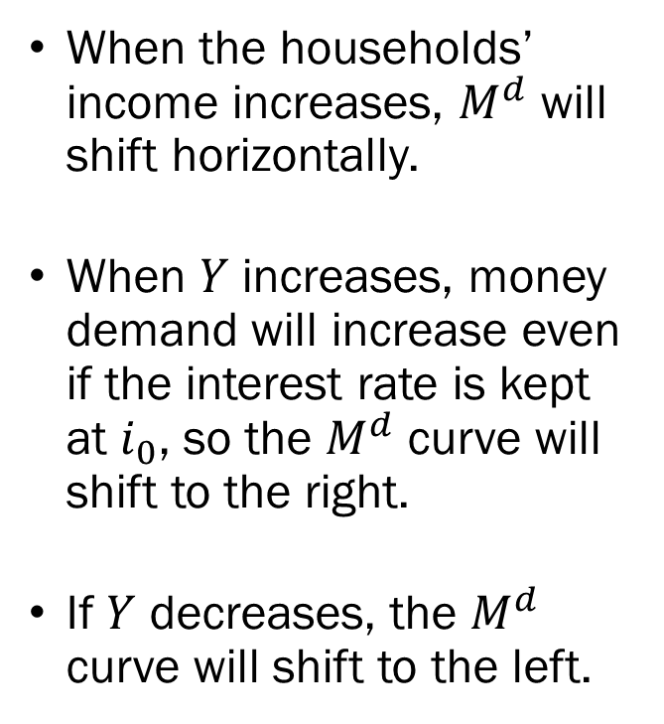

The Demand for Money
When the households’ income increases, $M^{d}$ will shift horizontally.
When $Y$ increases, money demand will increase even if the interest rate is kept at $i_{0}$, so the $M^{d}$ curve will shift to the right.
If $Y$ decreases, the $M^{d}$ curve will shift to the left.
Interest Rate
$$i_{0}$$
$$M^{d′}$$
$$M^{d}$$
$$M_{0}^{d}$$
$$M_{1}^{d}$$
Money

Slide 6
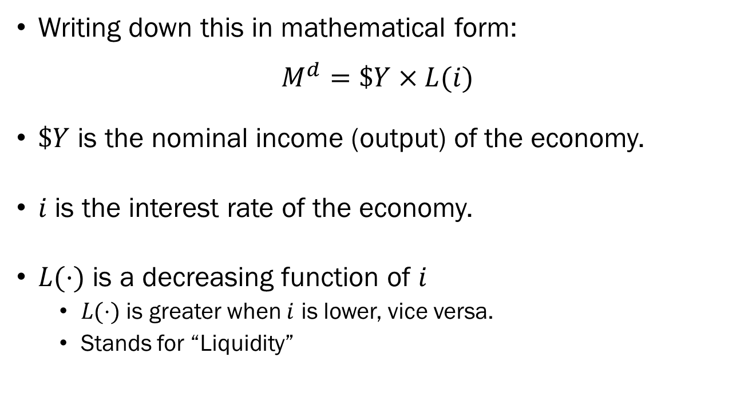
The Demand for Money
Writing down this in mathematical form:
$$M^{d}=\$Y×L(i)$$
$\$Y$ is the nominal income (output) of the economy.
$i$ is the interest rate of the economy.
$L(⋅)$ is a decreasing function of $i$
  $L(⋅)$ is greater when $i$ is lower, vice versa.
  Stands for “Liquidity”

Slide 7
Equilibrium in the Financial Market
We will combine money supply from the previous lectures, and money demand from this lecture to build a model that determines the equilibrium in the financial market.
Quick recap of money supply:
  Controlled by the Fed through its tools of monetary policies;
  Required Reserve Ratio.
  Key Interest Rates (Discount Rate, Federal Funds Rate).
  Open Market Operations.
  Expressed as a vertical line in graphs.

Slide 8

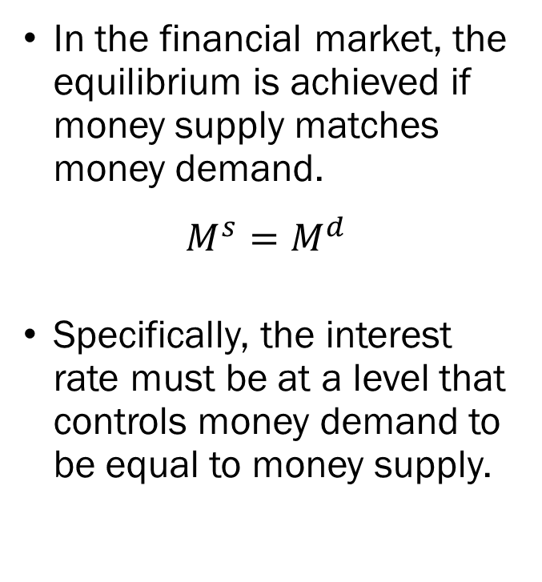



Equilibrium in the Financial Market
In the financial market, the equilibrium is achieved if money supply matches money demand.
$$M^{s}=M^{d}$$
Specifically, the interest rate must be at a level that controls money demand to be equal to money supply.
$$M^{s}$$
Interest Rate
$$i^{∗}$$
$$M^{d}$$
$$M^{s}=M^{d}=M^{∗}$$
Money

Slide 9
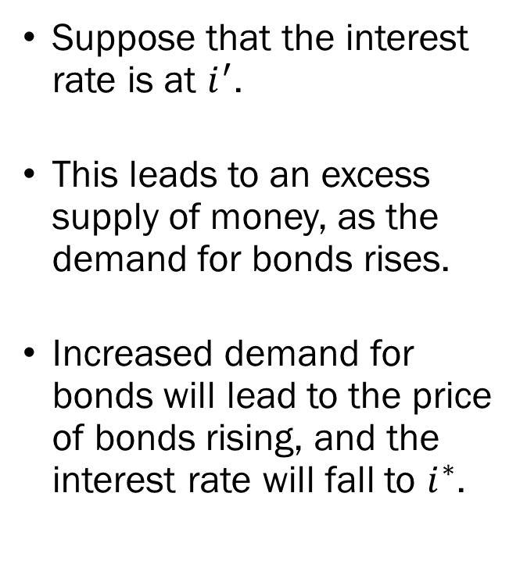

Equilibrium in the Financial Market
Suppose that the interest rate is at $i^{′}$.
This leads to an excess supply of money, as the demand for bonds rises.
Increased demand for bonds will lead to the price of bonds rising, and the interest rate will fall to $i^{∗}$.
$$M^{s}$$
Interest Rate
$$i^{′}$$
$$i^{∗}$$
$$M^{d}$$
Excess Money Supply
Money

Slide 10
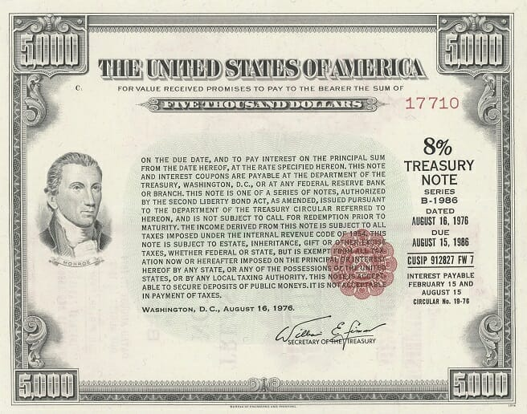
Detour: Bond Prices and Interest Rates
FACE VALUE
INTEREST
What does this mean?
  Face Value: $5,000
  Stated Interest Rate: 8%
  Maturity: 10 Years
“If you purchase this bond now, you will get 8% of the face value every 6 months, and at maturity (10 years from now) you will get the face value amount.”
MATURITY
INTEREST PAYMENTS

Slide 11
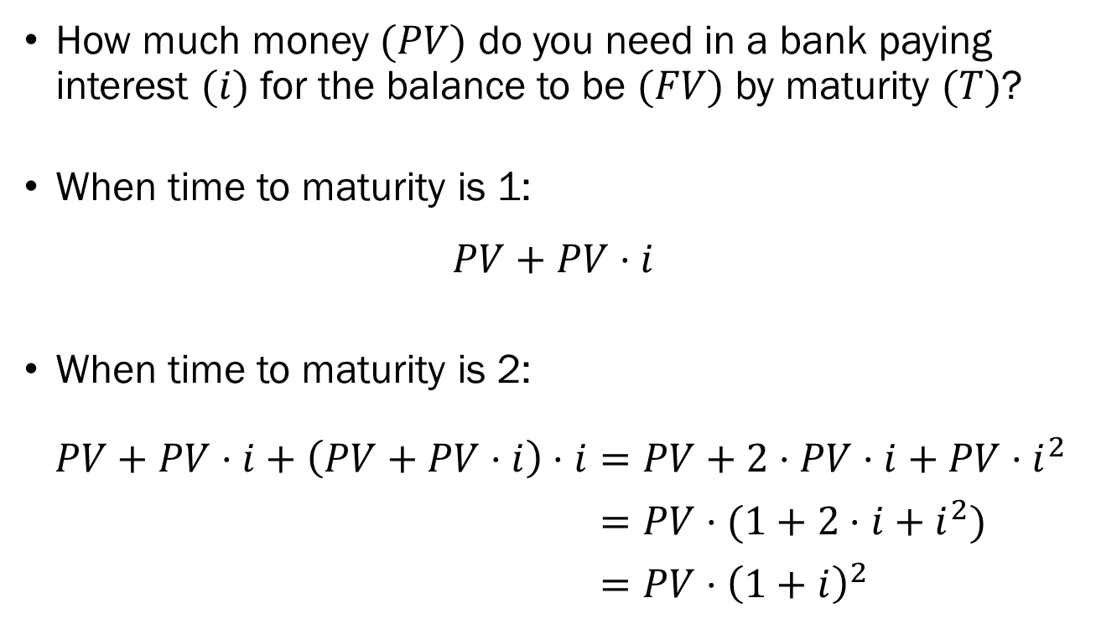
Detour: Bond Prices and Interest Rates
How much money $(PV)$ do you need in a bank paying interest $(i)$ for the balance to be $(FV)$ by maturity $(T)$?
When time to maturity is 1:
$$PV+PV⋅i$$
When time to maturity is 2:
$PV+PV⋅i+\left(PV+PV⋅i\right)⋅i=PV+2⋅PV⋅i+PV⋅i^{2}$
$=PV⋅(1+2⋅i+i^{2})$
$=PV⋅{\left(1+i\right)}^{2}$

Slide 12
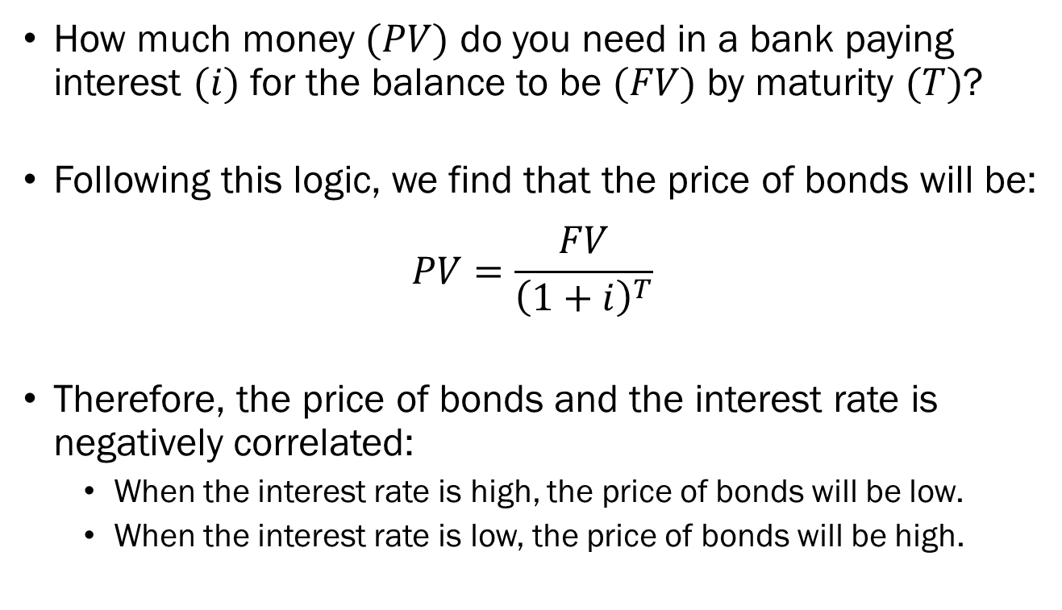
Detour: Bond Prices and Interest Rates
How much money $(PV)$ do you need in a bank paying interest $(i)$ for the balance to be $(FV)$ by maturity $(T)$?
Following this logic, we find that the price of bonds will be:
$$PV=\frac{FV}{{\left(1+i\right)}^{T}}$$
Therefore, the price of bonds and the interest rate is negatively correlated:
  When the interest rate is high, the price of bonds will be low.
  When the interest rate is low, the price of bonds will be high.

Slide 13
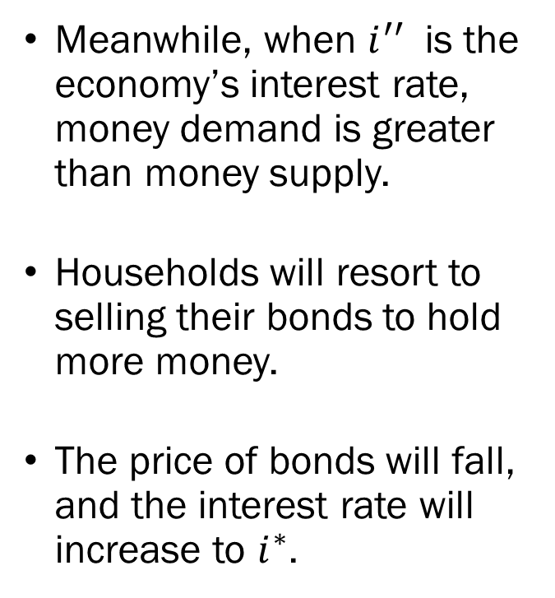

Equilibrium in the Financial Market
Meanwhile, when $i^{′′}$ is the economy’s interest rate, money demand is greater than money supply.
Households will resort to selling their bonds to hold more money.
The price of bonds will fall, and the interest rate will increase to $i^{∗}$.
$$M^{s}$$
Interest Rate
$$i^{∗}$$
$$i^{′′}$$
$$M^{d}$$
Excess Money Demand
Money

Slide 14

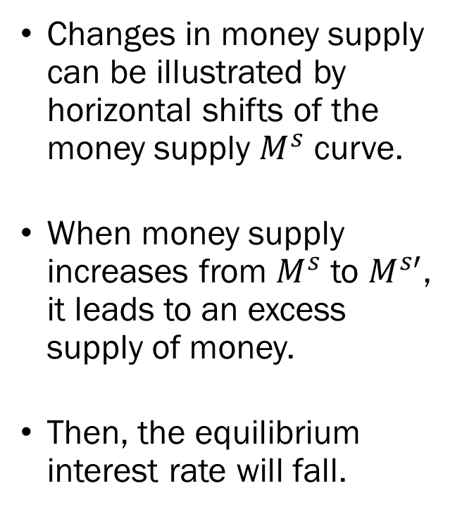

Changes in Money Supply
Changes in money supply can be illustrated by horizontal shifts of the money supply $M^{s}$ curve.
When money supply increases from $M^{s}$ to $M^{s′}$, it leads to an excess supply of money.
Then, the equilibrium interest rate will fall.
$$M^{s}$$
$$M^{s′}$$
Interest Rate
$$i^{∗}$$
$$i^{∗′}$$
$$M^{d}$$
Money

Slide 15

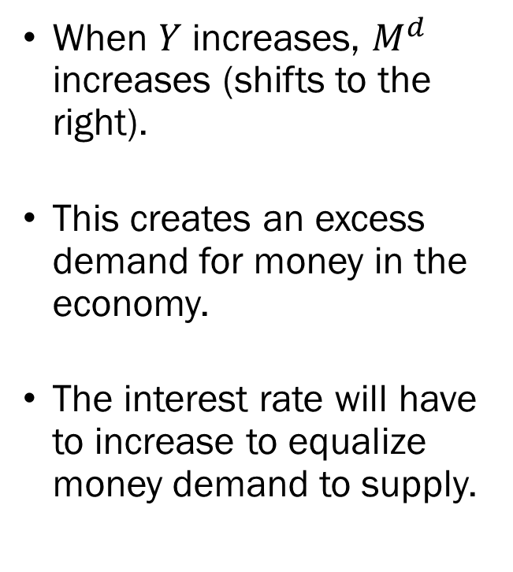


Changes in Nominal Income
When $Y$ increases, $M^{d}$ increases (shifts to the right).
This creates an excess demand for money in the economy.
The interest rate will have to increase to equalize money demand to supply.
$$M^{s}$$
Interest Rate
$$i^{∗′}$$
$$i^{∗}$$
$$M^{d′}$$
$$M^{d}$$
Money

Slide 16
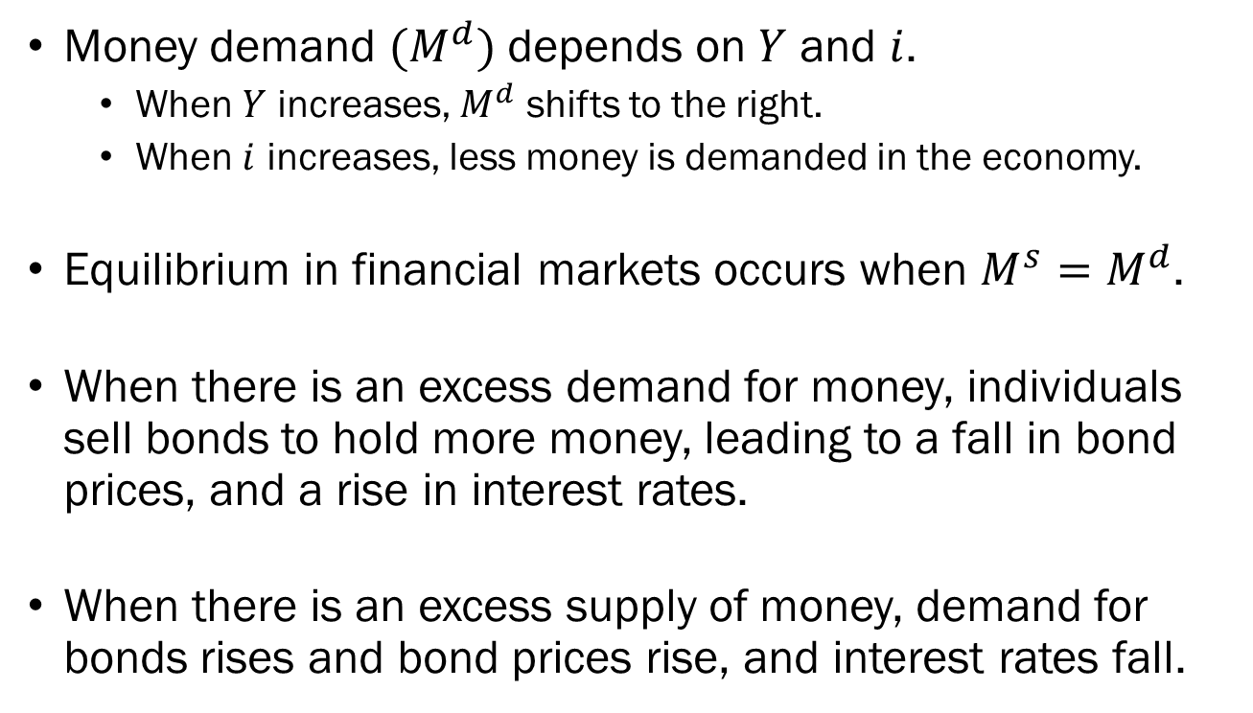
Recap
Money demand $(M^{d})$ depends on $Y$ and $i$.
  When $Y$ increases, $M^{d}$ shifts to the right.
  When $i$ increases, less money is demanded in the economy.
Equilibrium in financial markets occurs when $M^{s}=M^{d}$.
When there is an excess demand for money, individuals sell bonds to hold more money, leading to a fall in bond prices, and a rise in interest rates.
When there is an excess supply of money, demand for bonds rises and bond prices rise, and interest rates fall.

Slide 17
Combining the Goods Market and the Financial Market
The goods market is a place where economic agents trade goods and services, and its functions determine the equilibrium level of output in the economy.
This equilibrium level of output influences the financial market by shifting money demand.
The financial market is a place where financial assets are traded, and its functions determine the equilibrium level of interest rate in the economy.
The interest rate determined in the financial market will influence the goods market by shifting investment.

