Slide 1
The Short Run:
Financial Markets - Money Supply
ECON 301

Slide 2
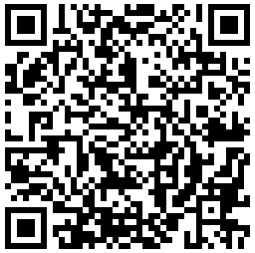
https://pollev.com/brianpark046

Slide 3
Defining Money
Money is a term that is well understood by most people.
It is tempting to equate “Money” to “Wealth.”
In the field of Economics, we define money by the role it plays in the market.
Money is an object that can serve three major roles:
  A medium of exchange, and
  A store of value, and
  A unit of account.

Slide 4
Money as a Medium of Exchange
A medium of exchange describes an asset that is accepted to facilitate the exchange of goods and services.
Anybody can use the USD to purchase goods and services almost anywhere in the US.
What would happen if we did not have a medium of exchange?
We would have return to a barter system, which requires a “double coincidence of wants.”

Slide 5
Money as a Store of Value
A store of value describes an asset that can preserve individuals’ purchasing power into the future.
If you have USD in hand, you can use it in the future to make a purchase.
Note that inflation may erode the purchasing power of USD over time.
That does not necessarily mean that USD does not serve as a store of value.

Slide 6
Money as a Unit of Account
A store of value describes an asset that can be used to represent the value of different goods and services.
Typically, we can quote a dollar-amount to communicate how valuable a good or service is considered.
We often quote value by stating something like “This cup of coffee is worth $5.”
Much easier to communicate than “This cup of coffee is worth 0.6% of an iPhone 15.”

Slide 7
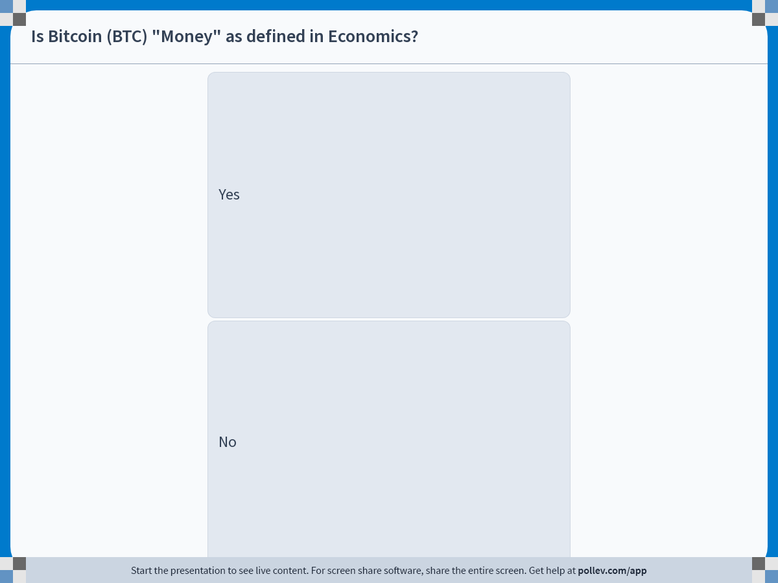
Notes:
Poll Title: Do not modify the notes in this section to avoid tampering with the Poll Everywhere activity.
More info at polleverywhere.com/support
Is Bitcoin (BTC) "Money" as defined in Economics?
https://www.polleverywhere.com/multiple_choice_polls/CFkm4E67pjh3k3Agpkw8G?display_state=instructions&activity_state=opened&state=opened&flow=Engagement&onscreen=persist

Slide 8
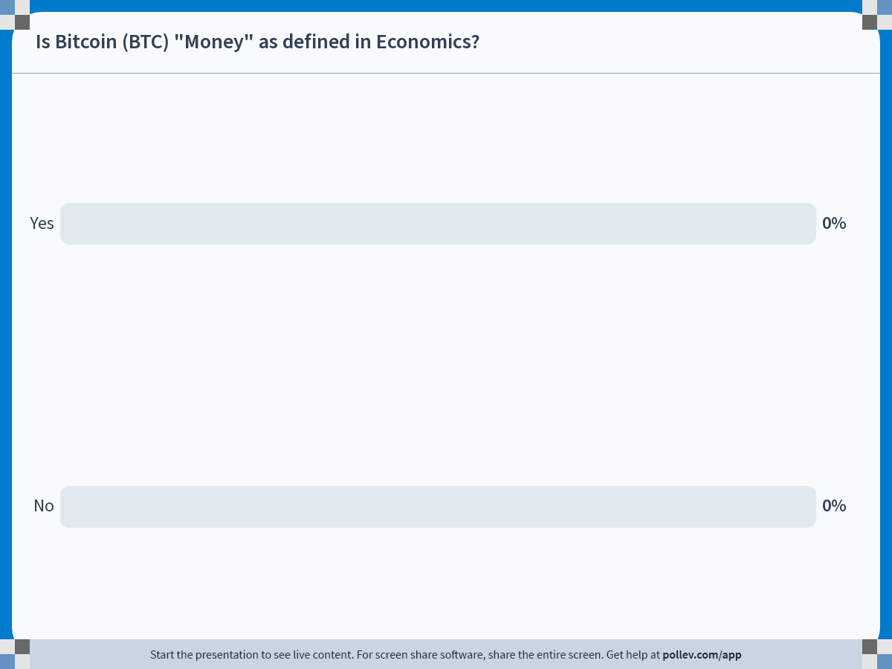
Notes:
Poll Title: Do not modify the notes in this section to avoid tampering with the Poll Everywhere activity.
More info at polleverywhere.com/support
Is Bitcoin (BTC) "Money" as defined in Economics?
https://www.polleverywhere.com/multiple_choice_polls/CFkm4E67pjh3k3Agpkw8G?display_state=chart&activity_state=closed&state=closed&flow=Engagement&onscreen=persist

Slide 9
Types of Money
Commodity Money
  Assets that are used as money that have an intrinsic value.
  Salt used as “Salary” for soldiers in the Roman empire.
  Precious metals such as gold, silver, etc.
Fiat Money
  Assets that are used as money that have no intrinsic value.
  Most modern currencies are classified as fiat money.
  Given value when designated as legal tender by governments.
  Top 5 Traded Currencies: USD, EUR, JPY, GBP, CNY

Slide 10
Measuring Money Supply: M1
M1 represents money that is immediately available for transactions.
M1 consists of the following:
  Currency
  Demand Deposits (Checking Account Balances)
  Traveler’s Checks
  Checkable Deposits
  Savings (was M2 pre-2020)
  Money Market Deposits (was M2 pre-2020)

Slide 11
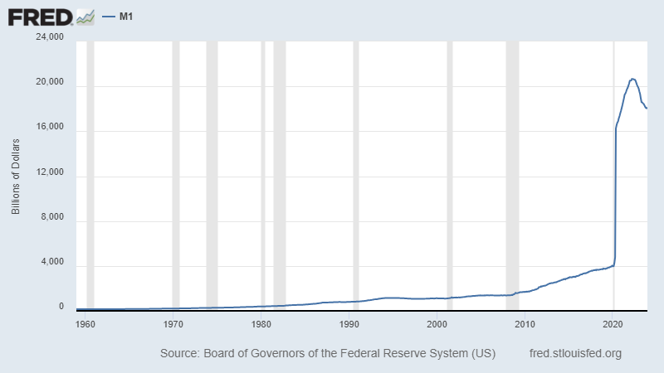
Measuring Money Supply: M1

Slide 12
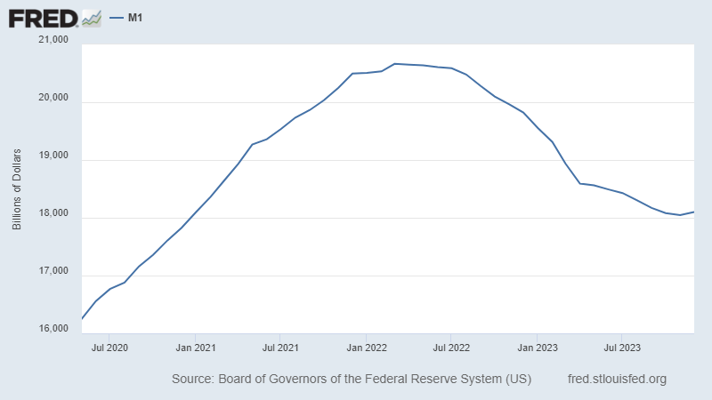
Measuring Money Supply: M1

Slide 13
Measuring Money Supply: M2
M2 refers to money that is immediately available for transactions, and its close substitutes.
M2 consists of the following:
  M1
  Small Time Deposits (CD)
  Money Market Funds
  Other “near money” assets
In most scenarios, “Money Supply” refers to the stock of M2 currency in the economy at a given point in time.

Slide 14
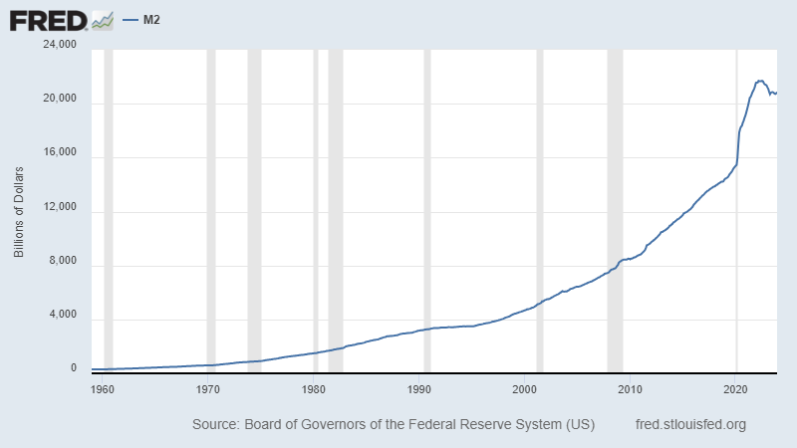
Measuring Money Supply: M2

Slide 15
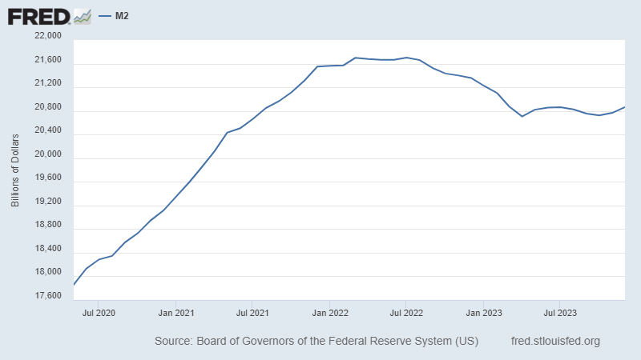
Measuring Money Supply: M2

Slide 16
Central Banks
Money supply is indirectly controlled by institutions called central banks of each country / entity.
  European Central Bank: EU and EUR
  Bank of England: UK and GDP
Central banks are government institutions that conducts monetary policy, which include:
  Monitoring financial institutions, and
  Controlling key interest rates, and
  (Indirectly) Controlling the money supply.
The Federal Reserve Bank is the central bank of the US.

Slide 17
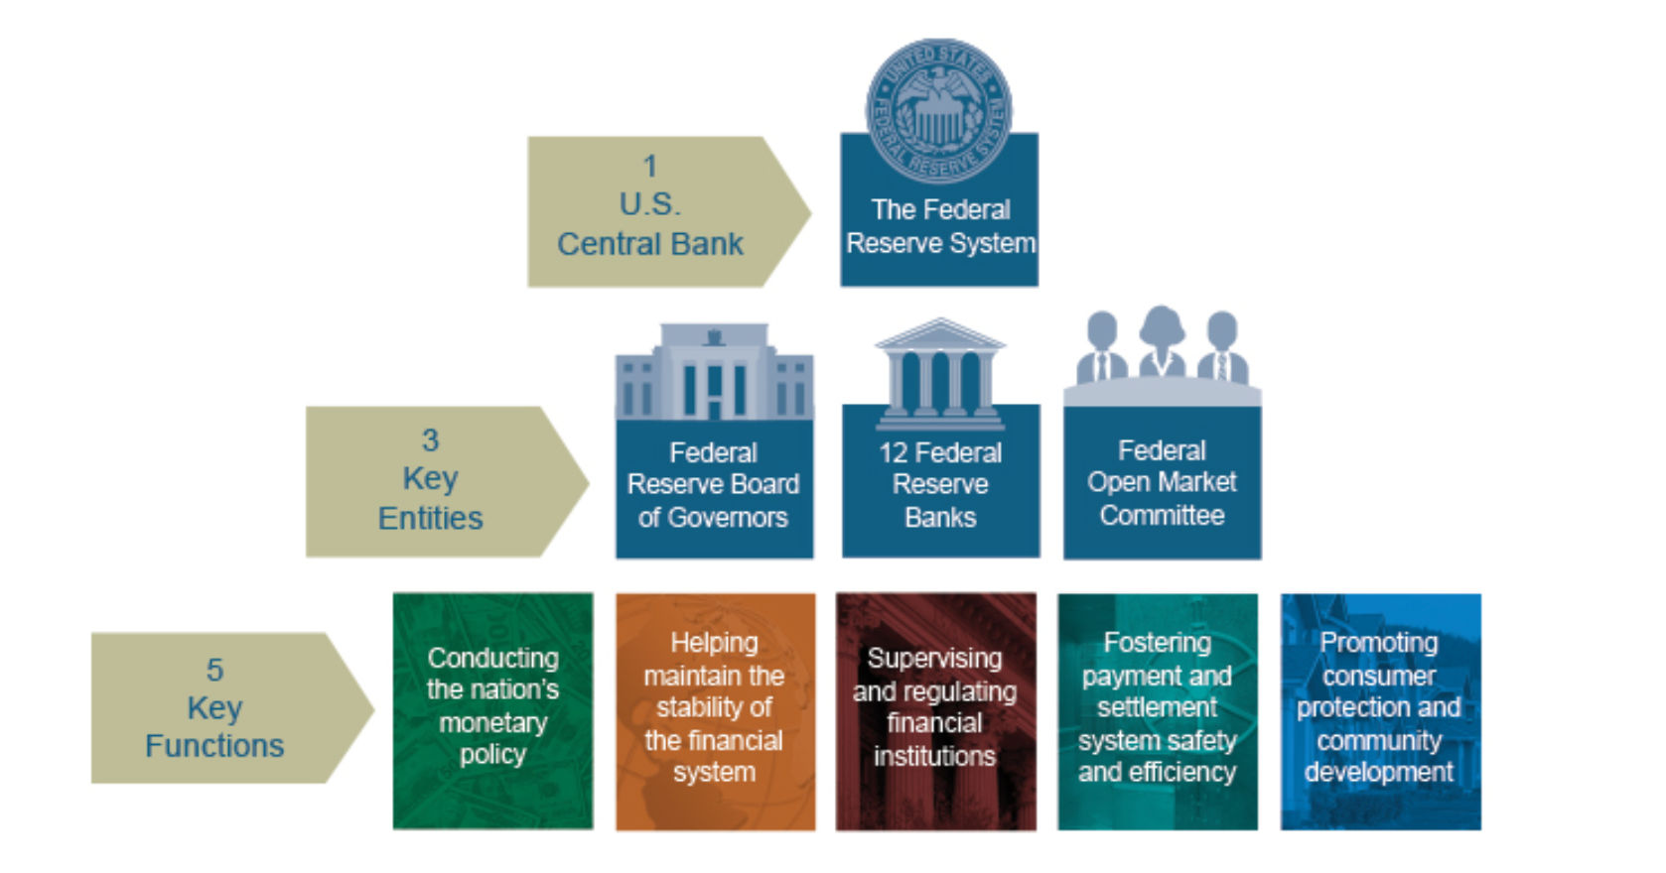
Federal Reserve System

Slide 18
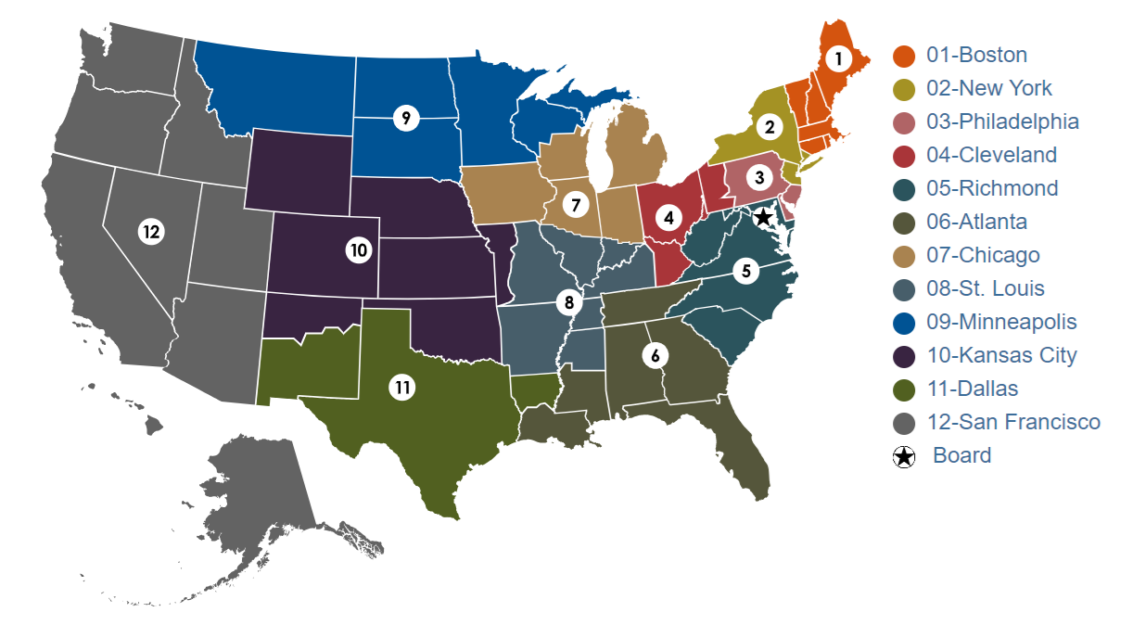
Federal Reserve System

Slide 19
Federal Reserve System
12 Regional Federal Reserve Banks
  Initially intended to work independently to accurately reflect local market conditions in 1913.
Board of Governors
  POTUS appoints 7 Governors for staggered 14-year terms.
  POTUS nominates the Chair of the Board for a 4-year term.
  Controls two out of the three tools of monetary policy; setting the discount rate, and the reserve requirements.
Federal Open Market Committee (FOMC)
  Conducts the third tool of monetary policy, open market operations.

Slide 20
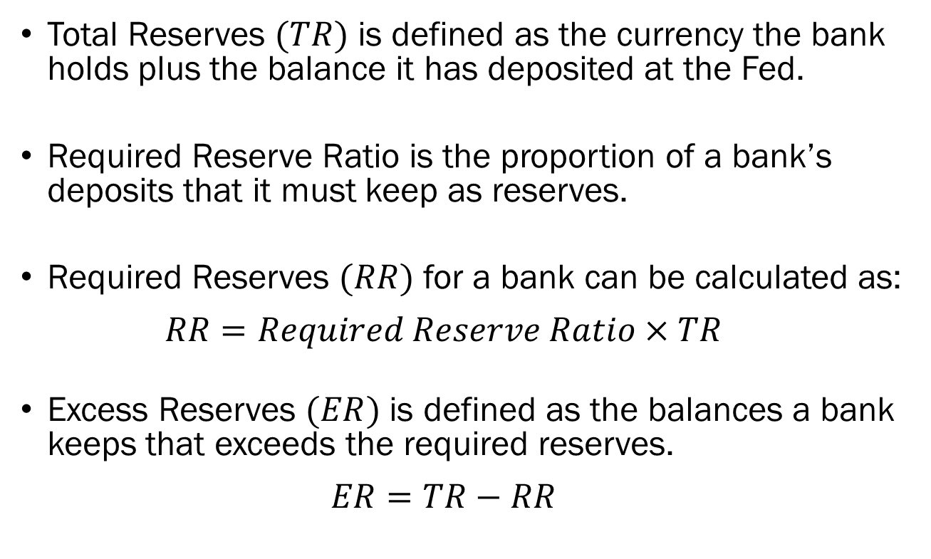
Reserve Requirements
Total Reserves $(TR)$ is defined as the currency the bank holds plus the balance it has deposited at the Fed.
Required Reserve Ratio is the proportion of a bank’s deposits that it must keep as reserves.
Required Reserves $(RR)$ for a bank can be calculated as:
  $$RR=Required Reserve Ratio×TR$$
Excess Reserves $(ER)$ is defined as the balances a bank keeps that exceeds the required reserves.
  $$ER=TR−RR$$

Slide 21
Reserve Requirements
Why does the ability to set reserve requirements matter?
Consider the following case:
  The required reserve ratio is set to be 10%
  Banks do not keep any excess reserves.
  There are infinite number of banks and consumers.
  Firm A deposits $100,000 to Bank A.
If all banks want to generate as much profit as possible, what would they be doing?
They would want to loan out as much funds as possible!

Slide 22
Reserve Requirements
Step 0:
  Money in the economy is $100,000, all held as assets (deposits) by Bank A.
Step 1:
  Bank A has $100,000 in deposits, and lends out the maximum allowed amount of $90,000 as loans to Consumer B.
  Bank A has $10,000 in reserves and $90,000 as loans for a total of $100,000 in assets.
  Consumer B deposits the entirety of $90,000 as savings with Bank B.
  Bank B has $90,000 as assets (deposits).
  Money in the economy now increased to $190,000.

Slide 23
Reserve Requirements
Step 2:
  Bank A has $10,000 in reserves and $90,000 as loans for a total of $100,000 in assets.
  Bank B has $90,000 in deposits, and lends out the maximum allowed amount of $81,000 as loans to Consumer C.
  Bank A has $9,000 in reserves and $81,000 as loans for a total of $90,000 in assets.
  Consumer C deposits the entirety of $81,000 as savings with Bank C.
  Bank C has $81,000 as assets (deposits).
  Money in the economy now increased to $271,000.

Slide 24
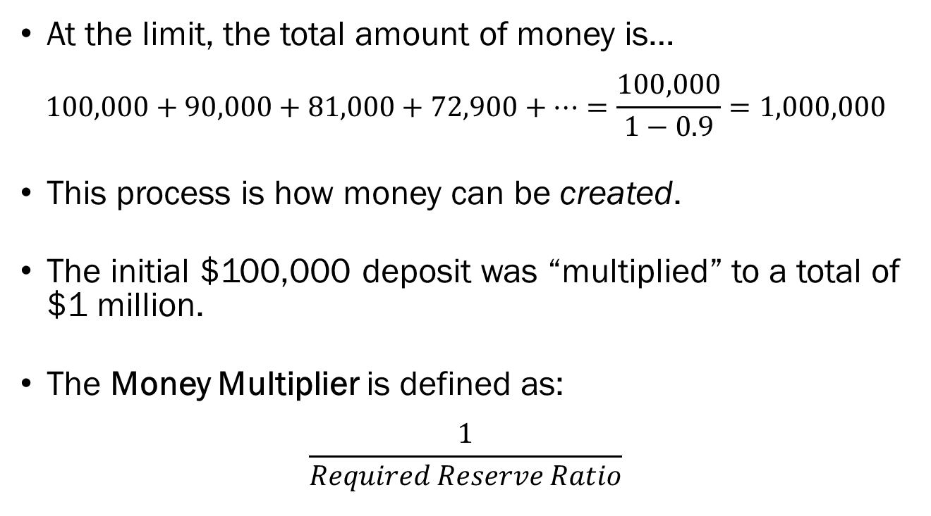
Reserve Requirements
At the limit, the total amount of money is…
$$100,000+90,000+81,000+72,900+⋯=\frac{100,000}{1−0.9}=1,000,000$$
This process is how money can be created.
The initial $100,000 deposit was “multiplied” to a total of $1 million.
The Money Multiplier is defined as:
$$\frac{1}{Required Reserve Ratio}$$

Slide 25
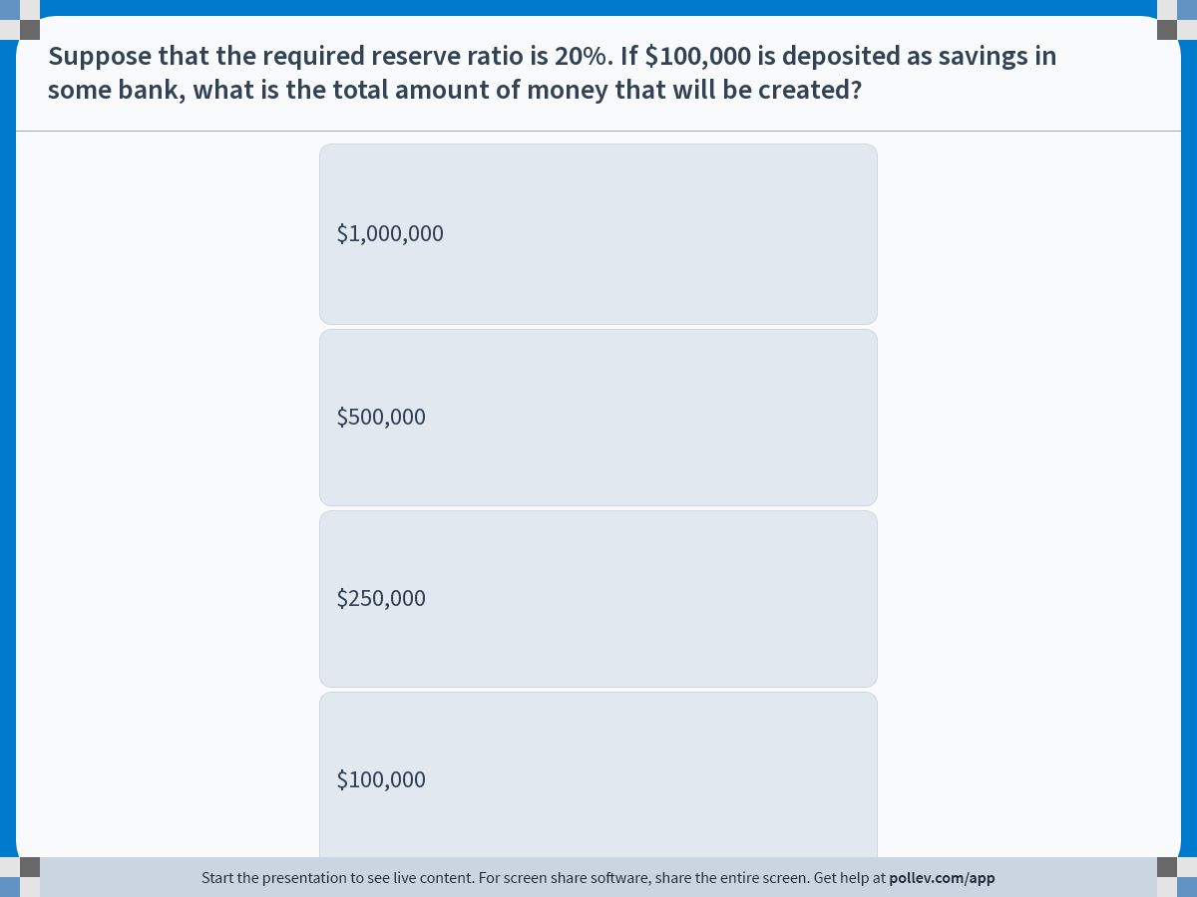
Notes:
Poll Title: Do not modify the notes in this section to avoid tampering with the Poll Everywhere activity.
More info at polleverywhere.com/support
Suppose that the required reserve ratio is 20%. If $100,000 is deposited as savings in some bank, what is the total amount of money that will be created?
https://www.polleverywhere.com/multiple_choice_polls/gndLgthmvl1J7CryvcbTd?display_state=instructions&activity_state=opened&state=opened&flow=Engagement&onscreen=persist

Slide 26
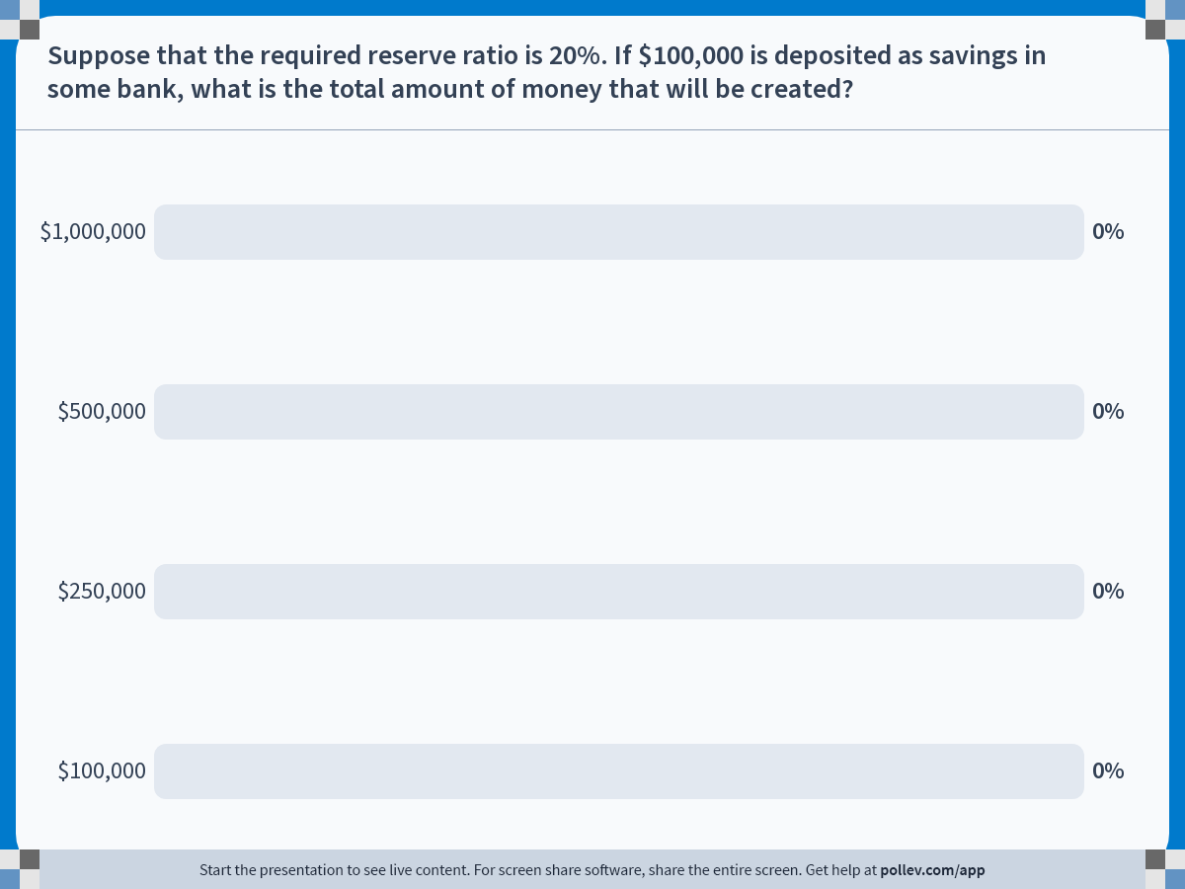
Notes:
Poll Title: Do not modify the notes in this section to avoid tampering with the Poll Everywhere activity.
More info at polleverywhere.com/support
Suppose that the required reserve ratio is 20%. If $100,000 is deposited as savings in some bank, what is the total amount of money that will be created?
https://www.polleverywhere.com/multiple_choice_polls/gndLgthmvl1J7CryvcbTd?display_state=chart&activity_state=closed&state=closed&flow=Engagement&onscreen=persist

Slide 27
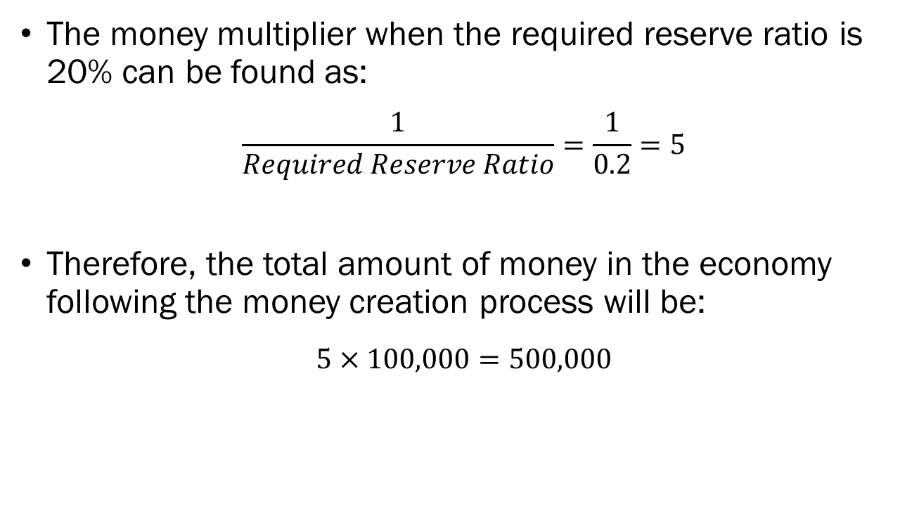
Solution to In-Class Poll
The money multiplier when the required reserve ratio is 20% can be found as:
$$\frac{1}{Required Reserve Ratio}=\frac{1}{0.2}=5$$
Therefore, the total amount of money in the economy following the money creation process will be:
$$5×100,000=500,000$$

Slide 28
Reserve Requirements
Note that by increasing the required reserve ratio, less money was created in the economy.
When the required reserve ratio is high, less money is created in the economy.
When the required reserve ratio is low, more money is created in the economy.
This is why the Federal Reserve considers the reserve requirements as a tool of monetary policy.

Slide 29
Reserve Requirements
The current required reserve ratio is…
  0%
  As of May 26th, 2020
  Response to the global pandemic and the resulting recession.
Prior to 2020,
  10% for large banks with more than $124.2 million in net transaction accounts.
  3% for mid-sized banks with more than $16.3 million to $124.2 million in net transaction accounts.
  0% for smaller banks with less than $16.3 million in net transaction accounts.

Slide 30
Reserve Requirements
If banks are profit-maximizing, they will lend out as much money as legally possible.
They will keep a small portion of their clients’ deposits, and loan out the remainder.
We call this a “fractional reserve banking” system, where banks are allowed to keep only fraction of deposits for withdrawal.

Slide 31
Reserve Requirements
But what happens when everyone wants their money at once?
When many customers request a withdrawal of their deposits over a short window of time, a bank run may occur.
The biggest bank run in history occurred on March 9th, 2023, when Silicon Valley Bank faced withdrawals of $42 billion in a single day.

Slide 32

Reserve Requirements

Slide 33
Controlling Interest Rates
Discount Rate
  The interest rate that is charged when private banks loan money from the Federal Reserve Bank.
  The channel is called the “discount window,” and it serves as private banks’ last resort under liquidity crises.
Federal Funds Rate
  The interest rate that private banks charge each other in the federal funds market.
  The federal funds market is an overnight (24 hour) market where banks lend and borrow from each other.
  It is called the federal funds market, since the funds traded are reserves held by the Federal Reserve Bank.

Slide 34
Controlling Interest Rates
The Fed sets a target for the federal funds rate by dictating the interest rate on reserves (or Open Market Operations).
As of Jan. 31st 2024, the target rate is 5.25% ~ 5.5%.
When interest rates are high, the cost of borrowing money is high, so borrowing will decrease, and money supply will fall.
When interest rates are low, cost of borrowing is low, so borrowing increases, and money supply increases.

Slide 35
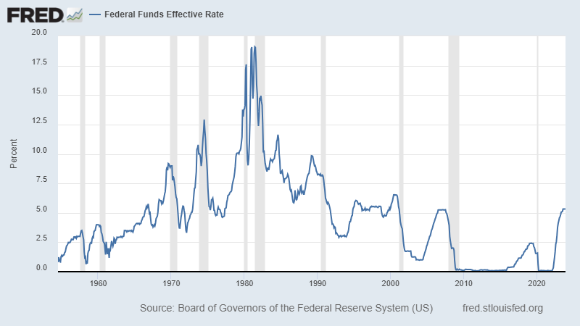
Controlling Interest Rates

Slide 36
Controlling Interest Rates
In the 1980s, Paul Volcker, then chair of the FRB raised the Federal Funds Rate to 20% to curb inflation and slow down the economy.
Influence on everyday consumers?
  New auto loan of $50,000 on a 60-month plan.
  Under a 5.5% interest, monthly payments is $955.06.
    Total sum of payments would have been $57,303.49.
  Under a 20% interest, monthly payments is $1,352.67.
    Total sum of payments would have been $81,160.08.
Called the “Volcker Shock,” but it did rein in inflation.

Slide 37
Open Market Operations
The Fed conducts open market operations, which simply means that they buy and sell securities, typically government bonds.
Open market purchases of securities by the Fed will lead to an increase of reserves in the banking system, which leads to an increase of money supply in the market.
Open market sales of securities by the Fed will lead to a decrease of reserves in the banking system, which leads to a decrease of money supply in the market.

Slide 38
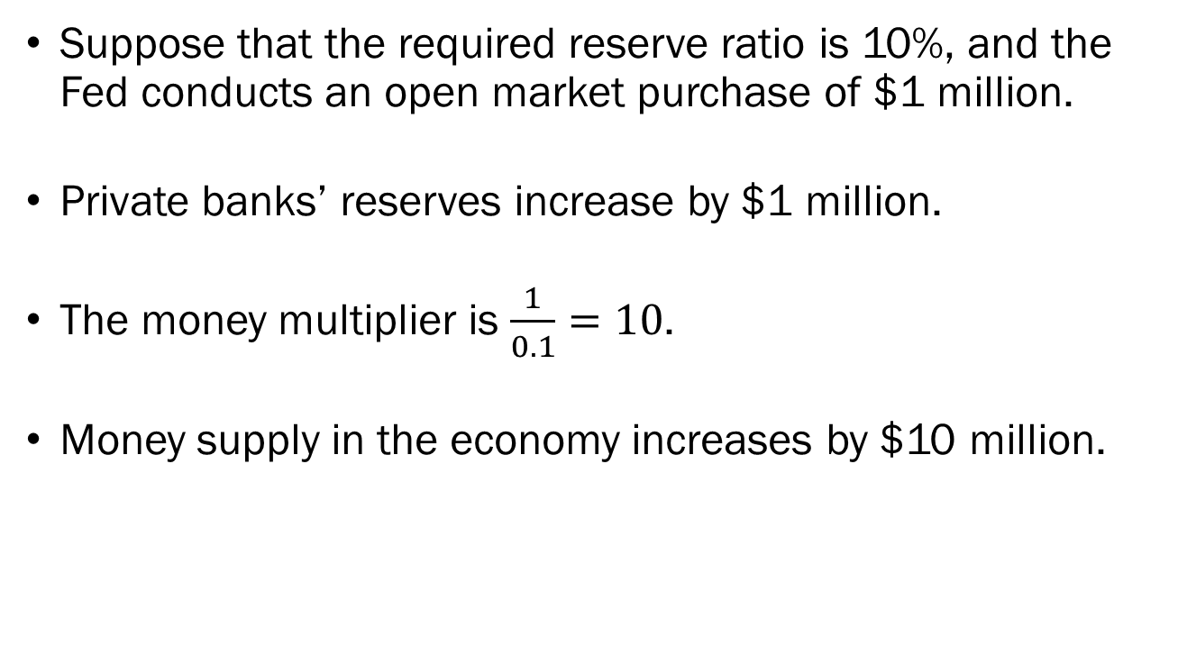
Open Market Operations: An Example
Suppose that the required reserve ratio is 10%, and the Fed conducts an open market purchase of $1 million.
Private banks’ reserves increase by $1 million.
The money multiplier is $\frac{1}{0.1}=10$.
Money supply in the economy increases by $10 million.

Slide 39
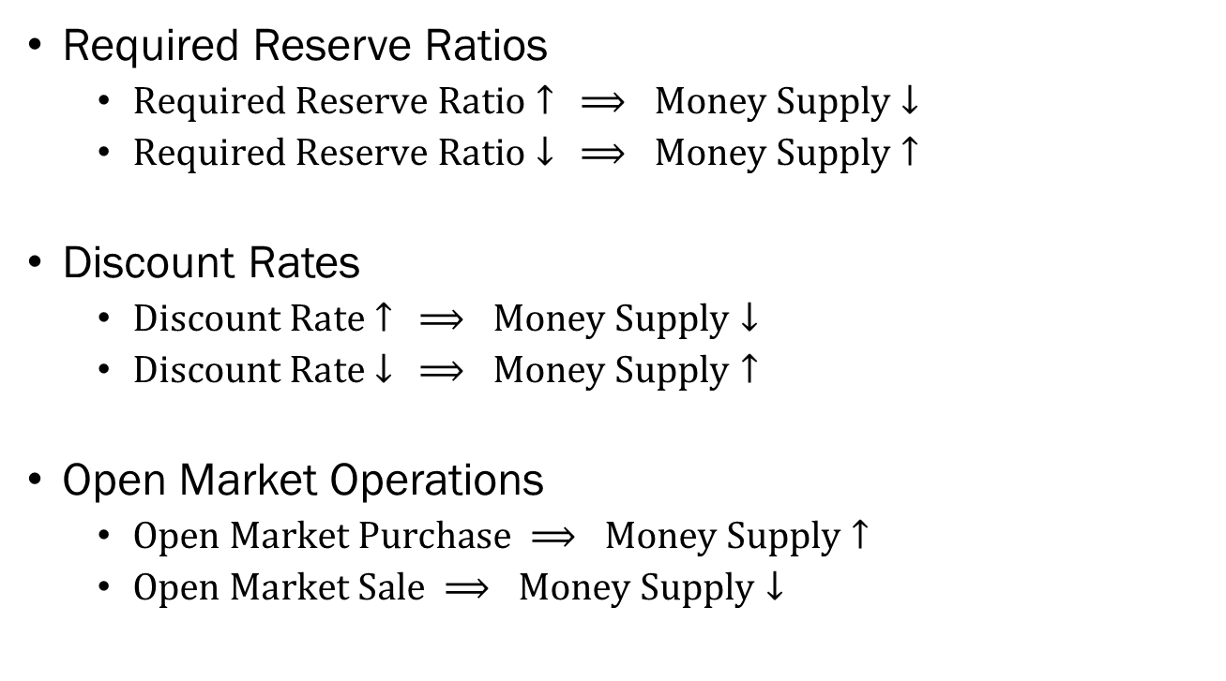
Federal Reserve’s Monetary Policy
Required Reserve Ratios
  $Required Reserve Ratio↑ ⟹ Money Supply↓$
  $Required Reserve Ratio↓ ⟹ Money Supply↑$
Discount Rates
  $Discount Rate↑ ⟹ Money Supply↓$
  $Discount Rate↓ ⟹ Money Supply↑$
Open Market Operations
  $Open Market Purchase ⟹ Money Supply↑$
  $Open Market Sale ⟹ Money Supply↓$

Slide 40

The Money Supply Curve
$$M^{S}$$
Money supply is under total control of the Fed.
Therefore, the money supply in our model will be a vertical line.
Money demand is more interesting, since it will be determined by households’ choices.
Interest
Money

