Slide 1
The Open Economy:
Goods and Financial Markets
ECON 301

Slide 2

https://pollev.com/brianpark046

Slide 3
Towards a Model of an Open Economy
Up to this point, we were operating under the assumption that the market was “closed.”
This means that we have been ignoring a major factor, the actions of other countries, their citizens, and their firms.
The share of trade in GDP varies widely country by country.
  Sudan has the lowest trade exposure of 4.2%, and
  Luxembourg has the highest trade exposure of 388.51%.
Trade accounts for about 61.44% of the world’s GDP, so it would be irresponsible to leave this out from the model.

Slide 4
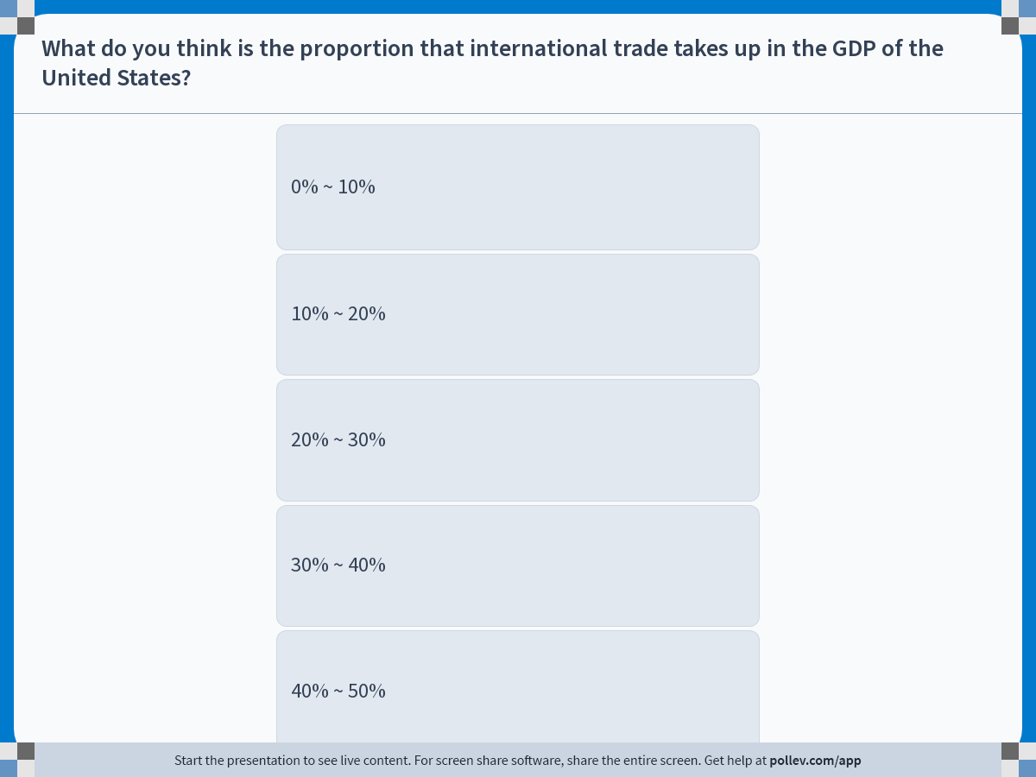
Notes:
Poll Title: Do not modify the notes in this section to avoid tampering with the Poll Everywhere activity.
More info at polleverywhere.com/support
What do you think is the proportion that international trade takes up in the GDP of the United States?
https://www.polleverywhere.com/multiple_choice_polls/XgE5IPoRfd3jpDD9XI7IZ?display_state=instructions&activity_state=opened&state=opened&flow=Engagement&onscreen=persist

Slide 5
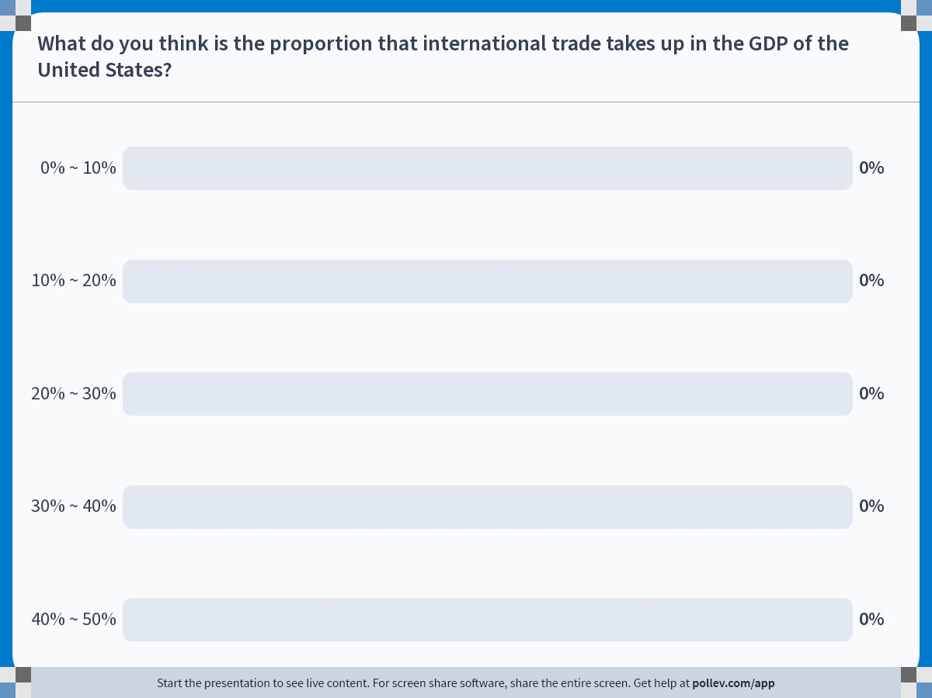
Notes:
Poll Title: Do not modify the notes in this section to avoid tampering with the Poll Everywhere activity.
More info at polleverywhere.com/support
What do you think is the proportion that international trade takes up in the GDP of the United States?
https://www.polleverywhere.com/multiple_choice_polls/XgE5IPoRfd3jpDD9XI7IZ?display_state=chart&activity_state=closed&state=closed&flow=Engagement&onscreen=persist

Slide 6
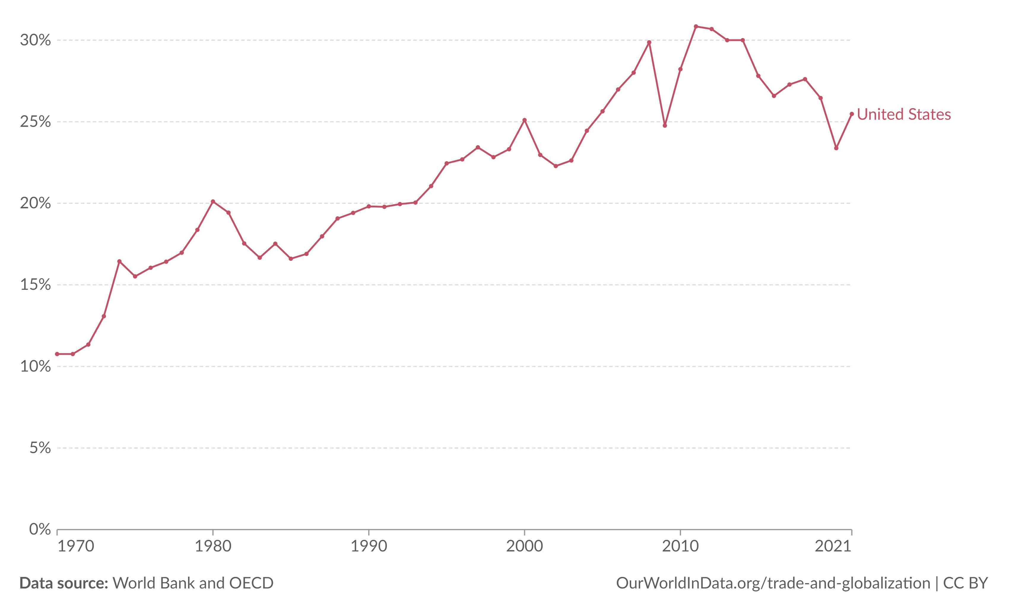
Trade as a Share of GDP: USA

Slide 7
The Three Dimensions of Openness
Openness in the Goods Markets
  If the market is open, consumers and firms may purchase either domestic goods or foreign goods.
Openness in the Financial Markets
  If the market is open, investors would have the option to invest in domestic or foreign assets.
Openness in the Factor Markets
  If the market is open, firms will be able to choose to produce domestically or in foreign destinations.
  Workers will also have the freedom to choose to work domestically or in foreign destinations.

Slide 8
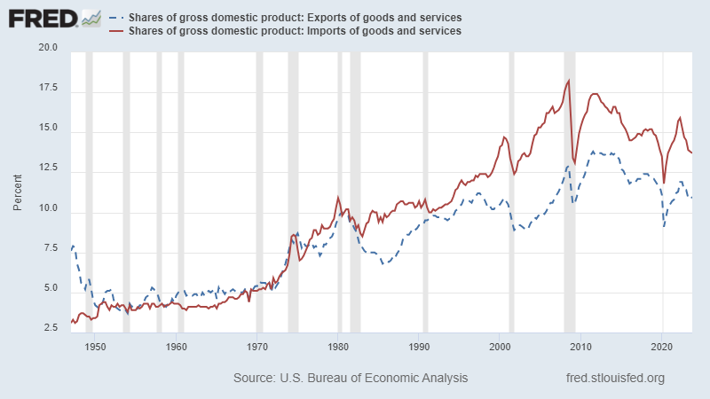
US Exports and US Imports

Slide 9
US Exports and US Imports
Observation #1:
Since the 1950s, the share that trade takes up in US GDP has been steadily increasing.
In the first quarter of 1960…
  US exports as a share of its GDP was 4.8%
  US imports as a share of its GDP was 4.3%
According to the most recent data of 2023 Q4…
  US exports as a share of its GDP was 10.9%
  US imports as a share of its GDP was 13.7%

Slide 10
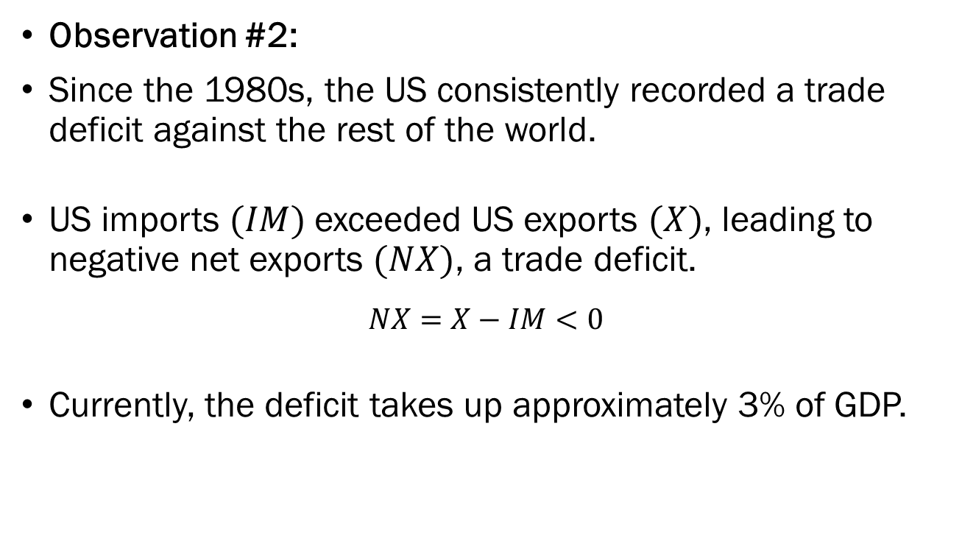
US Exports and US Imports
Observation #2:
Since the 1980s, the US consistently recorded a trade deficit against the rest of the world.
US imports $(IM)$ exceeded US exports $(X)$, leading to negative net exports $(NX)$, a trade deficit.
$$NX=X−IM<0$$
Currently, the deficit takes up approximately 3% of GDP.

Slide 11
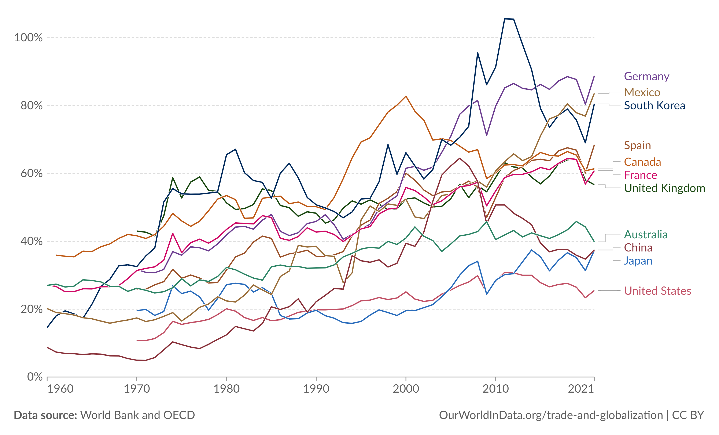
US Exports and US Imports

Slide 12
US Exports and US Imports
Observation #3:
The US has one of the lowest ratio of trade as a share of GDP in the world.
This does not necessarily mean that the US is less open to trade than the rest of the world.
Domestically produced US goods and services may be competitive to the degree that imports are not appealing to consumers.

Slide 13
Changes to the Model: Goods Market
In a closed goods market, the consumers’ choice is to…
  Spend a portion of their income as consumption, and
  Allocate the remainder as savings.
In an open goods market, the consumers’ choice is to…
  Spend a portion of their income to consume domestic goods, and
  Spend a portion of their income on foreign goods, and
  Allocate the remainder as savings.
The decision to purchase either domestic or foreign goods will depend heavily on the price of domestic goods relative to the price of foreign goods.

Slide 14
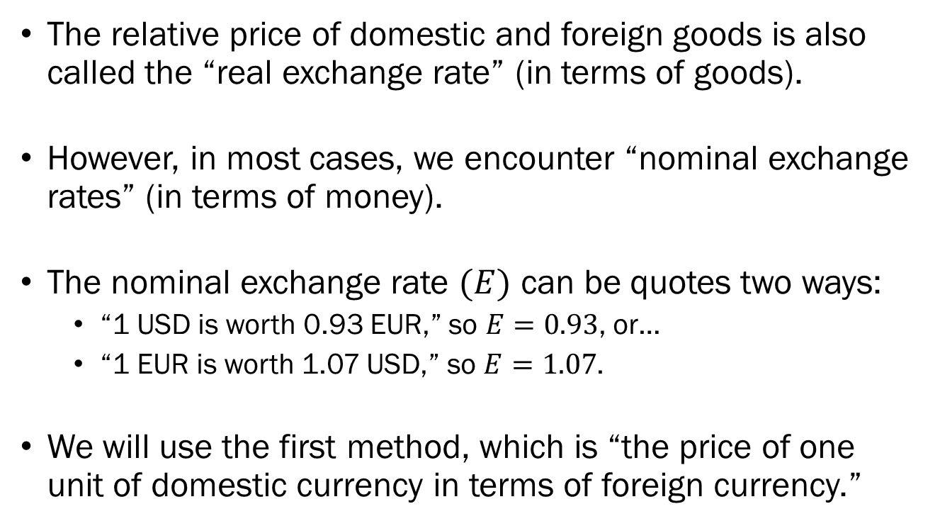
Exchange Rates
The relative price of domestic and foreign goods is also called the “real exchange rate” (in terms of goods).
However, in most cases, we encounter “nominal exchange rates” (in terms of money).
The nominal exchange rate $(E)$ can be quotes two ways:
  “1 USD is worth 0.93 EUR,” so $E=0.93$, or…
  “1 EUR is worth 1.07 USD,” so $E=1.07$.
We will use the first method, which is “the price of one unit of domestic currency in terms of foreign currency.”

Slide 15
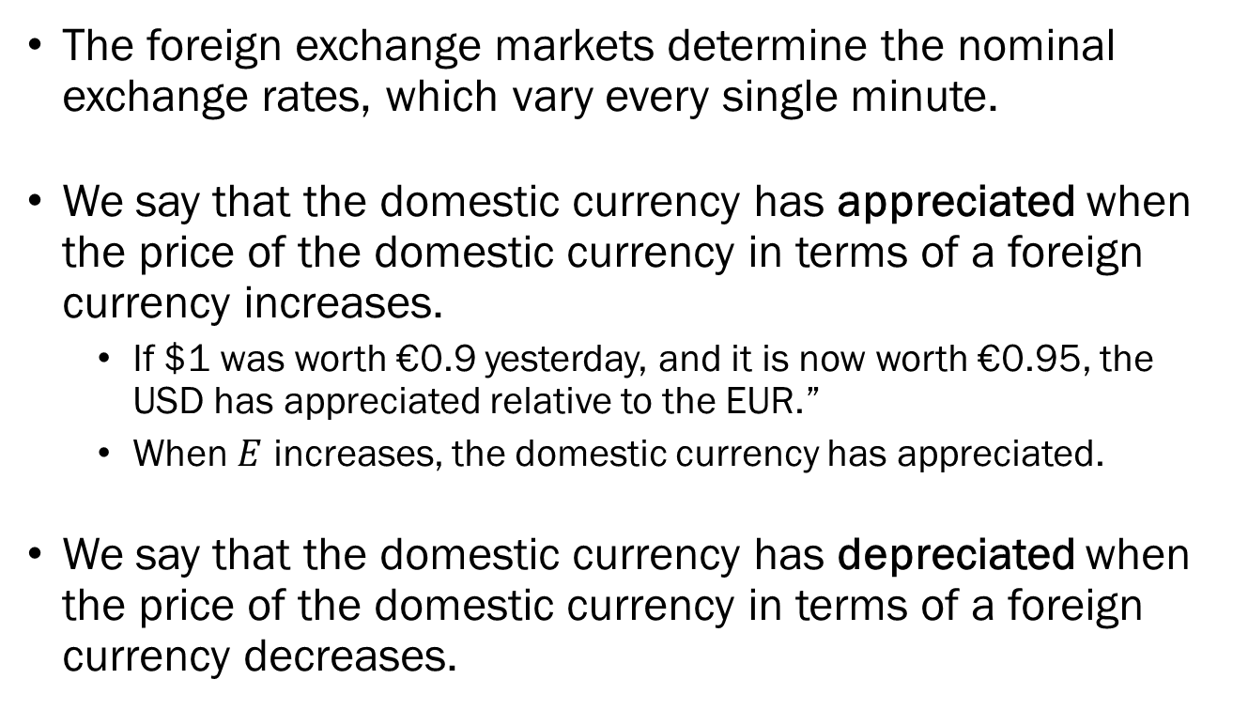
Nominal Exchange Rates
The foreign exchange markets determine the nominal exchange rates, which vary every single minute.
We say that the domestic currency has appreciated when the price of the domestic currency in terms of a foreign currency increases.
  If $1 was worth €0.9 yesterday, and it is now worth €0.95, the USD has appreciated relative to the EUR.”
  When $E$ increases, the domestic currency has appreciated.
We say that the domestic currency has depreciated when the price of the domestic currency in terms of a foreign currency decreases.

Slide 16
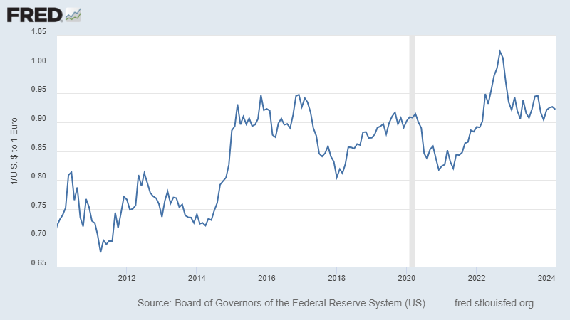
USD-EUR Exchange Rate:
“How many € do you need to buy $1”

Slide 17
Nominal Exchange Rates
Most of the widely used currencies are “free floating” so that the values are determined by the market.
There are some currencies that operate under “fixed exchange rate” regimes.
When the exchange rate of a currency under a fixed exchange rate regime…
  …increases (appreciates), it goes through a “revaluation.”
  …decreases (depreciates), it goes through a “devaluation.”

Slide 18
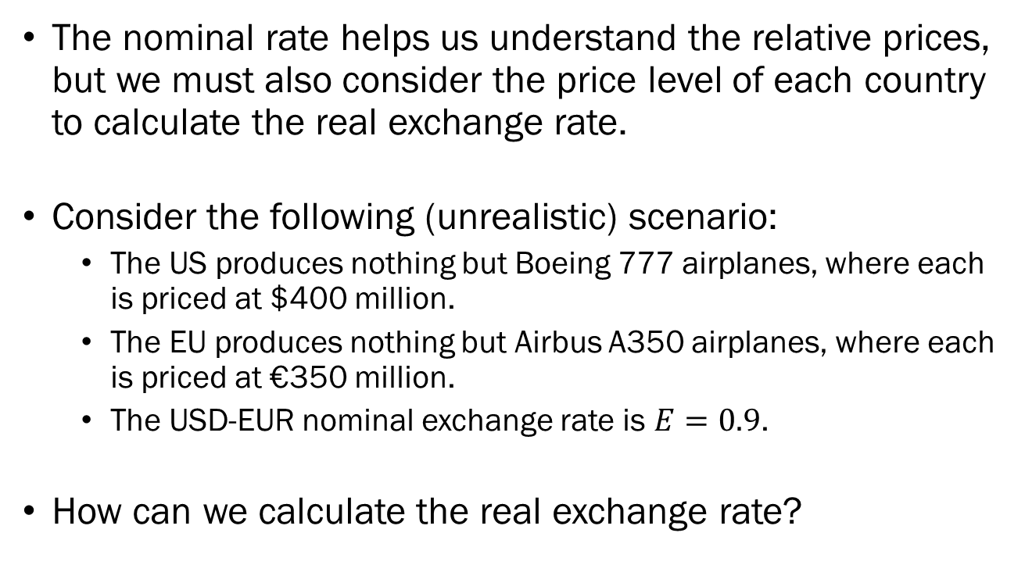
Real Exchange Rates
The nominal rate helps us understand the relative prices, but we must also consider the price level of each country to calculate the real exchange rate.
Consider the following (unrealistic) scenario:
  The US produces nothing but Boeing 777 airplanes, where each is priced at $400 million.
  The EU produces nothing but Airbus A350 airplanes, where each is priced at €350 million.
  The USD-EUR nominal exchange rate is $E=0.9$.
How can we calculate the real exchange rate?

Slide 19
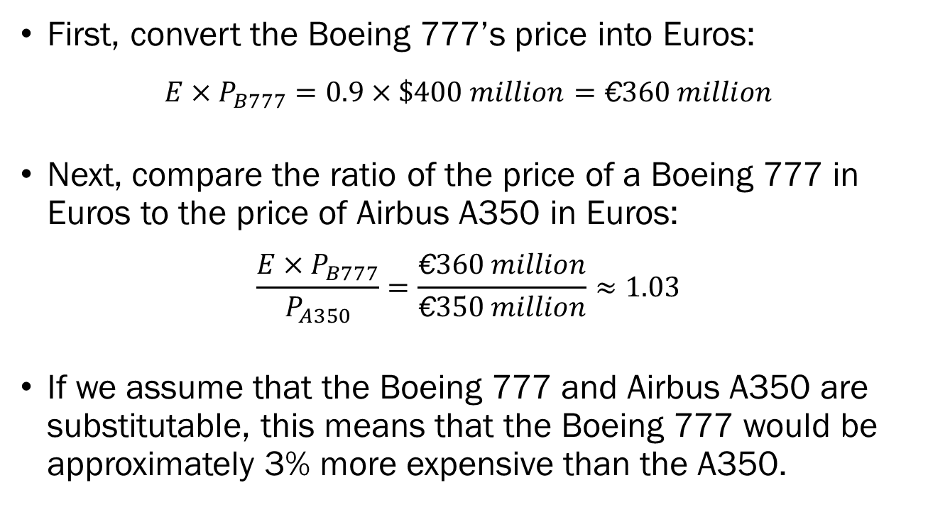
Real Exchange Rates
First, convert the Boeing 777’s price into Euros:
$$E×P_{B777}=0.9×\$400 million=\text{€}360 million$$
Next, compare the ratio of the price of a Boeing 777 in Euros to the price of Airbus A350 in Euros:
$$\frac{E×P_{B777}}{P_{A350}}=\frac{\text{€}360 million}{\text{€}350 million}≈1.03$$
If we assume that the Boeing 777 and Airbus A350 are substitutable, this means that the Boeing 777 would be approximately 3% more expensive than the A350.

Slide 20
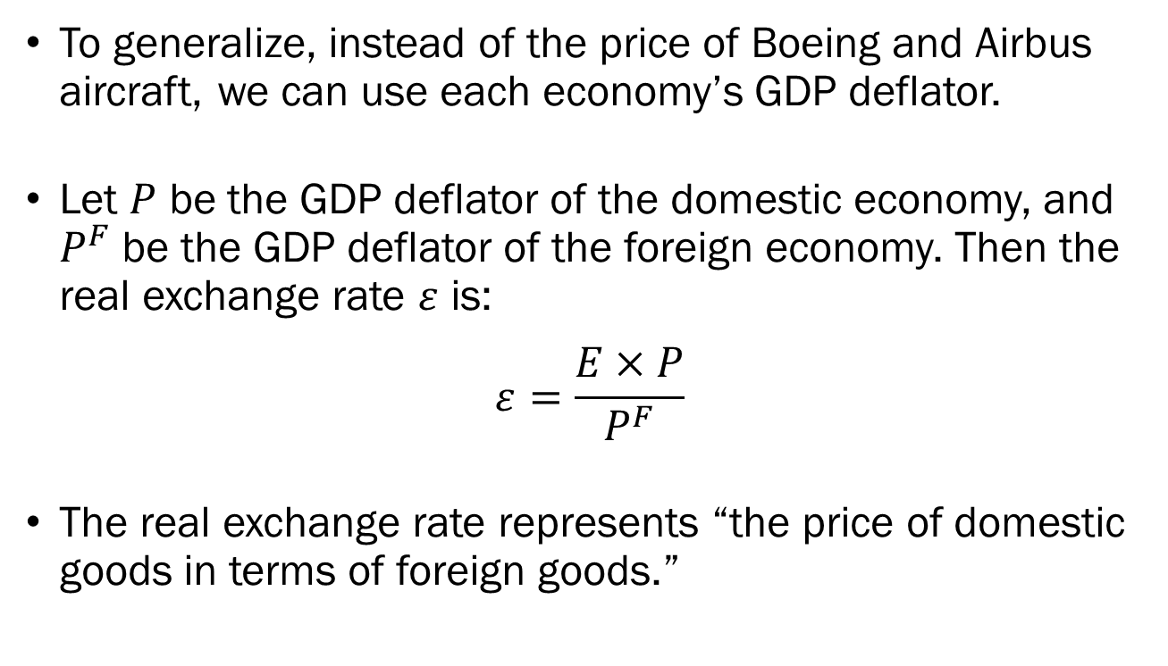
Real Exchange Rates
To generalize, instead of the price of Boeing and Airbus aircraft, we can use each economy’s GDP deflator.
Let $P$ be the GDP deflator of the domestic economy, and $P^{F}$ be the GDP deflator of the foreign economy. Then the real exchange rate $ε$ is:
$$ε=\frac{E×P}{P^{F}}$$
The real exchange rate represents “the price of domestic goods in terms of foreign goods.”

Slide 21
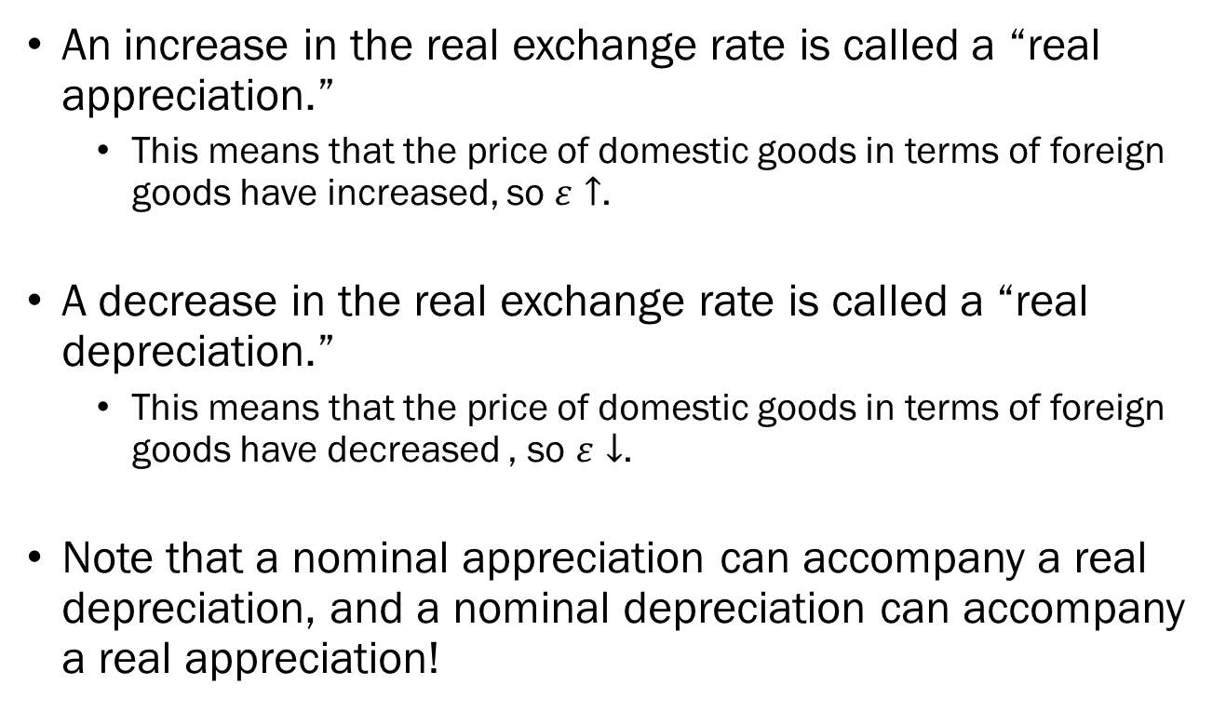
Real Exchange Rates
An increase in the real exchange rate is called a “real appreciation.”
  This means that the price of domestic goods in terms of foreign goods have increased, so $ε↑$.
A decrease in the real exchange rate is called a “real depreciation.”
  This means that the price of domestic goods in terms of foreign goods have decreased , so $ε↓$.
Note that a nominal appreciation can accompany a real depreciation, and a nominal depreciation can accompany a real appreciation!

Slide 22
Openness in Financial Markets
Openness in financial markets allow domestic agents to hold both domestic and foreign assets.
To trade foreign assets, one must engage in the purchase and sale of foreign currencies.
Approximately 88% of all global trade was recorded using USD as the intermediary.
The average daily trade of the US in 2023 was $8.2 billion in exports, and $10.4 billion in imports.

Slide 23
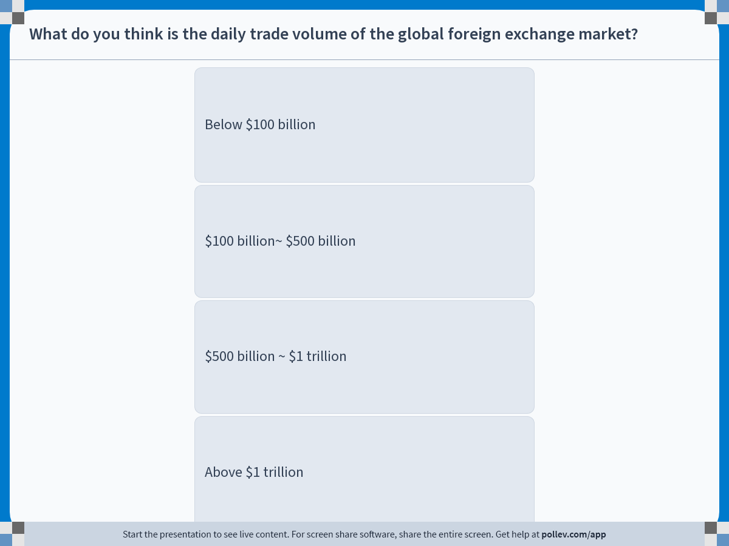
Notes:
Poll Title: Do not modify the notes in this section to avoid tampering with the Poll Everywhere activity.
More info at polleverywhere.com/support
What do you think is the daily trade volume of the global foreign exchange market?
https://www.polleverywhere.com/multiple_choice_polls/zPIjiy6pp4QDKBCPNWhDH?display_state=instructions&activity_state=opened&state=opened&flow=Engagement&onscreen=persist

Slide 24
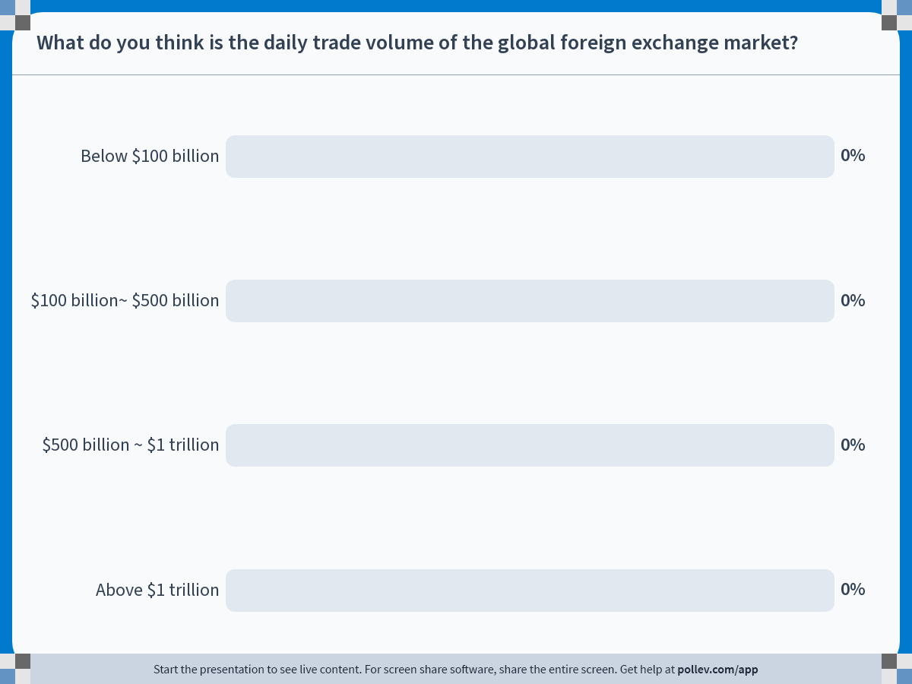
Notes:
Poll Title: Do not modify the notes in this section to avoid tampering with the Poll Everywhere activity.
More info at polleverywhere.com/support
What do you think is the daily trade volume of the global foreign exchange market?
https://www.polleverywhere.com/multiple_choice_polls/zPIjiy6pp4QDKBCPNWhDH?display_state=chart&activity_state=closed&state=closed&flow=Engagement&onscreen=persist

Slide 25
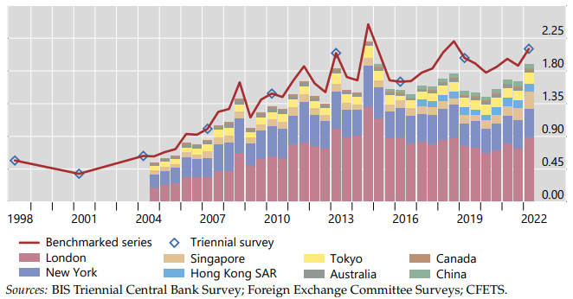
Openness in Financial Markets

Slide 26
Changes to the Model: Financial Market
In a closed financial market, the agents’ choice is to…
  How much income to hold as bonds, and
  How much income to hold as money.
In an open financial market, the agents’ choice is to…
  How much income to hold as domestic bonds, and
  How much income to hold as foreign bonds, and
  How much income to hold as domestic money.
If a domestic bond is offering 4% interest rates, while a foreign bond is offering 7% interest rates, which one should investors prefer?

Slide 27

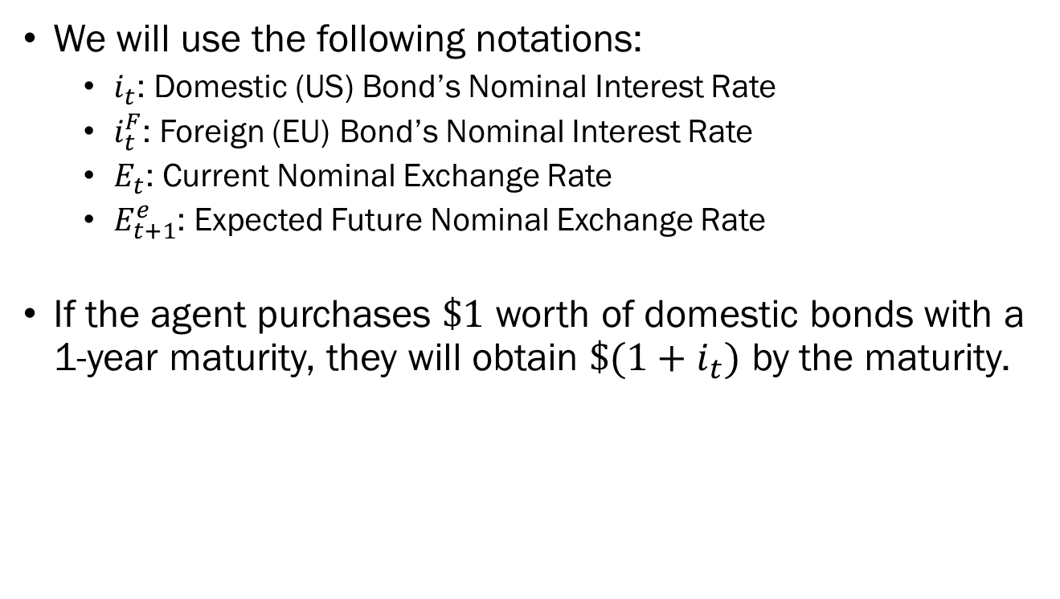

Choice of Domestic and Foreign Bonds
We will use the following notations:
  $i_{t}$: Domestic (US) Bond’s Nominal Interest Rate
  $i_{t}^{F}$: Foreign (EU) Bond’s Nominal Interest Rate
  $E_{t}$: Current Nominal Exchange Rate
  $E_{t+1}^{e}$: Expected Future Nominal Exchange Rate
If the agent purchases $\$1$ worth of domestic bonds with a 1-year maturity, they will obtain $\$(1+i_{t})$ by the maturity.
$$\$1$$
Bond Pays Interest
$$\$\left(1+i_{t}\right)$$

Slide 28





Choice of Domestic and Foreign Bonds
If the agent purchases $\$1$ worth of EU bonds with a 1-year maturity...
The expected dollar amount the investor will receive is:
$$\$\frac{E_{t}\left(1+i_{t}^{F}\right)}{E_{t+1}}$$
$$\$1$$
$$\$\frac{E_{t}\left(1+i_{t}^{F}\right)}{E_{t+1}^{e}}$$
Convert
Convert
USD to EUR
EUR to USD
$$€E_{t}$$
Bond Pays Interest
$$€E_{t}\left(1+i_{t}^{F}\right)$$

Slide 29
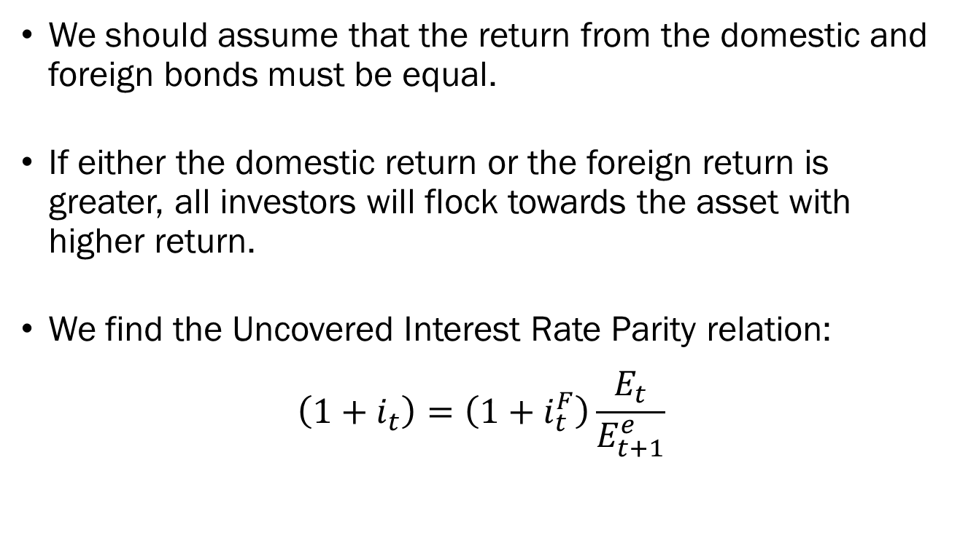
Interest Rate Parity and
Exchange Rates
We should assume that the return from the domestic and foreign bonds must be equal.
If either the domestic return or the foreign return is greater, all investors will flock towards the asset with higher return.
We find the Uncovered Interest Rate Parity relation:
$$\left(1+i_{t}\right)=\left(1+i_{t}^{F}\right)\frac{E_{t}}{E_{t+1}^{e}}$$

Slide 30
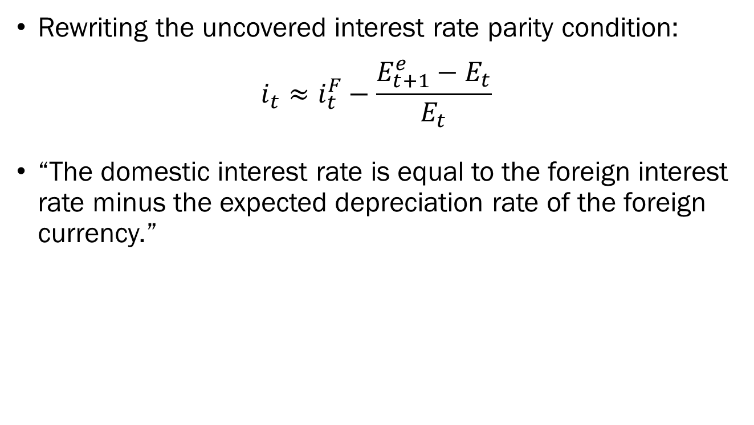
Interest Rate Parity and
Exchange Rates
Rewriting the uncovered interest rate parity condition:
$$i_{t}≈i_{t}^{F}−\frac{E_{t+1}^{e}−E_{t}}{E_{t}}$$
“The domestic interest rate is equal to the foreign interest rate minus the expected depreciation rate of the foreign currency.”

Slide 31
Interest Rate Parity and
Exchange Rates
Back to the question of the 4% interest rate domestic (US) bonds and the 7% foreign (EU) bonds…
If the investor expects the Euro to depreciate relative to the US dollar by…
  …more than 3%, then they should invest in domestic (US) bonds.
  …less than 3%, then they should invest in foreign (EU) bonds.
  …exactly 3%, then they would be indifferent between the two.
Note that these conclusions assume that…
  …that there is no transaction cost in acquiring foreign assets, and
  …that individuals are risk-neutral.

Slide 32
Wrapping Up
An open goods market allows individuals to choose between domestic and foreign produced goods, and the choice will depend on the real exchange rate.
An open financial market allows individuals to choose between domestic and foreign assets, and the choice will depend on each assets’ interest rates and the expected changes in the exchange rates.

