Slide 1
The Long Run:
Technological Progress and Growth
ECON 301

Slide 2

Technological Progress

Slide 3
Technological Progress
Previously, we examined the Solow model of growth, and concluded that…
  The accumulation of capital can contribute to the economy reaching a higher level of output per labor.
  However, the growth rate of the economy at the steady state was always zero.
To incorporate long run economic growth in the model, we will be introducing the concept of technological progress.
Let us revisit the aggregate production function and introduce technology into the model.

Slide 4
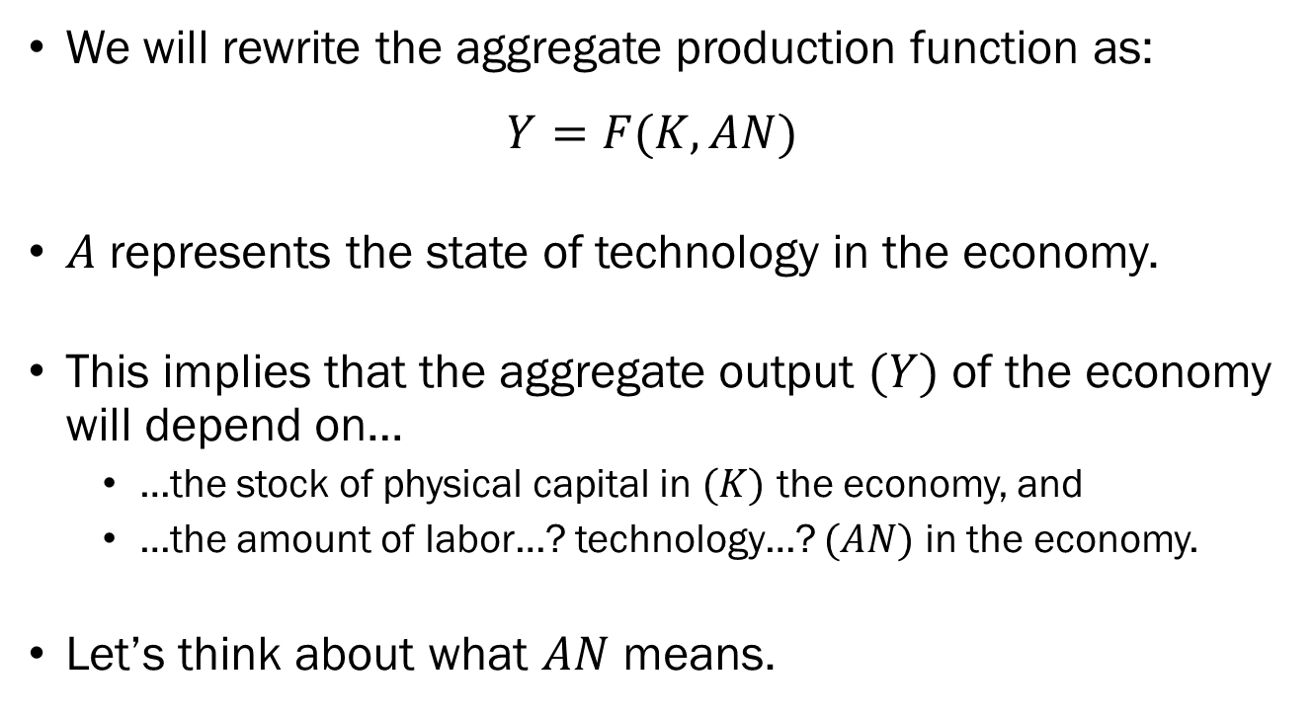
Technological Progress
We will rewrite the aggregate production function as:
$$Y=F(K,AN)$$
$A$ represents the state of technology in the economy.
This implies that the aggregate output $(Y)$ of the economy will depend on…
  …the stock of physical capital in $(K)$ the economy, and
  …the amount of labor…? technology…? $(AN)$ in the economy.
Let’s think about what $AN$ means.

Slide 5
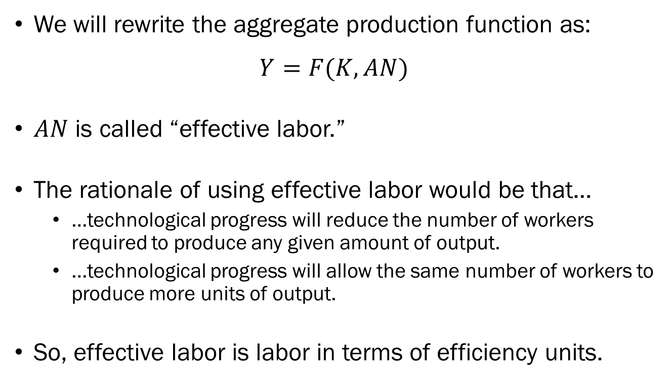
Technological Progress
We will rewrite the aggregate production function as:
$$Y=F(K,AN)$$
$AN$ is called “effective labor.”
The rationale of using effective labor would be that…
  …technological progress will reduce the number of workers required to produce any given amount of output.
  …technological progress will allow the same number of workers to produce more units of output.
So, effective labor is labor in terms of efficiency units.

Slide 6
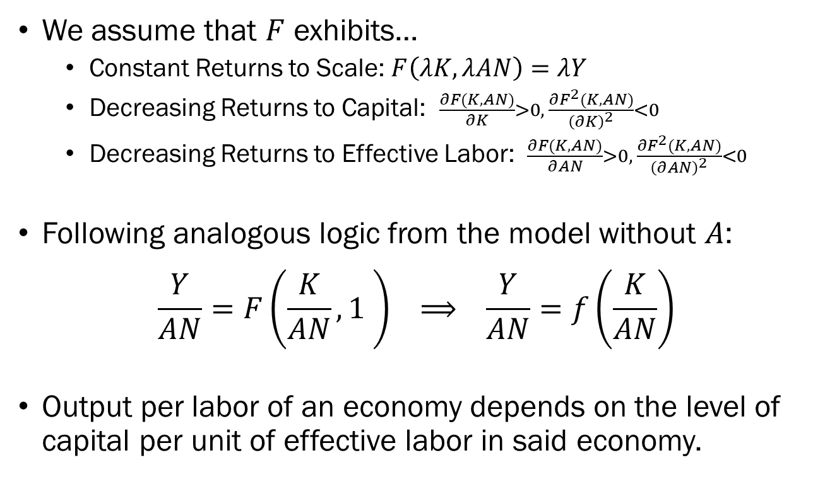
The Effect of Capital on Output
We assume that $F$ exhibits…
  Constant Returns to Scale: $F\left(λK,λAN\right)=λY$
  Decreasing Returns to Capital: $\frac{∂F(K,AN)}{∂K}>0, \frac{∂F^{2}(K,AN)}{{\left(∂K\right)}^{2}}<0$
  Decreasing Returns to Effective Labor: $\frac{∂F(K,AN)}{∂AN}>0, \frac{∂F^{2}(K,AN)}{{\left(∂AN\right)}^{2}}<0$
Following analogous logic from the model without $A$:
$$\frac{Y}{AN}=F\left(\frac{K}{AN},1 \right) ⟹ \frac{Y}{AN}=f\left(\frac{K}{AN}\right)$$
Output per labor of an economy depends on the level of capital per unit of effective labor in said economy.

Slide 7



The Effect of Capital on Output
The aggregate production function will look nearly identical to the previous model.
Is there anything missing from the new aggregate production function?
Yes, but we are leaving out the issue of human capital for now.
$$Y/AN$$
$$f\left(\frac{K_{t}}{AN}\right)$$
$$K/AN$$

Slide 8
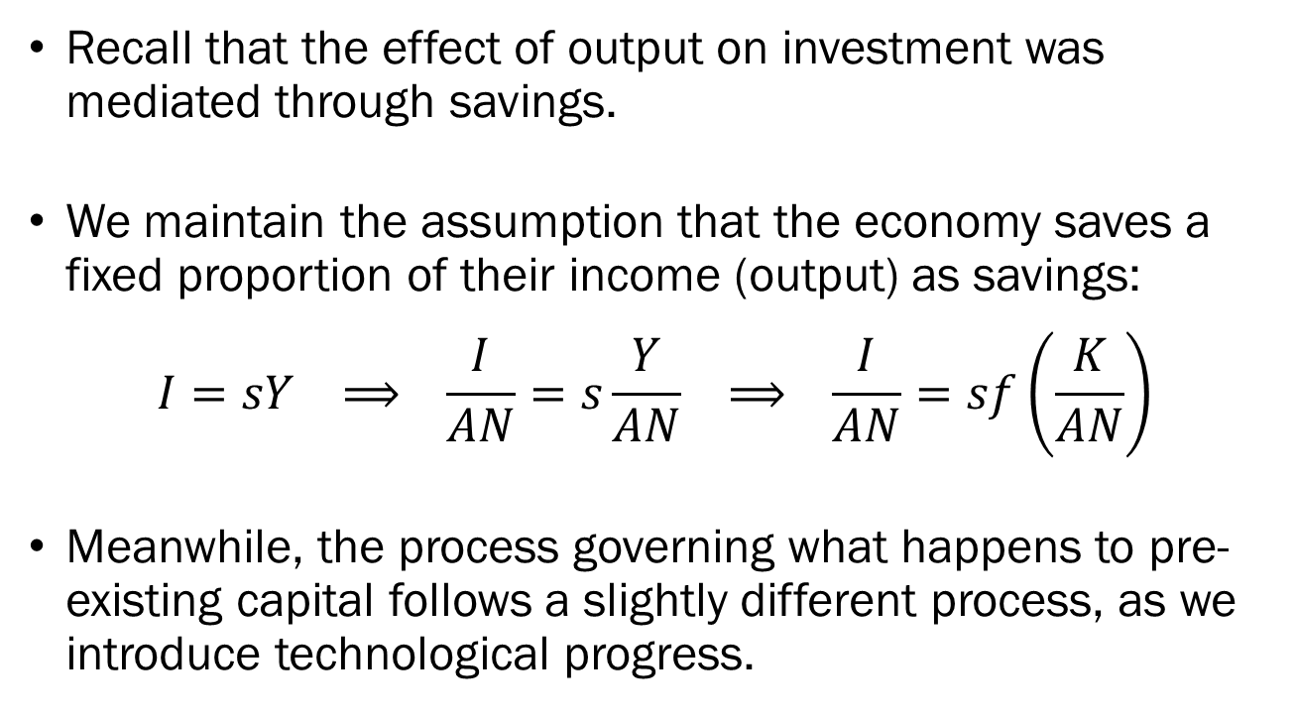
The Effect of Output on Investment
Recall that the effect of output on investment was mediated through savings.
We maintain the assumption that the economy saves a fixed proportion of their income (output) as savings:
$$I=sY ⟹ \frac{I}{AN}=s\frac{Y}{AN} ⟹ \frac{I}{AN}=sf\left(\frac{K}{AN}\right)$$
Meanwhile, the process governing what happens to pre-existing capital follows a slightly different process, as we introduce technological progress.

Slide 9
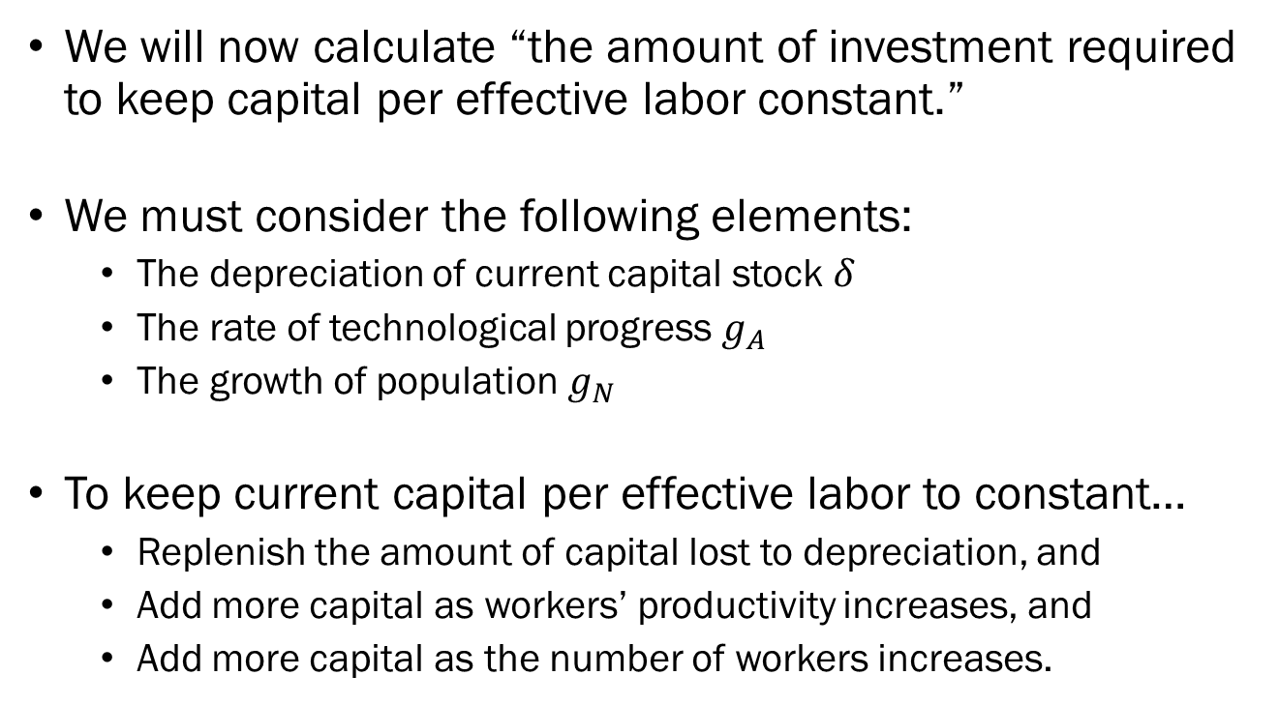
Evolution of Current Capital Stock
We will now calculate “the amount of investment required to keep capital per effective labor constant.”
We must consider the following elements:
  The depreciation of current capital stock $δ$
  The rate of technological progress $g_{A}$
  The growth of population $g_{N}$
To keep current capital per effective labor to constant…
  Replenish the amount of capital lost to depreciation, and
  Add more capital as workers’ productivity increases, and
  Add more capital as the number of workers increases.

Slide 10
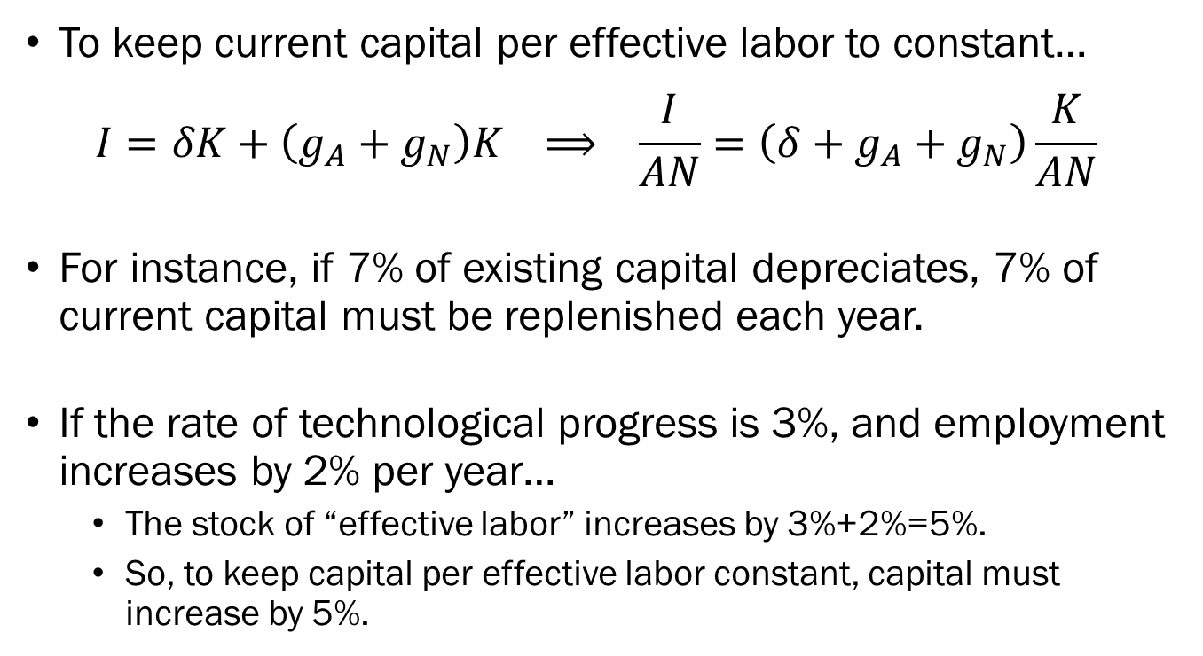
Evolution of Current Capital Stock
To keep current capital per effective labor to constant…
$$I=δK+\left(g_{A}+g_{N}\right)K ⟹ \frac{I}{AN}=\left(δ+g_{A}+g_{N}\right)\frac{K}{AN}$$
For instance, if 7% of existing capital depreciates, 7% of current capital must be replenished each year.
If the rate of technological progress is 3%, and employment increases by 2% per year…
  The stock of “effective labor” increases by 3%+2%=5%.
  So, to keep capital per effective labor constant, capital must increase by 5%.

Slide 11



Output, Investment, and Capital
$$(δ+g_{A}+g_{N})\frac{K}{AN}$$
We find that the graph is nearly identical to the case without growth.
The few differences are:
  The use of effective labor in place of simple labor, and
  Slightly different behavior of current capital stock.
$$Y/AN$$
$$f\left(\frac{K}{AN}\right)$$
$$sf\left(\frac{K}{AN}\right)$$
$$K/AN$$

Slide 12



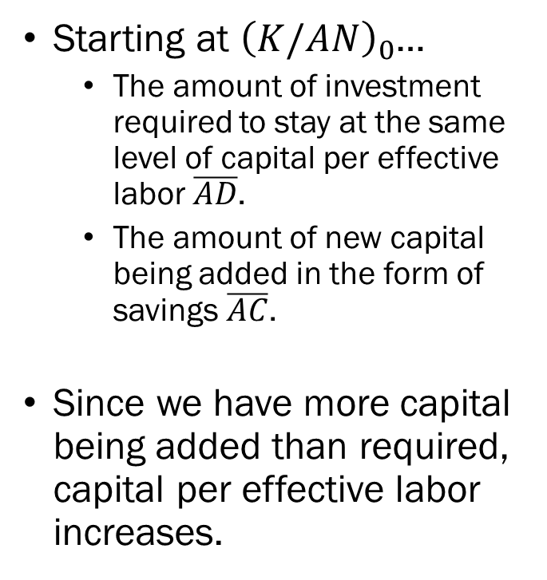



Output, Investment, and Capital
$$(δ+g_{A}+g_{N})\frac{K}{AN}$$
Starting at ${\left(K/AN\right)}_{0}$…
  The amount of investment required to stay at the same level of capital per effective labor $\overline{AD}$.
  The amount of new capital being added in the form of savings $\overline{AC}$.
Since we have more capital being added than required, capital per effective labor increases.
$$Y/AN$$
$$f\left(\frac{K}{AN}\right)$$
$$B$$
$$sf\left(\frac{K}{AN}\right)$$
$$C$$
$$D$$
$$A$$
$${\left(\frac{K}{AN}\right)}_{0}$$
$${\left(\frac{K}{AN}\right)}_{1}$$
$$K/AN$$

Slide 13

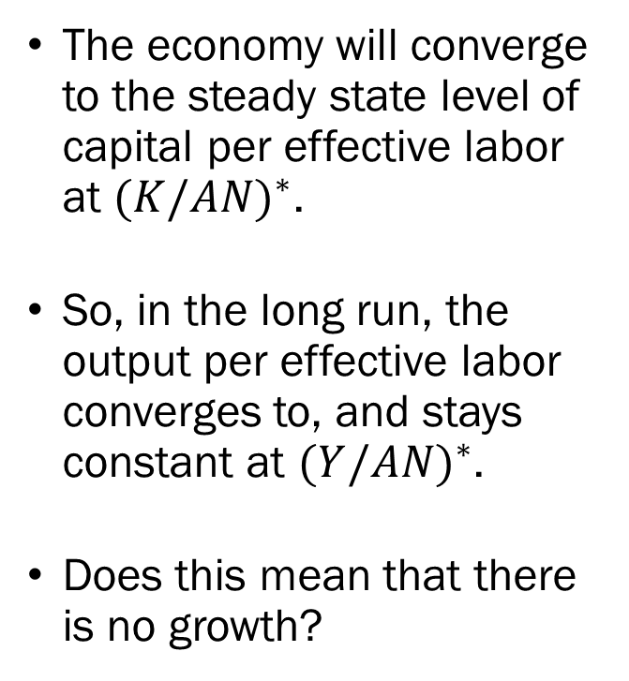
Output, Investment, and Capital
$$(δ+g_{A}+g_{N})\frac{K}{AN}$$
The economy will converge to the steady state level of capital per effective labor at ${(K/AN)}^{∗}$.
So, in the long run, the output per effective labor converges to, and stays constant at ${(Y/AN)}^{∗}$.
Does this mean that there is no growth?
$$Y/AN$$
$$f\left(\frac{K}{AN}\right)$$
$$sf\left(\frac{K}{AN}\right)$$
$${\left(\frac{K}{AN}\right)}^{∗}$$
$$K/AN$$

Slide 14
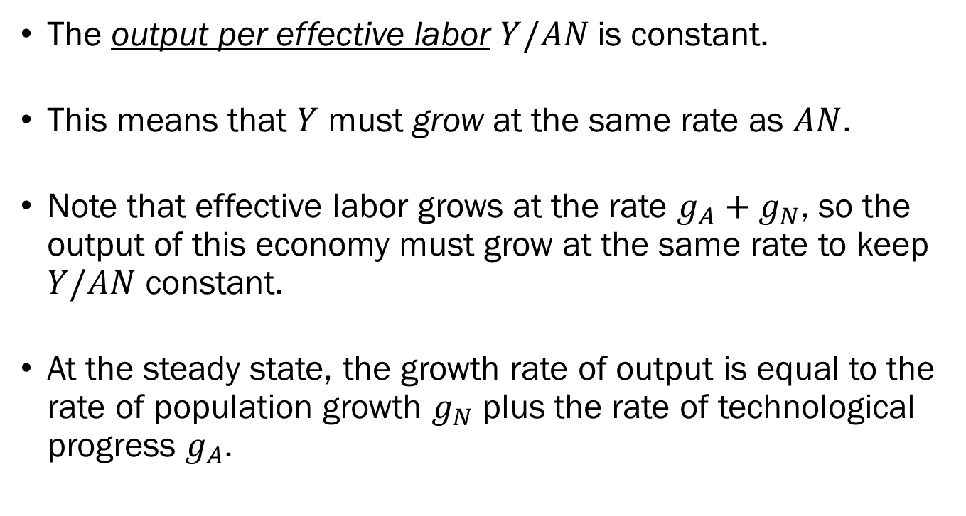
Output, Investment, and Capital
The output per effective labor $Y/AN$is constant.
This means that $Y$ must grow at the same rate as $AN$.
Note that effective labor grows at the rate $g_{A}+g_{N}$, so the output of this economy must grow at the same rate to keep $Y/AN$ constant.
At the steady state, the growth rate of output is equal to the rate of population growth $g_{N}$ plus the rate of technological progress $g_{A}$.

Slide 15



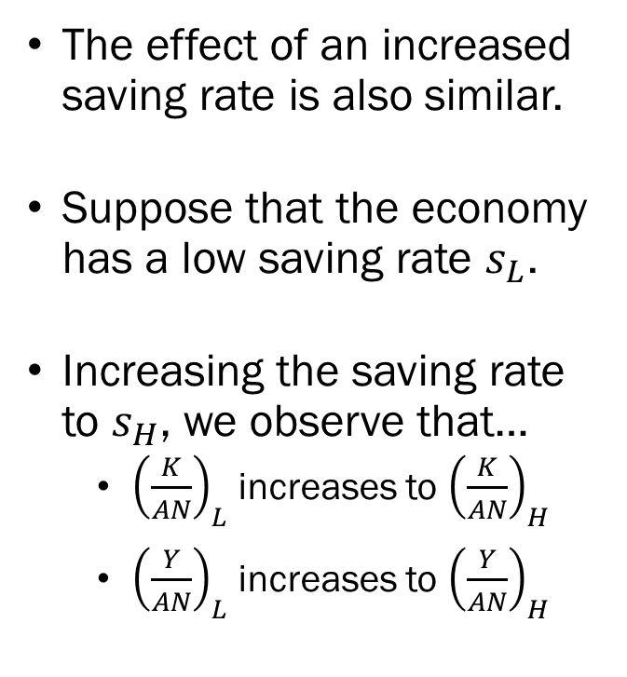



The Effect of Saving Rates on Output
$$(δ+g_{A}+g_{N})\frac{K}{AN}$$
The effect of an increased saving rate is also similar.
Suppose that the economy has a low saving rate $s_{L}$.
Increasing the saving rate to $s_{H}$, we observe that…
  ${\left(\frac{K}{AN}\right)}_{L}$ increases to ${\left(\frac{K}{AN}\right)}_{H}$
  ${\left(\frac{Y}{AN}\right)}_{L}$ increases to ${\left(\frac{Y}{AN}\right)}_{H}$
$$Y/AN$$
$$f\left(\frac{K}{AN}\right)$$
$${\left(\frac{Y}{AN}\right)}_{H}$$
$${\left(\frac{Y}{AN}\right)}_{L}$$
$$s_{H}f\left(\frac{K}{AN}\right)$$
$$s_{L}f\left(\frac{K}{AN}\right)$$
$${\left(\frac{K}{AN}\right)}_{L}$$
$${\left(\frac{K}{AN}\right)}_{H}$$
$$K/AN$$

Slide 16

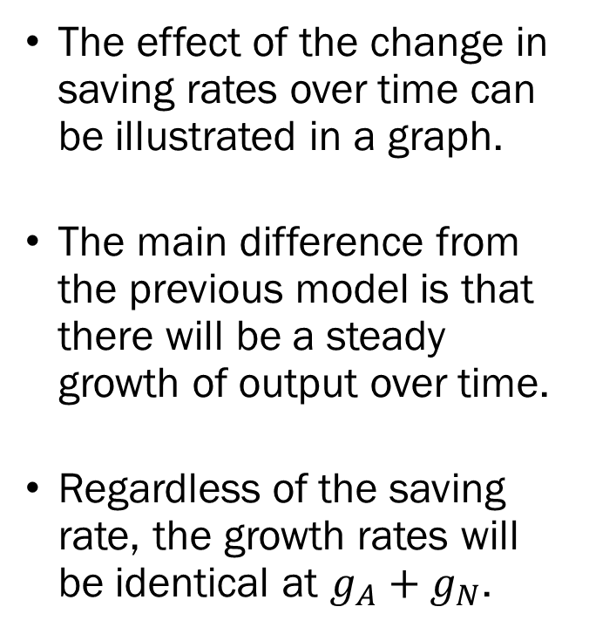
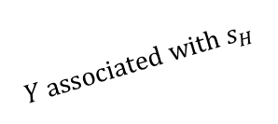
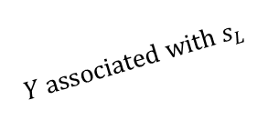

The Effect of Saving Rates on Output
The effect of the change in saving rates over time can be illustrated in a graph.
The main difference from the previous model is that there will be a steady growth of output over time.
Regardless of the saving rate, the growth rates will be identical at $g_{A}+g_{N}$.
$$log⁡(Y)$$
$$Y associated with s_{H}$$
$$Y associated with s_{L}$$
$$Time$$

Slide 17
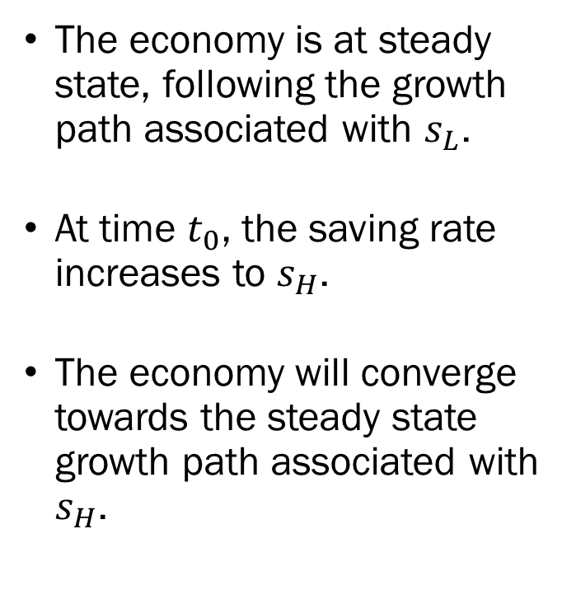

The Effect of Saving Rates on Output
The economy is at steady state, following the growth path associated with $s_{L}$.
At time $t_{0}$, the saving rate increases to $s_{H}$.
The economy will converge towards the steady state growth path associated with $s_{H}$.
$$log⁡(Y)$$
$$Y associated with s_{H}$$
$$Y associated with s_{L}$$
$$t_{0}$$
$$Time$$

Slide 18
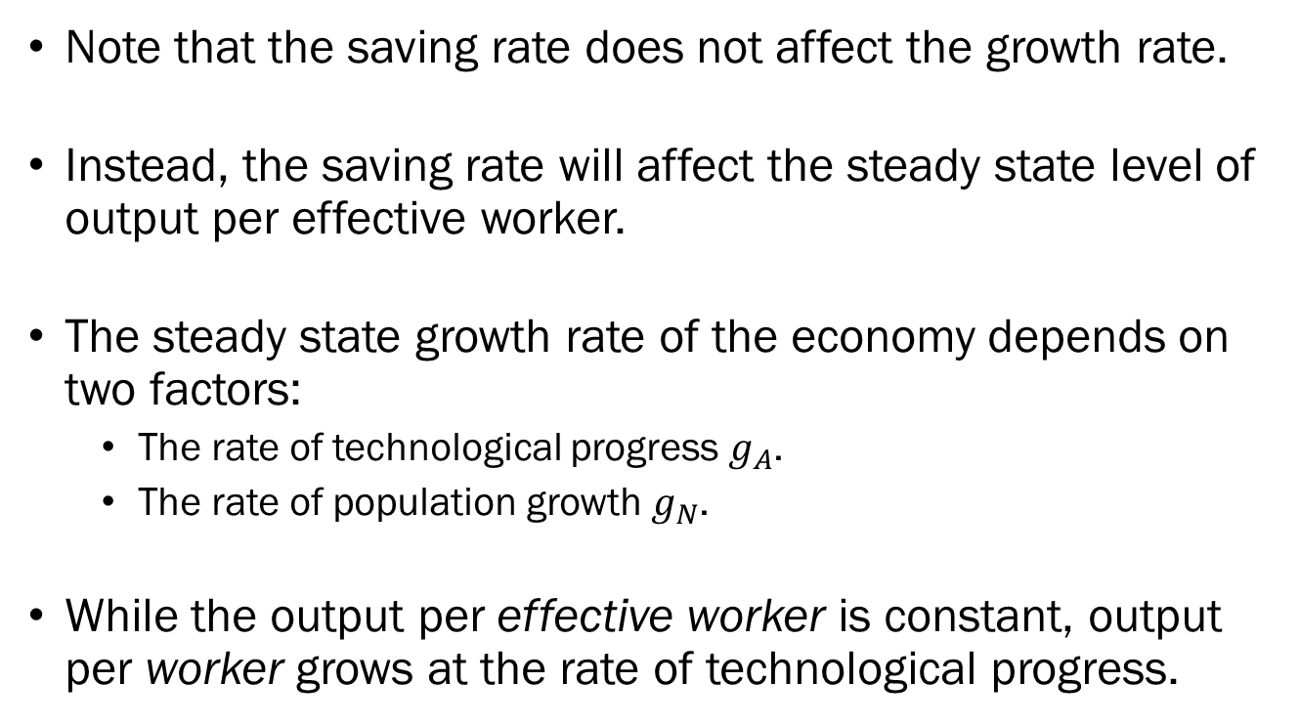
The Effect of Saving Rates on Output
Note that the saving rate does not affect the growth rate.
Instead, the saving rate will affect the steady state level of output per effective worker.
The steady state growth rate of the economy depends on two factors:
  The rate of technological progress $g_{A}$.
  The rate of population growth $g_{N}$.
While the output per effective worker is constant, output per worker grows at the rate of technological progress.

Slide 19
Technological Progress and Growth
Most technological progress happens through a process called research and development (R&D).
Among the most developed economies in the world, we usually see anywhere between 1.5% ~ 4% of GDP being spent on R&D.
As of 2021, according to the World Bank:
  United States: 3.5% of GDP is dedicated to R&D.
  South Korea: 4.8% / Japan: 3.3% / France: 2.4% / UK: 1.7%

Slide 20
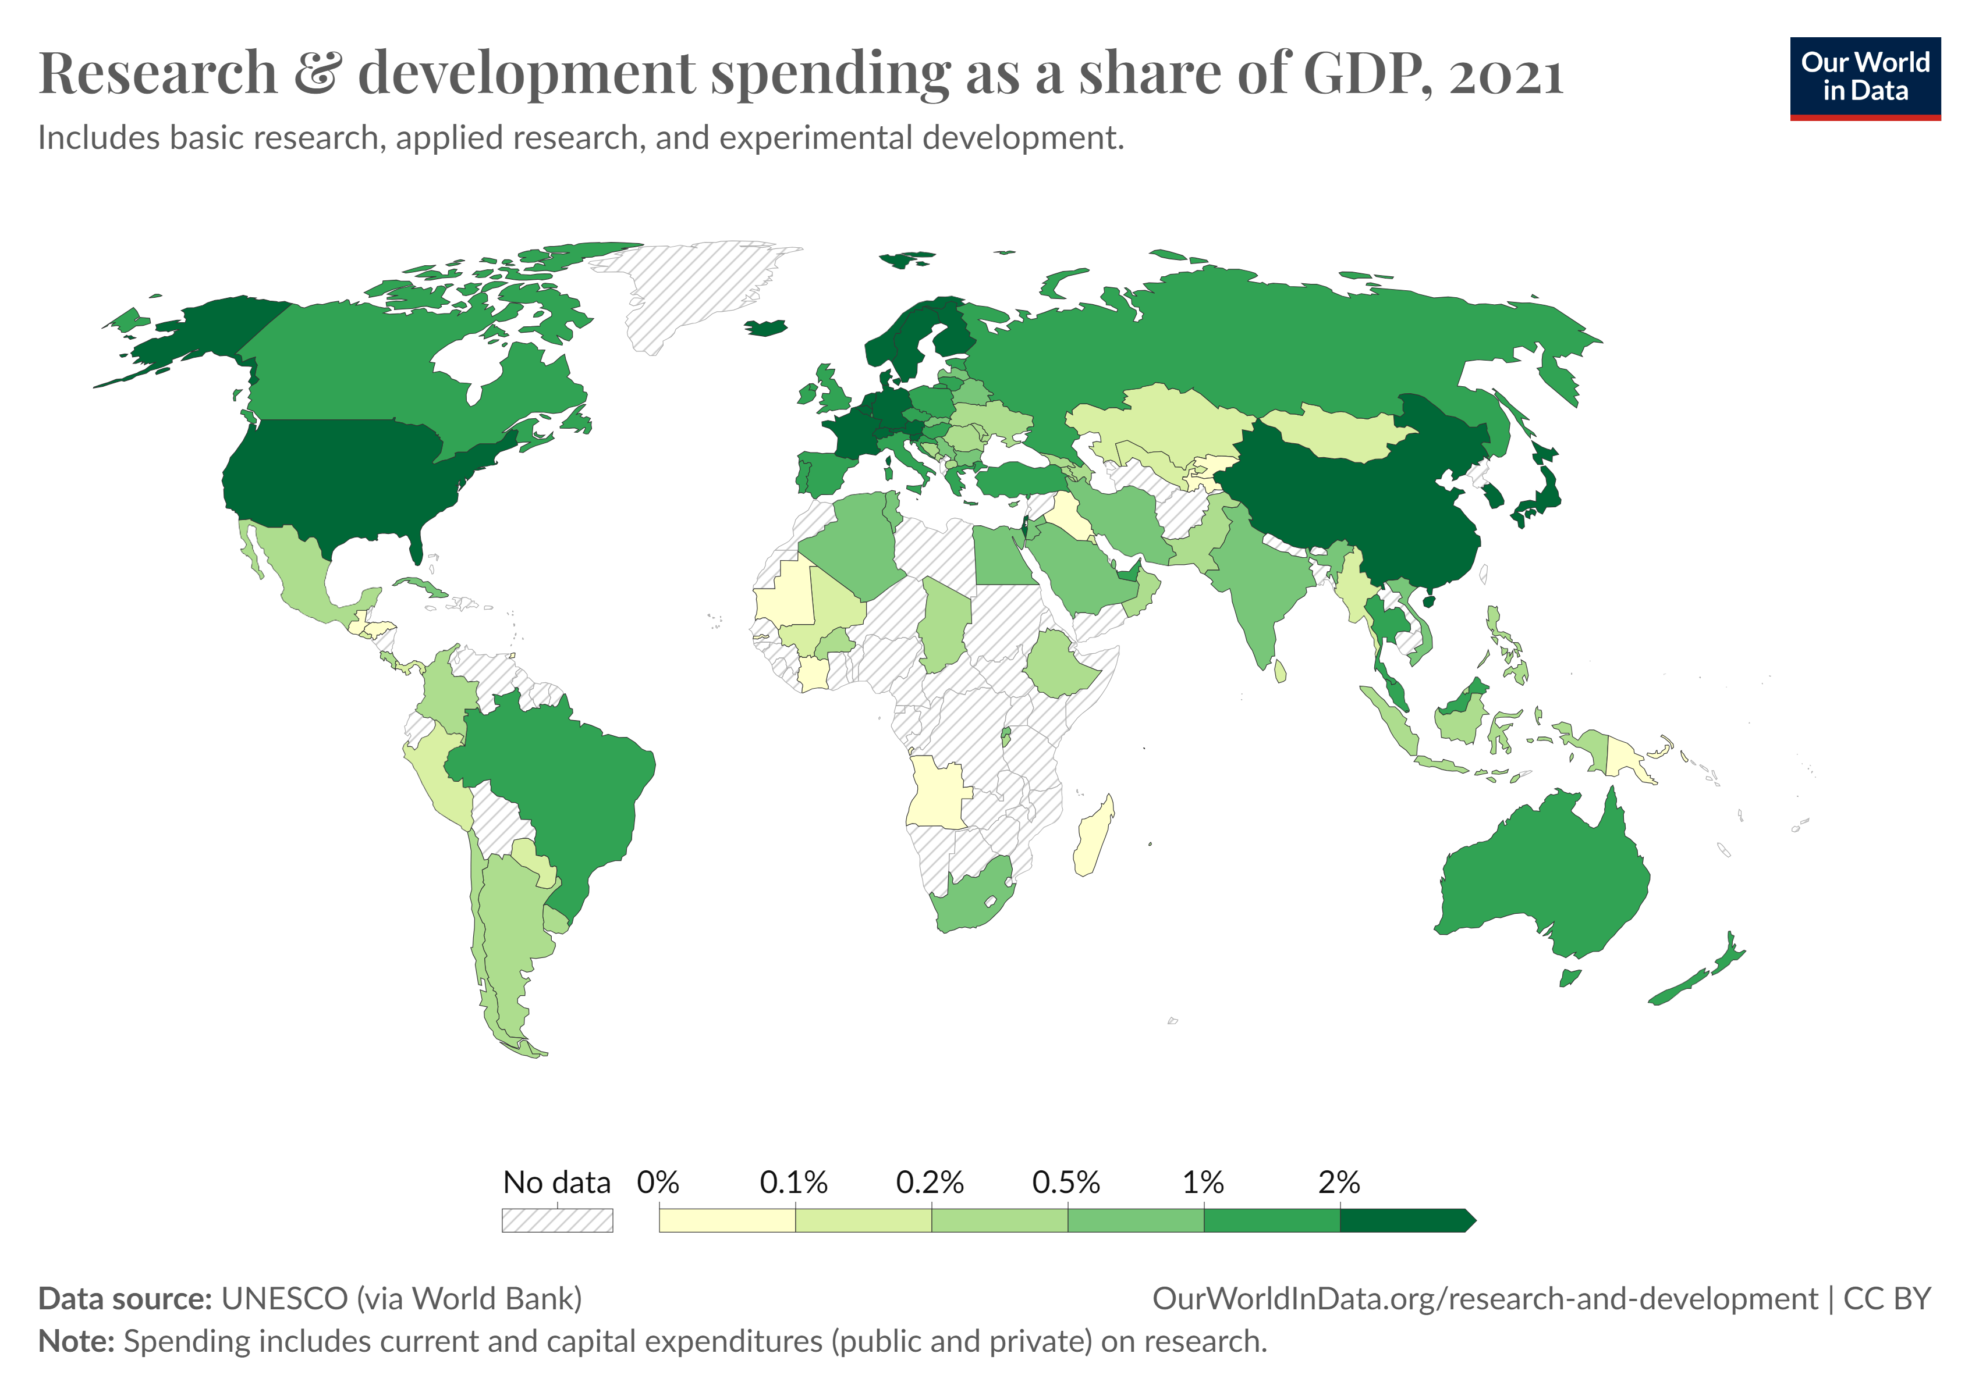

Slide 21
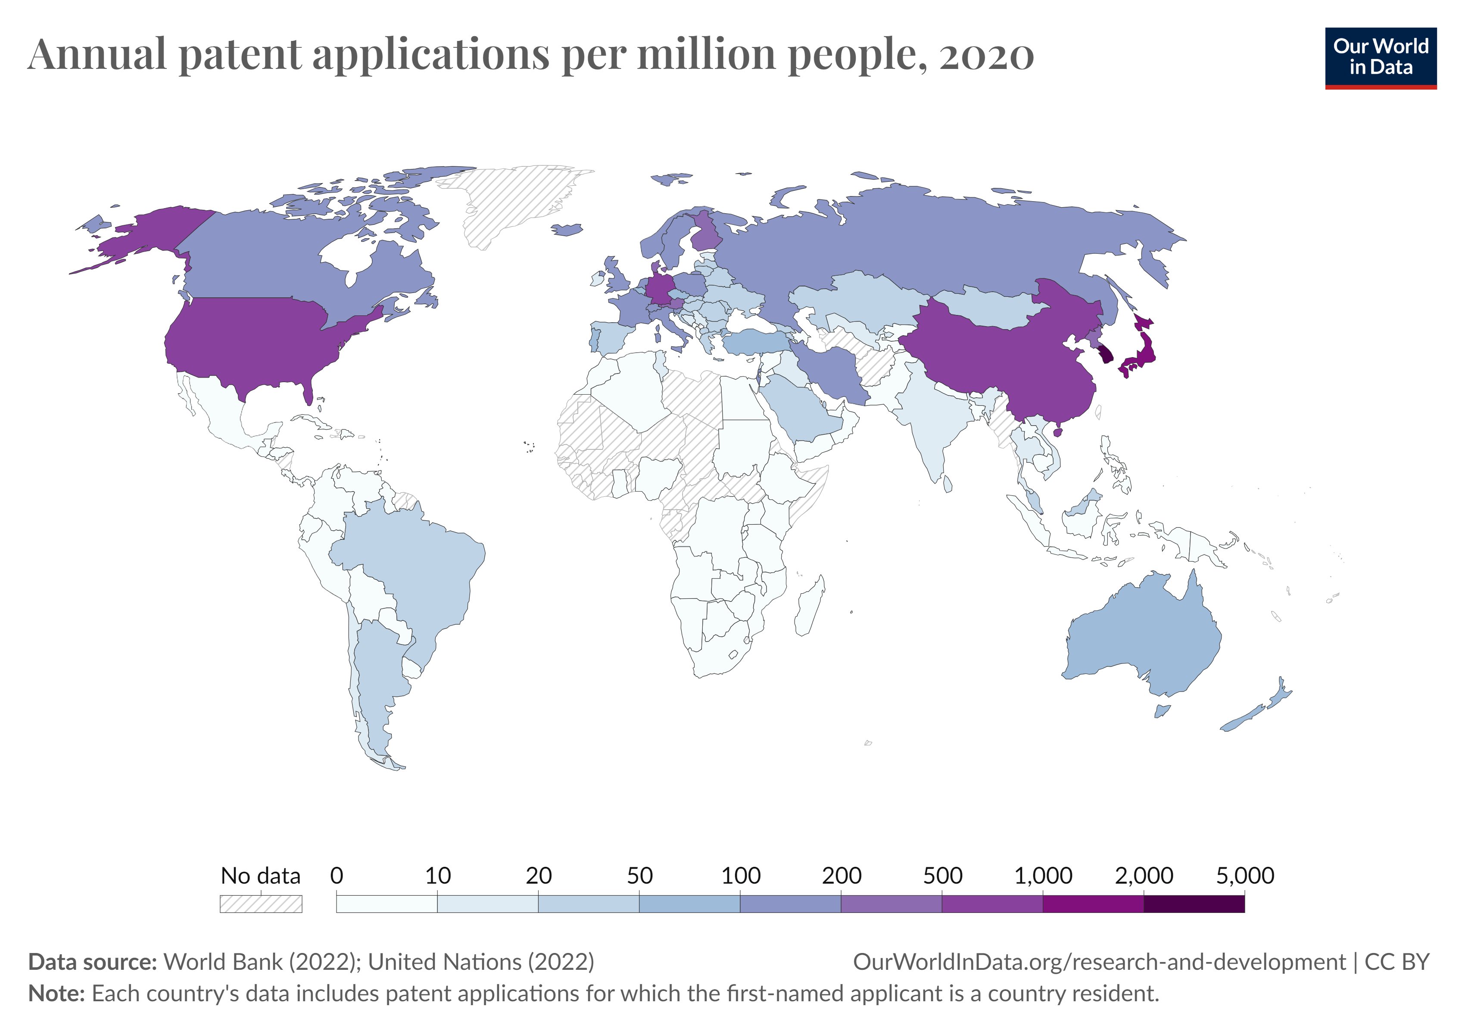

Slide 22
Determinants of Technological Progress
Technological progress depends on the fertility of research.
  Spending money on R&D does not necessarily guarantee fruitful (or marketable) returns.
  The fertility of research depends on factors that does not belong in the realm of economics.
Technological progress also depends on its appropriability.
  If the inventor of new technology is not allowed to reap the rewards in the form of profit, there will be less (or none of) R&D.
  Intellectual property rights are backed by the government in the form of patents and copyrights.
  However, excessive protection will limit R&D by not allowing others to build on others’ work.

Slide 23
Determinants of Technological Progress
It is also important to distinguish between innovation and imitation when it comes to technological progress.
Economies that are less mature can reap tremendous gains through imitation of pre-existing technologies.
Meanwhile, economies that are already well developed can only sustain a higher growth rate by innovation, which extends the technology frontier.
So, less developed countries should have an advantage in catching up to the more developed countries.

Slide 24
Determinants of Technological Progress
Then why did some countries manage to catch up, while others are still struggling to grow?
Institutions can be one of the major factors in determining the economic trajectory of countries.
Very “similar” countries have seen dramatically different rates of growth over time, and some claim that it is each countries’ institutions that contribute to this divergence.
Case study in the two Koreas.

Slide 25
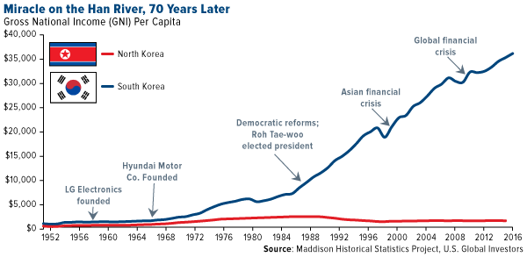
Determinants of Technological Progress

Slide 26
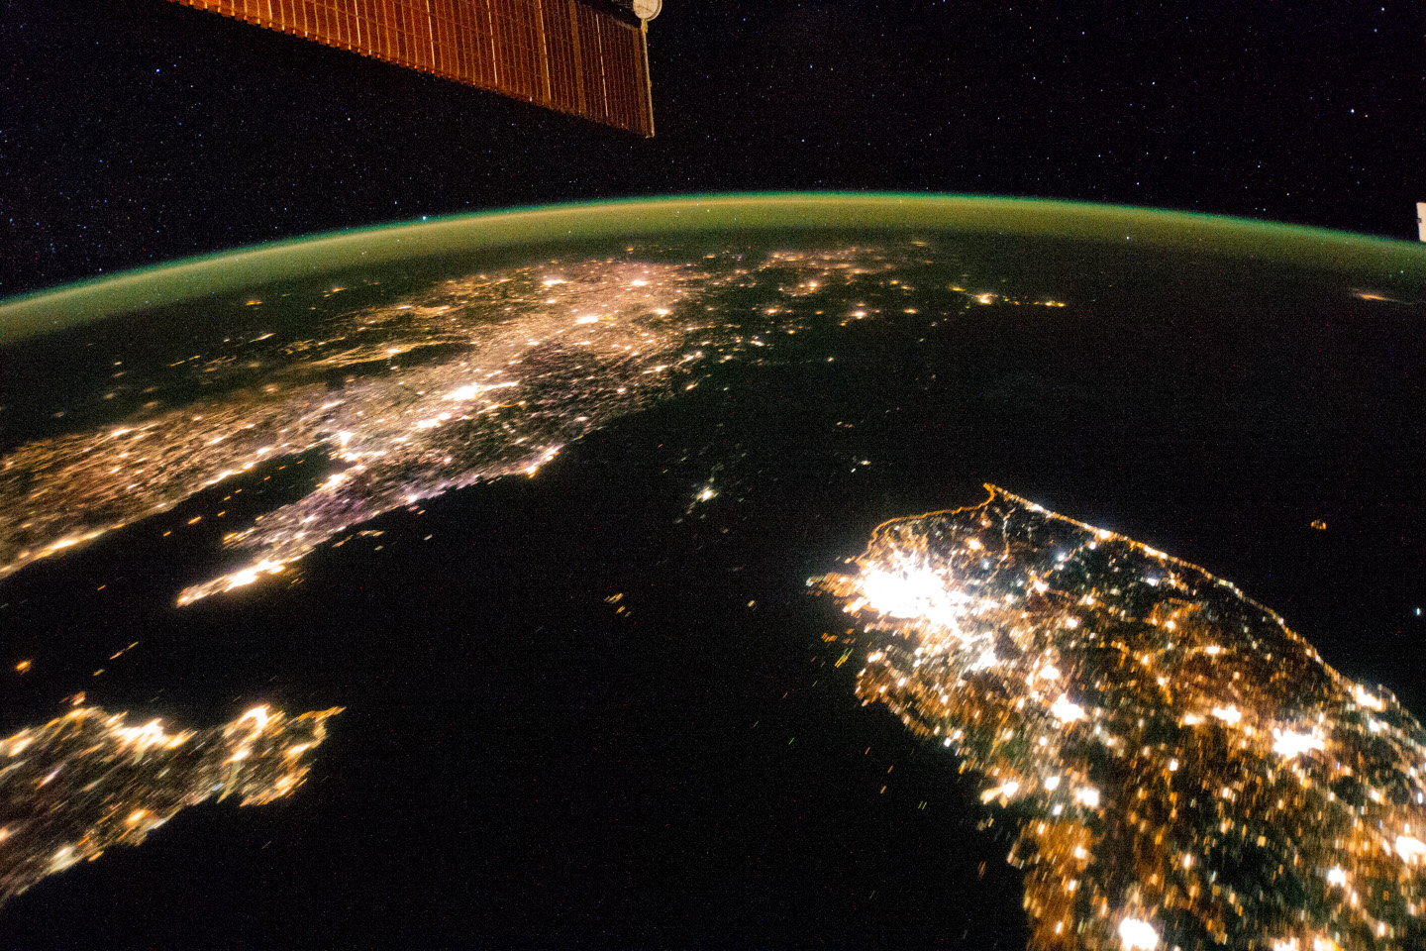
Determinants of Technological Progress

Slide 27
Measuring Technological Progress
Technological progress is in practice not easily quantifiable.
The number of new patents, or the number of academic publications can be a proxy measure.
One measure economists use to calculate technological progress is called the “Solow Residual,” or “Total Factor Productivity (TFP).”
Sparing the details, the Solow Residual is the “the amount of output growth that cannot be accounted for by known factors of production.”

Slide 28
Measuring Technological Progress
For instance, suppose that an economy experienced a 7% growth of output over some period.
Economists then measured the growth of labor and capital to be 4.5% over the same period.
The Solow Residual, which is the rate of TFP growth, which is also the rate of technological progress, would be 3.5%.

