Slide 1
The Long Run:
Capital Accumulation and Growth
ECON 301

Slide 2
Output and Capital in the Long Run
In the long run, output and capital interacts as follows:
  The capital stock in the economy determines the amount of output that can be produced in the economy.
  The amount of output produced in the economy in turn determines the amount of investment.
  The amount of investment in the economy determines the amount of capital accumulation.
  …and this closes the circular structure.
We will be looking into the details of each step in this circular process of growth.

Slide 3
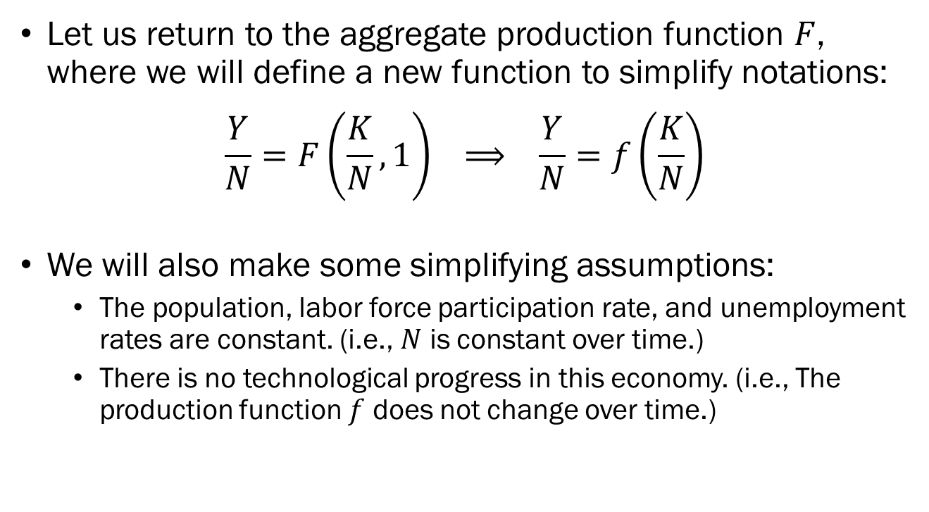
The Effect of Capital on Output
Let us return to the aggregate production function $F$, where we will define a new function to simplify notations:
$$\frac{Y}{N}=F\left(\frac{K}{N},1\right) ⟹ \frac{Y}{N}=f\left(\frac{K}{N}\right)$$
We will also make some simplifying assumptions:
  The population, labor force participation rate, and unemployment rates are constant. (i.e., $N$ is constant over time.)
  There is no technological progress in this economy. (i.e., The production function $f$ does not change over time.)

Slide 4
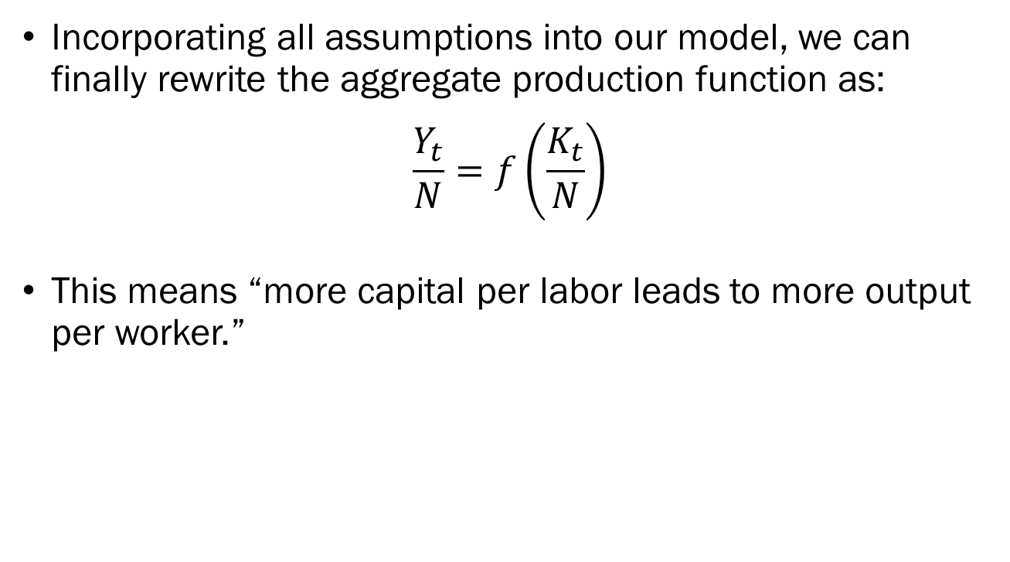
The Effect of Capital on Output
Incorporating all assumptions into our model, we can finally rewrite the aggregate production function as:
$$\frac{Y_{t}}{N}=f\left(\frac{K_{t}}{N}\right)$$
This means “more capital per labor leads to more output per worker.”

Slide 5
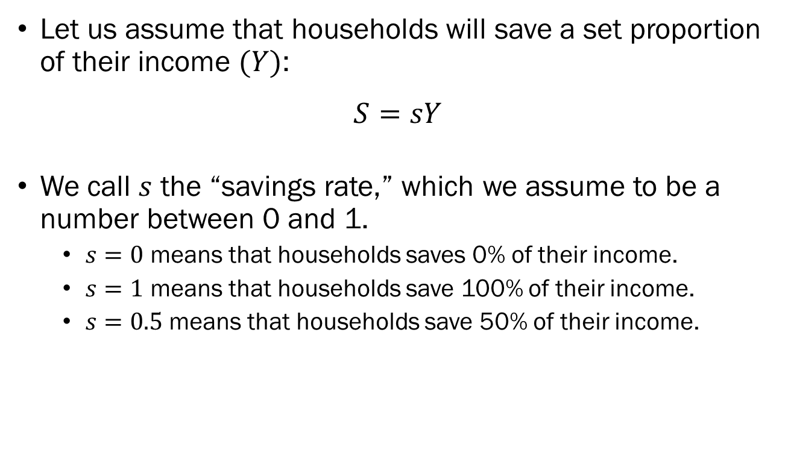
The Effect of Output on Investment
Let us assume that households will save a set proportion of their income $(Y)$:
$$S=sY$$
We call $s$ the “savings rate,” which we assume to be a number between 0 and 1.
  $s=0$ means that households saves 0% of their income.
  $s=1$ means that households save 100% of their income.
  $s=0.5$ means that households save 50% of their income.

Slide 6
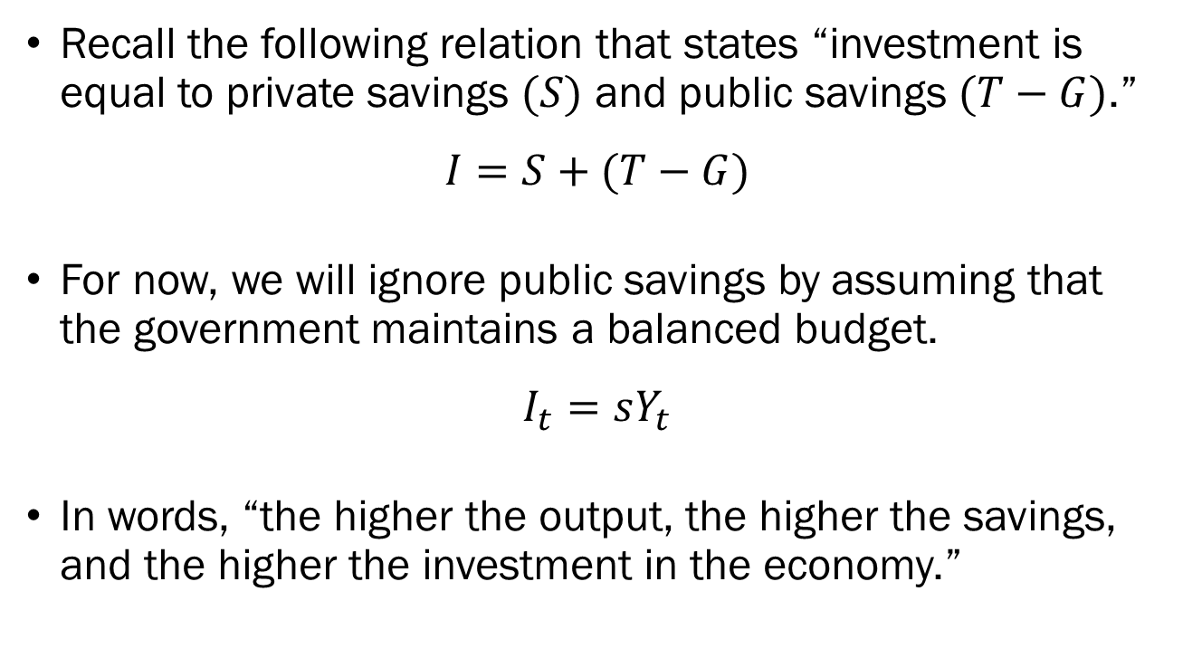
The Effect of Output on Investment
Recall the following relation that states “investment is equal to private savings $(S)$ and public savings $(T−G)$.”
$$I=S+(T−G)$$
For now, we will ignore public savings by assuming that the government maintains a balanced budget.
$$I_{t}=sY_{t}$$
In words, “the higher the output, the higher the savings, and the higher the investment in the economy.”

Slide 7
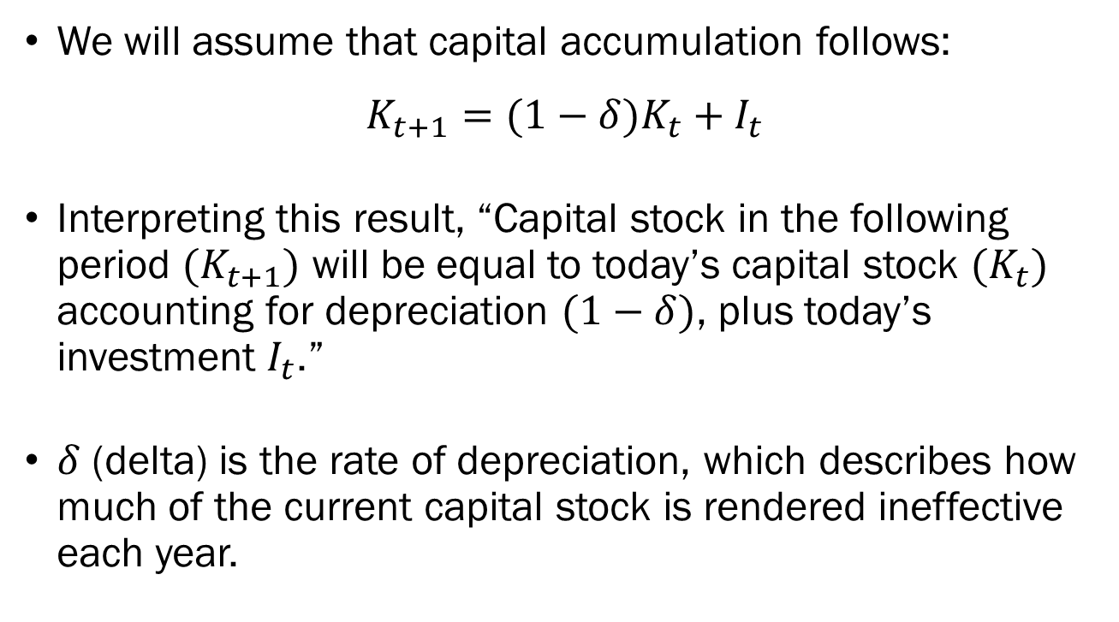
The Effect of Investment on Capital
We will assume that capital accumulation follows:
$$K_{t+1}=(1−δ)K_{t}+I_{t}$$
Interpreting this result, “Capital stock in the following period $(K_{t+1})$ will be equal to today’s capital stock $(K_{t})$ accounting for depreciation $(1−δ)$, plus today’s investment $I_{t}$.”
$δ$ (delta) is the rate of depreciation, which describes how much of the current capital stock is rendered ineffective each year.

Slide 8
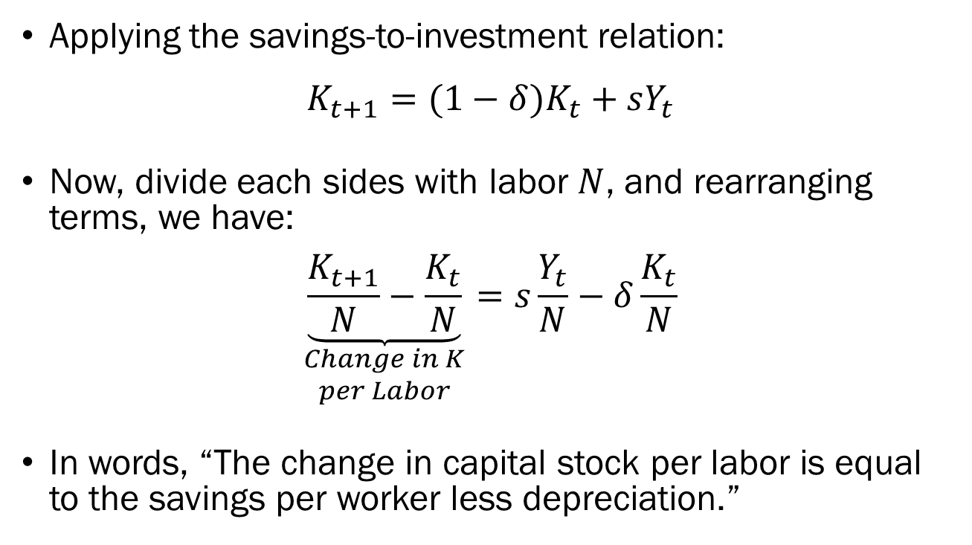
The Effect of Investment on Capital
Applying the savings-to-investment relation:
$$K_{t+1}=(1−δ)K_{t}+sY_{t}$$
Now, divide each sides with labor $N$, and rearranging terms, we have:
$$\underset{\begin{aligned}Change in K \\ per Labor\end{aligned}}{\underbrace{\frac{K_{t+1}}{N}−\frac{K_{t}}{N}}}=s\frac{Y_{t}}{N}−δ\frac{K_{t}}{N}$$
In words, “The change in capital stock per labor is equal to the savings per worker less depreciation.”

Slide 9
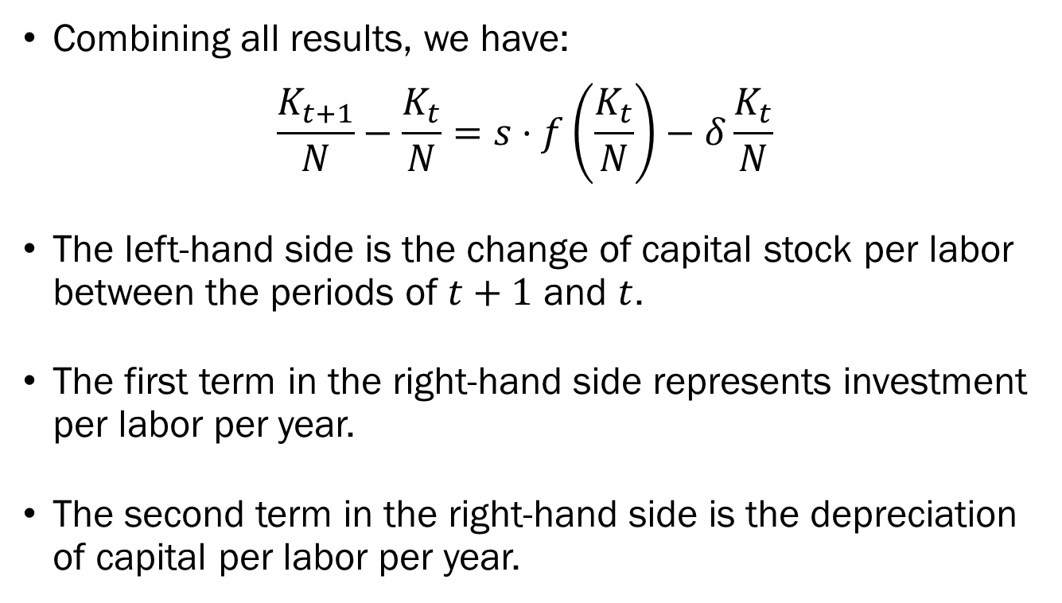
Output, Investment, and Capital
Combining all results, we have:
$$\frac{K_{t+1}}{N}−\frac{K_{t}}{N}=s⋅f\left(\frac{K_{t}}{N}\right)−δ\frac{K_{t}}{N}$$
The left-hand side is the change of capital stock per labor between the periods of $t+1$ and $t$.
The first term in the right-hand side represents investment per labor per year.
The second term in the right-hand side is the depreciation of capital per labor per year.

Slide 10
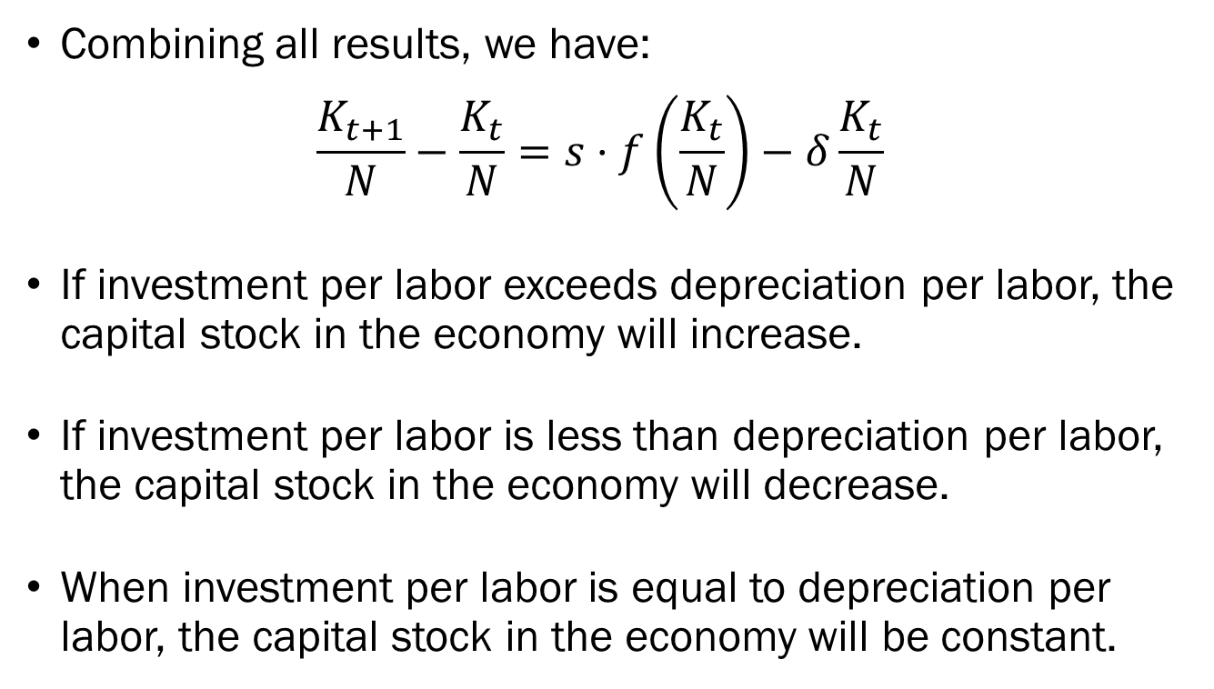
Output, Investment, and Capital
Combining all results, we have:
$$\frac{K_{t+1}}{N}−\frac{K_{t}}{N}=s⋅f\left(\frac{K_{t}}{N}\right)−δ\frac{K_{t}}{N}$$
If investment per labor exceeds depreciation per labor, the capital stock in the economy will increase.
If investment per labor is less than depreciation per labor, the capital stock in the economy will decrease.
When investment per labor is equal to depreciation per labor, the capital stock in the economy will be constant.

Slide 11


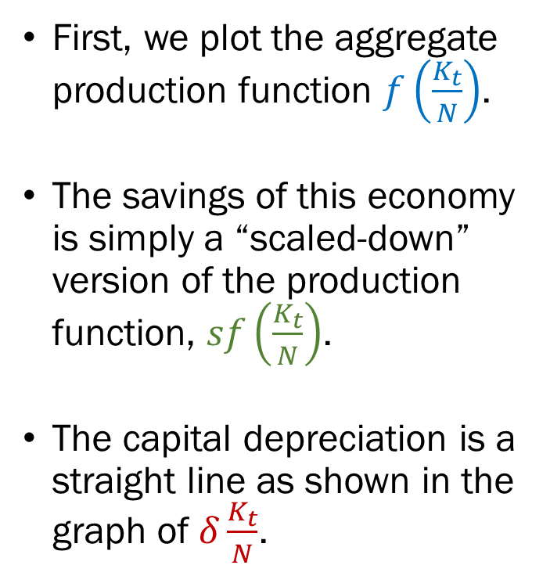



Output, Investment, and Capital
$$δ\frac{K_{t}}{N}$$
First, we plot the aggregate production function $f\left(\frac{K_{t}}{N}\right)$.
The savings of this economy is simply a “scaled-down” version of the production function, $sf\left(\frac{K_{t}}{N}\right)$.
The capital depreciation is a straight line as shown in the graph of $δ\frac{K_{t}}{N}$.
$$Y/N$$
$$f\left(\frac{K_{t}}{N}\right)$$
$$sf\left(\frac{K_{t}}{N}\right)$$
$$K/N$$

Slide 12


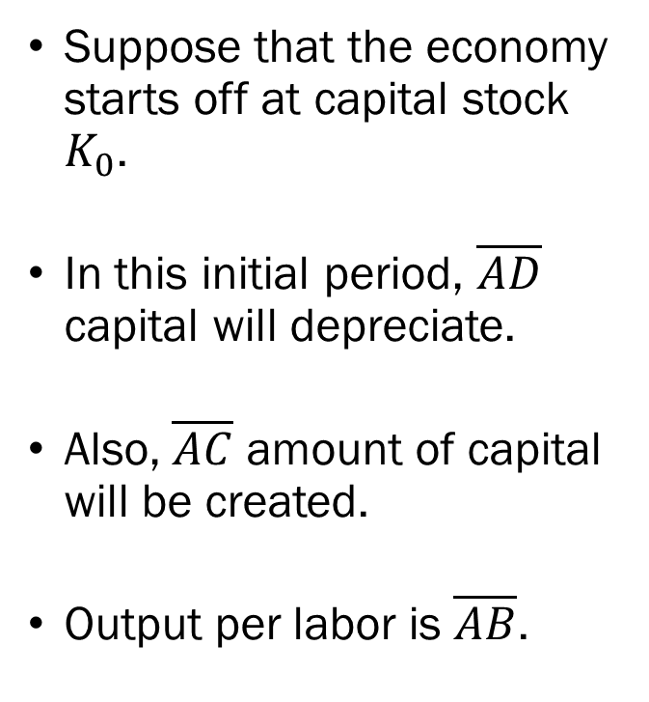



Output, Investment, and Capital
$$δ\frac{K_{t}}{N}$$
Suppose that the economy starts off at capital stock $K_{0}$.
In this initial period, $\overline{AD}$ capital will depreciate.
Also, $\overline{AC}$ amount of capital will be created.
Output per labor is $\overline{AB}$.
$$Y/N$$
$$f\left(\frac{K_{t}}{N}\right)$$
$$B$$
$$sf\left(\frac{K_{t}}{N}\right)$$
$$C$$
$$D$$
$$A$$
$$\frac{K_{0}}{N}$$
$$K/N$$

Slide 13

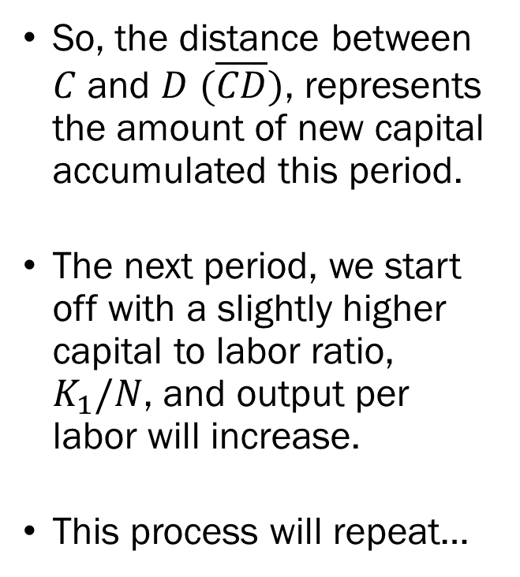
Output, Investment, and Capital
$$δ\frac{K_{t}}{N}$$
So, the distance between $C$ and $D$ $(\overline{CD})$, represents the amount of new capital accumulated this period.
The next period, we start off with a slightly higher capital to labor ratio, $K_{1}/N$, and output per labor will increase.
This process will repeat…
$$Y/N$$
$$f\left(\frac{K_{t}}{N}\right)$$
$$B$$
$$sf\left(\frac{K_{t}}{N}\right)$$
$$C$$
$$D$$
$$A$$
$$\frac{K_{0}}{N}$$
$$\frac{K_{1}}{N}$$
$$K/N$$

Slide 14

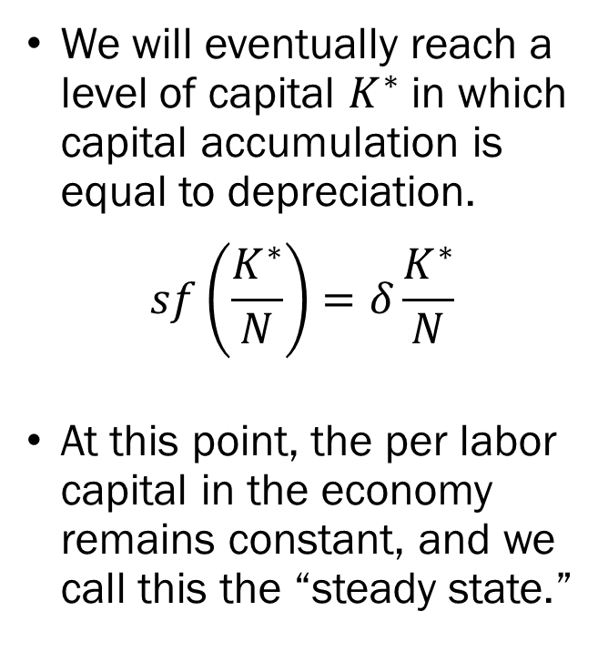
Output, Investment, and Capital
$$δ\frac{K_{t}}{N}$$
We will eventually reach a level of capital $K^{∗}$ in which capital accumulation is equal to depreciation.
$$sf\left(\frac{K^{∗}}{N}\right)=δ\frac{K^{∗}}{N}$$
At this point, the per labor capital in the economy remains constant, and we call this the “steady state.”
$$Y/N$$
$$f\left(\frac{K_{t}}{N}\right)$$
$$sf\left(\frac{K_{t}}{N}\right)$$
$$\frac{K^{∗}}{N}$$
$$K/N$$

Slide 15
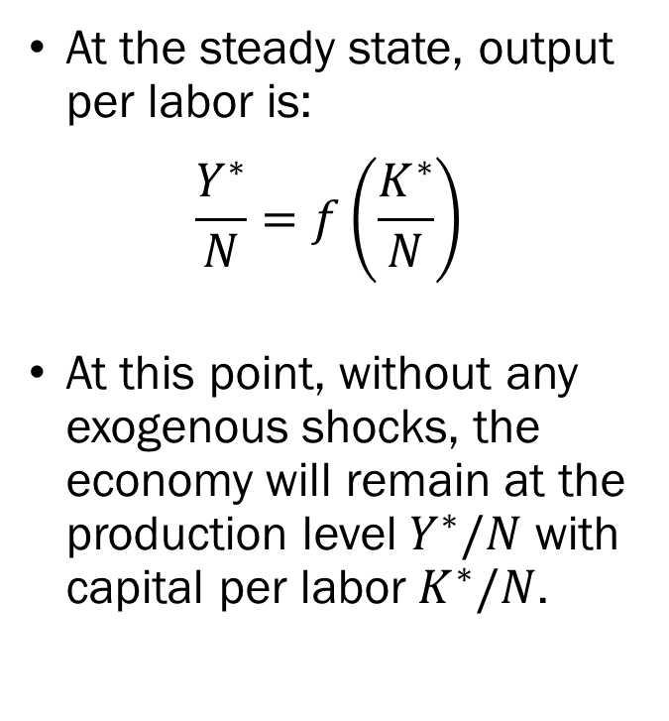
Output, Investment, and Capital
$$δ\frac{K_{t}}{N}$$
At the steady state, output per labor is:
$$\frac{Y^{∗}}{N}=f\left(\frac{K^{∗}}{N}\right)$$
At this point, without any exogenous shocks, the economy will remain at the production level $Y^{∗}/N$ with capital per labor $K^{∗}/N$.
$$Y/N$$
$$f\left(\frac{K_{t}}{N}\right)$$
$$sf\left(\frac{K_{t}}{N}\right)$$
$$\frac{K^{∗}}{N}$$
$$K/N$$

Slide 16
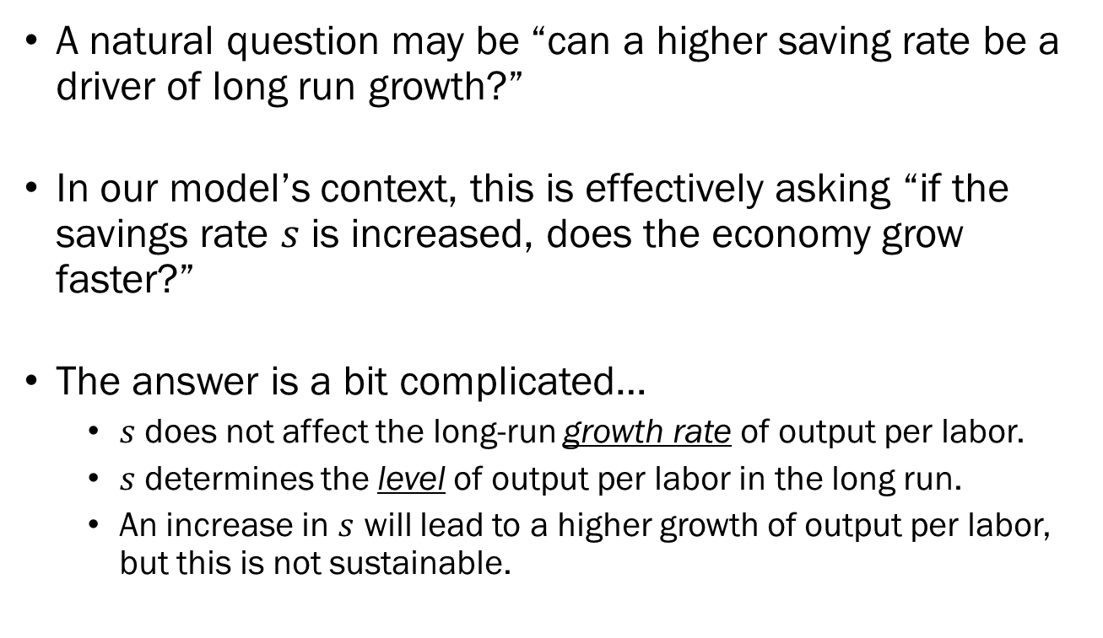
The Effect of Saving Rates on Output
A natural question may be “can a higher saving rate be a driver of long run growth?”
In our model’s context, this is effectively asking “if the savings rate $s$ is increased, does the economy grow faster?”
The answer is a bit complicated…
  $s$ does not affect the long-run growth rate of output per labor.
  $s$ determines the level of output per labor in the long run.
  An increase in $s$ will lead to a higher growth of output per labor, but this is not sustainable.

Slide 17
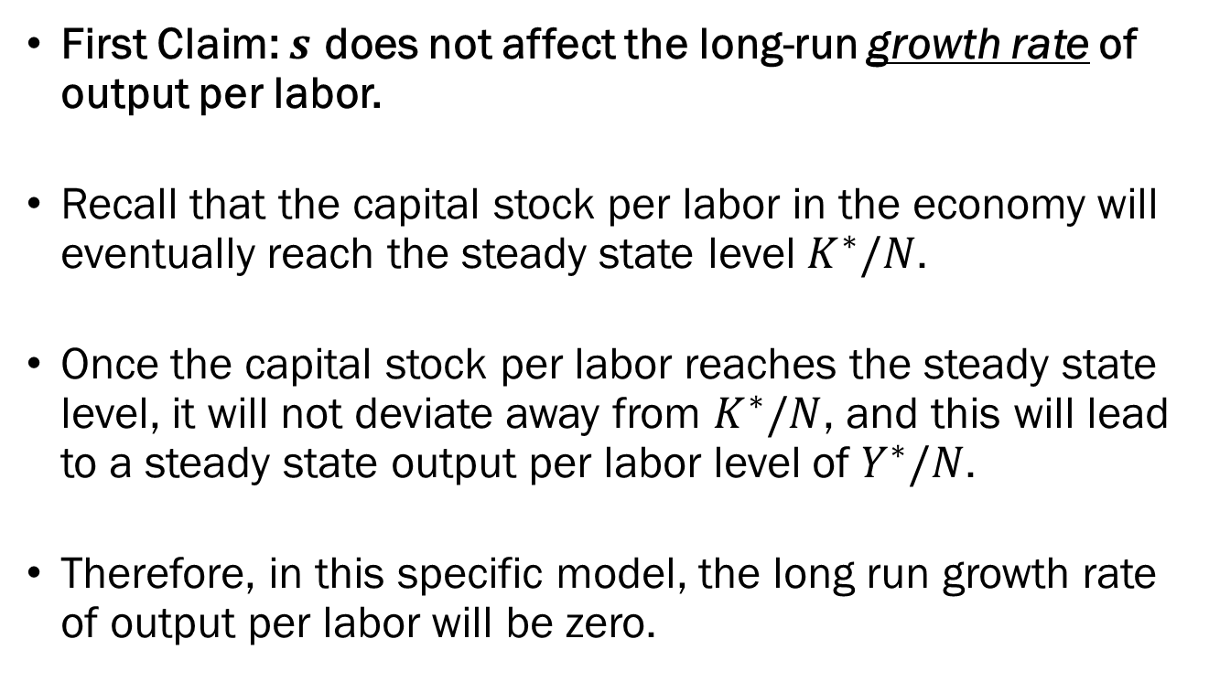
The Effect of Saving Rates on Output
First Claim: $s$ does not affect the long-run growth rate of output per labor.
Recall that the capital stock per labor in the economy will eventually reach the steady state level $K^{∗}/N$.
Once the capital stock per labor reaches the steady state level, it will not deviate away from $K^{∗}/N$, and this will lead to a steady state output per labor level of $Y^{∗}/N$.
Therefore, in this specific model, the long run growth rate of output per labor will be zero.

Slide 18
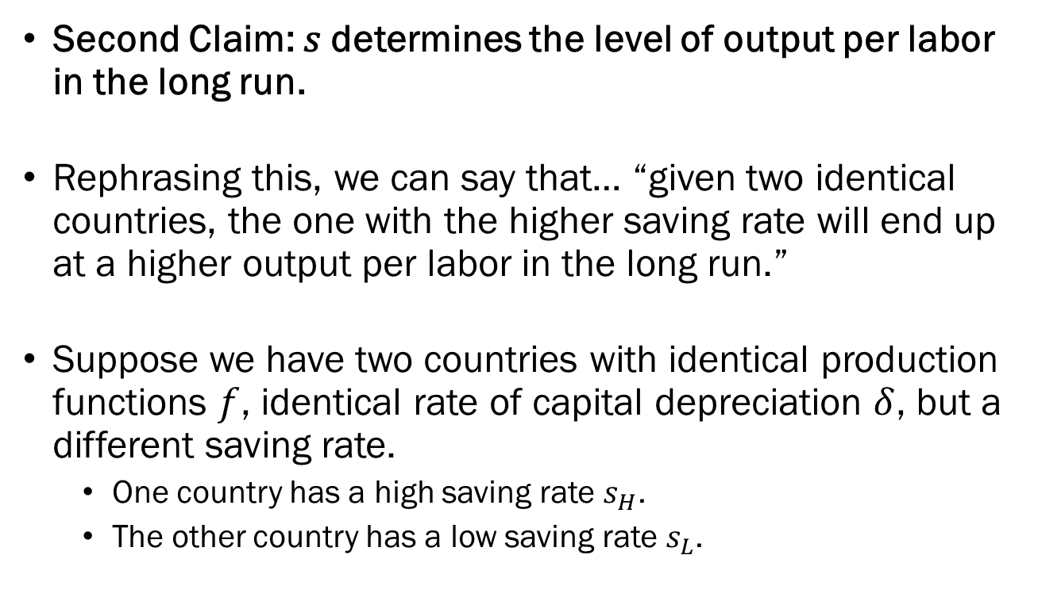
The Effect of Saving Rates on Output
Second Claim: 𝑠 determines the level of output per labor in the long run.
Rephrasing this, we can say that… “given two identical countries, the one with the higher saving rate will end up at a higher output per labor in the long run.”
Suppose we have two countries with identical production functions $f$, identical rate of capital depreciation $δ$, but a different saving rate.
  One country has a high saving rate $s_{H}$.
  The other country has a low saving rate $s_{L}$.

Slide 19









Output, Investment, and Capital
$$δ\frac{K_{t}}{N}$$
$$δ\frac{K_{t}}{N}$$
$$Y/N$$
$$Y/N$$
$$f\left(\frac{K_{t}}{N}\right)$$
$$f\left(\frac{K_{t}}{N}\right)$$
$$s_{H}f\left(\frac{K_{t}}{N}\right)$$
$$s_{L}f\left(\frac{K_{t}}{N}\right)$$
$$K_{H}^{∗}/N$$
$$K/N$$
$$K_{L}^{∗}/N$$
$$K/N$$

Slide 20
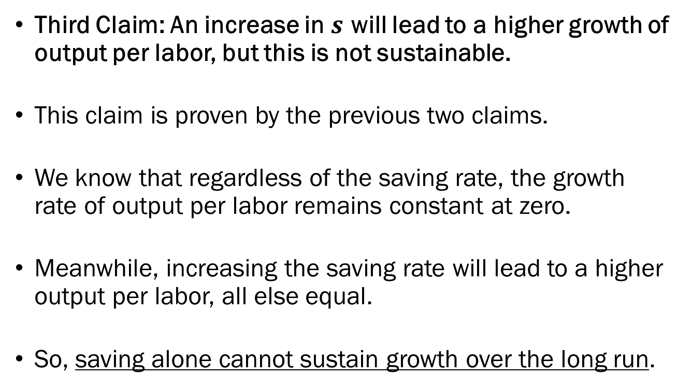
The Effect of Saving Rates on Output
Third Claim: An increase in $s$ will lead to a higher growth of output per labor, but this is not sustainable.
This claim is proven by the previous two claims.
We know that regardless of the saving rate, the growth rate of output per labor remains constant at zero.
Meanwhile, increasing the saving rate will lead to a higher output per labor, all else equal.
So, saving alone cannot sustain growth over the long run.

Slide 21


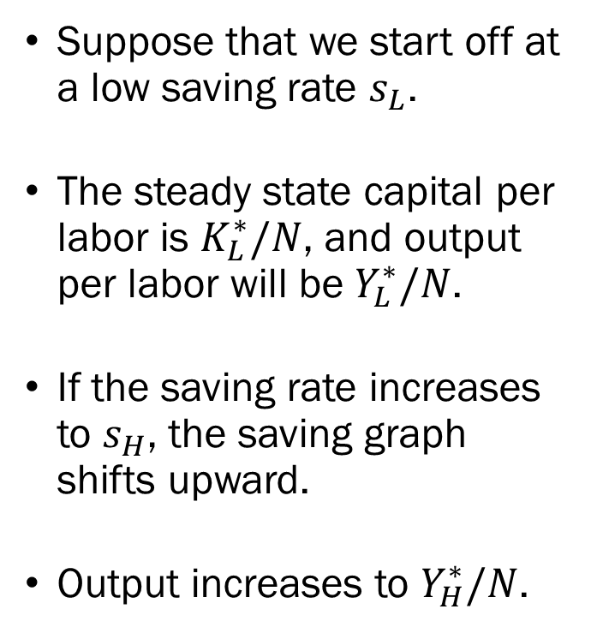



The Effect of Saving Rates on Output
$$δ\frac{K_{t}}{N}$$
Suppose that we start off at a low saving rate $s_{L}$.
The steady state capital per labor is $K_{L}^{∗}/N$, and output per labor will be $Y_{L}^{∗}/N$.
If the saving rate increases to $s_{H}$, the saving graph shifts upward.
Output increases to $Y_{H}^{∗}/N$.
$$Y/N$$
$$f\left(\frac{K_{t}}{N}\right)$$
$$Y_{H}^{∗}/N$$
$$Y_{L}^{∗}/N$$
$$s_{H}f\left(\frac{K_{t}}{N}\right)$$
$$s_{L}f\left(\frac{K_{t}}{N}\right)$$
$$K_{L}^{∗}/N$$
$$K_{H}^{∗}/N$$
$$K/N$$

Slide 22


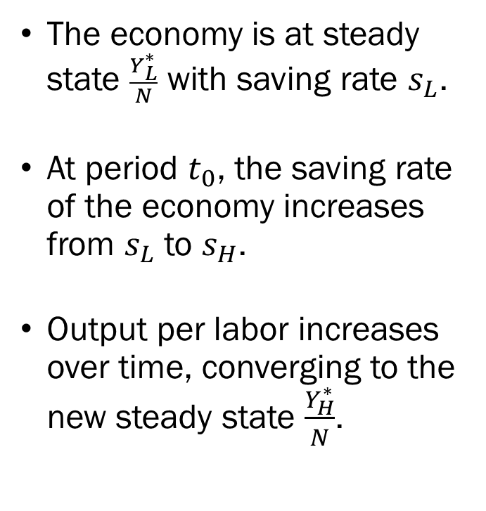


The Effect of Saving Rates on Output
The economy is at steady state $\frac{Y_{L}^{∗}}{N}$ with saving rate $s_{L}$.
At period $t_{0}$, the saving rate of the economy increases from $s_{L}$ to $s_{H}$.
Output per labor increases over time, converging to the new steady state $\frac{Y_{H}^{∗}}{N}$.
$$Y/N$$
$$\frac{Y_{H}^{∗}}{N}$$
$$\frac{Y_{L}^{∗}}{N}$$
$$t_{0}$$
$$Time$$

Slide 23
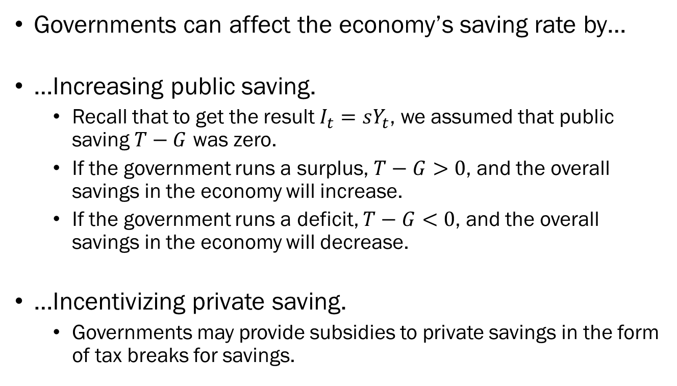
The Government and Saving Rates
Governments can affect the economy’s saving rate by…
…Increasing public saving.
  Recall that to get the result $I_{t}=sY_{t}$, we assumed that public saving $T−G$ was zero.
  If the government runs a surplus, $T−G>0$, and the overall savings in the economy will increase.
  If the government runs a deficit, $T−G<0$, and the overall savings in the economy will decrease.
…Incentivizing private saving.
  Governments may provide subsidies to private savings in the form of tax breaks for savings.

Slide 24
The “Best” Saving Rate?
So… what is the “best” saving rate for the economy?
Let’s assume that the government cares about the welfare of their citizens.
The welfare of the citizens depends on the output to a certain degree, but primarily depends on their level of consumption.
We established that increasing saving rates will…
  …increase output per worker, but…
  …come at the cost of decreasing consumption.

Slide 25

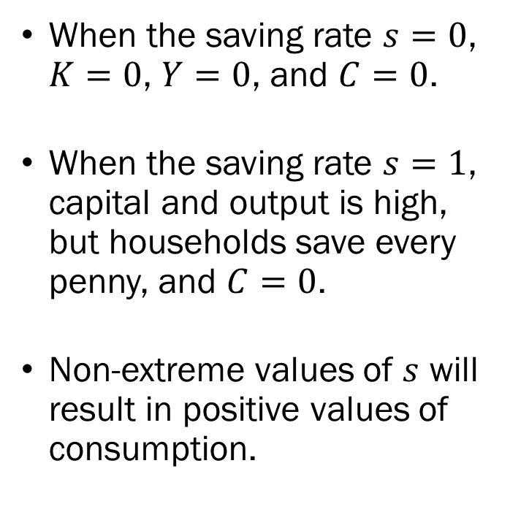



The “Best” Saving Rate?
When the saving rate $s=0$, $K=0$, $Y=0$, and $C=0$.
When the saving rate $s=1$, capital and output is high, but households save every penny, and $C=0$.
Non-extreme values of $s$ will result in positive values of consumption.
$$C/N$$
$$0$$
$$1$$
$$s$$

Slide 26


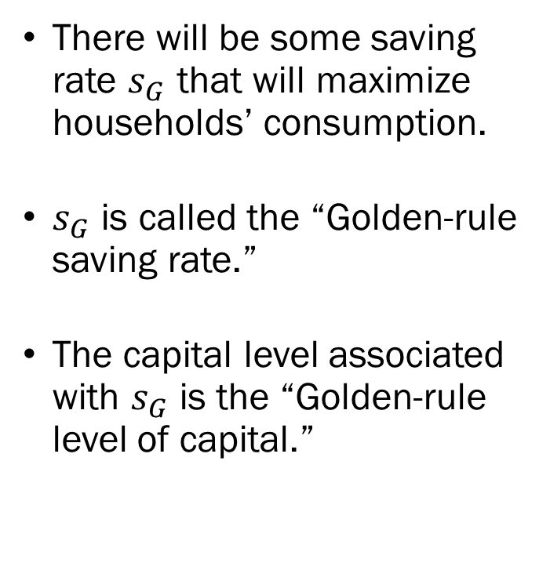
The “Best” Saving Rate?
There will be some saving rate $s_{G}$ that will maximize households’ consumption.
$s_{G}$ is called the “Golden-rule saving rate.”
The capital level associated with $s_{G}$ is the “Golden-rule level of capital.”
$$C/N$$
$$\frac{C^{MAX}}{N}$$
$$0$$
$$s_{G}$$
$$1$$
$$s$$

Slide 27
The “Best” Saving Rate?
Real-world data suggests that most developed countries are saving well below the golden-rule rate.
This means that if these countries’ governments were to nudge their citizens to a higher saving rate, consumption will eventually increase.
The complication arises when we consider the timing of each event.
  Increased saving rates mean that current generations’ consumption will decrease, but
  Future generations’ consumption will increase.

Slide 28
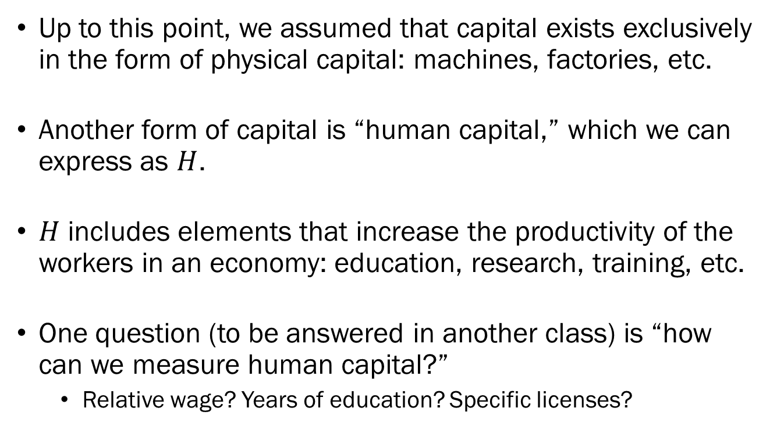
Physical Capital and Human Capital
Up to this point, we assumed that capital exists exclusively in the form of physical capital: machines, factories, etc.
Another form of capital is “human capital,” which we can express as $H$.
$H$ includes elements that increase the productivity of the workers in an economy: education, research, training, etc.
One question (to be answered in another class) is “how can we measure human capital?”
  Relative wage? Years of education? Specific licenses?

Slide 29
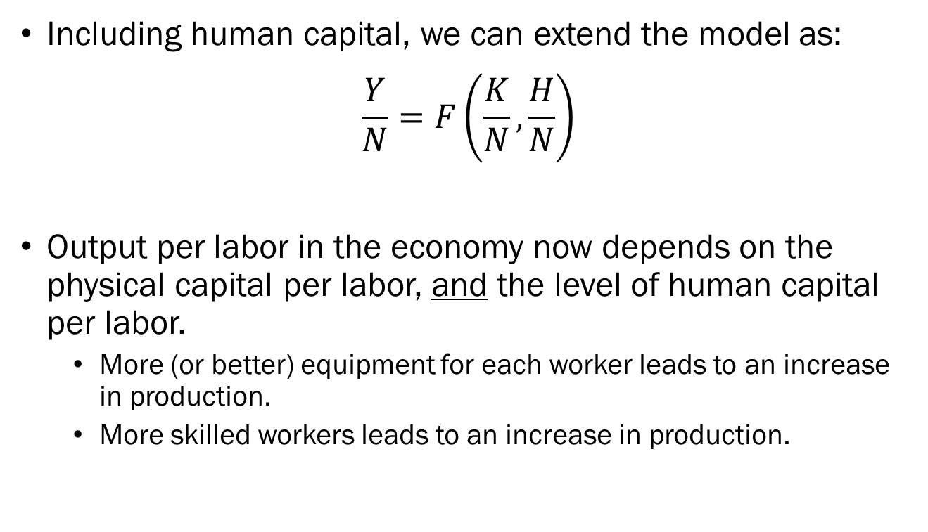
Physical Capital and Human Capital
Including human capital, we can extend the model as:
$$\frac{Y}{N}=F\left(\frac{K}{N},\frac{H}{N}\right)$$
Output per labor in the economy now depends on the physical capital per labor, and the level of human capital per labor.
  More (or better) equipment for each worker leads to an increase in production.
  More skilled workers leads to an increase in production.

Slide 30
Physical Capital and Human Capital
Our conclusions regarding the process of physical capital translates directly to the accumulation of human capital.
The economy will “save” in terms of human capital by investing in education and training programs.
This will increase the stock of human capital per labor, which leads to the increase of output per labor.
The issue is now “balancing” between investing in physical capital vs. human capital.
  Finding the optimal mix is beyond the scope of this course.

