Slide 1
The Medium Run: The Phillips Curve
ECON 301

Slide 2
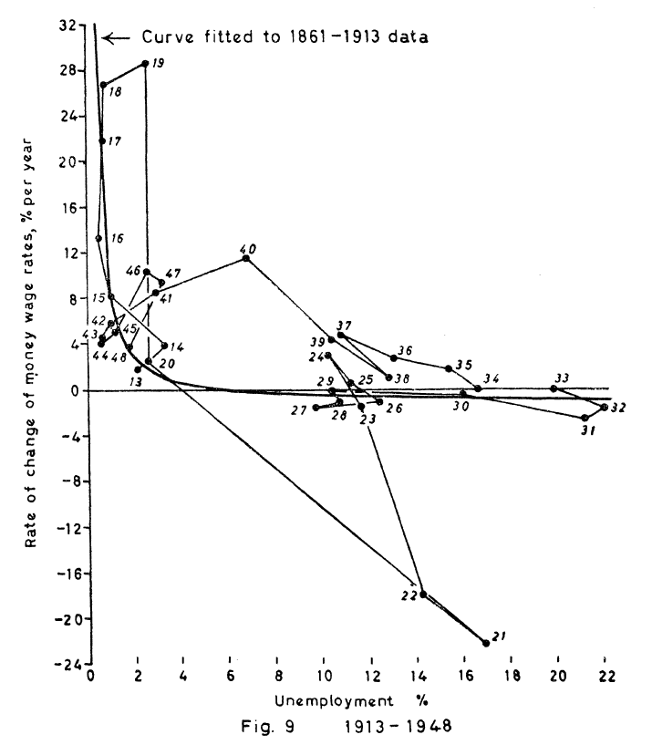
A. W. “Bill” Phillips
First proposed by A. W. Phillips, an Economist from New Zealand.
Studied the relationship between unemployment and inflation in the UK from 1861 to 1957.
A negative correlation between unemployment and inflation.

Slide 3
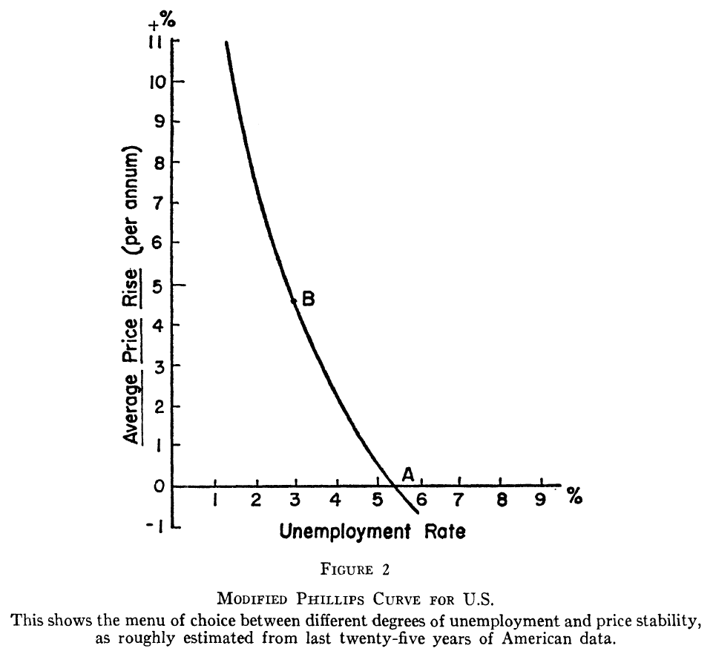
Paul Samuelson & Robert Solow
Paul Samuelson & Robert Solow found the same relation in the US using data from 1900 ~ 1960.
In this 1960 paper, this was named “the Phillips curve.”
This relation was slightly modified by future scholars to fit real world data.

Slide 4
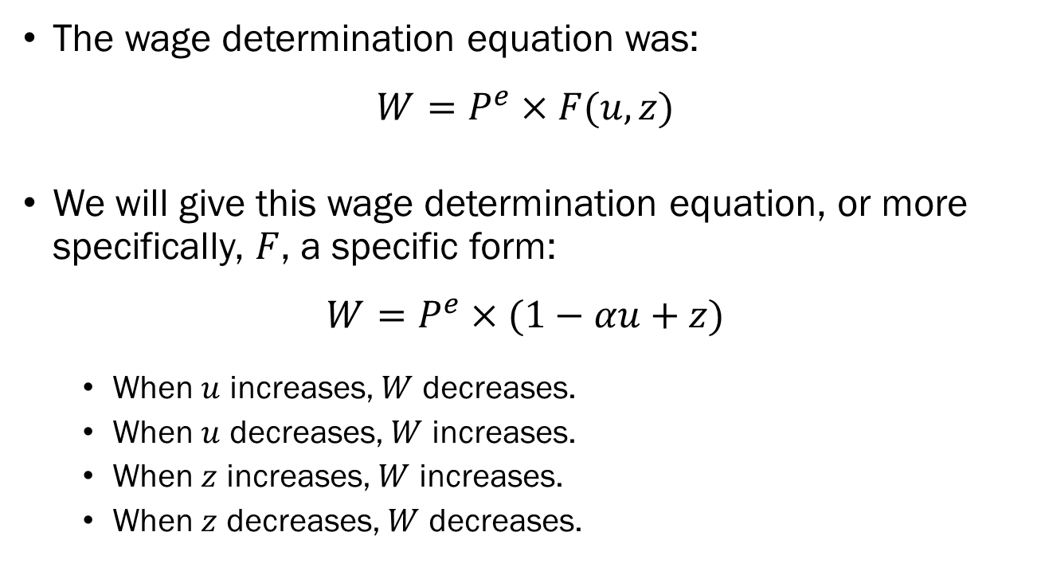
Deriving the Phillips Curve
The wage determination equation was:
$$W=P^{e}×F(u,z)$$
We will give this wage determination equation, or more specifically, $F$, a specific form:
$$W=P^{e}×(1−αu+z)$$
When $u$ increases, $W$ decreases.
When $u$ decreases, $W$ increases.
When $z$ increases, $W$ increases.
When $z$ decreases, $W$ decreases.

Slide 5
Deriving the Phillips Curve
The price determination equation was:
$$P=\left(1+m\right)×W$$
Combining wage determination and price determination:
$$P=\left(1+m\right)×\underset{Wage Determination}{\underbrace{\{P^{e}×\left(1−αu+z\right)\}}}$$
The equation above links the price level $P$ to the expected price level $P^{e}$ and the unemployment rate $u$.

Slide 6
The Phillips Curve
Following some tedious algebra, we can derive:
$$π_{t}=π_{t}^{e}+\left(m+z\right)−αu_{t}$$
An increase in expected inflation leads to an increase in actual inflation.
Given expected inflation, any factor that leads to an increase in wages will lead to an increase in inflation.
An increase in the markup will lead to an increase in inflation.
A decrease in unemployment will lead to an increase in inflation.

Slide 7
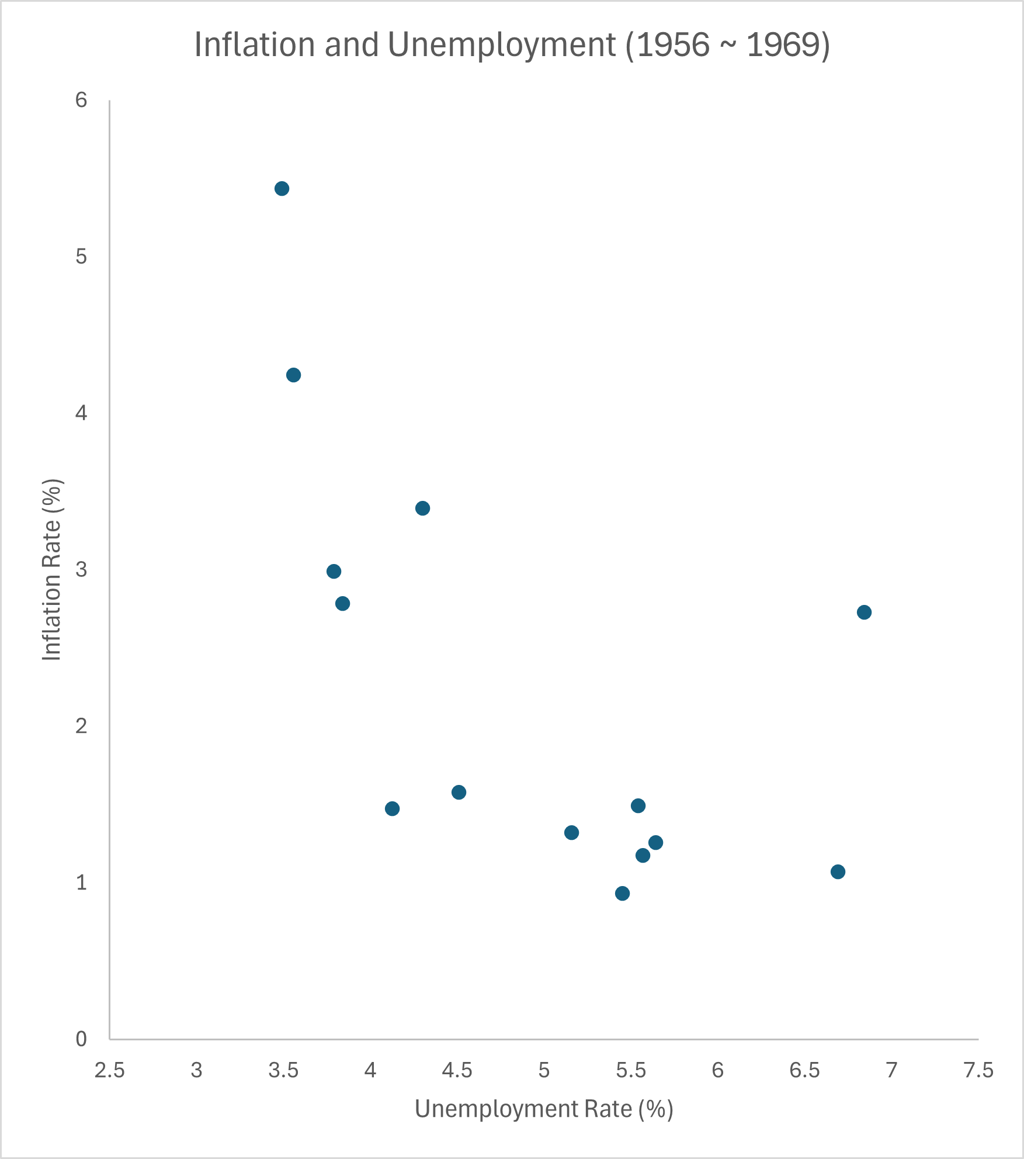
Variations of the Phillips Curve
Around the time that the Phillips curve was being formulated, the relation between $π$ and $u$ seem to hold.
At this point, the Phillips curve was characterized:
$$π_{t}=\overline{π}+\left(m+z\right)−αu_{t}$$
$\overline{π}$ is the “average level of inflation in a given year.”

Slide 8
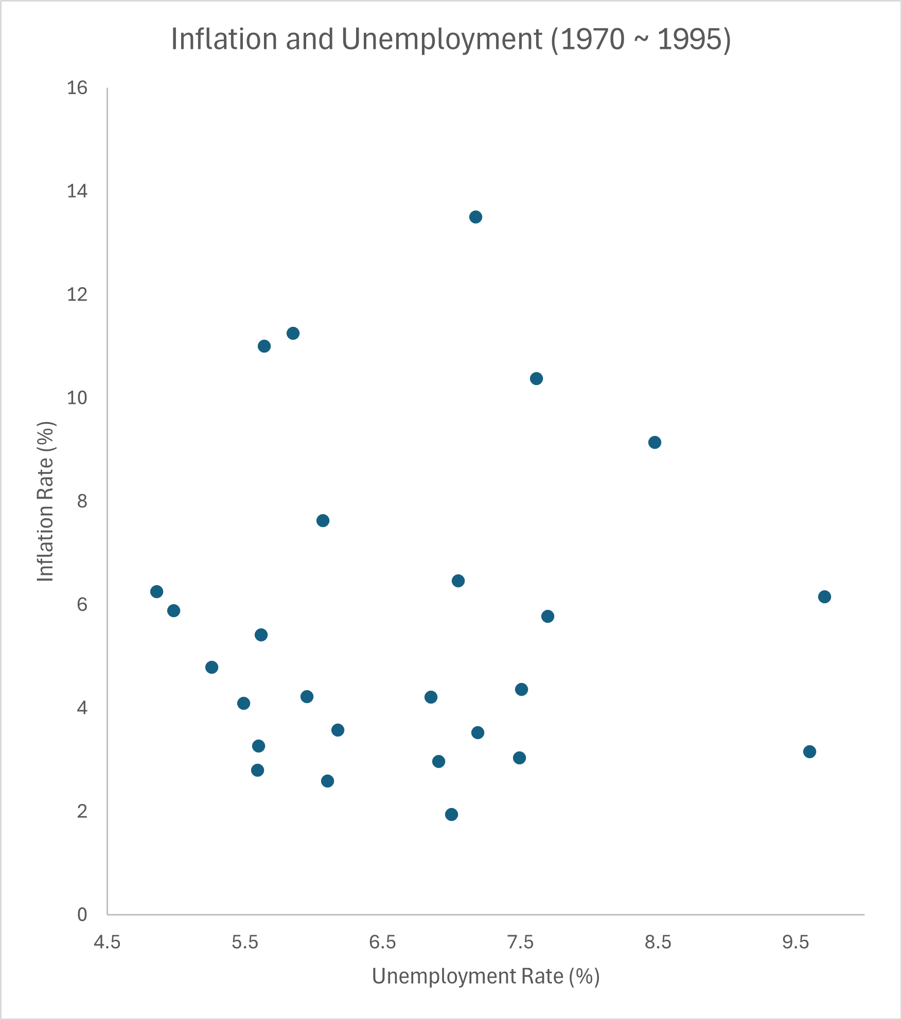
Variations of the Phillips Curve
In the 1970s, the relation started to break down.
What went wrong?
We notice a “de-anchoring of expectations.”
Wage setters adopted a new way of establishing their expectations.

Slide 9
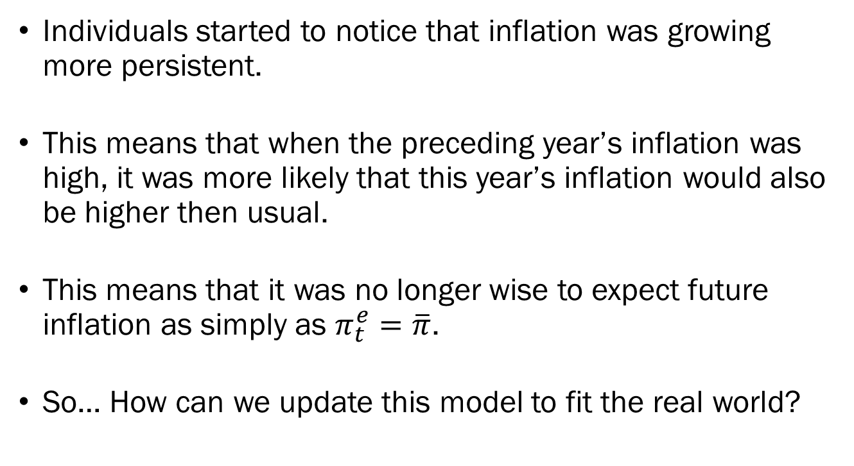
Variations of the Phillips Curve
Individuals started to notice that inflation was growing more persistent.
This means that when the preceding year’s inflation was high, it was more likely that this year’s inflation would also be higher then usual.
This means that it was no longer wise to expect future inflation as simply as $π_{t}^{e}=\overline{π}$.
So… How can we update this model to fit the real world?

Slide 10
Variations of the Phillips Curve
Economists updated the model to include some measure of past inflation in individuals’ expectations.
$$π_{t}^{e}=\left(1−θ\right)\overline{π}+θπ_{t−1}$$
Expected inflation is a weighted sum of the “average level of inflation” $\overline{π}$, and last period’s inflation $π_{t−1}$.
When $θ$ is close to 0, expectations are formed based more closely on $\overline{π}$.
When $θ$ gets closer to 1, expectations rely more on $π_{t−1}$.

Slide 11
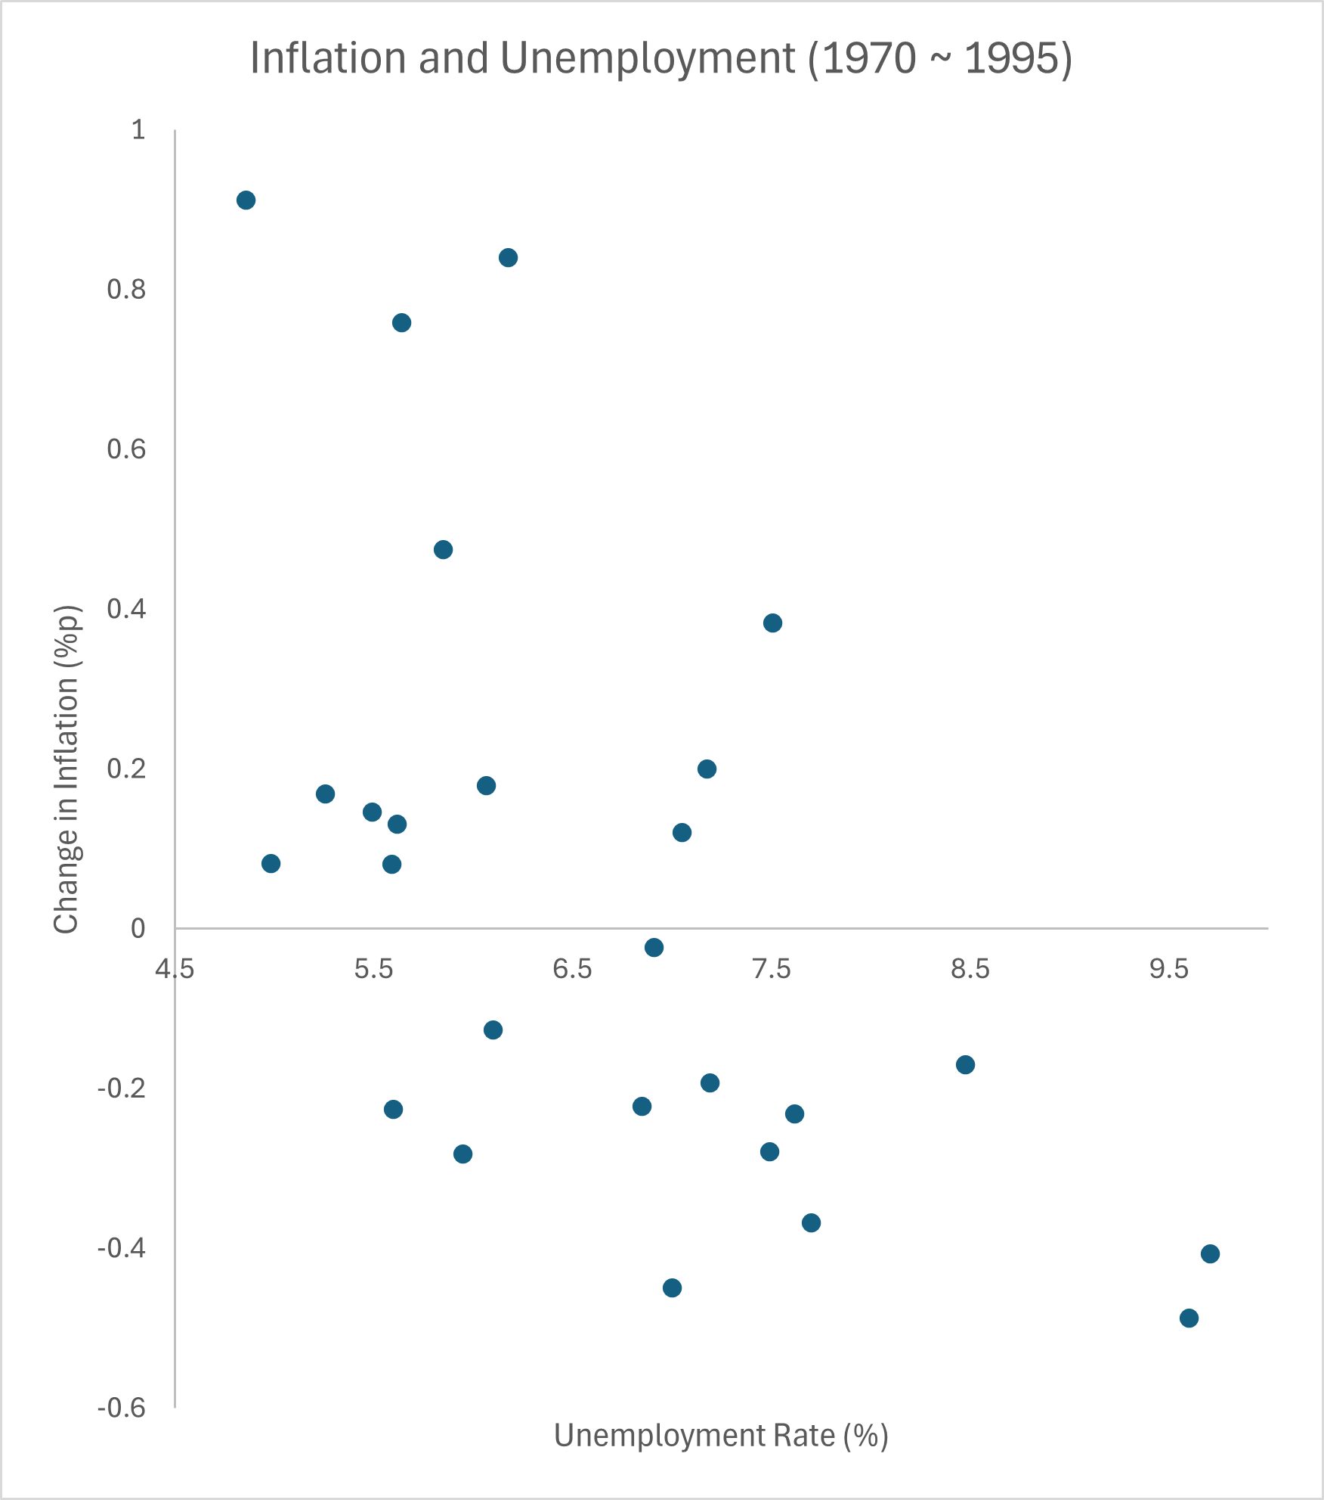
Variations of the Phillips Curve
Plotting the Phillips curve with the unemployment rate versus the change of inflation, we find the negative relation still holds.
The relation can be written:
$$π_{t}−π_{t−1}=\left(m+z\right)−αu_{t}$$
Known as the accelerationist Phillips curve.

Slide 12
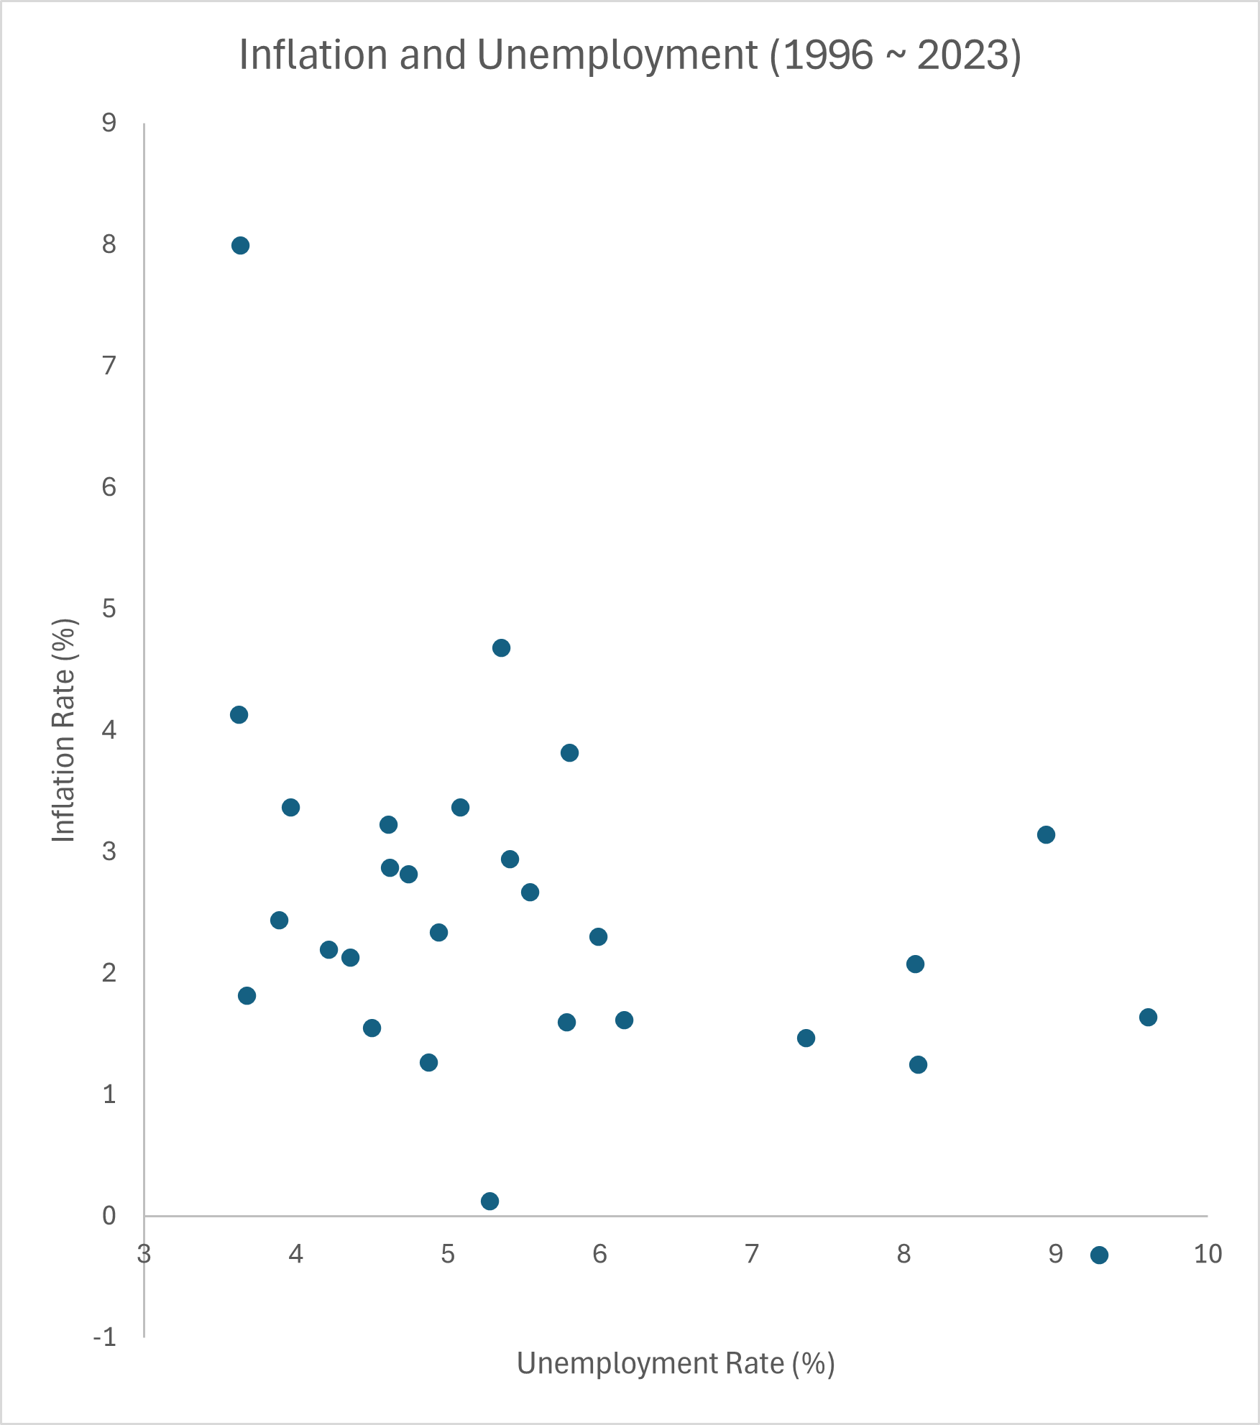
Variations of the Phillips Curve
In the 1980s, Central banks around the world changed the tone of their monetary policy, explicitly targeting inflation.
By the mid 1990s, inflation returned to a stable level, and expectations updated.
$θ$ returned closer to 0.

Slide 13
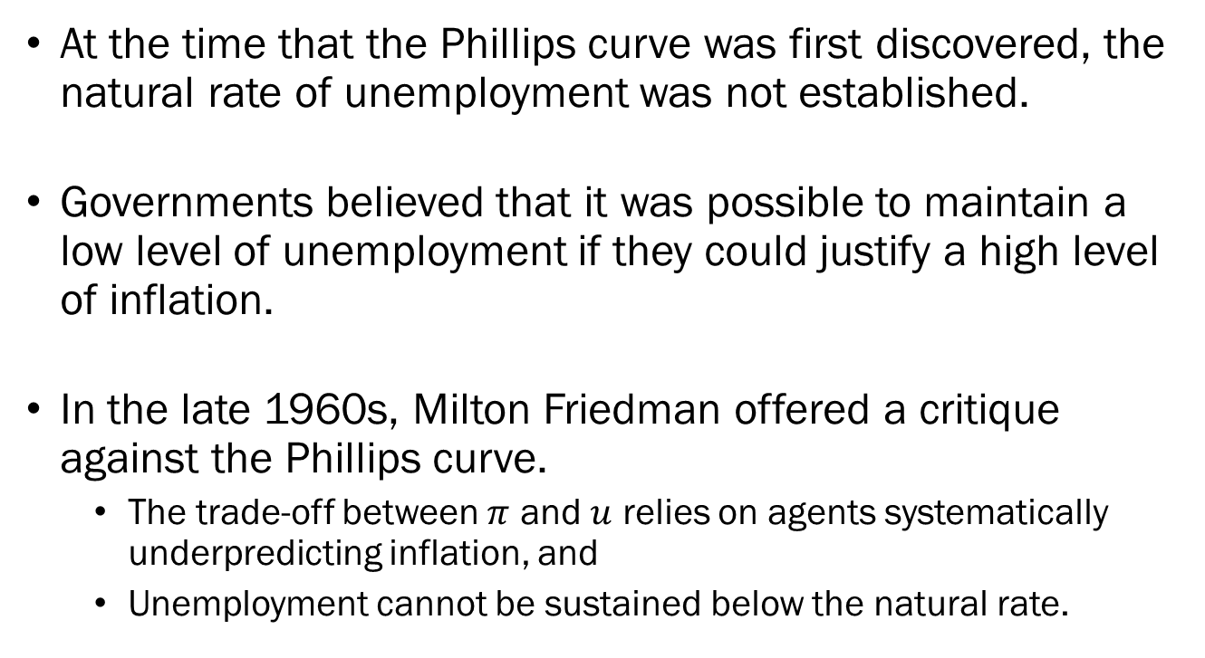
The Phillips Curve and the Natural Rate of Unemployment
At the time that the Phillips curve was first discovered, the natural rate of unemployment was not established.
Governments believed that it was possible to maintain a low level of unemployment if they could justify a high level of inflation.
In the late 1960s, Milton Friedman offered a critique against the Phillips curve.
The trade-off between $π$ and $u$ relies on agents systematically underpredicting inflation, and
Unemployment cannot be sustained below the natural rate.

Slide 14
The Phillips Curve and the Natural Rate of Unemployment
Recall that $u_{n}$ is the rate of unemployment that matches the expected price level to the actual price level.
$π_{t}=π_{t}^{e}+\left(m+z\right)−αu_{n}$
$⟹ π_{t}−π_{t}^{e}=\left(m+z\right)−αu_{n}$
$⟹0=\left(m+z\right)−αu_{n}$
$⟹αu_{n}=m+z$
$⟹u_{n}=\frac{m+z}{α}$

Slide 15
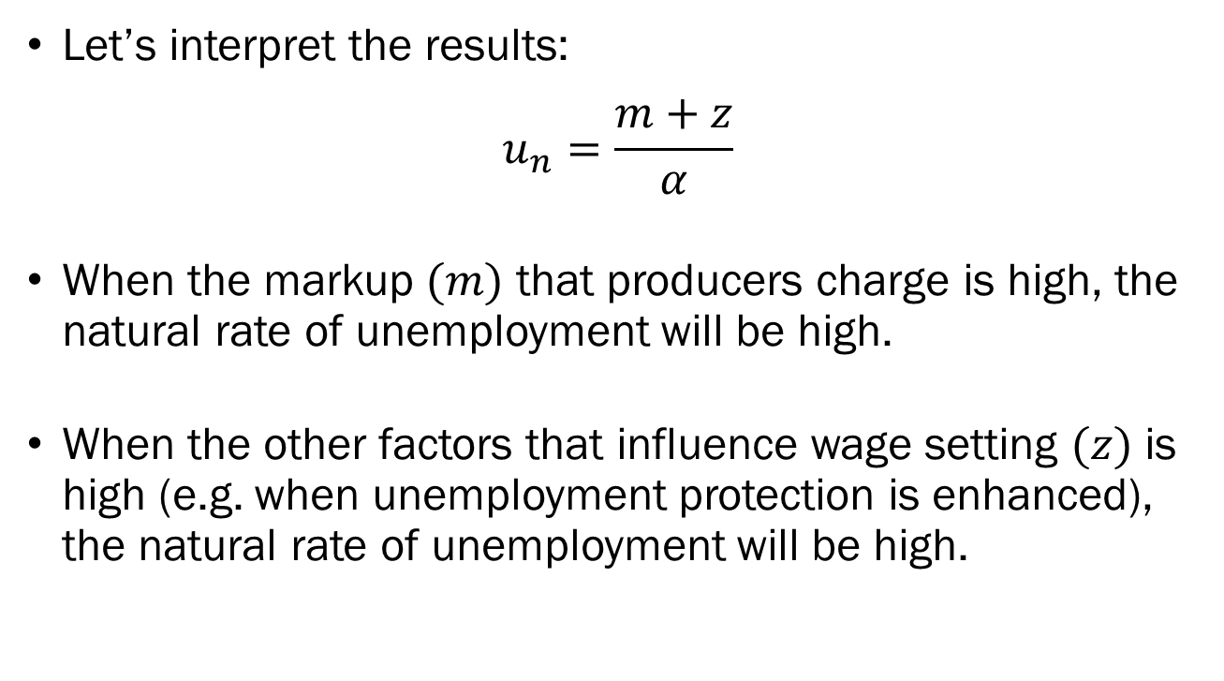
The Phillips Curve and the Natural Rate of Unemployment
Let’s interpret the results:
$$u_{n}=\frac{m+z}{α}$$
When the markup $(m)$ that producers charge is high, the natural rate of unemployment will be high.
When the other factors that influence wage setting $(z)$ is high (e.g. when unemployment protection is enhanced), the natural rate of unemployment will be high.

Slide 16
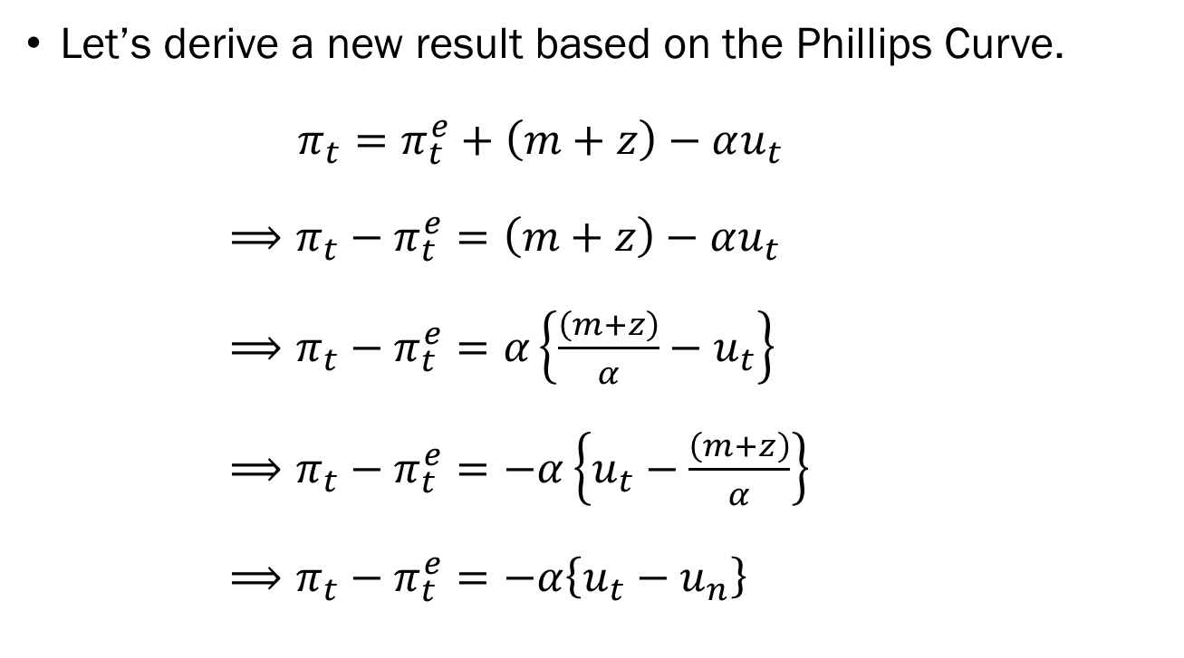
The Phillips Curve and the Natural Rate of Unemployment
Let’s derive a new result based on the Phillips Curve.
$π_{t}=π_{t}^{e}+\left(m+z\right)−αu_{t}$
$⟹π_{t}−π_{t}^{e}=\left(m+z\right)−αu_{t}$
$⟹π_{t}−π_{t}^{e}=α\left\{\frac{\left(m+z\right)}{α}−u_{t}\right\}$
$⟹π_{t}−π_{t}^{e}=−α\left\{u_{t}−\frac{\left(m+z\right)}{α}\right\}$
$⟹π_{t}−π_{t}^{e}=−α\left\{u_{t}−u_{n}\right\}$

Slide 17
The Phillips Curve and the Natural Rate of Unemployment
Let’s interpret the results:
$$π_{t}−π_{t}^{e}=−α\left\{u_{t}−u_{n}\right\}$$
This equation, derived from the Phillips curve, links inflation $\left(π\right)$, expected inflation $\left(π^{e}\right)$, unemployment $\left(u\right)$, and the natural rate of unemployment $\left(u_{n}\right)$.
If unemployment is below the natural rate, inflation will be higher than expected.
If unemployment is above the natural rate, inflation will be lower than expected.

Slide 18
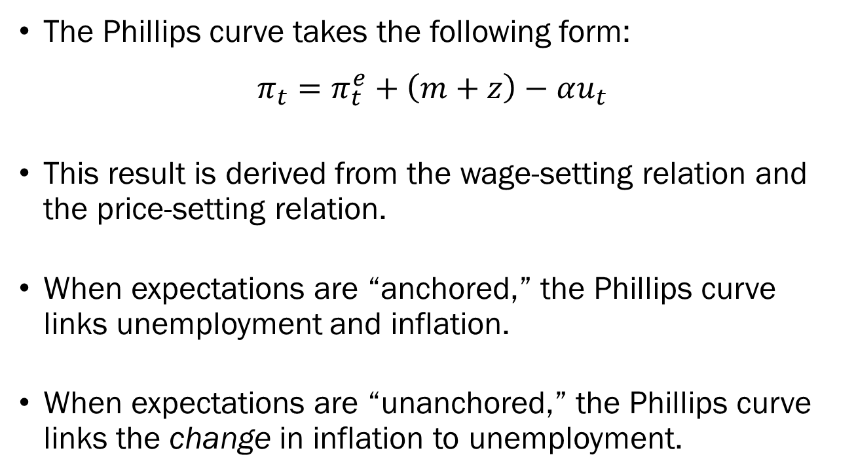
Recap
The Phillips curve takes the following form:
$$π_{t}=π_{t}^{e}+\left(m+z\right)−αu_{t}$$
This result is derived from the wage-setting relation and the price-setting relation.
When expectations are “anchored,” the Phillips curve links unemployment and inflation.
When expectations are “unanchored,” the Phillips curve links the change in inflation to unemployment.

Slide 19
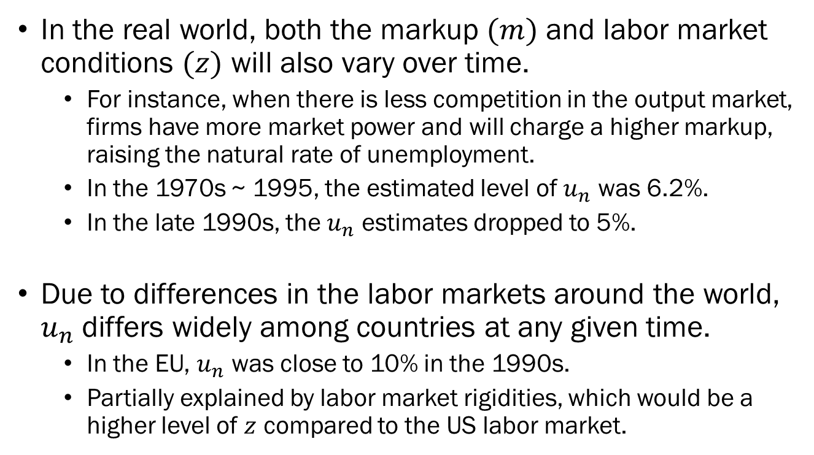
“Nuanced Discussions on the Phillips Curve”
In the real world, both the markup $(m)$ and labor market conditions $(z)$ will also vary over time.
For instance, when there is less competition in the output market, firms have more market power and will charge a higher markup, raising the natural rate of unemployment.
In the 1970s ~ 1995, the estimated level of $u_{n}$ was 6.2%.
In the late 1990s, the $u_{n}$ estimates dropped to 5%.
Due to differences in the labor markets around the world, $u_{n}$ differs widely among countries at any given time.
In the EU, $u_{n}$ was close to 10% in the 1990s.
Partially explained by labor market rigidities, which would be a higher level of $z$ compared to the US labor market.

