Slide 1
The Medium Run:
The Labor Market
ECON 301

Slide 2

https://pollev.com/brianpark046

Slide 3
The Medium Run
In the short run, the economy fluctuate around changes in the economy’s aggregate demand.
Over the medium run, the economy will revolve around the level of output that is associated with the “natural rate of unemployment.”
To analyze the medium run, we will examine…
  …the equilibrium in the labor market, and
  …the relationship between unemployment and inflation, and
  …construct the IS-LM-PC framework.

Slide 4
The Medium Run
While examining the short run, there were many elements that we have been ignoring.
For instance, suppose that aggregate demand increases in the economy.
In the short run…
  Firms instantly increase production, and
  This leads to consumers’ income increasing, and
  This leads to increased consumption, and
  Firms increase production to meet the demand, and
  The loop continues…

Slide 5
The Medium Run
In the short run, we were assuming that output increases at a given price range. But in the medium run, we will be abandoning this assumption.
In the medium run…
  Firms increasing production leads to increased employment, and
  Increased employment leads to lower unemployment, and
  Lower unemployment leads to higher wages, and
  Higher wages leads to higher costs of production, and
  Higher costs of production leads to prices increasing, and
  Higher prices leads to workers demanding higher wages, and
  The loop continues…

Slide 6
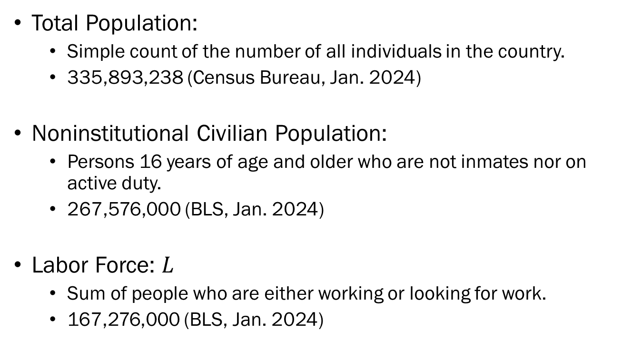
Recap: Unemployment
Total Population:
  Simple count of the number of all individuals in the country.
  335,893,238 (Census Bureau, Jan. 2024)
Noninstitutional Civilian Population:
  Persons 16 years of age and older who are not inmates nor on active duty.
  267,576,000 (BLS, Jan. 2024)
Labor Force: $L$
  Sum of people who are either working or looking for work.
  167,276,000 (BLS, Jan. 2024)

Slide 7
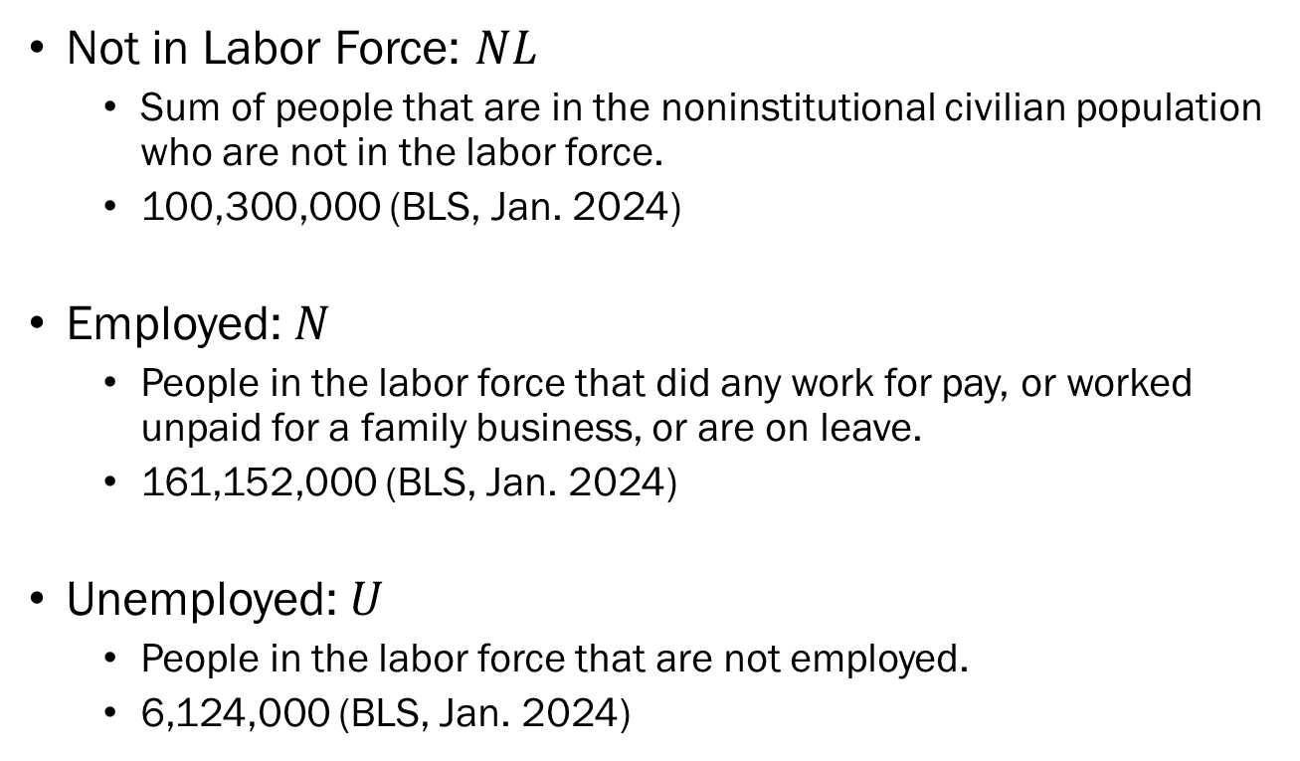
Recap: Unemployment
Not in Labor Force: $NL$
  Sum of people that are in the noninstitutional civilian population who are not in the labor force.
  100,300,000 (BLS, Jan. 2024)
Employed: $N$
  People in the labor force that did any work for pay, or worked unpaid for a family business, or are on leave.
  161,152,000 (BLS, Jan. 2024)
Unemployed: $U$
  People in the labor force that are not employed.
  6,124,000 (BLS, Jan. 2024)

Slide 8
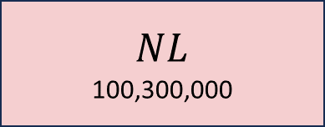

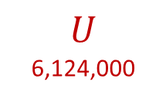

Recap: Unemployment
Total Population
335,893,238
Noninstitutional Civilian Population
267,576,000
$$L$$
167,276,000
$$NL$$
100,300,000
$$N$$
267,576,000
$$U$$
6,124,000

Slide 9
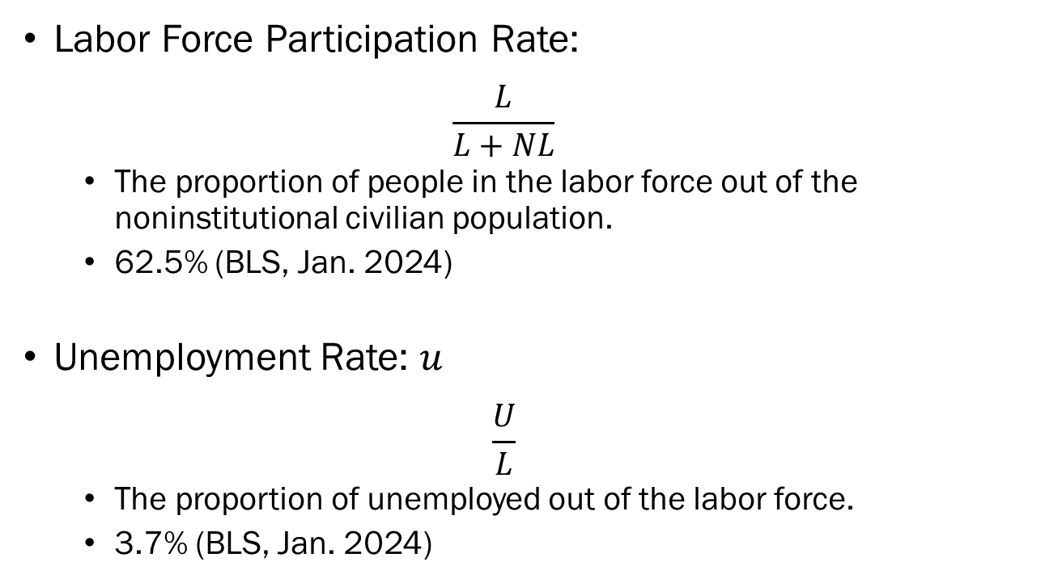
Recap: Unemployment
Labor Force Participation Rate:
  $$\frac{L}{L+NL}$$
  The proportion of people in the labor force out of the noninstitutional civilian population.
  62.5% (BLS, Jan. 2024)
Unemployment Rate: $u$
  $$\frac{U}{L}$$
  The proportion of unemployed out of the labor force.
  3.7% (BLS, Jan. 2024)

Slide 10
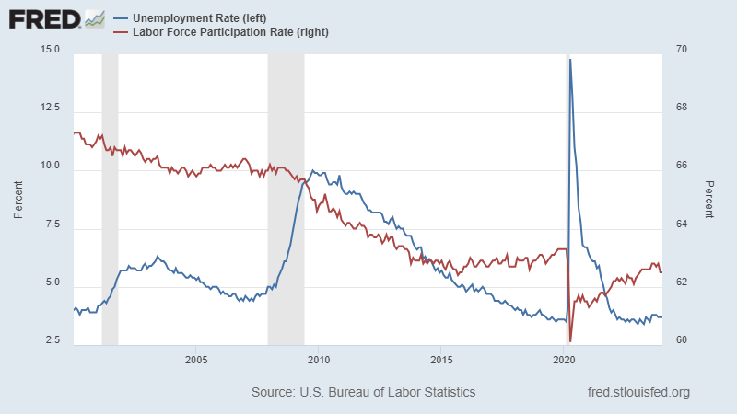
Recap: Unemployment

Slide 11
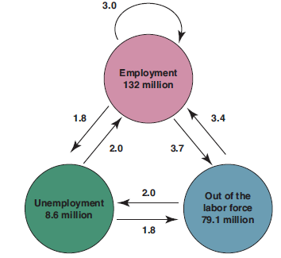
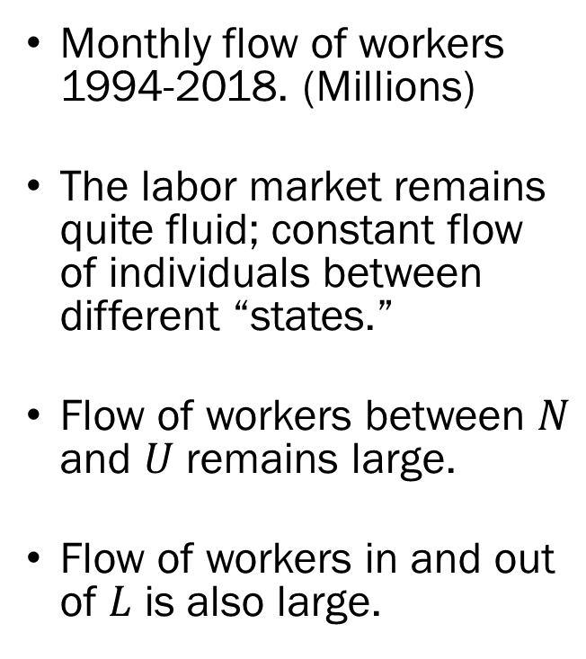
Facts about Unemployment
Monthly flow of workers 1994-2018. (Millions)
The labor market remains quite fluid; constant flow of individuals between different “states.”
Flow of workers between $N$ and $U$ remains large.
Flow of workers in and out of $L$ is also large.
Source: Blanchard (2021)

Slide 12
Facts about Unemployment
The average duration of a spell of unemployment in the US was approximately 2 months.
Fluctuations of unemployment rates are associated with recessions and expansions.
When unemployment rates are high…
  The share of unemployed finding a job is low, and
  The share of employed being separated from their job is high.

Slide 13
Wage Determination Basics
Suppose that you are about to accept a job offer.
In some cases, there will be a pre-set wage based on collective bargaining agreements.
When the wage is not pre-set, you would talk to HR with a “reservation wage” in mind.
Reservation wage is the wage that leaves you indifferent between unemployment and employment.

Slide 14
Wage Determination Basics
Most workers in the economy are paid a wage that is higher than their reservation wage.
While there are countless reasons why this happens, we will be concentrating on two main facets.
First, the workers may be demanding a higher wage based on their bargaining power, and
Second, the employers may pay a greater amount than the workers’ reservation wage for some reason.

Slide 15
Wage Determination:
Bargaining Power
Bargaining power depends on…
How costly is it for the employer to find a replacement for the position should the employee leave,
  If the job requires highly skilled workers, workers have more bargaining power.
  When unemployment is low, there are less people in the potential pool of workers, and workers have more bargaining power.
How easy is it for the employee to find another job once they decide to separate.
  When unemployment is low, it’s easier for workers to find a job elsewhere, and workers have more bargaining power.

Slide 16
Wage Determination:
Efficiency Wages
Employers may have an incentive to pay their workers a higher wage if they believe that wages are linked to the productivity of their workers.
This is called “efficiency wage theory” in labor economics.
Theory posits that when firms pay their employees well…
  Higher employee morale may lead to higher productivity,
  Higher employee commitment will lead to lower turnovers,
  Higher wages may attract highly qualified workers.

Slide 17
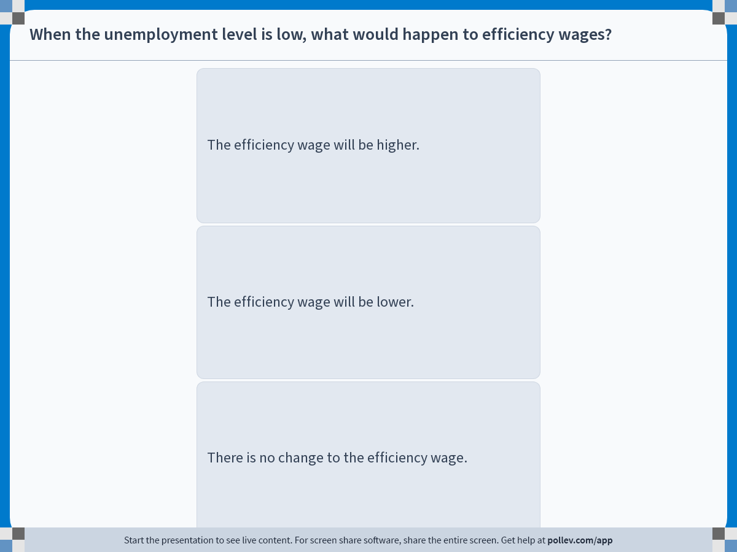
Notes:
Poll Title: Do not modify the notes in this section to avoid tampering with the Poll Everywhere activity.
More info at polleverywhere.com/support
When the unemployment level is low, what would happen to efficiency wages?
https://www.polleverywhere.com/multiple_choice_polls/3XQWkRmP7kumnkJecgKuZ?display_state=instructions&activity_state=opened&state=opened&flow=Engagement&onscreen=persist

Slide 18
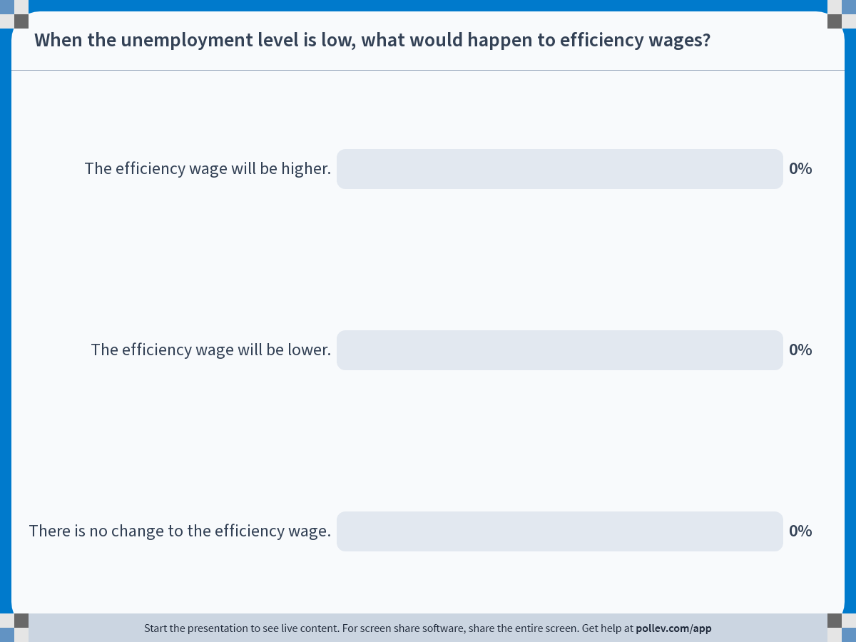
Notes:
Poll Title: Do not modify the notes in this section to avoid tampering with the Poll Everywhere activity.
More info at polleverywhere.com/support
When the unemployment level is low, what would happen to efficiency wages?
https://www.polleverywhere.com/multiple_choice_polls/3XQWkRmP7kumnkJecgKuZ?display_state=chart&activity_state=closed&state=closed&flow=Engagement&onscreen=persist

Slide 19
Solution to In-Class Poll
When unemployment is lower than usual…
Employees will find it easier to switch jobs…
Since efficiency wages are designed to deter turnovers…
The employers will have to offer even more to entice their employees to stay.
So, efficiency wages will increase.

Slide 20
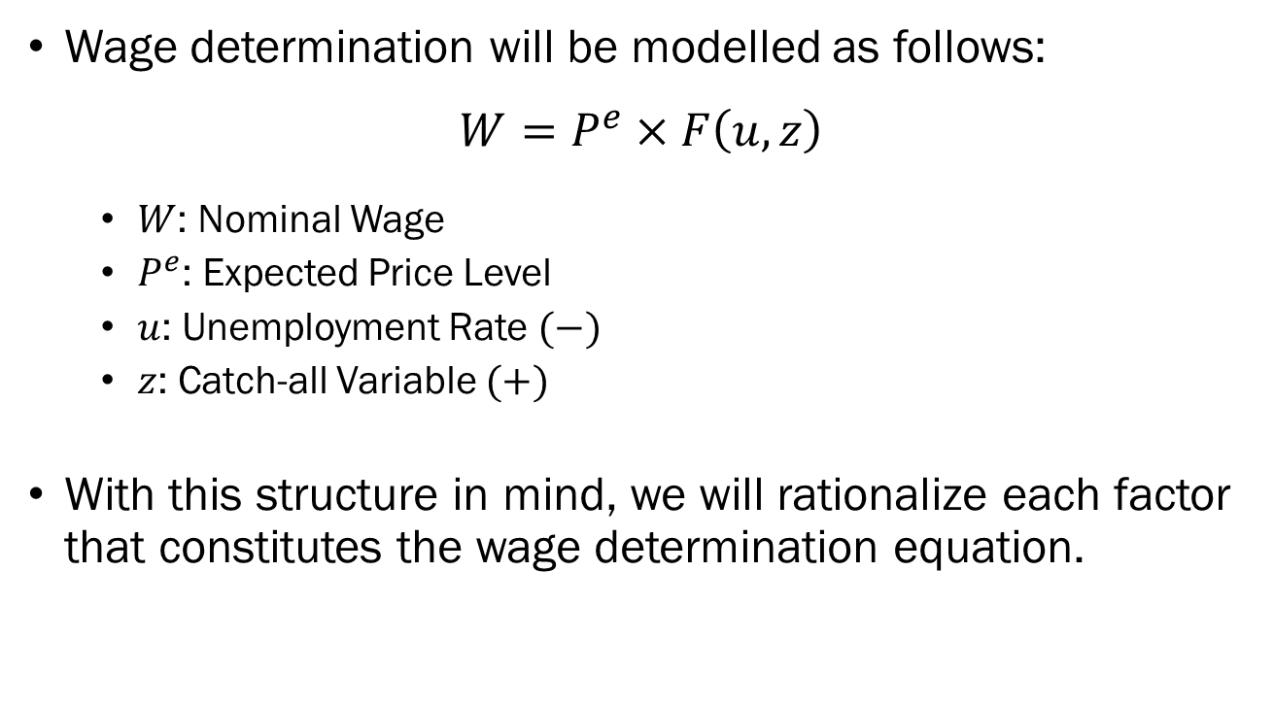
The Wage Determination Equation
Wage determination will be modelled as follows:
$$W=P^{e}×F\left(u,z\right)$$
  $W$: Nominal Wage
  $P^{e}$: Expected Price Level
  $u$: Unemployment Rate $(−)$
  $z$: Catch-all Variable $(+)$
With this structure in mind, we will rationalize each factor that constitutes the wage determination equation.

Slide 21
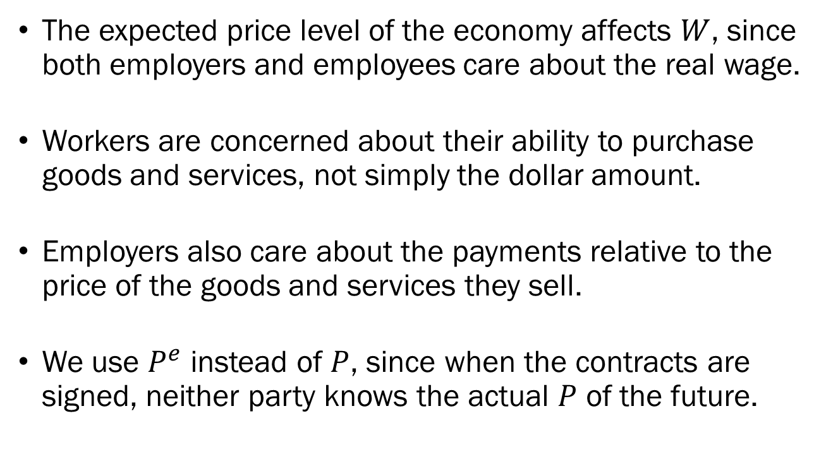

$P^{e}$ in Wage Determination
The expected price level of the economy affects $W$, since both employers and employees care about the real wage.
Workers are concerned about their ability to purchase goods and services, not simply the dollar amount.
Employers also care about the payments relative to the price of the goods and services they sell.
We use $P^{e}$ instead of $P$, since when the contracts are signed, neither party knows the actual $P$ of the future.

Slide 22
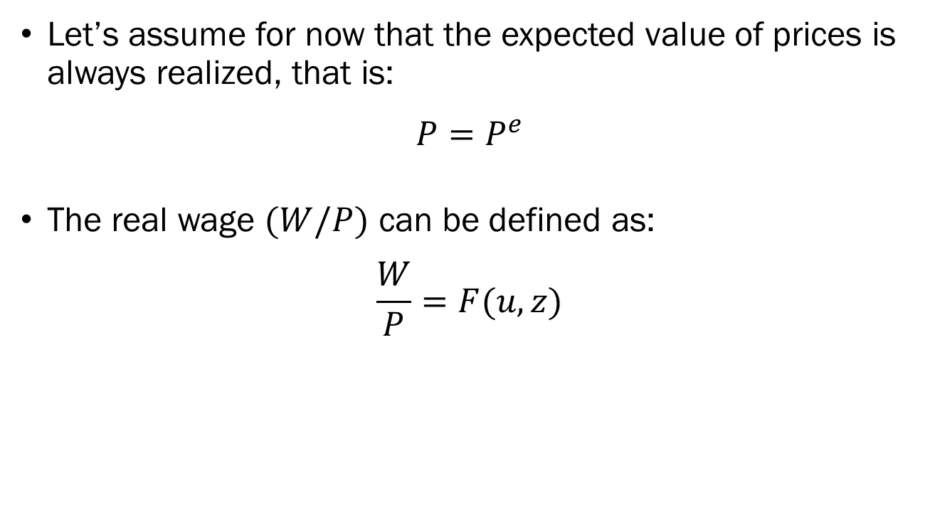
$P^{e}$ in Wage Determination
Let’s assume for now that the expected value of prices is always realized, that is:
$$P=P^{e}$$
The real wage $(W/P)$ can be defined as:
$$\frac{W}{P}=F(u,z)$$

Slide 23
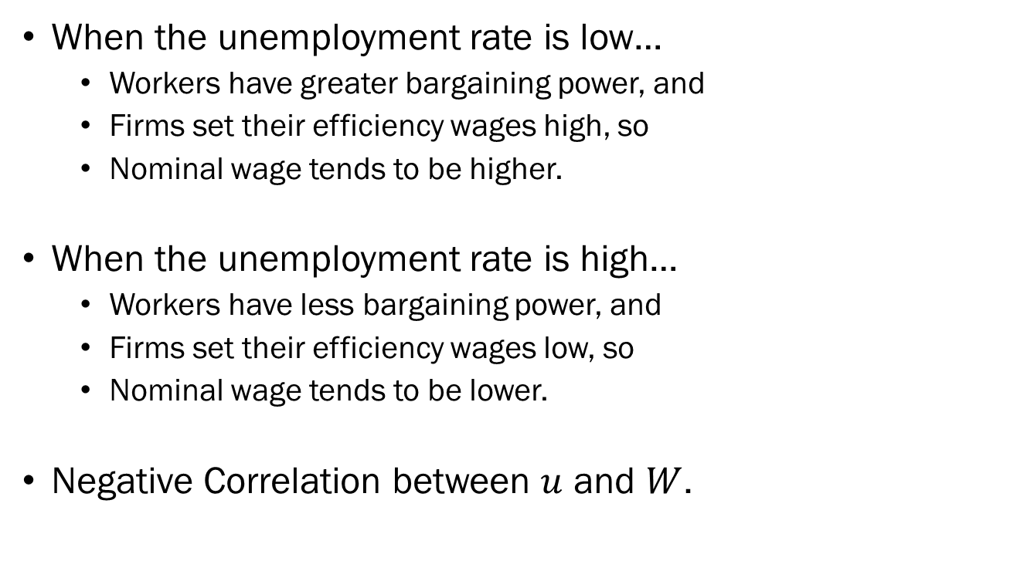

$u$ in Wage Determination
When the unemployment rate is low…
  Workers have greater bargaining power, and
  Firms set their efficiency wages high, so
  Nominal wage tends to be higher.
When the unemployment rate is high…
  Workers have less bargaining power, and
  Firms set their efficiency wages low, so
  Nominal wage tends to be lower.
Negative Correlation between $u$ and $W$.

Slide 24
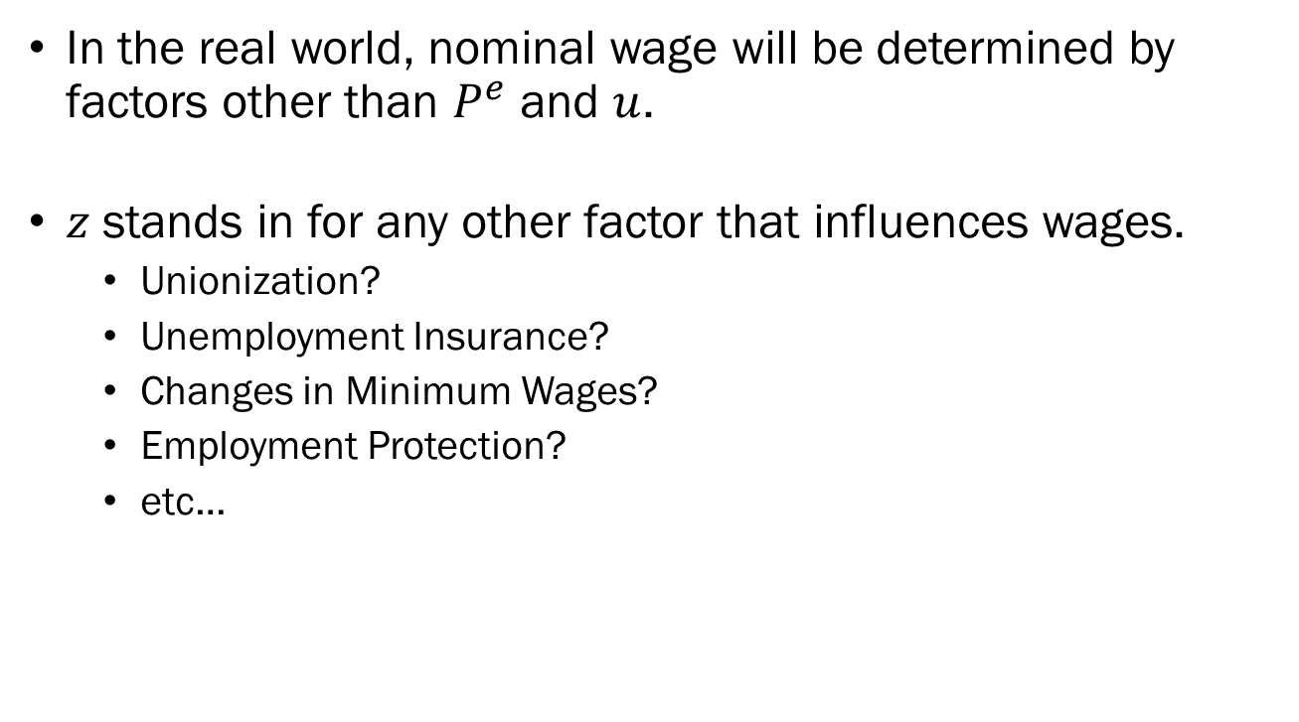

$z$ in Wage Determination
In the real world, nominal wage will be determined by factors other than $P^{e}$ and $u$.
$z$ stands in for any other factor that influences wages.
  Unionization?
  Unemployment Insurance?
  Changes in Minimum Wages?
  Employment Protection?
  etc…

Slide 25
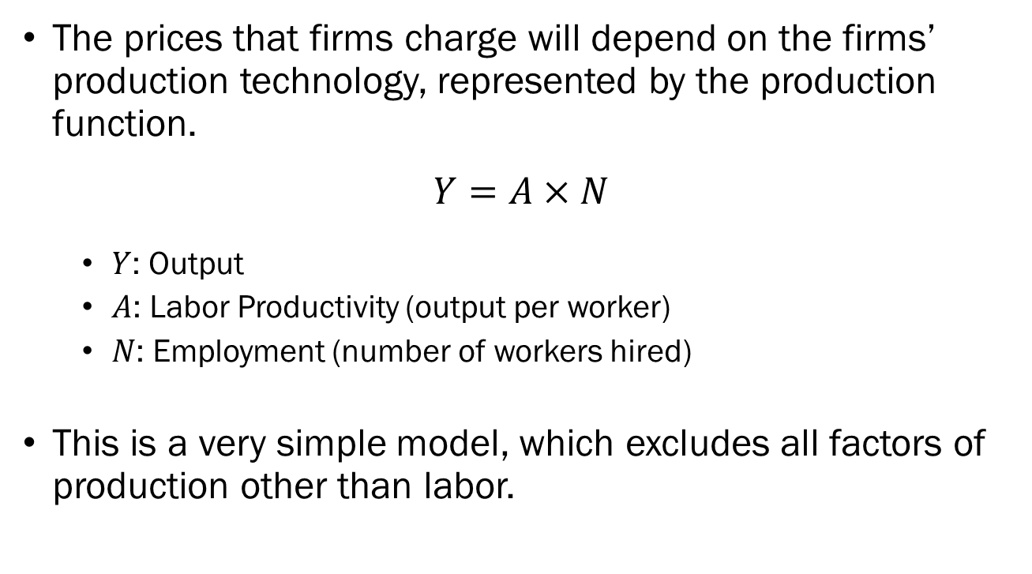
From Production to
Price Determination
The prices that firms charge will depend on the firms’ production technology, represented by the production function.
$$Y=A×N$$
  $Y$: Output
  $A$: Labor Productivity (output per worker)
  $N$: Employment (number of workers hired)
This is a very simple model, which excludes all factors of production other than labor.

Slide 26
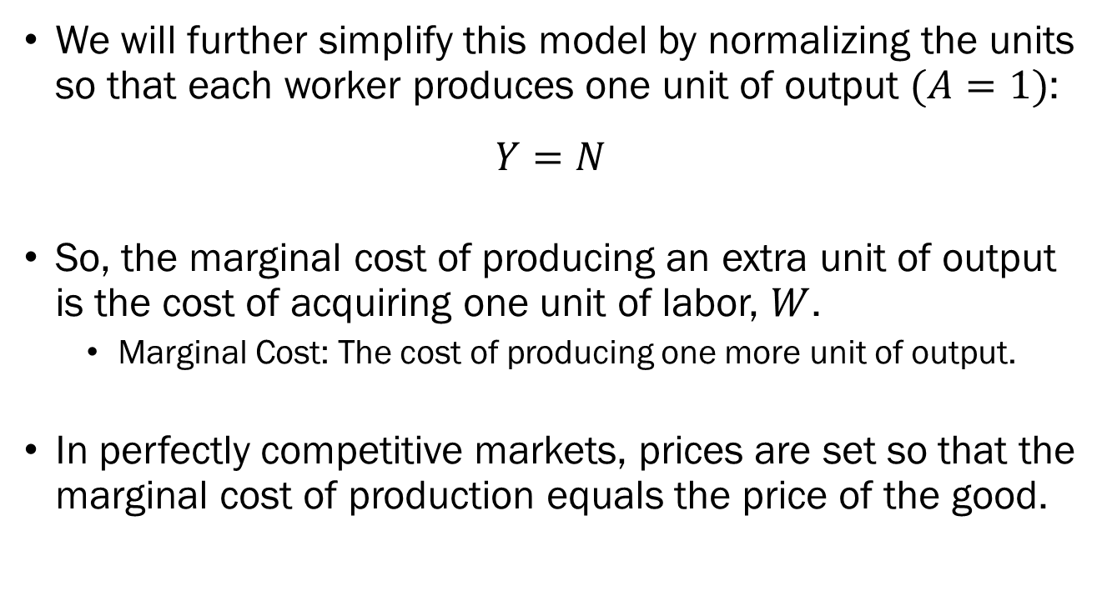
From Production to
Price Determination
We will further simplify this model by normalizing the units so that each worker produces one unit of output $(A=1)$:
$$Y=N$$
So, the marginal cost of producing an extra unit of output is the cost of acquiring one unit of labor, $W$.
  Marginal Cost: The cost of producing one more unit of output.
In perfectly competitive markets, prices are set so that the marginal cost of production equals the price of the good.

Slide 27
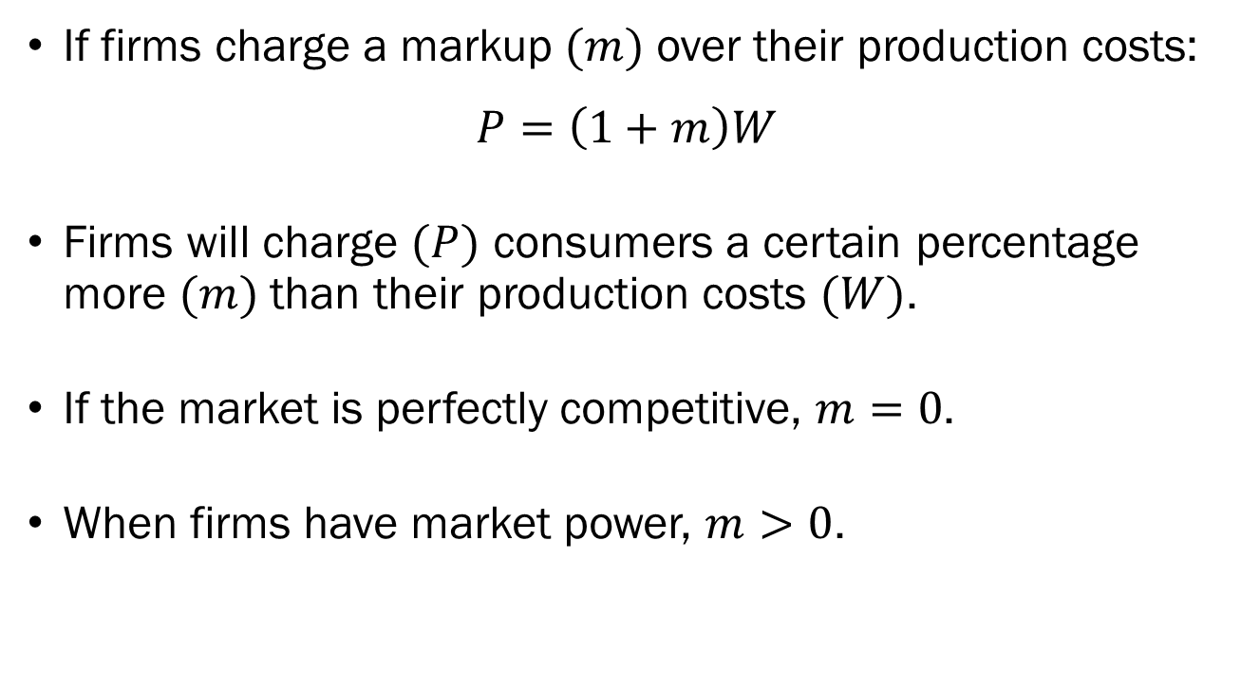
From Production to
Price Determination
If firms charge a markup $(m)$ over their production costs:
$$P=\left(1+m\right)W$$
Firms will charge $(P)$ consumers a certain percentage more $(m)$ than their production costs $(W)$.
If the market is perfectly competitive, $m=0$.
When firms have market power, $m>0$.

Slide 28
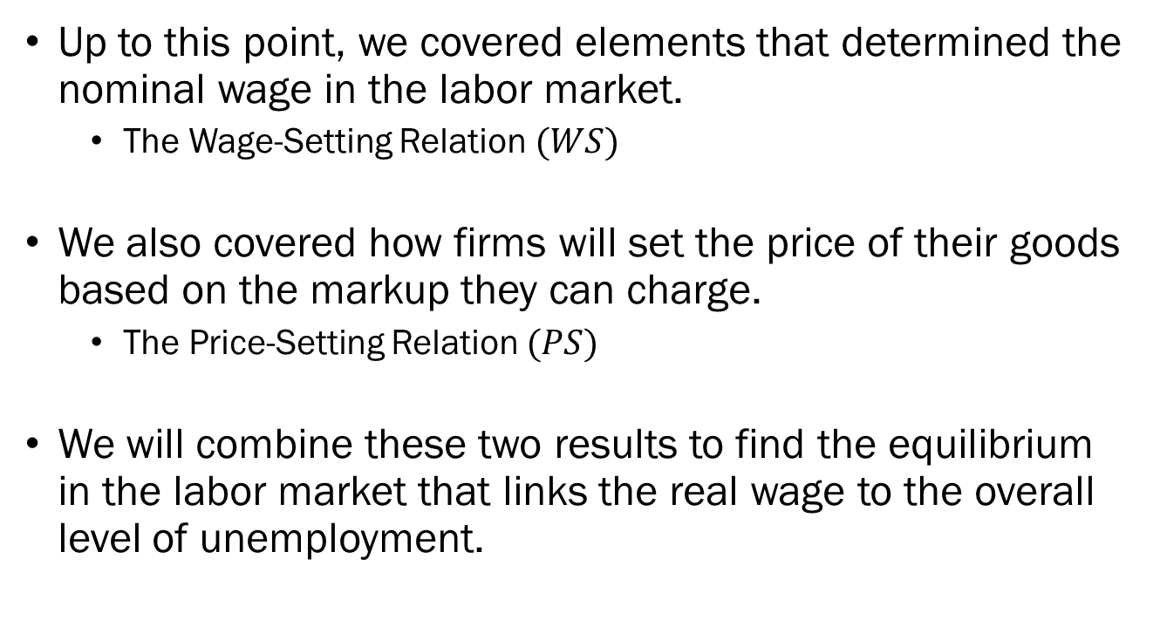
Towards a Model of
Wage Determination
Up to this point, we covered elements that determined the nominal wage in the labor market.
  The Wage-Setting Relation $(WS)$
We also covered how firms will set the price of their goods based on the markup they can charge.
  The Price-Setting Relation $(PS)$
We will combine these two results to find the equilibrium in the labor market that links the real wage to the overall level of unemployment.

Slide 29
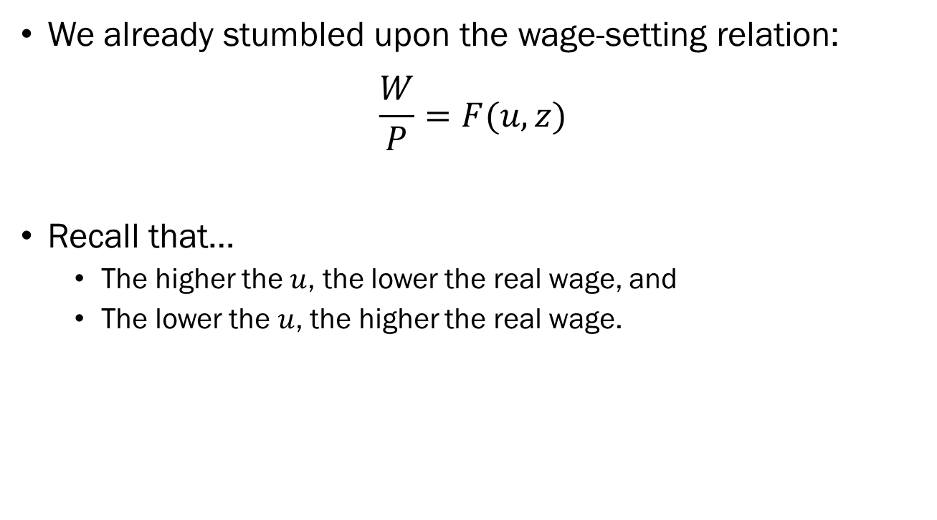
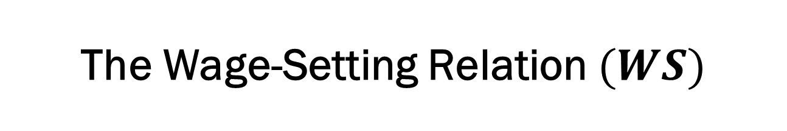
The Wage-Setting Relation $(WS)$
We already stumbled upon the wage-setting relation:
$$\frac{W}{P}=F(u,z)$$
Recall that…
  The higher the $u$, the lower the real wage, and
  The lower the $u$, the higher the real wage.

Slide 30
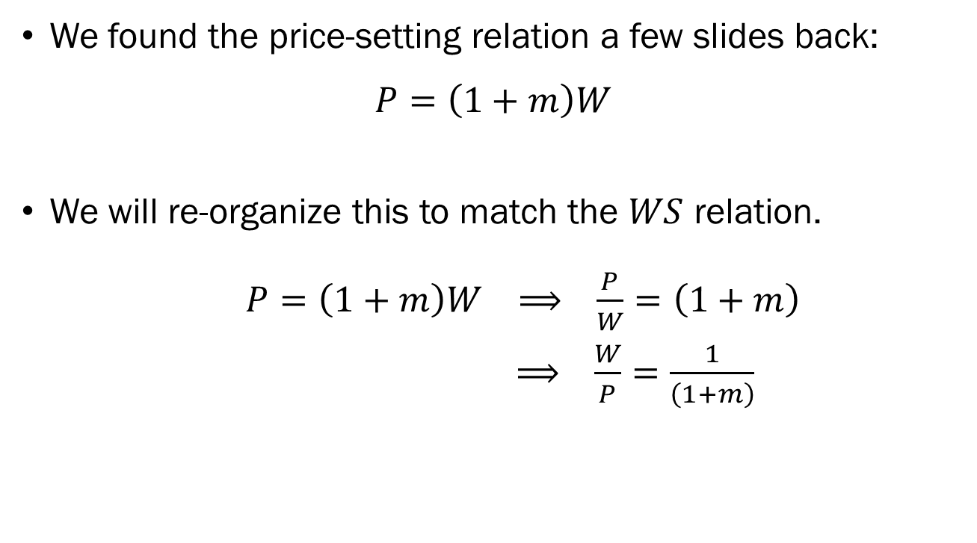
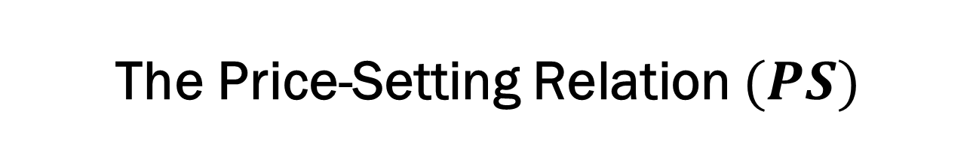
The Price-Setting Relation $(PS)$
We found the price-setting relation a few slides back:
$$P=\left(1+m\right)W$$
We will re-organize this to match the $WS$ relation.
$P=\left(1+m\right)W ⟹ \frac{P}{W}=\left(1+m\right)$
$⟹ \frac{W}{P}=\frac{1}{\left(1+m\right)}$

Slide 31

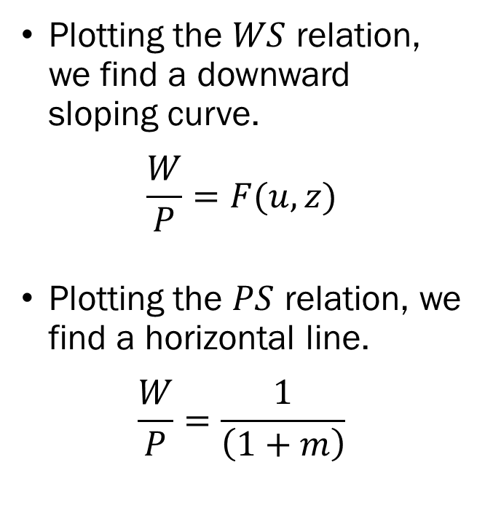


Real Wage and Unemployment
Plotting the $WS$ relation, we find a downward sloping curve.
$$\frac{W}{P}=F(u,z)$$
Plotting the $PS$ relation, we find a horizontal line.
$$\frac{W}{P}=\frac{1}{\left(1+m\right)}$$
Real Wage
$$\frac{1}{1+m}$$
$$PS$$
$$WS$$
Unemployment Rate

Slide 32

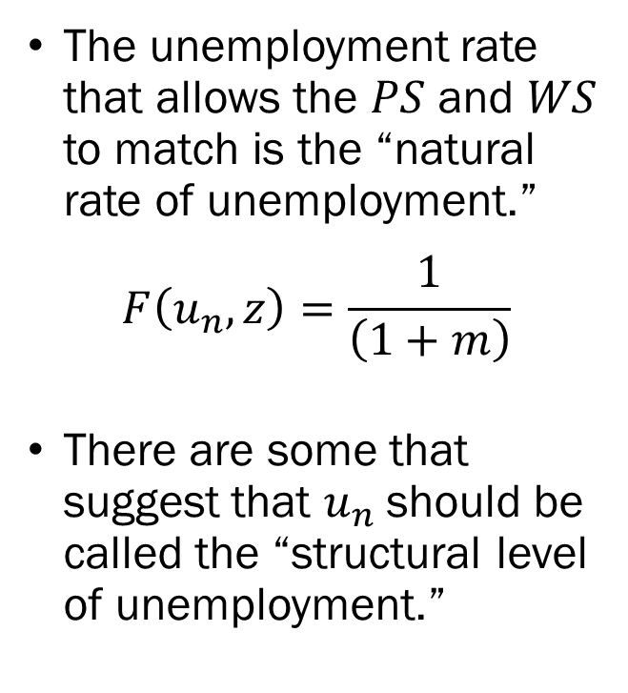

The Natural Rate of Unemployment
The unemployment rate that allows the $PS$ and $WS$ to match is the “natural rate of unemployment.”
$$F\left(u_{n},z\right)=\frac{1}{\left(1+m\right)}$$
There are some that suggest that $u_{n}$should be called the “structural level of unemployment.”
Real Wage
$$\frac{1}{1+m}$$
$$A$$
$$PS$$
$$WS$$
$$u_{n}$$
Unemployment Rate

Slide 33
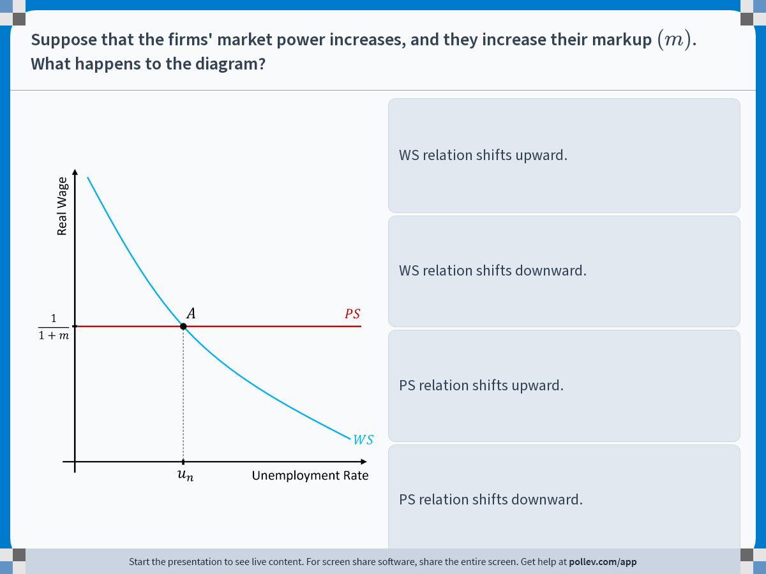
Notes:
Poll Title: Do not modify the notes in this section to avoid tampering with the Poll Everywhere activity.
More info at polleverywhere.com/support
Suppose that the firms' market power increases, and they increase their markup $$(m)$$. What happens to the diagram?
https://www.polleverywhere.com/multiple_choice_polls/rNawz15NwyfhnpeLEM9Ud?display_state=instructions&activity_state=opened&state=opened&flow=Engagement&onscreen=persist

Slide 34
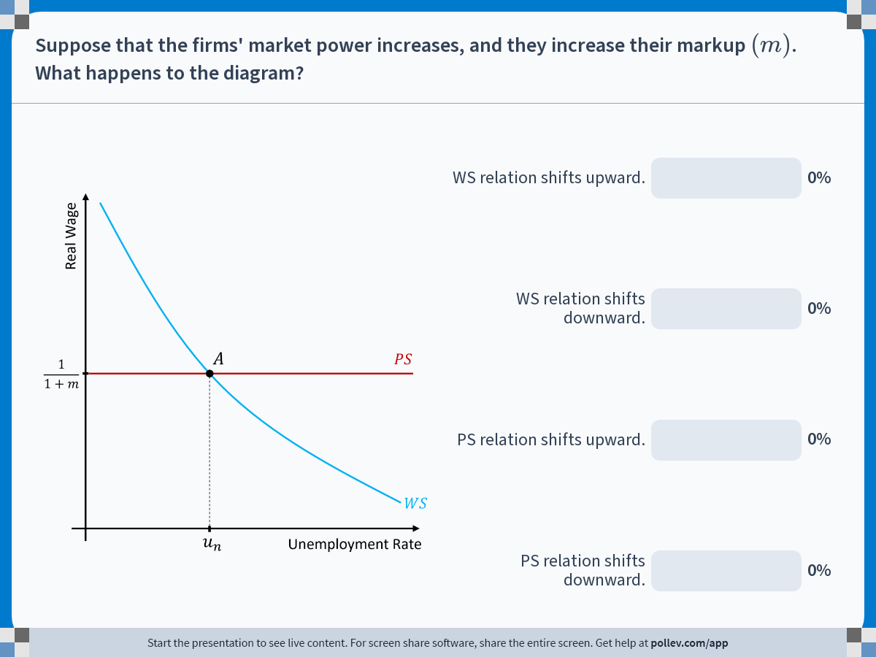
Notes:
Poll Title: Do not modify the notes in this section to avoid tampering with the Poll Everywhere activity.
More info at polleverywhere.com/support
Suppose that the firms' market power increases, and they increase their markup $$(m)$$. What happens to the diagram?
https://www.polleverywhere.com/multiple_choice_polls/rNawz15NwyfhnpeLEM9Ud?display_state=chart&activity_state=closed&state=closed&flow=Engagement&onscreen=persist

Slide 35


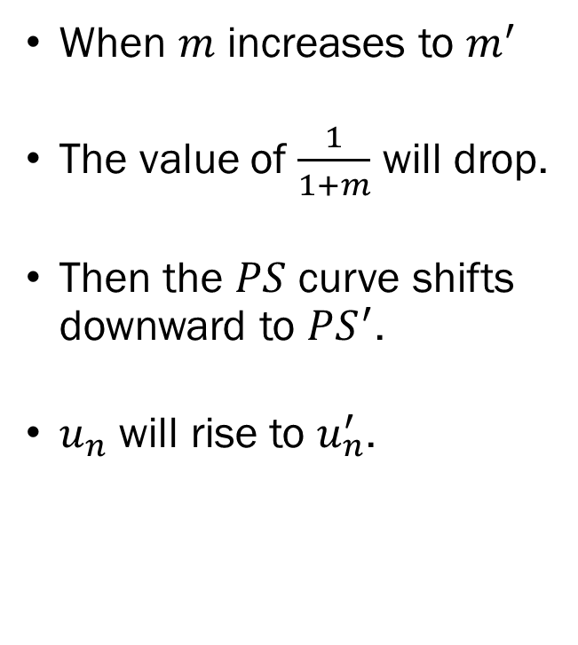



Solution to In-Class Poll
When $m$ increases to $m^{′}$
The value of $\frac{1}{1+m}$ will drop.
Then the $PS$ curve shifts downward to $PS^{′}$.
$u_{n}$ will rise to $u_{n}^{′}$.
Real Wage
$$\frac{1}{1+m}$$
$$A$$
$$PS$$
$$\frac{1}{1+m^{′}}$$
$$A^{′}$$
$$PS^{′}$$
$$WS$$
$$u_{n}$$
$$u_{n}^{′}$$
$$u$$

Slide 36
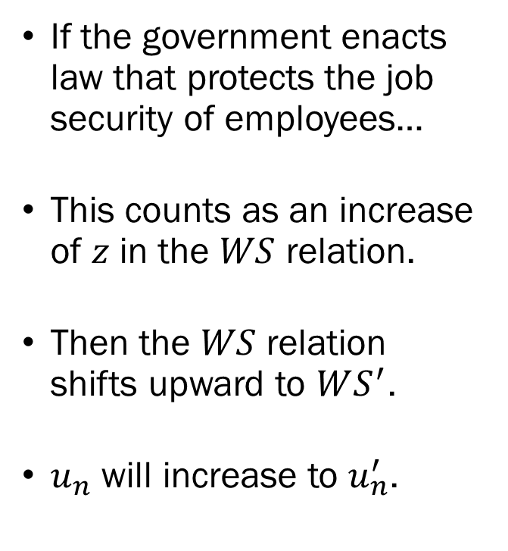



Employment Protection Legislation
If the government enacts law that protects the job security of employees…
This counts as an increase of $z$ in the $WS$ relation.
Then the $WS$ relation shifts upward to $WS^{′}$.
$u_{n}$ will increase to $u_{n}^{′}$.
Real Wage
$$\frac{1}{1+m}$$
$$A$$
$$A^{′}$$
$$PS$$
$$WS^{′}$$
$$WS$$
$$u_{n}$$
$$u_{n}^{′}$$
$$u$$

Slide 37
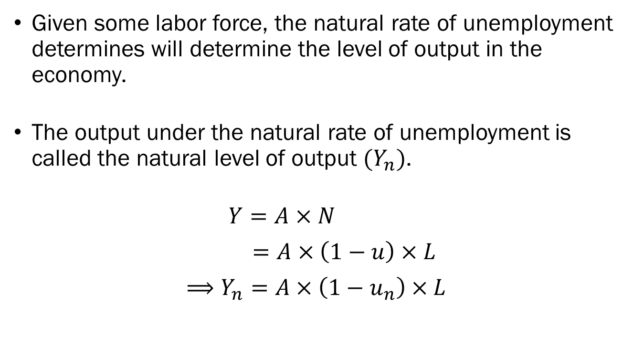
Natural Level of Output
Given some labor force, the natural rate of unemployment determines will determine the level of output in the economy.
The output under the natural rate of unemployment is called the natural level of output $(Y_{n})$.
$Y=A×N$
$=A×\left(1−u\right)×L$
$⟹Y_{n}=A×\left(1−u_{n}\right)×L$

Slide 38
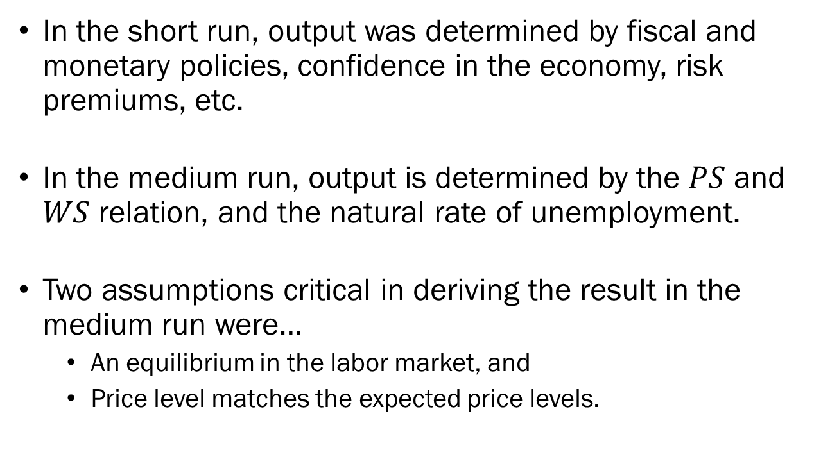
Short Run Results vs.
Medium Run Results
In the short run, output was determined by fiscal and monetary policies, confidence in the economy, risk premiums, etc.
In the medium run, output is determined by the $PS$ and $WS$ relation, and the natural rate of unemployment.
Two assumptions critical in deriving the result in the medium run were…
  An equilibrium in the labor market, and
  Price level matches the expected price levels.

Slide 39
Short Run Results vs.
Medium Run Results
In the short run, it is unlikely that individuals’ expectations exactly match the realized prices in the market.
In the medium run, it is less likely that expectations are systematically and significantly different from the realized value.
So, in the short run, output is influenced heavily by the factors we discussed in the previous chapters.
In the medium run, output will return to its natural level.

Slide 40
Roadmap for the Future
In the following lectures, we will relax some assumptions, and find a way to incorporate this framework to the IS-LM framework.
Specifically, in the next lecture, we will derive the full relationship between unemployment and inflation.
This is known as the “Phillips Curve.”
We will later use this to build the IS-LM-PC framework.

