Slide 1
The Short Run:
Extensions to the IS-LM Framework
ECON 301

Slide 2

https://pollev.com/brianpark046

Slide 3
Expanding the Financial Market
Up to this point, we have been working with a very simple model of the financial market.
But we now know that issues stemming from the financial sector can affect the market for goods and services.
We will expand the financial market by…
  …introducing two interest rates, and
  …introducing the concept of risk, and
  ..discuss the role of financial intermediaries.
…and update the IS-LM Framework accordingly!

Slide 4
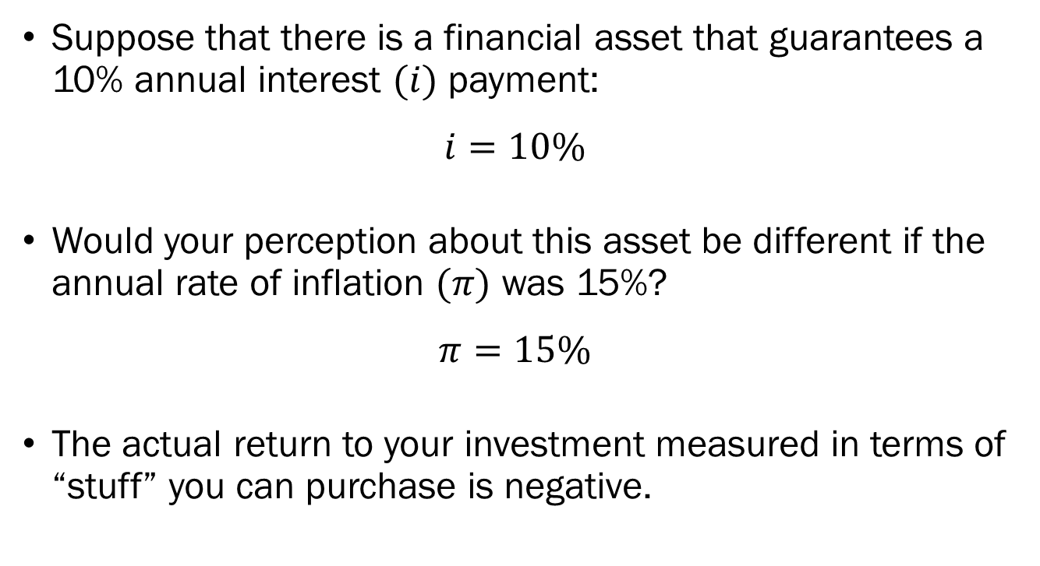
Nominal and Real Interest Rates
Suppose that there is a financial asset that guarantees a 10% annual interest $(i)$ payment:
$$i=10\%$$
Would your perception about this asset be different if the annual rate of inflation $(π)$ was 15%?
$$π=15\%$$
The actual return to your investment measured in terms of “stuff” you can purchase is negative.

Slide 5
Nominal and Real Interest Rates
Suppose you had $10,000 to invest in this financial asset, and there is only one good in the economy, coffee, which costs $4 for each cup.
With the $10,000 you have at this point you can purchase 2,500 cups of coffee.
Now, you invest $10,000 in the asset for a 10% return to receive $11,000 next year, but each cup of coffee got 15% more expensive at $4.6 for each cup.
With $11,000, you can purchase 2,391 cups of coffee.

Slide 6
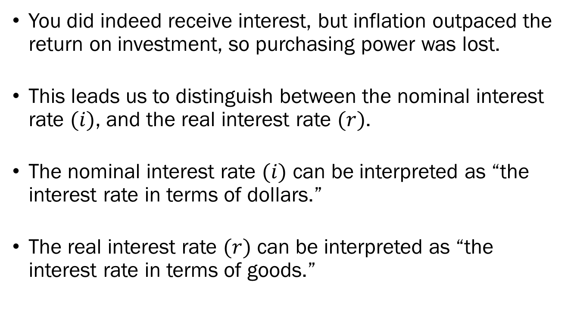
Nominal and Real Interest Rates
You did indeed receive interest, but inflation outpaced the return on investment, so purchasing power was lost.
This leads us to distinguish between the nominal interest rate $(i)$, and the real interest rate $(r)$.
The nominal interest rate $(i)$ can be interpreted as “the interest rate in terms of dollars.”
The real interest rate $(r)$ can be interpreted as “the interest rate in terms of goods.”

Slide 7
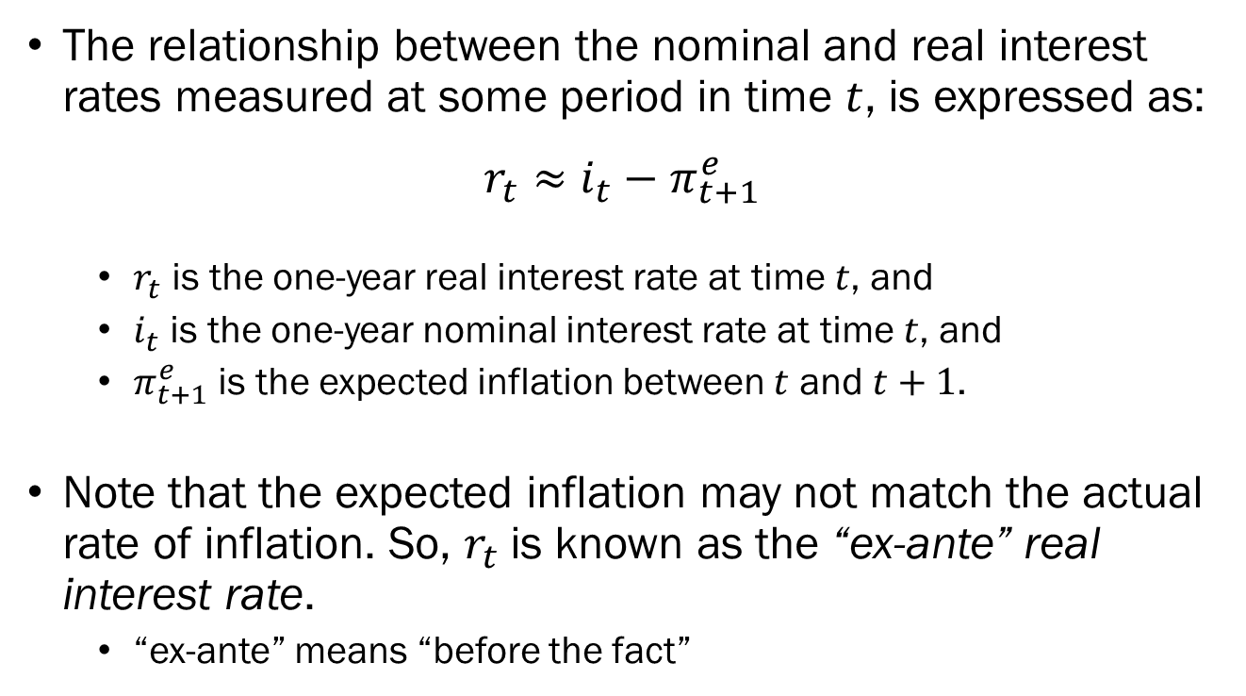
Nominal and Real Interest Rates
The relationship between the nominal and real interest rates measured at some period in time $t$, is expressed as:
$$r_{t}≈i_{t}−π_{t+1}^{e}$$
  $r_{t}$ is the one-year real interest rate at time $t$, and
  $i_{t}$ is the one-year nominal interest rate at time $t$, and
  $π_{t+1}^{e}$ is the expected inflation between $t$ and $t+1$.
Note that the expected inflation may not match the actual rate of inflation. So, $r_{t}$ is known as the “ex-ante” real interest rate.
  “ex-ante” means “before the fact”

Slide 8
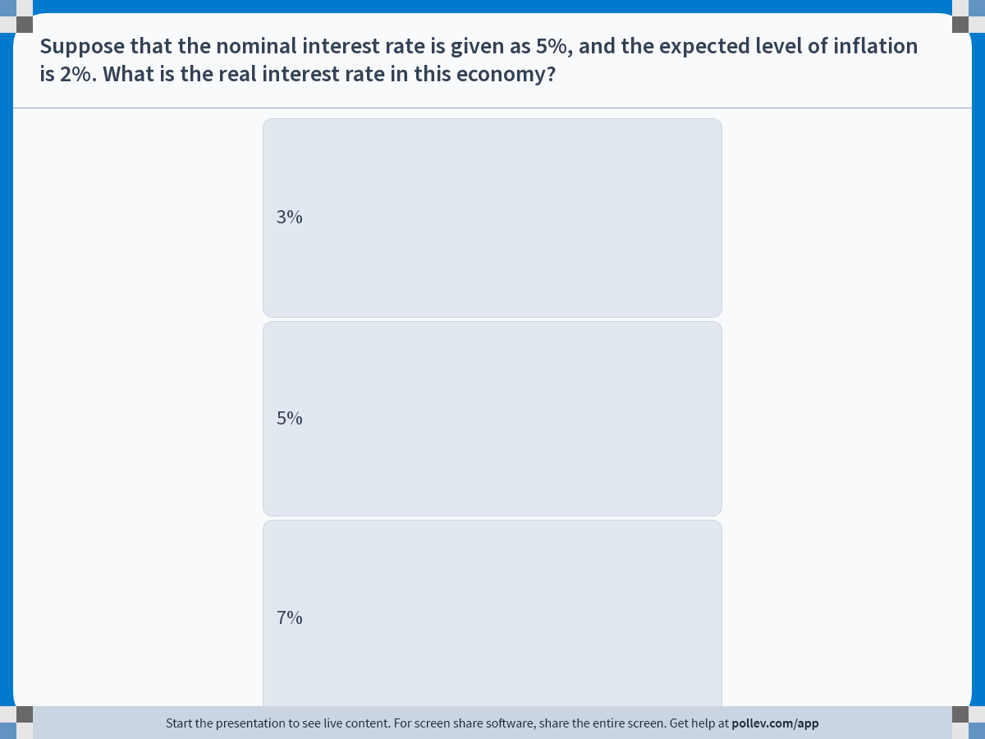
Notes:
Poll Title: Do not modify the notes in this section to avoid tampering with the Poll Everywhere activity.
More info at polleverywhere.com/support
Suppose that the nominal interest rate is given as 5%, and the expected level of inflation is 2%. What is the real interest rate in this economy?
https://www.polleverywhere.com/multiple_choice_polls/hh8WjZRjopxf2qSt68cwN?display_state=instructions&activity_state=opened&state=opened&flow=Engagement&onscreen=persist

Slide 9
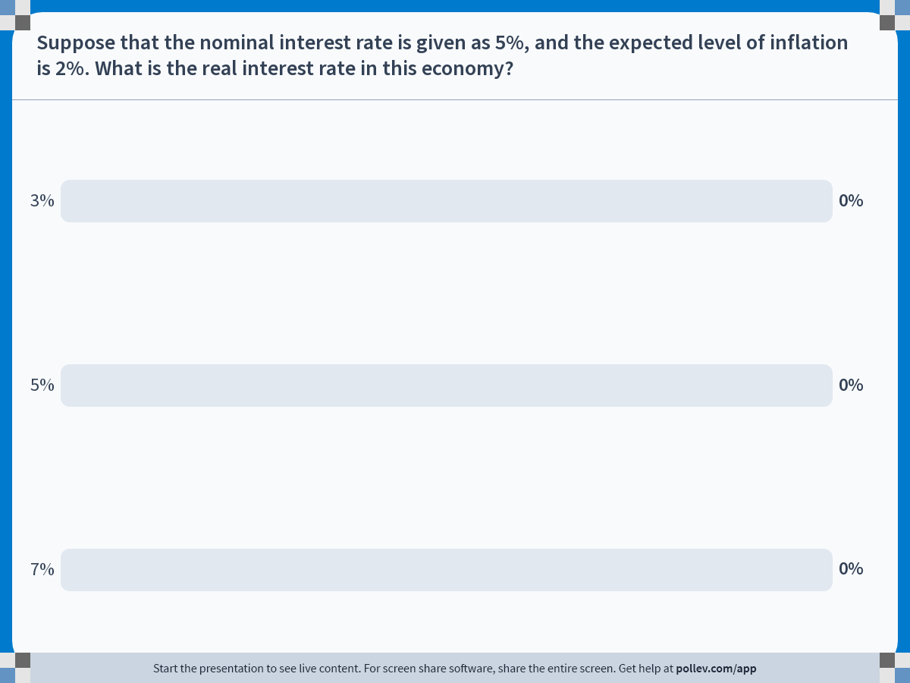
Notes:
Poll Title: Do not modify the notes in this section to avoid tampering with the Poll Everywhere activity.
More info at polleverywhere.com/support
Suppose that the nominal interest rate is given as 5%, and the expected level of inflation is 2%. What is the real interest rate in this economy?
https://www.polleverywhere.com/multiple_choice_polls/hh8WjZRjopxf2qSt68cwN?display_state=chart&activity_state=closed&state=closed&flow=Engagement&onscreen=persist

Slide 10
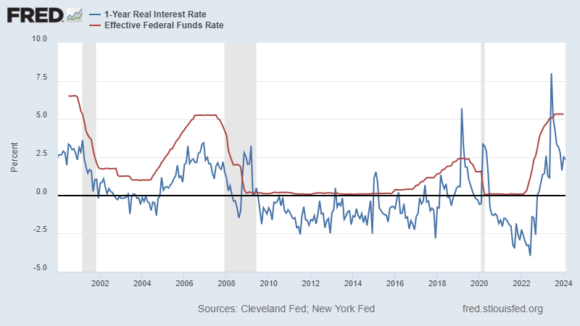
Nominal and Real Interest Rates

Slide 11
Risk and the Risk Premia
In the simple financial model, there were only two assets; money and bonds.
We assumed that there is only one type of bond, and that said bond had no risk of defaulting.
In the real-world, there are many different types of bonds.
  Different issuers, differing maturities, differing interest rates, etc.
This time, we will expand the model to include a measure of risk, and the premium associated with said risk.

Slide 12
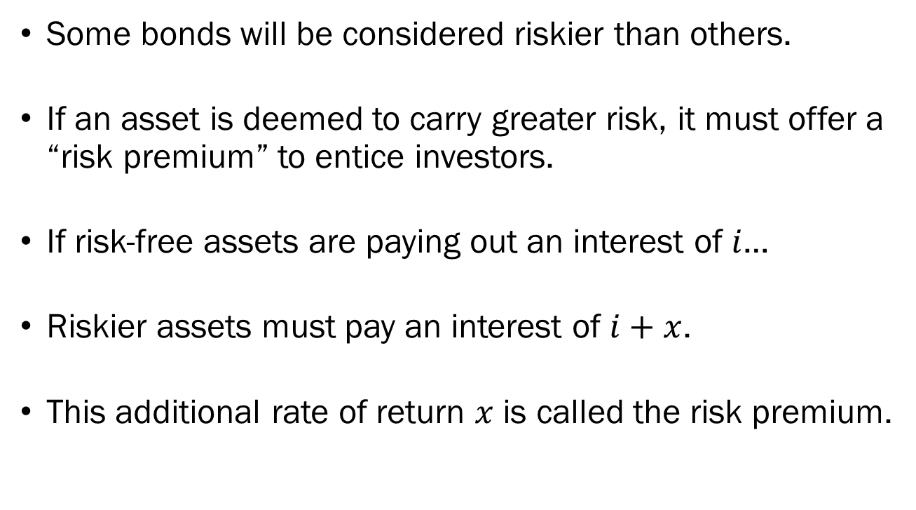
Risk and the Risk Premia
Some bonds will be considered riskier than others.
If an asset is deemed to carry greater risk, it must offer a “risk premium” to entice investors.
If risk-free assets are paying out an interest of $i$…
Riskier assets must pay an interest of $i+x$.
This additional rate of return $x$ is called the risk premium.

Slide 13
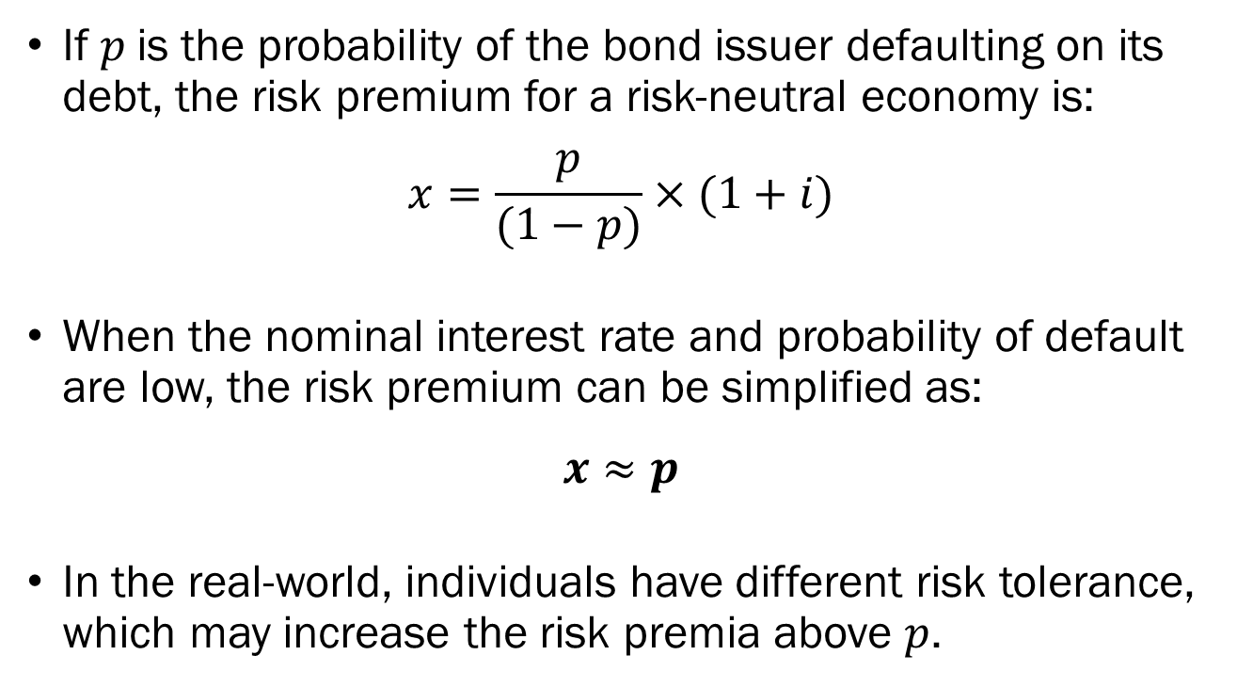
Risk and the Risk Premia
If $p$is the probability of the bond issuer defaulting on its debt, the risk premium for a risk-neutral economy is:
$$x=\frac{p}{(1−p)}×(1+i)$$
When the nominal interest rate and probability of default are low, the risk premium can be simplified as:
$$x≈p$$
In the real-world, individuals have different risk tolerance, which may increase the risk premia above $p$.

Slide 14
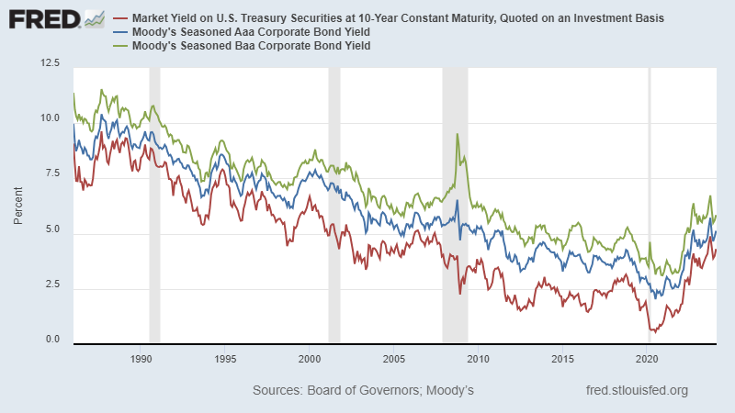
Risk and the Risk Premia

Slide 15
Financial Intermediaries
Another aspect of the financial market to consider is that households and firms do not partake in direct finance. That is, they don’t borrow money directly from the Fed.
Instead, they will rely on other financial intermediaries such as commercial banks, mortgage lenders, hedge funds, etc.
  Commercial Banks: JP Morgan Chase, Bank of America, etc.
  Mortgage Lenders: Mr. Cooper, Rocket Mortgage, etc.
  Hedge Funds: Bridgewater Associates, Quantum Group, etc.
The rates for individuals will be set by these intermediaries.

Slide 16
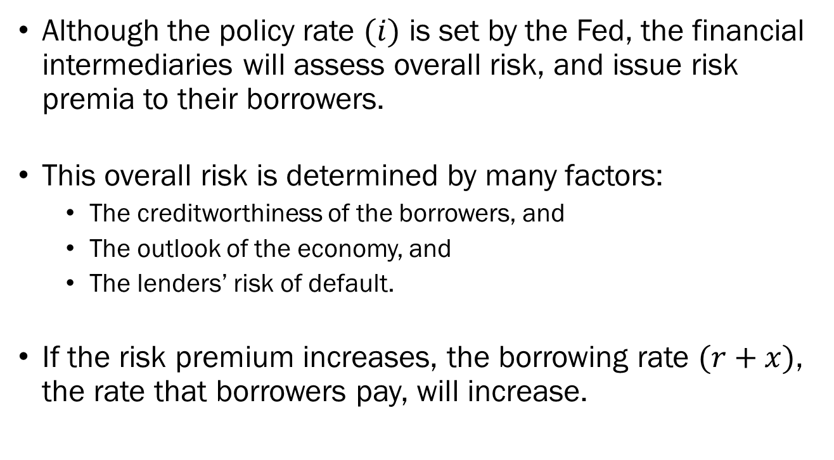
Financial Intermediaries
Although the policy rate $(i)$ is set by the Fed, the financial intermediaries will assess overall risk, and issue risk premia to their borrowers.
This overall risk is determined by many factors:
  The creditworthiness of the borrowers, and
  The outlook of the economy, and
  The lenders’ risk of default.
If the risk premium increases, the borrowing rate $(r+x)$, the rate that borrowers pay, will increase.

Slide 17
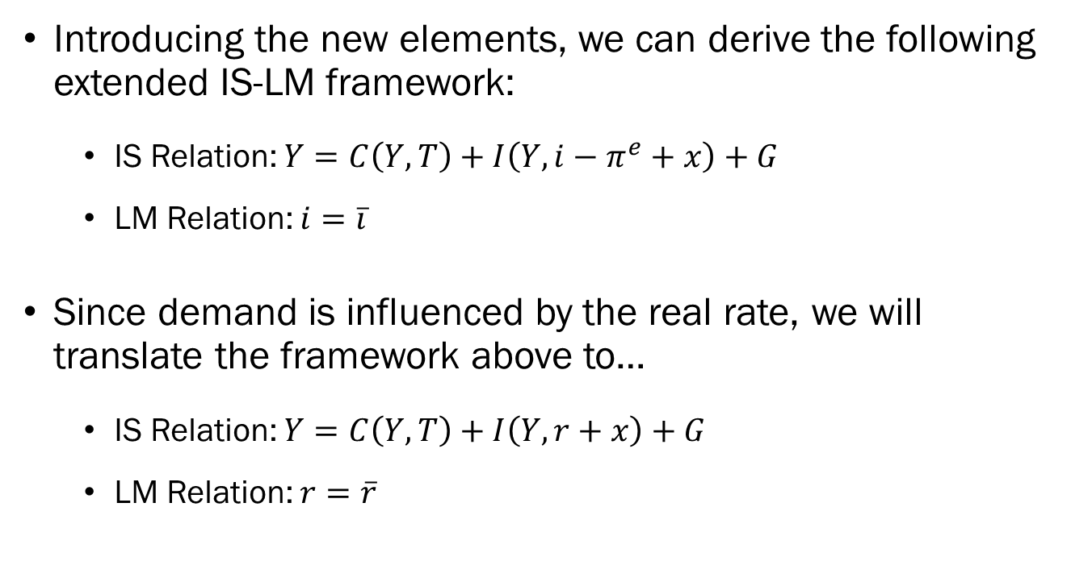
The Extended IS-LM Framework
Introducing the new elements, we can derive the following extended IS-LM framework:
  IS Relation: $Y=C\left(Y,T\right)+I\left(Y,i−π^{e}+x\right)+G$
  LM Relation: $i=\overline{i}$
Since demand is influenced by the real rate, we will translate the framework above to…
  IS Relation: $Y=C\left(Y,T\right)+I\left(Y,r+x\right)+G$
  LM Relation: $r=\overline{r}$

Slide 18
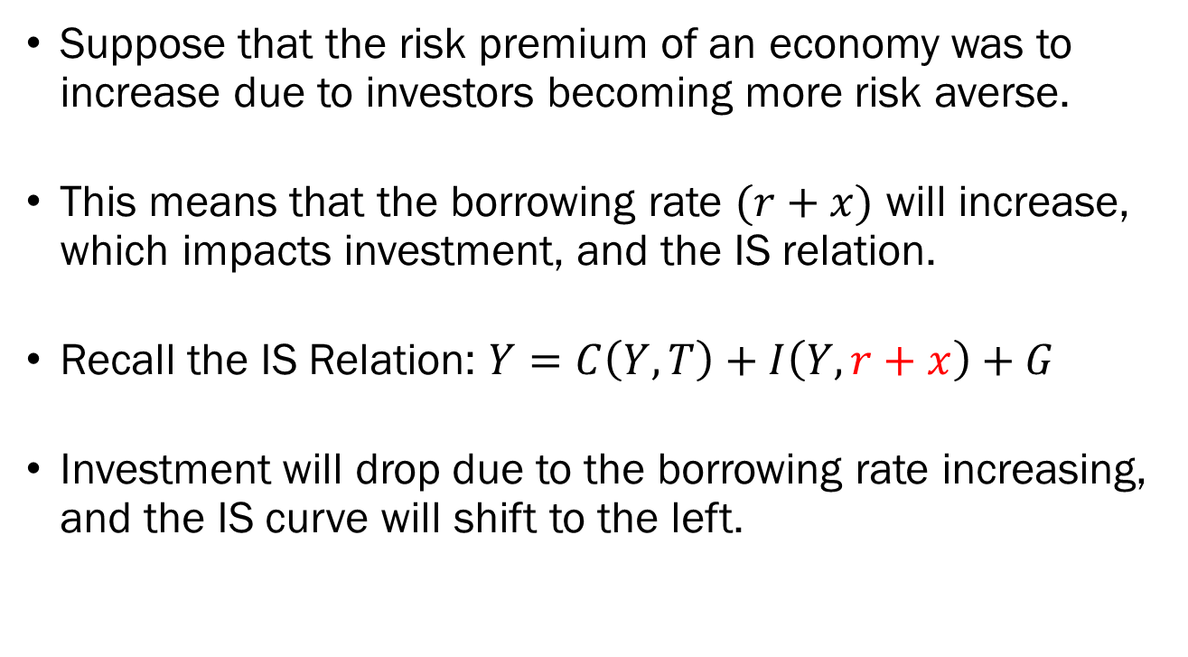
The Extended IS-LM Framework
Suppose that the risk premium of an economy was to increase due to investors becoming more risk averse.
This means that the borrowing rate $(r+x)$ will increase, which impacts investment, and the IS relation.
Recall the IS Relation: $Y=C\left(Y,T\right)+I\left(Y,r+x\right)+G$
Investment will drop due to the borrowing rate increasing, and the IS curve will shift to the left.

Slide 19










The Extended IS-LM Framework
Due to influences from the financial market, the IS curve, which represents the goods market, shifts from $IS$ to $IS^{′}$.
The equilibrium will shift from point $A$ to point $A^{′}$ along the LM curve.
The policy rate will remain at $\overline{r}$, and the equilibrium output will drop from $Y^{∗}$ to $Y^{∗′}$.
Real Interest Rate
$$A^{′}$$
$$A$$
$$LM$$
$$\overline{r}$$
$$0$$
$$Y^{∗′}$$
$$Y^{∗}$$
Output
$$IS$$
$$IS^{′}$$

Slide 20
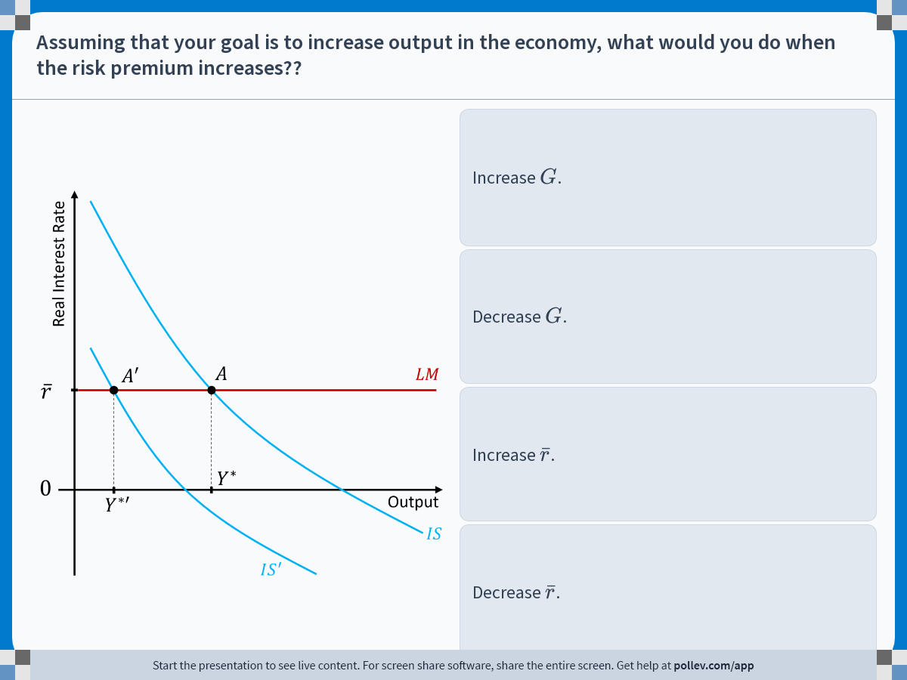
Notes:
Poll Title: Do not modify the notes in this section to avoid tampering with the Poll Everywhere activity.
More info at polleverywhere.com/support
Assuming that your goal is to increase output in the economy, what would you do when the risk premium increases??
https://www.polleverywhere.com/multiple_choice_polls/KpAuUUKhLX5IG9psWKCD5?display_state=instructions&activity_state=opened&state=opened&flow=Engagement&onscreen=persist

Slide 21
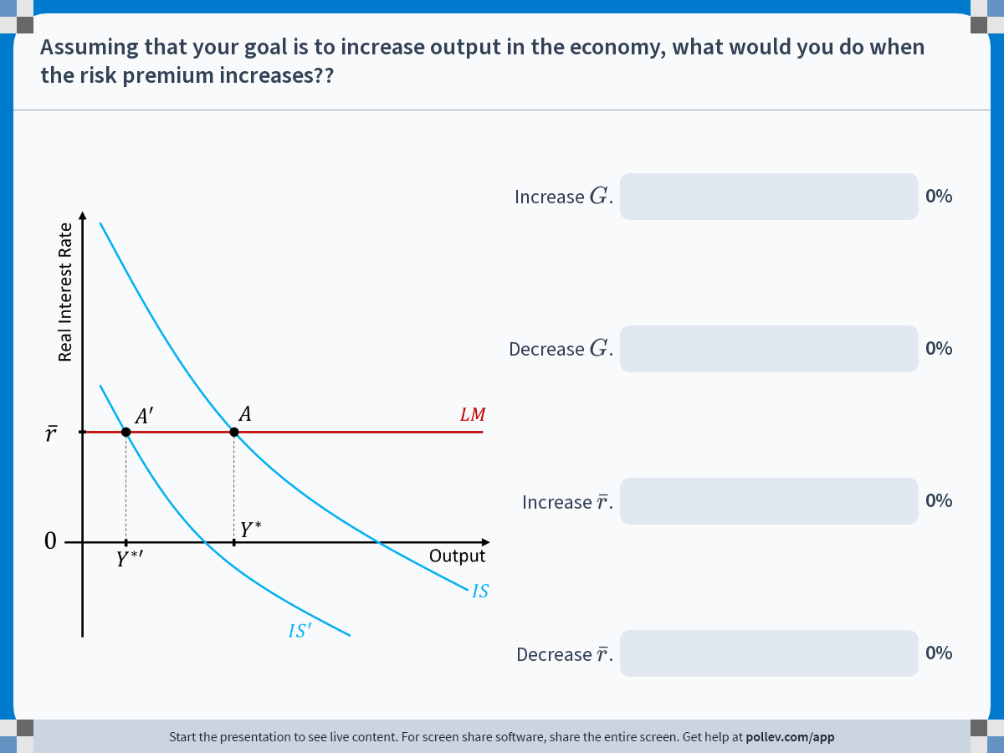
Notes:
Poll Title: Do not modify the notes in this section to avoid tampering with the Poll Everywhere activity.
More info at polleverywhere.com/support
Assuming that your goal is to increase output in the economy, what would you do when the risk premium increases??
https://www.polleverywhere.com/multiple_choice_polls/KpAuUUKhLX5IG9psWKCD5?display_state=chart&activity_state=closed&state=closed&flow=Engagement&onscreen=persist

Slide 22
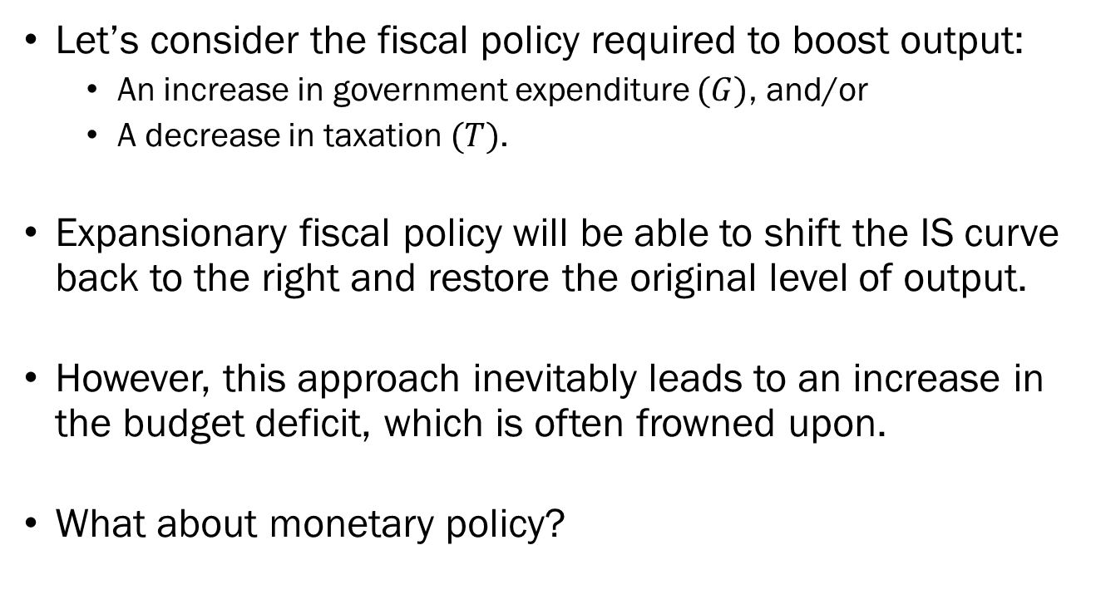
The Extended IS-LM Framework
Let’s consider the fiscal policy required to boost output:
  An increase in government expenditure $(G)$, and/or
  A decrease in taxation $(T)$.
Expansionary fiscal policy will be able to shift the IS curve back to the right and restore the original level of output.
However, this approach inevitably leads to an increase in the budget deficit, which is often frowned upon.
What about monetary policy?

Slide 23


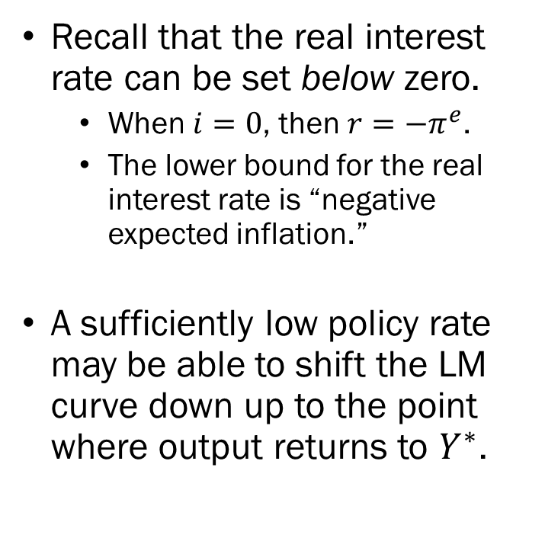


The Extended IS-LM Framework
Recall that the real interest rate can be set below zero.
  When $i=0$, then $r=−π^{e}$.
  The lower bound for the real interest rate is “negative expected inflation.”
A sufficiently low policy rate may be able to shift the LM curve down up to the point where output returns to $Y^{∗}$.
Real Interest Rate
$$A^{′}$$
$$A$$
$$LM$$
$$\overline{r}$$
$$0$$
$$Y^{∗′}$$
$$Y^{∗}$$
Output
$$\overline{r^{′}}$$
$$LM^{′}$$
$$A^{′′}$$
$$IS$$
$$IS^{′}$$

Slide 24
The Extended IS-LM Framework
By extending the IS-LM framework, we can now explain how crises in the financial sector may affect the “real” side of the economy.
Prior to the Financial Crisis of 2008, many economists believed that the impact of declining housing prices would cause issues in the financial market.
However, most of said economists believed that the effect of this disruption would be mild.
This was definitely not the case…

Slide 25
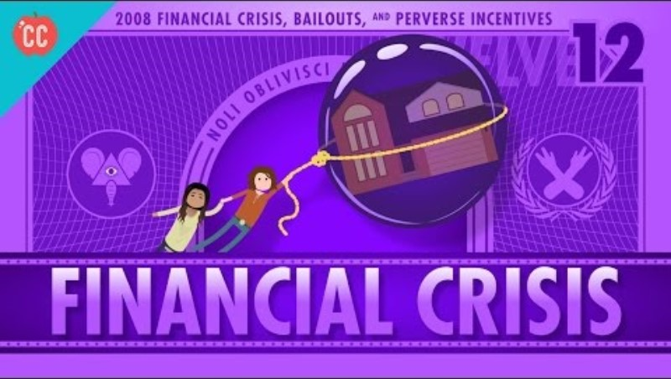
The Great Recession

Slide 26
The Great Recession
As the economy fell deeper into a financial crisis, interest rates increased while consumer / producer confidence dropped sharply.
Due to the higher cost of borrowing and lower confidence in the economy, the demand for goods also dropped.
In the IS-LM Framework, this translates to the IS curve shifting to the left.
Both the Fed and the government conducted expansionary policies as a reaction to the crisis.

Slide 27
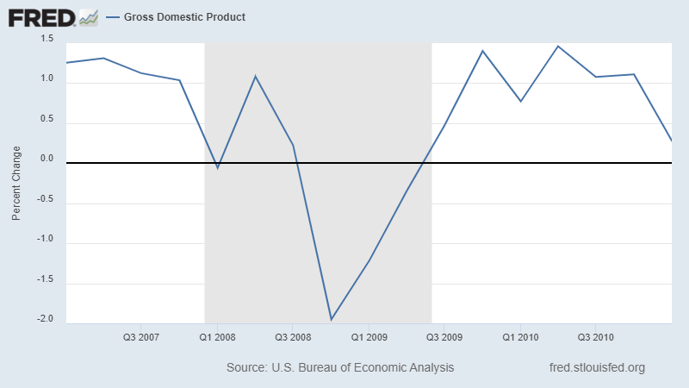
The Great Recession: The Scope

Slide 28
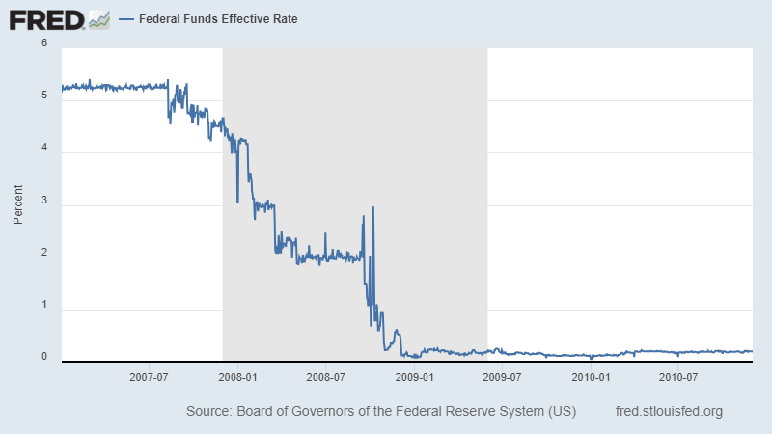
The Great Recession: Responses

Slide 29
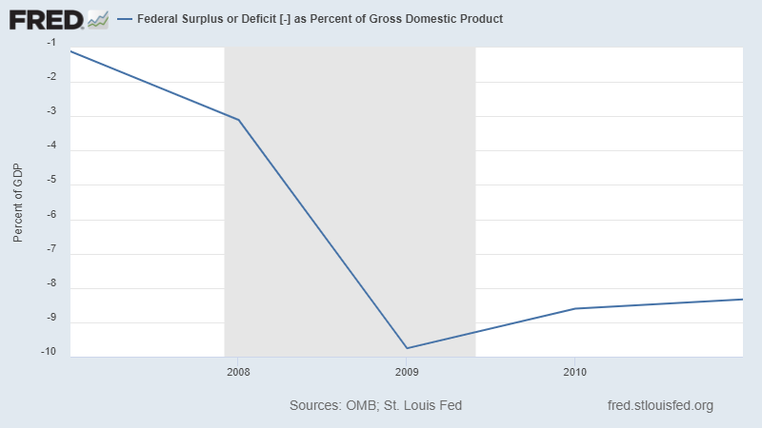
The Great Recession: Responses

Slide 30


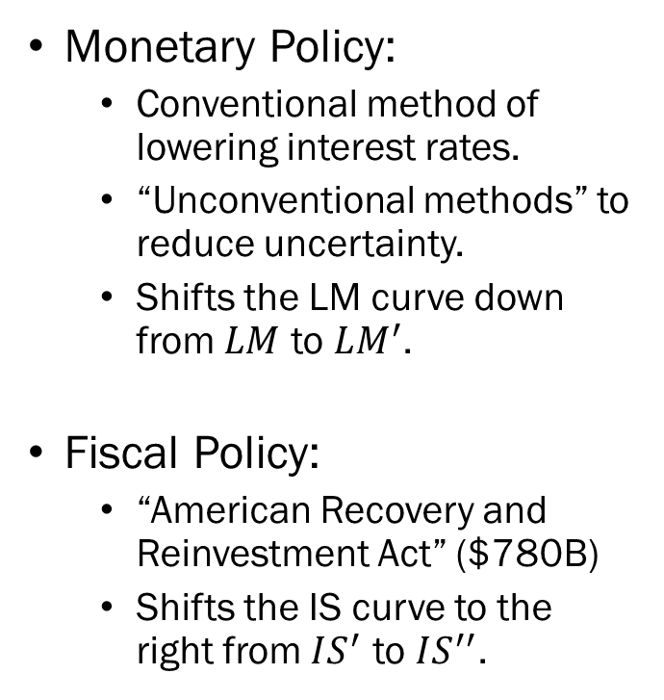








The Great Recession: Responses
Monetary Policy:
  Conventional method of lowering interest rates.
  “Unconventional methods” to reduce uncertainty.
  Shifts the LM curve down from $LM$ to $LM^{′}$.
Fiscal Policy:
  “American Recovery and Reinvestment Act” ($780B)
  Shifts the IS curve to the right from $IS^{′}$ to $IS^{′′}$.
Real Interest Rate
$$A^{′}$$
$$A$$
$$LM$$
$$\overline{r}$$
$$A^{′′}$$
$$LM^{′}$$
$$\overline{r^{′}}$$
$$0$$
$$Y^{∗′}$$
$$Y^{∗′′}$$
Output
$$Y^{∗}$$
$$IS$$
$$IS^{′′}$$
$$IS^{′}$$

Slide 31
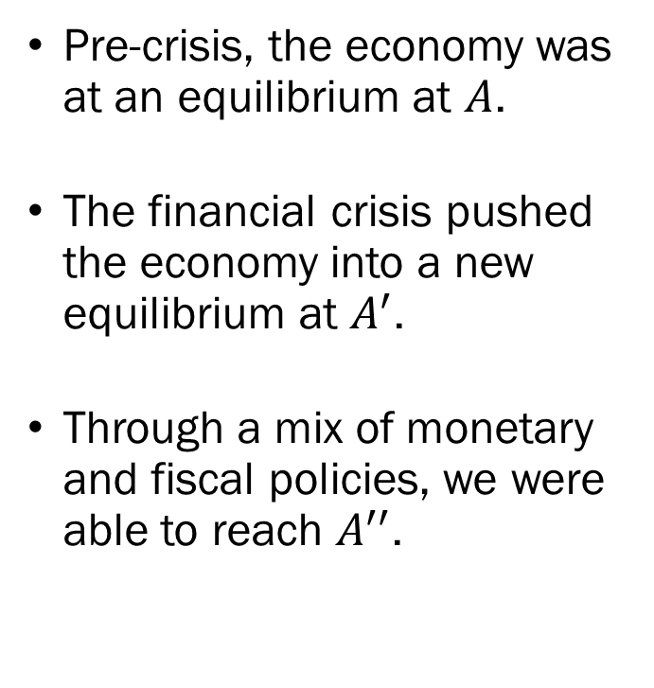
The Great Recession: Responses
Pre-crisis, the economy was at an equilibrium at $A$.
The financial crisis pushed the economy into a new equilibrium at $A^{′}$.
Through a mix of monetary and fiscal policies, we were able to reach $A^{′′}$.
Real Interest Rate
$$A^{′}$$
$$A$$
$$LM$$
$$\overline{r}$$
$$A^{′′}$$
$$LM^{′}$$
$$\overline{r^{′}}$$
$$0$$
$$Y^{∗′}$$
$$Y^{∗′′}$$
Output
$$Y^{∗}$$
$$IS$$
$$IS^{′′}$$
$$IS^{′}$$

Slide 32
Appendix
You will not be asked to replicate these steps that are shown in the appendix section of the lecture notes.
These are included as optional reading material for those who are interested in how we derive the relation between the nominal and real interest rates, or how risk premia are calculated.
While you do not need to know how these relationships are derived, you will still need to know the results themselves.

Slide 33
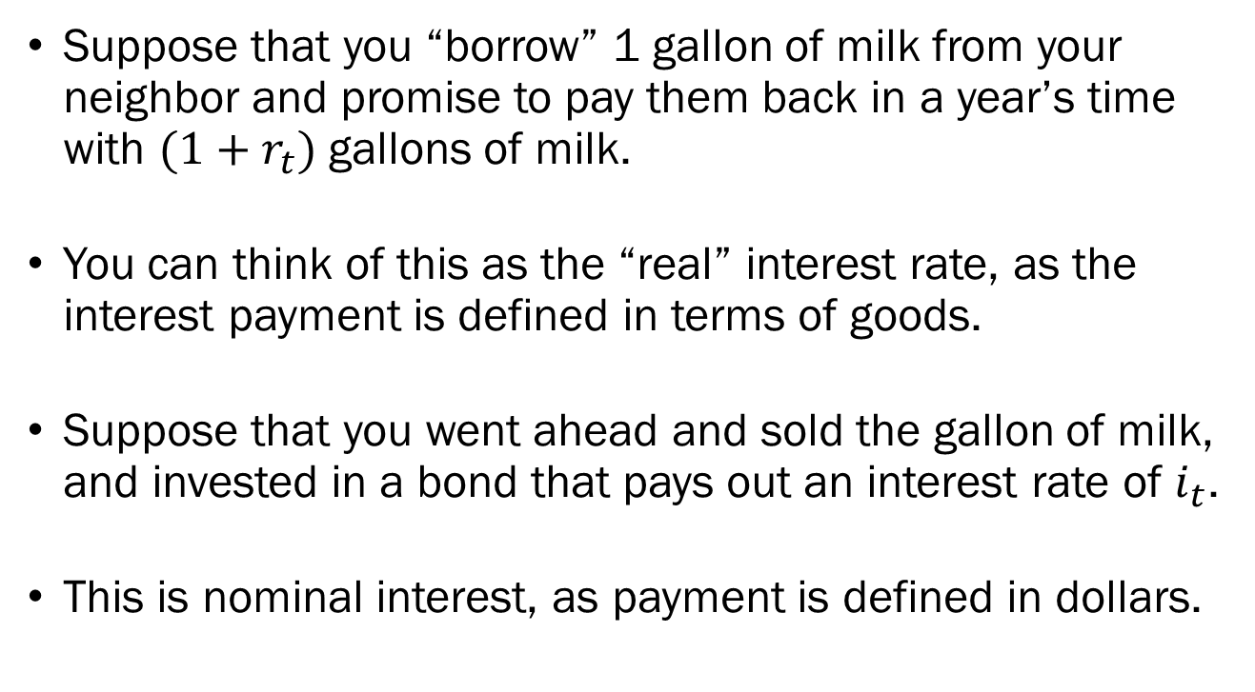
Appendix:
Deriving the Real Interest Rate
Suppose that you “borrow” 1 gallon of milk from your neighbor and promise to pay them back in a year’s time with $(1+r_{t})$ gallons of milk.
You can think of this as the “real” interest rate, as the interest payment is defined in terms of goods.
Suppose that you went ahead and sold the gallon of milk, and invested in a bond that pays out an interest rate of $i_{t}$.
This is nominal interest, as payment is defined in dollars.

Slide 34
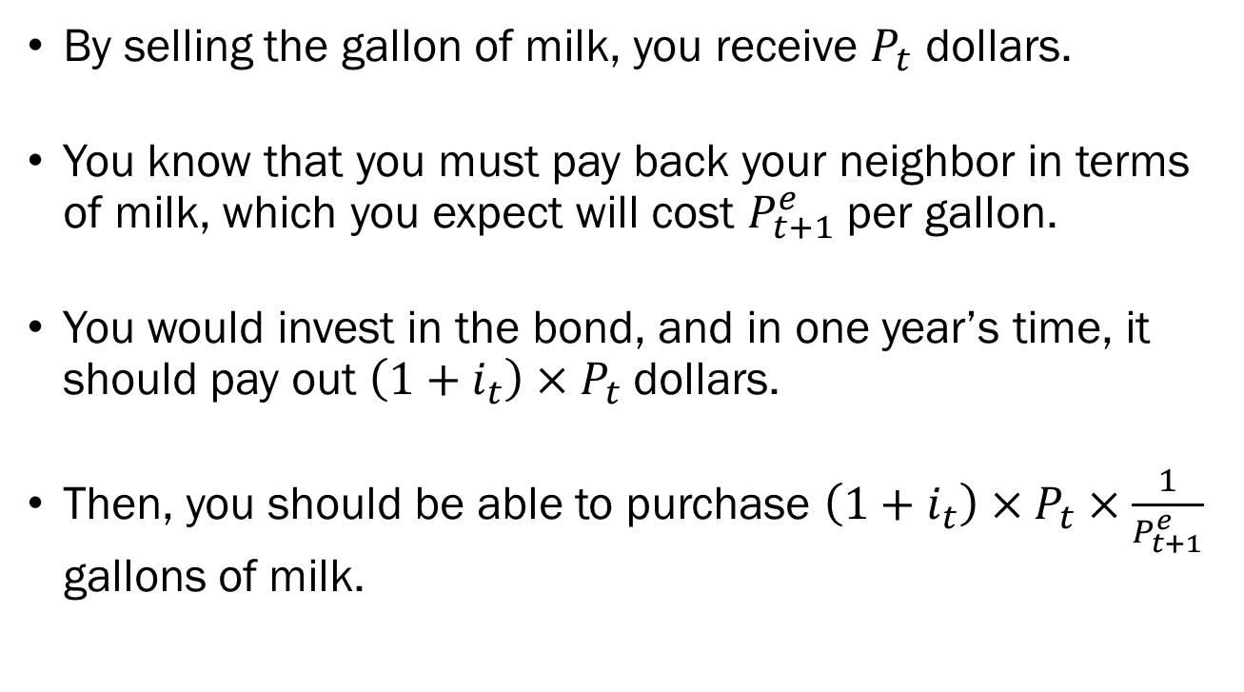
Appendix:
Deriving the Real Interest Rate
By selling the gallon of milk, you receive $P_{t}$ dollars.
You know that you must pay back your neighbor in terms of milk, which you expect will cost $P_{t+1}^{e}$ per gallon.
You would invest in the bond, and in one year’s time, it should pay out $\left(1+i_{t}\right)×P_{t}$ dollars.
Then, you should be able to purchase $\left(1+i_{t}\right)×P_{t}×\frac{1}{P_{t+1}^{e}}$ gallons of milk.

Slide 35
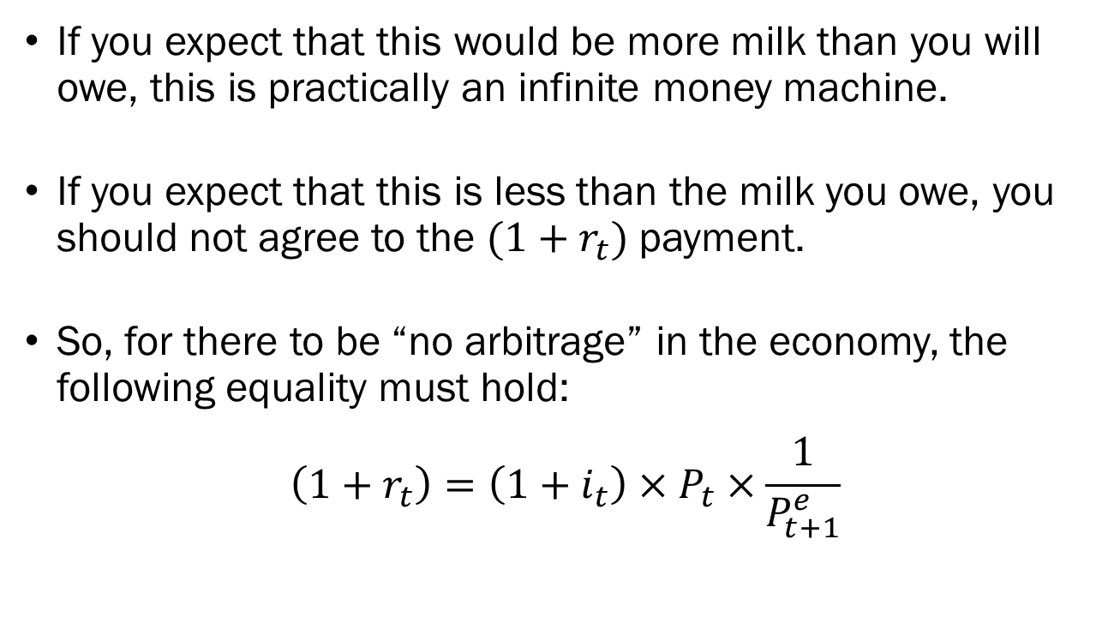
Appendix:
Deriving the Real Interest Rate
If you expect that this would be more milk than you will owe, this is practically an infinite money machine.
If you expect that this is less than the milk you owe, you should not agree to the $(1+r_{t})$ payment.
So, for there to be “no arbitrage” in the economy, the following equality must hold:
$$\left(1+r_{t}\right)=\left(1+i_{t}\right)×P_{t}×\frac{1}{P_{t+1}^{e}}$$

Slide 36
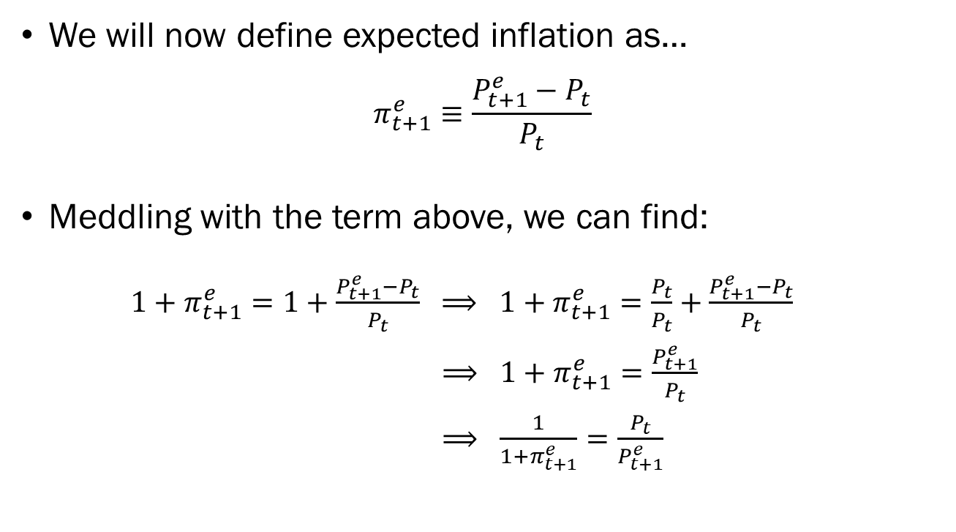
Appendix:
Deriving the Real Interest Rate
We will now define expected inflation as…
$$π_{t+1}^{e}≡\frac{P_{t+1}^{e}−P_{t}}{P_{t}}$$
Meddling with the term above, we can find:
${1+π}_{t+1}^{e}=1+\frac{P_{t+1}^{e}−P_{t}}{P_{t}} ⟹ {1+π}_{t+1}^{e}=\frac{P_{t}}{P_{t}}+\frac{P_{t+1}^{e}−P_{t}}{P_{t}}$
$⟹ {1+π}_{t+1}^{e}=\frac{P_{t+1}^{e}}{P_{t}}$
$⟹ \frac{1}{{1+π}_{t+1}^{e}}=\frac{P_{t}}{P_{t+1}^{e}}$

Slide 37
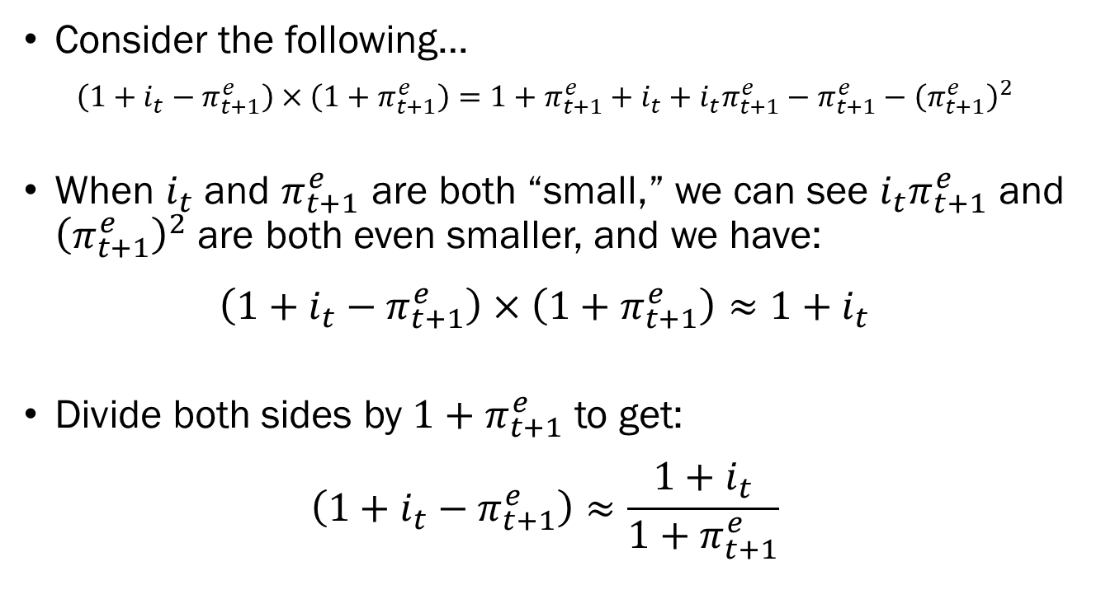
Appendix:
Deriving the Real Interest Rate
Consider the following…
$$\left(1+i_{t}−π_{t+1}^{e}\right)×\left(1+π_{t+1}^{e}\right)=1+π_{t+1}^{e}+i_{t}+i_{t}π_{t+1}^{e}−π_{t+1}^{e}−{\left(π_{t+1}^{e}\right)}^{2}$$
When $i_{t}$ and $π_{t+1}^{e}$ are both “small,” we can see $i_{t}π_{t+1}^{e}$ and ${\left(π_{t+1}^{e}\right)}^{2}$ are both even smaller, and we have:
$$\left(1+i_{t}−π_{t+1}^{e}\right)×\left(1+π_{t+1}^{e}\right)≈1+i_{t}$$
Divide both sides by $1+π_{t+1}^{e}$ to get:
$$\left(1+i_{t}−π_{t+1}^{e}\right)≈\frac{1+i_{t}}{1+π_{t+1}^{e}}$$

Slide 38
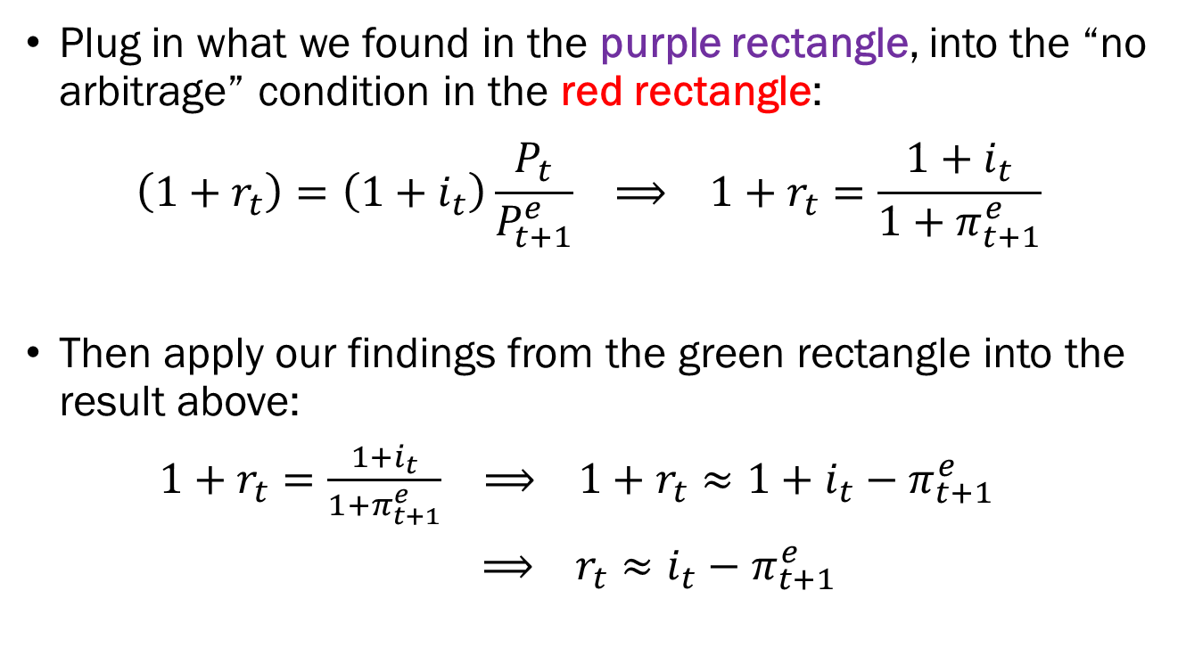
Appendix:
Deriving the Real Interest Rate
Plug in what we found in the purple rectangle, into the “no arbitrage” condition in the red rectangle:
$$\left(1+r_{t}\right)=\left(1+i_{t}\right)\frac{P_{t}}{P_{t+1}^{e}} ⟹ 1+r_{t}=\frac{1+i_{t}}{{1+π}_{t+1}^{e}}$$
Then apply our findings from the green rectangle into the result above:
$1+r_{t}=\frac{1+i_{t}}{{1+π}_{t+1}^{e}} ⟹ 1+r_{t}≈1+i_{t}−π_{t+1}^{e}$
$⟹ r_{t}≈i_{t}−π_{t+1}^{e}$

Slide 39
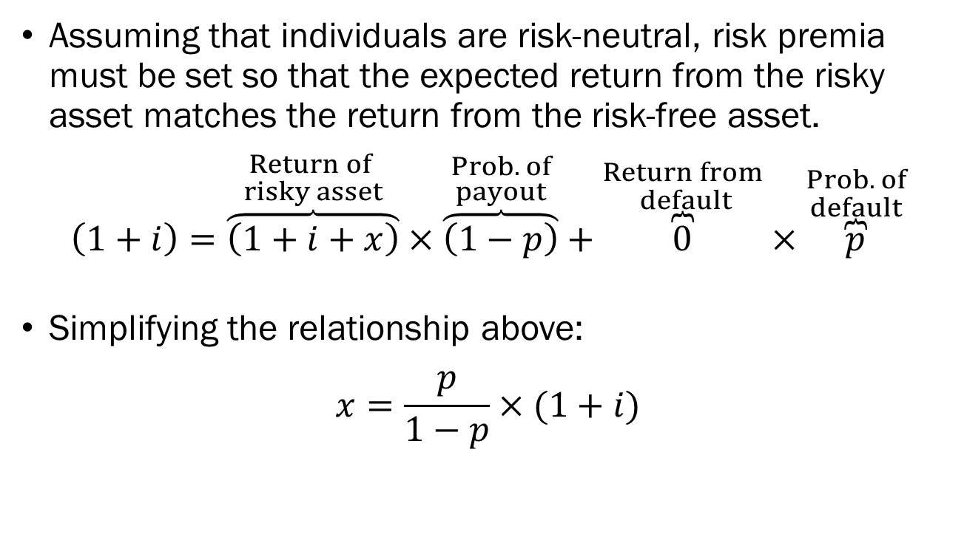
Appendix:
Deriving the Risk Premium
Assuming that individuals are risk-neutral, risk premia must be set so that the expected return from the risky asset matches the return from the risk-free asset.
$$\left(1+i\right)=\overset{\begin{aligned}Return of \\ risky asset\end{aligned}}{\overbrace{\left(1+i+x\right)}}×\overset{\begin{aligned}Prob. of \\ payout\end{aligned}}{\overbrace{\left(1−p\right)}}+\overset{\begin{aligned}Return from \\ default\end{aligned}}{\overbrace{0}}×\overset{\begin{aligned}Prob. of \\ default\end{aligned}}{\overbrace{p}}$$
Simplifying the relationship above:
$$x=\frac{p}{1−p}×(1+i)$$

