Slide 1
The Short Run:
The Goods Market
ECON 301

Slide 2
The Short Run
We build towards a model that explains the equilibrium in the goods and financial markets.
First, we examine the goods market to determine the level of output for the economy.
Then, we analyze the financial market to determine the optimal interest rates.
Once we have the two, we will build toward a model that combines them to reveal the short run equilibrium in the economy.

Slide 3
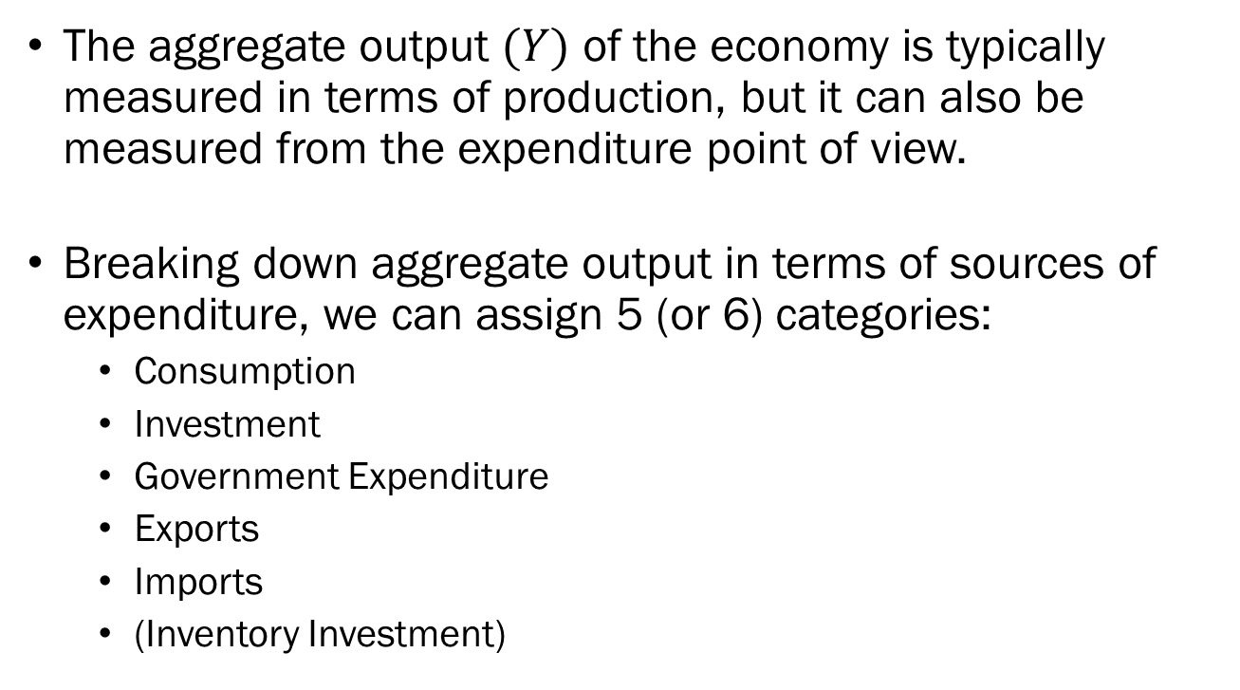
Aggregate Output
The aggregate output $(Y)$ of the economy is typically measured in terms of production, but it can also be measured from the expenditure point of view.
Breaking down aggregate output in terms of sources of expenditure, we can assign 5 (or 6) categories:
  Consumption
  Investment
  Government Expenditure
  Exports
  Imports
  (Inventory Investment)

Slide 4
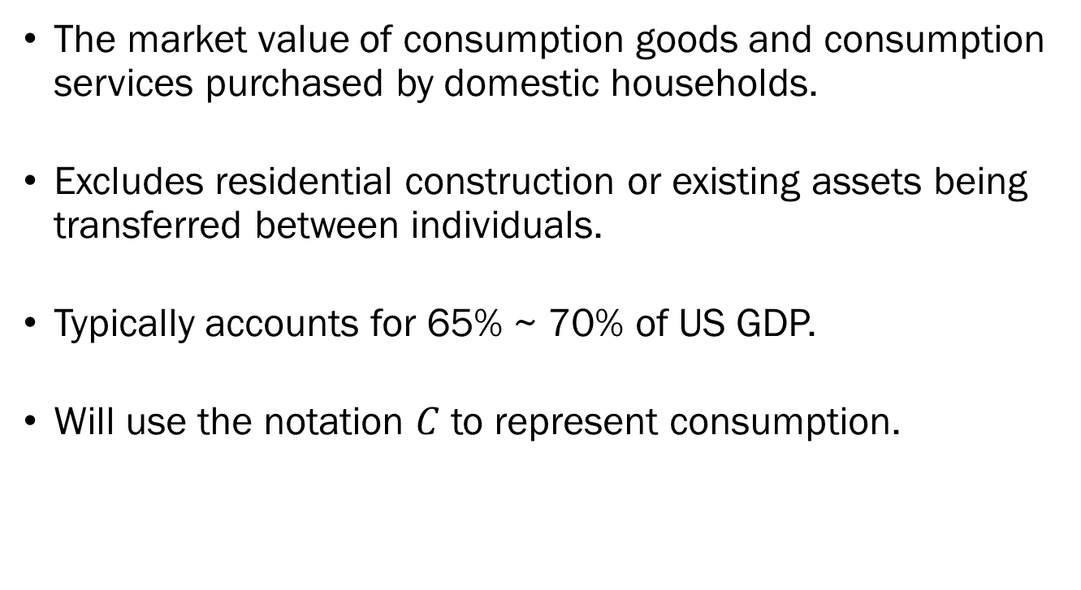
Consumption
The market value of consumption goods and consumption services purchased by domestic households.
Excludes residential construction or existing assets being transferred between individuals.
Typically accounts for 65% ~ 70% of US GDP.
Will use the notation $C$ to represent consumption.

Slide 5
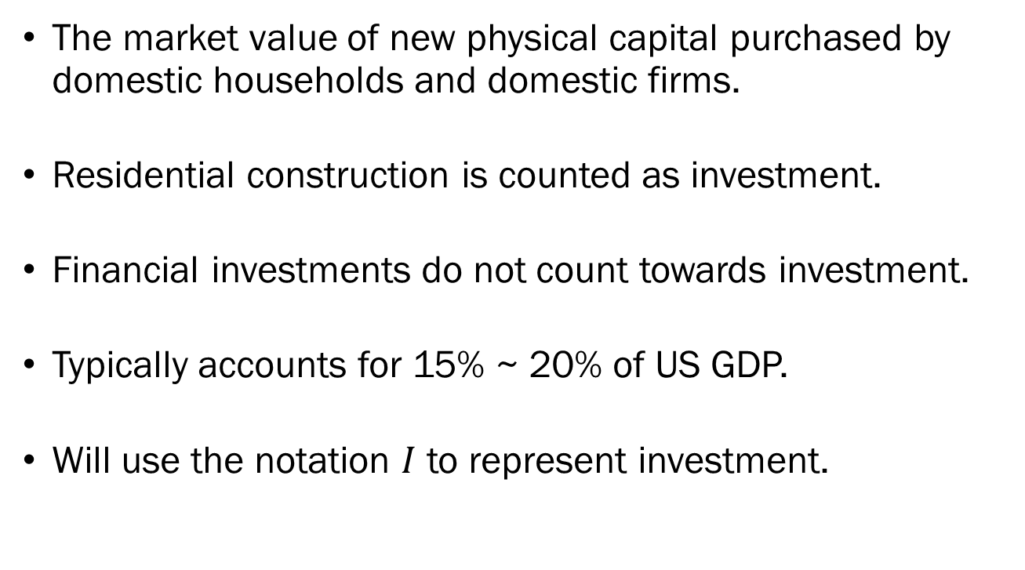
Investment
The market value of new physical capital purchased by domestic households and domestic firms.
Residential construction is counted as investment.
Financial investments do not count towards investment.
Typically accounts for 15% ~ 20% of US GDP.
Will use the notation $I$ to represent investment.

Slide 6
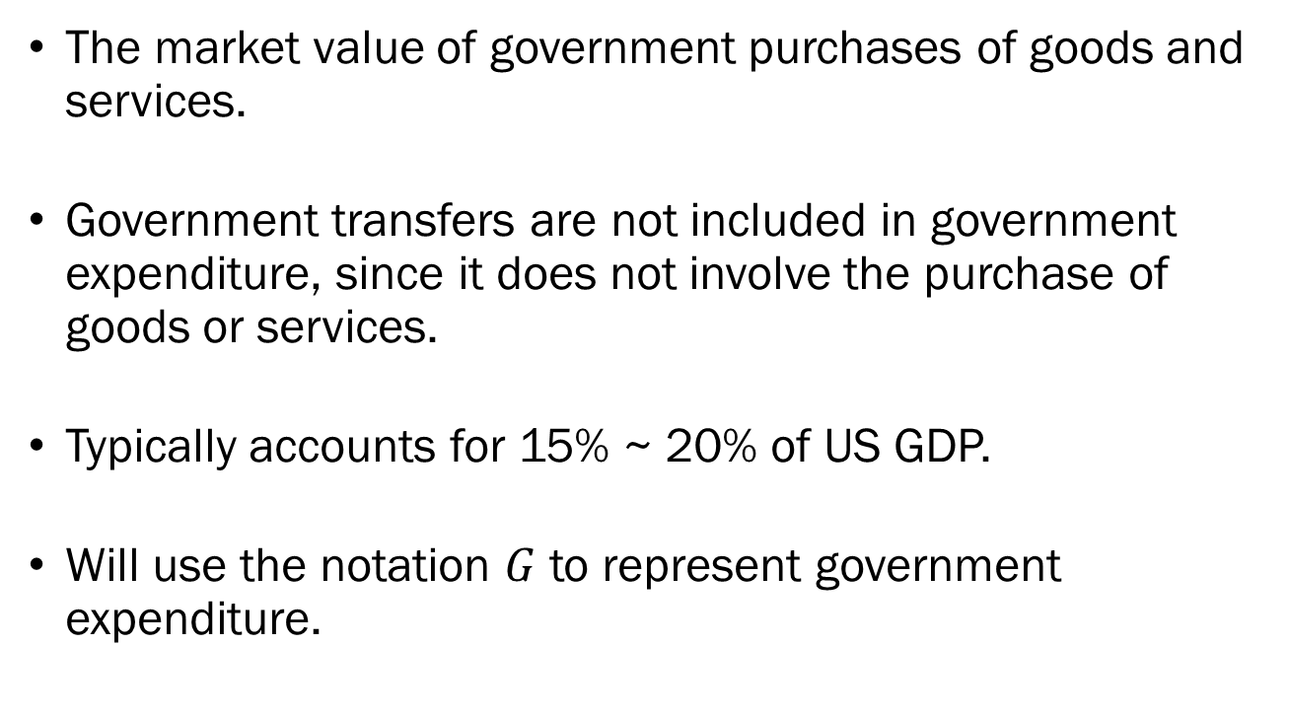
Government Expenditure
The market value of government purchases of goods and services.
Government transfers are not included in government expenditure, since it does not involve the purchase of goods or services.
Typically accounts for 15% ~ 20% of US GDP.
Will use the notation $G$ to represent government expenditure.

Slide 7
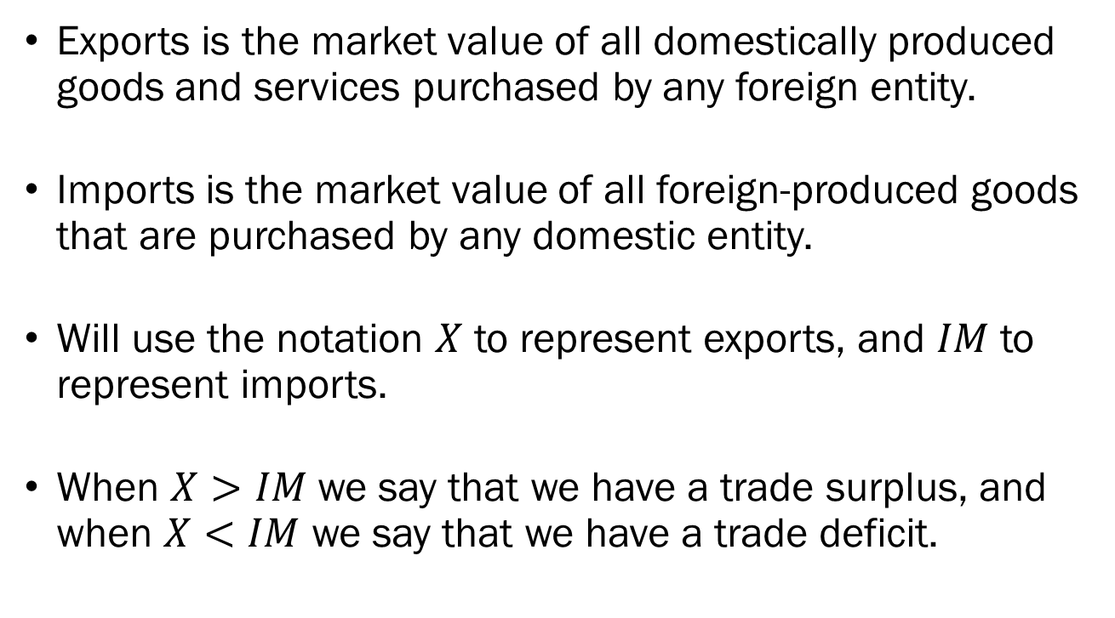
Exports and Imports
Exports is the market value of all domestically produced goods and services purchased by any foreign entity.
Imports is the market value of all foreign-produced goods that are purchased by any domestic entity.
Will use the notation $X$ to represent exports, and $IM$ to represent imports.
When $X>IM$ we say that we have a trade surplus, and when $X<IM$ we say that we have a trade deficit.

Slide 8
Inventory Investment
Inventory investment refers to the market value of goods produced domestically which have not been purchased in a given year.
If more goods are produced than are consumed, inventory investment is positive.
If more goods are consumed than produced, inventory investment is negative.

Slide 9
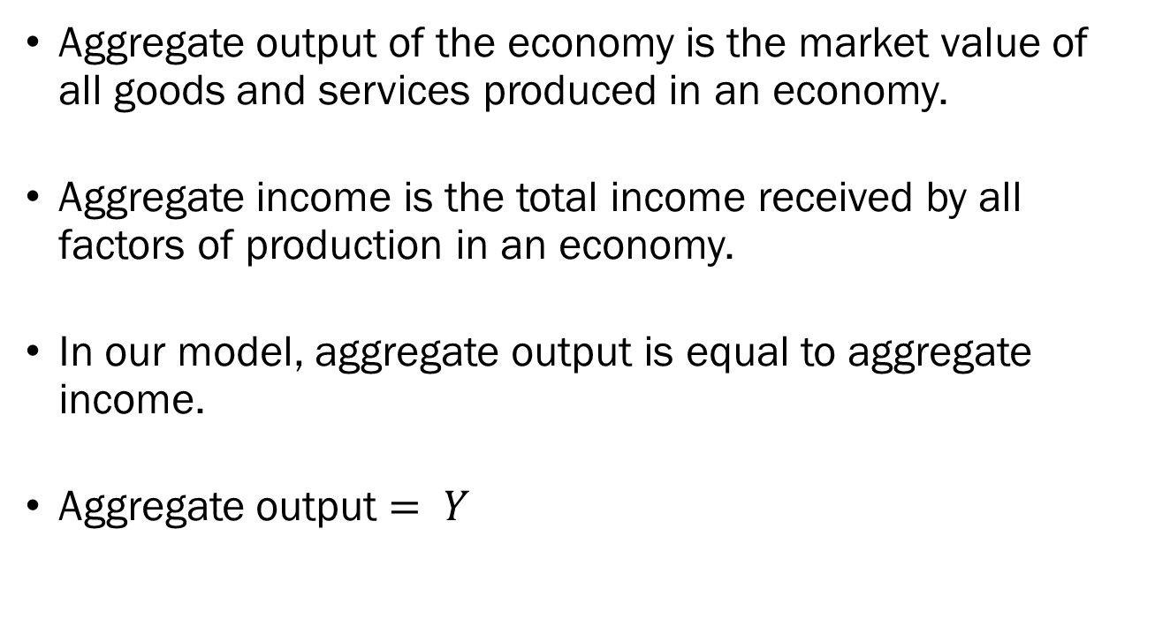
Aggregate Output and Income
Aggregate output of the economy is the market value of all goods and services produced in an economy.
Aggregate income is the total income received by all factors of production in an economy.
In our model, aggregate output is equal to aggregate income.
Aggregate output $= Y$

Slide 10
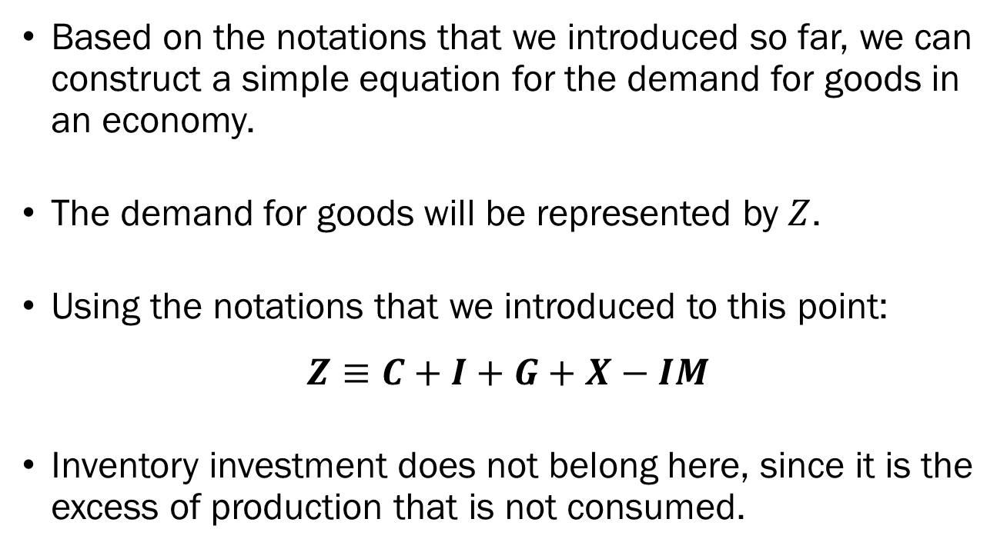
The Demand for Goods
Based on the notations that we introduced so far, we can construct a simple equation for the demand for goods in an economy.
The demand for goods will be represented by $Z$.
Using the notations that we introduced to this point:
$$Z≡C+I+G+X−IM$$
Inventory investment does not belong here, since it is the excess of production that is not consumed.

Slide 11
The Demand for Goods
We will make some simplifying assumptions…
Assume that there is only one good in the economy that is produced and purchased.
Assume that firms are willing and able to produce any amount of this good that is demanded in the economy.
  In the medium-run, we will abandon this assumption.
Assume a closed economy with no exports nor imports.
  We will expand our model for the open economy in the future.

Slide 12
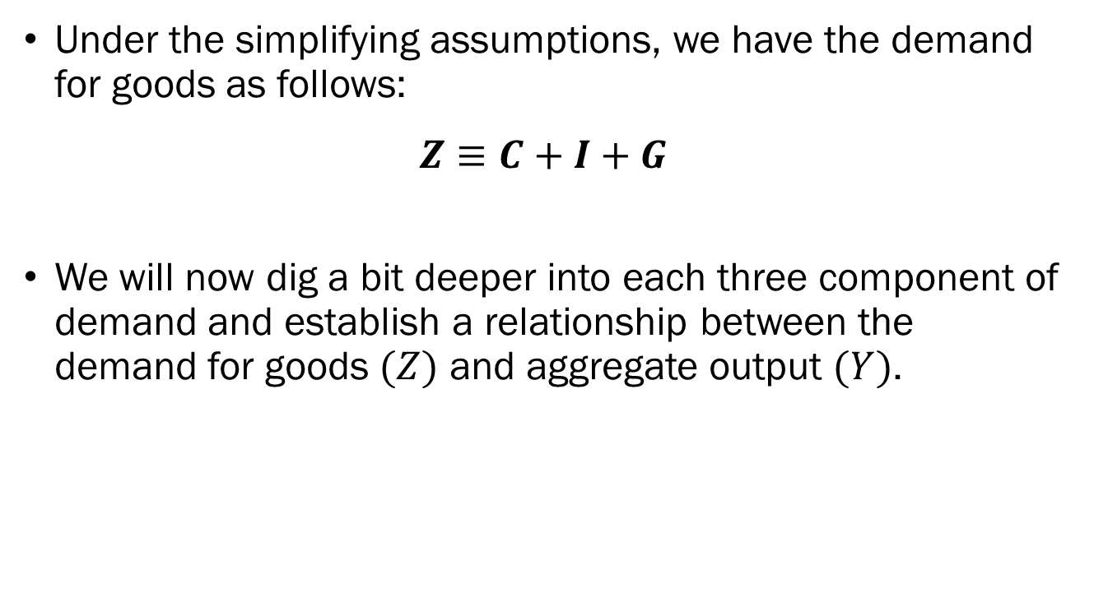
The Demand for Goods
Under the simplifying assumptions, we have the demand for goods as follows:
$$Z≡C+I+G$$
We will now dig a bit deeper into each three component of demand and establish a relationship between the demand for goods $(Z)$ and aggregate output $(Y)$.

Slide 13
Modelling Consumption
In the real world, households’ consumption will depend on countless variables.
For the sake of simplicity, we will assume that it can be broken down into two distinct parts.
  Households will increase their consumption as their income increases, and
  Even when income is zero, households will still consume some amount of goods and services.
Based on this criteria, we will construct a simple equation describing households’ consumption.

Slide 14
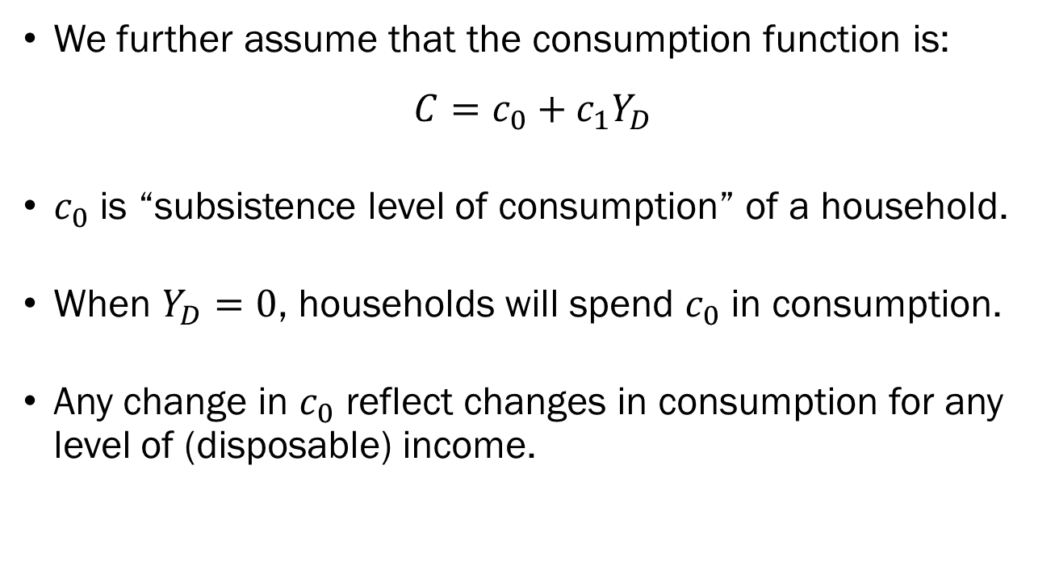
Modelling Consumption
We further assume that the consumption function is:
$$C=c_{0}+c_{1}Y_{D}$$
$c_{0}$ is “subsistence level of consumption” of a household.
When $Y_{D}=0$, households will spend $c_{0}$ in consumption.
Any change in $c_{0}$ reflect changes in consumption for any level of (disposable) income.

Slide 15
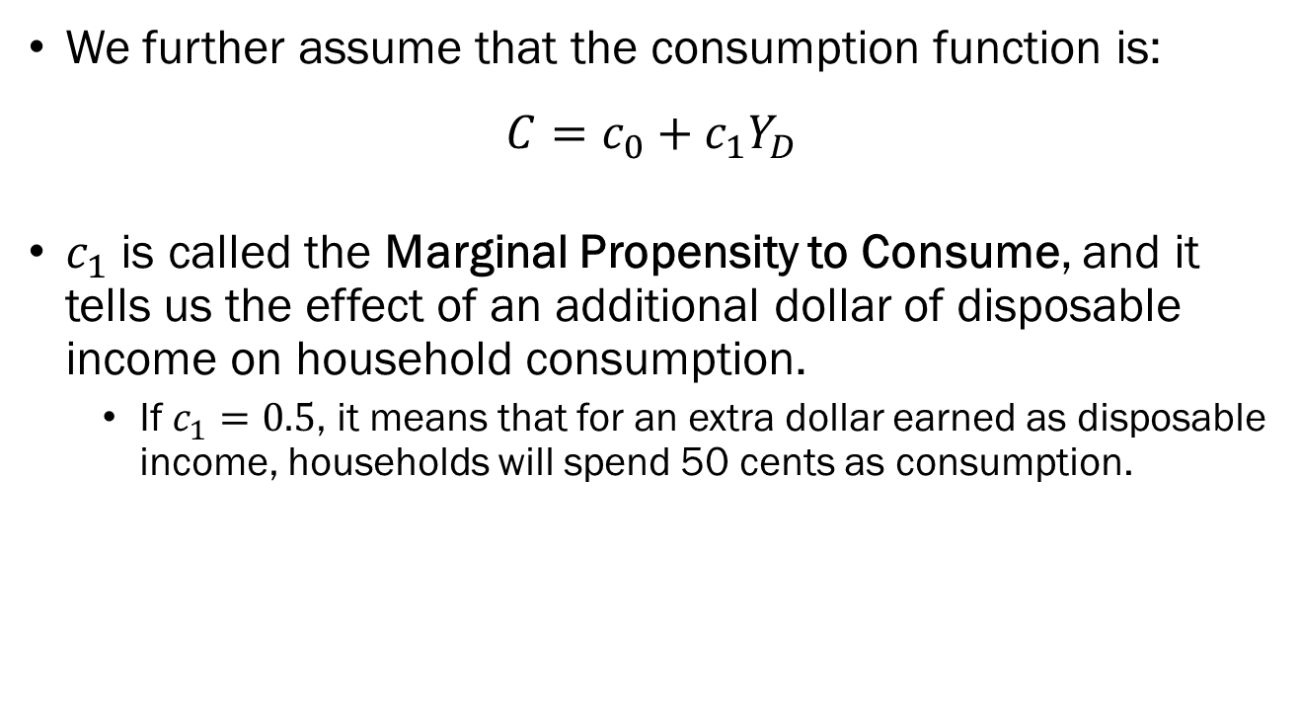
Modelling Consumption
We further assume that the consumption function is:
$$C=c_{0}+c_{1}Y_{D}$$
$c_{1}$ is called the Marginal Propensity to Consume, and it tells us the effect of an additional dollar of disposable income on household consumption.
  If $c_{1}=0.5$, it means that for an extra dollar earned as disposable income, households will spend 50 cents as consumption.

Slide 16
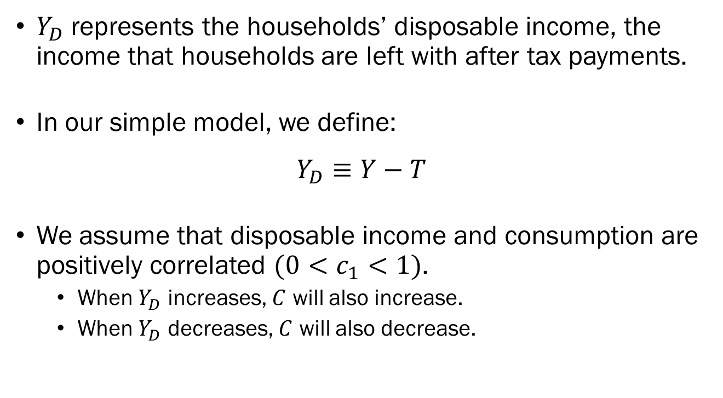
Modelling Consumption
$Y_{D}$ represents the households’ disposable income, the income that households are left with after tax payments.
In our simple model, we define:
$$Y_{D}≡Y−T$$
We assume that disposable income and consumption are positively correlated $(0<c_{1}<1)$.
  When $Y_{D}$ increases, $C$ will also increase.
  When $Y_{D}$ decreases, $C$ will also decrease.

Slide 17
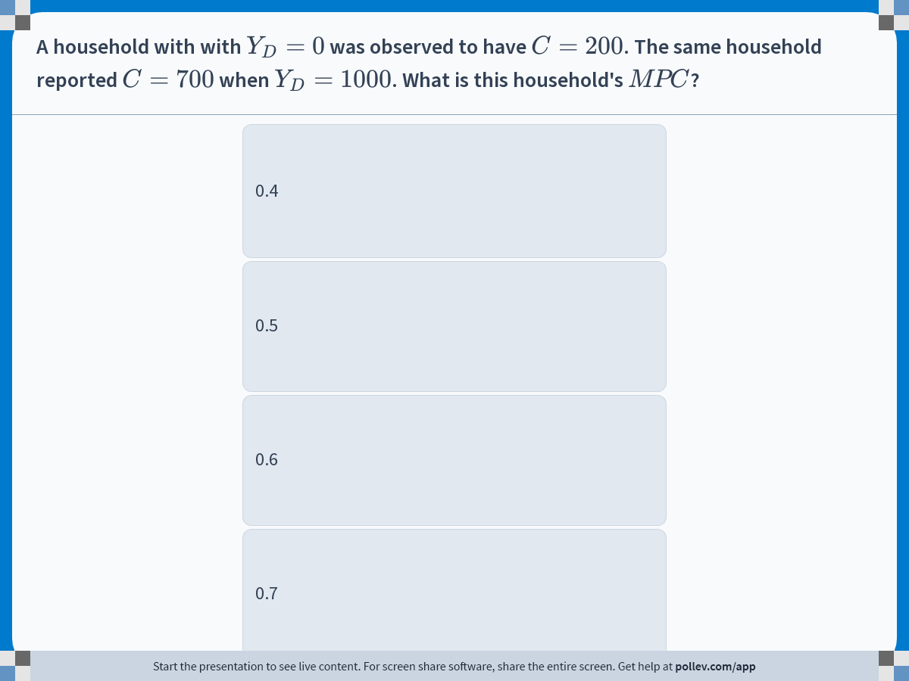
Notes:
Poll Title: Do not modify the notes in this section to avoid tampering with the Poll Everywhere activity.
More info at polleverywhere.com/support
A household with with $$Y_D=0$$ was observed to have $$C=200$$. The same household reported $$C=700$$ when $$Y_D=1000$$. What is this household's $$MPC$$?
https://www.polleverywhere.com/multiple_choice_polls/c5Fns1XNWyLgcQz5VxEeh?display_state=instructions&activity_state=opened&state=opened&flow=Engagement&onscreen=persist

Slide 18
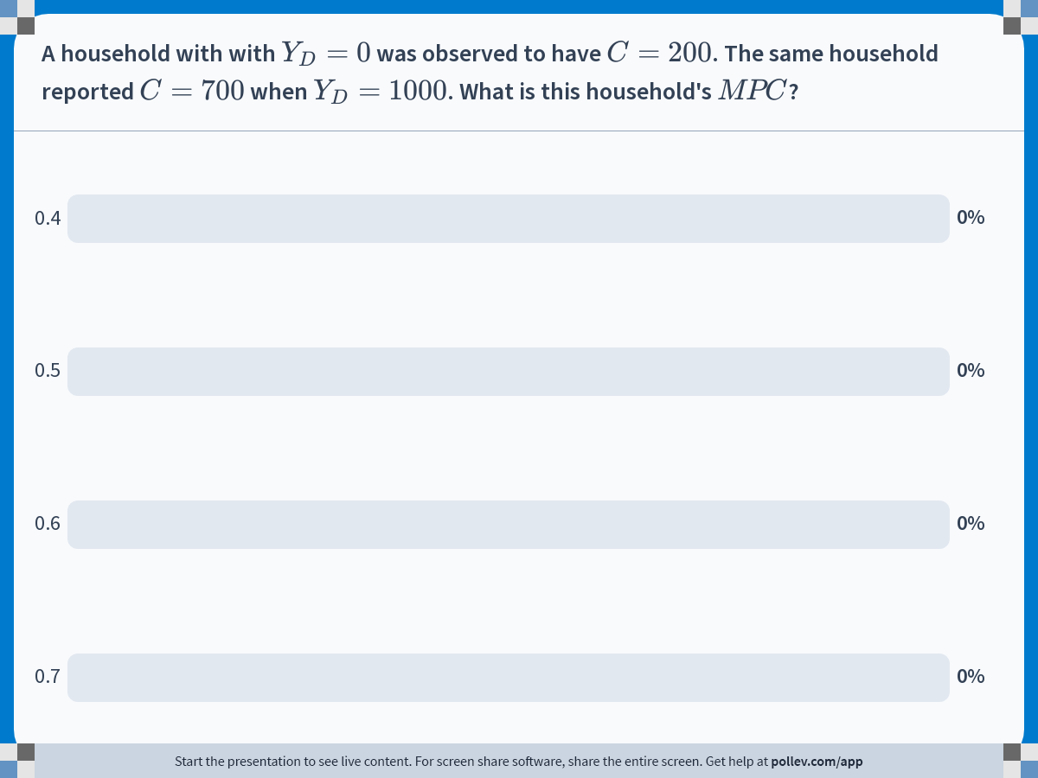
Notes:
Poll Title: Do not modify the notes in this section to avoid tampering with the Poll Everywhere activity.
More info at polleverywhere.com/support
A household with with $$Y_D=0$$ was observed to have $$C=200$$. The same household reported $$C=700$$ when $$Y_D=1000$$. What is this household's $$MPC$$?
https://www.polleverywhere.com/multiple_choice_polls/c5Fns1XNWyLgcQz5VxEeh?display_state=chart&activity_state=closed&state=closed&flow=Engagement&onscreen=persist

Slide 19
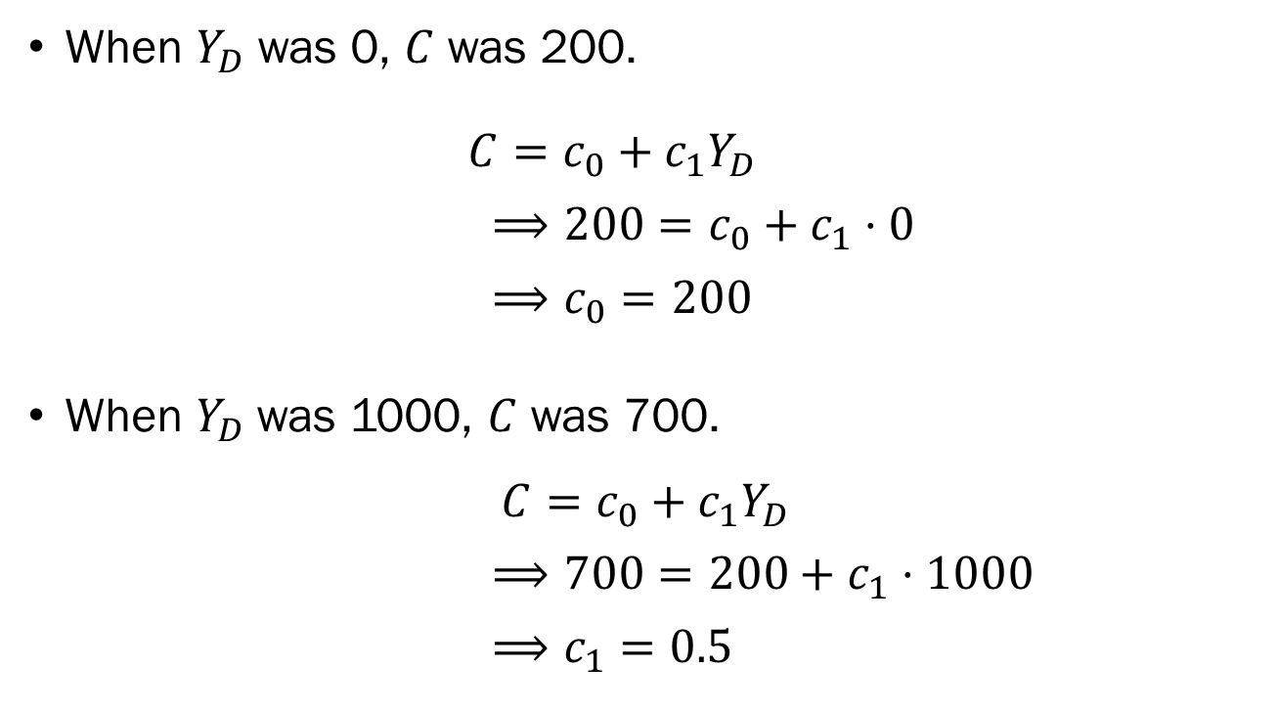
Solution to In-Class Poll
When $Y_{D}$ was 0, $C$ was 200.
$C=c_{0}+c_{1}Y_{D}$
$⟹200=c_{0}+c_{1}⋅0$
$⟹c_{0}=200$
When $Y_{D}$was 1000, $C$ was 700.
$$C=c_{0}+c_{1}Y_{D}$$
$⟹700=200+c_{1}⋅1000$
$⟹c_{1}=0.5$

Slide 20
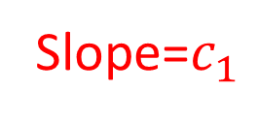

Modelling Consumption
Consumption
Slope=$c_{1}$
$$c_{0}$$
Disposable Income

Slide 21
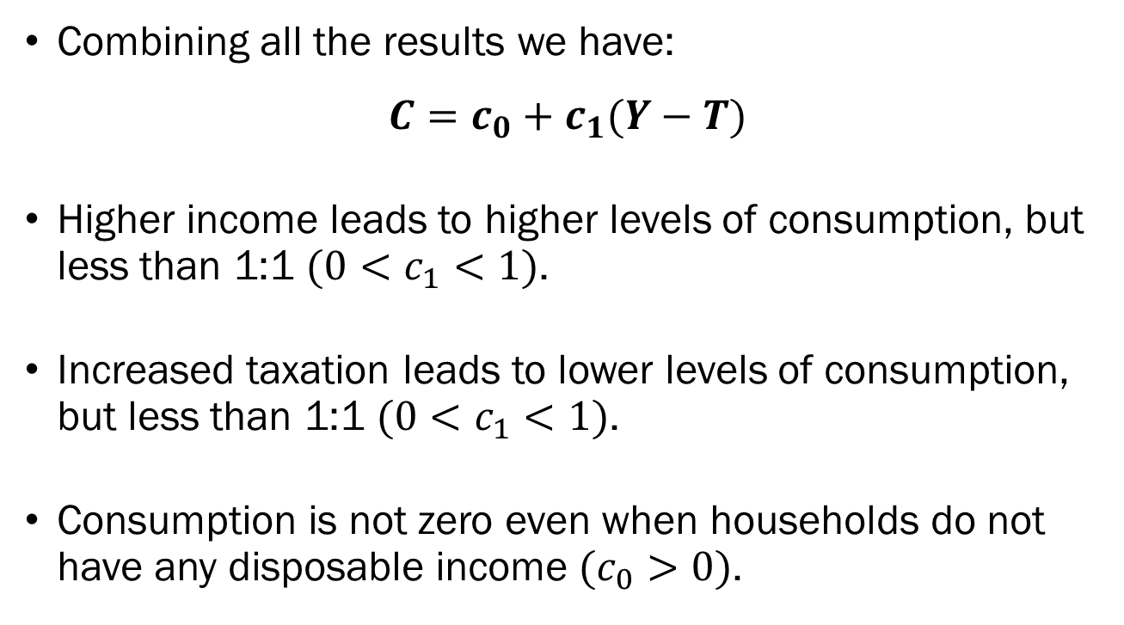
Modelling Consumption
Combining all the results we have:
$$C=c_{0}+c_{1}(Y−T)$$
Higher income leads to higher levels of consumption, but less than 1:1 $(0<c_{1}<1)$.
Increased taxation leads to lower levels of consumption, but less than 1:1 $(0<c_{1}<1)$.
Consumption is not zero even when households do not have any disposable income $(c_{0}>0)$.

Slide 22
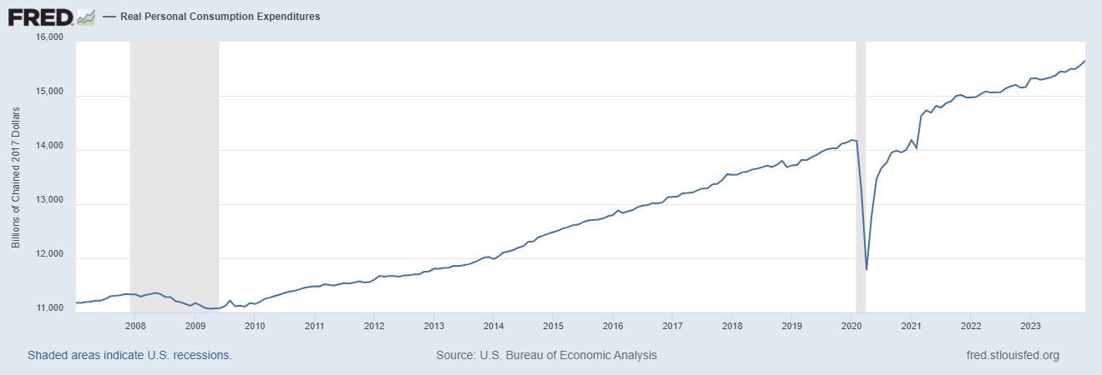
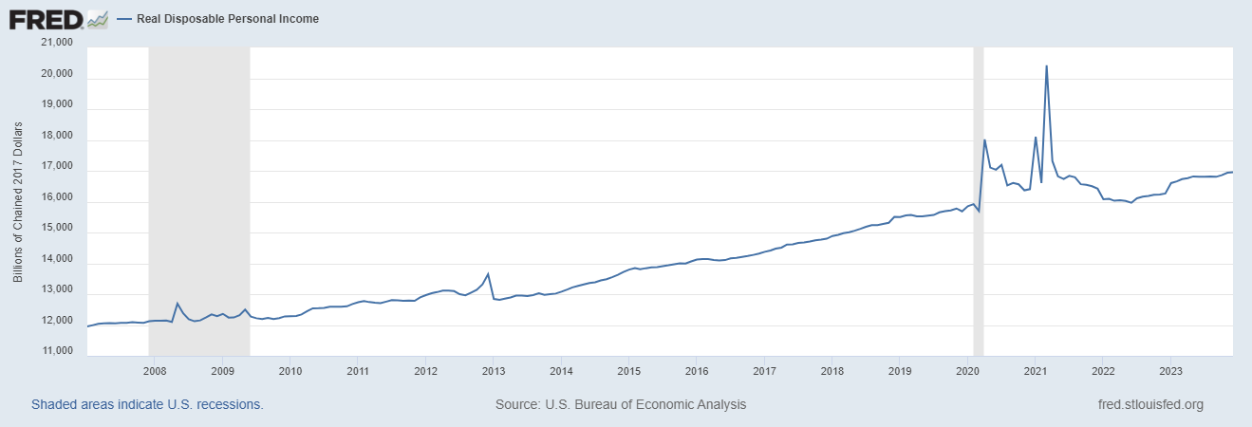
Modelling Consumption

Slide 23
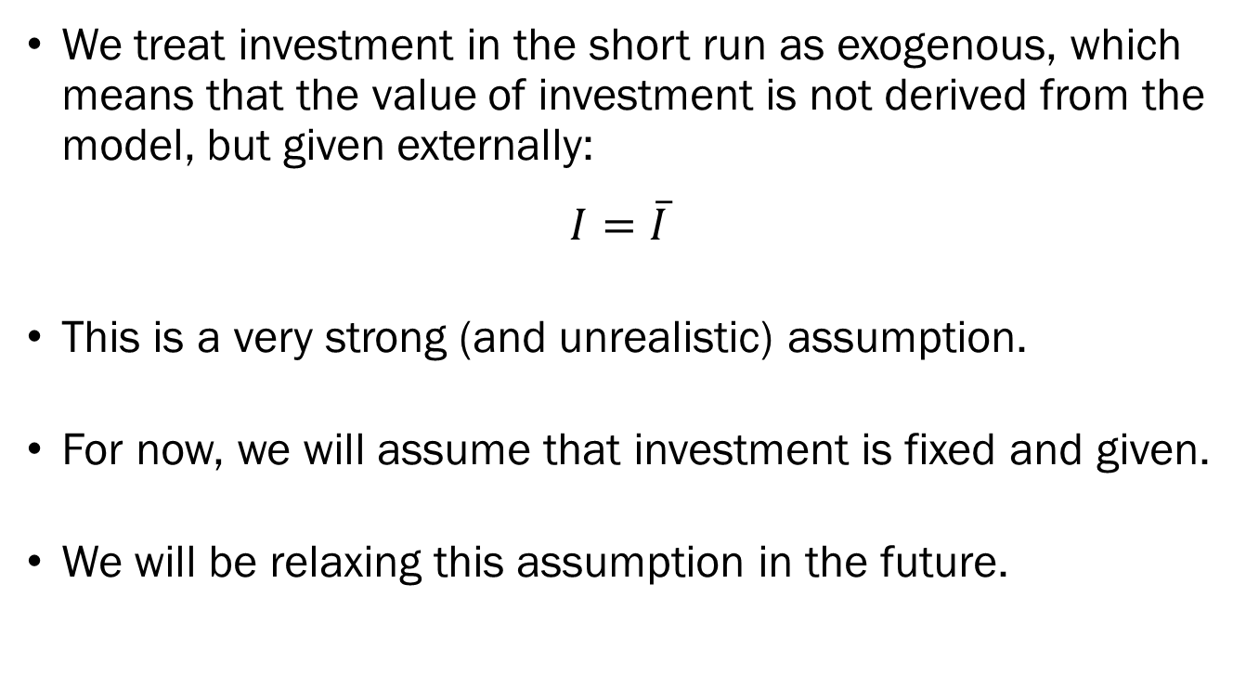
Modelling Investment
We treat investment in the short run as exogenous, which means that the value of investment is not derived from the model, but given externally:
$$I=\overline{I}$$
This is a very strong (and unrealistic) assumption.
For now, we will assume that investment is fixed and given.
We will be relaxing this assumption in the future.

Slide 24
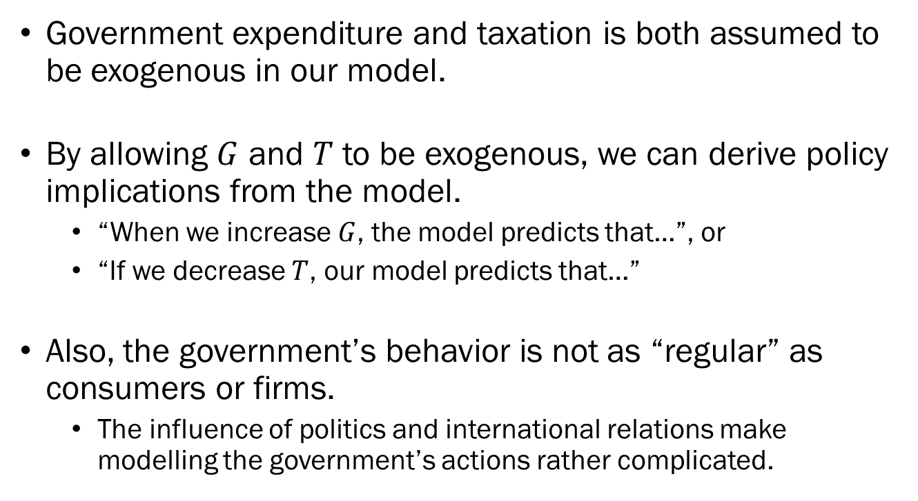
Modelling Government Expenditure
Government expenditure and taxation is both assumed to be exogenous in our model.
By allowing $G$ and $T$ to be exogenous, we can derive policy implications from the model.
  “When we increase $G$, the model predicts that…”, or
  “If we decrease $T$, our model predicts that…”
Also, the government’s behavior is not as “regular” as consumers or firms.
  The influence of politics and international relations make modelling the government’s actions rather complicated.

Slide 25
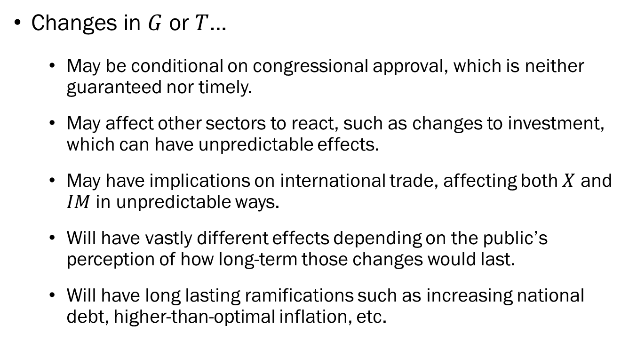
Modelling Government Expenditure
Changes in $G$ or $T$…
  May be conditional on congressional approval, which is neither guaranteed nor timely.
  May affect other sectors to react, such as changes to investment, which can have unpredictable effects.
  May have implications on international trade, affecting both $X$ and $IM$ in unpredictable ways.
  Will have vastly different effects depending on the public’s perception of how long-term those changes would last.
  Will have long lasting ramifications such as increasing national debt, higher-than-optimal inflation, etc.

Slide 26
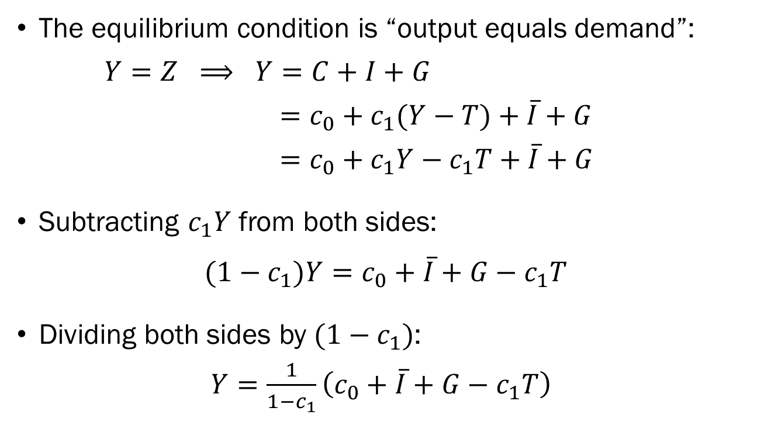
Determining Equilibrium Output: Math
The equilibrium condition is “output equals demand”:
$Y=Z ⟹ Y=C+I+G$
$=c_{0}+c_{1}(Y−T)+\overline{I}+G$
$=c_{0}+c_{1}Y−c_{1}T+\overline{I}+G$
Subtracting $c_{1}Y$ from both sides:
$$(1−c_{1})Y=c_{0}+\overline{I}+G−c_{1}T$$
Dividing both sides by $(1−c_{1})$:
$Y=\frac{1}{1−c_{1}}\left(c_{0}+\overline{I}+G−c_{1}T\right)$

Slide 27
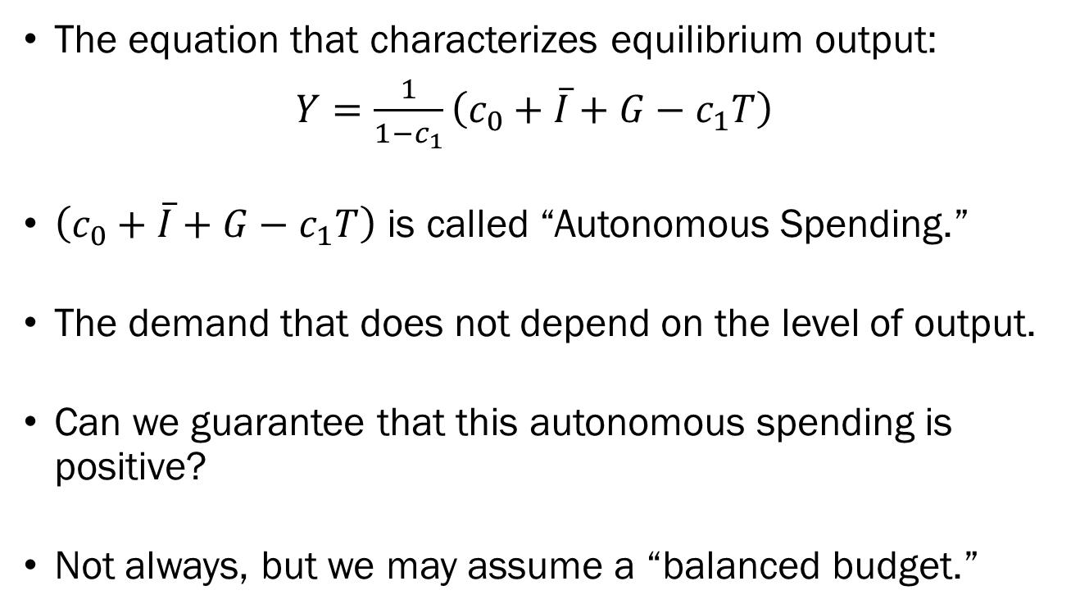
Determining Equilibrium Output: Math
The equation that characterizes equilibrium output:
$Y=\frac{1}{1−c_{1}}\left(c_{0}+\overline{I}+G−c_{1}T\right)$
$\left(c_{0}+\overline{I}+G−c_{1}T\right)$ is called “Autonomous Spending.”
The demand that does not depend on the level of output.
Can we guarantee that this autonomous spending is positive?
Not always, but we may assume a “balanced budget.”

Slide 28
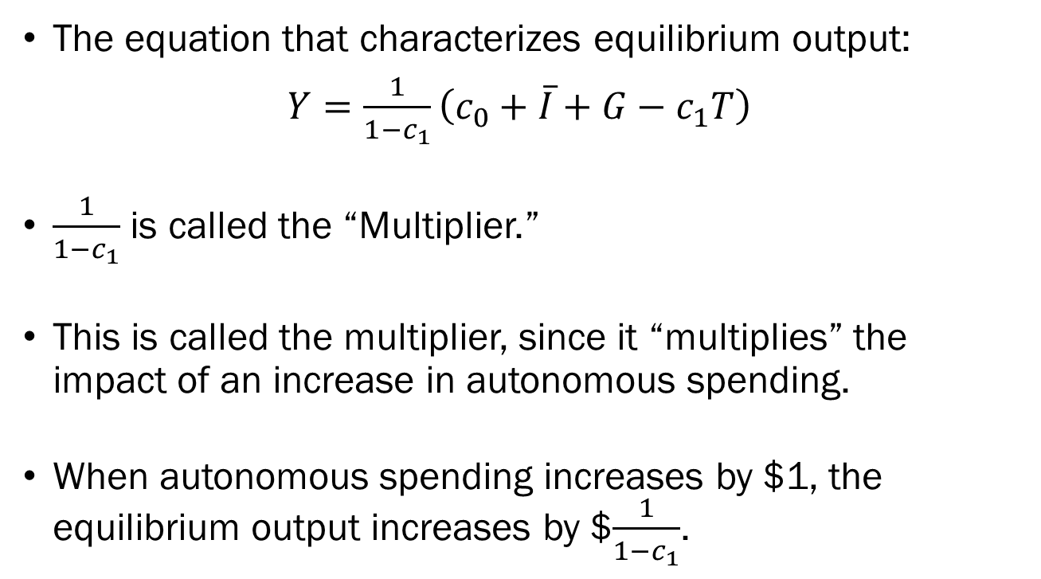
Determining Equilibrium Output: Math
The equation that characterizes equilibrium output:
$Y=\frac{1}{1−c_{1}}\left(c_{0}+\overline{I}+G−c_{1}T\right)$
$\frac{1}{1−c_{1}}$ is called the “Multiplier.”
This is called the multiplier, since it “multiplies” the impact of an increase in autonomous spending.
When autonomous spending increases by $1, the equilibrium output increases by $$\frac{1}{1−c_{1}}$.

Slide 29
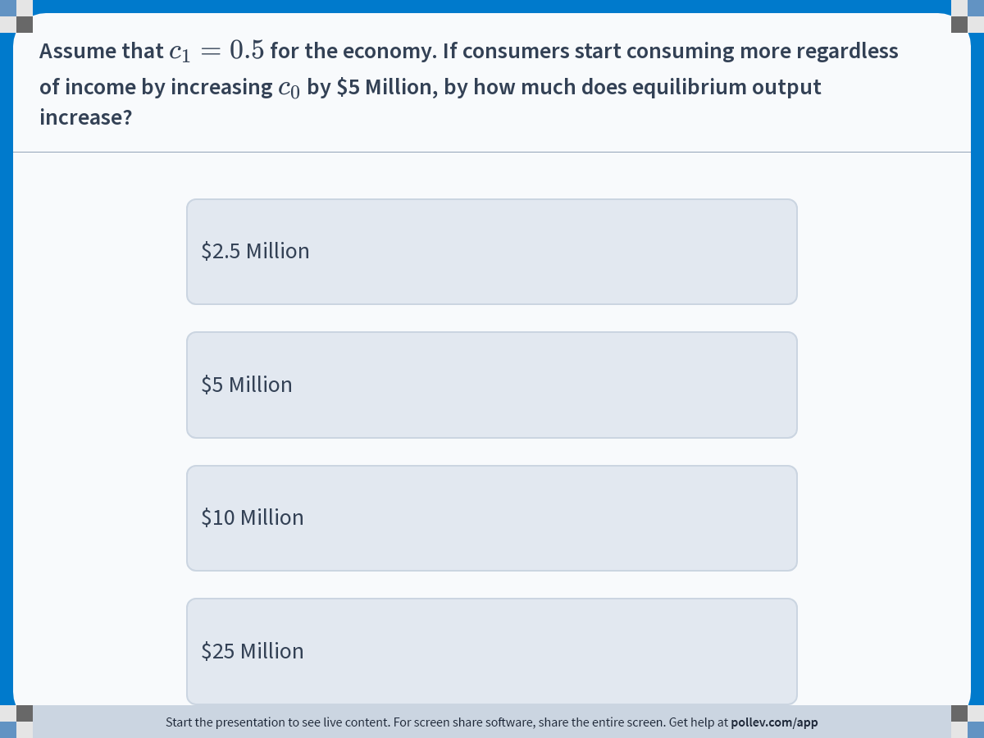
Notes:
Poll Title: Do not modify the notes in this section to avoid tampering with the Poll Everywhere activity.
More info at polleverywhere.com/support
Assume that $$c_1=0.5$$ for the economy. If consumers start consuming more regardless of income by increasing $$c_0$$ by $5 Million, by how much does equilibrium output increase?
https://www.polleverywhere.com/multiple_choice_polls/6MtWEfD7cnXf6Jmnjicuo?display_state=instructions&activity_state=opened&state=opened&flow=Engagement&onscreen=persist

Slide 30
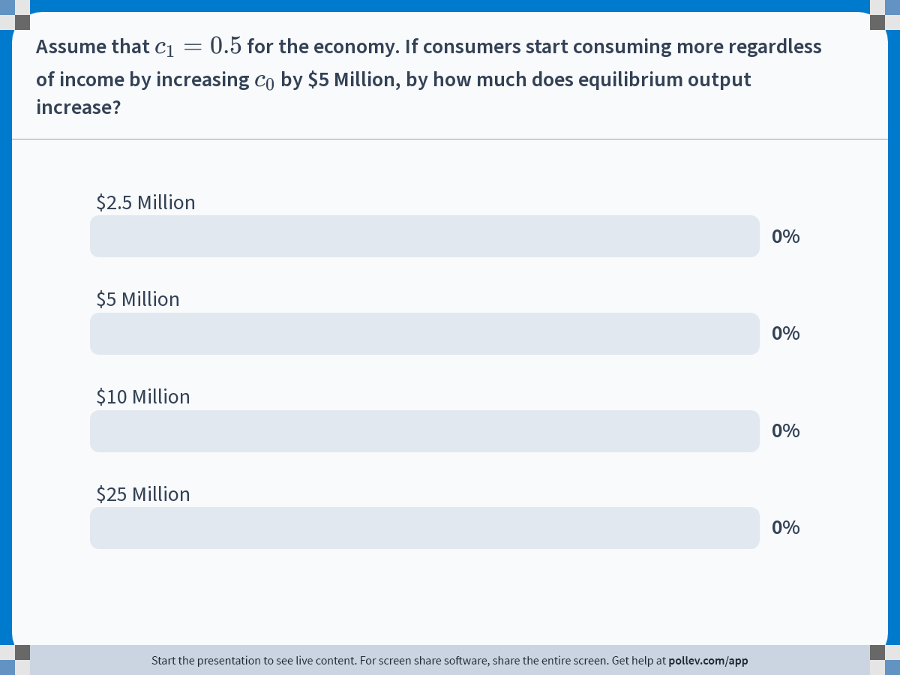
Notes:
Poll Title: Do not modify the notes in this section to avoid tampering with the Poll Everywhere activity.
More info at polleverywhere.com/support
Assume that $$c_1=0.5$$ for the economy. If consumers start consuming more regardless of income by increasing $$c_0$$ by $5 Million, by how much does equilibrium output increase?
https://www.polleverywhere.com/multiple_choice_polls/6MtWEfD7cnXf6Jmnjicuo?display_state=chart&activity_state=closed&state=closed&flow=Engagement&onscreen=persist

Slide 31
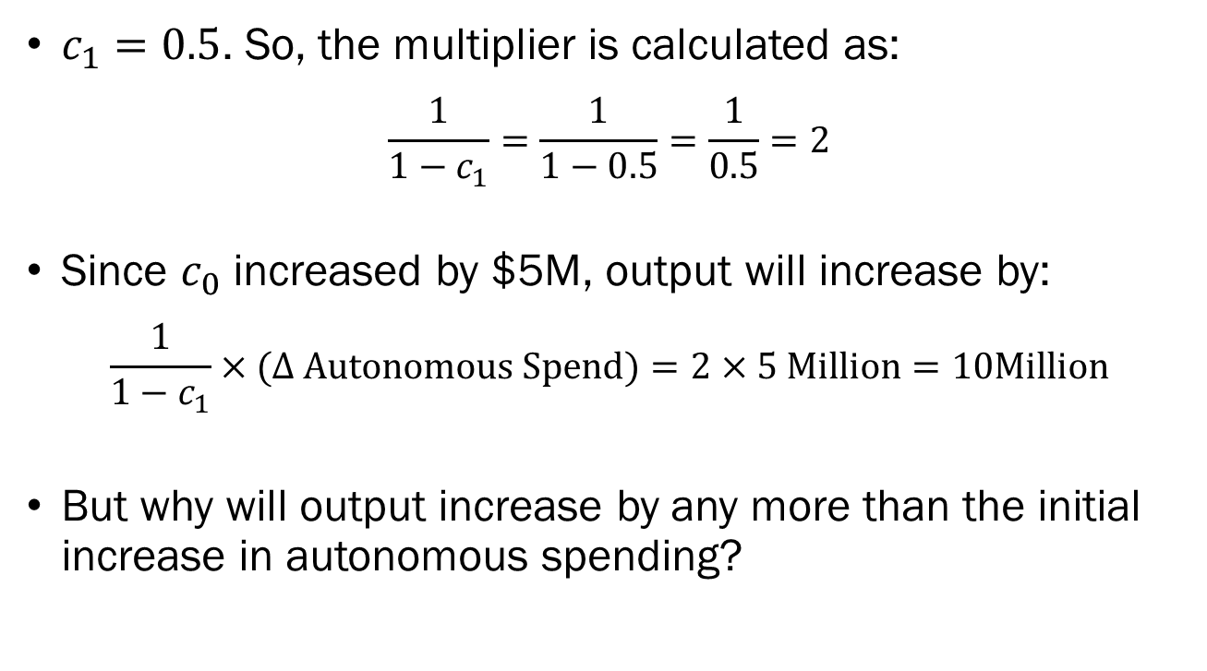
Solution to In-Class Poll
$c_{1}=0.5$. So, the multiplier is calculated as:
$$\frac{1}{1−c_{1}}=\frac{1}{1−0.5}=\frac{1}{0.5}=2$$
Since $c_{0}$ increased by $5M, output will increase by:
$$\frac{1}{1−c_{1}}×(∆ Autonomous Spend)=2×5 Million=10Million$$
But why will output increase by any more than the initial increase in autonomous spending?

Slide 32
The Multiplier
If any portion of autonomous spending increases, this is equivalent to an increase in the overall demand.
This increased demand will be met with an increase in overall output.
Since output increased, the households’ disposable income increases.
This leads to an increase in household consumption, which is an increase in demand.

Slide 33
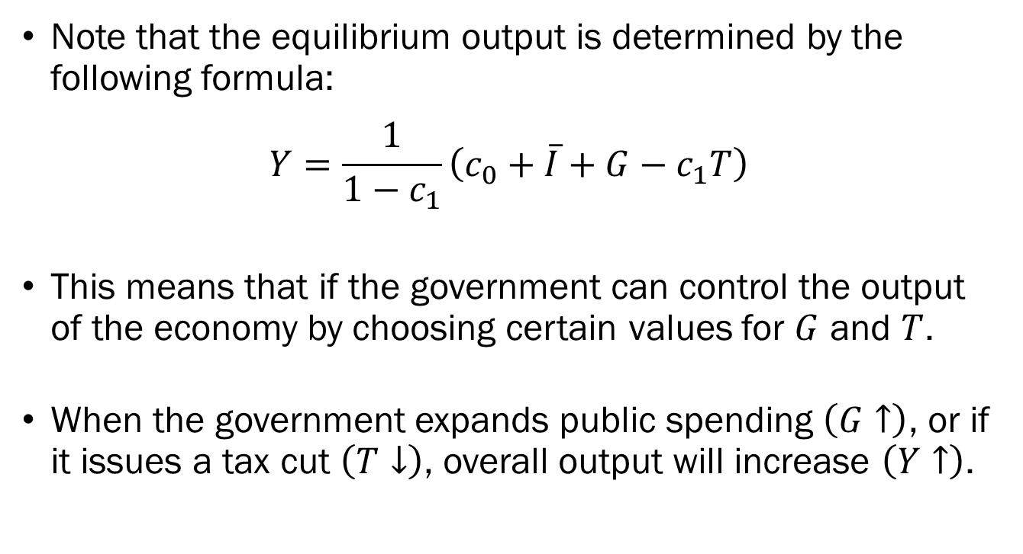
Government Intervention
Note that the equilibrium output is determined by the following formula:
$$Y=\frac{1}{1−c_{1}}\left(c_{0}+\overline{I}+G−c_{1}T\right)$$
This means that if the government can control the output of the economy by choosing certain values for $G$ and $T$.
When the government expands public spending $\left(G↑\right)$, or if it issues a tax cut $\left(T↓\right)$, overall output will increase $\left(Y↑\right)$.

Slide 34
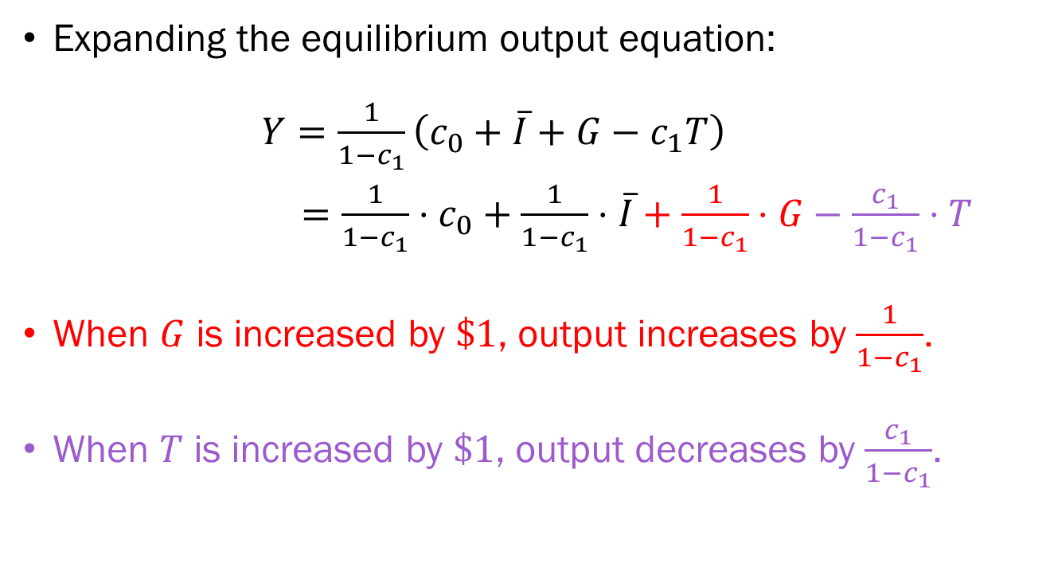
Government Intervention
Expanding the equilibrium output equation:
$Y=\frac{1}{1−c_{1}}\left(c_{0}+\overline{I}+G−c_{1}T\right)$
$=\frac{1}{1−c_{1}}⋅c_{0}+\frac{1}{1−c_{1}}⋅\overline{I}+\frac{1}{1−c_{1}}⋅G−\frac{c_{1}}{1−c_{1}}⋅T$
When $G$ is increased by $\$1$, output increases by $\frac{1}{1−c_{1}}$.
When $T$ is increased by $\$1$, output decreases by $\frac{c_{1}}{1−c_{1}}$.

Slide 35
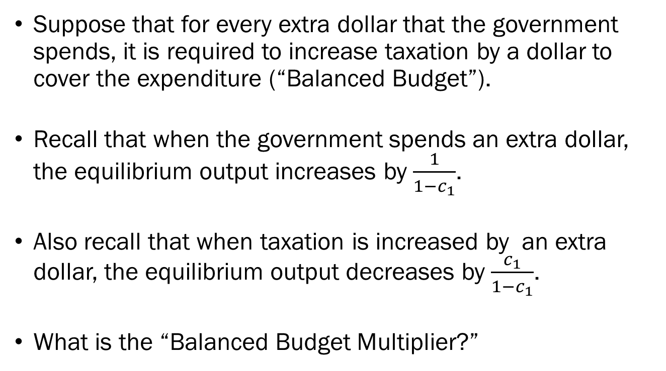
Government Intervention
Suppose that for every extra dollar that the government spends, it is required to increase taxation by a dollar to cover the expenditure (“Balanced Budget”).
Recall that when the government spends an extra dollar, the equilibrium output increases by $\frac{1}{1−c_{1}}$.
Also recall that when taxation is increased by an extra dollar, the equilibrium output decreases by $\frac{c_{1}}{1−c_{1}}$.
What is the “Balanced Budget Multiplier?”

Slide 36
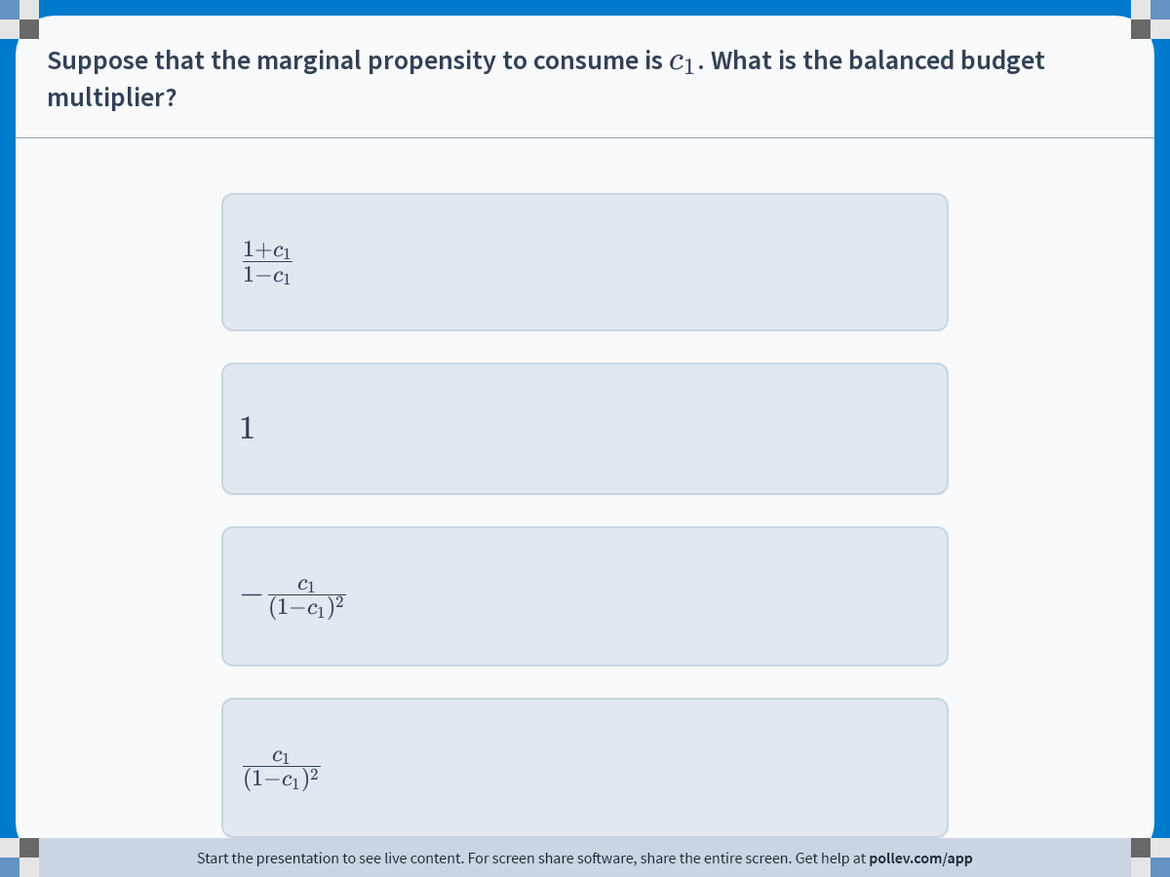
Notes:
Poll Title: Do not modify the notes in this section to avoid tampering with the Poll Everywhere activity.
More info at polleverywhere.com/support
Suppose that the marginal propensity to consume is $$c_1$$. What is the balanced budget multiplier?
https://www.polleverywhere.com/multiple_choice_polls/e0khh5eevHj88XtMsFn2K?display_state=instructions&activity_state=opened&state=opened&flow=Engagement&onscreen=persist

Slide 37
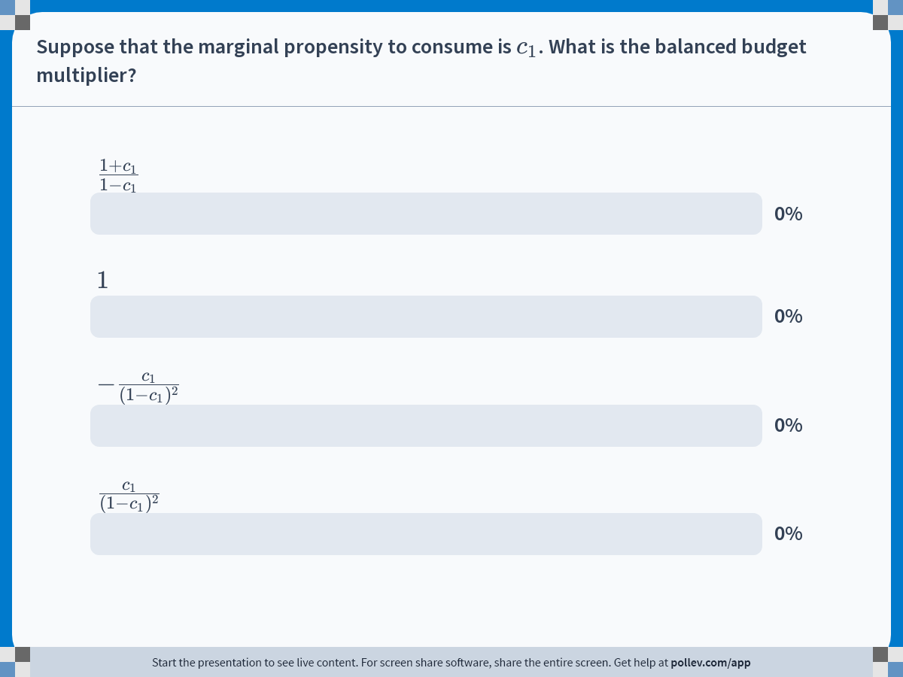
Notes:
Poll Title: Do not modify the notes in this section to avoid tampering with the Poll Everywhere activity.
More info at polleverywhere.com/support
Suppose that the marginal propensity to consume is $$c_1$$. What is the balanced budget multiplier?
https://www.polleverywhere.com/multiple_choice_polls/e0khh5eevHj88XtMsFn2K?display_state=chart&activity_state=closed&state=closed&flow=Engagement&onscreen=persist

Slide 38
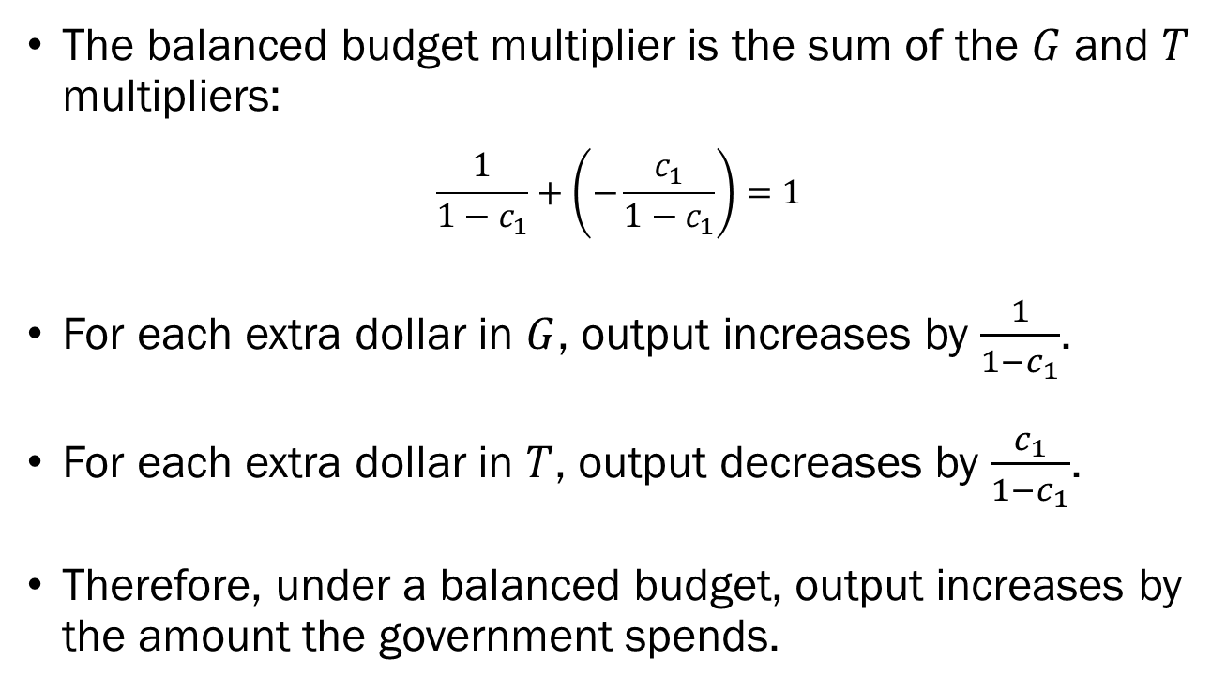
Solution to In-Class Poll
The balanced budget multiplier is the sum of the $G$ and $T$ multipliers:
$$\frac{1}{1−c_{1}}+\left(−\frac{c_{1}}{1−c_{1}}\right)=1$$
For each extra dollar in $G$, output increases by $\frac{1}{1−c_{1}}$.
For each extra dollar in $T$, output decreases by $\frac{c_{1}}{1−c_{1}}$.
Therefore, under a balanced budget, output increases by the amount the government spends.

Slide 39
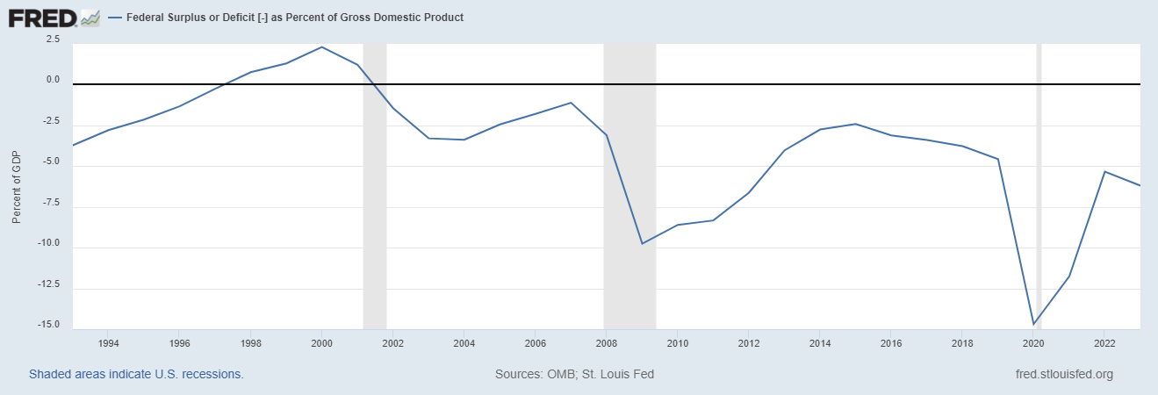

Balanced Budget
Under a balanced budget, the government spends as much as it gathers in taxation $\left(G=T\right)$.
Not necessarily in real life, but it seems that $\left(G>T\right)$.
CLINTON
BUSH
OBAMA
TRUMP

Slide 40
Determining Equilibrium Output: Graph
Demand,
Output
We visualize the equilibrium by plotting income in the x-axis and demand/output on the y-axis.
In an equilibrium, the economy’s production is equal to its income.
Production is plotted as a 45-degree line.
Production
Income

Slide 41
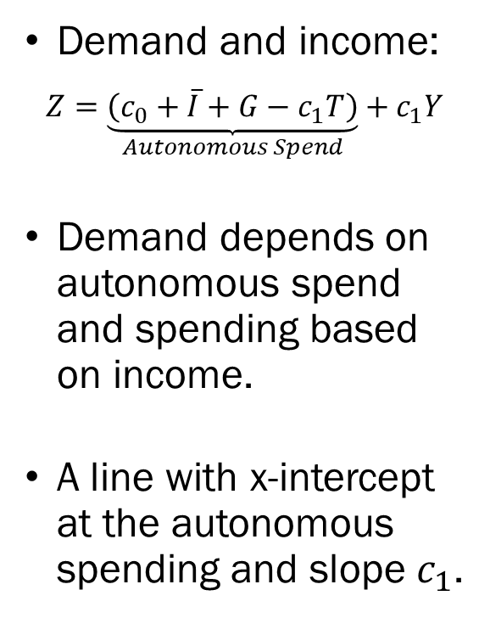

Determining Equilibrium Output: Graph
Demand,
Output
Demand and income:
$$Z=\underset{Autonomous Spend}{\underbrace{\left(c_{0}+\overline{I}+G−c_{1}T\right)}}+c_{1}Y$$
Demand depends on autonomous spend and spending based on income.
A line with x-intercept at the autonomous spending and slope $c_{1}$.
Production
Demand
Slope=$c_{1}$
Autonomous Spending
Income

Slide 42


Determining Equilibrium Output: Graph
Demand,
Output
To the left of A, there is excess demand.
To the right of A, there is excess supply.
Equilibrium is reached at the intersection of production and demand (Point A).
Production
Demand
$$Y$$
A
Slope=$c_{1}$
Autonomous Spending
$$Y$$
Income

Slide 43
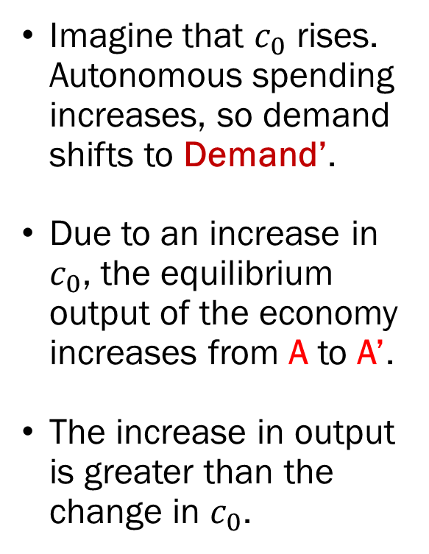
Determining Equilibrium Output: Graph
Demand,
Output
Imagine that $c_{0}$ rises. Autonomous spending increases, so demand shifts to Demand’.
Due to an increase in $c_{0}$, the equilibrium output of the economy increases from A to A’.
The increase in output is greater than the change in $c_{0}$.
Production
A’
Demand’
Demand
A
Income

Slide 44


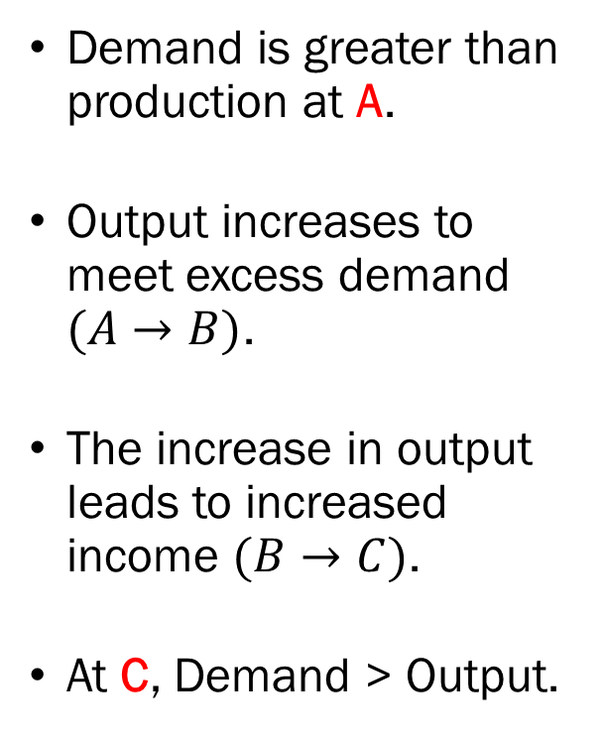
Determining Equilibrium Output: Graph
Demand,
Output
Demand is greater than production at A.
Output increases to meet excess demand $(A→B)$.
The increase in output leads to increased income $(B→C)$.
At C, Demand > Output.
Production
A’
Demand’
$$Y^{′}$$
B
C
Demand
$$Y$$
A
$$Y$$
$$Y^{′}$$
Income

Slide 45
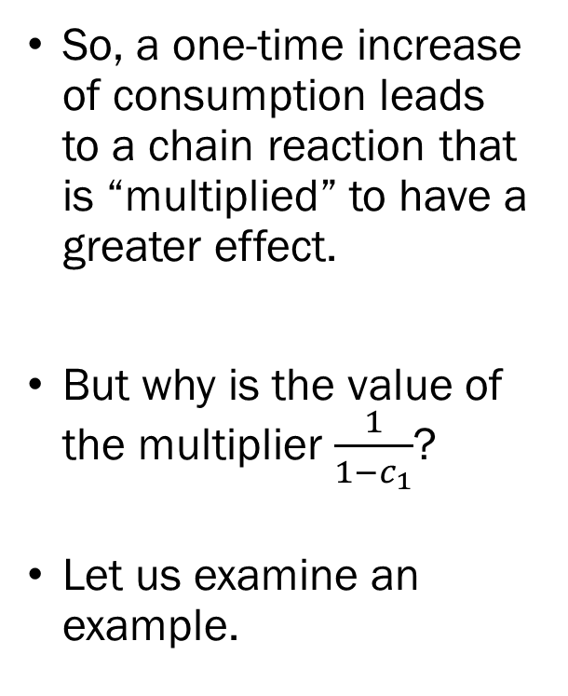
Determining Equilibrium Output: Graph
Demand,
Output
So, a one-time increase of consumption leads to a chain reaction that is “multiplied” to have a greater effect.
But why is the value of the multiplier $\frac{1}{1−c_{1}}$?
Let us examine an example.
Production
D
A’
Demand’
B
C
Demand
A
Income

Slide 46
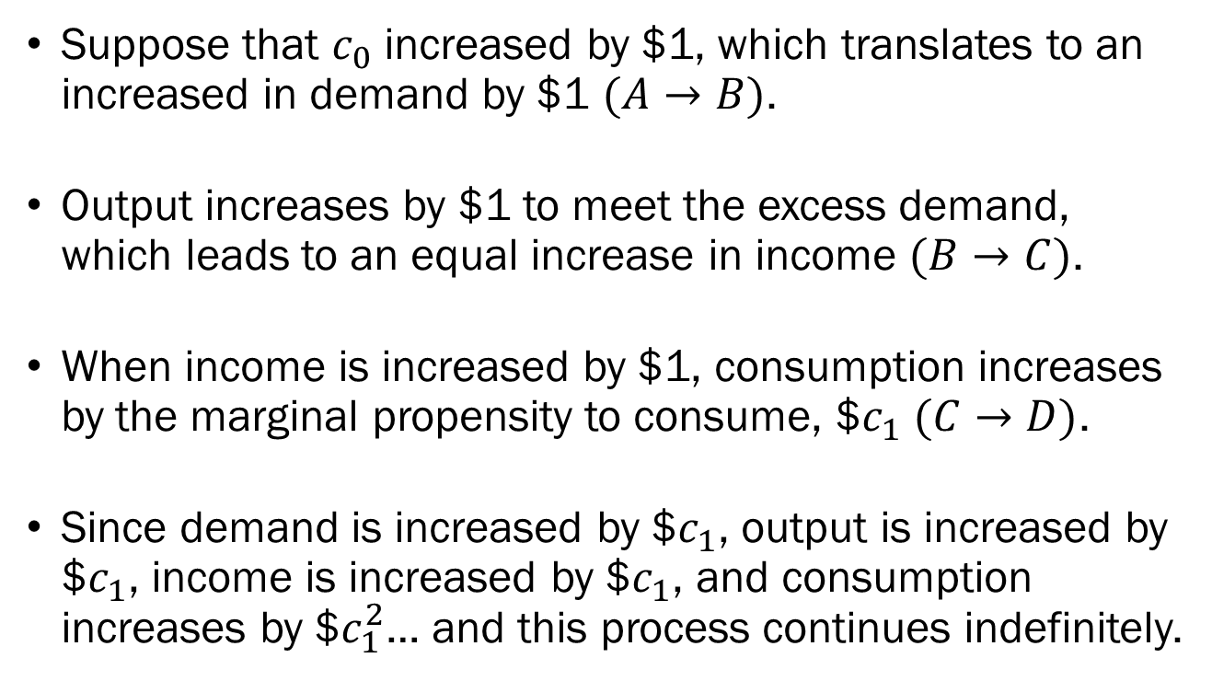
Determining Equilibrium Output: Words
Suppose that $c_{0}$ increased by $1, which translates to an increased in demand by $1 $(A→B)$.
Output increases by $1 to meet the excess demand, which leads to an equal increase in income $(B→C)$.
When income is increased by $1, consumption increases by the marginal propensity to consume, $$c_{1}$ $(C→D)$.
Since demand is increased by $$c_{1}$, output is increased by $$c_{1}$, income is increased by $$c_{1}$, and consumption increases by $$c_{1}^{2}$… and this process continues indefinitely.

Slide 47
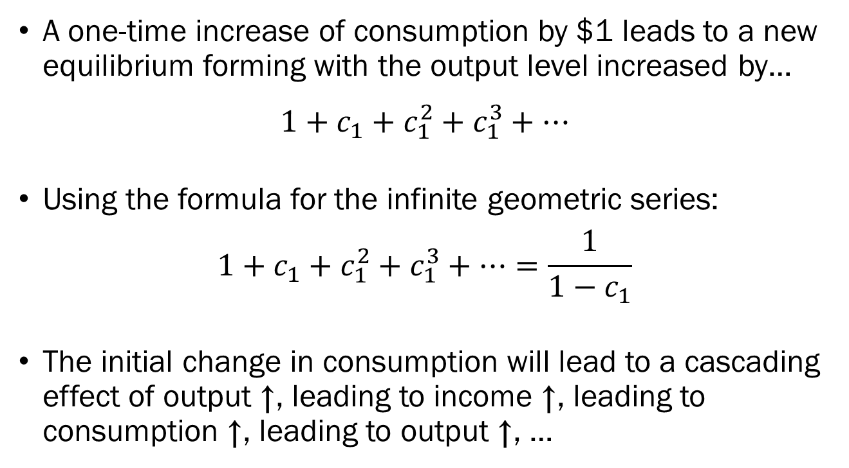
Determining Equilibrium Output: Words
A one-time increase of consumption by $1 leads to a new equilibrium forming with the output level increased by…
$$1+c_{1}+c_{1}^{2}+c_{1}^{3}+⋯$$
Using the formula for the infinite geometric series:
$$1+c_{1}+c_{1}^{2}+c_{1}^{3}+⋯=\frac{1}{1−c_{1}}$$
The initial change in consumption will lead to a cascading effect of output ↑, leading to income ↑, leading to consumption ↑, leading to output ↑, …

Slide 48
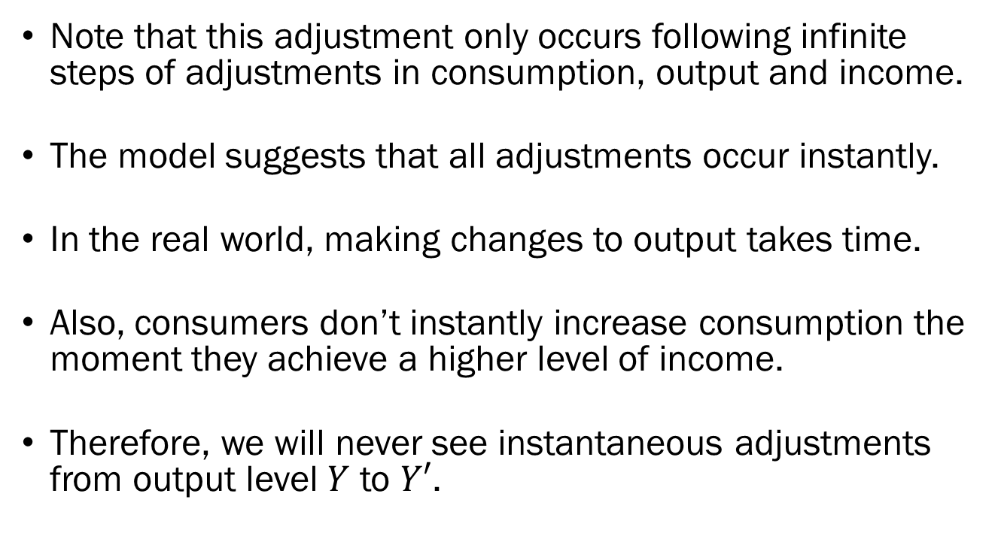
Speed of Adjustments
Note that this adjustment only occurs following infinite steps of adjustments in consumption, output and income.
The model suggests that all adjustments occur instantly.
In the real world, making changes to output takes time.
Also, consumers don’t instantly increase consumption the moment they achieve a higher level of income.
Therefore, we will never see instantaneous adjustments from output level $Y$ to $Y′$.

Slide 49
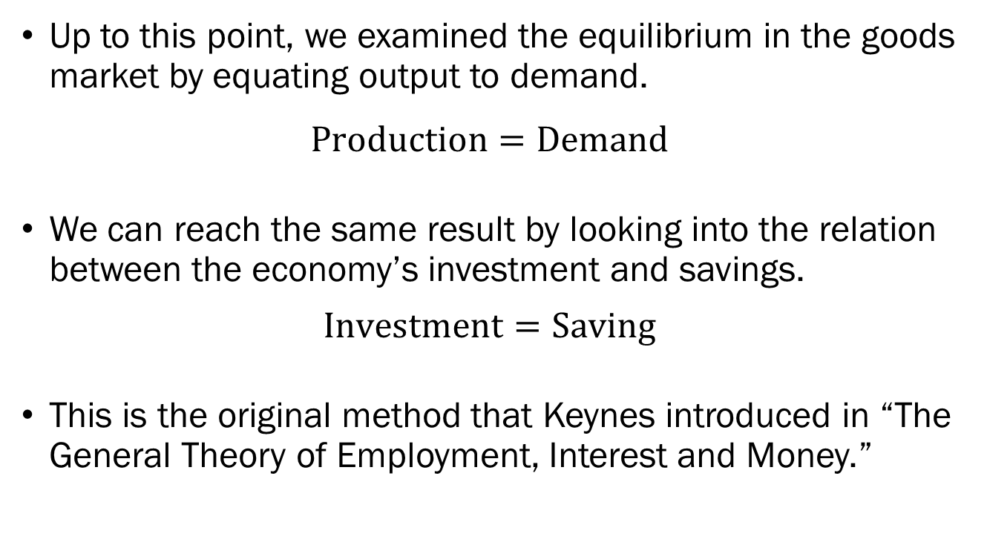
Keynes’ Method: Investment - Savings
Up to this point, we examined the equilibrium in the goods market by equating output to demand.
$$Production=Demand$$
We can reach the same result by looking into the relation between the economy’s investment and savings.
$$Investment=Saving$$
This is the original method that Keynes introduced in “The General Theory of Employment, Interest and Money.”

Slide 50
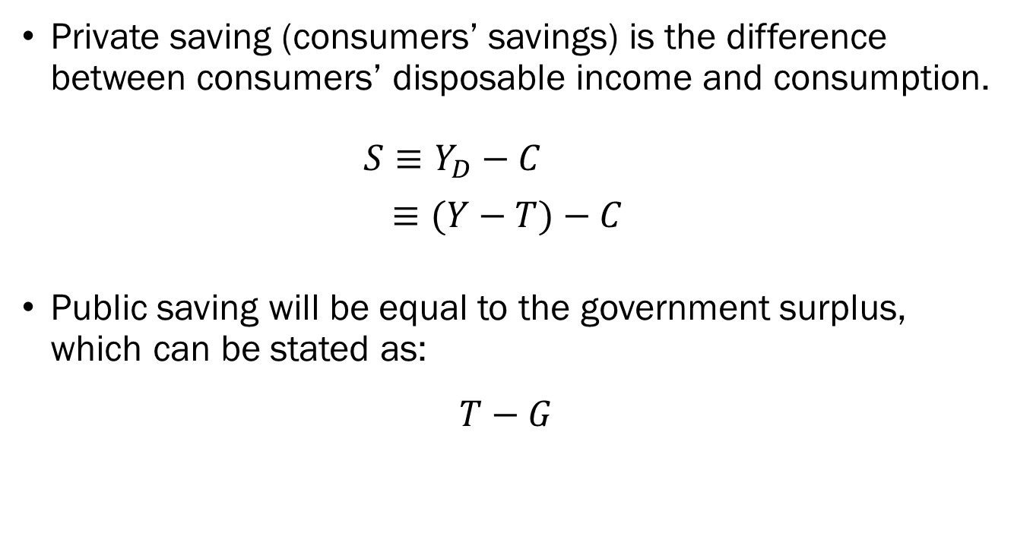
Keynes’ Method: Investment - Savings
Private saving (consumers’ savings) is the difference between consumers’ disposable income and consumption.
$S≡Y_{D}−C$
$≡(Y−T)−C$
Public saving will be equal to the government surplus, which can be stated as:
$$T−G$$

Slide 51
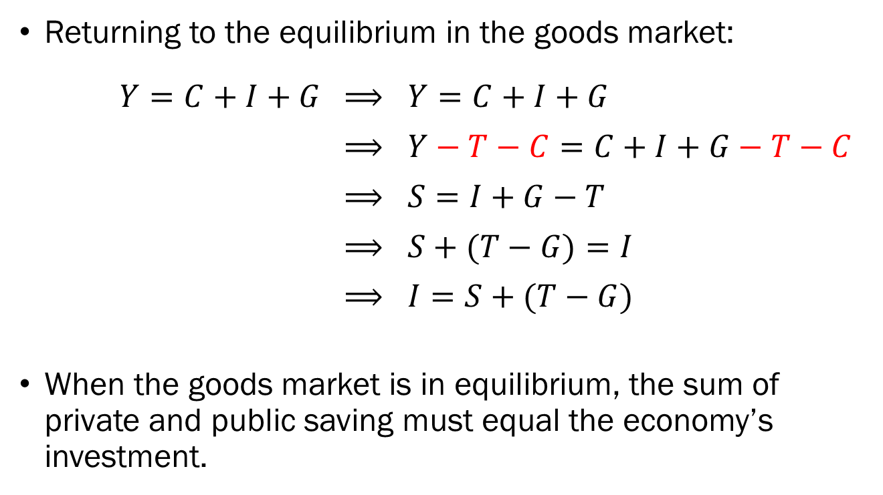
Keynes’ Method: Investment - Savings
Returning to the equilibrium in the goods market:
$Y=C+I+G$ $⟹ Y=C+I+G$
$⟹ Y−T−C=C+I+G−T−C$
$⟹ S=I+G−T$
$⟹ S+(T−G)=I$
$⟹ I=S+(T−G)$
When the goods market is in equilibrium, the sum of private and public saving must equal the economy’s investment.

Slide 52
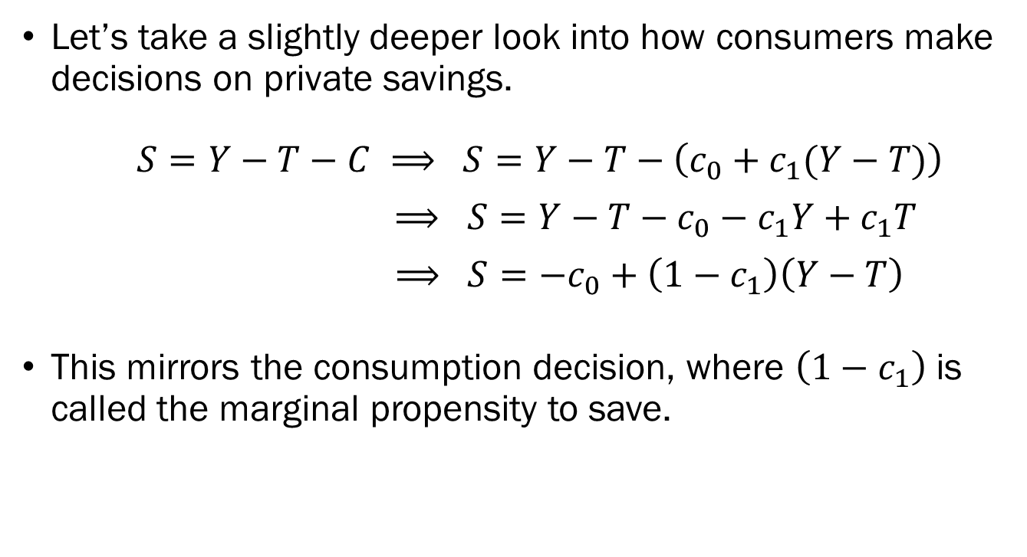
Keynes’ Method: Investment - Savings
Let’s take a slightly deeper look into how consumers make decisions on private savings.
$S=Y−T−C ⟹ S=Y−T−\left(c_{0}+c_{1}(Y−T)\right)$
$⟹ S=Y−T−c_{0}−c_{1}Y+c_{1}T$
$⟹ S=−c_{0}+\left(1−c_{1}\right)\left(Y−T\right)$
This mirrors the consumption decision, where $\left(1−c_{1}\right)$ is called the marginal propensity to save.

Slide 53
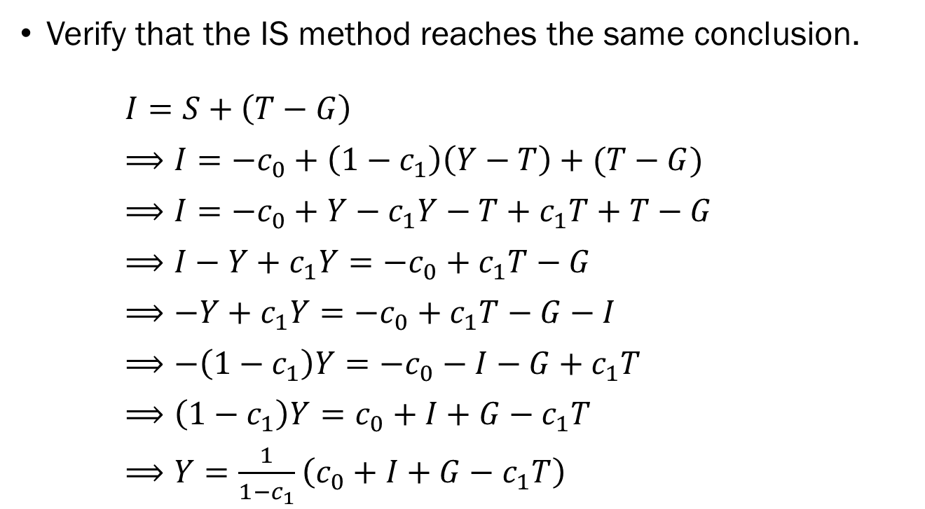
Keynes’ Method: Investment - Savings
Verify that the IS method reaches the same conclusion.
$I=S+\left(T−G\right)$
$⟹I=−c_{0}+\left(1−c_{1}\right)\left(Y−T\right)+(T−G)$
$⟹I=−c_{0}+Y−c_{1}Y−T+c_{1}T+T−G$
$⟹I−Y+c_{1}Y=−c_{0}+c_{1}T−G$
$⟹−Y+c_{1}Y=−c_{0}+c_{1}T−G−I$
$⟹−\left(1−c_{1}\right)Y=−c_{0}−I−G+c_{1}T$
$⟹\left(1−c_{1}\right)Y=c_{0}+I+G−c_{1}T$
$⟹Y=\frac{1}{1−c_{1}}\left(c_{0}+I+G−c_{1}T\right)$

Slide 54
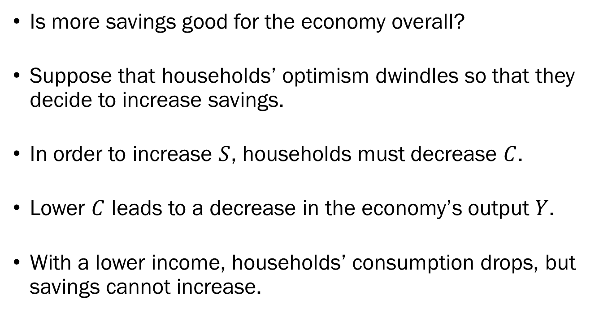
The Paradox of Thrift
Is more savings good for the economy overall?
Suppose that households’ optimism dwindles so that they decide to increase savings.
In order to increase $S$, households must decrease $C$.
Lower $C$ leads to a decrease in the economy’s output $Y$.
With a lower income, households’ consumption drops, but savings cannot increase.

