Slide 1
Final Exam Review
ECON 301

Slide 2
Problem 1. Definitions
Real Interest Rate
  The nominal interest rate adjusted for inflation.
Potential Output
  The level of output that is expected to arise when the economy is at its natural rate of unemployment so that the economy’s inflation matches expected inflation in the medium run.
Net Exports
  Balance of trade, measured by the difference between a country’s exports and imports.

Slide 3
Problem 1. Definitions
Required Reserve Ratio
  The percentage of deposits that a commercial bank must hold in reserve.
Labor Force
  The sum of the employed plus the unemployed, which measures the number of people who are working or actively seeking to work.
Monetary Policy
  A set of tools used by a nation's central bank to influence the money supply and credit conditions in the economy.

Slide 4
Problem 1. Definitions
Marginal Propensity to Consume
  The proportion of additional income that an individual consumes.
Gross Domestic Product
  The market value of all final goods and services produced in an economy over a given period of time.
Golden Rule Saving Rate
  The saving rate that maximizes long run per capita consumption in an economy.

Slide 5
Problem 2.A.
Open market purchases conducted by the Federal Reserve are expected to result in an increase in the economy’s interest rate.
  FALSE
  Open market purchases will increase money supply in the economy.
  All else constant, an increase in money supply will lead to a decrease in the economy’s interest rate.

Slide 6
Problem 2.B.
In the long run, the growth rate of output per capita is primarily driven by technological progress.
  TRUE
  One may be able to argue that the population growth rate also affects the total size of the economy, but not necessarily per capita output levels.

Slide 7
Problem 2.C.
An increase in consumers’ marginal propensity to consume will lead to a decrease in the economy’s equilibrium output.
  FALSE
  A higher MPC will lead to the multiplier of the economy increasing, which will lead to an increase in the economy’s equilibrium output.

Slide 8
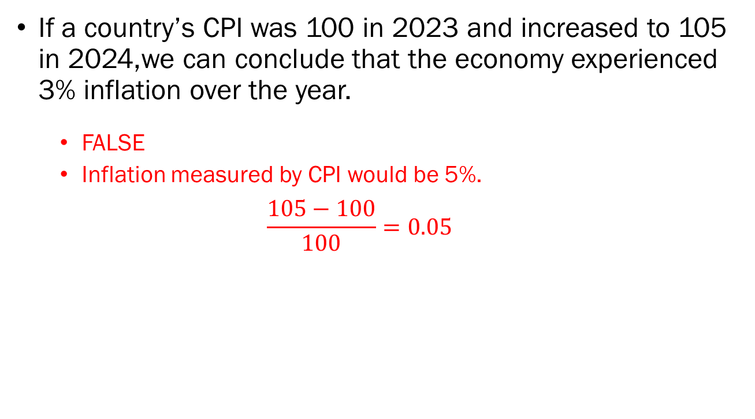
Problem 2.D.
If a country’s CPI was 100 in 2023 and increased to 105 in 2024,we can conclude that the economy experienced 3% inflation over the year.
  FALSE
  Inflation measured by CPI would be 5%.
  $$\frac{105−100}{100}=0.05$$

Slide 9
Problem 2.E.
If commercial banks' risk tolerance increases (i.e., they become more willing to take risks), the economy's output is expected to increase.
  TRUE (in general)
  If risk-taking is not excessive as to lead to a collapse of the financial system…

Slide 10
















Problem 3.A. & 3.B.
$$r_{n}^{′}$$
$$C$$
$$LM^{′}$$
3.A. Worker protection laws passed in Congress.
  The natural rate of unemployment increases.
  Potential output falls.
  PC shifts to the left.
3.B. The Fed counteracts.
  Output must fall to potential output levels.
  Contractionary monetary policy.
  LM shifts upward.
$$r_{n}$$
$$A$$
$$LM$$
$$Y_{n}$$
$$IS$$
$$π−\overline{π}$$
$$PC^{′}$$
$$PC$$
$$B$$
$$C$$
$$A$$
Output
$$Y_{n}^{′}$$
$$Y_{n}$$

Slide 11
Problem 3.C.
If the Fed had not acted as described in 3.B, the government would have intervened. In your own words, explain what policies the government could have implemented in response.
  Policies that are expected to lower the output of the economy qualify. That is, contractionary fiscal policies.
  Decreasing government expenditure.
  Increasing taxation.

Slide 12

















Problem 4.A.
$$i$$
$$i$$
$$Interest$$
$$Parity$$
$$B$$
$$B$$
$${\overline{i}}^{′}$$
$$LM^{′}$$
$$A$$
$$A$$
$$\overline{i}$$
$$LM$$
$$IS$$
$$Y^{′}$$
$$Y$$
Output, $Y$
$$E$$
$$E^{′}$$
Exchange Rate, $E$

Slide 13
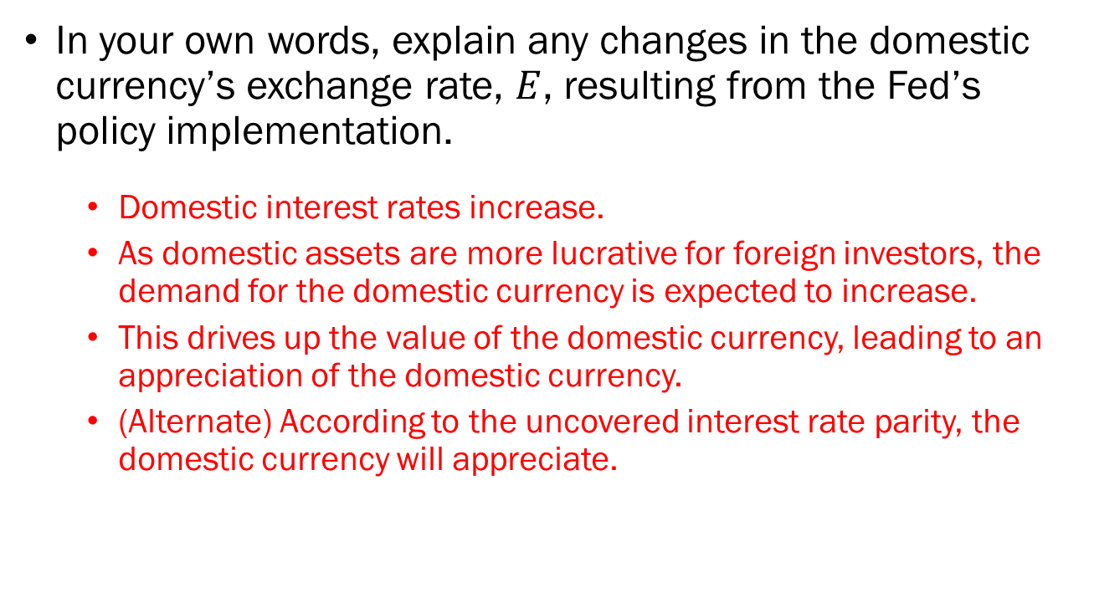
Problem 4.B.
In your own words, explain any changes in the domestic currency’s exchange rate, $E$, resulting from the Fed’s policy implementation.
  Domestic interest rates increase.
  As domestic assets are more lucrative for foreign investors, the demand for the domestic currency is expected to increase.
  This drives up the value of the domestic currency, leading to an appreciation of the domestic currency.
  (Alternate) According to the uncovered interest rate parity, the domestic currency will appreciate.

Slide 14
Problem 4.C.
Based on your answer to 4.B, predict and justify any changes to this economy’s net exports.
  Exports are expected to decrease, as foreign consumers will face a higher price tag.
  Imports can go either way:
    Foreign goods are cheaper for domestic consumers, so the volume of imports may increase.
    However, the price of each unit of imports are cheaper due to the stronger domestic currency.
  The final verdict is that the effect on net exports is ambiguous.

Slide 15
Problem 5.A.
The operations of the Federal Reserve and the government should remain independent of one another.
  Subsistence level of consumption

Slide 16
Problem 5.B.
The Federal Reserve should fully commit to maintaining inflation at its target rate, even above other economic indicators.
  Subsistence level of consumption

