Slide 1
Practice Final Review
ECON 301

Slide 2
Final Exam Reminders
Expanded office hours today and tomorrow: ~ 10:30 PM
Final Exam: May 8th in-class (12:00 PM ~ 12:50 PM)
  Complete the online course evaluations, and show proof of completion (screenshot, or a photo of completion)
  Confirm and sign the Pre-Final Exam Grade Reports and submit it on the day of the final exam.
  Bring the official cheat sheet and a calculator.
Checking Graded Results / Recovery Office Hours
  May 10th (Fri) 6:30 PM ~ 9:30 PM
  Send me an email if you cannot make it (or would like more time)

Slide 3
Final Exam Statistics
9 Pages
5 Problems with 20 sub-questions
5 Definitions
5 True / False Questions
3 Short Answer Questions
Priority
  Essential: Quiz, Lecture Slides
  Recommended: Textbook
  Optional: MyLab Homework

Slide 4
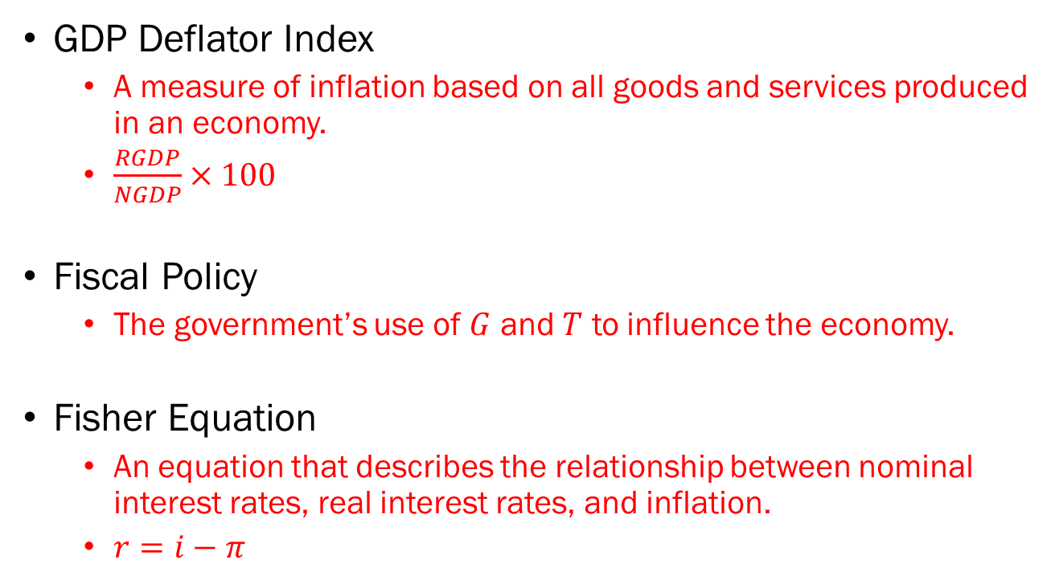
Problem 1. Definitions
GDP Deflator Index
  A measure of inflation based on all goods and services produced in an economy.
  $\frac{RGDP}{NGDP}×100$
Fiscal Policy
  The government’s use of $G$ and $T$ to influence the economy.
Fisher Equation
  An equation that describes the relationship between nominal interest rates, real interest rates, and inflation.
  $r=i−π$

Slide 5
Problem 1. Definitions
Open Market Operations
  A monetary policy tool of the Federal Reserve, where the Fed engages in the sale and purchase of bonds.
Frictional Unemployment
  Unemployment caused by the natural workings of the labor market (i.e. job search process taking time, etc)
Phillips Curve
  A model that describes the relationship between unemployment and inflation in an economy.

Slide 6
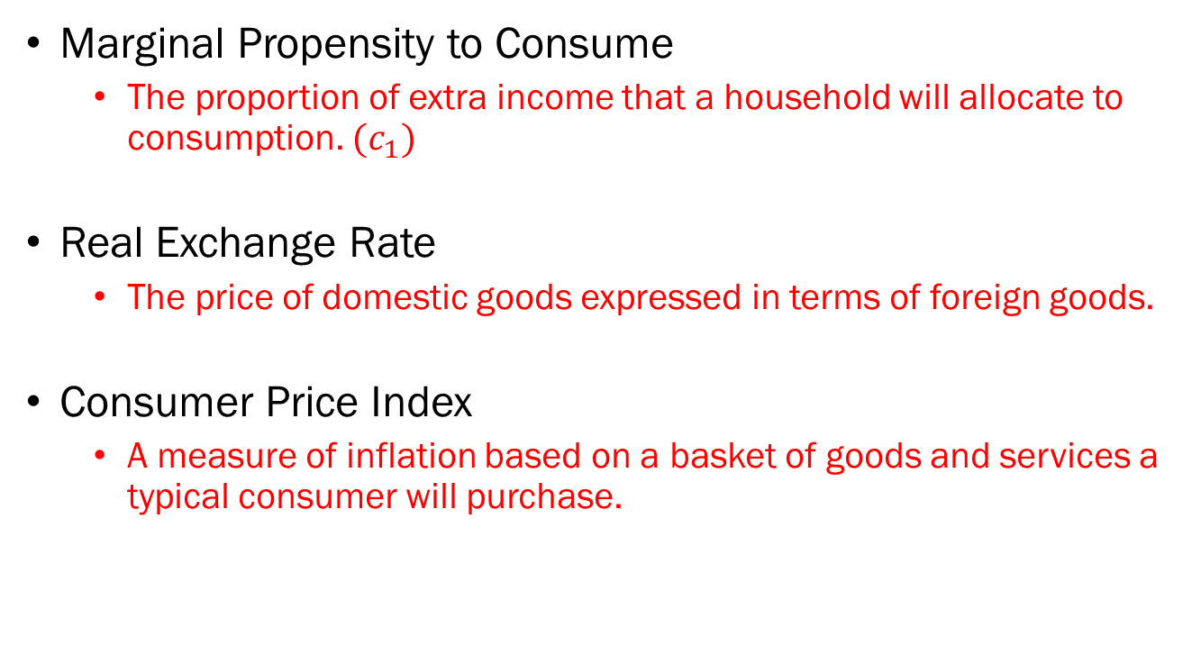
Problem 1. Definitions
Marginal Propensity to Consume
  The proportion of extra income that a household will allocate to consumption. $(c_{1})$
Real Exchange Rate
  The price of domestic goods expressed in terms of foreign goods.
Consumer Price Index
  A measure of inflation based on a basket of goods and services a typical consumer will purchase.

Slide 7
Problem 2.A.
In an open economy, when foreign output increases, domestic exports will decrease.
  FALSE
  When foreigners’ income increases, they will demand more goods in general.
  Some of that increased foreign demand will be absorbed by domestic firms in the form of exports.
  Therefore, exports should increase when foreign output increases.

Slide 8

Problem 2.B.
If the CPI as of 2020 was 258, and the CPI of 2021 was 262, the inflation rate would be 1.5%.
  TRUE
  $π=\frac{262−258}{258}=0.0155$

Slide 9
Problem 2.C.
Income distribution in a country with a Gini coefficient of 0.3 is more equal compared to a country with a Gini coefficient of 0.4.
  TRUE
  A Gini coefficient of 0 represents perfect equality.
  A Gini coefficient of 1 represents maximal inequality.

Slide 10
Problem 2.D.
In general, countries with higher levels of investment in R&D tend to exhibit a faster pace of technological progress.
  FALSE*
  Countries along the frontier of technological progress cannot exhibit faster progress than countries catching up.
  TRUE*
  Countries that do not invest in R&D will not be able to enjoy technological progress at all.

Slide 11



Problem 3.A.
Plot Money Supply, Money Demand, and Interest Rate.
$$M^{s}$$
Interest Rate
$$i^{∗}$$
$$M^{d}$$
Money

Slide 12


Problem 3.B.
What happens when Money Demand increases?
$$M^{s}$$
Interest Rate
$$i^{∗′}$$
$$i^{∗}$$
$$M^{d′}$$
$$M^{d}$$
Money

Slide 13

Problem 3.C.
If the Fed wants to keep the interest rate at $\left(i^{∗}\right)$, what should it do?
  Increase the money supply in the economy to lower interest rates.
  Expansionary monetary policy.

Slide 14

















Problem 4.A. & 4.B.
4.A. The government enacts contractionary fiscal policy.
4.B. The Fed counteracts the fiscal contraction with expansionary monetary policy.
$$r_{n}$$
$$B$$
$$A$$
$$LM$$
$$r_{n}^{′}$$
$$C$$
$$LM^{′}$$
$$Y^{′}$$
$$Y_{n}$$
$$IS^{′}$$
$$IS$$
$$π−\overline{π}$$
$$PC$$
$$Y^{′}$$
$$A$$
Output
$$Y_{n}$$
$$B$$

Slide 15












Problem 5.A.
The government carries out fiscal expansion.
$$Interest$$
$$Parity$$
Domestic Interest Rate $i$
Domestic Interest Rate $i$
$$\overline{i}$$
$$LM$$
$$\overline{i}$$
$$IS^{′}$$
$$IS$$
$$Y$$
$$Y^{′}$$
Output, $Y$
$$E$$
Exchange Rate, $E$

Slide 16
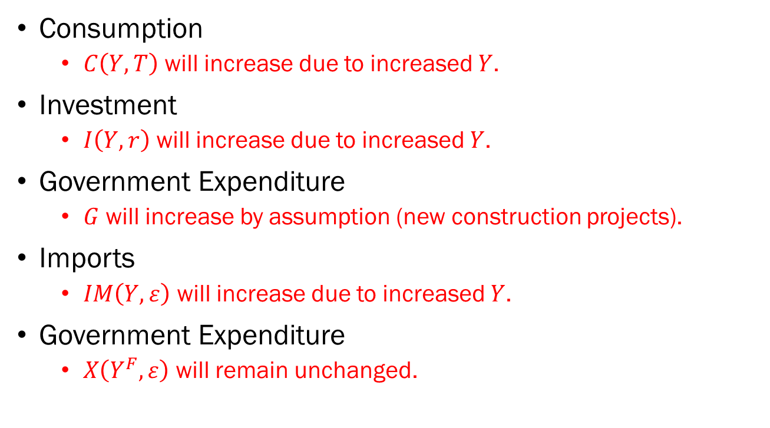
Problem 5.B.
Consumption
  $C\left(Y,T\right)$ will increase due to increased $Y$.
Investment
  $I\left(Y,r\right)$ will increase due to increased $Y$.
Government Expenditure
  $G$ will increase by assumption (new construction projects).
Imports
  $IM\left(Y,ε\right)$ will increase due to increased $Y$.
Government Expenditure
  $X\left(Y^{F},ε\right)$ will remain unchanged.

