Slide 1
Final Exam Review
ECON 301

Slide 2
Problem 1. Definitions
Gross Domestic Product
  The market value of all final goods and services produced in an economy over a given period of time.
Real Interest Rate
  The nominal interest rate adjusted for inflation.
Gini Coefficient
  A measure of inequality in an economy, where 0 indicates perfect equity, and 1 indicates perfect inequity.

Slide 3
Problem 1. Definitions
Discount Rate
  The interest rate that the Federal Reserve charges for short term loans over the discount window.
Monetary Policy
  The Central Banks’ tools used to influence the economy. Heavily involves targeting interest rates and money supply.
Phillips Curve
  A model that describes the relationship between unemployment and inflation in an economy.

Slide 4
Problem 1. Definitions
Potential Output
  The level of output that is expected to arise when the economy is at its natural rate of unemployment so that the economy’s inflation matches expected inflation in the medium run.
Interest Rate Parity
  The relationship between domestic and foreign interest rates and the exchange rate between the involved countries.
Consumer Price Index
  A measure of inflation based on a basket of goods and services a typical consumer will purchase.

Slide 5
Problem 2.A.
When the economy’s unemployment rate is high, workers’ nominal wages will tend to be high as well.
  FALSE
  When unemployment is high, labor supply is greater than labor demand, and wages will tend to be low.

Slide 6
Problem 2.B.
The primary factor that contributes to changes in the economy’s long run growth rate is its technological progress over time
  TRUE
  One may be able to argue that the population growth rate also affects the total size of the economy, but not necessarily per capita output levels.

Slide 7
Problem 2.C.
A recent college graduate who is currently looking for work will not be considered unemployed, since this is the first time they have entered the labor force.
  FALSE
  Since they are available to work, and is actively working for a job, they will be considered to be unemployed.

Slide 8
Problem 2.D.
If an economy experiences high inflation, creditors (those who lent people their money) will be at a disadvantage, and debtors (those who borrowed money) will be at an advantage.
  TRUE
  The value (in terms of purchasing power) of the money that the debtor is obligated to pay back will fall rapidly when inflation is high.

Slide 9
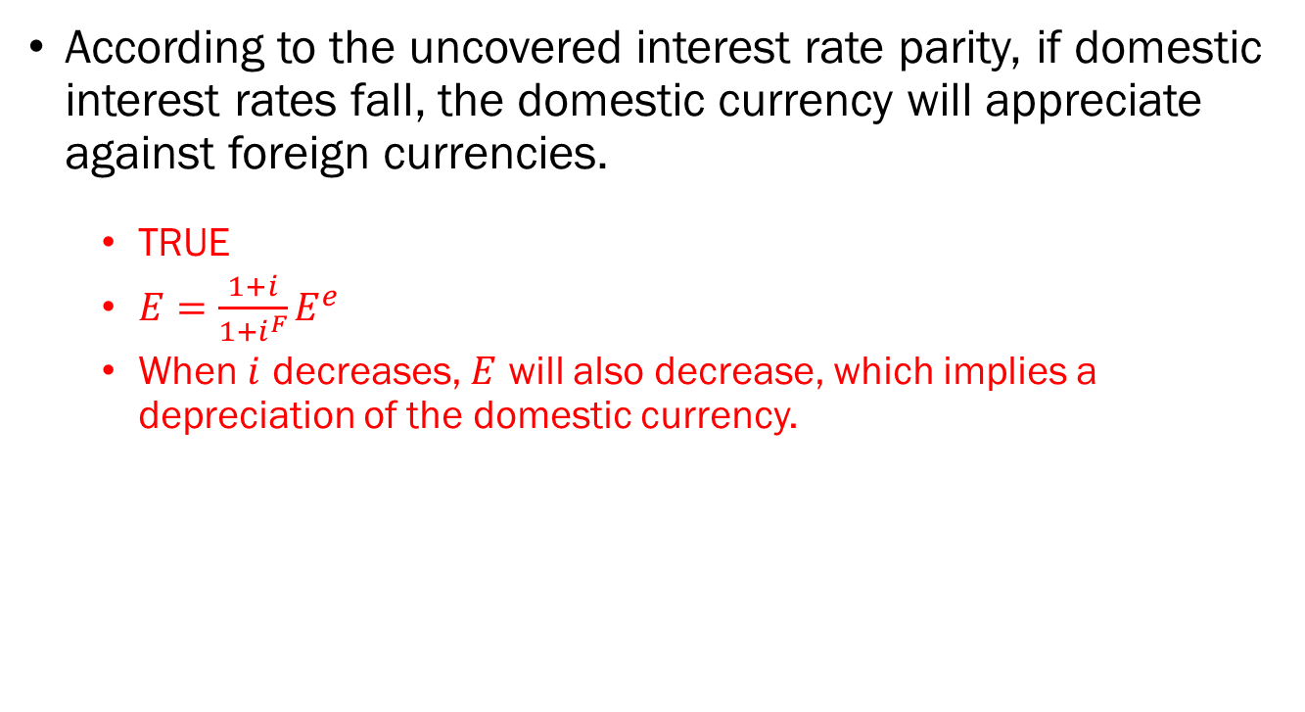
Problem 2.E.
According to the uncovered interest rate parity, if domestic interest rates fall, the domestic currency will appreciate against foreign currencies.
  TRUE
  $E=\frac{1+i}{1+i^{F}}E^{e}$
  When $i$ decreases, $E$ will also decrease, which implies a depreciation of the domestic currency.

Slide 10

















Problem 3.A. & 3.B.
$$r_{n}^{′}$$
$$C$$
$$LM^{′}$$
3.A. The government enacts expansionary fiscal policy.
  IS Curve shifts to the left.
3.B. The Fed counteracts the fiscal expansion with contractionary monetary policy.
  LM Curve shifts upwards.
$$A$$
$$B$$
$$r_{n}$$
$$LM$$
$$Y_{n}$$
$$Y^{′}$$
$$IS^{′}$$
$$π−\overline{π}$$
$$IS$$
$$PC$$
$$B$$
$$A$$
Output
$$Y_{n}$$
$$Y^{′}$$

Slide 11
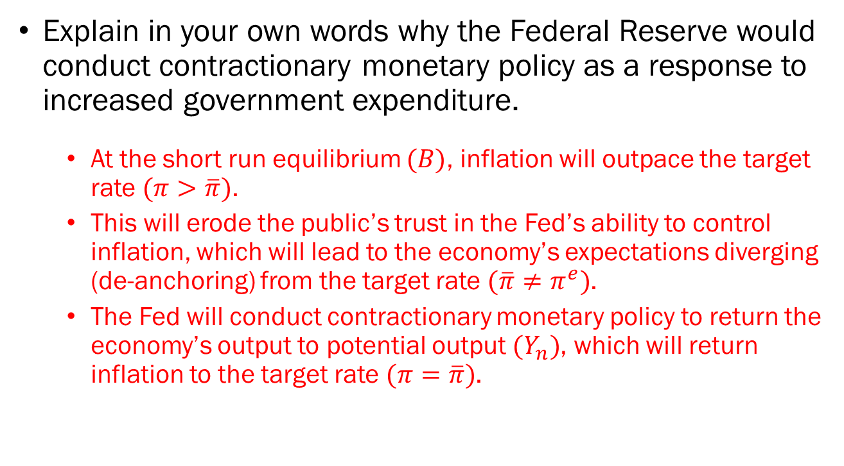
Problem 3.C.
Explain in your own words why the Federal Reserve would conduct contractionary monetary policy as a response to increased government expenditure.
  At the short run equilibrium $(B)$, inflation will outpace the target rate $(π>\overline{π})$.
  This will erode the public’s trust in the Fed’s ability to control inflation, which will lead to the economy’s expectations diverging (de-anchoring) from the target rate $(\overline{π}≠π^{e})$.
  The Fed will conduct contractionary monetary policy to return the economy’s output to potential output $(Y_{n})$, which will return inflation to the target rate $(π=\overline{π})$.

Slide 12













Problem 4.A. & 4.B. & 4.C.
$$Y/N$$
$$δ\frac{K}{N}$$
$$Y/N$$
$$f\left(\frac{K}{N}\right)$$
$${\left(\frac{Y}{N}\right)}_{1}^{∗}$$
$${\left(\frac{Y}{N}\right)}_{0}^{∗}$$
$$s_{H}⋅f\left(\frac{K}{N}\right)$$
$$s_{L}⋅f\left(\frac{K}{N}\right)$$
$${\left(\frac{K}{N}\right)}_{0}^{∗}$$
$${\left(\frac{K}{N}\right)}_{1}^{∗}$$
$$K/N$$
$$t_{0}$$
$$Time$$

Slide 13
Problem 4.D.
It is estimated that many developed economies are exhibiting a lower-than-optimal saving rates. However, policies aiming to boost the saving rate in an economy is often not popular among its constituents. Why would these policies be unpopular?
  To maximize long run consumption, the economy must increase its saving rate.
  This means that for future consumers to enjoy increased consumption, the current generation must increase savings by decreasing their own consumption.
  This is a hard sell for policymakers who depend on the support of the current generation of consumers.

Slide 14
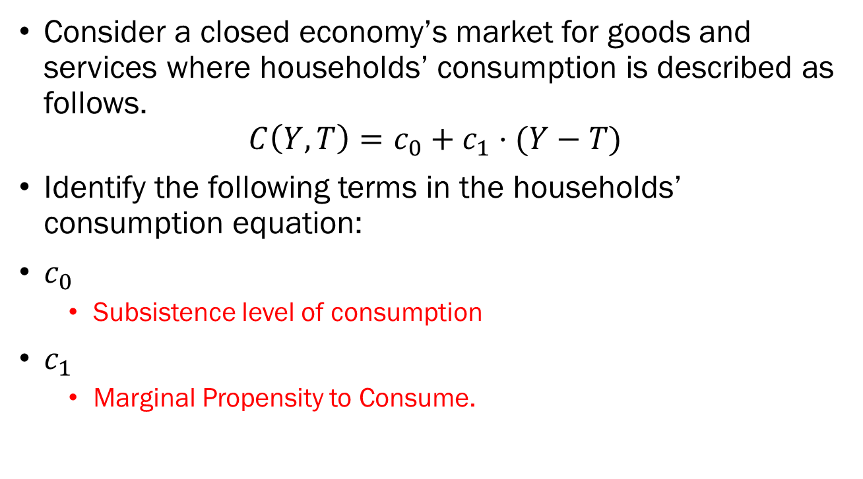
Problem 5.A.
Consider a closed economy’s market for goods and services where households’ consumption is described as follows.
$$C\left(Y,T\right)=c_{0}+c_{1}⋅(Y−T)$$
Identify the following terms in the households’ consumption equation:
$c_{0}$
  Subsistence level of consumption
$c_{1}$
  Marginal Propensity to Consume.

Slide 15
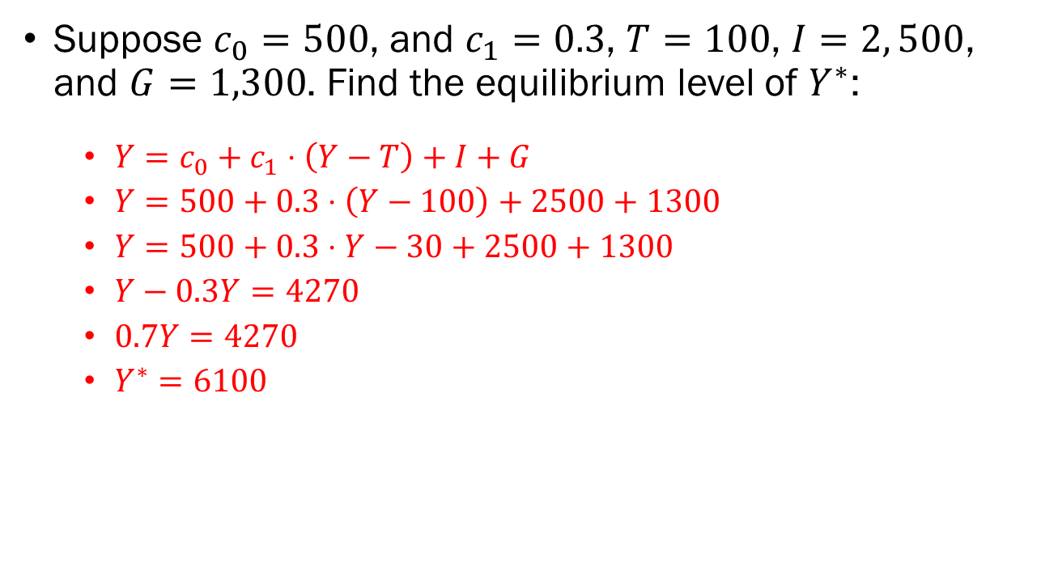
Problem 5.B.
Suppose $c_{0}=500$, and $c_{1}=0.3$, $T=100$, $I=2, 500$, and $G=1,300$. Find the equilibrium level of $Y^{∗}$:
  $Y=c_{0}+c_{1}⋅\left(Y−T\right)+I+G$
  $Y=500+0.3⋅\left(Y−100\right)+2500+1300$
  $Y=500+0.3⋅Y−30+2500+1300$
  $Y−0.3Y=4270$
  $0.7Y=4270$
  $Y^{∗}=6100$

Slide 16





Problem 5.C.
$$Y=Z$$
Demand
$$Z$$
$$c_{0}+I+G$$
$${45}^{°}$$
$$6100$$
Output

