Slide 1
Quiz #6 Review
ECON 300

Slide 2
Quiz #6 Recovery Office Hours
https://calendly.com/brianhwpark
Venue: Rm. 248 Center for Science and Business
Dates: Nov. 22nd ~ Nov. 26th, 2024 (Fri ~ Tue)
ABSOLUTELY REQUIRED that you review notes, problem sets, and homework assignments prior to the visit.
Recovery Rate: 50%

Slide 3
Definitions
Lecture Slide 17, Page 20 & 21

Slide 4
Problem 1. Definitions
Monopsony
  A market in which there is a single consumer.
  Lecture Slide 18, Page 24
Deadweight Loss
  The loss in societal surplus arising due to inefficiencies.
  Lecture Slide 16, Page 15
Price Ceiling
  A form of price control that disallows the good or service to be traded at a certain price or higher.
  Lecture Slide 16, Page 12

Slide 5
Problem 1. Definitions
Economy of Scale
  Efficiencies arising due to increased production quantities.
  Lecture Slide 18, Page 4
Market Power
  The ability to influence the market price of goods or services.
  Lecture Slide 18, Page 7
Consumer’s Burden (from Taxation)
  The proportion of tax revenue that the consumer “pays.”
  Lecture Slide 17, Page 14 & 15

Slide 6
True / False
Lecture Slide 17, Page 20 & 21

Slide 7
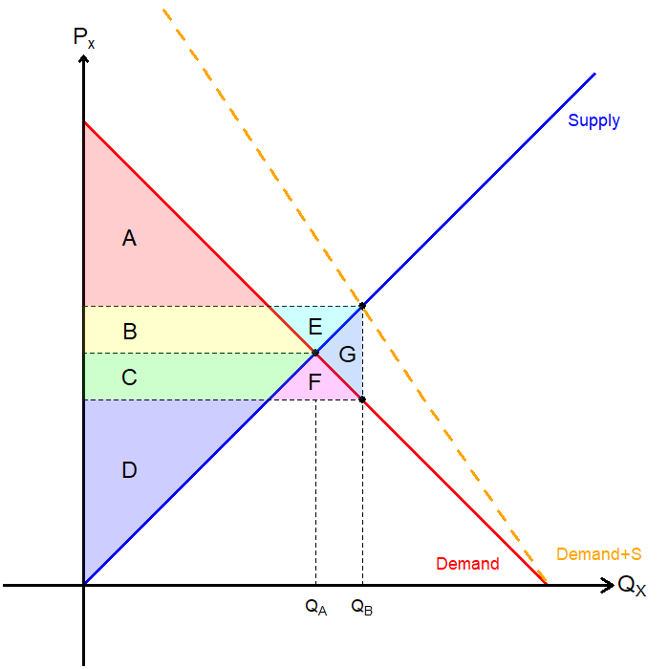
Problem 2.A.
The area A represents consumer surplus.
FALSE
The consumer surplus is the sum of the differences between the consumers’ willingness to pay and the actual price.
A+B+C+F.

Slide 8
Problem 2.B.
The area B + C + E + F + G represents government’s expenses in subsidizing the market.
TRUE

Slide 9
Problem 2.C.
The area E + F + G represents the deadweight loss.
FALSE
Out of government’s expense B+C+E+F+G…
  B+E if absorbed by producers, and
  C+F is absorbed by consumers,
Deadweight Loss is G.

Slide 10
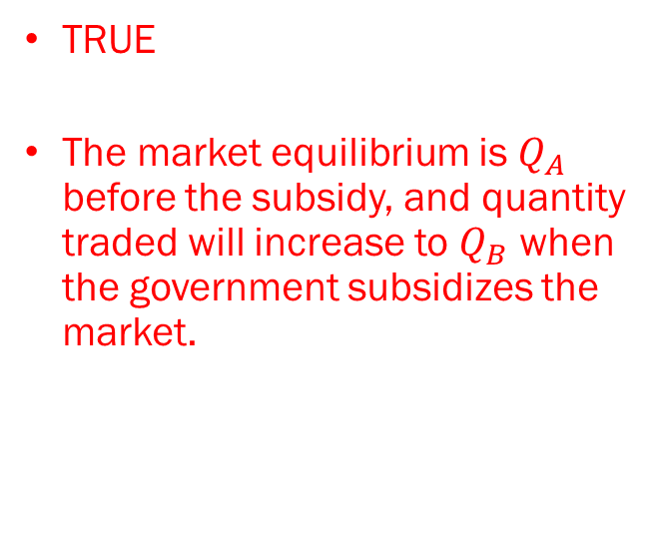
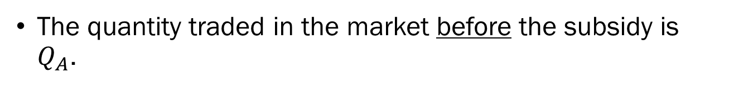
Problem 2.D.
The quantity traded in the market before the subsidy is $Q_{A}$.
TRUE
The market equilibrium is $Q_{A}$ before the subsidy, and quantity traded will increase to $Q_{B}$ when the government subsidizes the market.

Slide 11
Problem 3
- Lecture Slide 18, Page 10 ~ 20
- Problem Set 6 Part 2, Problem 1

Slide 12
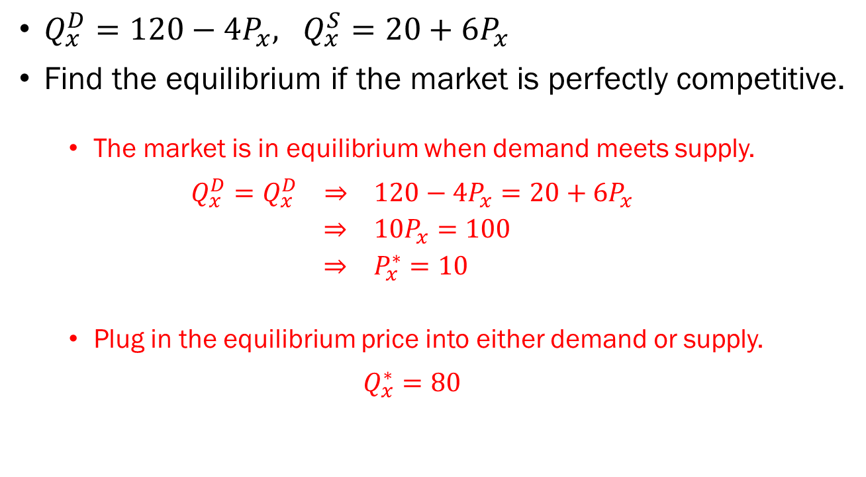
Problem 3.A.
$Q_{x}^{D}=120−4P_{x}, Q_{x}^{S}=20+6P_{x}$
Find the equilibrium if the market is perfectly competitive.
  The market is in equilibrium when demand meets supply.
  $$Q_{x}^{D}=Q_{x}^{D} ⇒ 120−4P_{x}=20+6P_{x}$$
  $⇒ 10P_{x}=100$
  $⇒ P_{x}^{∗}=10$
  Plug in the equilibrium price into either demand or supply.
  $$Q_{x}^{∗}=80$$

Slide 13
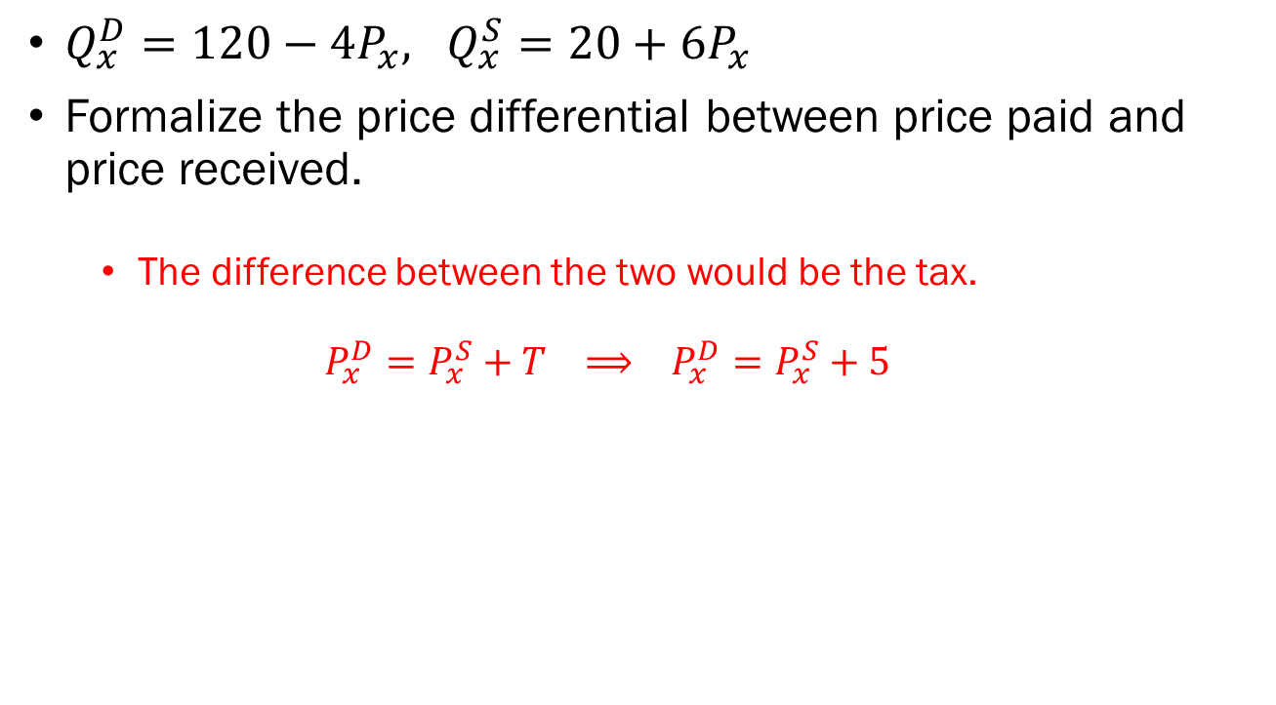
Problem 3.B.
$Q_{x}^{D}=120−4P_{x}, Q_{x}^{S}=20+6P_{x}$
Formalize the price differential between price paid and price received.
  The difference between the two would be the tax.
  $$P_{x}^{D}=P_{x}^{S}+T ⟹ P_{x}^{D}=P_{x}^{S}+5$$

Slide 14
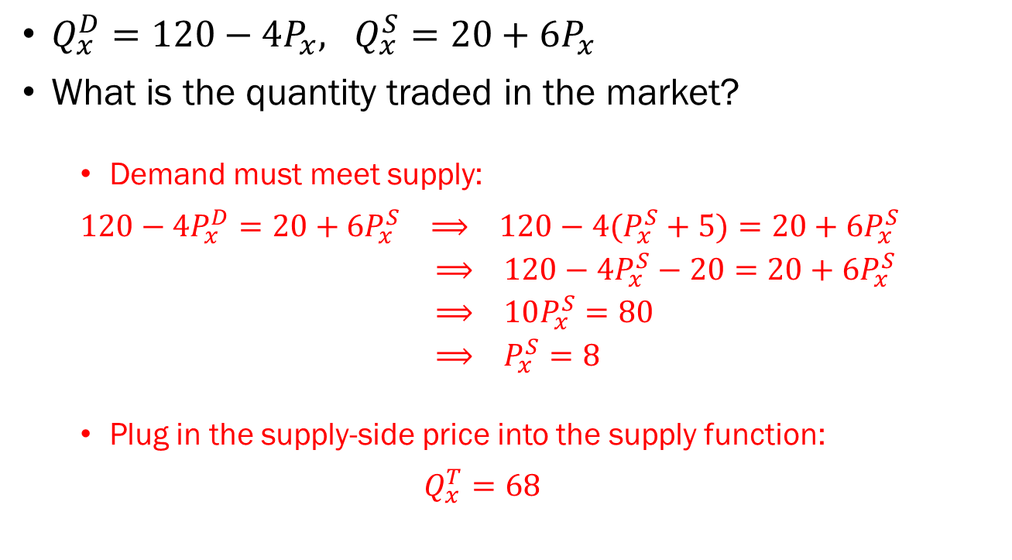
Problem 3.C.
$Q_{x}^{D}=120−4P_{x}, Q_{x}^{S}=20+6P_{x}$
What is the quantity traded in the market?
  Demand must meet supply:
  $$120−4P_{x}^{D}=20+6P_{x}^{S} ⟹ 120−4(P_{x}^{S}+5)=20+6P_{x}^{S}$$
  $⟹ 120−4P_{x}^{S}−20=20+6P_{x}^{S}$
  $⟹ 10P_{x}^{S}=80$
  $⟹ P_{x}^{S}=8$
  Plug in the supply-side price into the supply function:
  $$Q_{x}^{T}=68$$

Slide 15
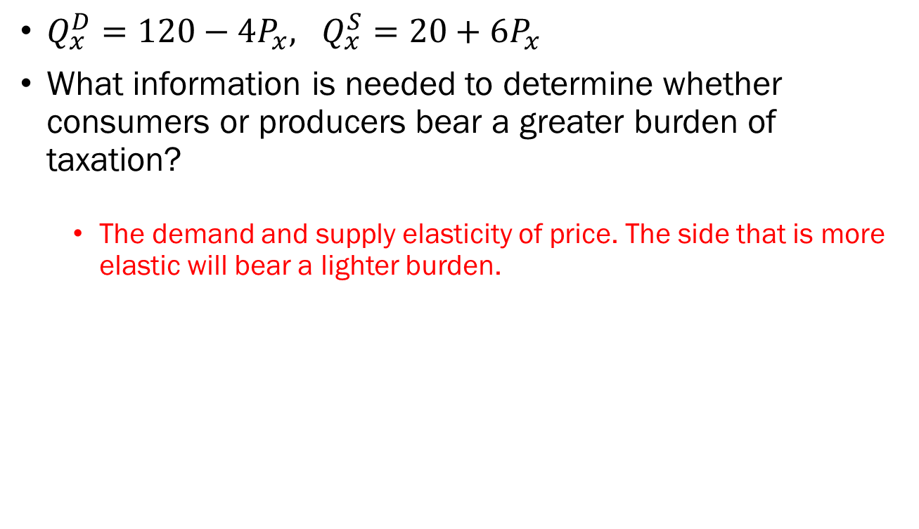
Problem 3.D.
$Q_{x}^{D}=120−4P_{x}, Q_{x}^{S}=20+6P_{x}$
What information is needed to determine whether consumers or producers bear a greater burden of taxation?
  The demand and supply elasticity of price. The side that is more elastic will bear a lighter burden.

Slide 16
Problem 4
- Lecture Slide 18, Page 26 ~ 32
- Problem Set 6 Part 2, Problem 2

Slide 17
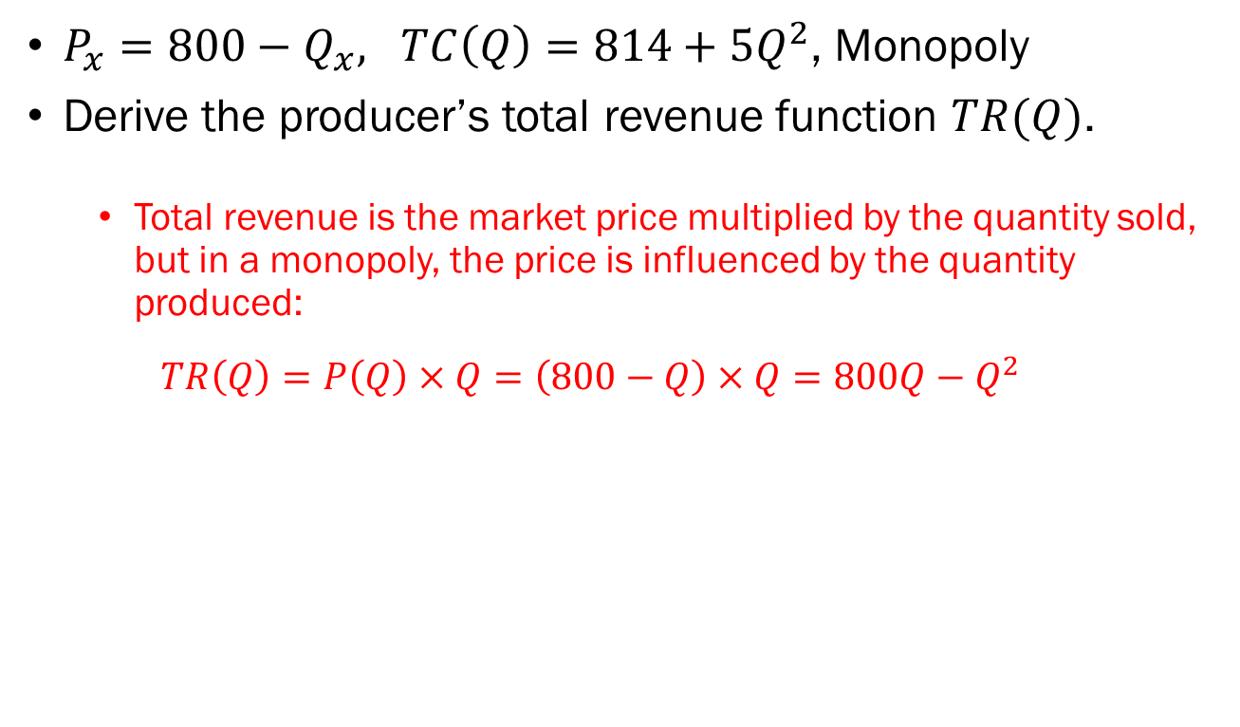
Problem 4.A.
$P_{x}=800−Q_{x}, TC\left(Q\right)=814+5Q^{2}$, Monopoly
Derive the producer’s total revenue function $TR(Q)$.
  Total revenue is the market price multiplied by the quantity sold, but in a monopoly, the price is influenced by the quantity produced:
  $$TR\left(Q\right)=P\left(Q\right)×Q=\left(800−Q\right)×Q=800Q−Q^{2}$$

Slide 18
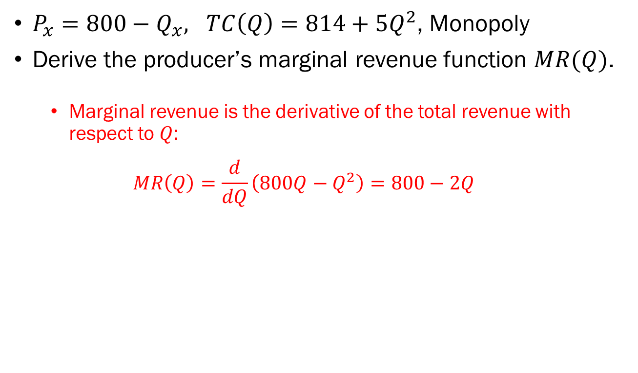
Problem 4.B.
$P_{x}=800−Q_{x}, TC\left(Q\right)=814+5Q^{2}$, Monopoly
Derive the producer’s marginal revenue function $MR(Q)$.
  Marginal revenue is the derivative of the total revenue with respect to $Q$:
  $$MR\left(Q\right)=\frac{d}{dQ}\left(800Q−Q^{2}\right)=800−2Q$$

Slide 19
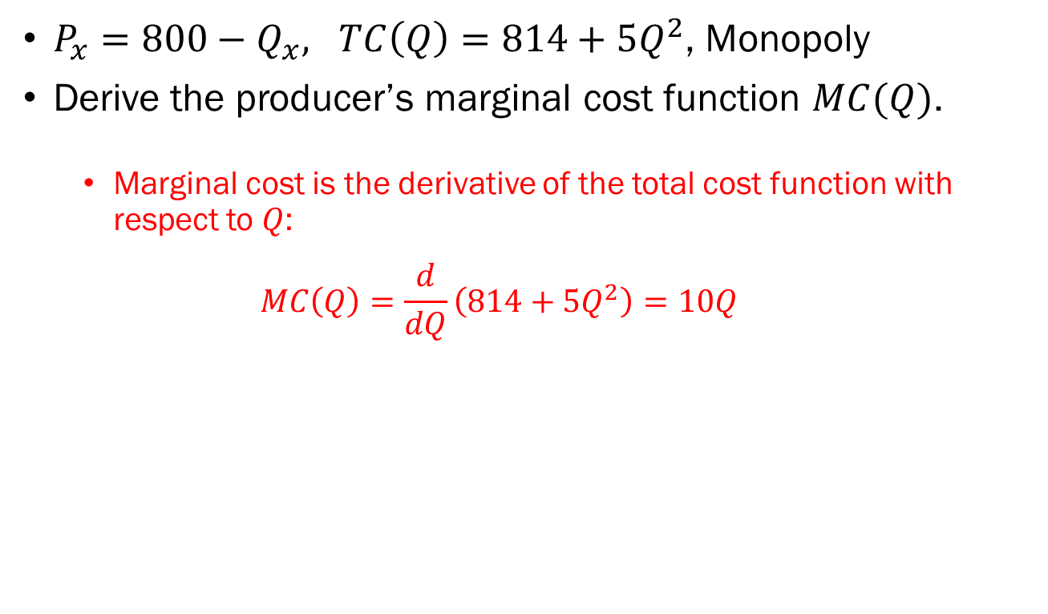
Problem 4.C.
$P_{x}=800−Q_{x}, TC\left(Q\right)=814+5Q^{2}$, Monopoly
Derive the producer’s marginal cost function $MC(Q)$.
  Marginal cost is the derivative of the total cost function with respect to $Q$:
  $$MC\left(Q\right)=\frac{d}{dQ}\left(814+5Q^{2}\right)=10Q$$

Slide 20
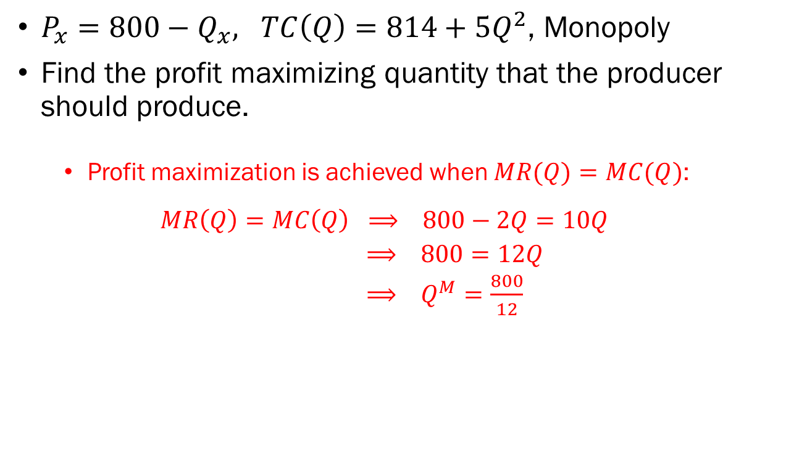
Problem 4.B.
$P_{x}=800−Q_{x}, TC\left(Q\right)=814+5Q^{2}\text{, }\text{Monopoly}$
Find the profit maximizing quantity that the producer should produce.
  Profit maximization is achieved when $MR(Q)=MC(Q)$:
  $$MR\left(Q\right)=MC\left(Q\right) ⟹ 800−2Q=10Q$$
  $⟹ 800=12Q$
  $⟹ Q^{M}=\frac{800}{12}$

