Slide 1
Quiz #5 Review
ECON 300

Slide 2
Quiz #5 Recovery Office Hours
https://calendly.com/brianhwpark
Venue: Rm. 248 Center for Science and Business
Dates: Nov. 11th ~ Nov. 15th, 2024 (Mon ~ Fri)
ABSOLUTELY REQUIRED that you review notes, problem sets, and homework assignments prior to the visit.
Recovery Rate: 50%

Slide 3
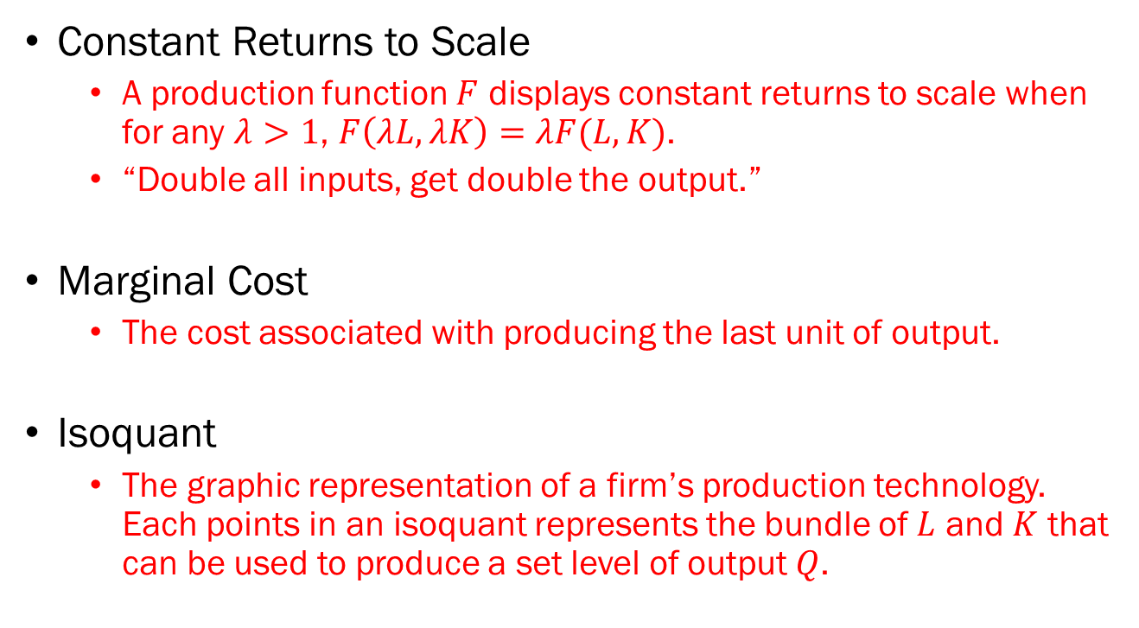
Problem 1. Definitions
Constant Returns to Scale
  A production function $F$ displays constant returns to scale when for any $λ>1$, $F\left(λL,λK\right)=λF(L,K)$.
  “Double all inputs, get double the output.”
Marginal Cost
  The cost associated with producing the last unit of output.
Isoquant
  The graphic representation of a firm’s production technology. Each points in an isoquant represents the bundle of $L$ and $K$ that can be used to produce a set level of output $Q$.

Slide 4
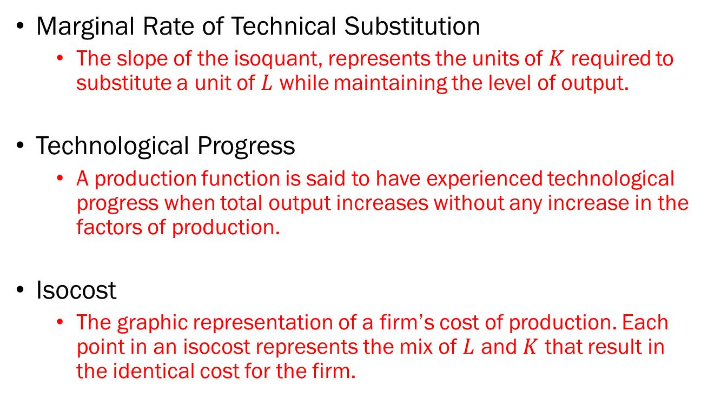
Problem 1. Definitions
Marginal Rate of Technical Substitution
  The slope of the isoquant, represents the units of $K$ required to substitute a unit of $L$ while maintaining the level of output.
Technological Progress
  A production function is said to have experienced technological progress when total output increases without any increase in the factors of production.
Isocost
  The graphic representation of a firm’s cost of production. Each point in an isocost represents the mix of $L$ and $K$ that result in the identical cost for the firm.

Slide 5
Problem 2.A.
The short run refers to a time frame in which all factors of production are variable.
  FALSE
  The long run refers to the time frame where all factors of production are variable.
  The short run refers to the time frame where at least one factor of production is fixed.

Slide 6
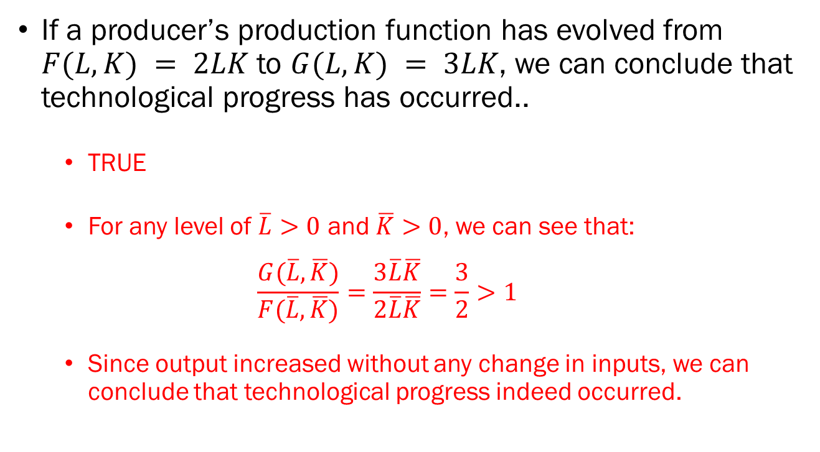
Problem 2.B.
If a producer’s production function has evolved from $F(L,K) = 2LK$ to $G(L,K) = 3LK$, we can conclude that technological progress has occurred..
  TRUE
  For any level of $\overline{L}>0$ and $\overline{K}>0$, we can see that:
  $$\frac{G(\overline{L},\overline{K})}{F(\overline{L},\overline{K})}=\frac{3\overline{L}\overline{K}}{2\overline{L}\overline{K}}=\frac{3}{2}>1$$
  Since output increased without any change in inputs, we can conclude that technological progress indeed occurred.

Slide 7
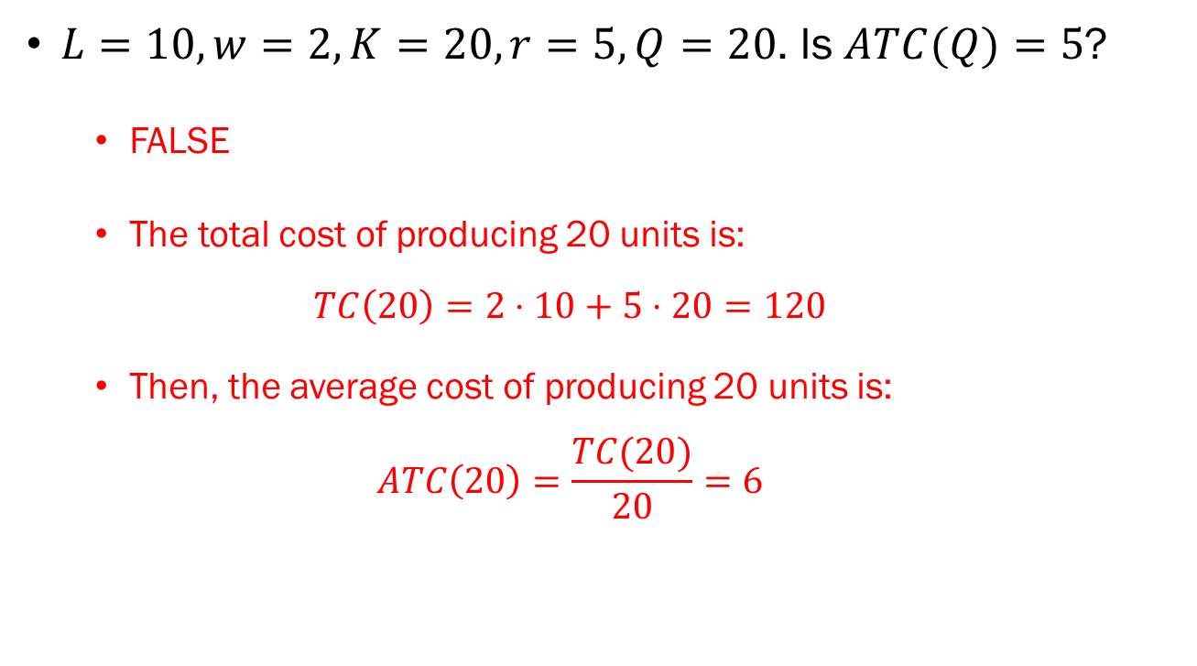
Problem 2.C.
$L=10, w=2, K=20, r=5, Q=20$. Is $ATC(Q)=5$?
  FALSE
  The total cost of producing 20 units is:
  $$TC\left(20\right)=2⋅10+5⋅20=120$$
  Then, the average cost of producing 20 units is:
  $$ATC\left(20\right)=\frac{TC(20)}{20}=6$$

Slide 8
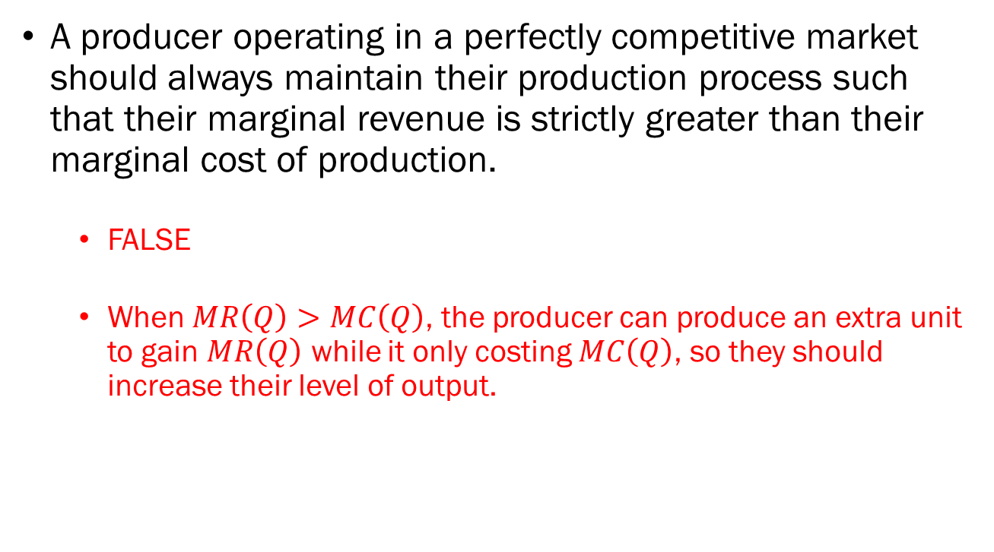
Problem 2.D.
A producer operating in a perfectly competitive market should always maintain their production process such that their marginal revenue is strictly greater than their marginal cost of production.
  FALSE
  When $MR\left(Q\right)>MC\left(Q\right)$, the producer can produce an extra unit to gain $MR\left(Q\right)$ while it only costing $MC\left(Q\right)$, so they should increase their level of output.

Slide 9
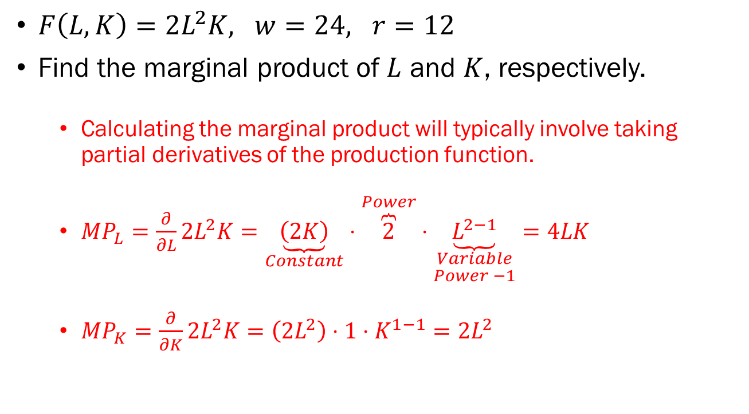
Problem 3.A.
$F\left(L,K\right)=2L^{2}K, w=24, r=12$
Find the marginal product of $L$ and $K$, respectively.
  Calculating the marginal product will typically involve taking partial derivatives of the production function.
  $MP_{L}=\frac{∂}{∂L}2L^{2}K=\underset{Constant}{\underbrace{\left(2K\right)}}⋅\overset{Power}{\overbrace{2}}⋅\underset{\begin{aligned}Variable \\ Power −1\end{aligned}}{\underbrace{L^{2−1}}}=4LK$
  $MP_{K}=\frac{∂}{∂K}2L^{2}K=\left(2L^{2}\right)⋅1⋅K^{1−1}=2L^{2}$

Slide 10
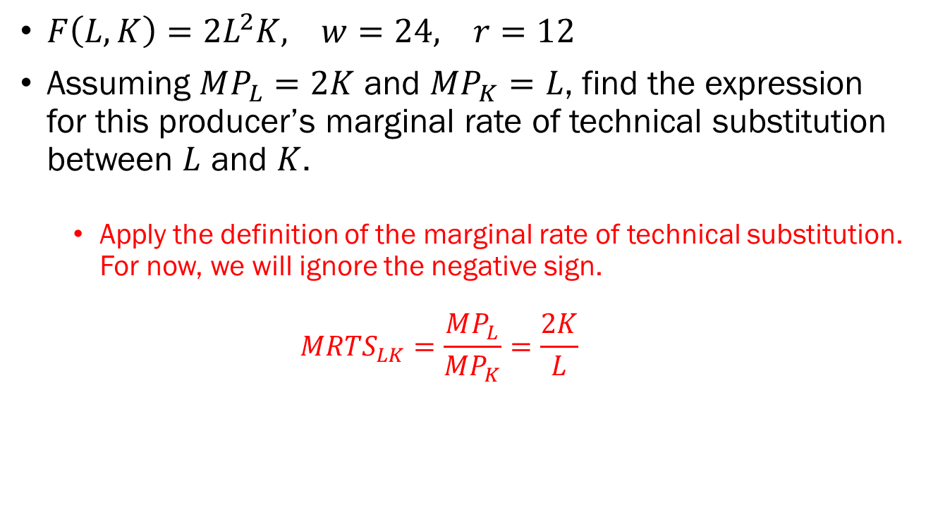
Problem 3.B.
$F\left(L,K\right)=2L^{2}K, w=24, r=12$
Assuming $MP_{L}=2K$ and $MP_{K}=L$, find the expression for this producer’s marginal rate of technical substitution between $L$ and $K$.
  Apply the definition of the marginal rate of technical substitution. For now, we will ignore the negative sign.
  $$MRTS_{LK}=\frac{MP_{L}}{MP_{K}}=\frac{2K}{L}$$

Slide 11
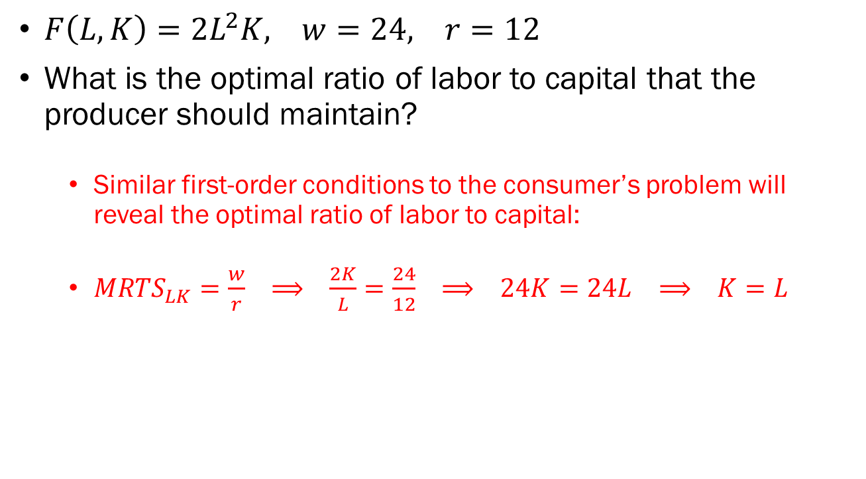
Problem 3.C.
$F\left(L,K\right)=2L^{2}K, w=24, r=12$
What is the optimal ratio of labor to capital that the producer should maintain?
  Similar first-order conditions to the consumer’s problem will reveal the optimal ratio of labor to capital:
  $MRTS_{LK}=\frac{w}{r} ⟹ \frac{2K}{L}=\frac{24}{12} ⟹ 24K=24L ⟹ K=L$

Slide 12
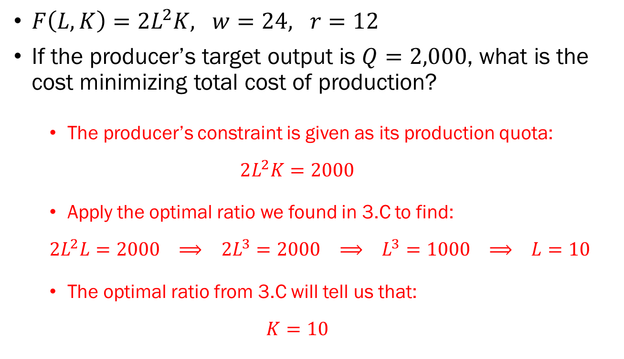
Problem 3.D.
$F\left(L,K\right)=2L^{2}K, w=24, r=12$
If the producer’s target output is $Q=2,000$, what is the cost minimizing total cost of production?
  The producer’s constraint is given as its production quota:
  $$2L^{2}K=2000$$
  Apply the optimal ratio we found in 3.C to find:
  $$2L^{2}L=2000 ⟹ {2L}^{3}=2000 ⟹ L^{3}=1000 ⟹ L=10$$
  The optimal ratio from 3.C will tell us that:
  $$K=10$$

Slide 13
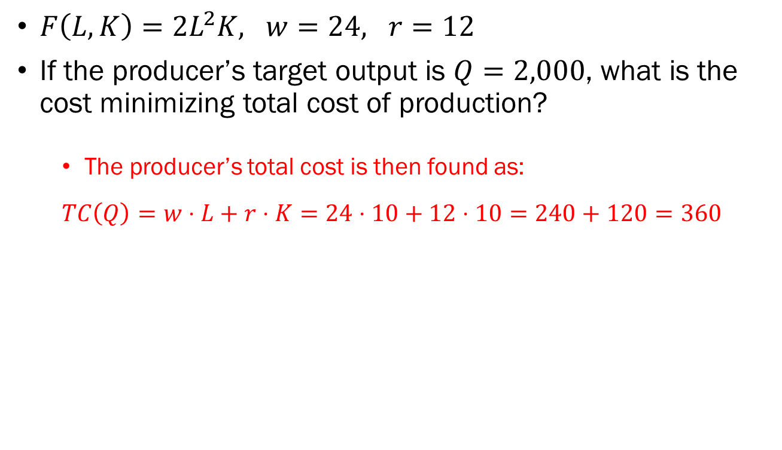
Problem 3.D. (continued)
$F\left(L,K\right)=2L^{2}K, w=24, r=12$
If the producer’s target output is $Q=2,000$, what is the cost minimizing total cost of production?
  The producer’s total cost is then found as:
  $$TC\left(Q\right)=w⋅L+r⋅K=24⋅10+12⋅10=240+120=360$$

Slide 14

Problem 4.A.
$P=100, TC\left(Q\right)=250+20Q+Q^{2}$
Find the producer’s total revenue function $TR(Q)$.
  Total revenue in a perfectly competitive market is simply the market price multiplied by the quantity sold:
  $$TR\left(Q\right)=P⋅Q=100⋅Q$$

Slide 15
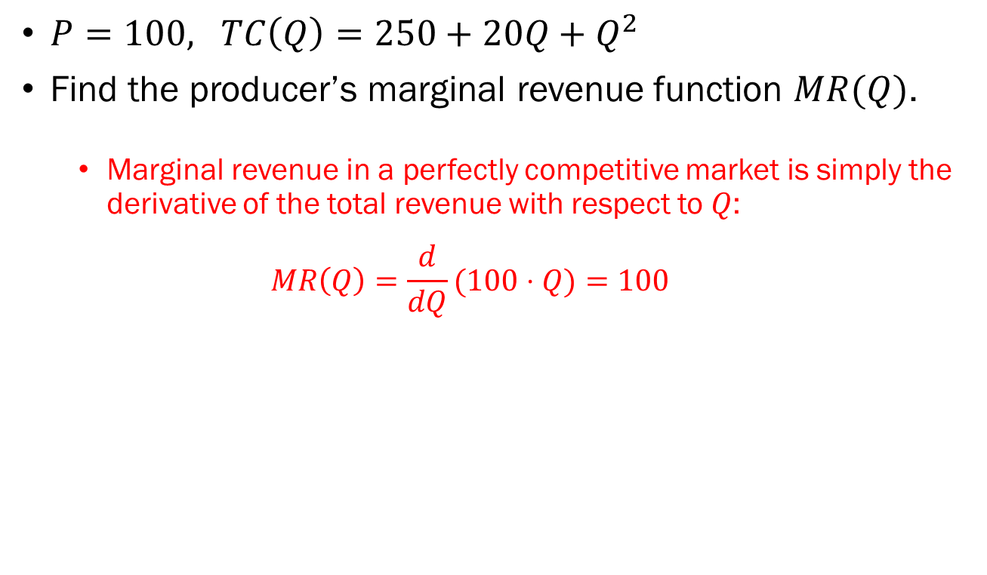
Problem 4.B.
$P=100, TC\left(Q\right)=250+20Q+Q^{2}$
Find the producer’s marginal revenue function $MR(Q)$.
  Marginal revenue in a perfectly competitive market is simply the derivative of the total revenue with respect to $Q$:
  $$MR\left(Q\right)=\frac{d}{dQ}(100⋅Q)=100$$

Slide 16
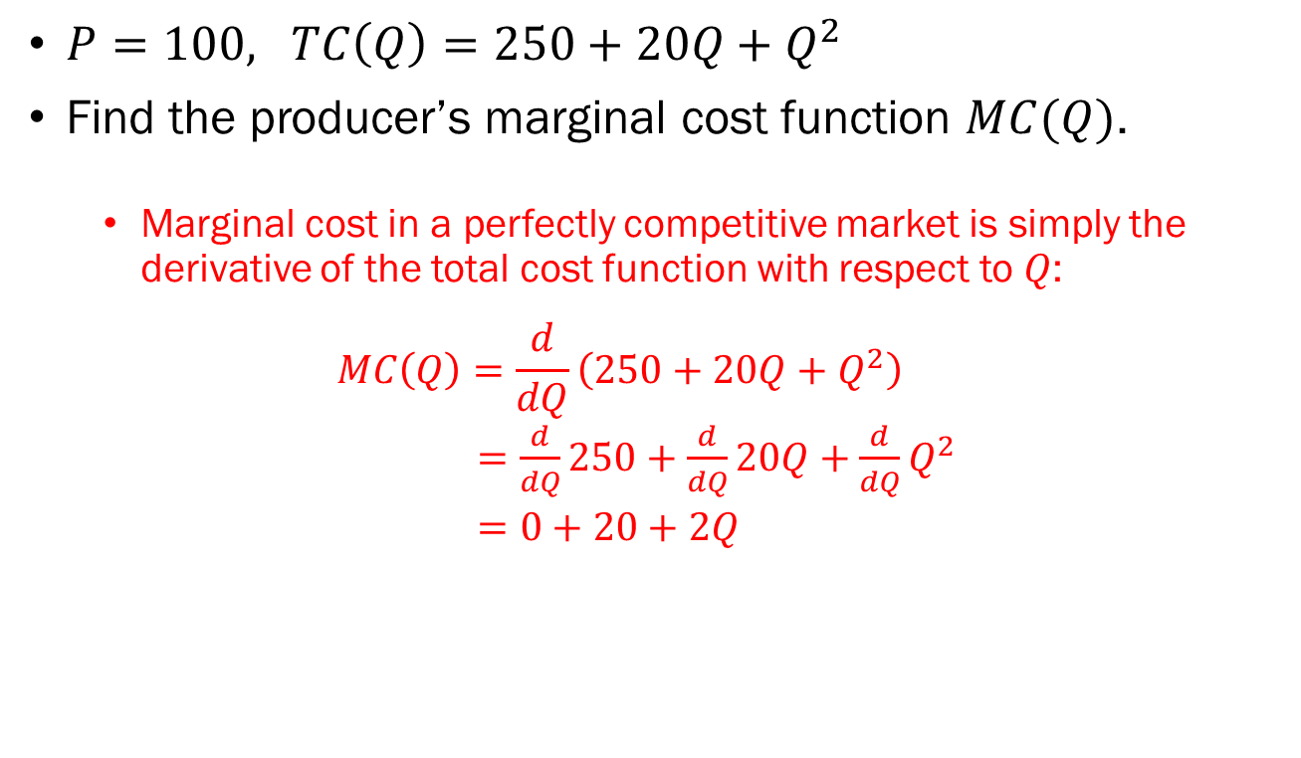
Problem 4.C.
$P=100, TC\left(Q\right)=250+20Q+Q^{2}$
Find the producer’s marginal cost function $MC(Q)$.
  Marginal cost in a perfectly competitive market is simply the derivative of the total cost function with respect to $Q$:
  $$MC\left(Q\right)=\frac{d}{dQ}\left(250+20Q+Q^{2}\right)$$
  $=\frac{d}{dQ}250+\frac{d}{dQ}20Q+\frac{d}{dQ}Q^{2}$
  $=0+20+2Q$

Slide 17
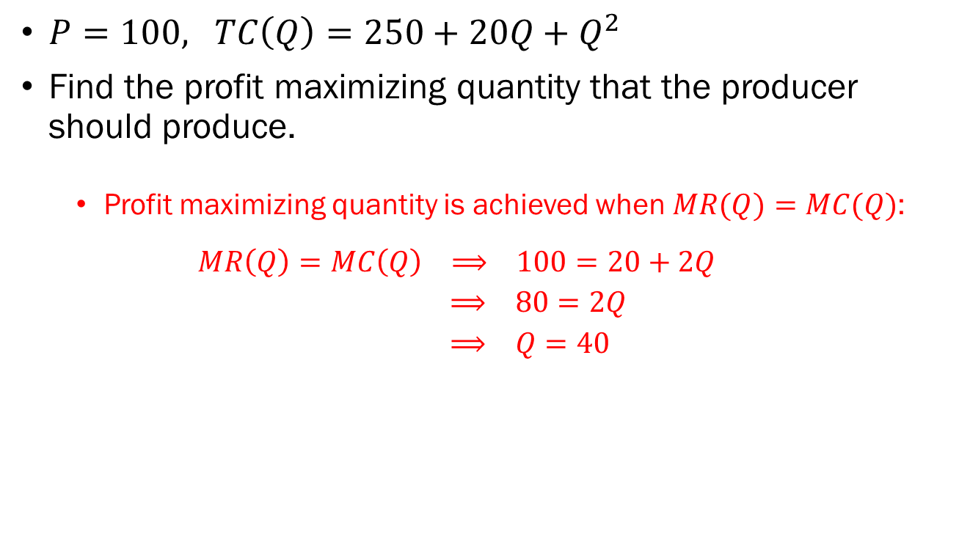
Problem 4.B.
$P=100, TC\left(Q\right)=250+20Q+Q^{2}$
Find the profit maximizing quantity that the producer should produce.
  Profit maximizing quantity is achieved when $MR(Q)=MC(Q)$:
  $$MR\left(Q\right)=MC\left(Q\right) ⟹ 100=20+2Q$$
  $⟹ 80=2Q$
  $⟹ Q=40$

