Slide 1
Quiz #4 Review
ECON 300

Slide 2
Quiz #4 Recovery Office Hours
https://calendly.com/brianhwpark
Venue: Rm. 248 Center for Science and Business
Dates: Oct. 28th ~ Nov. 1st, 2024 (Mon ~ Fri)
ABSOLUTELY REQUIRED that you review notes, problem sets, and homework assignments prior to the visit.
Recovery Rate: 50%

Slide 3
Problem 1. Definitions
Substitution Effect
  The isolated change in the consumer’s demand for a product due solely to the changes in relative prices.
Slutsky Equation
  Equation that tell us that the Price Effect can be decomposed into the sum of the Substitution Effect and Income Effects.
Normal Goods
  Goods whose demand increase when the consumer’s income increase, vice versa.
  Goods whose income elasticity of demand is greater than 1.

Slide 4
Problem 1. Definitions
The Engel Curve
  A curve that depicts the relationship between the quantity demanded of a good and the consumer’s income.
Necessary Goods
  Goods whose income elasticity of demand is greater than 0, but less than 1.
  Goods whose demand increase by less than 1% when the consumer’s income increase by 1%.
Ordinary Goods
  Goods whose quantity demanded increase when the price of said good decrease, vice versa.

Slide 5
Problem 2.A.
When analyzing a market with two goods, it is not possible for both goods to be inferior goods.
  TRUE
  Explanation to be given on the board.

Slide 6
Problem 2.B.
When the substitution effect is greater in magnitude than the income effect in case the price of a good decreases, the good can be identified as a Giffen good.
  FALSE
  Explanation to be given on the board.

Slide 7
Problem 2.C.
The “movement” from bundle B to bundle C represents the Slutsky substitution effect.
FALSE
First, the shift from B to C is an Income Effect.
Second, the method of preserving the consumer’s utility is the Hicksian approach.

Slide 8
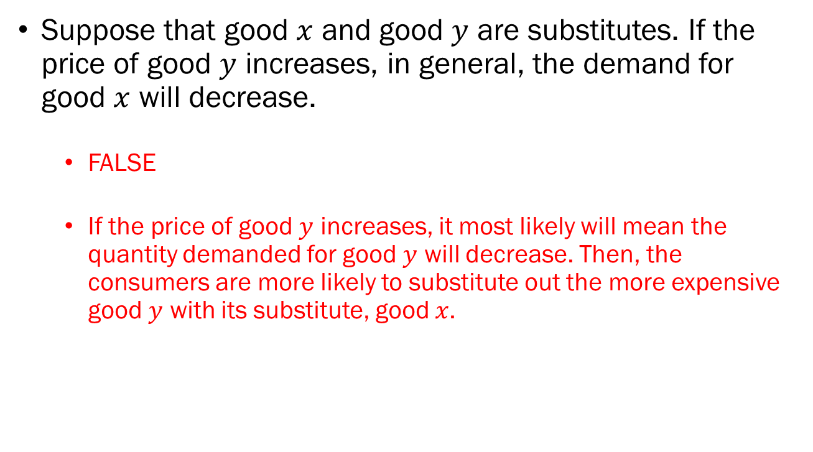
Problem 2.D.
Suppose that good $x$ and good $y$ are substitutes. If the price of good $y$ increases, in general, the demand for good $x$ will decrease.
  FALSE
  If the price of good $y$ increases, it most likely will mean the quantity demanded for good $y$ will decrease. Then, the consumers are more likely to substitute out the more expensive good $y$ with its substitute, good $x$.

Slide 9
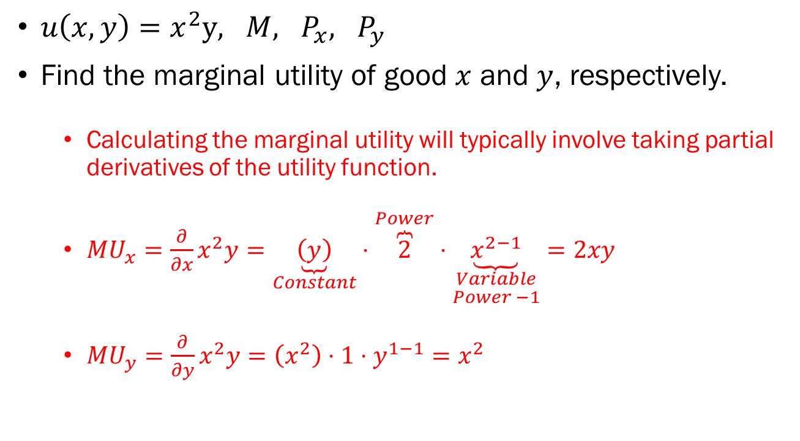
Problem 3.A.
$u\left(x,y\right)=x^{2}y, M, P_{x}, P_{y}$
Find the marginal utility of good $x$ and $y$, respectively.
  Calculating the marginal utility will typically involve taking partial derivatives of the utility function.
  $MU_{x}=\frac{∂}{∂x}x^{2}y=\underset{Constant}{\underbrace{\left(y\right)}}⋅\overset{Power}{\overbrace{2}}⋅\underset{\begin{aligned}Variable \\ Power −1\end{aligned}}{\underbrace{x^{2−1}}}=2xy$
  $MU_{y}=\frac{∂}{∂y}x^{2}y=\left(x^{2}\right)⋅1⋅y^{1−1}=x^{2}$

Slide 10
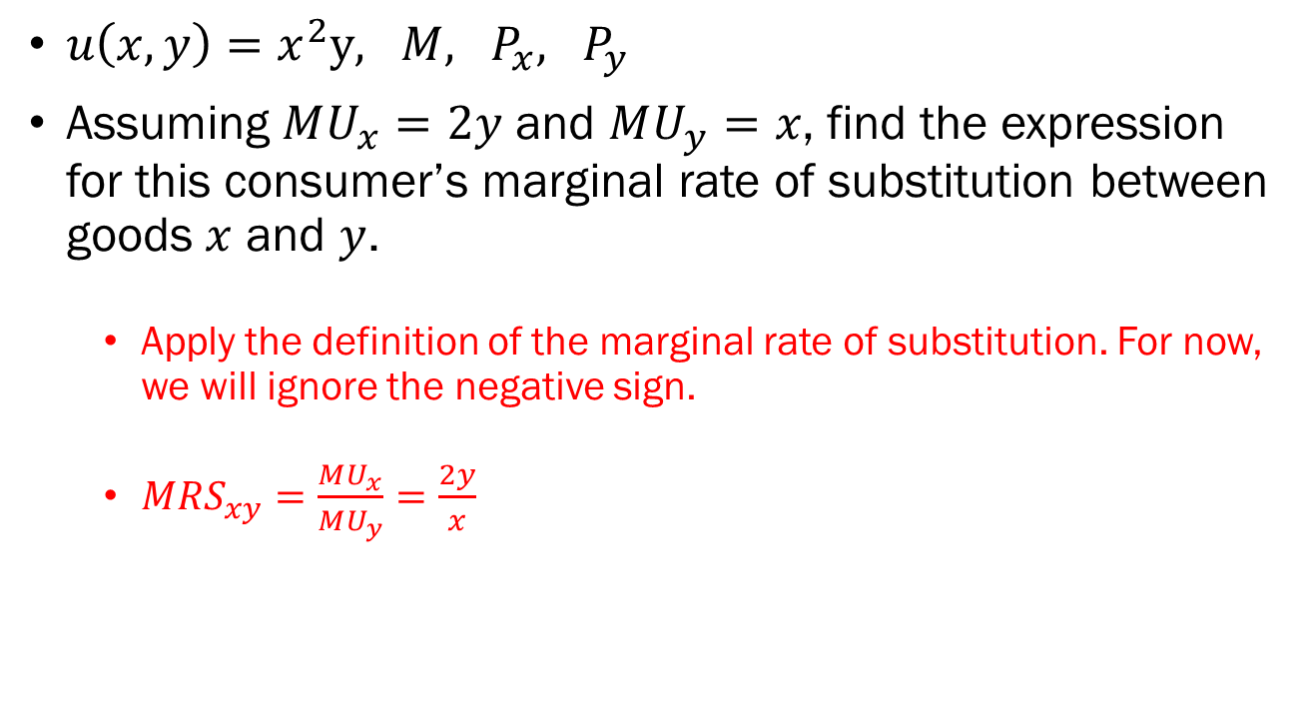
Problem 3.B.
$u\left(x,y\right)=x^{2}y, M, P_{x}, P_{y}$
Assuming $MU_{x}=2y$ and $MU_{y}=x$, find the expression for this consumer’s marginal rate of substitution between goods $x$ and $y$.
  Apply the definition of the marginal rate of substitution. For now, we will ignore the negative sign.
  $MRS_{xy}=\frac{MU_{x}}{MU_{y}}=\frac{2y}{x}$

Slide 11

Problem 3.C.
$u\left(x,y\right)=x^{2}y, M, P_{x}, P_{y}$
Find the formal expression for the consumer’s budget constraint.
  $P_{x}x+P_{y}y=M$

Slide 12
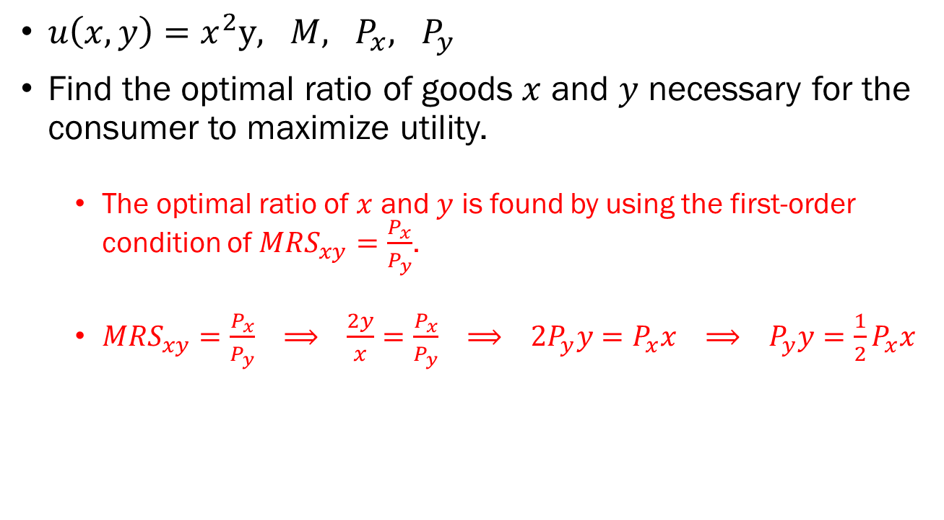
Problem 3.D.
$u\left(x,y\right)=x^{2}y, M, P_{x}, P_{y}$
Find the optimal ratio of goods $x$ and $y$ necessary for the consumer to maximize utility.
  The optimal ratio of $x$ and $y$ is found by using the first-order condition of $MRS_{xy}=\frac{P_{x}}{P_{y}}$.
  $MRS_{xy}=\frac{P_{x}}{P_{y}} ⟹ \frac{2y}{x}=\frac{P_{x}}{P_{y}} ⟹ 2P_{y}y=P_{x}x ⟹ P_{y}y=\frac{1}{2}P_{x}x$

Slide 13
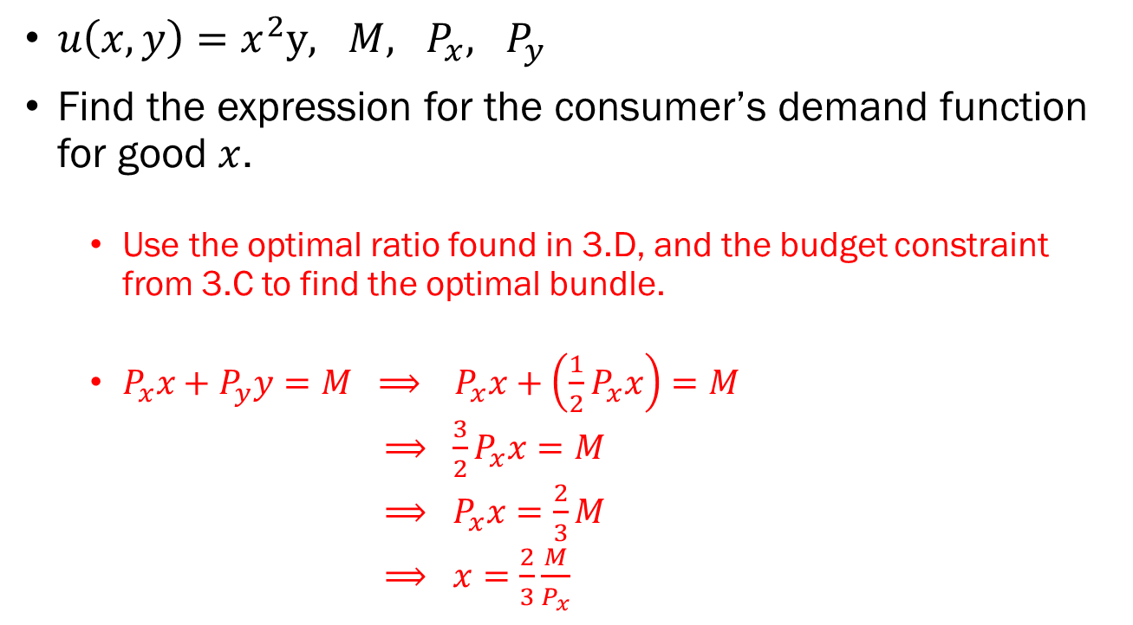
Problem 3.E.
$u\left(x,y\right)=x^{2}y, M, P_{x}, P_{y}$
Find the expression for the consumer’s demand function for good $x$.
  Use the optimal ratio found in 3.D, and the budget constraint from 3.C to find the optimal bundle.
  $P_{x}x+P_{y}y=M ⟹ P_{x}x+\left(\frac{1}{2}P_{x}x\right)=M$
  $⟹ \frac{3}{2}P_{x}x=M$
  $⟹ P_{x}x=\frac{2}{3}M$
  $⟹ x=\frac{2}{3}\frac{M}{P_{x}}$

Slide 14

Problem 4.A.
$x_{1}=40−\frac{1}{2}P_{x}$, $x_{2}=20−P_{x}$
Find the consumers’ inverse demand functions.
  $x_{1}=40−\frac{1}{2}P_{x} ⟹ x_{1}+\frac{1}{2}P_{x}=40$
  $⟹ \frac{1}{2}P_{x}=40−x_{1}$
  $⟹ P_{x}=80−2x_{1}$
  $x_{2}=20−P_{x} ⟹ x_{2}+P_{x}=20$
  $⟹ P_{x}=20−x_{2}$

Slide 15
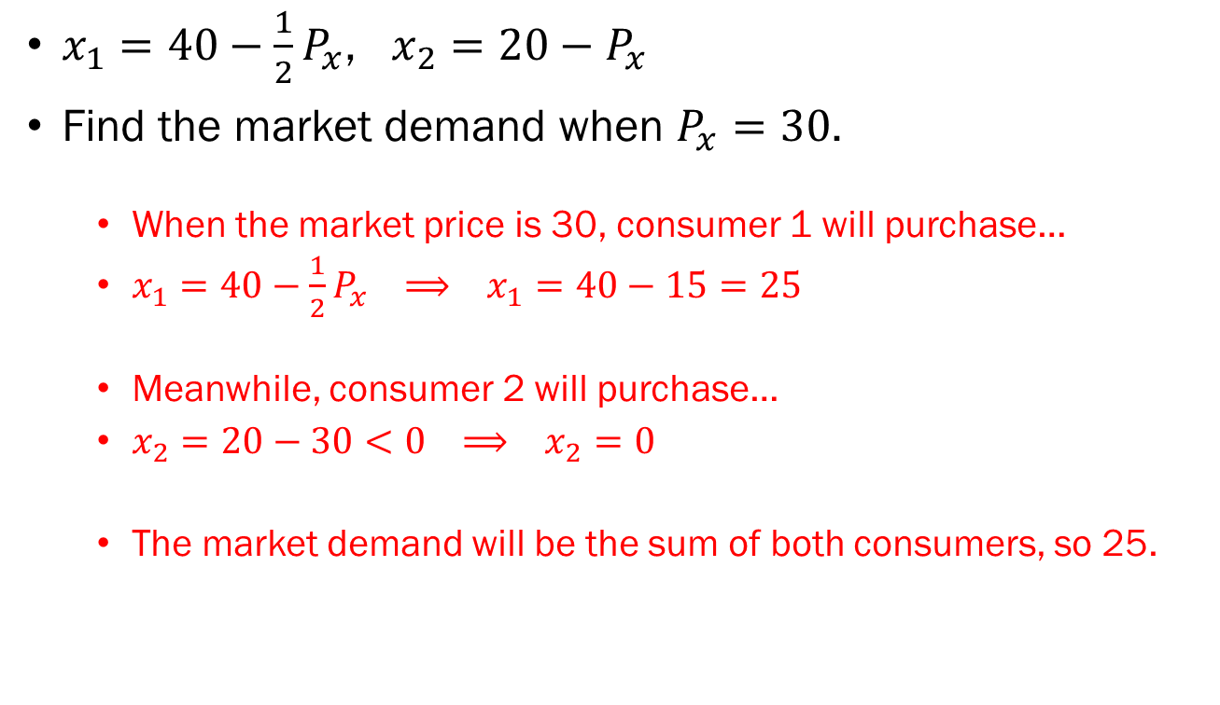
Problem 4.B.
$x_{1}=40−\frac{1}{2}P_{x}$, $x_{2}=20−P_{x}$
Find the market demand when $P_{x}=30$.
  When the market price is 30, consumer 1 will purchase…
  $x_{1}=40−\frac{1}{2}P_{x} ⟹ x_{1}=40−15=25$
  Meanwhile, consumer 2 will purchase…
  $x_{2}=20−30<0 ⟹ x_{2}=0$
  The market demand will be the sum of both consumers, so 25.

Slide 16
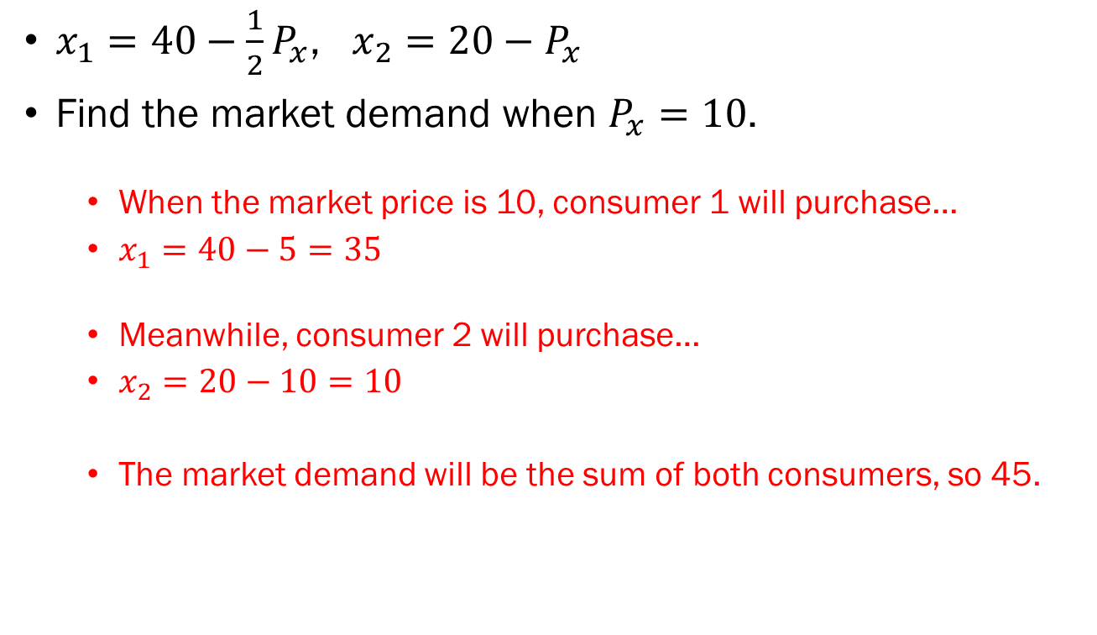
Problem 4.B. (continued)
$x_{1}=40−\frac{1}{2}P_{x}$, $x_{2}=20−P_{x}$
Find the market demand when $P_{x}=10$.
  When the market price is 10, consumer 1 will purchase…
  $x_{1}=40−5=35$
  Meanwhile, consumer 2 will purchase…
  $x_{2}=20−10=10$
  The market demand will be the sum of both consumers, so 45.

Slide 17
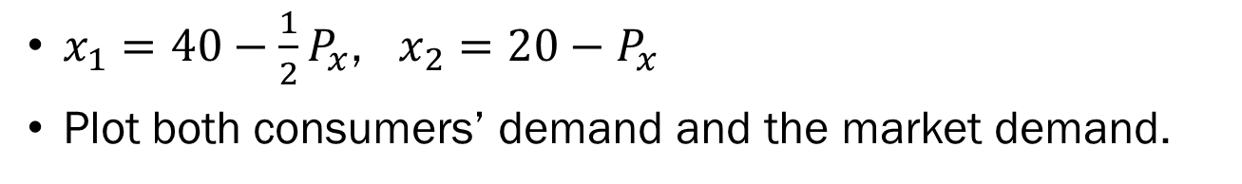
Problem 4.C.
$x_{1}=40−\frac{1}{2}P_{x}$, $x_{2}=20−P_{x}$
Plot both consumers’ demand and the market demand.
Consumer 1
Consumer 2
Market Demand
80
20
40
20
60

