Slide 1
Quiz #4 Review
ECON 300

Slide 2
Quiz #4 “Recovery” Office Hours
https://calendly.com/brianhwpark
Venue: Rm. 248 Center for Science and Business
Dates: Nov. 13th ~ Nov. 21st , 2023
Length: 30 Minutes per Session
Use the Whiteboard / Paper to correct your answers.
Recovery Rate: 70%

Slide 3
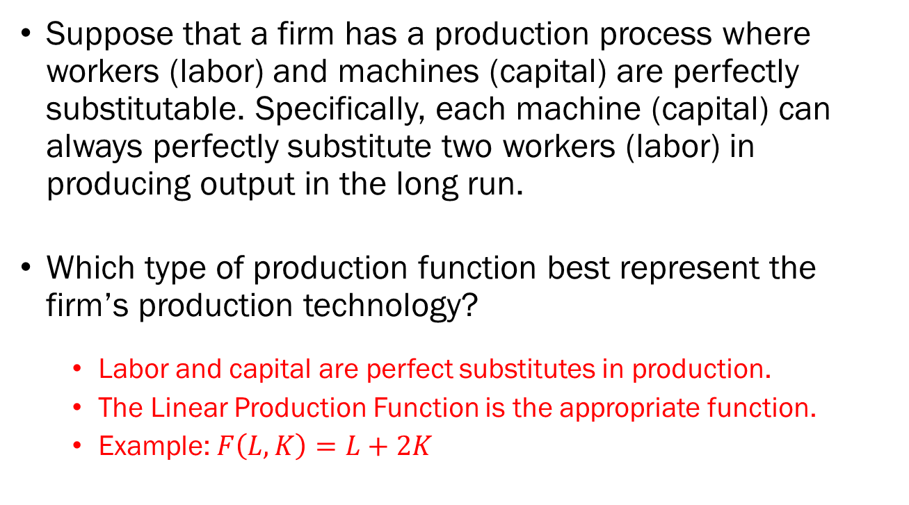
Problem 1.A.
Suppose that a firm has a production process where workers (labor) and machines (capital) are perfectly substitutable. Specifically, each machine (capital) can always perfectly substitute two workers (labor) in producing output in the long run.
Which type of production function best represent the firm’s production technology?
  Labor and capital are perfect substitutes in production.
  The Linear Production Function is the appropriate function.
  Example: $F\left(L,K\right)=L+2K$

Slide 4
Problem 1.B.
Suppose that a firm has a production process where workers (labor) and machines (capital) are perfectly substitutable. Specifically, each machine (capital) can always perfectly substitute two workers (labor) in producing output in the long run.
Plot a representative isoquant representing this firm’s production technology.
  The isoquant of a linear production function is a straight line.
  The slope will be 1/2

Slide 5
Problem 1.C.
Suppose that a firm has a production process where workers (labor) and machines (capital) are perfectly substitutable. Specifically, each machine (capital) can always perfectly substitute two workers (labor) in producing output in the long run.
Find the Marginal Rate of Technical Substitution between Labor and Capital.
  MRTS measures “how much capital can one labor substitute?”
  Each unit of labor does half the work of a unit of capital.
  So, the MRTS, which measures the amount of capital one can save by using 1 extra unit of labor is 1/2

Slide 6
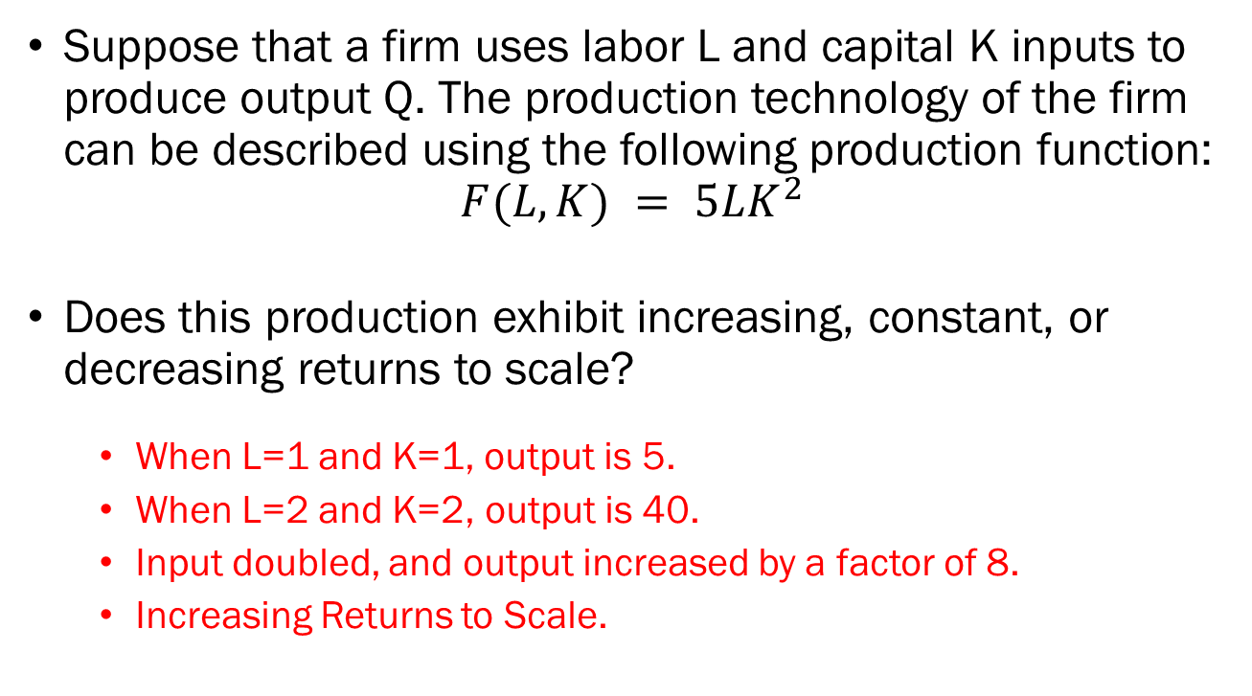
Problem 2.A.
Suppose that a firm uses labor L and capital K inputs to produce output Q. The production technology of the firm can be described using the following production function:
$$F(L,K) = 5LK^{2}$$
Does this production exhibit increasing, constant, or decreasing returns to scale?
  When L=1 and K=1, output is 5.
  When L=2 and K=2, output is 40.
  Input doubled, and output increased by a factor of 8.
  Increasing Returns to Scale.

Slide 7
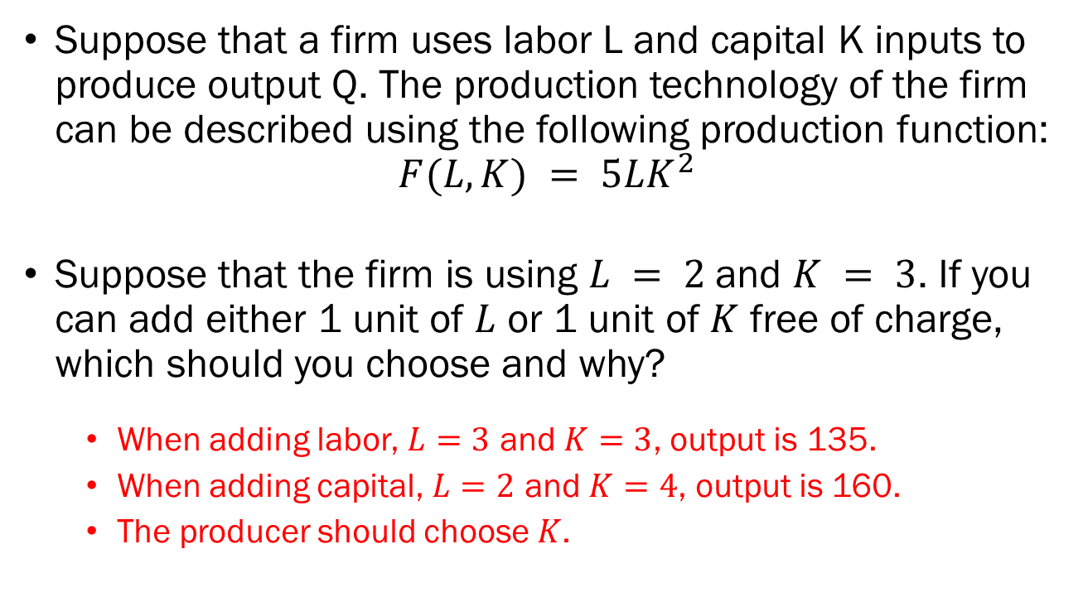
Problem 2.B.
Suppose that a firm uses labor L and capital K inputs to produce output Q. The production technology of the firm can be described using the following production function:
$$F(L,K) = 5LK^{2}$$
Suppose that the firm is using $L = 2$and $K = 3$. If you can add either 1 unit of $L$ or 1 unit of $K$ free of charge, which should you choose and why?
  When adding labor, $L=3$ and $K=3$, output is 135.
  When adding capital, $L=2$ and $K=4$, output is 160.
  The producer should choose $K$.

Slide 8
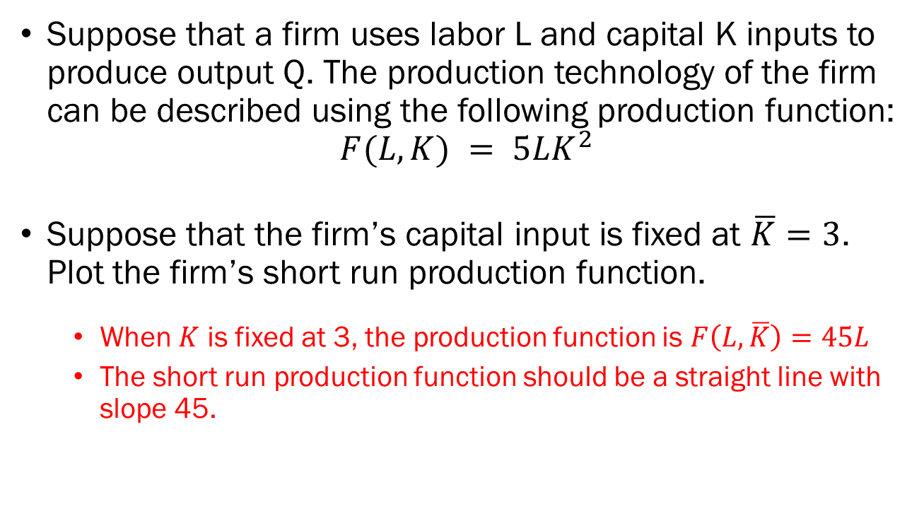
Problem 2.C.
Suppose that a firm uses labor L and capital K inputs to produce output Q. The production technology of the firm can be described using the following production function:
$$F(L,K) = 5LK^{2}$$
Suppose that the firm’s capital input is fixed at $\overline{K}=3$. Plot the firm’s short run production function.
  When $K$ is fixed at 3, the production function is $F\left(L,\overline{K}\right)=45L$
  The short run production function should be a straight line with slope 45.

Slide 9
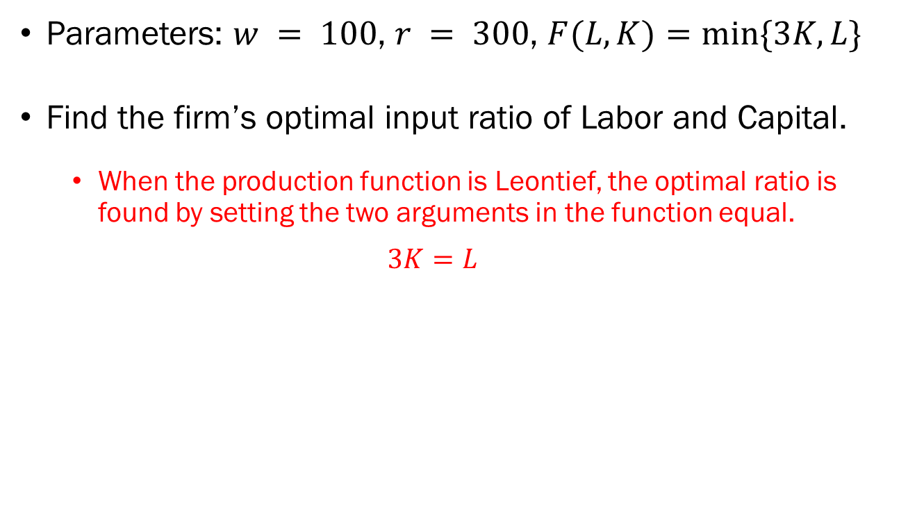
Problem 3.A.
Parameters: $w = 100$, $r = 300$, $F(L,K)=min⁡\{3K,L\}$
Find the firm’s optimal input ratio of Labor and Capital.
  When the production function is Leontief, the optimal ratio is found by setting the two arguments in the function equal.
  $$3K=L$$

Slide 10
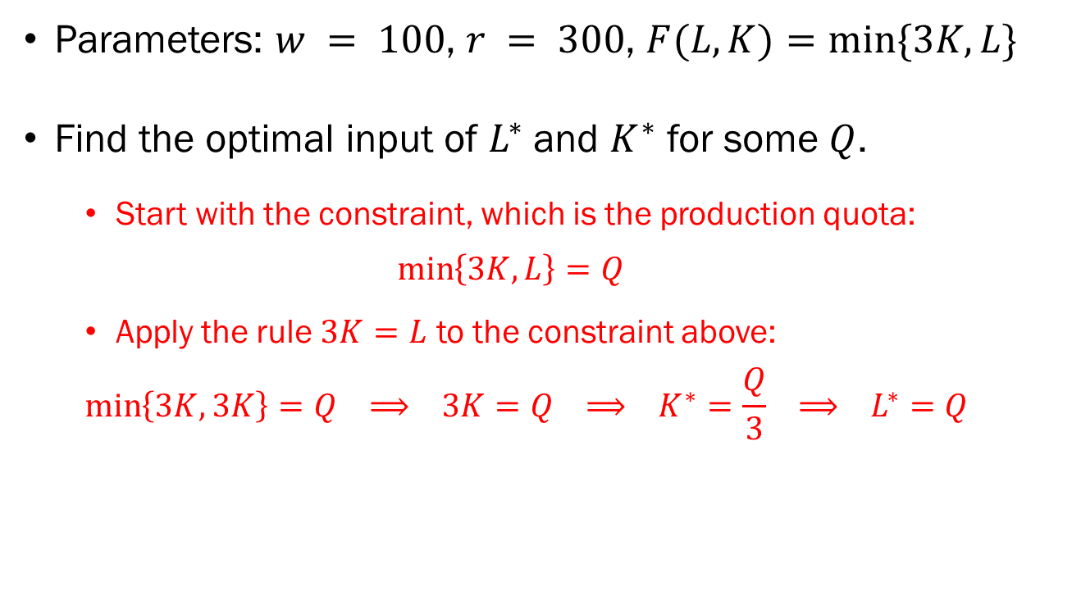
Problem 3.B.
Parameters: $w = 100$, $r = 300$, $F(L,K)=min⁡\{3K,L\}$
Find the optimal input of $L^{∗}$ and $K^{∗}$ for some $Q$.
  Start with the constraint, which is the production quota:
  $$\min\left\{3K,L\right\}=Q$$
  Apply the rule $3K=L$ to the constraint above:
  $$\min\left\{3K,3K\right\}=Q ⟹ 3K=Q ⟹ K^{∗}=\frac{Q}{3} ⟹ L^{∗}=Q$$

Slide 11
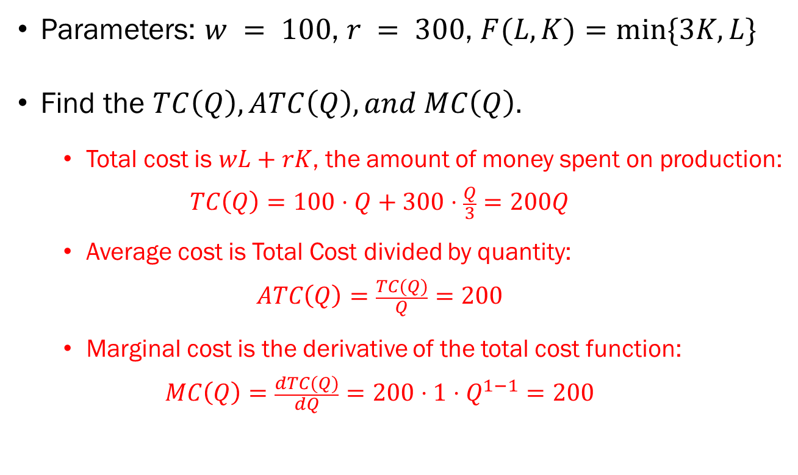
Problem 3.C.
Parameters: $w = 100$, $r = 300$, $F(L,K)=min⁡\{3K,L\}$
Find the $TC\left(Q\right), ATC\left(Q\right), and MC\left(Q\right).$
  Total cost is $wL+rK$, the amount of money spent on production:
  $$TC\left(Q\right)=100⋅Q+300⋅\frac{Q}{3}=200Q$$
  Average cost is Total Cost divided by quantity:
  $$ATC\left(Q\right)=\frac{TC(Q)}{Q}=200$$
  Marginal cost is the derivative of the total cost function:
  $$MC\left(Q\right)=\frac{dTC(Q)}{dQ}=200⋅1⋅Q^{1−1}=200$$

Slide 12
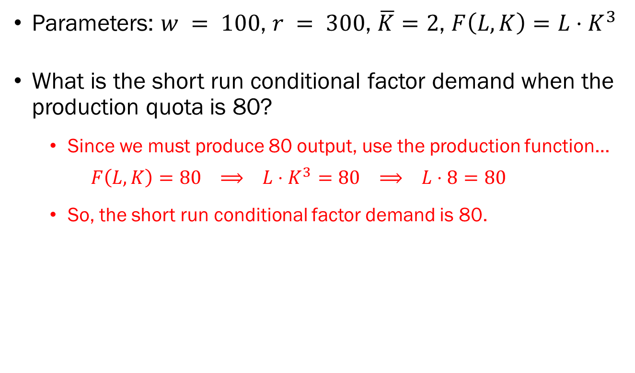
Problem 4.A.
Parameters: $w = 100$, $r = 300$, $\overline{K}=2$, $F\left(L,K\right)=L⋅K^{3}$
What is the short run conditional factor demand when the production quota is 80?
  Since we must produce 80 output, use the production function…
  $$F\left(L,K\right)=80 ⟹ L⋅K^{3}=80 ⟹ L⋅8=80$$
  So, the short run conditional factor demand is 80.

Slide 13

Problem 4.B.
Parameters: $w = 100$, $r = 300$, $\overline{K}=2$, $F\left(L,K\right)=L⋅K^{3}$
Calculate the short run total cost for this firm.
  Short run total cost is $w⋅L+r⋅K$, so…
  $$STC\left(Q=80\right)=100⋅10+300⋅2=1,600$$

Slide 14
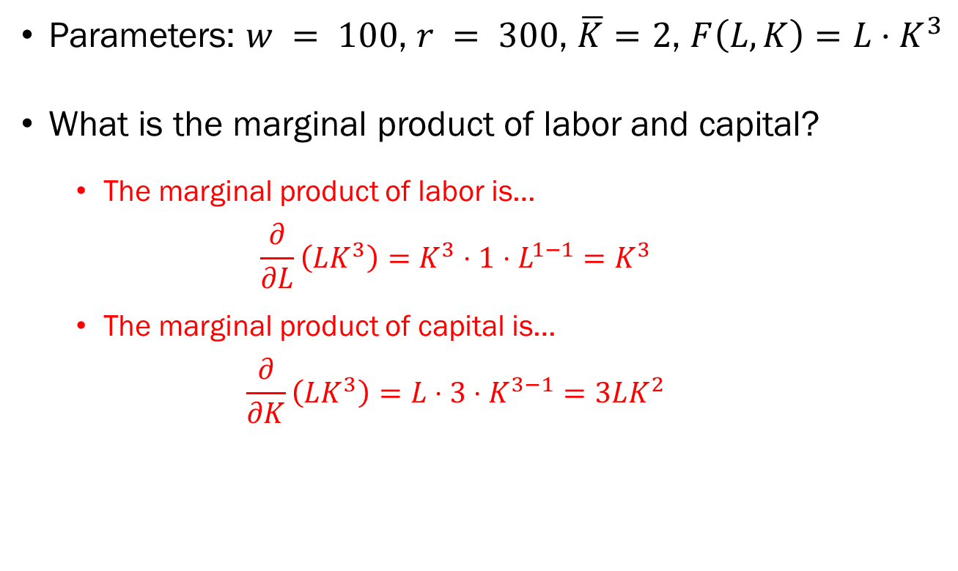
Problem 4.C.
Parameters: $w = 100$, $r = 300$, $\overline{K}=2$, $F\left(L,K\right)=L⋅K^{3}$
What is the marginal product of labor and capital?
  The marginal product of labor is…
  $$\frac{∂}{∂L}\left(LK^{3}\right)=K^{3}⋅1⋅L^{1−1}=K^{3}$$
  The marginal product of capital is…
  $$\frac{∂}{∂K}\left(LK^{3}\right)=L⋅3⋅K^{3−1}=3LK^{2}$$

Slide 15
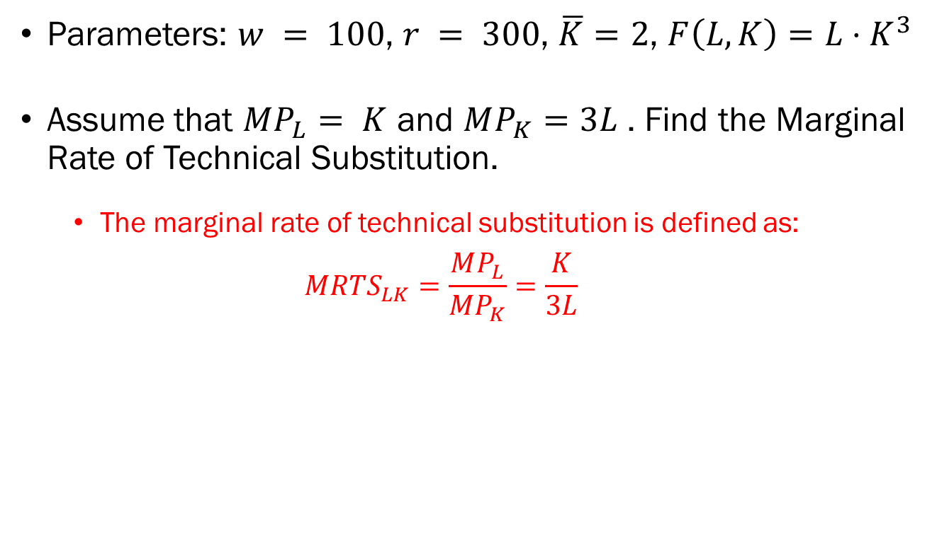
Problem 4.D.
Parameters: $w = 100$, $r = 300$, $\overline{K}=2$, $F\left(L,K\right)=L⋅K^{3}$
Assume that $MP_{L}= K$ and $MP_{K}=3L$ . Find the Marginal Rate of Technical Substitution.
  The marginal rate of technical substitution is defined as:
  $$MRTS_{LK}=\frac{MP_{L}}{MP_{K}}=\frac{K}{3L}$$

Slide 16
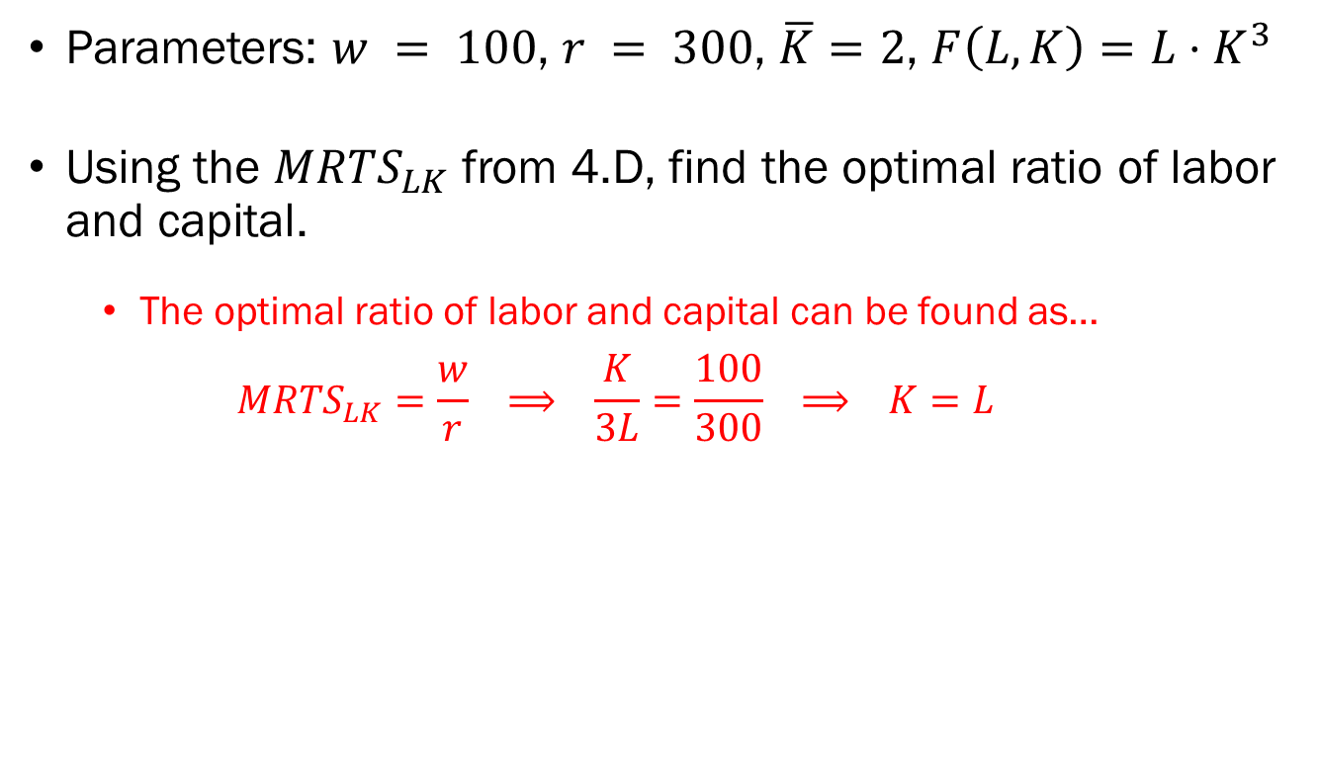
Problem 4.E.
Parameters: $w = 100$, $r = 300$, $\overline{K}=2$, $F\left(L,K\right)=L⋅K^{3}$
Using the $MRTS_{LK}$ from 4.D, find the optimal ratio of labor and capital.
  The optimal ratio of labor and capital can be found as…
  $$MRTS_{LK}=\frac{w}{r} ⟹ \frac{K}{3L}=\frac{100}{300} ⟹ K=L$$

Slide 17
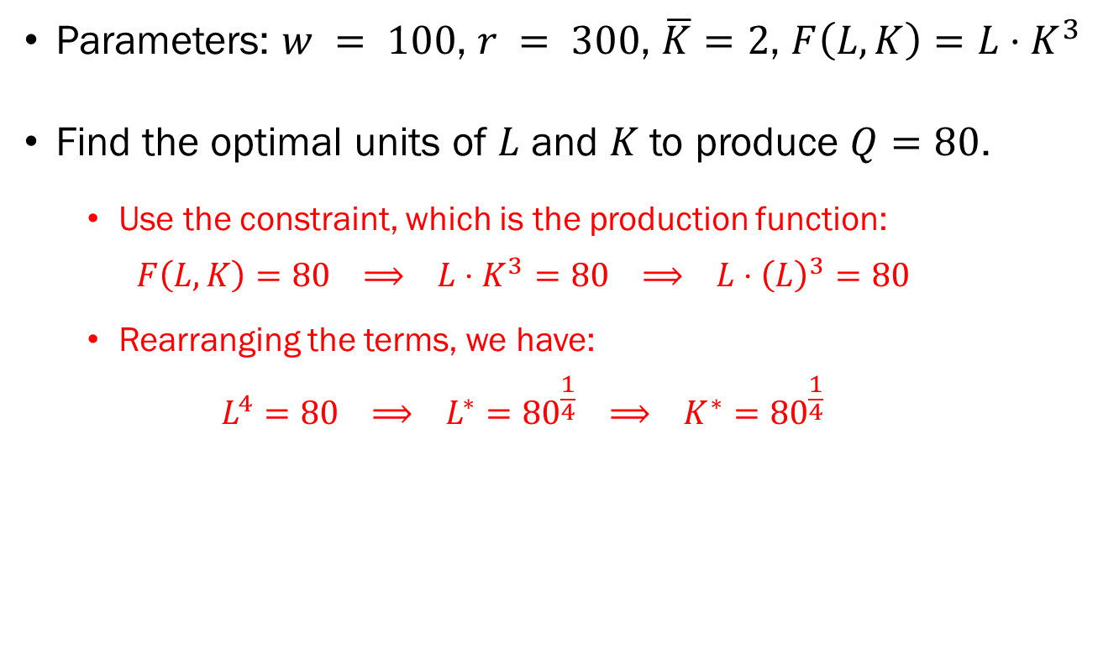
Problem 4.F.
Parameters: $w = 100$, $r = 300$, $\overline{K}=2$, $F\left(L,K\right)=L⋅K^{3}$
Find the optimal units of $L$ and $K$ to produce $Q=80$.
  Use the constraint, which is the production function:
  $$F\left(L,K\right)=80 ⟹ L⋅K^{3}=80 ⟹ L⋅{\left(L\right)}^{3}=80$$
  Rearranging the terms, we have:
  $$L^{4}=80 ⟹ L^{∗}={80}^{\frac{1}{4}} ⟹ K^{∗}={80}^{\frac{1}{4}}$$

Slide 18
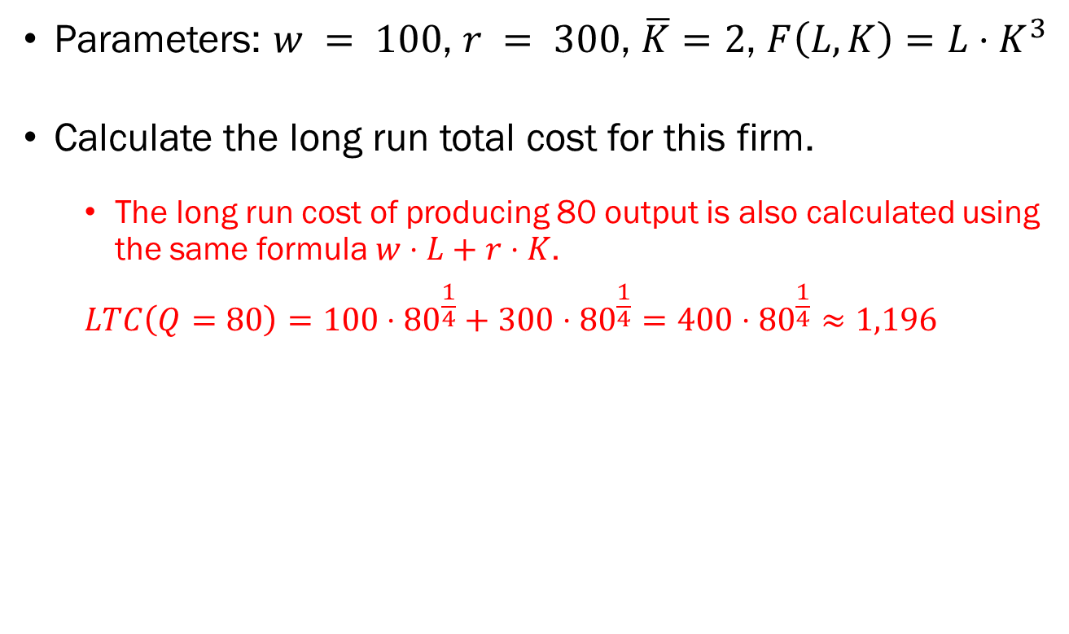
Problem 4.G.
Parameters: $w = 100$, $r = 300$, $\overline{K}=2$, $F\left(L,K\right)=L⋅K^{3}$
Calculate the long run total cost for this firm.
  The long run cost of producing 80 output is also calculated using the same formula $w⋅L+r⋅K$.
  $$LTC\left(Q=80\right)=100⋅{80}^{\frac{1}{4}}+300⋅{80}^{\frac{1}{4}}=400⋅{80}^{\frac{1}{4}}≈1,196$$

Slide 19
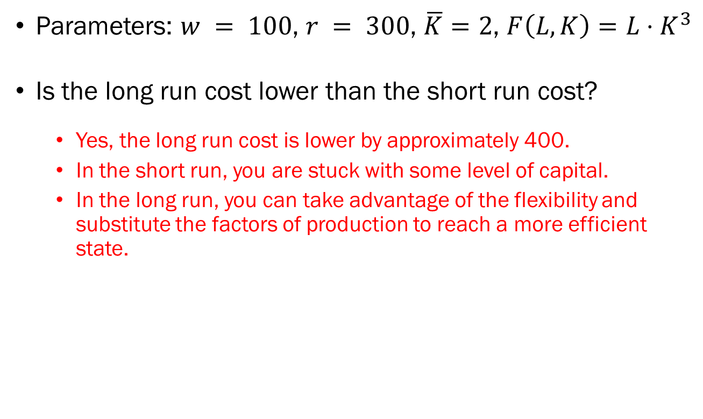
Problem 4.H.
Parameters: $w = 100$, $r = 300$, $\overline{K}=2$, $F\left(L,K\right)=L⋅K^{3}$
Is the long run cost lower than the short run cost?
  Yes, the long run cost is lower by approximately 400.
  In the short run, you are stuck with some level of capital.
  In the long run, you can take advantage of the flexibility and substitute the factors of production to reach a more efficient state.

Slide 20
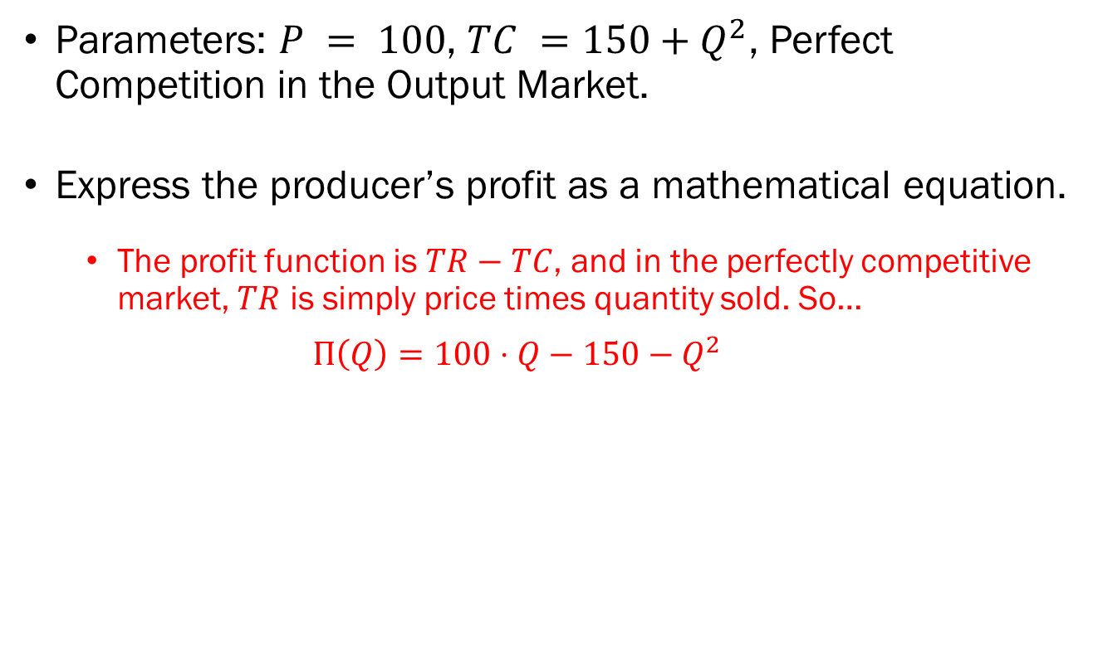
Problem 5.A.
Parameters: $P = 100$, $TC =150+Q^{2}$, Perfect Competition in the Output Market.
Express the producer’s profit as a mathematical equation.
  The profit function is $TR−TC$, and in the perfectly competitive market, $TR$ is simply price times quantity sold. So…
  $$Π\left(Q\right)=100⋅Q−150−Q^{2}$$

Slide 21
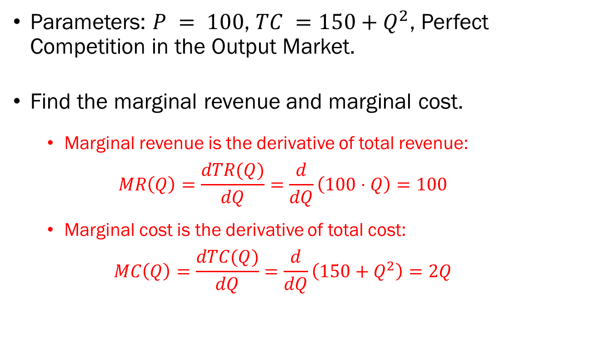
Problem 5.B.
Parameters: $P = 100$, $TC =150+Q^{2}$, Perfect Competition in the Output Market.
Find the marginal revenue and marginal cost.
  Marginal revenue is the derivative of total revenue:
  $$MR\left(Q\right)=\frac{dTR(Q)}{dQ}=\frac{d}{dQ}\left(100⋅Q\right)=100$$
  Marginal cost is the derivative of total cost:
  $$MC\left(Q\right)=\frac{dTC(Q)}{dQ}=\frac{d}{dQ}\left(150+Q^{2}\right)=2Q$$

Slide 22
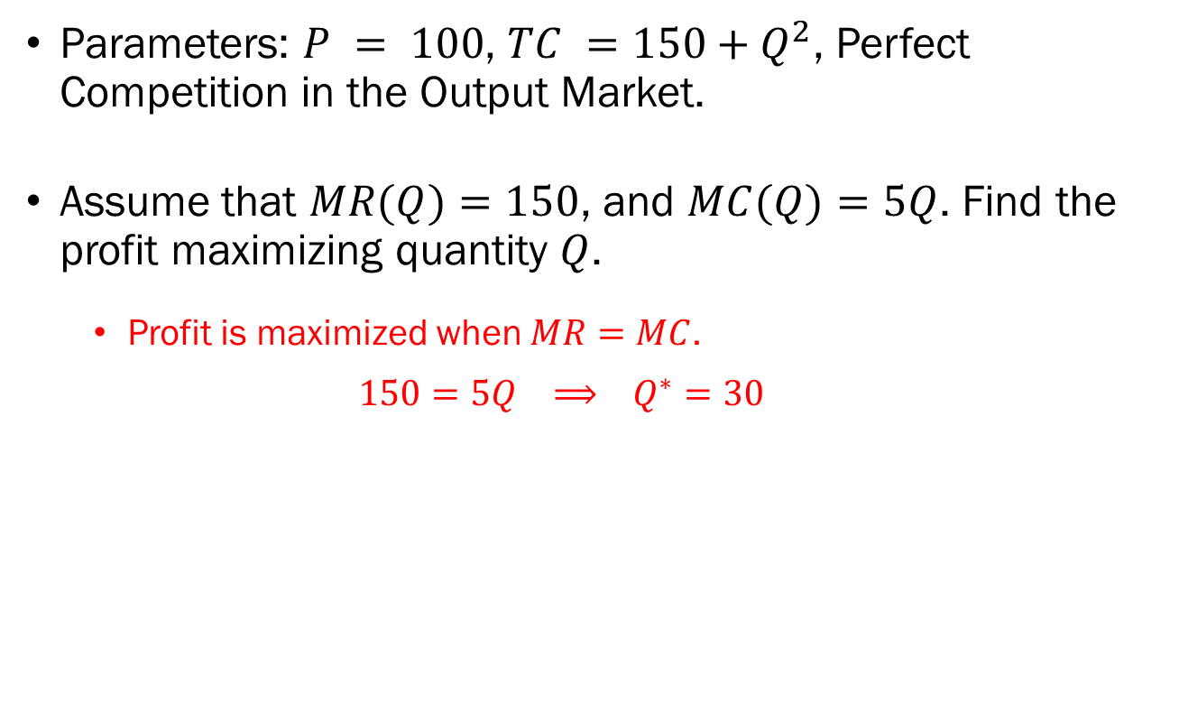
Problem 5.C.
Parameters: $P = 100$, $TC =150+Q^{2}$, Perfect Competition in the Output Market.
Assume that $MR(Q)=150$, and $MC(Q)=5Q$. Find the profit maximizing quantity $Q$.
  Profit is maximized when $MR=MC$.
  $$150=5Q ⟹ Q^{∗}=30$$

