Slide 1
Quiz #3 Review
ECON 300

Slide 2
Quiz #3 “Recovery” Office Hours
https://calendly.com/brianhwpark
Venue: Rm. 248 Center for Science and Business
Dates: Oct. 16th ~ Oct. 23rd, 2023
Length: 30 Minutes per Session
Use the Whiteboard / Paper to correct your answers.
Recovery Rate: 70%

Slide 3
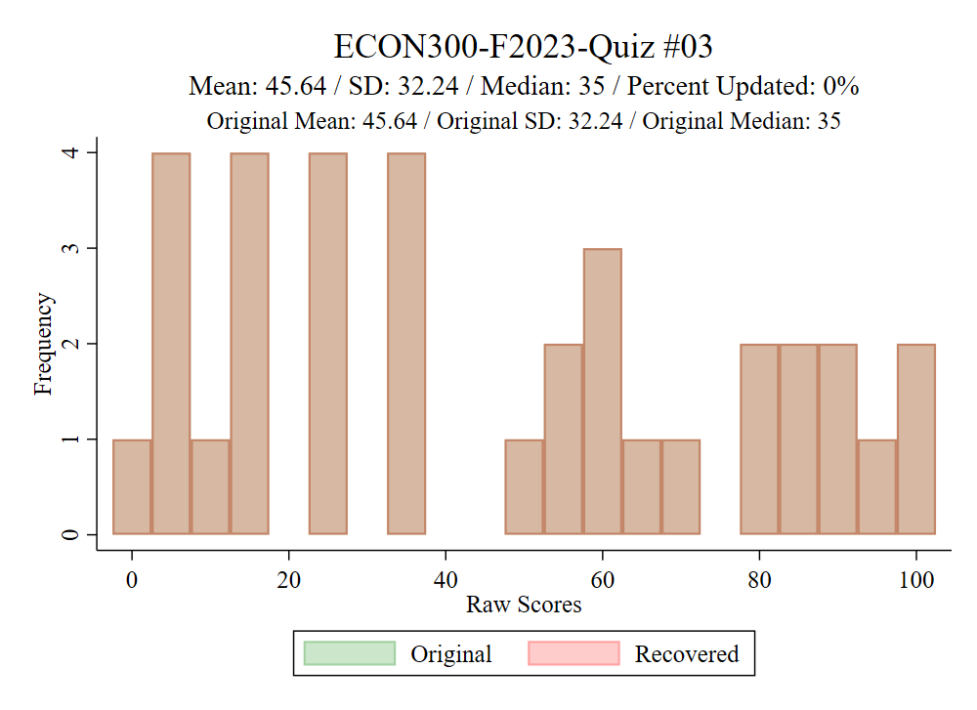

Slide 4
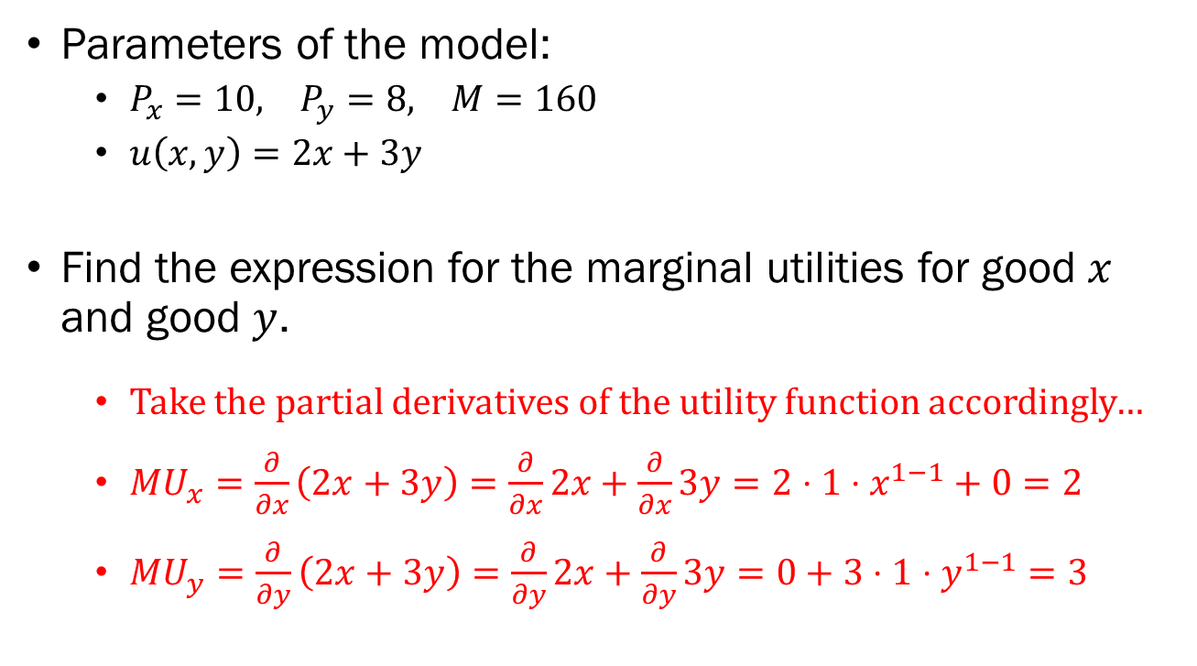
Problem 1.A.
Parameters of the model:
  $P_{x}=10, P_{y}=8, M=160$
  $u\left(x,y\right)=2x+3y$
Find the expression for the marginal utilities for good $x$ and good $y$.
  Take the partial derivatives of the utility function accordingly…
  $MU_{x}=\frac{∂}{∂x}\left(2x+3y\right)=\frac{∂}{∂x}2x+\frac{∂}{∂x}3y=2⋅1⋅x^{1−1}+0=2$
  $MU_{y}=\frac{∂}{∂y}\left(2x+3y\right)=\frac{∂}{∂y}2x+\frac{∂}{∂y}3y=0+3⋅1⋅y^{1−1}=3$

Slide 5
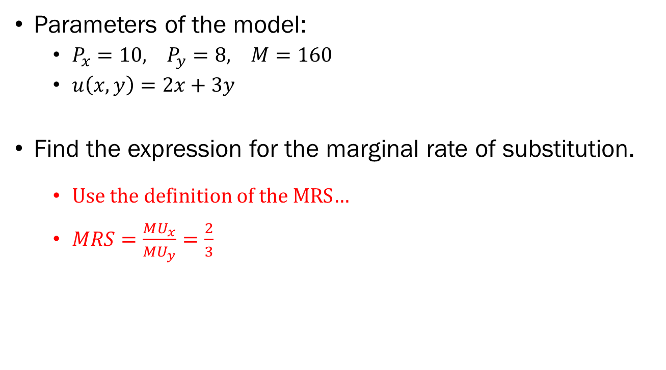
Problem 1.B.
Parameters of the model:
  $P_{x}=10, P_{y}=8, M=160$
  $u\left(x,y\right)=2x+3y$
Find the expression for the marginal rate of substitution.
  Use the definition of the MRS…
  $MRS=\frac{MU_{x}}{MU_{y}}=\frac{2}{3}$

Slide 6
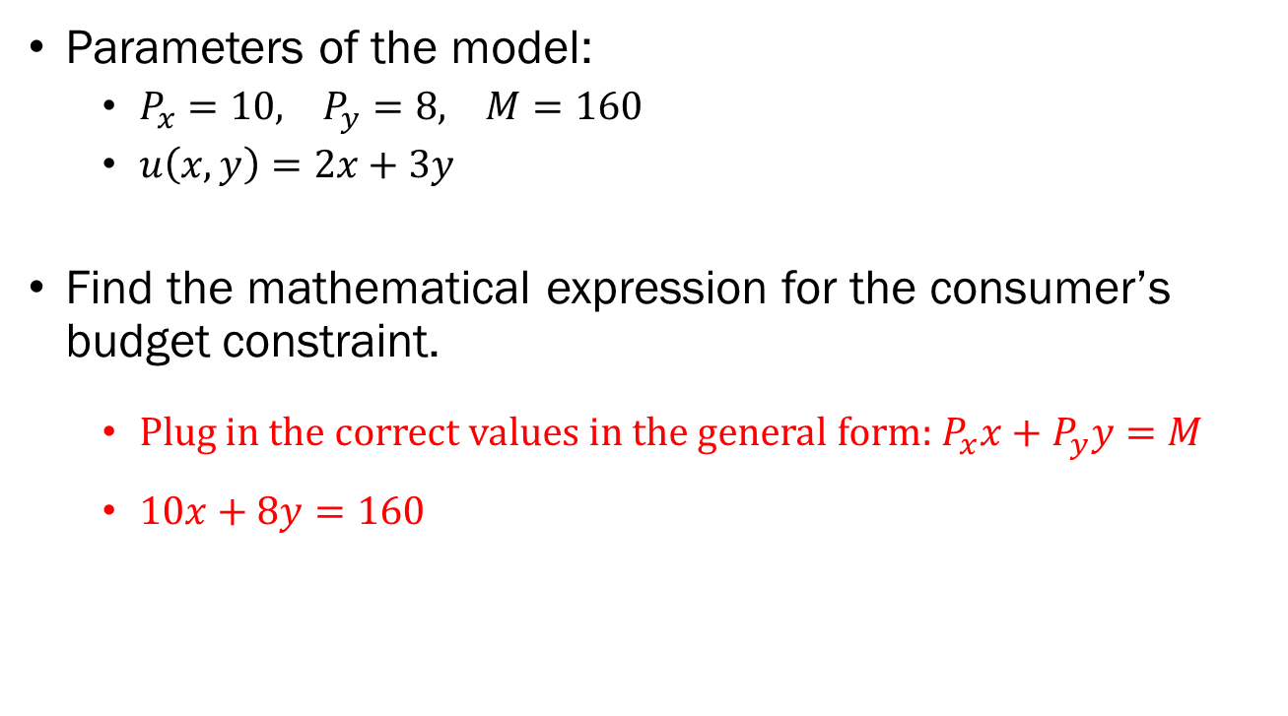
Problem 1.C.
Parameters of the model:
  $P_{x}=10, P_{y}=8, M=160$
  $u\left(x,y\right)=2x+3y$
Find the mathematical expression for the consumer’s budget constraint.
  Plug in the correct values in the general form: $P_{x}x+P_{y}y=M$
  $10x+8y=160$

Slide 7
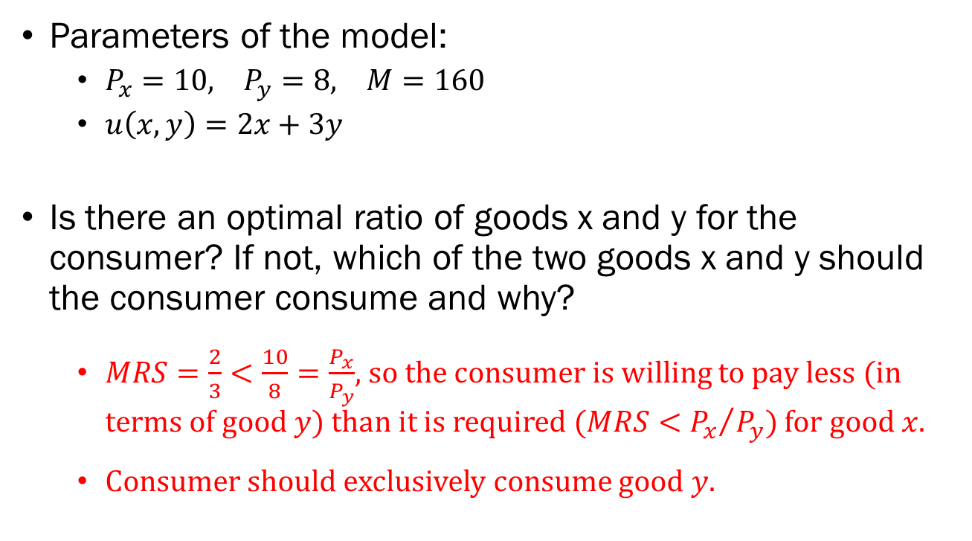
Problem 1.D.
Parameters of the model:
  $P_{x}=10, P_{y}=8, M=160$
  $u\left(x,y\right)=2x+3y$
Is there an optimal ratio of goods x and y for the consumer? If not, which of the two goods x and y should the consumer consume and why?
  $MRS=\frac{2}{3}<\frac{10}{8}=\frac{P_{x}}{P_{y}}$, so the consumer is willing to pay less (in terms of good $y$) than it is required $(MRS<{P_{x}}/{P_{y}})$ for good $x$.
  Consumer should exclusively consume good $y$.

Slide 8
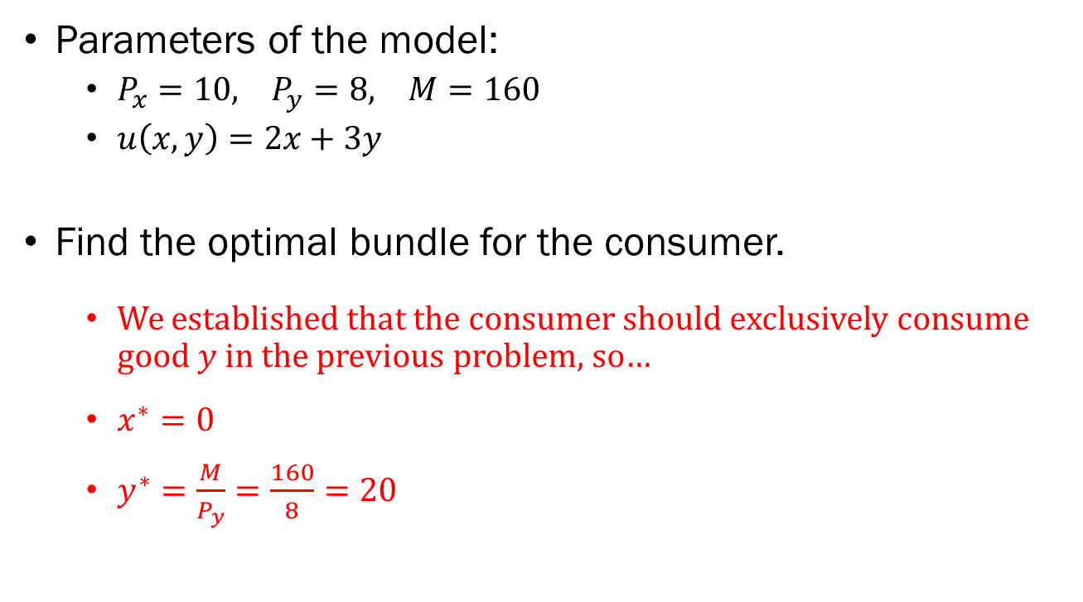
Problem 1.E.
Parameters of the model:
  $P_{x}=10, P_{y}=8, M=160$
  $u\left(x,y\right)=2x+3y$
Find the optimal bundle for the consumer.
  We established that the consumer should exclusively consume good $y$ in the previous problem, so…
  $x^{∗}=0$
  $y^{∗}=\frac{M}{P_{y}}=\frac{160}{8}=20$

Slide 9
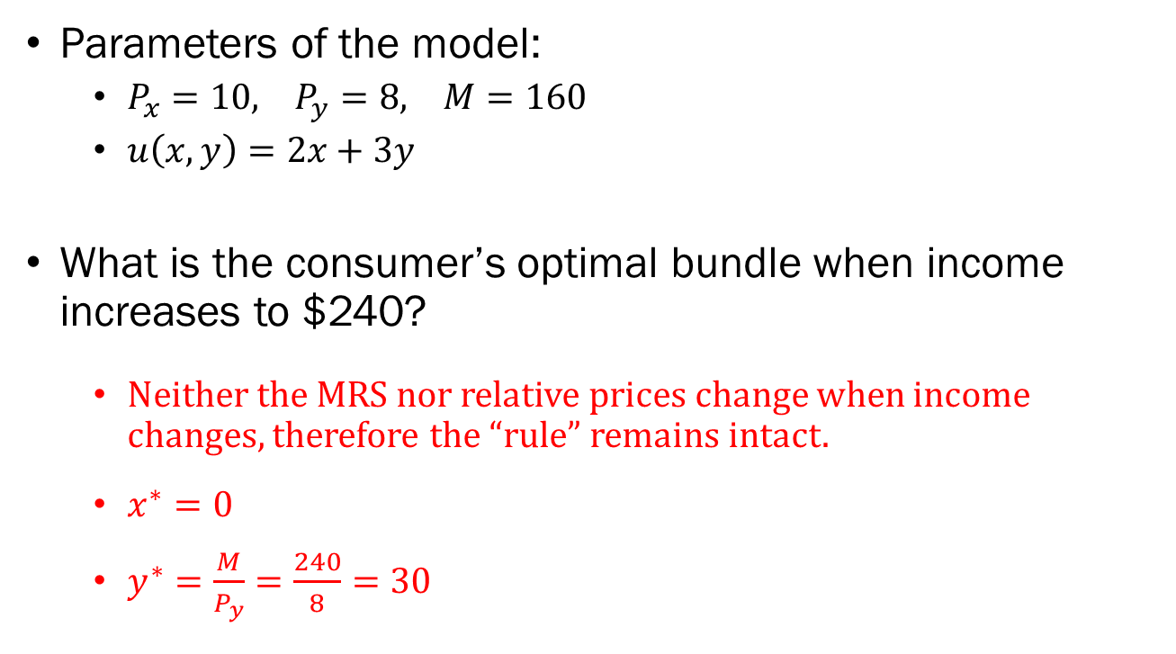
Problem 1.F.
Parameters of the model:
  $P_{x}=10, P_{y}=8, M=160$
  $u\left(x,y\right)=2x+3y$
What is the consumer’s optimal bundle when income increases to $240?
  Neither the MRS nor relative prices change when income changes, therefore the “rule” remains intact.
  $x^{∗}=0$
  $y^{∗}=\frac{M}{P_{y}}=\frac{240}{8}=30$

Slide 10
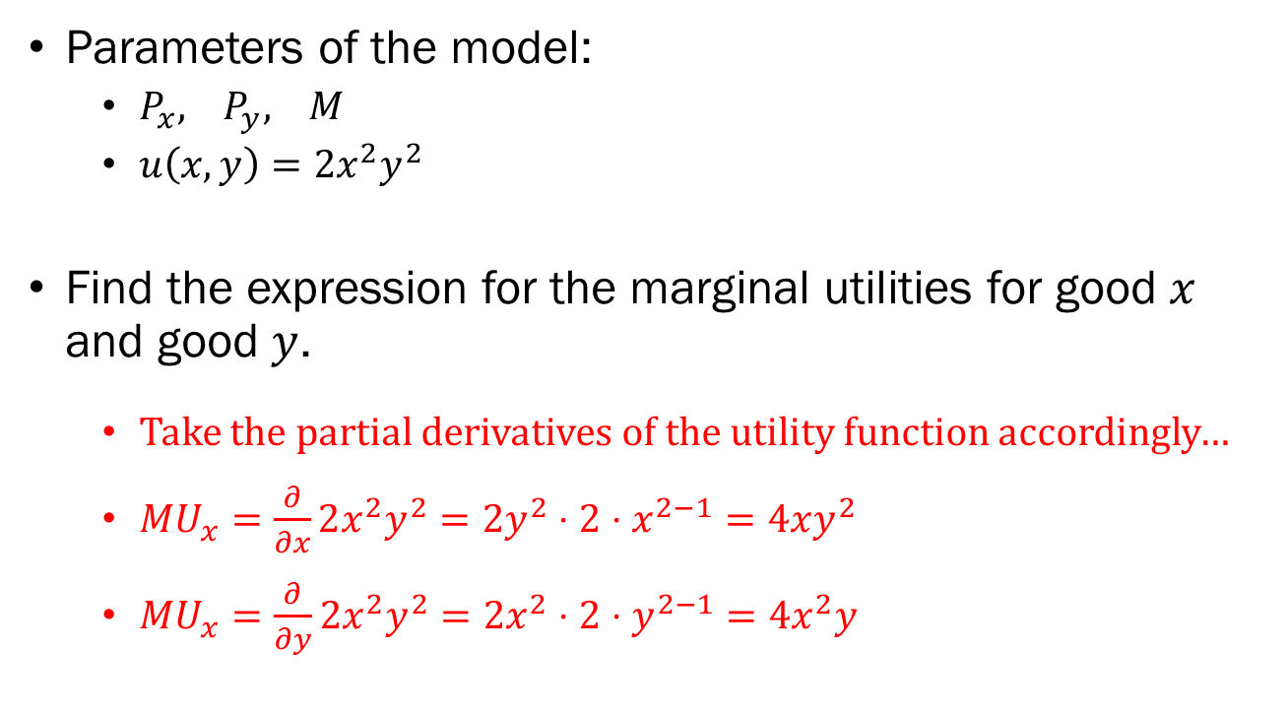
Problem 2.A.
Parameters of the model:
  $P_{x}, P_{y}, M$
  $u\left(x,y\right)=2x^{2}y^{2}$
Find the expression for the marginal utilities for good $x$ and good $y$.
  Take the partial derivatives of the utility function accordingly…
  $MU_{x}=\frac{∂}{∂x}2x^{2}y^{2}=2y^{2}⋅2⋅x^{2−1}=4xy^{2}$
  $MU_{x}=\frac{∂}{∂y}2x^{2}y^{2}=2x^{2}⋅2⋅y^{2−1}=4x^{2}y$

Slide 11
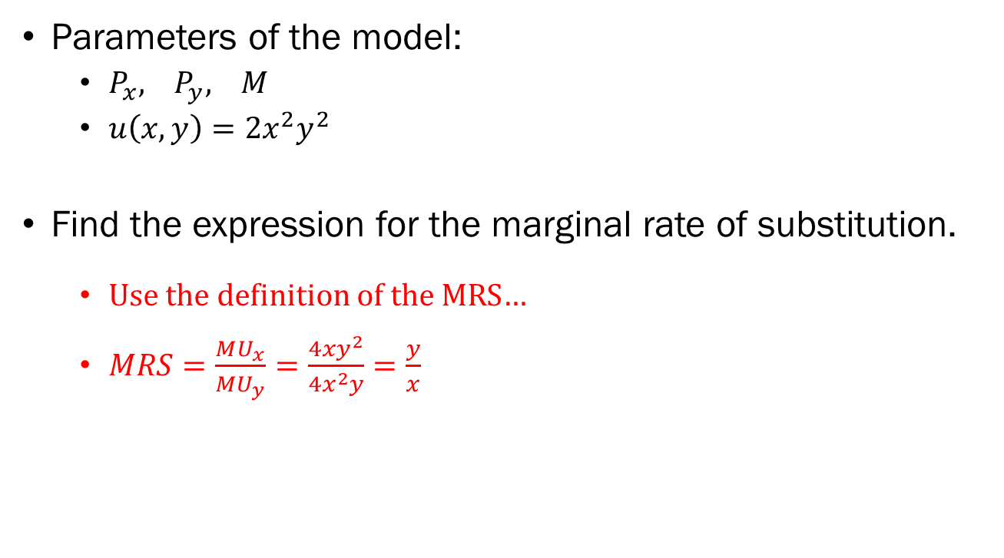
Problem 2.B.
Parameters of the model:
  $P_{x}, P_{y}, M$
  $u\left(x,y\right)=2x^{2}y^{2}$
Find the expression for the marginal rate of substitution.
  Use the definition of the MRS…
  $MRS=\frac{MU_{x}}{MU_{y}}=\frac{4xy^{2}}{4x^{2}y}=\frac{y}{x}$

Slide 12

Problem 2.C.
Parameters of the model:
  $P_{x}, P_{y}, M$
  $u\left(x,y\right)=2x^{2}y^{2}$
Find the mathematical expression for the consumer’s budget constraint.
  $P_{x}x+P_{y}y=M$

Slide 13
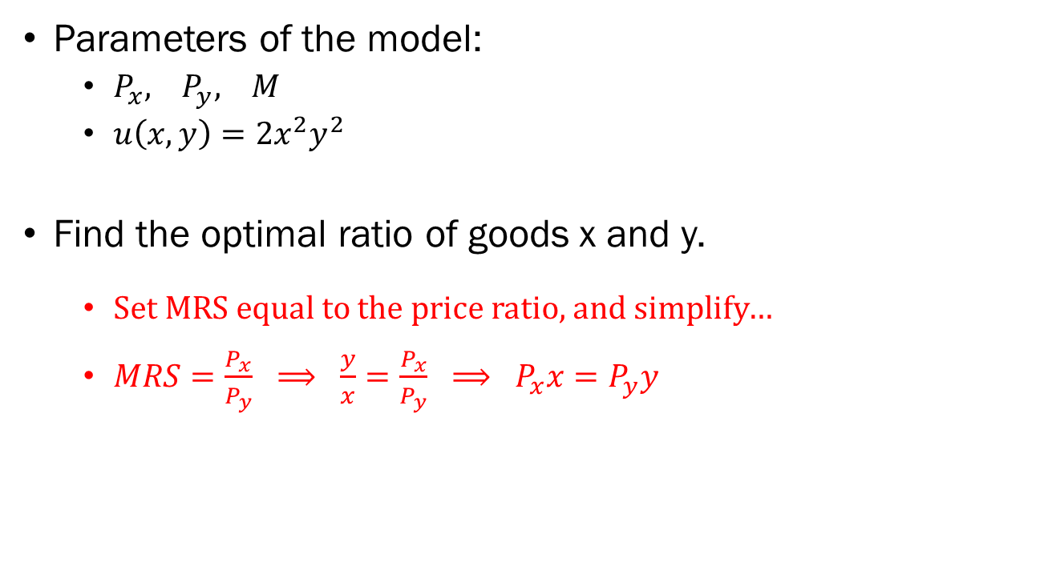
Problem 2.D.
Parameters of the model:
  $P_{x}, P_{y}, M$
  $u\left(x,y\right)=2x^{2}y^{2}$
Find the optimal ratio of goods x and y.
  Set MRS equal to the price ratio, and simplify…
  $MRS=\frac{P_{x}}{P_{y}} ⟹ \frac{y}{x}=\frac{P_{x}}{P_{y}} ⟹ P_{x}x=P_{y}y$

Slide 14
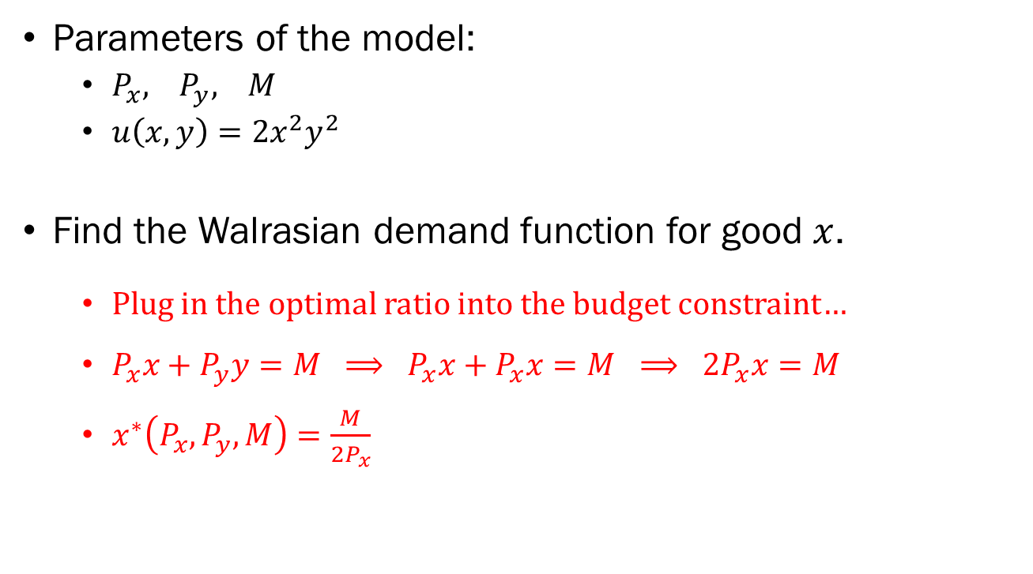
Problem 2.E.
Parameters of the model:
  $P_{x}, P_{y}, M$
  $u\left(x,y\right)=2x^{2}y^{2}$
Find the Walrasian demand function for good $x$.
  Plug in the optimal ratio into the budget constraint…
  $P_{x}x+P_{y}y=M ⟹ P_{x}x+P_{x}x=M ⟹ 2P_{x}x=M$
  $x^{∗}\left(P_{x},P_{y},M\right)=\frac{M}{2P_{x}}$

Slide 15
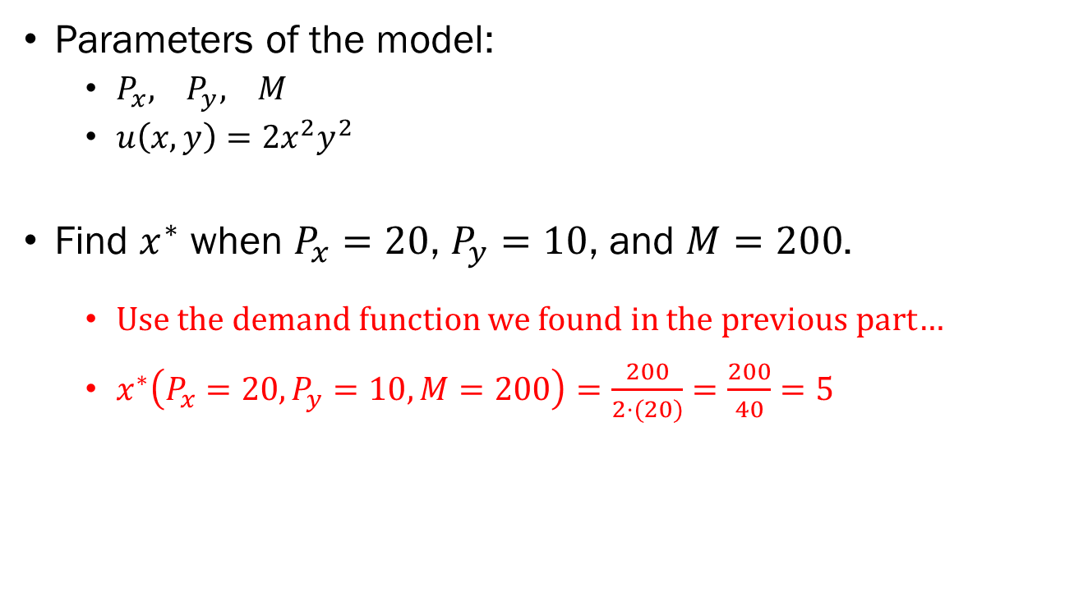
Problem 2.F.
Parameters of the model:
  $P_{x}, P_{y}, M$
  $u\left(x,y\right)=2x^{2}y^{2}$
Find $x^{∗}$ when $P_{x}=20$, $P_{y}=10$, and $M=200$.
  Use the demand function we found in the previous part…
  $x^{∗}\left(P_{x}=20,P_{y}=10,M=200\right)=\frac{200}{2⋅(20)}=\frac{200}{40}=5$

Slide 16
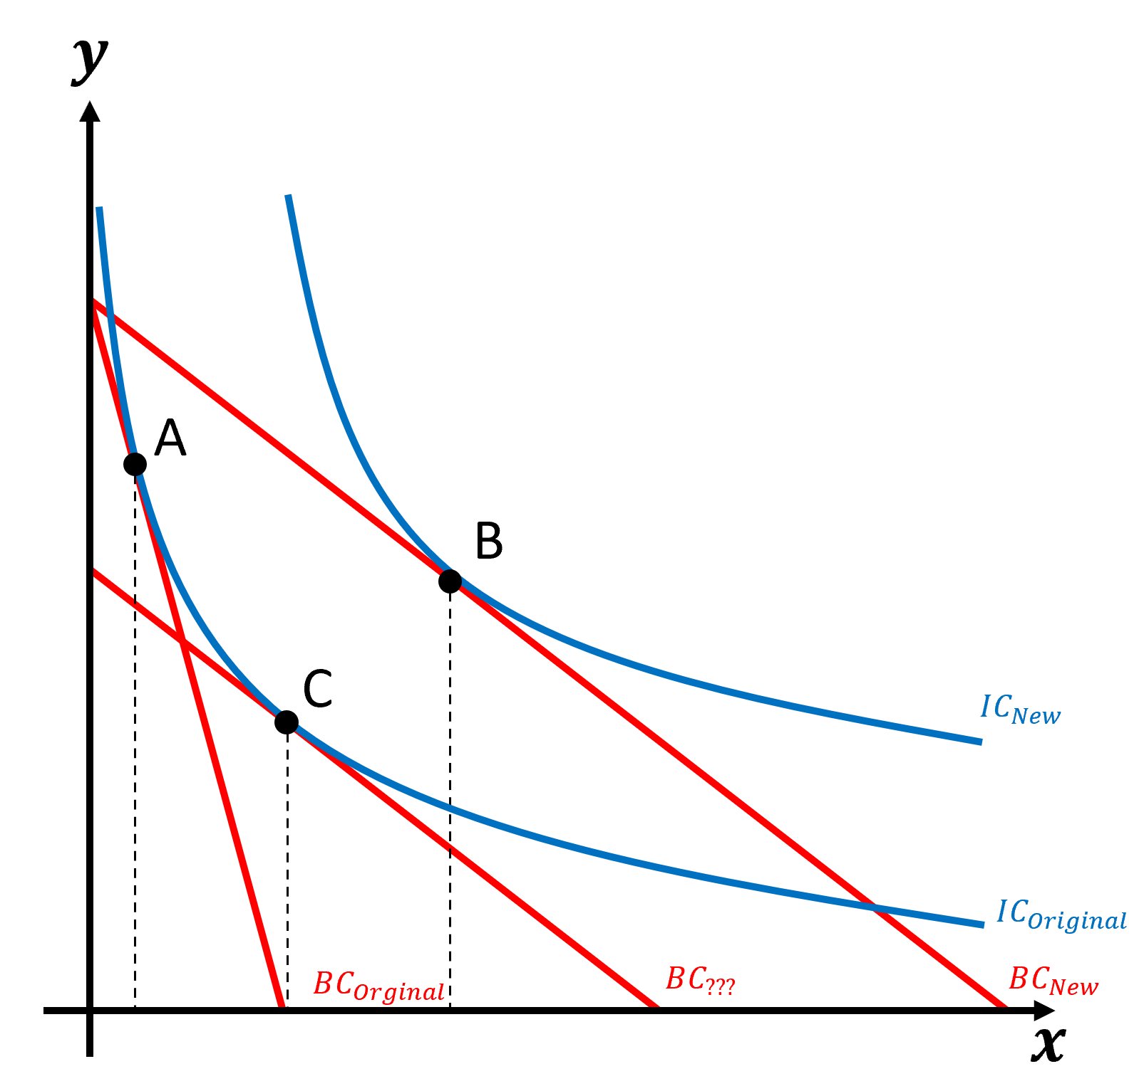
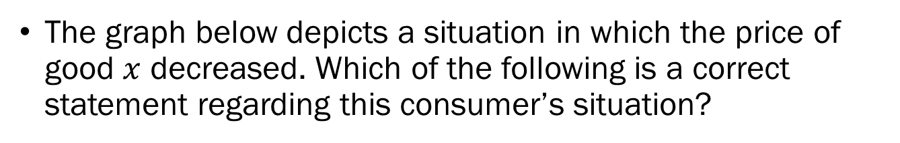
Problem 3.A.
The graph below depicts a situation in which the price of good $x$ decreased. Which of the following is a correct statement regarding this consumer’s situation?
The Slutsky Substitution Effect is represented by the change A → B
The Hicksian Substitution Effect is represented by the change A → B
The Slutsky Substitution Effect is represented by the change A → C
The Hicksian Substitution Effect is represented by the change A → C

Slide 17
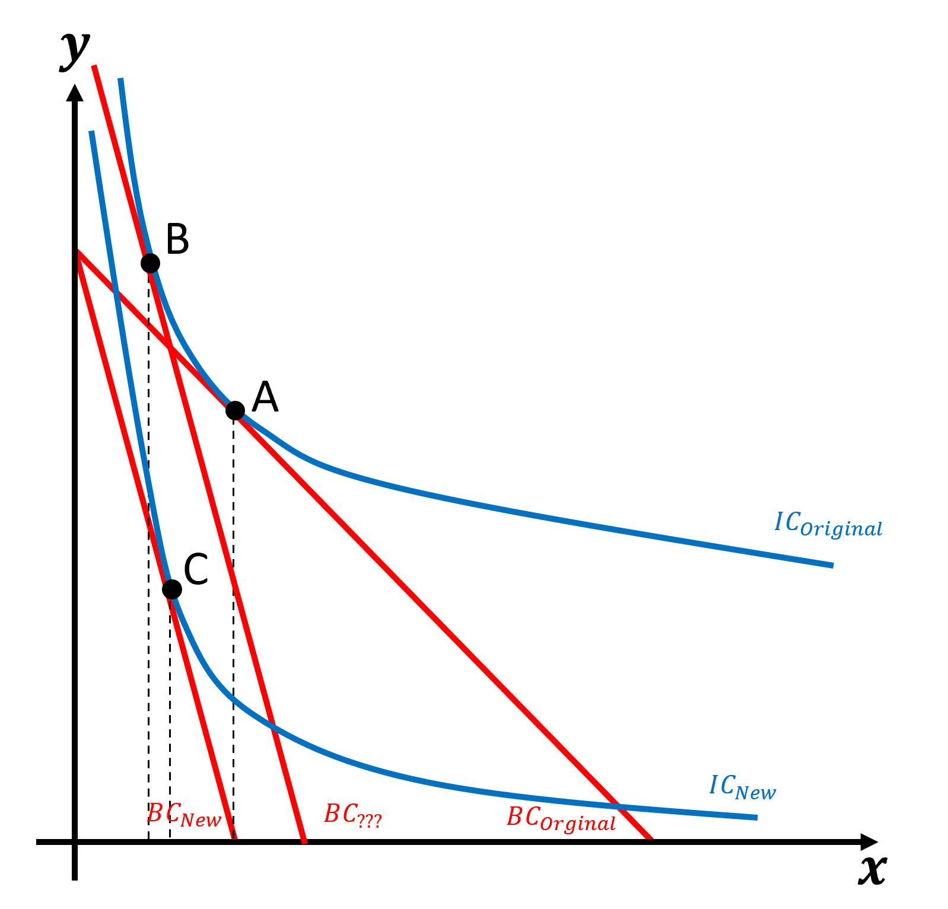
Problem 3.B.
The graph below depicts a situation where the price of good x increased. Which of the following statements is correct?
Good x is a Giffen Good.
The substitution effect is greater in magnitude than the income effect.
The income and substitution effects act in the same direction.
The diagram is relevant for finding the Slutsky substitution effect.

Slide 18
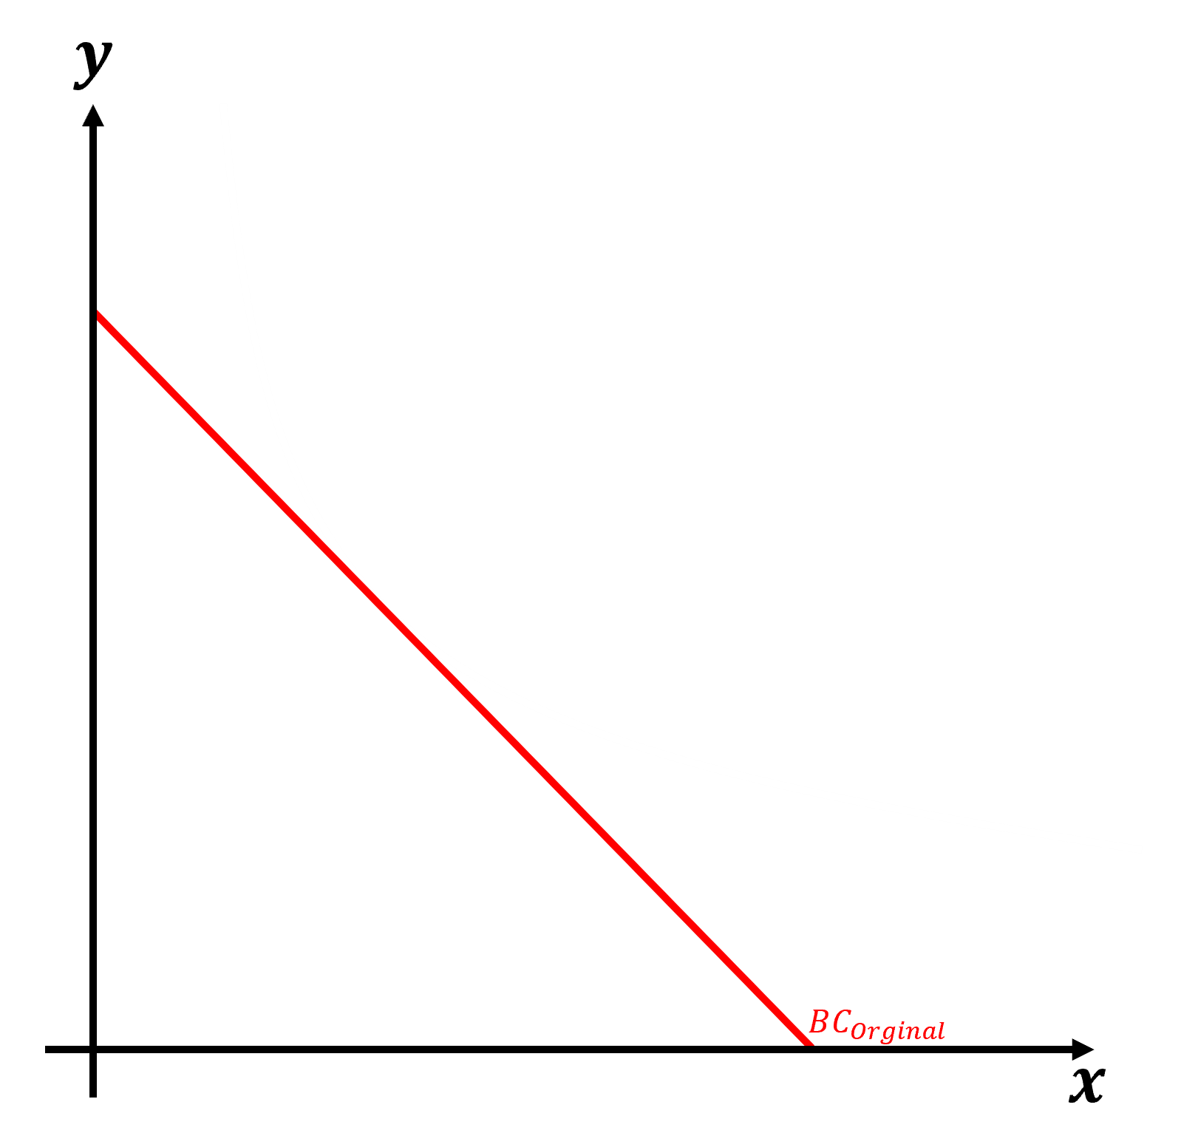
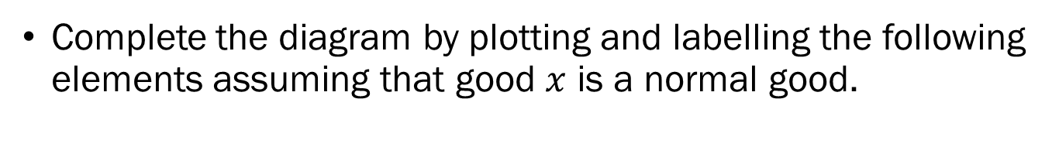
Problem 3.C.
Complete the diagram by plotting and labelling the following elements assuming that good $x$ is a normal good.
An indifference curve of a consumer maximizing their utility under the current budget constraint

Slide 19
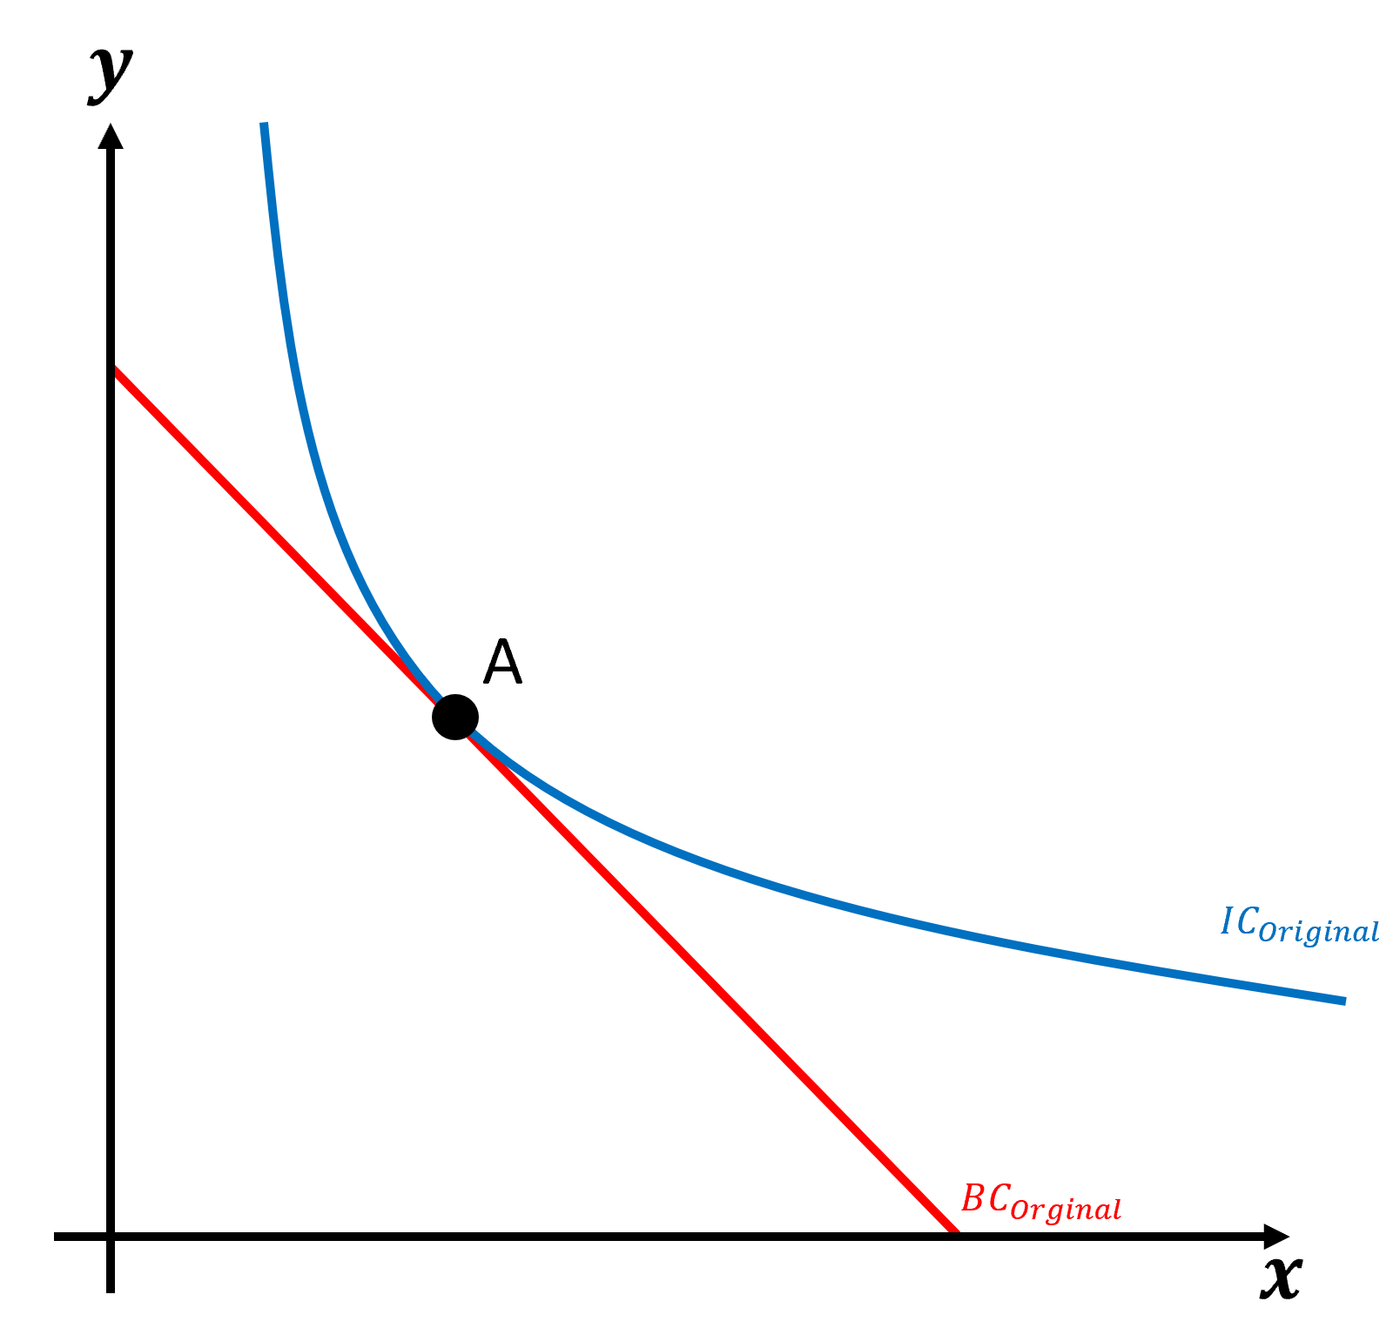

Problem 3.C.
Complete the diagram by plotting and labelling the following elements assuming that good $x$ is a normal good.
An indifference curve of a consumer maximizing their utility under the current budget constraint
The new budget line when the price of good $x$ increases.

Slide 20
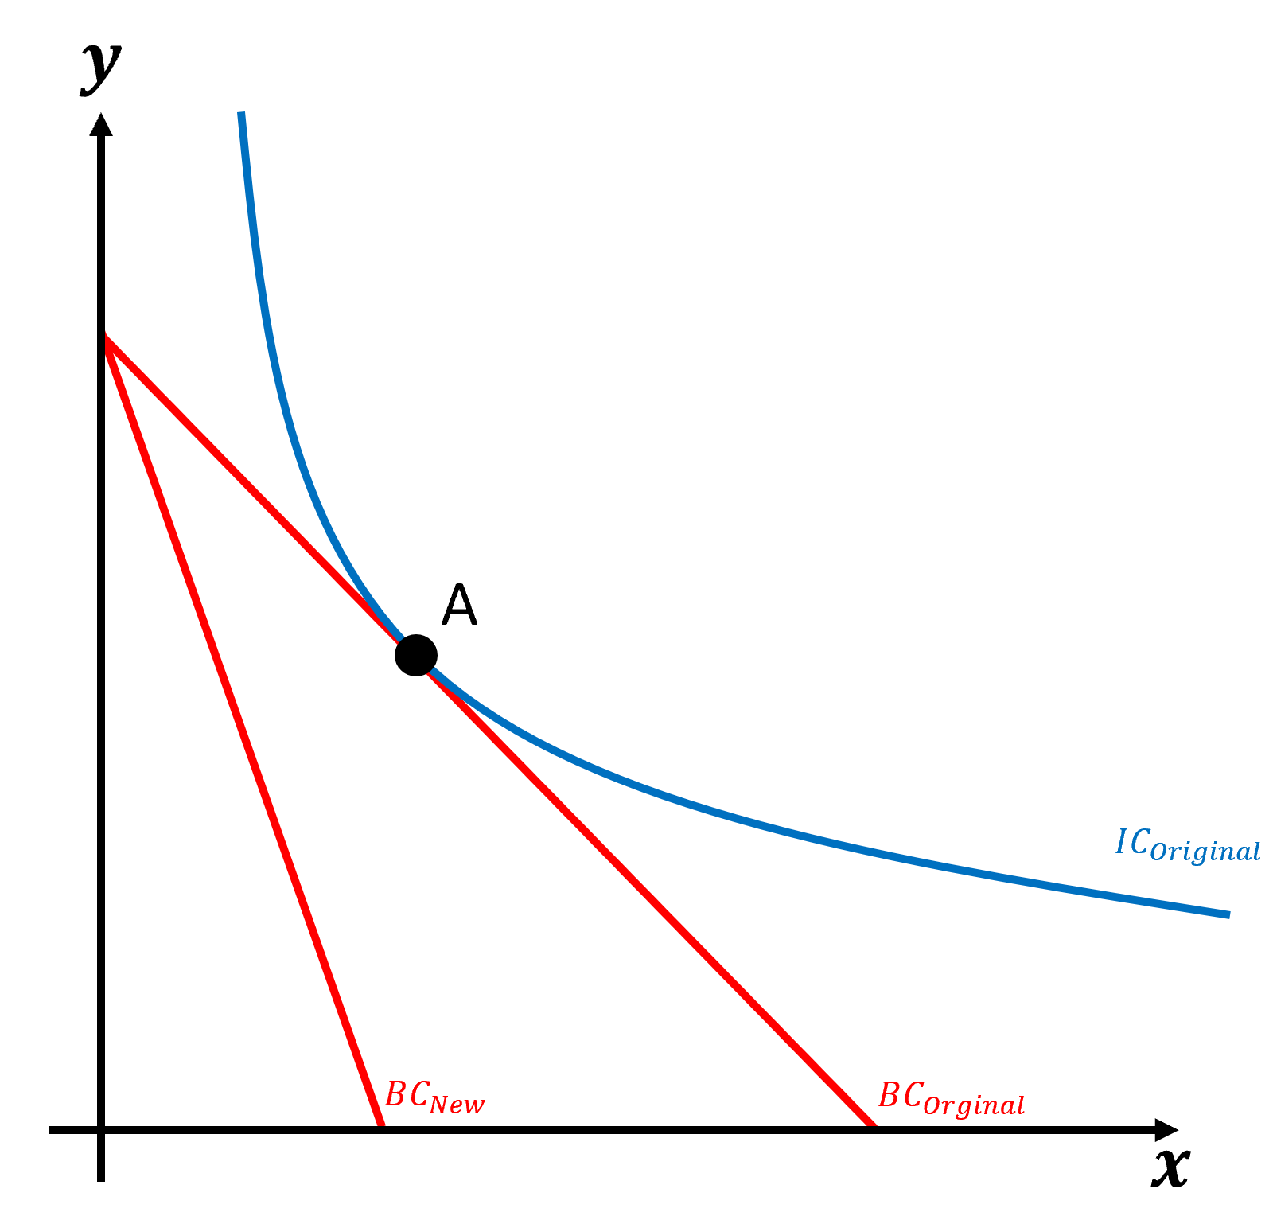
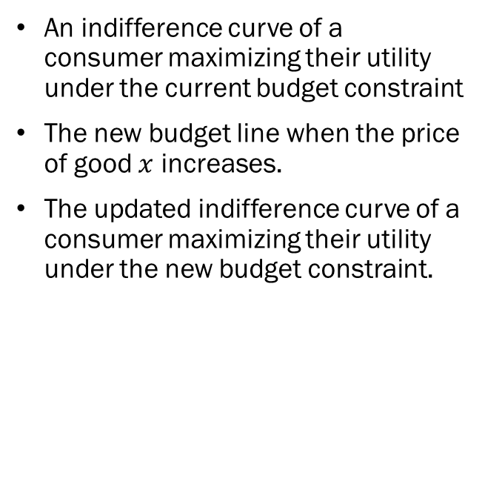
Problem 3.C.
Complete the diagram by plotting and labelling the following elements assuming that good $x$ is a normal good.
An indifference curve of a consumer maximizing their utility under the current budget constraint
The new budget line when the price of good $x$ increases.
The updated indifference curve of a consumer maximizing their utility under the new budget constraint.

Slide 21
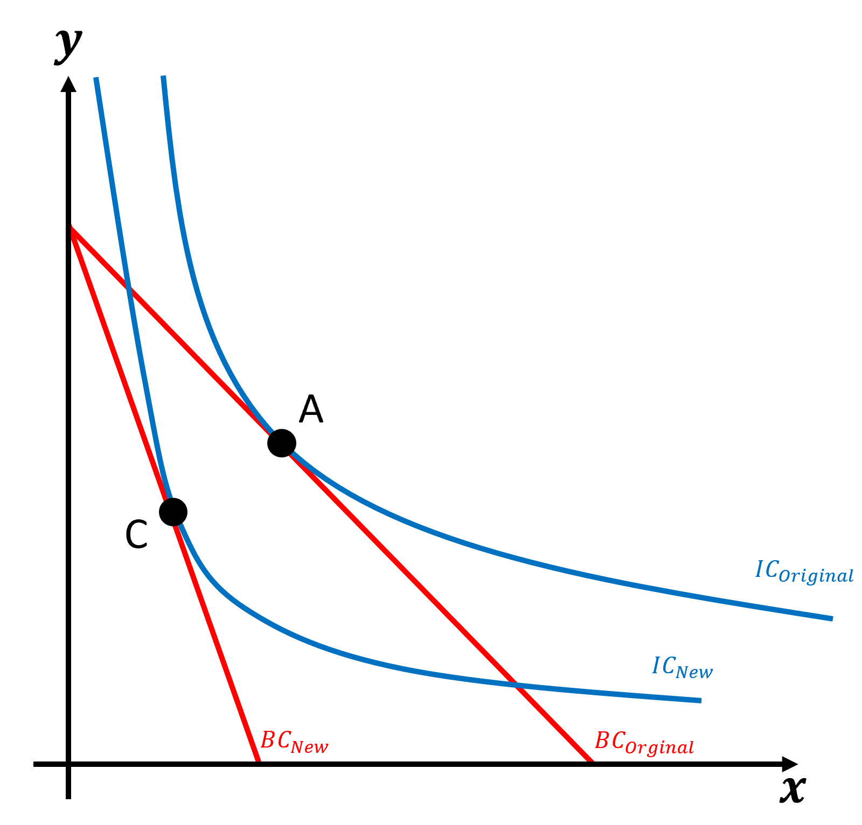
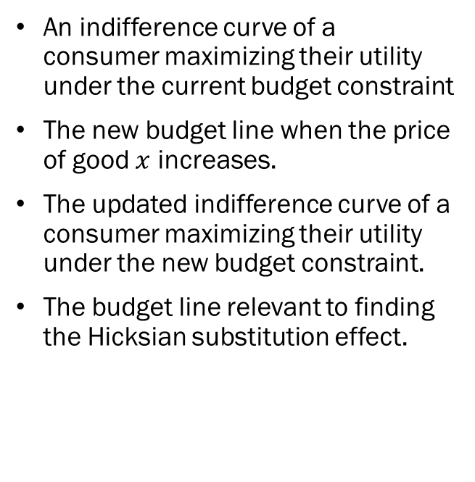
Problem 3.C.
Complete the diagram by plotting and labelling the following elements assuming that good $x$ is a normal good.
An indifference curve of a consumer maximizing their utility under the current budget constraint
The new budget line when the price of good $x$ increases.
The updated indifference curve of a consumer maximizing their utility under the new budget constraint.
The budget line relevant to finding the Hicksian substitution effect.

Slide 22
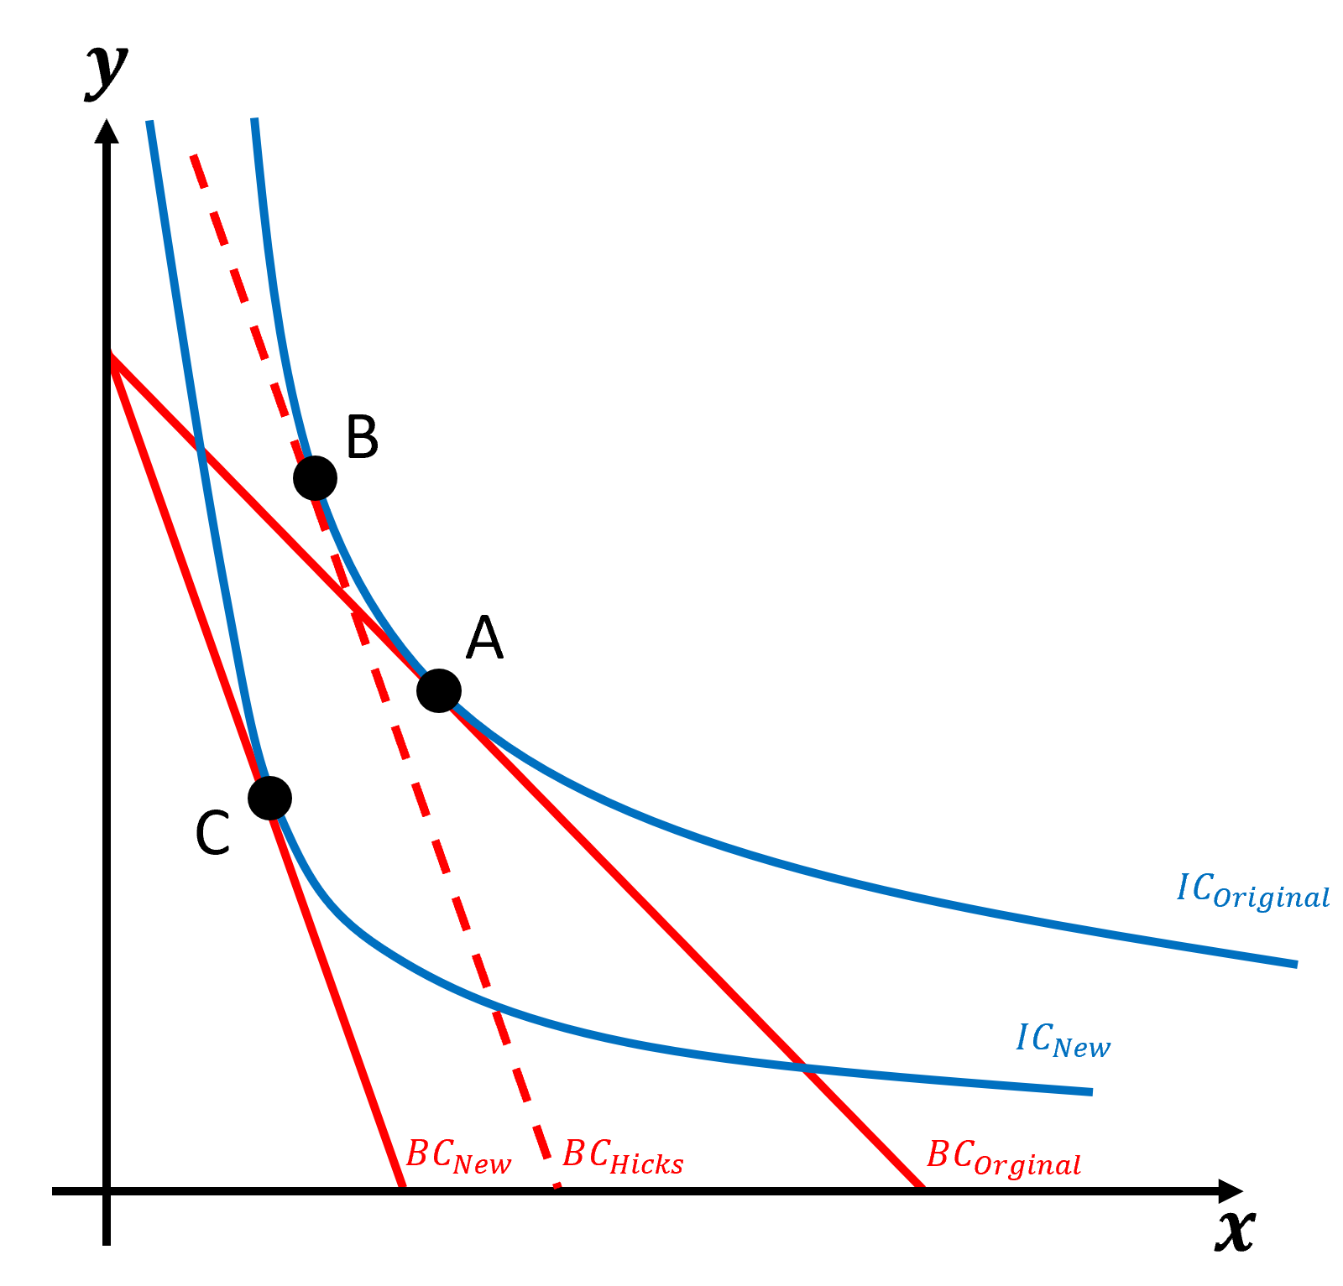
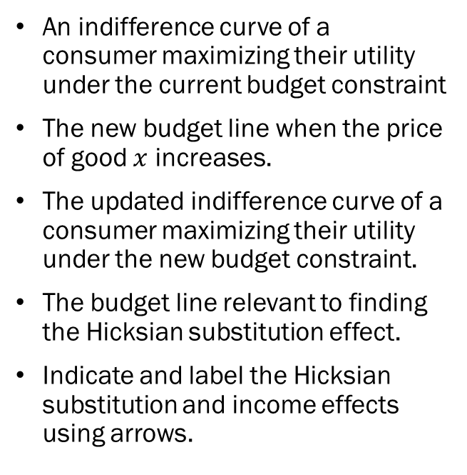
Problem 3.C.
Complete the diagram by plotting and labelling the following elements assuming that good $x$ is a normal good.
An indifference curve of a consumer maximizing their utility under the current budget constraint
The new budget line when the price of good $x$ increases.
The updated indifference curve of a consumer maximizing their utility under the new budget constraint.
The budget line relevant to finding the Hicksian substitution effect.
Indicate and label the Hicksian substitution and income effects using arrows.

Slide 23
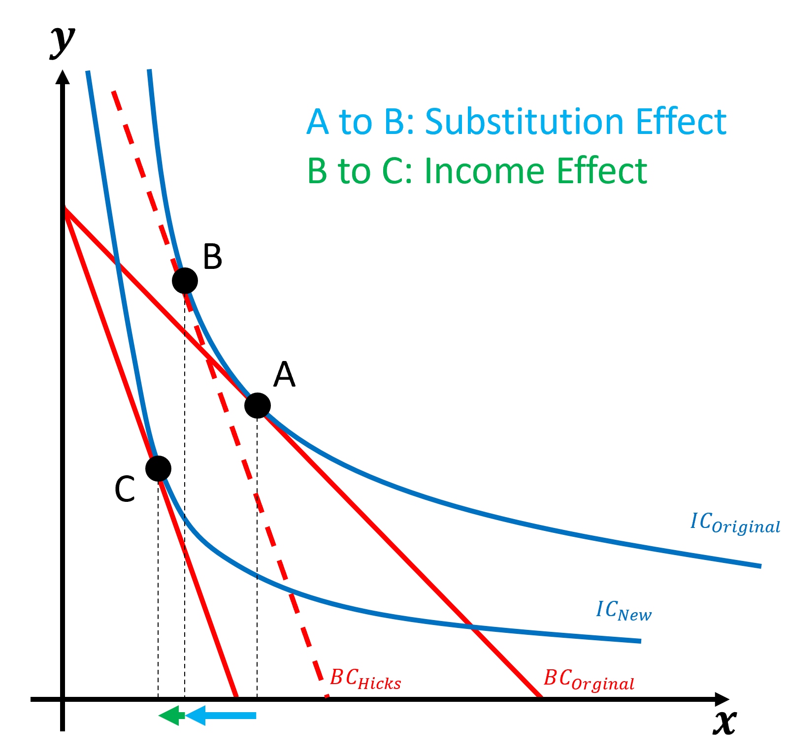
Problem 3.C.
Complete the diagram by plotting and labelling the following elements assuming that good $x$ is a normal good.
An indifference curve of a consumer maximizing their utility under the current budget constraint
The new budget line when the price of good $x$ increases.
The updated indifference curve of a consumer maximizing their utility under the new budget constraint.
The budget line relevant to finding the Hicksian substitution effect.
Indicate and label the Hicksian substitution and income effects using arrows.

