Slide 1
Quiz #2 Review
ECON 300

Slide 2
Quiz #2 “Recovery” Office Hours
https://calendly.com/brianhwpark
Venue: Rm. 248 Center for Science and Business
Dates: Sep. 22nd ~ Sep 29th, 2023
Length: 15 Minutes per Session
Use the Whiteboard / Paper to correct your answers.
Recovery Rate: 80%

Slide 3
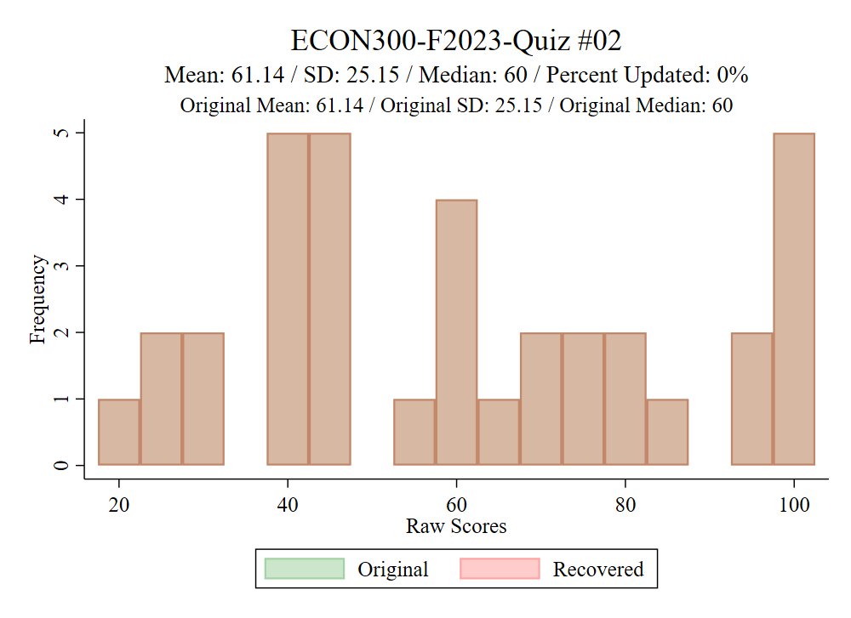
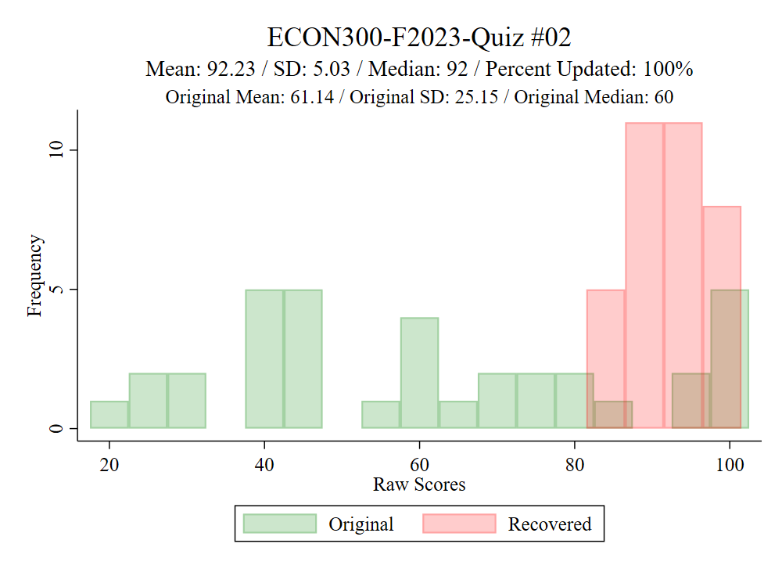

Slide 4

Problem 1.A.
Select the preference axiom that states “if $A≿B$, and $B≿C$, then $A≿C$.”
  Completeness
  Transitivity
  Strong Monotonicity
  Convexity

Slide 5
Problem 1.B.
Select the preference axiom that states “consumers prefer diversity in consumption.”
  Completeness
  Transitivity
  Strong Monotonicity
  Convexity

Slide 6
Problem 1.C.
Which are the axioms that are required for the preference to be rational?
  Completeness and Transitivity
  Completeness and Convexity
  Transitivity and Reflexivity
  Transitivity and Strong Monotonicity

Slide 7

Problem 1.D.
If $A≻B$, which of the following must be true?
  $u\left(A\right)<u(B)$
  $u\left(A\right)=u(B)$
  $u\left(A\right)>u(B)$
  $u\left(A\right)≤u(B)$

Slide 8
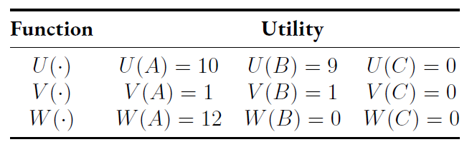
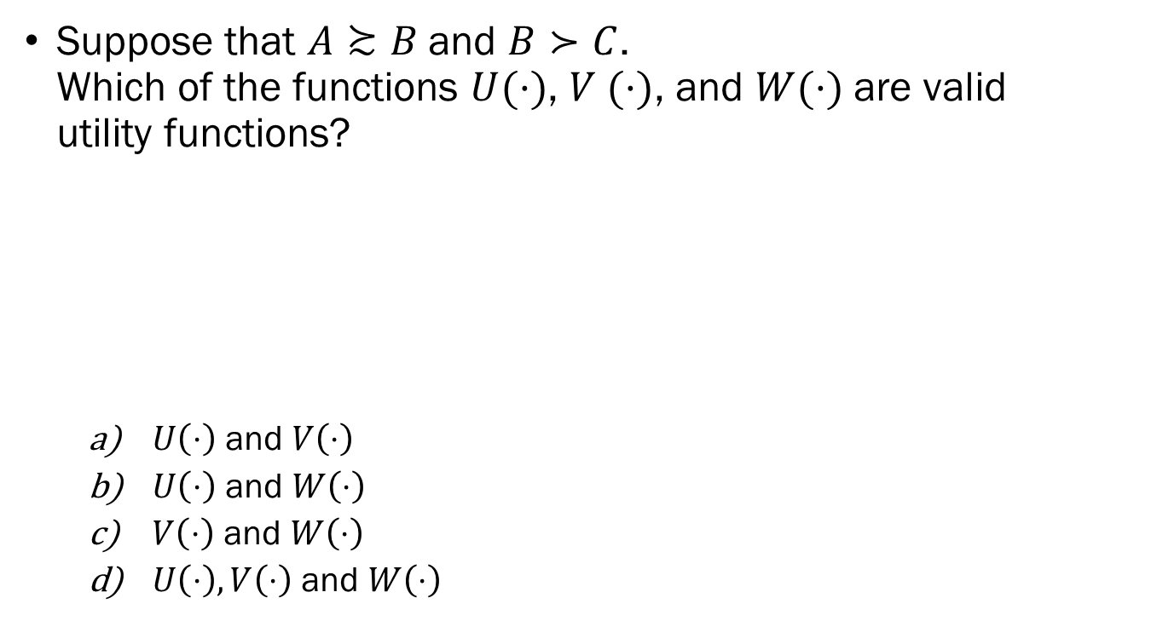
Problem 1.E.
Suppose that $A≿B$and $B≻C$. Which of the functions $U(·)$, $V (·)$, and $W(·)$are valid utility functions?
  $U\left(⋅\right)$ and $V\left(⋅\right)$
  $U\left(⋅\right)$ and $W\left(⋅\right)$
  $V\left(⋅\right)$ and $W\left(⋅\right)$
  $U\left(⋅\right), V\left(⋅\right)$ and $W\left(⋅\right)$

Slide 9

Problem 1.F.
What is the correct expression of the Marginal Rate of Substitution, $MRS_{xy}$?
  $−\frac{MU_{x}}{MU_{y}}$
  $−\frac{P_{x}}{P_{y}}$
  $\frac{{MU}_{x}}{P_{x}}$
  $\frac{{MU}_{y}}{P_{y}}$

Slide 10
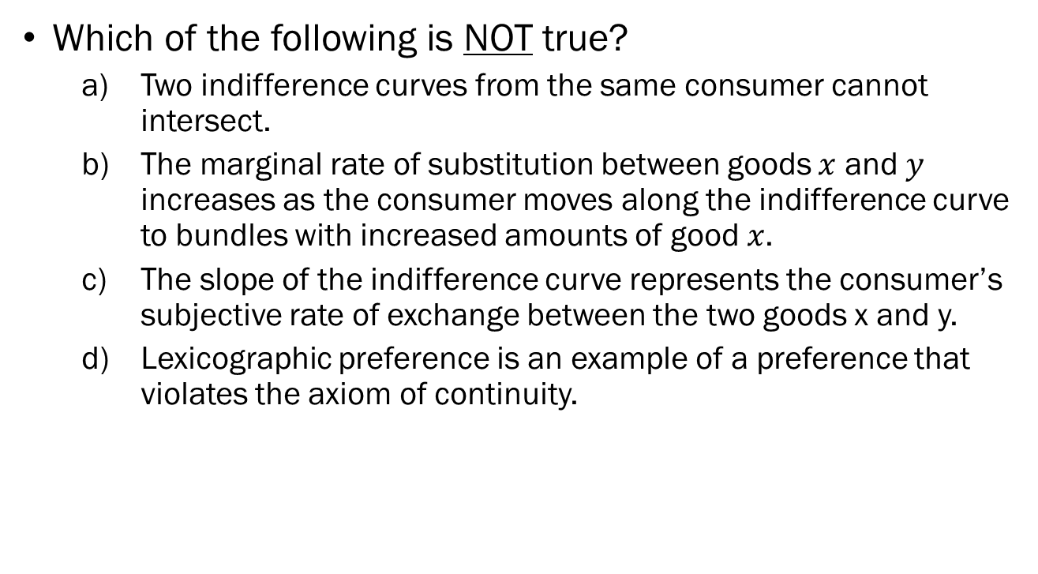
Problem 1.G.
Which of the following is NOT true?
  Two indifference curves from the same consumer cannot intersect.
  The marginal rate of substitution between goods $x$ and $y$ increases as the consumer moves along the indifference curve to bundles with increased amounts of good $x$.
  The slope of the indifference curve represents the consumer’s subjective rate of exchange between the two goods x and y.
  Lexicographic preference is an example of a preference that violates the axiom of continuity.

Slide 11
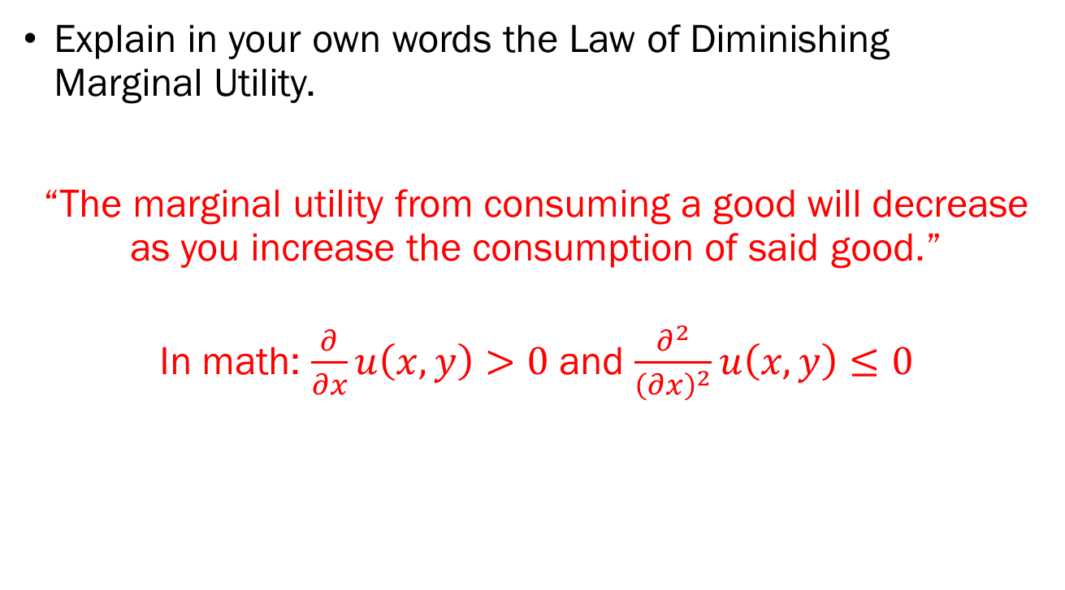
Problem 2.A.
Explain in your own words the Law of Diminishing Marginal Utility.
“The marginal utility from consuming a good will decrease as you increase the consumption of said good.”
In math: $\frac{∂}{∂x}u\left(x,y\right)>0$ and $\frac{∂^{2}}{{\left(∂x\right)}^{2}}u\left(x,y\right)≤0$

Slide 12
Problem 2.B.
Economists consider utility to be ordinal. What does this mean?
“The only information you can get from utility values is the relative order of bundles that a consumer values. The fact that one bundle gives 100 utility, while another gives 10 does not mean that the former is 10 times more desirable.”

Slide 13

Problem 2.C.
If two goods $x$ and $y$ in the market are perfect complements, what utility function would most accurately reflect the consumer’s preferences?
“The Leontief Utility Function”

Slide 14
Problem 3.A.
What does the slope of the indifference curve represent?
“The Subjective Rate of Exchange”
“The Marginal Rate of Substitution”

Slide 15
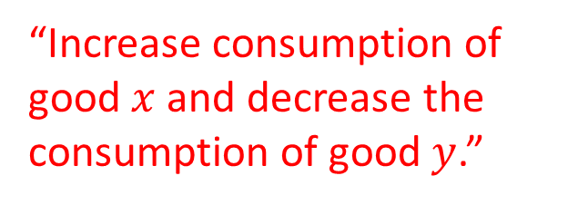
Problem 3.B.
Assuming that the consumer is currently consuming at bundle A, is it possible to make changes to the quantity of goods x and y to reach a higher level of utility? If so, what changes should the consumer make to increase their utility?
“Increase consumption of good $x$ and decrease the consumption of good $y$.”

Slide 16
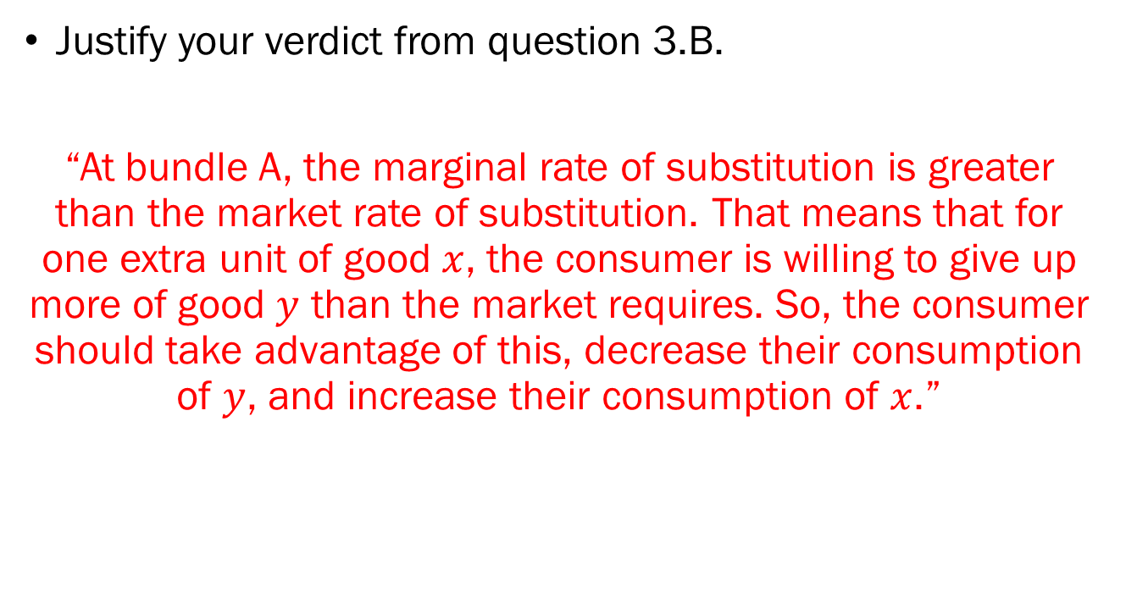
Problem 3.C.
Justify your verdict from question 3.B.
“At bundle A, the marginal rate of substitution is greater than the market rate of substitution. That means that for one extra unit of good $x$, the consumer is willing to give up more of good $y$ than the market requires. So, the consumer should take advantage of this, decrease their consumption of $y$, and increase their consumption of $x$.”

Slide 17

Extra Credit
$\frac{∂}{∂x}\left(10x^{2}y^{3}\right)$
$$\frac{∂}{∂x}\left(10x^{2}y^{3}\right)=10y^{3}⋅2⋅x^{2−1}=20xy^{3}$$
$\frac{∂}{∂y}\left(10x^{2}y^{3}\right)$
$$\frac{∂}{∂y}\left(10x^{2}y^{3}\right)=10x^{2}⋅3⋅y^{3−1}=30x^{2}y^{2}$$

