Slide 1
Quiz #1 Review
ECON 300

Slide 2
Quiz #1 “Recovery” Office Hours
https://calendly.com/brianhwpark
Venue: Rm. 248 Center for Science and Business
Dates: Sep. 11th ~ Sep 18th, 2023
Length: 10 Minutes per Session
Use the Whiteboard to correct your answers.
Recovery Rate: 90%

Slide 3
Quiz #1: Statistics
Pre-recovery Statistics
  Average: 83
  Standard Deviation: 14.1
  Median: 85
Post-recovery (Potential) Statistics
  Average: 98.3
  Standard Deviation: 1.41
  Median: 98.5

Slide 4
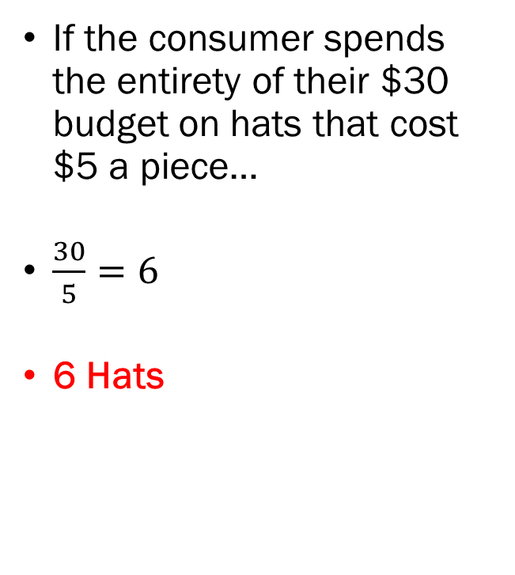
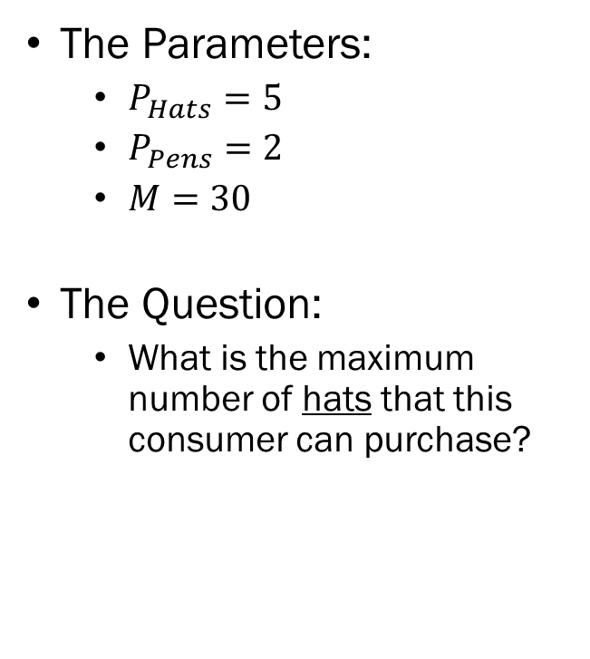
Problem 1.A.
The Parameters:
  $P_{Hats}=5$
  $P_{Pens}=2$
  $M=30$
The Question:
  What is the maximum number of hats that this consumer can purchase?
If the consumer spends the entirety of their $30 budget on hats that cost $5 a piece…
$\frac{30}{5}=6$
6 Hats

Slide 5
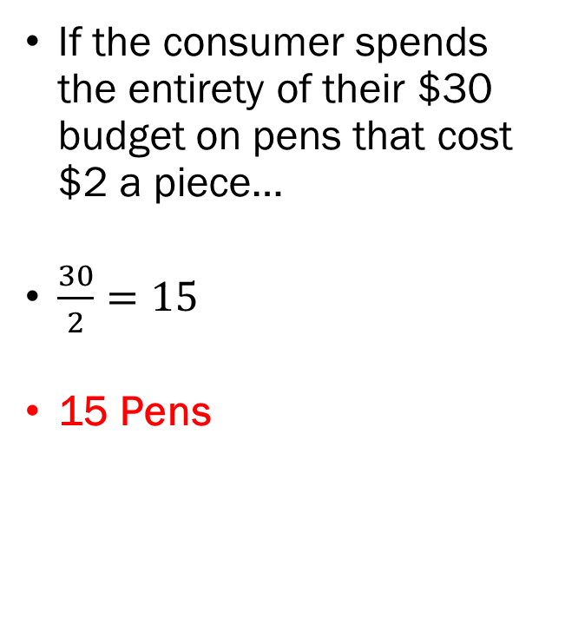
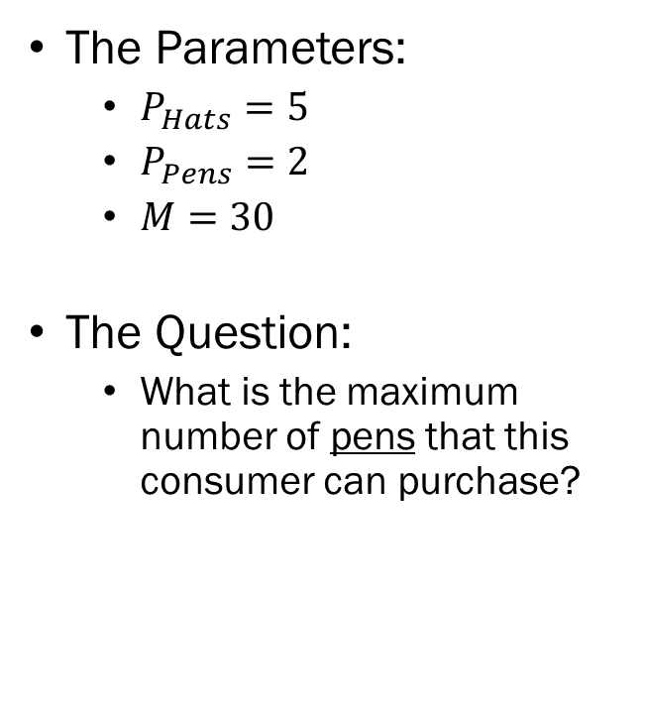
Problem 1.B.
The Parameters:
  $P_{Hats}=5$
  $P_{Pens}=2$
  $M=30$
The Question:
  What is the maximum number of pens that this consumer can purchase?
If the consumer spends the entirety of their $30 budget on pens that cost $2 a piece…
$\frac{30}{2}=15$
15 Pens

Slide 6
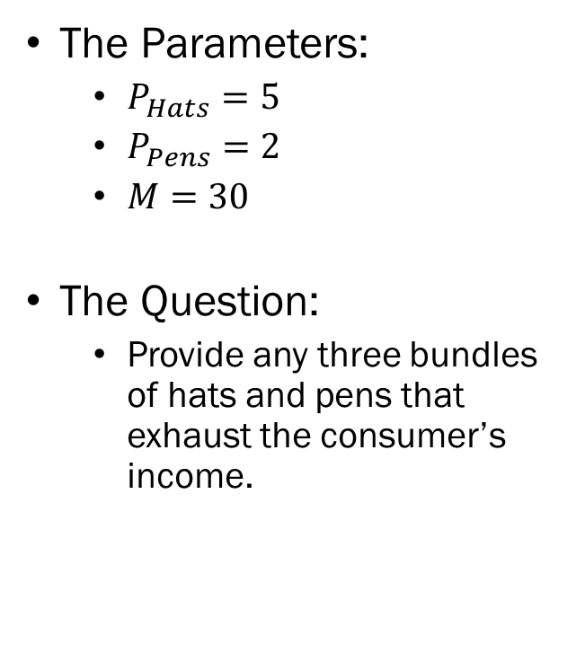
Problem 1.C.
The Parameters:
  $P_{Hats}=5$
  $P_{Pens}=2$
  $M=30$
The Question:
  Provide any three bundles of hats and pens that exhaust the consumer’s income.
Suppose that the consumer purchases 2 hats.
The consumer spends $10 on hats and has $20 left in their budget.
The consumer spends the remaining $20 on pens and can purchase up to 10.
2 Hats and 10 Pens

Slide 7
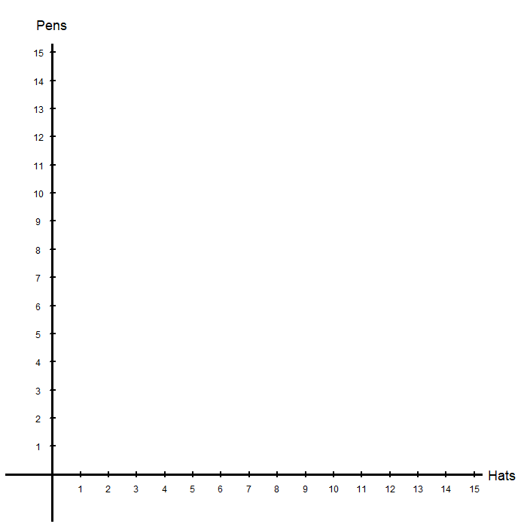
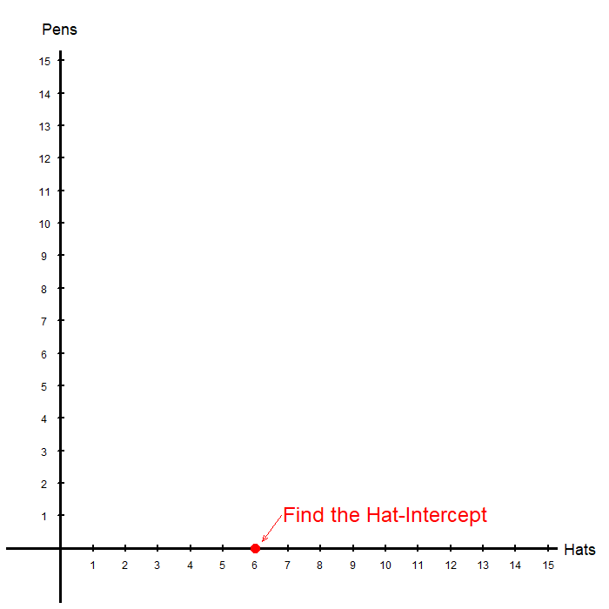
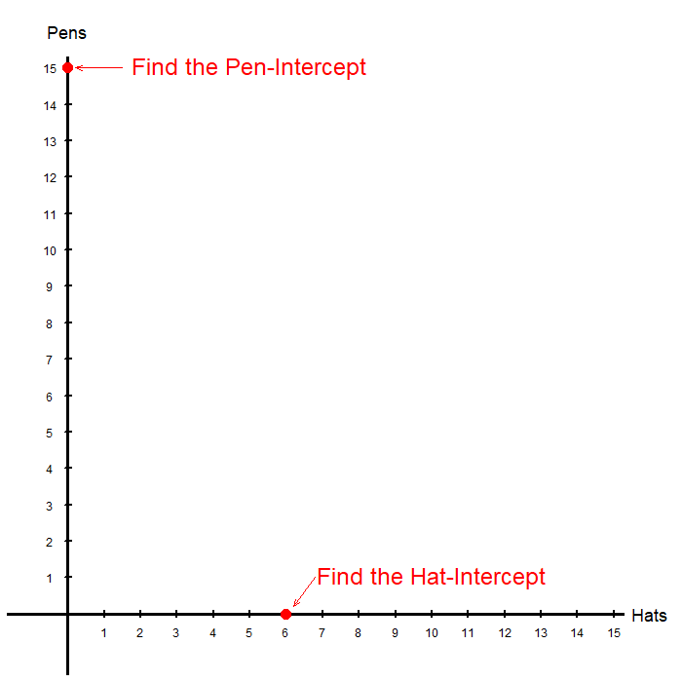
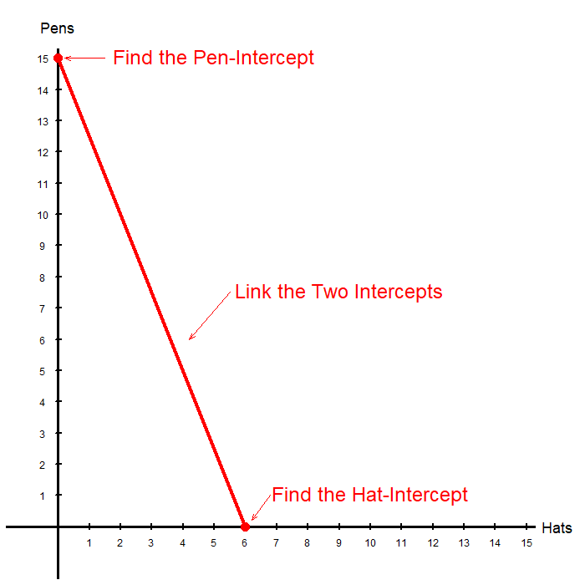
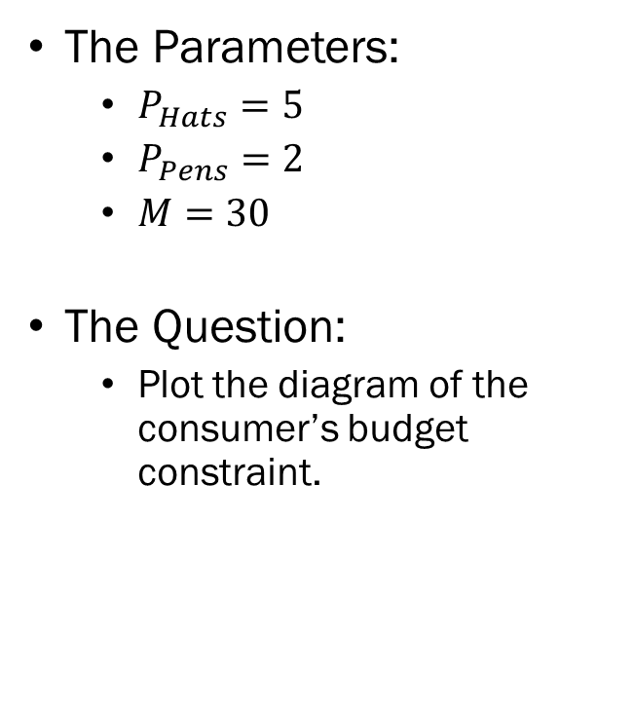
Problem 1.D.
The Parameters:
  $P_{Hats}=5$
  $P_{Pens}=2$
  $M=30$
The Question:
  Plot the diagram of the consumer’s budget constraint.

Slide 8
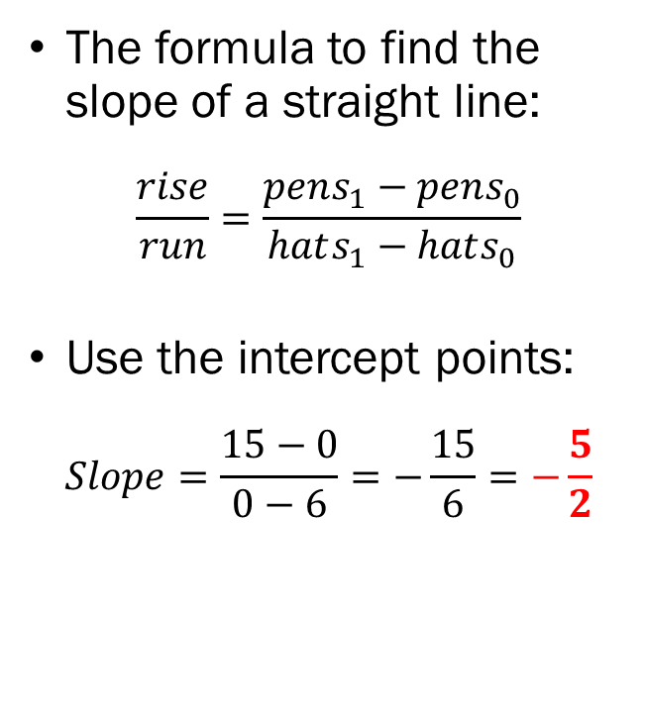
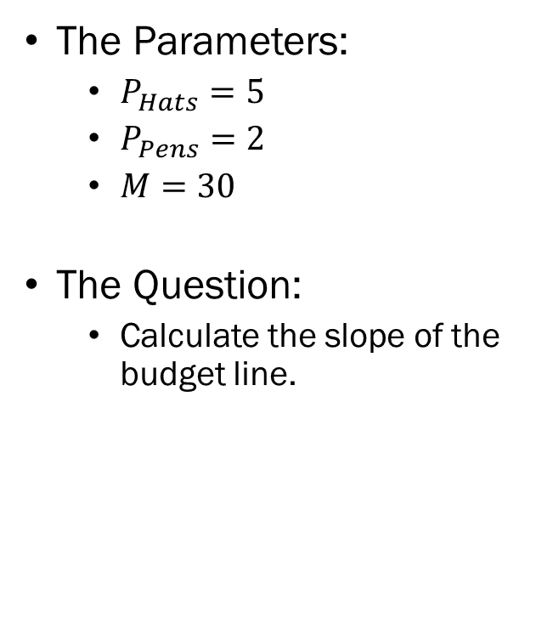
Problem 1.E.
The Parameters:
  $P_{Hats}=5$
  $P_{Pens}=2$
  $M=30$
The Question:
  Calculate the slope of the budget line.
The formula to find the slope of a straight line:
$$\frac{rise}{run}=\frac{pens_{1}−pens_{0}}{hats_{1}−hats_{0}}$$
Use the intercept points:
$$Slope=\frac{15−0}{0−6}=−\frac{15}{6}=−\frac{5}{2}$$

Slide 9
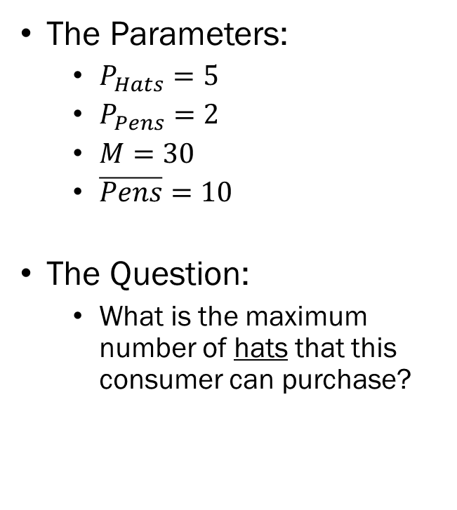
Problem 2.A.
The Parameters:
  $P_{Hats}=5$
  $P_{Pens}=2$
  $M=30$
  $\overline{Pens}=10$
The Question:
  What is the maximum number of hats that this consumer can purchase?
If the consumer spends the entirety of their $30 budget on hats that cost $5 a piece…
$\frac{30}{5}=6$
6 Hats

Slide 10
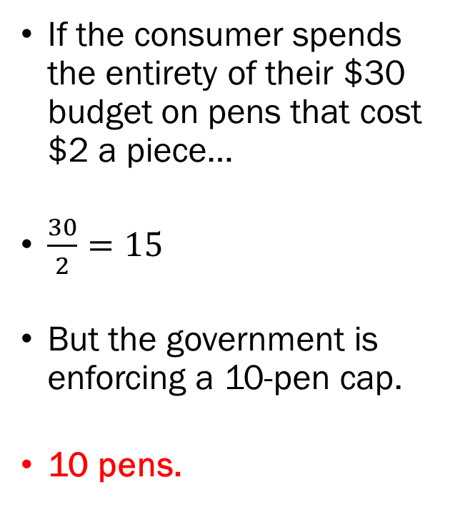
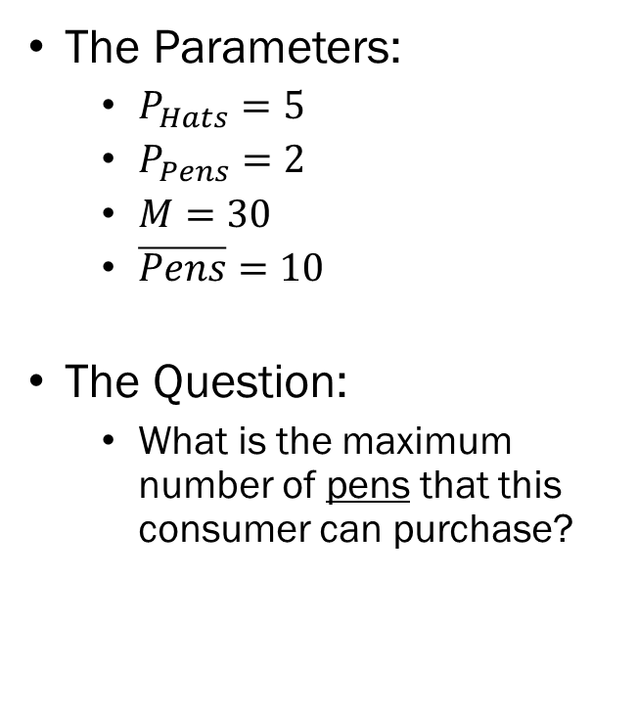
Problem 2.B.
The Parameters:
  $P_{Hats}=5$
  $P_{Pens}=2$
  $M=30$
  $\overline{Pens}=10$
The Question:
  What is the maximum number of pens that this consumer can purchase?
If the consumer spends the entirety of their $30 budget on pens that cost $2 a piece…
$\frac{30}{2}=15$
But the government is enforcing a 10-pen cap.
10 pens.

Slide 11
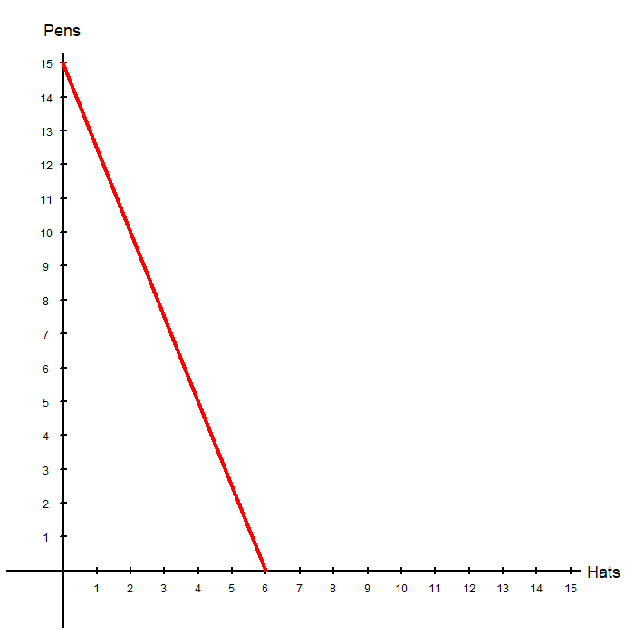
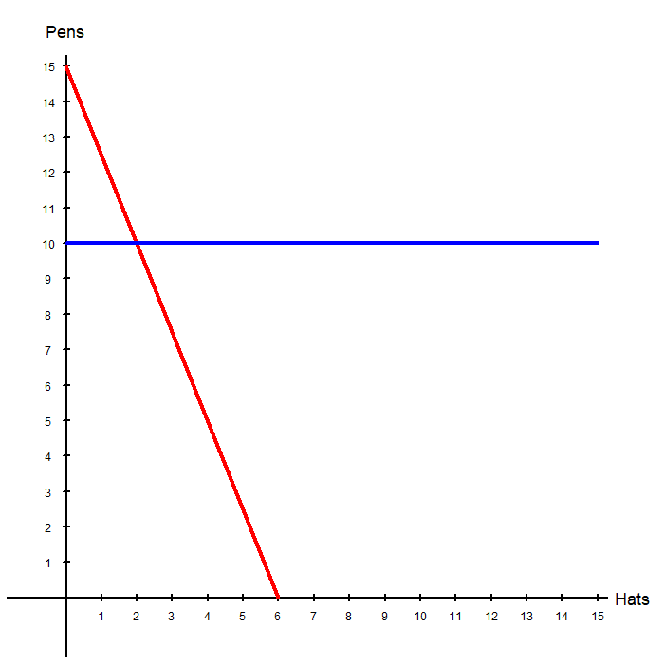
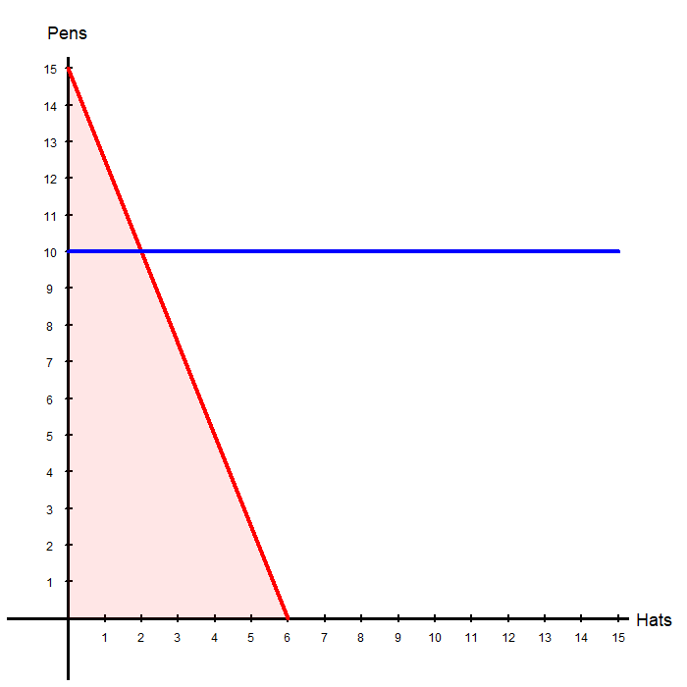
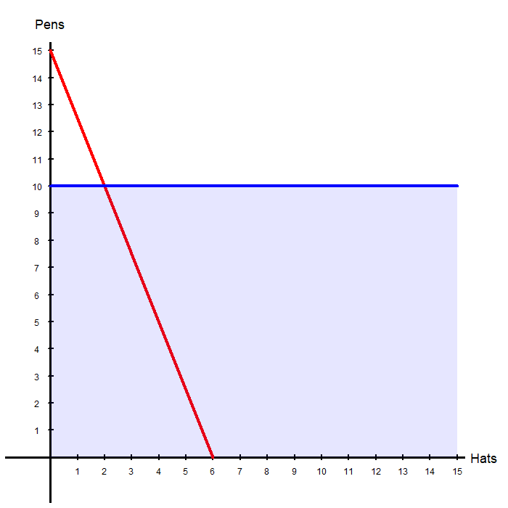
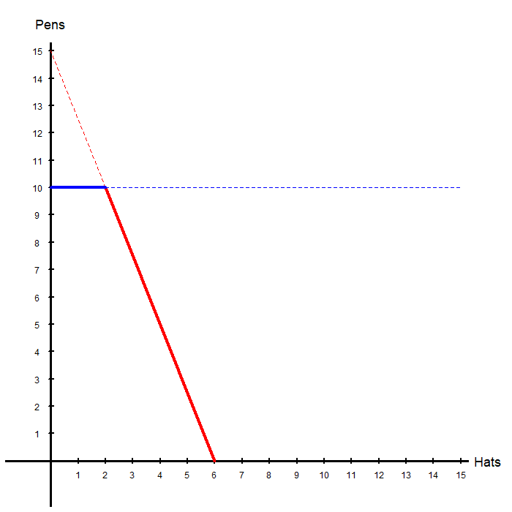
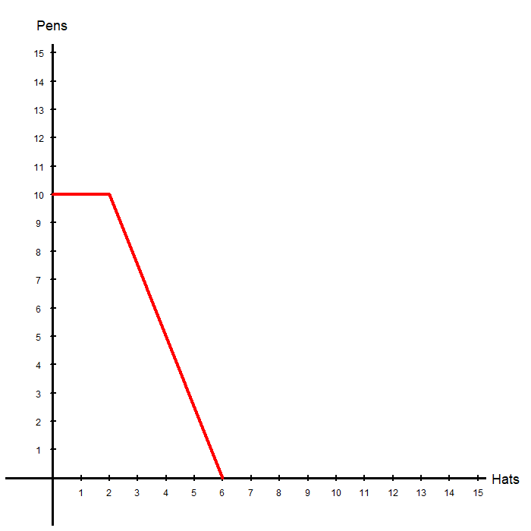
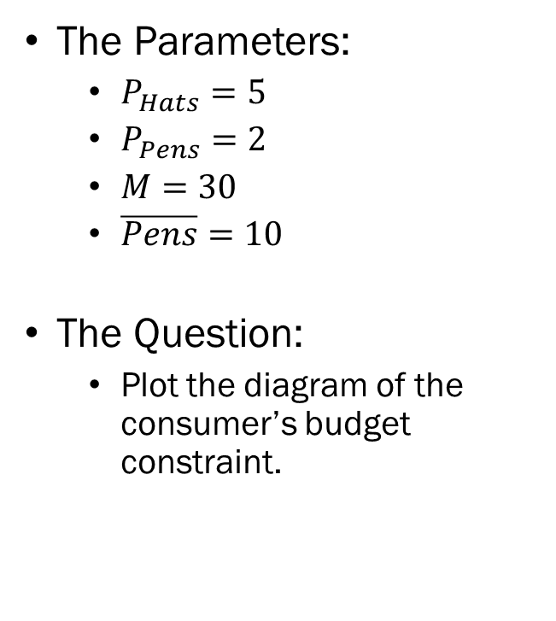
Problem 2.C.
The Parameters:
  $P_{Hats}=5$
  $P_{Pens}=2$
  $M=30$
  $\overline{Pens}=10$
The Question:
  Plot the diagram of the consumer’s budget constraint.

Slide 12
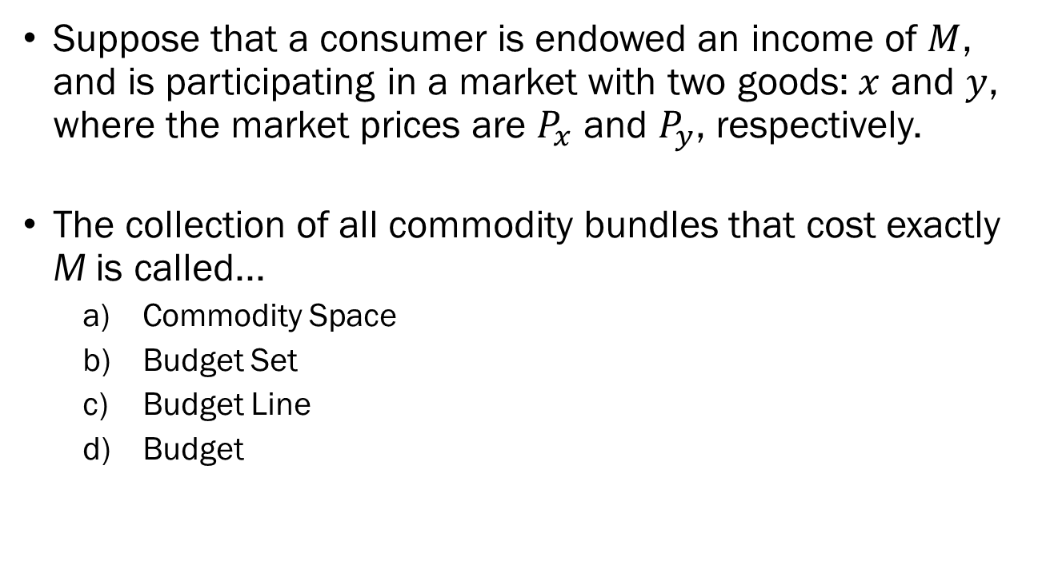
Problem 3.A.
Suppose that a consumer is endowed an income of $M$, and is participating in a market with two goods: $x$ and $y$, where the market prices are $P_{x}$ and $P_{y}$, respectively.
The collection of all commodity bundles that cost exactly M is called...
  Commodity Space
  Budget Set
  Budget Line
  Budget

Slide 13
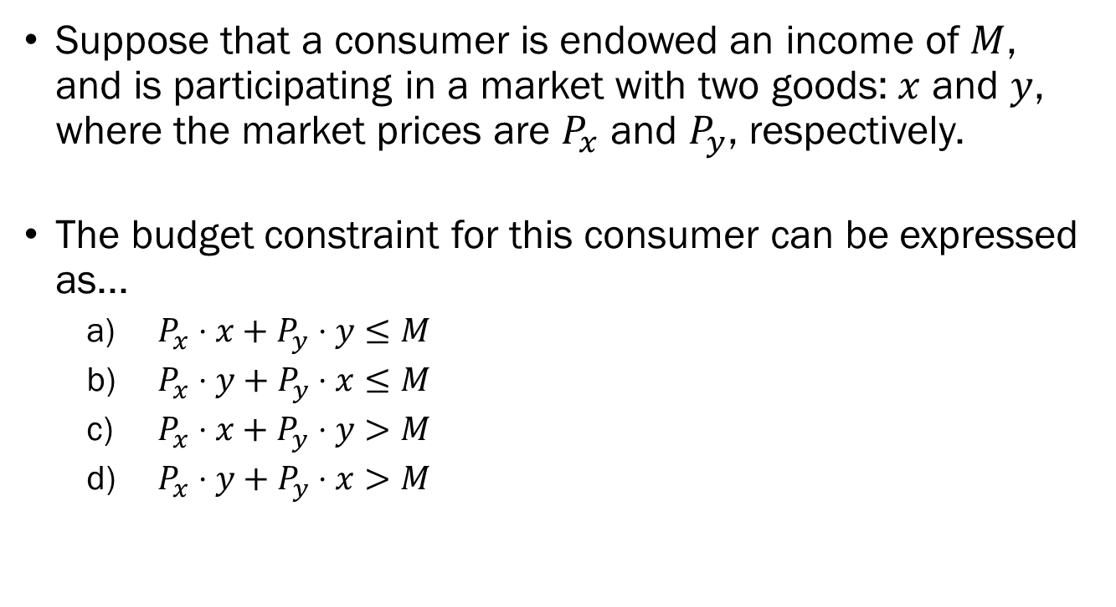
Problem 3.B.
Suppose that a consumer is endowed an income of $M$, and is participating in a market with two goods: $x$ and $y$, where the market prices are $P_{x}$ and $P_{y}$, respectively.
The budget constraint for this consumer can be expressed as...
  $P_{x}⋅x+P_{y}⋅y≤M$
  $P_{x}⋅y+P_{y}⋅x≤M$
  $P_{x}⋅x+P_{y}⋅y>M$
  $P_{x}⋅y+P_{y}⋅x>M$

Slide 14
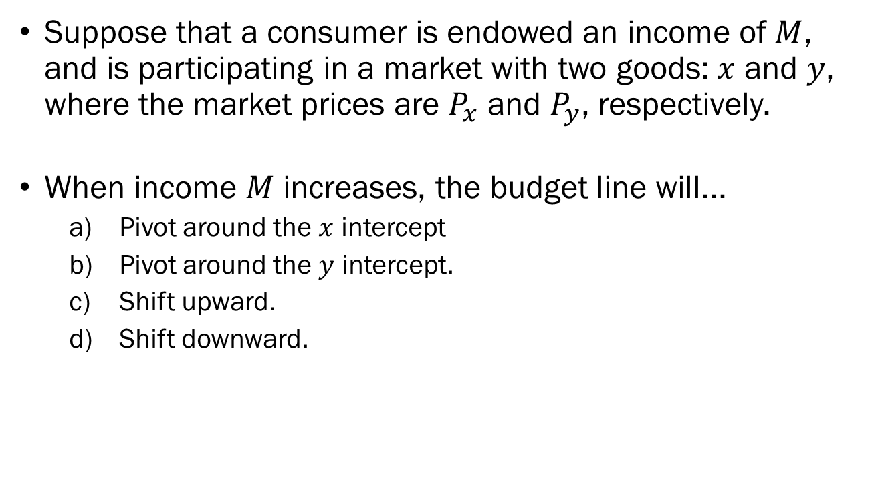
Problem 3.C.
Suppose that a consumer is endowed an income of $M$, and is participating in a market with two goods: $x$ and $y$, where the market prices are $P_{x}$ and $P_{y}$, respectively.
When income $M$ increases, the budget line will...
  Pivot around the $x$ intercept
  Pivot around the $y$ intercept.
  Shift upward.
  Shift downward.

Slide 15
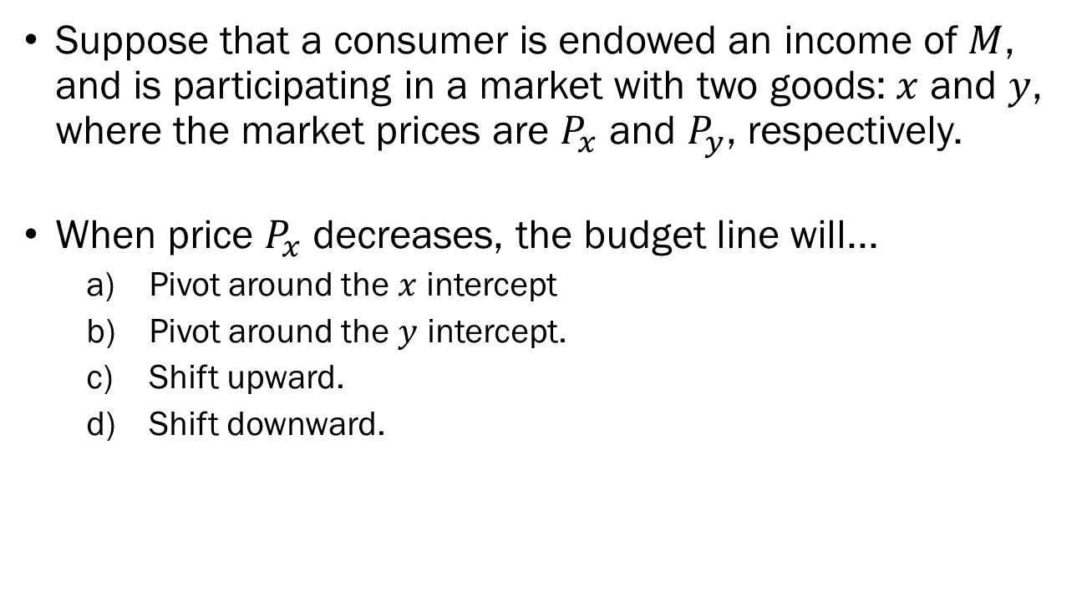
Problem 3.D.
Suppose that a consumer is endowed an income of $M$, and is participating in a market with two goods: $x$ and $y$, where the market prices are $P_{x}$ and $P_{y}$, respectively.
When price $P_{x}$ decreases, the budget line will...
  Pivot around the $x$ intercept
  Pivot around the $y$ intercept.
  Shift upward.
  Shift downward.

Slide 16
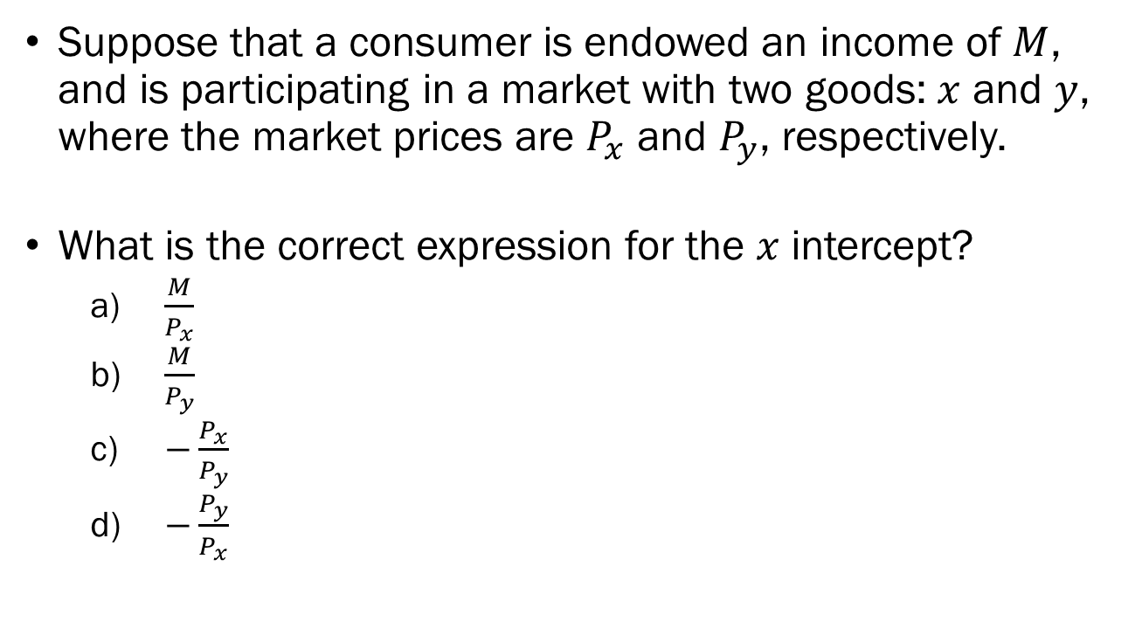
Problem 3.E.
Suppose that a consumer is endowed an income of $M$, and is participating in a market with two goods: $x$ and $y$, where the market prices are $P_{x}$ and $P_{y}$, respectively.
What is the correct expression for the $x$ intercept?
  $\frac{M}{P_{x}}$
  $\frac{M}{P_{y}}$
  $−\frac{P_{x}}{P_{y}}$
  $−\frac{P_{y}}{P_{x}}$

Slide 17
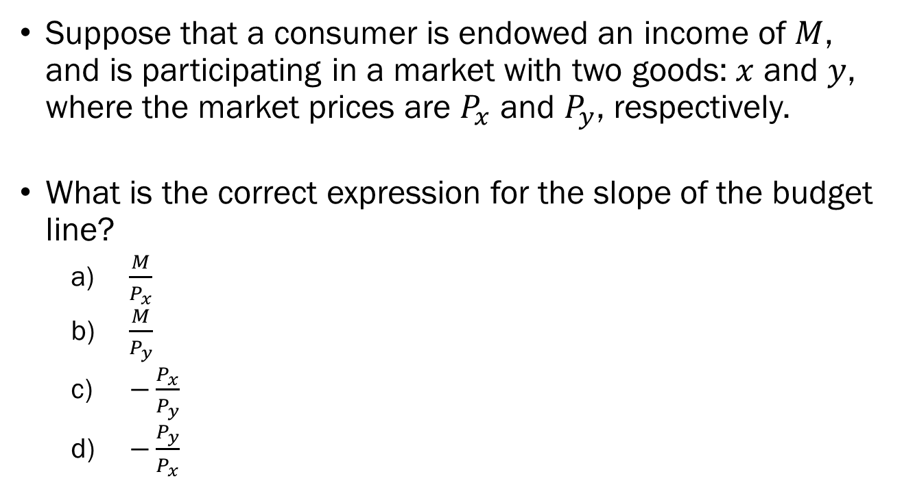
Problem 3.F.
Suppose that a consumer is endowed an income of $M$, and is participating in a market with two goods: $x$ and $y$, where the market prices are $P_{x}$ and $P_{y}$, respectively.
What is the correct expression for the slope of the budget line?
  $\frac{M}{P_{x}}$
  $\frac{M}{P_{y}}$
  $−\frac{P_{x}}{P_{y}}$
  $−\frac{P_{y}}{P_{x}}$

Slide 18
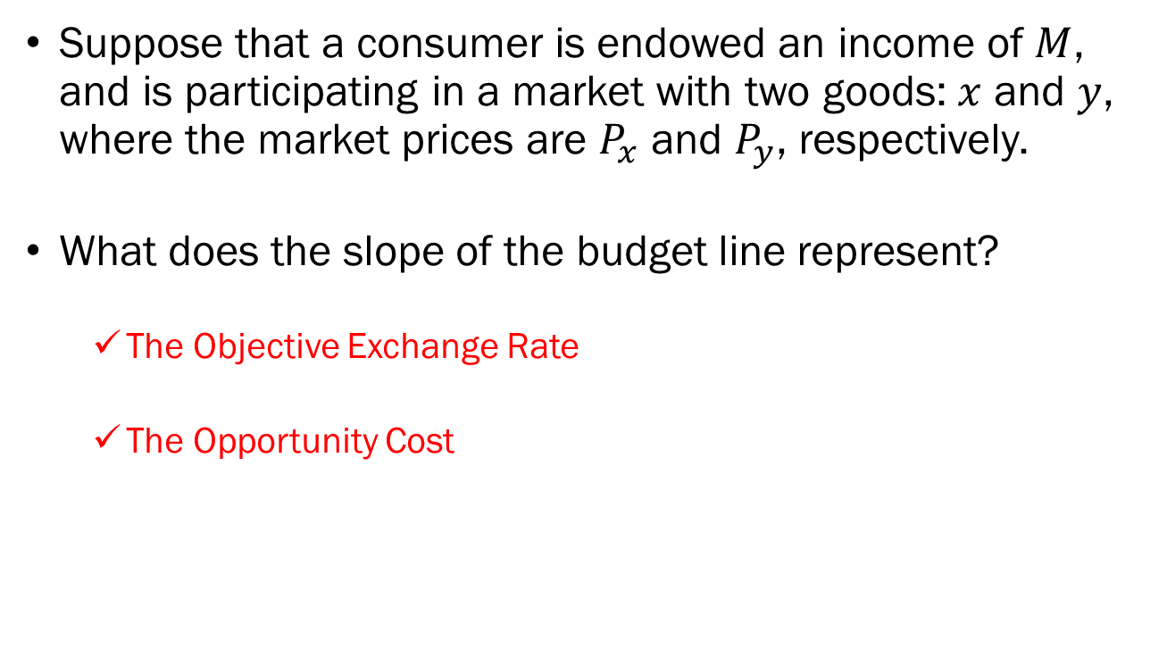
Problem 3.G.
Suppose that a consumer is endowed an income of $M$, and is participating in a market with two goods: $x$ and $y$, where the market prices are $P_{x}$ and $P_{y}$, respectively.
What does the slope of the budget line represent?
  The Objective Exchange Rate
  The Opportunity Cost

