Slide 1
Game Theory:
Repeated and Dynamic Games
ECON 300

Slide 2
Today’s Topics
Previously, we examined the Nash Equilibrium, the normal form representation of a game, and how to find the Pure Strategy Nash Equilibrium (PSNE).
Today, we will expand on this concept by examining two different types of games.
Repeated Static Games of Complete Information.
Dynamic Games of Complete Information.

Slide 3
Repeated Static Games of Complete Information
While we covered static games of complete information, we noticed the existence of some “problems.”
One was the Prisoner’s Dilemma, where the players in the game end up choosing strategies that is not beneficial for neither party.
Let’s see what happens when we have the players repeat the game, and how we can define strategies in this repeated game.

Slide 4
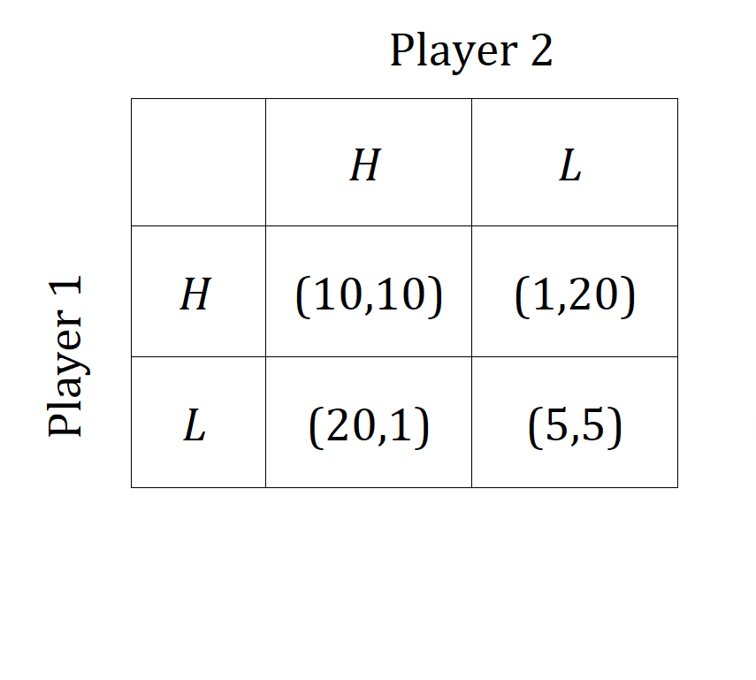
Repeated Static Games of Complete Information
Let us first consider the scenario where both players know that this game will be played a finite number of times.

Slide 5
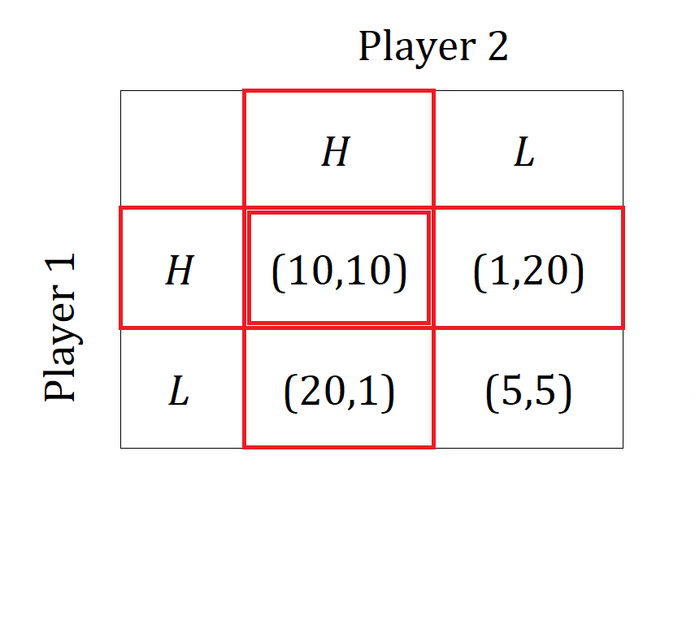
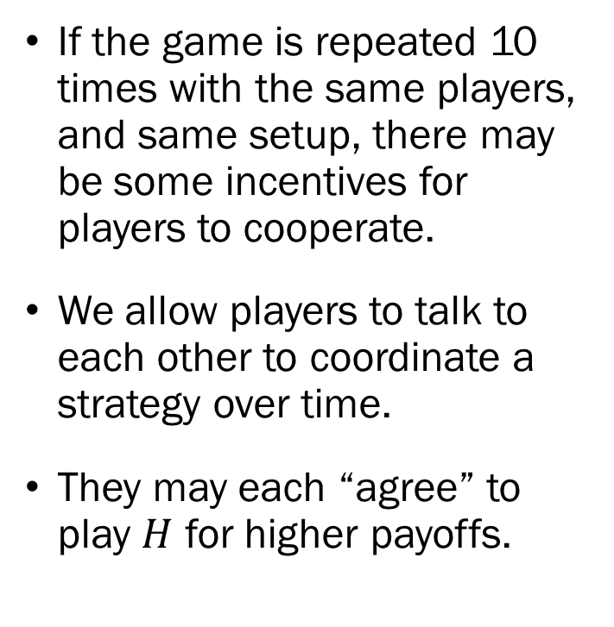
Finite Horizon Repeated Static
Games of Complete Information
If the game is repeated 10 times with the same players, and same setup, there may be some incentives for players to cooperate.
We allow players to talk to each other to coordinate a strategy over time.
They may each “agree” to play $H$ for higher payoffs.

Slide 6
Finite Horizon Repeated Static
Games of Complete Information
The question will then be “how long can this trust last”?
To answer this question, we must put ourselves in the shoes of these players.
Specifically, suppose you are player 1 at the 10th stage of the game.

Slide 7
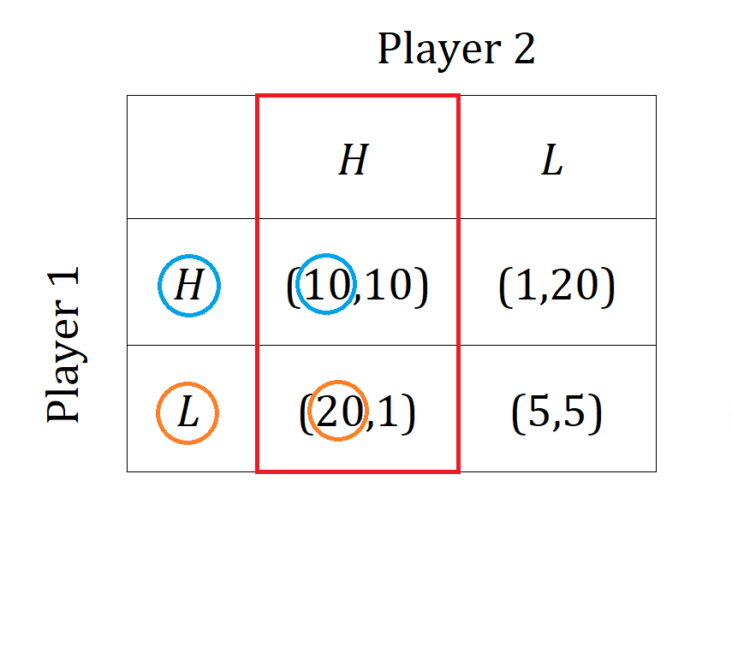
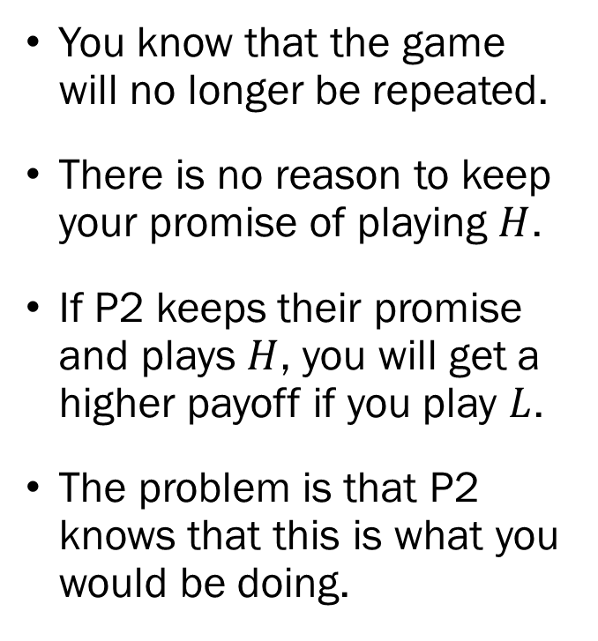
Finite Horizon Repeated Static
Games of Complete Information
You know that the game will no longer be repeated.
There is no reason to keep your promise of playing $H$.
If P2 keeps their promise and plays $H$, you will get a higher payoff if you play $L$.
The problem is that P2 knows that this is what you would be doing.

Slide 8
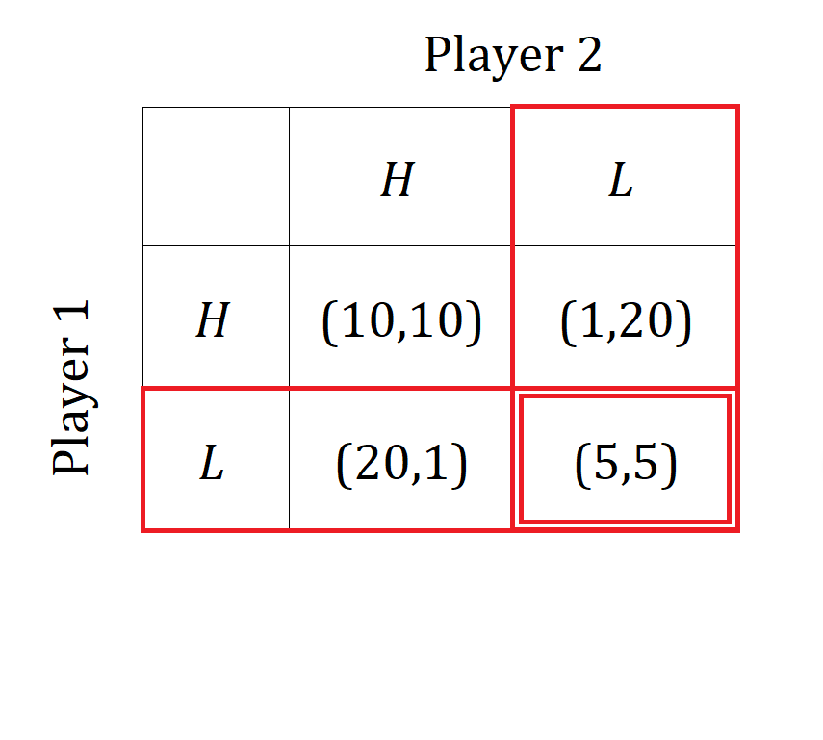
Finite Horizon Repeated Static
Games of Complete Information
Therefore, P2 will not be willing to cooperate in the 10th stage.
This means that P1 and P2 will not cooperate in the 10th stage.
Furthermore, both you and P2 knows that this is what will happen in the 10th step.

Slide 9
Finite Horizon Repeated Static
Games of Complete Information
Since you know that there will be no cooperation in the 10th stage, you should consider the 9th stage as the last step.
Then, at the last stage, you do not cooperate with P2, and P2 also knows this, and…
Therefore, no cooperation in the 9th stage.

Slide 10
Finite Horizon Repeated Static
Games of Complete Information
Iterating this step, we will eventually conclude that there can be no cooperation even in the first step.
In fact, this is a general result. When there is an explicit final stage, there will be no cooperation between agents.
This method of thinking from the very last stage, leading up to the initial stage is called “backward induction.”
This will be slightly different when there is no “final stage” that is common knowledge to the players.

Slide 11
Infinite Horizon Repeated Static
Games of Complete Information
Unlike the previous case, there is no “last stage” to begin our analysis, so we must take a different approach.
Strategies that we can employ over time?
Tit-for-Tat Strategy
  Cooperate in the first stage, and then from the second stage onward, imitate whatever your opponent chose previously.
Trigger Strategy
  Cooperate with your opponent until they betray first, from that period onward, never cooperate.

Slide 12
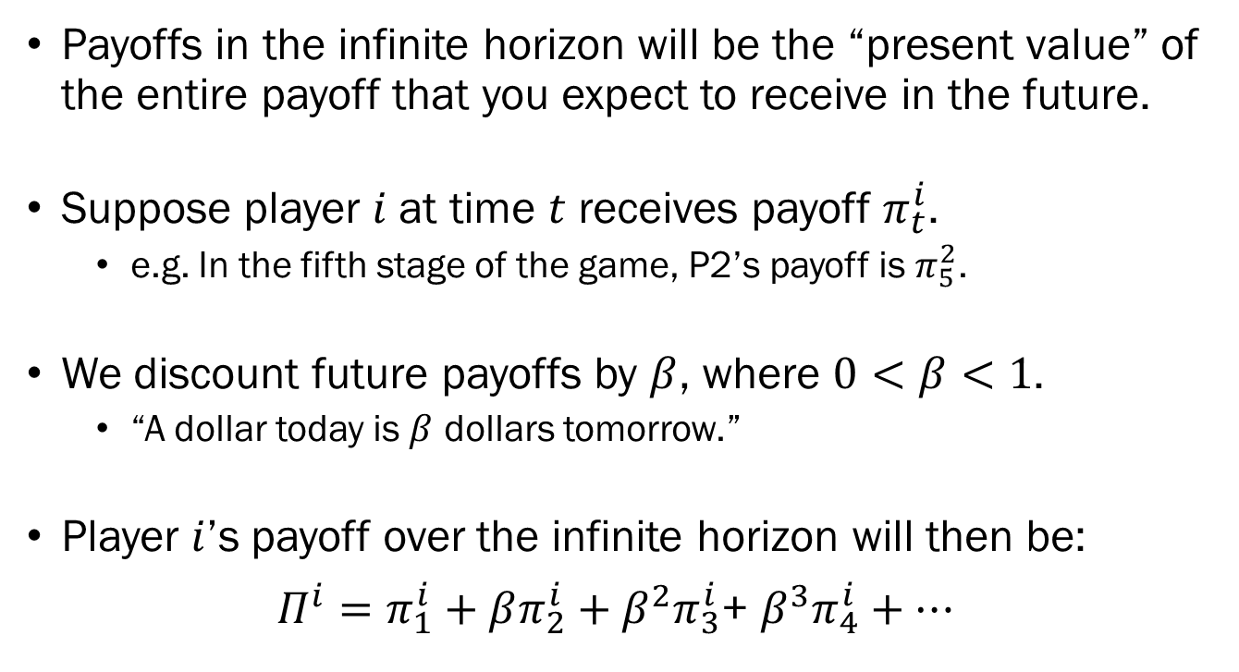
Payoffs in the Infinite Horizon
Payoffs in the infinite horizon will be the “present value” of the entire payoff that you expect to receive in the future.
Suppose player $i$ at time $t$ receives payoff $π_{t}^{i}$.
  e.g. In the fifth stage of the game, P2’s payoff is $π_{5}^{2}$.
We discount future payoffs by $β$, where $0<β<1$.
  “A dollar today is $β$ dollars tomorrow.”
Player $i$’s payoff over the infinite horizon will then be:
$Π^{i}=π_{1}^{i}+βπ_{2}^{i}+β^{2}π_{3}^{i}$+ $β^{3}π_{4}^{i}+⋯$

Slide 13
Payoffs Under the Trigger Strategy
Let’s imagine what the payoffs will be when one party adopts the trigger strategy in this infinitely repeated game.

Slide 14
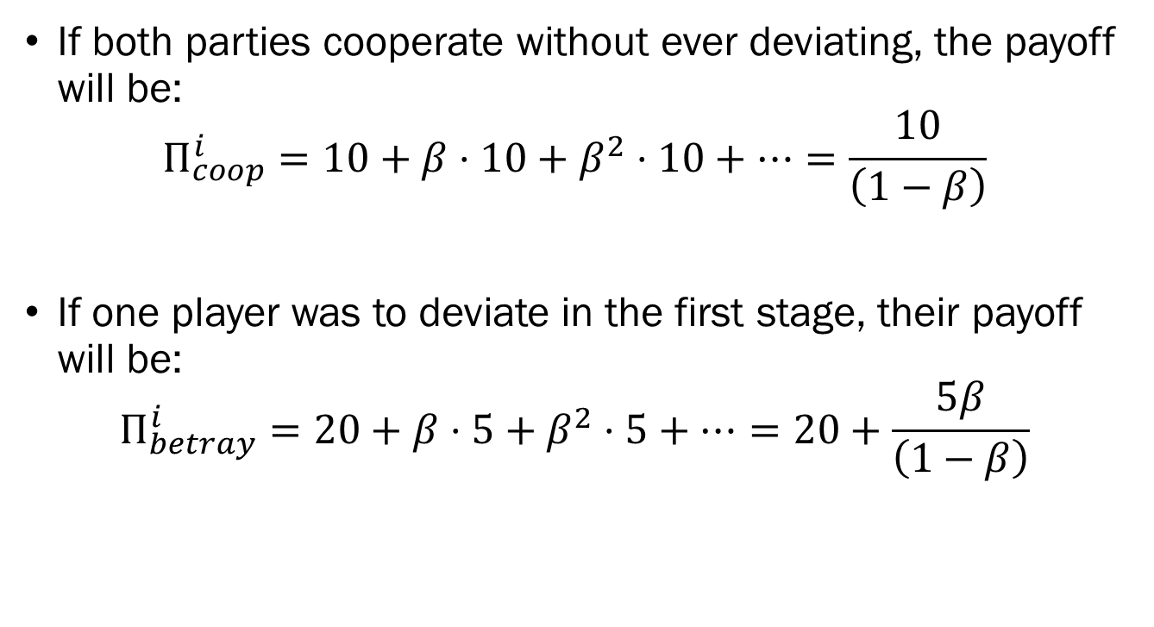
Payoffs Under the Trigger Strategy
If both parties cooperate without ever deviating, the payoff will be:
$$Π_{coop}^{i}=10+β⋅10+β^{2}⋅10+⋯=\frac{10}{\left(1−β\right)}$$
If one player was to deviate in the first stage, their payoff will be:
$$Π_{betray}^{i}=20+β⋅5+β^{2}⋅5+⋯=20+\frac{5β}{\left(1−β\right)}$$

Slide 15
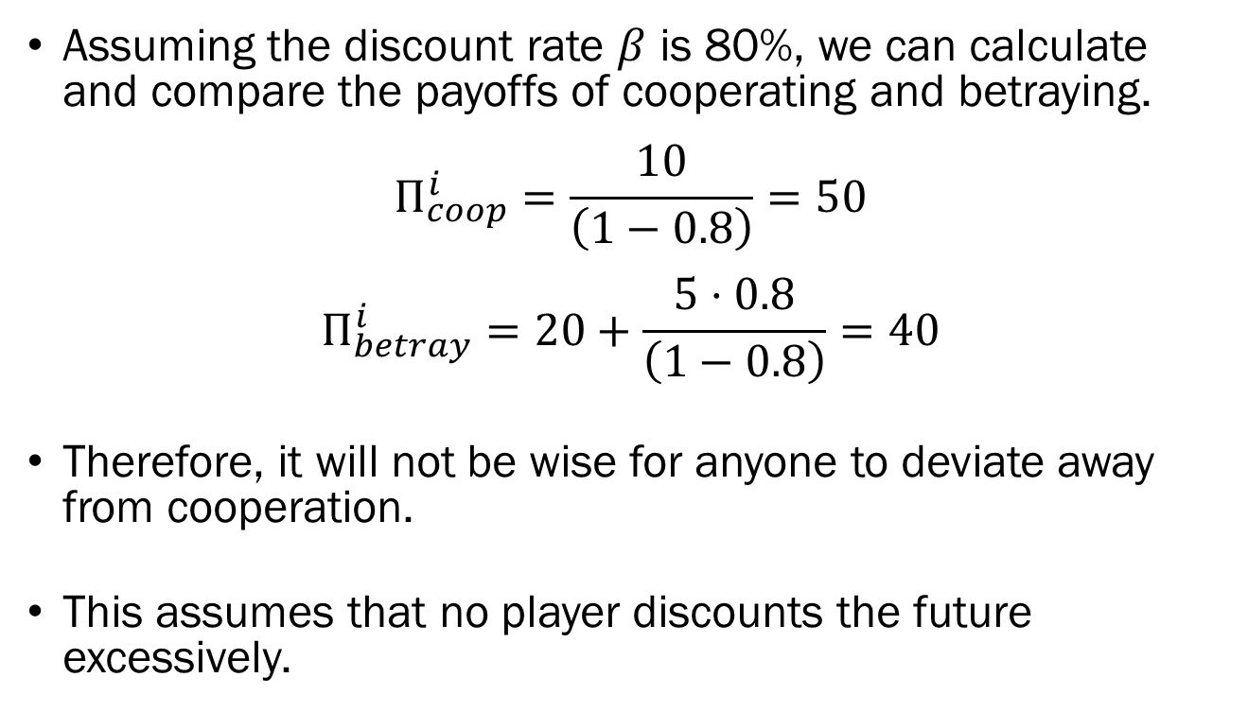
Payoffs Under the Trigger Strategy
Assuming the discount rate $β$ is 80%, we can calculate and compare the payoffs of cooperating and betraying.
$$Π_{coop}^{i}=\frac{10}{\left(1−0.8\right)}=50$$
$$Π_{betray}^{i}=20+\frac{5⋅0.8}{\left(1−0.8\right)}=40$$
Therefore, it will not be wise for anyone to deviate away from cooperation.
This assumes that no player discounts the future excessively.

Slide 16
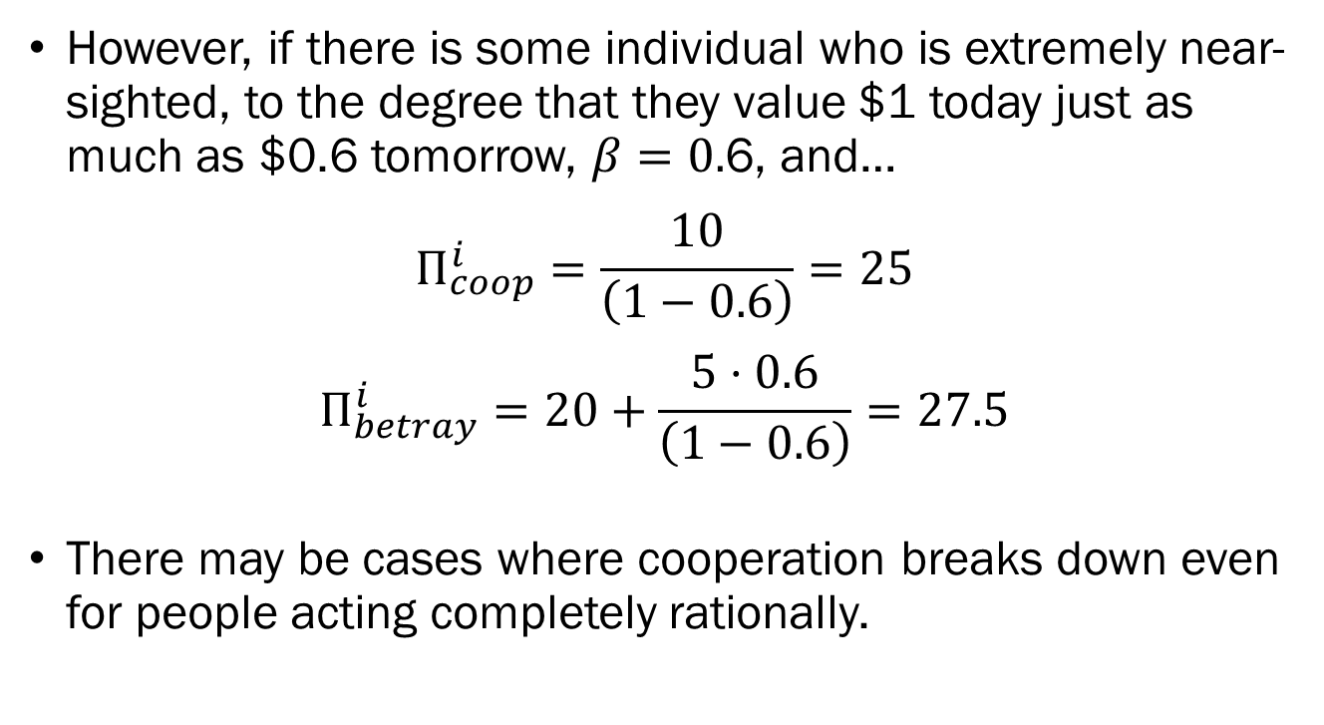
Payoffs Under the Trigger Strategy
However, if there is some individual who is extremely near-sighted, to the degree that they value $1 today just as much as $0.6 tomorrow, $β=0.$6, and…
$$Π_{coop}^{i}=\frac{10}{\left(1−0.6\right)}=25$$
$$Π_{betray}^{i}=20+\frac{5⋅0.6}{\left(1−0.6\right)}=27.5$$
There may be cases where cooperation breaks down even for people acting completely rationally.

Slide 17
Dynamic Games of
Complete Information
Up to this point, we have been considering situations in which all players make their moves simultaneously.
What happens when actions are sequential, where one player makes the first move, then the next player decides their action with the knowledge of the first mover’s action.
Let’s set up a simple example to see how we represent a dynamic game.

Slide 18
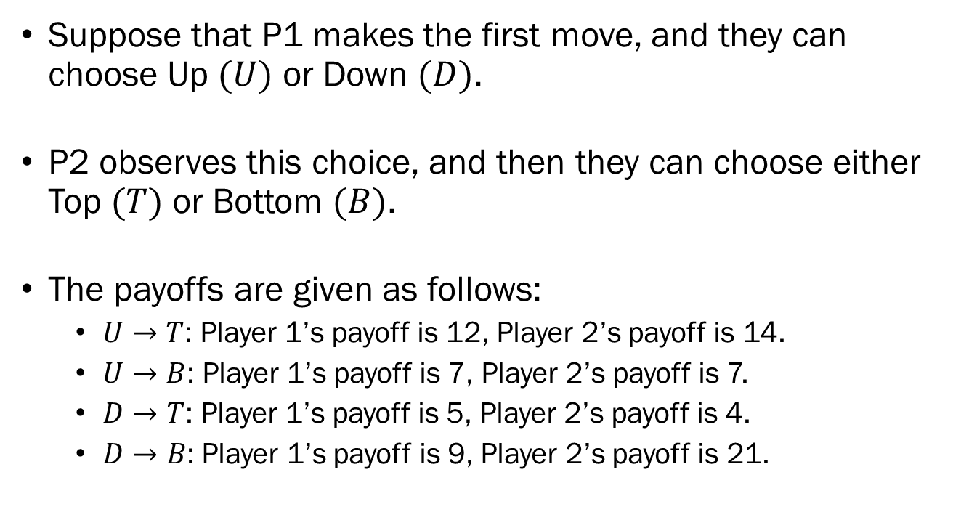
Dynamic Games of
Complete Information
Suppose that P1 makes the first move, and they can choose Up $(U)$ or Down $(D)$.
P2 observes this choice, and then they can choose either Top $(T)$ or Bottom $(B)$.
The payoffs are given as follows:
  $U→T$: Player 1’s payoff is 12, Player 2’s payoff is 14.
  $U→B$: Player 1’s payoff is 7, Player 2’s payoff is 7.
  $D→T$: Player 1’s payoff is 5, Player 2’s payoff is 4.
  $D→B\text{:}$ Player 1’s payoff is 9, Player 2’s payoff is 21.

Slide 19
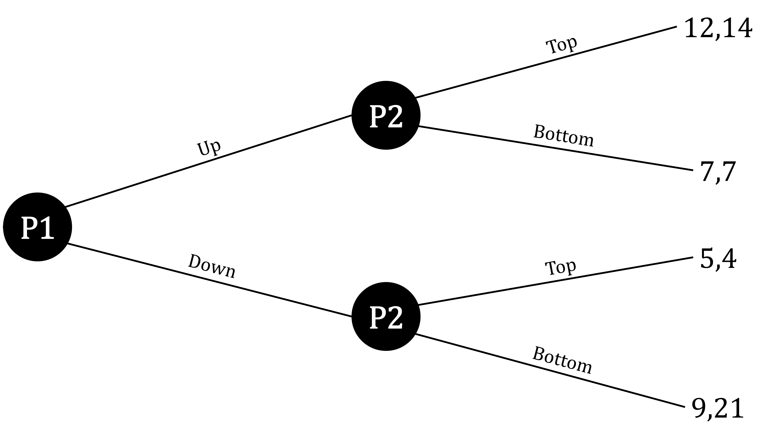
Dynamic Games of
Complete Information
Typically, we express dynamic games in its “extensive form,” which resembles a tree diagram.

Slide 20
Dynamic Games of
Complete Information
We can solve this problem using “backwards induction,” which means that we start from the very last node, and work our way back

Slide 21
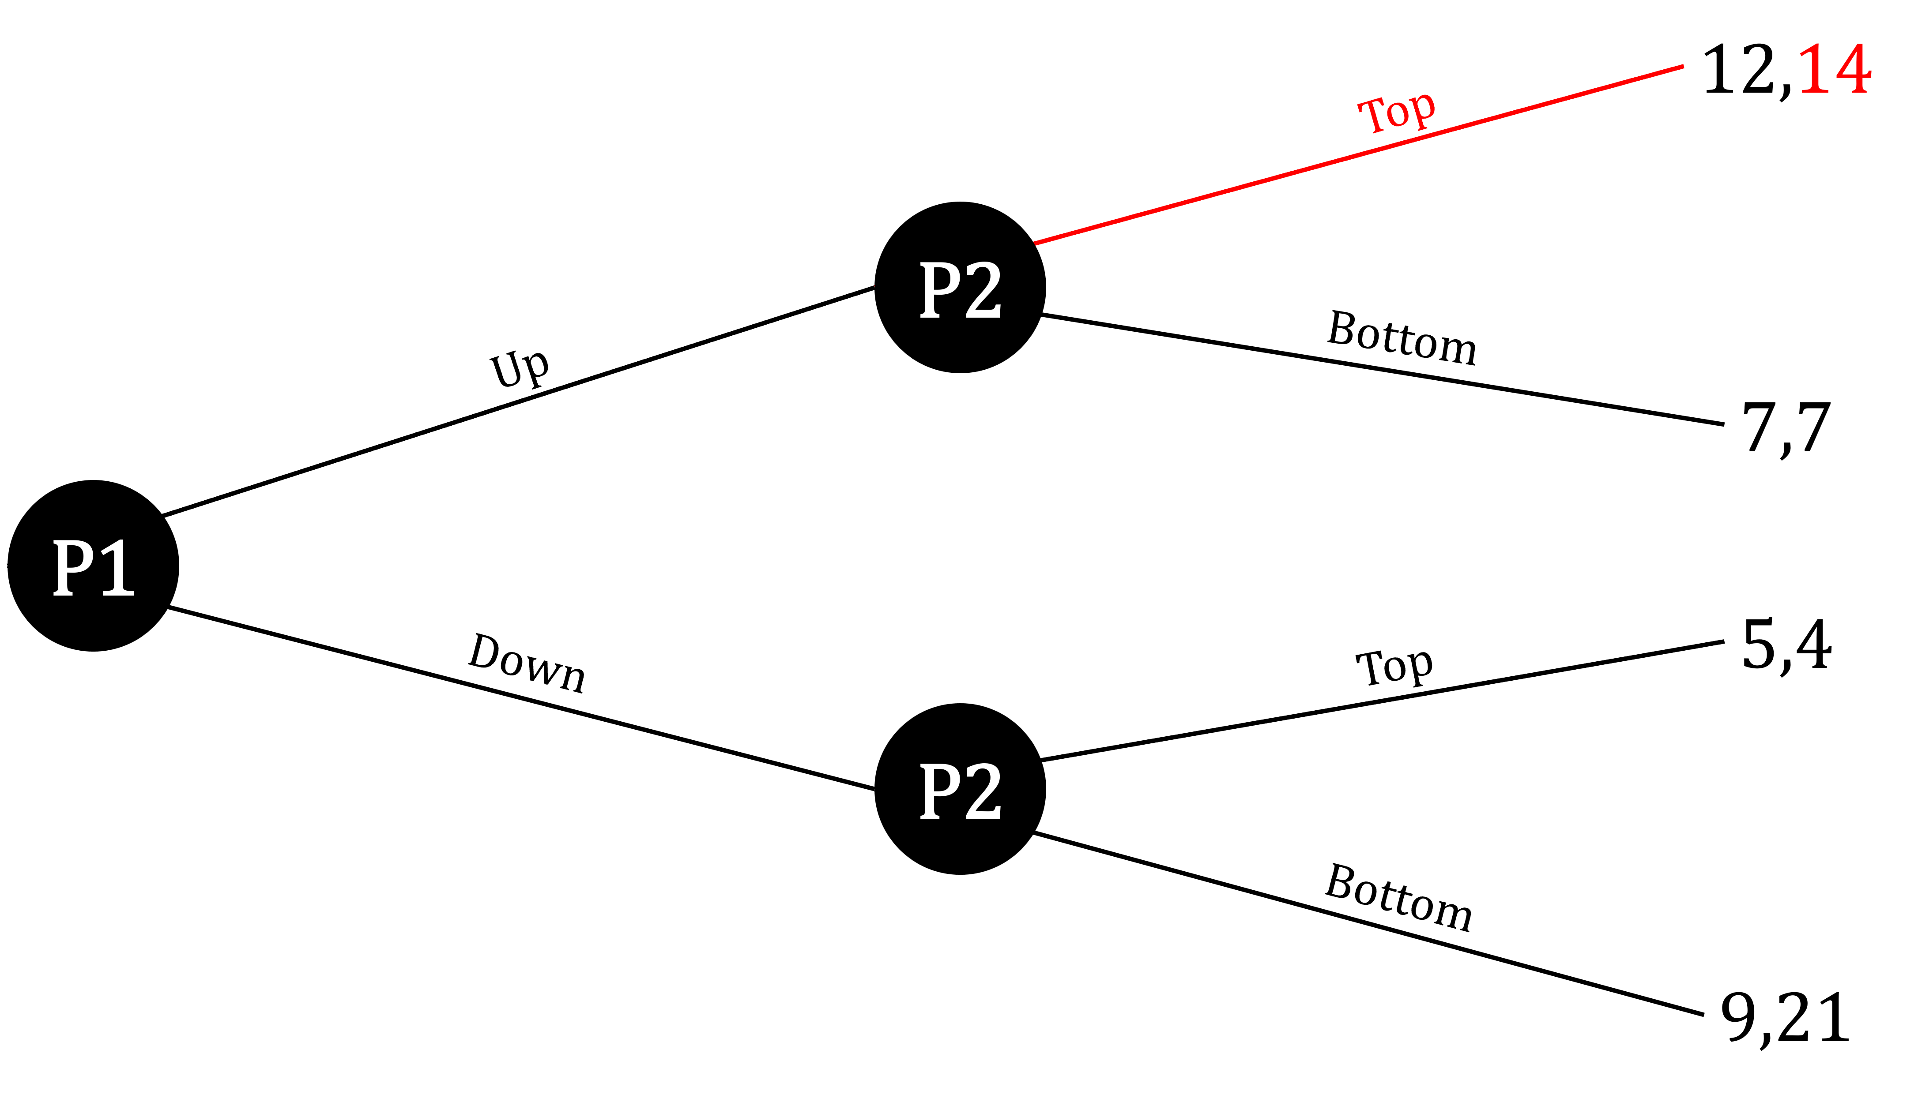

Dynamic Games of
Complete Information
If player 1 plays $U$, the best response from player 2 will be to play $T$. We will mark this choice down in the extensive form.

Slide 22
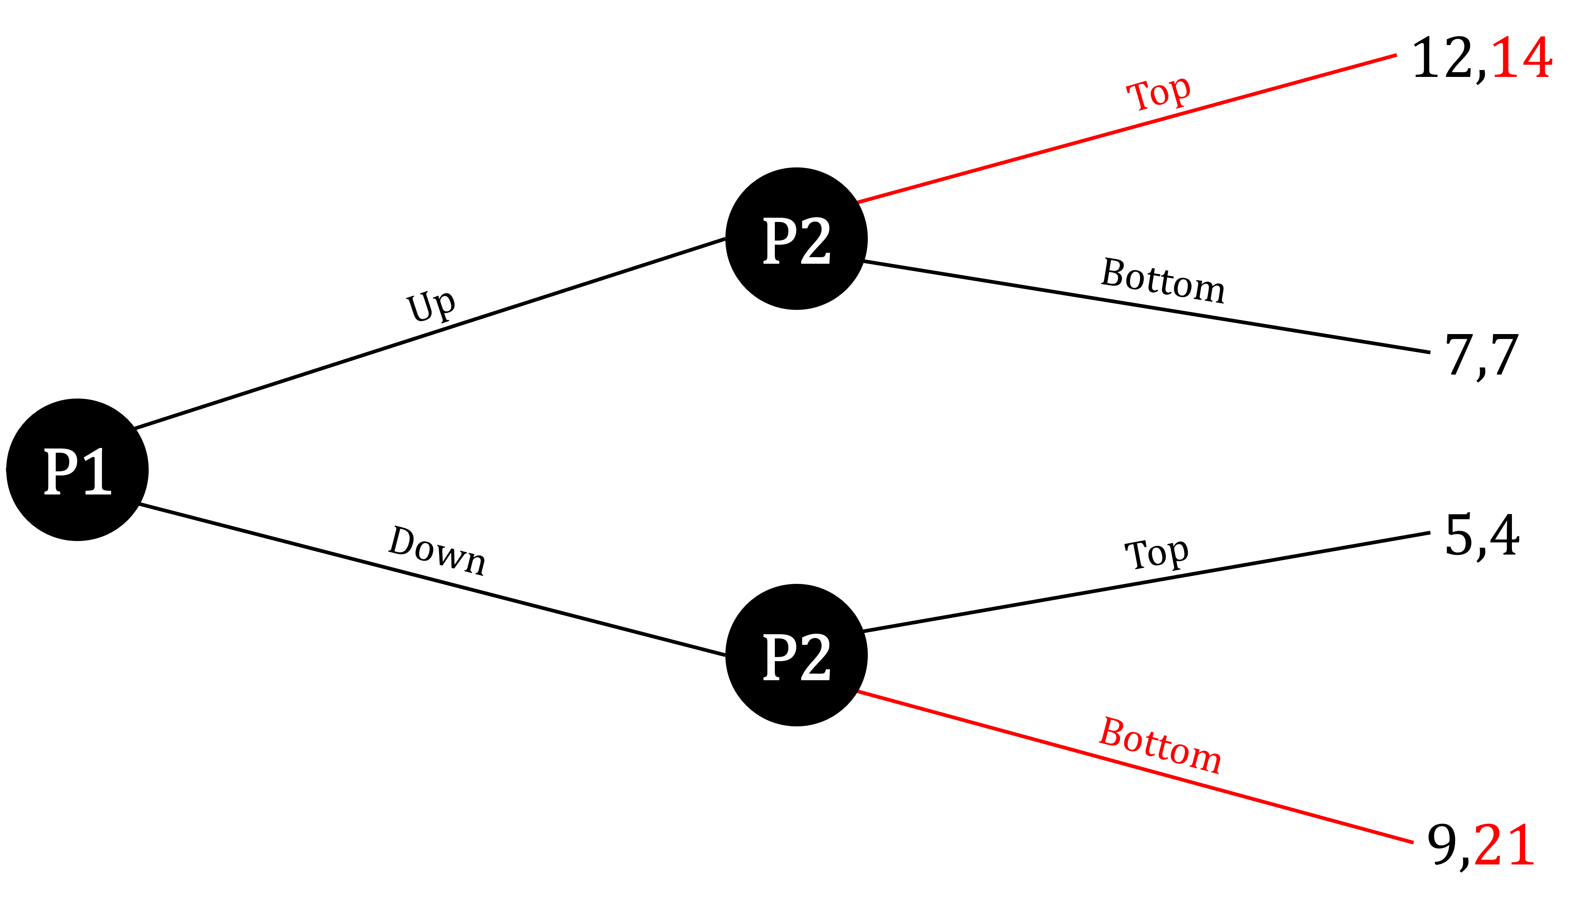

Dynamic Games of
Complete Information
If player 1 plays $D$, the best response from player 2 will be to play $B$. We will mark this choice down in the extensive form as well.

Slide 23

Dynamic Games of
Complete Information
So, player 2’s strategy would be “If P1 plays $U$, I play $T$. When P1 plays $D$, I play $B$.” We can write this down by stating P2’s strategy as $TB$.

Slide 24
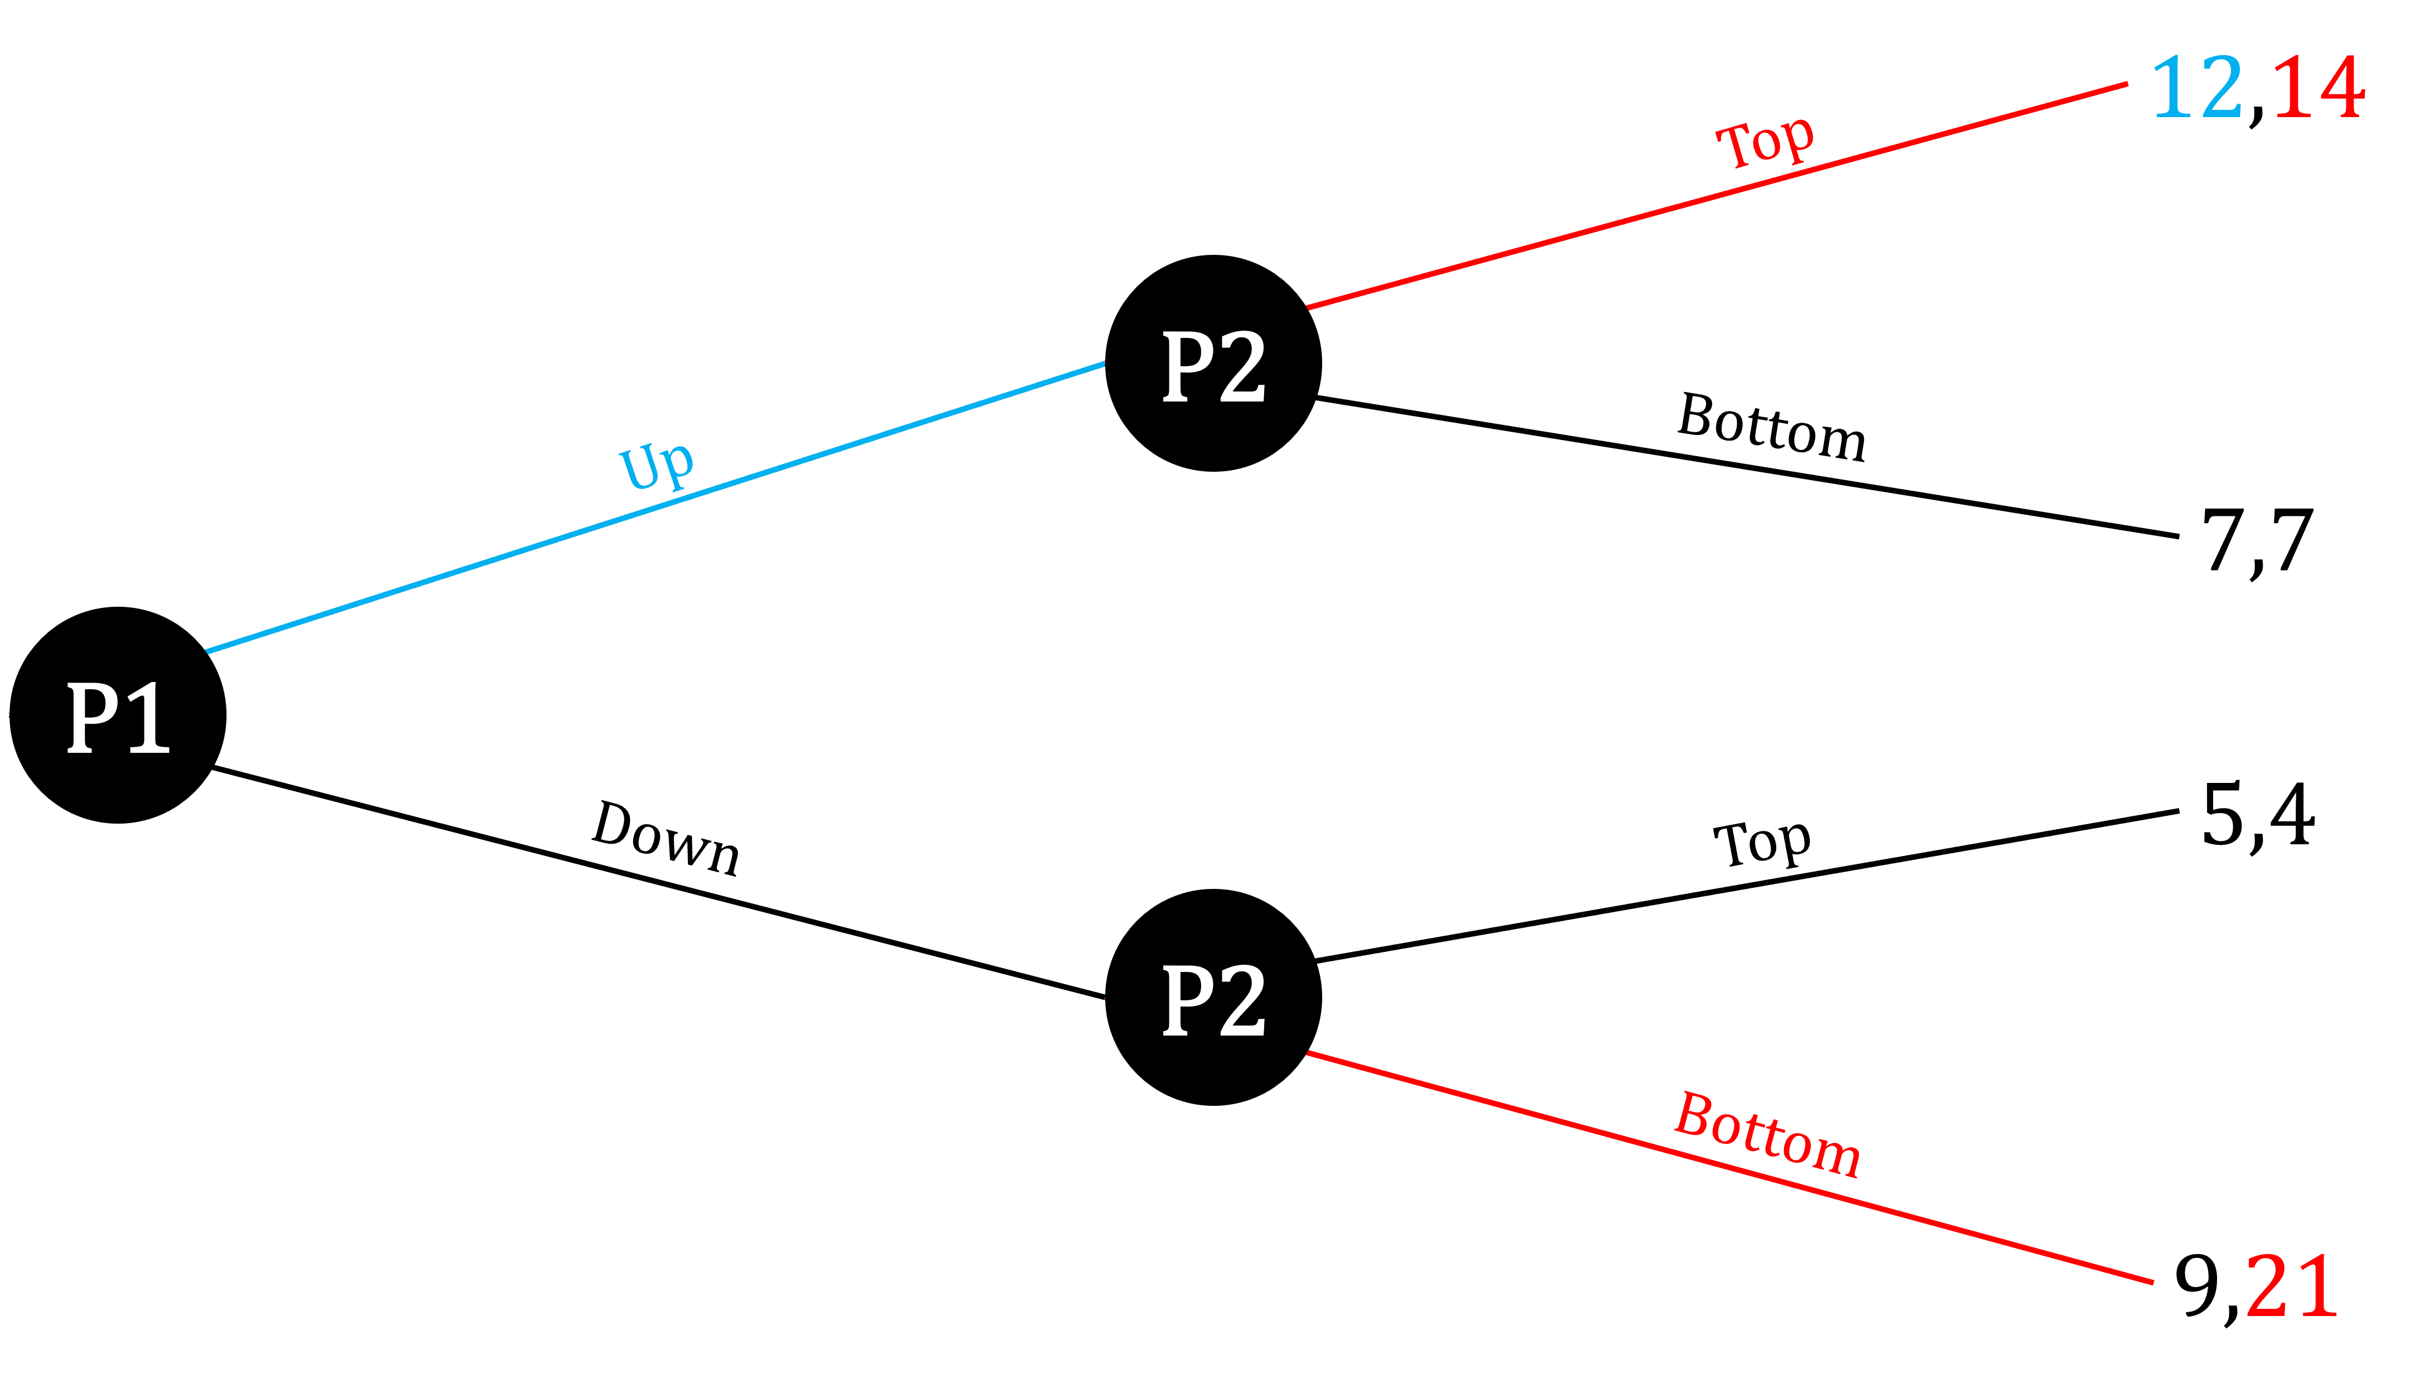

Dynamic Games of
Complete Information
Player 1 knows that if they play $U$, player 2 will play $T$. They also know that when they play $D$, player 2 will play $B$. Therefore player 1 should play $U$.

Slide 25

Dynamic Games of
Complete Information
Thus, the “Subgame Perfect” Nash Equilibrium in this case should be $SPNE=(U,TB)$.

Slide 26
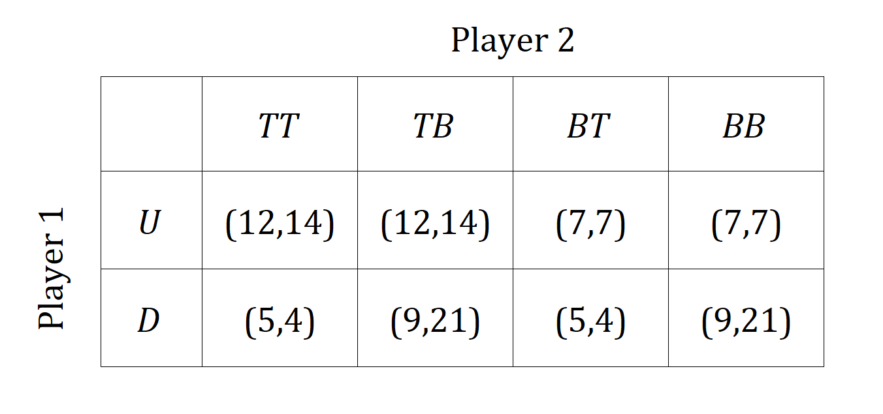
Dynamic Games of
Complete Information
Meanwhile, we can also break this down to its “normal form,” which resembles a table.

Slide 27
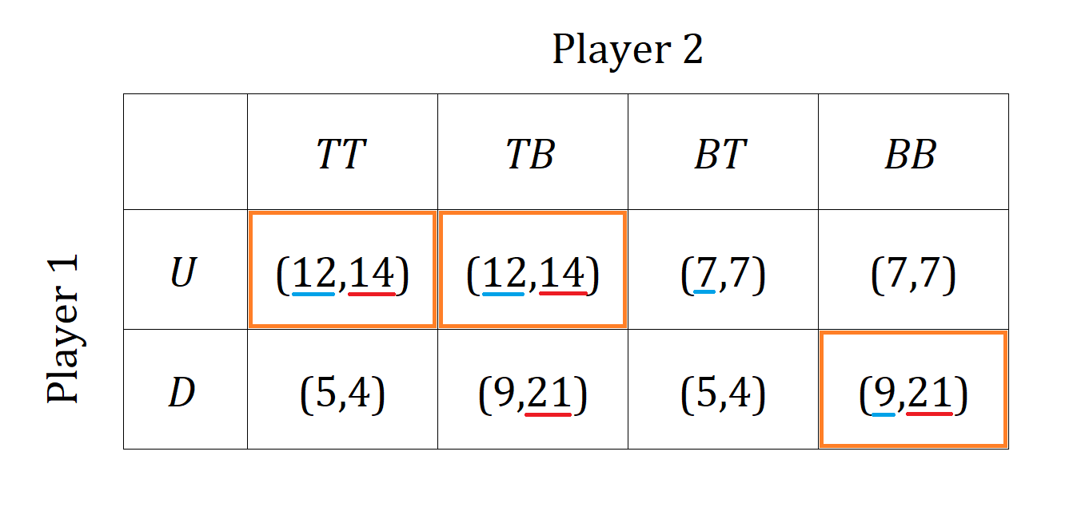

Dynamic Games of
Complete Information
Solving this table, we find three equilibria?
$$NE=\left(U,TT\right),\left(U,TB\right),(D,BB)$$

Slide 28
Example: Pirate Game
Group of 5 rational pirates A, B, C, D, and E found 100 gold coins, which they must distribute among themselves.
The pirates will take turns proposing a distribution starting from the most senior member, A.
  If the majority agrees, coins are distributed, and the game ends.
  If the majority rejects, the proposer walks the plank, and the pirate next in line becomes the proposer (alphabetic).
  Each pirate’s primary goal is to survive, while getting as much gold as possible.
  All else equal (unless they get more gold), pirates will reject a proposal.
  No collusion or coordination between pirates.

Slide 29
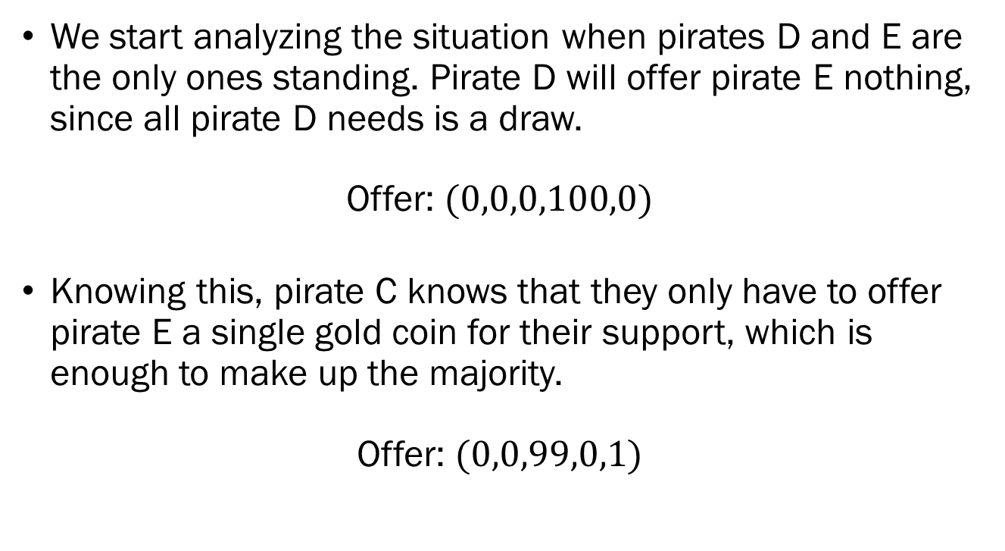
Example: Pirate Game
We start analyzing the situation when pirates D and E are the only ones standing. Pirate D will offer pirate E nothing, since all pirate D needs is a draw.
Offer: $(0,0,0,100,0)$
Knowing this, pirate C knows that they only have to offer pirate E a single gold coin for their support, which is enough to make up the majority.
Offer: $(0,0,99,0,1)$

Slide 30
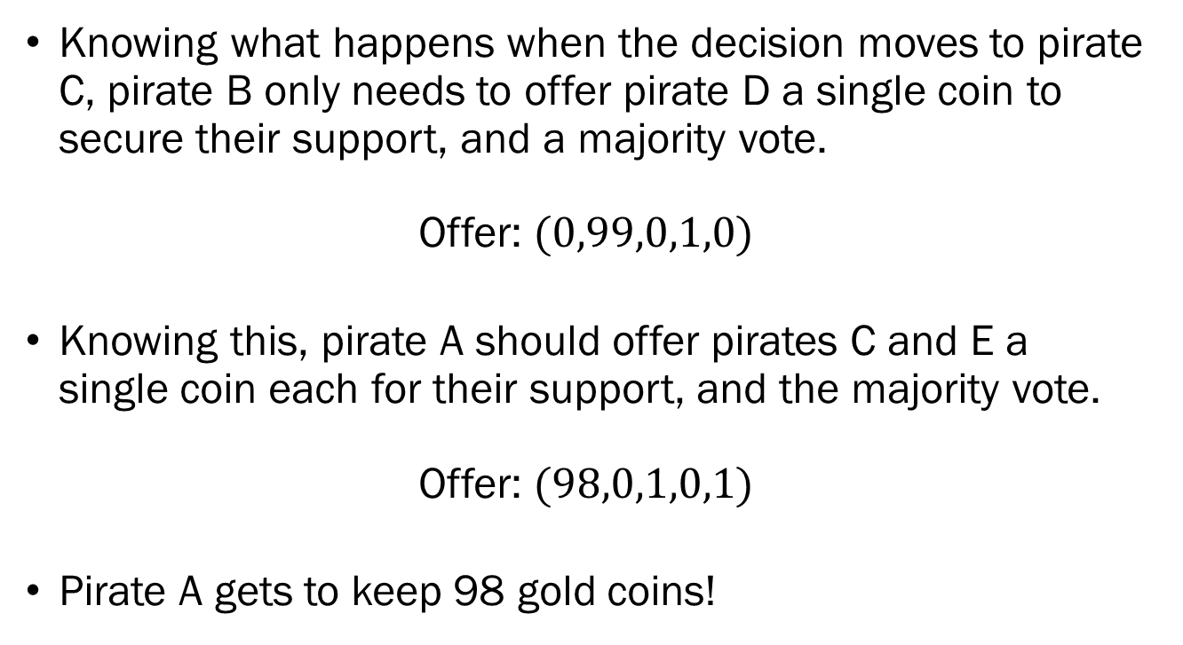
Example: Pirate Game
Knowing what happens when the decision moves to pirate C, pirate B only needs to offer pirate D a single coin to secure their support, and a majority vote.
Offer: $(0,99,0,1,0)$
Knowing this, pirate A should offer pirates C and E a single coin each for their support, and the majority vote.
Offer: $(98,0,1,0,1)$
Pirate A gets to keep 98 gold coins!

