Slide 1
Market Analysis: Taxes and Subsidies
ECON 300

Slide 2
Last Lecture
The concept of supply and demand.
Defined consumer and producer surplus.
Consumer Surplus: Willingness to Pay – Actual Price.
Producer Surplus: Willingness to Accept – Actual Price.
Examined the effect of price controls.
Binding / Non-binding Interventions.
Surplus / Shortage in the market.
Actual Amount Traded in the Market.
Deadweight Loss of Interventions.

Slide 3
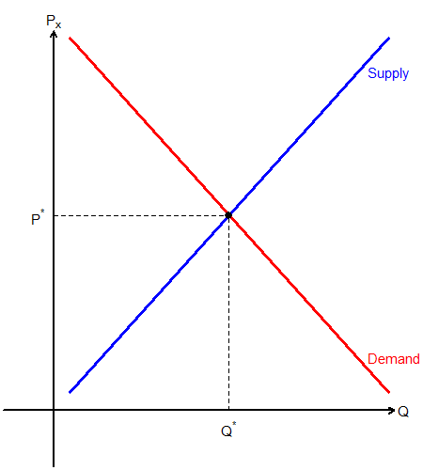
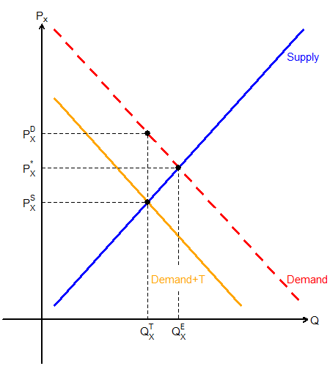
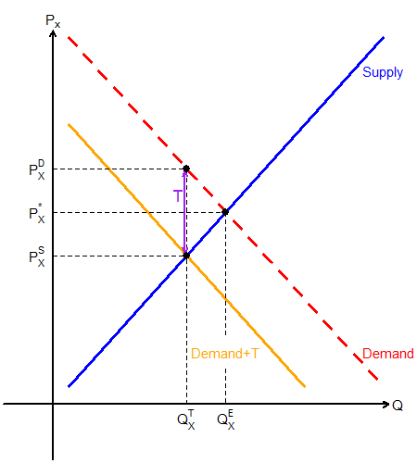
Per Unit Fixed Amount Tax
Suppose the government sets a $\$T$ tax per unit sold.
The number of units traded in the market is $Q_{x}^{T}$.
The consumer pays $P_{x}^{D}$.
The producer gets $P_{x}^{S}$.
$P_{x}^{D}−P_{x}^{S}=T$

Slide 4
Finding Market Equilibrium Under Per Unit Fixed Dollar Tax
Continue from the previous question:
Market Demand: $Q_{x}^{D}=100−2P_{x}$
Market Supply: $Q_{x}^{S}=20+2P_{x}$
Fixed Per Unit Tax: $T=10$
Set up the problem by noting that $P_{x}^{D}=P_{x}^{S}+T$.
The market is in equilibrium when $Q_{x}^{D}=Q_{x}^{S}$
$$100−2P_{x}^{D}=20+2P_{x}^{S} ⟹100−2(P_{x}^{S}+10)=20+2P_{x}^{S}$$
$⟹80−2P_{x}^{S}=20+2P_{x}^{S}$
$⟹4P_{x}^{S}=60$
$⟹P_{x}^{S}=15$

Slide 5
Finding Market Equilibrium Under Per Unit Fixed Dollar Tax
Continue from the previous question:
Market Demand: $Q_{x}^{D}=100−2P_{x}$
Market Supply: $Q_{x}^{S}=20+2P_{x}$
Fixed Per Unit Tax: $T=10$
Since $P_{x}^{S}=15$, and $P_{x}^{D}=P_{x}^{S}+T$, we find that $P_{x}^{D}=25$.
Since $P_{x}^{S}=15$, use the supply function to find $Q_{x}^{T}$.
$$Q_{x}^{S}=20+2P_{x} ⟹ Q_{x}^{S}=20+2⋅15 ⟹ {Q_{x}^{S}=Q}_{x}^{T}=50$$

Slide 6
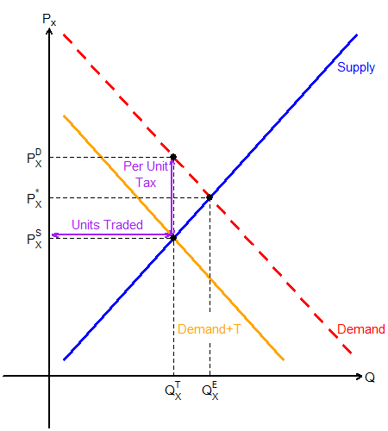
Per Unit Fixed Amount Tax
Taxation also causes some deadweight loss,
However, it will generate some revenue for the government (GR).
The government will collect $T⋅Q_{x}^{T}$ amount as revenue.
Per unit tax multiplied by the # Units Traded

Slide 7
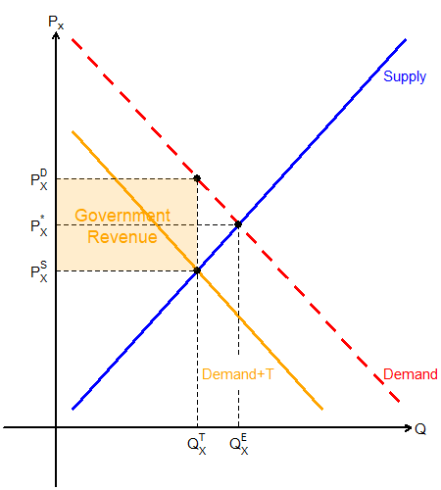
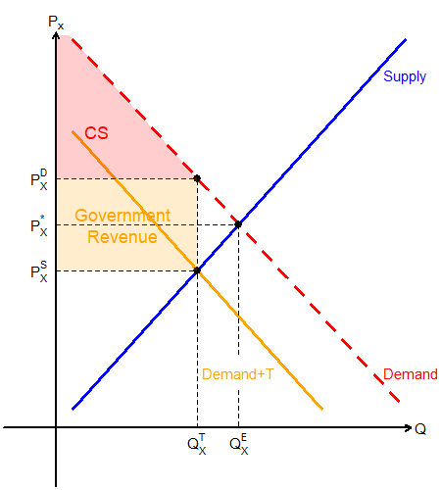
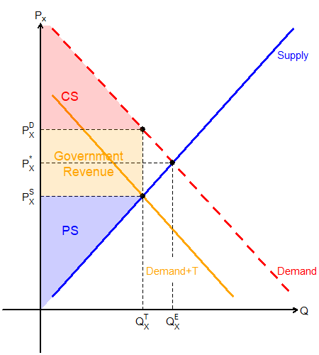
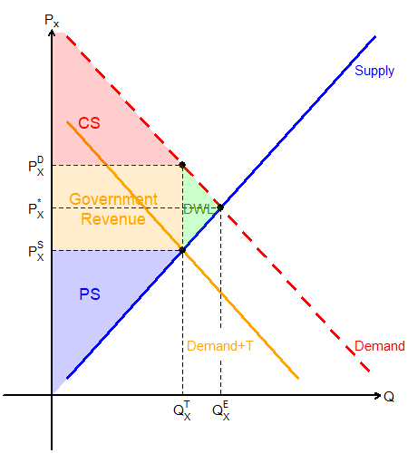
Per Unit Fixed Amount Tax
Government revenue is the orange rectangle.
Consumer surplus is the red triangle.
Producer surplus is the blue triangle.
Deadweight loss is the green triangle.

Slide 8
Why Tax the Market?
Suppose that the government’s goal is to regulate the consumption of certain goods that are harmful.
While they know that there will be deadweight loss due to intervention, they may be able to justify stepping in.
The government may use taxation as a tool to nudge the market to trade less of this good.
Unlike price control, this also generates revenue for the government to use in other affairs.

Slide 9
Taxation to Curb Consumption
Continue from the previous question:
Market Demand: $Q_{x}^{D}=100−2P_{x}$
Market Supply: $Q_{x}^{S}=20+2P_{x}$
Target Consumption Level: $Q_{x}^{Opt}=40$
Set up the problem by noting that $P_{x}^{D}=P_{x}^{S}+T$.
Set up two equations and two unknowns:
$$100−2P_{x}^{D}=40$$
$$20+2P_{x}^{S}=40$$

Slide 10
Taxation to Curb Consumption
Continue from the previous question:
Market Demand: $Q_{x}^{D}=100−2P_{x}$
Market Supply: $Q_{x}^{S}=20+2P_{x}$
Target Consumption Level: $Q_{x}^{Opt}=40$
Apply the price difference between demand and supply:
Demand: $100−2(P_{x}^{S}+T)=40$
Supply: $20+2P_{x}^{S}=40$
Solve the two equations & two unknowns:
$$T=20$$

Slide 11
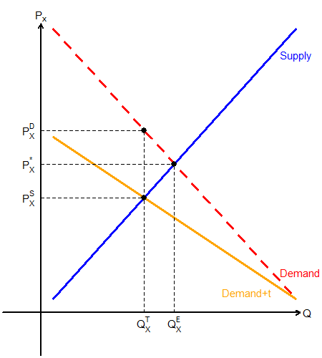
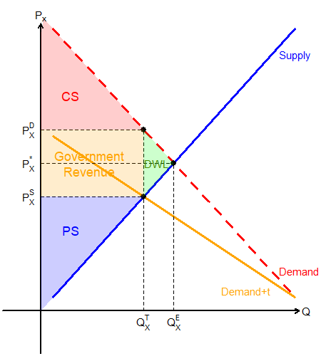
Per Unit % Tax
Suppose the government sets a $t\%$ tax per unit sold.
The number of units traded in the market is $Q_{x}^{T}$.
The consumer pays $P_{x}^{D}$.
The producer gets $P_{x}^{S}$.
$P_{x}^{D}=P_{x}^{S}(1+t)$

Slide 12
Finding Market Equilibrium Under Per Unit Fixed Percentage Tax
Continue from the previous question:
Market Demand: $Q_{x}^{D}=100−2P_{x}$
Market Supply: $Q_{x}^{S}=20+2P_{x}$
Tax Rate: $t=20\%$
Set up the problem by noting that $P_{x}^{D}=P_{x}^{S}\left(1+0.2\right)=1.2P_{x}^{S}$.
The market is in equilibrium when $Q_{x}^{D}=Q_{x}^{S}$
$$100−2P_{x}^{D}=20+2P_{x}^{S} ⟹100−2(1.2P_{x}^{S})=20+2P_{x}^{S}$$
$⟹100−2.4P_{x}^{S}=20+2P_{x}^{S}$
$⟹4.4P_{x}^{S}=80$
$⟹P_{x}^{S}=\frac{80}{4.4}≈18.18$

Slide 13
Finding Market Equilibrium Under Per Unit Fixed Percentage Tax
Continue from the previous question:
Market Demand: $Q_{x}^{D}=100−2P_{x}$
Market Supply: $Q_{x}^{S}=20+2P_{x}$
Tax Rate: $t=20\%$
Since $P_{x}^{S}=\frac{80}{4.4}$, and $P_{x}^{D}=1.2P_{x}^{S}$, we find that $P_{x}^{D}≈21.81$.
Since $P_{x}^{S}=\frac{80}{4.4}$, use the supply function to find $Q_{x}^{T}$.
$$Q_{x}^{S}=20+2P_{x} ⟹ Q_{x}^{S}=20+2⋅\frac{80}{4.4} ⟹ {Q_{x}^{S}=Q}_{x}^{T}≈56.36$$

Slide 14
Burdens from Taxation
When the government imposes tax, the consumers and producers both share the “burden.”
The consumers pay higher prices, and the producers receive lower prices.
The consumer’s burden is the share of the government’s revenue that is “paid by” the consumers.
Conversely, the producer’s burden is the share of the government’s revenue that is “paid by” the producers.

Slide 15
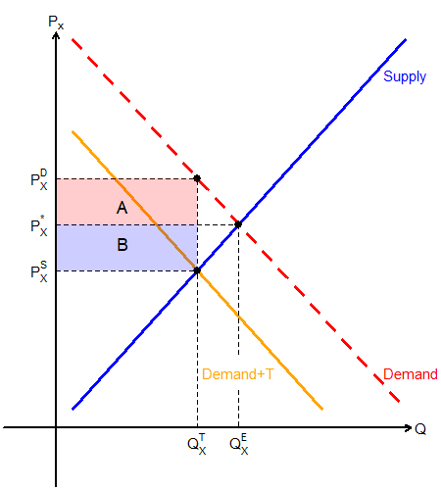
Burdens from Taxation
$A+B$ is the government’s revenue and is “paid for” by the consumer and producers.
The consumer’s burden is $A/(A+B)$
The producer’s burden is $B/(A+B)$

Slide 16
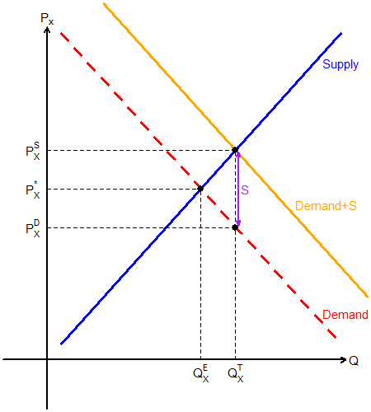
Per Unit Fixed Amount Subsidies
Government subsidizes the producer / consumer by a certain dollar amount $\$S$ for each sale / purchase.
$P_{x}^{S}−P_{x}^{D}=S$
Promotes the consumption of certain goods.
Example: EV Incentives

Slide 17
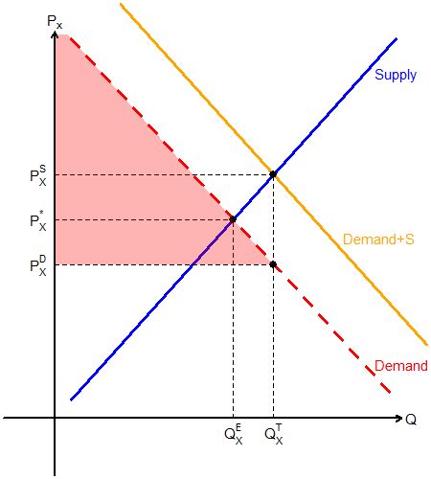
Per Unit Fixed Amount Subsidies
The consumer pays along the demand curve at $P_{x}^{D}$.
The amount traded in the market is $Q_{x}^{T}$.
Consumer surplus can be represented by the red triangle.

Slide 18
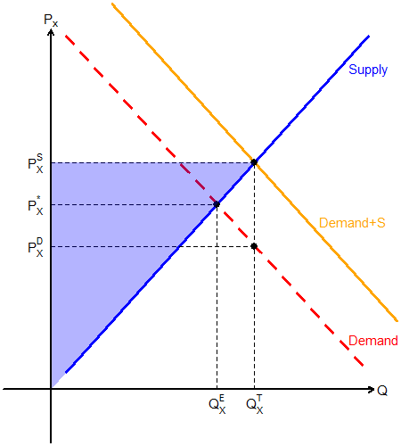
Per Unit Fixed Amount Subsidies
The producer collects along the supply curve: $P_{x}^{S}$
The amount traded in the market is $Q_{x}^{T}$.
Producer surplus can be represented by the blue triangle.

Slide 19
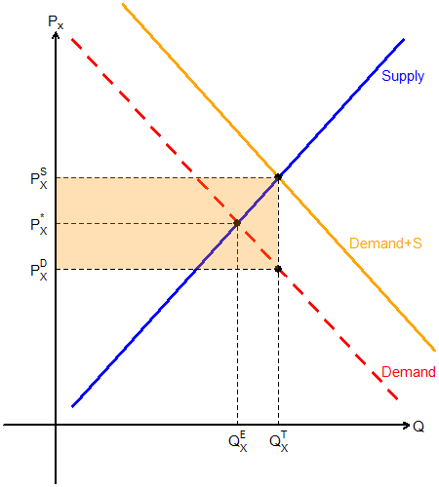
Per Unit Fixed Amount Subsidies
The per unit $S$ subsidies is paid by government spending.
The amount traded in the market is $Q_{x}^{T}$.
The government’s spending can be represented by the orange rectangle.

Slide 20
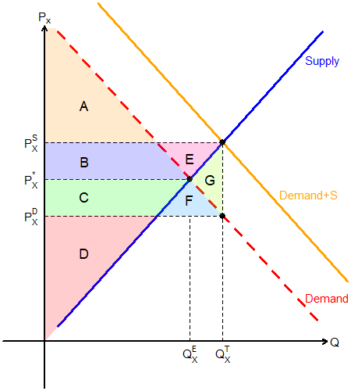
Per Unit Fixed Amount Subsidies
Consumer Surplus: A+B+C+F
Producer Surplus: B+C+D+E
Government Expenditure: B+C+E+F+G
Deadweight Loss: G

Slide 21
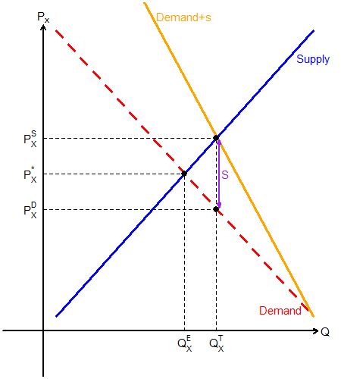
Per Unit % Subsidies
Like the case of taxation, subsidies may also be provided as a $s\%$ of the unit price.
The amount that the consumer pays is less than what the producer receives.
$P_{x}^{S}=P_{x}^{D}(1+s)$

Slide 22
Benefits from Subsidies
When the government grants subsidies, both the consumers and producers will reap some benefits.
The consumers pay lower prices, and the producers receive higher prices.
The consumer’s benefit is the share of the government’s expenditure that is “soaked up by” the consumers.
The producer’s benefit is the share of the government’s expenditure that is “soaked up by” the producers.

Slide 23
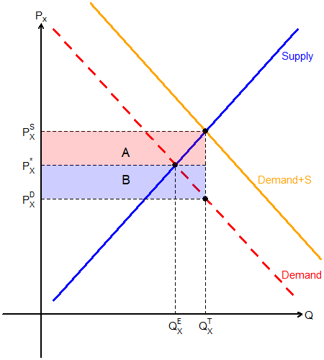
Benefits from Subsidies
$A+B$ is the government’s expenditure, absorbed by the consumers and producers.
The consumer’s benefit is $B/(A+B)$
The producer’s benefit is $A/(A+B)$

Slide 24
Burdens and Benefits and Elasticity
The own price elasticity of demand and supply will determine how much of the burden lies on the consumer and producer.
Conversely, elasticity will also inform us how much of the benefits from subsidies are absorbed by the consumers and producers.
The more elastic the demand compared to supply…
The consumers will bear a lower burden, and
The consumers will reap greater benefits.

Slide 25
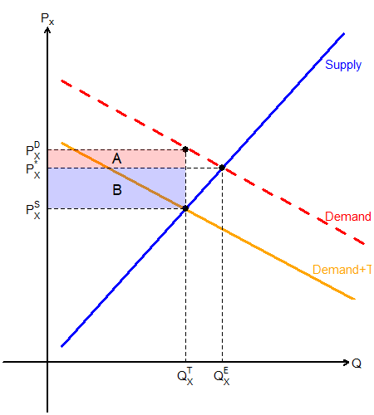
Elasticities and Burden Sharing
Less Elastic Demand
More Elastic Demand

