Slide 1
Producer Theory:
Production Technology
ECON 300

Slide 2

PollEv.com/brianpark046

Slide 3
Production
We covered consumer theory in three large “parts.”
  Examined the consumer’s budget constraint.
  Model the consumer’s preferences.
  Combined the two parts to find the utility maximizing consumer’s choice.
The producer’s theory also consists of three large “parts.”
  Model the producer’s production technology.
  Account for costs of production.
  Determine the optimal mix of inputs for production.
We start by talking about production technology.

Slide 4
Production
Suppose that we want to become producers of Monmouth College branded pencils.
Ignoring production costs for a moment, what are some questions we need to answer?
What are the required inputs?
How do we combine these inputs to create output?
How much of each input do we need?

Slide 5
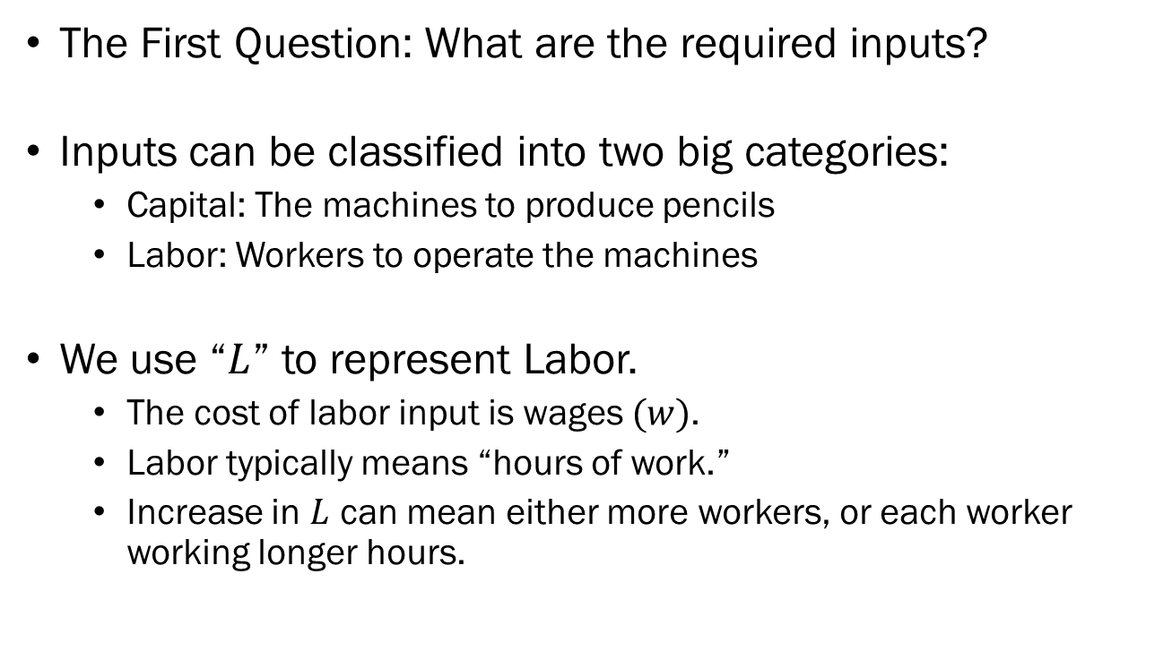
Factors of Production
The First Question: What are the required inputs?
Inputs can be classified into two big categories:
  Capital: The machines to produce pencils
  Labor: Workers to operate the machines
We use “$L$” to represent Labor.
  The cost of labor input is wages $(w)$.
  Labor typically means “hours of work.”
  Increase in $L$ can mean either more workers, or each worker working longer hours.

Slide 6

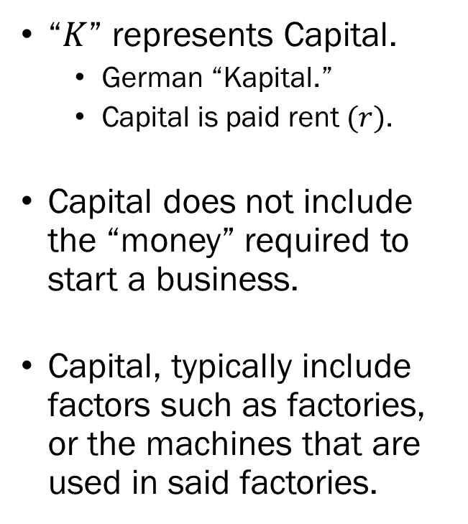
Factors of Production
“$K$” represents Capital.
  German “Kapital.”
  Capital is paid rent $(r)$.
Capital does not include the “money” required to start a business.
Capital, typically include factors such as factories, or the machines that are used in said factories.

Slide 7
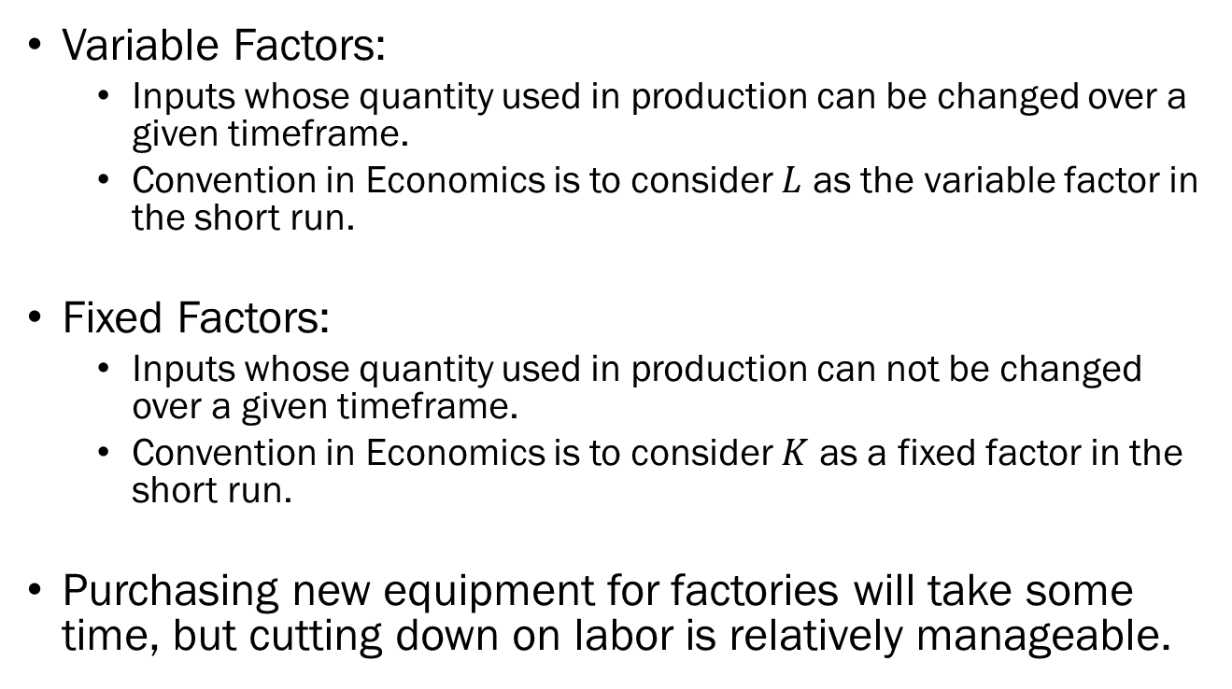
Variable and Fixed Factors
Variable Factors:
  Inputs whose quantity used in production can be changed over a given timeframe.
  Convention in Economics is to consider $L$ as the variable factor in the short run.
Fixed Factors:
  Inputs whose quantity used in production can not be changed over a given timeframe.
  Convention in Economics is to consider $K$ as a fixed factor in the short run.
Purchasing new equipment for factories will take some time, but cutting down on labor is relatively manageable.

Slide 8
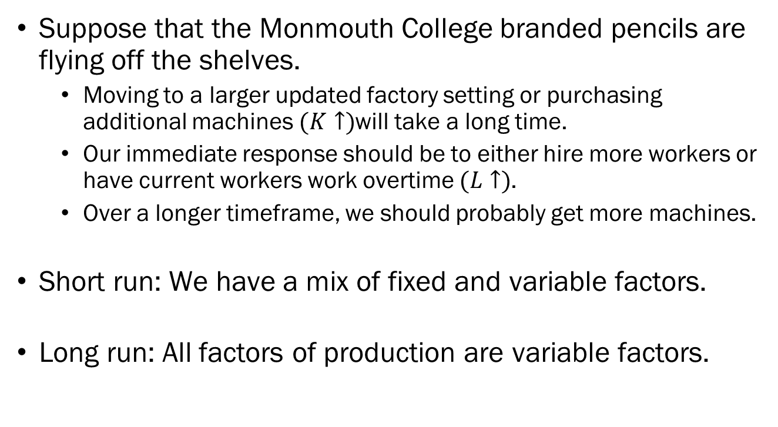
The Short Run and the Long Run
Suppose that the Monmouth College branded pencils are flying off the shelves.
  Moving to a larger updated factory setting or purchasing additional machines $(K↑)$will take a long time.
  Our immediate response should be to either hire more workers or have current workers work overtime $(L↑)$.
  Over a longer timeframe, we should probably get more machines.
Short run: We have a mix of fixed and variable factors.
Long run: All factors of production are variable factors.

Slide 9
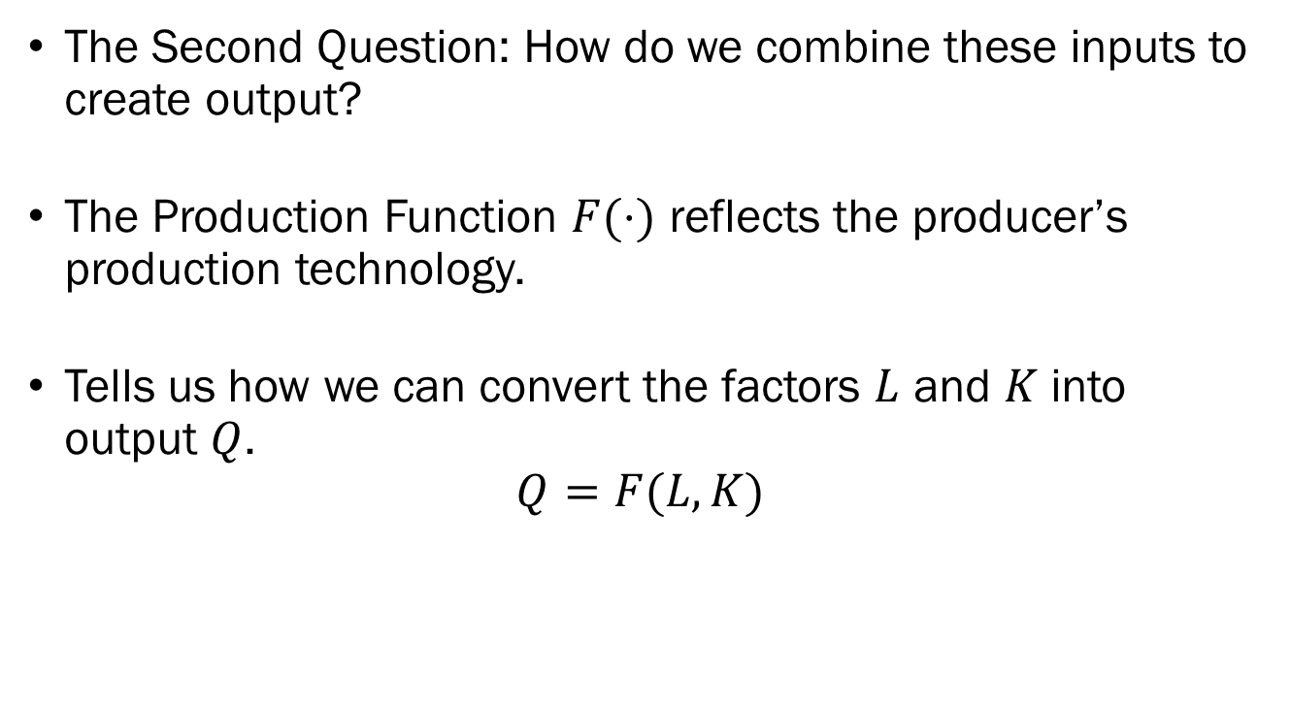
Production Function
The Second Question: How do we combine these inputs to create output?
The Production Function $F(⋅)$ reflects the producer’s production technology.
Tells us how we can convert the factors $L$ and $K$ into output $Q$.
$$Q=F(L,K)$$

Slide 10
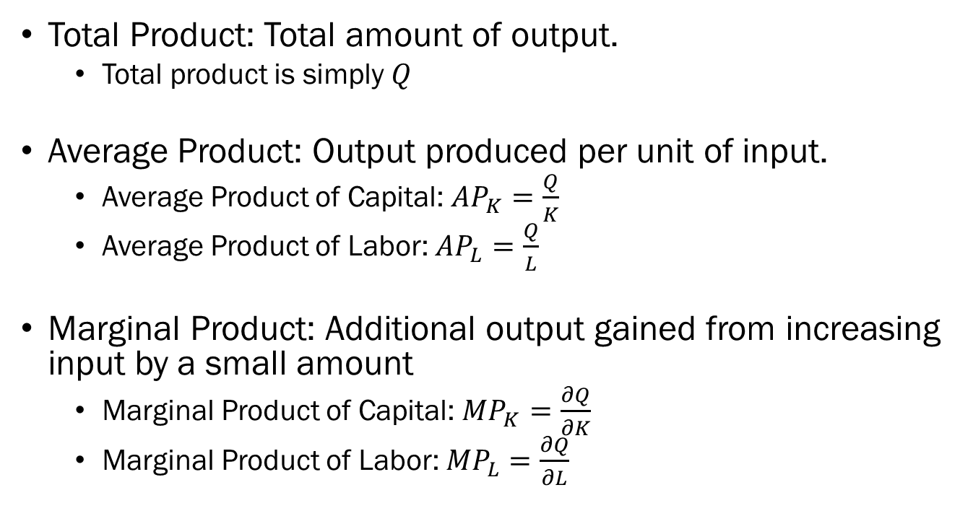
Production Function
Total Product: Total amount of output.
  Total product is simply $Q$
Average Product: Output produced per unit of input.
  Average Product of Capital: $AP_{K}=\frac{Q}{K}$
  Average Product of Labor: ${AP}_{L}=\frac{Q}{L}$
Marginal Product: Additional output gained from increasing input by a small amount
  Marginal Product of Capital: $MP_{K}=\frac{∂Q}{∂K}$
  Marginal Product of Labor: ${MP}_{L}=\frac{∂Q}{∂L}$

Slide 11
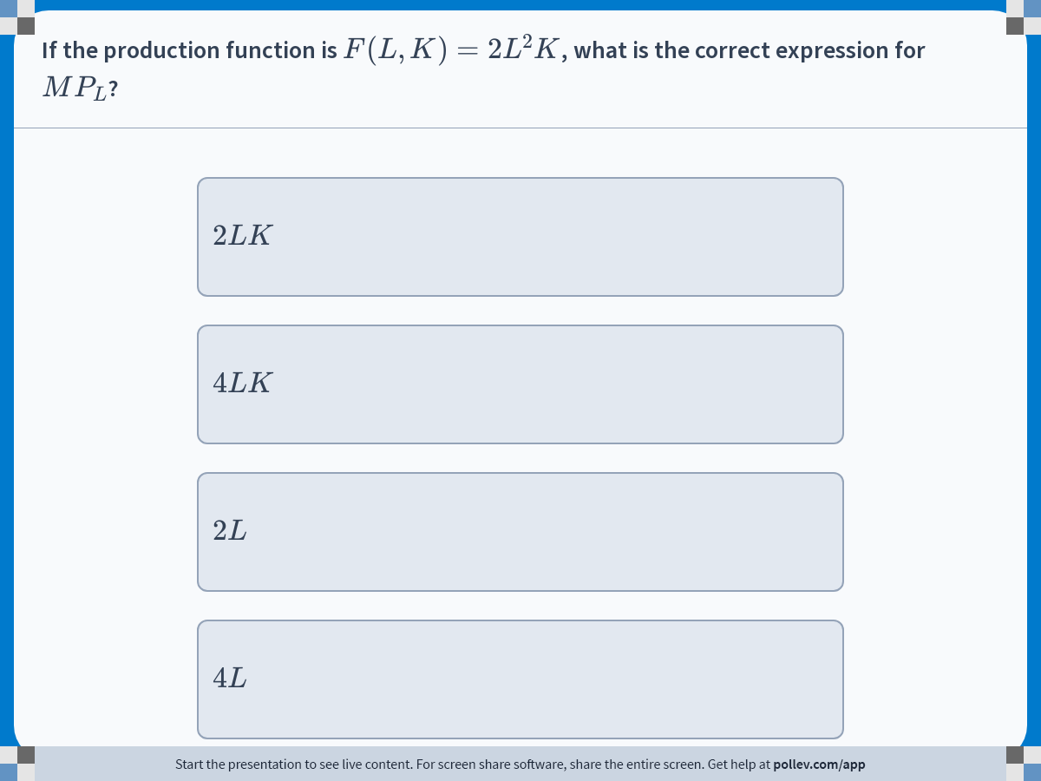
Notes:
Poll Title: Do not modify the notes in this section to avoid tampering with the Poll Everywhere activity.
More info at polleverywhere.com/support
If the production function is $$F(L,K)=2L^2K$$, what is the correct expression for $$MP_L$$?
https://www.polleverywhere.com/multiple_choice_polls/9mjs5QteI5GkBSftzPQ3d?display_state=instructions&activity_state=opened&state=opened&flow=Engagement&onscreen=persist

Slide 12
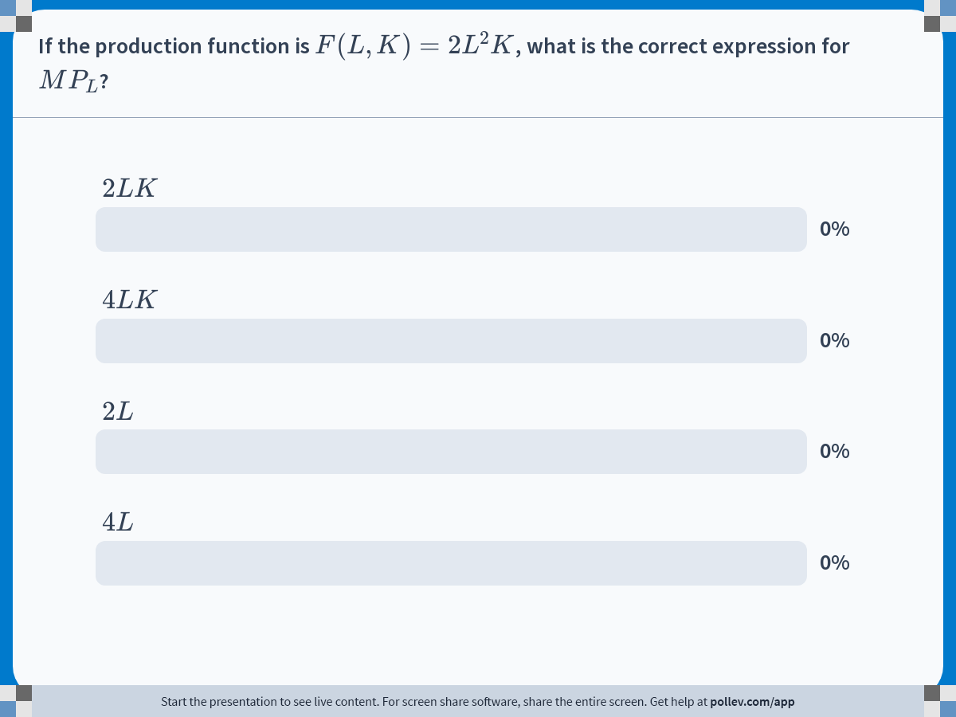
Notes:
Poll Title: Do not modify the notes in this section to avoid tampering with the Poll Everywhere activity.
More info at polleverywhere.com/support
If the production function is $$F(L,K)=2L^2K$$, what is the correct expression for $$MP_L$$?
https://www.polleverywhere.com/multiple_choice_polls/9mjs5QteI5GkBSftzPQ3d?display_state=chart&activity_state=closed&state=closed&flow=Engagement&onscreen=persist

Slide 13
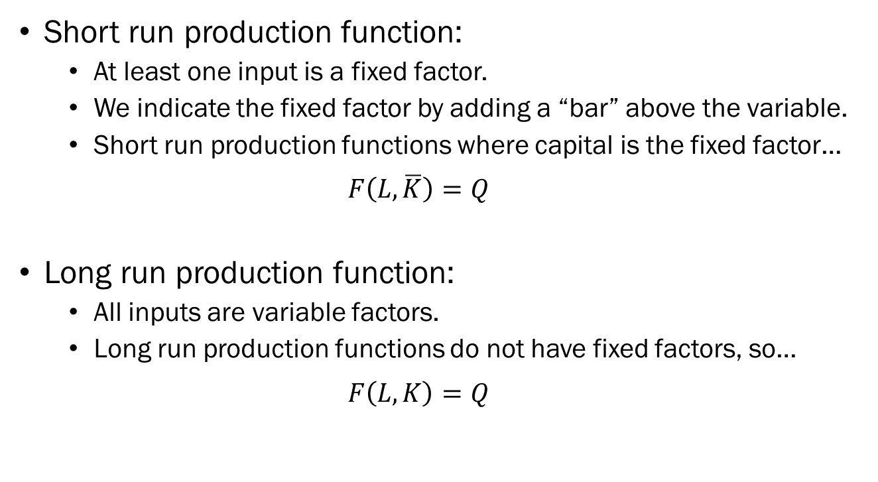
Production Function
Short run production function:
  At least one input is a fixed factor.
  We indicate the fixed factor by adding a “bar” above the variable.
  Short run production functions where capital is the fixed factor…
  $$F\left(L,\overline{K}\right)=Q$$
Long run production function:
  All inputs are variable factors.
  Long run production functions do not have fixed factors, so…
  $$F\left(L,K\right)=Q$$

Slide 14
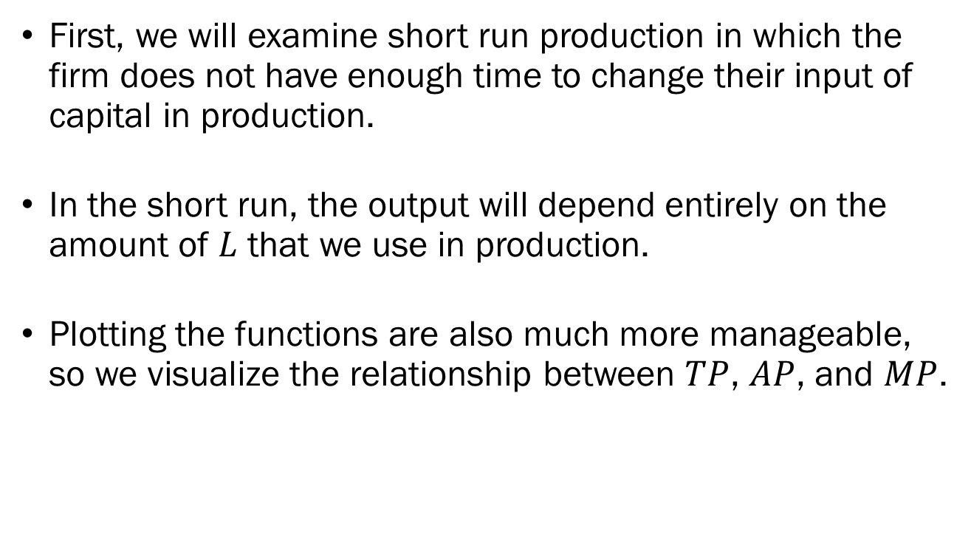
Short Run Production
First, we will examine short run production in which the firm does not have enough time to change their input of capital in production.
In the short run, the output will depend entirely on the amount of $L$ that we use in production.
Plotting the functions are also much more manageable, so we visualize the relationship between $TP$, $AP$, and $MP$.

Slide 15
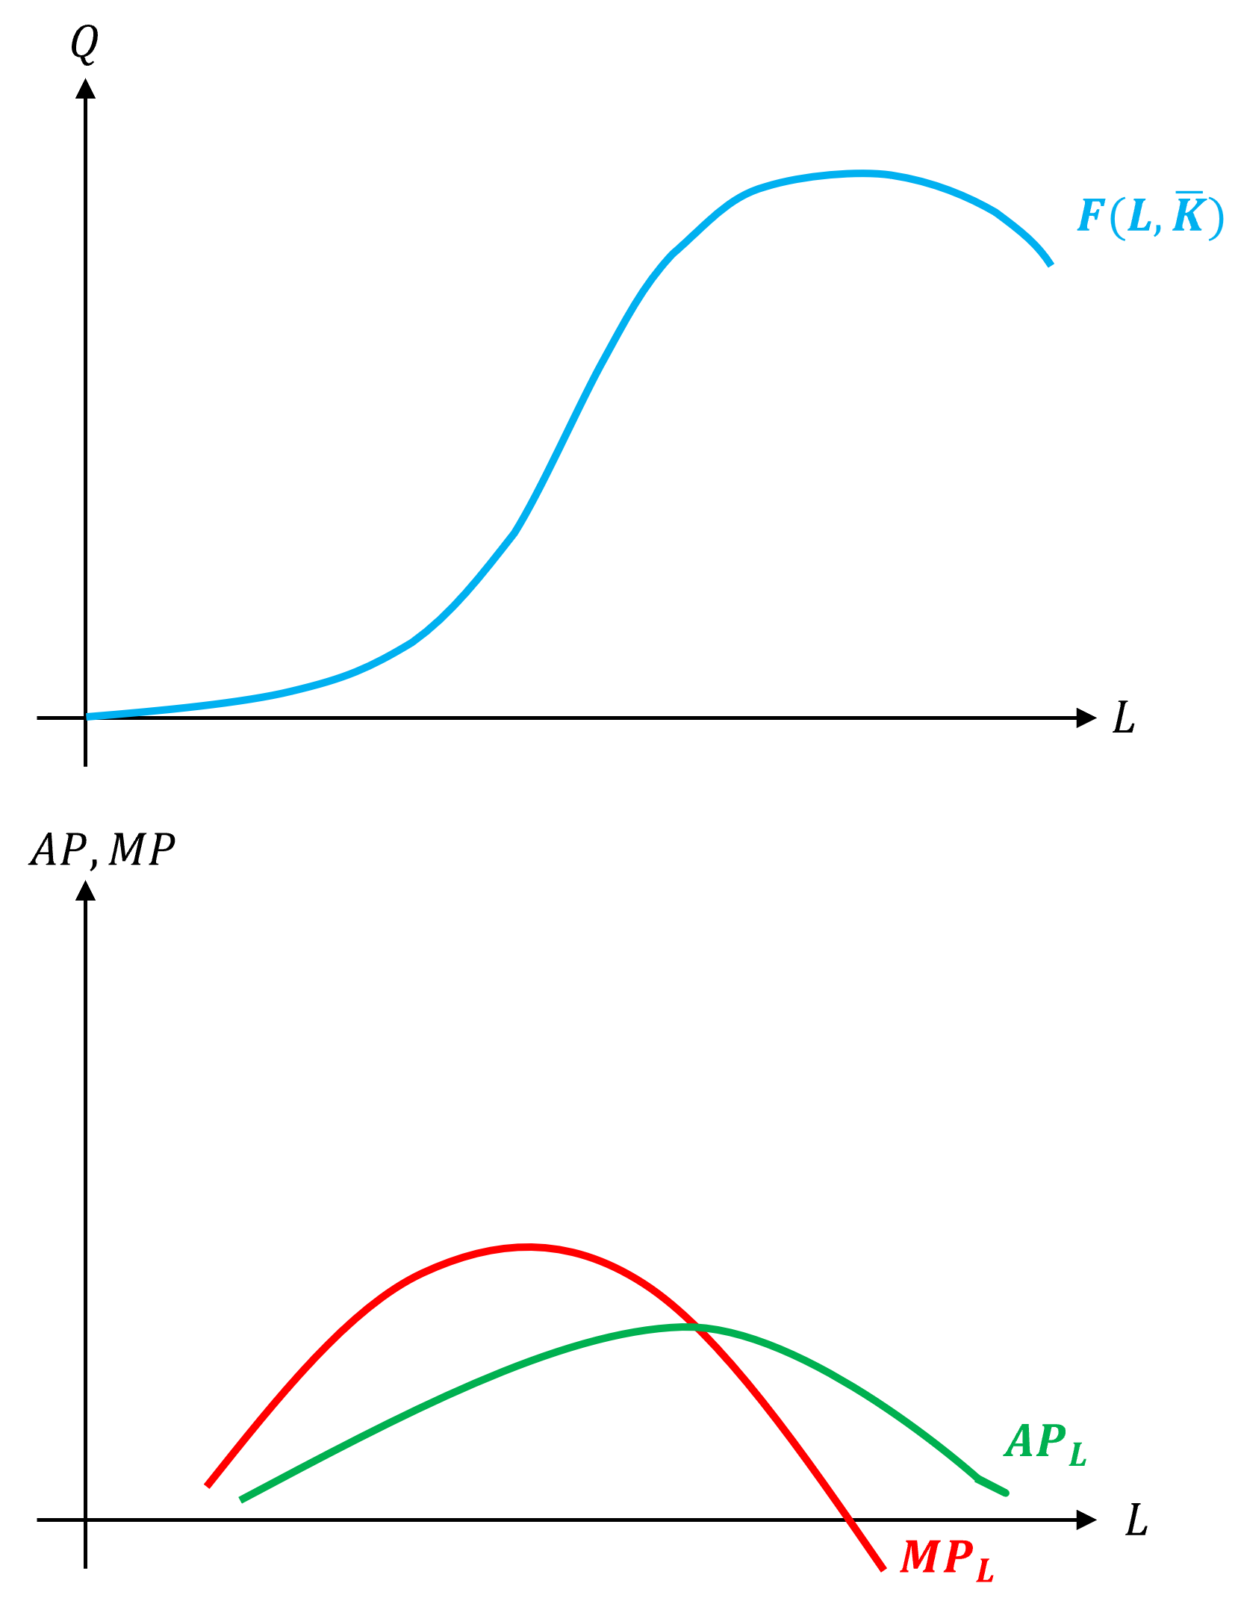

$TP$, $AP$, $MP$ in the Short Run
Total product is plotted on top panel.
In the panel below, the average and marginal products.
Observe the relationship between these three concepts.

Slide 16
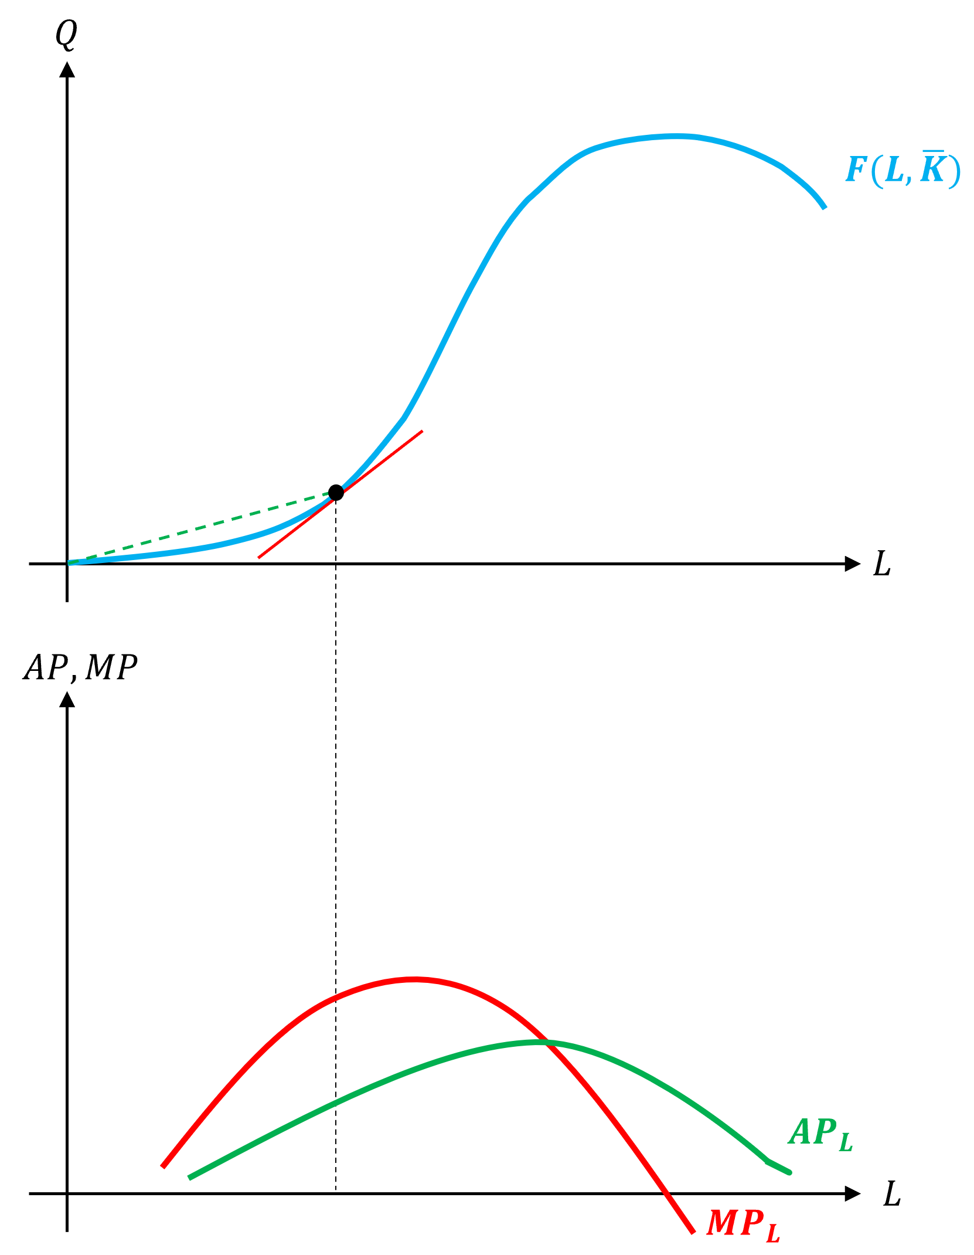
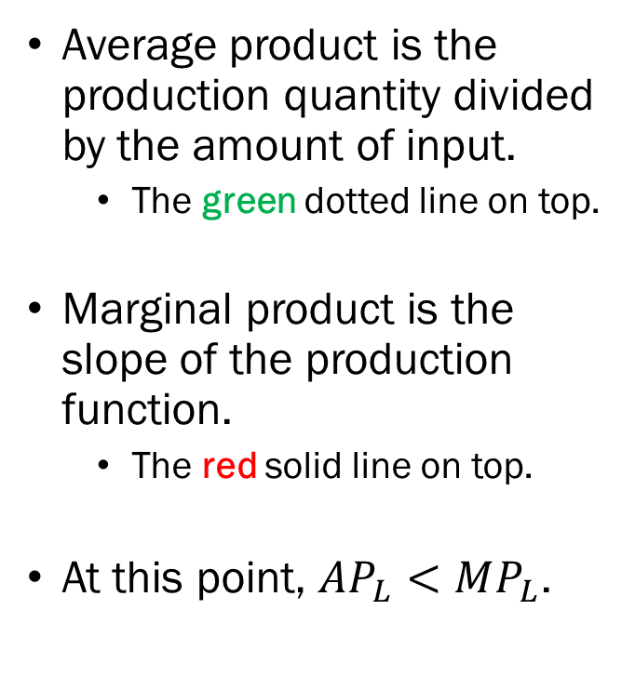
$TP$, $AP$, $MP$ in the Short Run
Average product is the production quantity divided by the amount of input.
  The green dotted line on top.
Marginal product is the slope of the production function.
  The red solid line on top.
At this point, $AP_{L}<MP_{L}$.

Slide 17
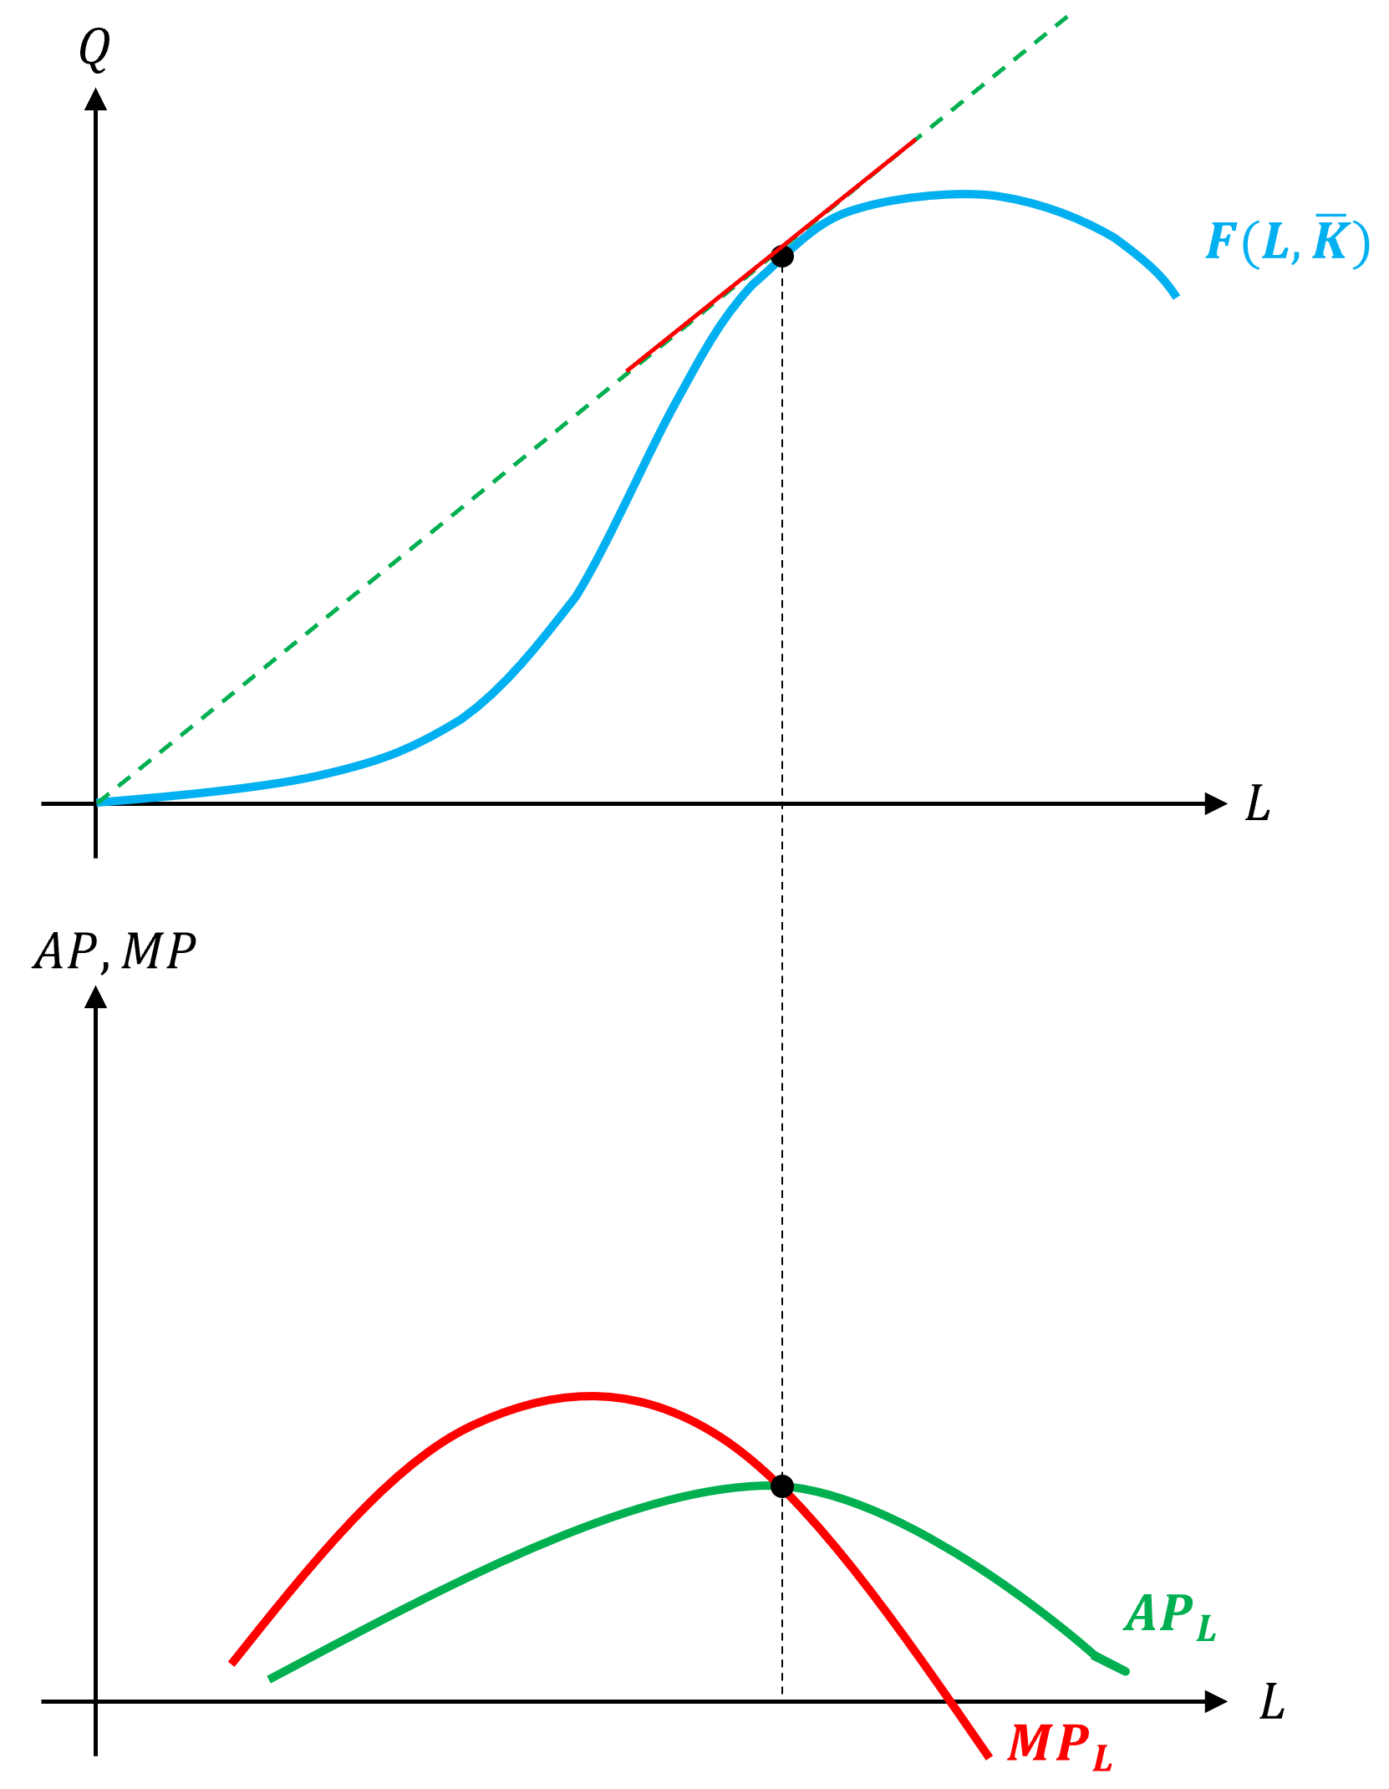
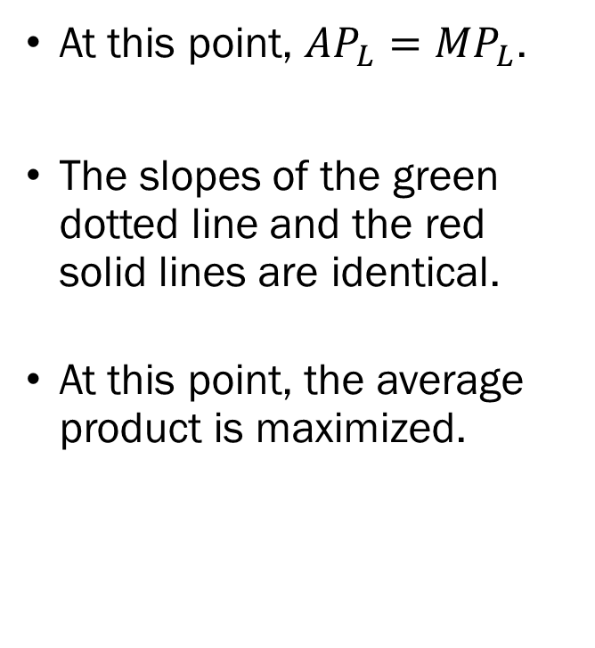
$TP$, $AP$, $MP$ in the Short Run
At this point, $AP_{L}=MP_{L}$.
The slopes of the green dotted line and the red solid lines are identical.
At this point, the average product is maximized.

Slide 18
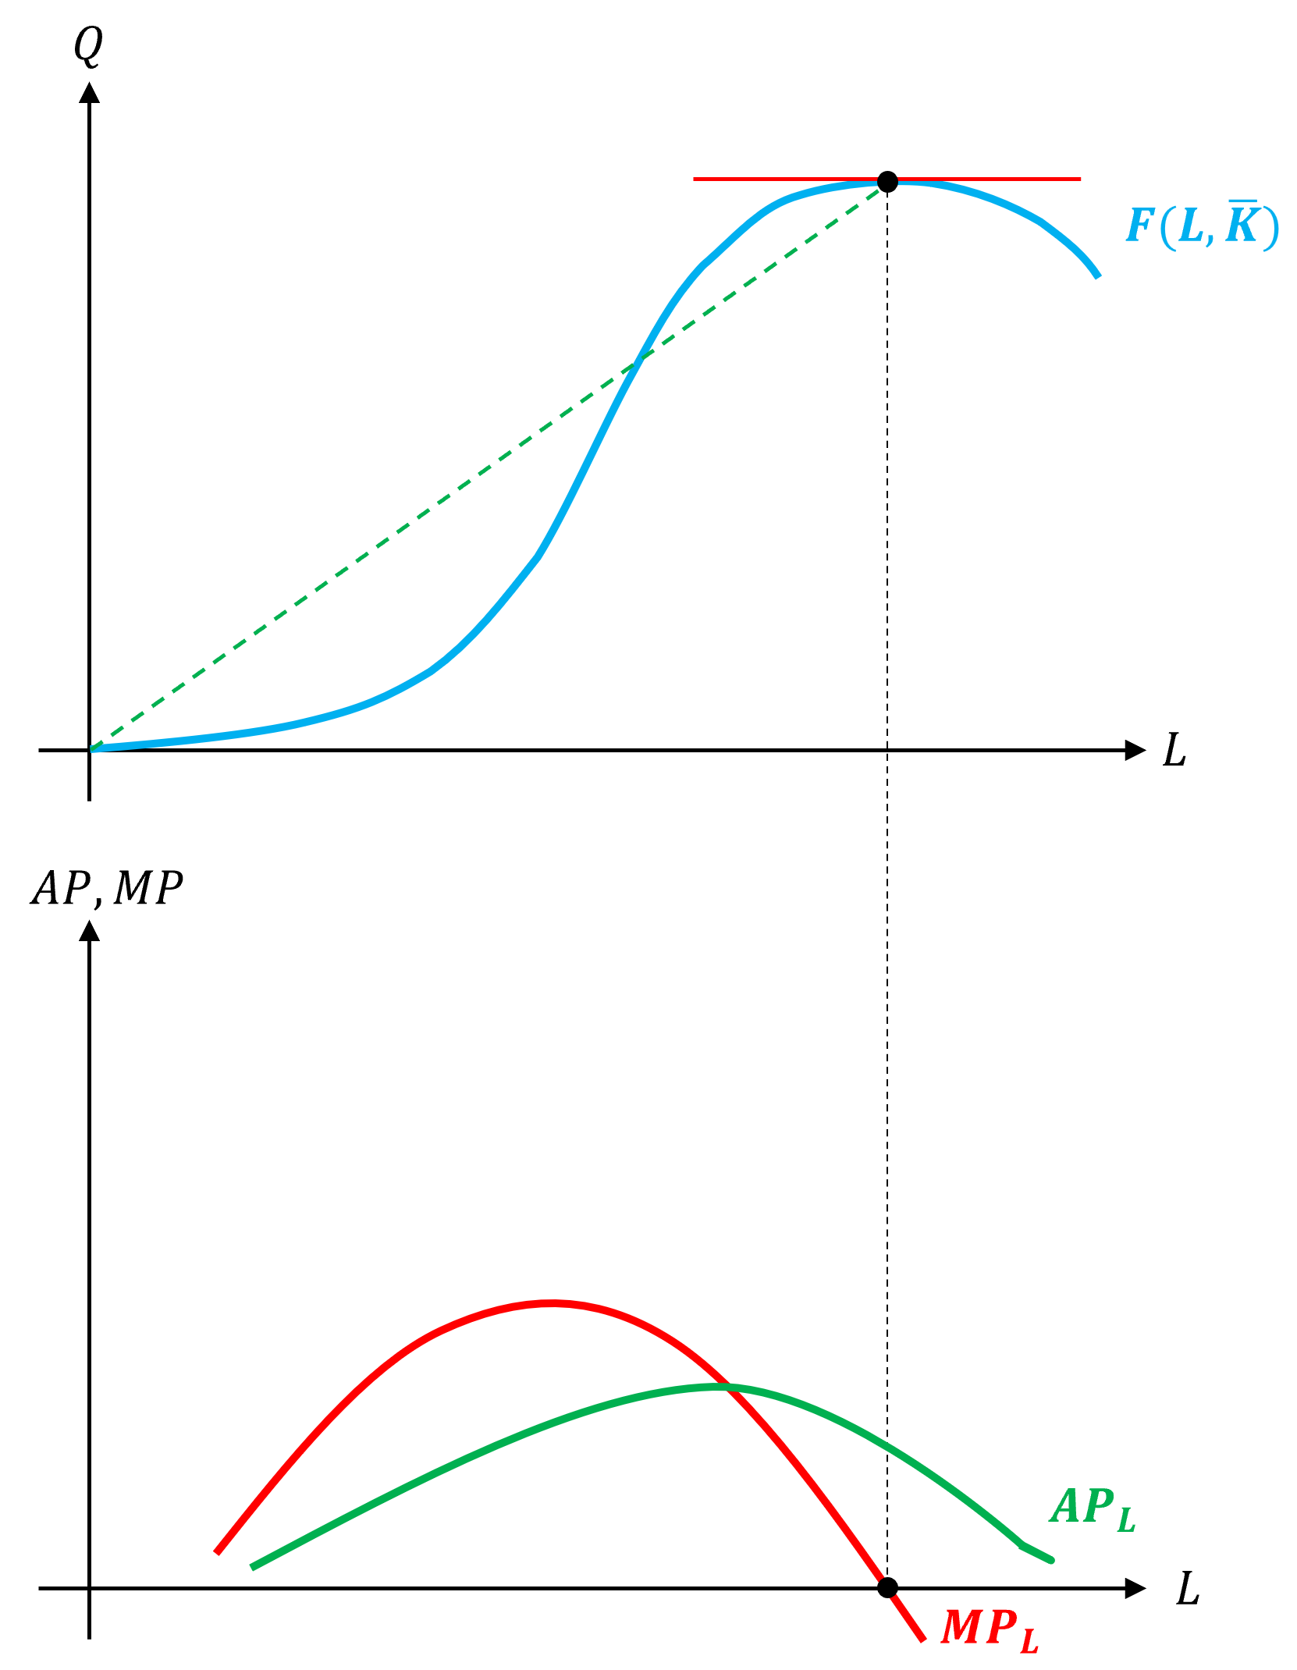
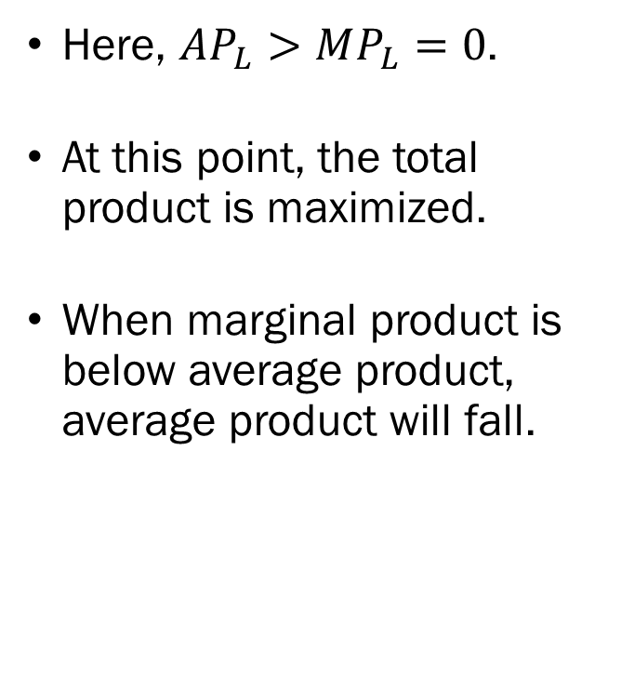
$TP$, $AP$, $MP$ in the Short Run
Here, $AP_{L}>MP_{L}=0$.
At this point, the total product is maximized.
When marginal product is below average product, average product will fall.

Slide 19
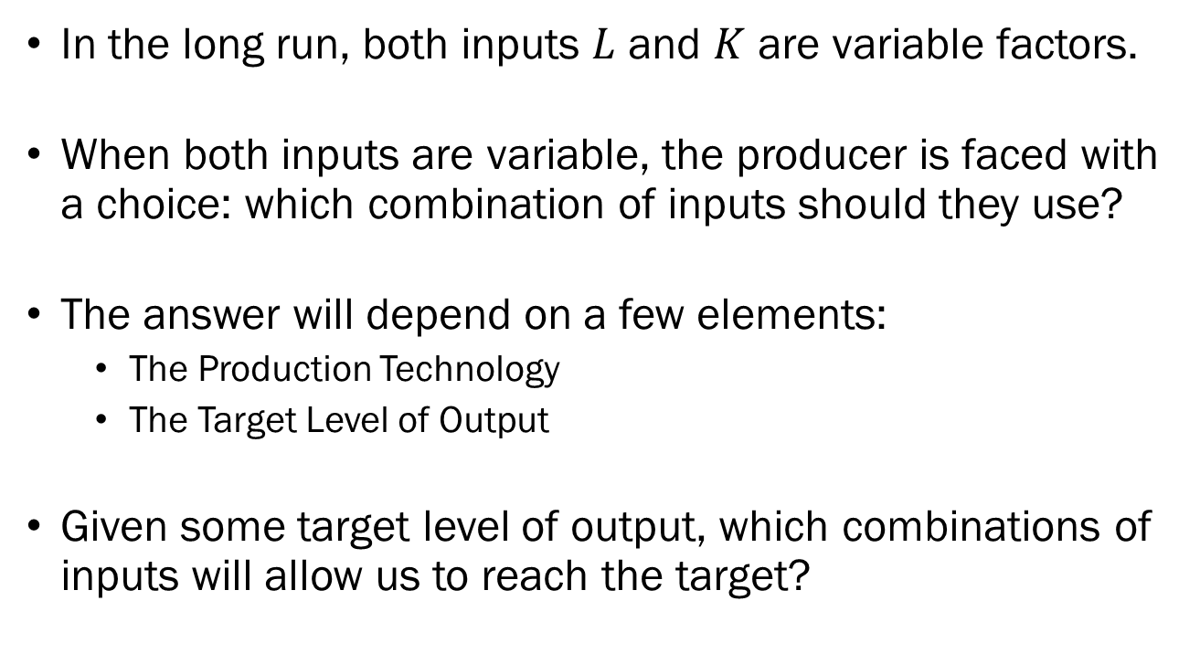
Long Run Production
In the long run, both inputs $L$ and $K$ are variable factors.
When both inputs are variable, the producer is faced with a choice: which combination of inputs should they use?
The answer will depend on a few elements:
  The Production Technology
  The Target Level of Output
Given some target level of output, which combinations of inputs will allow us to reach the target?

Slide 20
Isoquant
The question we are asking here should remind you of…
  Given some target level of output, which combinations of inputs will allow us to reach the target?
  Given some target utility level, what are the bundles that will give our consumer that much utility?
This concept is analogous to the consumers’ indifference curves.
For producers, this object is called the “isoquant.”
  Iso- : Same, Equal (e.g., Isosceles, Isotope)
  Quant: Quantity

Slide 21
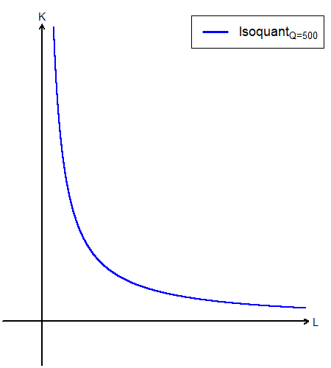
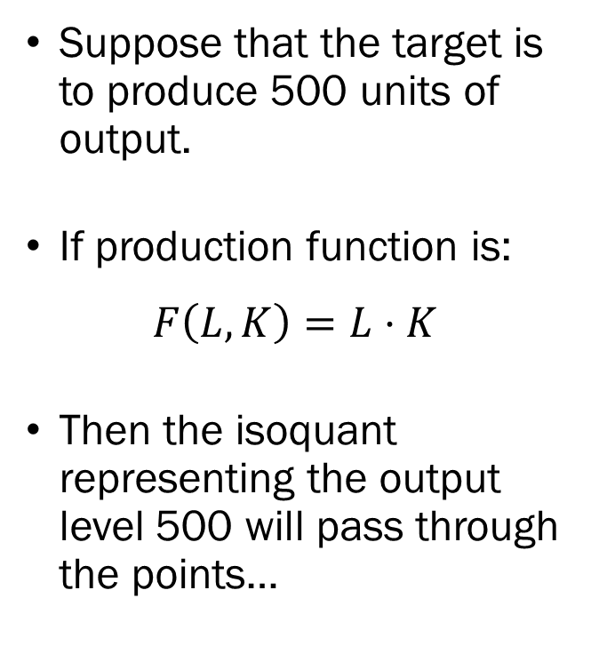
Isoquant
Suppose that the target is to produce 500 units of output.
If production function is:
$$F\left(L,K\right)=L⋅K$$
Then the isoquant representing the output level 500 will pass through the points…

Slide 22

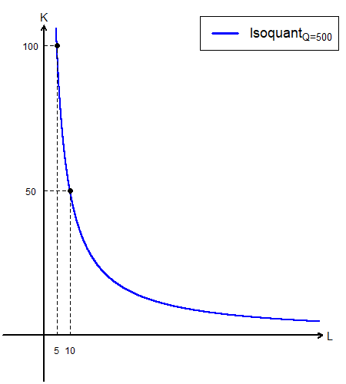
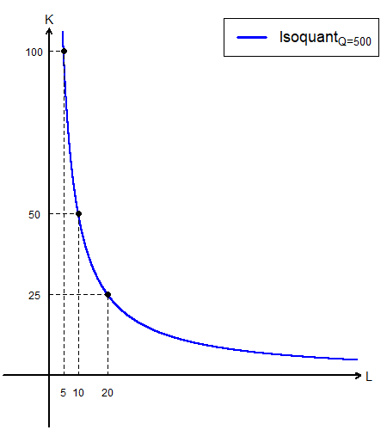
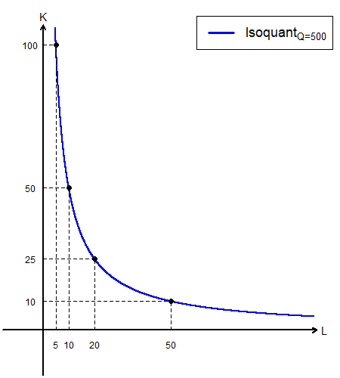
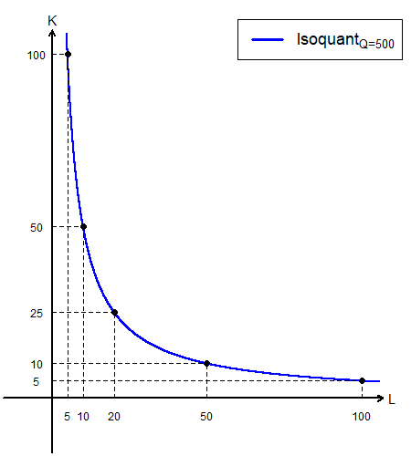
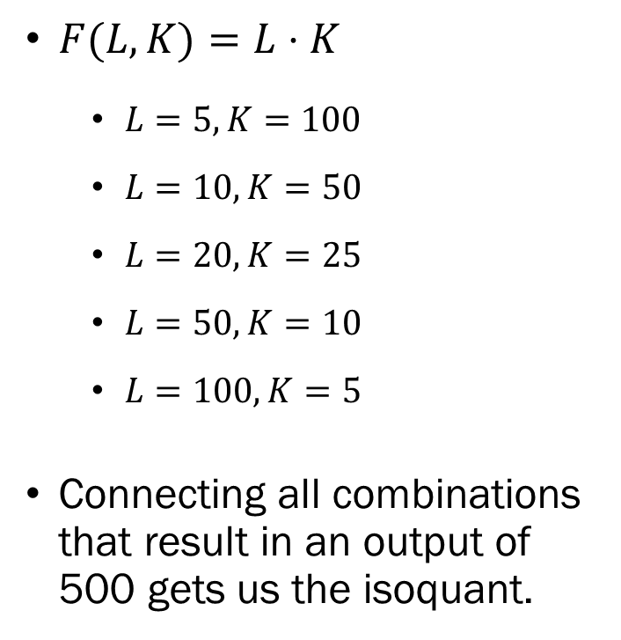
Isoquant
$F(L,K)=L⋅K$
  $L=5, K=100$
  $L=10,K=50$
  $L=20,K=25$
  $L=50,K=10$
  $L=100,K=5$
Connecting all combinations that result in an output of 500 gets us the isoquant.

Slide 23
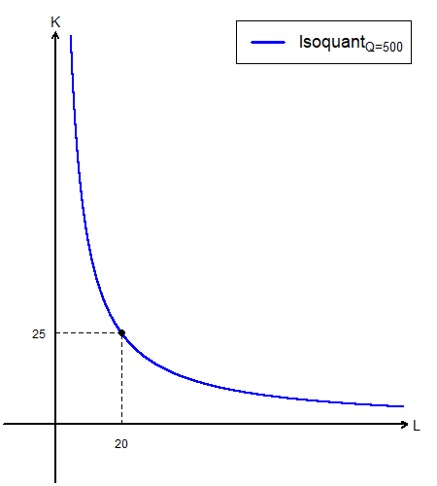
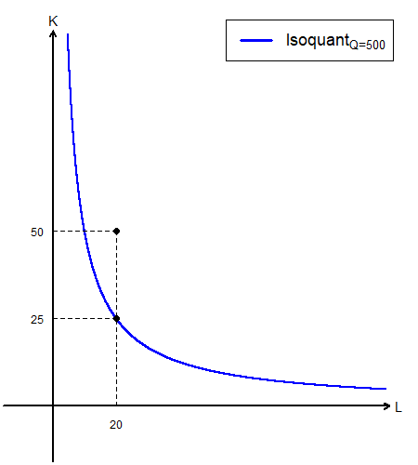
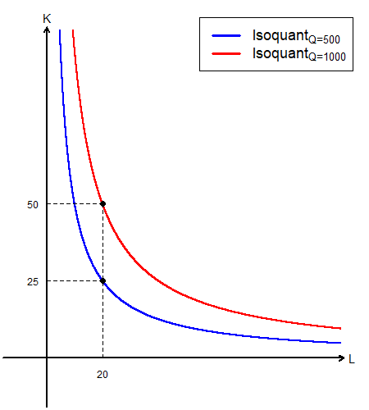
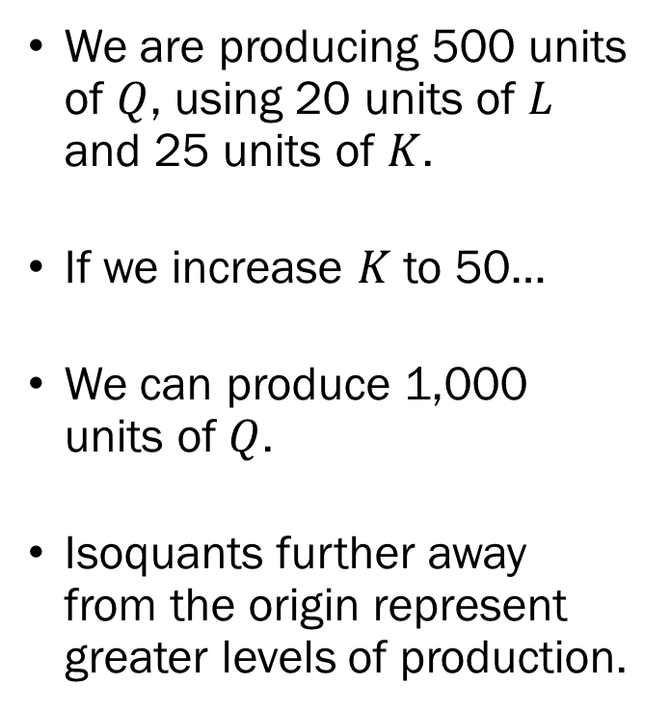
Isoquant
We are producing 500 units of $Q$, using 20 units of $L$ and 25 units of $K$.
If we increase $K$ to 50…
We can produce 1,000 units of $Q$.
Isoquants further away from the origin represent greater levels of production.

Slide 24
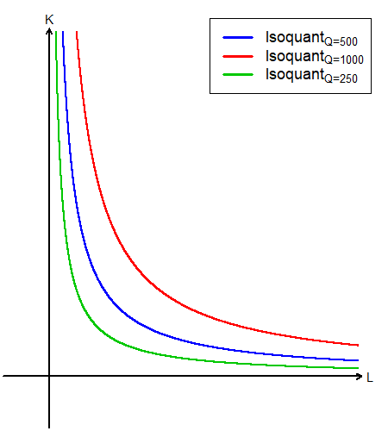
Isoquant
Isoquants are very similar to indifference curves.
Indifference curves tell us which combinations of goods result in the same level of utility.
Isoquants tell us which combinations of inputs result in the same level of output.

Slide 25
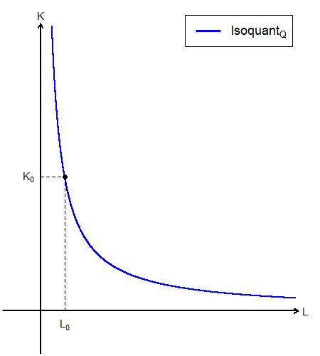
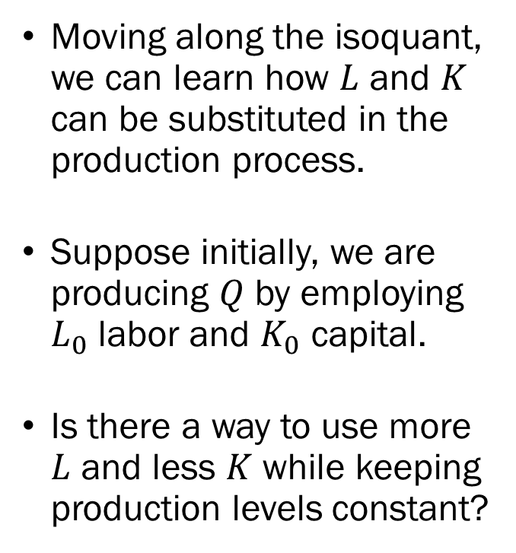
Isoquant
Moving along the isoquant, we can learn how $L$ and $K$ can be substituted in the production process.
Suppose initially, we are producing $Q$ by employing $L_{0}$ labor and $K_{0}$ capital.
Is there a way to use more $L$ and less $K$ while keeping production levels constant?

Slide 26
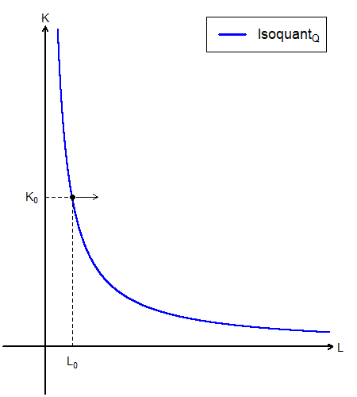
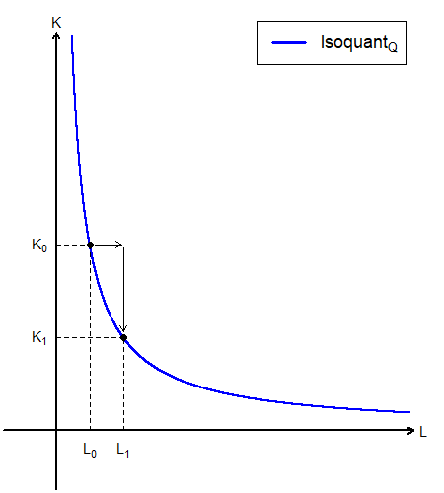
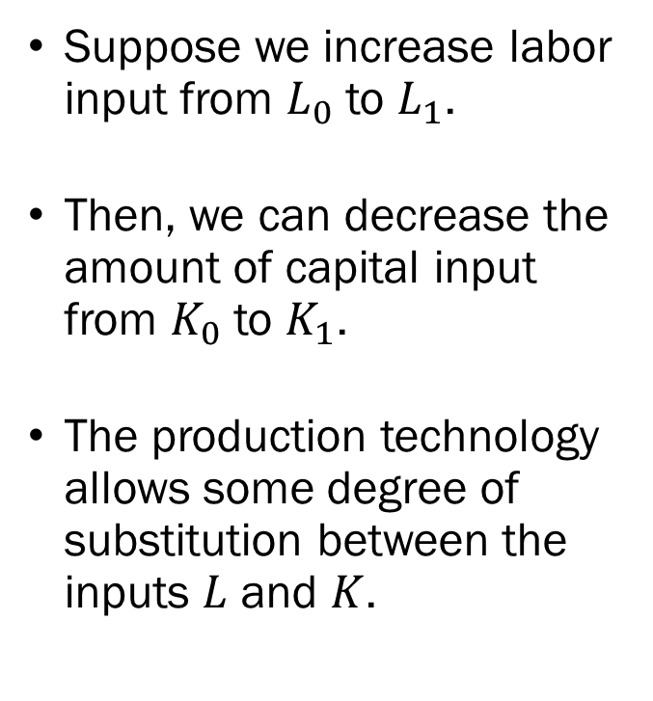
Isoquant
Suppose we increase labor input from $L_{0}$ to $L_{1}$.
Then, we can decrease the amount of capital input from $K_{0}$ to $K_{1}$.
The production technology allows some degree of substitution between the inputs $L$ and $K$.

Slide 27
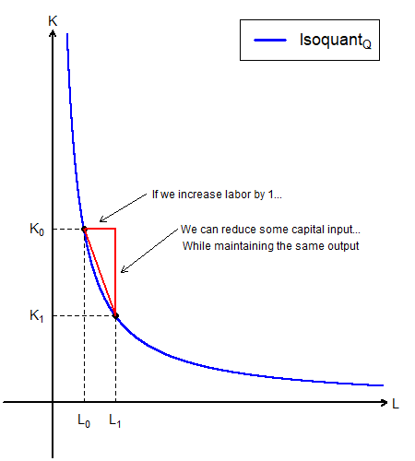
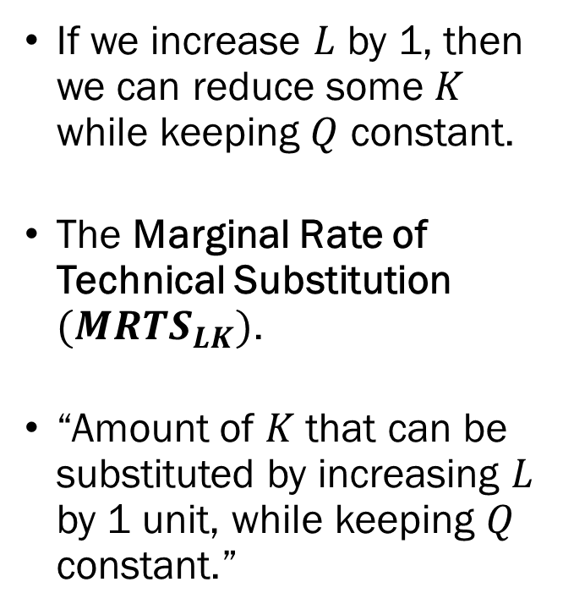
Marginal Rate of Technical Substitution
If we increase $L$ by 1, then we can reduce some $K$ while keeping $Q$ constant.
The Marginal Rate of Technical Substitution $(MRTS_{LK})$.
“Amount of $K$ that can be substituted by increasing $L$ by 1 unit, while keeping $Q$ constant.”

Slide 28
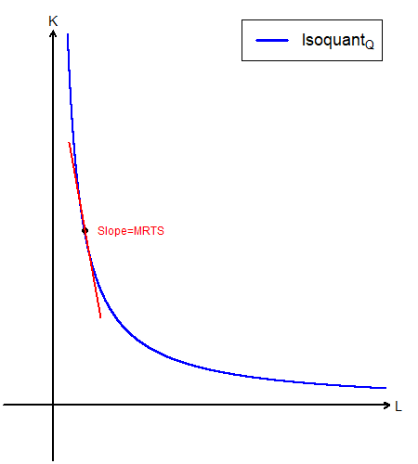
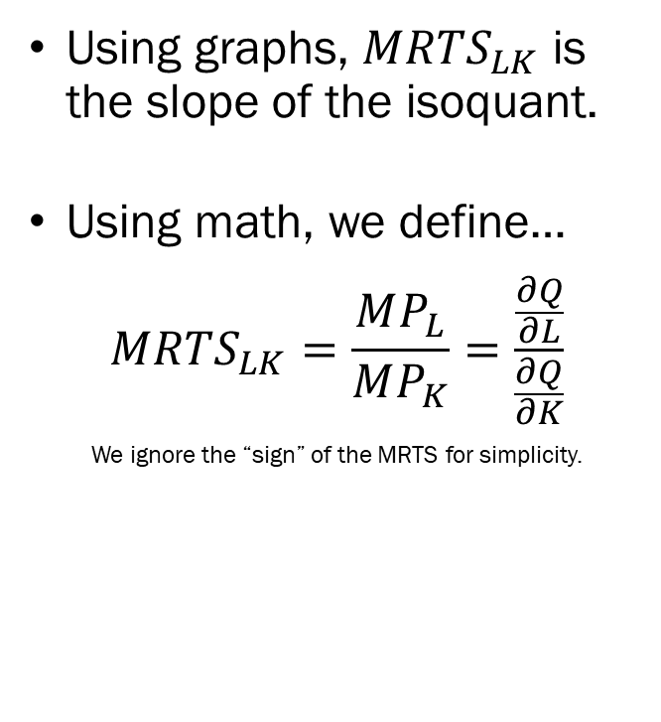
Marginal Rate of Technical Substitution
Using graphs, $MRTS_{LK}$ is the slope of the isoquant.
Using math, we define…
$$MRTS_{LK}=\frac{MP_{L}}{MP_{K}}=\frac{\frac{∂Q}{∂L}}{\frac{∂Q}{∂K}}$$
We ignore the “sign” of the MRTS for simplicity.

Slide 29
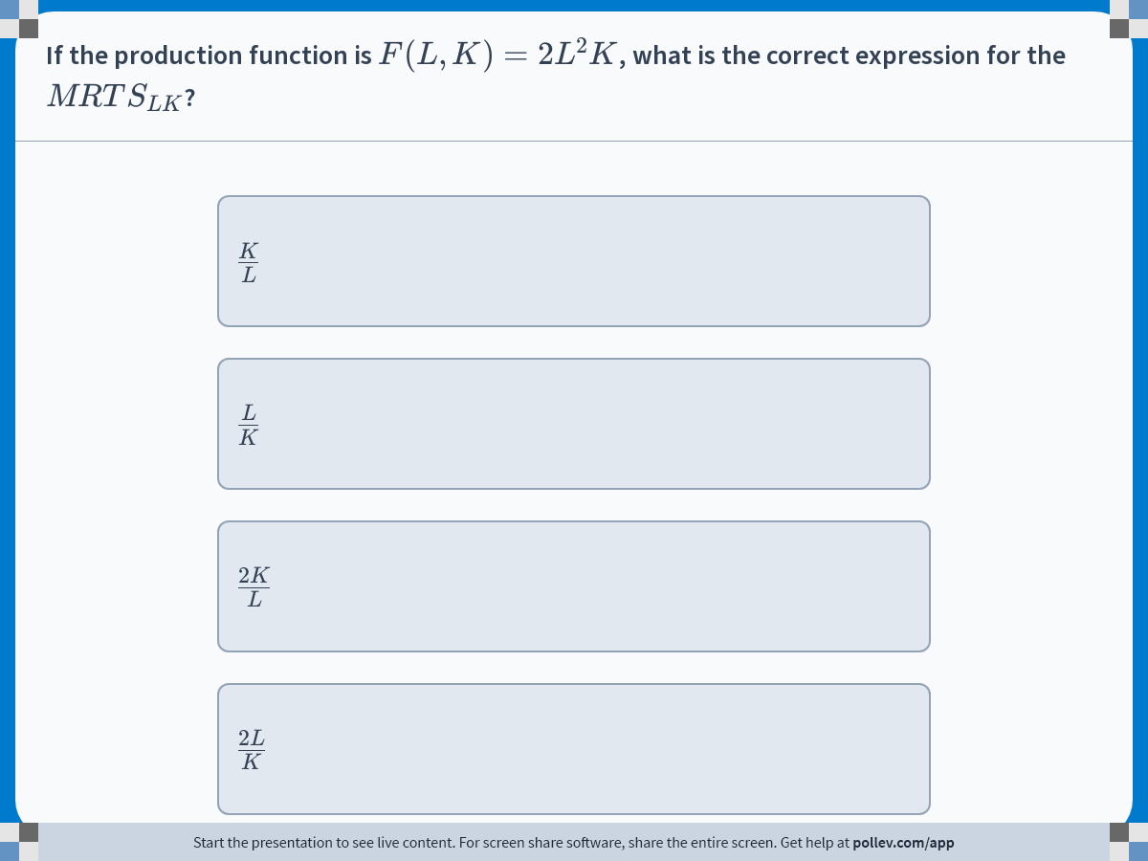
Notes:
Poll Title: Do not modify the notes in this section to avoid tampering with the Poll Everywhere activity.
More info at polleverywhere.com/support
If the production function is $$F(L,K)=2L^2K$$, what is the correct expression for the $$MRTS_{LK}$$?
https://www.polleverywhere.com/multiple_choice_polls/H0vwbWof0kAOzInRUZ2ft?display_state=instructions&activity_state=opened&state=opened&flow=Engagement&onscreen=persist

Slide 30
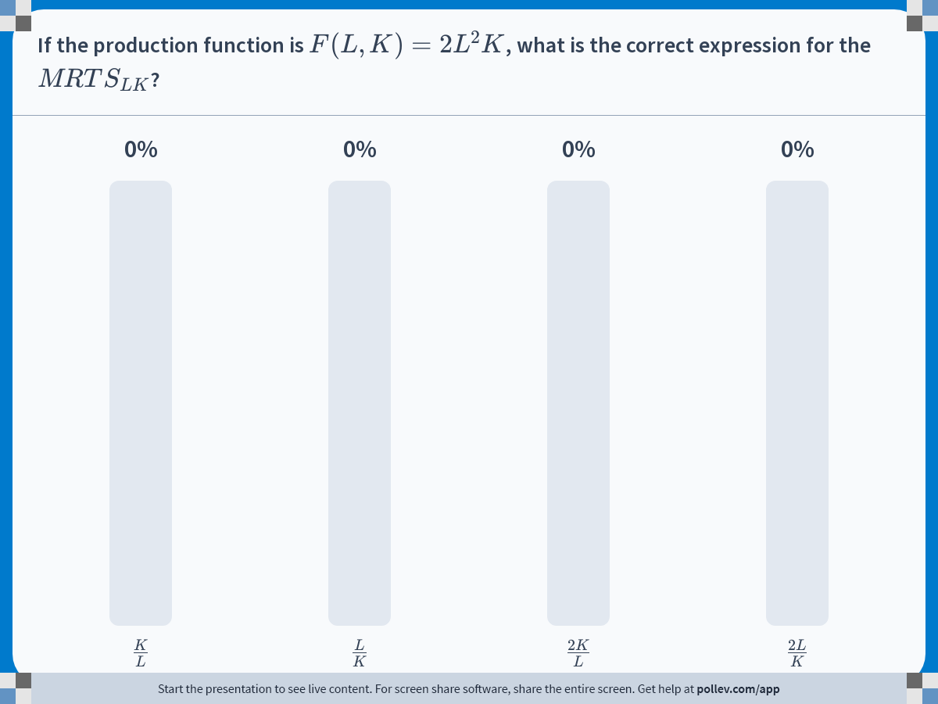
Notes:
Poll Title: Do not modify the notes in this section to avoid tampering with the Poll Everywhere activity.
More info at polleverywhere.com/support
If the production function is $$F(L,K)=2L^2K$$, what is the correct expression for the $$MRTS_{LK}$$?
https://www.polleverywhere.com/multiple_choice_polls/H0vwbWof0kAOzInRUZ2ft?display_state=chart&activity_state=closed&state=closed&flow=Engagement&onscreen=persist

Slide 31
Other Topics in Production Technology
Returns to Scale
  Constant Returns to Scale
  Increasing Returns to Scale
  Decreasing Returns to Scale
Technical Progress
Types of Production Functions
  Cobb-Douglas Production Functions
  Linear Production Functions
  Leontief Production Functions

Slide 32
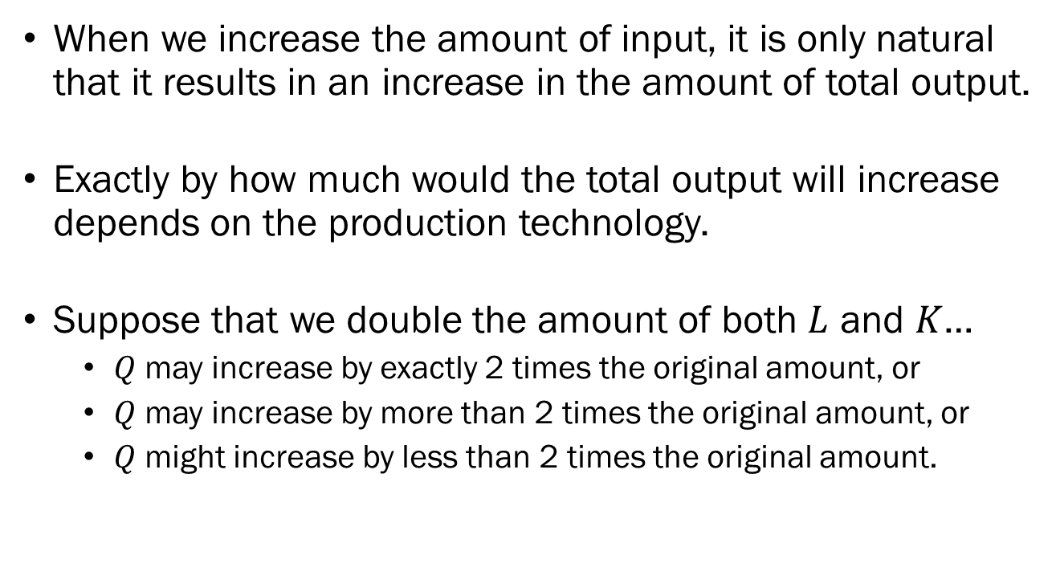
Returns to Scale
When we increase the amount of input, it is only natural that it results in an increase in the amount of total output.
Exactly by how much would the total output will increase depends on the production technology.
Suppose that we double the amount of both $L$ and $K$…
  $Q$ may increase by exactly 2 times the original amount, or
  $Q$ may increase by more than 2 times the original amount, or
  $Q$ might increase by less than 2 times the original amount.

Slide 33
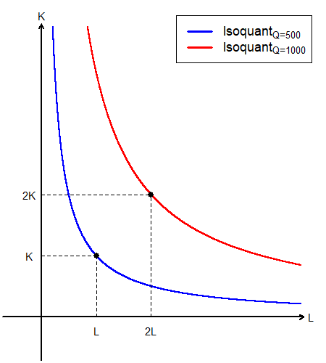
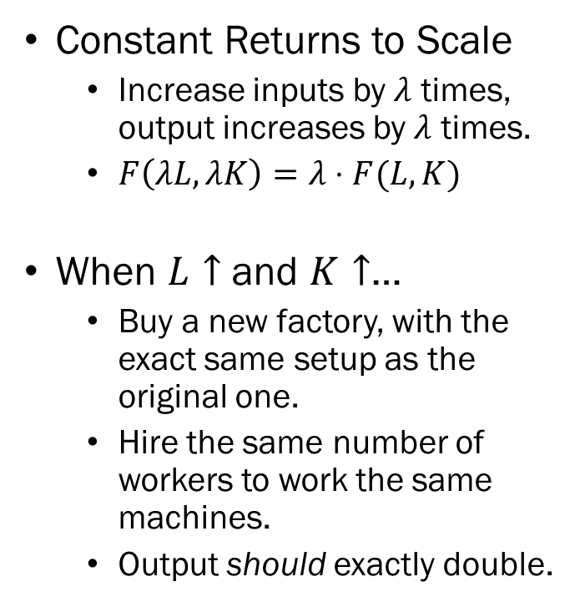
Returns to Scale
Constant Returns to Scale
  Increase inputs by $λ$ times, output increases by $λ$ times.
  $F\left(λL,λK\right)=λ⋅F(L,K)$
When $L↑$ and $K↑$…
  Buy a new factory, with the exact same setup as the original one.
  Hire the same number of workers to work the same machines.
  Output should exactly double.

Slide 34

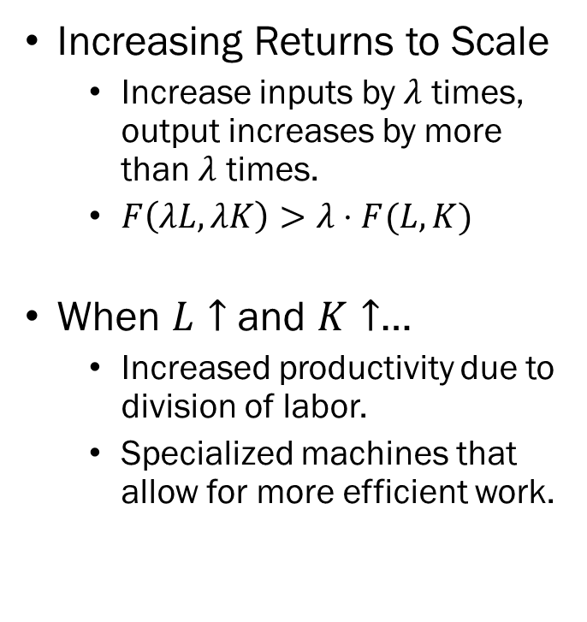
Returns to Scale
Increasing Returns to Scale
  Increase inputs by $λ$ times, output increases by more than $λ$ times.
  $F\left(λL,λK\right)>λ⋅F(L,K)$
When $L↑$ and $K↑$…
  Increased productivity due to division of labor.
  Specialized machines that allow for more efficient work.

Slide 35

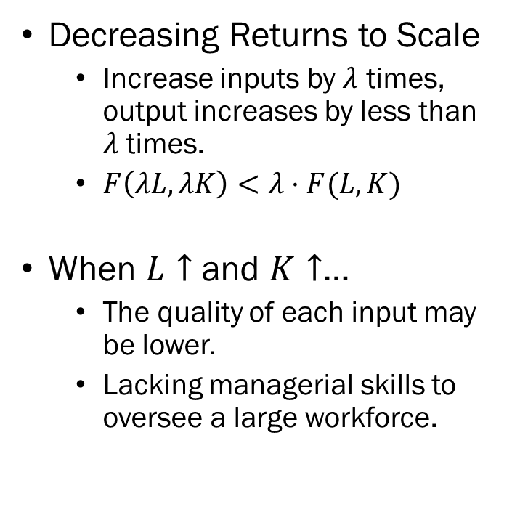
Returns to Scale
Decreasing Returns to Scale
  Increase inputs by $λ$ times, output increases by less than $λ$ times.
  $F\left(λL,λK\right)<λ⋅F(L,K)$
When $L↑$ and $K↑$…
  The quality of each input may be lower.
  Lacking managerial skills to oversee a large workforce.

Slide 36
Technical Progress
Output may increase as a reaction to increased inputs, but it may also increase due to the improvement of the production technology itself.
When output increases in absence of an increase of inputs in production, we say that there was Technical Progress.
Technical progress is the evolution of the production function itself.

Slide 37
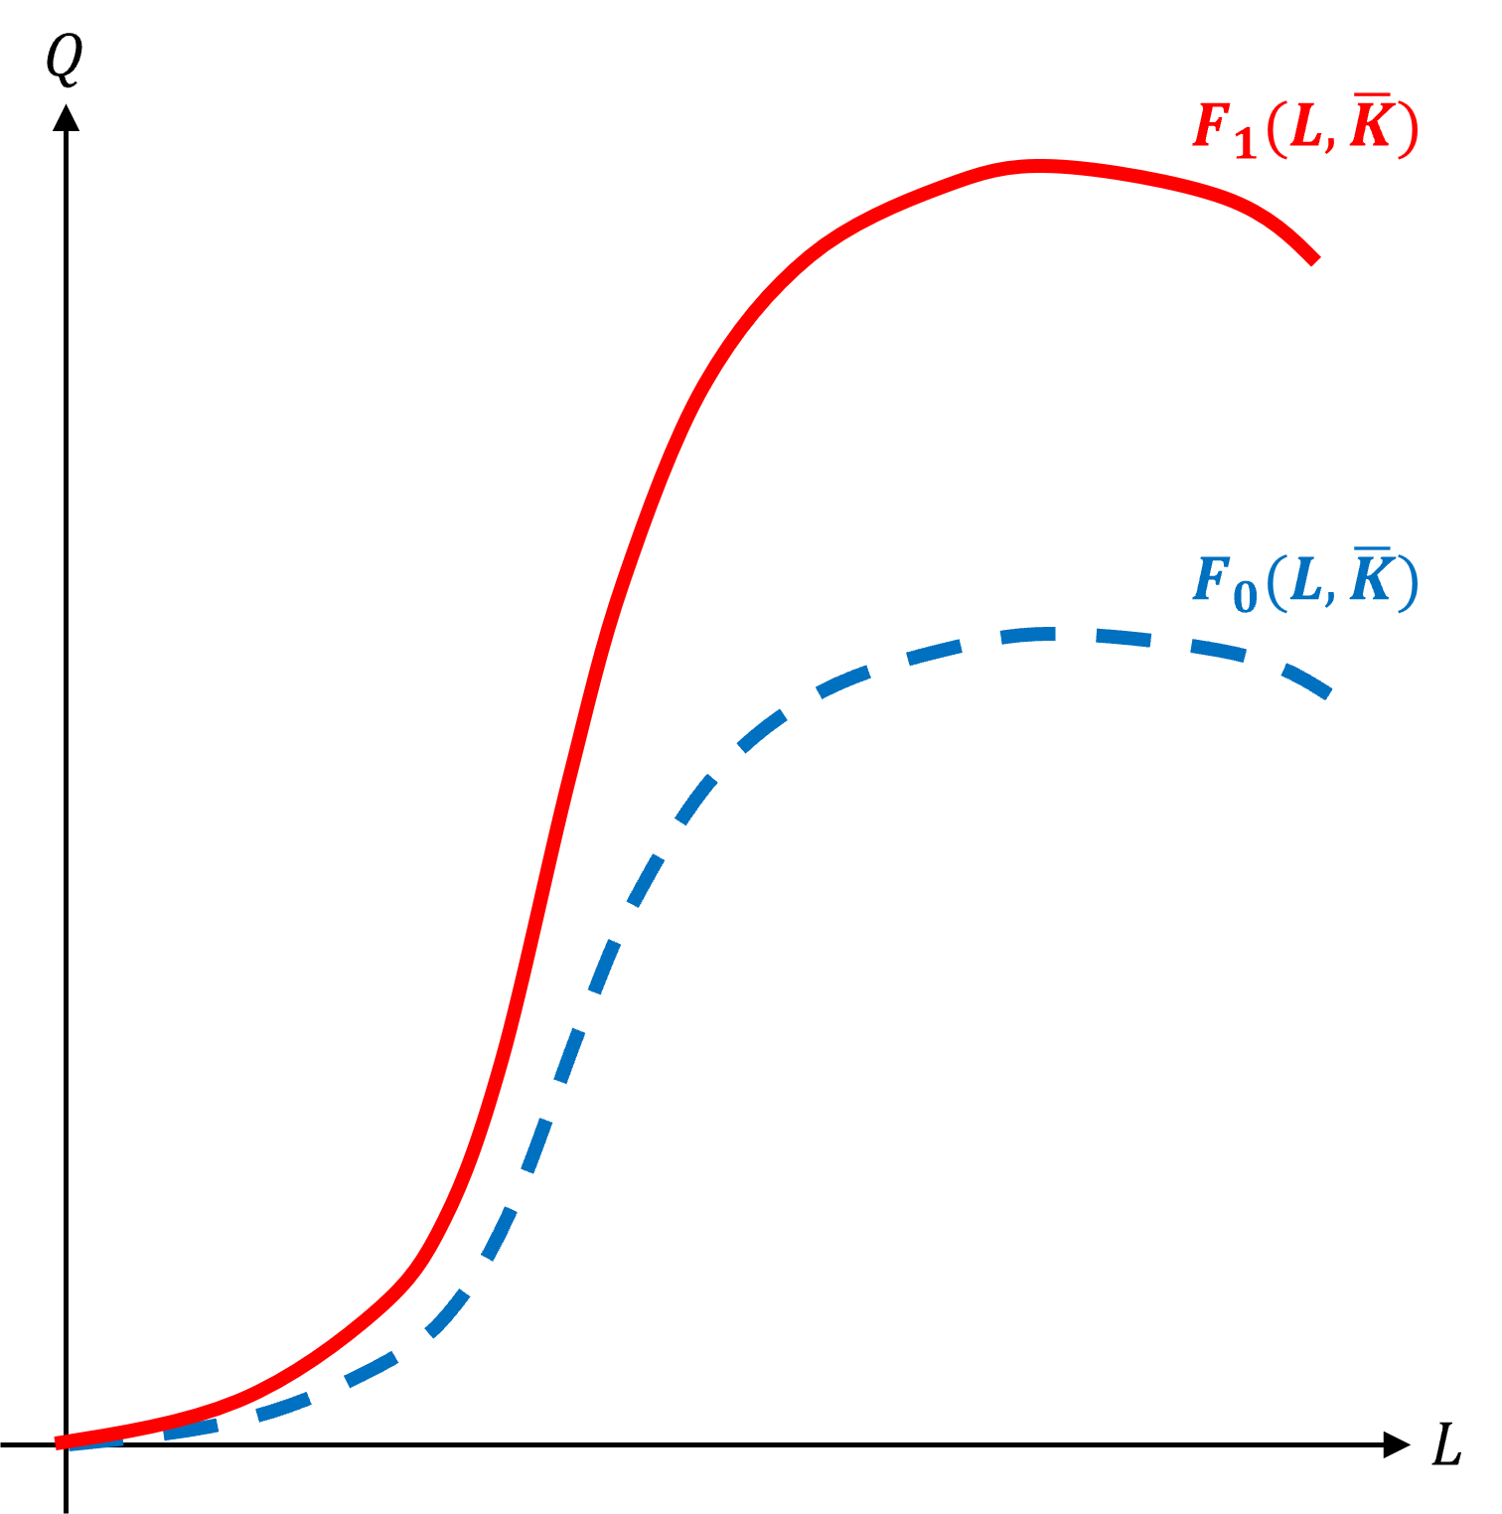
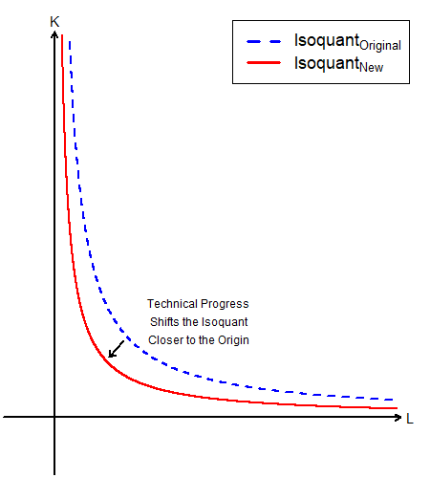
Technical Progress
Short Run Production
Long Run Production

Slide 38
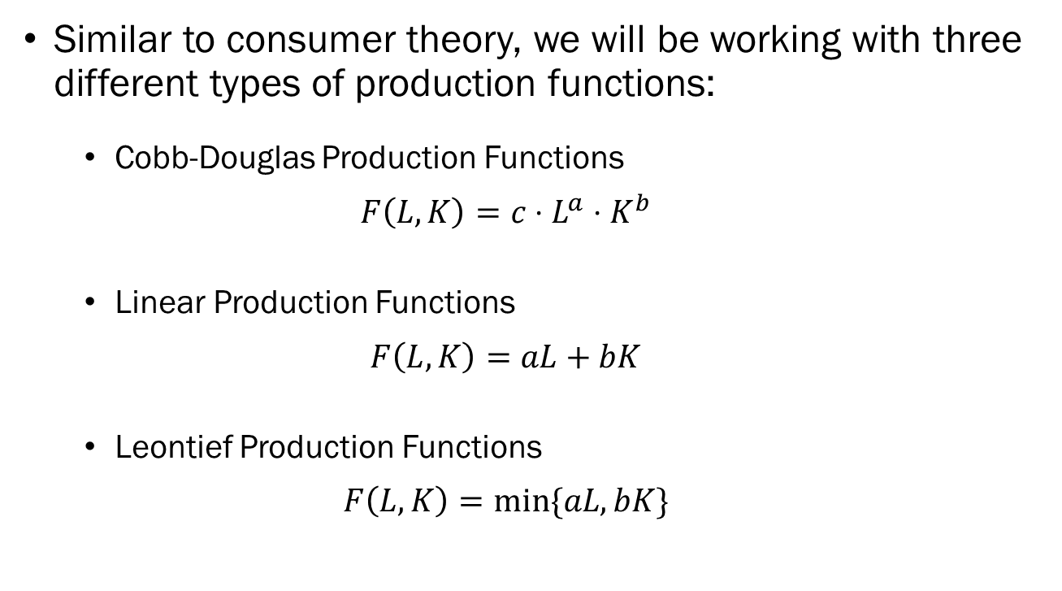
Three Types of Production Functions
Similar to consumer theory, we will be working with three different types of production functions:
  Cobb-Douglas Production Functions
  $$F\left(L,K\right)=c⋅L^{a}⋅K^{b}$$
  Linear Production Functions
  $$F\left(L,K\right)=aL+bK$$
  Leontief Production Functions
  $$F\left(L,K\right)=min⁡\{aL,bK\}$$

