Slide 1
Consumer Theory:
Comparative Statics of UMP Part 3
ECON 300

Slide 2
Recap of Previous Lectures
Changes in the Consumer’s Income
  Normal and Inferior Goods
  Luxury and Necessary Goods
  The Income Consumption Curve
  The Engel Curve
Changes in the Market Price(s)
  Ordinary and Giffen Goods
  The Price Consumption Curve
  The (Walrasian) Demand Curve

Slide 3
Breaking Down the Effect of
Changes in the Market Prices
Suppose the consumer is spending $100 on 10 apples and 10 oranges when apples and oranges are $5 each.
If the market price of apples drop to $3, what happens to the consumer’s choice?
Two effects can be observed:
  Apples are now relatively cheaper than oranges, and
  The purchasing power of the consumer has changed, even though income itself did not change.

Slide 4
The Substitution Effect
The fact that apples are now relatively cheaper than oranges itself will send a signal to the consumer to…
  Decrease the consumption of oranges, and
  Increase the consumption of apples.
In other words, to substitute oranges out in favor of the now relatively cheaper apples.
Therefore, this effect is called the “Substitution Effect.”
The substitution effect is always negatively correlated with market prices.

Slide 5
The Income Effect
The fact that the consumer’s purchasing power has increased will lead the consumer to…
  Increase their consumption of apples, or
  Decrease their consumption of apples?
  The effect is not as clear-cut as the substitution effect.
The consumer’s increased purchasing power feels as if their income increased.
Therefore, this effect is called the “Income Effect.”

Slide 6
The Price, Substitution, and Income Effects
The difference between the optimal number of apples the consumer would purchase before and after the price change is called the Price Effect.
The Substitution Effect is the effect of the change in relative prices, isolated away from the change in purchasing power.
The Income Effect is the effect of the change in purchasing power, isolated away from the change in the relative prices.

Slide 7
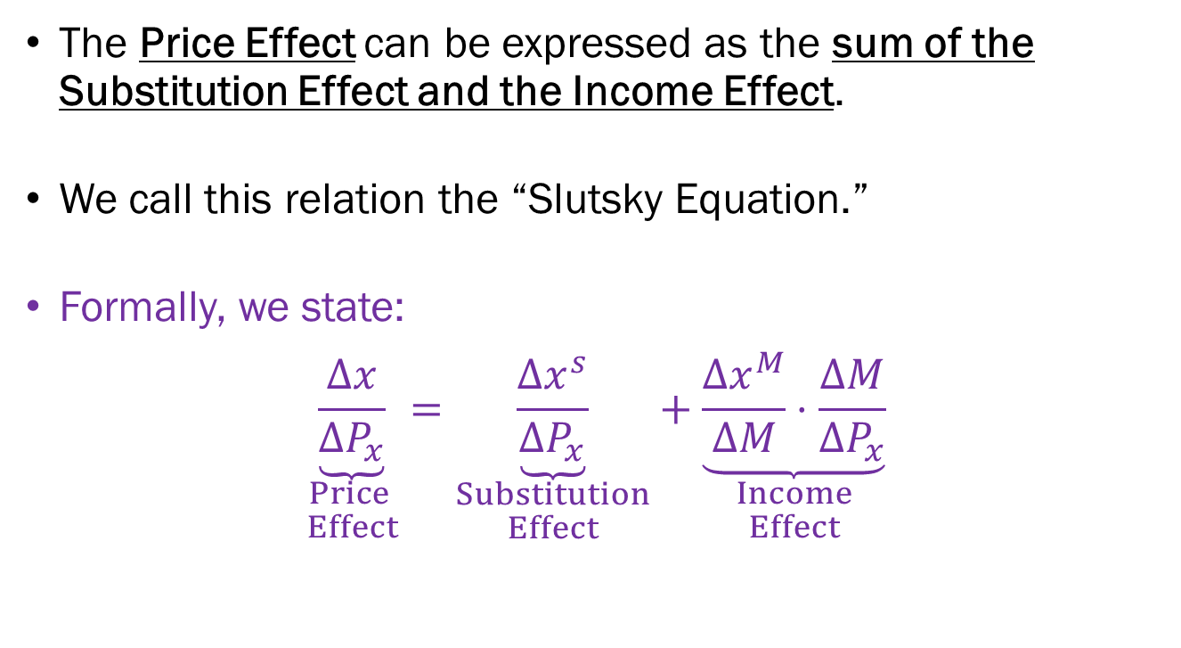
The Slutsky Equation
The Price Effect can be expressed as the sum of the Substitution Effect and the Income Effect.
We call this relation the “Slutsky Equation.”
Formally, we state:
$$\underset{\begin{aligned}Price \\ Effect\end{aligned}}{\underbrace{\frac{∆x}{∆P_{x}}}}=\underset{\begin{aligned}Substitution \\ Effect\end{aligned}}{\underbrace{\frac{∆x^{s}}{∆P_{x}}}}+\underset{\begin{aligned}Income \\ Effect\end{aligned}}{\underbrace{\frac{∆x^{M}}{∆M}⋅\frac{∆M}{∆P_{x}}}}$$

Slide 8
The Slutsky and Hicksian
Substitution Effect
When we want to measure what it the effect of the altered relative prices, we run into a problem.
How can we decouple the effect of any change in relative prices to the changes in the purchasing power?
A single change, the change in the market price of apples caused both effects to manifest.
Two methods:
  The Slutsky Substitution Effect
  The Hicksian Substitution Effect

Slide 9
The Slutsky Substitution Effect
One way is to “adjust” the consumer’s income such that they can purchase the pre-price-change optimal bundle.
In our example, we had…
  Income: $100
  Original Price of Apples: $5
  Updated Price of Apples: $3
  Price of Oranges: $5
  Original Bundle: 10 Apples, 10 Oranges
The original bundle, under the updated price is now $??.

Slide 10
The Slutsky Substitution Effect
To find the Slutsky substitution effect, we run the utility maximization problem for the consumer while…
  Adjusting the consumer’s income to $80, and
  Applying the updated prices of $3 for apples and $5 for oranges.
The difference between the original bundle and this new bundle is free from the effect of the consumer’s increased/diminished purchasing power.
This is how we derive the Slutsky substitution effect.

Slide 11
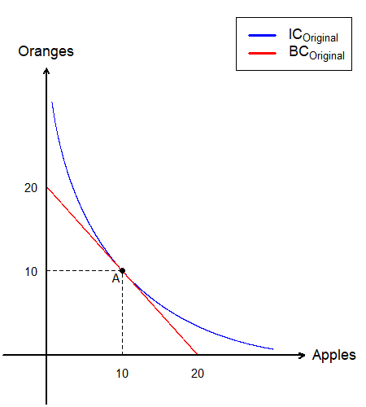
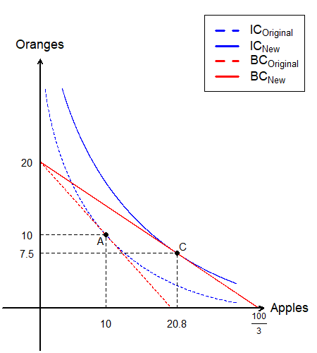
The Slutsky Substitution Effect
Originally, the consumer is maximizing their utility by consuming 10 apples and 10 oranges (bundle A).
The price of apples fall to $3, and the consumer moves to bundle C.
We will “divide” the change from bundle A to C, using the Slutsky method.

Slide 12
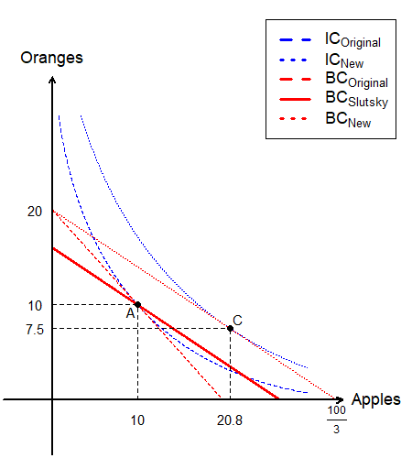
The Slutsky Substitution Effect
The Slutsky method relies on “adjusting the consumer’s income so that the original bundle exhausts their income.”
Graphically, it will be equivalent to finding a budget line with the “new” slope, which passes through the “original” bundle.

Slide 13
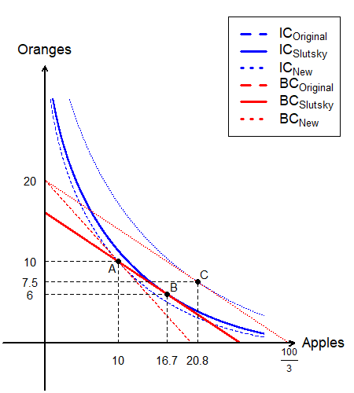
The Slutsky Substitution Effect
We then find the optimal bundle under this new “compensated income” level, which is bundle B.
The shift from bundle A to B is the “Substitution Effect.”
The shift from bundle B to C is the “Income Effect.”

Slide 14
The Hicksian Substitution Effect
Another way is to “adjust” the consumer’s income such that they can attain the pre-price-change utility level.
In our example, we had…
  Original Price of Apples: $5
  Updated Price of Apples: $3
  Price of Oranges: $5
  Original Bundle: 10 Apples, 10 Oranges
  Suppose the Utility from this original bundle was 40.
We need to find the budget line that has the updated relative price, which is tangent to the original indifference curve.

Slide 15
The Hicksian Substitution Effect
Originally, the consumer is maximizing their utility by consuming 10 apples and 10 oranges (bundle A).
The price of apples fall to $3, and the consumer moves to bundle C.
We will “divide” the change from bundle A to C, using the Hicksian method.

Slide 16
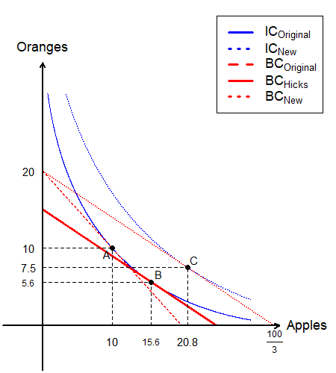
The Hicksian Substitution Effect
The Hicksian method relies on “adjusting the consumer’s income so that the original utility level is attainable.”
Graphically, it will be equivalent to finding a budget line with the “new” slope, which is tangent to the “original” indifference curve.

Slide 17
The Hicksian Substitution Effect
The shift from bundle A to B is the “Substitution Effect.”
The shift from bundle B to C is the “Income Effect.”
The shift from bundle A to C is the “Price Effect.”
  See also: Slutsky Equation

Slide 18
Comparing the Two Methods
Slutsky Substitution
Hicksian Substitution

Slide 19
Recap of Substitution Effects
Substitution Effect:
  The effect of the change in relative prices, isolated away from any effect that the change in purchasing power would impose.
  Always negatively correlated to changes in price .
  If the price increases, the substitution effect is negative.
Slutsky Method:
  Adjust the consumer’s income so that they can purchase their original bundle.
Hicksian Method:
  Adjust the consumer’s income so that they can attain their original level of utility.
  In this course, the default “Substitution Effect” is Hicksian.

Slide 20
Income Effects
Income Effect:
  The effect of the change in purchasing power, isolated away from any effect that the change in relative price would impose.
  Total Price Effect – Substitution Effect
The “Sign” of the Income Effect
  Unlike the substitution effect, the income effect can vary widely.
  The sign and magnitude of the income effect will differ based on whether the good is a…
    Normal Good
    Inferior Good
    Giffen Good

Slide 21
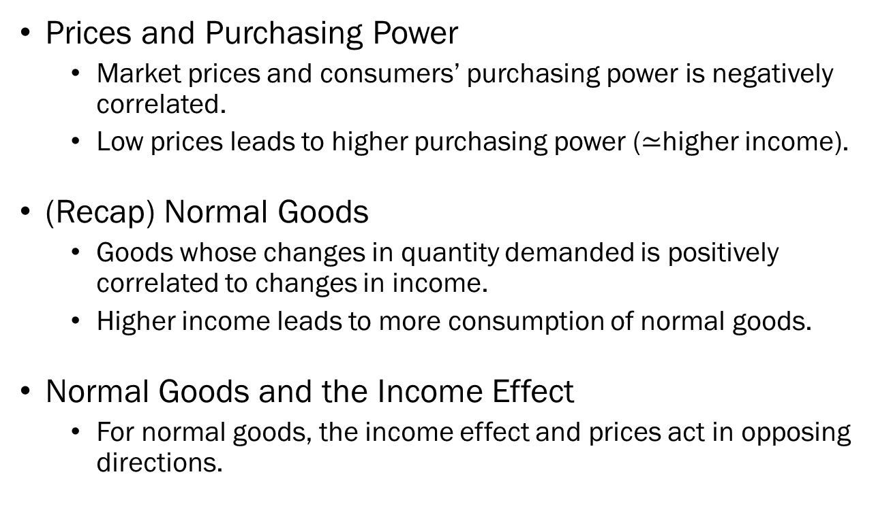
Normal Goods and the Income Effect
Prices and Purchasing Power
  Market prices and consumers’ purchasing power is negatively correlated.
  Low prices leads to higher purchasing power ($≃$higher income).
(Recap) Normal Goods
  Goods whose changes in quantity demanded is positively correlated to changes in income.
  Higher income leads to more consumption of normal goods.
Normal Goods and the Income Effect
  For normal goods, the income effect and prices act in opposing directions.

Slide 22
Income Effect for Normal Goods
The example that we have been dealing with is an example where apples are normal goods.
The price of apples fell, and the income effect from bundle B to bundle C is “positive.” (more apples)
In this case, apples are also “ordinary” goods.

Slide 23
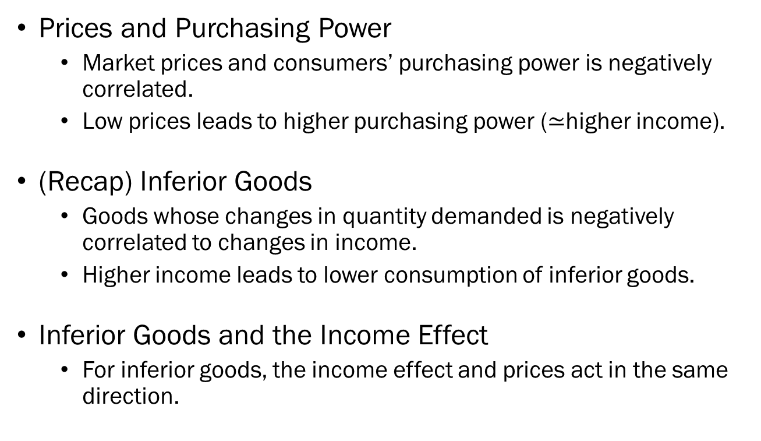
Inferior Goods and the Income Effect
Prices and Purchasing Power
  Market prices and consumers’ purchasing power is negatively correlated.
  Low prices leads to higher purchasing power ($≃$higher income).
(Recap) Inferior Goods
  Goods whose changes in quantity demanded is negatively correlated to changes in income.
  Higher income leads to lower consumption of inferior goods.
Inferior Goods and the Income Effect
  For inferior goods, the income effect and prices act in the same direction.

Slide 24
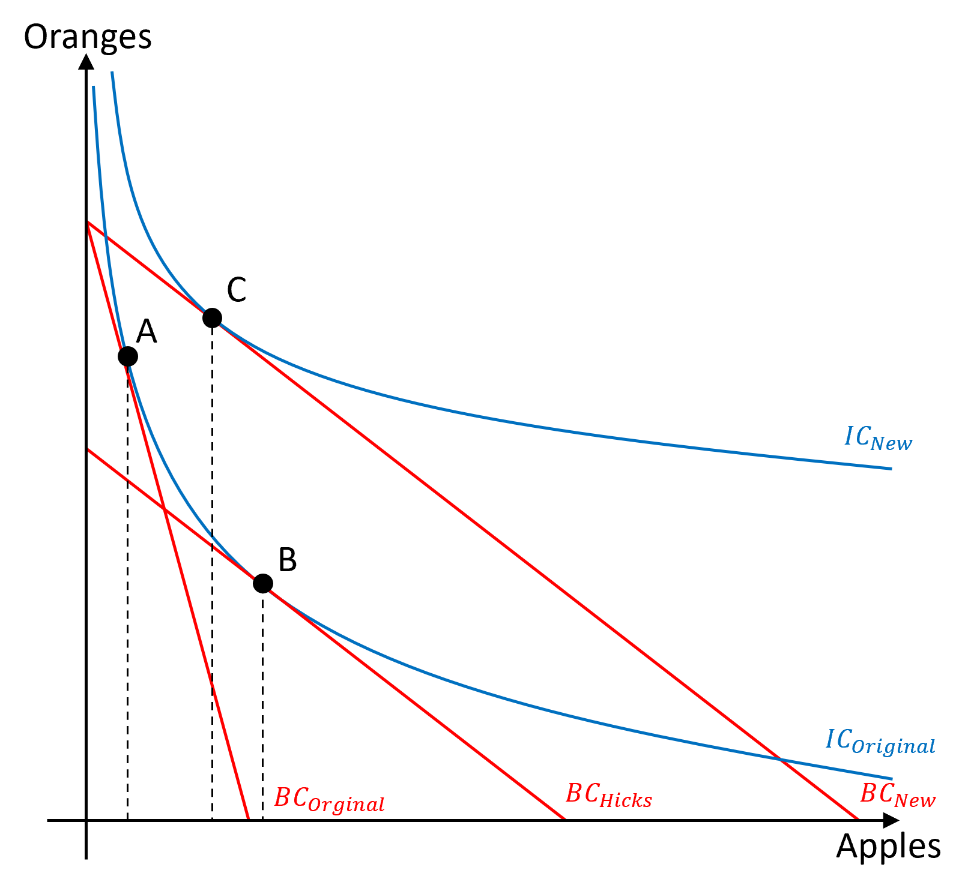
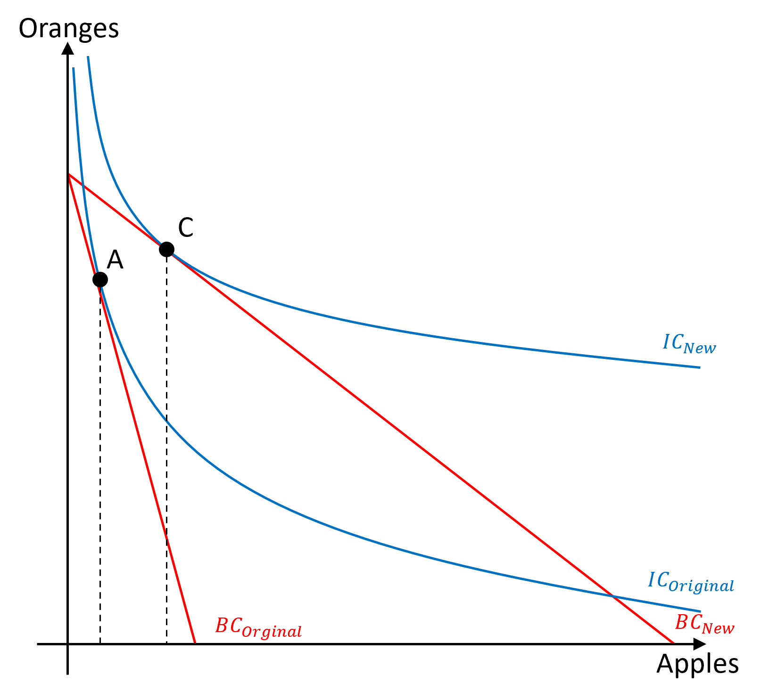
Income Effect for Inferior Goods
Suppose that apples are inferior goods.
Original choice at bundle A.
A price drop in apples leads the consumer to bundle C.
The shift from A to B is the substitution effect.
The shift from B to C is the income effect.

Slide 25
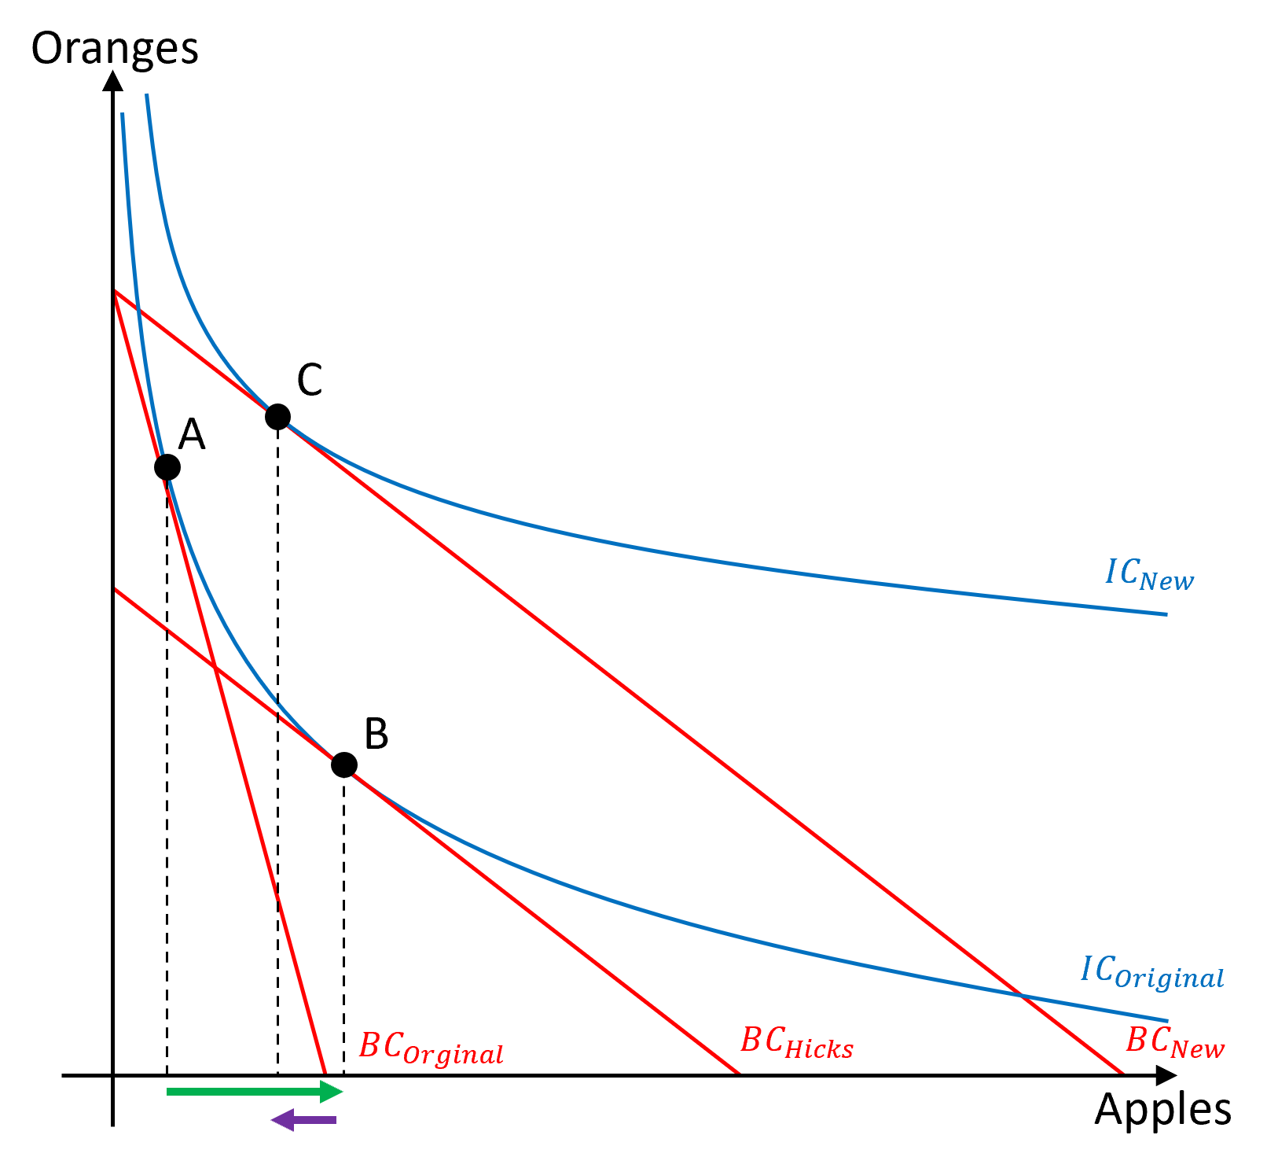
Income Effect for Inferior Goods
When apples are inferior…
The substitution effect is negatively correlated to price changes.
The income effect is positively correlated to price changes.
The income effect does not overpower the substitution effect. So, apples are “ordinary.”

Slide 26
Giffen Goods and the Income Effect
(Recap) Giffen Goods
  Goods whose changes in quantity demanded is positively correlated to changes in the market price.
  Higher prices leads to more consumption of Giffen goods.
Giffen Goods and the Income Effect
  For Giffen goods, the income effect and prices act in the same direction.
  Critically for Giffen goods, the income effect must overpower the substitution effect.

Slide 27
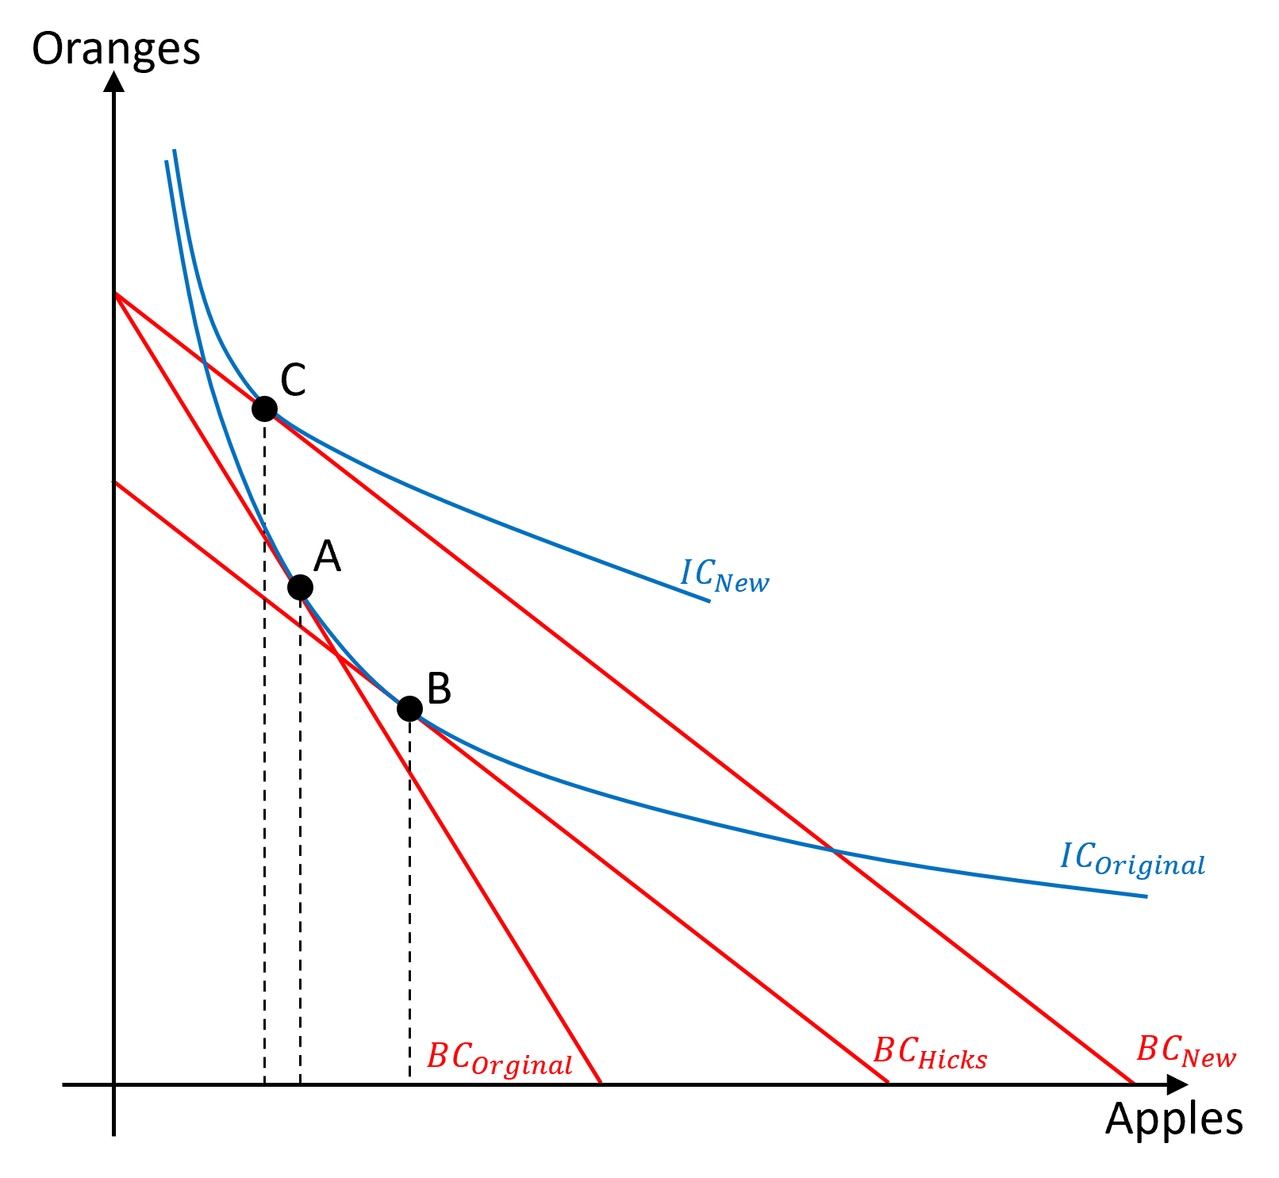
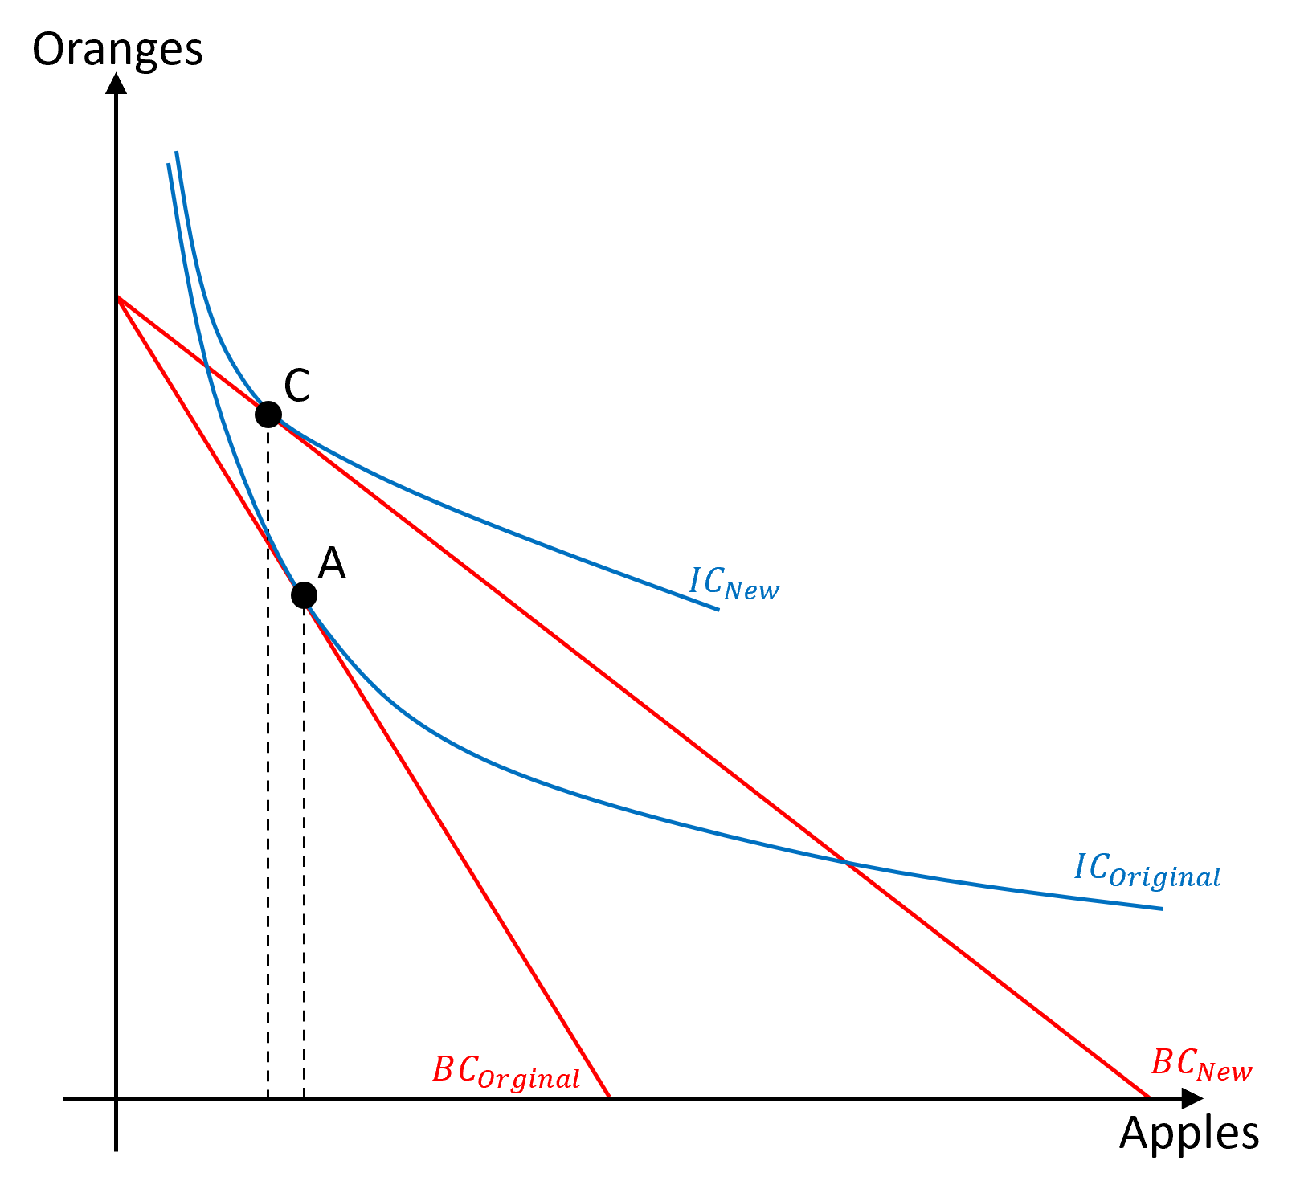
Income Effect for Giffen Goods
Suppose that apples are Giffen goods.
Original choice at bundle A.
A price drop in apples leads the consumer to bundle C.
The shift from A to B is the substitution effect.
The shift from B to C is the income effect.

Slide 28
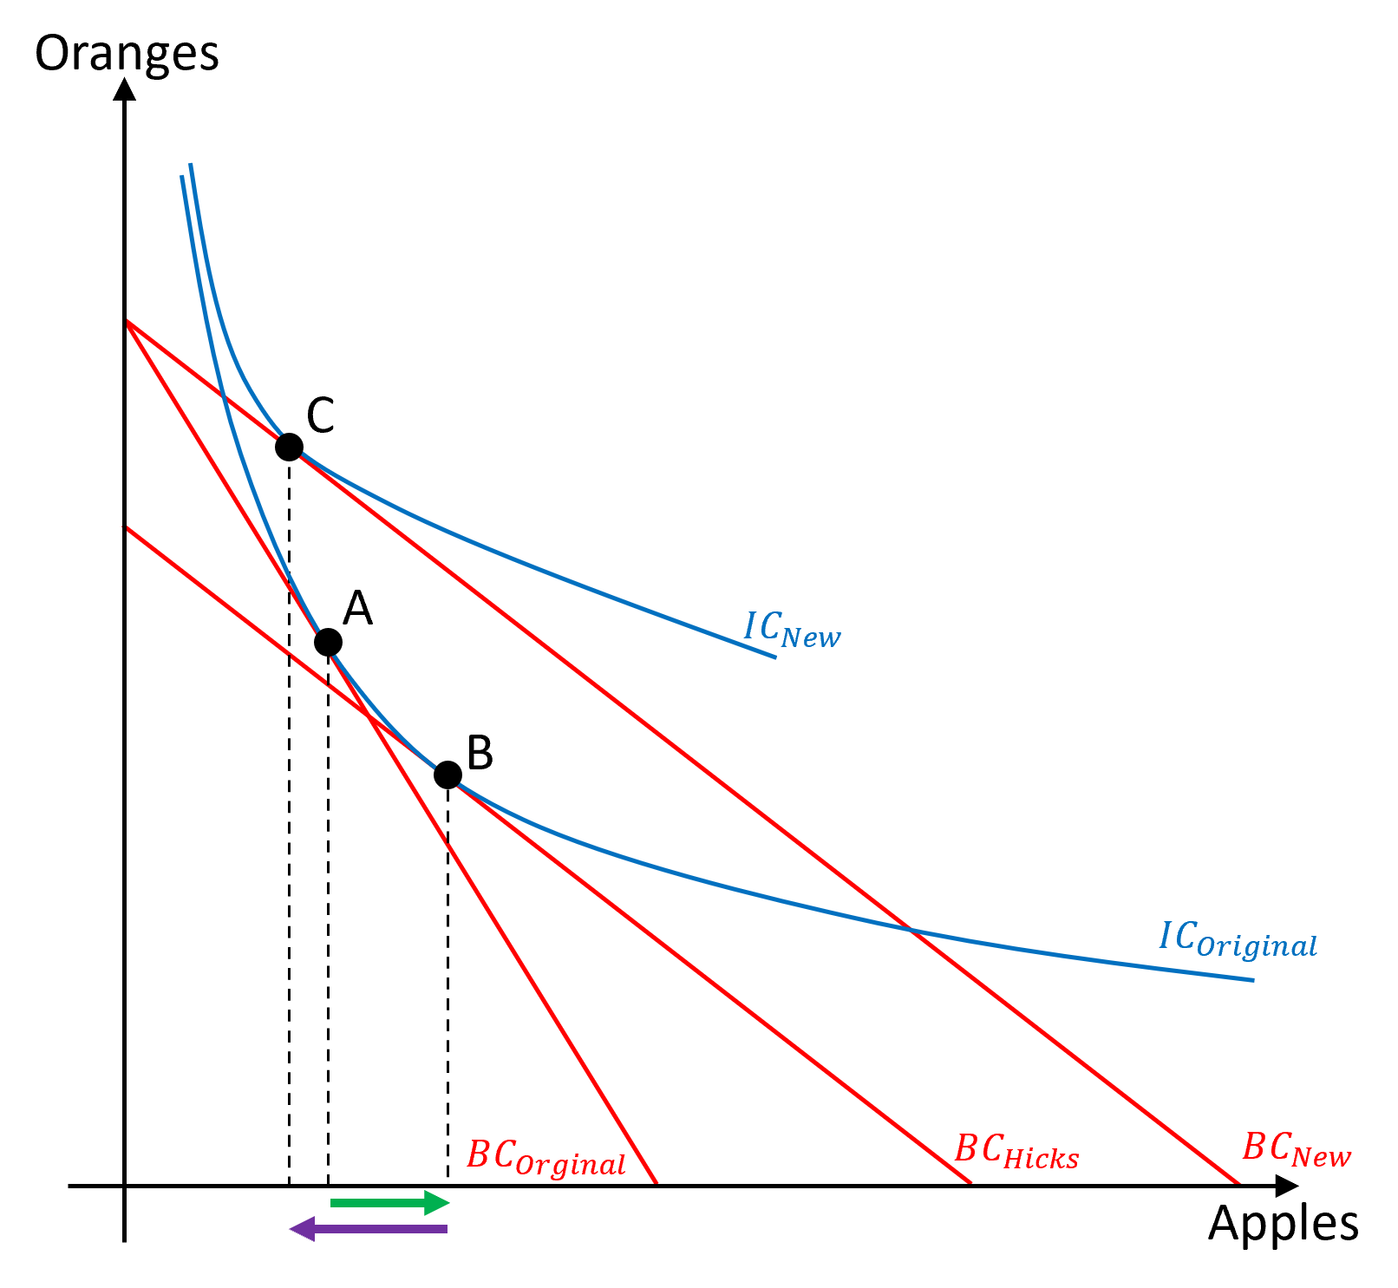
Income Effect for Giffen Goods
For Giffen goods…
The substitution effect is negatively correlated to price changes.
The income effect is positively correlated to price changes.
The income effect must be greater than the opposing substitution effect.

Slide 29
Types of Goods and their
Substitution, Income, and Price Effects
See the following table for a recap on the relationship between the changes in market price, and the direction of the income, substitution, and price effects.
  For example, if a good is inferior and ordinary, when prices decrease (-), the substitution effect is positive (+), the income effect is negative (-), and overall price effect is positive (+)
Effect Type of Goods . |  | Substitution Effect | Income Effect | Price Effect
Normal | Ordinary | Opposite | Opposite | Opposite
Inferior | Ordinary | Opposite | Same | Opposite
 | Giffen | Opposite | Same | Same

Slide 30
Hicksian Substitution and the
Expenditure Minimization Problem
The Hicksian substitution effect was obtained by finding the budget line with the new relative price ratio that is tangent to the old indifference curve.
“What is the bundle that requires the minimum amount of money to purchase while reaching a set level of utility?”
We were in fact solving the Expenditure Minimization Problem (EMP)

Slide 31
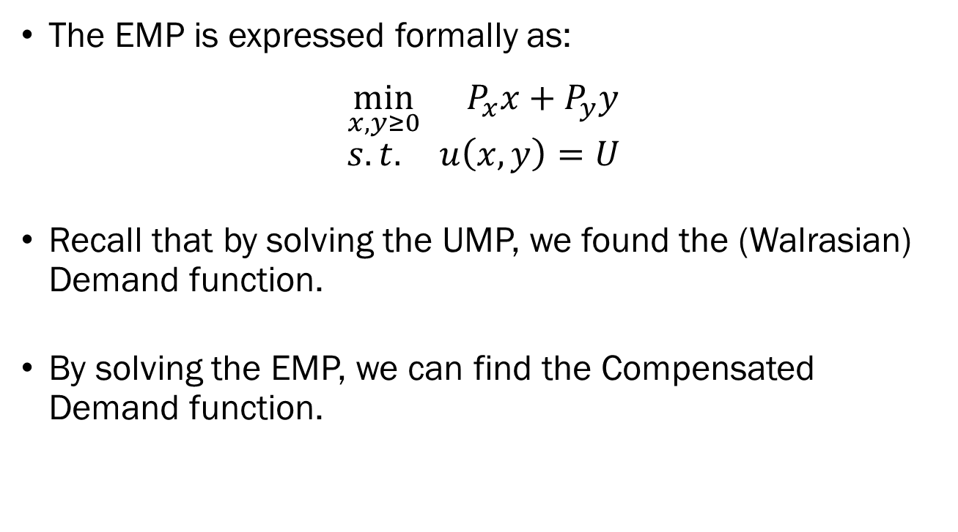
The Expenditure Minimization Problem
The EMP is expressed formally as:
$$\min_{x,y≥0}{{ P}_{x}x+P_{y}y}$$
$$s.t. u\left(x,y\right)=U$$
Recall that by solving the UMP, we found the (Walrasian) Demand function.
By solving the EMP, we can find the Compensated Demand function.

Slide 32
Recap of Today’s Lecture
Breaking Down the Price Effect
  Substitution Effect
  Income Effect
  Slutsky Equation
  Slutsky Substitution Effect
  Hicksian Substitution Effect
  Expenditure Minimization

