Slide 1
Consumer Theory: Indifference Curves Part 2
ECON 300

Slide 2
Slopes and their Meanings
Recall that the slope of the budget line represents the objective rate of exchange determined by the market.
This was made clear when we calculated the slope of the budget line, $−\frac{P_{x}}{P_{y}}$, the relative price of the two goods.
The slope of the indifference curve represents the subjective exchange rate determined by the consumers’ preferences.
We will now start investigating why this is true.

Slide 3
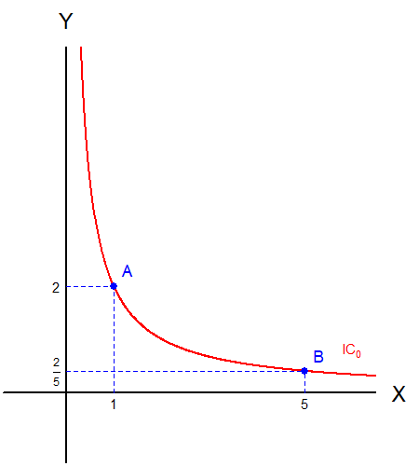
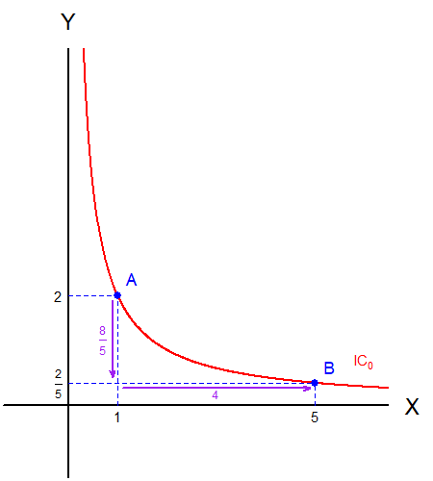
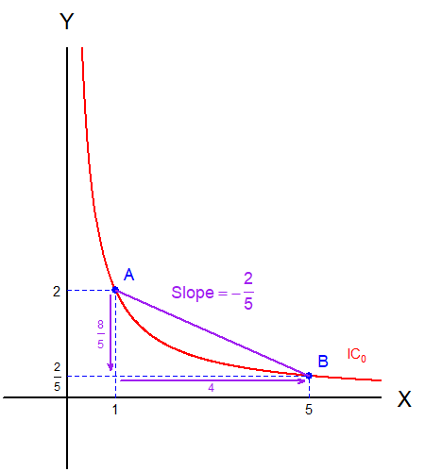
The Slope Along the Indifference Curve
Consider a bundle $A$ and the indifference curve $IC_{0}$ passing through $A$, and another bundle $B$ on $IC_{0}$.
When the consumer is at bundle $A$, they will be equally satisfied if they gave up 8/5 units of good $Y$ for 4 units of good $X$.
The slope between bundle $A$ and bundle $B$on $IC_{0}$?

Slide 4
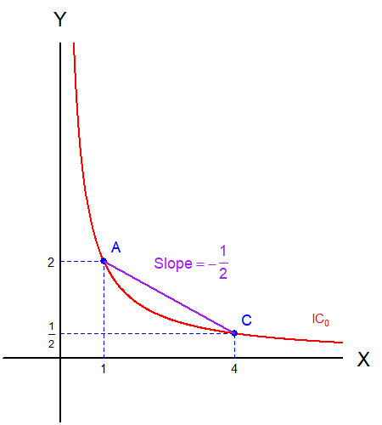
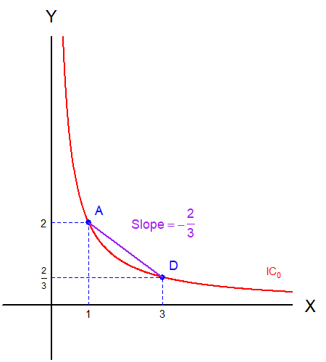
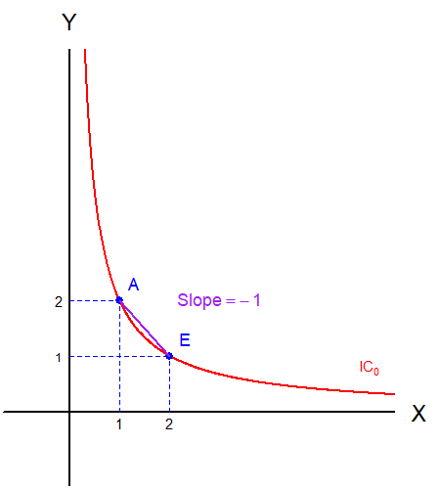
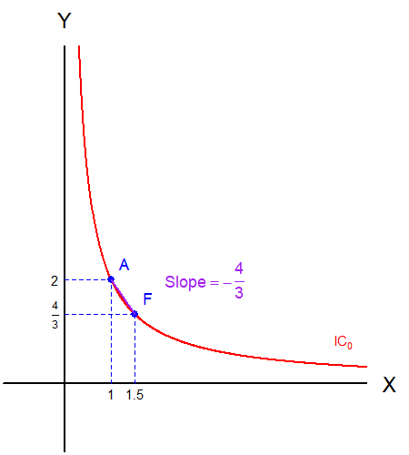
The Slope Along the Indifference Curve
Now consider the slopes between other bundles.
The slope will change as the comparison bundle moves “closer” to bundle $A$.
What will happen when we take this to the extreme?

Slide 5
The Slope “On” the Indifference Curve
We arrive at the slope “at the point.”
This slope still represents the subjective rate of exchange of the consumer who is currently consuming bundle A.
But how do we calculate this “instantaneous” slope?

Slide 6
Detour: Marginal Utility
Marginal Utility, in discrete terms, is the utility the consumer obtains from “at the margin.”
Let us see with a simplified example:
Units of X | U(X) | U’(X)
1 | 100 | 100
2 | 180 | 80
3 | 244 | 64
4 | 295 | 51
5 | 336 | 41
6 | 369 | 33

Slide 7
Detour: Marginal Utility
But the model we use assume “continuous” goods.
Consumers are allowed to purchase 0.00001 units.
We cannot use tables, so we rely on graphs.
For this exercise, we are assuming that good $Y$ is fixed to some value.

Slide 8
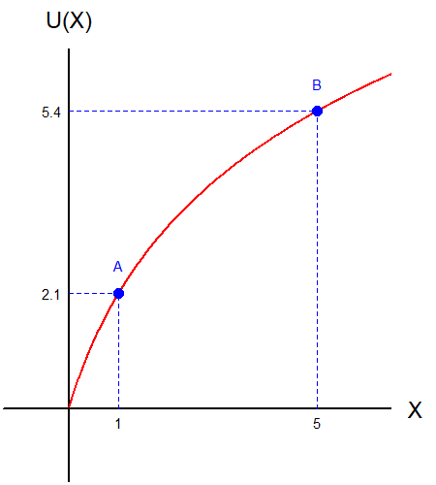
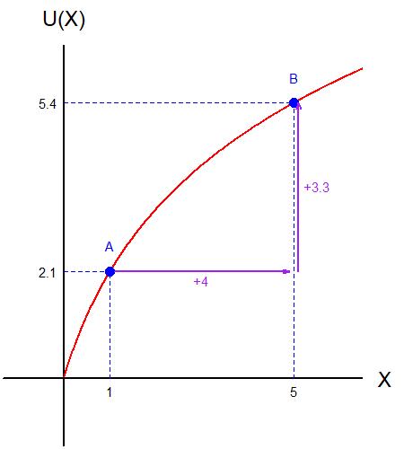
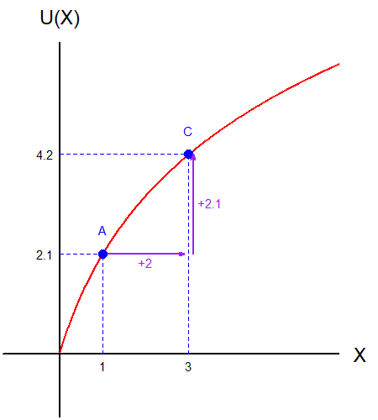
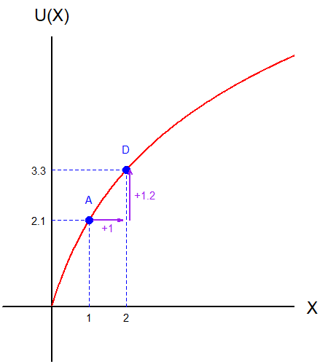
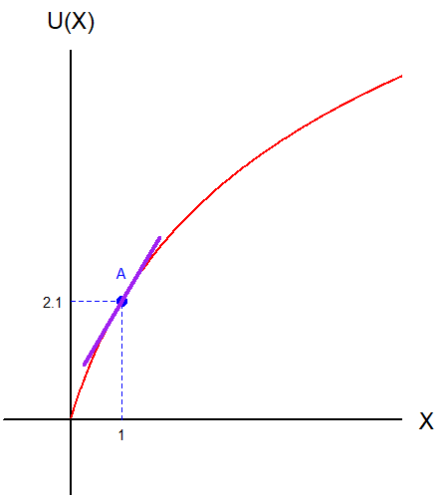
Detour: Marginal Utility
Consider point $A$.
The “marginal” utility from moving to point $B$?
The “marginal” utility from moving to point $C$?
The “marginal” utility from moving to point $D$?
Taken to the “limit?” The marginal utility at $A$?

Slide 9
Detour: Derivatives
We learned that the slope calculated at one point is the derivative.
$$\frac{d}{dx}cx^{a}=acx^{a−1}$$
Using actual numbers as examples, we have:
$\frac{d}{dx}x^{2}=2x$
$\frac{d}{dx}x=1$
$\frac{d}{dx}5x^{3}=5⋅\left(3x^{2}\right)=15x^{2}$

Slide 10
Detour: Partial Derivatives
One complication arises because we typically have more than one variable (good) that the consumer can choose.
This is where the concept of a “partial derivative” enters.
$$\frac{∂}{∂x}f\left(x,y\right)=f_{x}(x,y)$$
$$\frac{∂}{∂y}f\left(x,y\right)=f_{y}(x,y)$$
The rules are basically identical to the previous case, but we treat the variables we are not interested in as constants.

Slide 11
Detour: Partial Derivatives
We learned that the slope calculated at one point is the derivative.
$$\frac{∂}{∂x}\left({cx}^{a}y^{b}\right)=acx^{a−1}y^{b}$$
Using actual numbers as examples, we have:
$\frac{∂}{∂x}x^{2}y=2xy$
$\frac{∂}{∂x}xy=y$
$\frac{∂}{∂x}5x^{3}y^{2}=15x^{2}y^{2}$

Slide 12
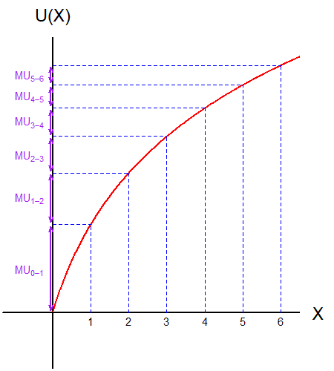
Marginal Utility
If we pretend that goods are discrete… (i.e., Cannot buy “fractional” items)
The marginal utility is the amount of utility gained from each additional unit consumed.
Marginal Utility is often denoted as $MU(⋅)$

Slide 13
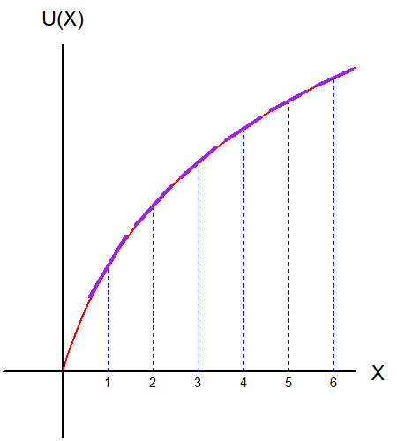
Marginal Utility
However, our models assume continuous goods. (i.e., can purchase “fractional” items)
Marginal Utility is defined as the partial derivative of the utility function.
It can be calculated as the slope of the utility function at a given point.

Slide 14
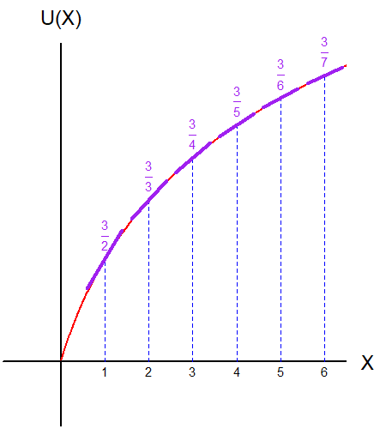
The Law of Diminishing Marginal Utility
The marginal utility must decrease as the quantity of goods consumed increases.
Loosely translated in plain words, “consumers are less happy with goods that they have already had.”

Slide 15
The Marginal Rate of Substitution
Recall that we wanted to find the slope of the indifference curve, which was claimed to be the consumers’ subjective rate of exchange.
This lead us down a rabbit hole of partial derivatives and marginal utilities.
So how does this relate to the slope of the indifference curve?

Slide 16
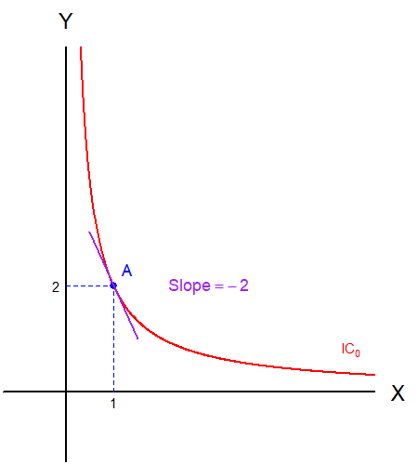
The Marginal Rate of Substitution
Suppose that we are given this indifference curve.
We covered why the slope of the indifference curve is the subjective rate of exchange.
We also covered why we want to find the instantaneous slope.

Slide 17
The Marginal Rate of Substitution
The marginal rate of substitution is defined as:
.
$$MRS_{xy}=−\frac{MU_{x}}{MU_{y}}$$
Recall that the marginal utility are the partial derivatives:
$$MRS_{xy}=−\frac{\frac{∂}{∂x}u\left(x,y\right)}{\frac{∂}{∂y}u\left(x,y\right)}=−\frac{u_{x}(x,y)}{u_{y}(x,y)}$$

Slide 18
The Marginal Rate of Substitution
Let’s walk through an example.
The utility function used in this plot is:
$$u\left(x,y\right)=x⋅y$$
$MRS_{xy}=−\frac{\frac{∂}{∂x}xy}{\frac{∂}{∂y}xy}=−\frac{y}{x}$

Slide 19
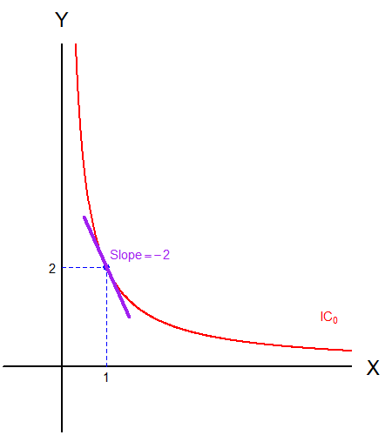
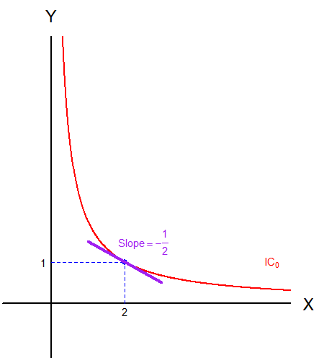
The Marginal Rate of Substitution
$MRS_{xy}=−\frac{y}{x}$ means that the slope will change depending on the amount of goods $x$ and $y$ in the bundle.
When we are at (1,2), the slope is $MRS_{xy}=−2$.
When we are at (2,1), the slope is $MRS_{xy}=−\frac{1}{2}$.

Slide 20
The Marginal Rate of Substitution
The Marginal Rate of Substitution (MRS) is the slope of the indifference curve.
The MRS represents the consumer’s subjective rate of exchange between the two goods in the market.
How many units of good $y$ is the consumer willing to give up for one extra unit of good $x$.
The Law of Diminishing Marginal Rate of Substitution.

Slide 21
“Families” of Utility Functions and ICs
Throughout the semester, we will be working three different “families” of utility functions.
Cobb-Douglas Utility Functions
Linear Utility Functions
Leontief Utility Functions
Each family of utility function stands in for a specific type of preferences.
Most indifference curves that we have been plotting come from a variation of the Cobb-Douglas utility function.

Slide 22
The Cobb-Douglas Utility Function
The Cobb-Douglas Utility Function takes the form of:
$$u\left(x,y\right)=Cx^{a}y^{b}$$
This is one the most frequently used utility functions.
Goods show some degree of substitutability and complementarity.

Slide 23
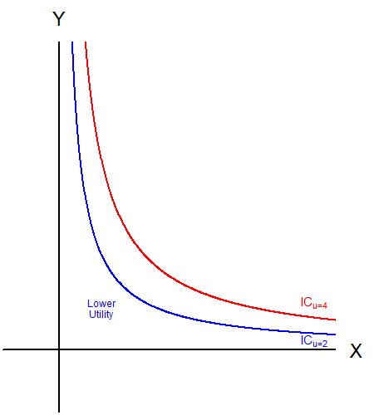
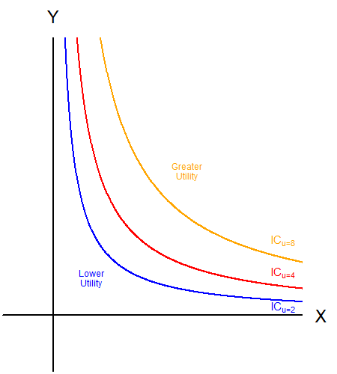
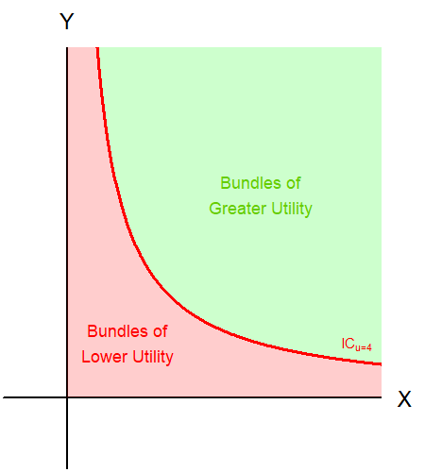
The Cobb-Douglas Utility Function
Similarly, points closer to the origin represent lower utility levels.
The points further away from the origin represent bundles of greater utility.
Like the budget constraint, the indifference curve splits the commodity space in two.

Slide 24
The Linear Utility Function
The Linear Utility Function takes the form of:
$$u\left(x,y\right)=ax+by$$
When the two goods are perfect substitutes, we use the linear utility function.
Perfect substitutes mean that one good can stand in for the other.

Slide 25
The Linear Utility Function
The goods being perfect substitutes does not necessarily mean that they will be a 1:1 perfect substitute.
The slope of the linear utility function is $−\frac{a}{b}$.
The slope determines the subjective rate of substitution.

Slide 26
The Linear Utility Function
$$u\left(x,y\right)=3x+y$$
$$u\left(x,y\right)=x+3y$$

Slide 27
The Linear Utility Function
Points further away from the origin represent higher utility.

Slide 28
The Leontief Utility Function
The Leontief Utility Function takes the form of:
$$u\left(x,y\right)=min⁡\{ax,by\}$$
The utility from consuming the bundle $\left(x,y\right)$ is the lesser between $ax$ or $by$.
For example, $\min\left\{120,75\right\}=75$

Slide 29
The Leontief Utility Function
Bundle A, B, and C provide the same level of utility.
“Having more of one good means nothing if I don’t have enough of the other to complement it.”
We can tell that the goods are perfect complements.

Slide 30
The Leontief Utility Function
The optimal mix of goods $x$ and $y$ to be consumed is determined by the parameters $a$ and $b$.
The ray spanning out from the origin represents this optimal mix.
The slope of this ray is $\frac{a}{b}$
Draw $y=$ $\frac{a}{b}x$

Slide 31
The Leontief Utility Function
$$u\left(x,y\right)=max⁡\{3x,y\}$$
$$u\left(x,y\right)=max⁡\{x,3y\}$$

Slide 32
The Leontief Utility Function
Points further away from the origin represent higher utility.

Slide 33
Recap of Today’s Lecture
The Law of Diminishing Marginal Utility.
Marginal Rate of Substitution.
Cobb-Douglas Utility Functions.
Linear Utility Functions.
Leontief Utility Functions.

Slide 34
Next Lecture
Starting off the Utility Maximization Problem.
Conditions of Utility Maximization.
Comparing Slopes

