Slide 1
Consumer Theory:
Indifference Curves Part 1
ECON 300

Slide 2

PollEv.com/brianpark046

Slide 3
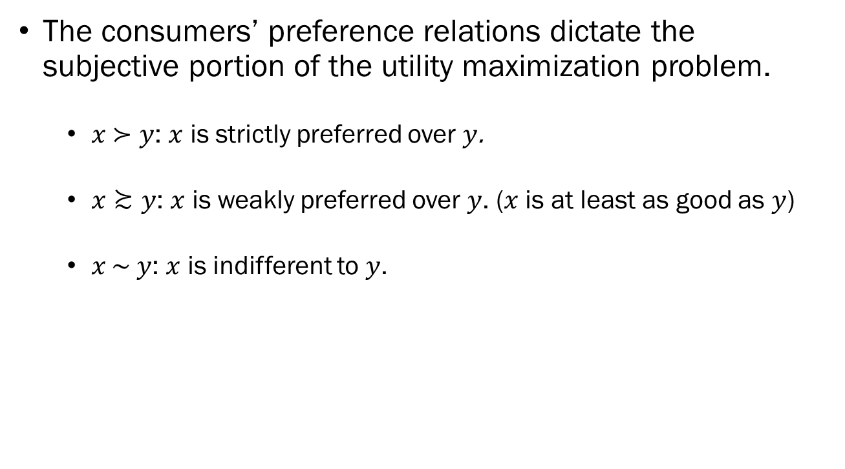
Recap: Preferences
The consumers’ preference relations dictate the subjective portion of the utility maximization problem.
  $x \text{≻ }y$: $x$ is strictly preferred over $y$.
  $x≿y$: $x$ is weakly preferred over $y$. ($x$ is at least as good as $y$)
  $x \text{∼} y$: $x$ is indifferent to $y$.

Slide 4
Recap: Preferences
The six axioms of preferences:
  Complete: Consumer can always compare any two bundles.
  Transitive: No circular preferences allowed.
  Reflexive: A bundle is always as good as itself.
  Continuous: No sudden jumps in preference.
  Strongly Monotone: The more the better.
  Convex: Consumers like diversity in consumption.

Slide 5
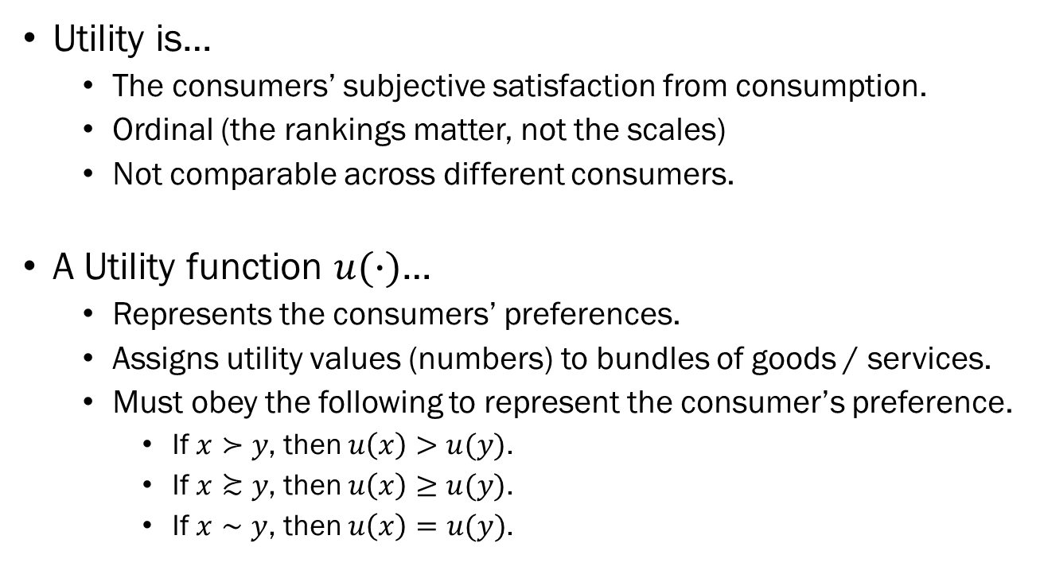
Recap: Utility / Utility Functions
Utility is…
  The consumers’ subjective satisfaction from consumption.
  Ordinal (the rankings matter, not the scales)
  Not comparable across different consumers.
A Utility function $u(∙)$…
  Represents the consumers’ preferences.
  Assigns utility values (numbers) to bundles of goods / services.
  Must obey the following to represent the consumer’s preference.
    If $x≻y$, then $u\left(x\right)>u(y)$.
    If $x≿y$, then $u\left(x\right)≥u(y)$.
    If $x∼y$, then $u\left(x\right)=u(y)$.

Slide 6
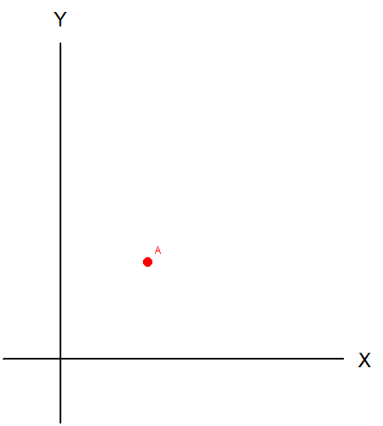
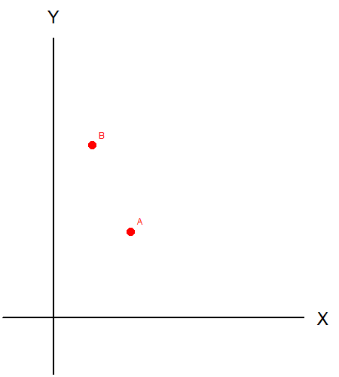
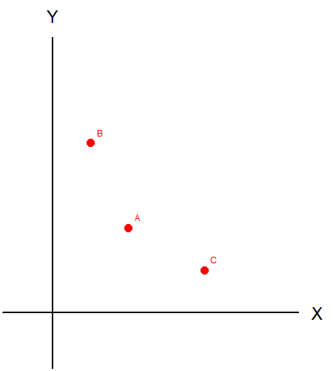
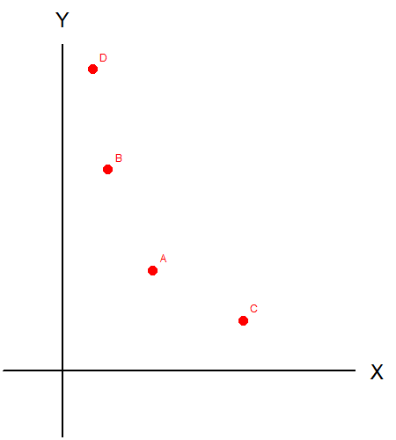
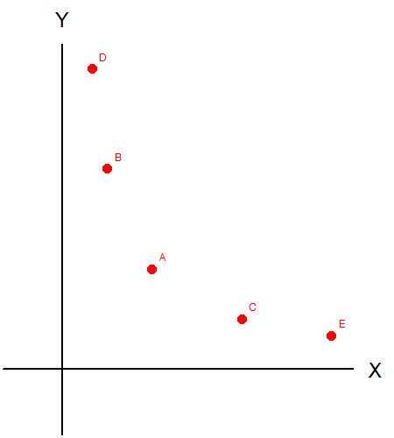
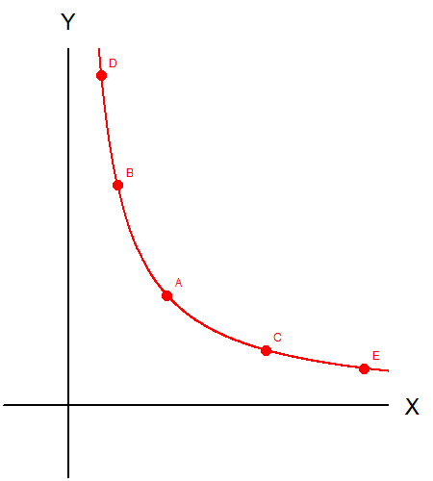
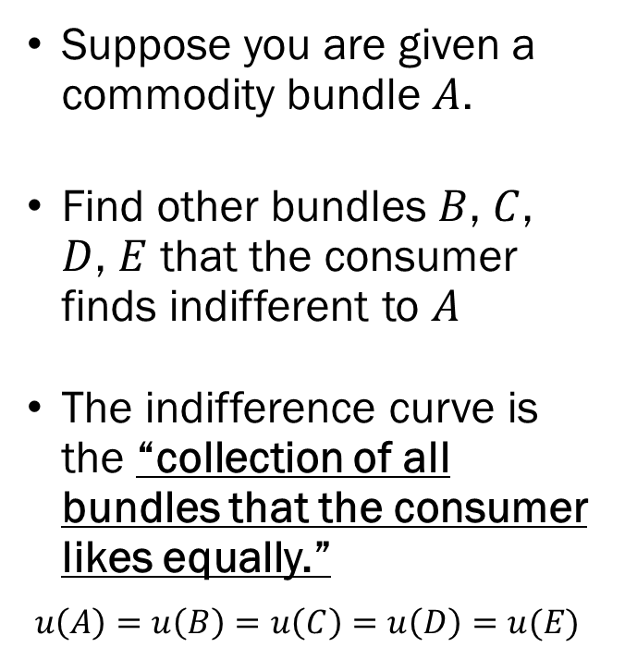
Indifference Curves
Suppose you are given a commodity bundle $A$.
Find other bundles $B$, $C$, $D$, $E$ that the consumer finds indifferent to $A$.
The indifference curve is the “collection of all bundles that the consumer likes equally.”
$$u\left(A\right)=u\left(B\right)=u\left(C\right)=u\left(D\right)=u(E)$$

Slide 7
Indifference Curves and Topographic Maps
When reading a map, the contour lines show us the locations that share a common altitude.
Indifference curves are contour lines that show us the points that share the same utility level.
When we see a commodity plane, imagine that there is a “mountain” of utility with the “peak” somewhere to the extreme end.

Slide 8
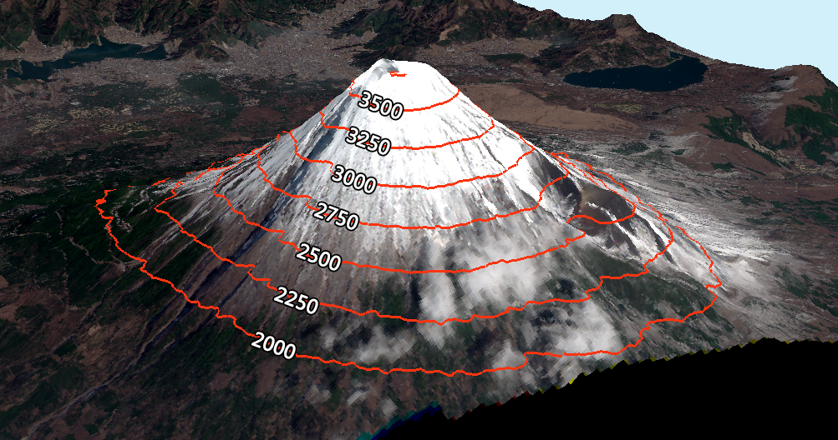
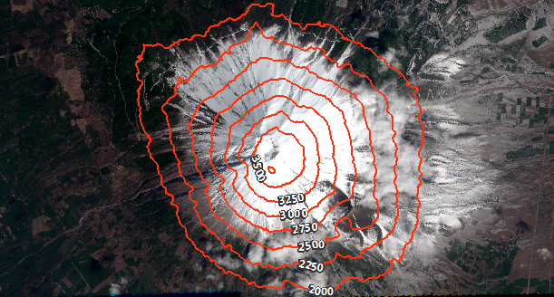
Similarity to Topographic Maps
3D Map
Topographic Map
Imagine that there is a hidden third axis, representing “Height” or “Utility.”

Slide 9
Properties of the Indifference Curve
Every commodity bundle must have an indifference curve passing through.

Slide 10
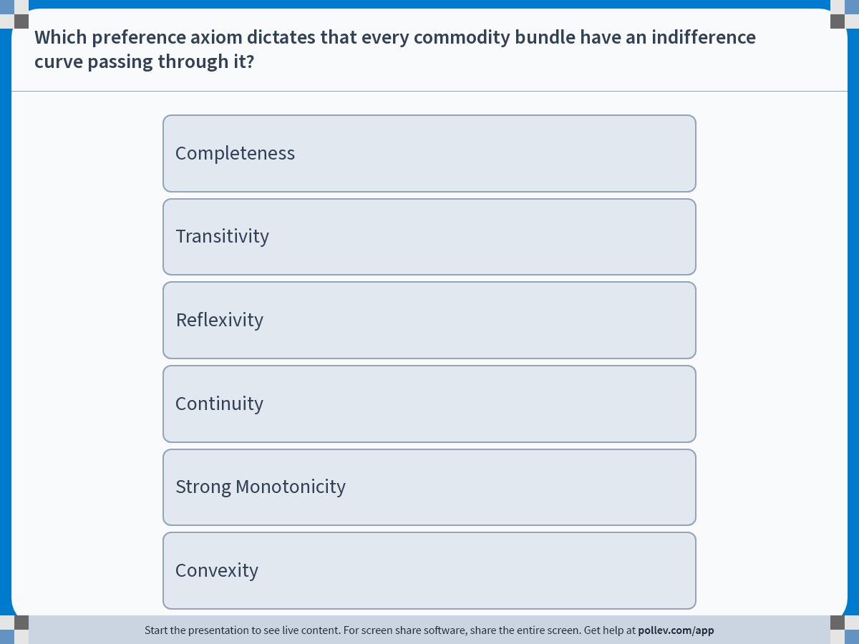
Notes:
Poll Title: Do not modify the notes in this section to avoid tampering with the Poll Everywhere activity.
More info at polleverywhere.com/support
Which preference axiom dictates that every commodity bundle have an indifference curve passing through it?
https://www.polleverywhere.com/multiple_choice_polls/ofOyif8D8dRzskz9k1I4y?display_state=instructions&activity_state=opened&state=opened&flow=Engagement&onscreen=persist

Slide 11
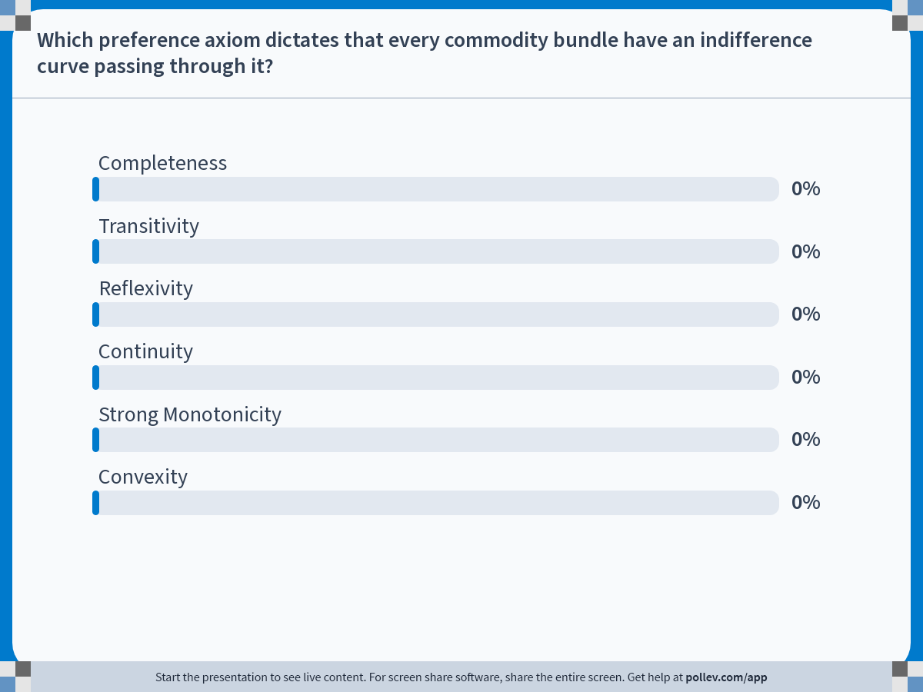
Notes:
Poll Title: Do not modify the notes in this section to avoid tampering with the Poll Everywhere activity.
More info at polleverywhere.com/support
Which preference axiom dictates that every commodity bundle have an indifference curve passing through it?
https://www.polleverywhere.com/multiple_choice_polls/ofOyif8D8dRzskz9k1I4y?display_state=chart&activity_state=closed&state=closed&flow=Engagement&onscreen=persist

Slide 12
Properties of the Indifference Curve
Every commodity bundle must have an indifference curve passing through. (Completeness)
“Higher” indifference curves are preferred.

Slide 13
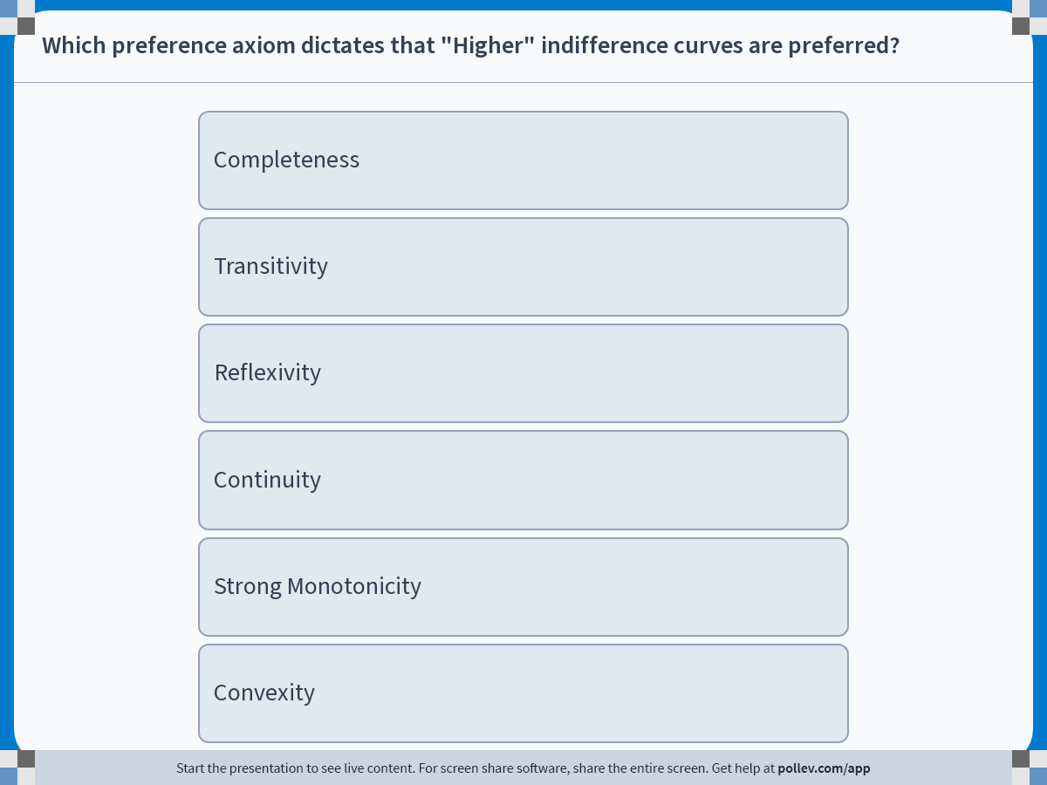
Notes:
Poll Title: Do not modify the notes in this section to avoid tampering with the Poll Everywhere activity.
More info at polleverywhere.com/support
Which preference axiom dictates that "Higher" indifference curves are preferred?
https://www.polleverywhere.com/multiple_choice_polls/q6thGDDSC516CqgeA94OW?display_state=instructions&activity_state=opened&state=opened&flow=Engagement&onscreen=persist

Slide 14
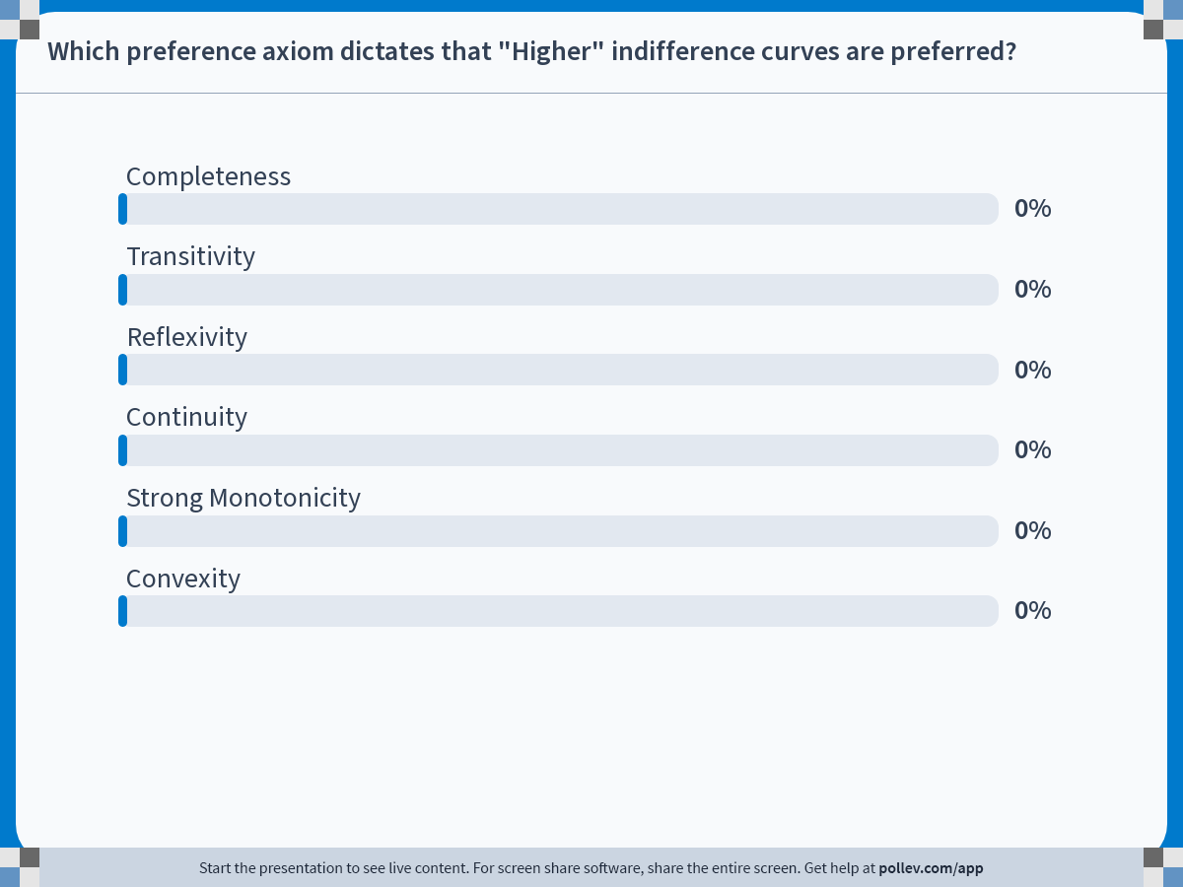
Notes:
Poll Title: Do not modify the notes in this section to avoid tampering with the Poll Everywhere activity.
More info at polleverywhere.com/support
Which preference axiom dictates that "Higher" indifference curves are preferred?
https://www.polleverywhere.com/multiple_choice_polls/q6thGDDSC516CqgeA94OW?display_state=chart&activity_state=closed&state=closed&flow=Engagement&onscreen=persist

Slide 15
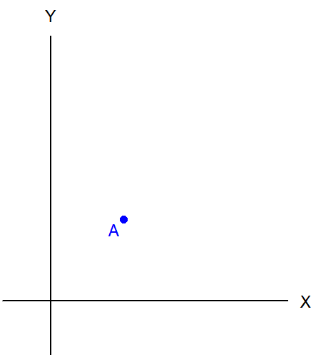
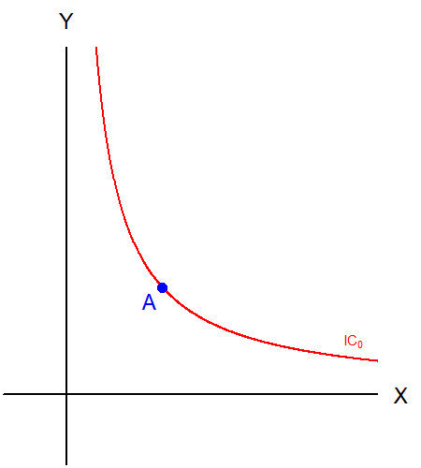
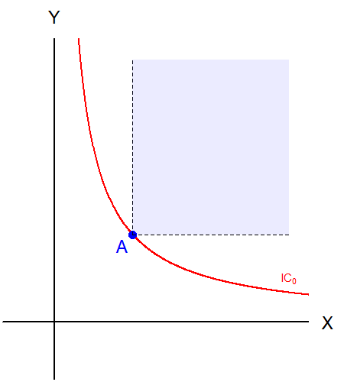
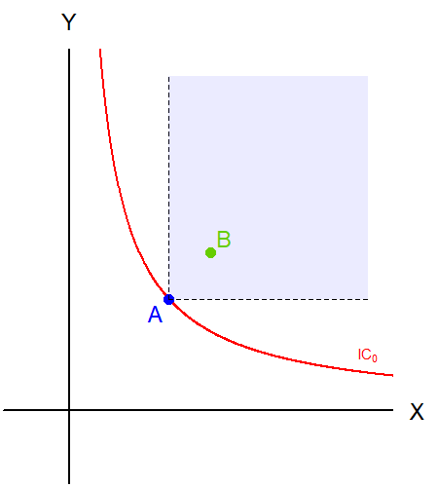
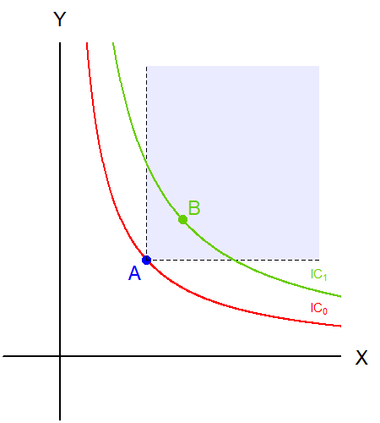
Why “Higher” Indifference Curves?
Suppose you are given A.
Draw an IC through it.
Strong Monotonicity tells us that bundles in the shaded zone are better.
Find point B in the shade.
Draw an IC through it to show “Higher” ICs are preferred.

Slide 16
Properties of the Indifference Curve
Every commodity bundle must have an indifference curve passing through. (Completeness)
“Higher” indifference curves are preferred. (Monotonicity)
Indifference curves cannot intersect.

Slide 17
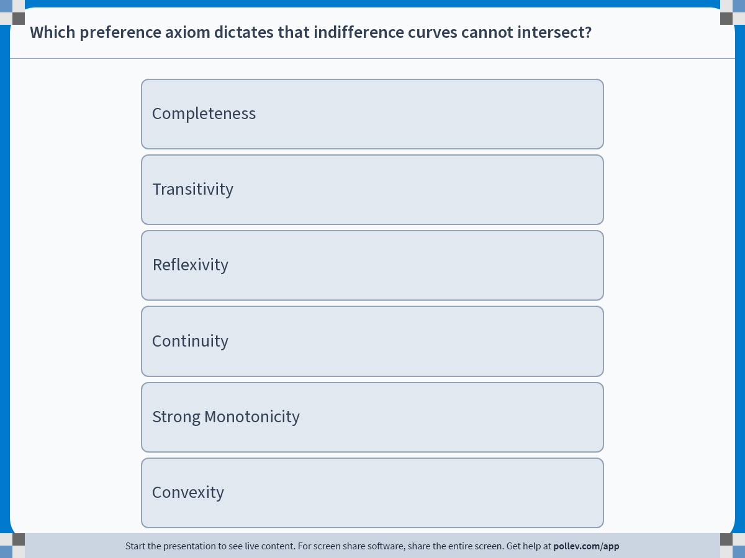
Notes:
Poll Title: Do not modify the notes in this section to avoid tampering with the Poll Everywhere activity.
More info at polleverywhere.com/support
Which preference axiom dictates that indifference curves cannot intersect?
https://www.polleverywhere.com/multiple_choice_polls/qBuIu0cMRZnDofFfgpPYq?display_state=instructions&activity_state=opened&state=opened&flow=Engagement&onscreen=persist

Slide 18
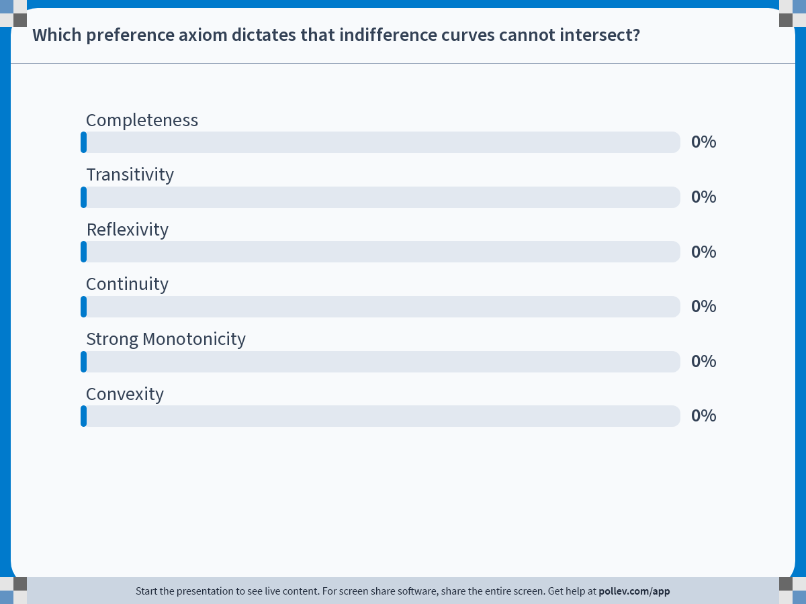
Notes:
Poll Title: Do not modify the notes in this section to avoid tampering with the Poll Everywhere activity.
More info at polleverywhere.com/support
Which preference axiom dictates that indifference curves cannot intersect?
https://www.polleverywhere.com/multiple_choice_polls/qBuIu0cMRZnDofFfgpPYq?display_state=chart&activity_state=closed&state=closed&flow=Engagement&onscreen=persist

Slide 19
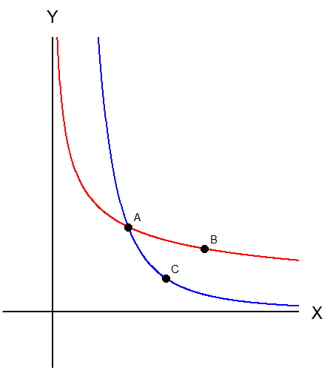
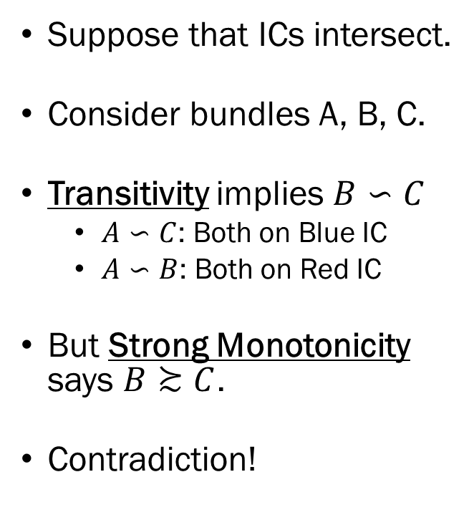
Intersecting Indifference Curves?
Suppose that ICs intersect.
Consider bundles A, B, C.
Transitivity implies $B∽C$
  $A∽C$: Both on Blue IC
  $A∽B$: Both on Red IC
But Strong Monotonicity says $B≿C$.
Contradiction!

Slide 20
Properties of the Indifference Curve
Every commodity bundle must have an indifference curve passing through. (Completeness)
“Higher” indifference curves are preferred. (Monotonicity)
Indifference curves cannot intersect. (Monotonicity & Transitivity)
Indifference curves must slope downward.

Slide 21
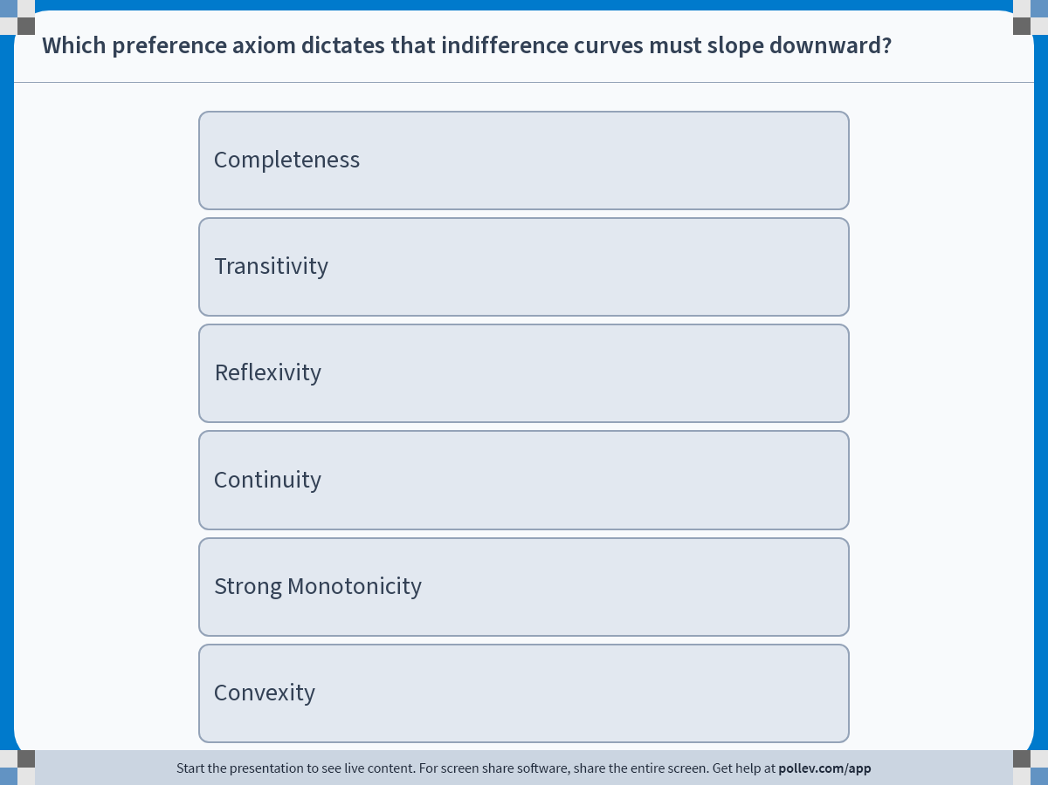
Notes:
Poll Title: Do not modify the notes in this section to avoid tampering with the Poll Everywhere activity.
More info at polleverywhere.com/support
Which preference axiom dictates that indifference curves must slope downward?
https://www.polleverywhere.com/multiple_choice_polls/Ohf6homg48WINXjqJYenM?display_state=instructions&activity_state=opened&state=opened&flow=Engagement&onscreen=persist

Slide 22
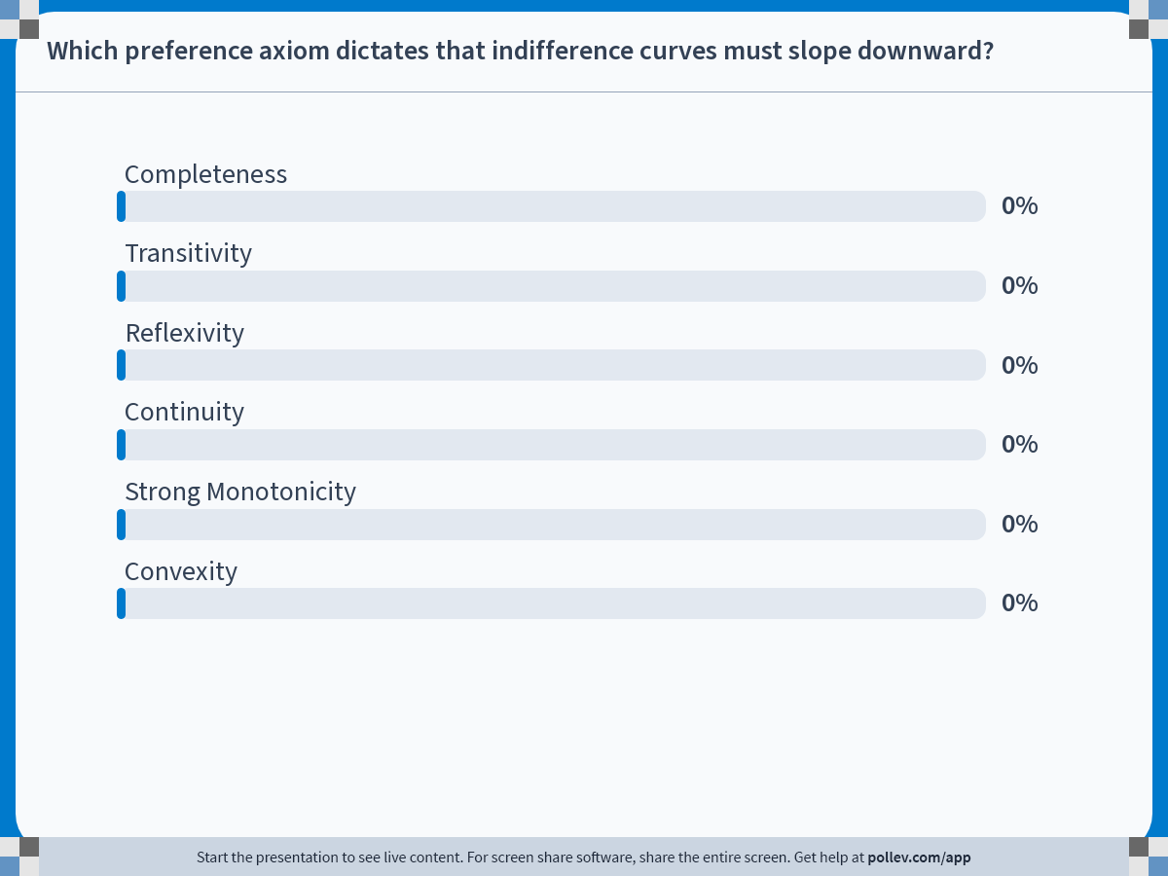
Notes:
Poll Title: Do not modify the notes in this section to avoid tampering with the Poll Everywhere activity.
More info at polleverywhere.com/support
Which preference axiom dictates that indifference curves must slope downward?
https://www.polleverywhere.com/multiple_choice_polls/Ohf6homg48WINXjqJYenM?display_state=chart&activity_state=closed&state=closed&flow=Engagement&onscreen=persist

Slide 23
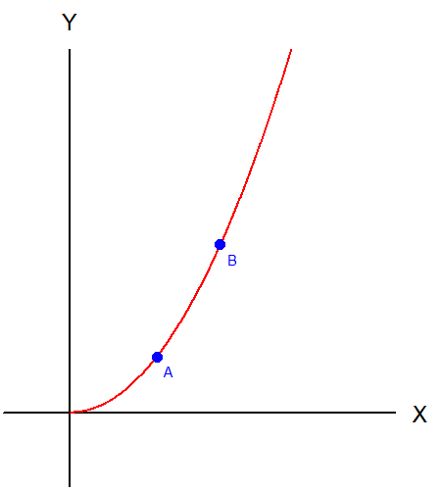
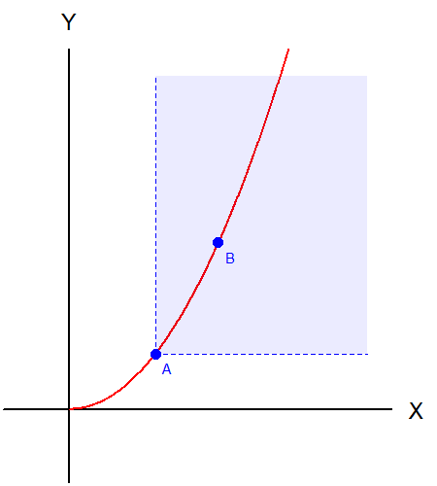
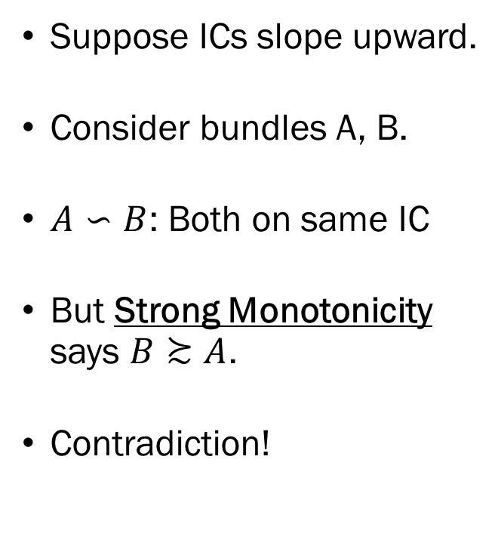
Upward Sloping ICs?
Suppose ICs slope upward.
Consider bundles A, B.
$A∽B$: Both on same IC
But Strong Monotonicity says $B≿A$.
Contradiction!

Slide 24
Properties of the Indifference Curve
Every commodity bundle must have an indifference curve passing through. (Completeness)
“Higher” indifference curves are preferred. (Monotonicity)
Indifference curves cannot intersect. (Monotonicity & Transitivity)
Indifference curves must slope downward. (Monotonicity)
Indifference curves cannot “bulge outward.”

Slide 25
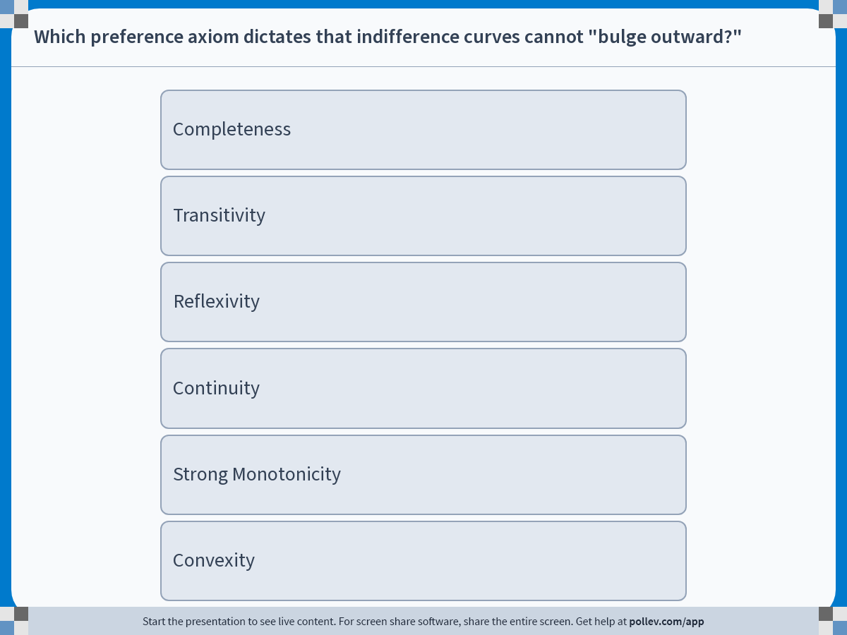
Notes:
Poll Title: Do not modify the notes in this section to avoid tampering with the Poll Everywhere activity.
More info at polleverywhere.com/support
Which preference axiom dictates that indifference curves cannot "bulge outward?"
https://www.polleverywhere.com/multiple_choice_polls/fLqMfmo7GcXNtp18k4fL1?display_state=instructions&activity_state=opened&state=opened&flow=Engagement&onscreen=persist

Slide 26

Notes:
Poll Title: Do not modify the notes in this section to avoid tampering with the Poll Everywhere activity.
More info at polleverywhere.com/support
Which preference axiom dictates that indifference curves cannot "bulge outward?"
https://www.polleverywhere.com/multiple_choice_polls/fLqMfmo7GcXNtp18k4fL1?display_state=chart&activity_state=closed&state=closed&flow=Engagement&onscreen=persist

Slide 27
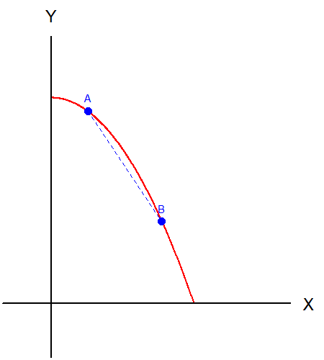
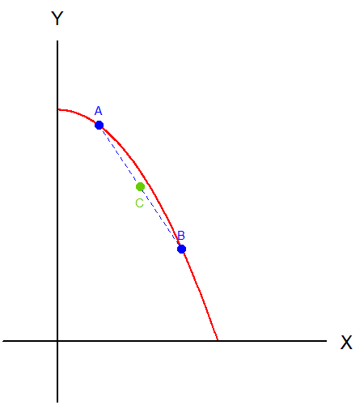
Outward Bulging ICs?
Suppose ICs bulge out.
Consider a bundle that is a more diversified bundle compared to A and B.
Due to Convexity, C should be preferred to A and B.
Contradiction!

Slide 28
Properties of the Indifference Curve
Every commodity bundle must have an indifference curve passing through. (Completeness)
“Higher” indifference curves are preferred. (Monotonicity)
Indifference curves cannot intersect. (Monotonicity & Transitivity)
Indifference curves must slope downward. (Monotonicity)
Indifference curves cannot “bulge outward.” (Convexity)

Slide 29
Recap
Indifference curves are the graphic representation of consumers’ utility functions.
Indifference curves link all bundles that are “just as good as one another” into one line.
Indifference curves are similar to contour lines on maps.
Properties we assumed regarding preference relations have implications on the shape and behavior of the indifference curves.

