Slide 1
Fall 2024
Practice Final Exam Review
ECON 300

Slide 2
Problem 1. Definitions
Normal Goods
  Goods whose quantity demanded decreases (increases) when the consumer’s income decreases (increases).
Marginal Revenue
  The additional revenue that a producer enjoys when increasing their production by a small amount.
Deadweight Loss
  The loss in societal surplus arising due to inefficiencies.

Slide 3
Problem 1. Definitions
Perfect Competition
  A market in which there are 1)infinitely many consumers and producers, and 2)perfect information, and 3)zero transaction fees, and 4)no barriers to entry and exit, and 5)homogeneous goods.
Nash Equilibrium
  A Nash equilibrium describes an equilibrium in which no player can change their own strategy for a higher payoff.
Indifference Curves
  A collection of bundles of goods and/or services that when consumed, provides the consumer with the same level of utility.

Slide 4
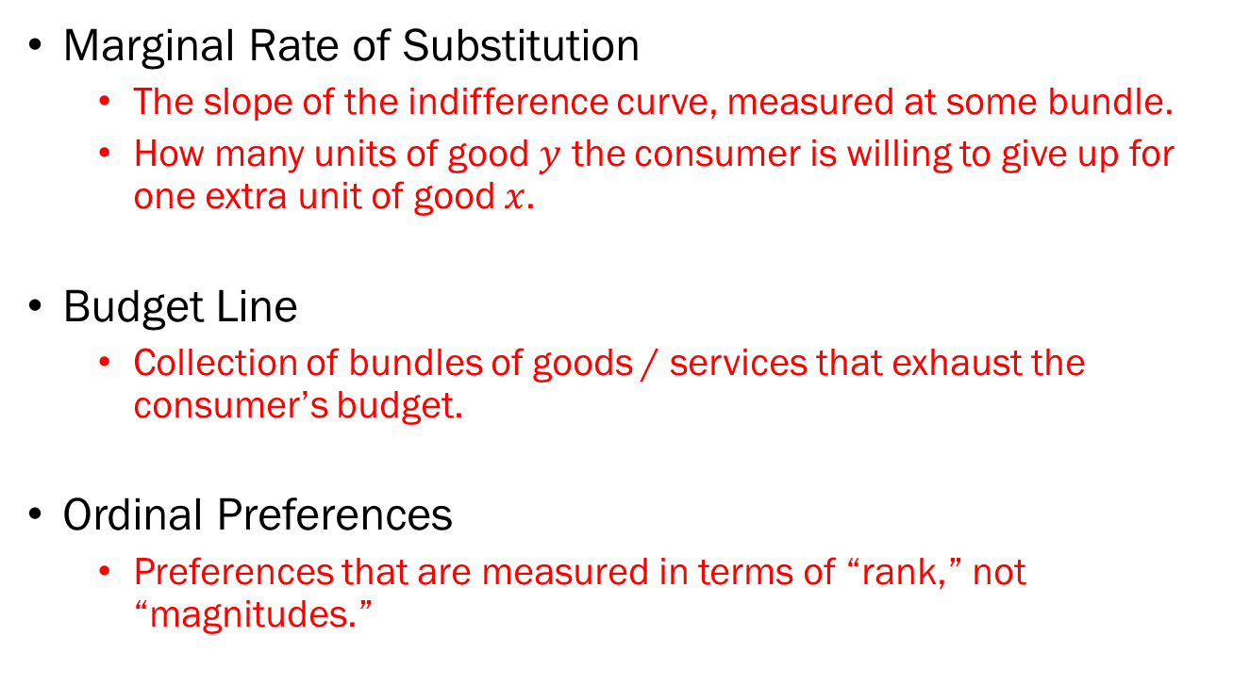
Problem 1. Definitions
Marginal Rate of Substitution
  The slope of the indifference curve, measured at some bundle.
  How many units of good $y$ the consumer is willing to give up for one extra unit of good $x$.
Budget Line
  Collection of bundles of goods / services that exhaust the consumer’s budget.
Ordinal Preferences
  Preferences that are measured in terms of “rank,” not “magnitudes.”

Slide 5
Problem 2.A.
When a Nash equilibrium is achieved, it is guaranteed that the societal welfare is maximized.
  FALSE.
  Recall the example of the Prisoners’ dilemma.
  A Nash equilibrium is simply a point where neither party will benefit from unilaterally making a different choice.

Slide 6
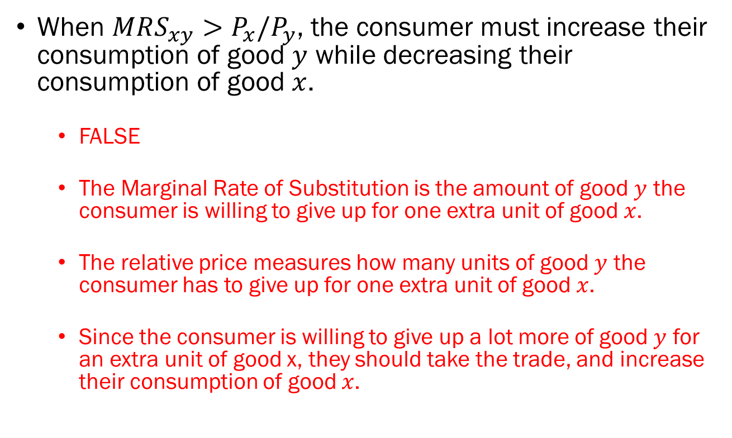
Problem 2.B.
When $MRS_{xy}>P_{x}/P_{y}$, the consumer must increase their consumption of good $y$ while decreasing their consumption of good $x$.
  FALSE
  The Marginal Rate of Substitution is the amount of good $y$ the consumer is willing to give up for one extra unit of good $x$.
  The relative price measures how many units of good $y$ the consumer has to give up for one extra unit of good $x$.
  Since the consumer is willing to give up a lot more of good $y$ for an extra unit of good x, they should take the trade, and increase their consumption of good $x$.

Slide 7
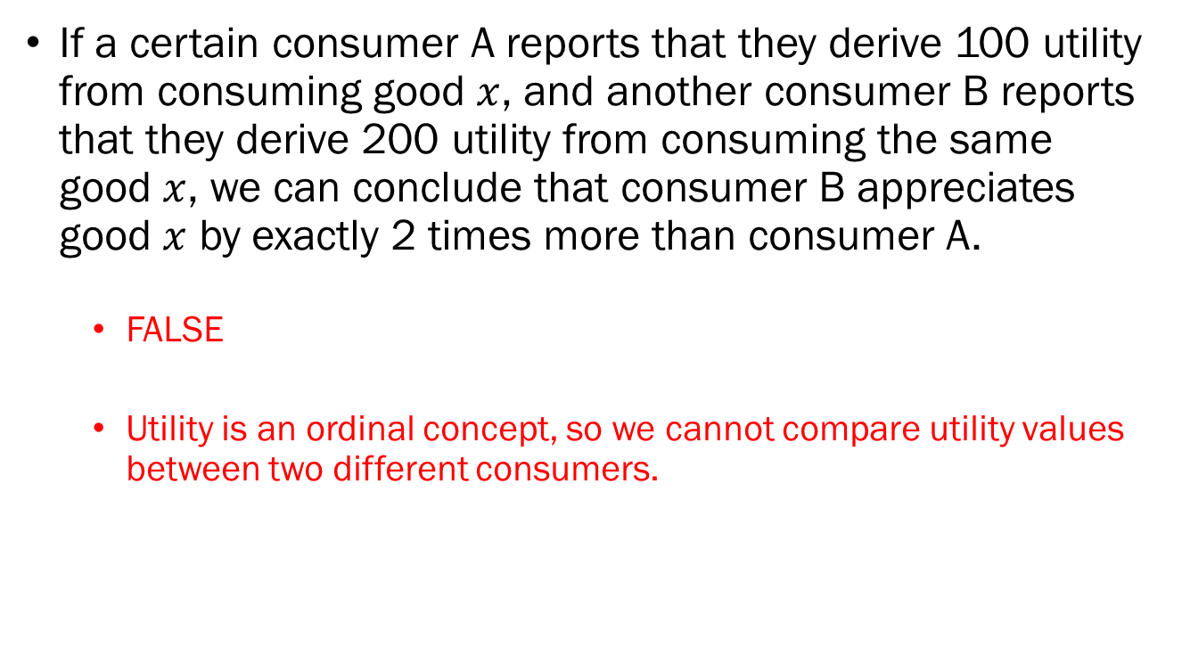
Problem 2.C.
If a certain consumer A reports that they derive 100 utility from consuming good $x$, and another consumer B reports that they derive 200 utility from consuming the same good $x$, we can conclude that consumer B appreciates good $x$ by exactly 2 times more than consumer A.
  FALSE
  Utility is an ordinal concept, so we cannot compare utility values between two different consumers.

Slide 8
Problem 2.D.
If an output market is in a state of monopoly, both the market price and quantity traded will be greater than that of a perfectly competitive market.
  FALSE
  In monopolies, prices tend to be higher than that of perfectly competitive markets, due to the quantity supplied being lower.

Slide 9
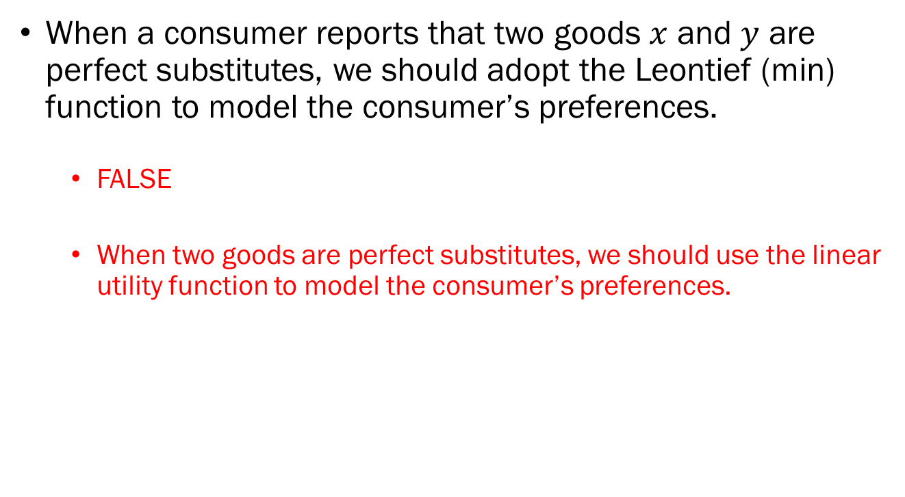
Problem 2.E.
When a consumer reports that two goods $x$ and $y$ are perfect substitutes, we should adopt the Leontief (min) function to model the consumer’s preferences.
  FALSE
  When two goods are perfect substitutes, we should use the linear utility function to model the consumer’s preferences.

Slide 10
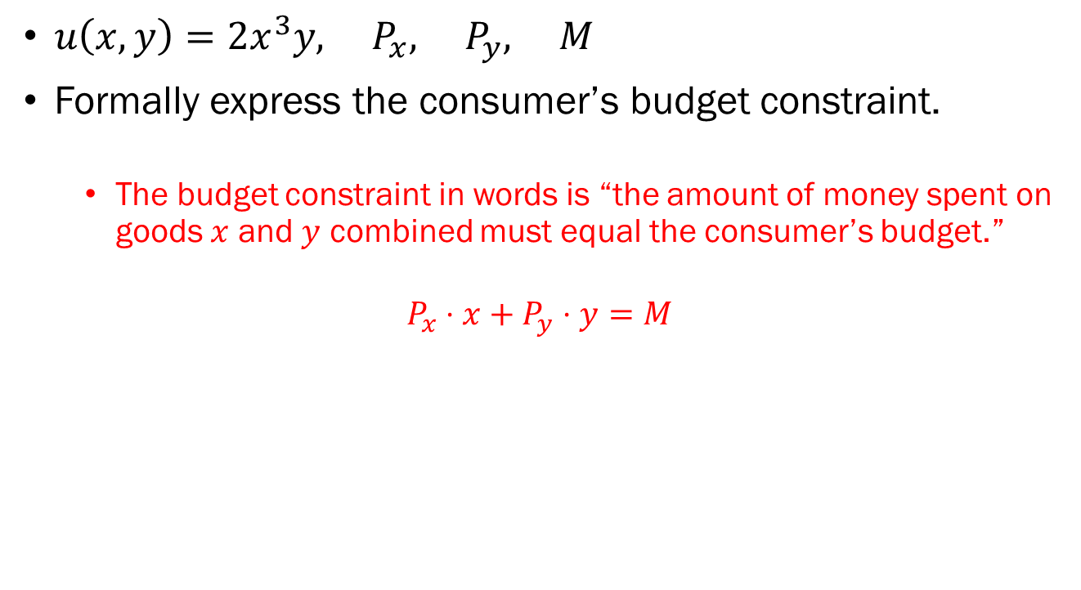
Problem 3.A.
$u\left(x,y\right)=2x^{3}y, P_{x}, P_{y}, M$
Formally express the consumer’s budget constraint.
  The budget constraint in words is “the amount of money spent on goods $x$ and $y$ combined must equal the consumer’s budget.”
$$P_{x}⋅x+P_{y}⋅y=M$$

Slide 11
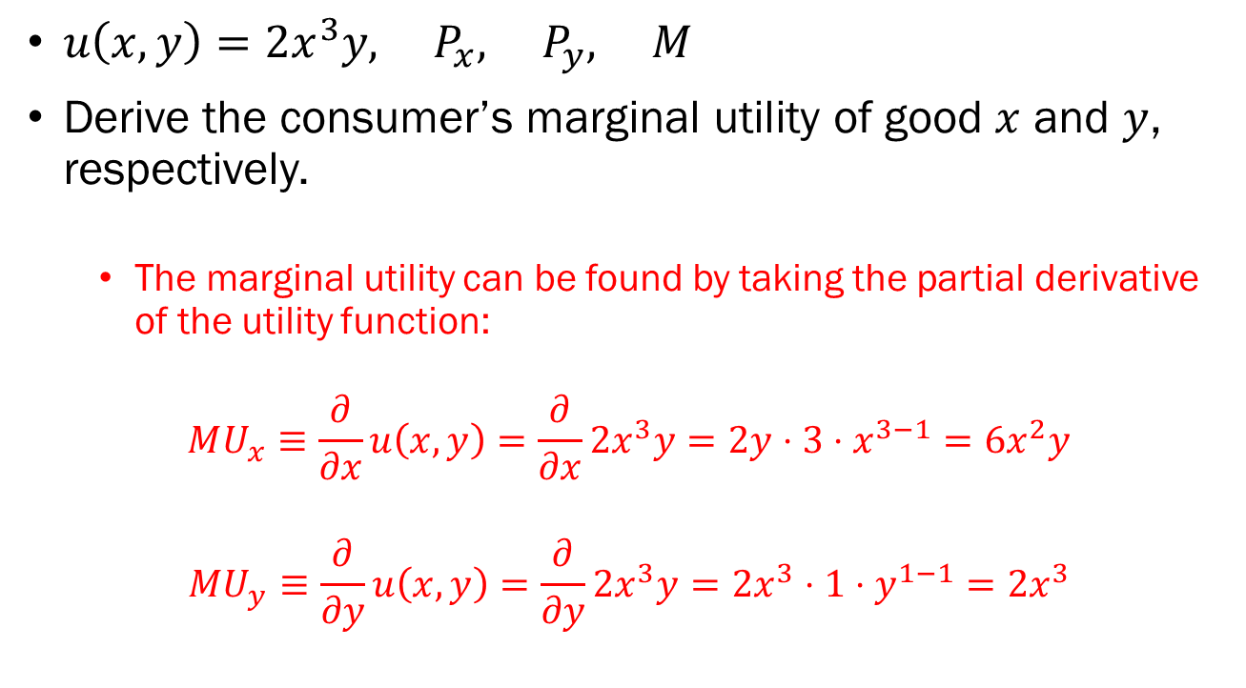
Problem 3.B.
$u\left(x,y\right)=2x^{3}y, P_{x}, P_{y}, M$
Derive the consumer’s marginal utility of good $x$ and $y$, respectively.
  The marginal utility can be found by taking the partial derivative of the utility function:
$$MU_{x}≡\frac{∂}{∂x}u\left(x,y\right)=\frac{∂}{∂x}2x^{3}y=2y⋅3⋅x^{3−1}=6x^{2}y$$
$$MU_{y}≡\frac{∂}{∂y}u\left(x,y\right)=\frac{∂}{∂y}2x^{3}y=2x^{3}⋅1⋅y^{1−1}=2x^{3}$$

Slide 12
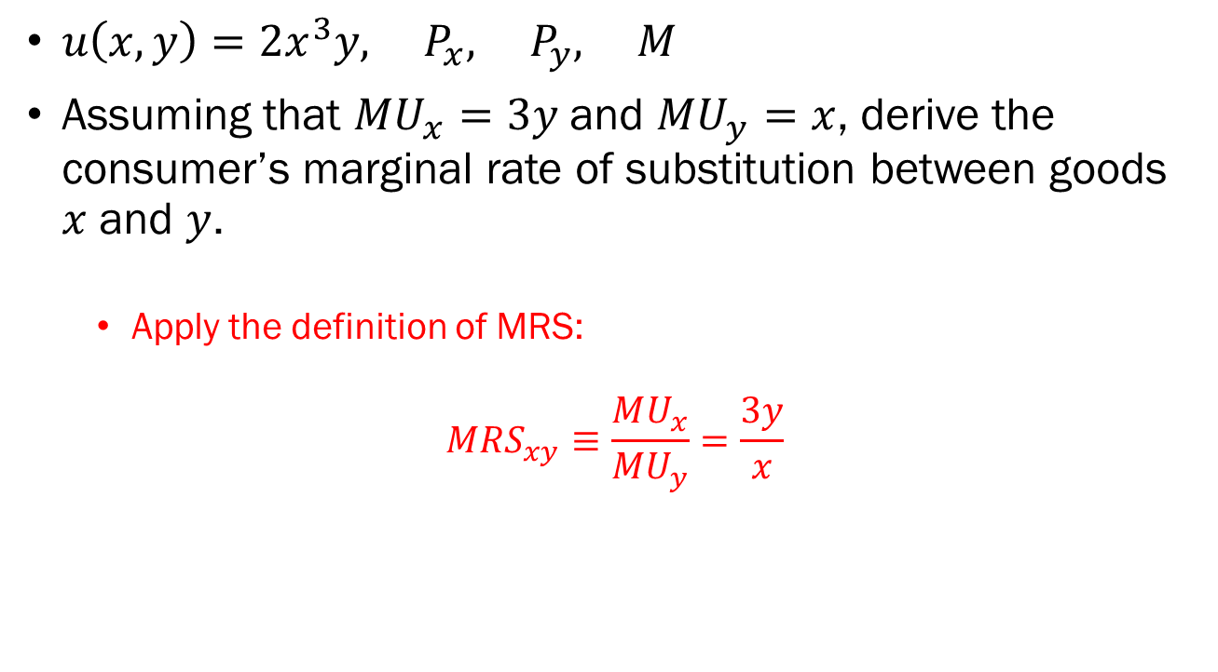
Problem 3.C.
$u\left(x,y\right)=2x^{3}y, P_{x}, P_{y}, M$
Assuming that $MU_{x}=3y$and $MU_{y}=x$, derive the consumer’s marginal rate of substitution between goods $x$ and $y$.
  Apply the definition of MRS:
$$MRS_{xy}≡\frac{MU_{x}}{MU_{y}}=\frac{3y}{x}$$

Slide 13
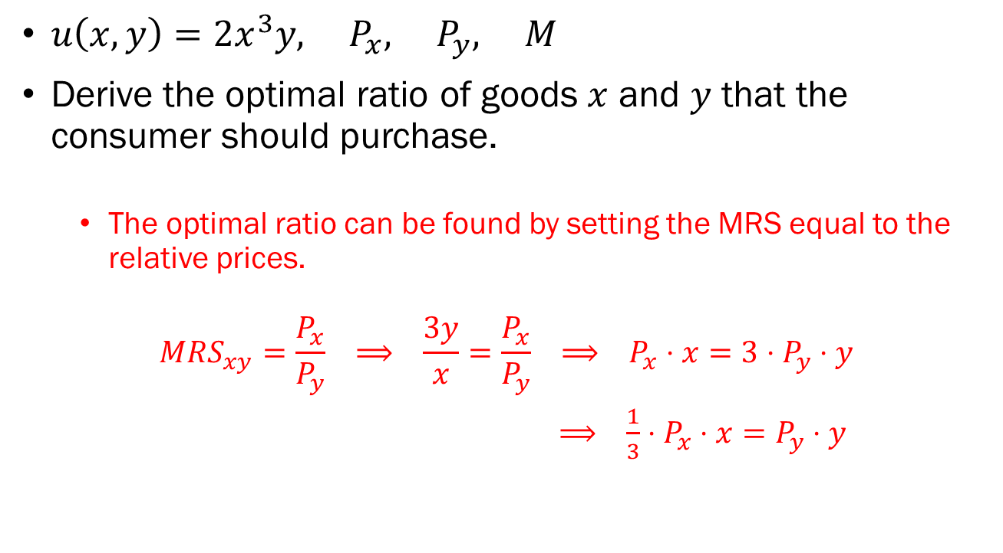
Problem 3.D.
$u\left(x,y\right)=2x^{3}y, P_{x}, P_{y}, M$
Derive the optimal ratio of goods $x$ and $y$ that the consumer should purchase.
  The optimal ratio can be found by setting the MRS equal to the relative prices.
$$MRS_{xy}=\frac{P_{x}}{P_{y}} ⟹ \frac{3y}{x}=\frac{P_{x}}{P_{y}} ⟹ P_{x}⋅x=3⋅P_{y}⋅y$$
$⟹ \frac{1}{3}⋅P_{x}⋅x=P_{y}⋅y$

Slide 14
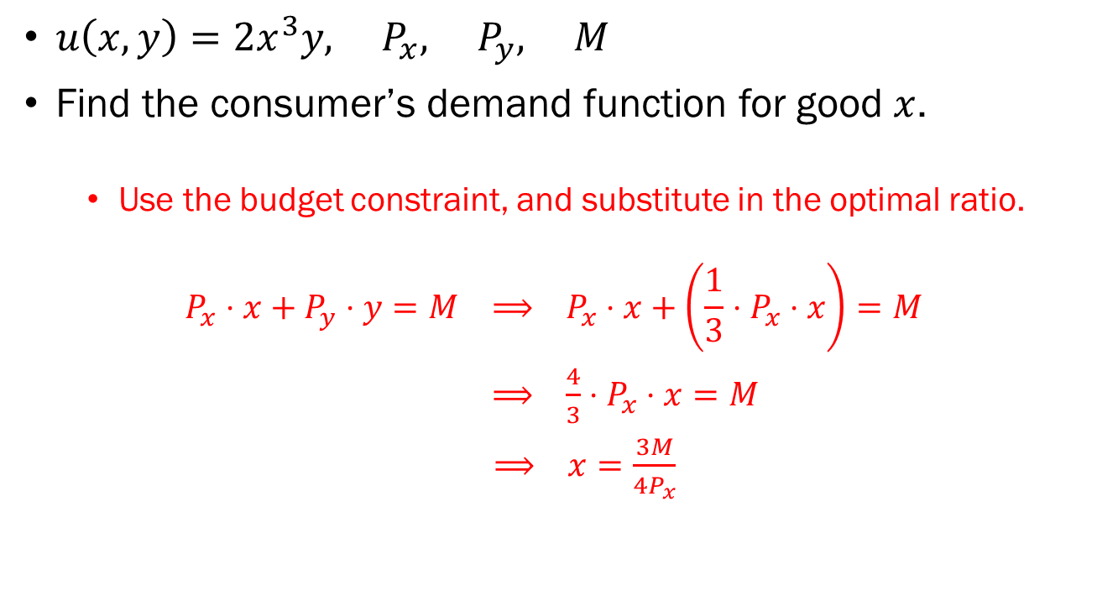
Problem 3.E.
$u\left(x,y\right)=2x^{3}y, P_{x}, P_{y}, M$
Find the consumer’s demand function for good $x$.
  Use the budget constraint, and substitute in the optimal ratio.
$$P_{x}⋅x+P_{y}⋅y=M ⟹ P_{x}⋅x+\left(\frac{1}{3}⋅P_{x}⋅x\right)=M$$
$⟹ \frac{4}{3}⋅P_{x}⋅x=M$
$⟹ x=\frac{3M}{4P_{x}}$

Slide 15
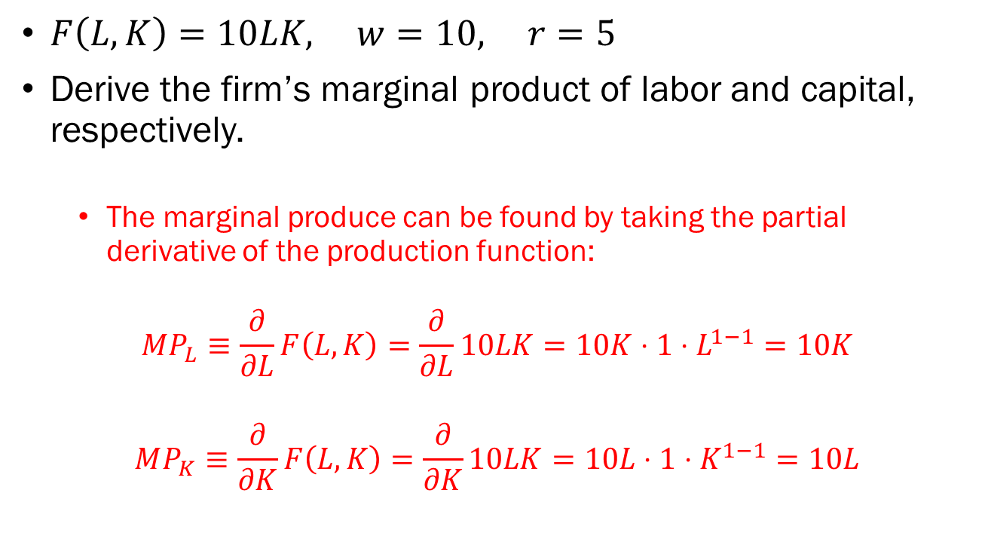
Problem 4.A.
$F\left(L,K\right)=10LK, w=10, r=5$
Derive the firm’s marginal product of labor and capital, respectively.
  The marginal produce can be found by taking the partial derivative of the production function:
$$MP_{L}≡\frac{∂}{∂L}F\left(L,K\right)=\frac{∂}{∂L}10LK=10K⋅1⋅L^{1−1}=10K$$
$$MP_{K}≡\frac{∂}{∂K}F\left(L,K\right)=\frac{∂}{∂K}10LK=10L⋅1⋅K^{1−1}=10L$$

Slide 16
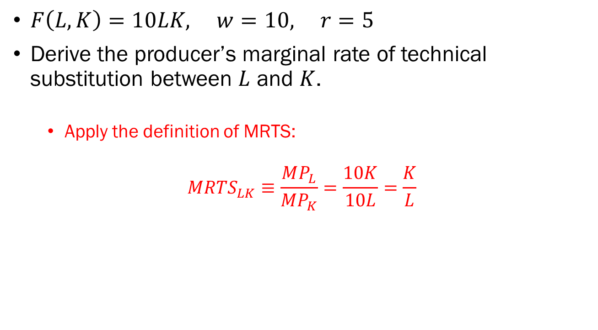
Problem 4.B.
$F\left(L,K\right)=10LK, w=10, r=5$
Derive the producer’s marginal rate of technical substitution between $L$ and $K$.
  Apply the definition of MRTS:
$$MR{TS}_{LK}≡\frac{MP_{L}}{MP_{K}}=\frac{10K}{10L}=\frac{K}{L}$$

Slide 17
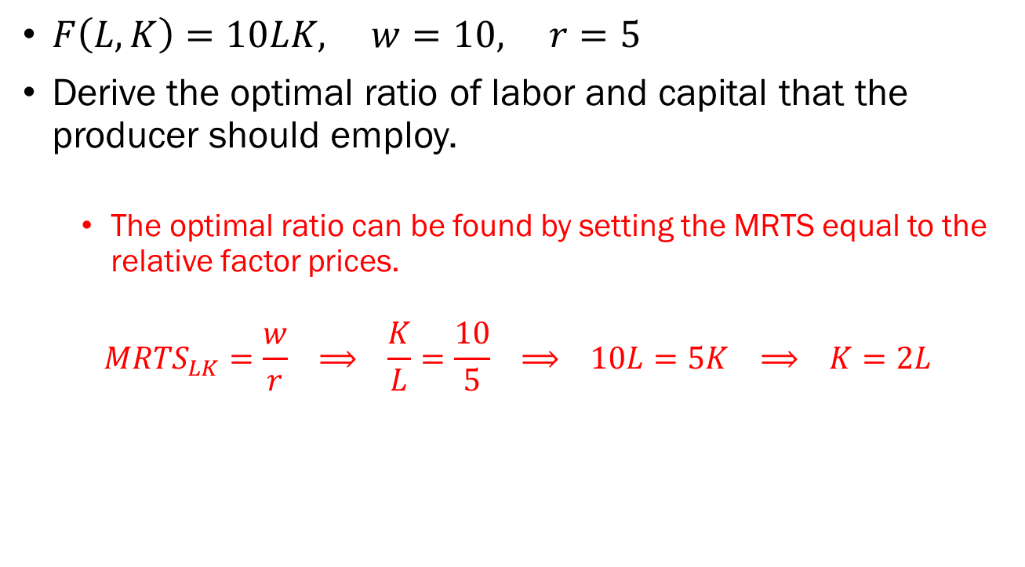
Problem 4.C.
$F\left(L,K\right)=10LK, w=10, r=5$
Derive the optimal ratio of labor and capital that the producer should employ.
  The optimal ratio can be found by setting the MRTS equal to the relative factor prices.
$$MRTS_{LK}=\frac{w}{r} ⟹ \frac{K}{L}=\frac{10}{5} ⟹ 10L=5K ⟹ K=2L$$

Slide 18
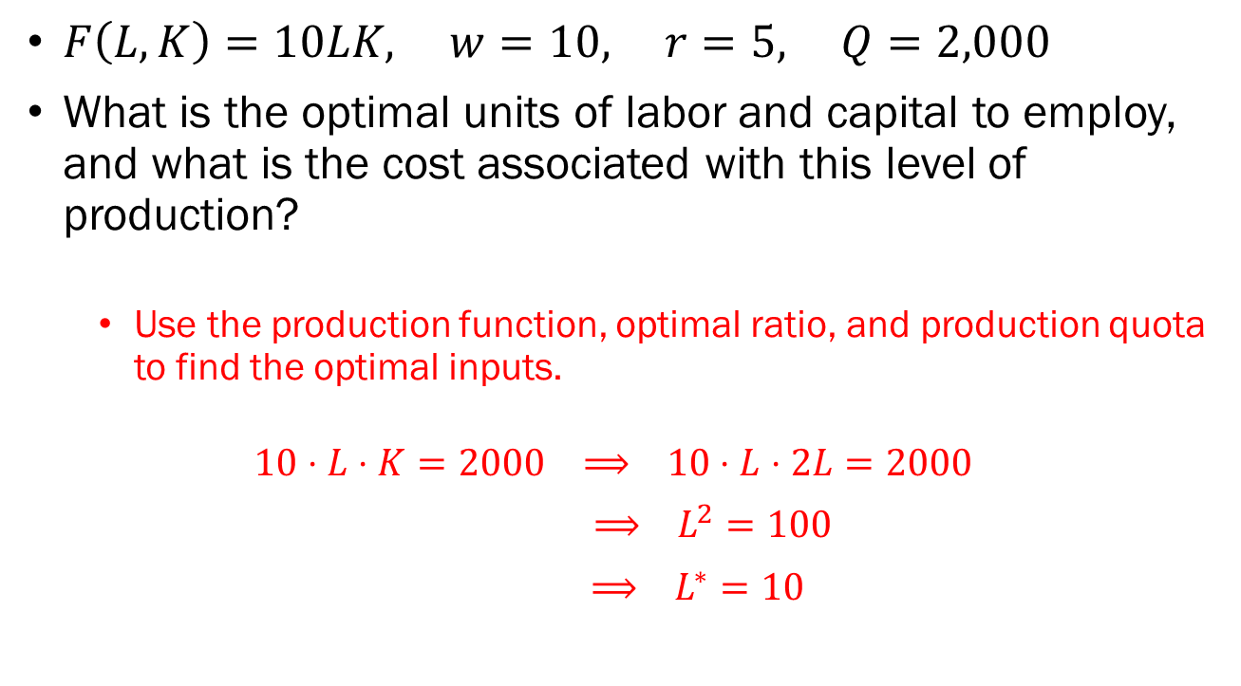
Problem 4.D.
$F\left(L,K\right)=10LK, w=10, r=5, Q=2,000$
What is the optimal units of labor and capital to employ, and what is the cost associated with this level of production?
  Use the production function, optimal ratio, and production quota to find the optimal inputs.
$$10⋅L⋅K=2000 ⟹ 10⋅L⋅2L=2000$$
$⟹ L^{2}=100$
$⟹ L^{∗}=10$

Slide 19
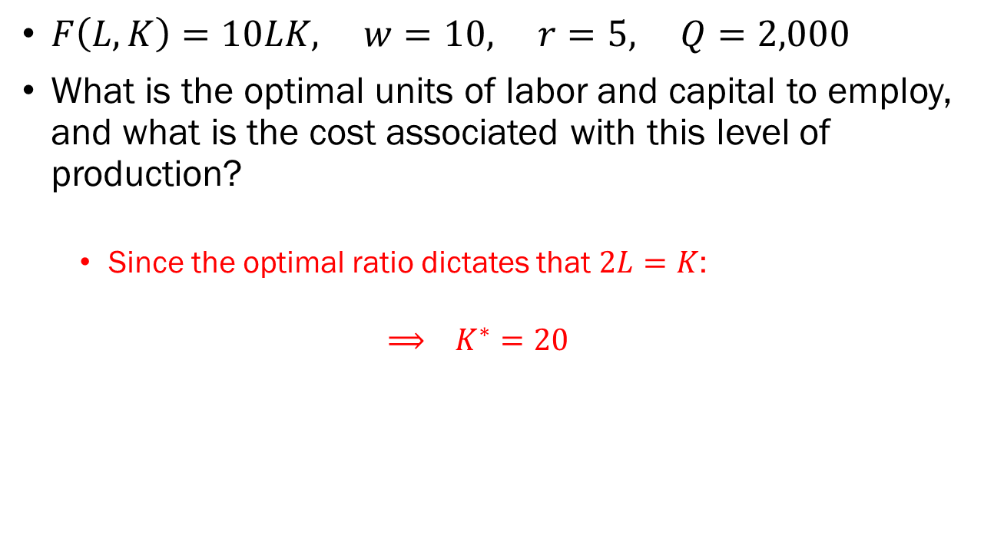
Problem 4.D. (continued)
$F\left(L,K\right)=10LK, w=10, r=5, Q=2,000$
What is the optimal units of labor and capital to employ, and what is the cost associated with this level of production?
  Since the optimal ratio dictates that $2L=K$:
  $$⟹ K^{∗}=20$$

Slide 20
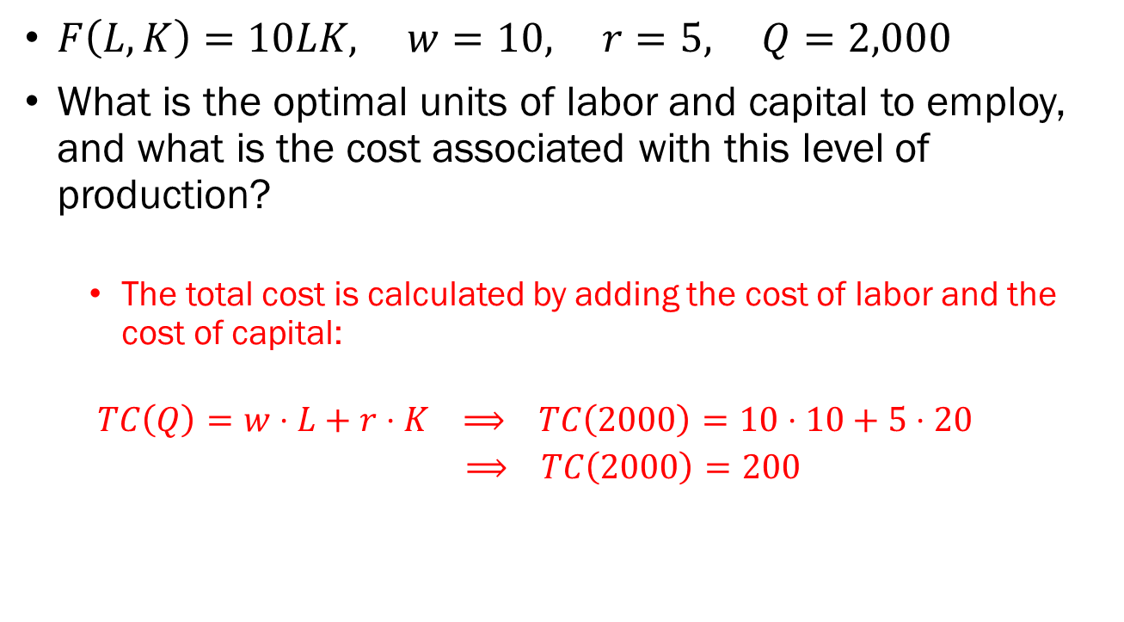
Problem 4.D. (continued)
$F\left(L,K\right)=10LK, w=10, r=5, Q=2,000$
What is the optimal units of labor and capital to employ, and what is the cost associated with this level of production?
  The total cost is calculated by adding the cost of labor and the cost of capital:
  $$TC\left(Q\right)=w⋅L+r⋅K ⟹ TC\left(2000\right)=10⋅10+5⋅20$$
  $⟹ TC\left(2000\right)=200$

Slide 21
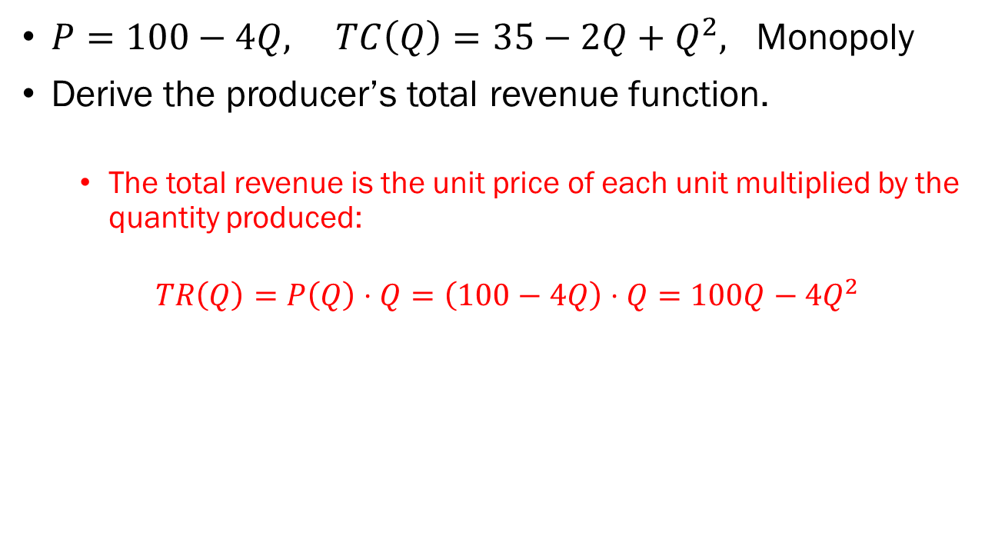
Problem 5.A.
$P=100−4Q, TC\left(Q\right)=35−2Q+Q^{2},$ Monopoly
Derive the producer’s total revenue function.
  The total revenue is the unit price of each unit multiplied by the quantity produced:
$$TR\left(Q\right)=P\left(Q\right)⋅Q=\left(100−4Q\right)⋅Q=100Q−4Q^{2}$$

Slide 22
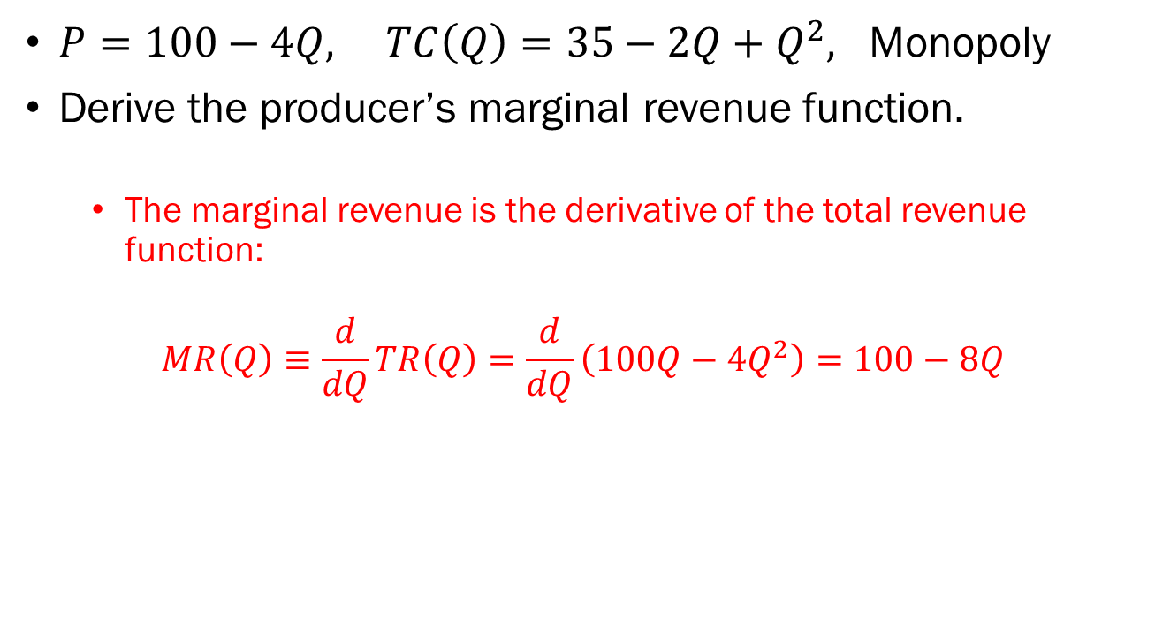
Problem 5.B.
$P=100−4Q, TC\left(Q\right)=35−2Q+Q^{2},$ Monopoly
Derive the producer’s marginal revenue function.
  The marginal revenue is the derivative of the total revenue function:
$$MR\left(Q\right)≡\frac{d}{dQ}TR\left(Q\right)=\frac{d}{dQ}\left(100Q−4Q^{2}\right)=100−8Q$$

Slide 23
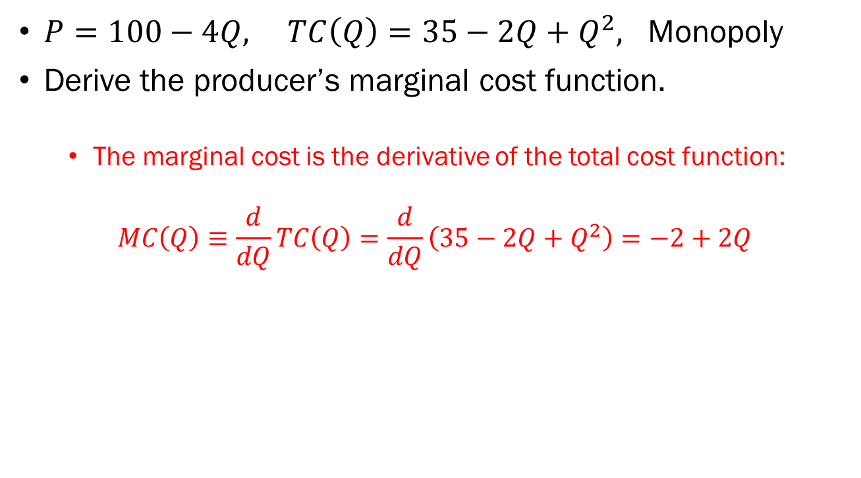
Problem 5.C.
$P=100−4Q, TC\left(Q\right)=35−2Q+Q^{2},$ Monopoly
Derive the producer’s marginal cost function.
  The marginal cost is the derivative of the total cost function:
$$MC\left(Q\right)≡\frac{d}{dQ}TC\left(Q\right)=\frac{d}{dQ}\left(35−2Q+Q^{2}\right)=−2+2Q$$

Slide 24
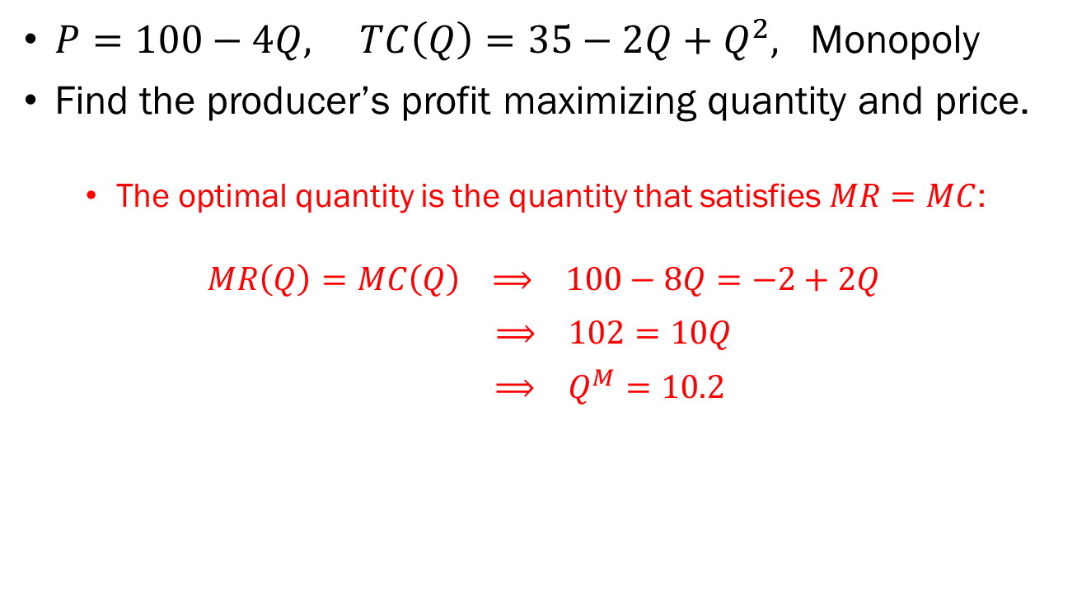
Problem 5.D.
$P=100−4Q, TC\left(Q\right)=35−2Q+Q^{2},$ Monopoly
Find the producer’s profit maximizing quantity and price.
  The optimal quantity is the quantity that satisfies $MR=MC$:
$$MR\left(Q\right)=MC\left(Q\right) ⟹ 100−8Q=−2+2Q$$
$⟹ 102=10Q$
$⟹ Q^{M}=10.2$

Slide 25

Problem 5.D. (continued)
$P=100−4Q, TC\left(Q\right)=35−2Q+Q^{2},$ Monopoly
Find the producer’s profit maximizing quantity and price.
  Use the inverse demand function to find the optimal price:
$$P^{M}=100−4Q^{M}=100−4⋅10.2=59.2$$

