Slide 1
Fall 2024
Final Exam Review
ECON 300

Slide 2
Problem 1. Definitions
Marginal Rate of Substitution
  The rate at which a consumer can give up some amount of one good in exchange for another good while maintaining the same level of utility.
Ordinary Goods
  Goods where the quantity demanded decreases as the price increases, and vice versa.
Consumer Surplus
  The measure of the benefit consumers receive when they buy a product or service at a price lower than what they are willing to pay.

Slide 3
Problem 1. Definitions
Marginal Utility
  The additional utility that a consumer enjoys when increasing the consumption of one good / service by a small amount.
Deadweight Loss
  The loss of economic efficiency that can occur when equilibrium for a good or service is not achieved or is distorted.
Monopoly
  A monopoly occurs when a single company is the exclusive provider of a product or service, controlling prices and supply.

Slide 4
Problem 1. Definitions
Marginal Revenue
  The additional revenue generated by selling one more unit of a good or service.
Nash Equilibrium
  A Nash equilibrium describes an equilibrium in which no player can change their own strategy for a higher payoff.
Isoquant
  A curve on a graph that shows all the possible combinations of inputs that will produce the same level of output.

Slide 5
Problem 2.A.
If a profit-maximizing producer finds that their marginal revenue is greater than their marginal cost, the producer should reduce their level of output.
  FALSE
  Assuming our usual properties of the production and cost functions, the producer should increase the level of production.

Slide 6
Problem 2.B.
Price controls will always result in deadweight loss, as they distort prices.
  FALSE
  If the price ceiling or floor is non-binding, price controls do not affect the overall welfare of consumers and producers.
    Price ceilings are non-binding if the market price is already below the ceiling.
    Price floors are non-binding if the market price is already higher than the floor.

Slide 7
Problem 2.C.
If a firm’s production function displays decreasing returns to scale, it is likely that it will result in a natural monopoly.
  FALSE
  If a firm’s production technology displays Increasing Returns to Scale, it is likely to lead to a natural monopoly.
  Under DRS, the cost of production rises, making large-scale production less efficient.

Slide 8
Problem 2.D.
When two goods are seen as perfect complements to each other, we can use the Leontief (min) family of utility functions to model the consumer’s preferences.
  TRUE

Slide 9
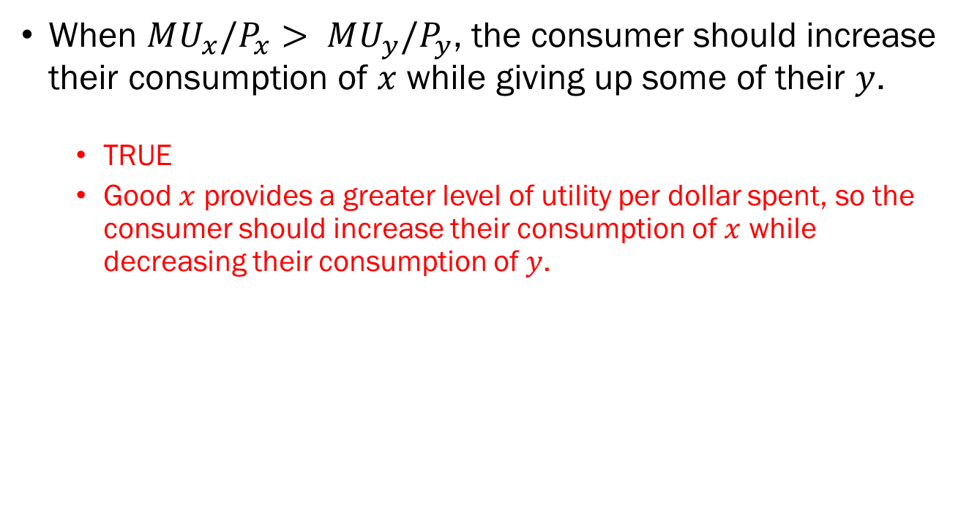
Problem 2.E.
When $MU_{x}/P_{x}> MU_{y}/P_{y}$, the consumer should increase their consumption of $x$ while giving up some of their $y$.
  TRUE
  Good $x$ provides a greater level of utility per dollar spent, so the consumer should increase their consumption of $x$ while decreasing their consumption of $y$.

Slide 10

Problem 3.A.
$u\left(x,y\right)=5x^{2}y^{3}, P_{x}=5, P_{y}=15, M=1000$
Formally express the consumer’s budget constraint.
$$P_{x}x+P_{y}y=M ⇒ 5x+15y=1000$$

Slide 11
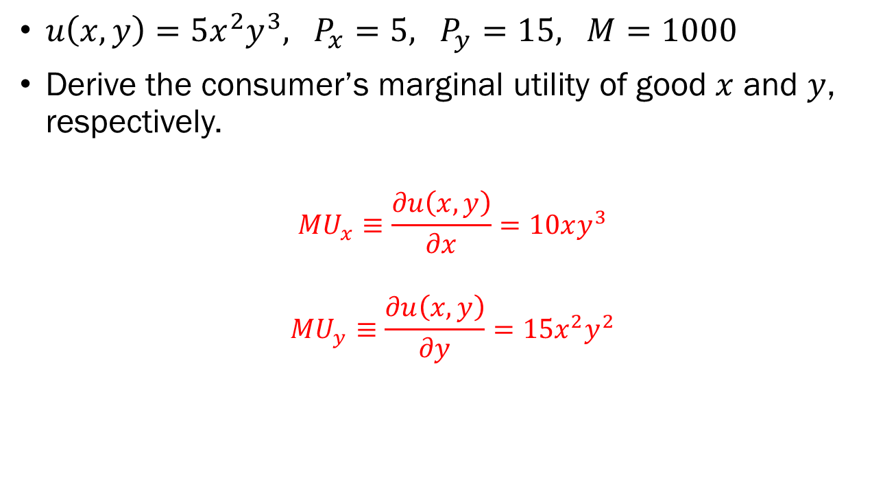
Problem 3.B.
$u\left(x,y\right)=5x^{2}y^{3}, P_{x}=5, P_{y}=15, M=1000$
Derive the consumer’s marginal utility of good $x$ and $y$, respectively.
$$MU_{x}≡\frac{∂u\left(x,y\right)}{∂x}=10xy^{3}$$
$$MU_{y}≡\frac{∂u\left(x,y\right)}{∂y}=15x^{2}y^{2}$$

Slide 12
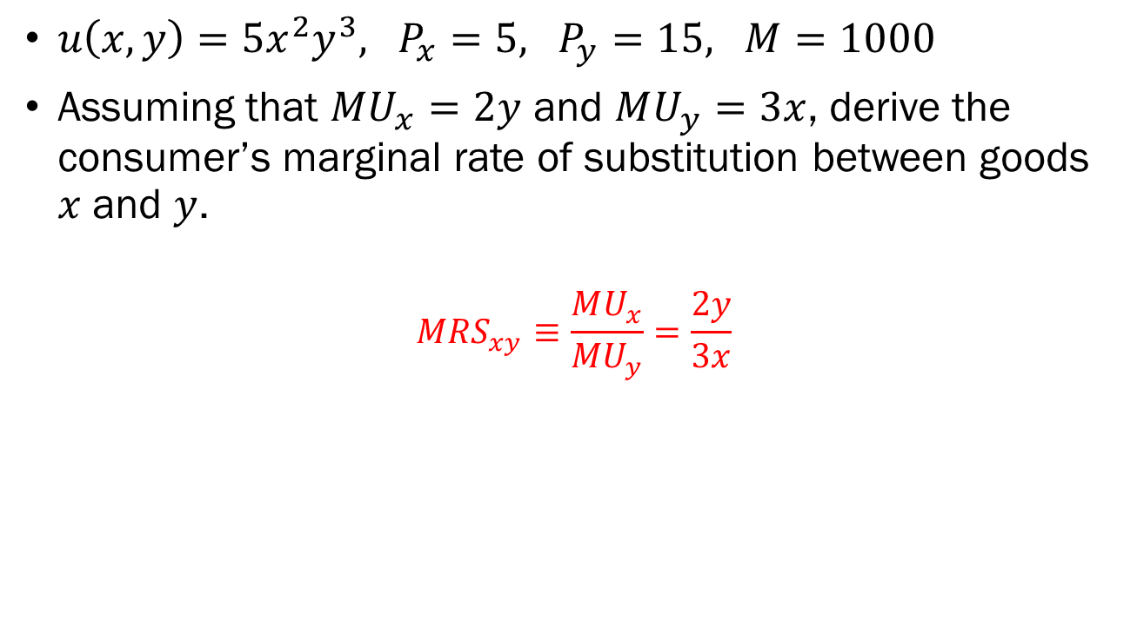
Problem 3.C.
$u\left(x,y\right)=5x^{2}y^{3}, P_{x}=5, P_{y}=15, M=1000$
Assuming that $MU_{x}=2y$ and $MU_{y}=3x$, derive the consumer’s marginal rate of substitution between goods $x$ and $y$.
$$MRS_{xy}≡\frac{MU_{x}}{MU_{y}}=\frac{2y}{3x}$$

Slide 13
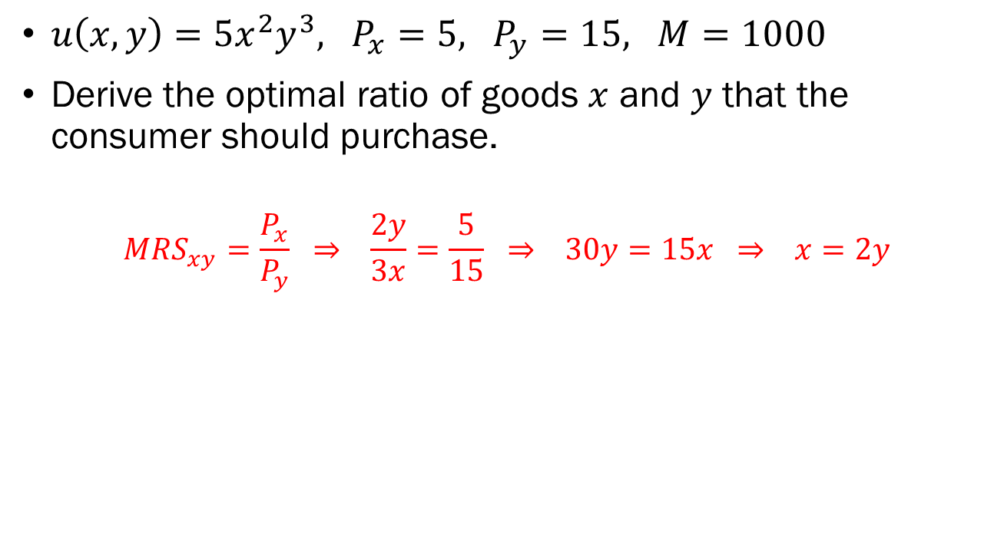
Problem 3.D.
$u\left(x,y\right)=5x^{2}y^{3}, P_{x}=5, P_{y}=15, M=1000$
Derive the optimal ratio of goods $x$ and $y$ that the consumer should purchase.
$$MRS_{xy}=\frac{P_{x}}{P_{y}} ⇒ \frac{2y}{3x}=\frac{5}{15} ⇒ 30y=15x ⇒ x=2y$$

Slide 14
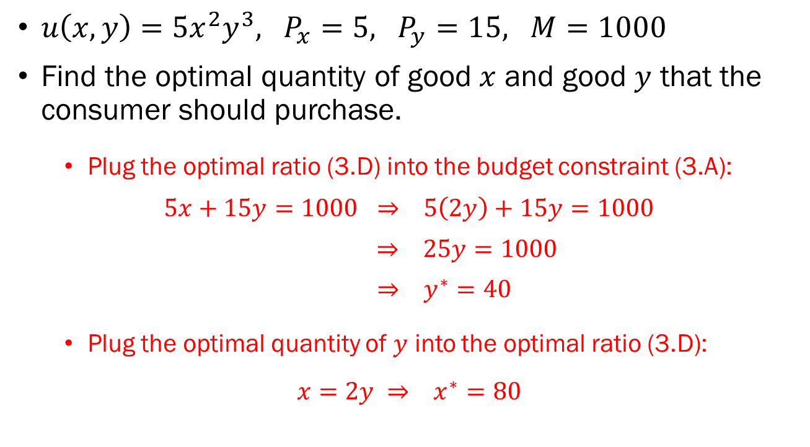
Problem 3.E.
$u\left(x,y\right)=5x^{2}y^{3}, P_{x}=5, P_{y}=15, M=1000$
Find the optimal quantity of good $x$ and good $y$ that the consumer should purchase.
  Plug the optimal ratio (3.D) into the budget constraint (3.A):
$$5x+15y=1000 ⇒ 5\left(2y\right)+15y=1000$$
$⇒ 25y=1000$
$⇒ y^{∗}=40$
  Plug the optimal quantity of $y$ into the optimal ratio (3.D):
$$x=2y ⇒ x^{∗}=80$$

Slide 15

Problem 4.A.
$P=6−Q, TC\left(Q\right)=5+2Q+Q^{2}$, Perfect Competition
Derive the producer’s marginal cost function.
$$MC\left(Q\right)≡\frac{dTC\left(Q\right)}{dQ}=2+2Q$$

Slide 16

Problem 4.B.
$P=6−Q, TC\left(Q\right)=5+2Q+Q^{2}$, Perfect Competition
Derive the producer’s total revenue function if $P_{x}=6$.
$$TR\left(Q\right)=P×Q=6Q$$

Slide 17

Problem 4.C.
$P=6−Q, TC\left(Q\right)=5+2Q+Q^{2}$, Perfect Competition
Derive the producer’s marginal revenue function if $P_{x}=6$.
$$MR\left(Q\right)≡\frac{dTR\left(Q\right)}{dQ}=6$$

Slide 18
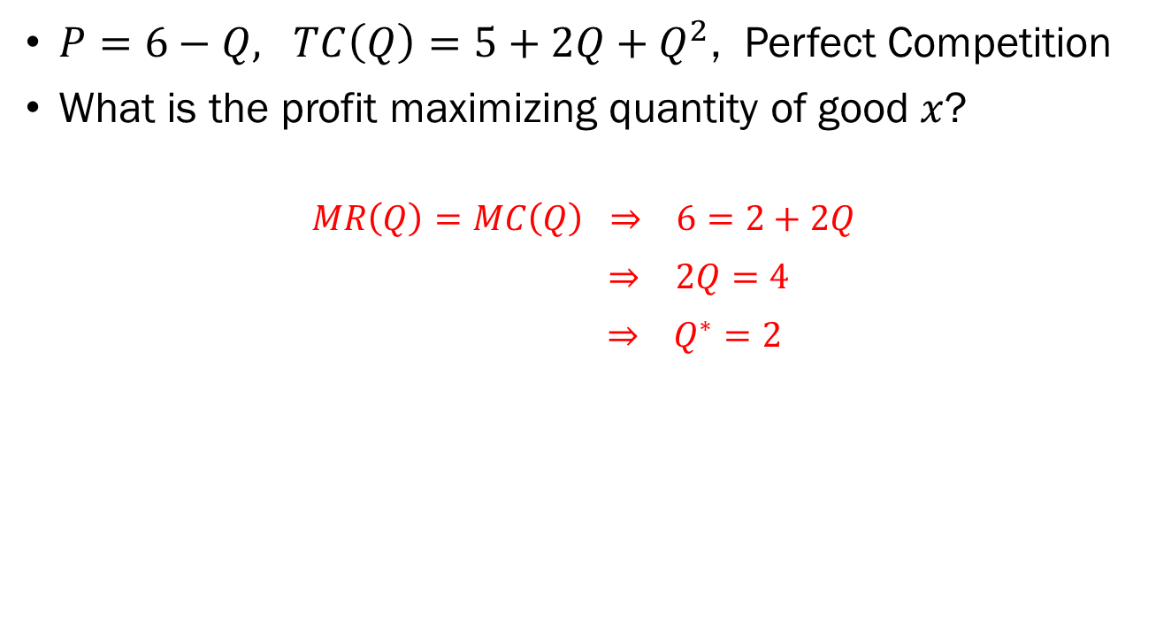
Problem 4.D.
$P=6−Q, TC\left(Q\right)=5+2Q+Q^{2}$, Perfect Competition
What is the profit maximizing quantity of good $x$?
$$MR\left(Q\right)=MC\left(Q\right) ⇒ 6=2+2Q$$
$⇒ 2Q=4$
$⇒ Q^{∗}=2$

Slide 19

Problem 4.E.
$P=6−Q, TC\left(Q\right)=5+2Q+Q^{2}$, Monopoly
Derive the producer’s total revenue function.
$$TR\left(Q\right)=P×Q=\left(6−Q\right)×Q$$
$=6Q−Q^{2}$

Slide 20

Problem 4.F.
$P=6−Q, TC\left(Q\right)=5+2Q+Q^{2}$, Monopoly
Derive the producer’s marginal revenue function.
$$MR\left(Q\right)≡\frac{dTR\left(Q\right)}{dQ}=6−2Q$$

Slide 21
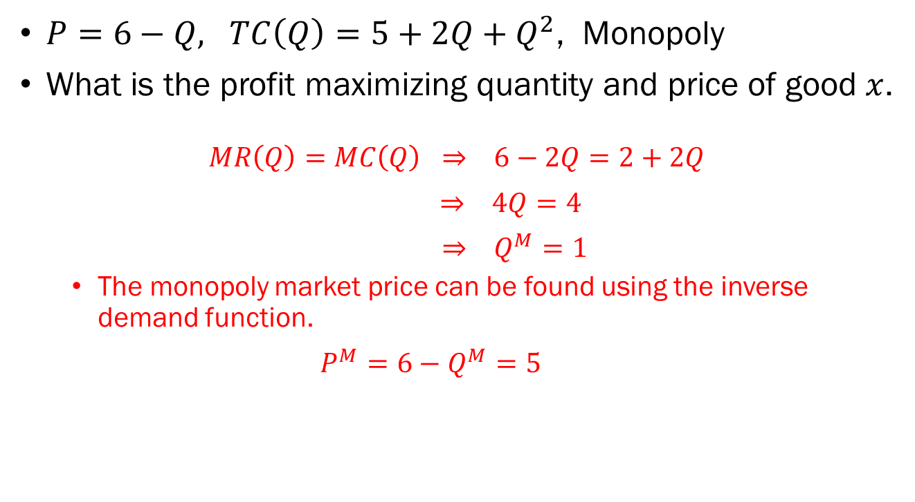
Problem 4.G.
$P=6−Q, TC\left(Q\right)=5+2Q+Q^{2}$, Monopoly
What is the profit maximizing quantity and price of good $x$.
$$MR\left(Q\right)=MC\left(Q\right) ⇒ 6−2Q=2+2Q$$
$⇒ 4Q=4$
$⇒ Q^{M}=1$
  The monopoly market price can be found using the inverse demand function.
  $$P^{M}=6−Q^{M}=5$$

Slide 22

Problem 5.A.
Express this game in its normal form.
  $(U,L)$: Player 1 receives 15, player 2 receives 1.
  $(U,R)$: Player 1 receives 4, player 2 receives 16.
  $(D,L)$: Player 1 receives 10, player 2 receives 20.
  $(D,R)$: Player 1 receives 9, player 2 receives 3.
 | L | R
U | (15,1) | (4,16)
D | (10,20) | (9,3)

Slide 23
Problem 5.B.
Are there any strictly dominant / dominated strategies? If so, identify them.
  If player 2 plays L, player 1’s best response is U, and if player 2 plays R, player 1’s best response is D.
  If player 1 plays U, player 2’s best response is R, and if player 1 plays D, player 2’s best response is L.
  Neither player has a strictly dominant strategy.
 | L | R
U | (15,1) | (4,16)
D | (10,20) | (9,3)

Slide 24
Problem 5.C.
Find the pure strategy Nash equilibrium.
  There is no pure strategy Nash equilibrium in this game.
 | L | R
U | (15,1) | (4,16)
D | (10,20) | (9,3)

