Slide 1
Market Analysis: Supply, Demand, and Interventions
ECON 300

Slide 2
Supply and Demand
The demand function tells us “the total quantity of some good that consumers are willing and able to purchase at each price point.”
The supply function tells us “the total quantity of some good that producers are willing and able to sell at each price point.”
We derived each of these objects over the semester, and now we can use them together to analyze the market.

Slide 3
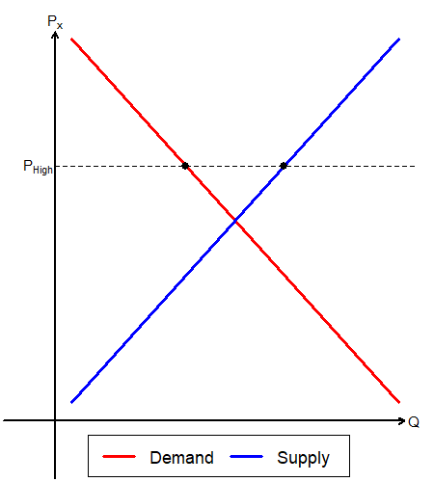
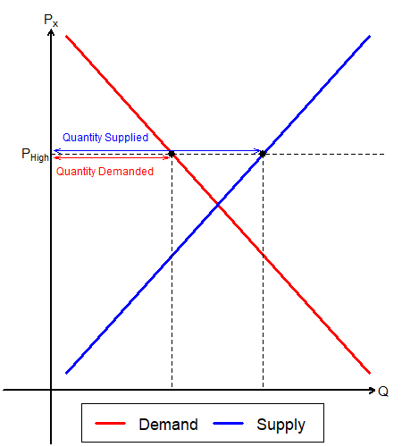
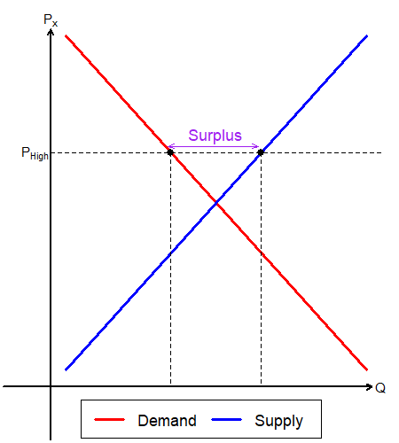
When Prices are High
Suppose that the market price was set at $P_{High}$.
The quantity demanded by the market is less than the quantity supplied.
This surplus generates pressure for the price to fall over time.

Slide 4
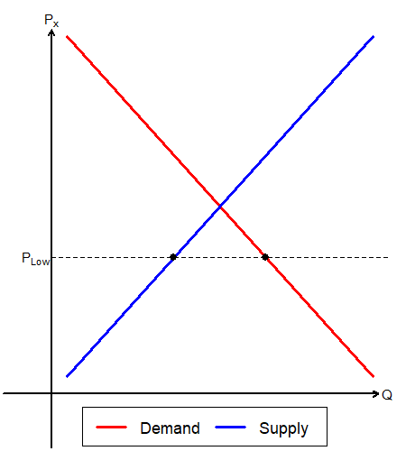
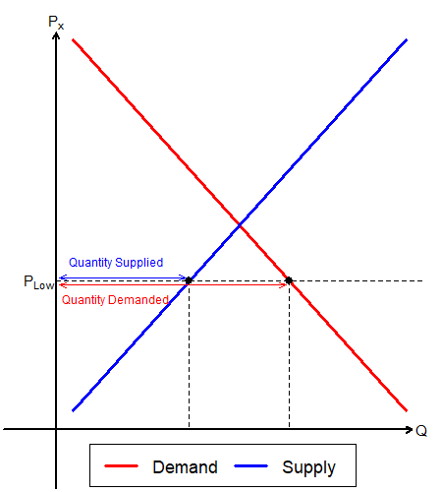
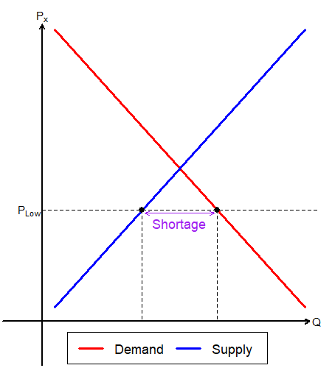
When Prices are Low
Suppose that the market price was set at $P_{Low}$.
The quantity demanded by the market exceeds the quantity supplied.
This shortage generates pressure for the price to rise over time.

Slide 5
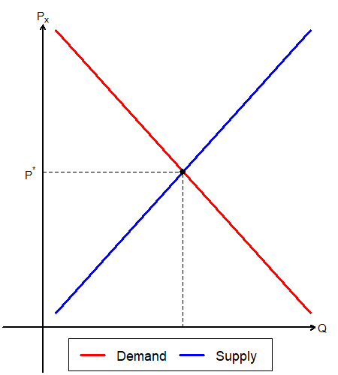
Equilibrium
Eventually, the market price will reach a point where there is no surplus and no shortage.
This price is the equilibrium market price. Also called the market clearing price.
The quantity traded in the market at this price is the equilibrium quantity.

Slide 6
Calculating the Equilibrium
Suppose that the market demand and supply are given:
Market Demand: $Q_{x}^{D}=100−2P_{x}$
Market Supply: $Q_{x}^{S}=20+2P_{x}$
Find the equilibrium price and quantity.
The market is in equilibrium when $Q_{x}^{D}=Q_{x}^{S}$
$$100−2P_{x}=20+2P_{x} ⟹ 80=4P_{x} ⟹ P_{x}=20$$
Calculate the equilibrium quantity using the equilibrium price.
$Q_{x}^{D}=100−2P_{x} ⟹ Q_{x}^{D}=100−2⋅20 ⟹ Q_{x}^{D}=60$

Slide 7
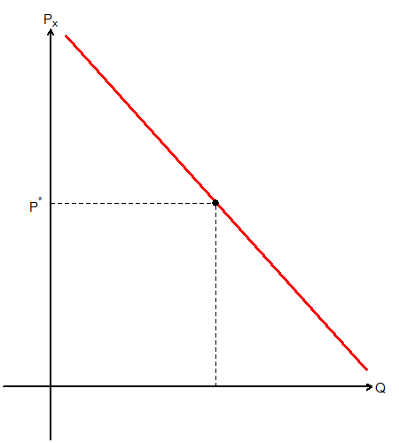
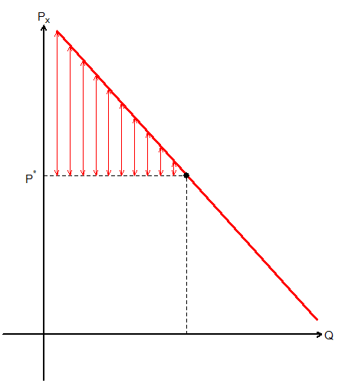
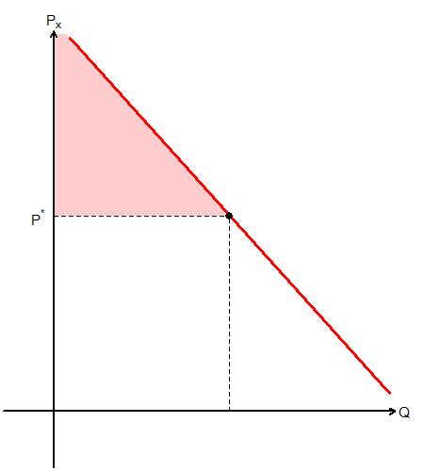
Demand and Consumer Surplus
Consumer surplus (CS) is the difference between the consumers’ maximum willingness to pay and the amount actually paid.
In a graph, this difference is the distance between the price and the demand curve.
CS: Red Triangle

Slide 8
Finding Consumer Surplus
Continue from the previous question:
Market Demand: $Q_{x}^{D}=100−2P_{x}$
Market Supply: $Q_{x}^{S}=20+2P_{x}$
Equilibrium Price: $P_{x}^{∗}=20$
Equilibrium Quantity: $Q^{∗}=60$
Find consumer surplus.
When $Q_{x}^{D}=0$, $P_{x}=50$ from the demand function, and
When $P_{x}^{∗}=20$, $Q^{∗}=60$ from the equilibrium.
CS is a triangle with height 30 and width 60.
CS is measured to be 900.

Slide 9
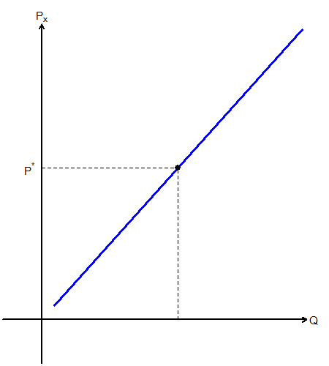
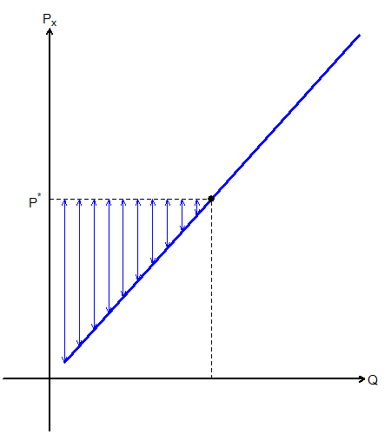
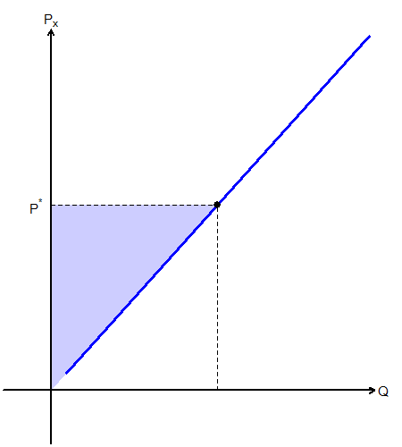
Supply and Producer Surplus
Producer surplus (PS) is the difference between the amount the producer receives and the minimum willingness to sell.
In a graph, this difference is the distance between the price and the supply curve.
PS: Blue Triangle

Slide 10
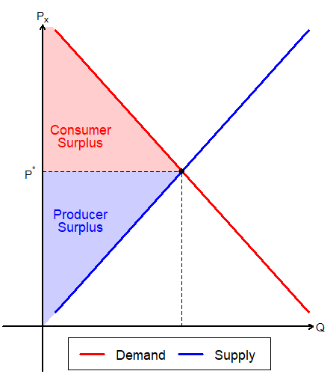
Consumer and Producer Welfare Under no Interventions
While markets operates with no inefficiency due to interventions, societal surplus is maximized.
This will be the standard that we use when we talk about the impact of government interventions.
Tax, Subsidy, Price Controls, etc…

Slide 11
Government Interventions
While there are many types of government interventions, we will be discussing the following topics:
Price Control
Price Ceilings: Rent Control
Price Floors: Minimum Wage
Taxation and Subsidies
Per Unit $ Tax / Subsidies
Per Unit % Tax / Subsidies

Slide 12
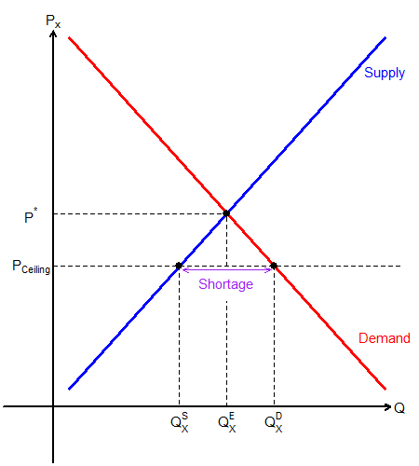
Price Ceiling
Governments can set a price cap, the max price that a firm can charge for its product.
Not effective if ceiling is set above $P_{x}^{∗}$.
If effective, will cause a shortage in the market.
Quantity demanded is $Q_{D}^{x}$.
Quantity supplied is $Q_{S}^{x}$.
Only $Q_{S}^{x}$ can be traded in the market.

Slide 13
Finding Shortage Under Price Ceilings
Continue from the previous question:
Market Demand: $Q_{x}^{D}=100−2P_{x}$
Market Supply: $Q_{x}^{S}=20+2P_{x}$
Price Ceiling: $P_{Ceil}=25$
Is there a shortage in the market? If so, find the shortage.
When $P_{Ceil}=25$, use the demand function to find $Q_{x}^{D}$.
$$Q_{x}^{D}=100−2⋅25=50$$
When $P_{Ceil}=25$, use the supply function to find $Q_{x}^{S}$.
$$Q_{x}^{S}=20+2⋅25=70$$
There is no shortage in the market, as $P_{Ceil}$ is set above $P_{x}^{∗}$.

Slide 14
Finding Shortage Under Price Ceilings
Continue from the previous question:
Market Demand: $Q_{x}^{D}=100−2P_{x}$
Market Supply: $Q_{x}^{S}=20+2P_{x}$
Price Ceiling: $P_{Ceil}=15$
Is there a shortage in the market? If so, find the shortage.
When $P_{Ceil}=15$, use the demand function to find $Q_{x}^{D}$.
$$Q_{x}^{D}=100−2⋅15=70$$
When $P_{Ceil}=15$, use the supply function to find $Q_{x}^{S}$.
$$Q_{x}^{S}=20+2⋅15=50$$
The shortage is $Q_{x}^{D}−Q_{x}^{S}$, so it is 20.

Slide 15
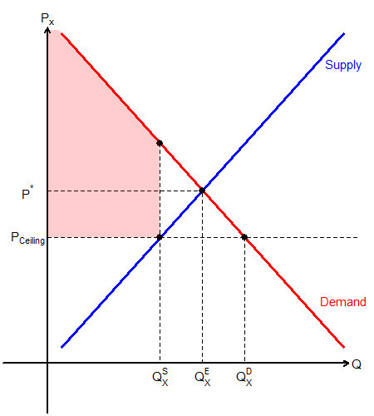
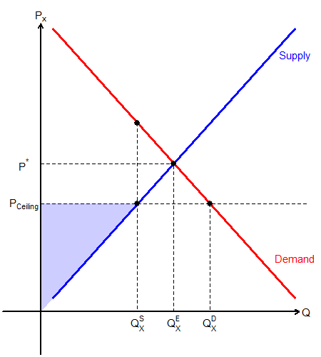
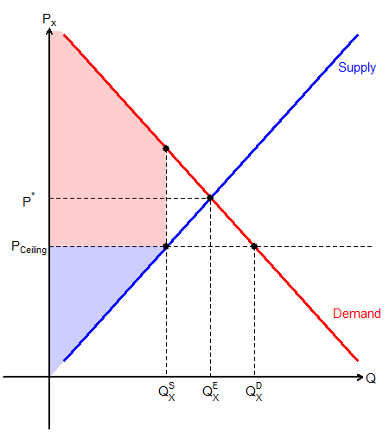
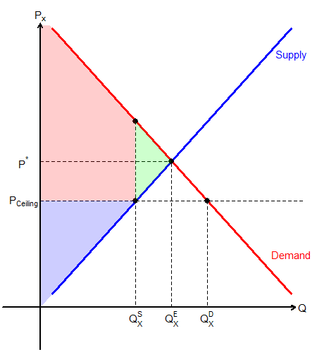
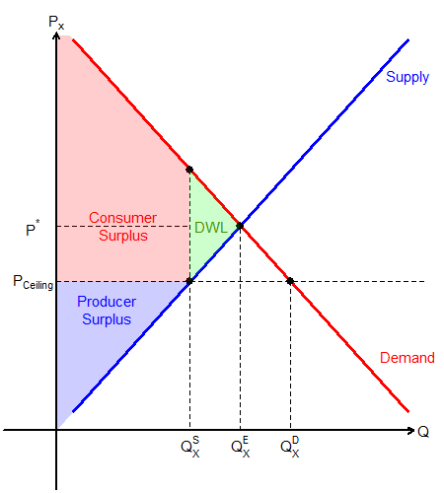
Welfare Loss Under Price Ceilings
Let us analyze social welfare under price control.
CS: Red Polygon
PS: Blue Triangle
Some potential surplus is lost due to price control.
This green triangle lost due to inefficiency is called the deadweight loss (DWL).

Slide 16
Finding DWL Under Price Ceilings
Continue from the previous question:
Market Demand: $Q_{x}^{D}=100−2P_{x}$
Price Ceiling: $P_{Ceil}=15$
Equilibrium Quantity: $Q^{∗}=60$
Quantity Traded: $Q_{x}^{T}=50$
Calculate the society’s deadweight loss.
When $Q_{x}^{T}=50$, use the demand function to find $P_{x}$.
$$50=100−2⋅P_{x} ⟹ P_{x}=25$$
The base is ${P_{x}−P}_{Ceil}=10$, and the height is $Q^{∗}−Q_{x}^{T}=10$.
$$DWL=10⋅10⋅\frac{1}{2}=50$$

Slide 17
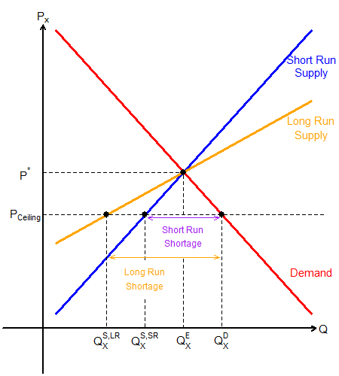
Long Run Effects of Price Ceilings
Sometimes, price controls are enforced in the long run…
In the long run, due to firms entering and exiting the market, the shortage will be exacerbated.
Ex) Rent control leading to increased AirBnB listings?

Slide 18
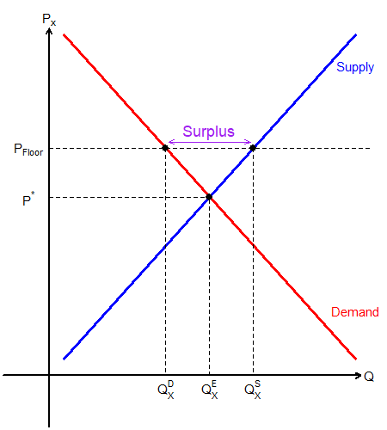
Price Floor
Governments can set a price floor, the minimum price that a consumer is allowed to pay.
Not effective if floor is set below $P_{x}^{∗}$.
If effective, will cause a surplus in the market.
Quantity demanded is $Q_{D}^{x}$.
Quantity supplied is $Q_{S}^{x}$.
Only $Q_{D}^{x}$ can be traded in the market.

Slide 19
Finding Surplus Under Price Floors
Continue from the previous question:
Market Demand: $Q_{x}^{D}=100−2P_{x}$
Market Supply: $Q_{x}^{S}=20+2P_{x}$
Price Ceiling: $P_{Floor}=30$
Is there a surplus in the market? If so, find the surplus.
When $P_{Floor}=30$, use the demand function to find $Q_{x}^{D}$.
$$Q_{x}^{D}=100−2⋅30=40$$
When $P_{Floor}=30$, use the supply function to find $Q_{x}^{S}$.
$$Q_{x}^{D}=20+2⋅30=80$$
The shortage is $Q_{x}^{S}−Q_{x}^{D}$, so it is 40.

