Slide 1
Consumer Theory: Indifference Curves Part 3
ECON 300

Slide 2
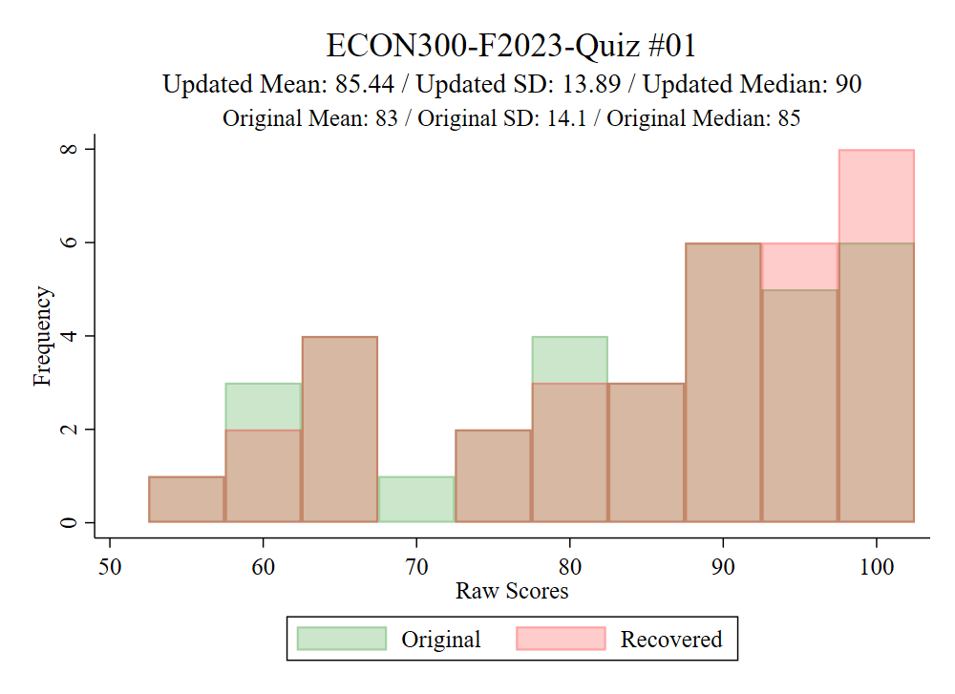
Quiz #01 Recovery Statistics

Slide 3
Review of Previous Lecture
We were talking about…
The subjective rate of exchange between two goods that left the consumer equally satisfied.
Covered “slope between bundles A and B”
Reached the concept of the “slope at the bundle.”
Defined partial derivatives.

Slide 4
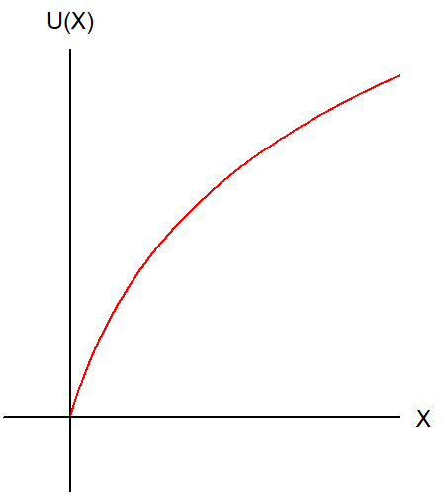
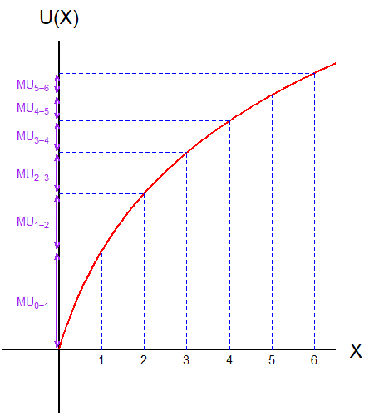
Marginal Utility
If we pretend that goods are discrete… (i.e., Cannot buy “fractional” items)
The marginal utility is the amount of utility gained from each additional unit consumed.
Marginal Utility is often denoted as $MU(⋅)$

Slide 5
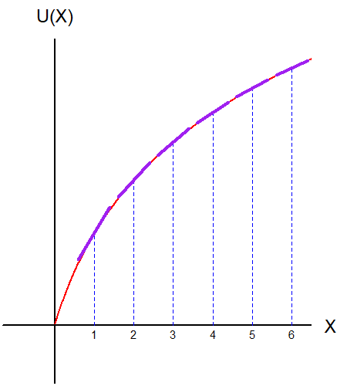
Marginal Utility
However, our models assume continuous goods. (i.e., can purchase “fractional” items)
Marginal Utility is defined as the partial derivative of the utility function.
It can be calculated as the slope of the utility function at a given point.

Slide 6
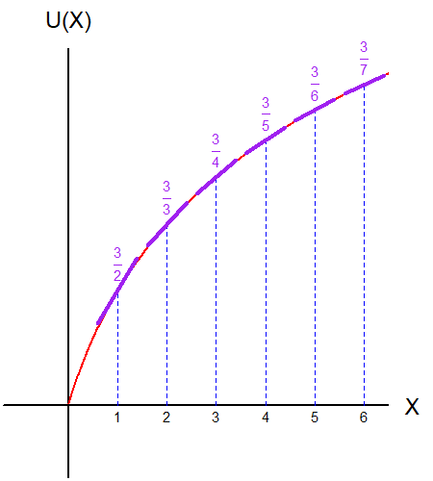
The Law of Diminishing Marginal Utility
The marginal utility must decrease as the quantity of goods consumed increases.
Loosely translated in plain words, “consumers are less happy with goods that they have already had.”

Slide 7
The Marginal Rate of Substitution
Recall that we wanted to find the slope of the indifference curve, which was claimed to be the consumers’ subjective rate of exchange.
This lead us down a rabbit hole of partial derivatives and marginal utilities.
So how does this relate to the slope of the indifference curve?

Slide 8
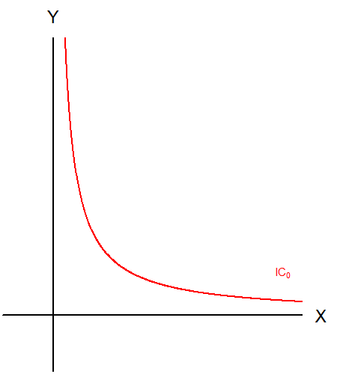
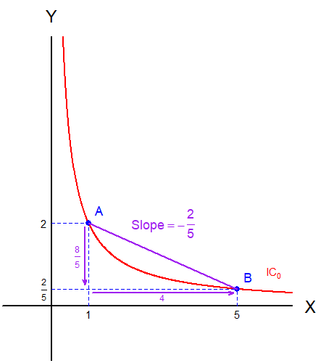
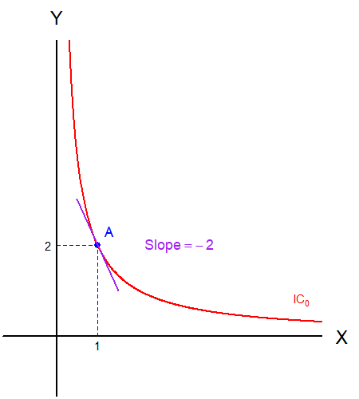
The Marginal Rate of Substitution
Suppose that we are given this indifference curve.
We covered why the slope of the indifference curve is the subjective rate of exchange.
We also covered why we want to find the instantaneous slope.

Slide 9
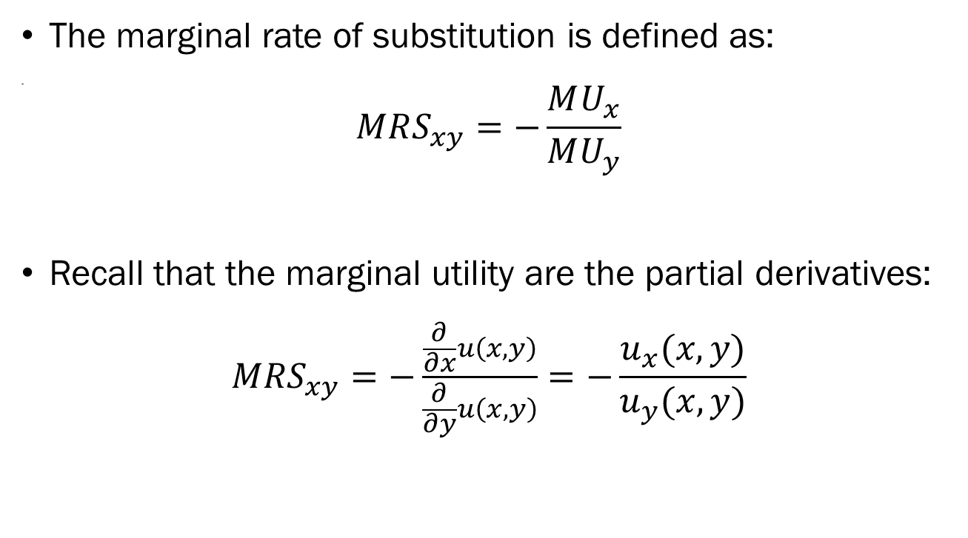
The Marginal Rate of Substitution
The marginal rate of substitution is defined as:
.
$$MRS_{xy}=−\frac{MU_{x}}{MU_{y}}$$
Recall that the marginal utility are the partial derivatives:
$$MRS_{xy}=−\frac{\frac{∂}{∂x}u\left(x,y\right)}{\frac{∂}{∂y}u\left(x,y\right)}=−\frac{u_{x}(x,y)}{u_{y}(x,y)}$$

Slide 10
The Marginal Rate of Substitution
Let’s walk through an example.
The utility function used in this plot is:
$$u\left(x,y\right)=x⋅y$$
$MRS_{xy}=−\frac{\frac{∂}{∂x}xy}{\frac{∂}{∂y}xy}=−\frac{y}{x}$

Slide 11
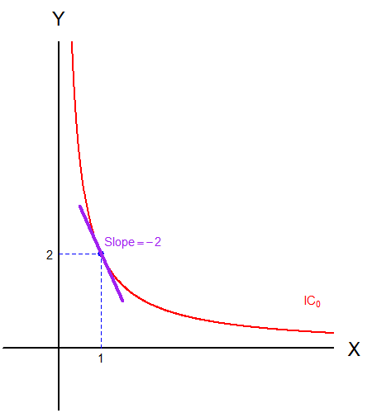
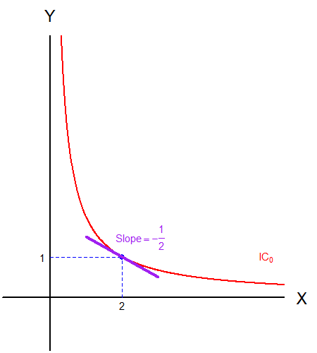
The Marginal Rate of Substitution
$MRS_{xy}=−\frac{y}{x}$ means that the slope will change depending on the amount of goods $x$ and $y$ in the bundle.
When we are at (1,2), the slope is $MRS_{xy}=−2$.
When we are at (2,1), the slope is $MRS_{xy}=−\frac{1}{2}$.

Slide 12
The Marginal Rate of Substitution
The Marginal Rate of Substitution (MRS) is the slope of the indifference curve.
The MRS represents the consumer’s subjective rate of exchange between the two goods in the market.
How many units of good $y$ is the consumer willing to give up for one extra unit of good $x$.
The Law of Diminishing Marginal Rate of Substitution.

Slide 13
“Families” of Utility Functions and ICs
Throughout the semester, we will be working three different “families” of utility functions.
Cobb-Douglas Utility Functions
Linear Utility Functions
Leontief Utility Functions
Each family of utility function stands in for a specific type of preferences.
Most indifference curves that we have been plotting come from a variation of the Cobb-Douglas utility function.

Slide 14
The Cobb-Douglas Utility Function
The Cobb-Douglas Utility Function takes the form of:
$$u\left(x,y\right)=Cx^{a}y^{b}$$
This is one the most frequently used utility functions.
Goods show some degree of substitutability and complementarity.

Slide 15
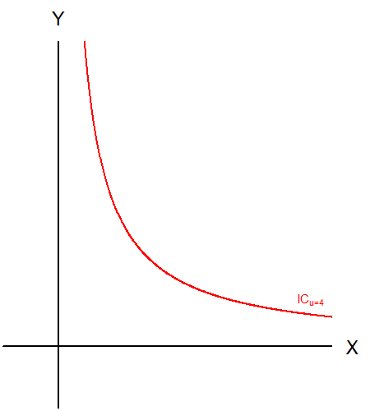
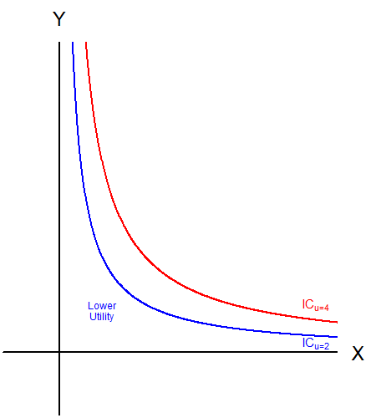
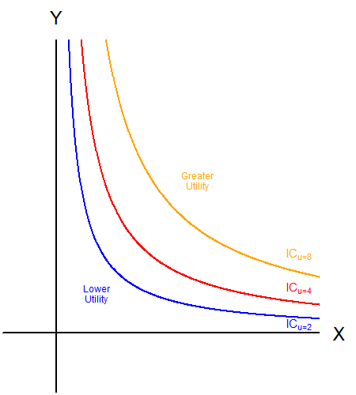
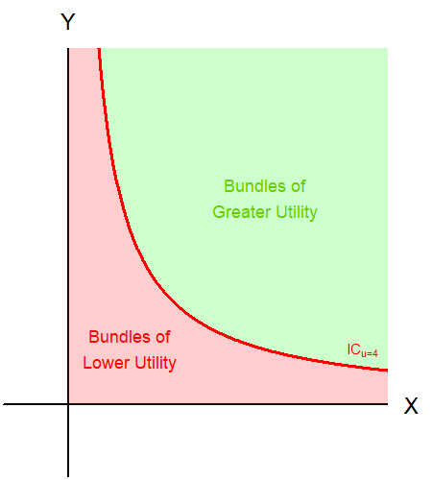
The Cobb-Douglas Utility Function
Similarly, points closer to the origin represent lower utility levels.
The points further away from the origin represent bundles of greater utility.
Like the budget constraint, the indifference curve splits the commodity space in two.

Slide 16
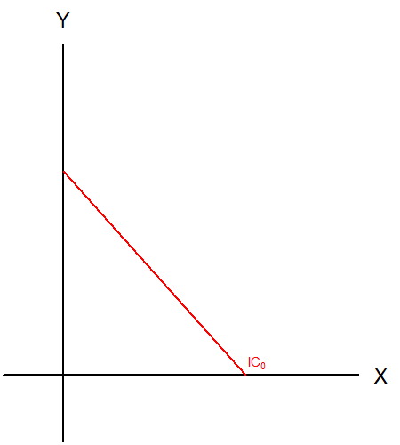
The Linear Utility Function
The Linear Utility Function takes the form of:
$$u\left(x,y\right)=ax+by$$
When the two goods are perfect substitutes, we use the linear utility function.
Perfect substitutes mean that one good can stand in for the other.

Slide 17
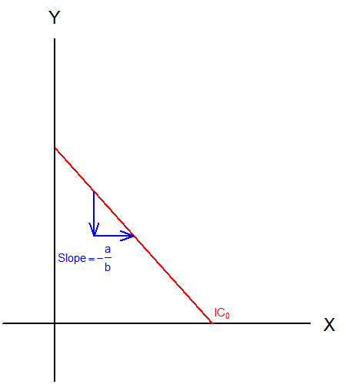
The Linear Utility Function
The goods being perfect substitutes does not necessarily mean that they will be a 1:1 perfect substitute.
The slope of the linear utility function is $−\frac{a}{b}$.
The slope determines the subjective rate of substitution.

Slide 18
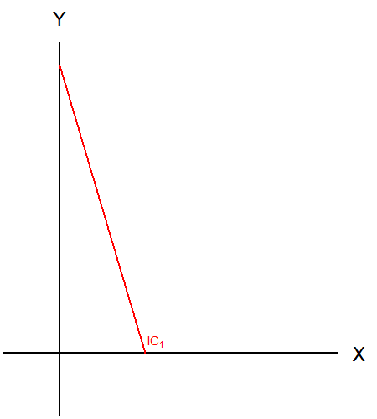
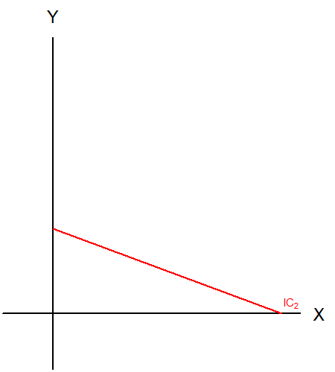
The Linear Utility Function
$$u\left(x,y\right)=3x+y$$
$$u\left(x,y\right)=x+3y$$

Slide 19
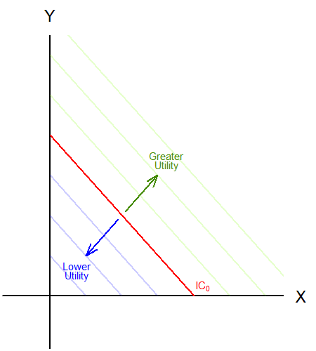
The Linear Utility Function
Points further away from the origin represent higher utility.

Slide 20
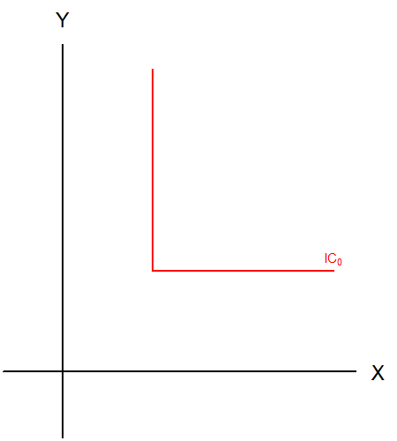
The Leontief Utility Function
The Leontief Utility Function takes the form of:
$$u\left(x,y\right)=min⁡\{ax,by\}$$
The utility from consuming the bundle $\left(x,y\right)$ is the lesser between $ax$ or $by$.
For example, $\min\left\{120,75\right\}=75$

Slide 21
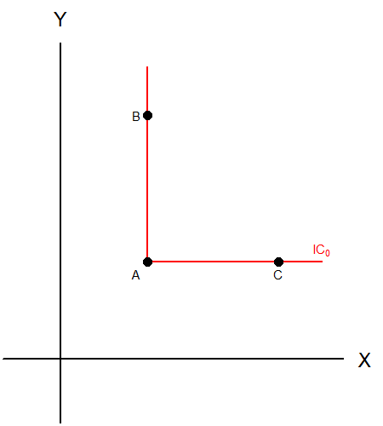
The Leontief Utility Function
Bundle A, B, and C provide the same level of utility.
“Having more of one good means nothing if I don’t have enough of the other to complement it.”
We can tell that the goods are perfect complements.

Slide 22
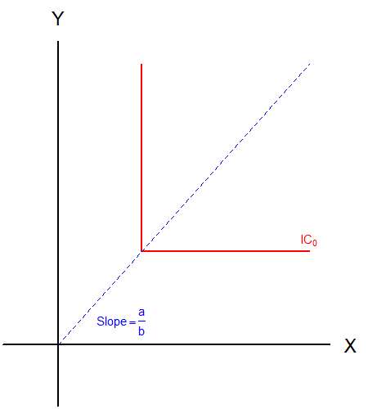
The Leontief Utility Function
The optimal mix of goods $x$ and $y$ to be consumed is determined by the parameters $a$ and $b$.
The ray spanning out from the origin represents this optimal mix.
The slope of this ray is $\frac{a}{b}$
Draw $y=$ $\frac{a}{b}x$

Slide 23
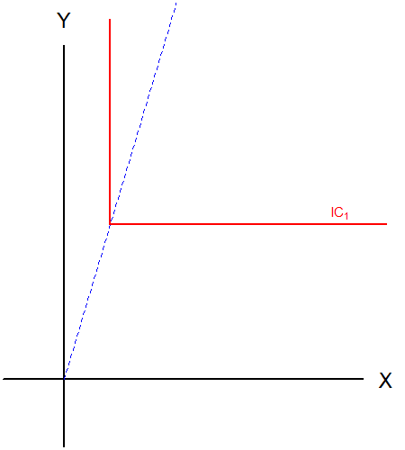
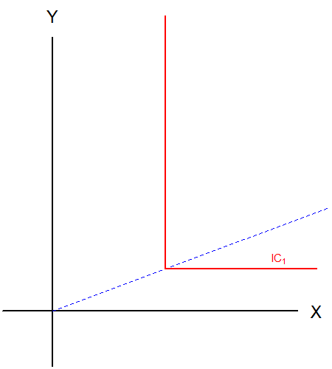
The Leontief Utility Function
$$u\left(x,y\right)=max⁡\{3x,y\}$$
$$u\left(x,y\right)=max⁡\{x,3y\}$$

Slide 24
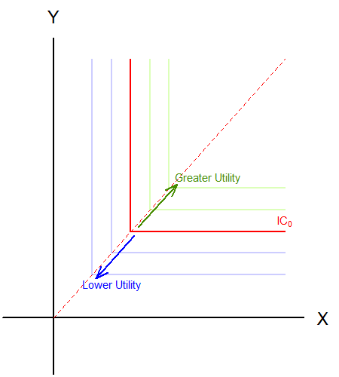
The Leontief Utility Function
Points further away from the origin represent higher utility.

Slide 25
Recap of Today’s Lecture
The Law of Diminishing Marginal Utility.
Marginal Rate of Substitution.
Cobb-Douglas Utility Functions.
Linear Utility Functions.
Leontief Utility Functions.

Slide 26
Next Lecture
Starting off the Utility Maximization Problem.
Conditions of Utility Maximization.
Comparing Slopes

