Slide 1
BUSINESS STATISTICS
Chapter 8: Interval Estimation

Slide 2
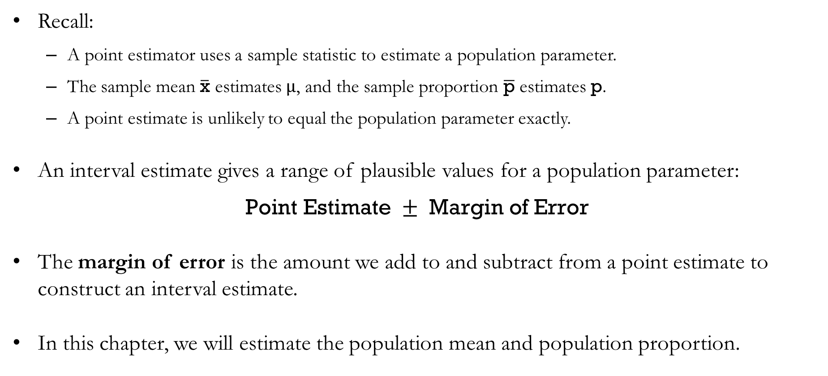
Recap: Point Estimators and Interval Estimates
Recall:
  A point estimator uses a sample statistic to estimate a population parameter.
  The sample mean $\overline{\text{x}}$ estimates $μ$, and the sample proportion $\overline{\text{p}}$ estimates $\text{p}$.
  A point estimate is unlikely to equal the population parameter exactly.
An interval estimate gives a range of plausible values for a population parameter:
$$\text{Point Estimate }±\text{ Margin of Error}$$
The margin of error is the amount we add to and subtract from a point estimate to construct an interval estimate.
In this chapter, we will estimate the population mean and population proportion.

Slide 3
Population Mean: Known $σ$

Slide 4
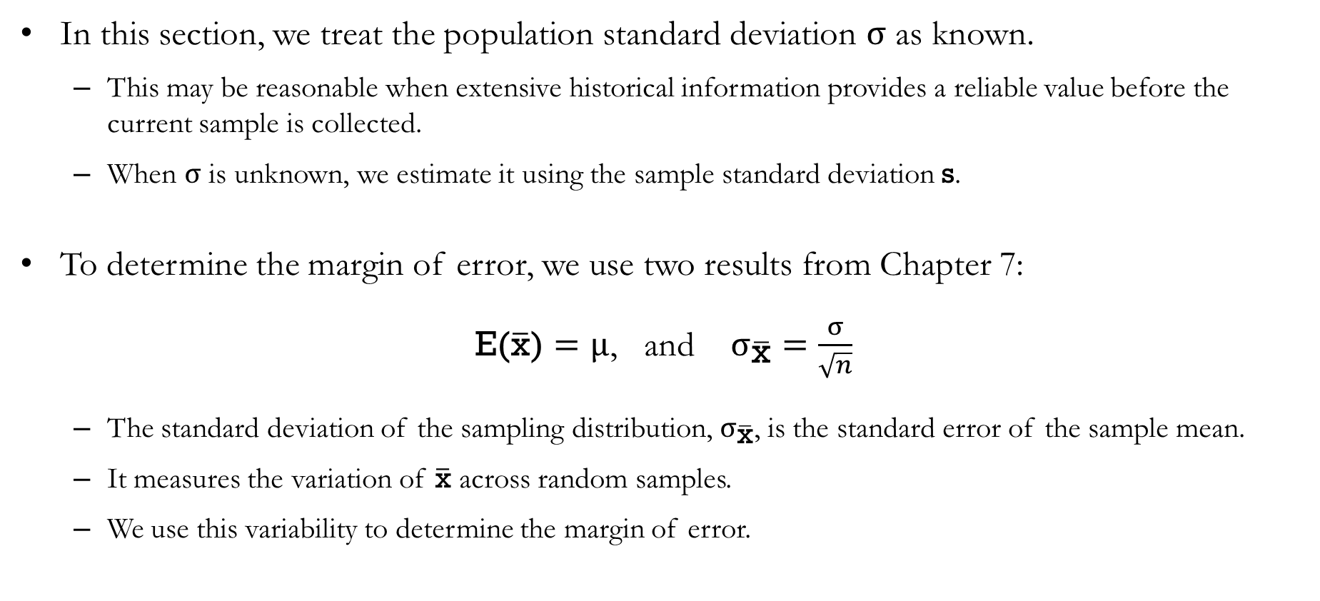
Population Mean: Known σ
In this section, we treat the population standard deviation $σ$ as known.
  This may be reasonable when extensive historical information provides a reliable value before the current sample is collected.
  When $σ$ is unknown, we estimate it using the sample standard deviation $\text{s}$.
To determine the margin of error, we use two results from Chapter 7:
$\text{E(}\overline{\text{x}}\text{)}=μ$, and $σ_{\overline{\text{x}}}=\frac{σ}{\sqrt{n}}$
  The standard deviation of the sampling distribution, $σ_{\overline{\text{x}}}$, is the standard error of the sample mean.
  It measures the variation of $\overline{\text{x}}$ across random samples.
  We use this variability to determine the margin of error.

Slide 5
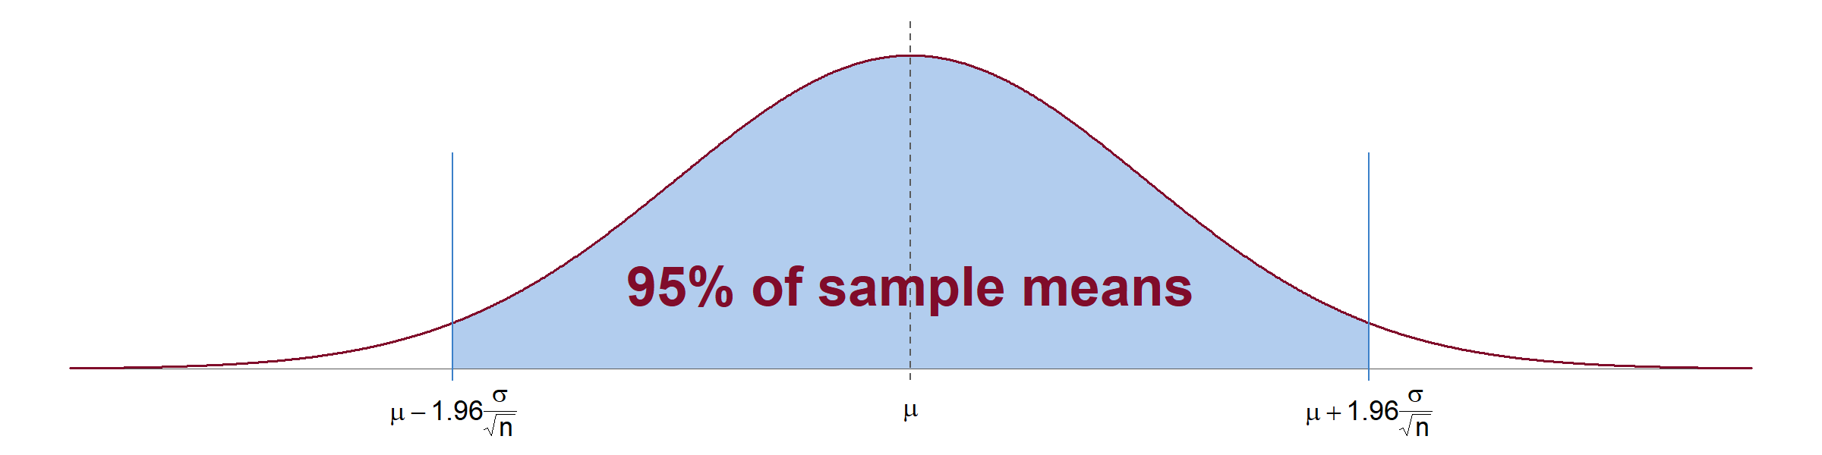
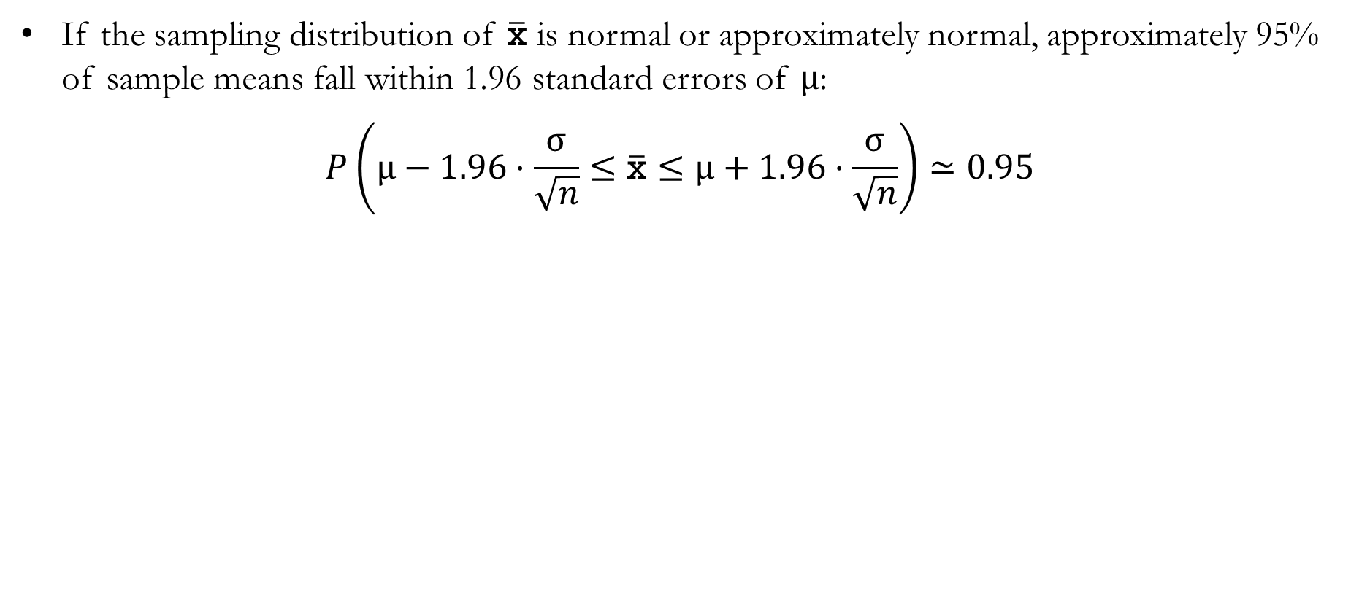
How Close to $μ$ is $\overline{\text{x}}$?
If the sampling distribution of $\overline{\text{x}}$ is normal or approximately normal, approximately 95% of sample means fall within 1.96 standard errors of $μ$:
$$P\left(μ−1.96⋅\frac{σ}{\sqrt{n}}≤\overline{\text{x}}≤μ+1.96⋅\frac{σ}{\sqrt{n}}\right)≃0.95$$

Slide 6
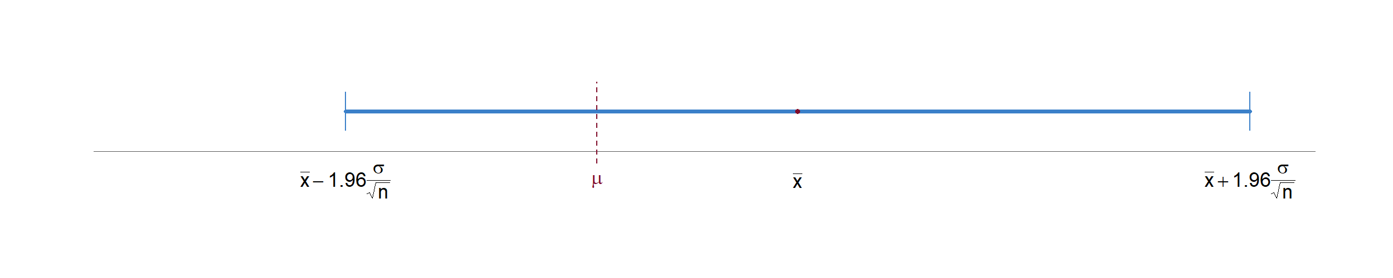
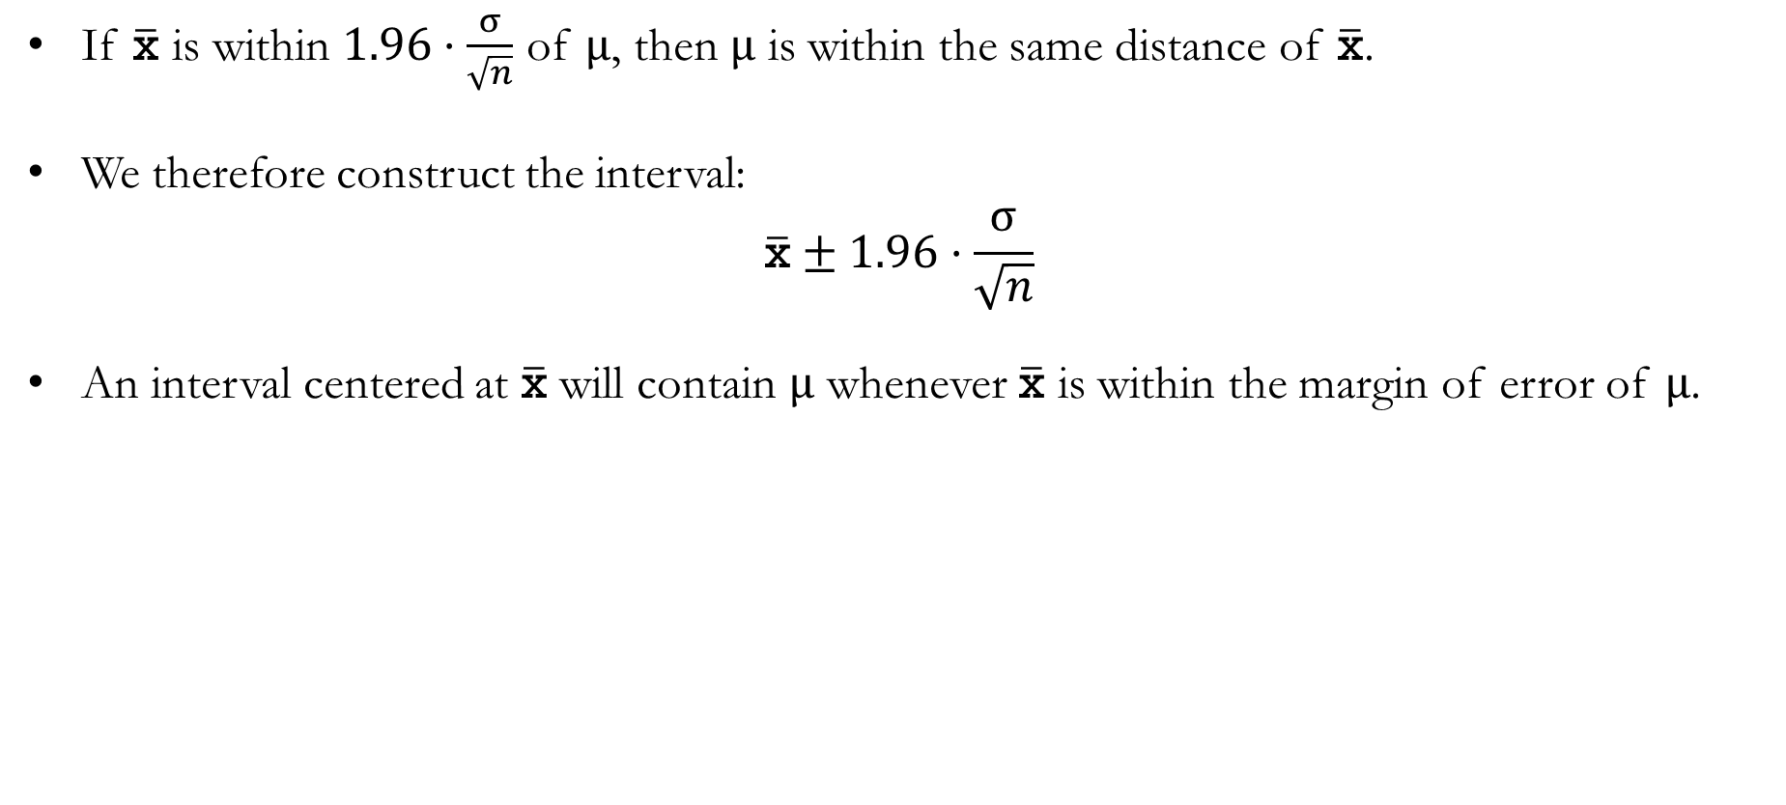
Constructing an Interval Around $\overline{\text{x}}$
If $\overline{\text{x}}$ is within $1.96⋅\frac{σ}{\sqrt{n}}$ of $μ$, then $μ$ is within the same distance of $\overline{\text{x}}$.
We therefore construct the interval:
$$\overline{\text{x}}±1.96⋅\frac{σ}{\sqrt{n}}$$
An interval centered at $\overline{\text{x}}$ will contain $μ$ whenever $\overline{\text{x}}$ is within the margin of error of $μ$.

Slide 7
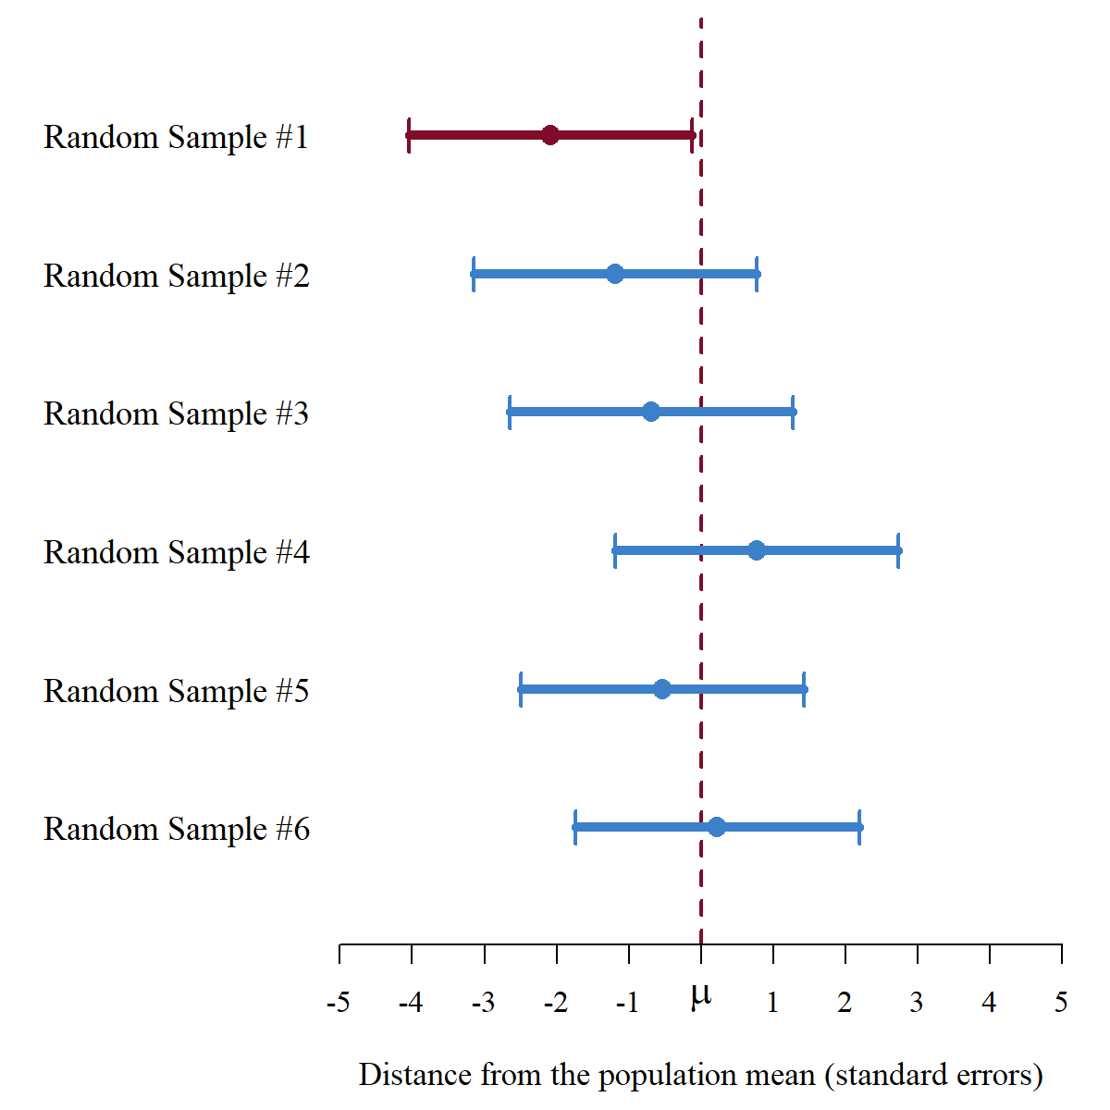
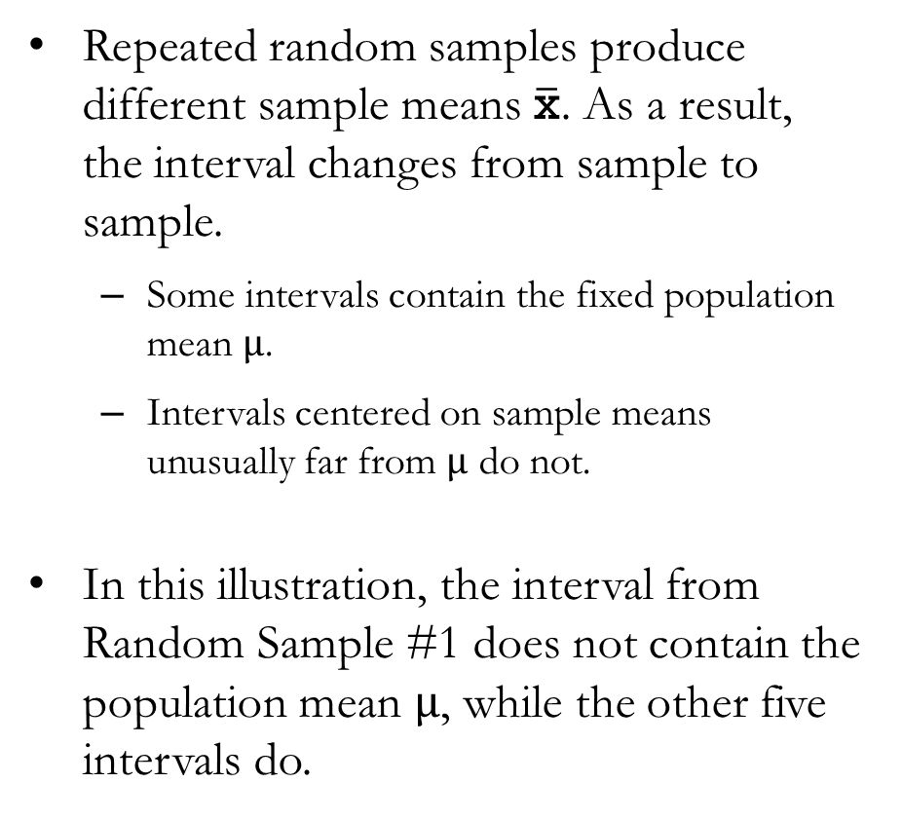
Different Samples Produce Different Intervals
Repeated random samples produce different sample means $\overline{\text{x}}$. As a result, the interval changes from sample to sample.
  Some intervals contain the fixed population mean $μ$.
  Intervals centered on sample means unusually far from $μ$ do not.
In this illustration, the interval from Random Sample #1 does not contain the population mean $μ$, while the other five intervals do.

Slide 8
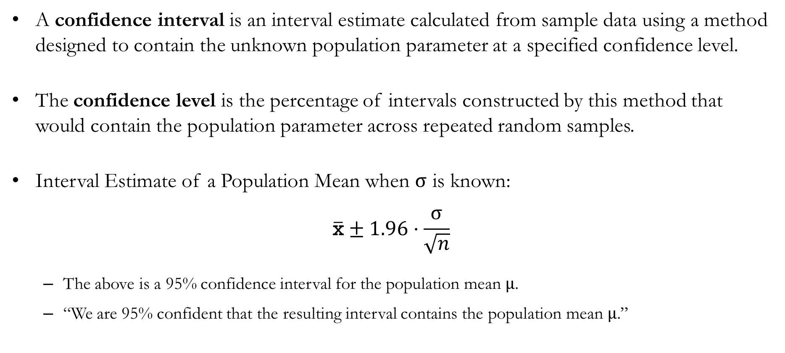
Confidence Intervals
A confidence interval is an interval estimate calculated from sample data using a method designed to contain the unknown population parameter at a specified confidence level.
The confidence level is the percentage of intervals constructed by this method that would contain the population parameter across repeated random samples.
Interval Estimate of a Population Mean when $σ$ is known:
$$\overline{\text{x}}±1.96⋅\frac{σ}{\sqrt{n}}$$
  The above is a 95% confidence interval for the population mean $μ$.
  “We are 95% confident that the resulting interval contains the population mean $μ$.”

Slide 9
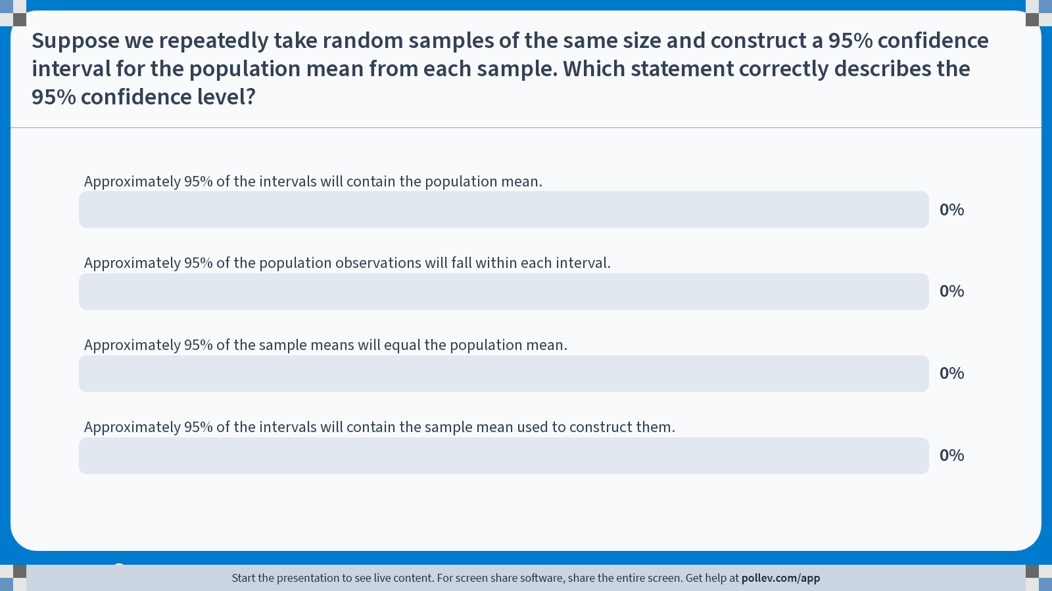
Poll Everywhere multiple choice poll activity
Activity Title: Suppose we repeatedly take random samples of the same size and construct a 95% confidence interval for the population mean from each sample. Which statement correctly describes the 95% confidence level?
Slide 9
Notes:
Do not modify the notes in this section to avoid tampering with the Poll Everywhere activity.
More info at polleverywhere.com/support
Suppose we repeatedly take random samples of the same size and construct a 95% confidence interval for the population mean from each sample. Which statement correctly describes the 95% confidence level?
https://www.polleverywhere.com/multiple_choice_polls/T2Eu0M42xxvtF9YJO5haS?state=opened&flow=Default&onscreen=persist

Slide 10
Solution to In-class Poll
Correct answer: Approximately 95% of the intervals will contain the population mean.
  The population mean is fixed, but the confidence interval changes from sample to sample.
  Across repeated random samples, approximately 95% of the intervals constructed using this method will contain the population mean.
Why the other answers are incorrect:
  B: A confidence interval estimates the population mean. It does not describe where 95% of individual observations fall.
  C: Sample means vary around the population mean and need not equal it exactly.
  D: Every interval constructed contains its own sample mean.

Slide 11
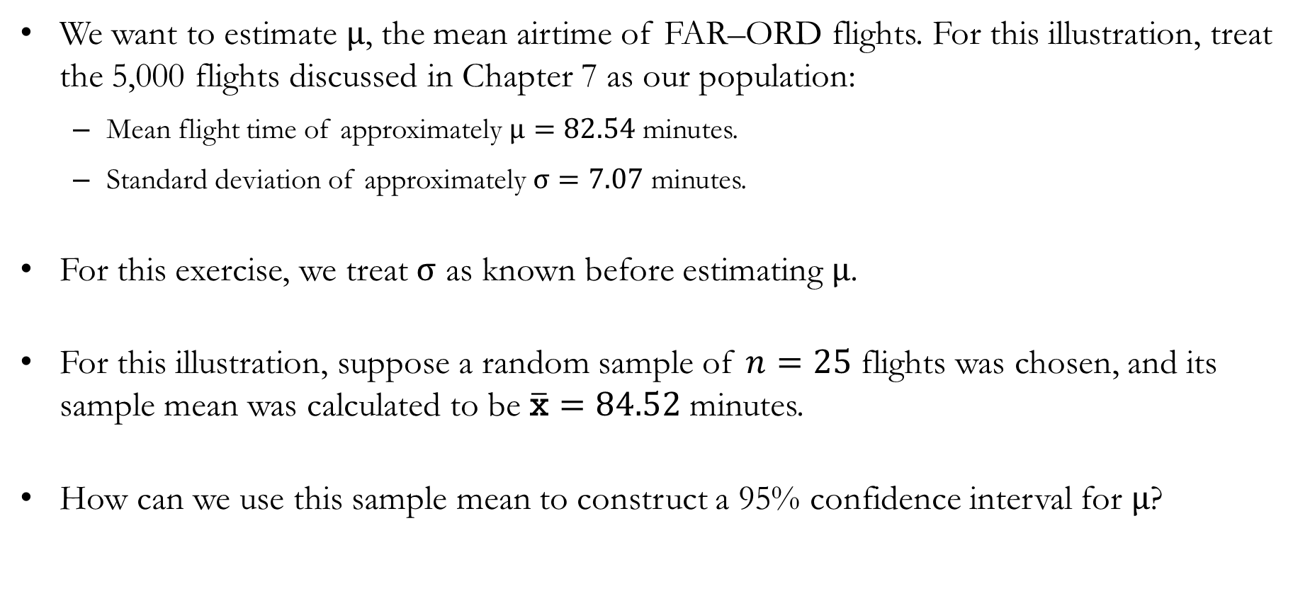
Example: Real-World Flight Data from FAR to ORD
We want to estimate $μ$, the mean airtime of FAR–ORD flights. For this illustration, treat the 5,000 flights discussed in Chapter 7 as our population:
  Mean flight time of approximately $μ=82.54$ minutes.
  Standard deviation of approximately $σ=7.07$ minutes.
For this exercise, we treat $σ$ as known before estimating $μ$.
For this illustration, suppose a random sample of $n=25$ flights was chosen, and its sample mean was calculated to be $\overline{\text{x}}=84.52$ minutes.
How can we use this sample mean to construct a 95% confidence interval for $μ$?

Slide 12
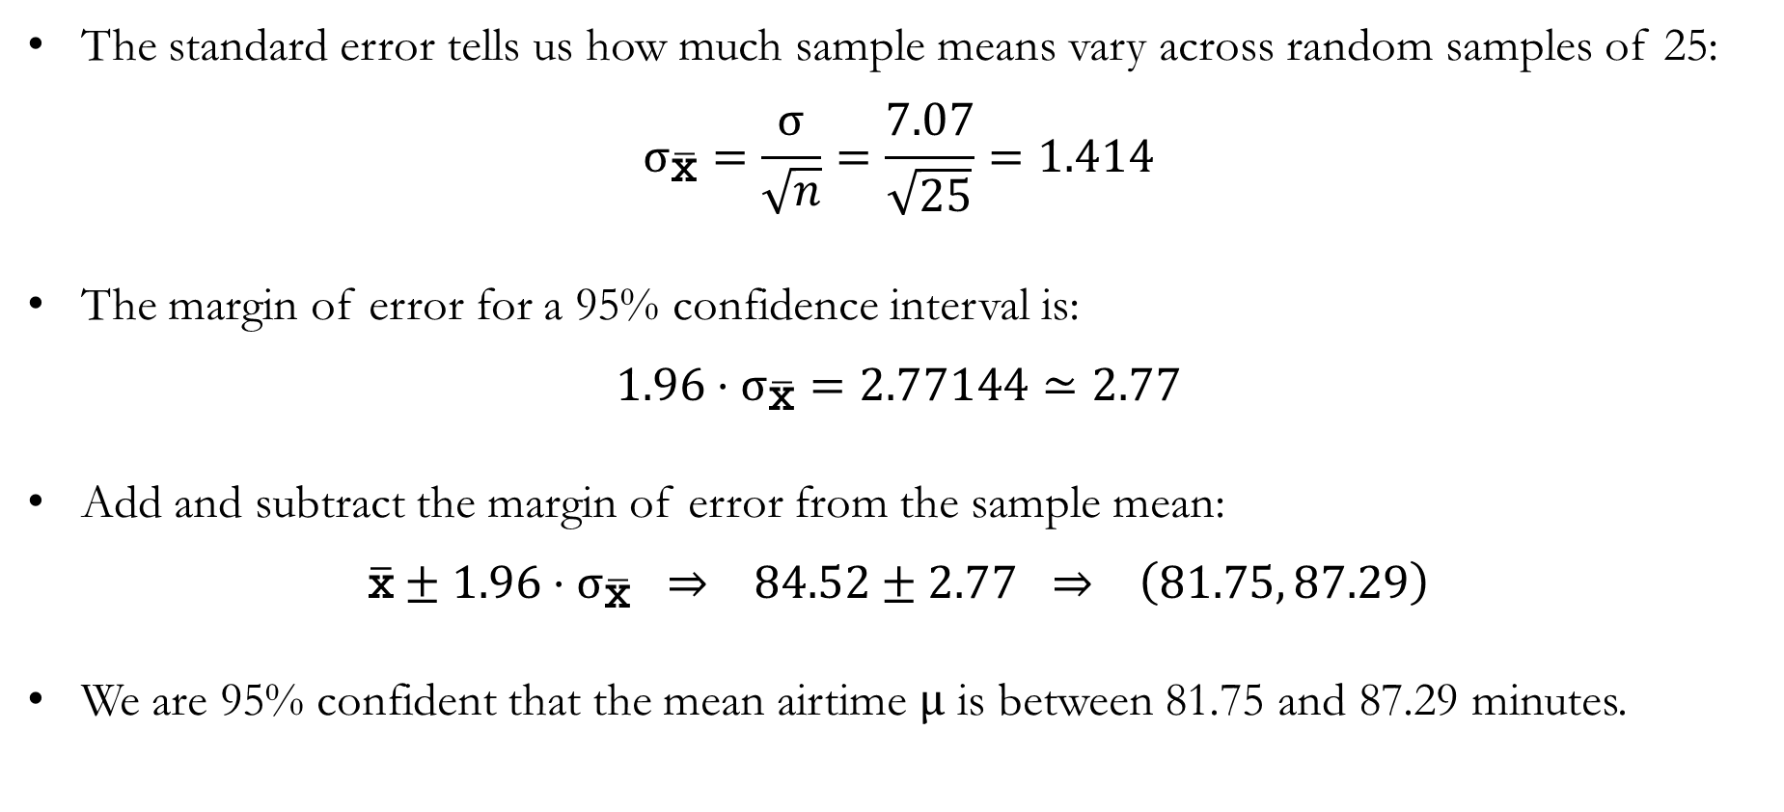
Example: Real-World Flight Data from FAR to ORD
The standard error tells us how much sample means vary across random samples of 25:
$$σ_{\overline{\text{x}}}=\frac{σ}{\sqrt{n}}=\frac{7.07}{\sqrt{25}}=1.414$$
The margin of error for a 95% confidence interval is:
$$1.96⋅σ_{\overline{\text{x}}}=2.77144≃2.77$$
Add and subtract the margin of error from the sample mean:
$$\overline{\text{x}}±1.96⋅σ_{\overline{\text{x}}} ⇒ 84.52±2.77 ⇒ \left(81.75, 87.29\right)$$
We are 95% confident that the mean airtime $μ$ is between 81.75 and 87.29 minutes.

Slide 13
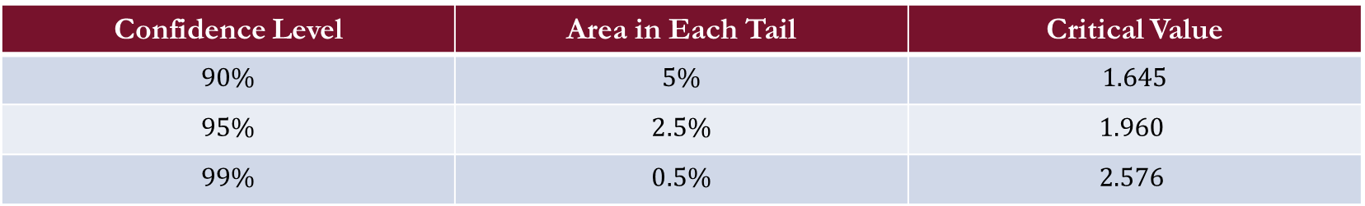
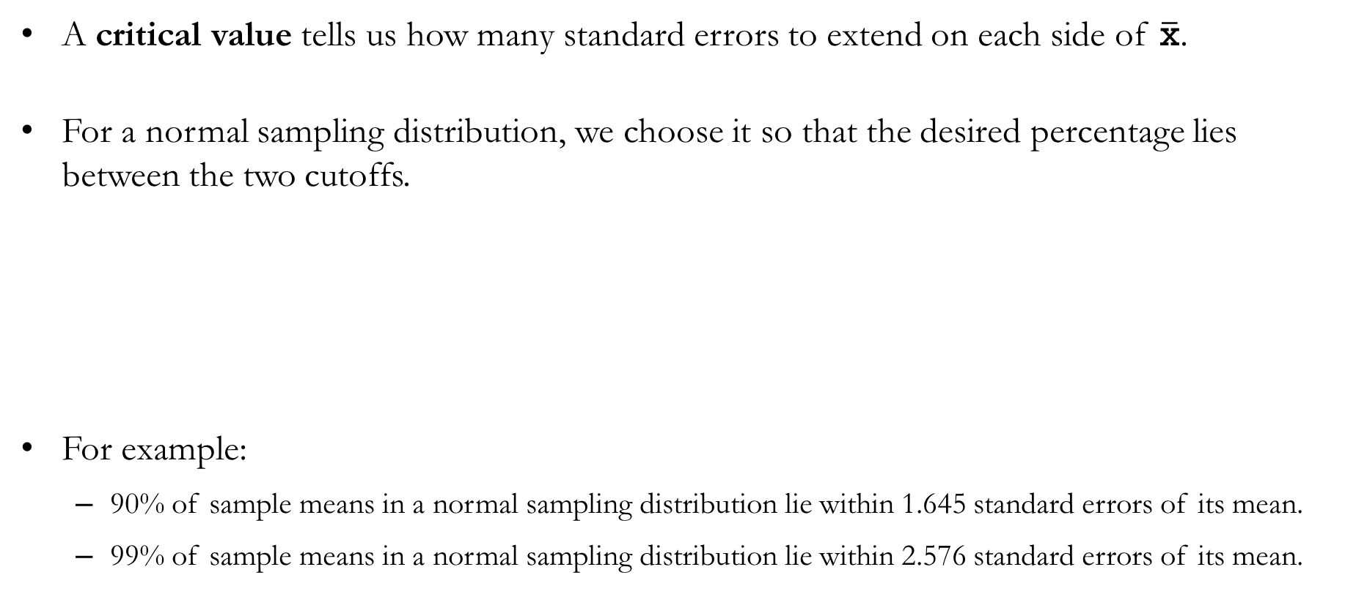
Choosing a Confidence Level
A critical value tells us how many standard errors to extend on each side of $\overline{\text{x}}$.
For a normal sampling distribution, we choose it so that the desired percentage lies between the two cutoffs.
For example:
  90% of sample means in a normal sampling distribution lie within 1.645 standard errors of its mean.
  99% of sample means in a normal sampling distribution lie within 2.576 standard errors of its mean.
Confidence Level | Area in Each Tail | Critical Value
$$90\%$$ | $$5\%$$ | $$1.645$$
$$95\%$$ | $$2.5\%$$ | $$1.960$$
$$99\%$$ | $$0.5\%$$ | $$2.576$$

Slide 14
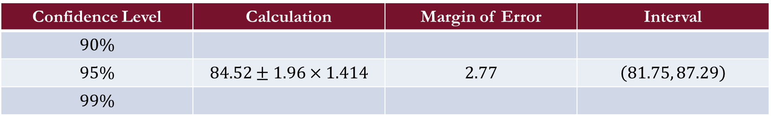
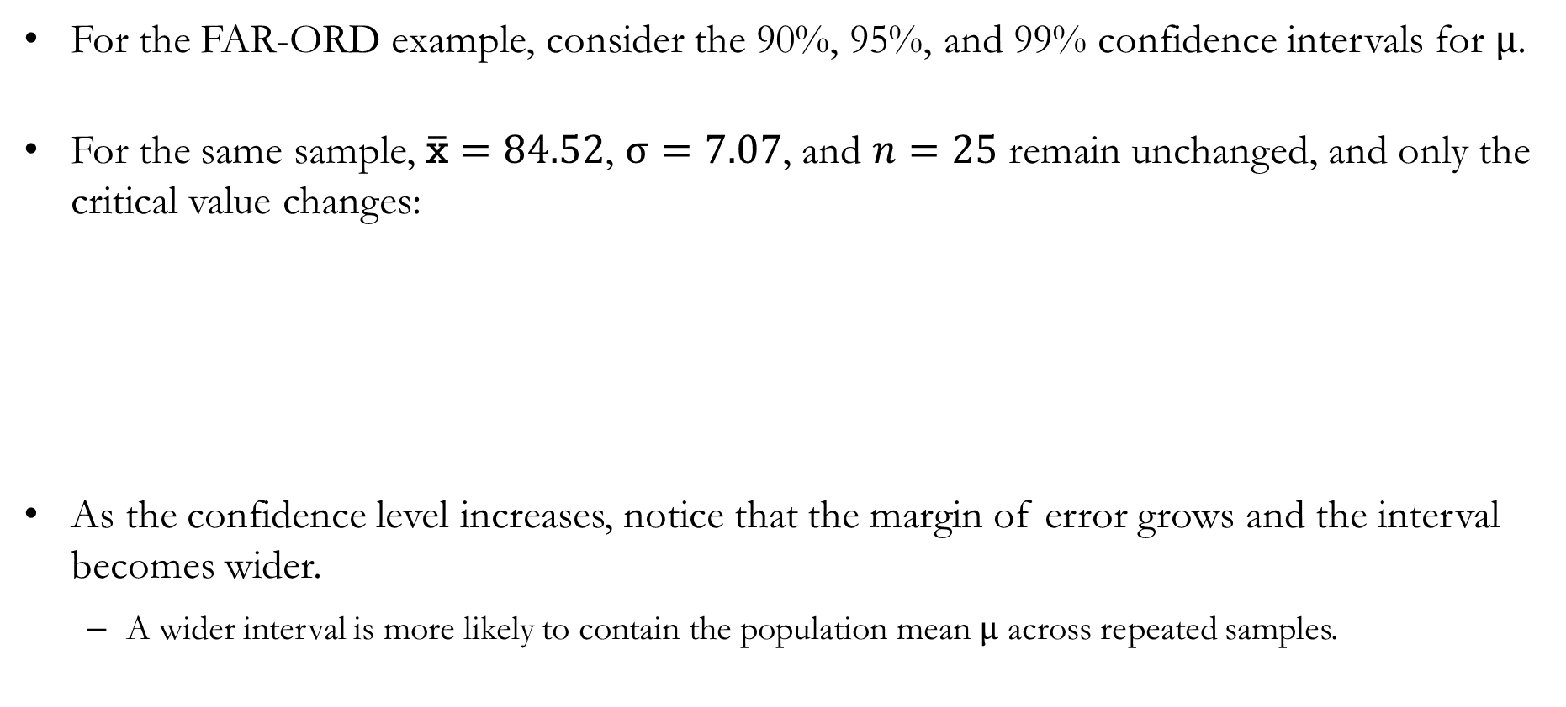
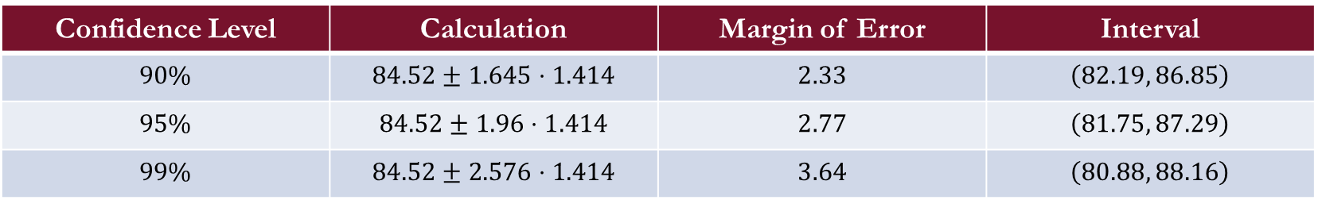
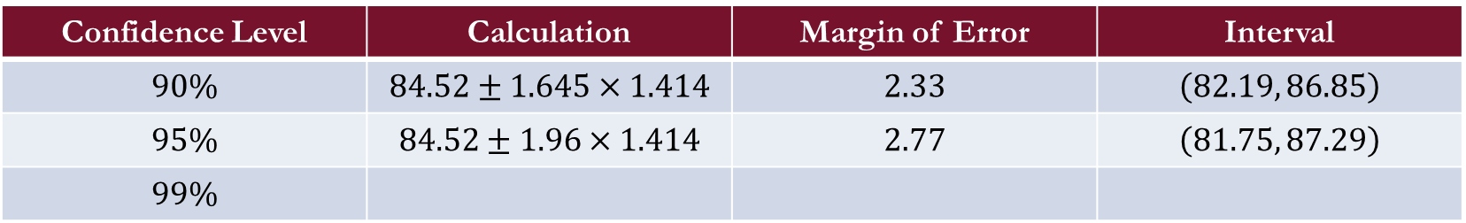
Example: Real-World Flight Data from FAR to ORD
For the FAR-ORD example, consider the 90%, 95%, and 99% confidence intervals for $μ$.
For the same sample, $\overline{\text{x}}=84.52$, $σ=7.07$, and $n=25$ remain unchanged, and only the critical value changes:
As the confidence level increases, notice that the margin of error grows and the interval becomes wider.
  A wider interval is more likely to contain the population mean $μ$ across repeated samples.
Confidence Level | Calculation | Margin of Error | Interval
$$90\%$$
$$95\%$$ | $$84.52±1.96×1.414$$ | $$2.77$$ | $$\left(81.75, 87.29\right)$$
$$99\%$$
Confidence Level | Calculation | Margin of Error | Interval
$$90\%$$ | $$84.52±1.645×1.414$$ | $$2.33$$ | $$\left(82.19, 86.85\right)$$
$$95\%$$ | $$84.52±1.96×1.414$$ | $$2.77$$ | $$\left(81.75, 87.29\right)$$
$$99\%$$
Confidence Level | Calculation | Margin of Error | Interval
$$90\%$$ | $$84.52±1.645⋅1.414$$ | $$2.33$$ | $$\left(82.19, 86.85\right)$$
$$95\%$$ | $$84.52±1.96⋅1.414$$ | $$2.77$$ | $$\left(81.75, 87.29\right)$$
$$99\%$$ | $$84.52±2.576⋅1.414$$ | $$3.64$$ | $$\left(80.88, 88.16\right)$$

Slide 15
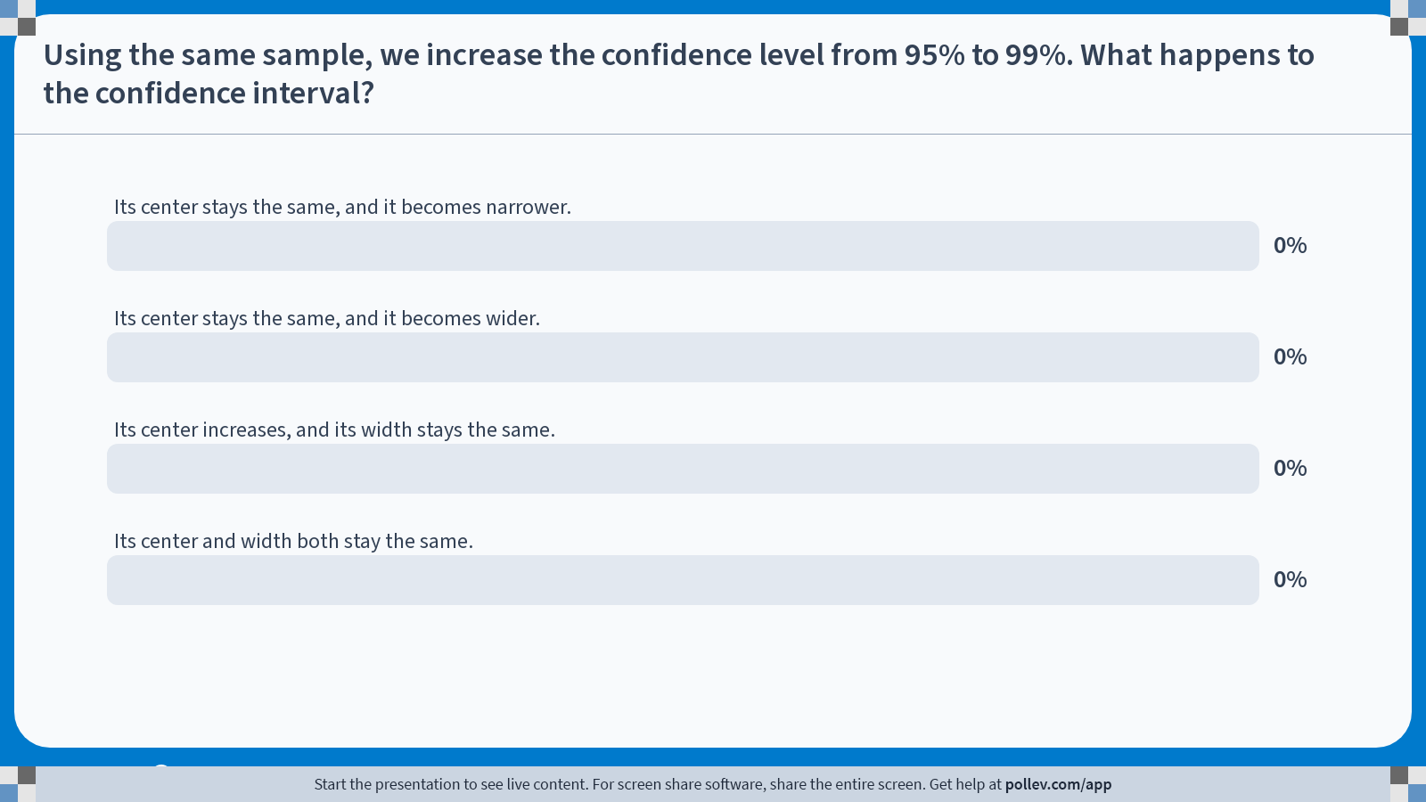
Poll Everywhere multiple choice poll activity
Activity Title: Using the same sample, we increase the confidence level from 95% to 99%. What happens to the confidence interval?
Slide 15
Notes:
Do not modify the notes in this section to avoid tampering with the Poll Everywhere activity.
More info at polleverywhere.com/support
Using the same sample, we increase the confidence level from 95% to 99%. What happens to the confidence interval?
https://www.polleverywhere.com/multiple_choice_polls/rIivLAzI87k4ODG8G7LIG?state=opened&flow=Default&onscreen=persist

Slide 16
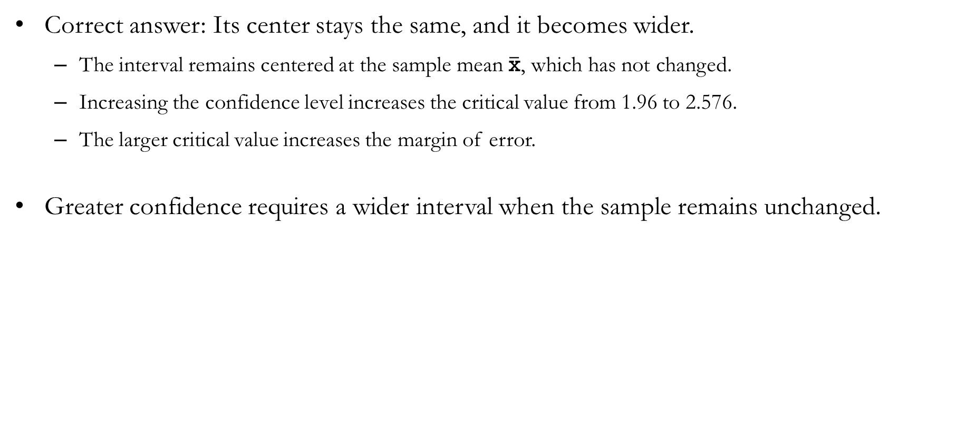
Solution to In-class Poll
Correct answer: Its center stays the same, and it becomes wider.
  The interval remains centered at the sample mean $\overline{\text{x}}$, which has not changed.
  Increasing the confidence level increases the critical value from 1.96 to 2.576.
  The larger critical value increases the margin of error.
Greater confidence requires a wider interval when the sample remains unchanged.

Slide 17
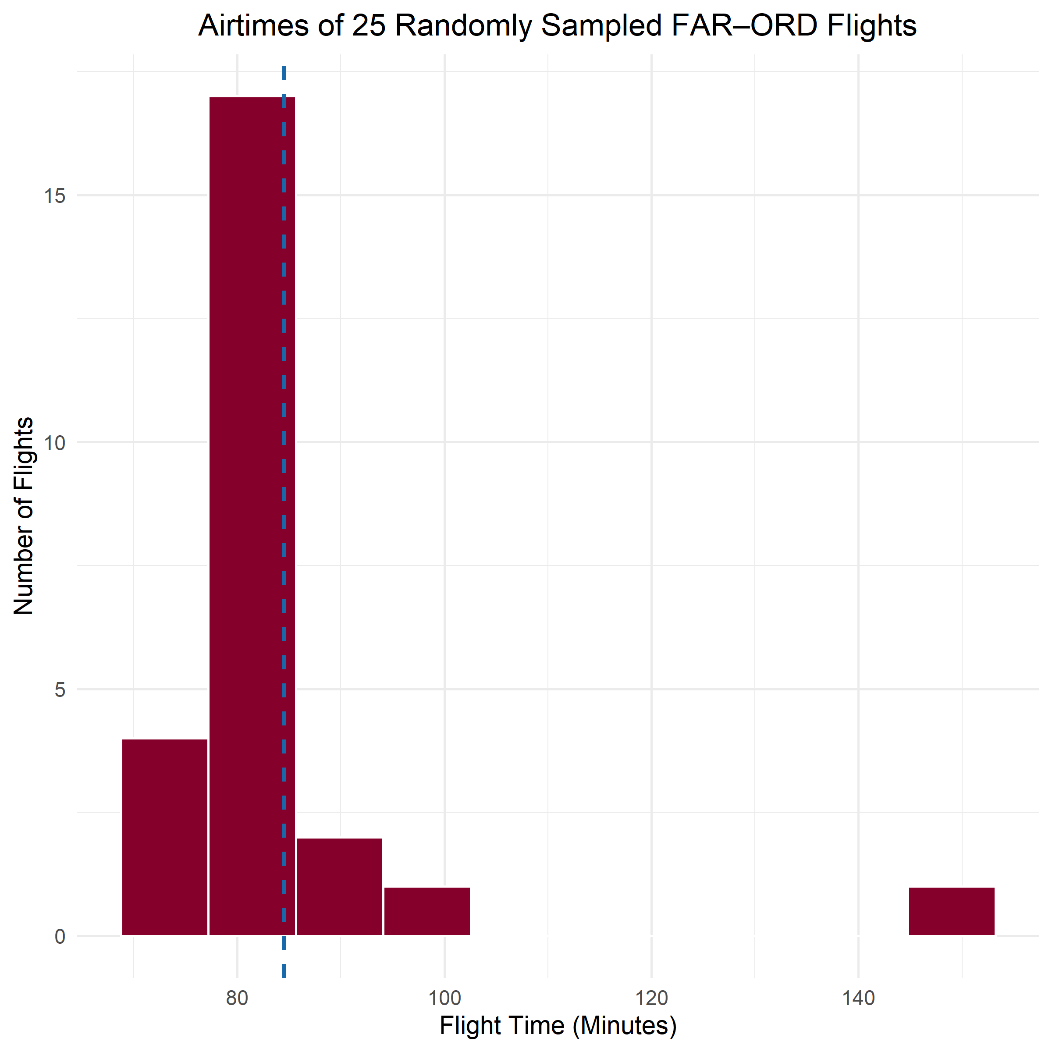
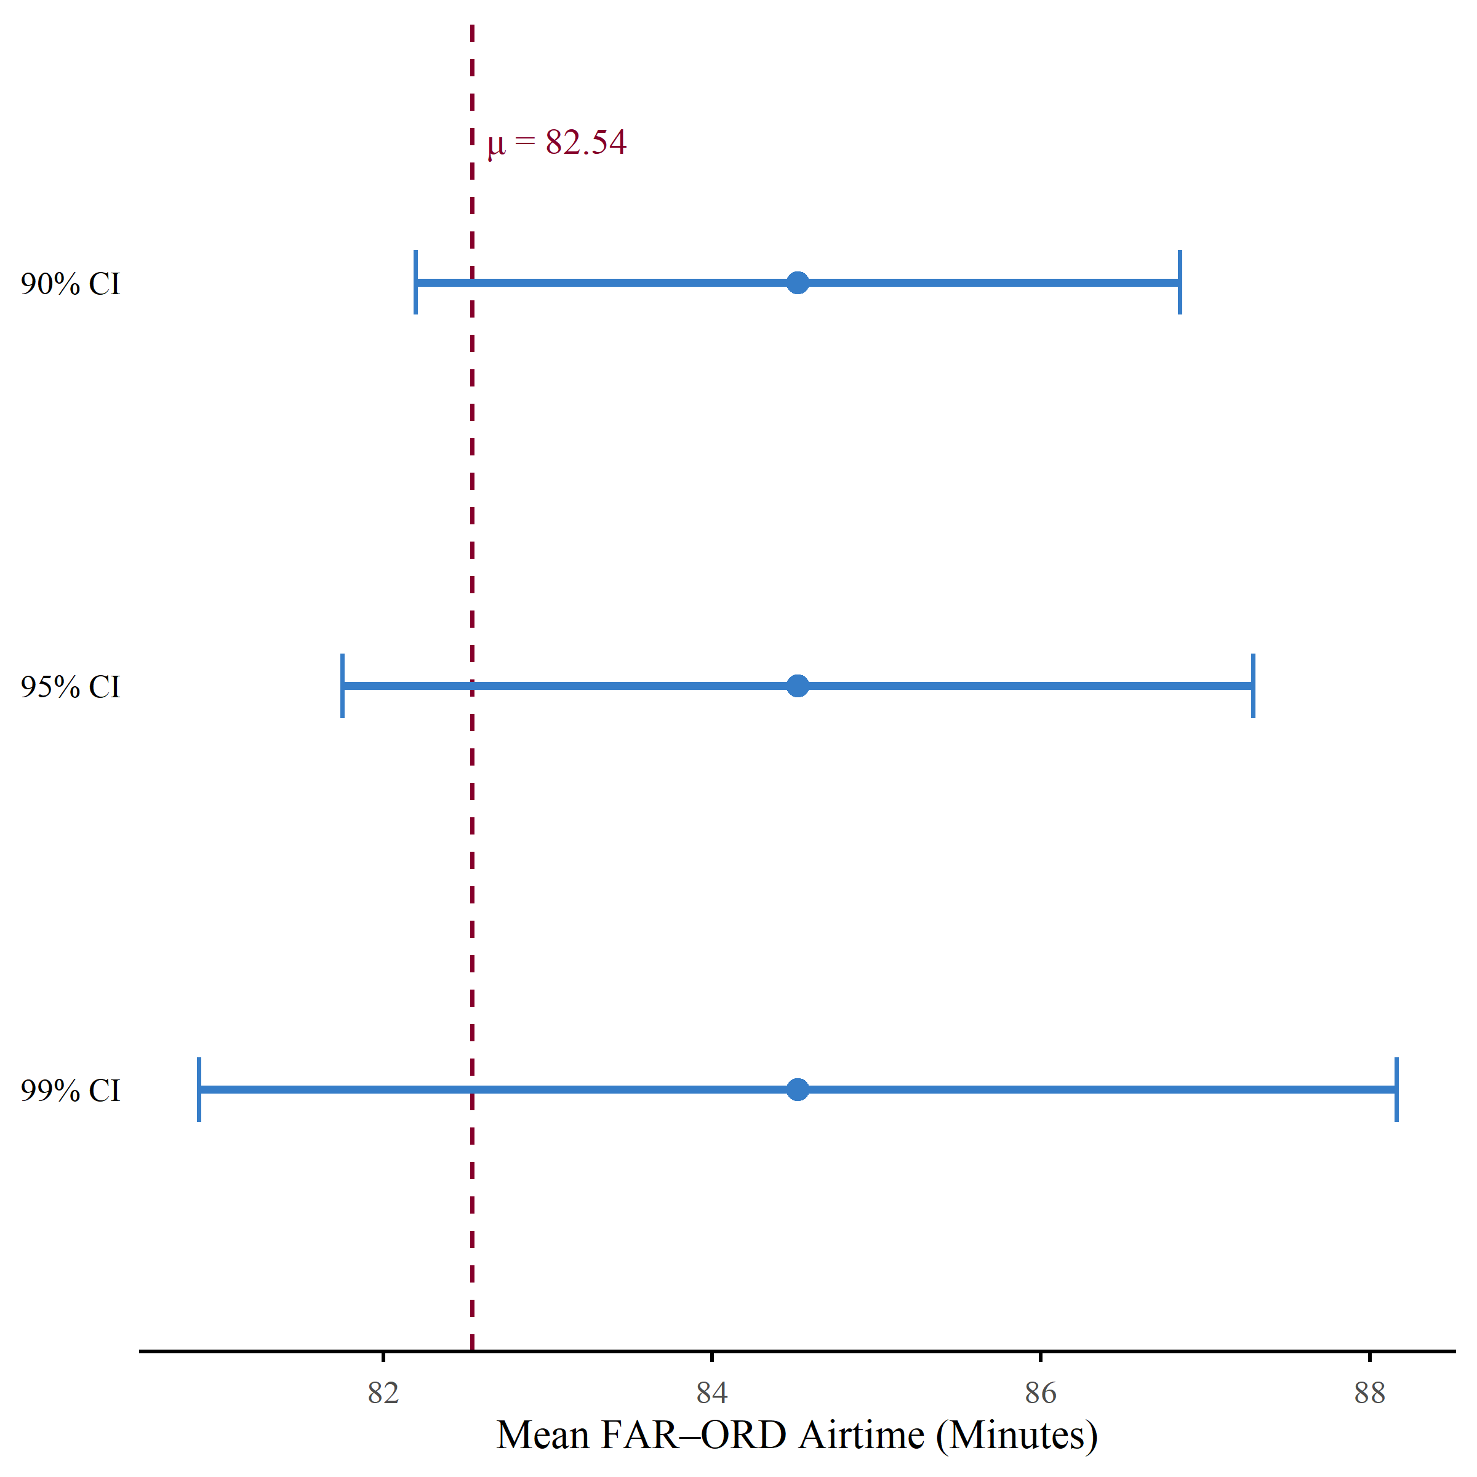
Example: Real-World Flight Data from FAR to ORD

Slide 18
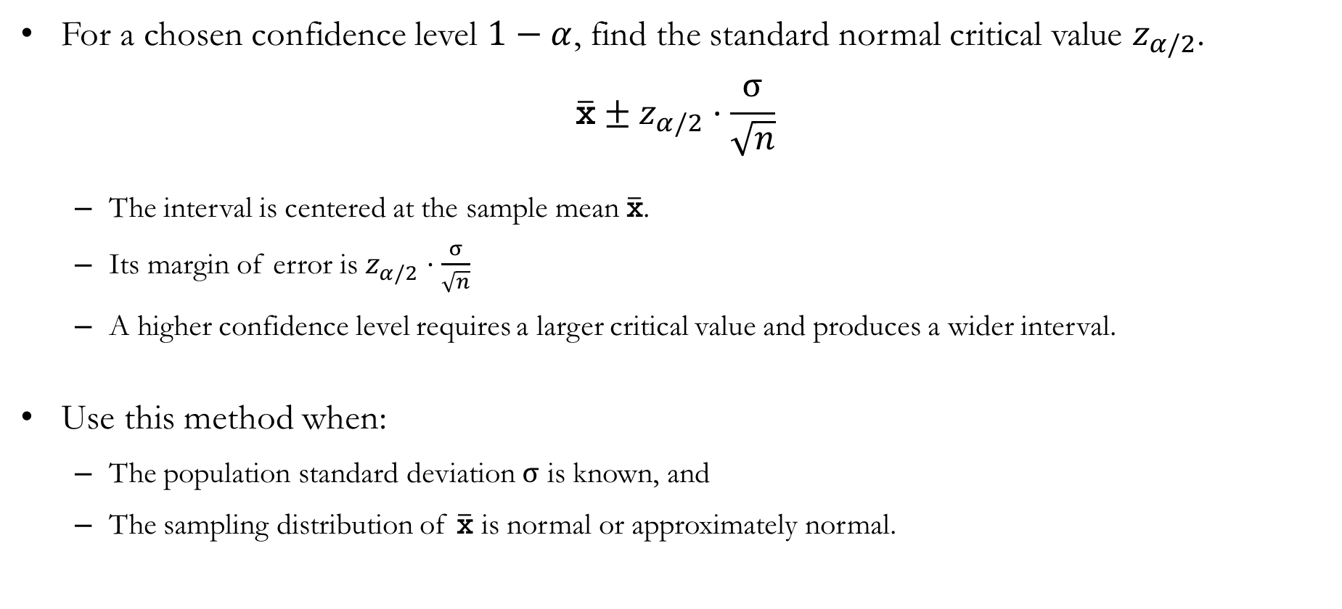
Choosing a General Confidence Level
For a chosen confidence level $1−α$, find the standard normal critical value $z_{α/2}$.
$$\overline{\text{x}}±z_{α/2}⋅\frac{σ}{\sqrt{n}}$$
  The interval is centered at the sample mean $\overline{\text{x}}$.
  Its margin of error is $z_{α/2}⋅\frac{σ}{\sqrt{n}}$
  A higher confidence level requires a larger critical value and produces a wider interval.
Use this method when:
  The population standard deviation $σ$ is known, and
  The sampling distribution of $\overline{\text{x}}$ is normal or approximately normal.

Slide 19
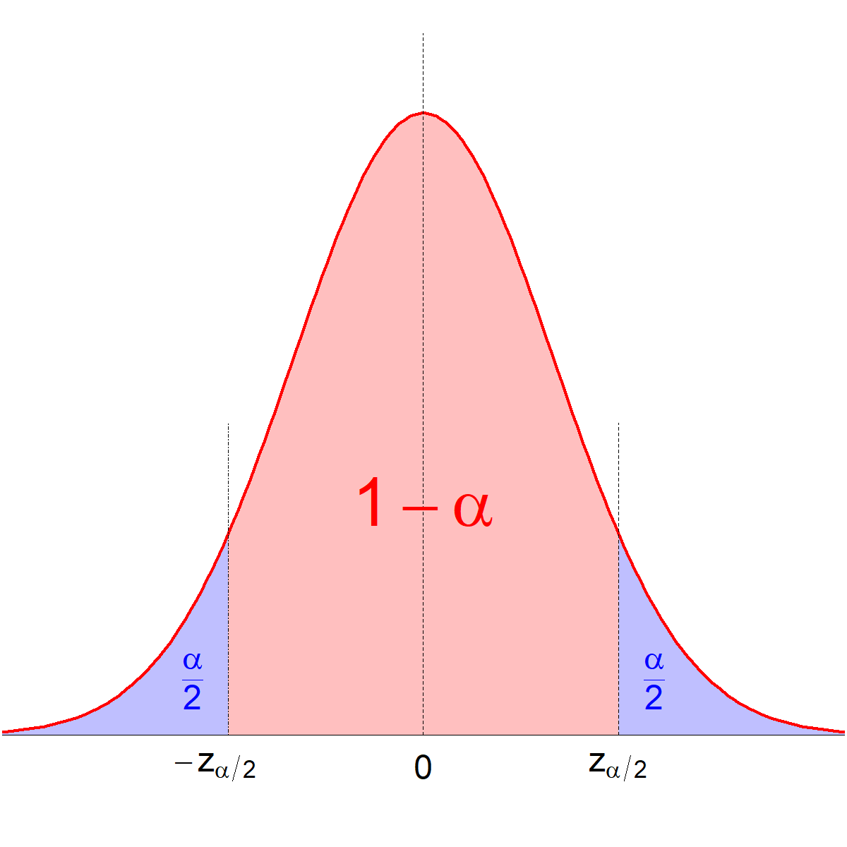
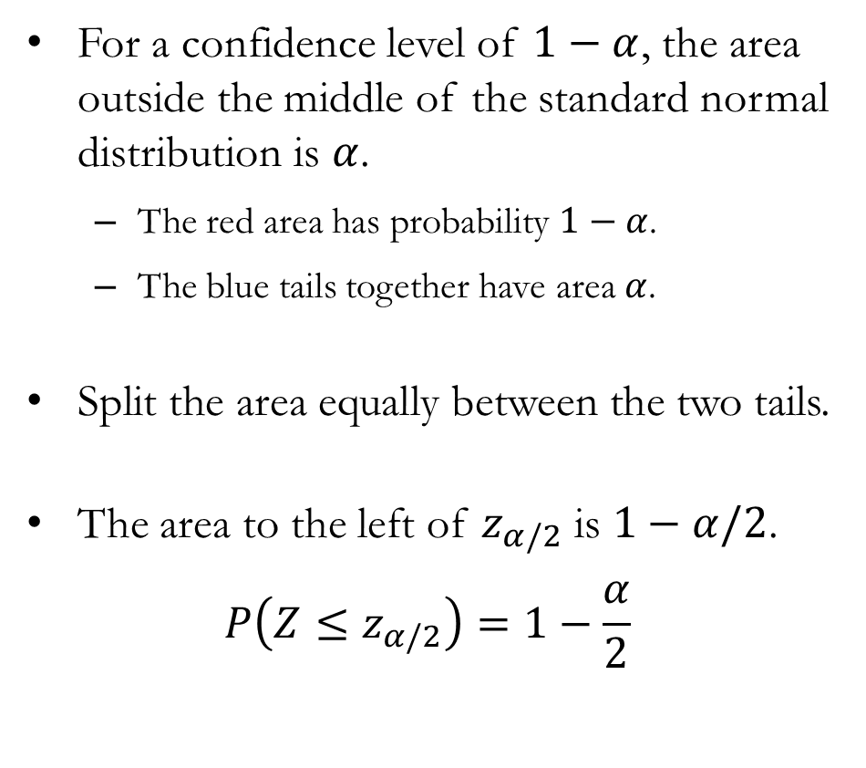
Finding $z_{α/2}$ for Any Confidence Level
For a confidence level of $1−α$, the area outside the middle of the standard normal distribution is $α$.
  The red area has probability $1−α$.
  The blue tails together have area $α$.
Split the area equally between the two tails.
The area to the left of $z_{α/2}$ is $1−α/2$.
$$P\left(Z≤z_{α/2}\right)=1−\frac{α}{2}$$

Slide 20
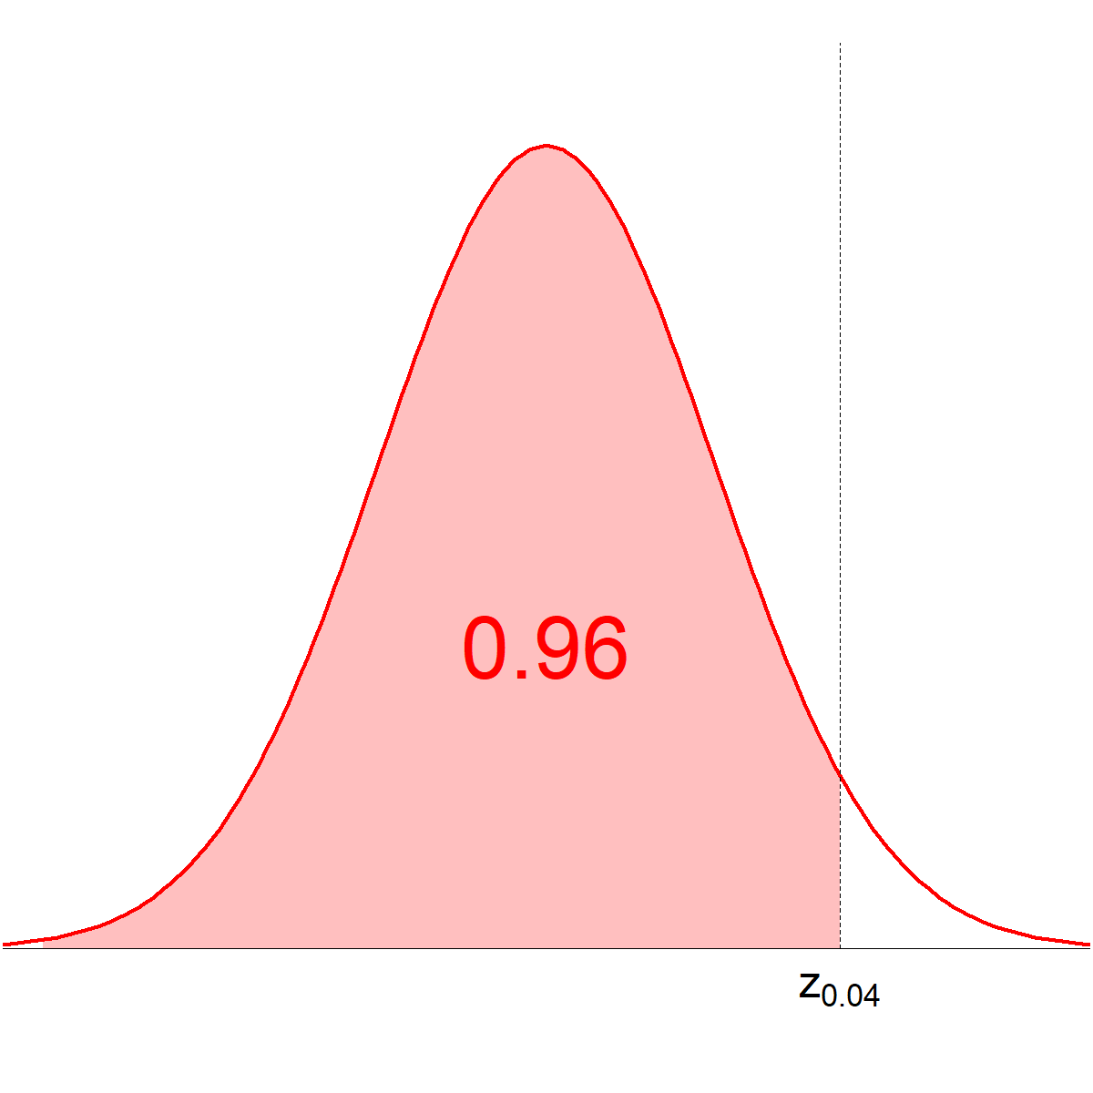
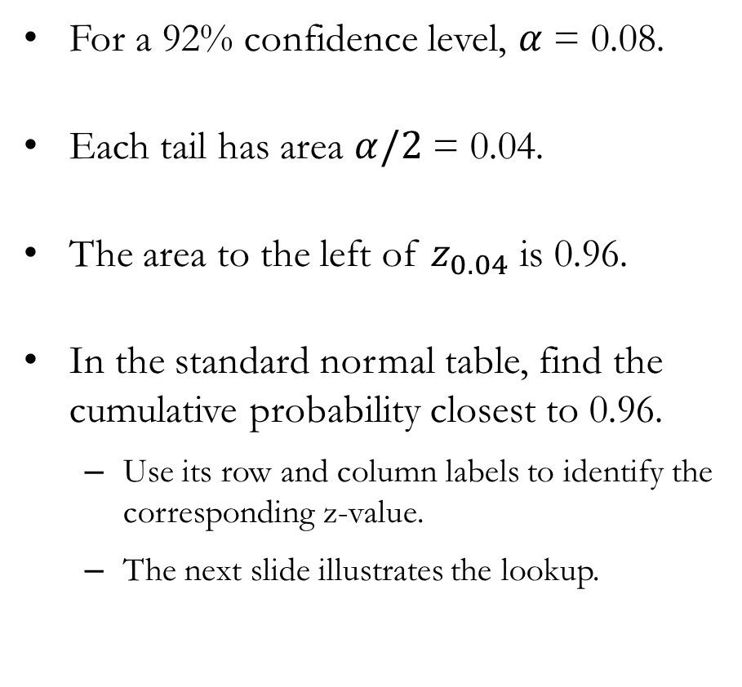
Example: Finding $z_{α/2}$ for Any Confidence Level
For a 92% confidence level, $α$ = 0.08.
Each tail has area $α/2$ = 0.04.
The area to the left of $z_{0.04}$ is 0.96.
In the standard normal table, find the cumulative probability closest to 0.96.
  Use its row and column labels to identify the corresponding z-value.
  The next slide illustrates the lookup.

Slide 21
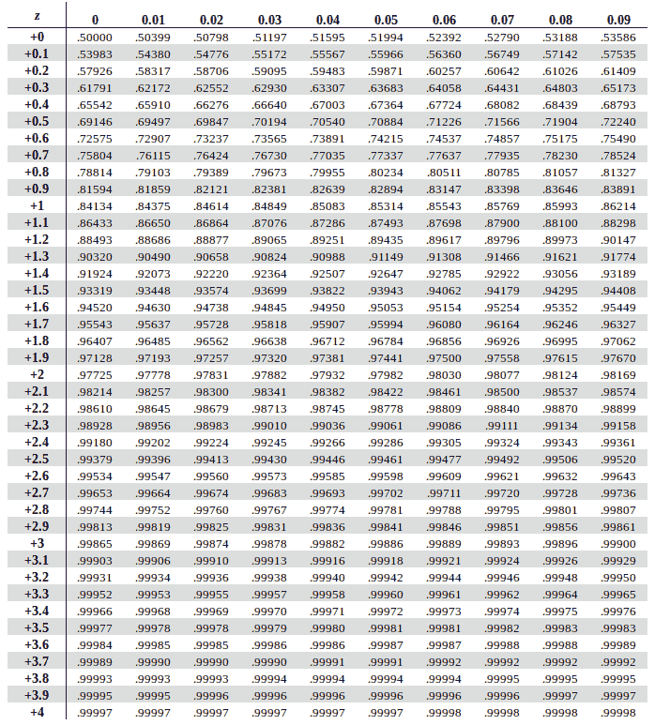
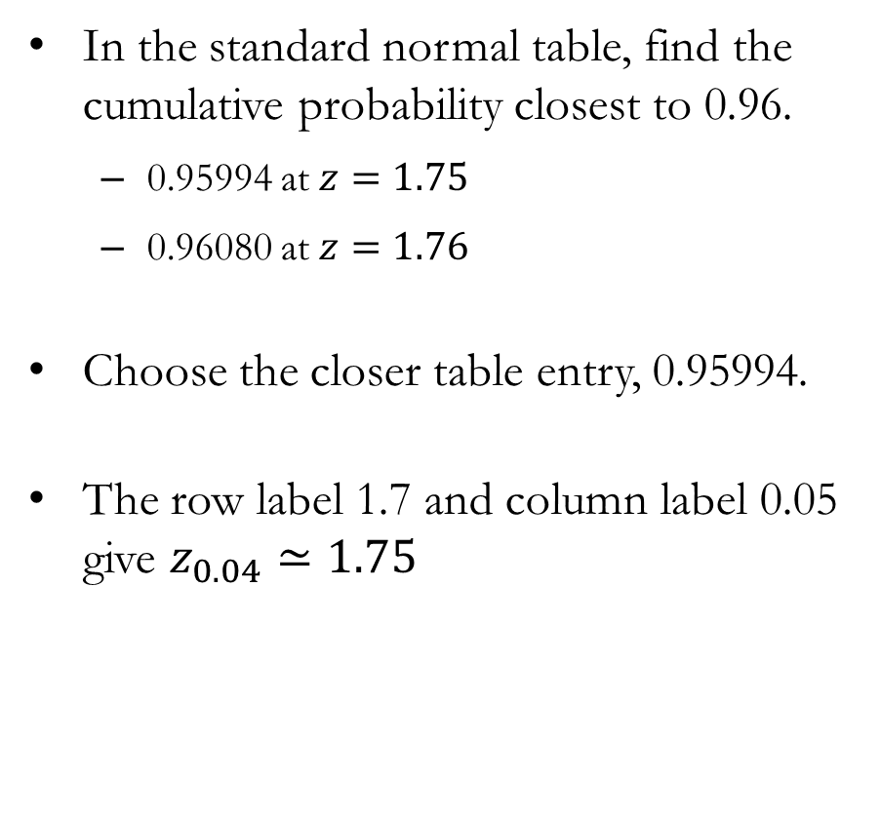
Example: Finding $z_{α/2}$ for Any Confidence Level
In the standard normal table, find the cumulative probability closest to 0.96.
  0.95994 at $z=1.75$
  0.96080 at $z=1.76$
Choose the closer table entry, 0.95994.
The row label 1.7 and column label 0.05 give $z_{0.04}≃1.75$

Slide 22
Population Mean: Unknown $σ$

Slide 23
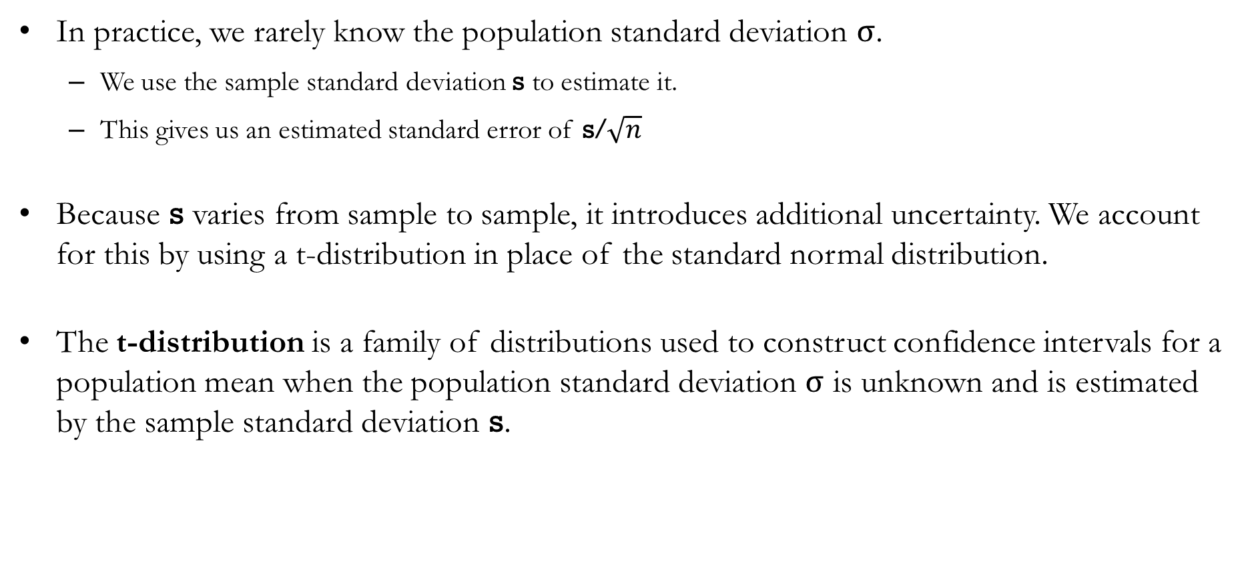
When $σ$ is Unknown
In practice, we rarely know the population standard deviation $σ$.
  We use the sample standard deviation $\text{s}$ to estimate it.
  This gives us an estimated standard error of $\text{s}\text{/}\sqrt{n}$
Because $\text{s}$ varies from sample to sample, it introduces additional uncertainty. We account for this by using a t-distribution in place of the standard normal distribution.
The t-distribution is a family of distributions used to construct confidence intervals for a population mean when the population standard deviation $σ$ is unknown and is estimated by the sample standard deviation $\text{s}$.

Slide 24
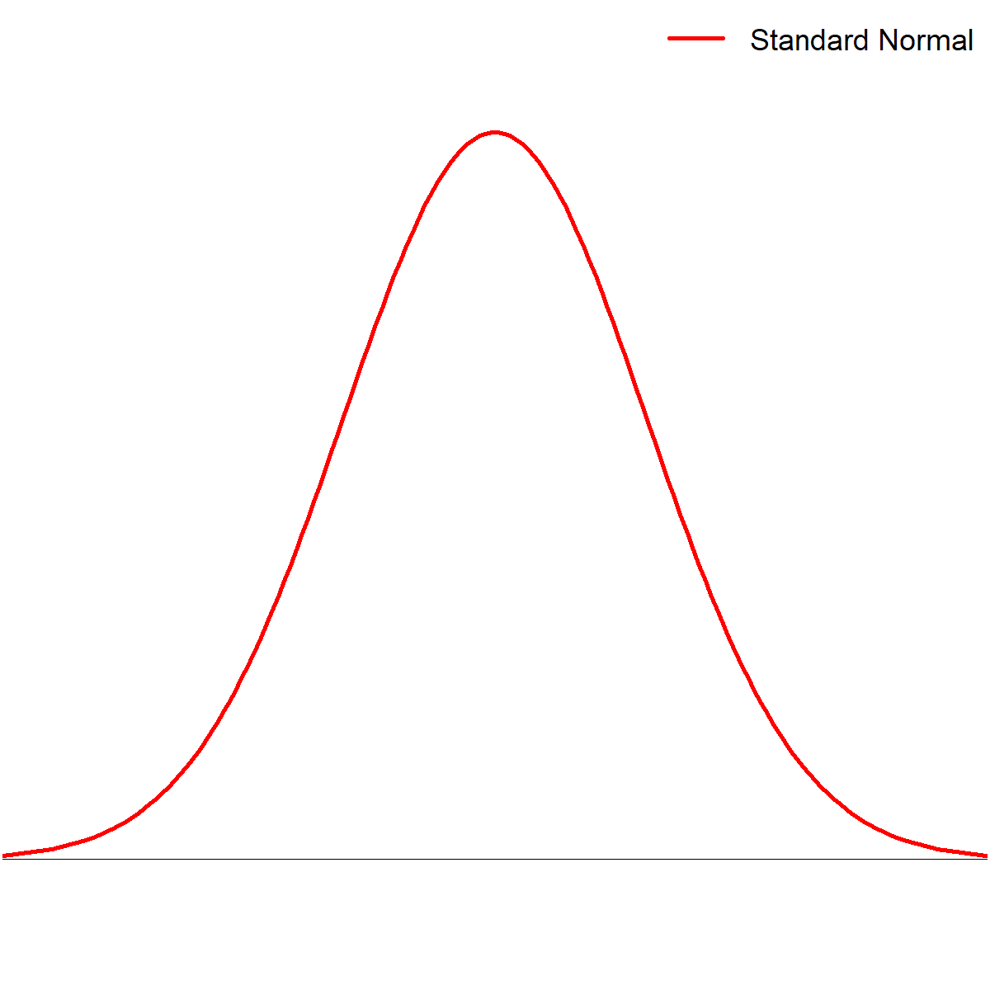
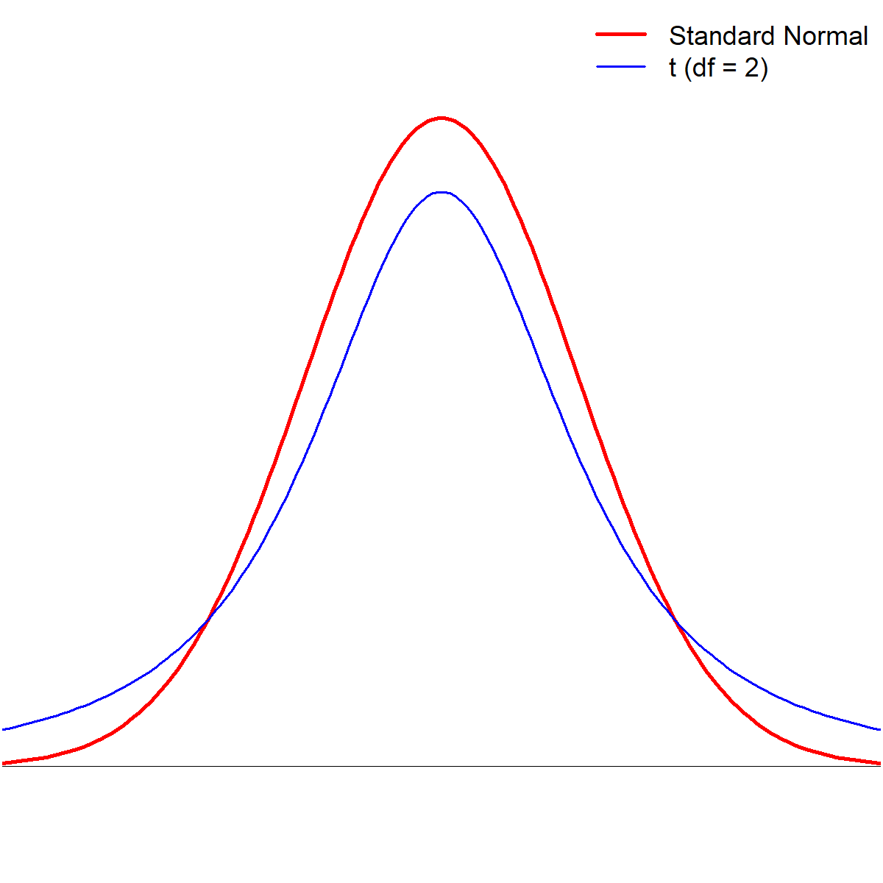
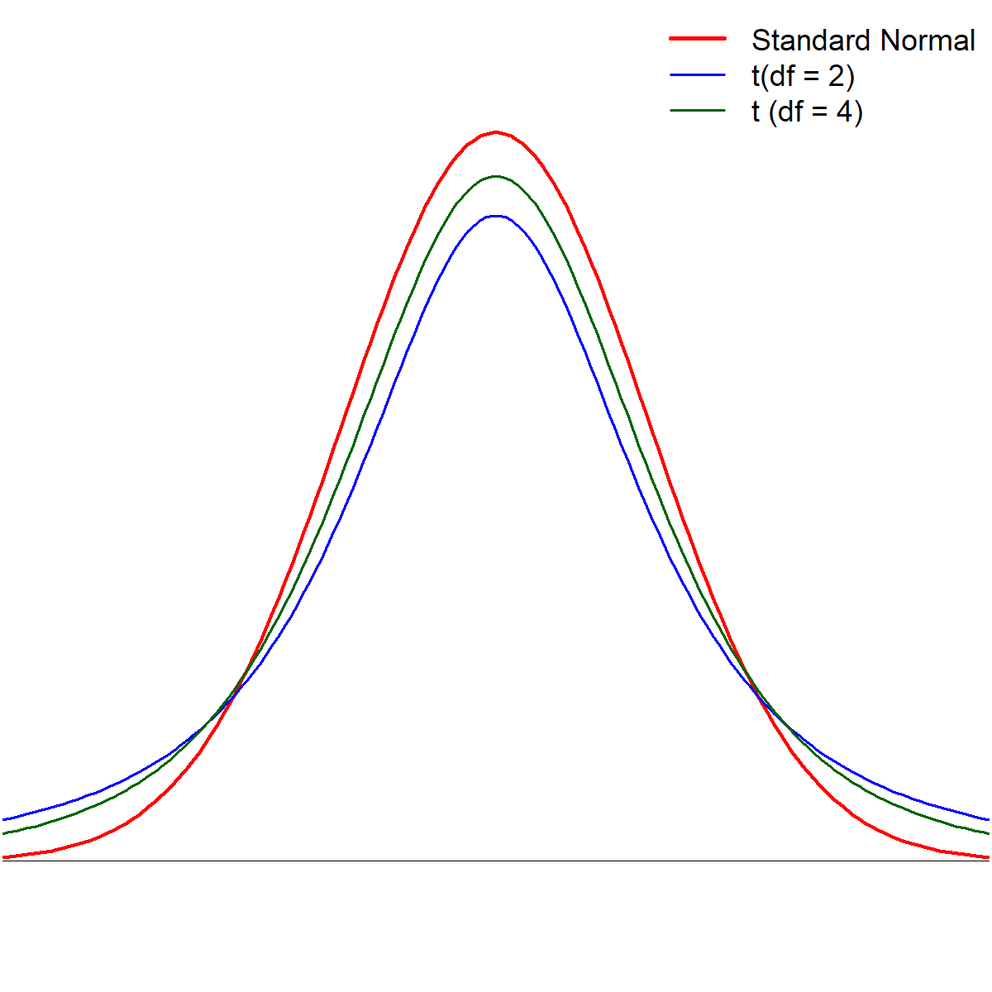
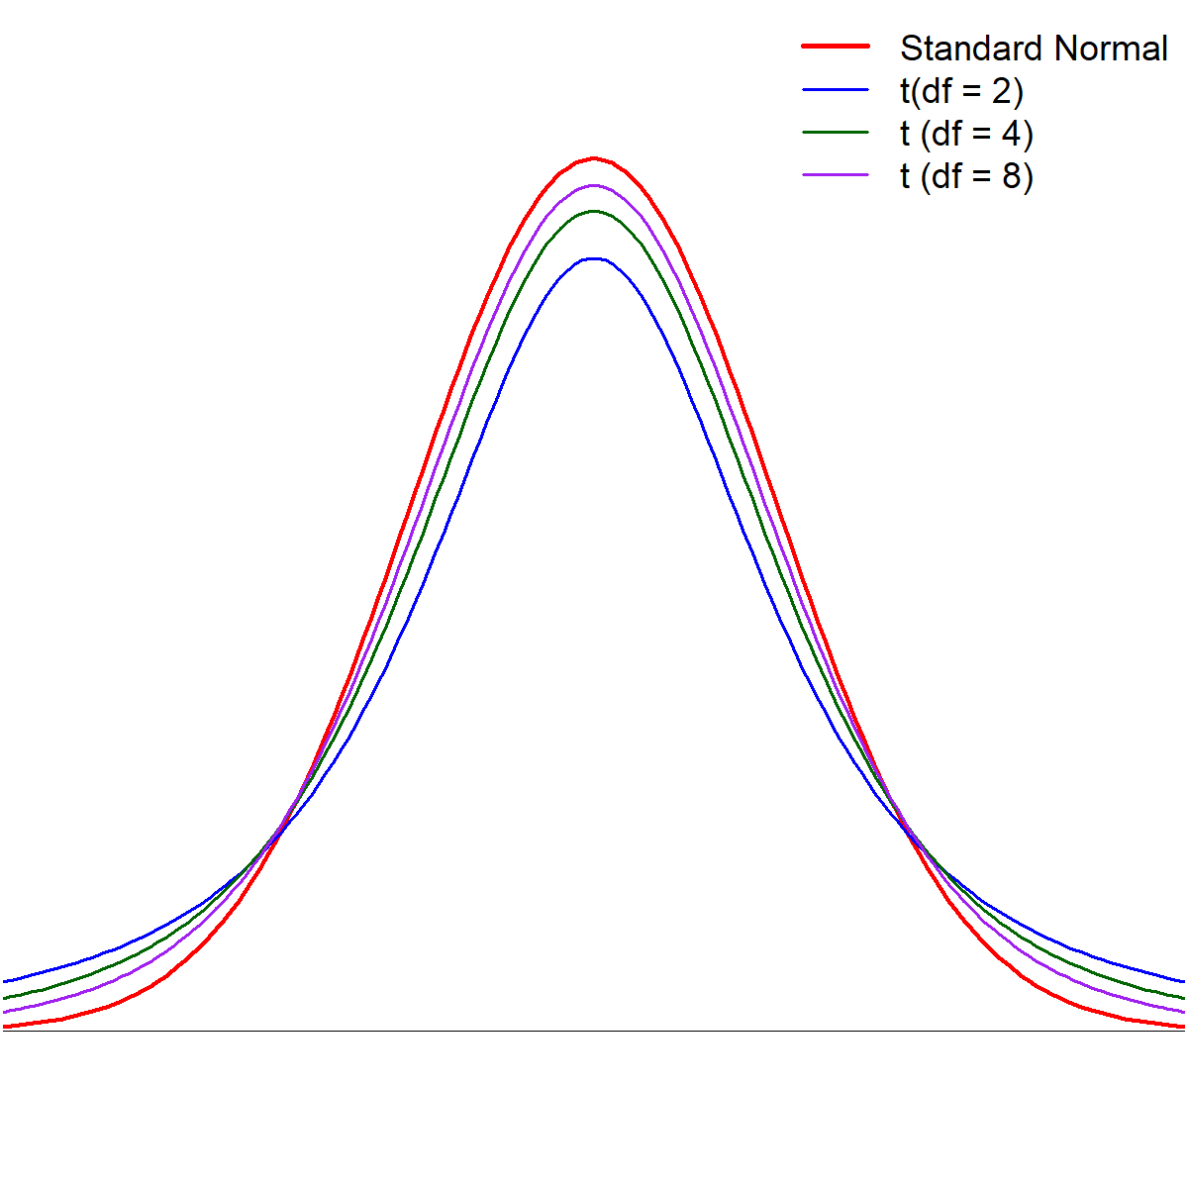
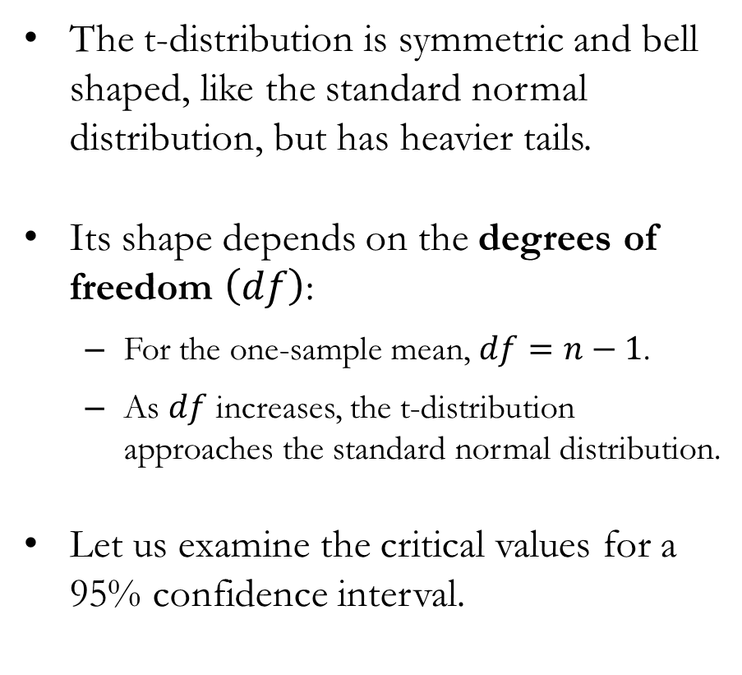
The t-Distribution
The t-distribution is symmetric and bell shaped, like the standard normal distribution, but has heavier tails.
Its shape depends on the degrees of freedom $\left(df\right)$:
  For the one-sample mean, $df=n−1$.
  As $df$ increases, the t-distribution approaches the standard normal distribution.
Let us examine the critical values for a 95% confidence interval.

Slide 25
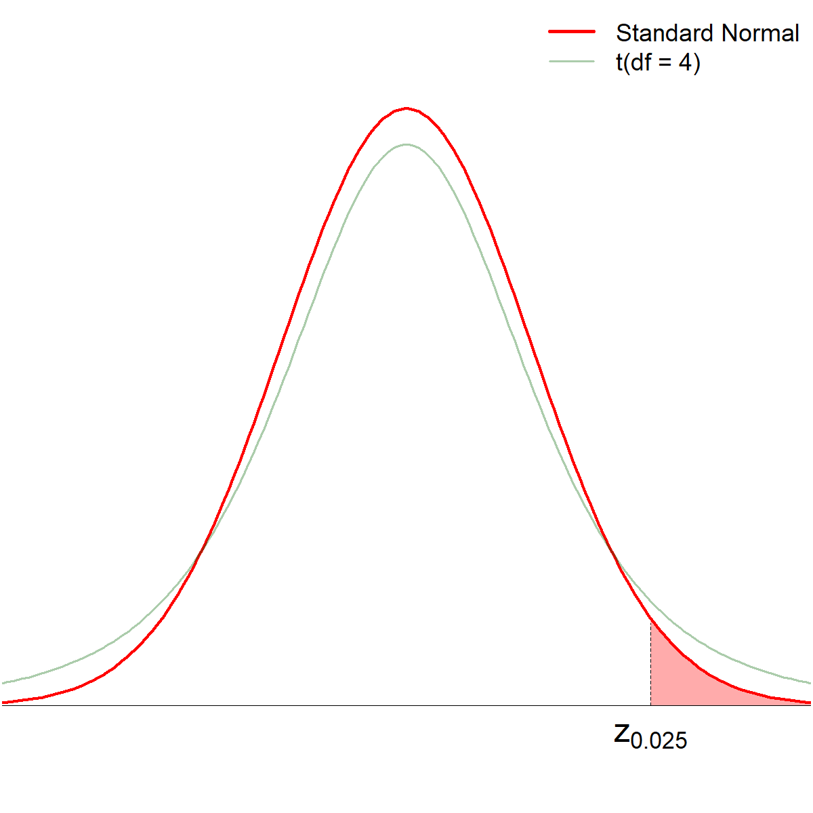
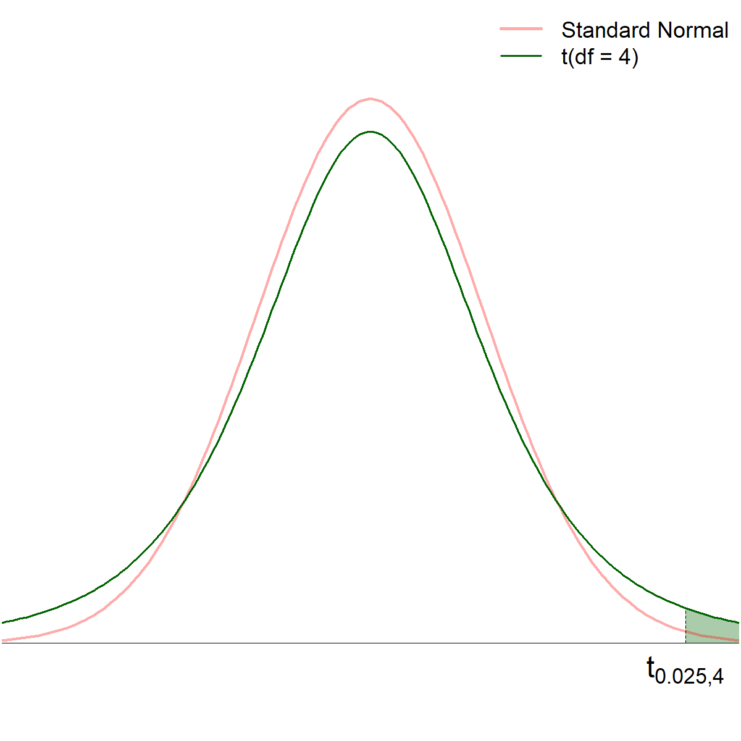
Comparing the Two Distributions

Slide 26
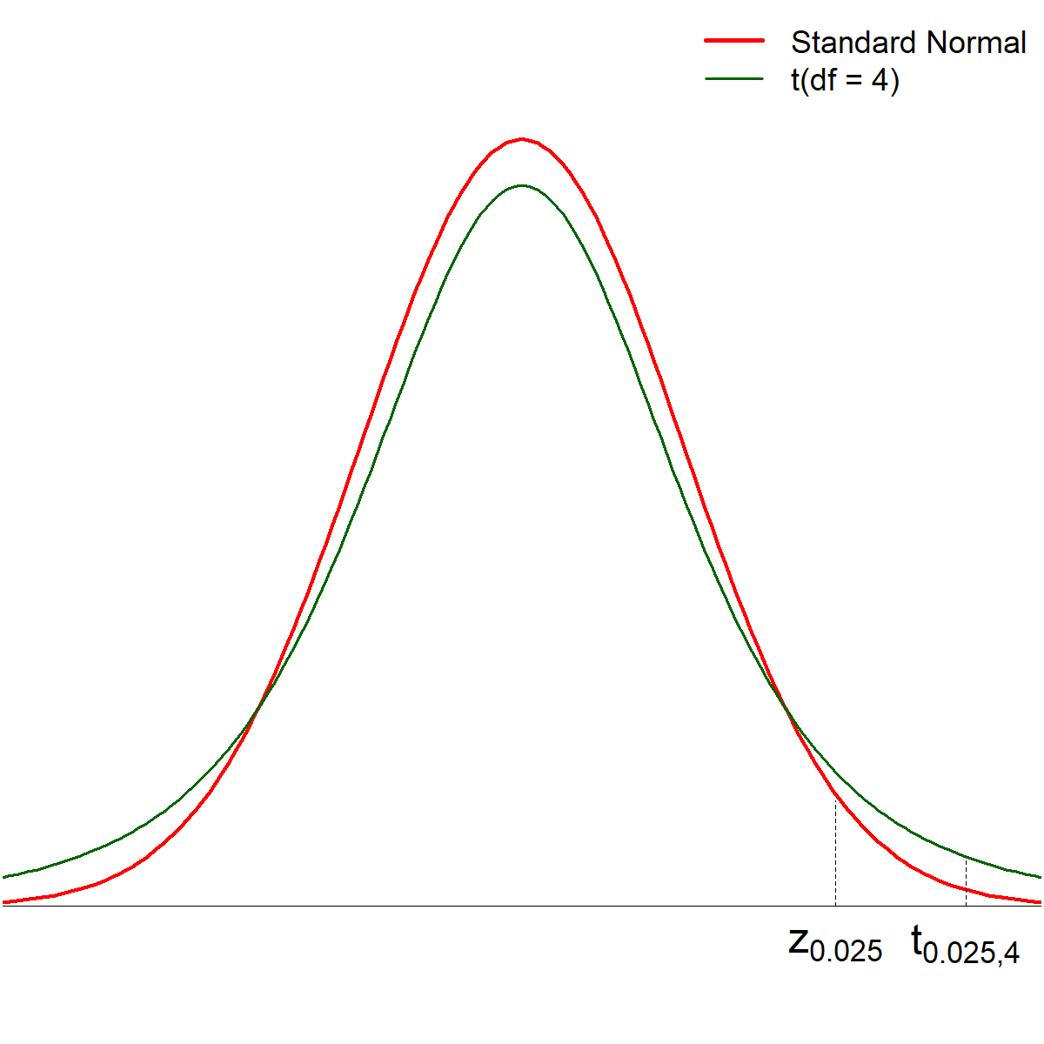
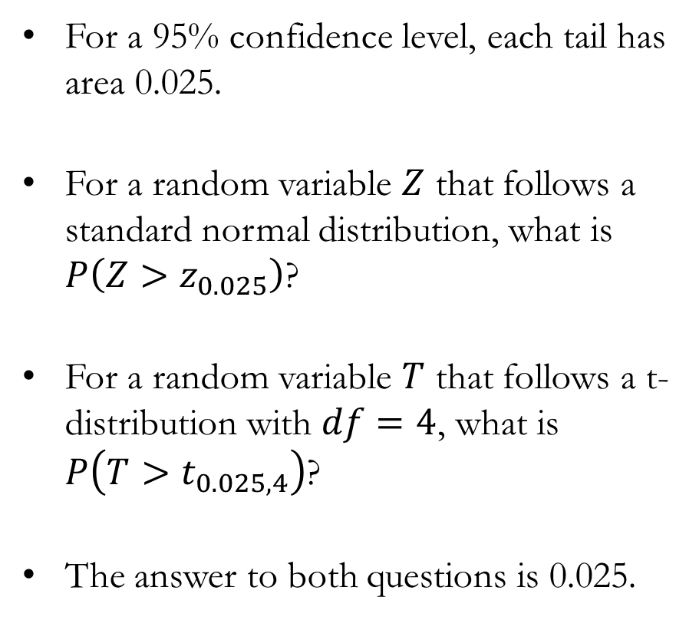
Comparing the Two Distributions
For a 95% confidence level, each tail has area 0.025.
For a random variable $Z$ that follows a standard normal distribution, what is $P\left(Z>z_{0.025}\right)$?
For a random variable $T$ that follows a t-distribution with $df=4$, what is $P\left(T>t_{0.025,4}\right)$?
The answer to both questions is 0.025.

Slide 27
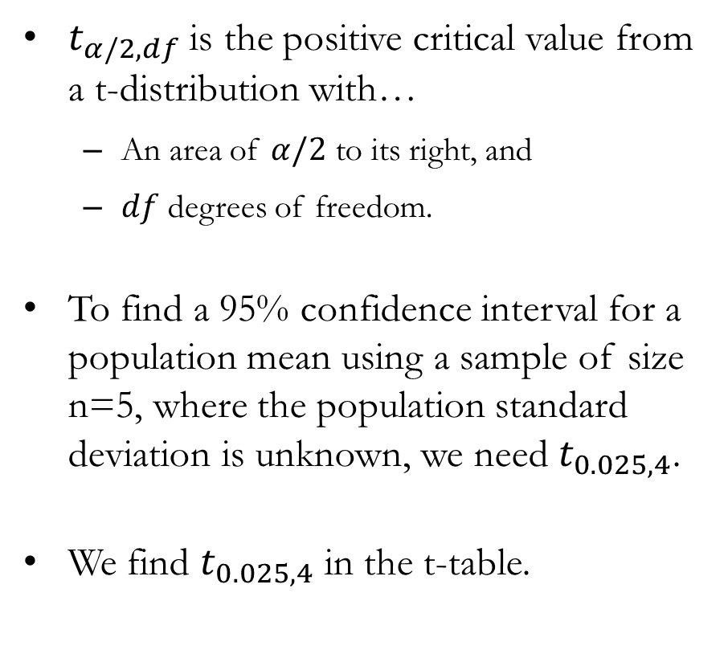
The Critical Values of the t-Distribution
$t_{α/2,df}$ is the positive critical value from a t-distribution with…
  An area of $α/2$ to its right, and
  $df$ degrees of freedom.
To find a 95% confidence interval for a population mean using a sample of size n=5, where the population standard deviation is unknown, we need $t_{0.025,4}$.
We find $t_{0.025,4}$ in the t-table.

Slide 28
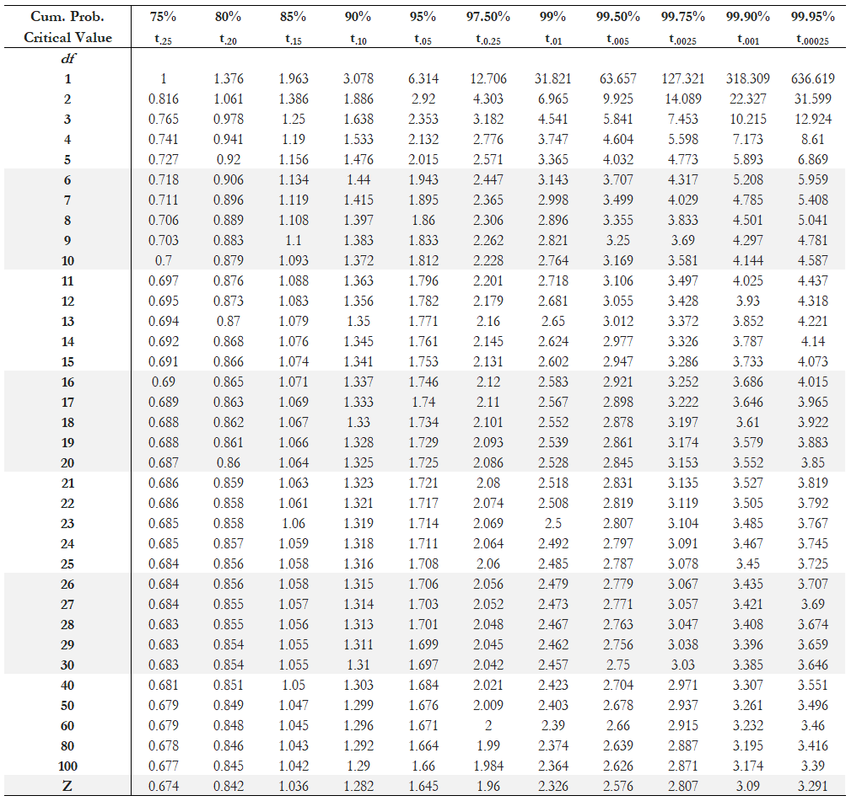
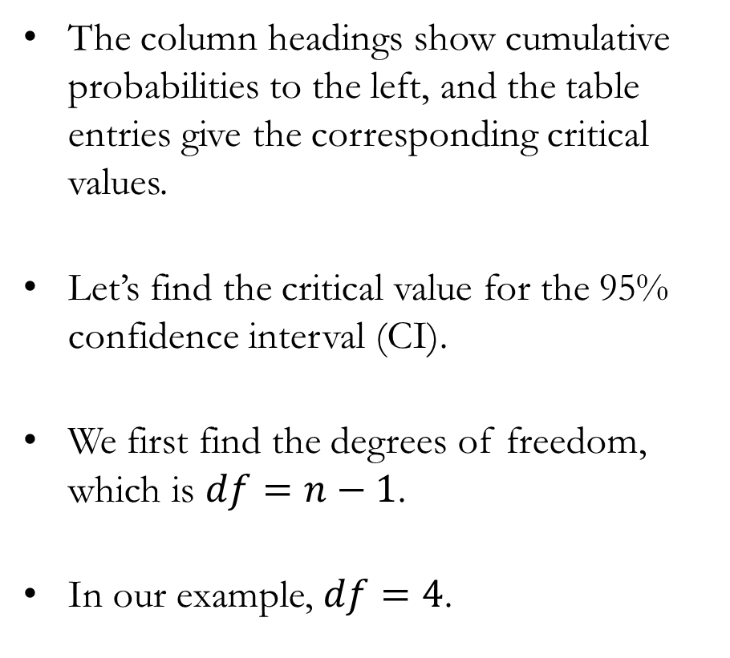
The t-Table
The column headings show cumulative probabilities to the left, and the table entries give the corresponding critical values.
Let’s find the critical value for the 95% confidence interval (CI).
We first find the degrees of freedom, which is $df=n−1$.
In our example, $df=4$.

Slide 29
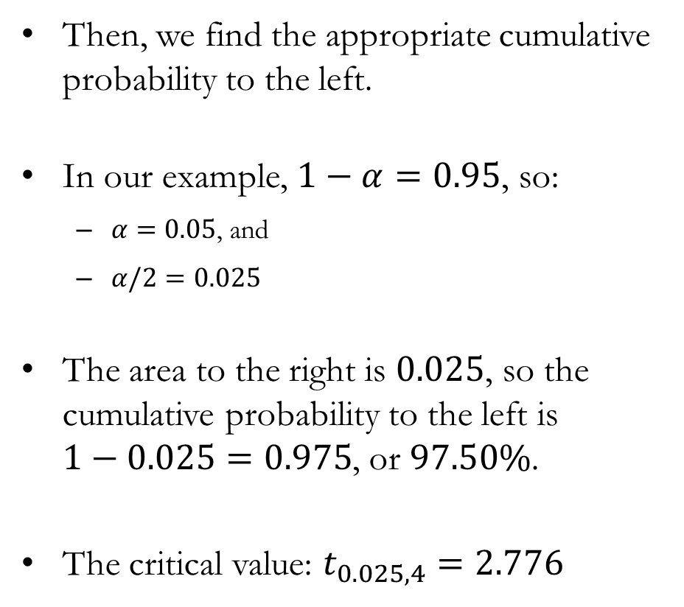
The t-Table and the Critical Value
Then, we find the appropriate cumulative probability to the left.
In our example, $1−α=0.95$, so:
  $α=0.05$, and
  $α/2=0.025$
The area to the right is $0.025$, so the cumulative probability to the left is $1−0.025=0.975$, or $97.50\%$.
The critical value: $t_{0.025,4}=2.776$

Slide 30
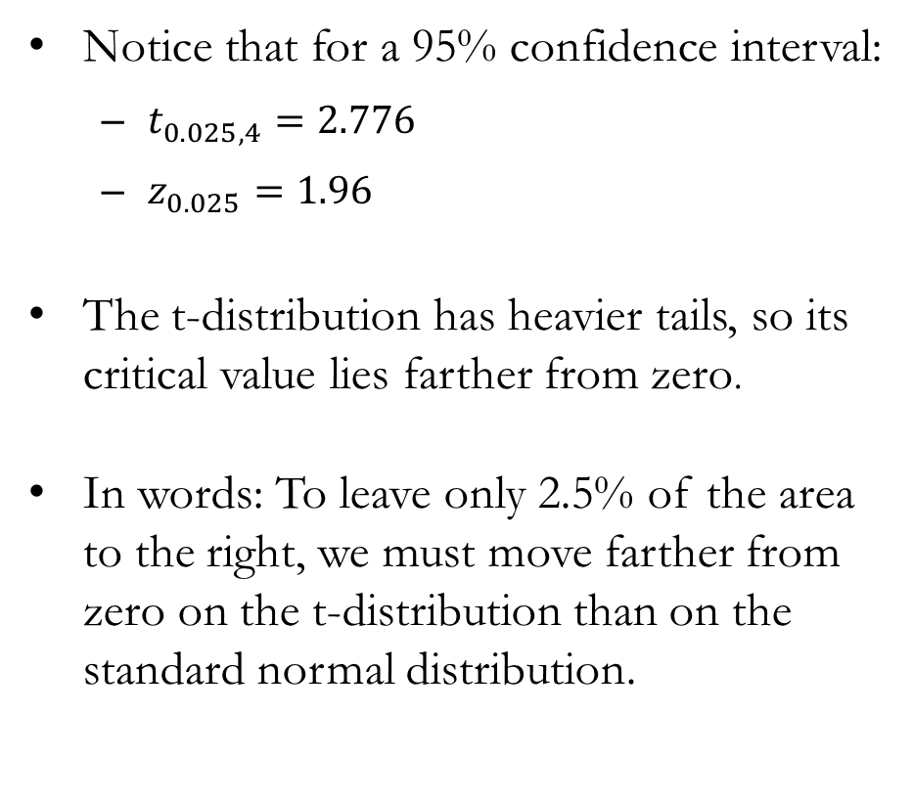
Comparing t and z Critical Values
Notice that for a 95% confidence interval:
  $t_{0.025,4}=2.776$
  $z_{0.025}=1.96$
The t-distribution has heavier tails, so its critical value lies farther from zero.
In words: To leave only 2.5% of the area to the right, we must move farther from zero on the t-distribution than on the standard normal distribution.

Slide 31
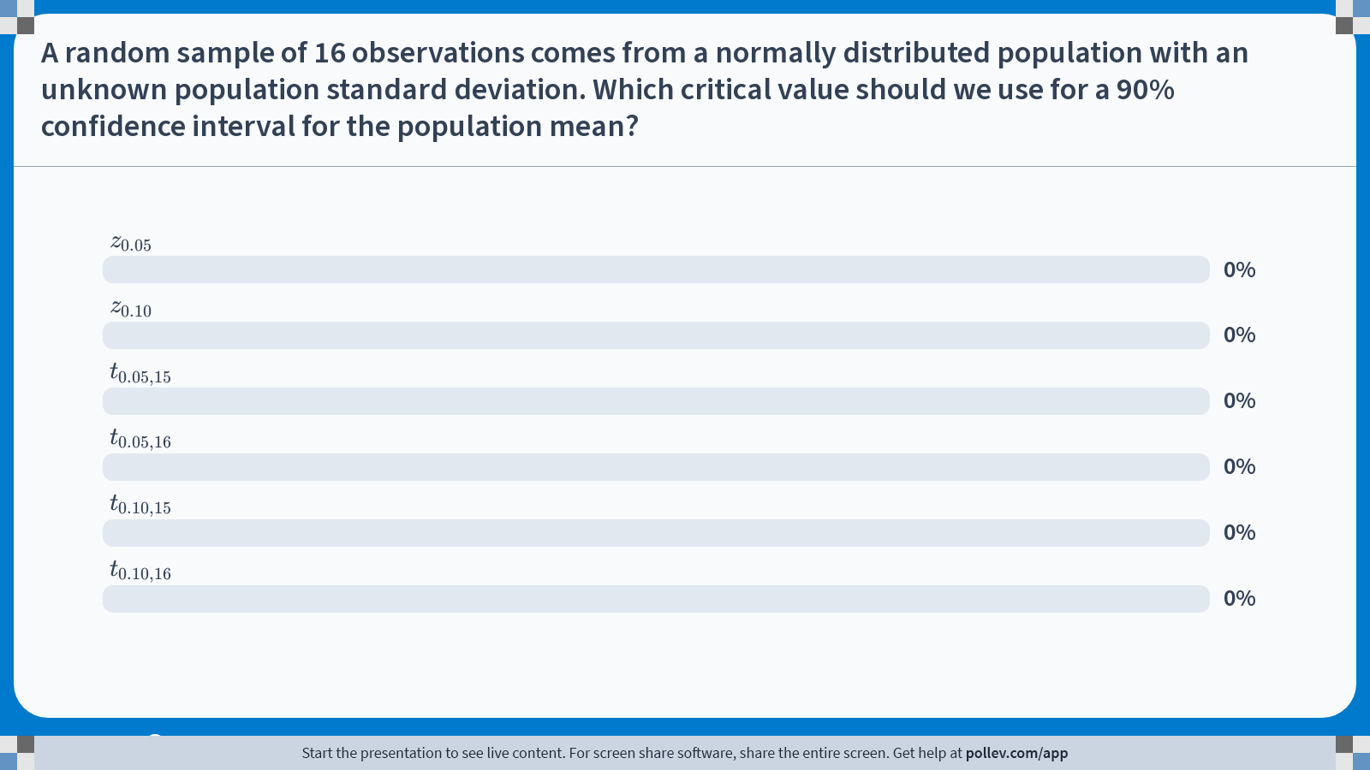
Poll Everywhere multiple choice poll activity
Activity Title: A random sample of 16 observations comes from a normally distributed population with an unknown population standard deviation. Which critical value should we use for a 90% confidence interval for the population mean?
Slide 31
Notes:
Do not modify the notes in this section to avoid tampering with the Poll Everywhere activity.
More info at polleverywhere.com/support
A random sample of 16 observations comes from a normally distributed population with an unknown population standard deviation. Which critical value should we use for a 90% confidence interval for the population mean?
https://www.polleverywhere.com/multiple_choice_polls/q6xZizuaBnjMQODhzBb0W?state=opened&flow=Default&onscreen=persist

Slide 32
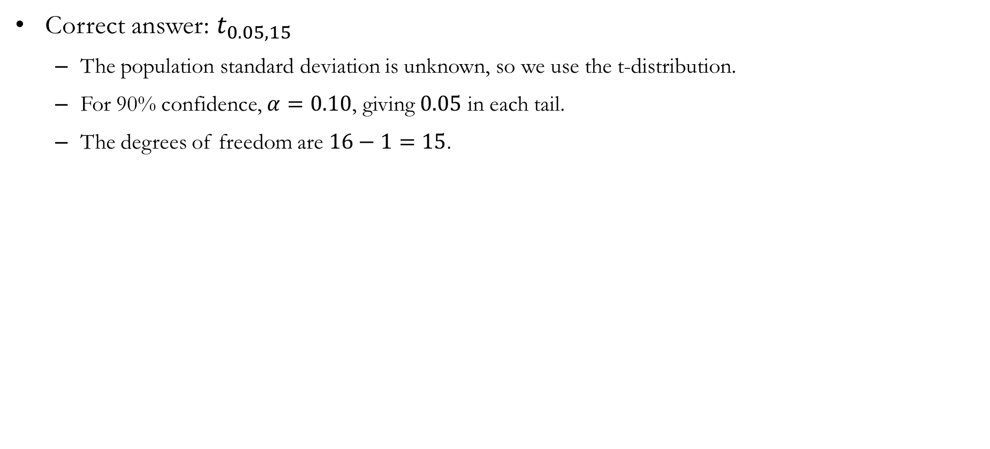
Solution to In-class Poll
Correct answer: $t_{0.05,15}$
  The population standard deviation is unknown, so we use the t-distribution.
  For 90% confidence, $α=0.10$, giving $0.05$ in each tail.
  The degrees of freedom are $16−1=15$.

Slide 33
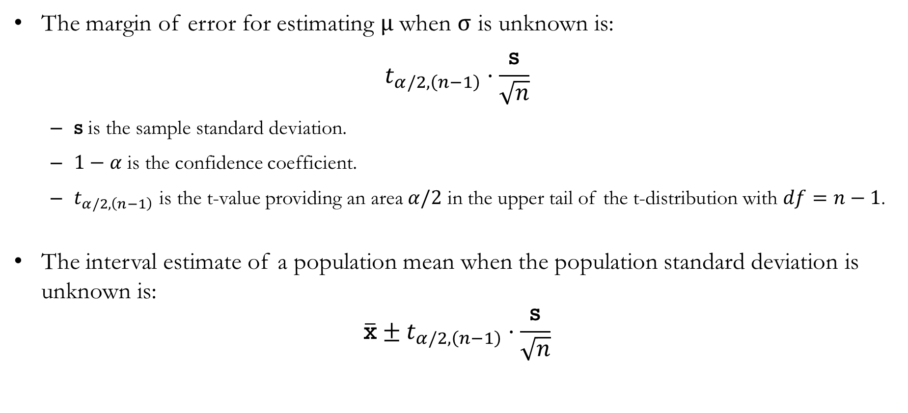
Interval Estimate of $μ$ When $σ$ is Unknown
The margin of error for estimating $μ$ when $σ$ is unknown is:
$$t_{α/2,\left(n−1\right)}⋅\frac{\text{s}}{\sqrt{n}}$$
  $\text{s}$ is the sample standard deviation.
  $1−α$ is the confidence coefficient.
  $t_{α/2,\left(n−1\right)}$ is the t-value providing an area $α/2$ in the upper tail of the t-distribution with $df=n−1$.
The interval estimate of a population mean when the population standard deviation is unknown is:
$$\overline{\text{x}}±t_{α/2,\left(n−1\right)}⋅\frac{\text{s}}{\sqrt{n}}$$

Slide 34
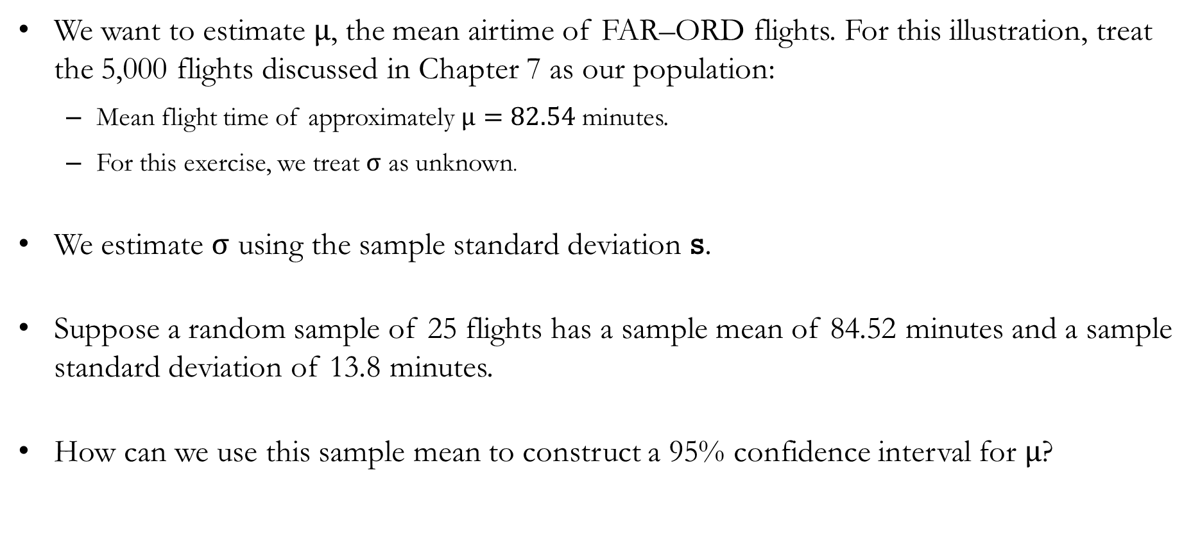
Example: Real-World Flight Data from FAR to ORD
We want to estimate $μ$, the mean airtime of FAR–ORD flights. For this illustration, treat the 5,000 flights discussed in Chapter 7 as our population:
  Mean flight time of approximately $μ=82.54$ minutes.
  For this exercise, we treat $σ$ as unknown.
We estimate $σ$ using the sample standard deviation s.
Suppose a random sample of 25 flights has a sample mean of 84.52 minutes and a sample standard deviation of 13.8 minutes.
How can we use this sample mean to construct a 95% confidence interval for $μ$?

Slide 35
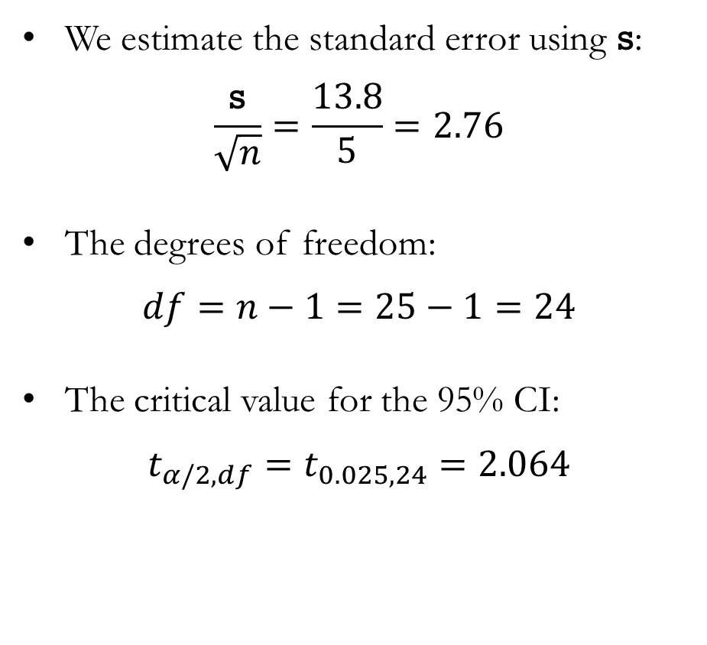
Example: Real-World Flight Data from FAR to ORD
We estimate the standard error using s:
$$\frac{\text{s}}{\sqrt{n}}=\frac{13.8}{5}=2.76$$
The degrees of freedom:
$$df=n−1=25−1=24$$
The critical value for the 95% CI:
$$t_{α/2,df}=t_{0.025,24}=2.064$$

Slide 36
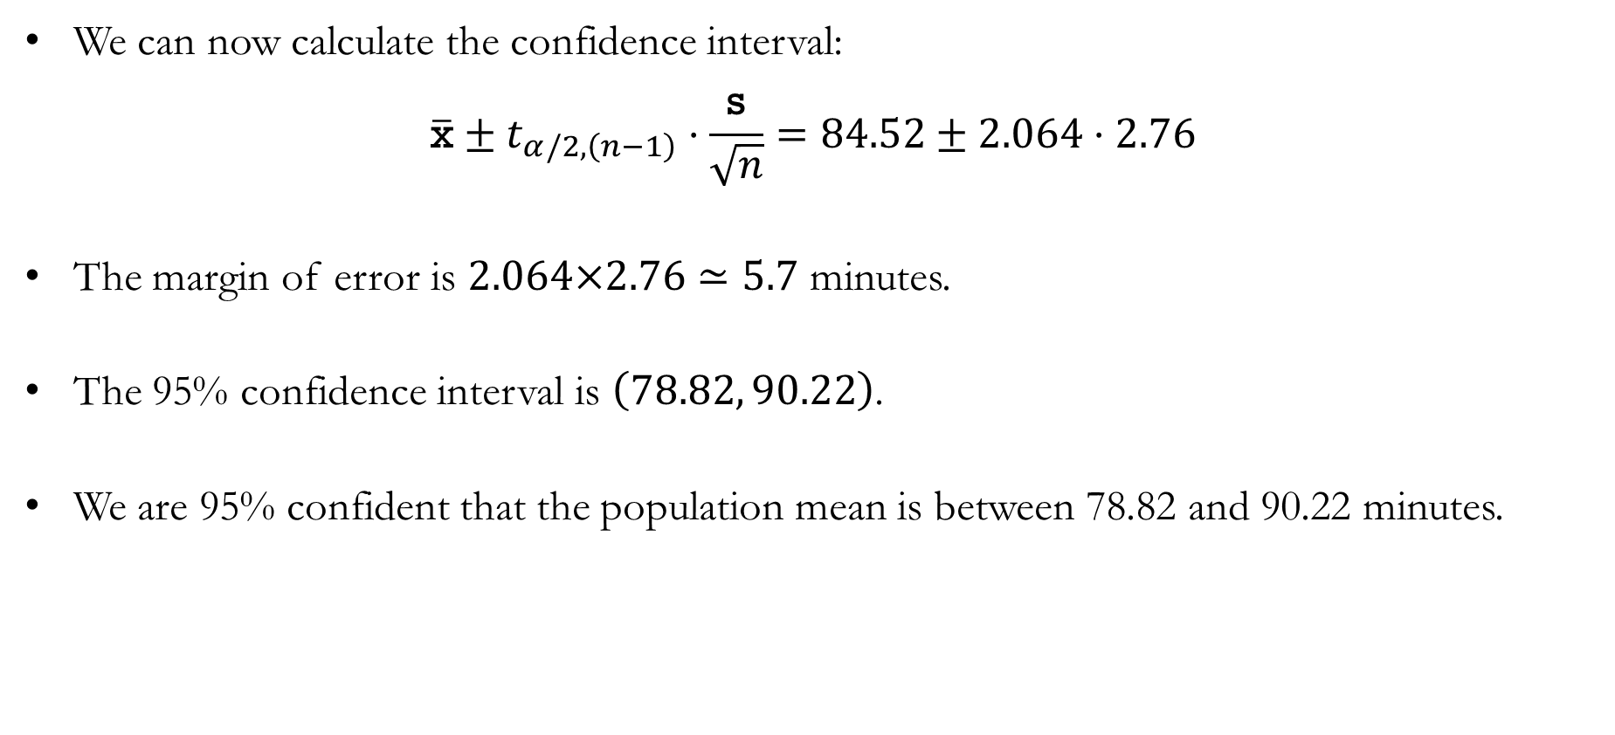
Example: Real-World Flight Data from FAR to ORD
We can now calculate the confidence interval:
$$\overline{\text{x}}±t_{α/2,\left(n−1\right)}⋅\frac{\text{s}}{\sqrt{n}}=84.52±2.064⋅2.76$$
The margin of error is $2.064×2.76≃5.7$ minutes.
The 95% confidence interval is $\left(78.82, 90.22\right)$.
We are 95% confident that the population mean is between 78.82 and 90.22 minutes.

Slide 37
Sample Size Considerations

Slide 38

When $σ$ is Known vs. Unknown
When $σ$ is known, and we know that the population follows a normal distribution, we can use the following confidence interval regardless of the sample size:
$$\overline{\text{x}}±z_{α/2}⋅\frac{σ}{\sqrt{n}}$$
When $σ$ is unknown, but we know that the population follows a normal distribution, we can use the following confidence interval regardless of the sample size $(n≥2)$:
$$\overline{\text{x}}±t_{α/2,\left(n−1\right)}⋅\frac{\text{s}}{\sqrt{n}}$$
When the population is not known to be normally distributed, we must consider the sample size.

Slide 39

Sample Size Considerations
When the population is not known to be normally distributed, we can use the same formulas as approximations, provided the sample size is sufficiently large.
  As a general guideline, $n≥30$ is often adequate.
  If the population is strongly skewed or has substantial outliers, a larger sample may be required.
  If the population is nearly symmetric without unusual outliers, a smaller sample may be sufficient.
The Central Limit Theorem explains why these approximations improve as the sample size increases (see Chapter 7).
  With a sufficiently large sample, the sampling distribution of $\overline{\text{x}}$ is approximately normal, even when the population is not normally distributed.
  If $σ$ is unknown, a larger sample also makes $\text{s}$ a more reliable estimate of $σ$.
  Strong skewness or extreme outliers may require a larger sample for the approximation to be adequate.

Slide 40

Poll Everywhere multiple choice poll activity
Activity Title: A random sample of 12 observations comes from a strongly skewed population. The population standard deviation $$\\sigma$$ is known. Is knowing $$\\sigma$$ sufficient to justify the usual z-confidence interval for the population mean?
Slide 38
Notes:
Do not modify the notes in this section to avoid tampering with the Poll Everywhere activity.
More info at polleverywhere.com/support
A random sample of 12 observations comes from a strongly skewed population. The population standard deviation $$\\sigma$$ is known. Is knowing $$\\sigma$$ sufficient to justify the usual z-confidence interval for the population mean?
https://www.polleverywhere.com/multiple_choice_polls/Qd5IKX2e5X5FcLPIaRwMl?state=opened&flow=Default&onscreen=persist

Slide 41

Solution to In-class Poll
Correct answer: No, because a sample of 12 from a strongly skewed population may not have an approximately normal sampling distribution.
  Knowing $σ$ allows us to calculate the standard error, $\frac{σ}{\sqrt{n}}$.
  The usual z-interval also requires the sampling distribution of $\overline{\text{x}}$ to be normal or approximately normal.
  With strong population skewness and $n=12$, that approximation may be inadequate.
Why the other answers are incorrect:
  A and B: Knowing $σ$ does not determine the shape of the sampling distribution.
  D: There is no universal minimum of 30. For a normal population, a z-interval is valid even with a small random sample.

Slide 42

Sample Size and the Margin of Error
Suppose we want to estimate the population mean with a margin of error E at confidence level $1−α$.
When $σ$ is known, the margin of error is:
$$\text{E}\text{ = }z_{α/2}⋅\frac{σ}{\sqrt{n}}$$
Solving for the sample size $n$, we find that:
$$n={\left(\frac{z_{α/2}σ}{\text{E}}\right)}^{2}$$

Slide 43

Example: Sample Size and the Margin of Error
Suppose we want to estimate the mean flight time between FAR and ORD with a margin of error of $\text{E}$ minutes at a $1−α$ confidence level. Assume that the population is normally distributed with a population standard deviation of 7.07 minutes.
Because the population is normally distributed and the population standard deviation is known, the margin of error is given by:
$$\text{E}=z_{α/2}⋅\frac{σ}{\sqrt{n}}$$
We calculate the required sample size for three different situations:
  Example #1: Margin of error of 2 minutes, 95% confidence level
  Example #2: Margin of error of 1 minute, 95% confidence level
  Example #3: Margin of error of 2 minutes, 99% confidence level

Slide 44

Example #1: Margin of 2 Minutes, 95% Confidence
The 95% level of confidence means that $α=0.05$, and $z_{0.05/2}=z_{0.025}=1.96$. Applying $z_{0.025}=1.96$, $σ=7.07$, and $\text{E}=2$, we find that:
$$2=1.96⋅\frac{7.07}{\sqrt{n}}$$
Solving for the sample size required, we find that:
$$n={\left(\frac{1.96⋅7.07}{2}\right)}^{2}≃48.01$$
We round up to a sample size of 49 flights so that the margin of error is no more than 2 minutes at the 95% confidence level.

Slide 45

Example #2: Margin of 1 Minute, 95% Confidence
The 95% level of confidence means that $α=0.05$, and $z_{0.05/2}=z_{0.025}=1.96$. Applying $z_{0.025}=1.96$, $σ=7.07$, and $\text{E}=1$, we find that:
$$1=1.96⋅\frac{7.07}{\sqrt{n}}$$
Solving for the sample size required, we find that:
$$n={\left(\frac{1.96⋅7.07}{1}\right)}^{2}≃192.02$$
We round up to a sample size of 193 flights so that the margin of error is no more than 1 minute at the 95% confidence level.

Slide 46

Example #3: Margin of 2 Minutes, 99% Confidence
The 99% level of confidence means that $α=0.01$, and $z_{0.01/2}=z_{0.005}=2.576$. Applying $z_{0.005}=2.576$, $σ=7.07$, and $\text{E}=2$, we find that:
$$2=2.576⋅\frac{7.07}{\sqrt{n}}$$
Solving for the sample size required, we find that:
$$n={\left(\frac{2.576⋅7.07}{2}\right)}^{2}≃82.92$$
We round up to a sample size of 83 flights so that the margin of error is no more than 2 minutes at the 99% confidence level.

Slide 47
Example: Sample Size and the Margin of Error
Comparing the three examples, we found that:
Greater precision requires a larger sample.
  Keeping the confidence level at 95%, halving the margin of error from 2 minutes to 1 minute raises the required sample size from 49 to 193 flights.
Greater confidence also requires a larger sample.
  Keeping the margin of error at 2 minutes, increasing confidence from 95% to 99% raises the required sample from 49 to 83 flights.
Example | Margin of Error | Confidence Level | Required Sample Size
#1 | 2 Minutes | 95% | 49 Flights
#2 | 1 Minute | 95% | 193 Flights
#3 | 2 Minutes | 99% | 83 Flights

Slide 48
Population Proportion

Slide 49

Interval Estimates of $\text{p}$
Recall that the interval estimate for the population parameter is:
$$\overline{\text{p}} ±\text{ Margin of Error}$$
From Chapter 7, the sampling distribution of $\overline{\text{p}}$is approximately normal when $n⋅\text{p}≥5$ and $n⋅\left(1−\text{p}\right)≥5$.
The mean and standard error of the sampling distribution are:
$\text{E(}\overline{\text{p}}\text{)}=\text{p}$, and $σ_{\overline{\text{p}}}=\sqrt{\frac{\text{p}\left(1−\text{p}\right)}{n}}$

Slide 50

Confidence Interval for a Population Proportion
When the conditions for the normal approximation hold, we use $z_{α/2}$ as the critical value for confidence level $1−α$.
Because $\text{p}$ is unknown, we substitute $\overline{\text{p}}$ for $\text{p}$ to estimate the standard error. The margin of error is:
$$\text{E}\text{ = }z_{α/2}⋅\sqrt{\frac{\overline{\text{p}}\left(1−\overline{\text{p}}\right)}{n}}$$
The approximate confidence interval for $\text{p}$ is:
$$\overline{\text{p}}±z_{α/2}⋅\sqrt{\frac{\overline{\text{p}}\left(1−\overline{\text{p}}\right)}{n}}$$

Slide 51

Example: Real-World Flight Data from FAR to ORD
We want to estimate $\text{p}$, the proportion of FAR–ORD flights with a flight time less than 85 minutes.
In a random sample of 25 flights, 18 have airtimes under 85 minutes, giving $\overline{\text{p}}=0.72$.
  The approximation conditions are satisfied: $n\overline{\text{p}}=18≥5$ and $n\left(1−\overline{\text{p}}\right)=7≥5$.
The 95% confidence interval is:
$$0.72±1.96⋅\sqrt{\frac{0.72\left(1−0.72\right)}{25}}≃0.72±0.176 ⇒ \left(0.544,0.896\right)$$
We are 95% confident that 54.4% to 89.6% of FAR–ORD flights have airtimes under 85 minutes.

Slide 52

Sample Size and the Margin of Error
Suppose we want to estimate the population proportion with a margin of error E at confidence level $1−α$.
From our previous discussion, we know that:
$$\text{E}\text{ =} z_{α/2}⋅\sqrt{\frac{\overline{\text{p}}\left(1−\overline{\text{p}}\right)}{n}}$$
Solving for $n$, we find:
$$n=\frac{{\left(z_{α/2}\right)}^{2}\overline{\text{p}}\left(1−\overline{\text{p}}\right)}{{\text{E}}^{2}}$$

Slide 53

Sample Size and the Margin of Error
We cannot substitute the future sample proportion $\overline{\text{p}}$, because we must choose the sample size before collecting the sample. We therefore use ${\text{p}}^{∗}$, a planning estimate of the population proportion $\text{p}$:
$$n=\frac{{\left(z_{α/2}\right)}^{2}{\text{p}}^{∗}\left(1−{\text{p}}^{∗}\right)}{{\text{E}}^{2}}$$
To choose ${\text{p}}^{∗}$:
  Use a sample proportion from a previous study of the same population, or
  Use a preliminary estimate from a pilot study, or
  Use an informed estimate based on available information, or
  If no reliable estimate is available, use ${\text{p}}^{∗}=0.5$, which maximizes ${\text{p}}^{∗}\left(1−{\text{p}}^{∗}\right)$ and produces the largest required sample size.

Slide 54

Poll Everywhere multiple choice poll activity
Activity Title: We want to determine the sample size needed to estimate a population proportion. No reliable prior estimate of $$\\texttt{p}$$ is available. Why do we use $$\\texttt{p}^*=0.5$$?
Slide 52
Notes:
Do not modify the notes in this section to avoid tampering with the Poll Everywhere activity.
More info at polleverywhere.com/support
We want to determine the sample size needed to estimate a population proportion. No reliable prior estimate of $$\\texttt{p}$$ is available. Why do we use $$\\texttt{p}^*=0.5$$?
https://www.polleverywhere.com/multiple_choice_polls/U4h2YiZGfP8tXSL29ojR0?state=opened&flow=Default&onscreen=persist

Slide 55

Solution to In-class Poll
Correct answer: It produces the largest required sample size for the chosen confidence level and margin of error.
  The required sample size is $\frac{{\left(z_{α/2}\right)}^{2}{\text{p}}^{∗}\left(1−{\text{p}}^{∗}\right)}{{\text{E}}^{2}}$
  Holding confidence and margin of error fixed, the required sample size increases with ${\text{p}}^{∗}\left(1−{\text{p}}^{∗}\right)$.
  This product reaches its maximum of 0.25 when ${\text{p}}^{∗}=0.5$.
  Therefore, ${\text{p}}^{∗}=0.5$ gives a conservative sample-size recommendation when no reliable estimate is available.
Using ${\text{p}}^{∗}=0.5$ is a planning choice. It does not imply that the population proportion actually equals 0.5

Slide 56
Big Data and
Confidence Intervals

Slide 57

Big Data and the Precision of Confidence Intervals
At a fixed confidence level, larger samples generally produce narrower confidence intervals for population means and proportions:
$\overline{\text{x}}±t_{α/2,\left(n−1\right)}⋅\frac{\text{s}}{\sqrt{n}}$ and $\overline{\text{p}}±z_{α/2}⋅\sqrt{\frac{\overline{\text{p}}\left(1−\overline{\text{p}}\right)}{n}}$
For the population mean, a larger sample reduces the margin of error in two ways.
$$\text{E}\text{ = }t_{α/2,\left(n−1\right)}⋅\frac{\text{s}}{\sqrt{n}}$$
  As $df=n−1$ increases, the critical value $t_{α/2,\left(n−1\right)}$ decreases towards $z_{α/2}$.
  Holding $\text{s}$ fixed, the estimated standard error $\text{s}\text{/}\sqrt{n}$ decreases.

Slide 58

Example: Sample Size and the Margin of Error
Consider 5 samples from a normally distributed population. Suppose each has a sample standard deviation of $\text{s}=20$.
Compare their margins of error at a 95% confidence level:
Sample Size | Critical Value | Estimated SE | Margin of Error
5 | 2.776 | 8.944 | 24.829
10 | 2.262 | 6.325 | 14.307
20 | 2.093 | 4.472 | 9.360
51 | 2.009 | 2.801 | 5.627
101
Sample Size | Critical Value | Estimated SE | Margin of Error
5 | 2.776 | 8.944 | 24.829
10 | 2.262 | 6.325 | 14.307
20 | 2.093 | 4.472 | 9.360
51
101
Sample Size | Critical Value | Estimated SE | Margin of Error
5 | 2.776 | 8.944 | 24.829
10
20
51
101
Sample Size | Critical Value | Estimated SE | Margin of Error
5
10
20
51
101
Sample Size | Critical Value | Estimated SE | Margin of Error
5 | 2.776 | 8.944 | 24.829
10 | 2.262 | 6.325 | 14.307
20
51
101
Sample Size | Critical Value | Estimated SE | Margin of Error
5 | 2.776 | 8.944 | 24.829
10 | 2.262 | 6.325 | 14.307
20 | 2.093 | 4.472 | 9.360
51 | 2.009 | 2.801 | 5.627
101 | 1.984 | 1.990 | 3.948

Slide 59
Implications of Big Data for Confidence Intervals
Increasing the sample size generally improves precision by reducing sampling error.
  Additionally, for a sufficiently large random sample, the sampling distribution of the sample mean is approximately normal under the conditions of the central limit theorem.
When an estimate differs from a previous population value, consider three possible explanations:
  Sampling error from random variation between samples.
  Nonsampling error, such as biased selection or inaccurate measurement.
  A change in the population parameter since the earlier period.
A narrow confidence interval can still miss the true population parameter if the data are biased.

Slide 60
Recap & Preview

Slide 61
Recap: Chapter 8
In this chapter, we learned how to:
  Construct and interpret confidence intervals for population parameters.
  Estimate a population mean using z when σ is known and t when σ is unknown.
  Identify when population normality or a sufficiently large sample supports these methods.
  Construct an approximate confidence interval for a population proportion.
  Determine the sample size needed for a desired margin of error.
  Explain how confidence level and sample size affect interval width.
  Recognize that larger samples improve precision but do not automatically correct nonsampling error.
Takeaway: Confidence intervals quantify uncertainty from random sampling. Their reliability also depends on how the data were collected.

Slide 62
Preview: Chapter 9
In the next chapter, we will use sample evidence to evaluate claims about population parameters.
Topics include:
  Developing null and alternative hypotheses.
  Understanding Type I and Type II errors.
  Testing claims about a population mean when σ is known or unknown.
  Testing claims about a population proportion.
  Using hypothesis tests to support decisions.
  Calculating Type II error probabilities and determining required sample sizes.
  Distinguishing statistical significance from practical significance with large samples.

