Slide 1
MANAGEMENT INFORMATION SYSTEMS
Chapter 3: Information Systems, Organizations, and Strategy

Slide 2

Internship Opportunity
Part-time (20 hours/week) Market Research Assistant at the Rural Export Center in Fargo.
Tasks:
  Support professional market research reports for rural U.S. companies
  Assist with country-specific market analysis & actionable recommendations
  Record client meeting notes and project updates in tracking systems
  Join team meetings and occasional client calls
  Contribute to training content for rural exporters
Qualifications:
  U.S. Citizen, Bachelor’s (or in progress) in Business/Econ or related
  Strong analytical, writing, and Excel/Word/PowerPoint skills
  Market research or export experience preferred
Deadline: September 30th, 2025 (Tue)
Apply via Handshake: https://concordia.joinhandshake.com/jobs/10314109

Slide 3
Administrative Announcements: Tue/Thu
Problem Set #1
  Due in class: September 23, 2025
Quiz #1
  In class, 75 minutes: Thursday, September 25, 2025
  Covers Chapters 1, 2, and 3
  Format (similar to Problem Set #1):
    Definition questions
    Multiple-choice questions
    Short-answer questions
    No long essay questions on Quiz #1
If you have any accommodation requests or know you will be missing this class, please let me know as soon as possible so we can work it out.

Slide 4
Recap of Chapter 2
How do business processes relate to information systems?
How does information systems serve different management groups?
How do enterprise applications improve firm performance?
What are collaboration tools?
What are social business tools?
How can managers evaluate collaboration and social business tools?
What are knowledge management systems?
What is the role of the information systems function?

Slide 5
The Technical and Behavioral
Views of Organizations

Slide 6
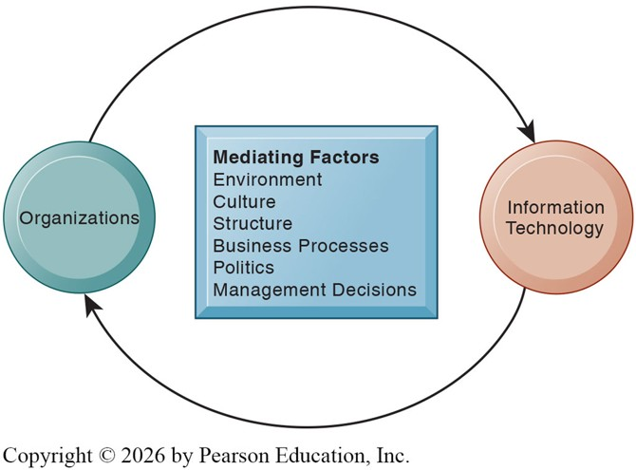
Organizations and Information Systems
Information systems and organizations influence one another:
  Information systems are designed to serve the interests of organizations.
  Organizations, in turn, are shaped by the systems they adopt.
This feedback loop is mediated by various factors, making the relationship complex.
Managers must recognize and understand this dynamic interaction between IS and organizations.

Slide 7
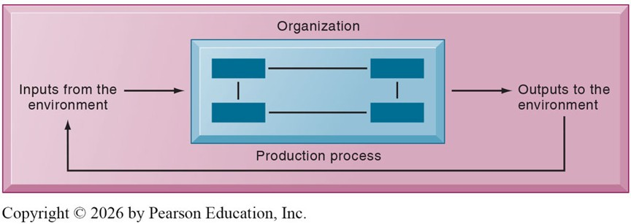
Technical View of an Organization
The technical microeconomic definition of an organization is that it is:
  A stable, formal social structure
  That takes resources from the environment
  And processes them to produce outputs.
The technical definition is clear and powerful, but it can also be less practical.

Slide 8
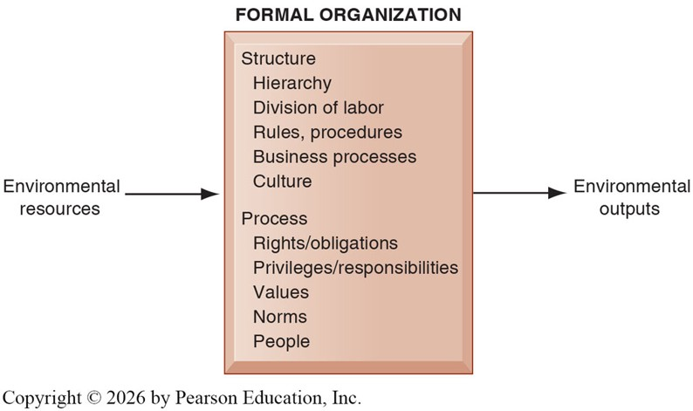
Behavioral View of an Organization
Organizations must abide by laws and, as social structures, they must also consider social elements.
The behavioral definition of an organization is:
  A collection of rights, privileges, obligations, and responsibilities
  Delicately balanced over a period of time
  Through conflict and conflict resolution.

Slide 9
Viewpoints and Information Systems
How we view the role of IS in organizations depends on how we define organizations.
The Technical View of the organization encourages managers to:
  Focus on how inputs are combined to create outputs when new technology is adopted.
  Assume firms are infinitely malleable, with easy substitution between inputs and quick adjustments.
The Behavioral View of the organization is more realistic. It encourages managers to:
  Consider how work is designed and the procedures used to achieve outcomes.
  Recognize that building or replacing information systems involves much more than reallocating resources.
  Understand that changes to information systems can alter the organizational balance of rights, privileges, obligations, responsibilities, and long-standing relationships.
  Acknowledge that such changes can be time-consuming, disruptive, and require significant resources for training.

Slide 10
Viewpoints and Information Systems
It is important to recognize that the technical and behavioral views are not contradictory but complementary.
Each perspective offers valuable insights into understanding the relationship between information systems and organizations.
  Technical: “How can IS improve efficiency and outputs?”
  Behavioral: “How will people, culture, and politics respond to IS?”
Before exploring this relationship further, let us first consider how organizational structures and features can influence information systems.
Notes:
Remote Work Platforms (Zoom, Teams, Slack)
Technical View: Considers cost savings from reduced office space and gains in productivity from better communication tools.
Behavioral View: Explores effects on organizational culture, team trust, and employee well-being, recognizing that digital tools reshape work relationships and collaboration norms.

Slide 11
How Features of Organizations
Affect Information Systems

Slide 12
Features of Organizations Affecting IS
Routines and Business Processes
Organizational Politics
Organizational Culture
Organizational Environments
Organizational Structure
And Some Other Features

Slide 13
Routines and Business Processes
Routines are precise rules, procedures, and practices that have been developed to cope with expected situations.
  Restaurant: Hosts seat customers, servers take orders, cooks prepare meals, and bussers clean tables. Each role follows well-defined routines.
  College: Instructors prepare lectures, students follow class schedules, assignments are collected through a set procedure, and exams follow established rules.
Routines are often called “Standard Operating Procedures.”
Business processes can be understood as a collection of these routines. They are:.
  The way work is organized, coordinated, and focused to produce a valuable product or service.
  The collection of activities required to create that product or service.

Slide 14
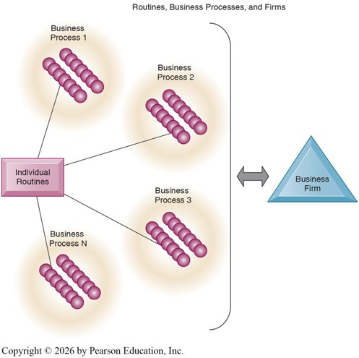
Routines and Business Processes
To be effective, information systems must affect individual workers’ routines and thus improve the overall business process of the organization.
College classroom example:
  Traditional: Paper assignments are distributed, collected, and graded manually.
  IS-enhanced: Assignments are submitted and graded through a learning system, providing faster feedback and greater efficiency.
  By changing individual routines, the information system improves the overall teaching and learning process.

Slide 15
Organizational Politics
Organizational Politics
  People in different positions have unique specialties and perspectives.
  Leads to divergent views on resources, rewards, and punishments.
  Creates political struggles, competition, and conflict.
  Political resistance is a major barrier to organizational change, especially in IS development.
  Large IS investments often trigger political conflict.
Managerial Implications
  Implementing new IS is rarely a neutral, technical decision.
  Managers must anticipate political resistance and identify key stakeholders early.
  Success requires building coalitions and negotiating interests across divisions.
  Skilled managers use organizational politics strategically to implement change.

Slide 16
Organizational Politics: Kodak
In the 1970s and 80s, Kodak controlled 90% of U.S. film sales and 85% of camera sales.
Kodak invented the digital camera and invested heavily in digital technology.
Acquired photo-sharing site Ofoto in 2001 but used it mainly to promote printing.
Organizational politics tied digital to the old print business model.
Missed the true disruption, online photo sharing and mobile platforms. (e.g., Instagram)
Politics and incentives can distort how new IS are used, even when a firm recognizes the disruption.

Slide 17
Organizational Culture
Organizational Culture
  Bedrock, unquestioned assumptions that define goals & products.
  Business processes are rooted in cultural assumptions.
  Culture restrains change, especially technological change.
Managerial Implications
  Managers must recognize cultural assumptions, as they are often invisible but powerful constraints.
  Successful IS implementation requires aligning new technology with existing cultural values or deliberately reshaping those values.
  Leaders should communicate how new IS supports core goals (efficiency, service, innovation) to reduce resistance.
  Cultural change takes time: managers must invest in training, incentives, and reinforcement mechanisms.

Slide 18
Organizational Environments
Organizational Environments
  Organizations draw resources from their environments and supply them with goods and services.
  This is a reciprocal relationship: organizations depend on their environments but also influence them.
  Information systems support environmental scanning, helping firms detect and act on external changes.
  Environments change faster than organizations, creating pressure on culture, politics, and people.
  Inertia, conflict, and cultural resistance make adaptation difficult; many firms fail to adjust in time.
Managerial Implications
  Managers must use IS to monitor external changes: technology, tastes, regulations, competition.
  Adapting quickly is essential, as delay creates vulnerability to disruption.
  Inertia and resistance inside the organization must be anticipated and managed.
  Alliances, partnerships, and lobbying can be tools for influencing the environment.
  Long-term survival depends on balancing adaptation with stability in core routines.

Slide 19
Organizational Environments: Disruptive Innovation
Disruptive Technologies
  Radically change the business environment and landscape
  Substitute for existing products, services, and models
    Horse-drawn Carriages to Cars
    CDs to Online Streaming
    Film Cameras to Digital cameras
  Can destroy entire industries or expand markets at lower cost
  Not all innovators profit: first movers often fail, while fast followers succeed (e.g., IBM, Microsoft).
Managerial Implications
  Managers must scan the environment for disruptive threats and opportunities
  Disruption may require abandoning efficient but obsolete routines
  Success depends on adapting culture, politics, and processes before rivals do
  Being first is not enough — firms need resources and strategy to capture value

Slide 20
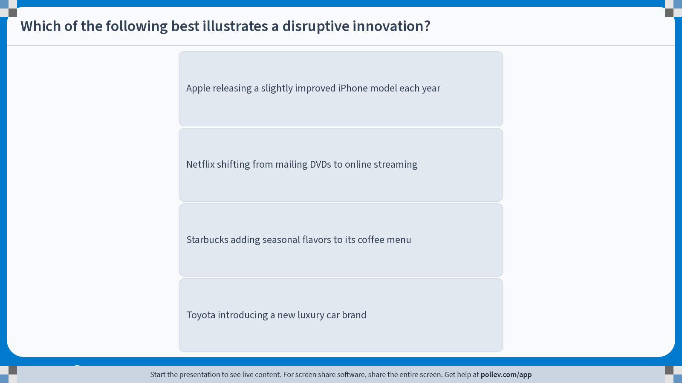
Poll Everywhere multiple choice poll instructions screen
Activity Title: Which of the following best illustrates a disruptive innovation?
Slide 20
Notes:
Do not modify the notes in this section to avoid tampering with the Poll Everywhere activity.
More info at polleverywhere.com/support
Which of the following best illustrates a disruptive innovation?
https://www.polleverywhere.com/multiple_choice_polls/H0Akx2tZ3NvYZDaYkPriT?display_state=instructions&activity_state=opened&state=opened&flow=Engagement&onscreen=persist

Slide 21
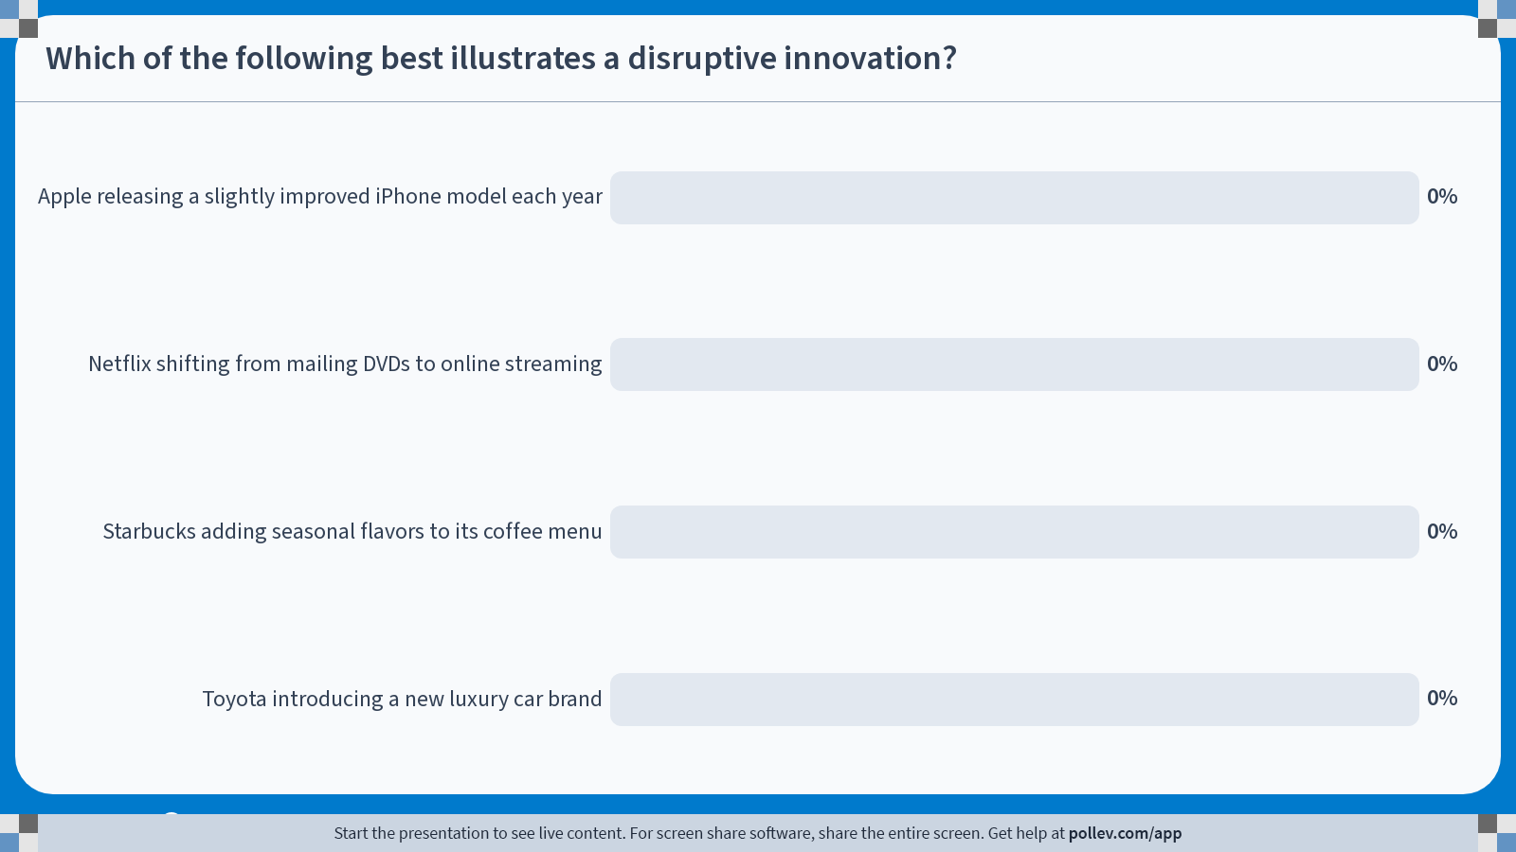
Poll Everywhere multiple choice poll chart screen
Activity Title: Which of the following best illustrates a disruptive innovation?
Slide 22
Notes:
Do not modify the notes in this section to avoid tampering with the Poll Everywhere activity.
More info at polleverywhere.com/support
Which of the following best illustrates a disruptive innovation?
https://www.polleverywhere.com/multiple_choice_polls/H0Akx2tZ3NvYZDaYkPriT?display_state=chart&activity_state=closed&state=closed&flow=Engagement&onscreen=persist

Slide 22

Organizational Environments: Disruptive Innovation

Slide 23
Organizational Structure
All organizations have a structure or shape.
Structure influences the type of IS used and the nature of IS problems.
Managerial Implications
  IS design must align with organizational structure.
  Mismatched systems create inefficiency, duplication, and conflict.
  Integration challenges grow with size and complexity.
  Managers must assess whether IS reinforces or undermines the existing structure.

Slide 24
Organizational Structure: Mintzberg (1971)
Entrepreneurial Structure
  Young, small firm in a fast-changing environment. It has a simple structure and is managed by an entrepreneur serving as its single chief executive officer. (e.g. Small start-up business)
Machine Bureaucracy
  Large bureaucracy existing in a slowly changing environment, producing standard products. It is dominated by a centralized management team and centralized decision making. (e.g. Midsize manufacturing firm)
Divisionalized Bureaucracy
  Combination of multiple machine bureaucracies, each producing a different product or service, all topped by one central headquarters. (e.g. Fortune 500 firms)

Slide 25
Organizational Structure: Mintzberg (1971)
Professional Bureaucracy
  Knowledge-based organization where goods and services depend on the expertise and knowledge of professionals. Dominated by department heads with weak centralized authority. (e.g. Law firms, school systems, hospitals)
Adhocracy
  Task force organization that must respond to rapidly changing environments. Consists of large groups of specialists organized into short-lived multidisciplinary teams and has weak central management. (e.g. Consulting firms or Think tanks)
  Ac Hoc (“for this purpose”)+ Bureaucracy

Slide 26
Other Organizational Features
Other features of the organization would shape how information systems are designed and used.
Goals
  Coercive: Organizations that compel people to participate or comply. (e.g. Prisons)
  Utilitarian: Organizations that provide compensation in exchange for participation. (e.g. Businesses)
  Normative: Organizations that people join to pursue shared values or beliefs. (e.g. Religion)
Constituencies: Benefit Members, Clients, Stockholders, or the Public
Leadership: Democratic vs. Authoritarian Styles
Tasks & Technology:
  Routine tasks → Formal rules, little judgment (e.g., auto parts manufacturing)
  Nonroutine tasks → Judgment, expertise (e.g., consulting firms)
Notes:
Coercive = monitoring and enforcement
Utilitarian = efficiency and performance
Normative = communication and community
Members → IS for engagement & benefits.
Clients → IS for service delivery & personalization.
Stockholders → IS for financials & compliance.
Public → IS for transparency & accessibility.

Slide 27
How Information Systems
Affect Organizations

Slide 28
Economic Impact: Shifting Relative Costs
Over the past decade, information systems have fundamentally altered the economics of organizations.
IT as a factor of production can substitute for both labor and capital, the traditional factors of production.
Declining IT costs shift the balance making IT relatively cheaper than labor or capital.
  Labor Substitution: Routine clerical work and middle management tasks are increasingly automated.
  Capital Substitution: IT reduces the need for expensive capital by enabling digital processes.
Therefore, firms are increasingly investing more heavily in IT, as it delivers efficiency at a lower relative cost.

Slide 29
Economic Impact: Economics of Information
The traditional challenge was obtaining, sharing, and verifying information across markets.
Transaction Costs are costs incurred when a firm buys on the marketplace what it cannot make itself:
  Searching for and evaluating suppliers
  Negotiating and monitoring contracts
  Managing risk and insurance
  Gathering product and market information
Traditionally, firms engaged in vertical integration to mitigate transaction costs.
IT impact:
  Lowers transaction costs dramatically (e.g., online sourcing, instant communication, digital monitoring)
  Allows firms to contract in size, outsourcing more activities instead of performing everything in-house

Slide 30
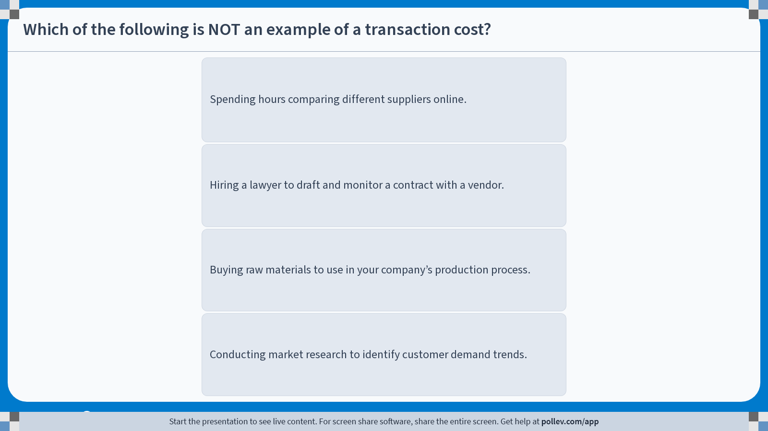
Poll Everywhere multiple choice poll instructions screen
Activity Title: Which of the following is NOT an example of a transaction cost?
Slide 28
Notes:
Do not modify the notes in this section to avoid tampering with the Poll Everywhere activity.
More info at polleverywhere.com/support
Which of the following is NOT an example of a transaction cost?
https://www.polleverywhere.com/multiple_choice_polls/Epv2Q8G9ELGF1AtKNjveQ?display_state=instructions&activity_state=opened&state=opened&flow=Engagement&onscreen=persist

Slide 31
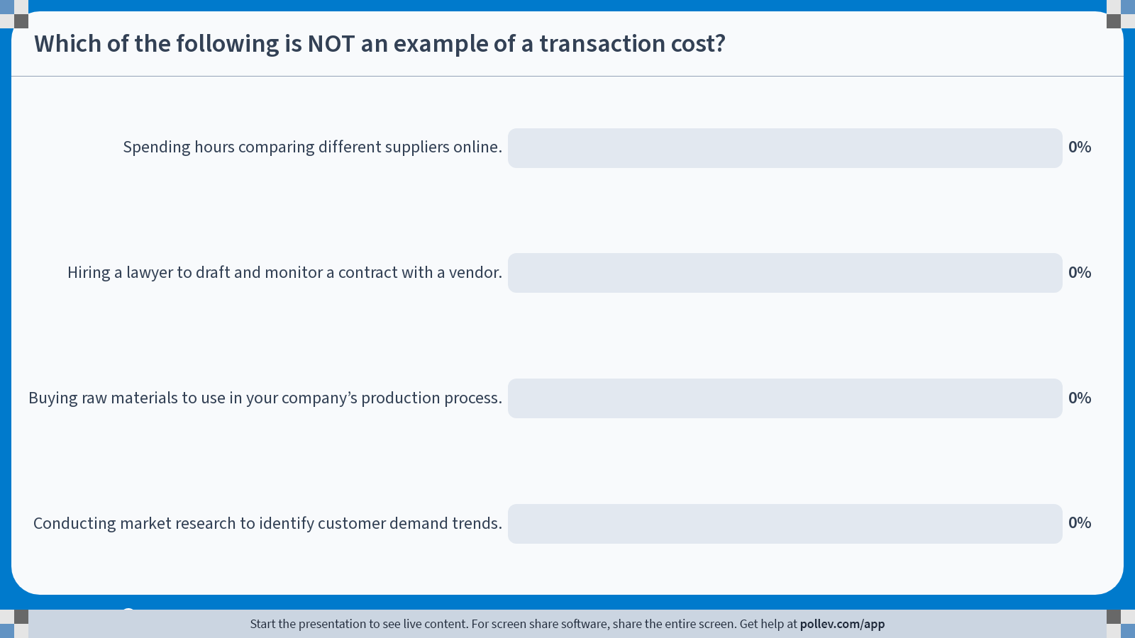
Poll Everywhere multiple choice poll chart screen
Activity Title: Which of the following is NOT an example of a transaction cost?
Slide 30
Notes:
Do not modify the notes in this section to avoid tampering with the Poll Everywhere activity.
More info at polleverywhere.com/support
Which of the following is NOT an example of a transaction cost?
https://www.polleverywhere.com/multiple_choice_polls/Epv2Q8G9ELGF1AtKNjveQ?display_state=chart&activity_state=closed&state=closed&flow=Engagement&onscreen=persist

Slide 32
Economic Impact: Economics of Information
Agency Theory posits that firms are “Nexus of Contracts” among self-interested individuals.
  Principals (owners) employ agents (employees), and
  Agents require supervision to align their interests with the owners’.
As firms grow, agency costs (coordination & supervision) rise.
IT impact:
  Reduces cost of acquiring & analyzing information
  Makes it easier to oversee more employees with fewer managers
  Shrinks the number of middle managers & clerical staff
As a result, firms can be smaller, more efficient, and still increase revenues.

Slide 33
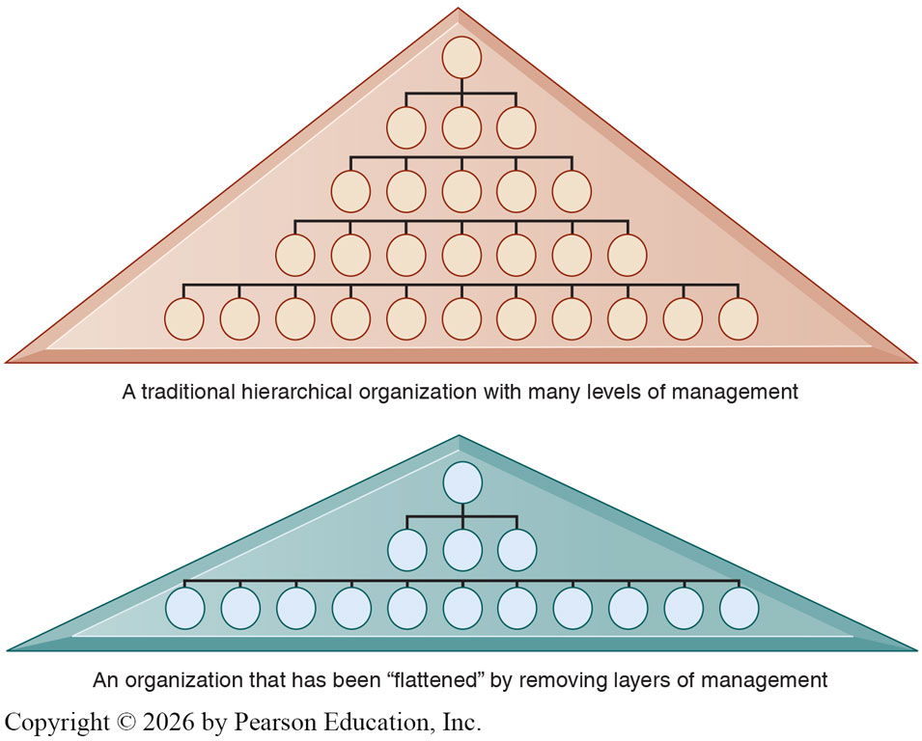
Organizational & Behavioral Impact
IT “Flattens” organizations: Reduces levels in hierarchies and downsizes large bureaucracies.
This happens through three main channels:
  Broader distribution of information empowers lower-level employees to make decisions.
  Managers gaining efficiency:
    Faster, more accurate information leading to quicker decisions
    Fewer managers needed; management costs decline
  Span of control widens, and senior managers oversee more workers across greater distances.
Result: thousands of middle management roles eliminated in many firms

Slide 34
Organizational Resistance to Change
While updating information systems in an organization is often viewed as universally “good,” it isn’t free of internal challenges and politics.
Information Systems…
  Affect access to information, a key resource in organizations.
  Influence who does what, when, where, and how in the organization.
  Changes to well-established personal routines.
  Often require training or education that isn’t compensated.
Because shifts in information systems alter structure, culture, processes, and strategy, they often face considerable resistance.
Managers’ ability to work with people and organizations can be just as important as their technical awareness and knowledge.

Slide 35
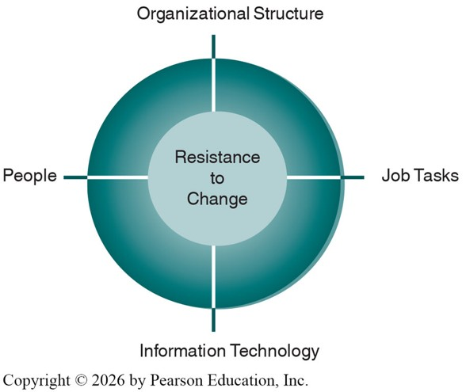
Organizational Resistance to Change
Research highlights four key factors of resistance :
  Nature of the IT innovation
  Organization’s structure
  Culture of people in the organization
  Tasks affected by the innovation
These factors interact:
  Changes are often absorbed, deflected, or defeated unless technology, tasks, structure, and people change together.
  “Unfreeze → Change → Refreeze” may be necessary to institutionalize change.

Slide 36
Organizational Factors of Consideration
Genuine benefits require understanding the organization where the system will be used.
Key organizational factors to consider:
  The external environment in which the firm operates.
  The structure: hierarchy, specialization, routines, processes.
  The culture and politics that shape behavior.
  The type of organization and leadership style.
  The interest groups affected and worker attitudes toward the system.
  The tasks, decisions, and business processes the IS is meant to support.
Firms also compete in external environments, where IS can create strategic advantages that explain why some firms consistently outperform others.

Slide 37
The Competitive Forces Model

Slide 38
Competitive Forces Model
In every industry, some firms consistently outperform others:
  Toyota (automotive), Amazon (online retail), Walmart (offline retail), Google (web search)
Superior performers have a competitive advantage:
  Access to unique resources or
  Use common resources more efficiently (knowledge, IS assets)
Those with competitive advantages enjoy greater revenue growth, profitability, productivity, and market valuation.
A widely used framework of understanding competitive advantages is Michael Porter’s Competitive Forces Model
Five competitive forces shape fate of firm!

Slide 39
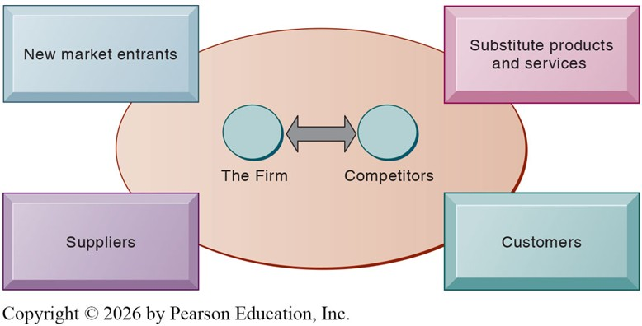
Competitive Forces Model

Slide 40
The Five Competitive Forces
Traditional Competitors
  Rivals compete by improving efficiency, introducing new products, and building strong brands.
  Switching costs, the costs (financial, time, effort, or inconvenience) that customers face when changing from one product or service to another, help firms retain customers.
New Market Entrants
  Entry is easier in some industries (e.g., pizza shop) and harder in others (e.g., computer chips).
  Advantages: No legacy costs, younger/cheaper workforce, higher motivation.
  Weaknesses: Need financing, little brand recognition, less experience.
Substitute Products and Services
  Alternatives reduce pricing power and profit margins.
  e.g. electric cars vs. gas cars; solar/wind vs. fossil fuels; streaming vs. cable TV

Slide 41
The Five Competitive Forces
Customers
  The customers’ power grows when switching is easy, or competition is price-only.
  Transparent markets increase customer power (e.g., online used textbook market)
  Firms attempt to create brand loyalty with unique, hard-to-copy products.
Suppliers
  Powerful suppliers can erode profits if firms cannot raise prices as quickly.
  More supplier options often translate to more control for firms.
  e.g. Laptop makers use multiple suppliers for parts like keyboards and screens.
Firms respond to competitive forces by adopting IS-enabled strategies that strengthen their market position.

Slide 42
IS Strategies for Competitive Forces
Low-cost Leadership
  Use IS to achieve lowest operating costs & prices.
  Example: Walmart
    Continuous replenishment system links checkout to suppliers.
    Real-time inventory tracking keeps shelves stocked & reduces warehouse costs.
    Efficient customer response system directly ties consumer behavior to supply chain.
Product Differentiation
  IS enables new products & services and enhances customer convenience.
  Examples:
    Amazon’s One-click Shopping: Revolutionized the early-stage e-commerce scene.
    Apple’s iTunes Store: First firm to develop a legal online marketplace for digital music.
  Beyond differentiating products, but can manage the entire customer experience

Slide 43
IS Strategies for Competitive Forces
Focusing on Market Niches
  IS supports specialized focus, serving narrow markets better than competitors.
  Tools: Data mining, AI/ML, CRM systems.
  Examples:
    Charlotte Hornets: Real-time fan profiles for personalized marketing.
    Credit Cards: Predict profitable cardholders via purchase data analysis.
  Enables “one-to-one” marketing tailored to individual preferences.
Strengthening Customer and Supplier Intimacy
  Tighten linkages with suppliers and build stronger relationships with customers.
  Examples:
    Toyota: Suppliers access production schedules, decide shipping.
    Amazon: Recommends products based on user history & peer purchases.
  Benefits: Higher switching costs, stronger loyalty, competitive advantage.

Slide 44
How IT is Changing Competitive Advantages
Competitive forces intensified (Porter, 2001)
  Universal standards make entry easier
  Price competition increases
  Customers gain bargaining power (easy to compare prices online)
  Profits dampened across many industries
Industries Disrupted: Newspapers, music, books, retail, telecommunication, etc.
Opportunities created:
  Entirely new markets & business models
  Large customer bases & brand-building
  Examples: Amazon, eBay, YouTube, Facebook, Expedia, Google

Slide 45
The Value Chain Model

Slide 46
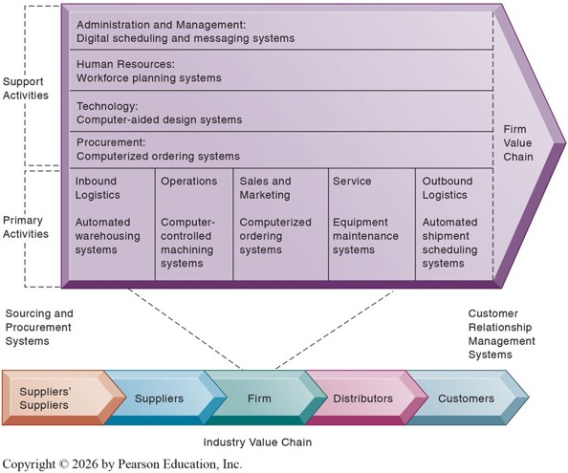
The Value Chain Model
Porter’s Five Forces are helpful for identifying competition, but not specific on what to do.
Value Chain Model:
  Highlights where IS can add the most value
  Identifies leverage points to improve efficiency & competitive position
The value chain model views the firm as a chain of activities adding margin of value to products/services.
Two Activities: Primary and Support.

Slide 47
The Value Chain Model: Primary Activities
Primary Activities are directly related to production and distribution.
Inbound Logistics: Receiving & storing materials for production.
  e.g. RFID & warehouse management systems optimize inventory flows
Operations: Transforming inputs into finished products.
  e.g. CAD systems, robotics, process automation
Outbound Logistics: Storing & distributing finished goods.
  e.g. UPS/FedEx package tracking, logistics optimization software
Sales & Marketing: Promoting & selling products.
  e.g. CRM systems, AI-driven targeted ads, e-commerce platforms
Service: Maintenance & repair after the sale.
  e.g. Online service portals, predictive maintenance via IoT sensors

Slide 48
The Value Chain Model: Support Activities
Support Activities make the delivery of the primary activities possible.
Infrastructure: Admin & Management
  e.g. ERP systems integrate finance, planning, and operations
Human Resources: Recruiting, hiring, training
  e.g. LinkedIn, online applicant tracking systems, e-learning platforms
Technology: Improving products & processes
  e.g. R&D databases, AI/ML for product design
Procurement: Purchasing inputs
  e.g. E-procurement systems, supplier portals, automated bidding tools

Slide 49
The Value Chain Model: Benchmarking
The adoption of the value chain model leads to benchmarking and the identification of best practices.
Benchmarking: Compare efficiency & effectiveness of processes against strict standards, then measuring the performance against said standards.
Best Practices: Proven solutions identified by consulting firms, research organizations, government agencies, or industry groups.
IS can support both by:
  Collecting and analyzing performance data.
  Enabling comparisons across units, firms, or industries.
  Highlighting areas for process improvement.

Slide 50
Extension: The Value Web
A firm’s value chain is linked to those of suppliers, distributors, and customers
Performance depends on how well firms coordinate across the chain
IS can provide industry-level strategic advantage by:
  Creating standards for electronic information exchange
  Building industrywide IT-supported networks/consortia
  Raising entry costs and reducing substitution through shared systems
Example: Amazon
  Supplier integration (easy product display & store setup)
  Customer integration (easy payments, shipment tracking)
  Logistics coordination with UPS/FedEx

Slide 51
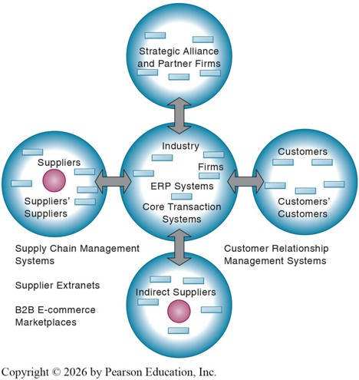
Extension: The Value Web
A Value Web is a network of independent firms using IS to coordinate value chains collectively.
More customer-driven, flexible, and adaptive than linear value chains.
Synchronizes business processes across suppliers, customers, and partners
Benefits:
  Faster time-to-market
  Rapid response to changes in supply & demand
  Ability to choose best partners for price, speed, and location

Slide 52
Synergies, Core Competencies,
And Network Economics

Slide 53
Synergies
IS can achieve additional efficiencies by promoting synergies and core competencies.
Synergies refer to benefits created when combined units generate more value together than alone.
Typically found in a business environment when:
  Output of one unit becomes input for another, or
  Firms pool markets and expertise to lower costs & increase profits.
Examples: Bank Mergers
  JPMorgan Chase + Bank of New York
  Bank of America + Countrywide

Slide 54
Core Competencies
Core Competencies are activities where a firm is an industry leader.
Built on years of practical experience, research, and committed employees.
Role of IS in enhancing core competencies:
  Encourages knowledge sharing across business units.
  Makes external knowledge accessible.
  Leverages existing competencies into related markets.
Example: Procter & Gamble (P&G)
  IS connects R&D, engineering, marketing, legal, and other units worldwide.
  Employees share reports, charts, videos, and expertise online.
  Links to outside scientists & entrepreneurs to accelerate innovation.

Slide 55
Network-Based Strategies
IS can also create value by connecting firms into larger networks.
  Network Economics
  Virtual Company Model
  Business Ecosystems and Platforms
Network Economics
  Value grows as more people use a product or network.
  Example: A phone, email, or social network is only valuable when millions of others also use it.
  Traditional Economics: Production experience diminishing returns.
  Network Effects: Marginal cost is close to 0, but marginal gain grows as the userbase grows.
  IS applications:
    Build communities of users (e.g., Facebook, eBay, Airbnb, Uber).
    Larger installed bases increase software & platform value.
    Strong customer loyalty through community and shared experience.

Slide 56
Network-Based Strategies
Virtual Company Model
  Uses networks to link people, assets, and ideas across firms.
  Flexible alliances without traditional boundaries or physical constraints.
  Able to acquire capabilities quickly and cost-effectively and adapt rapidly to market opportunities.
Business Ecosystems & Platforms
  Interdependent networks of firms in related industries that co-create value.
  Example: Device makers (Apple, Samsung), Telecommunications (Verizon, AT&T), etc
  Value is created collectively, not individually.
  Keystone Firms: Dominate ecosystems and provide platforms for others. (e.g. Facebook, Microsoft)
  Strategic options: Become a keystone firm (build platforms others use) or thrive as a profitable niche player within an ecosystem.

Slide 57
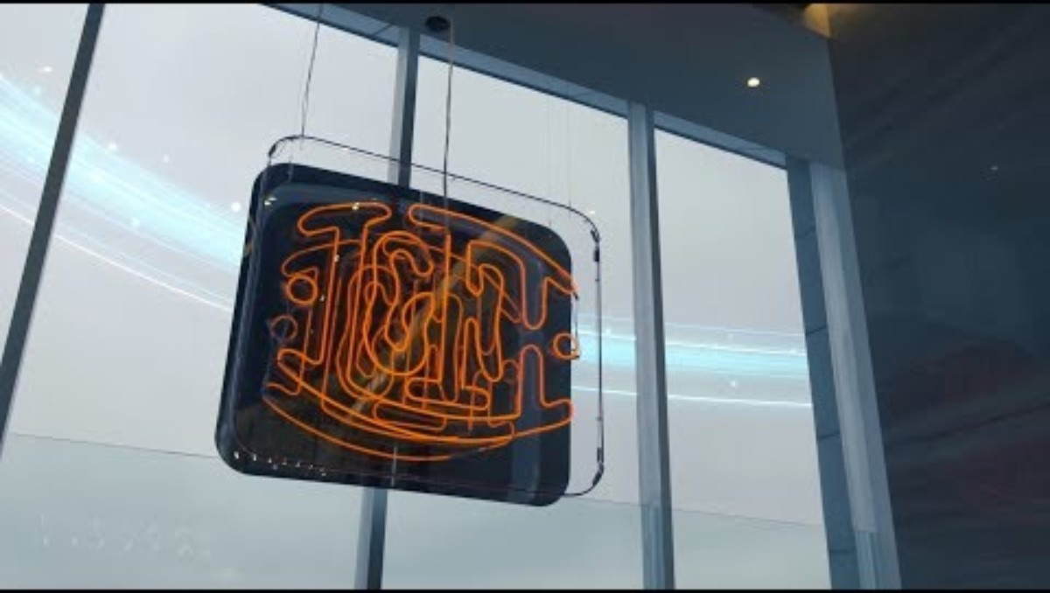
Virtual Company: Li & Fung

Slide 58
The use of AI in Competitive Strategy

Slide 59
AI in Competitive Strategy
AI is transforming how information systems operate and deliver value.
Capabilities of AI:
  Automates and enhances decision-making (AI in fraudulent transaction detection for banks)
  Improves user experience and customer personalization (Netflix and Spotify’s recommendations)
  Optimizes resource allocation & business processes (Airlines’ dynamic pricing models)
  Enables new products, services, and business models (AI diagnostics in healthcare)
AI is now embedded across information systems in every industry.

Slide 60
AI and the Value Chain
AI is improving performance within existing business models and creating new business models and reshaping competition.
  More data-driven, accurate, and precise decision-making.
  AI assists executives but does not replace strategic decision-making.
  Useful for ideation, problem-solving, and scenario planning.
Examples: See Table 3.6 for a full description.
  Inbound logistics: Predictive supply chain management.
  Operations: Automated quality checks, process optimization.
  Marketing & Sales: AI-driven personalization, dynamic pricing.
  Service: Chatbots, predictive maintenance.
  …and More!

Slide 61
AI and the Competitive Forces Model
AI reshapes industry structures and rules of competition.
Challenges:
  Requires massive, accurate, and well-organized datasets.
  Demands expertise in AI tools, computing power, and change management.
Opportunities:
  Can strengthen or weaken customer/supplier power.
  Creates entirely new products and services.
  Open-source AI platforms enable some new entrants despite high barriers.
Firms with strong AI expertise and resources gain lasting competitive advantage.
See Table 3.7 for a full description.

Slide 62
Strategic Information Systems

Slide 63
Strategic Information Systems
Strategic IS refers to information systems that are developed or adopted specifically to give an organization a competitive advantage by supporting or shaping its strategy.
Its purpose is not just efficiency or automation but to change the way the organization competes, operates, or delivers value.
Examples:
  American Airlines SABRE: First computerized reservation system that transformed airline competition.
  Amazon Recommendation Engine: Uses data and AI to drive sales and customer loyalty.
  Walmart’s Inventory Replenishment System: Enabled low-cost leadership by cutting supply chain costs.

Slide 64
Strategic Information Systems
Competitive advantages rarely last long:
  Competitors can copy or retaliate quickly.
  Markets, technology, and customer expectations evolve rapidly.
  IS alone cannot guarantee long-term advantages.
Firms that align IT with business strategy are more profitable.
Common Pitfalls:
  IT takes on a life of its own, disconnected from business goals.
  Unrealistic expectations of IT capabilities.
Successful Firms:
  Actively shape IT to fit strategy.
  Measure IT’s impact on revenues, profits, and competitiveness.

Slide 65
Management Checklist: Strategic Systems Analysis
To identify the types of systems that provide a strategic advantage to their firms, managers should ask the following questions:
  What is the structure of the industry in which the firm is located?
  What are the business and industry value chains for this particular firm?
  Have we aligned IT with our business strategy and goals? Have we correctly articulated our business strategy and goals?

Slide 66
Recap of Chapter 3

Slide 67
Recap of Chapter 3
What are the technical and behavioral views of organizations?
How do features of an organization affect information systems, and how do information systems affect organizations?
What is Porter’s Competitive Forces Model and the Value Chain Model?
Explain synergies, core competencies, and network economics.
How can AI be used in competitive strategies?
What are challenges posed by strategic information systems?

