Slide 1
MANAGEMENT INFORMATION SYSTEMS
Chapter 2: Global E-business and Collaboration

Slide 2
Recap of Chapter 1
How does IS transform businesses and careers?
What are the key challenges and opportunities created by new MIS technologies?
What are the key features of a digital firm?
What are the business objectives of information systems?
What is an information system, and how does it work?
What are the organizational, managerial, and technological dimensions of IS?
Why are complementary assets important?
What are the approaches in studying IS?

Slide 3
How Business Processes
Relate to Information Systems

Slide 4
Understanding the Business Process
Recap: Business Processes refer to…
  The way work is organized, coordinated, and focused to produce a valuable product or service.
  The collection of activities required to create that product or service.
Business processes are supported by flows of material, information, and knowledge among participants.
The overall performance of an organization largely depends on how well its business processes are designed and coordinated.
  Done well, they are essential assets
  Poorly designed processes can become liabilities
Notes:
Businesses must deal with many different pieces of information about suppliers, customers, employees, invoices, payments, and of course their products and services. They must organize work activities that use this information to operate efficiently and enhance the overall performance of the firm. Information systems make it possible for firms to manage all their information, make better decisions, and improve the execution of their business processes.

Slide 5
Understanding the Business Process
Many business processes fall within distinct functional areas.
At the same time, some processes cut across multiple functional areas.
Functional Area | Business Process
Manufacturing & Production | Assembling the product Quality checks Producing bills of materials
Sales & Marketing | Identifying customers Making customers aware of the firm’s product Selling the product
Finance & Accounting | Paying creditors Creating financial statements Managing cash accounts
Human Resources | Hiring employees Evaluating employees’ performance Enrolling employees in benefit plans

Slide 6
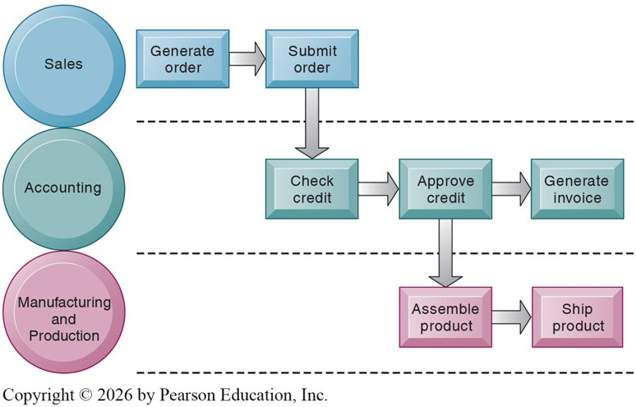
Understanding the Business Process
Consider the process of filling a customer order.
  Sales receives the order.
  Accounting verifies that the customer is creditworthy.
  Production produces and ships the product.
  Sales and Accounting are notified for follow-up.
  Accounting generates a bill or invoice.
  Sales follows up with Q&A.

Slide 7
Understanding the Business Process
Even a seemingly simple business process, such as filling an order, can involve many functional groups and require close cooperation between departments.
To make this more complex, suppose the firm receives its order through a third party (e.g., Amazon, eBay) and relies on an outside shipping company (e.g., USPS, FedEx, UPS) to deliver the product to the customer.
In this case, fulfilling an order becomes both cross-functional and interorganizational.
The efficiency of such processes depends on well-functioning information systems that enable cooperation and coordination.

Slide 8
How IS Enhances Business Processes
IS can enhance business processes by automating steps that were previously handled manually.
Example #1: Payroll Processing
  Past: Employees filled out timesheets; payroll staff calculated wages and deductions by hand.
  Now: Payroll software automatically calculates wages, taxes, and deposits.
  Manual calculations are replaced by instant, automated processing.
Example #2: Barcode Scanning at Checkout
  Past: Cashiers manually entered product codes or prices for each item.
  Now: Scanning barcodes instantly retrieves product details and updates totals.
  Manual data entry is replaced by automated recognition, reducing errors and speeding up checkout.
Other Examples: Airline e-ticketing, automated invoice generation, etc.

Slide 9
How IS Enhances Business Processes
IS can enhance business processes by changing the flow of information.
Example #1: Online Order Tracking
  Past: Customers had to call customer service to ask about package status.
  Now: Major shipping companies give customers direct access to shipment data online.
  Information once shared only internally is now accessible to customers.
Example #2: Electronic Medical Records (EMR)
  Past: Patients’ health records were stored on paper, often in a single doctor’s office.
  Now: Hospitals use EMRs accessible by multiple departments and patients.
  Information now moves seamlessly between doctors, labs, and patients.
Other Examples: Airline check-in systems, retail point-of-sale and inventory systems, etc.

Slide 10
How IS Enhances Business Processes
IS can enhance business processes by creating new business models.
Example #1: Airbnb
  Past: Travelers booked hotels through traditional travel agencies or chains.
  Now: Airbnb connects hosts and guests directly through an online platform.
  The development of IS enabled a peer-to-peer model that disrupted the hotel industry.
Example #2: Amazon
  Past: Retail shopping required visiting physical stores.
  Now: Amazon allows customers to browse, purchase, and receive goods entirely online.
  IS enabled a large-scale e-commerce model that transformed retail.
Other Examples: Netflix, Uber, Spotify, etc.

Slide 11
How Information Systems Serve
Different Management Groups

Slide 12
Systems for Different Management Groups
Because a firm consists of distinct specialties and organizational hierarchies, a single system cannot provide all the information it requires.
A typical firm has systems that support each major business function:
  Sales and Marketing
  Manufacturing and Production
  Finance and Accounting
  Human Resources
In addition, a typical firm will often have separate systems to support the needs of different management levels:
  Operational Management
  Middle Management
  Senior Management

Slide 13
Transaction Processing Systems
Transaction Processing Systems (TPS) are information systems that perform and record the daily routine transactions necessary to conduct business.
  Examples include sales, receipts, cash deposits, buy/sell orders, payroll, credit decisions, and the flow of materials in production lines.
TPS can be used to answer questions such as:
  How many parts are in inventory right now?
  What is happening to a customer’s payment processing?
The primary purpose of a TPS is to enable managers to monitor the status of operations and the organization’s relationship with its external environment.
These systems mainly serve operational management and staff by supporting predefined, structured goals and decision-making.

Slide 14
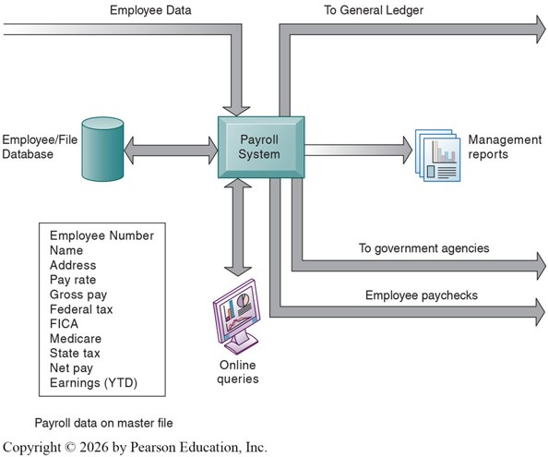
TPS Examples: Payroll
Let’s examine an example: a payroll TPS.
An employee timesheet (name, ID, hours worked, etc.) is the basic transaction in this system.
This new line of data is entered into the payroll system, which updates the employee database.
The data in the system can then be accessed and queried online for various purposes.

Slide 15
TPS Case Study: Knight Capital (2012)
Knight Capital, a major stock trading firm, deployed new trading software, but a failure in its transaction processing system caused it to send millions of erroneous buy and sell orders in just 45 minutes.
Consequences:
  The company lost $440 million in less than an hour.
  Its stock price collapsed, and the firm nearly went bankrupt.
  It was eventually acquired by a rival because it couldn’t recover from the financial damage.
The TPS was not properly tested, and a critical software flag wasn’t updated across all servers. This caused old, unused code to execute during live trades, processing transactions incorrectly at high speed.

Slide 16
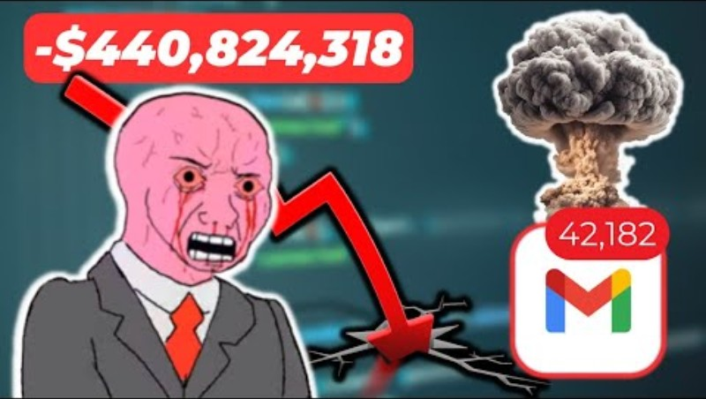
TPS Case Study: Knight Capital (2012)

Slide 17
Systems for Business Intelligence
Business Intelligence (BI) refers to applications and technologies designed to help users make more informed and thus better business decisions.
BI systems address the decision-making needs of all levels of management:
  Management Information Systems (MIS)
  Decision Support Systems (DSS)
  Executive Support Systems (ESS)
Management Information Systems (MIS) here refers to a specific category of information systems that serve middle management.
Recall that MIS as an academic field is more broadly defined as the study of information systems and their use in business.

Slide 18
BI Examples: Management Information Systems
The main function of MIS is to provide reports on a firm’s current performance, drawing on data from TPS.
These systems typically have limited analytical capability, as they are designed to answer routine questions using predefined procedures.
Example: Walmart’s Retail Link System
  Proprietary MIS developed by Walmart in the 1990s.
  Each customer purchase at checkout feeds into the central database (TPS)
  Retail Link compiles this TPS data into routine reports on sales trends, inventory levels, and stockouts
  Suppliers can log in to view these reports and manage replenishment directly
  Provides middle management with standardized reports that improve inventory control and reduce costs

Slide 19
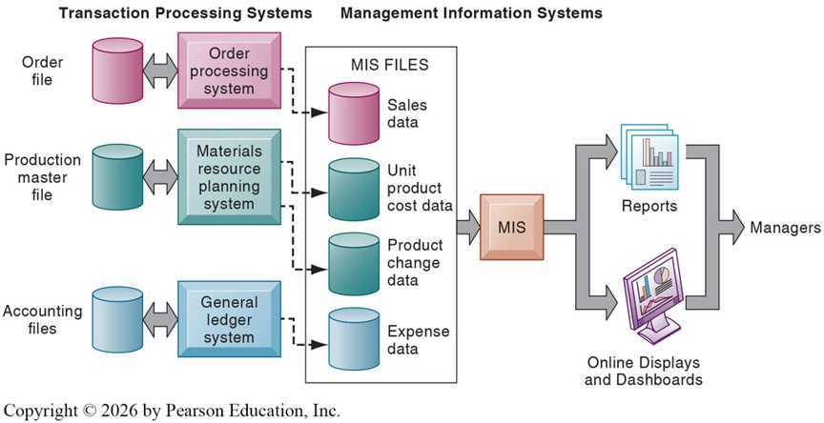
BI Examples: MIS and TPS

Slide 20
BI Examples: Decision Support Systems
A Decision Support System (DSS) is a type of BI system that combines data with sophisticated analytical models and tools to support decision-making.
Examples of questions a DSS can address include:
  What would the firm’s profit margin be if the launch of a new product were delayed by four months?
  How many employees would the firm need to hire to double production within six months?
DSS may appear similar to MIS, since both draw on internal data from TPS to generate business insights.
However, unlike MIS, DSS also incorporate data from external sources, providing greater flexibility and analytical depth.

Slide 21
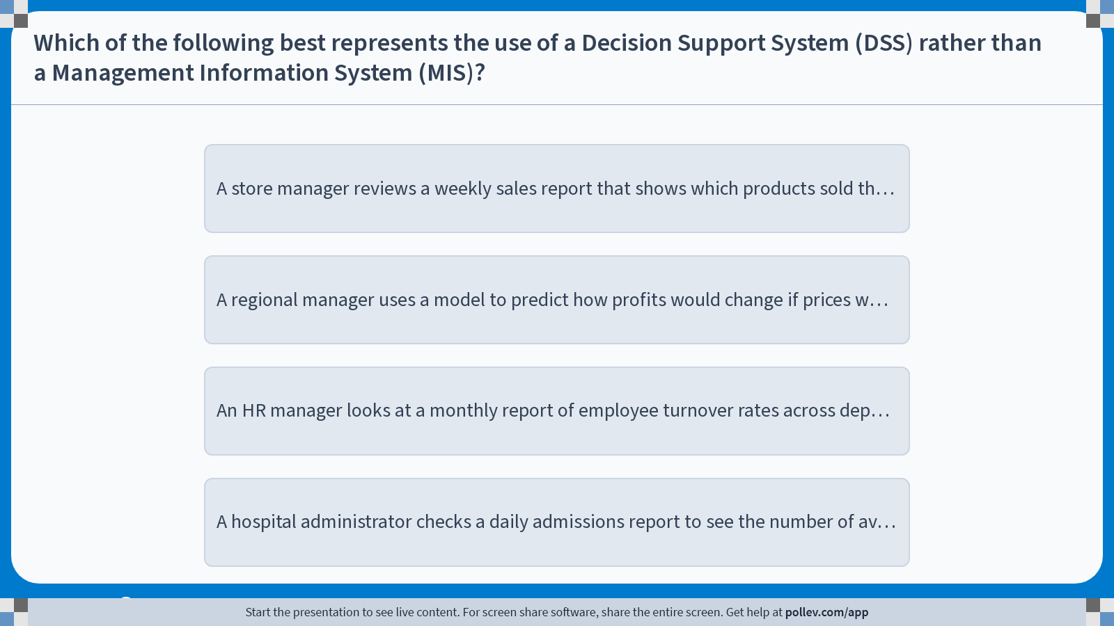
Poll Everywhere multiple choice poll instructions screen
Activity Title: Which of the following best represents the use of a Decision Support System (DSS) rather than a Management Information System (MIS)?
Slide 21
Notes:
Do not modify the notes in this section to avoid tampering with the Poll Everywhere activity.
More info at polleverywhere.com/support
Which of the following best represents the use of a Decision Support System (DSS) rather than a Management Information System (MIS)?
https://www.polleverywhere.com/multiple_choice_polls/criIMQdgtE9tNIxDIH8yN?display_state=instructions&activity_state=opened&state=opened&flow=Engagement&onscreen=persist

Slide 22
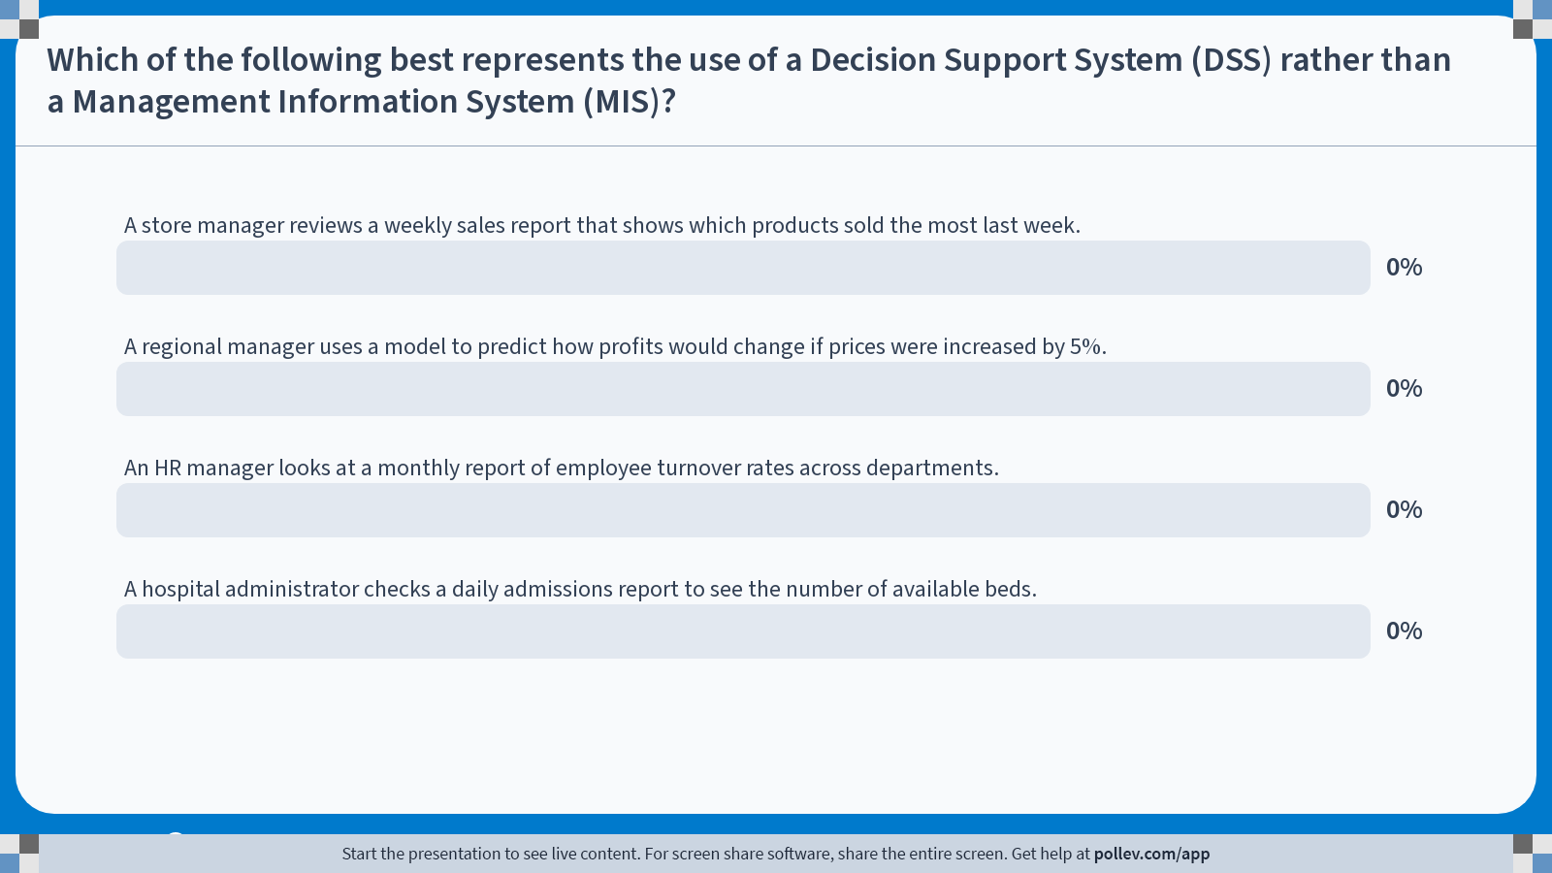
Poll Everywhere multiple choice poll chart screen
Activity Title: Which of the following best represents the use of a Decision Support System (DSS) rather than a Management Information System (MIS)?
Slide 23
Notes:
Do not modify the notes in this section to avoid tampering with the Poll Everywhere activity.
More info at polleverywhere.com/support
Which of the following best represents the use of a Decision Support System (DSS) rather than a Management Information System (MIS)?
https://www.polleverywhere.com/multiple_choice_polls/criIMQdgtE9tNIxDIH8yN?display_state=chart&activity_state=closed&state=closed&flow=Engagement&onscreen=persist

Slide 23
BI Examples: Executive Support Systems
Executive Support Systems (ESS) are information systems designed to help senior managers make nonroutine decisions that require judgment, evaluation, and insight.
ESS draws summarized information from MIS and DSS, but also incorporates data about external events such as new tax laws or competitors’ actions.
A critical feature of an ESS is ease of use and clarity of display, since executives require quick, intuitive access to the most important data.
Information is often delivered through a portal, which is a web interface that presents integrated, personalized business content from multiple sources.
BI dashboards, which display key performance indicators in the form of graphs and charts on a single screen, are also frequently incorporated into ESS.

Slide 24
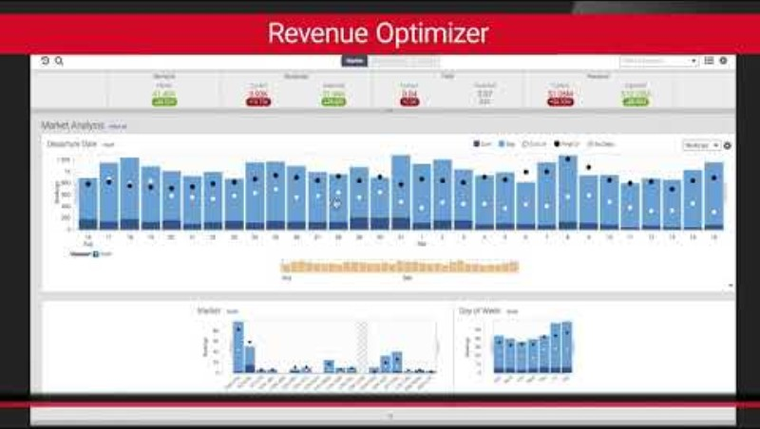
BI Example: Sabre Airline Solutions Dashboard

Slide 25
Enterprise Applications

Slide 26
Enterprise Applications
How do firms manage the different levels of information systems that are used across various aspects of their operations?
One solution is to implement Enterprise Applications:
  Systems that coordinate activities, decisions, and knowledge across functions, levels, and business units
  Span multiple functional areas
  Encompass processes across the entire organization and, in some cases, extend beyond it (to customers, suppliers, and other key partners)
  Serve all levels of management
  Ensure that TPS, MIS, DSS, and ESS work together smoothly
There are four major applications: ERP, SCM, CRM, and KMS

Slide 27
Enterprise Resource Planning (ERP) Systems
One of the four components of enterprise applications is the Enterprise System, also known as an Enterprise Resource Planning (ERP) system.
ERP systems are integrated, enterprise-wide information systems that enable firms to coordinate key business processes across functional areas.
Recall the “fulfilling an order” example we covered earlier, how interconnected each business functions are in a modern business.
SAP is the global leader in ERP, and its flagship product (SAP ERP) integrates finance, HR, manufacturing, supply chain and more under one roof.
In fact, the most valuable company in Germany by market capitalization is SAP, at $313 B.
  Followed by Siemens ($207 B), Deutsche Telekom ($181 B), Allianz ($159 B), and Rheinmetall ($91 B).

Slide 28
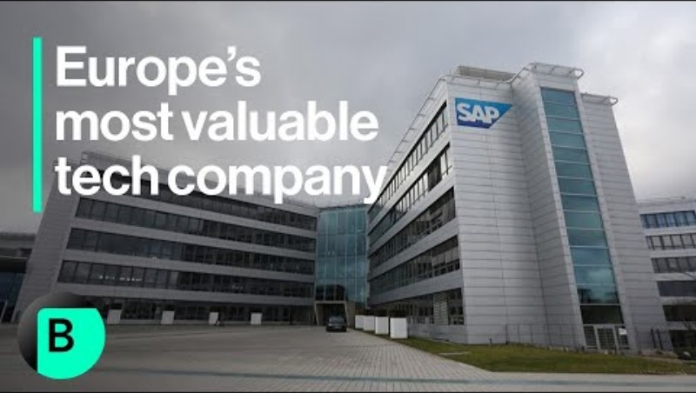
ERP Showcase: SAP

Slide 29
Supply Chain Management (SCM) Systems
Another component of an enterprise application are Supply Chain Management (SCM) systems.
SCM systems:
  Automate the flow of information between a firm and its suppliers.
  Optimize planning, sourcing, manufacturing, and delivery of goods and services.
  Act as interorganizational systems, managing relationships with suppliers, distributors, and logistics partners.
  Must be designed with the processes of partners and suppliers in mind.
  Increase firm profitability by lowering the costs of moving and making products.
  Goal: deliver the right products to the right place in the shortest time and at the lowest cost.
SAP SCM, Oracle SCM Cloud, Infor Supply Chain are some examples of SCM software.

Slide 30
SCM Showcase: Dell Inc.
Dell became famous in the 1990s for its direct-to-consumer model.
Customers placed customized orders online or by phone.
Dell’s SCM system immediately coordinated with suppliers to source components “just in time.”
This minimized inventory costs while ensuring fast assembly and delivery.
Dell achieved cost efficiency, reduced waste, and offered consumers personalized products at scale.

Slide 31
Customer Relationship Management (CRM) Systems
The next component we will discuss are Customer Relationship Management (CRM) systems.
CRM systems are information systems that enables a firm to coordinate all business processes that deal with customers.
Salesforce is the global leader, with competition from SAP, Oracle, and Microsoft.
Coca-Cola integrated customer data fragmented across 200+ countries under Salesforce CRM to centralize customer insights into a unified platform:
  Real-time data access for sales and service for teams world-wide.
  Better demand forecasting and order tracking.
  Personalized marketing at a global scale.

Slide 32

CRM Showcase: Salesforce & Coca-Cola

Slide 33
Knowledge Management Systems (KMS)
The final component we will discuss are Knowledge Management Systems (KMS).
KMS are information systems that support the creation, capture, storage, and dissemination of firm expertise and knowledge.
  Collect relevant knowledge and experience in the firm
  Links to external sources of knowledge
  Makes that knowledge available wherever and whenever it is needed to improve business processes and management decisions
Examples may include:
  Microsoft SharePoint: Document management and team collaboration.
  Google Workspace (G Suite): Cloud-based suite for collaborative knowledge sharing.
  Notion: Increasingly adopted for flexible team knowledge management.

Slide 34

KMS Showcase: NASA’s LLIS

Slide 35
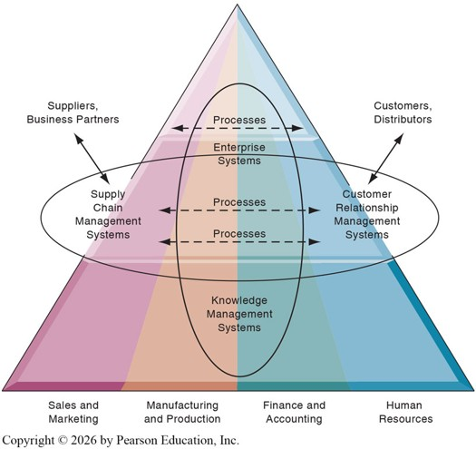
Enterprise Applications Overview
Enterprise Applications: Systems that coordinate activities, processes, and information across functions and levels of a firm.
ERP: Integrates internal business processes across functions into a single system.
SCM: Manages the flow of goods, information, and relationships with suppliers and partners.
CRM: Focuses on managing a firm’s interactions with current and potential customers.
KMS: Captures, organizes, and shares an organization’s knowledge and expertise.

Slide 36
Intranets and Extranets
Intranets and Extranets can be cheaper alternatives to Enterprise Applications.
An Intranet is a private, internal network that uses internet technologies to provide employees within an organization access to information, resources, and collaboration.
An Extranet is an extension of an intranet that allows authorized outsiders (suppliers, partners, or customers) to securely access parts of the organization’s information system.
Example: Marigold (formerly CM Group)
  Marketing technology company with 900+ employees across four continents
  Faced challenges with fragmented communication tools
  Adopted a unified intranet to improve information sharing and collaboration
  Achieved stronger collaboration, streamlined document management, and higher employee engagement.

Slide 37
Collaboration and
Social Business Systems

Slide 38
Collaboration
Collaboration is defined as working with others to achieve shared and explicit goals.
  It focuses on accomplishing a task or mission
  Typically occurs within organizations as well as between them
  Can be either short-lived or long-term in nature
  May involve bilateral or multilateral relationships
The importance of collaboration is ever growing as the business landscape changes.
  Changing nature of work
  Growth of professional work
  Changing organization of the firm
  Changing scopes of the firm
  Growing emphasis on innovation
  Changing culture of work and business

Slide 39
Collaboration
Changing Nature of Work
  Traditionally, each stage in the production process occurred independently of the others.
  Now, jobs of all kinds require much closer coordination.
Growth of Professional Work
  “Interaction” jobs tend to be professional jobs that require close coordination and collaboration.
  Each actor brings specialized expertise, and all actors must collaborate to solve problems.
Changing Organization of the Firm
  Traditionally, managers organized work in a hierarchical fashion with limited flexibility for workers.
  Now, jobs are typically organized in groups or teams, with more flexibility granted to individuals.
Notes:
Changing Nature of Work
e.g. Supply chain teams at Amazon must coordinate inventory management, warehouse operations, and last-mile delivery partners to ensure on-time fulfillment.
Growth of Professional Work
e.g. Investment banking deal teams at Goldman Sachs involves bankers, lawyers, and accountants coordinating to close a merger.
e.g. A consulting engagement at McKinsey requires collaboration between industry experts, data analysts, and client managers to deliver strategic recommendations
Changing Organization of the Firm
e.g. Google pioneered cross-functional “20 percent time” projects where employees could dedicate part of their workweek to passion projects. Gmail and Google News emerged from this model, showing how flatter team structures and individual autonomy can drive innovation.

Slide 40
Collaboration
Changing Scopes of the Firm
  Traditionally, firms heavily relied on serving their immediate vicinity or within country boundaries.
  Now, multinational firms must coordinate efforts on a global scale.
Growing Emphasis on Innovation
  Innovation is often viewed as a work of a single brilliant individual (e.g. Steve Jobs, Bill Gates, etc)
  In reality, most innovation comes from collaborative efforts of many talented individuals.
Changing Culture of Work and Business
  Research shows that diverse teams are more productive than individuals working on their own.
Notes:
Changing Scopes of the Firm
e.g. Starbucks operates in over 80 countries, adapting menus and supply chains to local tastes while maintaining a unified brand identity. This requires coordination between global headquarters and regional managers to balance consistency with localization.
Growing Emphasis on Innovation
e.g. Apple’s iPhone does owe much to its “inventor” Steve Jobs, but it was a collaborative effort between Apple’s engineers, and outside suppliers that enabled the launch of the product.
Changing Culture of Work and Business
e.g. Nadella emphasized a “growth mindset” and collaboration culture after replacing Steve Ballmer in 2014 and broke down silos between projects. Many cite this as the catalyst that revitalized innovation and made Microsoft one of the world’s most valuable firms again.

Slide 41
Social Business
Many firms today enhance and encourage collaboration by embracing Social Business.
Social business refers to the use of social networking platforms, as well as internal corporate tools, to engage employees, customers, and suppliers.
The goal is to deepen interactions and improve information sharing and decision-making.
  Social business fosters continued conversations between customers, suppliers, employees, management, and other stakeholders, strengthening relationships and increasing emotional involvement with the firm.
Effective social business requires a high degree of information transparency for conversations and feedback to be truly useful.
When implemented well, it can drive operational efficiency, spark innovation, and accelerate decision-making.

Slide 42
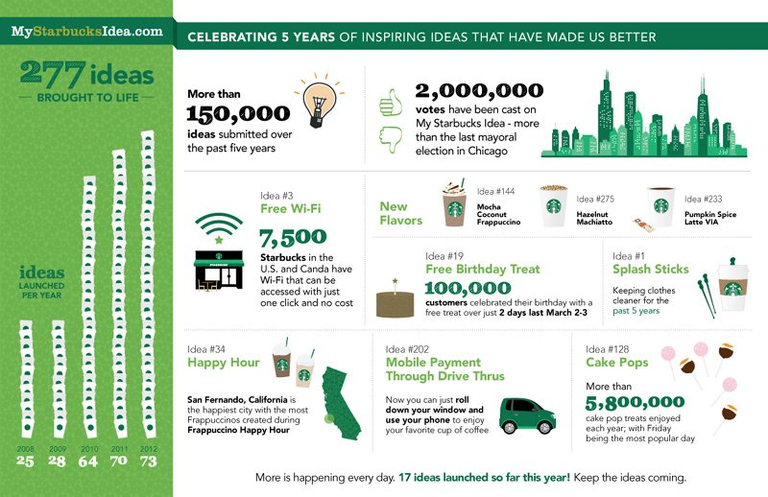
Social Business Showcase: “My Starbucks Idea”
Launched in 2008 and ran for approximately five years.
Gathered more than 150,000 customer ideas and over 2 million votes on submitted ideas.
Implemented 277 ideas, including:
  Free in-store Wi-Fi
  New drink flavors
  Cake pops
  …and more

Slide 43
Social Business Showcase: “My Starbucks Idea”
Customer Engagement
  Millions of users participated, making it one of the largest brand-customer collaborations of its time.
Implemented Ideas
  Examples included free Wi-Fi in stores, new drink flavors (like the Pumpkin Spice Latte tweaks), and eco-friendly practices (reusable cup discounts).
Brand Loyalty
  Customers felt their voices mattered, which deepened trust and emotional attachment to the brand.
However, engaging the internet exposes firms to the risk of opening decision-making too widely to the public without adequate guardrails.

Slide 44
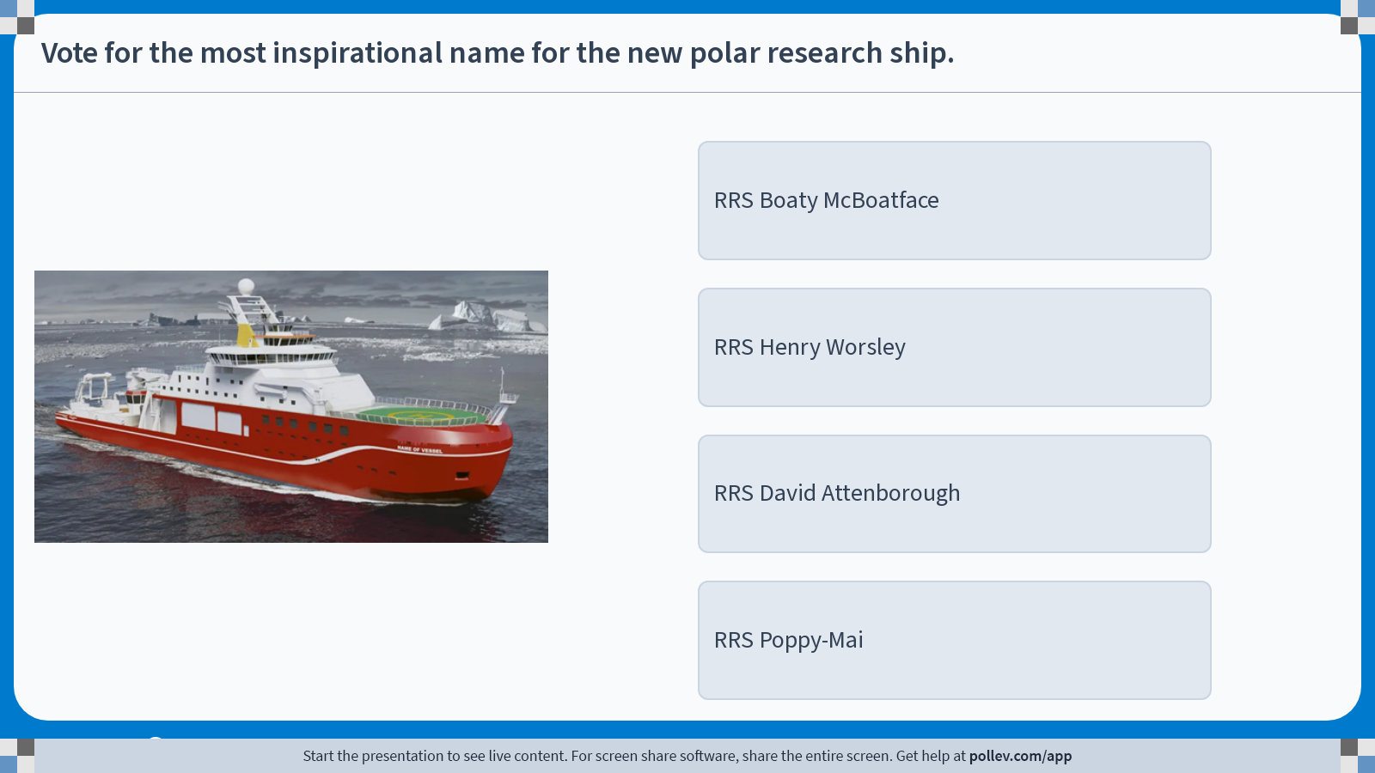
Poll Everywhere multiple choice poll instructions screen
Activity Title: Vote for the most inspirational name for the new polar research ship.
Slide 44
Notes:
Do not modify the notes in this section to avoid tampering with the Poll Everywhere activity.
More info at polleverywhere.com/support
Vote for the most inspirational name for the new polar research ship.
https://www.polleverywhere.com/multiple_choice_polls/dSFrQTbdKY0U5DWd9gOFR?display_state=instructions&activity_state=opened&state=opened&flow=Engagement&onscreen=persist

Slide 45
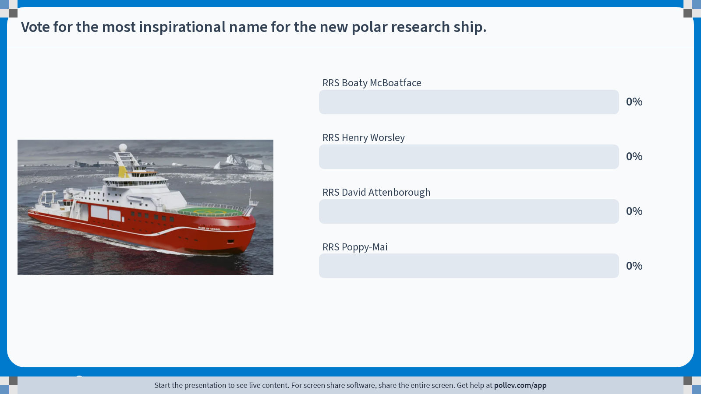
Poll Everywhere multiple choice poll chart screen
Activity Title: Vote for the most inspirational name for the new polar research ship.
Slide 46
Notes:
Do not modify the notes in this section to avoid tampering with the Poll Everywhere activity.
More info at polleverywhere.com/support
Vote for the most inspirational name for the new polar research ship.
https://www.polleverywhere.com/multiple_choice_polls/dSFrQTbdKY0U5DWd9gOFR?display_state=chart&activity_state=closed&state=closed&flow=Engagement&onscreen=persist

Slide 46

RRS Boaty McBoatface?
31% of all votes went to Boaty McBoatface.
Other options that garnered many votes:
  RRS It’s Bloody Cold Here
  RRS Usain Boat
  RRS What Iceberg?
  RRS Boatimus Prime
  …and many more silly suggestions
But the NERC decided to name the vessel RRS Sir David Attenborough.
Firms should be careful when engaging the internet.

Slide 47

Björn Borg’s “Weapons of Mass Seduction”

Slide 48
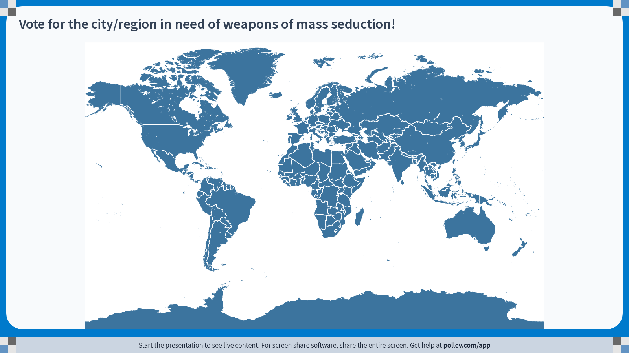
Poll Everywhere clickable image activity
Activity Title: Vote for the city/region in need of weapons of mass seduction!
Slide 48
Notes:
Do not modify the notes in this section to avoid tampering with the Poll Everywhere activity.
More info at polleverywhere.com/support
Vote for the city/region in need of weapons of mass seduction!
https://www.polleverywhere.com/clickable_images/fQ0i971vRavQ0CVyUXhJ0

Slide 49
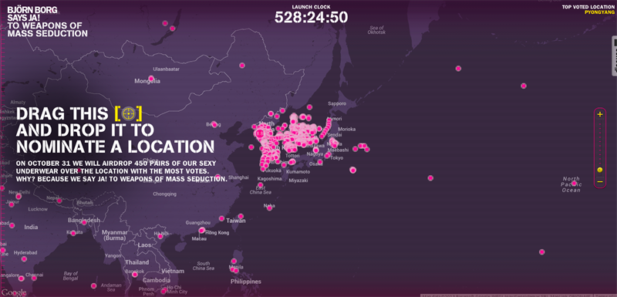
Björn Borg’s “Weapons of Mass Seduction”

Slide 50

Björn Borg’s “Weapons of Mass Seduction”

Slide 51
Social Business
Some commonly used applications (with some examples) of social business include:
  Social networks: LinkedIn, Facebook
  Crowdsourcing: Starbucks’ My Starbucks Idea, Dell’s IdeaStorm
  Shared workplaces: Slack, Microsoft Teams
  Blogs and wikis: WordPress, Wikipedia
  Social commerce: Facebook Marketplace, Etsy
  File sharing: Dropbox, Google Drive
  Social marketing: Nike’s #JustDoIt, Coca-Cola’s Share a Coke
  Communities: Reddit forums, SAP Community Network
The general consensus, supported by academic research, is that firms that are more collaborative tend to be more successful.

Slide 52
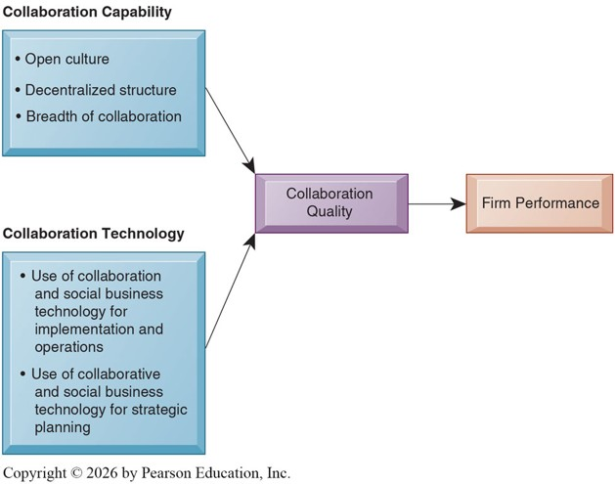
Caveats of Collaboration
Yet, many firms that claim to be collaboration-oriented still fail to meet their goals.
True collaboration requires both:
  Technology: The tools that enable coordination and information sharing.
  Capability: The values, practices, and structures that support openness and teamwork.

Slide 53
Collaboration Tools
There are various tools that are used to enable collaboration, some expensive, but others are available online for free.
Email and Instant Messaging
Collaboration Platforms
  Virtual Meeting Systems
  Cloud Collaboration Services
Human-AI Collaboration
  Interactions between humans and AI systems.
  Combine their respective complementary strengths to achieve goals.

Slide 54
Social Business Tools
Tools for collaboration can be used to support social business, but there are also specialized tools designed for this purpose.
Enterprise Social Networking Tools
  These tools create business value by connecting members of an organization through features such as:
    Profiles: Share member information, interests, and specialties.
    Content Sharing: Store, manage, and distribute content.
    Feeds and Notifications: Provide real-time updates and announcements.
    Groups and Team Workspaces: Collaborate and coordinate on projects.
    Tagging and Social Bookmarking: Organize, classify, and indicate preferences.
    Permissions and Privacy: Secure sensitive information within the right circles.
  e.g. Salesforce Chatter, Microsoft Viva Engage, etc.
Virtual Worlds
  Online 3D environments populated by avatars that allow interaction, training, and simulation.

Slide 55
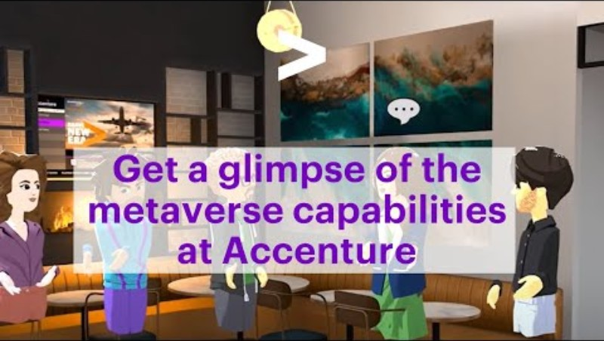
Social Business Tools: Accenture’s Virtual Offices

Slide 56
Social Business Tools: Accenture’s Virtual Offices
To support onboarding, Accenture created a virtual campus called the Nth Floor.
Employees, represented by avatars, could walk around virtual offices, attend training, meet colleagues, and collaborate in simulated environments.
By 2022, Accenture had distributed tens of thousands of VR headsets to new hires globally to enable access.
Helped onboard over 150,000 employees in a shared virtual space, reducing isolation and fostering a sense of culture and community across global offices.
Firms experiment with immersive technologies to extend collaboration beyond traditional digital tools.

Slide 57
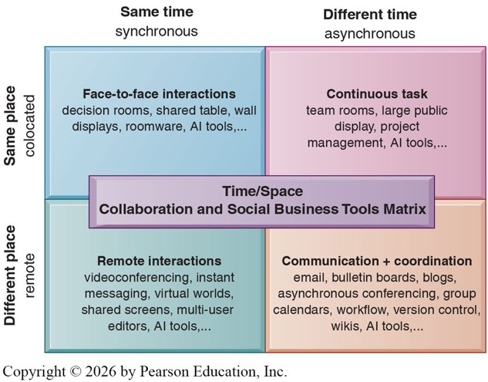
Evaluating Collaboration and Social Business Tools
With so many tools available, how can a manager choose the right one for their firm?
The Time/Space Collaboration Tool Matrix provides a framework to begin evaluating which tools best fit the firm’s needs.
For example, coordinating between offices in Chicago and Singapore may make videoconferencing difficult, suggesting the need for asynchronous collaboration tools.

Slide 58
Evaluating Collaboration and Social Business Tools
Six steps in evaluating software tools:
  Identify your firm’s collaboration challenges
  Identify what kinds of solutions are available
  Analyze available products’ cost and benefits
  Evaluate security risks
  Consult users for implementation and training issues
  Evaluate product vendors
In addition to selecting the right tools for collaboration, organizations must also ensure that the necessary knowledge for collaboration, decision-making, and ongoing operations is readily available.

Slide 59
Knowledge Management Systems

Slide 60
Knowledge Management
Knowledge Management refers to the processes developed in an organization to create, collect, store, maintain, and disseminate the firm’s knowledge.
Knowledge-based Core Competencies are the few things that an organization does exceptionally well, giving it a competitive advantage.
  A unique build-to-order production system (Dell’s direct-to-consumer model)
  Proprietary algorithms (Netflix’s viewing data analytics and recommendations)
  World-class logistics and supply chain system (Amazon’s fulfillment network)
  Highly efficient manufacturing process (Toyota’s lean production system)
Types of Knowledge
  Structured Knowledge: Knowledge in the form of structured documents and reports.
  Tacit Knowledge: The expertise and experience of members that has not been formally documented.
  Explicit Knowledge: Knowledge that has been documented

Slide 61
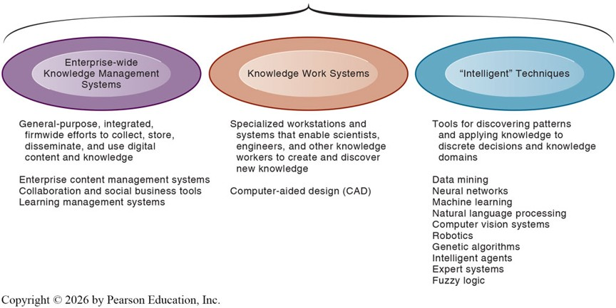
Knowledge Management Systems
KMS provide capabilities for storing and searching for all of these different types of knowledge, and for locating employee expertise within the firm.

Slide 62
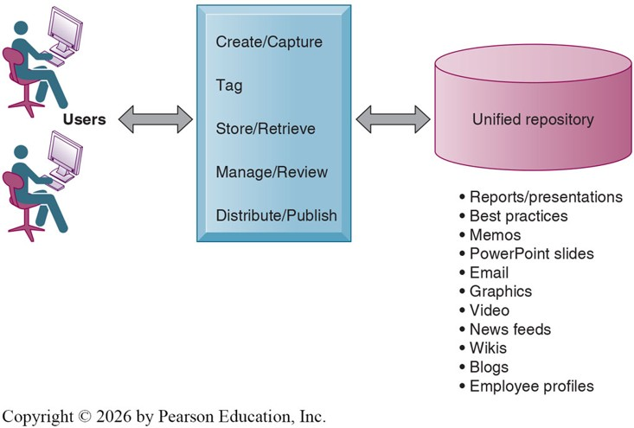
Enterprise-wide KMS
Enterprise Content Management (ECM) Systems
  Information systems that collect and manage structured, semi-structured, and unstructured types of information.
  Provide a unified repository for documents, reports, presentations, and best practices.
  Include taxonomy capabilities to organize and classify knowledge in meaningful ways, making it easily accessible.

Slide 63
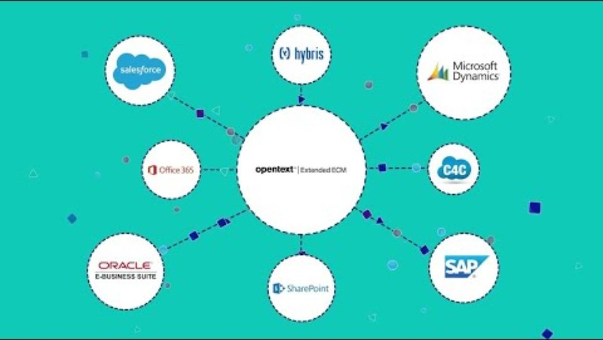
Enterprise Content Management: OpenText

Slide 64
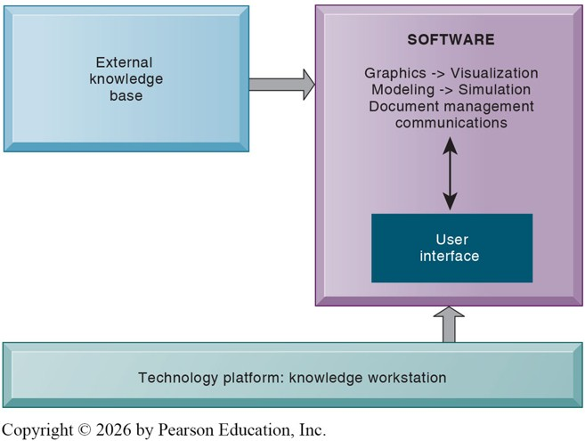
Knowledge Work Systems
Knowledge Work Systems (KWS) are information systems that aid knowledge workers in discovering, creating, and integrating new knowledge into the organization.
The software is the central component of the workstation.
Systems are highly specific to the type of work.
  CAD for engineers and architects.
  Tableau for BI specialists.
  …and many more.

Slide 65
Information Systems Function
To support these systems, firms require specialized workers who can maintain and manage them effectively.
Information Systems (IS) Department:
  A formal organizational unit responsible for information technology services within the organization
  Maintains the hardware, software, data storage, and networks that comprise the firm’s IT infrastructure
  Provides technical support and ensures system reliability, security, and scalability
  Works closely with business units to align IT resources with organizational goals
IT Governance
  Refers to the strategy and policies for using information technology within an organization
  Defines decision rights and accountability to ensure IT investments support business objectives
  Balances innovation and efficiency while addressing risk management, compliance, and security requirements

Slide 66
Recap of Chapter 2

Slide 67
Recap of Chapter 2
How do business processes relate to information systems?
How does information systems serve different management groups?
How do enterprise applications improve firm performance?
What are collaboration tools?
What are social business tools?
How can managers evaluate collaboration and social business tools?
What are knowledge management systems?
What is the role of the information systems function?

