Slide 1
MANAGEMENT INFORMATION SYSTEMS
Chapter 1: Information Systems in Global Business Today

Slide 2
Updated Policies: Homework
Homework will primarily consist of take-home problem sets, with the possibility of substitution by case study essays.
Assignments will be given roughly weekly, with the first due by the end of the third week of the term.
Students will typically have one week to complete a problem set, with assignments due on the same day of the following week.
If a homework assignment is replaced with a longer case study essay, the deadline may be extended.

Slide 3
Why should we care about MIS?

Slide 4

WCPO 9. (2012, February 20). Target knows when you're pregnant [Video].
YouTube. https://youtu.be/XH1wQEgROg4

Slide 5
What are Management Information Systems?
Management Information Systems (MIS) permeate our everyday lives.
For instance, did you ever participate in any of the following activities last month?
  Transferred funds online?
  Placed a food delivery order?
  Applied for an internship?
  Shopped online?
  Booked an airline ticket?
If you answered yes to any of these questions, you interacted with MIS.

Slide 6
How MIS Transform Business
“If a business is not using information systems,
chances are it isn’t being as effective as it could be.”
Between 2019 and 2023, firms spent more than $20 trillion on information technology and IT services worldwide
An extra $5 trillion investment estimated in 2024.
Nearly 2.9 billion people worldwide is expected to engage in online shopping.
2/3 of all retail e-commerce revenue to be generated by people using mobile devices.

Slide 7
How MIS Transform Business
Embracing information systems enables firms to track consumer demand accurately and optimize supply chains.
With the rise of social media, companies also need effective online customer relationship programs.
Digital advertising spending, projected to reach $900 billion worldwide, requires firms to improve the targeting of advertisements.
The vast amounts of data generated each day (estimated at 330 million terabytes) must be processed and safeguarded to support efficient operations.
Artificial intelligence is the latest technology transforming businesses, although the full extent of its impact is not yet fully understood.

Slide 8
How MIS Transform Careers
MIS is reshaping jobs and careers: how, where, when we work, and how much we earn.
Millions of new jobs created, not just in IT or software engineering.
A 2023 study (43M job postings, 2021 data) shows:
  95% of entry-level jobs require digital skills.
  92% of all jobs require digital skills.
  Workers with at least one digital skill earned, on average, 23% more than those without.
  Workers moving from non-digital jobs to digital jobs earned, on average, 45% more.
In short, individuals who understand and work effectively with technology enjoy a significant advantage in today’s labor market.
MIS is an innovative force with both challenges and opportunities.

Slide 9
Challenges & Opportunities: Cloud Computing
Cloud computing refers to the use of remote servers hosted on the internet to store, manage, and process data, rather than relying on local servers or personal computers.
Cloud computing is increasingly popular among both firms and individuals.
  Salesforce manages customer data and sales pipelines.
  OneDrive or Google Drive is used to share important documents.
  R&D often relies on remote access to powerful computing devices not owned by a firm.
Cloud computing offers scalability, cost savings, and global accessibility.
However, it can also create dependency on providers and raise security concerns.
Challenge: How much should an organization offload to cloud providers?

Slide 10

Salesforce. (2021, September 7). What is CRM and how does it work? [Video].
YouTube. https://youtu.be/SlhESAKF1Tk

Slide 11
Challenges & Opportunities: Big Data
Big Data refers to extremely large datasets that can be analyzed computationally to uncover patterns, trends, and associations, often related to human behavior.
IoT is a network of physical objects connected to the internet and equipped with sensors, software, and other technologies to collect and exchange data.
Big Data and the Internet of Things (IoT) are reshaping the business landscape.
  Amazon, Walmart, Target process vast amounts of data to better target consumer behavior.
  Airlines employ data analysts to offer different prices to different consumers to maximize revenue.
However, having access to vast amounts of data does not necessarily mean it will be used effectively.
Challenge: Can firms analyze and process data in ways that generate real value?

Slide 12

Uber. (2018, November 30). How surge pricing and the Uber marketplace work [Video].
YouTube. https://youtu.be/6JZ6yjJprok?si=MQoDcHSCPf2oU86C

Slide 13
Challenges & Opportunities: AI
AI refers to the simulation of human intelligence in machines, enabling systems to perform tasks that typically require human cognitive abilities.
Artificial Intelligence is one of the most recent forces transforming the business landscape.
AI can increase efficiency and productivity, reduce costs, and provide services around the clock.
At the same time, it may displace jobs, involve high upfront costs, and raise privacy concerns.
Challenge: What are the boundaries of AI, and what are its associated costs, benefits, and risks?

Slide 14
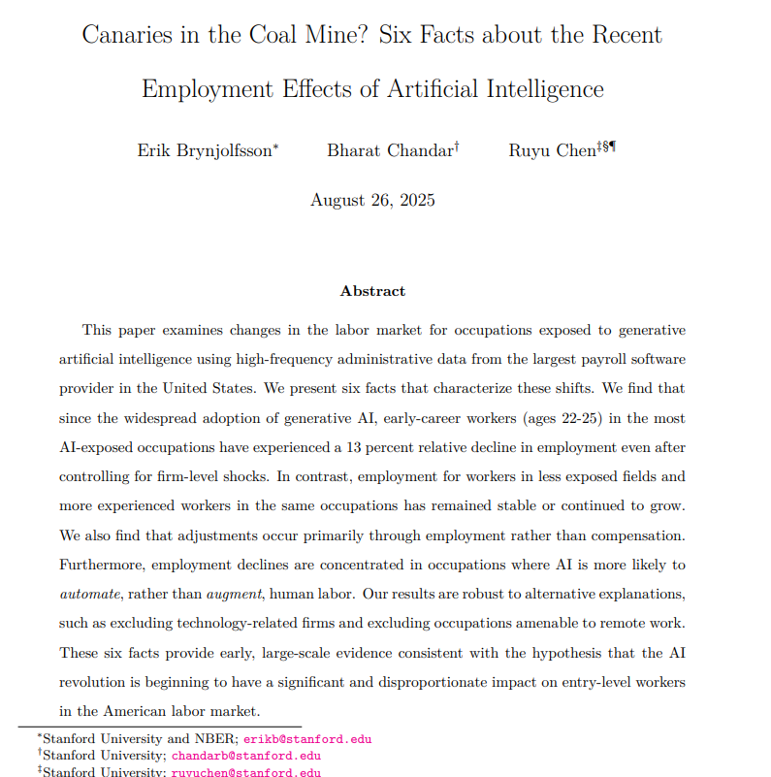
The Impact of AI on the Labor Market
The adoption of AI in business has significant implications for the future of labor markets.
A recent study by researchers at Stanford University found that:
  Workers aged 22 to 25 in fields most exposed to AI experienced a 13% decline in employment.
  More experienced workers, or those in fields less affected by AI, tended to see benefits.
  Employment declines were concentrated in occupations where AI is more likely to automate rather than augment human labor.

Slide 15
Challenges & Opportunities: Globalization
Globalization refers to the flow of goods, services, capital, people, and ideas across international boundaries.
Driven largely by advances in information technology, globalization has reached levels unimaginable just a few decades ago.
  An estimated 35% of revenue of Fortune 500 companies generated overseas.
  World trade accounts for about 60% of all global economic activity.
Globalization offers firms opportunities such as access to cheaper labor and a larger consumer base.
Challenge: It can also invite increased levels of competition for your own firm.

Slide 16
Other Key Challenges and Opportunities
Rising popularity of mobile devices.
Understanding the true ROI of MIS investments.
Facilitating efficient online collaboration.
Addressing security and privacy concerns.
Adapting to social networking platforms.
Deciding how and when to accommodate hybrid work.
…and many more that we don’t expect.

Slide 17
The Rise of the Digital Firm
The new opportunities we just discussed made the Digital Firm a possibility.
A Digital Firm is defined as an organization where…
  Nearly all significant business processes and relationships with customers, suppliers, and employees are digitally enabled, and
  Key corporate assets are managed through digital means.
More simply, a digital firm is an organization in which Core Business Processes are accomplished through digital means.
Business Processes refer to the unique ways in which organizations coordinate and organize work activities, information, and knowledge to produce a product or service.
  Developing new products, filing an order, hiring employees, etc.
  Details to be discussed in future lectures.

Slide 18
The Rise of the Digital Firm
Key Corporate Assets include intellectual property, core competencies, and financial and human resources.
A digital firm’s primary competitive advantage over traditional counterparts lies in its greater flexibility in organization and management.
For example, in digital firms, time shifting and space shifting are common:
  Time shifting: Business can be conducted 24/7 rather than limited to a typical 9-to-5 schedule.
  Space shifting: Business can be conducted anywhere in the world rather than confined to a physical office.
Because of these benefits, many firms pursue Digital Transformation; large-scale change efforts aimed at capturing the advantages of digital technologies.

Slide 19
Business Objectives of Information Systems
There is a growing interdependence between:
  A firm’s ability to use information technology, and
  Its ability to implement corporate strategies and achieve goals.
Changes in strategy, rules, and business processes typically require changes in Software, Hardware, Data Management, Networking and Telecommunications.
Firms invest in information systems to achieve six strategic business objectives:
  Operational Excellence: Improved Efficiency and Higher Profitability
  New Business Models, Products, Services: Creating New Markets
  Customer and Supplier Intimacy: Knowing Your Customers and Letting them Know You.
  Improved Decision Making: Rely Less on Luck and Instincts, More on Clear Information
  Competitive Advantage: Doing Things Better than the Competition
  Survival: Self-explanatory

Slide 20
Business Objectives of Information Systems
Operational Excellence & Improved Decision Making:
  Walmart relies on its Retail Link and Global Replenishment System that links suppliers to its Walmart stores worldwide and informs them of replacement shipment requirements in real-time.
New Business Models, Products, and Services:
  Netflix, which started as a DVD-by-mail service competing with Blockbuster, transitioned to a streaming platform with personalized recommendations and global accessibility.
Customer and Supplier Intimacy:
  High-end hotels such as the Ritz-Carlton or Four Seasons use information systems to track its customers’ tastes (e.g. room temperature) so that other locations can offer a personalized service.
Competitive Advantage & Survival

Slide 21
Case Study: Southwest Airlines
Brief background:
  Southwest Airlines canceled thousands of flights during the 2022 holiday season. While bad weather triggered the crisis, the root cause was the airline’s outdated crew scheduling and information systems, which couldn’t handle the disruption.
How bad can things get when information systems fail?
Could an information system failure be worse than equipment failure?
Think about these questions:
  Which MIS failures are highlighted?
  What is the impact on the brand and customer relations?
  How (if at all possible) could this have been avoided?

Slide 22
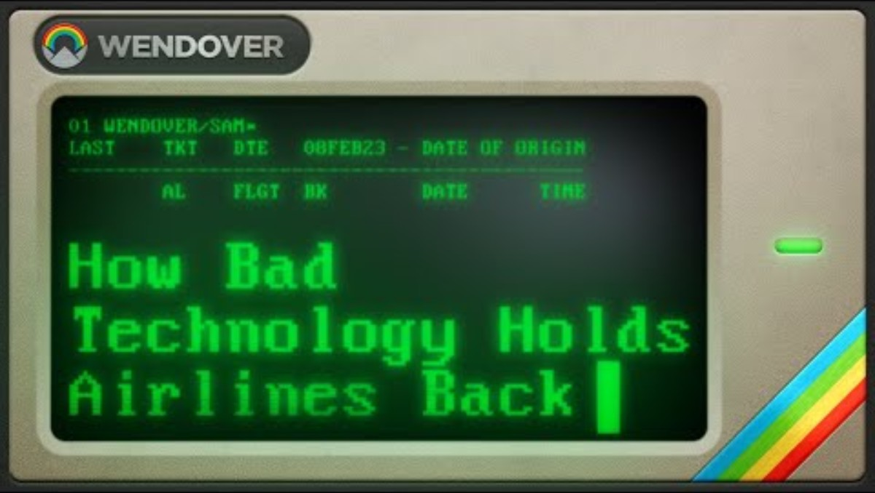
Wendover Productions. (2023, January 5). The airline industry’s problem with absolutely ancient IT [Video]. YouTube. https://youtu.be/1-m_Jjse-cs?si=0sMcoYV_Eg-ofYKa

Slide 23
Case Study: Southwest Airlines
Highlighted Failures:
  Outdated systems
  Lack of integration with real-time operations and crew scheduling
  Limited scalability
  Poor information visibility
What is the impact on the brand?
  Frustrated customers
  Massive financial costs
  Damage to reputation
  Customer retention

Slide 24
What is MIS?

Slide 25
What is a Management Information System?
Management
  How to run an organization well.
  The process of achieving organizational goals by overseeing the functions of an organization.
  Involves planning, organizing, leading, and controlling various aspects of the organization.
Information
  Interpretation of data that is useful in decision making.
  Data: Raw unprocessed facts which is not immediately useful in decision making.
  Information: Processed data that provides insight useful for decision making.
Systems
  Collection of components that are interconnected to accomplish a task.

Slide 26
What is a Management Information System?
Information Systems (IS)
  A system that gathers data and distributes information to its users to aid in decision making.
Management Information System
  An information system that analyzes an organization’s data to produce useful information based on which the manager(s) can make the optimal decisions for the organization.
Relation to Information Technology
  The hardware and software a business uses to achieve objectives.
“If an information system is like a house, the computers
and software are the raw materials and power tools used to build it.”

Slide 27
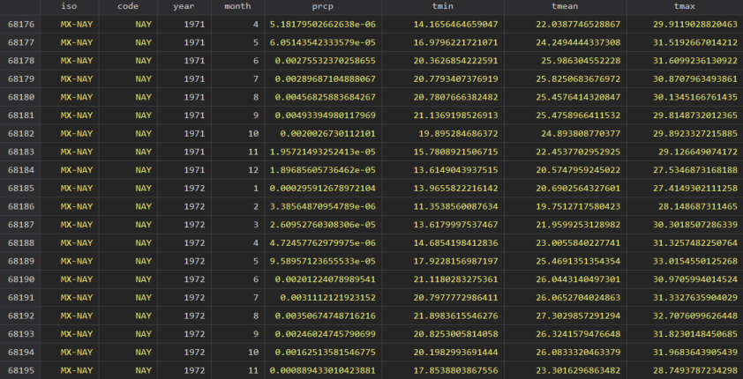
Data
Example of Data: Monthly Rainfall, Temperature Observations in Mexico

Slide 28
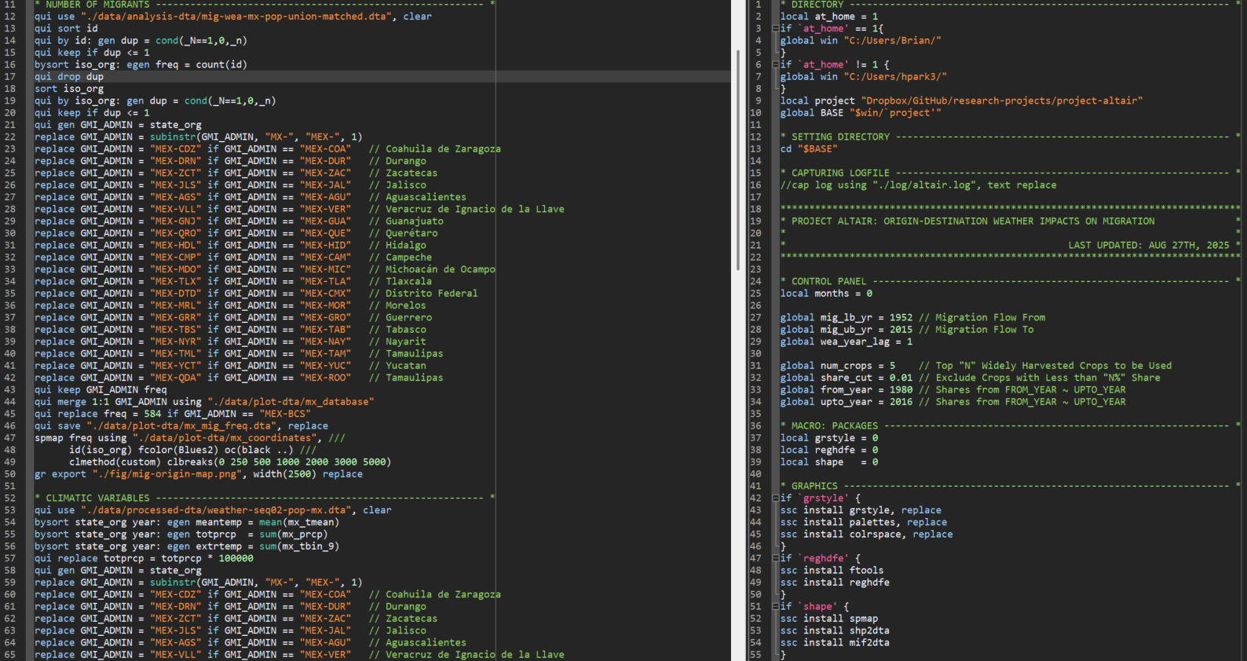
Information System
Example of Information System: Coding to Transform Data into Information

Slide 29
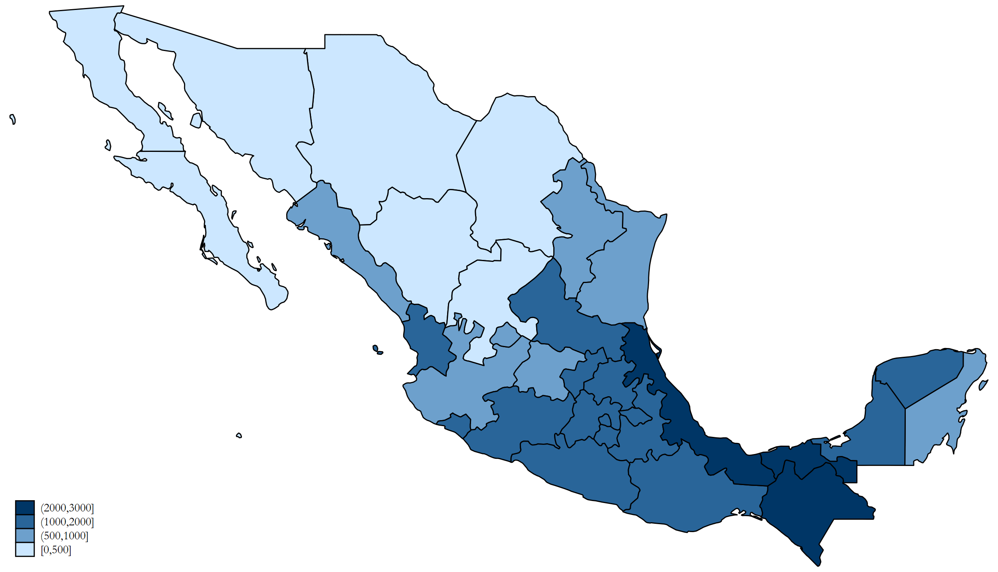
Information
Example of Information: Climate Data Map

Slide 30
How Information Systems Work
The examples illustrate only a small portion of each step in the function of an information system.
Activities in an information system that produce information include:
  Input: Collecting raw data for processing.
  Processing: Converting and analyzing input into a more meaningful form.
  Output: Distributing processed information to those who need it.
  Feedback: Returning output to the system to help evaluate or adjust the input stage.
Information systems do not operate in a vacuum. They are influenced by environmental factors such as Shareholders, Competitors, Customers, Suppliers, and Regulators

Slide 31
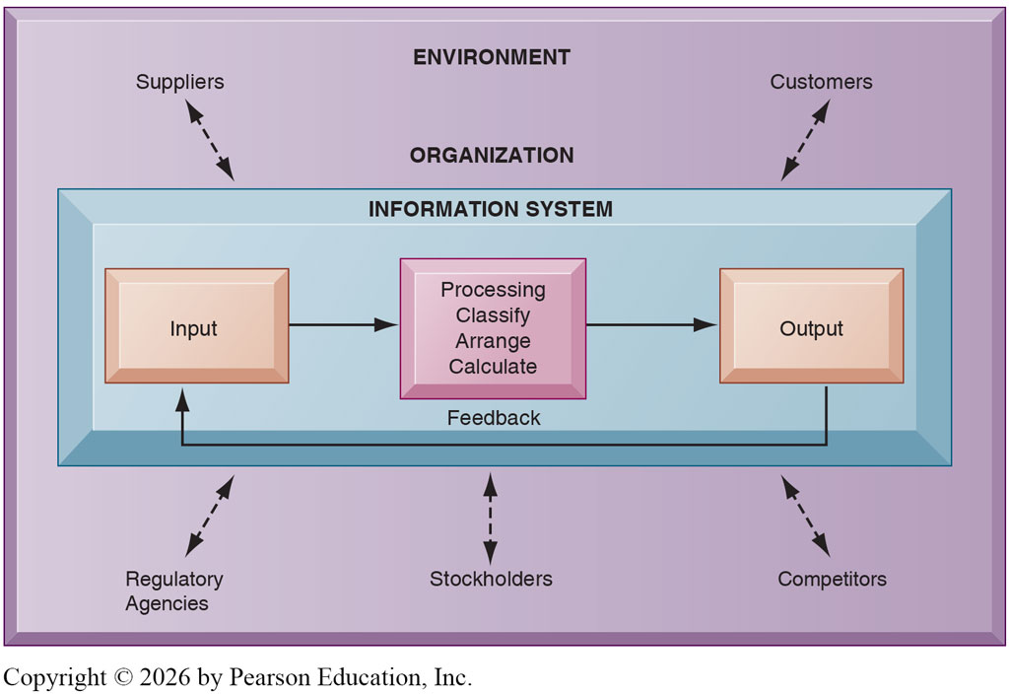
How Information Systems Work

Slide 32
The Role of Management and Organizations
Information system literacy is often mistaken for computer literacy.
  Computer literacy: Knowledge of information technology and an understanding of how computer-based technologies work.
  Information system literacy: A broader understanding of information systems that includes organizational, behavioral, and technical aspects of computers.
To fully understand information systems, we must consider three key dimensions:
  Managerial Dimension
  Organizational Dimension
  Technology Dimension
MIS is the study of information systems literacy within a business context.

Slide 33
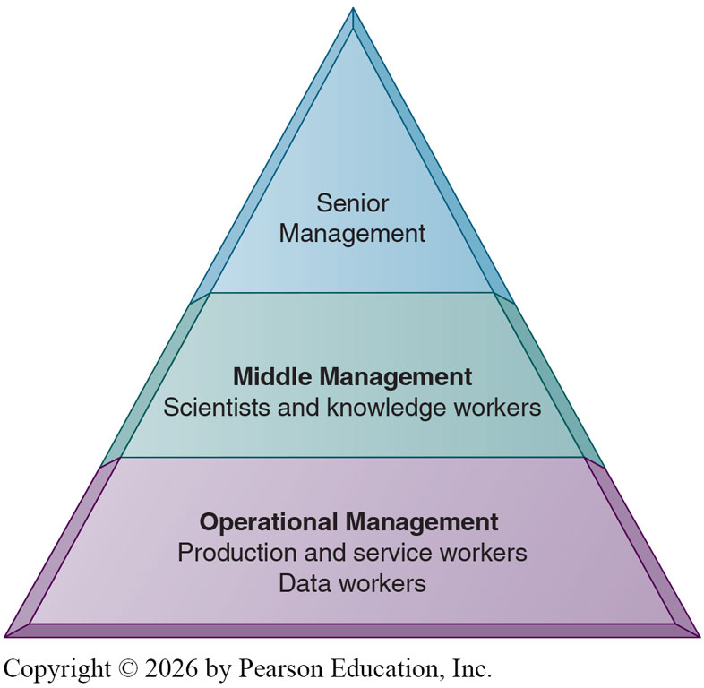
The Organizational Dimension
Organizations have a structure made up of a hierarchy of authority and responsibilities.
Senior management is responsible for long-range strategic decisions.
Middle management implements the programs and plans of senior management.
  Knowledge workers: Create knowledge for the firm.
Operational management oversees the daily activities of the business.
  Data workers: Assists with administrative work.

Slide 34
The Organizational Dimension
An organization can also be broken down to its distinct business functions.
  Sales and Marketing: Selling the firm’s products and services.
  Human Resources: Attracting, developing, and maintaining the workforce.
  Finance and Accounting: Managing financial assets and maintaining its records.
  Manufacturing and Production: Producing and delivering products and services.
Organizations also have a unique culture - a set of assumptions, values, and ways of doing things that MIS reflects.
No matter how we divide the organization, MIS plays a crucial role in each dimension.
More on how this happens will be discussed in future lectures.

Slide 35
The Managerial Dimension
The primary functions of a manager are to:
  Analyze: Make sense of organizational situations and environmental challenges
  Decide: Choose strategies and formulate action plans
  Act: Implement decisions and solve problems
  Innovate: Create new products, services, and reshape the organization when needed
A substantial part of management is creative work, driven by new knowledge and information.
Information systems play a powerful role in supporting managers in these duties.
More on how this happens will be discussed in future lectures (most likely latter half).

Slide 36
The Technology Dimension
Information technology is one of the many tools managers use to cope with change and complexity. Examples include:
  Computer hardware: The physical equipment used to sustain the information system.
  Computer software: The preprogrammed instructions that control the computer hardware.
  Data management technology: The software governing the organization of data.
  Networking technology: Physical devices and software that link various computers together.
Together with the people who manage them, these technologies make up the organization’s IT infrastructure.
The IT infrastructure provides the platform on which the firm builds its information systems.

Slide 37
The Importance of Complementary Assets
Firms invest substantial amounts of money in improving and maintaining their IT infrastructure, where the assumption is that such investments will generate greater returns than money spent elsewhere.
In reality, the returns on IS investments vary widely across firms.
A key factor that determines ROI is the presence of Complementary Assets, resources required to derive value from a primary investment.
Investment in IT alone cannot make organizations or managers more effective unless it is accompanied by supportive values, structures, and behavioral patterns.
For instance, a consumer may purchase a brand-new electric vehicle, but if there is no EV charger, well paved roads, or even a drivers license, that investment does not make sense.

Slide 38
The Importance of Complementary Assets
Organizational Assets
  Supportive corporate culture that values data-driven decision-making
  Efficient business processes aligned with new technology
  Decentralized authority and flexible structures enabling IT-driven change
Managerial Assets
  Strong support from senior management
  Incentive systems that encourage innovation and training for IS adoption
  Clear vision and strategic alignment between IS and business goals
Social Assets
  Adoption of technology standards and supportive regulation
  Skilled workforce
  Strategic partnerships

Slide 39
Approaches in Studying MIS
There are two broad approaches to studying MIS: Technical and Behavioral.
The Technical Approach
  Emphasizes mathematical models, physical technology, and formal system capabilities
  Disciplines: Computer Science, Operations Research, Management Science
The Behavioral Approach
  Focuses on the human and organizational aspects of information systems rather than technical details
  Examines how systems affect individuals, groups, and organizations
  Disciplines: Sociology, Economics, Psychology, Political Science
In this course, we will take a middle-ground, or “sociotechnical,” view, recognizing that systems consist of both technical and social elements.

Slide 40
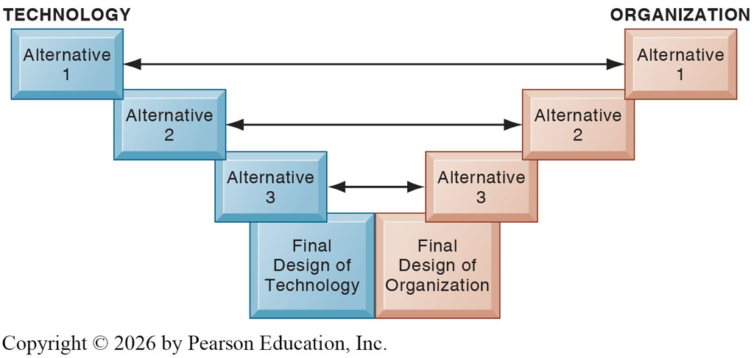
Approaches in Studying MIS

Slide 41
Recap of Chapter 1

Slide 42
Recap
How does IS transform businesses and careers?
What are the key challenges and opportunities created by new MIS technologies?
What are the key features of a digital firm?
What are the business objectives of information systems?
What is an information system, and how does it work?
What are the organizational, managerial, and technological dimensions of IS?
Why are complementary assets important?
What are the approaches in studying IS?

