Slide 1
MANAGEMENT INFORMATION SYSTEMS
Chapter 0: Introduction

Slide 2
Announcements: About Me
Brian H. Park
First year at Concordia College
Ph.D. in Applied Economics and Management, Cornell University
B.A. in Economics, Korea University
Research Interests
  Environmental Economics and Demographic Economics
  Climate Change and Migration Pattern of Agricultural Workers
  Interactions of Border Enforcement Policies and International Migration
  Influence of Pop Culture on Fertility Intent of Married Couples

Slide 3
Announcements: Contact
Email: HPARK3@cord.edu
  Please include BUSN315 in the subject line, and my target response is within 1 business day.
Office: Grant Center 101
Regular Office Hours
  Mondays & Wednesdays 10:30 AM to 12:30 PM, and
  By appointment via Calendly
Calendly: calendly.com/brianhwpark
  Book on-demand office hours in 15-minute increments
  Calendar opens 10 days in advance, with a minimum of 90 minutes notice
  For longer sessions, you may book 2~3 sessions in a row
    e.g. Book a session at 2:00 PM, and another at 2:15 PM for a meeting from 2:00 PM through 2:30 PM.

Slide 4

Announcements: Textbook
Management Information Systems: Managing the Digital Firm
18th Edition
Laudon, Laudon, Traver
Pearson
Lecture notes to be distributed over Moodle
Previous editions are acceptable

Slide 5
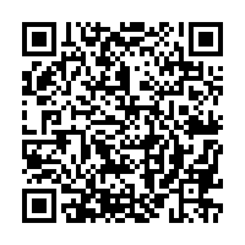
Announcements: PollEverywhere
This is a QR code to PollEverywhere, an online polling system.
  Please scan the QR code and have your device ready as there will be a few in-class exercises.
  If you do not have access to your mobile device, log in using the URL below:
  Your responses are anonymous and not be used in grading.
https://pollev.com/brianpark046

Slide 6
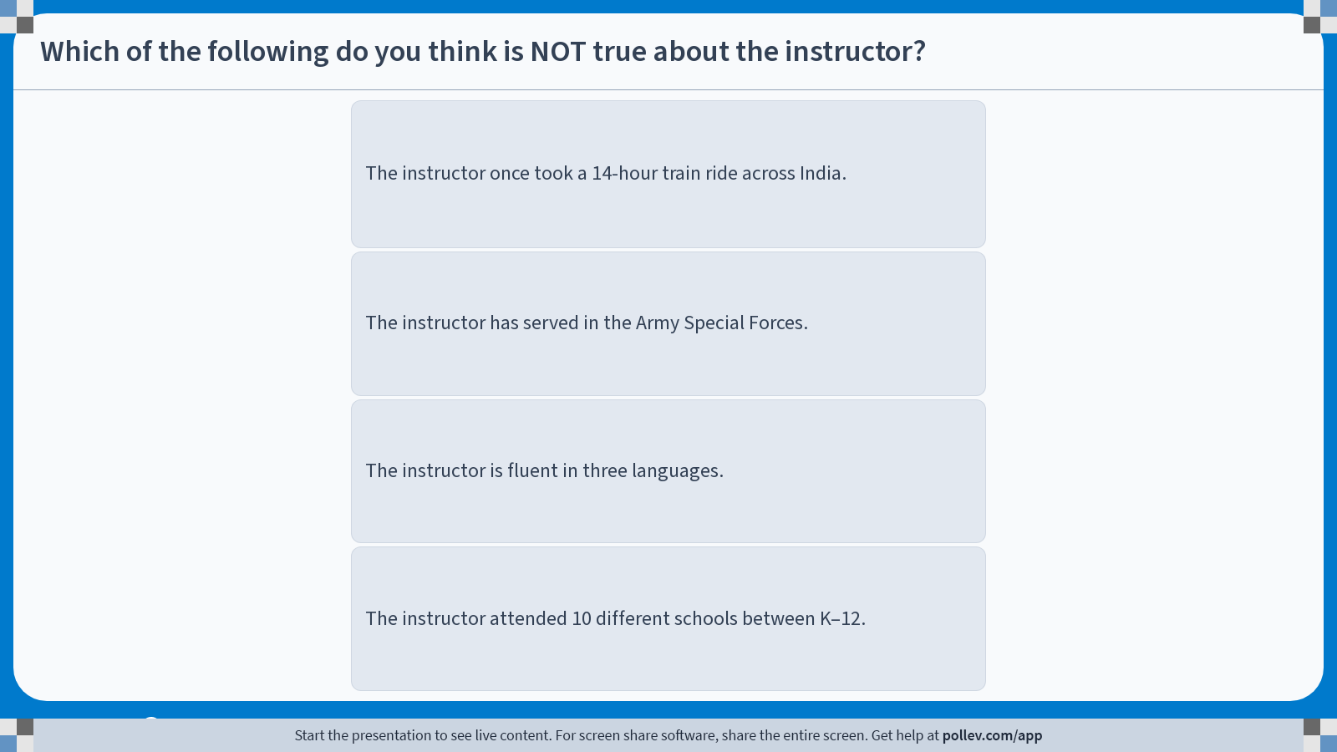
Poll Everywhere multiple choice poll instructions screen
Activity Title: Which of the following do you think is NOT true about the instructor?
Slide 6
Notes:
Do not modify the notes in this section to avoid tampering with the Poll Everywhere activity.
More info at polleverywhere.com/support
Which of the following do you think is NOT true about the instructor?
https://www.polleverywhere.com/multiple_choice_polls/9dCAEjDoSTcrselUyEGYu?display_state=instructions&activity_state=opened&state=opened&flow=Engagement&onscreen=persist

Slide 7
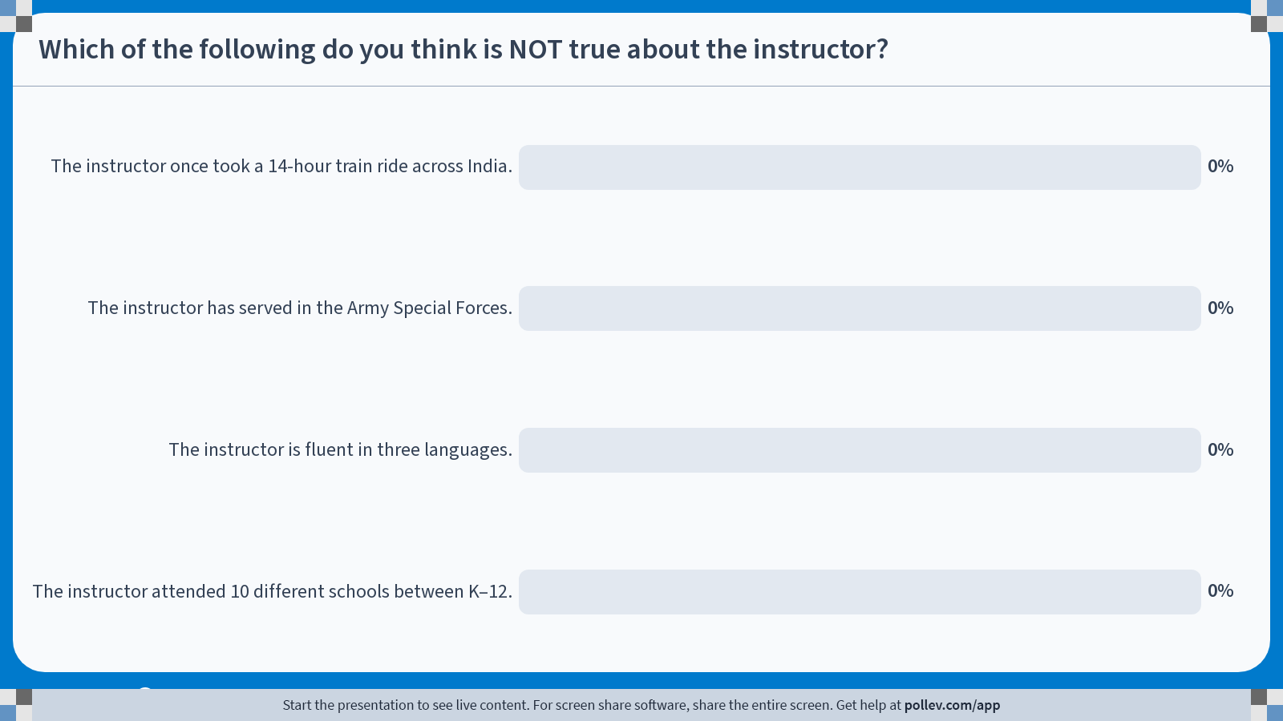
Poll Everywhere multiple choice poll chart screen
Activity Title: Which of the following do you think is NOT true about the instructor?
Slide 8
Notes:
Do not modify the notes in this section to avoid tampering with the Poll Everywhere activity.
More info at polleverywhere.com/support
Which of the following do you think is NOT true about the instructor?
https://www.polleverywhere.com/multiple_choice_polls/9dCAEjDoSTcrselUyEGYu?display_state=chart&activity_state=closed&state=closed&flow=Engagement&onscreen=persist

Slide 8
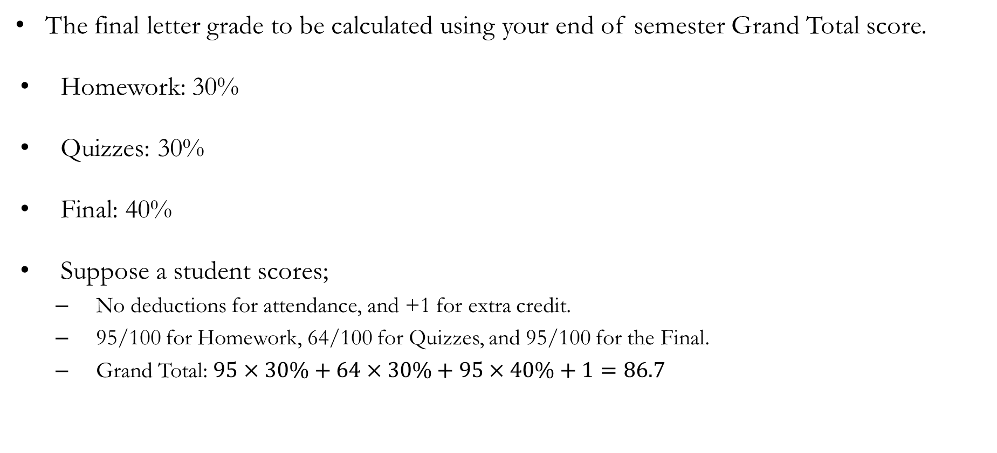
Policies: Grading
The final letter grade to be calculated using your end of semester Grand Total score.
Homework: 30%
Quizzes: 30%
Final: 40%
Suppose a student scores;
  No deductions for attendance, and +1 for extra credit.
  95/100 for Homework, 64/100 for Quizzes, and 95/100 for the Final.
  Grand Total: $95×30\%+64×30\%+95×40\%+1=86.7$

Slide 9
Policies: Attendance
Attendance may be checked at the beginning of each class session.
Attendance after the first 15 minutes of a class session will count as one-half of an absence.
Each student is permitted one unexcused absence per calendar month without penalty.
For every two unexcused absences, 3 points will be deducted from the Grand Total score.
Six or more unexcused absences may result in a failing grade, at the instructor’s discretion.
The criteria for determining whether an absence is excused or unexcused will follow Concordia College policy, with final discretion resting with the instructor.

Slide 10
Policies: Homework
Homework will primarily consist of Pearson MyLab assignments, with occasional substitutions of case study essays.
  Course Code for Mon & Wed section: park08214
  Course Code for Tue & Thu section: park07345
Homework assignments will be given roughly weekly, with the first assignment due by the end of the third week of the term.
If homework assignments are replaced with an essay, students may be allowed to work in groups of up to three.
TO BE UPDATED BY
NEXT CLASS SESSION

Slide 11
Policies: Quizzes
Up to 4 closed-book, in-class quizzes will be administered throughout the semester.
Quizzes will include a mix of multiple-choice, short-answer, and essay questions.
Because quizzes are designed to be low-stakes and frequent check-ins, students will have opportunities to recover deducted points.
To participate in grade recovery, students must review their graded material, demonstrate a clear understanding of the error, and present the correct answer to the instructor in person during office hours.
Deadlines for grade recovery opportunities will be announced in class when graded quizzes are returned.

Slide 12
Policies: Final
The final assignment consists of a written research paper and a presentation, which may be completed in groups of 3 to 5 students.
Each group will present their paper to the class, using presentation software, on the scheduled date of the final exam.
Each group will select a topic, conduct in-depth research, and write a paper that summarizes and analyzes their findings.
The research paper should be of sufficient length to develop, explain, and integrate the chosen theme into a cohesive document with complete references.
The topic (relevant to the course content) must be approved by the instructor.

Slide 13
Policies: Final
Suggested topics include, but are not limited to:
  Information Security
  Systems Design Applications
  Decision Support Systems
  Database Management Systems (DBMS)
  Big Data Issues
  Electronic Commerce
  MIS and Corporate Governance
  Strategic Information Systems
  Issues Related to AI in the Workplace
Too broad a topic may lead to a superficial treatment of the theme which may produce a non-specific paper; too narrow a topic may lead to a lack of source material.

Slide 14
Policies: Final
A suggested format is as follows:
  Abstract: Brief summary of the paper (one short paragraph).
  Introduction: Background information and motivation for selecting the topic.
  Discussion: Main body of the paper, presenting analysis of the chosen topic.
  Summary: Recap of the topic and key findings.
  Implications: Connections to issues relevant to businesses.
  Recommendations: Advice or guidance for managers.
  Conclusion: Integration of all sections into a cohesive closing.
  References: Complete list of sources cited in the paper.
Groups may choose any professional citation style; however, APA is the standard style in Business.

Slide 15
Policies: General
Extra credit opportunities may be offered on rare occasions at the instructor’s discretion.
The maximum number of extra credit points that may be applied to a student’s Grand Total score will not exceed 5 points.
Late submissions without a written excuse approved by the instructor will not be eligible for full credit. The extent of the deduction will depend on the circumstances and may vary by assignment, at the instructor’s discretion.
Assignments submitted more than 72 hours after the deadline, without a written excuse approved by the instructor, will not be accepted and will receive a grade of zero.
Students are responsible for checking their Concordia email and the course learning platform regularly for announcements.

