Slide 1
INTERMEDIATE MICROECONOMIC THEORY
Chapter 19: Technology

Slide 2
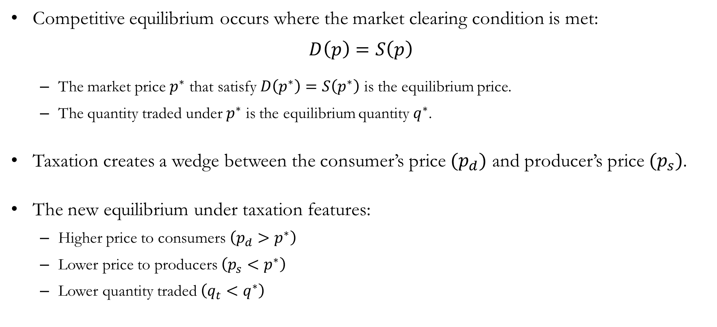
Recap: Equilibrium
Competitive equilibrium occurs where the market clearing condition is met:
$$D\left(p\right)=S\left(p\right)$$
The market price $p^{∗}$ that satisfy $D\left(p^{∗}\right)=S\left(p^{∗}\right)$ is the equilibrium price.
The quantity traded under $p^{∗}$ is the equilibrium quantity $q^{∗}$.
Taxation creates a wedge between the consumer’s price $(p_{d})$ and producer’s price $(p_{s})$.
The new equilibrium under taxation features:
Higher price to consumers $\left(p_{d}>p^{∗}\right)$
Lower price to producers $\left(p_{s}<p^{∗}\right)$
Lower quantity traded $\left(q_{t}<q^{∗}\right)$

Slide 3
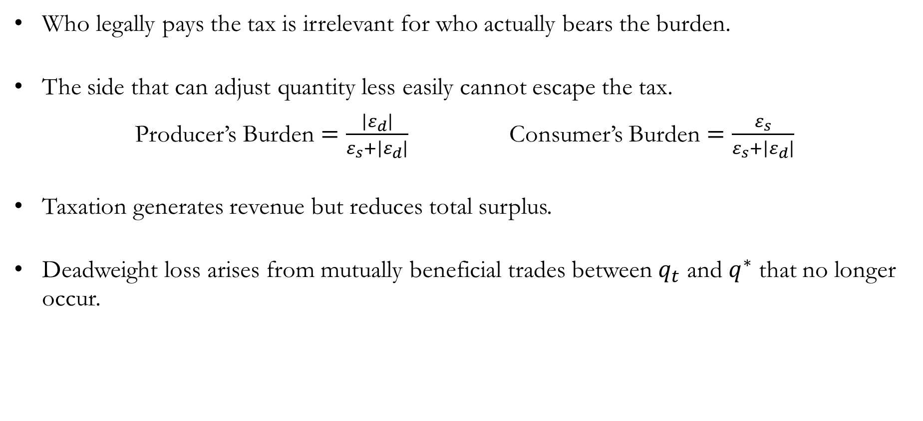
Recap: Equilibrium
Who legally pays the tax is irrelevant for who actually bears the burden.
The side that can adjust quantity less easily cannot escape the tax.
Producer’s Burden $=\frac{\left|ε_{d}\right|}{ε_{s}+\left|ε_{d}\right|}$ Consumer’s Burden $=\frac{ε_{s}}{ε_{s}+\left|ε_{d}\right|}$
Taxation generates revenue but reduces total surplus.
Deadweight loss arises from mutually beneficial trades between $q_{t}$ and $q^{∗}$ that no longer occur.

Slide 4
Describing the Firm’s
Production Technology

Slide 5
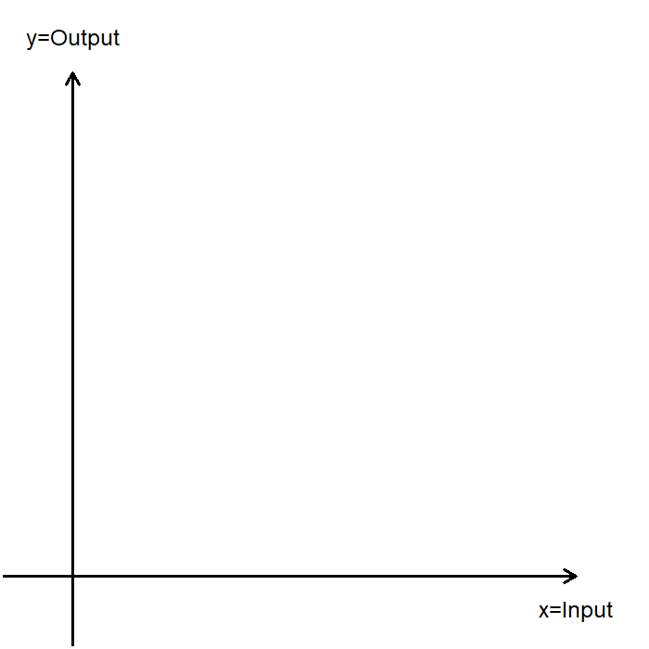
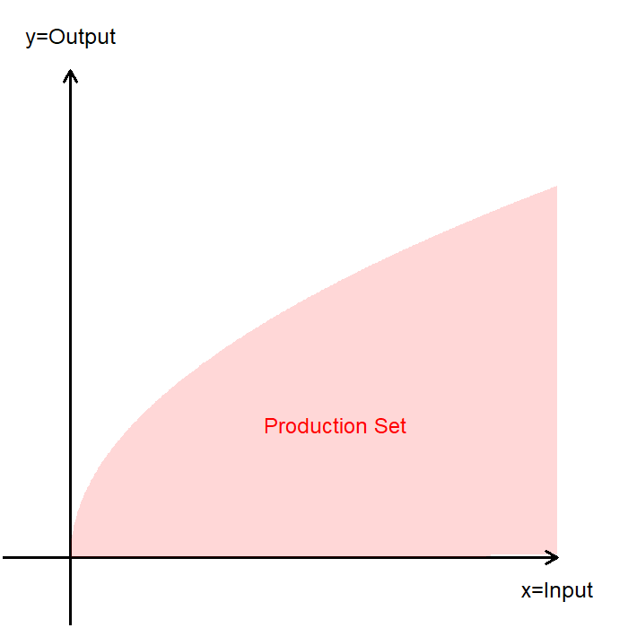
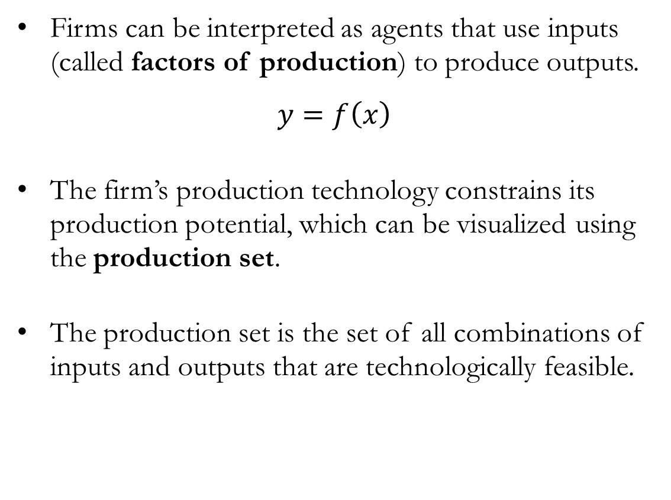
Technological Constraints
Firms can be interpreted as agents that use inputs (called factors of production) to produce outputs.
$$y=f\left(x\right)$$
The firm’s production technology constrains its production potential, which can be visualized using the production set.
The production set is the set of all combinations of inputs and outputs that are technologically feasible.

Slide 6
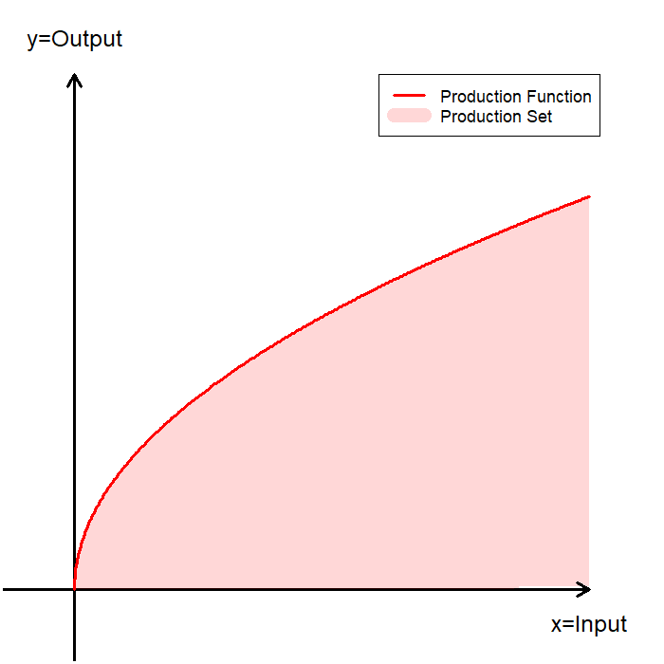
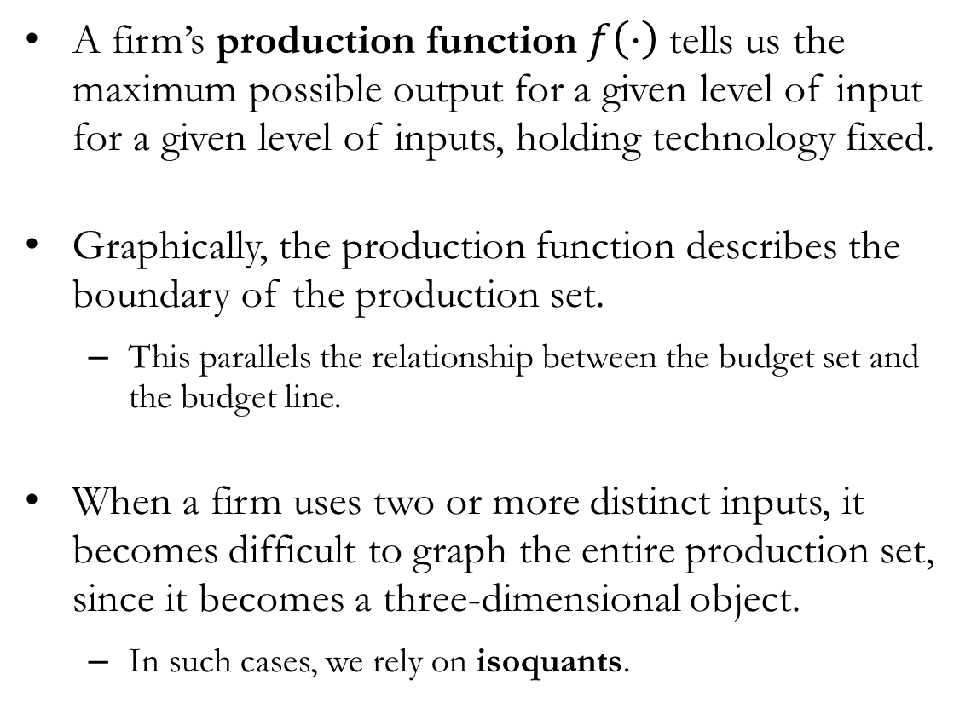
Production Functions
A firm’s production function $f\left(⋅\right)$tells us the maximum possible output for a given level of input for a given level of inputs, holding technology fixed.
Graphically, the production function describes the boundary of the production set.
This parallels the relationship between the budget set and the budget line.
When a firm uses two or more distinct inputs, it becomes difficult to graph the entire production set, since it becomes a three-dimensional object.
In such cases, we rely on isoquants.

Slide 7
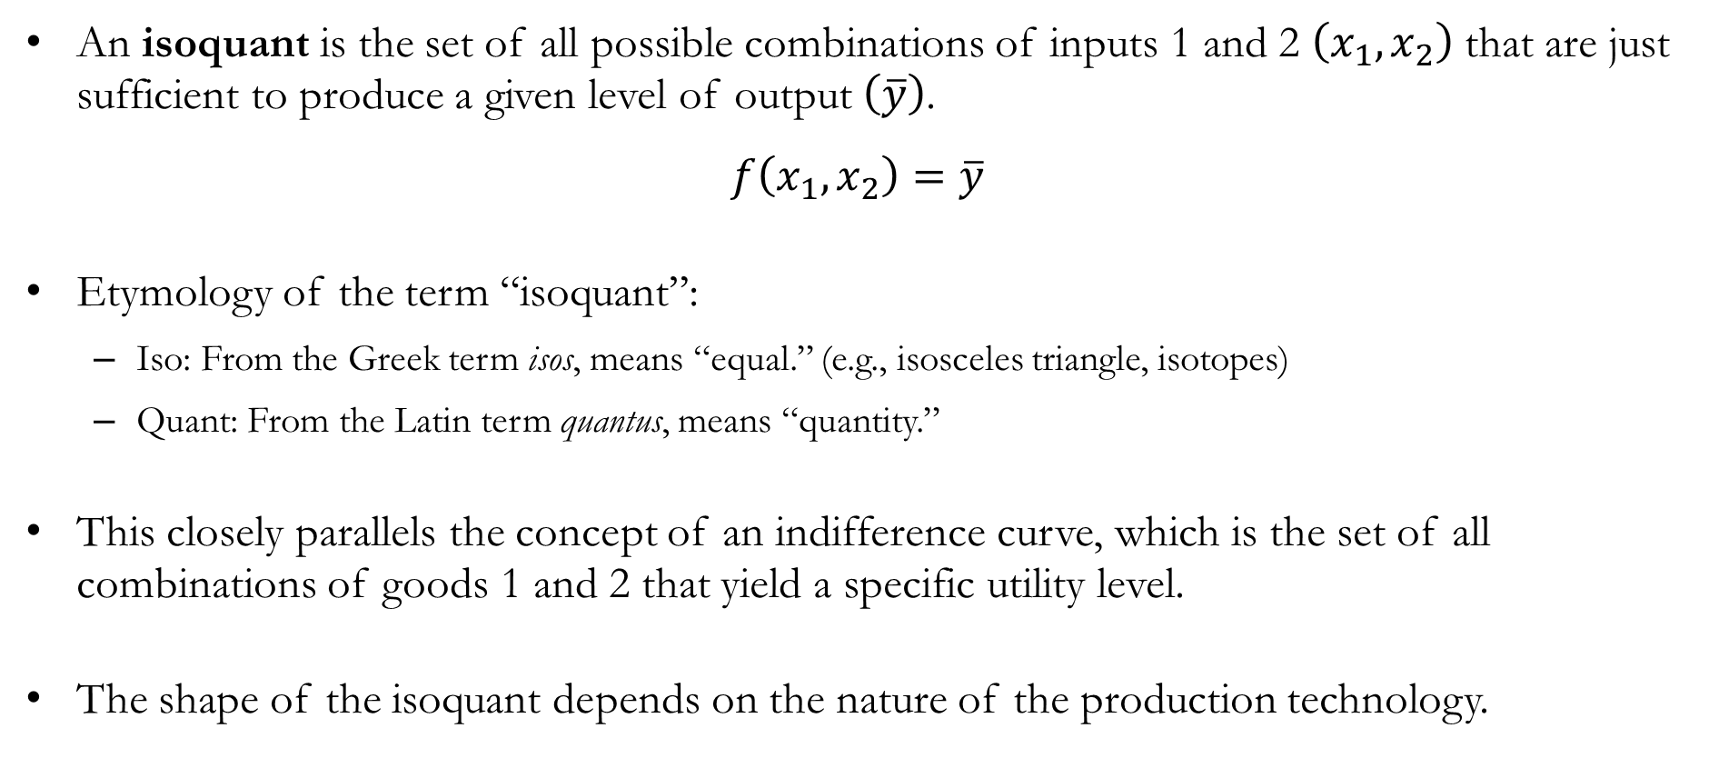
Isoquants
An isoquant is the set of all possible combinations of inputs 1 and 2 $\left(x_{1},x_{2}\right)$ that are just sufficient to produce a given level of output $\left(\overline{y}\right)$.
$$f\left(x_{1},x_{2}\right)=\overline{y}$$
Etymology of the term “isoquant”:
Iso: From the Greek term isos, means “equal.” (e.g., isosceles triangle, isotopes)
Quant: From the Latin term quantus, means “quantity.”
This closely parallels the concept of an indifference curve, which is the set of all combinations of goods 1 and 2 that yield a specific utility level.
The shape of the isoquant depends on the nature of the production technology.

Slide 8
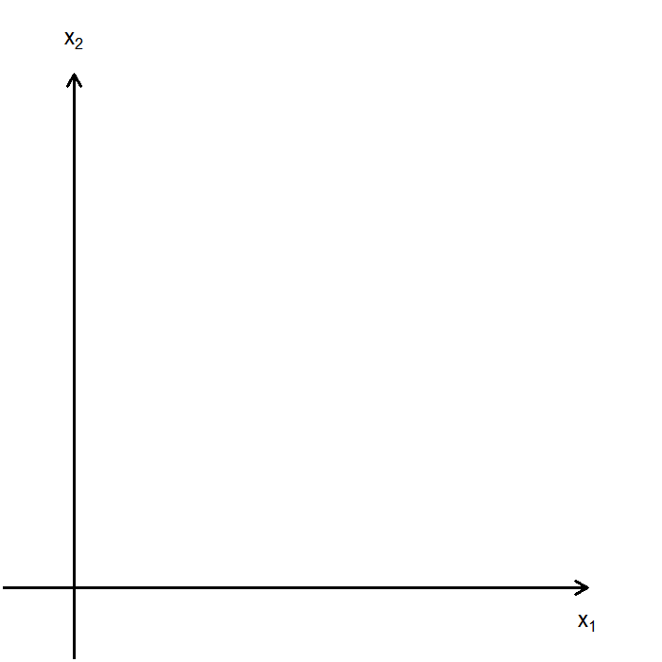
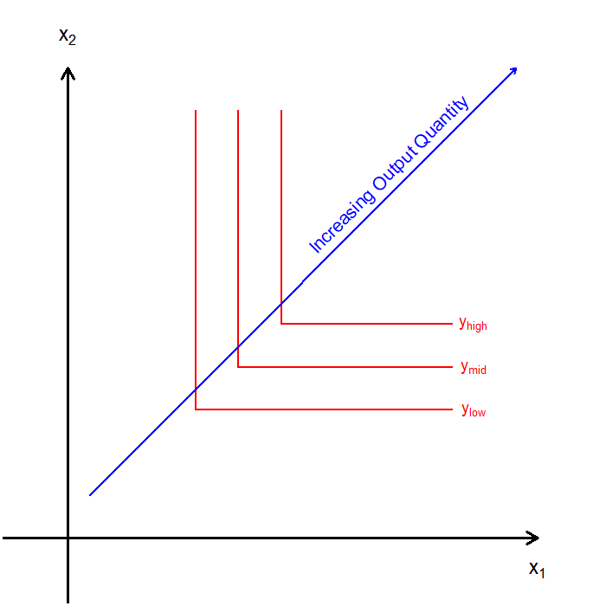
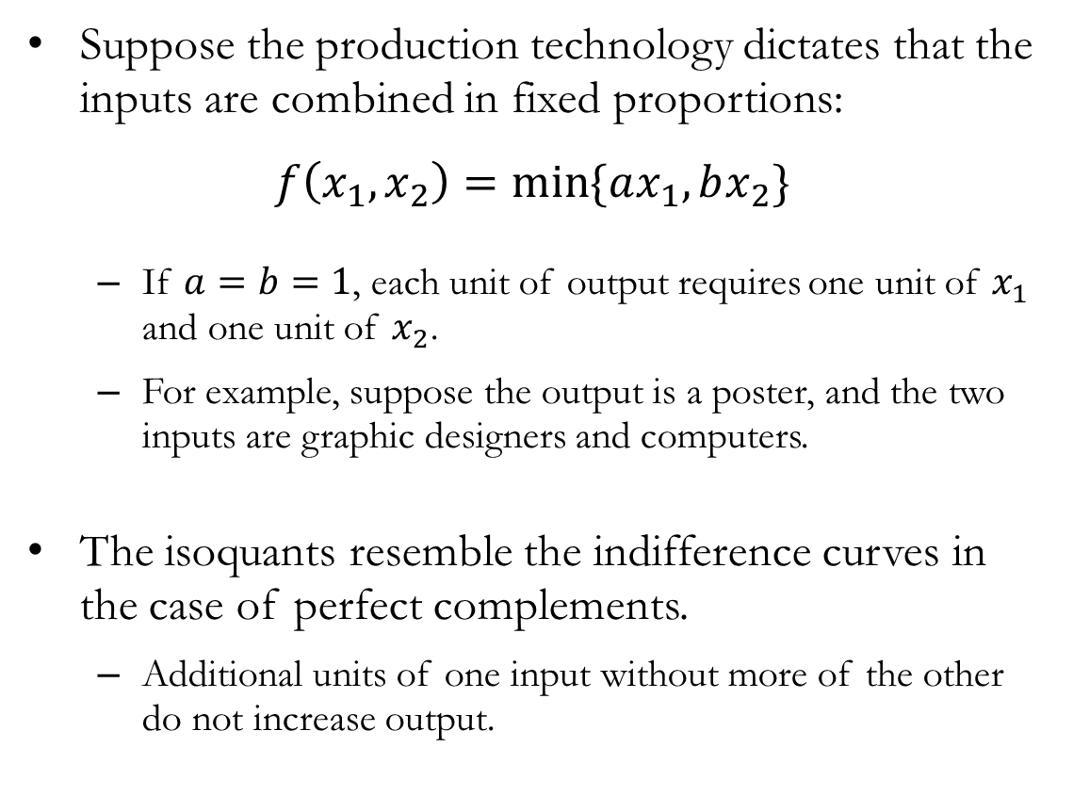
Isoquants: Fixed Proportions
Suppose the production technology dictates that the inputs are combined in fixed proportions:
$$f\left(x_{1},x_{2}\right)=\min{\{ax_{1},bx_{2}\}}$$
If $a=b=1$, each unit of output requires one unit of $x_{1}$ and one unit of $x_{2}$.
For example, suppose the output is a poster, and the two inputs are graphic designers and computers.
The isoquants resemble the indifference curves in the case of perfect complements.
Additional units of one input without more of the other do not increase output.

Slide 9
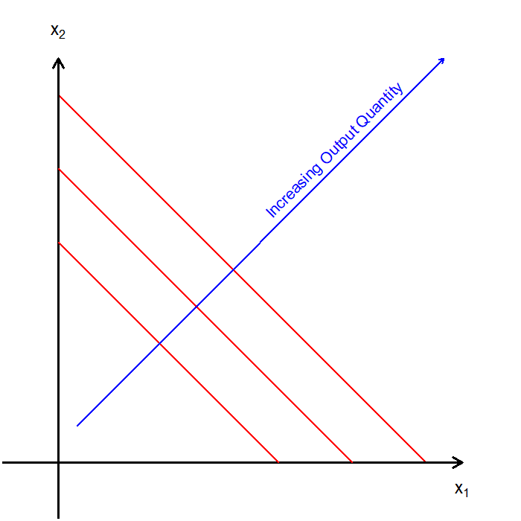
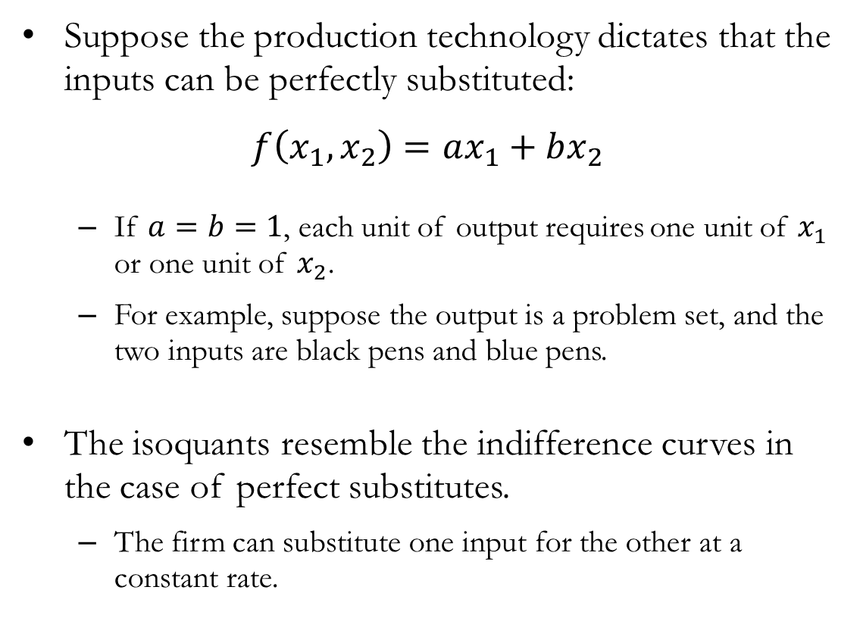
Isoquants: Perfect Substitutes
Suppose the production technology dictates that the inputs can be perfectly substituted:
$$f\left(x_{1},x_{2}\right)=ax_{1}+bx_{2}$$
If $a=b=1$, each unit of output requires one unit of $x_{1}$ or one unit of $x_{2}$.
For example, suppose the output is a problem set, and the two inputs are black pens and blue pens.
The isoquants resemble the indifference curves in the case of perfect substitutes.
The firm can substitute one input for the other at a constant rate.

Slide 10
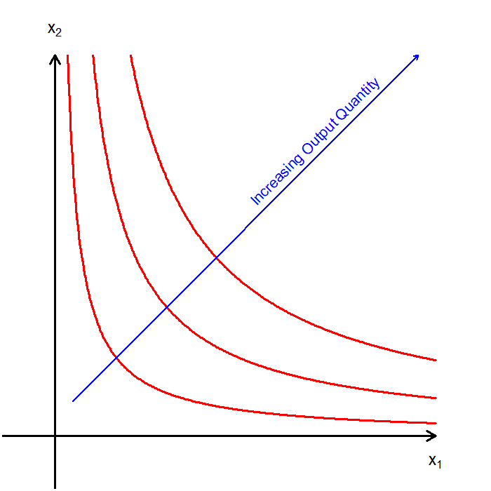
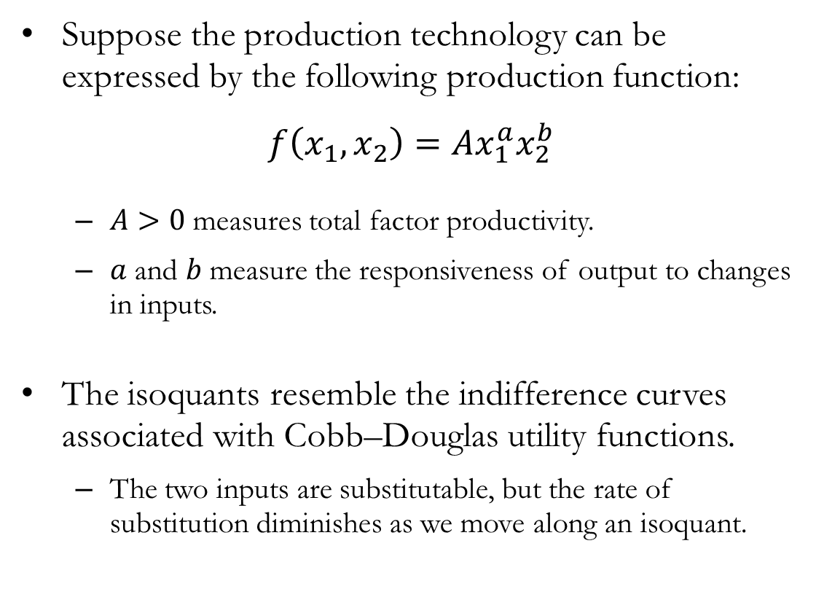
Isoquants: Cobb-Douglas
Suppose the production technology can be expressed by the following production function:
$$f\left(x_{1},x_{2}\right)=Ax_{1}^{a}x_{2}^{b}$$
$A>0$ measures total factor productivity.
$a$ and $b$ measure the responsiveness of output to changes in inputs.
The isoquants resemble the indifference curves associated with Cobb–Douglas utility functions.
The two inputs are substitutable, but the rate of substitution diminishes as we move along an isoquant.

Slide 11
Isoquants and Indifference Curves
Isoquants and indifference curves are similar in many respects, but they have important differences.
First, an isoquant is a direct reflection of the objective production technology, not subjective preference relations.
Indifference curves represent preference rankings over bundles, whereas isoquants represent technologically feasible input combinations.
“Higher” isoquants correspond to higher levels of output in an objective sense.
Moreover, production quantity, unlike preference-based utility, is a cardinal concept.
Because output has a physical meaning, transforming the production function changes the amount of output produced from a given input bundle.
Therefore, monotonic transformations change the production function but not utility representations.

Slide 12
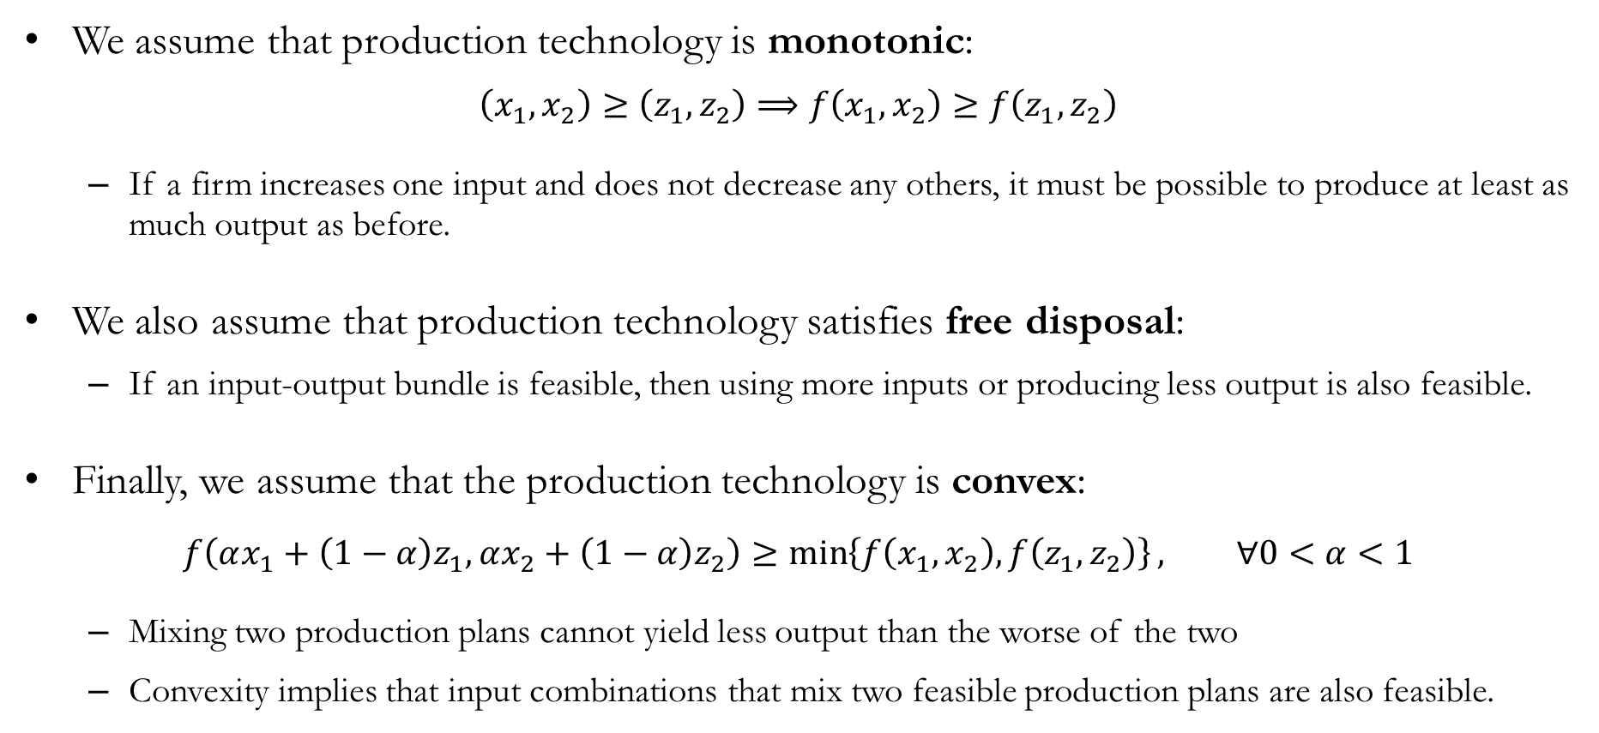
Properties of Technology
We assume that production technology is monotonic:
$$\left(x_{1},x_{2}\right)≥\left(z_{1},z_{2}\right)⟹f\left(x_{1},x_{2}\right)≥f\left(z_{1},z_{2}\right)$$
If a firm increases one input and does not decrease any others, it must be possible to produce at least as much output as before.
We also assume that production technology satisfies free disposal:
If an input-output bundle is feasible, then using more inputs or producing less output is also feasible.
Finally, we assume that the production technology is convex:
$$f\left(αx_{1}+\left(1−α\right)z_{1},αx_{2}+\left(1−α\right)z_{2}\right)≥\min\left\{f\left(x_{1},x_{2}\right),f\left(z_{1},z_{2}\right)\right\}, ∀0<α<1$$
Mixing two production plans cannot yield less output than the worse of the two
Convexity implies that input combinations that mix two feasible production plans are also feasible.

Slide 13
Production Technology:
Describing “Changes”

Slide 14
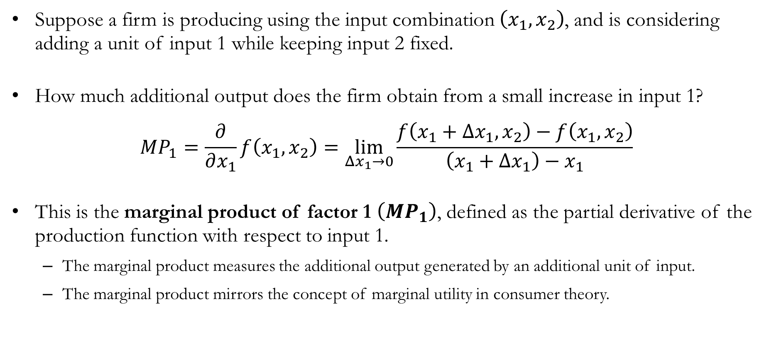
The Marginal Product
Suppose a firm is producing using the input combination $\left(x_{1},x_{2}\right)$, and is considering adding a unit of input 1 while keeping input 2 fixed.
How much additional output does the firm obtain from a small increase in input 1?
$$MP_{1}=\frac{∂}{∂x_{1}}f\left(x_{1},x_{2}\right)=\lim_{Δx_{1}→0}\frac{f\left(x_{1}+Δx_{1},x_{2}\right)−f\left(x_{1},x_{2}\right)}{\left(x_{1}+Δx_{1}\right)−x_{1}}$$
This is the marginal product of factor 1 $\left(MP_{1}\right)$, defined as the partial derivative of the production function with respect to input 1.
The marginal product measures the additional output generated by an additional unit of input.
The marginal product mirrors the concept of marginal utility in consumer theory.

Slide 15
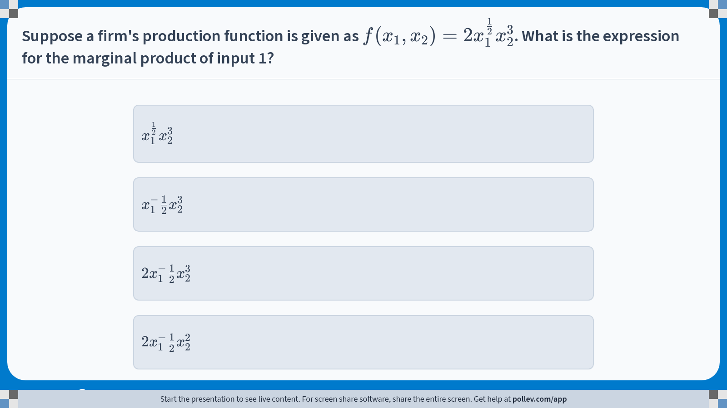
Poll Everywhere multiple choice poll instructions screen Activity Title: Suppose a firm's production function is given as $$f(x_1,x_2)=2x_1^\\frac{1}{2}x_2^3$$. What is the expression for the marginal product of input 1? Slide 15
Notes:
Do not modify the notes in this section to avoid tampering with the Poll Everywhere activity. More info at polleverywhere.com/support Suppose a firm's production function is given as $$f(x_1,x_2)=2x_1^\\frac{1}{2}x_2^3$$. What is the expression for the marginal product of input 1? https://www.polleverywhere.com/multiple_choice_polls/s5IX7M3bym1KpKIj64sML?display_state=instructions&activity_state=opened&state=opened&flow=Engagement&onscreen=persist

Slide 16
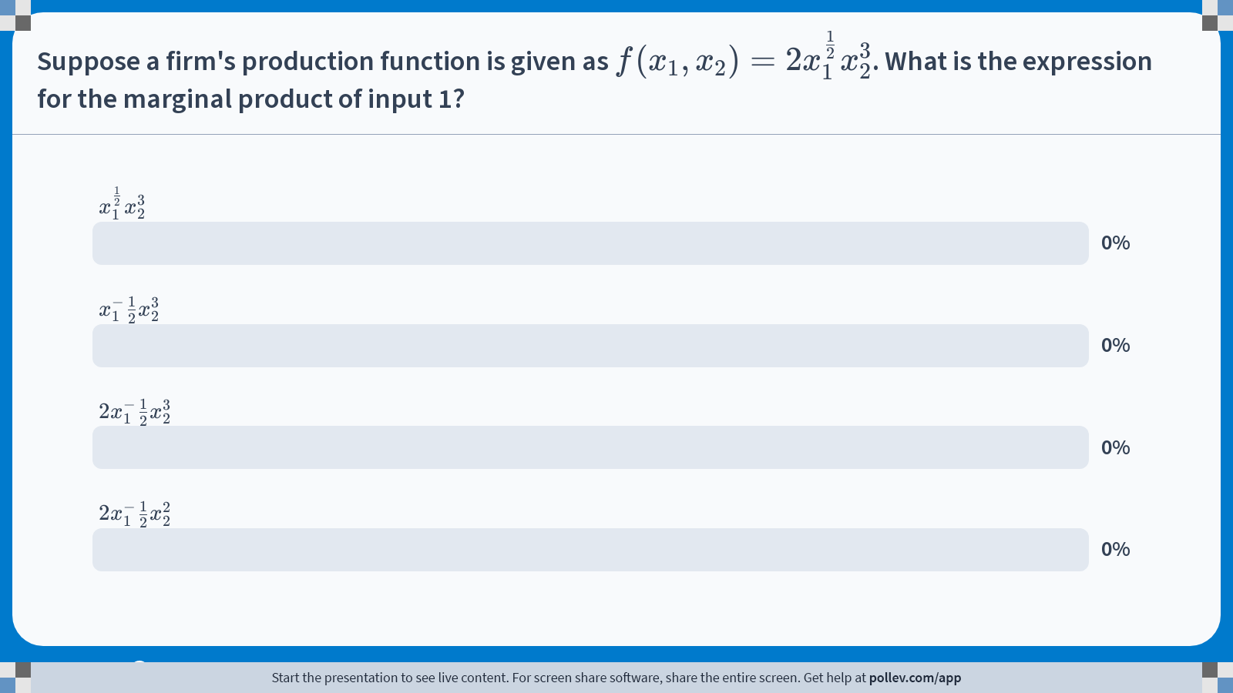
Poll Everywhere multiple choice poll chart screen Activity Title: Suppose a firm's production function is given as $$f(x_1,x_2)=2x_1^\\frac{1}{2}x_2^3$$. What is the expression for the marginal product of input 1? Slide 17
Notes:
Do not modify the notes in this section to avoid tampering with the Poll Everywhere activity. More info at polleverywhere.com/support Suppose a firm's production function is given as $$f(x_1,x_2)=2x_1^\\frac{1}{2}x_2^3$$. What is the expression for the marginal product of input 1? https://www.polleverywhere.com/multiple_choice_polls/s5IX7M3bym1KpKIj64sML?display_state=chart&activity_state=closed&state=closed&flow=Engagement&onscreen=persist

Slide 17

Solution to In-class Poll #1
Apply the definition of the marginal product:
$$MP_{1}=\frac{∂}{∂x_{1}}2x_{1}^{0.5}x_{2}^{3}=\left(2x_{2}^{3}\right)⋅0.5⋅x_{1}^{0.5−1}=x_{1}^{−0.5}x_{2}^{3}$$

Slide 18
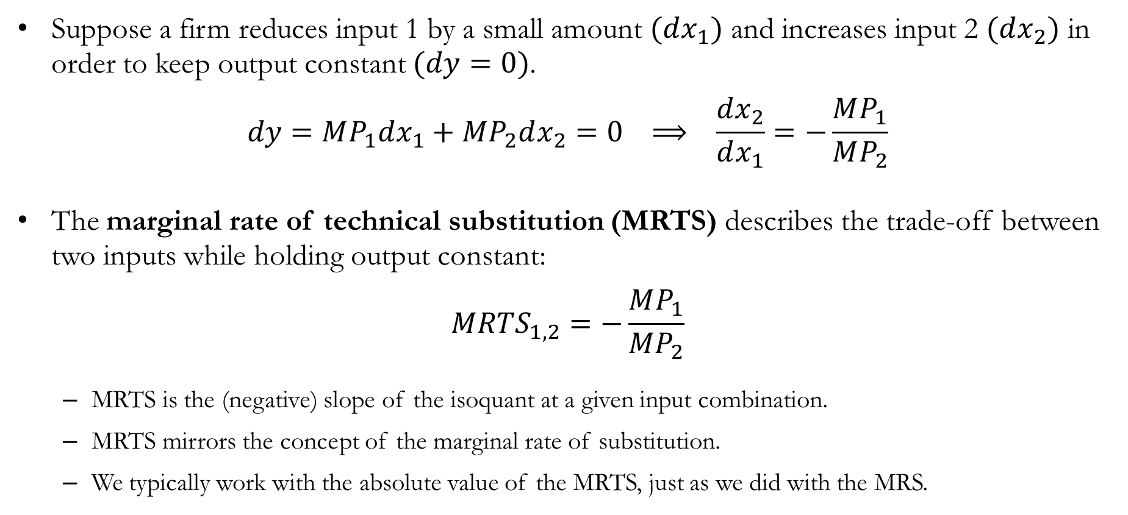
The Marginal Rate of Technical Substitution
Suppose a firm reduces input 1 by a small amount $(dx_{1})$ and increases input 2 $(dx_{2})$ in order to keep output constant $(dy=0)$.
$$dy=MP_{1}dx_{1}+MP_{2}dx_{2}=0 ⟹ \frac{dx_{2}}{dx_{1}}=−\frac{MP_{1}}{MP_{2}}$$
The marginal rate of technical substitution (MRTS) describes the trade-off between two inputs while holding output constant:
$$MRTS_{1,2}=−\frac{MP_{1}}{MP_{2}}$$
MRTS is the (negative) slope of the isoquant at a given input combination.
MRTS mirrors the concept of the marginal rate of substitution.
We typically work with the absolute value of the MRTS, just as we did with the MRS.

Slide 19
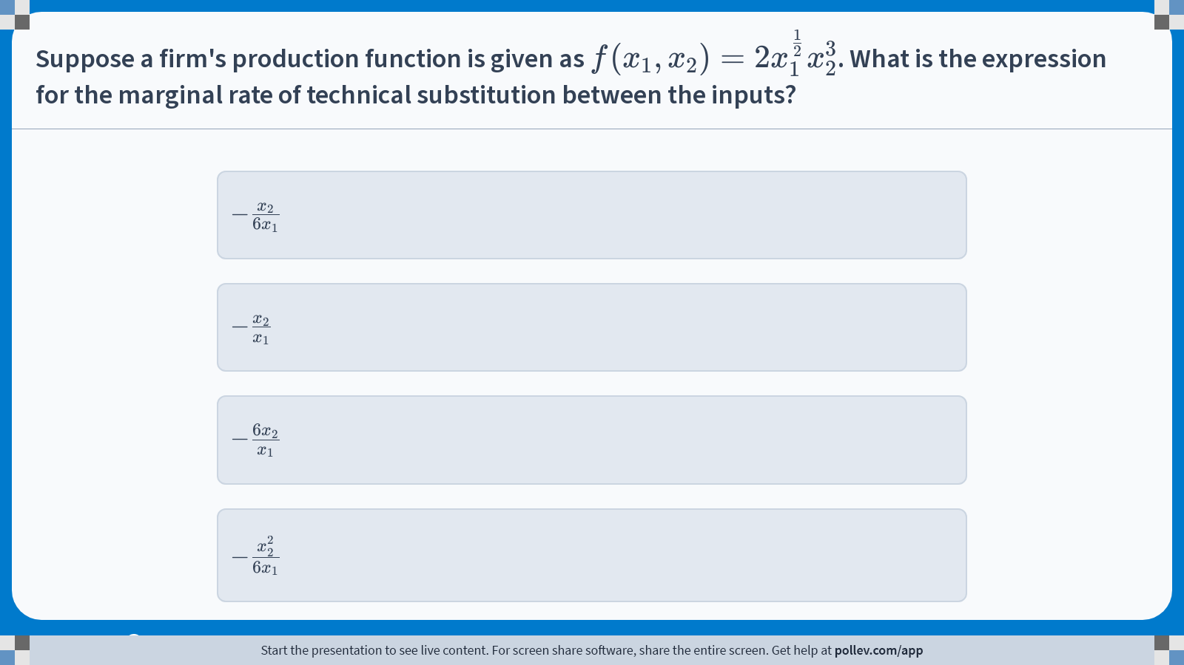
Poll Everywhere multiple choice poll instructions screen Activity Title: Suppose a firm's production function is given as $$f(x_1,x_2)=2x_1^\\frac{1}{2}x_2^3$$. What is the expression for the marginal rate of technical substitution between the inputs? Slide 19
Notes:
Do not modify the notes in this section to avoid tampering with the Poll Everywhere activity. More info at polleverywhere.com/support Suppose a firm's production function is given as $$f(x_1,x_2)=2x_1^\\frac{1}{2}x_2^3$$. What is the expression for the marginal rate of technical substitution between the inputs? https://www.polleverywhere.com/multiple_choice_polls/kV3x9FZ13h6yCqeNrHfPV?display_state=instructions&activity_state=opened&state=opened&flow=Engagement&onscreen=persist

Slide 20
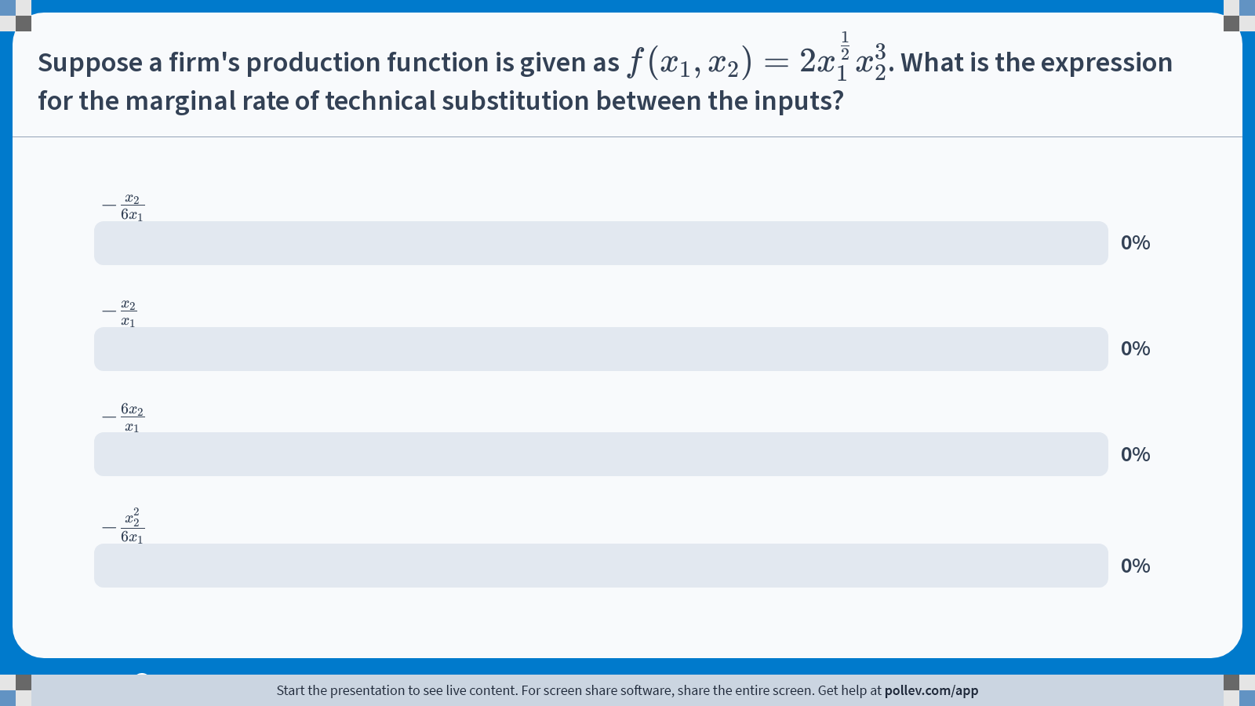
Poll Everywhere multiple choice poll chart screen Activity Title: Suppose a firm's production function is given as $$f(x_1,x_2)=2x_1^\\frac{1}{2}x_2^3$$. What is the expression for the marginal rate of technical substitution between the inputs? Slide 21
Notes:
Do not modify the notes in this section to avoid tampering with the Poll Everywhere activity. More info at polleverywhere.com/support Suppose a firm's production function is given as $$f(x_1,x_2)=2x_1^\\frac{1}{2}x_2^3$$. What is the expression for the marginal rate of technical substitution between the inputs? https://www.polleverywhere.com/multiple_choice_polls/kV3x9FZ13h6yCqeNrHfPV?display_state=chart&activity_state=closed&state=closed&flow=Engagement&onscreen=persist

Slide 21

Solution to In-class Poll #2
Find the marginal products:
$$MP_{1}=\frac{∂}{∂x_{1}}2x_{1}^{0.5}x_{2}^{3}=\left(2x_{2}^{3}\right)⋅0.5⋅x_{1}^{0.5−1}=x_{1}^{−0.5}x_{2}^{3}$$
$$MP_{2}=\frac{∂}{∂x_{2}}2x_{1}^{0.5}x_{2}^{3}=\left(2x_{1}^{0.5}\right)⋅3⋅x_{2}^{3−1}=6x_{1}^{0.5}x_{2}^{2}$$
Apply the definition of the marginal rate of technical substitution:
$$MRTS_{1,2}=−\frac{MP_{1}}{MP_{2}}=−\frac{x_{1}^{−0.5}x_{2}^{3}}{6x_{1}^{0.5}x_{2}^{2}}=−\frac{x_{2}}{6x_{1}}$$

Slide 22
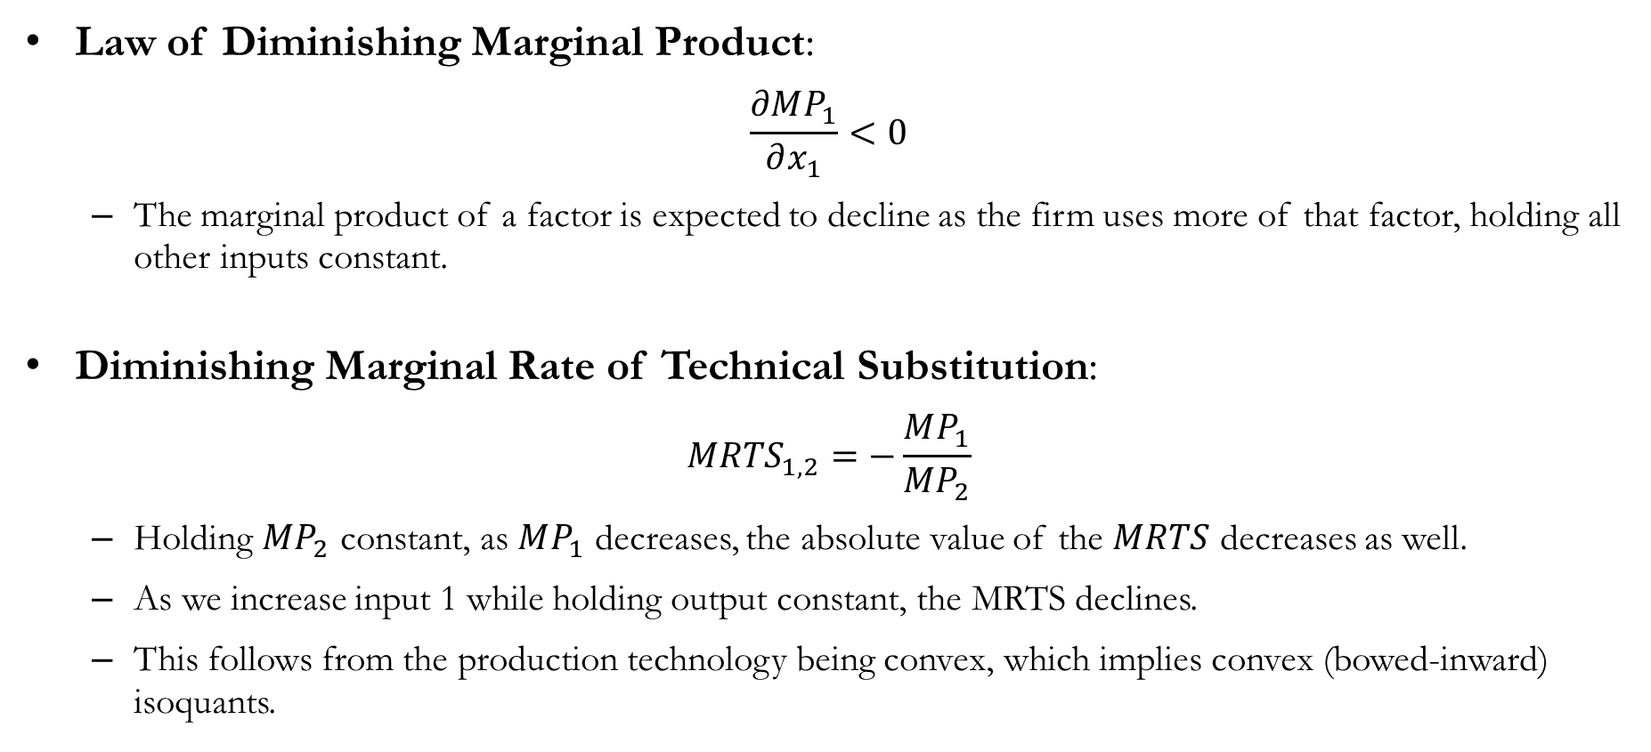
(More) Properties of Technology
Law of Diminishing Marginal Product:
$$\frac{∂MP_{1}}{∂x_{1}}<0$$
The marginal product of a factor is expected to decline as the firm uses more of that factor, holding all other inputs constant.
Diminishing Marginal Rate of Technical Substitution:
$$MRTS_{1,2}=−\frac{MP_{1}}{MP_{2}}$$
Holding $MP_{2}$ constant, as $MP_{1}$ decreases, the absolute value of the $MRTS$ decreases as well.
As we increase input 1 while holding output constant, the MRTS declines.
This follows from the production technology being convex, which implies convex (bowed-inward) isoquants.

Slide 23
The Short-run vs. Long-run
In economics, we define time horizons in terms of the short run and the long run.
The short run is a period of time in which the quantity of at least one input is fixed.
The long run is a period of time in which all inputs can vary freely.
The distinction between the short run and the long run depends on the types of choices under consideration.
Consider the production process of a farmer:
The farmer’s factors of production may include labor (workers) and land.
Given a week to increase production, the farmer may work longer hours or hire seasonal workers.
However, within that week, it would be infeasible to acquire additional farmland.
In this example, a week constitutes the short run.
The long run is the time horizon over which all inputs, including land and capital, can be adjusted.

Slide 24
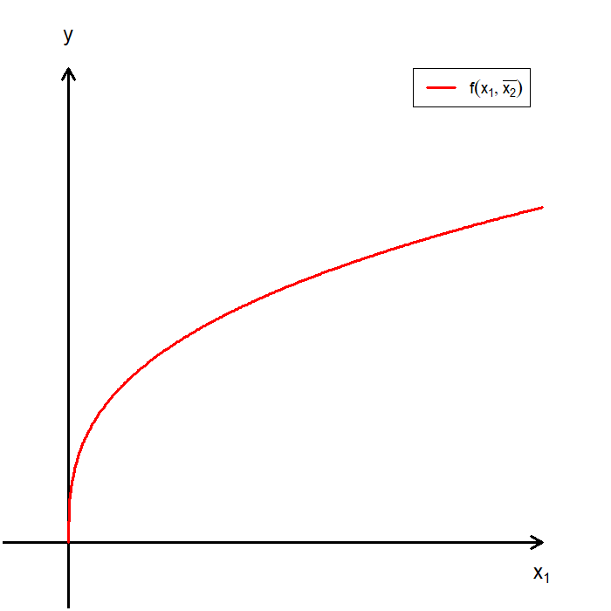
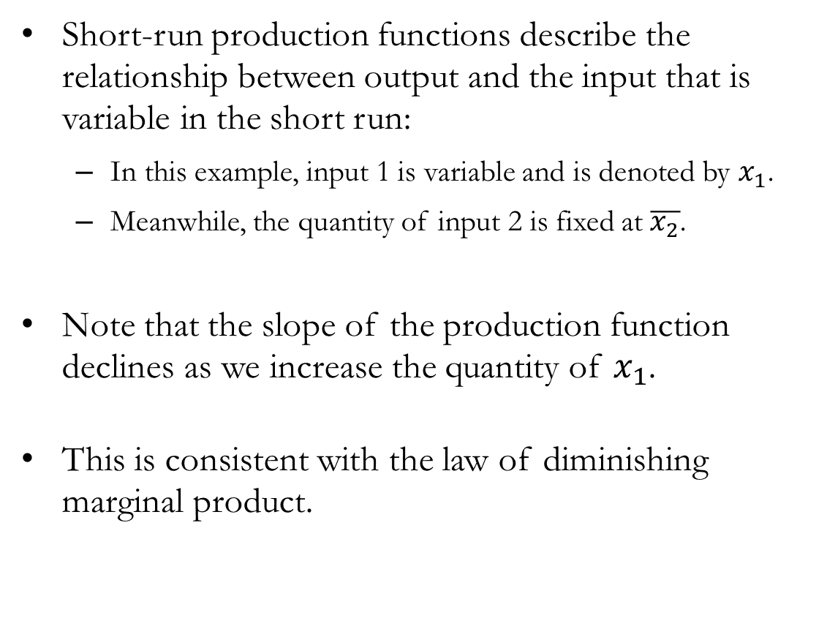
Short-run Production Functions
Short-run production functions describe the relationship between output and the input that is variable in the short run:
In this example, input 1 is variable and is denoted by $x_{1}$.
Meanwhile, the quantity of input 2 is fixed at $\overline{x_{2}}$.
Note that the slope of the production function declines as we increase the quantity of $x_{1}$.
This is consistent with the law of diminishing marginal product.

Slide 25
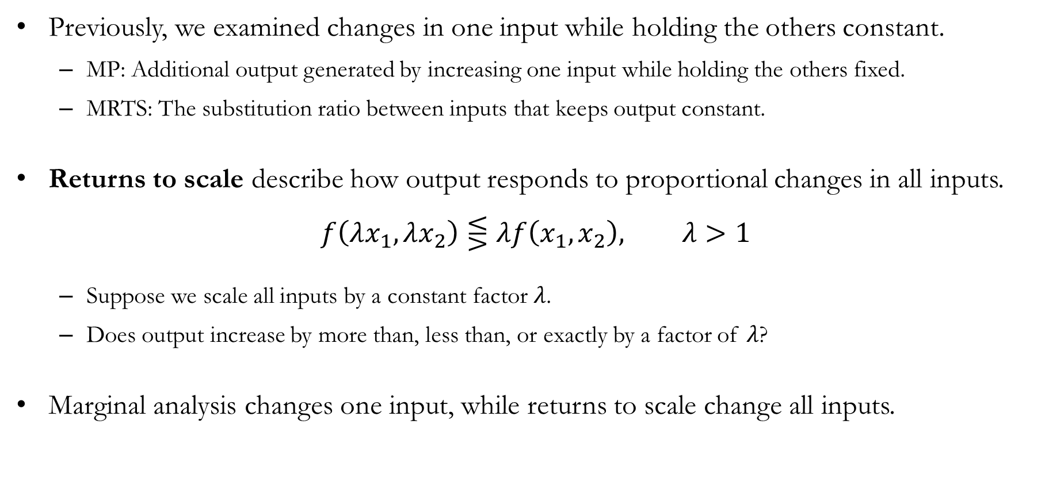
Returns to Scale
Previously, we examined changes in one input while holding the others constant.
MP: Additional output generated by increasing one input while holding the others fixed.
MRTS: The substitution ratio between inputs that keeps output constant.
Returns to scale describe how output responds to proportional changes in all inputs.
$$f\left(λx_{1},λx_{2}\right)⋚λf\left(x_{1},x_{2}\right), λ>1$$
Suppose we scale all inputs by a constant factor $λ$.
Does output increase by more than, less than, or exactly by a factor of $λ$?
Marginal analysis changes one input, while returns to scale change all inputs.

Slide 26
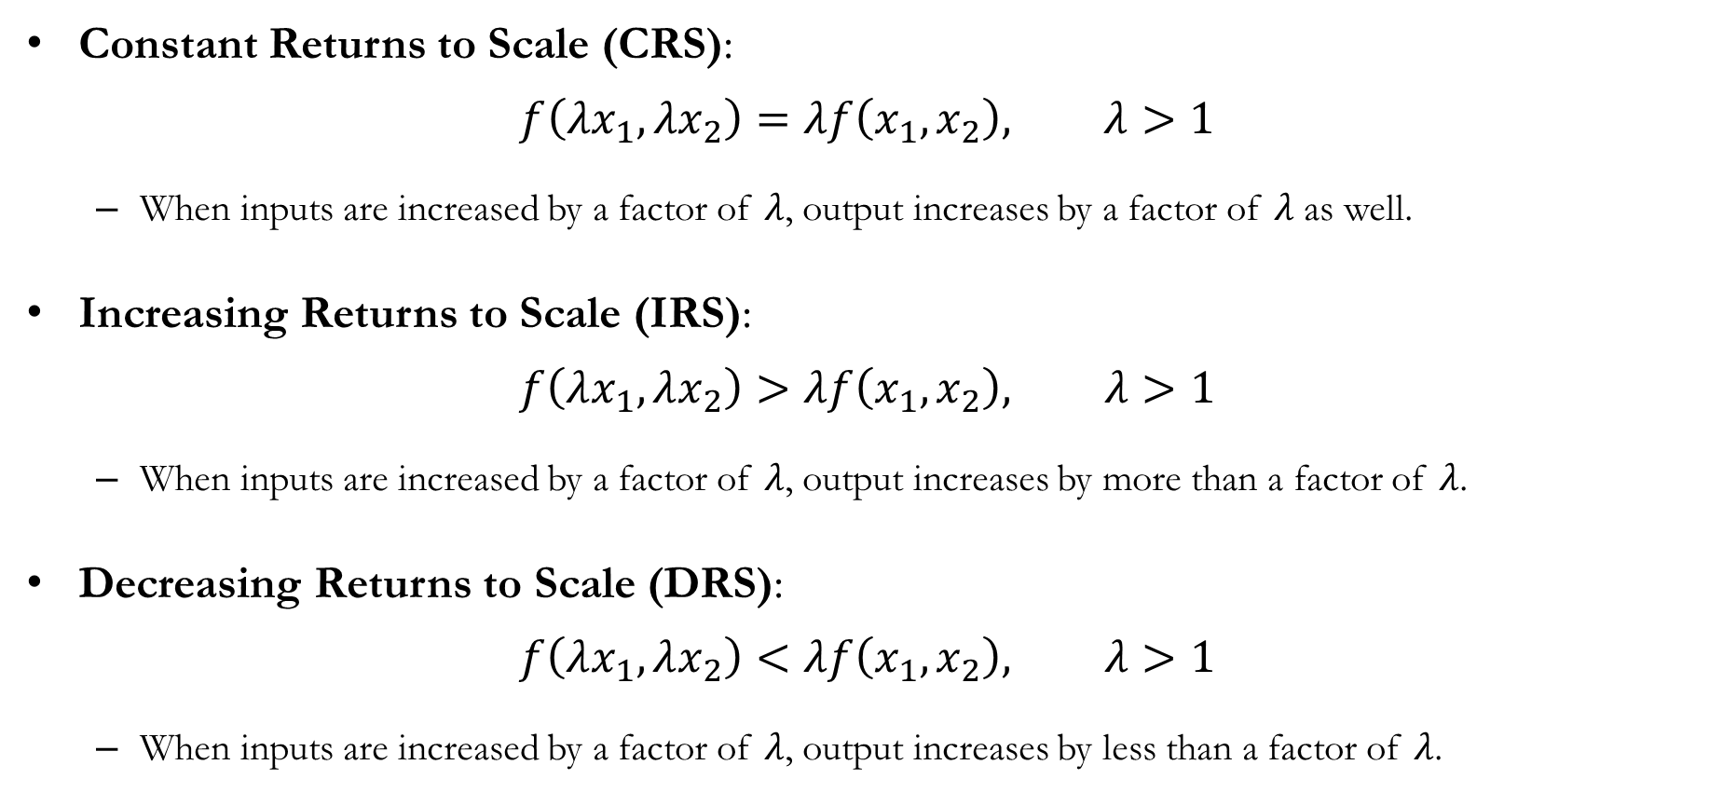
Returns to Scale
Constant Returns to Scale (CRS):
$$f\left(λx_{1},λx_{2}\right)=λf\left(x_{1},x_{2}\right), λ>1$$
When inputs are increased by a factor of $λ$, output increases by a factor of $λ$ as well.
Increasing Returns to Scale (IRS):
$$f\left(λx_{1},λx_{2}\right)>λf\left(x_{1},x_{2}\right), λ>1$$
When inputs are increased by a factor of $λ$, output increases by more than a factor of $λ$.
Decreasing Returns to Scale (DRS):
$$f\left(λx_{1},λx_{2}\right)<λf\left(x_{1},x_{2}\right), λ>1$$
When inputs are increased by a factor of $λ$, output increases by less than a factor of $λ$.

Slide 27
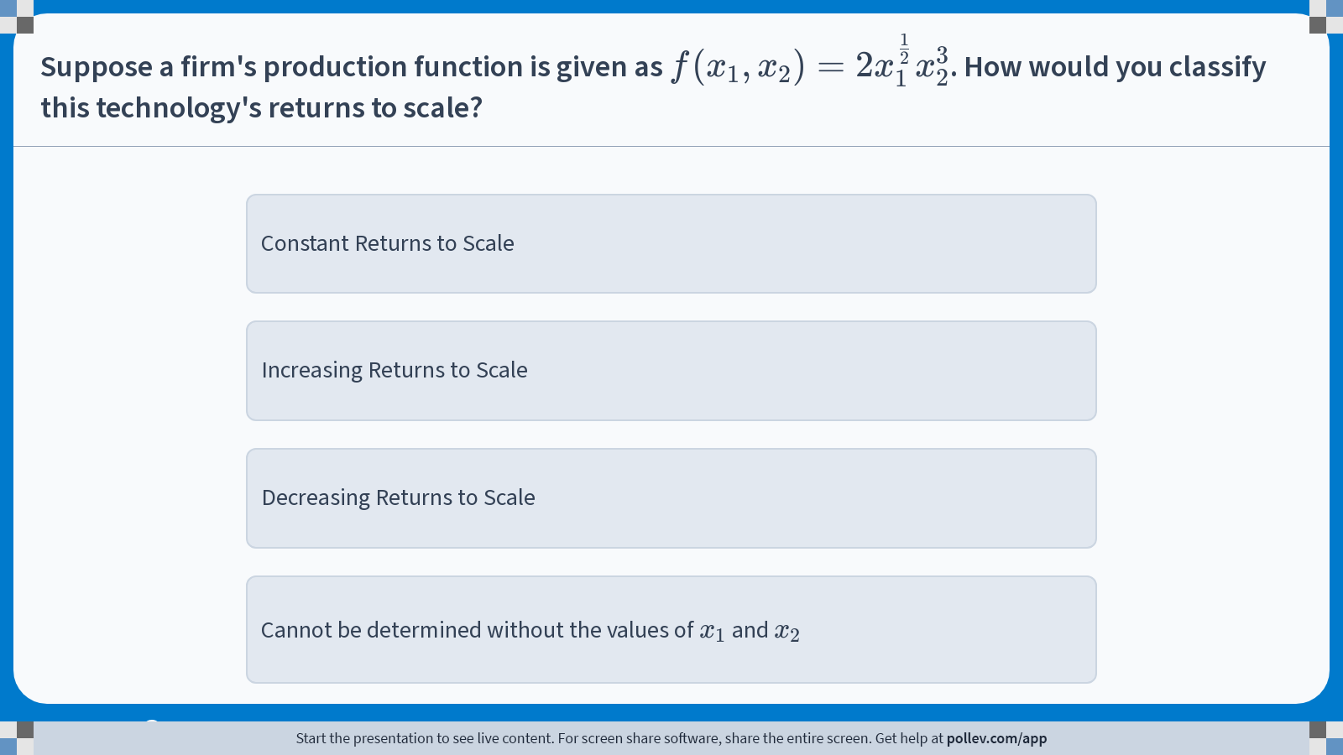
Poll Everywhere multiple choice poll instructions screen Activity Title: Suppose a firm's production function is given as $$f(x_1,x_2)=2x_1^\\frac{1}{2}x_2^3$$. How would you classify this technology's returns to scale? Slide 27
Notes:
Do not modify the notes in this section to avoid tampering with the Poll Everywhere activity. More info at polleverywhere.com/support Suppose a firm's production function is given as $$f(x_1,x_2)=2x_1^\\frac{1}{2}x_2^3$$. How would you classify this technology's returns to scale? https://www.polleverywhere.com/multiple_choice_polls/mAGAfxODe6UNsX8AXxxM9?display_state=instructions&activity_state=opened&state=opened&flow=Engagement&onscreen=persist

Slide 28
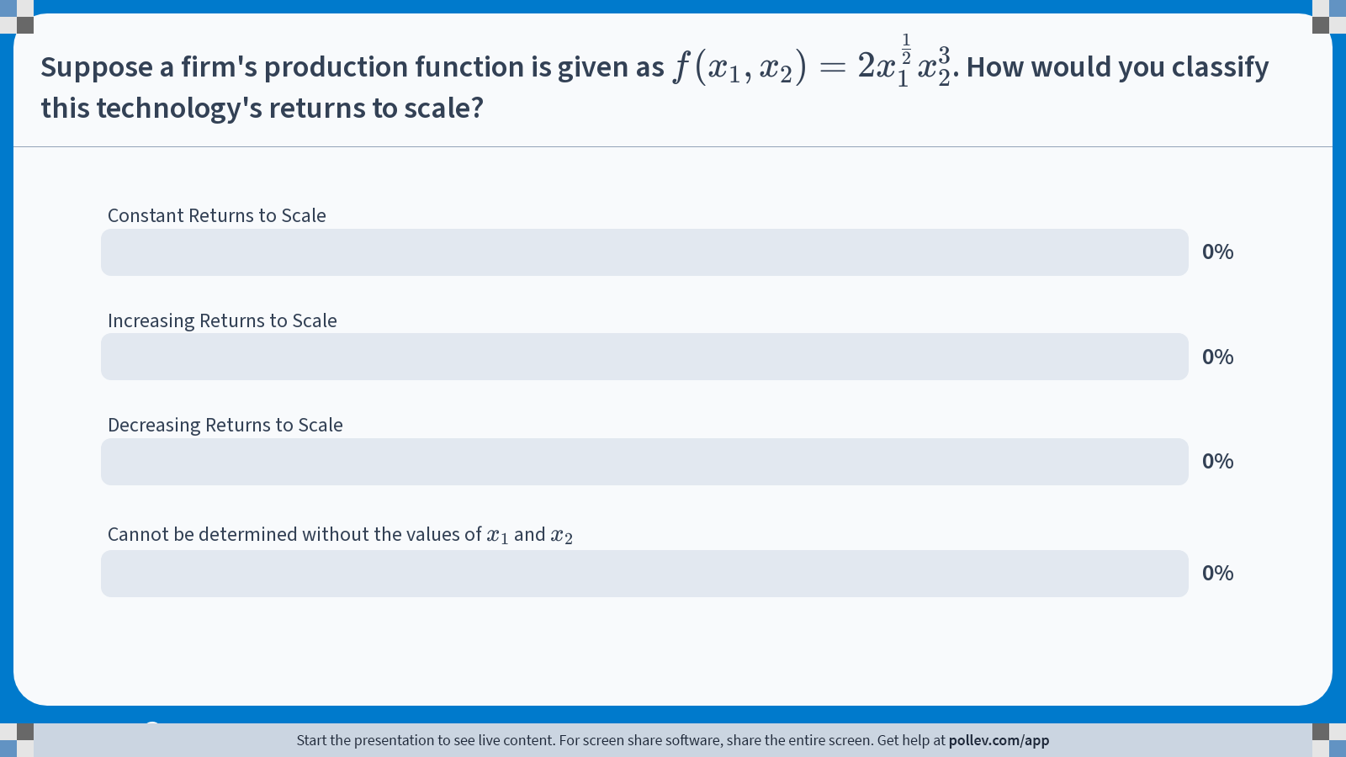
Poll Everywhere multiple choice poll chart screen Activity Title: Suppose a firm's production function is given as $$f(x_1,x_2)=2x_1^\\frac{1}{2}x_2^3$$. How would you classify this technology's returns to scale? Slide 29
Notes:
Do not modify the notes in this section to avoid tampering with the Poll Everywhere activity. More info at polleverywhere.com/support Suppose a firm's production function is given as $$f(x_1,x_2)=2x_1^\\frac{1}{2}x_2^3$$. How would you classify this technology's returns to scale? https://www.polleverywhere.com/multiple_choice_polls/mAGAfxODe6UNsX8AXxxM9?display_state=chart&activity_state=closed&state=closed&flow=Engagement&onscreen=persist

Slide 29
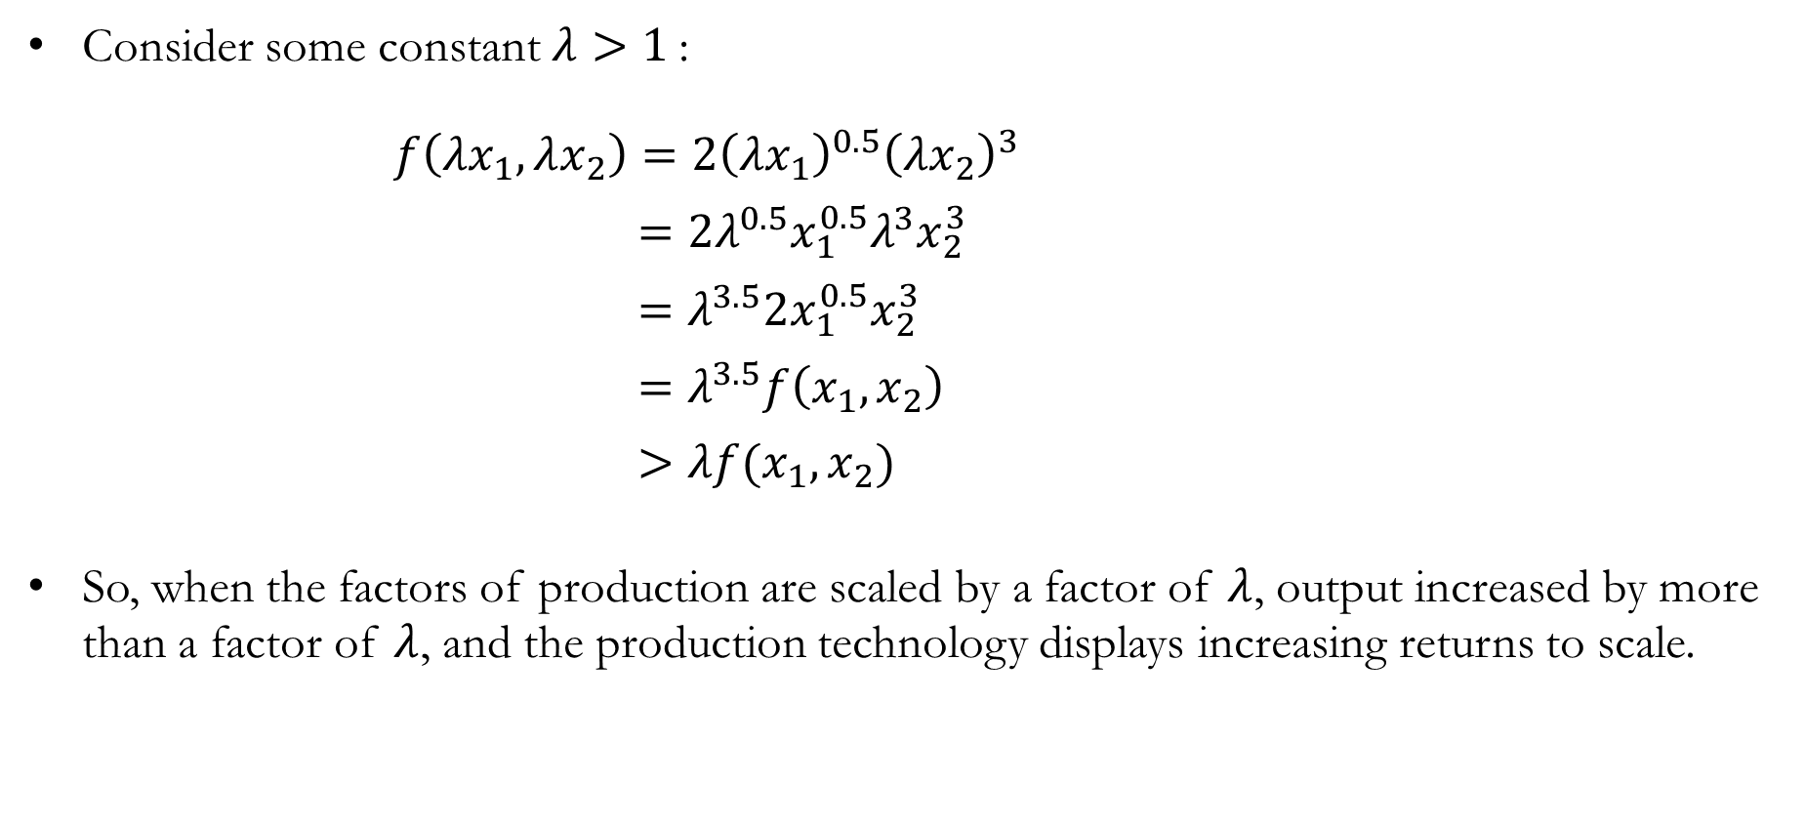
Solution to In-class Poll #3
Consider some constant $λ>1$:
$f\left(λx_{1},λx_{2}\right)=2{\left(λx_{1}\right)}^{0.5}{\left(λx_{2}\right)}^{3}$
$=2λ^{0.5}x_{1}^{0.5}λ^{3}x_{2}^{3}$
$=λ^{3.5}2x_{1}^{0.5}x_{2}^{3}$
$=λ^{3.5}f\left(x_{1}, x_{2}\right)$
$>λf(x_{1},x_{2})$
So, when the factors of production are scaled by a factor of $λ$, output increased by more than a factor of $λ$, and the production technology displays increasing returns to scale.

Slide 30
Recap & Preview

Slide 31
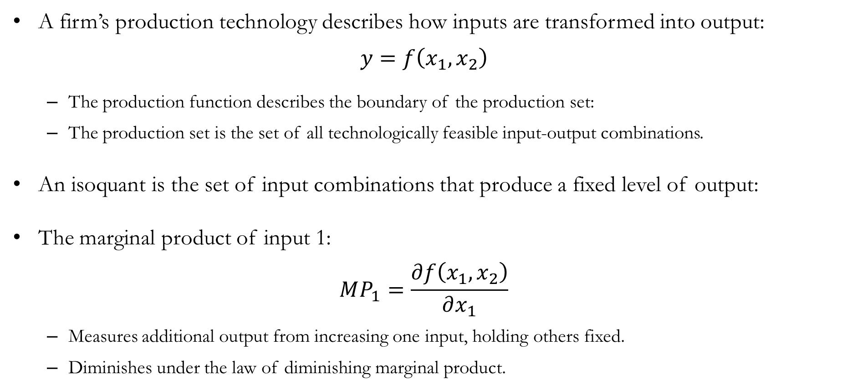
Recap: Technology
A firm’s production technology describes how inputs are transformed into output:
$$y=f\left(x_{1},x_{2}\right)$$
The production function describes the boundary of the production set:
The production set is the set of all technologically feasible input-output combinations.
An isoquant is the set of input combinations that produce a fixed level of output:
The marginal product of input 1:
$$MP_{1}=\frac{∂f\left(x_{1},x_{2}\right)}{∂x_{1}}$$
Measures additional output from increasing one input, holding others fixed.
Diminishes under the law of diminishing marginal product.

Slide 32
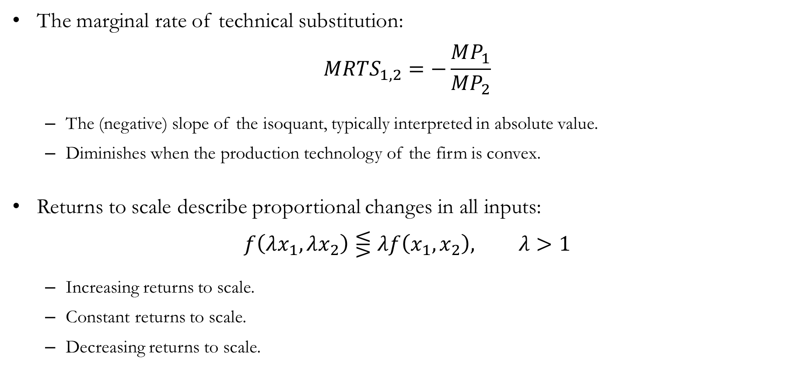
Recap: Technology
The marginal rate of technical substitution:
$$MRTS_{1,2}=−\frac{MP_{1}}{MP_{2}}$$
The (negative) slope of the isoquant, typically interpreted in absolute value.
Diminishes when the production technology of the firm is convex.
Returns to scale describe proportional changes in all inputs:
$$f\left(λx_{1},λx_{2}\right)⋚λf\left(x_{1},x_{2}\right), λ>1$$
Increasing returns to scale.
Constant returns to scale.
Decreasing returns to scale.

Slide 33
Preview: Profit Maximization
So far, we studied technology and how firms transform inputs into output.
Now we ask: how do firms choose how much to produce?
Firms operate in markets where output prices and input prices are given.
A profit-maximizing firm chooses inputs and output to maximize:
What does it mean to maximize profit?
How do output prices and input prices affect firm behavior?
What is the difference between short-run and long-run profit maximization?

