Slide 1
INTERMEDIATE MICROECONOMIC THEORY
Chapter 16: Equilibrium

Slide 2
Recap: Market Demand
Market demand is the horizontal sum of individual demand curves.
A representative consumer framework works only when aggregation preserves demand behavior, for example when income distribution does not change aggregate demand.
The price elasticity of demand measures the percentage change in quantity resulting from a percentage change in price.
Elasticity determines how price and quantity changes affect total revenue.
When |𝜀|>1, raising the price (or decreasing quantity) reduces revenue.
When |𝜀|<1, raising the price (or decreasing quantity) increases revenue.
When |𝜀|=1, revenue is maximized along the demand curve.

Slide 3
Market Equilibrium

Slide 4
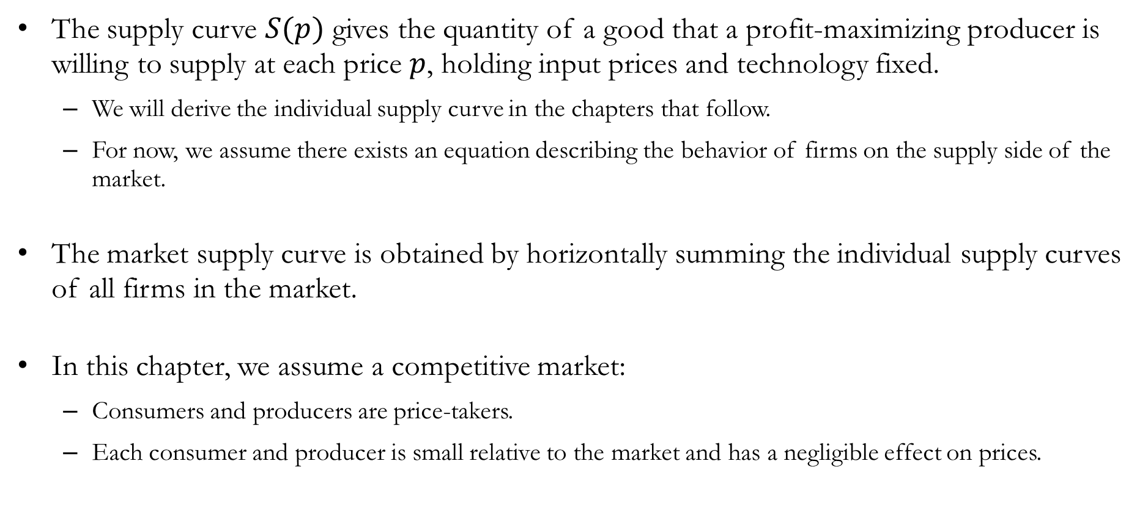
Supply and Competitive Markets
The supply curve $S(p)$ gives the quantity of a good that a profit-maximizing producer is willing to supply at each price $p$, holding input prices and technology fixed.
We will derive the individual supply curve in the chapters that follow.
For now, we assume there exists an equation describing the behavior of firms on the supply side of the market.
The market supply curve is obtained by horizontally summing the individual supply curves of all firms in the market.
In this chapter, we assume a competitive market:
Consumers and producers are price-takers.
Each consumer and producer is small relative to the market and has a negligible effect on prices.

Slide 5
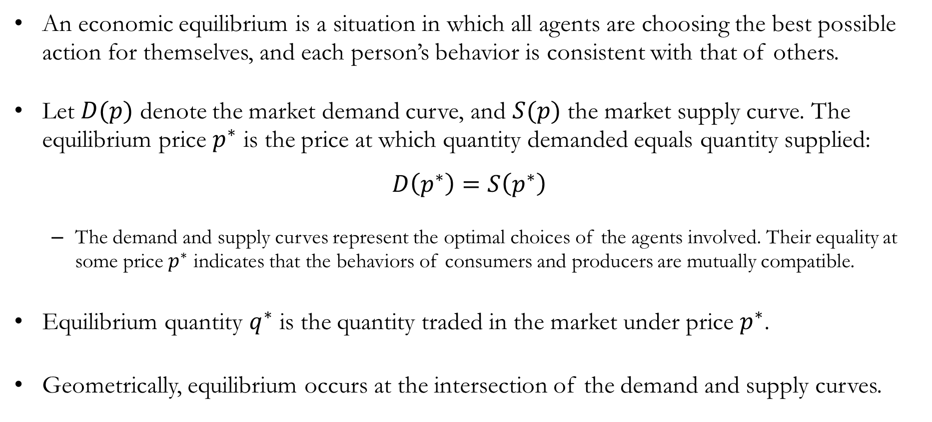
Economic Equilibrium
An economic equilibrium is a situation in which all agents are choosing the best possible action for themselves, and each person’s behavior is consistent with that of others.
Let $D(p)$ denote the market demand curve, and $S(p)$ the market supply curve. The equilibrium price $p^{∗}$ is the price at which quantity demanded equals quantity supplied:
$$D\left(p^{∗}\right)=S\left(p^{∗}\right)$$
The demand and supply curves represent the optimal choices of the agents involved. Their equality at some price $p^{∗}$ indicates that the behaviors of consumers and producers are mutually compatible.
Equilibrium quantity $q^{∗}$ is the quantity traded in the market under price $p^{∗}$.
Geometrically, equilibrium occurs at the intersection of the demand and supply curves.

Slide 6
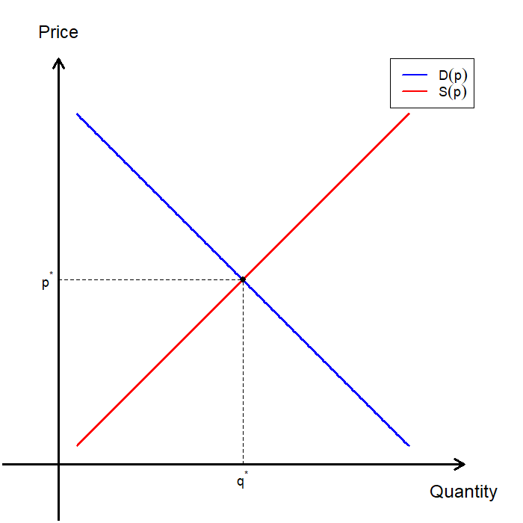
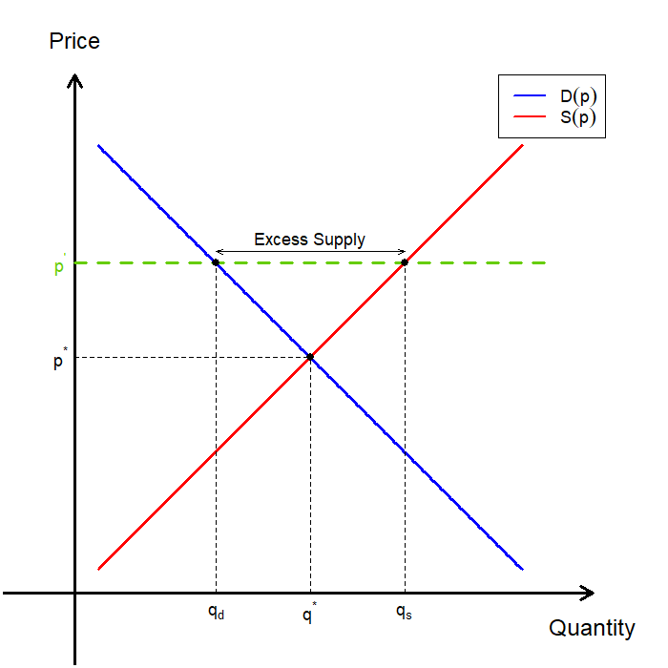
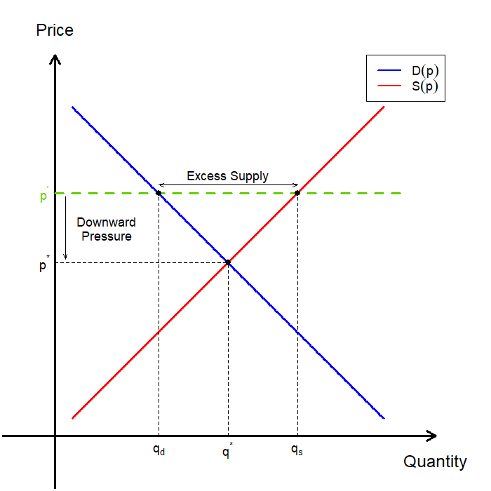
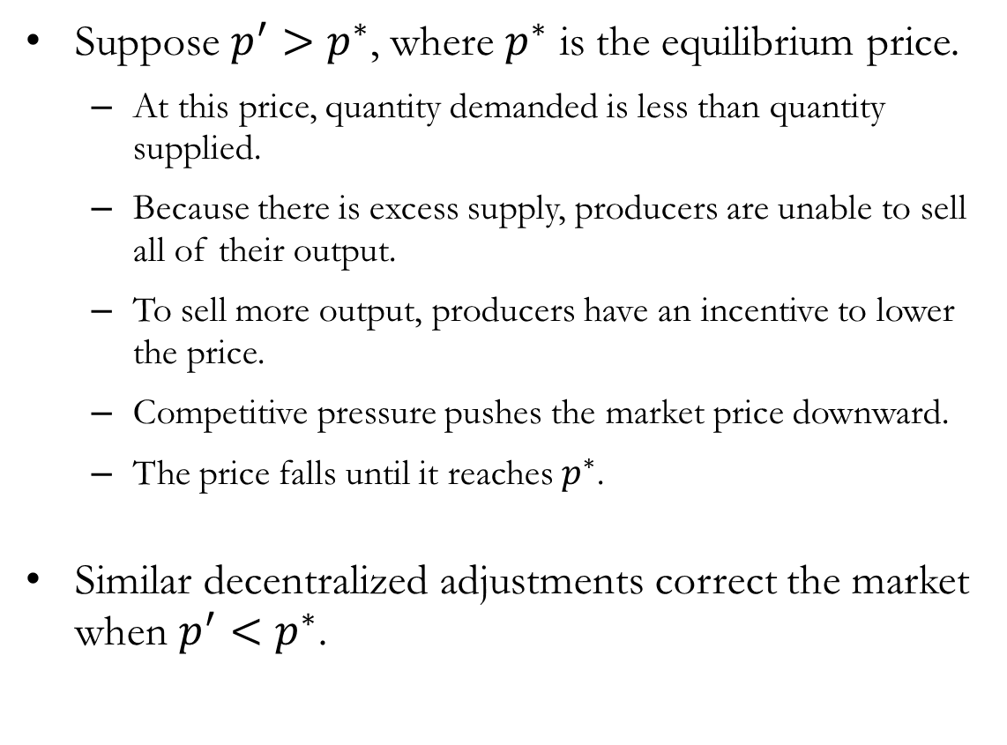
Economic Equilibrium: $p^{∗}<p^{′}$
Suppose $p^{′}>p^{∗}$, where $p^{∗}$ is the equilibrium price.
At this price, quantity demanded is less than quantity supplied.
Because there is excess supply, producers are unable to sell all of their output.
To sell more output, producers have an incentive to lower the price.
Competitive pressure pushes the market price downward.
The price falls until it reaches $p^{∗}$.
Similar decentralized adjustments correct the market when $p^{′}<p^{∗}$.

Slide 7
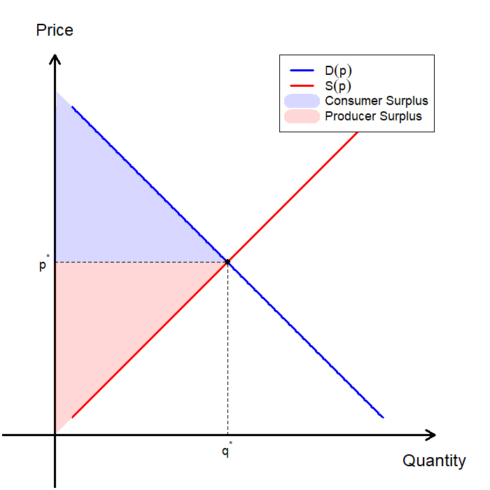
Recap: Total Surplus
Total surplus is the sum of all gains from trade in a market.
In a simple market with consumers and producers as the only agents, total surplus equals the sum of consumer surplus and producer surplus.
A competitive equilibrium maximizes total surplus under the following conditions:
No externalities
No transaction cost
Complete information

Slide 8
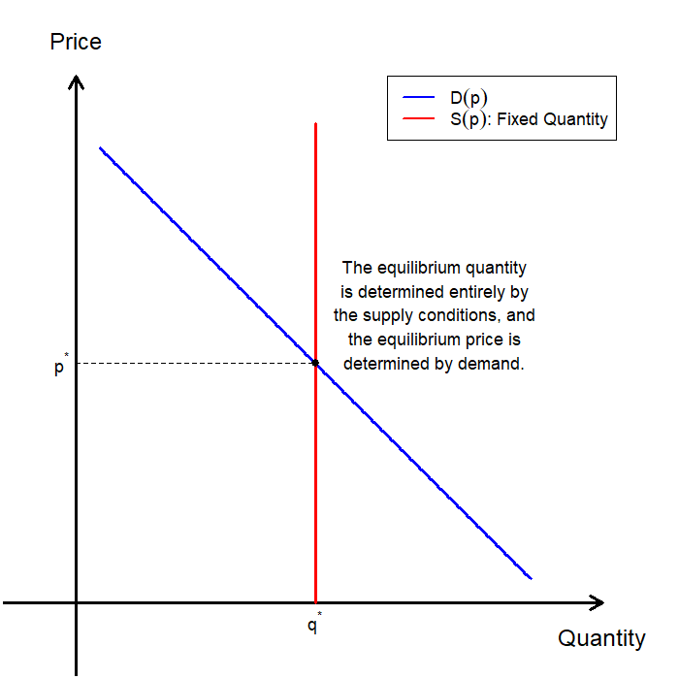
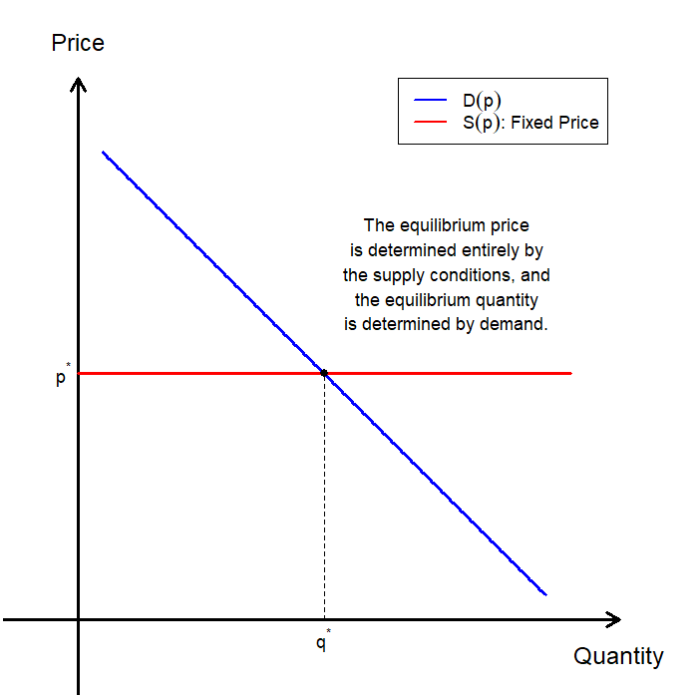
Special Cases: Vertical and Horizontal Supply

Slide 9
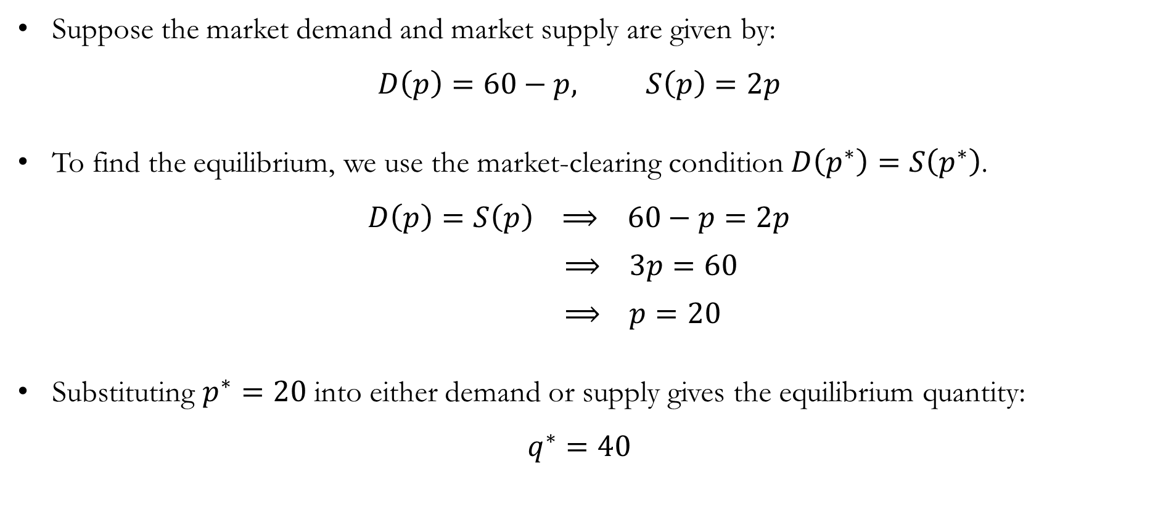
Finding the Equilibrium
Suppose the market demand and market supply are given by:
$$D\left(p\right)=60−p, S\left(p\right)=2p$$
To find the equilibrium, we use the market-clearing condition $D\left(p^{∗}\right)=S\left(p^{∗}\right)$.
$$D\left(p\right)=S\left(p\right) ⟹ 60−p=2p$$
$⟹ 3p=60$
$⟹ p=20$
Substituting $p^{∗}=20$ into either demand or supply gives the equilibrium quantity:
$$q^{∗}=40$$

Slide 10
Comparative Statics:
Taxation

Slide 11
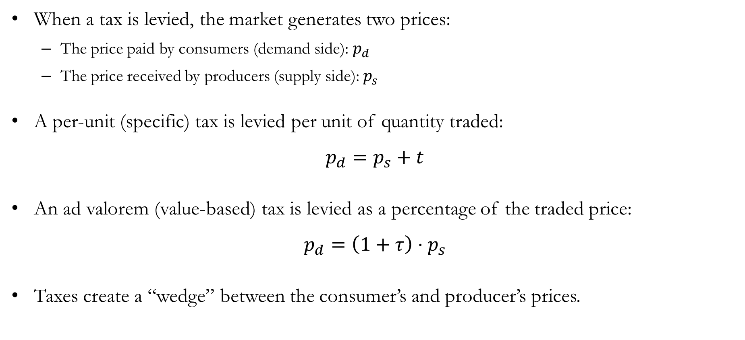
Taxation
When a tax is levied, the market generates two prices:
The price paid by consumers (demand side): $p_{d}$
The price received by producers (supply side): $p_{s}$
A per-unit (specific) tax is levied per unit of quantity traded:
$$p_{d}=p_{s}+t$$
An ad valorem (value-based) tax is levied as a percentage of the traded price:
$$p_{d}=\left(1+τ\right)⋅p_{s}$$
Taxes create a “wedge” between the consumer’s and producer’s prices.

Slide 12
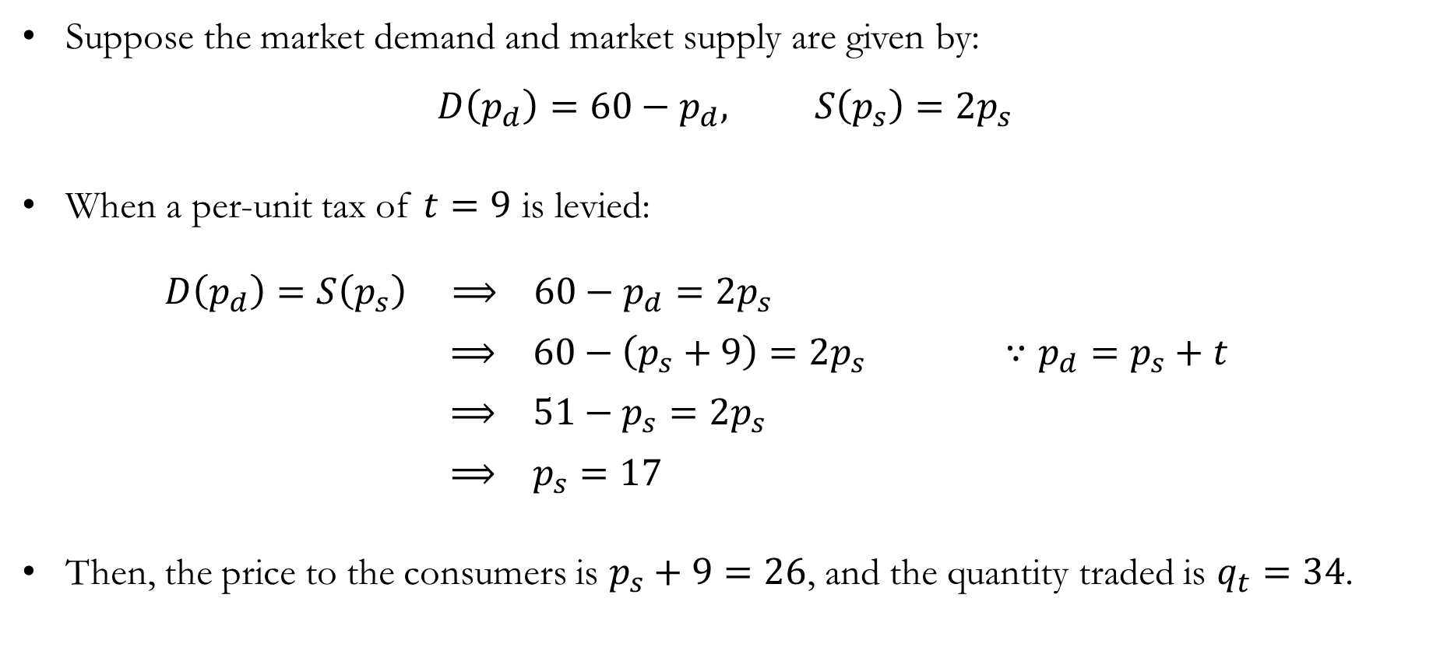
Taxation: Per-unit Taxes
Suppose the market demand and market supply are given by:
$$D\left(p_{d}\right)=60−p_{d}, S\left(p_{s}\right)=2p_{s}$$
When a per-unit tax of $t=9$ is levied:
$D\left(p_{d}\right)=S\left(p_{s}\right) ⟹ 60−p_{d}=2p_{s}$
$⟹ 60−\left(p_{s}+9\right)=2p_{s} ∵p_{d}=p_{s}+t$
$⟹ 51−p_{s}=2p_{s}$
$⟹ p_{s}=17$
Then, the price to the consumers is $p_{s}+9=26$, and the quantity traded is $q_{t}=34$.

Slide 13
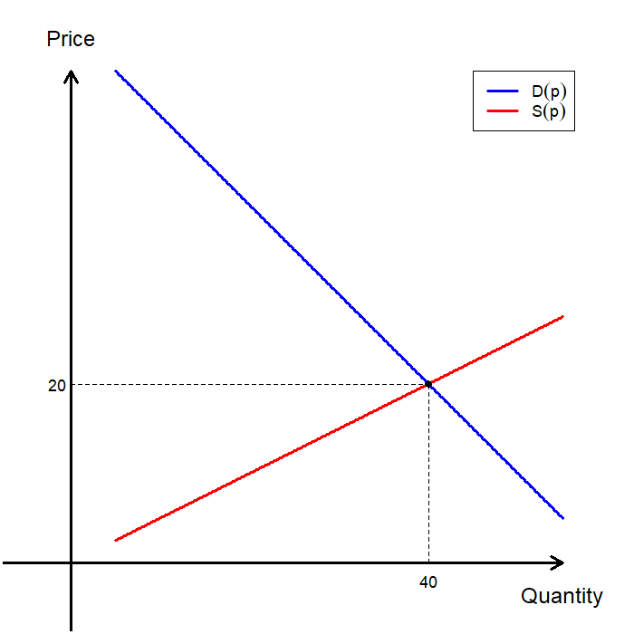
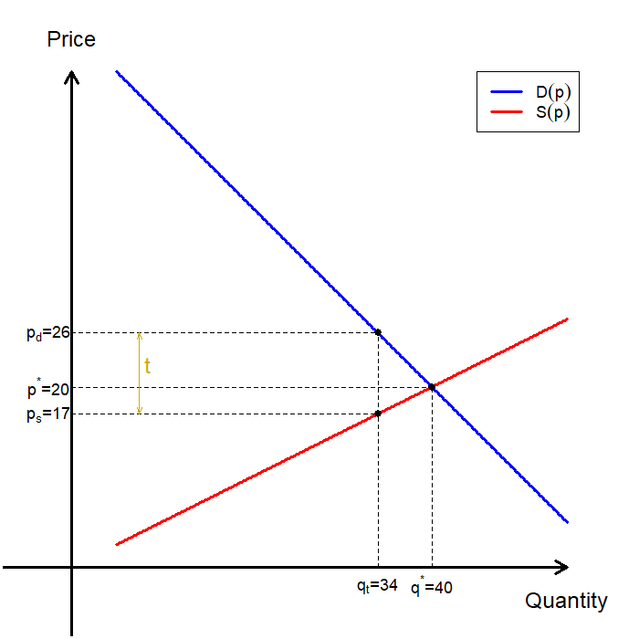
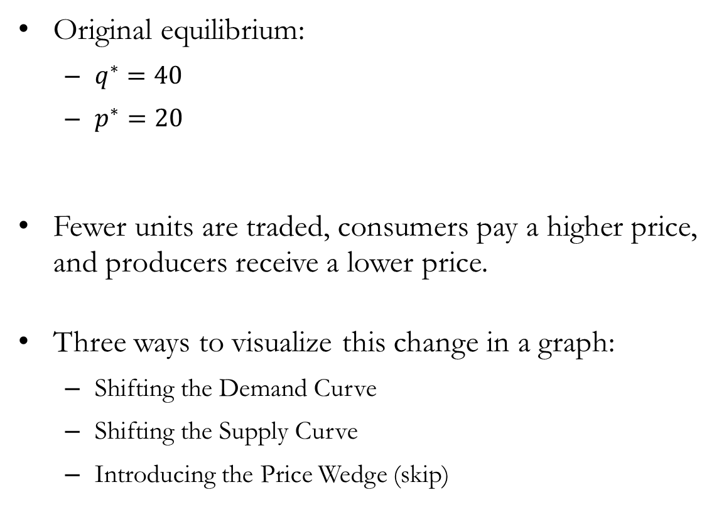
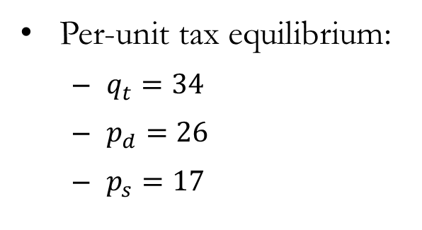
Taxation: Per-unit Taxes
Original equilibrium:
$q^{∗}=40$
$p^{∗}=20$
Fewer units are traded, consumers pay a higher price, and producers receive a lower price.
Three ways to visualize this change in a graph:
Shifting the Demand Curve
Shifting the Supply Curve
Introducing the Price Wedge (skip)
Per-unit tax equilibrium:
$q_{t}=34$
$p_{d}=26$
$p_{s}=17$

Slide 14
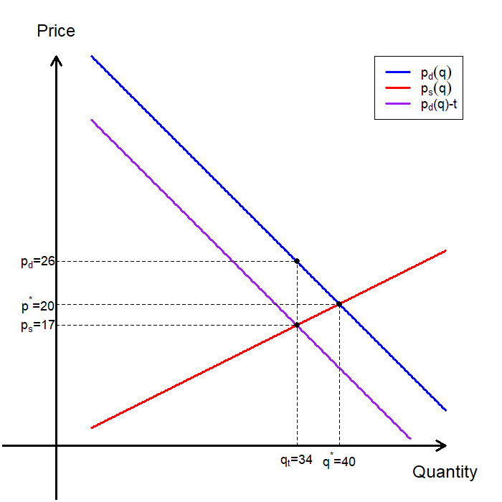
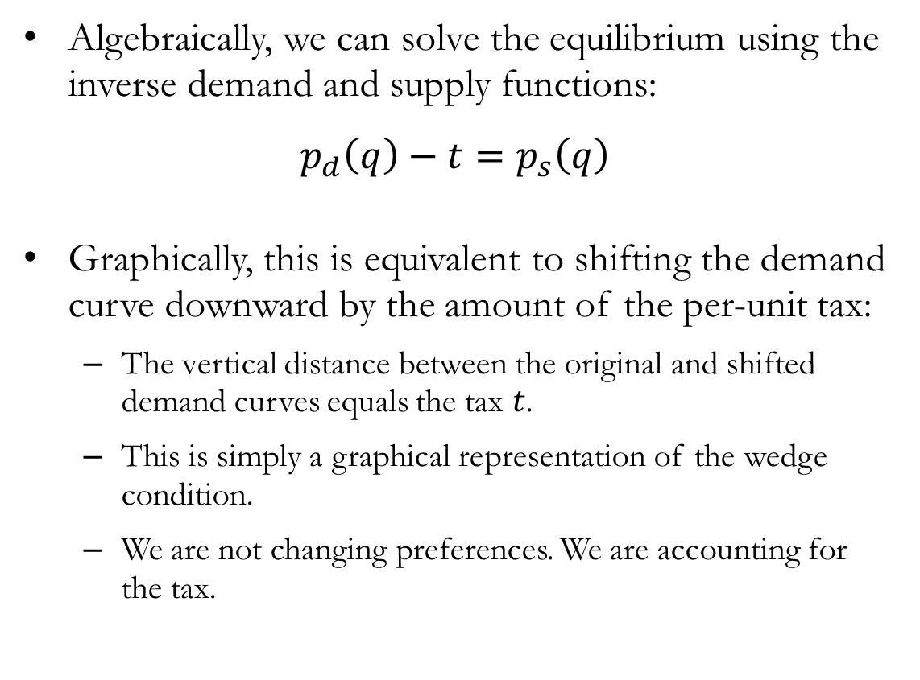
Per-unit Taxes: Shifting the Demand Curve
Algebraically, we can solve the equilibrium using the inverse demand and supply functions:
$$p_{d}\left(q\right)−t=p_{s}\left(q\right)$$
Graphically, this is equivalent to shifting the demand curve downward by the amount of the per-unit tax:
The vertical distance between the original and shifted demand curves equals the tax $t$.
This is simply a graphical representation of the wedge condition.
We are not changing preferences. We are accounting for the tax.

Slide 15
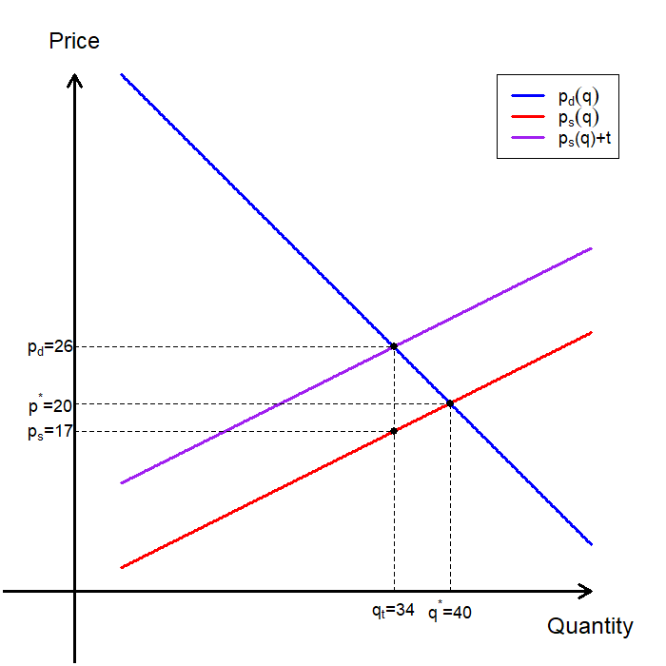
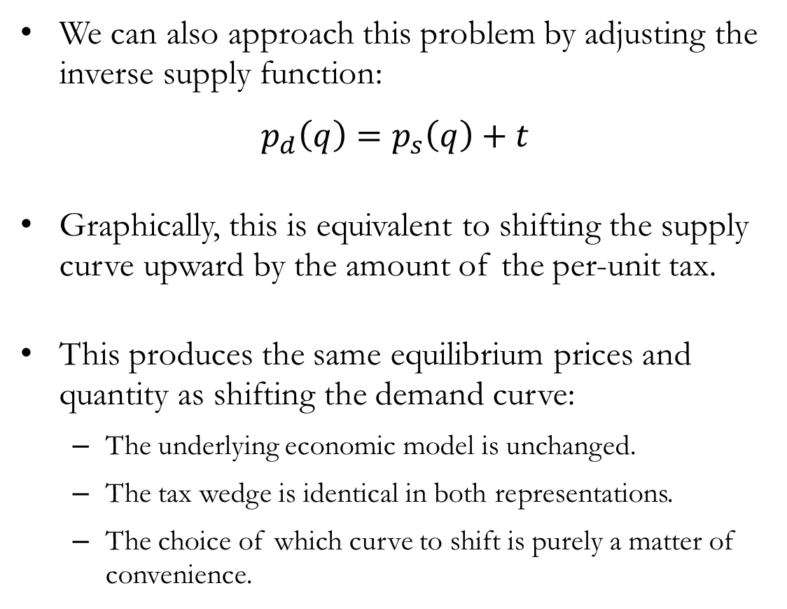
Per-unit Taxes: Shifting the Supply Curve
We can also approach this problem by adjusting the inverse supply function:
$$p_{d}\left(q\right)=p_{s}\left(q\right)+t$$
Graphically, this is equivalent to shifting the supply curve upward by the amount of the per-unit tax.
This produces the same equilibrium prices and quantity as shifting the demand curve:
The underlying economic model is unchanged.
The tax wedge is identical in both representations.
The choice of which curve to shift is purely a matter of convenience.

Slide 16
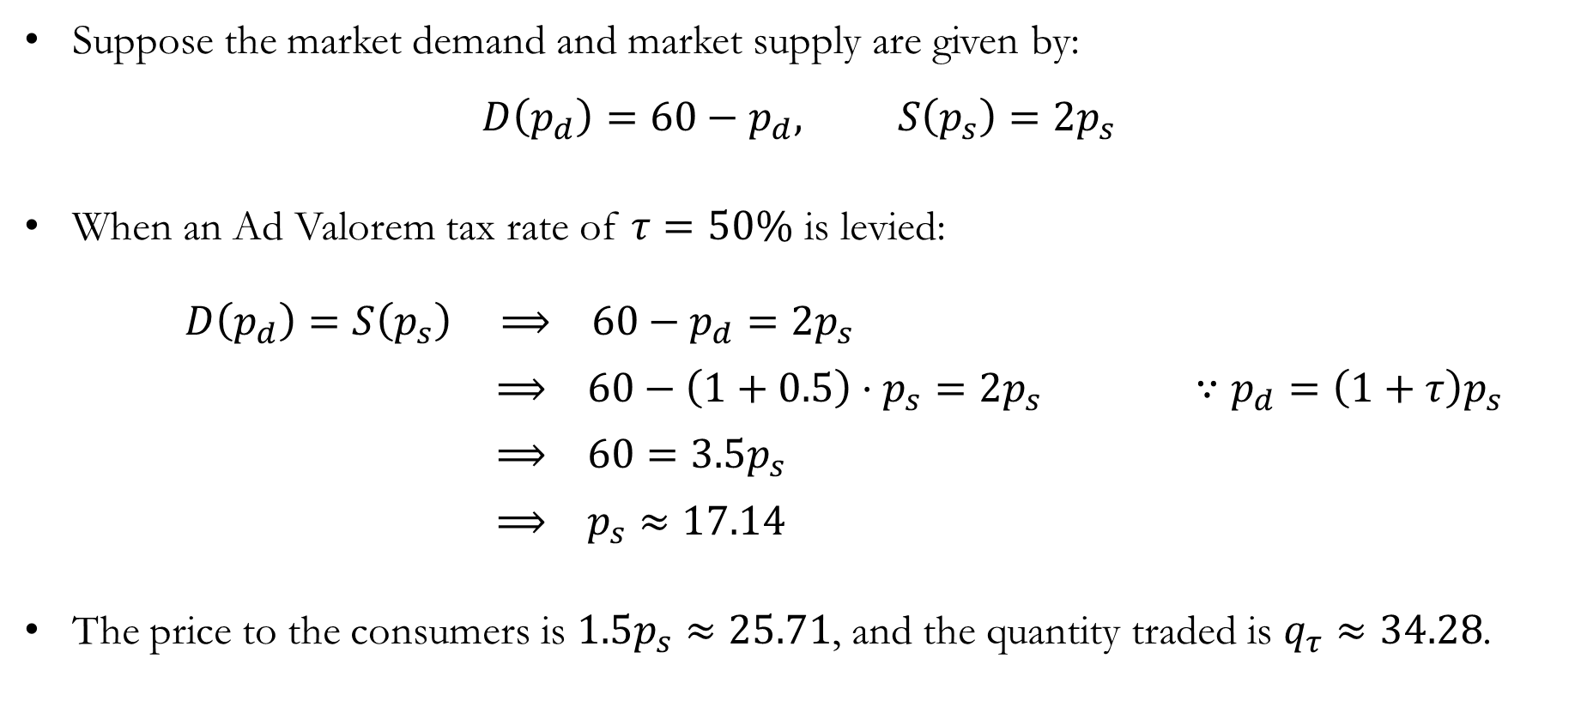
Taxation: Ad Valorem Taxes
Suppose the market demand and market supply are given by:
$$D\left(p_{d}\right)=60−p_{d}, S\left(p_{s}\right)=2p_{s}$$
When an Ad Valorem tax rate of $τ=50\%$ is levied:
$D\left(p_{d}\right)=S\left(p_{s}\right) ⟹ 60−p_{d}=2p_{s}$
$⟹ 60−\left(1+0.5\right)⋅p_{s}=2p_{s} ∵p_{d}=\left(1+τ\right)p_{s}$
$⟹ 60=3.5p_{s}$
$⟹ p_{s}≈17.14$
The price to the consumers is $1.5p_{s}≈25.71$, and the quantity traded is $q_{τ}≈34.28$.

Slide 17
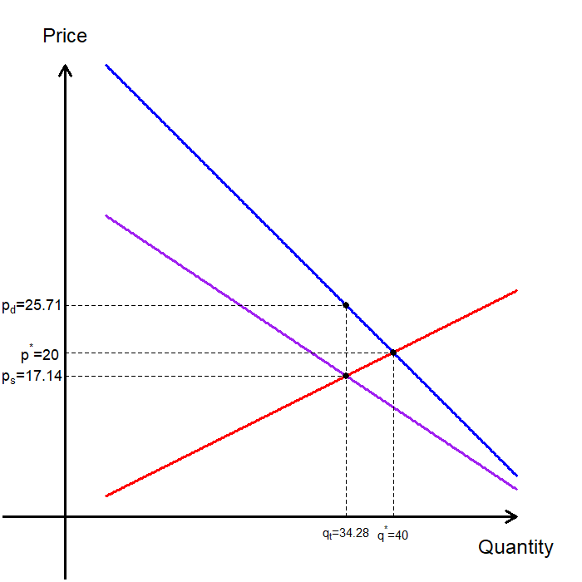
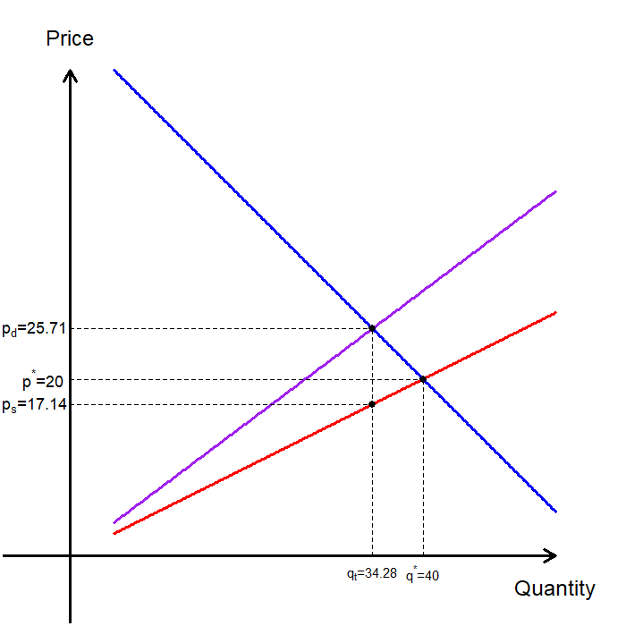
Ad Valorem Taxes: Pivoting Demand / Supply Curves

Slide 18
Passing Along a Tax
We found that the equilibrium price and quantity can be determined regardless of whether we adjust demand or supply.
The statutory assignment of the tax does not affect the final equilibrium prices or the quantity traded.
The market adjusts prices so that:
Consumers pay more than before.
Producers receive less than before.
The tax wedge equals the tax.
The relative changes in the consumer’s and producer’s prices resulting from the tax are determined by the price elasticities of supply and demand.

Slide 19
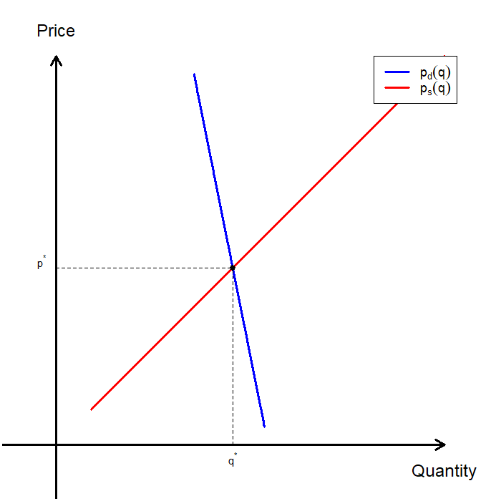
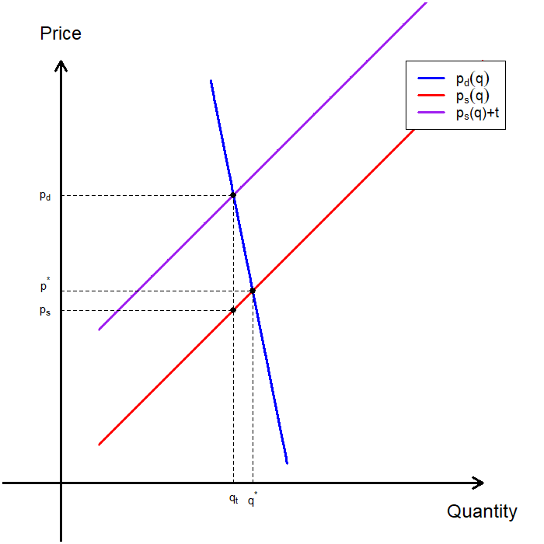
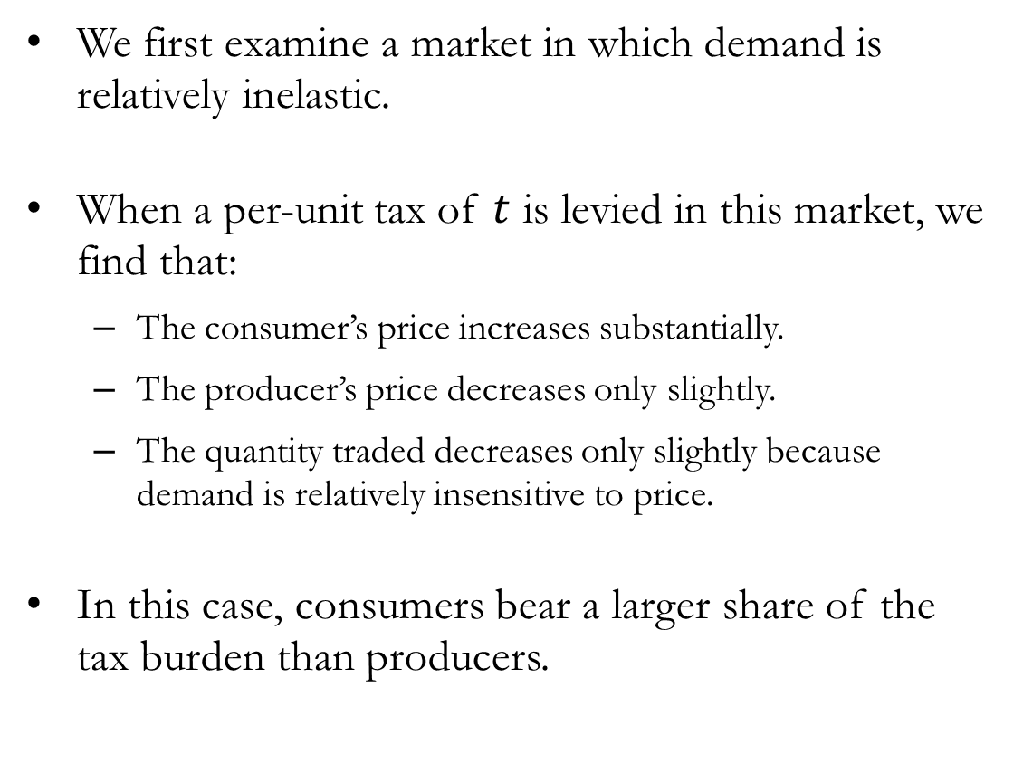
Passing Along a Tax: Inelastic Demand
We first examine a market in which demand is relatively inelastic.
When a per-unit tax of $t$ is levied in this market, we find that:
The consumer’s price increases substantially.
The producer’s price decreases only slightly.
The quantity traded decreases only slightly because demand is relatively insensitive to price.
In this case, consumers bear a larger share of the tax burden than producers.

Slide 20
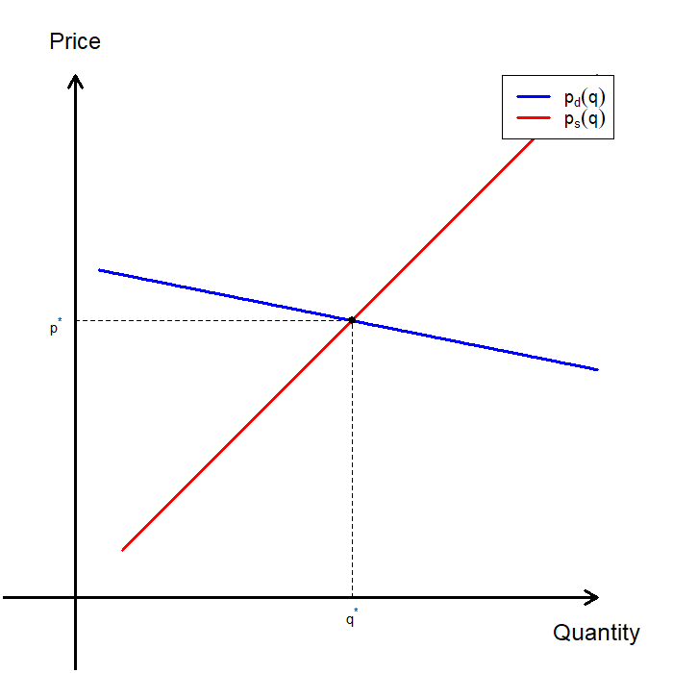
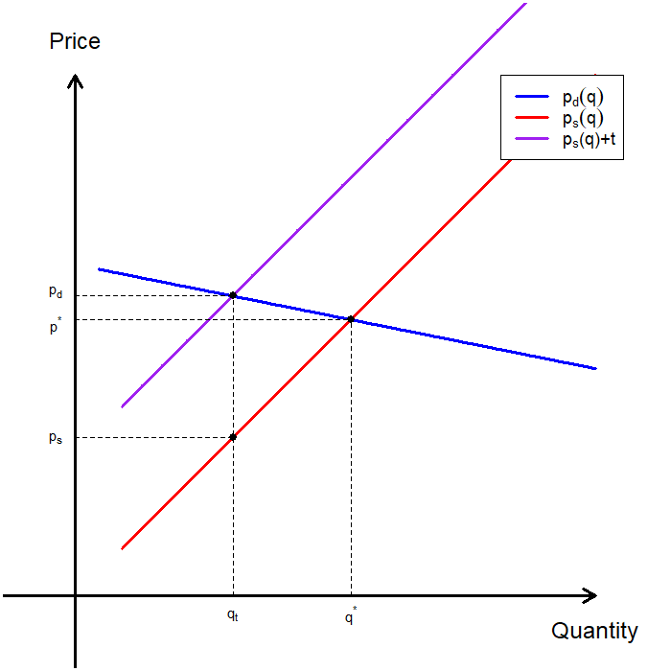
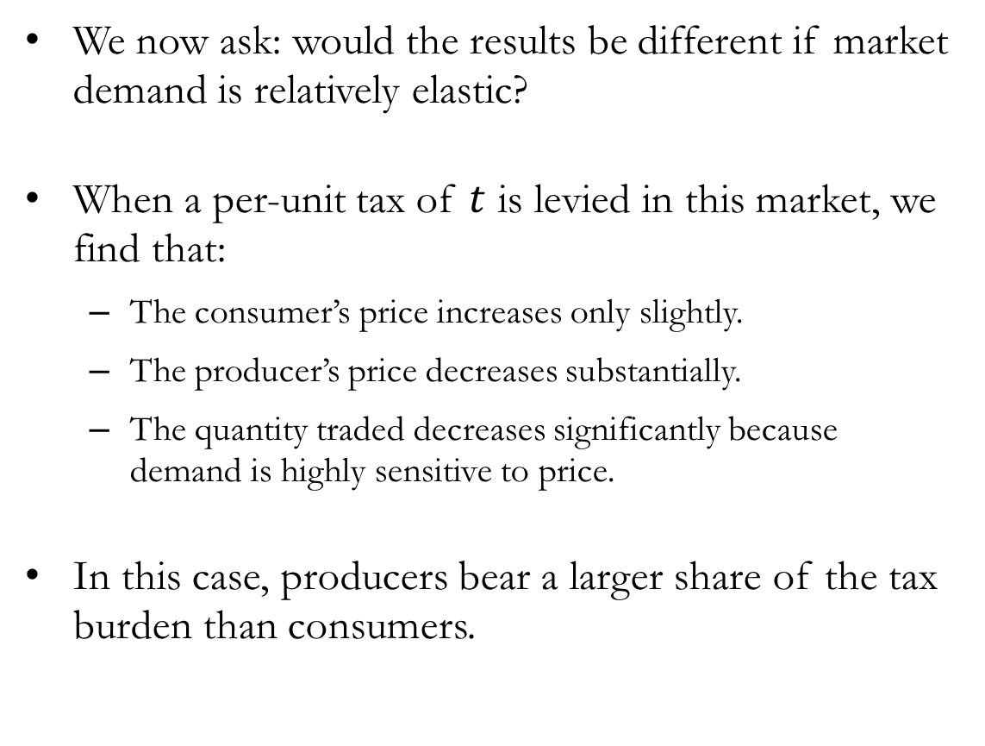
Passing Along a Tax: Elastic Demand
We now ask: would the results be different if market demand is relatively elastic?
When a per-unit tax of $t$ is levied in this market, we find that:
The consumer’s price increases only slightly.
The producer’s price decreases substantially.
The quantity traded decreases significantly because demand is highly sensitive to price.
In this case, producers bear a larger share of the tax burden than consumers.

Slide 21
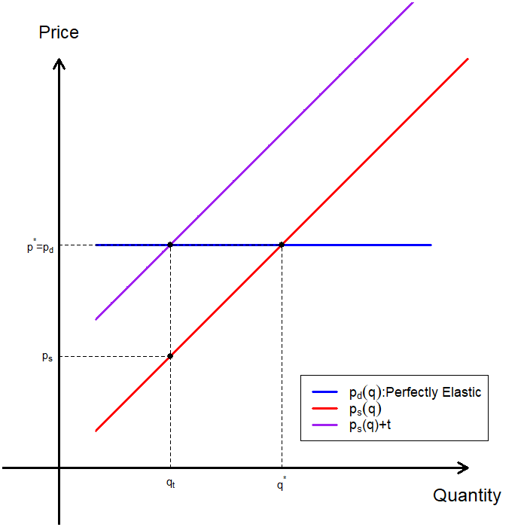
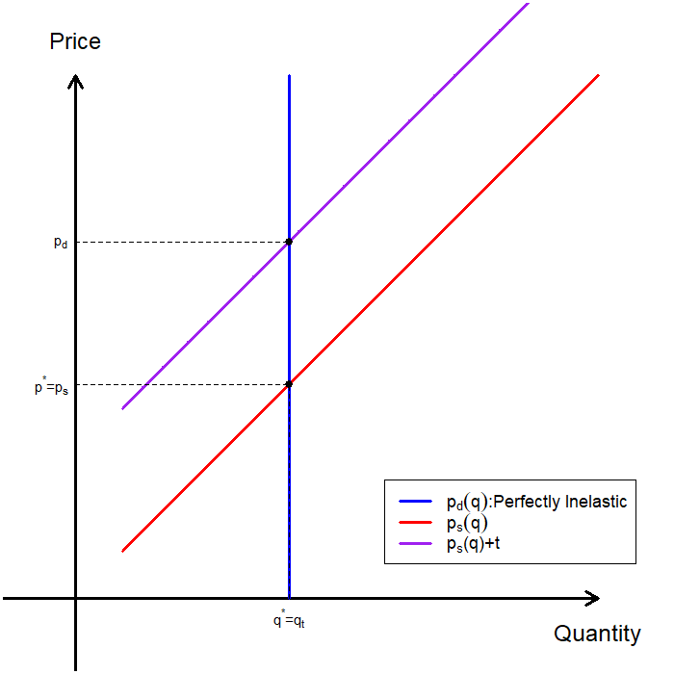
Passing Along a Tax : Extreme Cases

Slide 22
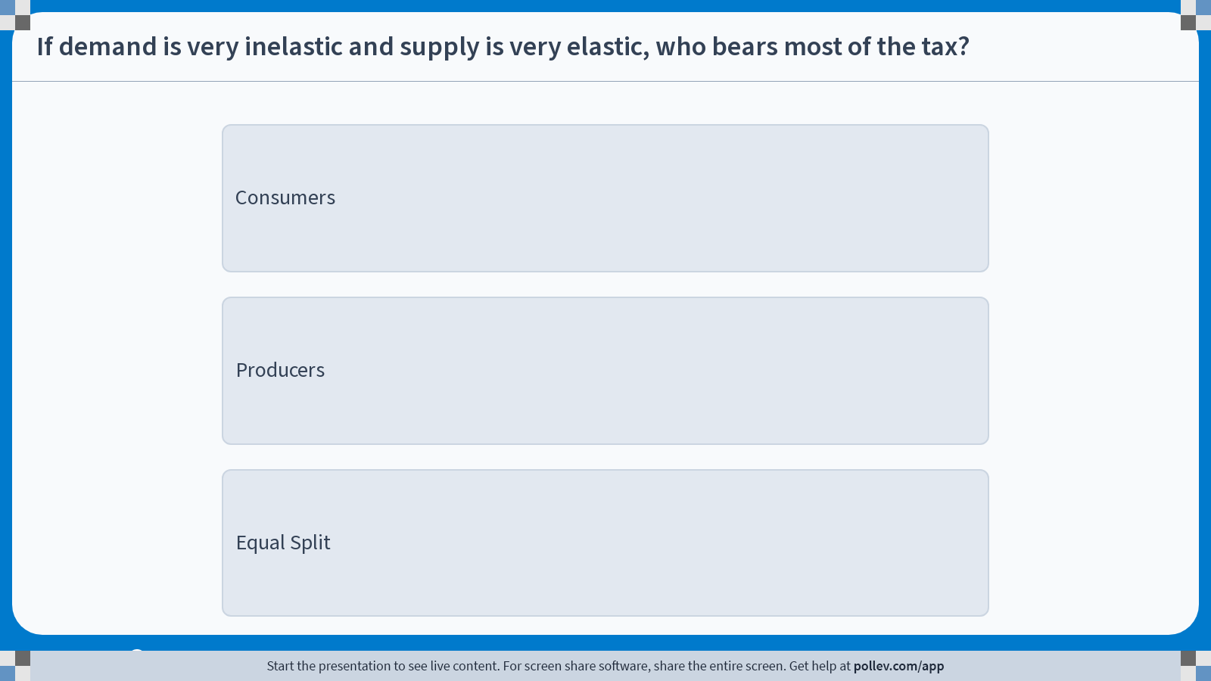
Poll Everywhere multiple choice poll instructions screen Activity Title: If demand is very inelastic and supply is very elastic, who bears most of the tax? Slide 25
Notes:
Do not modify the notes in this section to avoid tampering with the Poll Everywhere activity. More info at polleverywhere.com/support If demand is very inelastic and supply is very elastic, who bears most of the tax? https://www.polleverywhere.com/multiple_choice_polls/YvDlcBAnV74gvuvKmlL9Z?display_state=instructions&activity_state=opened&state=opened&flow=Engagement&onscreen=persist

Slide 23
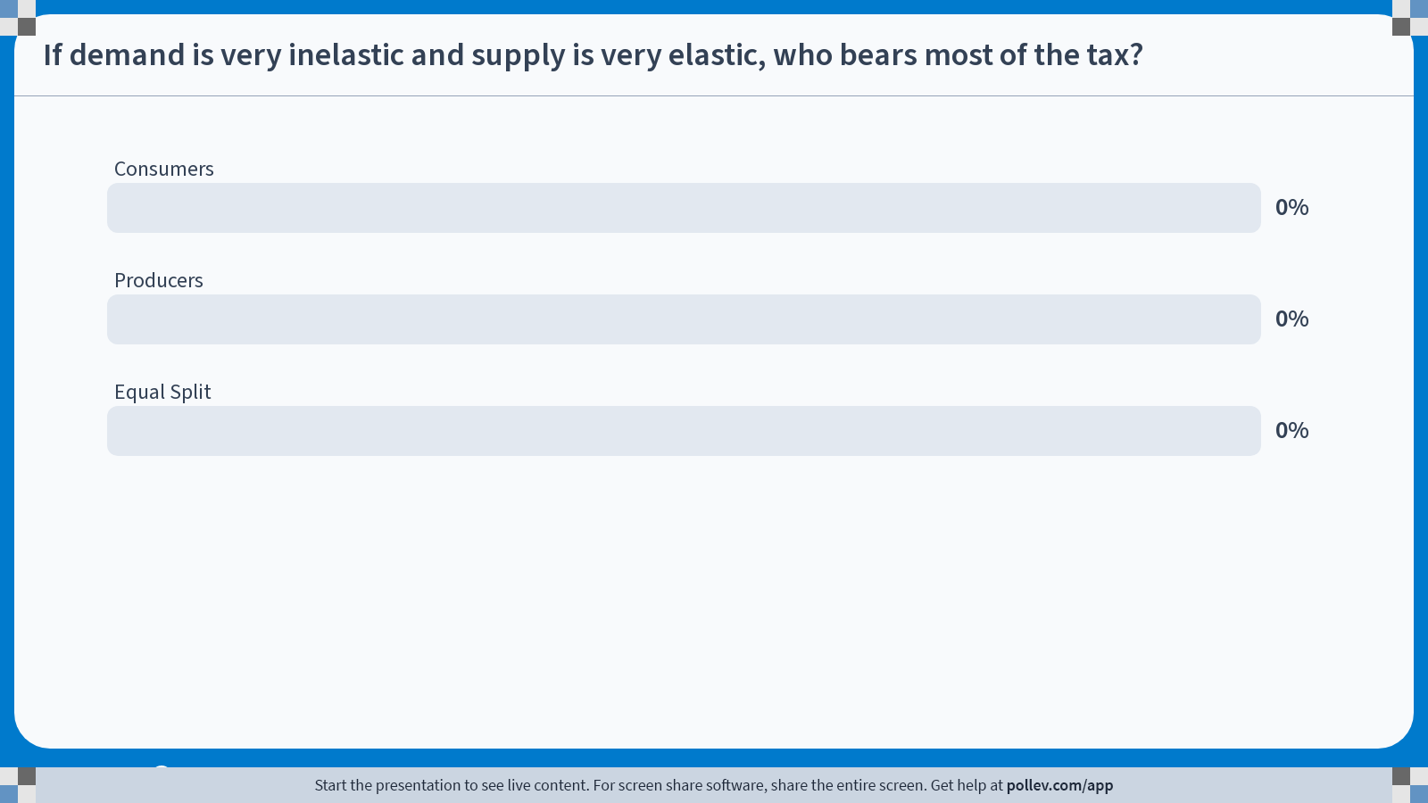
Poll Everywhere multiple choice poll chart screen Activity Title: If demand is very inelastic and supply is very elastic, who bears most of the tax? Slide 27
Notes:
Do not modify the notes in this section to avoid tampering with the Poll Everywhere activity. More info at polleverywhere.com/support If demand is very inelastic and supply is very elastic, who bears most of the tax? https://www.polleverywhere.com/multiple_choice_polls/YvDlcBAnV74gvuvKmlL9Z?display_state=chart&activity_state=closed&state=closed&flow=Engagement&onscreen=persist

Slide 24
Passing Along a Tax: Elasticities and Burden
Please try varying the supply elasticity at home.
The side of the market that is relatively less elastic bears a larger share of the tax burden.
The less elastic side cannot easily change quantity.
Therefore, it cannot easily avoid the tax.
The more elastic side can adjust quantity more easily and therefore bears less of the burden.
The next natural question is: how can we quantify the relative burden on consumers and producers?
We now examine the welfare consequences of taxation and how tax burdens are related to price elasticities.

Slide 25
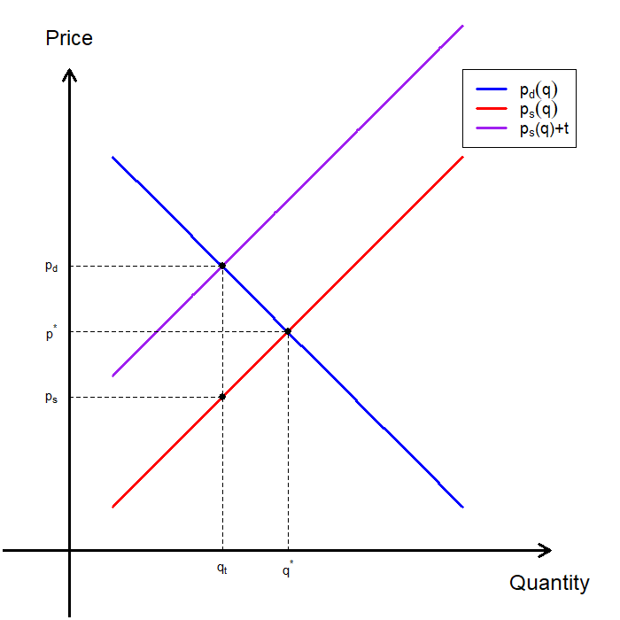
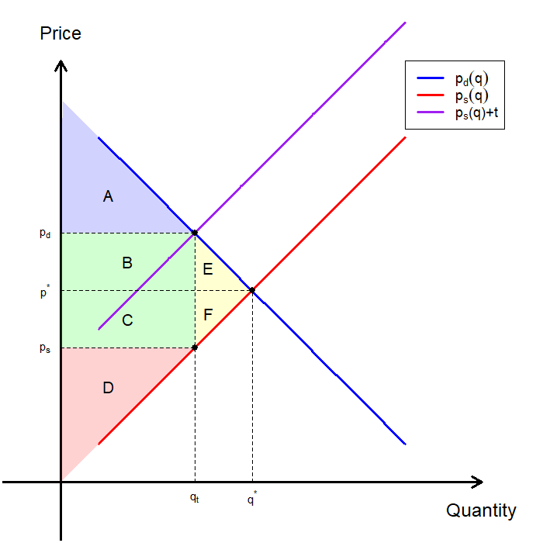
Welfare Consequences of Taxation
Taxation leads to a change in total surplus because:
Consumers who remain in the market pay a higher price.
Producers receive a lower price on the units they sell.
Some mutually beneficial trades no longer occur.
The government collects tax revenue.
The graphical breakdown is as follows:
 | Before Tax | After Tax | Change
Consumer Surplus | A+B+E | A | -B-E
Producer Surplus | C+D+F | D | -C-F
Tax Revenue | - | B+C | +B+C
Total Surplus | A+B+C+D+E+F | A+B+C+D | -E-F

Slide 26
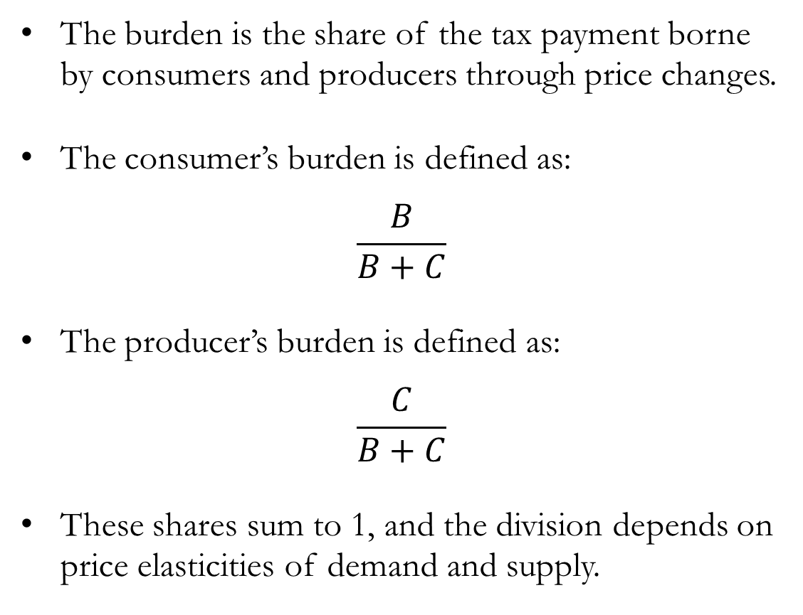
The Burden of Taxation
The burden is the share of the tax payment borne by consumers and producers through price changes.
The consumer’s burden is defined as:
$$\frac{B}{B+C}$$
The producer’s burden is defined as:
$$\frac{C}{B+C}$$
These shares sum to 1, and the division depends on price elasticities of demand and supply.

Slide 27
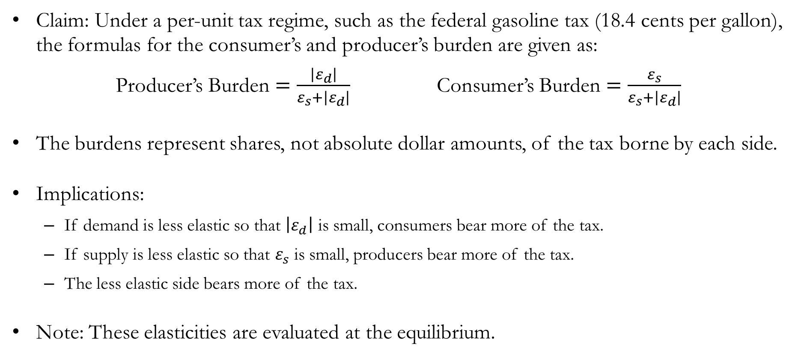
Burden & Elasticities under Per-unit Taxes
Claim: Under a per-unit tax regime, such as the federal gasoline tax (18.4 cents per gallon), the formulas for the consumer’s and producer’s burden are given as:
Producer’s Burden $=\frac{\left|ε_{d}\right|}{ε_{s}+\left|ε_{d}\right|}$ Consumer’s Burden $=\frac{ε_{s}}{ε_{s}+\left|ε_{d}\right|}$
The burdens represent shares, not absolute dollar amounts, of the tax borne by each side.
Implications:
If demand is less elastic so that $\left|ε_{d}\right|$ is small, consumers bear more of the tax.
If supply is less elastic so that $ε_{s}$ is small, producers bear more of the tax.
The less elastic side bears more of the tax.
Note: These elasticities are evaluated at the equilibrium.

Slide 28
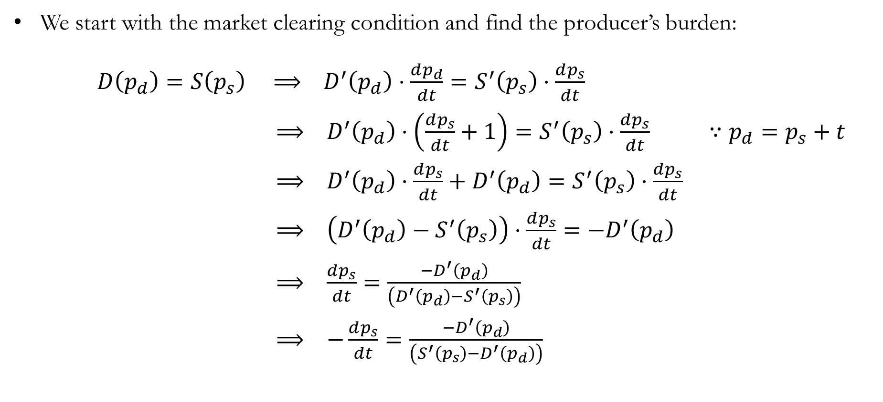
Detour: Burden & Elasticities under Per-unit Taxes
We start with the market clearing condition and find the producer’s burden:
$D\left(p_{d}\right)=S\left(p_{s}\right) ⟹ D^{′}\left(p_{d}\right)⋅\frac{dp_{d}}{dt}=S^{′}\left(p_{s}\right)⋅\frac{dp_{s}}{dt}$
$⟹ D^{′}\left(p_{d}\right)⋅\left(\frac{dp_{s}}{dt}+1\right)=S^{′}\left(p_{s}\right)⋅\frac{dp_{s}}{dt} ∵p_{d}=p_{s}+t$
$⟹ D^{′}\left(p_{d}\right)⋅\frac{dp_{s}}{dt}+D^{′}\left(p_{d}\right)=S^{′}\left(p_{s}\right)⋅\frac{dp_{s}}{dt}$
$⟹ \left(D^{′}\left(p_{d}\right)−S^{′}\left(p_{s}\right)\right)⋅\frac{dp_{s}}{dt}=−D^{′}\left(p_{d}\right)$
$⟹ \frac{dp_{s}}{dt}=\frac{−D^{′}\left(p_{d}\right)}{\left(D^{′}\left(p_{d}\right)−S^{′}\left(p_{s}\right)\right)}$
$⟹ −\frac{dp_{s}}{dt}=\frac{−D^{′}\left(p_{d}\right)}{\left(S^{′}\left(p_{s}\right)−D^{′}\left(p_{d}\right)\right)}$

Slide 29
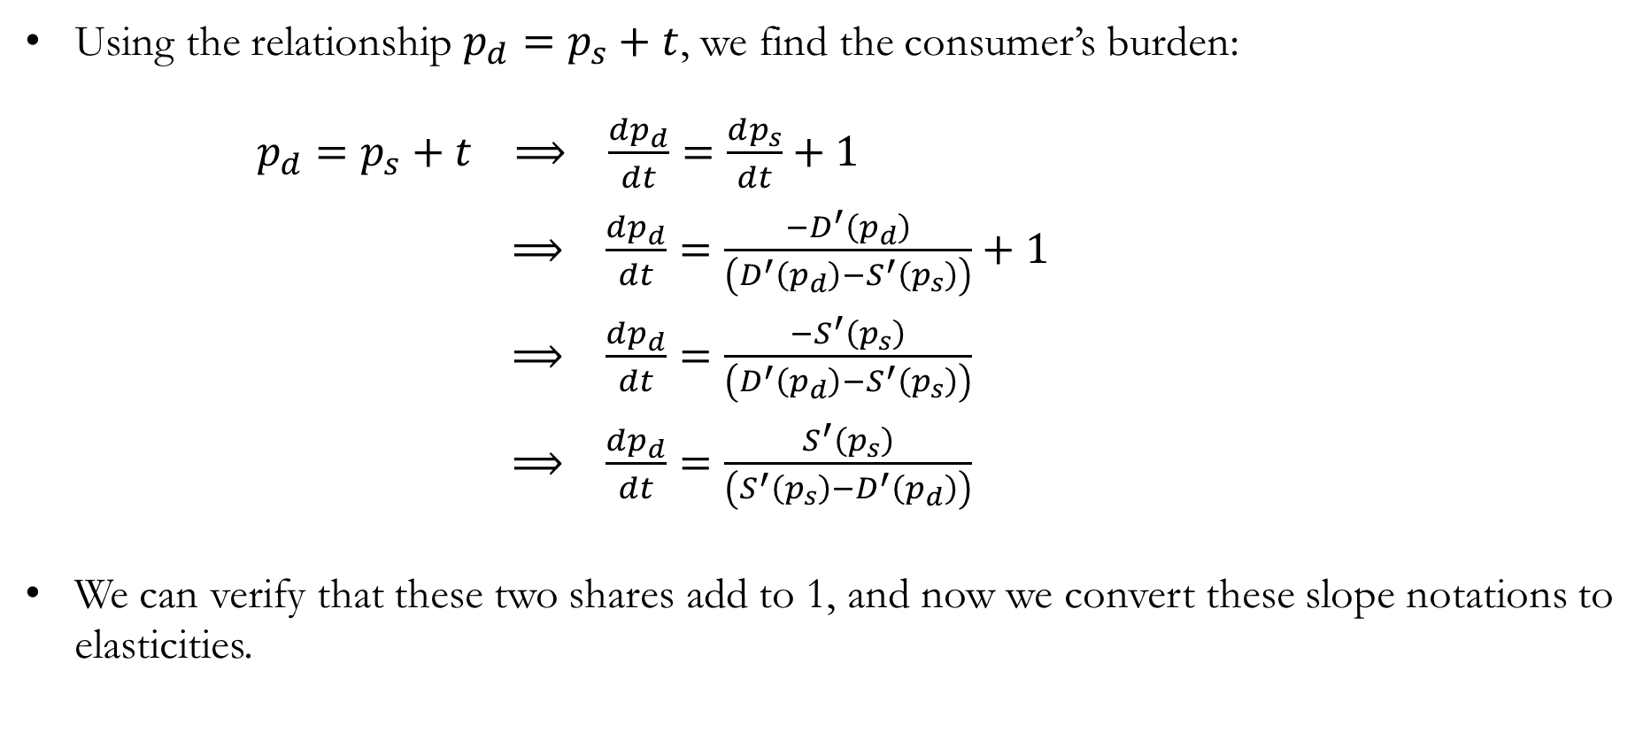
Detour: Burden & Elasticities under Per-unit Taxes
Using the relationship $p_{d}=p_{s}+t$, we find the consumer’s burden:
$p_{d}=p_{s}+t ⟹ \frac{dp_{d}}{dt}=\frac{dp_{s}}{dt}+1$
$⟹ \frac{dp_{d}}{dt}=\frac{−D^{′}\left(p_{d}\right)}{\left(D^{′}\left(p_{d}\right)−S^{′}\left(p_{s}\right)\right)}+1$
$⟹ \frac{dp_{d}}{dt}=\frac{−S^{′}\left(p_{s}\right)}{\left(D^{′}\left(p_{d}\right)−S^{′}\left(p_{s}\right)\right)}$
$⟹ \frac{dp_{d}}{dt}=\frac{S^{′}\left(p_{s}\right)}{\left({S^{′}\left(p_{s}\right)−D}^{′}\left(p_{d}\right)\right)}$
We can verify that these two shares add to 1, and now we convert these slope notations to elasticities.

Slide 30
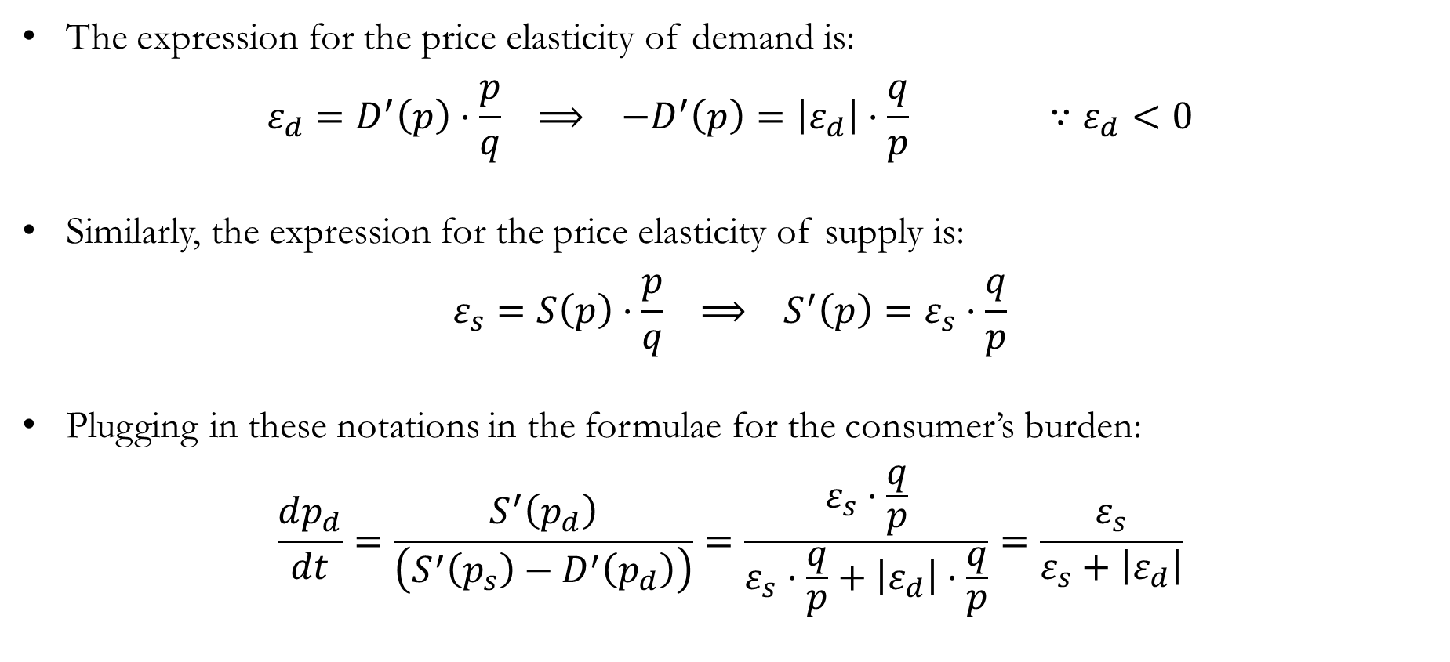
Detour: Burden & Elasticities under Per-unit Taxes
The expression for the price elasticity of demand is:
$$ε_{d}=D^{′}\left(p\right)⋅\frac{p}{q} ⟹ −D^{′}\left(p\right)=\left|ε_{d}\right|⋅\frac{q}{p} ∵ε_{d}<0$$
Similarly, the expression for the price elasticity of supply is:
$$ε_{s}=S\left(p\right)⋅\frac{p}{q} ⟹ S^{′}\left(p\right)=ε_{s}⋅\frac{q}{p}$$
Plugging in these notations in the formulae for the consumer’s burden:
$$\frac{dp_{d}}{dt}=\frac{S^{′}\left(p_{d}\right)}{\left({S^{′}\left(p_{s}\right)−D}^{′}\left(p_{d}\right)\right)}=\frac{ε_{s}⋅\frac{q}{p}}{ε_{s}⋅\frac{q}{p}+\left|ε_{d}\right|⋅\frac{q}{p}}=\frac{ε_{s}}{ε_{s}+\left|ε_{d}\right|}$$

Slide 31

Detour: Burden & Elasticities under Per-unit Taxes
Plugging in these notations in the formulae for the producer’s burden:
$$−\frac{dp_{s}}{dt}=\frac{−D^{′}\left(p_{d}\right)}{\left(S^{′}\left(p_{s}\right)−D^{′}\left(p_{d}\right)\right)}=\frac{\left|ε_{d}\right|⋅\frac{q}{p}}{ε_{s}⋅\frac{q}{p}+\left|ε_{d}\right|⋅\frac{q}{p}}=\frac{\left|ε_{d}\right|}{ε_{s}+\left|ε_{d}\right|}$$

Slide 32
Recap & Preview

Slide 33
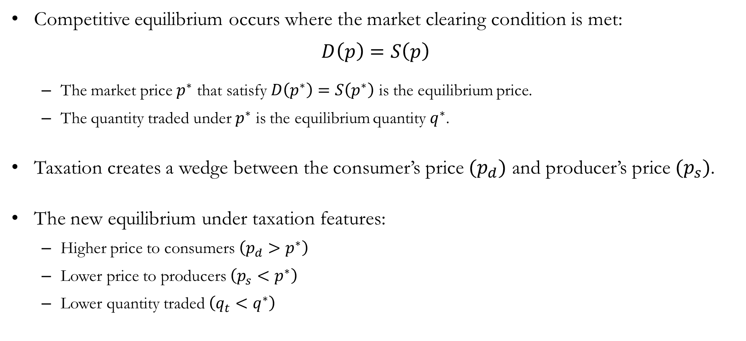
Recap: Equilibrium
Competitive equilibrium occurs where the market clearing condition is met:
$$D\left(p\right)=S\left(p\right)$$
The market price $p^{∗}$ that satisfy $D\left(p^{∗}\right)=S\left(p^{∗}\right)$ is the equilibrium price.
The quantity traded under $p^{∗}$ is the equilibrium quantity $q^{∗}$.
Taxation creates a wedge between the consumer’s price $(p_{d})$ and producer’s price $(p_{s})$.
The new equilibrium under taxation features:
Higher price to consumers $\left(p_{d}>p^{∗}\right)$
Lower price to producers $\left(p_{s}<p^{∗}\right)$
Lower quantity traded $\left(q_{t}<q^{∗}\right)$

Slide 34
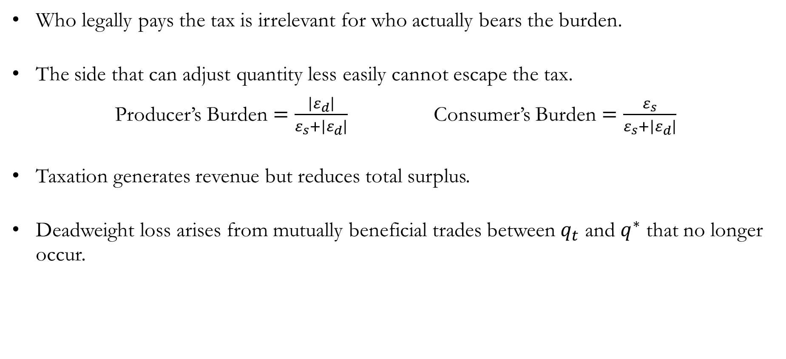
Recap: Equilibrium
Who legally pays the tax is irrelevant for who actually bears the burden.
The side that can adjust quantity less easily cannot escape the tax.
Producer’s Burden $=\frac{\left|ε_{d}\right|}{ε_{s}+\left|ε_{d}\right|}$ Consumer’s Burden $=\frac{ε_{s}}{ε_{s}+\left|ε_{d}\right|}$
Taxation generates revenue but reduces total surplus.
Deadweight loss arises from mutually beneficial trades between $q_{t}$ and $q^{∗}$ that no longer occur.

Slide 35
Preview: Technology
So far, we treated the supply curve as given, but what determines supply?
Firms choose how much to produce based on the available technology, inputs, relative productivity, and costs.
We now begin producer theory by studying the production function.
Key questions:
What is technological feasibility?
What does it mean to substitute between inputs?
How do diminishing returns arise?

