Slide 1
INTERMEDIATE MICROECONOMIC THEORY
Chapter 15: Market Demand

Slide 2
Recap: Consumer’s Surplus
Reservation prices describe the maximum price a consumer is willing to pay for each unit of a good.
Consumer surplus measures the difference between:
The consumer’s gross benefit, and
Total expenditure at the market price.
For discrete goods, consumer surplus is computed by summing reservation prices net of expenditure.
For continuous goods, consumer surplus is represented by the area:
Under the individual demand curve,
Above the market price.

Slide 3
Recap: Consumer’s Surplus
This area interpretation relies on the consumer’s preferences being represented by a quasilinear utility function.
When income effects are small, the area under the demand curve provides a useful approximation of consumer surplus.
Under quasilinear preferences, the utility function takes the form:
$$u\left(x_{1},x_{2}\right)=v\left(x_{1}\right)+x_{2}$$
Quasilinear utility implies:
No income effect for good 1.
Reservation prices are independent of income.

Slide 4
Individual Demand
to Market Demand

Slide 5
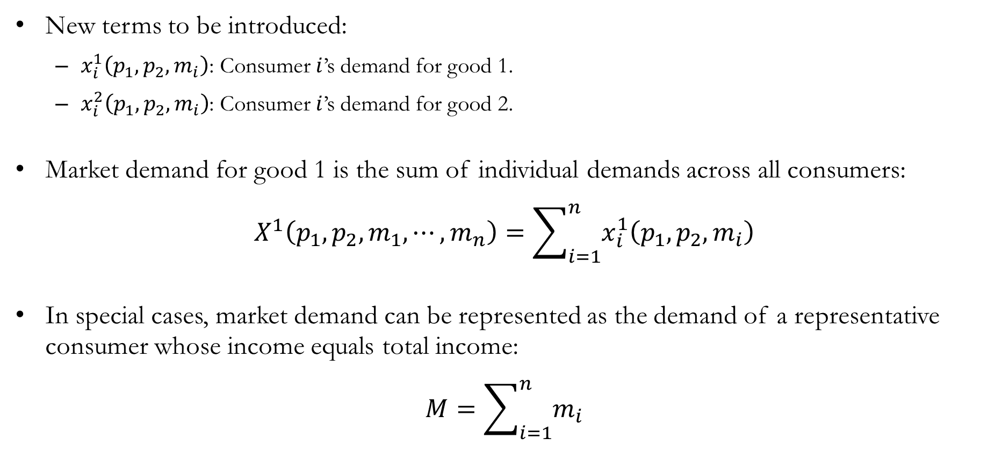
Individual to Market Demand
New terms to be introduced:
$x_{i}^{1}\left(p_{1},p_{2},m_{i}\right)$: Consumer $i$’s demand for good 1.
$x_{i}^{2}\left(p_{1},p_{2},m_{i}\right)$: Consumer $i$’s demand for good 2.
Market demand for good 1 is the sum of individual demands across all consumers:
$$X^{1}\left(p_{1},p_{2},m_{1},⋯,m_{n}\right)=\sum_{i=1}^{n}{x_{i}^{1}\left(p_{1},p_{2},m_{i}\right)}$$
In special cases, market demand can be represented as the demand of a representative consumer whose income equals total income:
$$M=\sum_{i=1}^{n}{m_{i}}$$

Slide 6
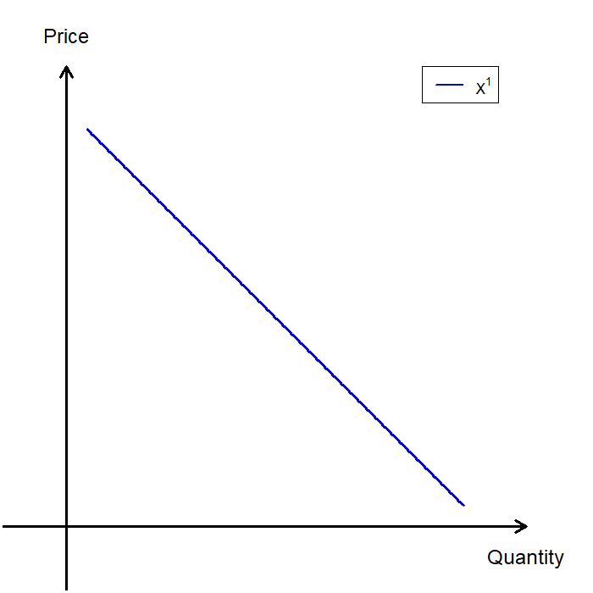
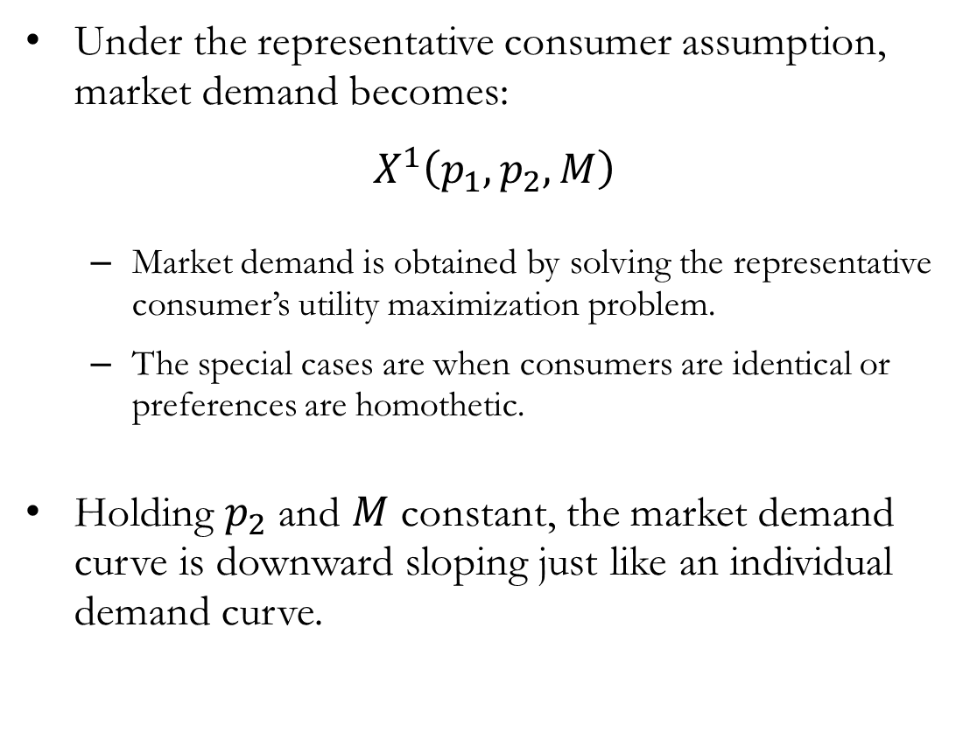
Market Demand: The Representative Consumer
Under the representative consumer assumption, market demand becomes:
$$X^{1}\left(p_{1},p_{2},M\right)$$
Market demand is obtained by solving the representative consumer’s utility maximization problem.
The special cases are when consumers are identical or preferences are homothetic.
Holding $p_{2}$ and $M$ constant, the market demand curve is downward sloping just like an individual demand curve.

Slide 7
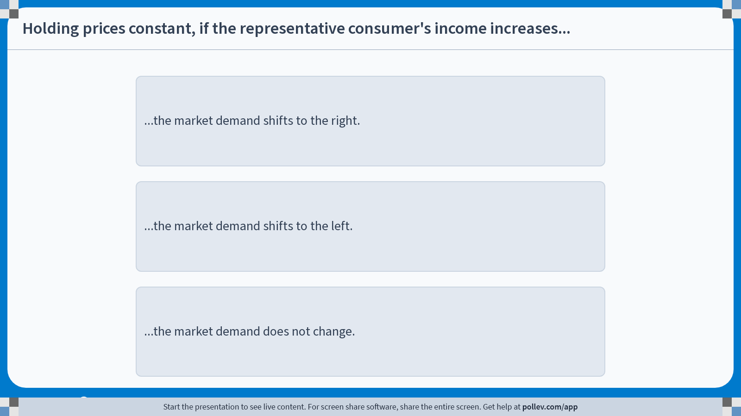
Poll Everywhere multiple choice poll instructions screen Activity Title: Holding prices constant, if the representative consumer's income increases... Slide 7
Notes:
Do not modify the notes in this section to avoid tampering with the Poll Everywhere activity. More info at polleverywhere.com/support Holding prices constant, if the representative consumer's income increases... https://www.polleverywhere.com/multiple_choice_polls/87JAQVY0LYjYDUUZtlswY?display_state=instructions&activity_state=opened&state=opened&flow=Engagement&onscreen=persist

Slide 8
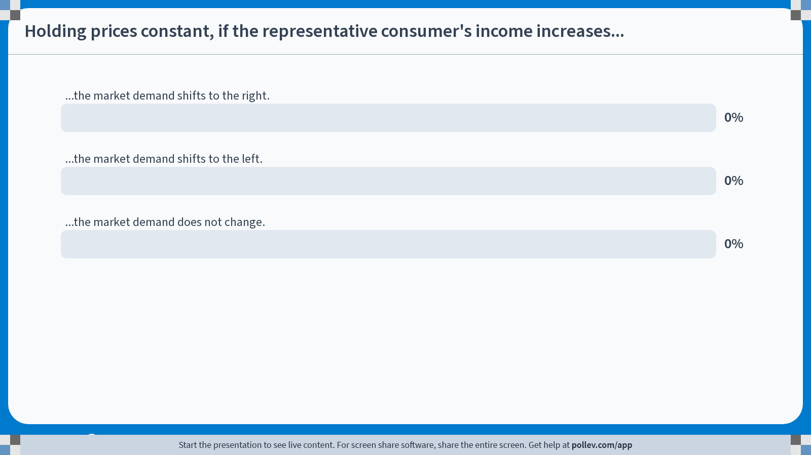
Poll Everywhere multiple choice poll chart screen Activity Title: Holding prices constant, if the representative consumer's income increases... Slide 9
Notes:
Do not modify the notes in this section to avoid tampering with the Poll Everywhere activity. More info at polleverywhere.com/support Holding prices constant, if the representative consumer's income increases... https://www.polleverywhere.com/multiple_choice_polls/87JAQVY0LYjYDUUZtlswY?display_state=chart&activity_state=closed&state=closed&flow=Engagement&onscreen=persist

Slide 9
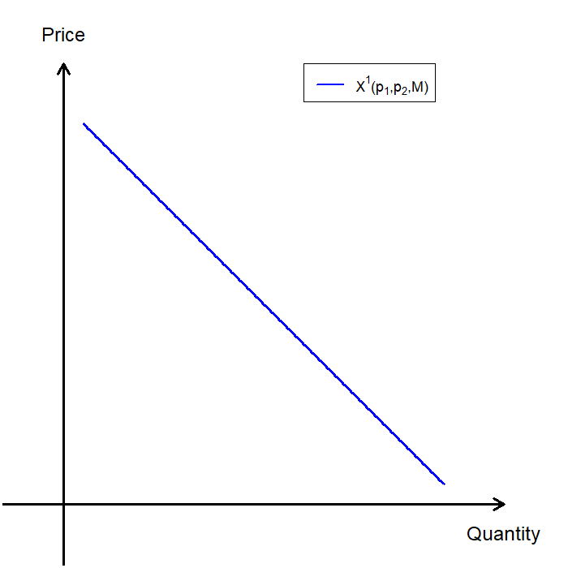
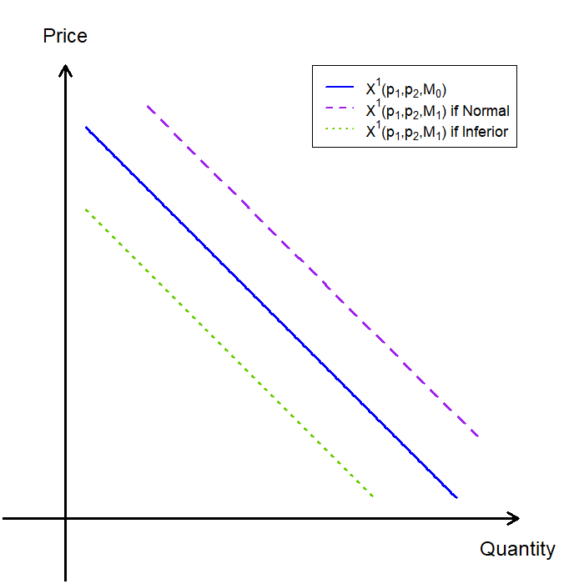
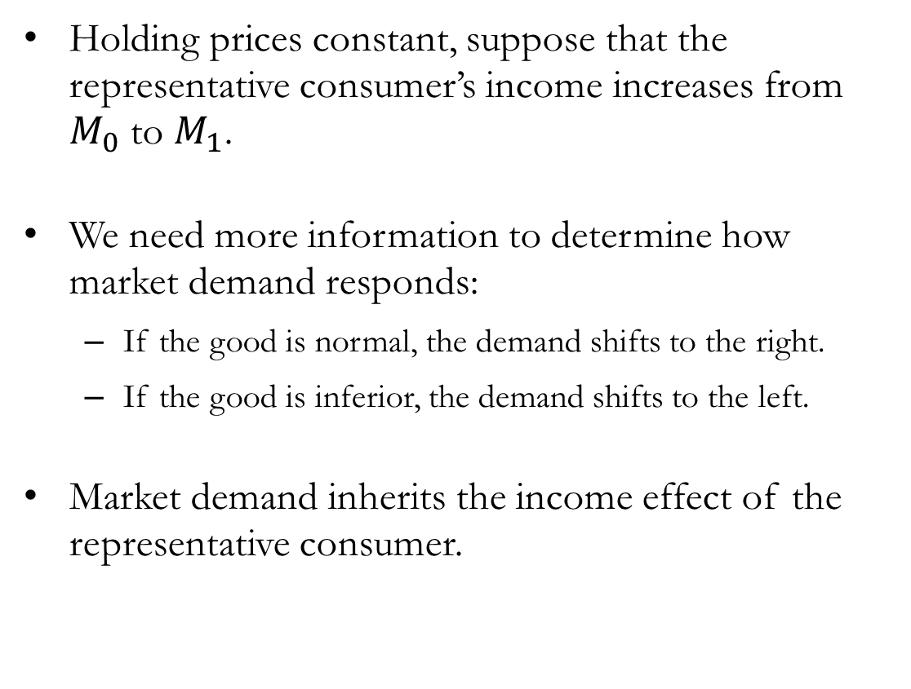
Market Demand: Shifts in Income
Holding prices constant, suppose that the representative consumer’s income increases from $M_{0}$ to $M_{1}$.
We need more information to determine how market demand responds:
If the good is normal, the demand shifts to the right.
If the good is inferior, the demand shifts to the left.
Market demand inherits the income effect of the representative consumer.

Slide 10
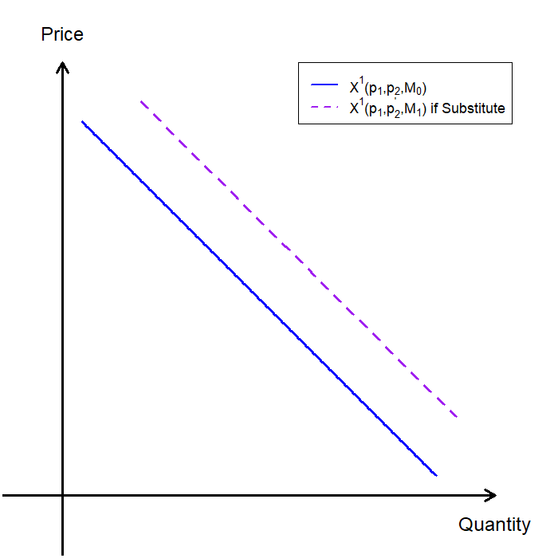
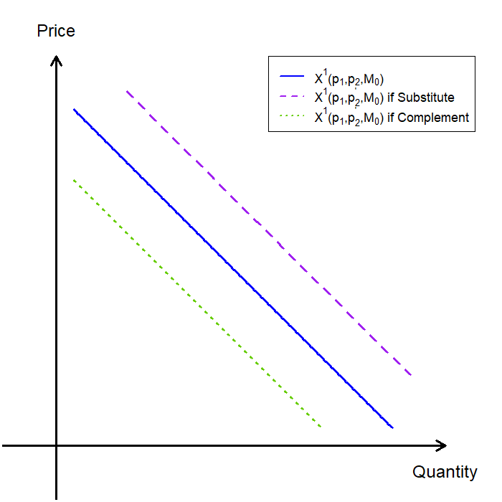
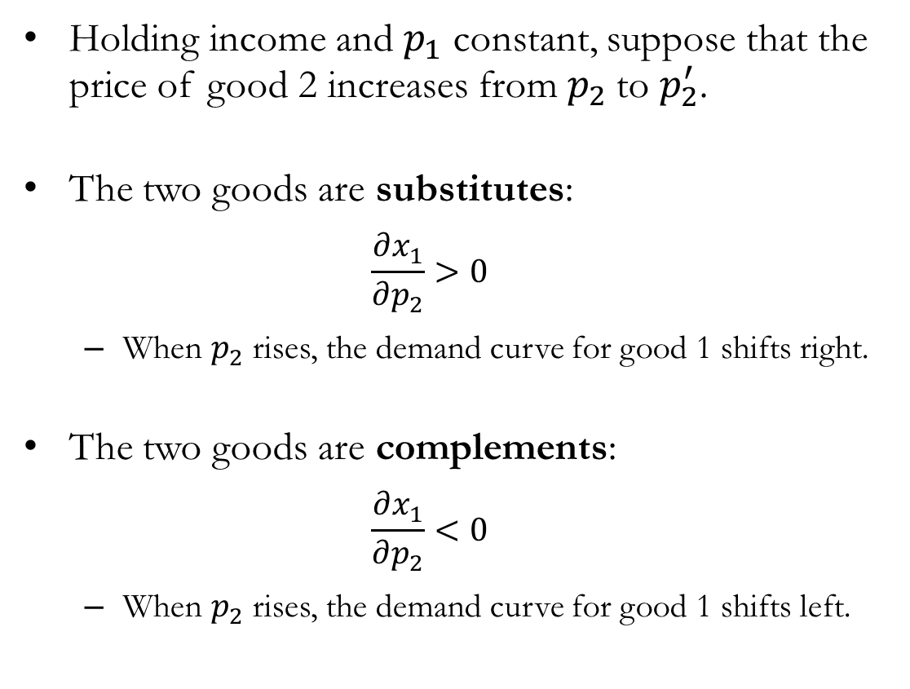
Market Demand: Shifts in Prices of Other Goods
Holding income and $p_{1}$ constant, suppose that the price of good 2 increases from $p_{2}$to $p_{2}^{′}$.
The two goods are substitutes:
$$\frac{∂x_{1}}{∂p_{2}}>0$$
When $p_{2}$ rises, the demand curve for good 1 shifts right.
The two goods are complements:
$$\frac{∂x_{1}}{∂p_{2}}<0$$
When $p_{2}$ rises, the demand curve for good 1 shifts left.

Slide 11
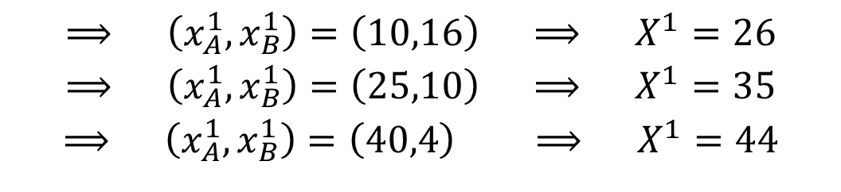
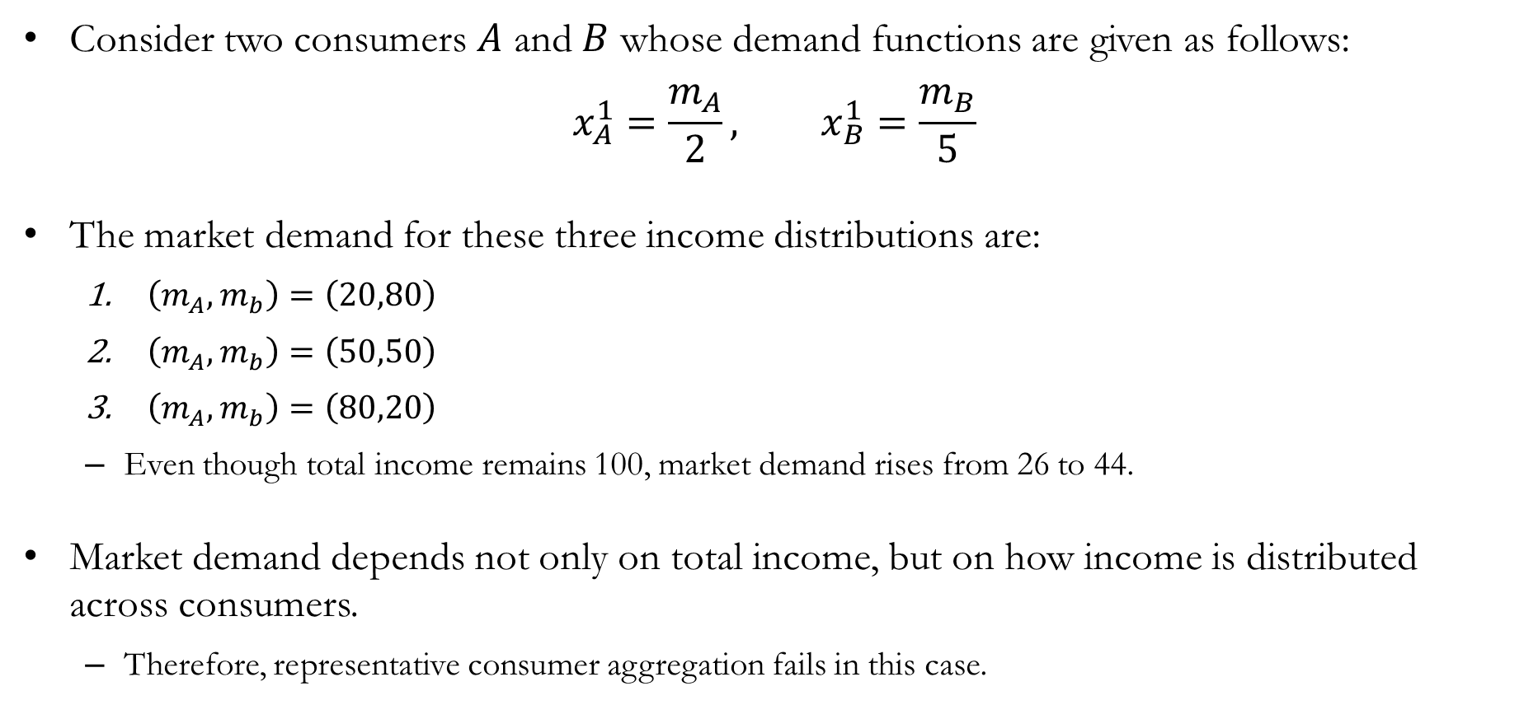
When Distribution of Incomes Matter
Consider two consumers $A$ and $B$ whose demand functions are given as follows:
$$x_{A}^{1}=\frac{m_{A}}{2}, x_{B}^{1}=\frac{m_{B}}{5}$$
The market demand for these three income distributions are:
$\left(m_{A},m_{b}\right)=\left(20,80\right)$
$\left(m_{A},m_{b}\right)=\left(50,50\right)$
$\left(m_{A},m_{b}\right)=\left(80,20\right)$
Even though total income remains 100, market demand rises from 26 to 44.
Market demand depends not only on total income, but on how income is distributed across consumers.
Therefore, representative consumer aggregation fails in this case.
$$⟹ \left(x_{A}^{1},x_{B}^{1}\right)=\left(10,16\right) ⟹ X^{1}=26$$
$$⟹ \left(x_{A}^{1},x_{B}^{1}\right)=\left(25,10\right) ⟹ X^{1}=35$$
$$⟹ \left(x_{A}^{1},x_{B}^{1}\right)=\left(40,4\right) ⟹ X^{1}=44$$

Slide 12
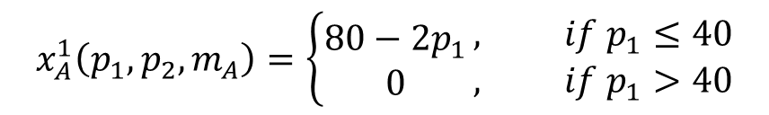
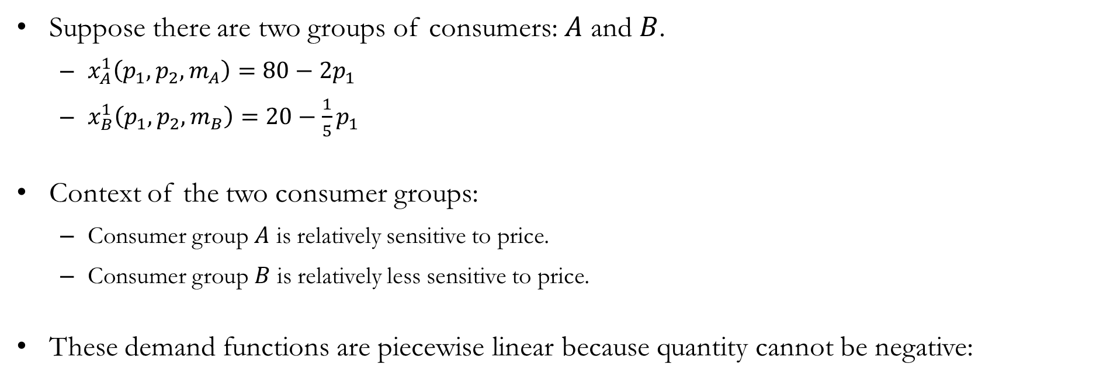
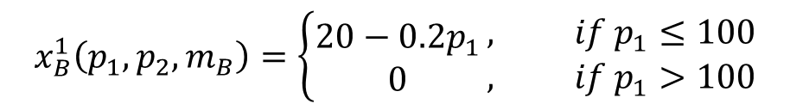
When Distribution of Preferences Matters
Suppose there are two groups of consumers: $A$ and $B$.
$x_{A}^{1}\left(p_{1},p_{2},m_{A}\right)=80−2p_{1}$
$x_{B}^{1}\left(p_{1},p_{2},m_{B}\right)=20−\frac{1}{5}p_{1}$
Context of the two consumer groups:
Consumer group $A$ is relatively sensitive to price.
Consumer group $B$ is relatively less sensitive to price.
These demand functions are piecewise linear because quantity cannot be negative:
$$x_{A}^{1}\left(p_{1},p_{2},m_{A}\right)=\left\{\begin{aligned}80−2p_{1} \\ 0\end{aligned}\right.\begin{matrix}, if p_{1}≤40 \\ , if p_{1}>40\end{matrix}$$
$$x_{B}^{1}\left(p_{1},p_{2},m_{B}\right)=\left\{\begin{aligned}20−0.2p_{1} \\ 0\end{aligned}\right.\begin{matrix}, if p_{1}≤100 \\ , if p_{1}>100\end{matrix}$$

Slide 13
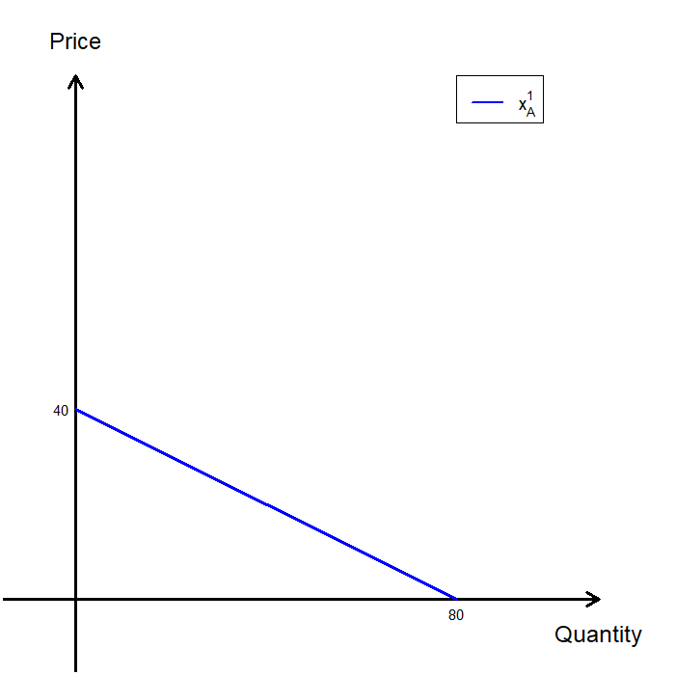
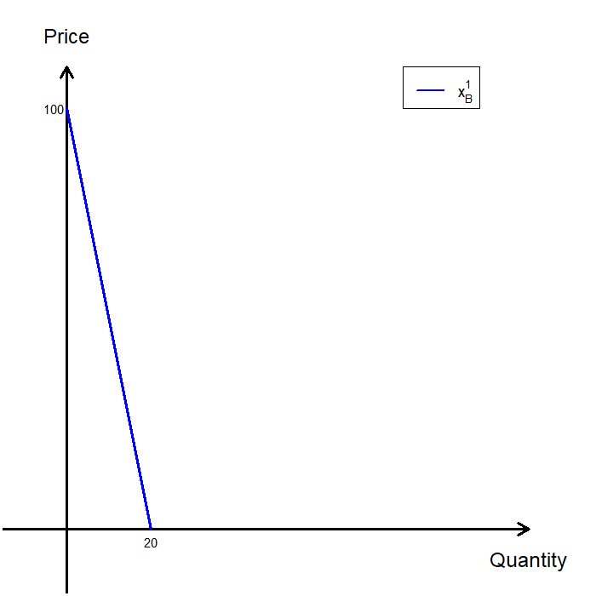
Aggregating Consumers’ Demand

Slide 14
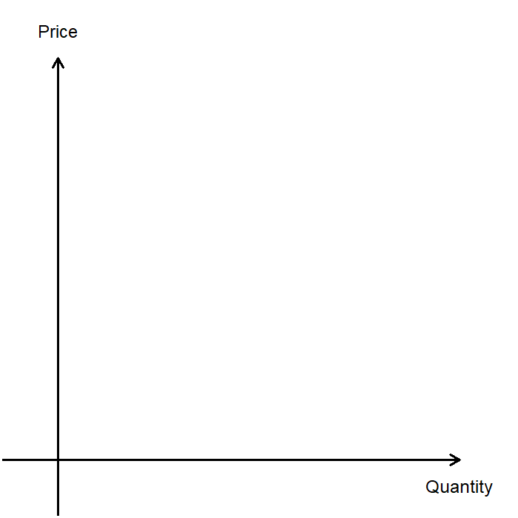
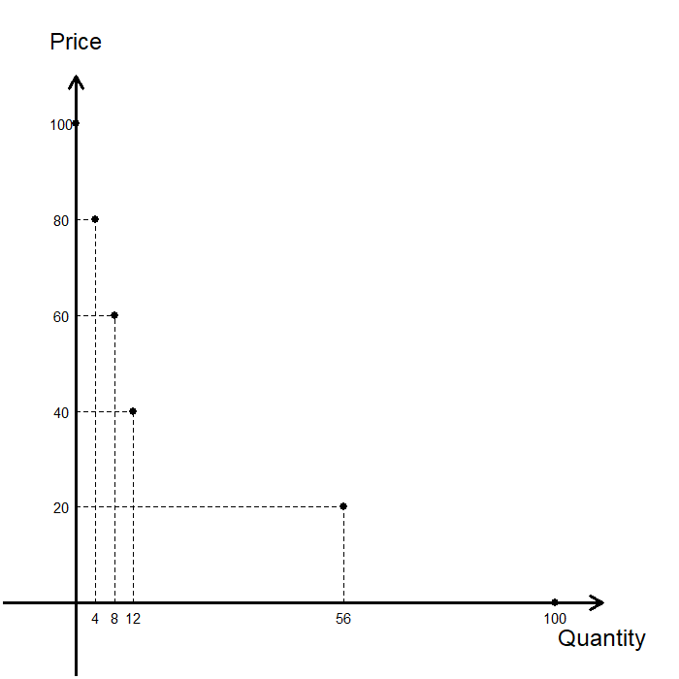

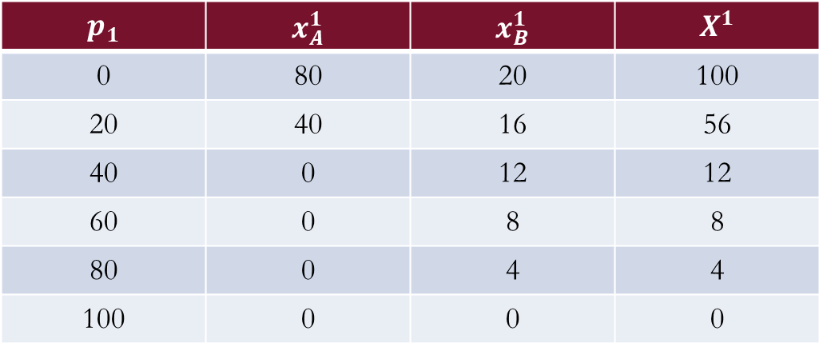
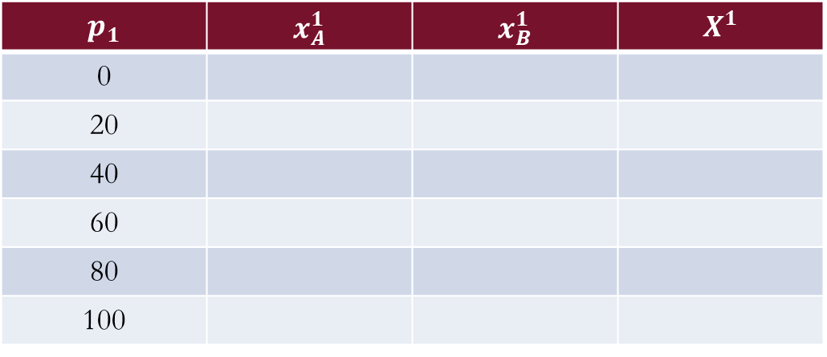
Aggregating Consumers’ Demand
Recall the group-wise demand functions:
$x_{A}^{1}\left(p_{1},p_{2},m_{A}\right)=80−2p_{1}$
$x_{B}^{1}\left(p_{1},p_{2},m_{B}\right)=20−\frac{1}{5}p_{1}$
Let’s construct market demand:
$$p_{1}$$ | $$x_{A}^{1}$$ | $$x_{B}^{1}$$ | $$X^{1}$$
0
20
40
60
80
100
$$p_{1}$$ | $$x_{A}^{1}$$ | $$x_{B}^{1}$$ | $$X^{1}$$
0 | 80 | 20 | 100
20 | 40 | 16 | 56
40 | 0 | 12 | 12
60 | 0 | 8 | 8
80 | 0 | 4 | 4
100 | 0 | 0 | 0

Slide 15
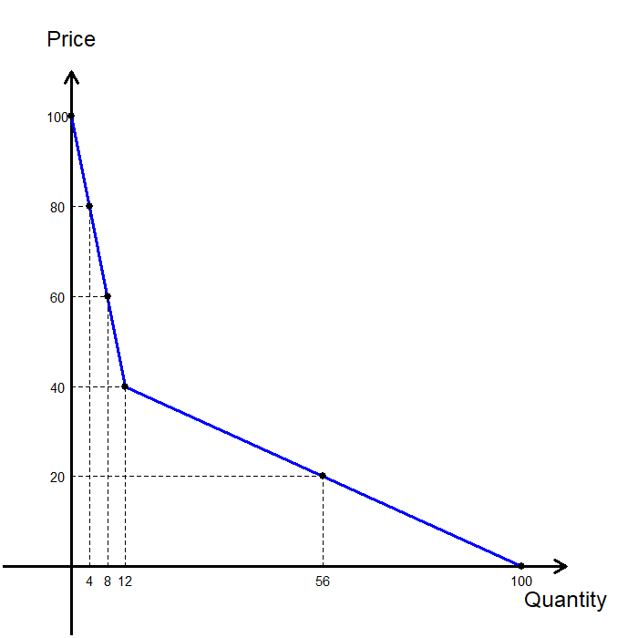
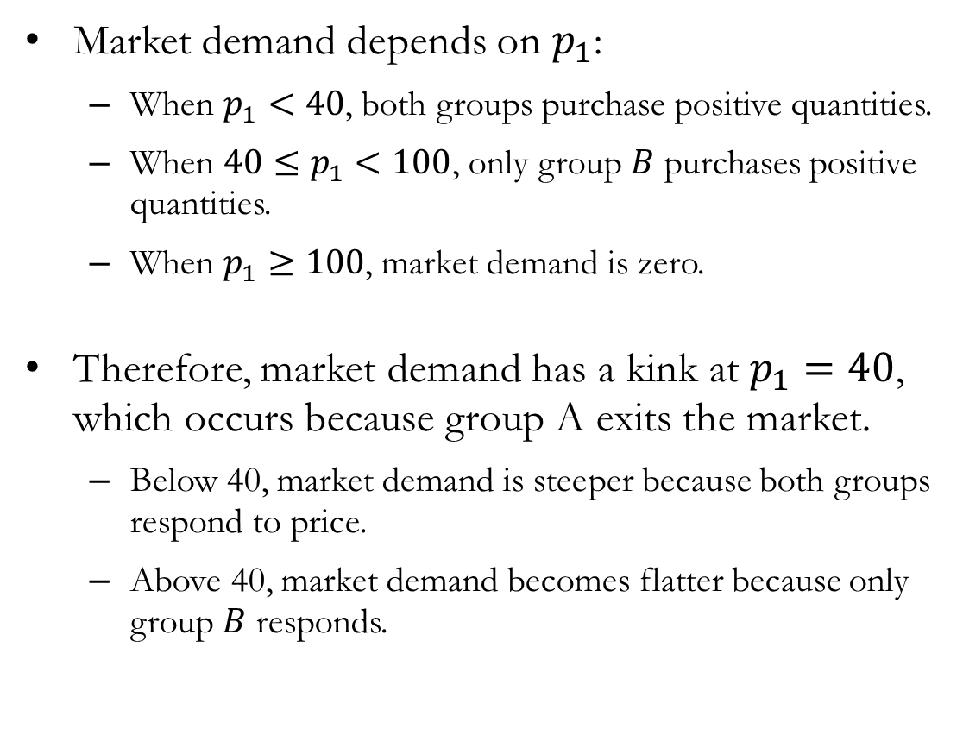
Aggregating Consumers’ Demand
Market demand depends on $p_{1}$:
When $p_{1}<40$, both groups purchase positive quantities.
When $40≤p_{1}<100$, only group $B$ purchases positive quantities.
When $p_{1}≥100$, market demand is zero.
Therefore, market demand has a kink at $p_{1}=40$, which occurs because group A exits the market.
Below 40, market demand is steeper because both groups respond to price.
Above 40, market demand becomes flatter because only group $B$ responds.

Slide 16
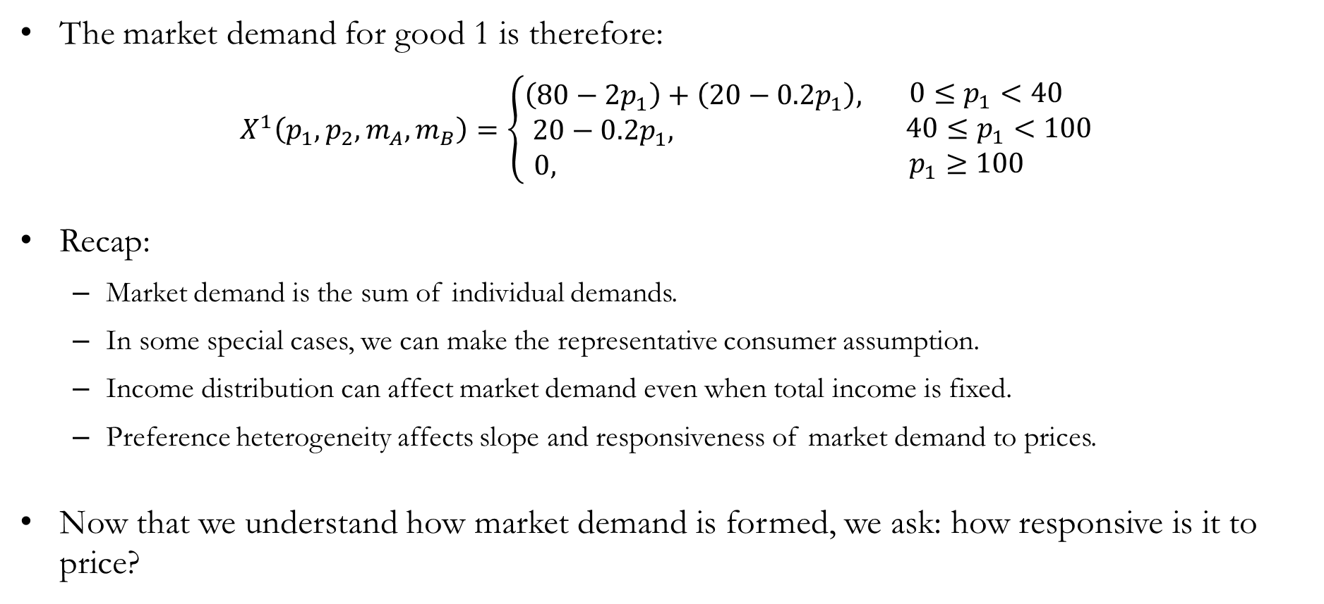
Aggregating Consumers’ Demand
The market demand for good 1 is therefore:
$$X^{1}\left(p_{1},p_{2},m_{A},m_{B}\right)=\left\{\begin{aligned}\left(80−2p_{1}\right)+\left(20−0.2p_{1}\right), \\ 20−0.2p_{1}, \\ 0, \end{aligned}\right.\begin{matrix} 0≤p_{1}<40 \\ 40≤p_{1}<100 \\ p_{1}≥100 \end{matrix}$$
Recap:
Market demand is the sum of individual demands.
In some special cases, we can make the representative consumer assumption.
Income distribution can affect market demand even when total income is fixed.
Preference heterogeneity affects slope and responsiveness of market demand to prices.
Now that we understand how market demand is formed, we ask: how responsive is it to price?

Slide 17
The Price Elasticity of Demand

Slide 18
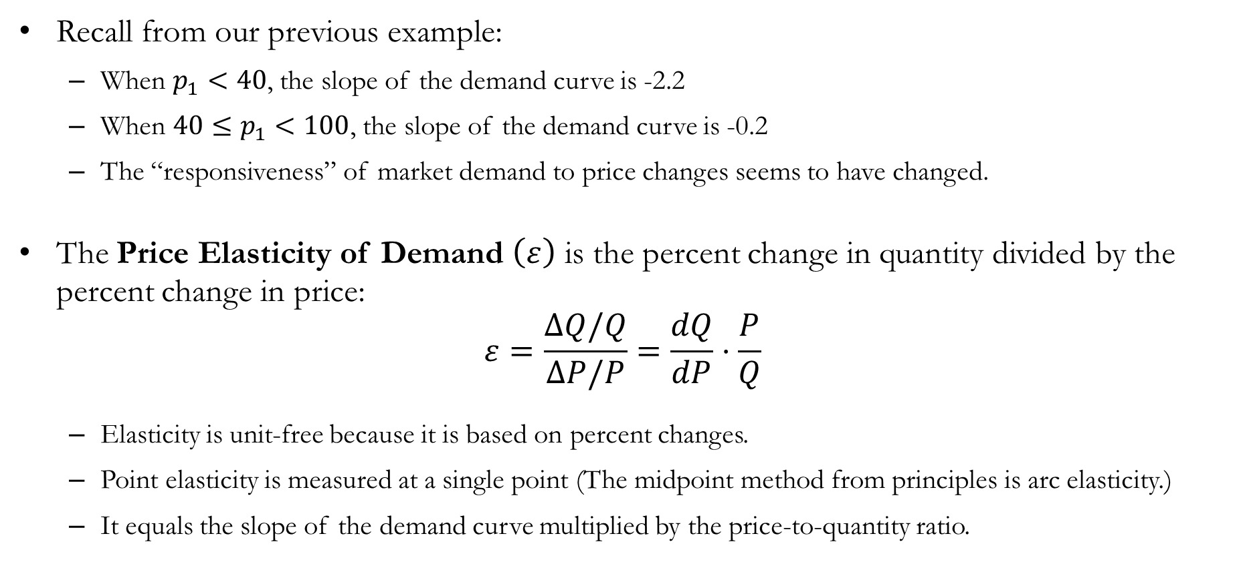
Responsiveness: Elasticity
Recall from our previous example:
When $p_{1}<40$, the slope of the demand curve is -2.2
When $40≤p_{1}<100$, the slope of the demand curve is -0.2
The “responsiveness” of market demand to price changes seems to have changed.
The Price Elasticity of Demand $\left(ε\right)$ is the percent change in quantity divided by the percent change in price:
$$ε=\frac{ΔQ/Q}{ΔP/P}=\frac{dQ}{dP}⋅\frac{P}{Q}$$
Elasticity is unit-free because it is based on percent changes.
Point elasticity is measured at a single point (The midpoint method from principles is arc elasticity.)
It equals the slope of the demand curve multiplied by the price-to-quantity ratio.

Slide 19
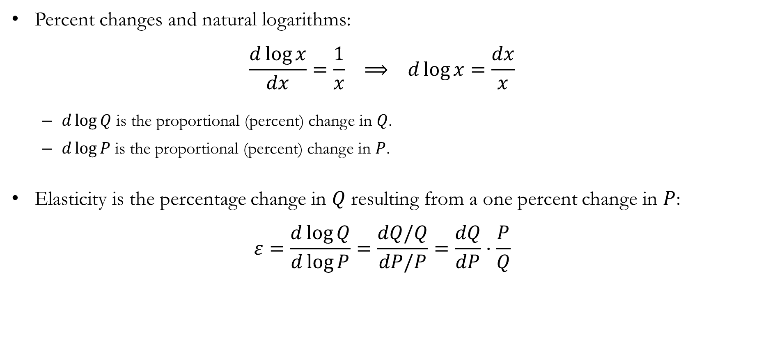
Detour: Price Elasticity of Demand
Percent changes and natural logarithms:
$$\frac{d\log{x}}{dx}=\frac{1}{x} ⟹ d\log{x}=\frac{dx}{x}$$
$d\log{Q}$ is the proportional (percent) change in $Q$.
$d\log{P}$ is the proportional (percent) change in $P$.
Elasticity is the percentage change in $Q$ resulting from a one percent change in $P$:
$$ε=\frac{d\log{Q}}{d\log{P}}=\frac{dQ/Q}{dP/P}=\frac{dQ}{dP}⋅\frac{P}{Q}$$

Slide 20
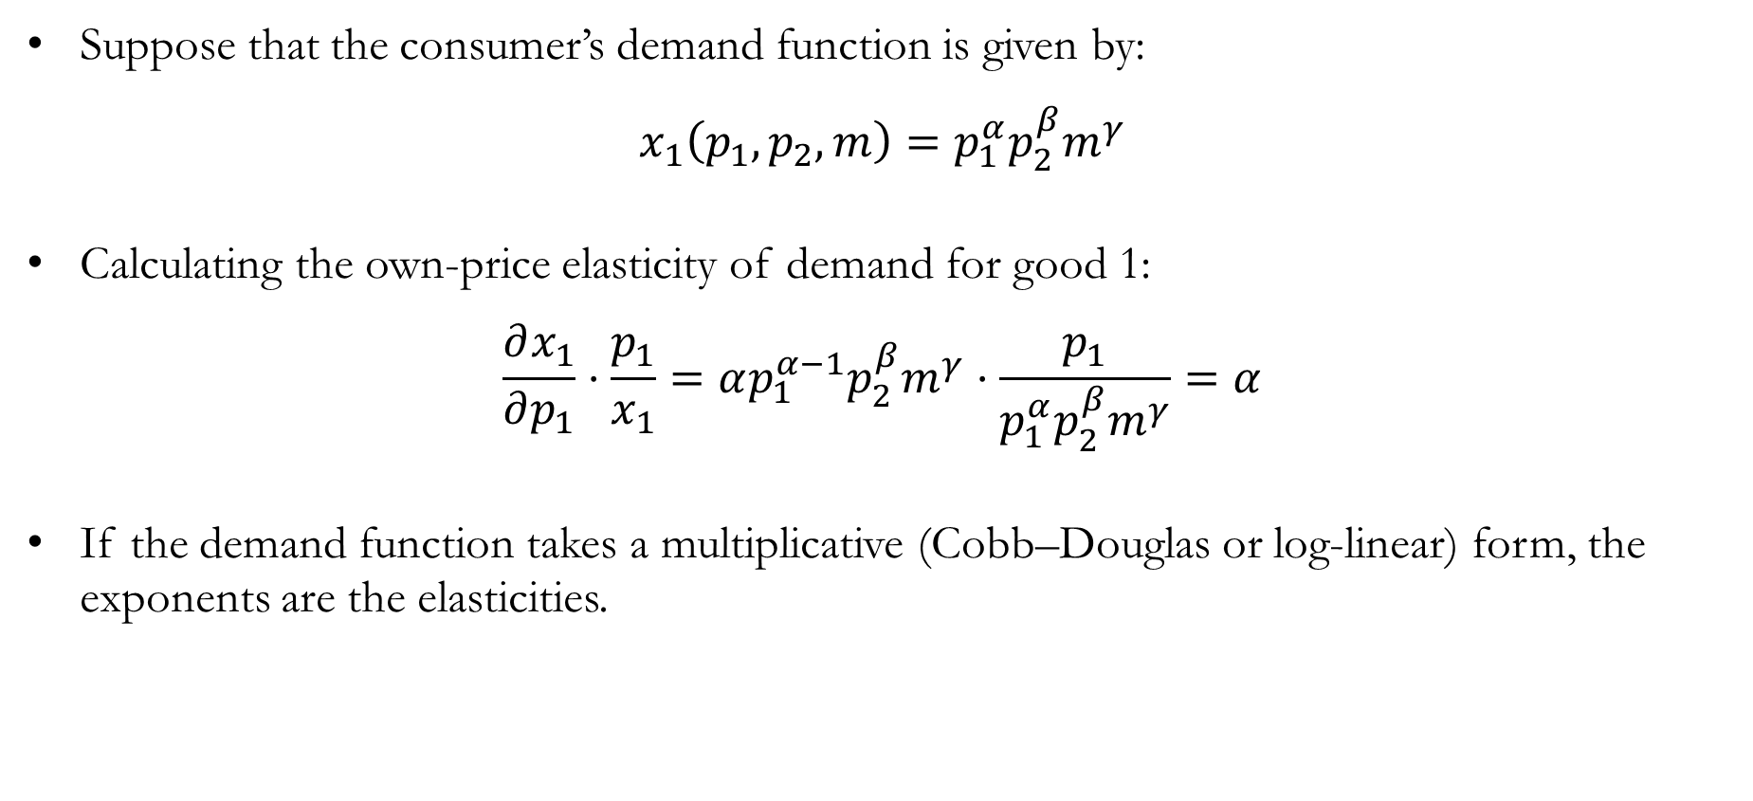
Calculating Elasticity
Suppose that the consumer’s demand function is given by:
$$x_{1}\left(p_{1},p_{2},m\right)=p_{1}^{α}p_{2}^{β}m^{γ}$$
Calculating the own-price elasticity of demand for good 1:
$$\frac{∂x_{1}}{∂p_{1}}⋅\frac{p_{1}}{x_{1}}=αp_{1}^{α−1}p_{2}^{β}m^{γ}⋅\frac{p_{1}}{p_{1}^{α}p_{2}^{β}m^{γ}}=α$$
If the demand function takes a multiplicative (Cobb–Douglas or log-linear) form, the exponents are the elasticities.

Slide 21
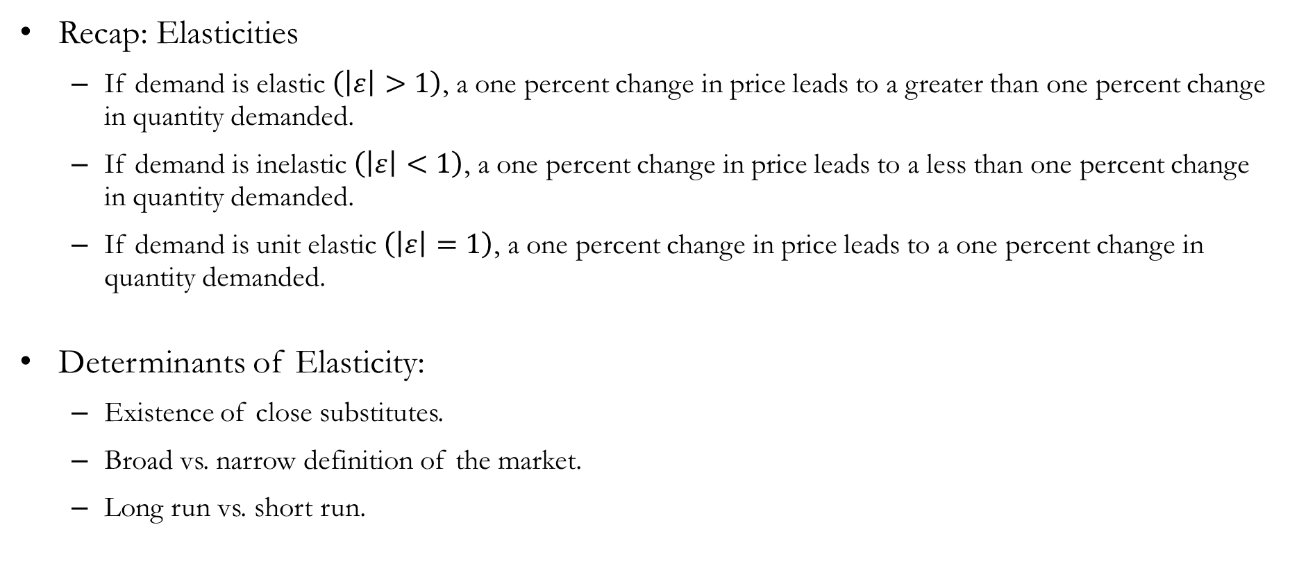
Recap: Elasticities
Recap: Elasticities
If demand is elastic $\left(\left|ε\right|>1\right)$, a one percent change in price leads to a greater than one percent change in quantity demanded.
If demand is inelastic $\left(\left|ε\right|<1\right)$, a one percent change in price leads to a less than one percent change in quantity demanded.
If demand is unit elastic $\left(\left|ε\right|=1\right)$, a one percent change in price leads to a one percent change in quantity demanded.
Determinants of Elasticity:
Existence of close substitutes.
Broad vs. narrow definition of the market.
Long run vs. short run.

Slide 22
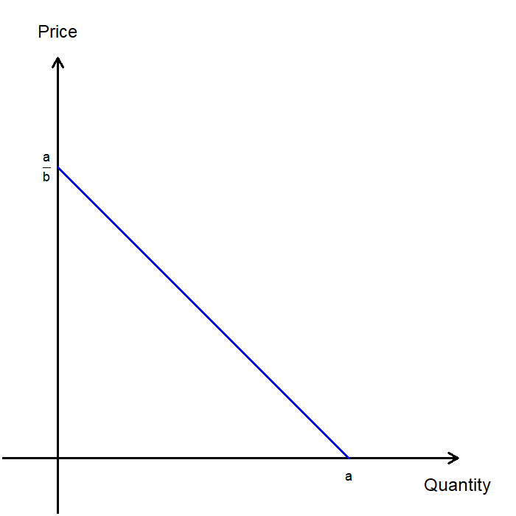
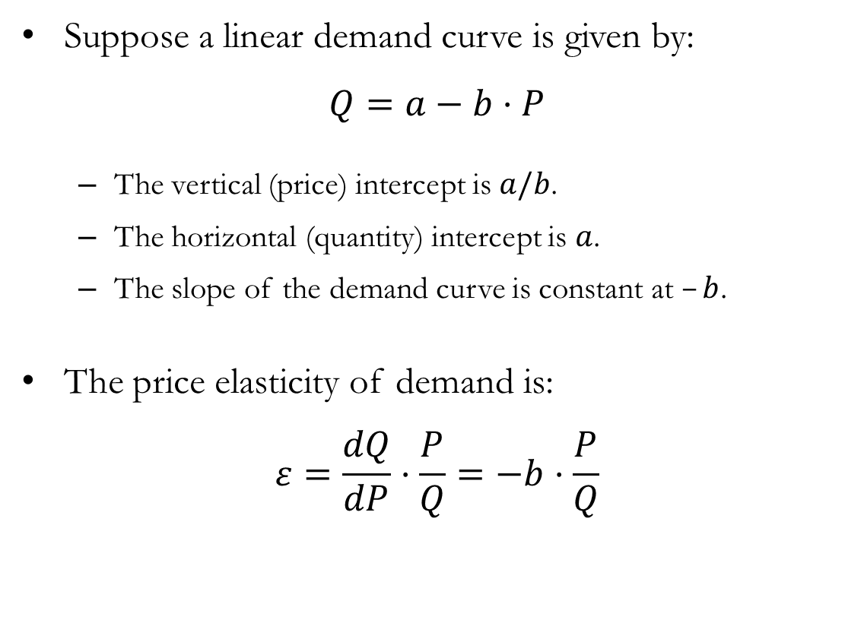
Elasticity of Linear Demand Curves
Suppose a linear demand curve is given by:
$$Q=a−b⋅P$$
The vertical (price) intercept is $a/b$.
The horizontal (quantity) intercept is $a$.
The slope of the demand curve is constant at $–b$.
The price elasticity of demand is:
$$ε=\frac{dQ}{dP}⋅\frac{P}{Q}=−b⋅\frac{P}{Q}$$

Slide 23
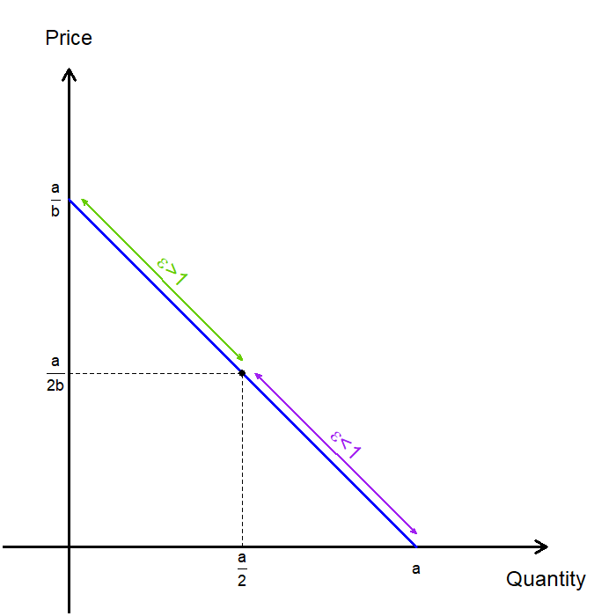
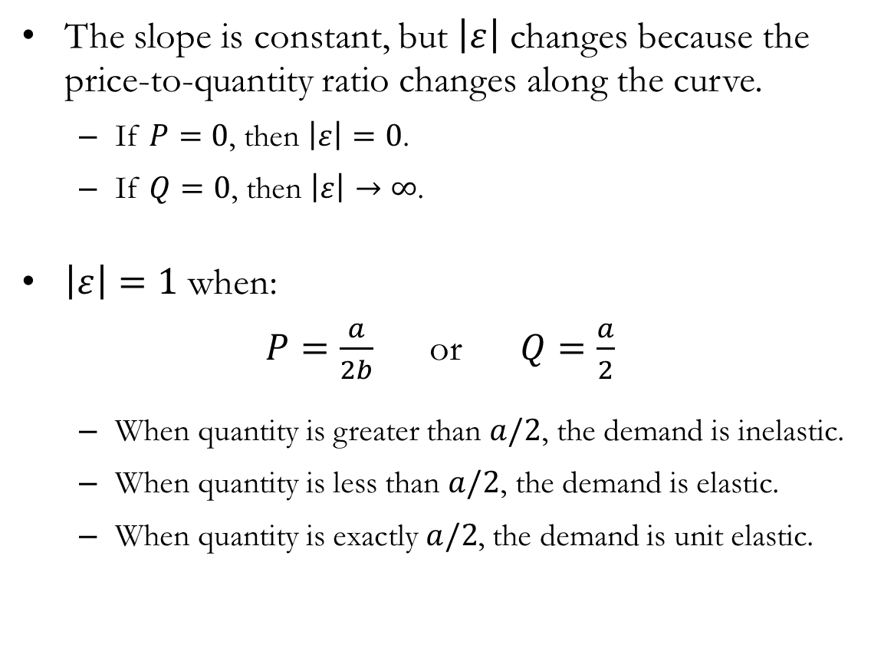
Elasticity of Linear Demand Curves
The slope is constant, but $\left|ε\right|$ changes because the price-to-quantity ratio changes along the curve.
If $P=0$, then $\left|ε\right|=0$.
If $Q=0$, then $\left|ε\right|→∞$.
$\left|ε\right|=1$ when:
$P=\frac{a}{2b}$ or $Q=\frac{a}{2}$
When quantity is greater than $a/2$, the demand is inelastic.
When quantity is less than $a/2$, the demand is elastic.
When quantity is exactly $a/2$, the demand is unit elastic.

Slide 24
Price Elasticity of Demand
and Revenue

Slide 25
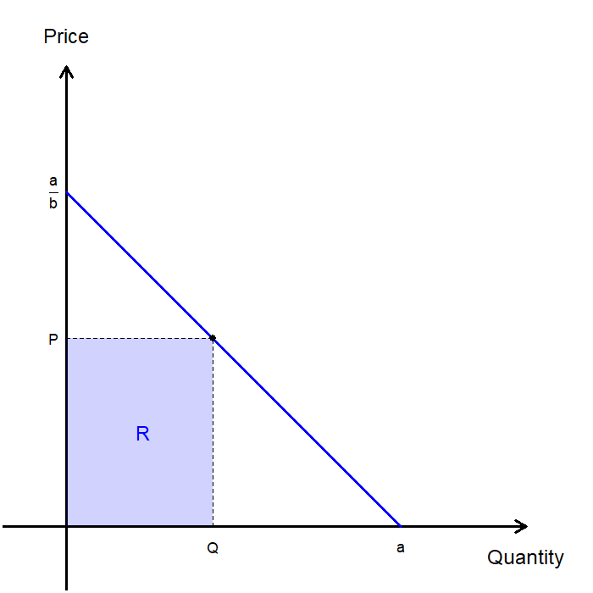
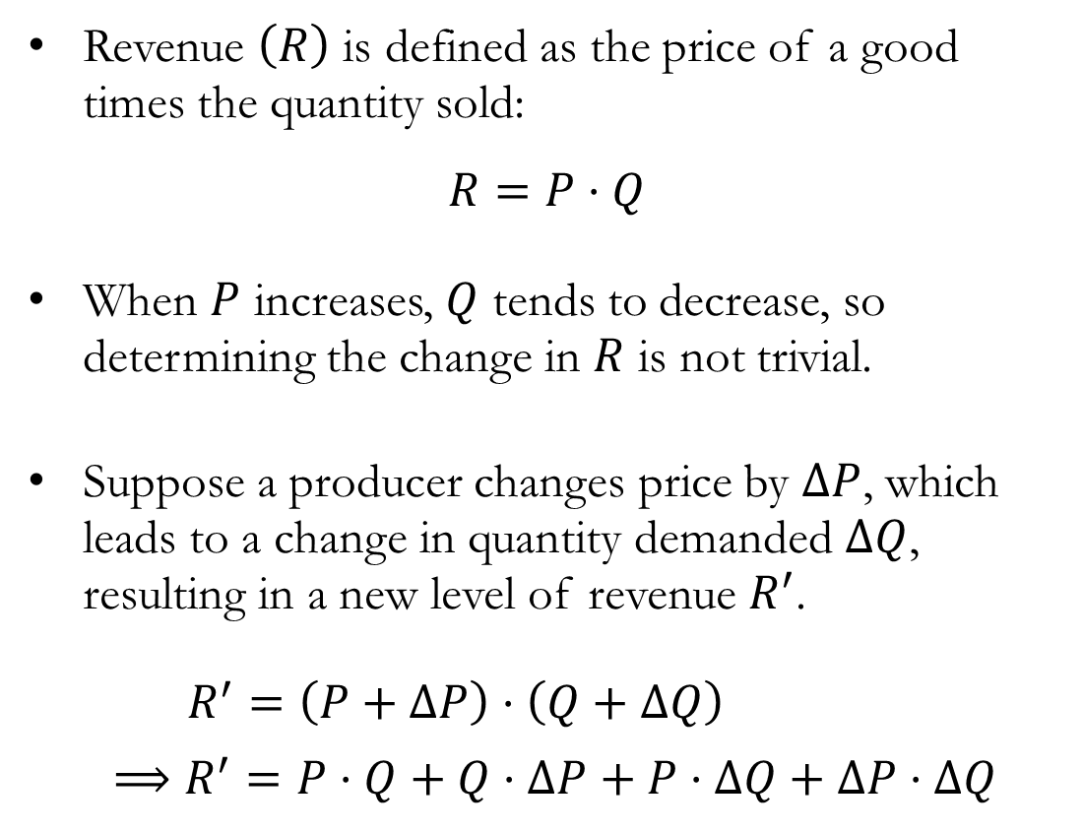
Elasticity and Revenue
Revenue $\left(R\right)$ is defined as the price of a good times the quantity sold:
$$R=P⋅Q$$
When $P$ increases, $Q$ tends to decrease, so determining the change in $R$ is not trivial.
Suppose a producer changes price by $ΔP$, which leads to a change in quantity demanded $ΔQ$, resulting in a new level of revenue $R^{′}$.
$R^{′}=\left(P+ΔP\right)⋅\left(Q+ΔQ\right)$
$⟹R^{′}=P⋅Q+Q⋅ΔP+P⋅ΔQ+ΔP⋅ΔQ$

Slide 26
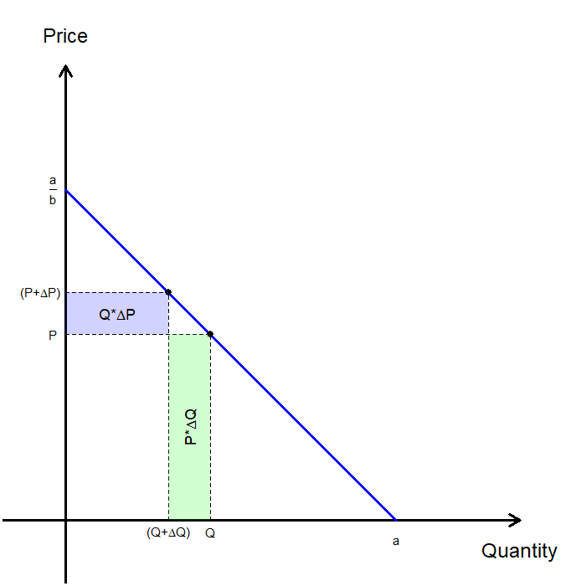
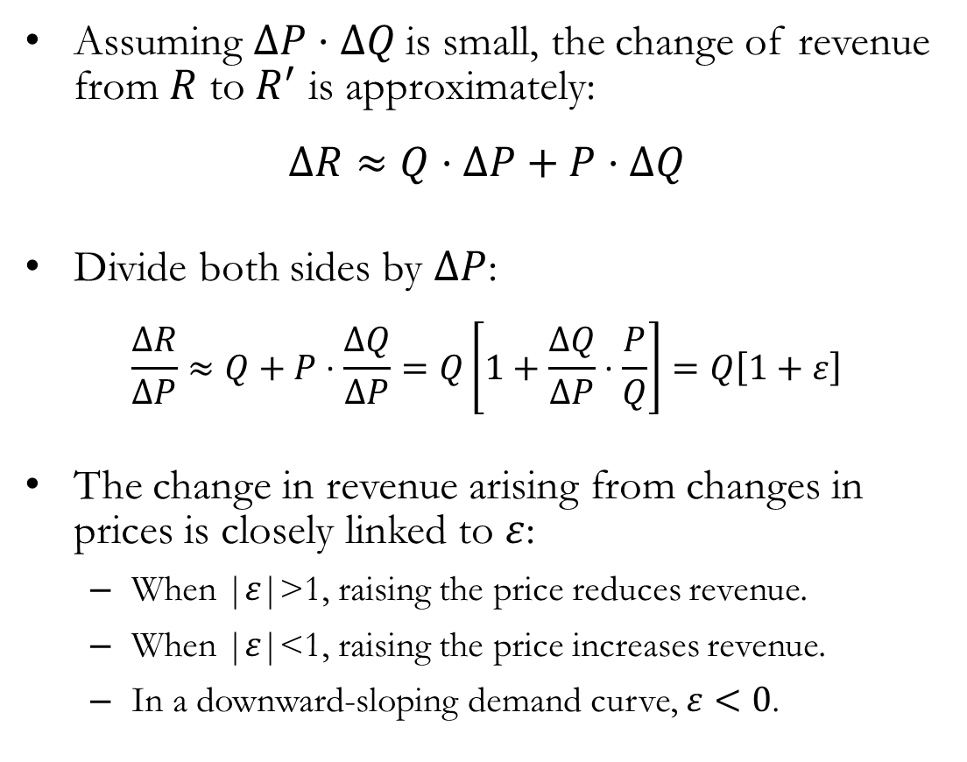
Elasticity and Revenue
Assuming $ΔP⋅ΔQ$is small, the change of revenue from $R$ to $R^{′}$ is approximately:
$$ΔR≈Q⋅ΔP+P⋅ΔQ$$
Divide both sides by $ΔP$:
$$\frac{ΔR}{ΔP}≈Q+P⋅\frac{ΔQ}{ΔP}=Q\left[1+\frac{ΔQ}{ΔP}⋅\frac{P}{Q}\right]=Q\left[1+ε\right]$$
The change in revenue arising from changes in prices is closely linked to $ε$:
When |𝜀|>1, raising the price reduces revenue.
When |𝜀|<1, raising the price increases revenue.
In a downward-sloping demand curve, $ε<0$.

Slide 27
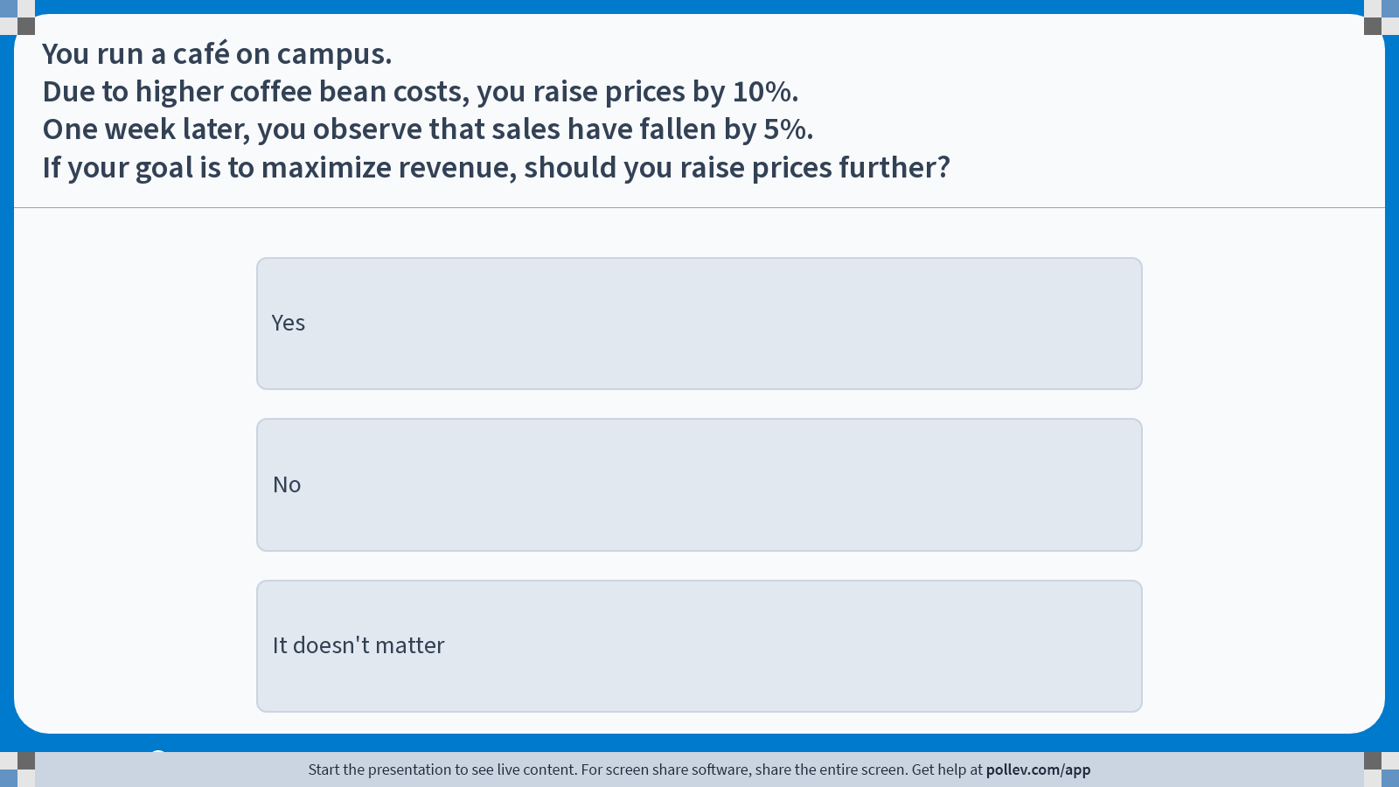
Poll Everywhere multiple choice poll instructions screen Activity Title: You run a café on campus. Due to higher coffee bean costs, you raise prices by 10%. One week later, you observe that sales have fallen by 5%. If your goal is to maximize revenue, should you raise prices further? Slide 26
Notes:
Do not modify the notes in this section to avoid tampering with the Poll Everywhere activity. More info at polleverywhere.com/support You run a café on campus. Due to higher coffee bean costs, you raise prices by 10%. One week later, you observe that sales have fallen by 5%. If your goal is to maximize revenue, should you raise prices further? https://www.polleverywhere.com/multiple_choice_polls/qXrCSdToBSSUNxtFoWO7V?display_state=instructions&activity_state=opened&state=opened&flow=Engagement&onscreen=persist

Slide 28
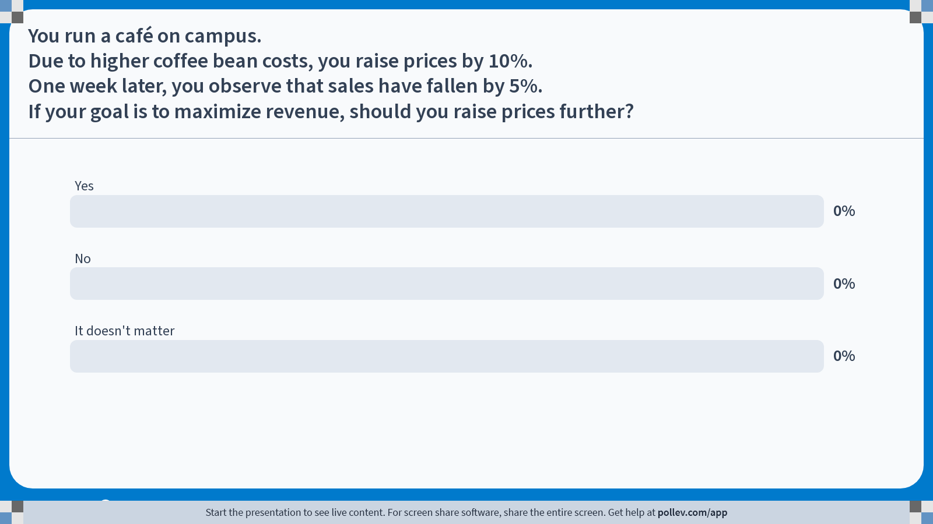
Poll Everywhere multiple choice poll chart screen Activity Title: You run a café on campus. Due to higher coffee bean costs, you raise prices by 10%. One week later, you observe that sales have fallen by 5%. If your goal is to maximize revenue, should you raise prices further? Slide 28
Notes:
Do not modify the notes in this section to avoid tampering with the Poll Everywhere activity. More info at polleverywhere.com/support You run a café on campus. Due to higher coffee bean costs, you raise prices by 10%. One week later, you observe that sales have fallen by 5%. If your goal is to maximize revenue, should you raise prices further? https://www.polleverywhere.com/multiple_choice_polls/qXrCSdToBSSUNxtFoWO7V?display_state=chart&activity_state=closed&state=closed&flow=Engagement&onscreen=persist

Slide 29
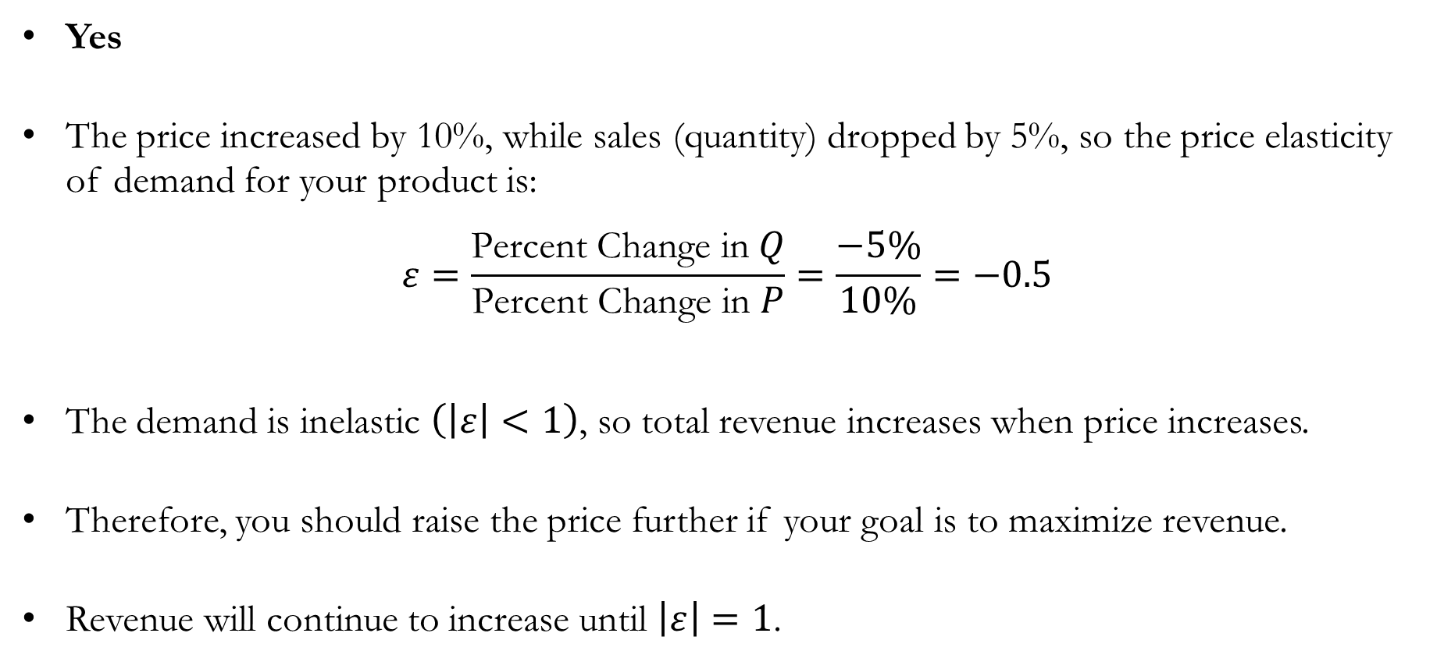
Solution to In-class Poll #2
Yes
The price increased by 10%, while sales (quantity) dropped by 5%, so the price elasticity of demand for your product is:
$$ε=\frac{\text{Percent} \text{Change} \text{in} Q}{\text{Percent} \text{Change} \text{in} P}=\frac{−5\%}{10\%}=−0.5$$
The demand is inelastic $\left(\left|ε\right|<1\right)$, so total revenue increases when price increases.
Therefore, you should raise the price further if your goal is to maximize revenue.
Revenue will continue to increase until $\left|ε\right|=1$.

Slide 30
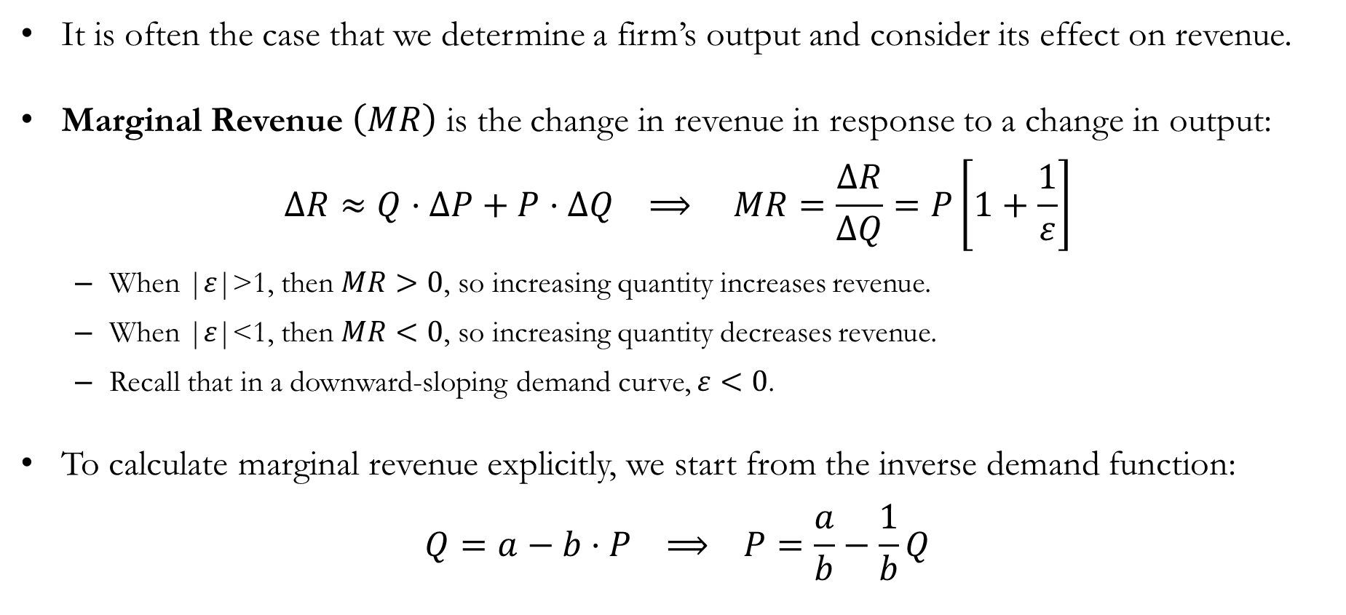
Elasticity and Marginal Revenue
It is often the case that we determine a firm’s output and consider its effect on revenue.
Marginal Revenue $\left(MR\right)$ is the change in revenue in response to a change in output:
$$ΔR≈Q⋅ΔP+P⋅ΔQ ⟹ MR=\frac{ΔR}{ΔQ}=P\left[1+\frac{1}{ε}\right]$$
When |𝜀|>1, then $MR>0$, so increasing quantity increases revenue.
When |𝜀|<1, then $MR<0$, so increasing quantity decreases revenue.
Recall that in a downward-sloping demand curve, $ε<0$.
To calculate marginal revenue explicitly, we start from the inverse demand function:
$$Q=a−b⋅P ⟹ P=\frac{a}{b}−\frac{1}{b}Q$$

Slide 31
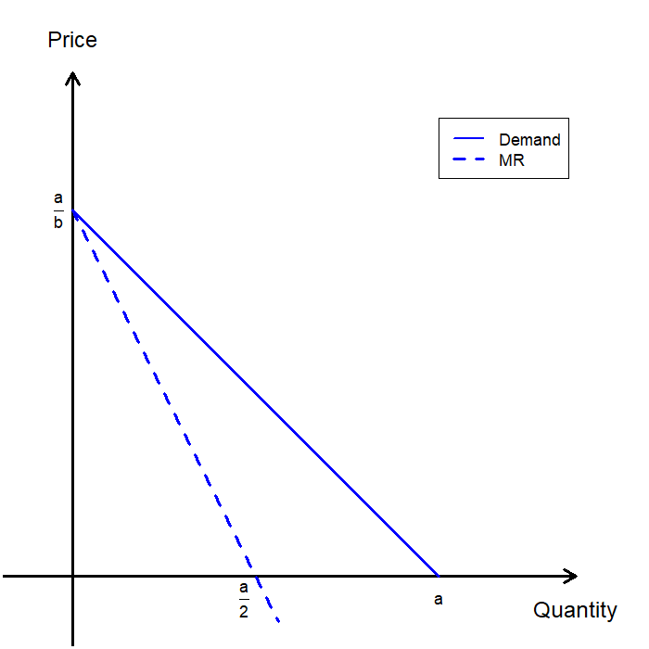
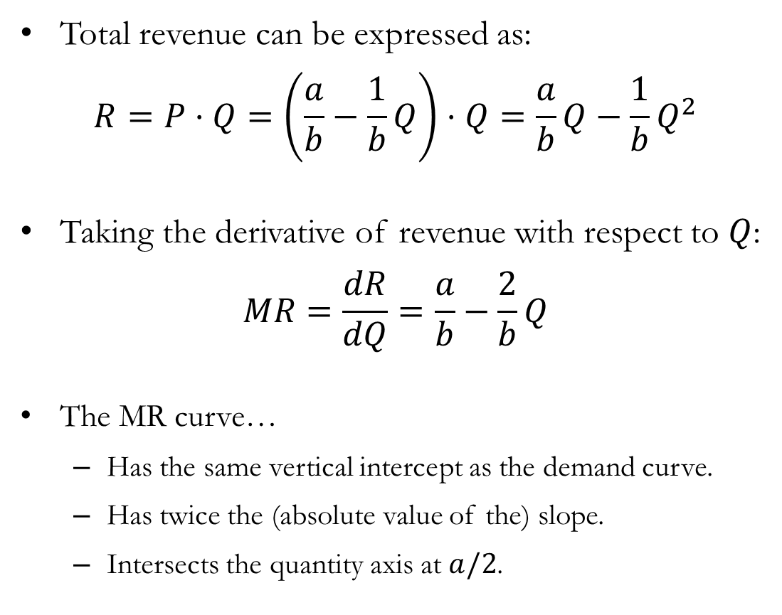
The Marginal Revenue Curve
Total revenue can be expressed as:
$$R=P⋅Q=\left(\frac{a}{b}−\frac{1}{b}Q\right)⋅Q=\frac{a}{b}Q−\frac{1}{b}Q^{2}$$
Taking the derivative of revenue with respect to $Q$:
$$MR=\frac{dR}{dQ}=\frac{a}{b}−\frac{2}{b}Q$$
The MR curve…
Has the same vertical intercept as the demand curve.
Has twice the (absolute value of the) slope.
Intersects the quantity axis at $a/2$.

Slide 32
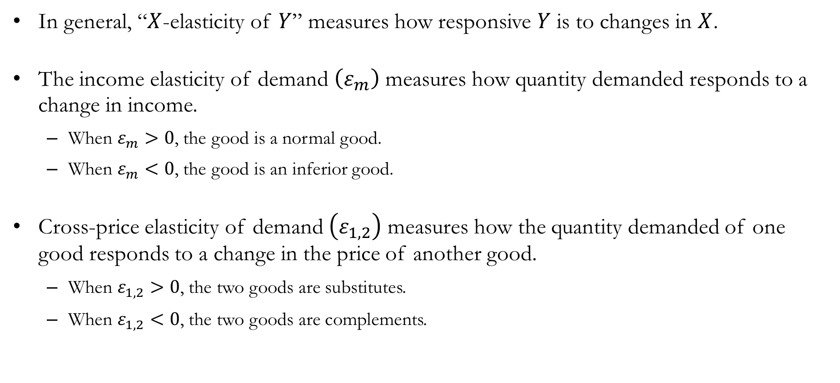
Other Elasticities
In general, “$X$-elasticity of $Y$” measures how responsive $Y$ is to changes in $X$.
The income elasticity of demand $\left(ε_{m}\right)$ measures how quantity demanded responds to a change in income.
When $ε_{m}>0$, the good is a normal good.
When $ε_{m}<0$, the good is an inferior good.
Cross-price elasticity of demand $\left(ε_{1,2}\right)$ measures how the quantity demanded of one good responds to a change in the price of another good.
When $ε_{1,2}>0$, the two goods are substitutes.
When $ε_{1,2}<0$, the two goods are complements.

Slide 33
Recap & Preview

Slide 34
Recap: Market Demand
Market demand is the horizontal sum of individual demand curves.
A representative consumer framework works only when aggregation preserves demand behavior, for example when income distribution does not change aggregate demand.
The price elasticity of demand measures the percentage change in quantity resulting from a percentage change in price.
Elasticity determines how price and quantity changes affect total revenue.
When |𝜀|>1, raising the price (or decreasing quantity) reduces revenue.
When |𝜀|<1, raising the price (or decreasing quantity) increases revenue.
When |𝜀|=1, revenue is maximized along the demand curve.

Slide 35
Preview: Market Equilibrium
We now combine demand and supply to study market equilibria.
Equilibrium occurs where quantity demanded equals quantity supplied.
Market equilibrium determines:
The equilibrium market price.
The equilibrium quantity traded in the market.
We analyze:
The effects of shifts in demand and supply.
The effects of taxation and price wedges.
Welfare effects of taxes and market interventions.

