Slide 1
INTERMEDIATE MICROECONOMIC THEORY
Chapter 14: Consumer’s Surplus

Slide 2
Recap: Demand
We studied how a consumer’s optimal choice responds to changes in parameters.
The Engel curve describes how optimal consumption of a good changes as income varies, holding prices fixed.
The shape of the Engel curve allows us to classify goods:
Normal goods: Consumption increases as income rises.
Inferior goods: Consumption decreases over some income range.
Luxury goods: Consumption increases more than proportionally with income.
Necessities: Consumption increases less than proportionally with income.
Engel curves are observable objects that help us infer preferences from data.

Slide 3
Recap: Demand
The (Walrasian) demand curve shows how optimal consumption changes as the price of a good varies, holding income fixed.
From the consumer’s choice problem, we derived demand functions that describe optimal consumption as a function of prices, income, and the consumer’s preferences.
We examined special cases:
Perfect substitutes.
Perfect complements.
Giffen goods.
Comparative statics provide the bridge between individual optimization and market demand.

Slide 4
Quasilinear Utility Functions

Slide 5
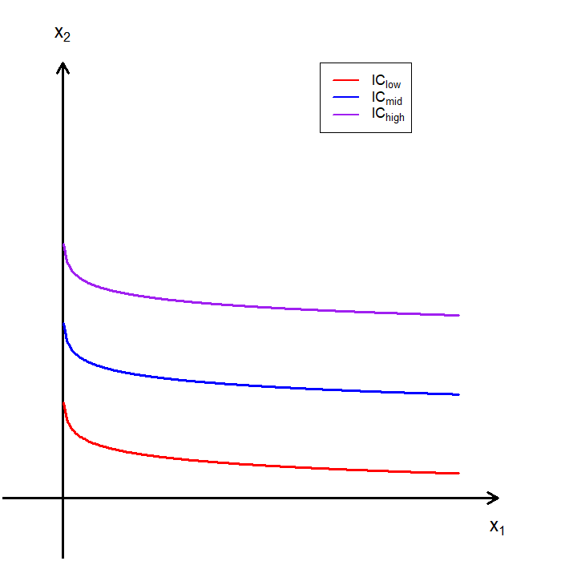
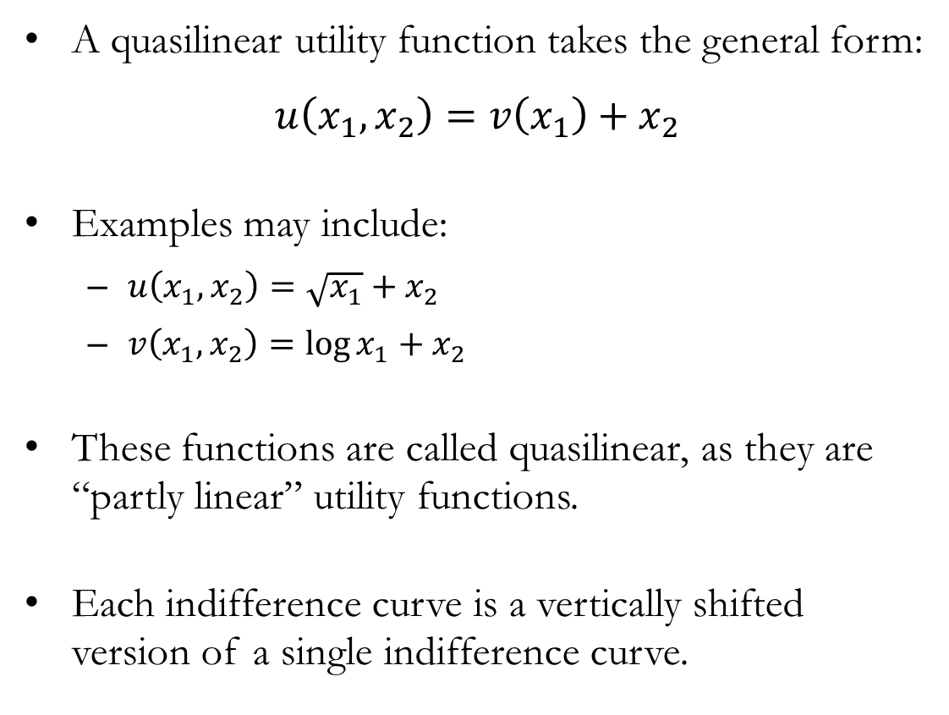
Quasilinear Utility
A quasilinear utility function takes the general form:
$$u\left(x_{1},x_{2}\right)=v\left(x_{1}\right)+x_{2}$$
Examples may include:
$u\left(x_{1},x_{2}\right)=\sqrt{x_{1}}+x_{2}$
$v\left(x_{1},x_{2}\right)=\log{x_{1}}+x_{2}$
These functions are called quasilinear, as they are “partly linear” utility functions.
Each indifference curve is a vertically shifted version of a single indifference curve.

Slide 6
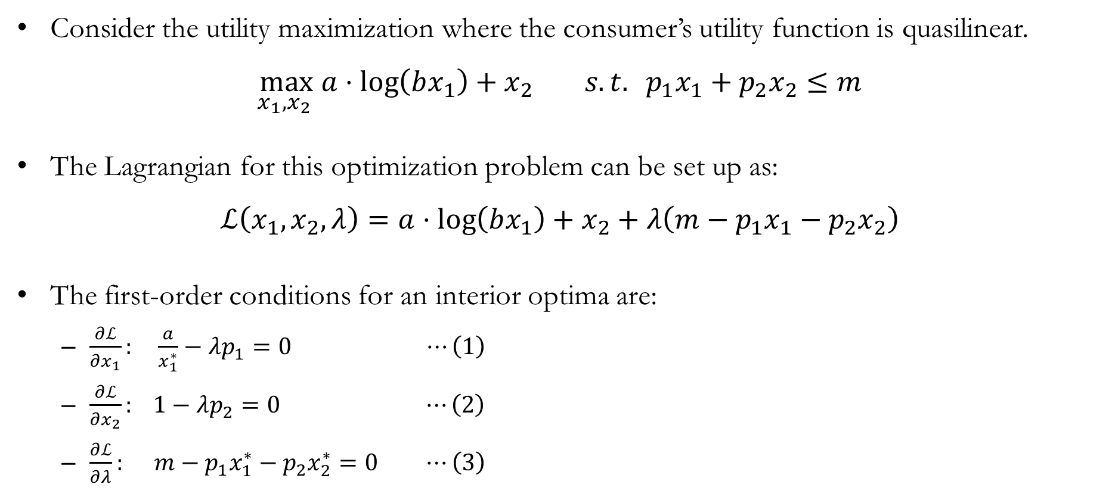
Utility Maximization with Quasilinear Utility
Consider the utility maximization where the consumer’s utility function is quasilinear.
$$\max_{x_{1},x_{2} }{a⋅\log\left(bx_{1}\right)+x_{2}} s.t. p_{1}x_{1}+p_{2}x_{2}≤m$$
The Lagrangian for this optimization problem can be set up as:
$$ℒ\left(x_{1},x_{2},λ\right)=a⋅\log\left(bx_{1}\right)+x_{2}+λ\left(m−p_{1}x_{1}−p_{2}x_{2}\right)$$
The first-order conditions for an interior optima are:
$\frac{∂ℒ}{∂x_{1}}: \frac{a}{x_{1}^{∗}}−λp_{1}=0 ⋯\left(1\right)$
$\frac{∂ℒ}{∂x_{2}}: 1−λp_{2}=0 ⋯\left(2\right)$
$\frac{∂ℒ}{∂λ}: m−p_{1}x_{1}^{∗}−p_{2}x_{2}^{∗}=0 ⋯\left(3\right)$

Slide 7
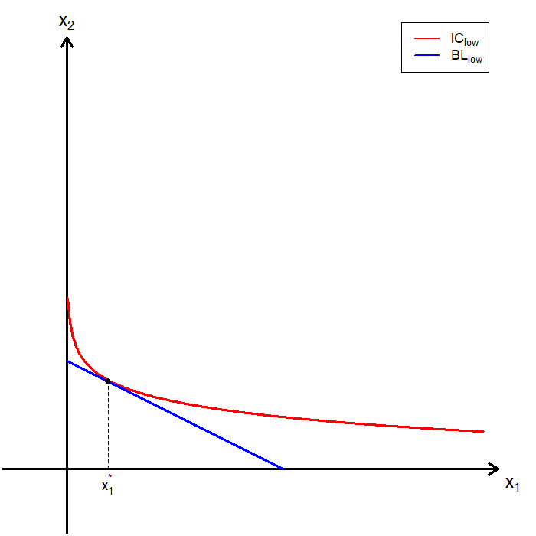
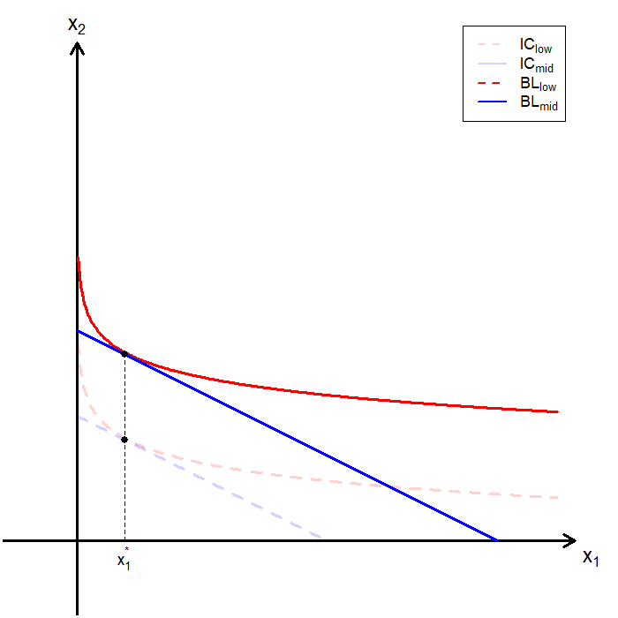
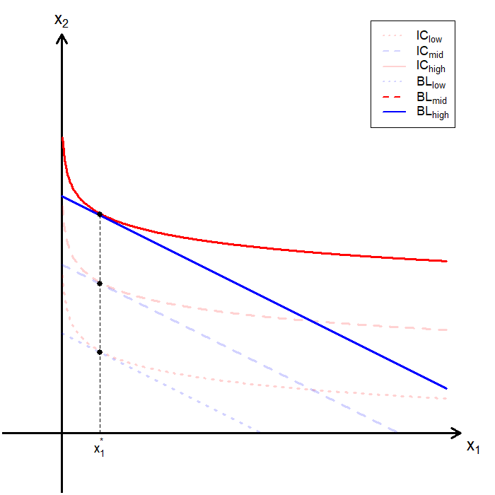
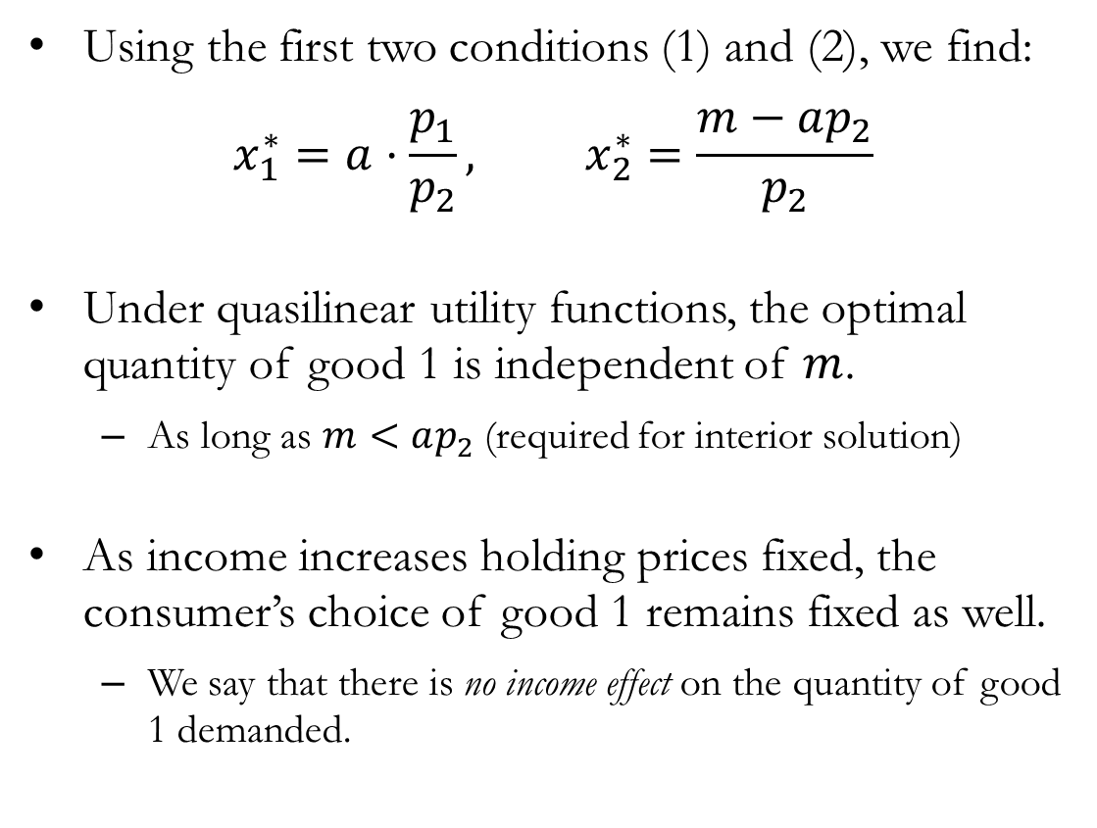
Quasilinear Utility: No Income Effect
Using the first two conditions (1) and (2), we find:
$$x_{1}^{∗}=a⋅\frac{p_{1}}{p_{2}}, x_{2}^{∗}=\frac{m−ap_{2}}{p_{2}}$$
Under quasilinear utility functions, the optimal quantity of good 1 is independent of $m$.
As long as $m<ap_{2}$ (required for interior solution)
As income increases holding prices fixed, the consumer’s choice of good 1 remains fixed as well.
We say that there is no income effect on the quantity of good 1 demanded.

Slide 8
Consumer’s Surplus:
Discrete Goods

Slide 9
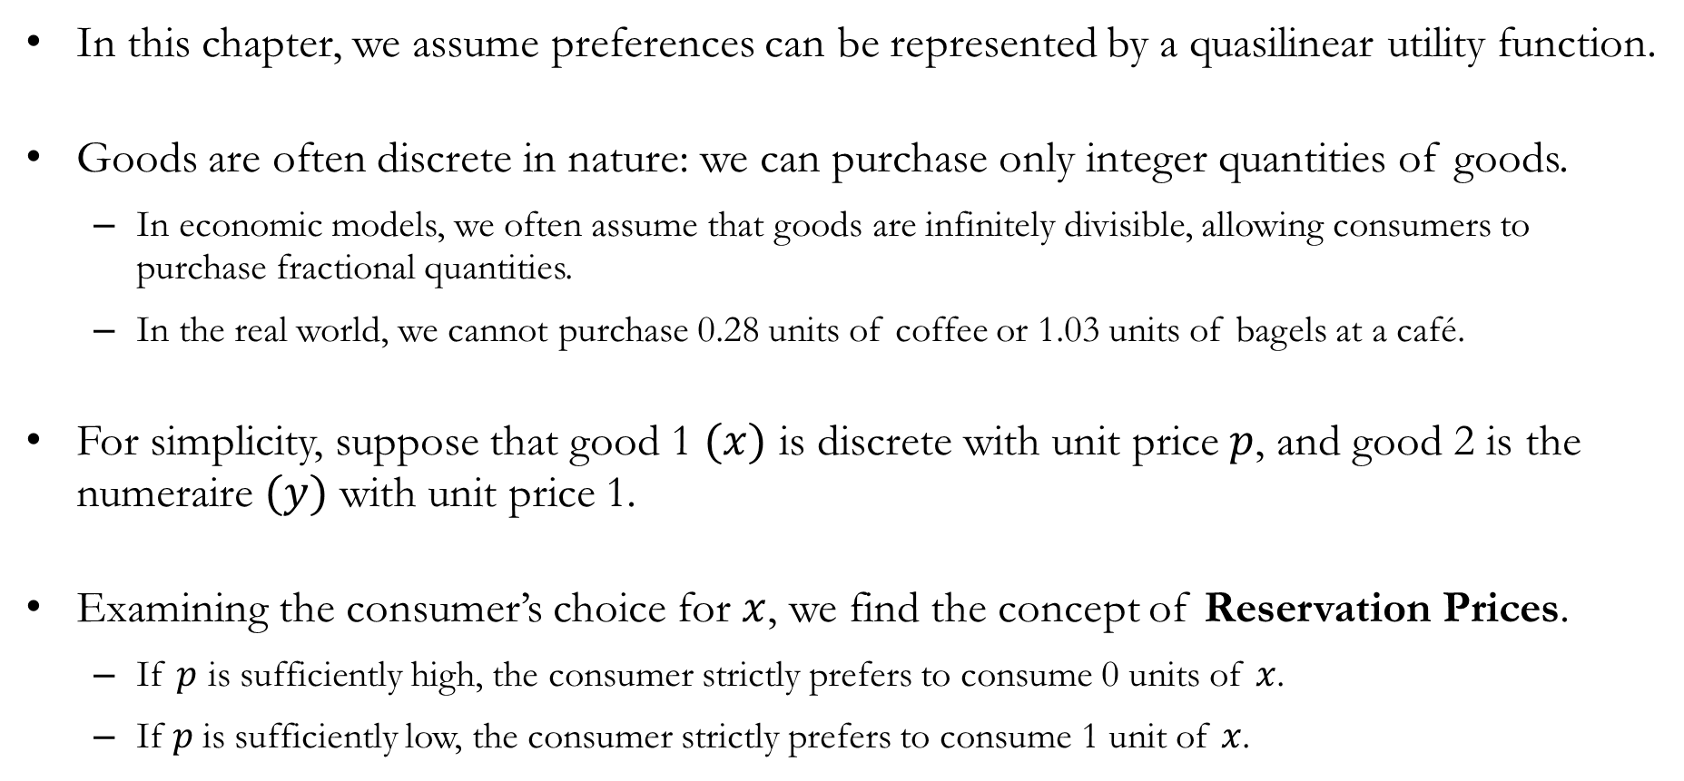
Discrete Goods
In this chapter, we assume preferences can be represented by a quasilinear utility function.
Goods are often discrete in nature: we can purchase only integer quantities of goods.
In economic models, we often assume that goods are infinitely divisible, allowing consumers to purchase fractional quantities.
In the real world, we cannot purchase 0.28 units of coffee or 1.03 units of bagels at a café.
For simplicity, suppose that good 1 $(x)$ is discrete with unit price $p$, and good 2 is the numeraire $(y)$ with unit price 1.
Examining the consumer’s choice for $x$, we find the concept of Reservation Prices.
If $p$​ is sufficiently high, the consumer strictly prefers to consume 0 units of $x$.
If​ $p$ is sufficiently low, the consumer strictly prefers to consume 1 unit of $x$.

Slide 10
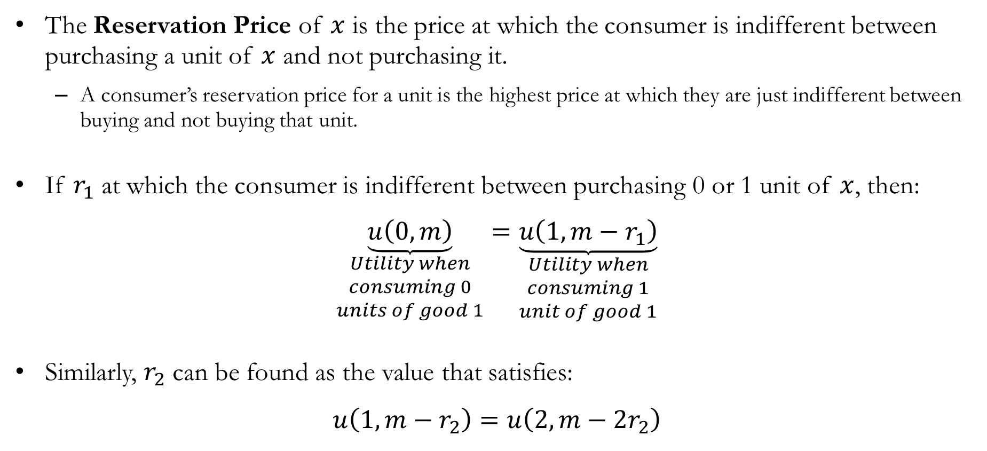
Reservation Prices
The Reservation Price of $x$ is the price at which the consumer is indifferent between purchasing a unit of $x$ and not purchasing it.
A consumer’s reservation price for a unit is the highest price at which they are just indifferent between buying and not buying that unit.
If $r_{1}$ at which the consumer is indifferent between purchasing 0 or 1 unit of $x$, then:
$$\underset{\begin{aligned}Utility when \\ consuming 0 \\ units of good 1\end{aligned}}{\underbrace{u\left(0,m\right)}}=\underset{\begin{aligned}Utility when \\ consuming 1 \\ unit of good 1\end{aligned}}{\underbrace{u\left(1,m−r_{1}\right)}}$$
Similarly, $r_{2}$ can be found as the value that satisfies:
$$u\left(1,m−r_{2}\right)=u\left(2,m−2r_{2}\right)$$

Slide 11
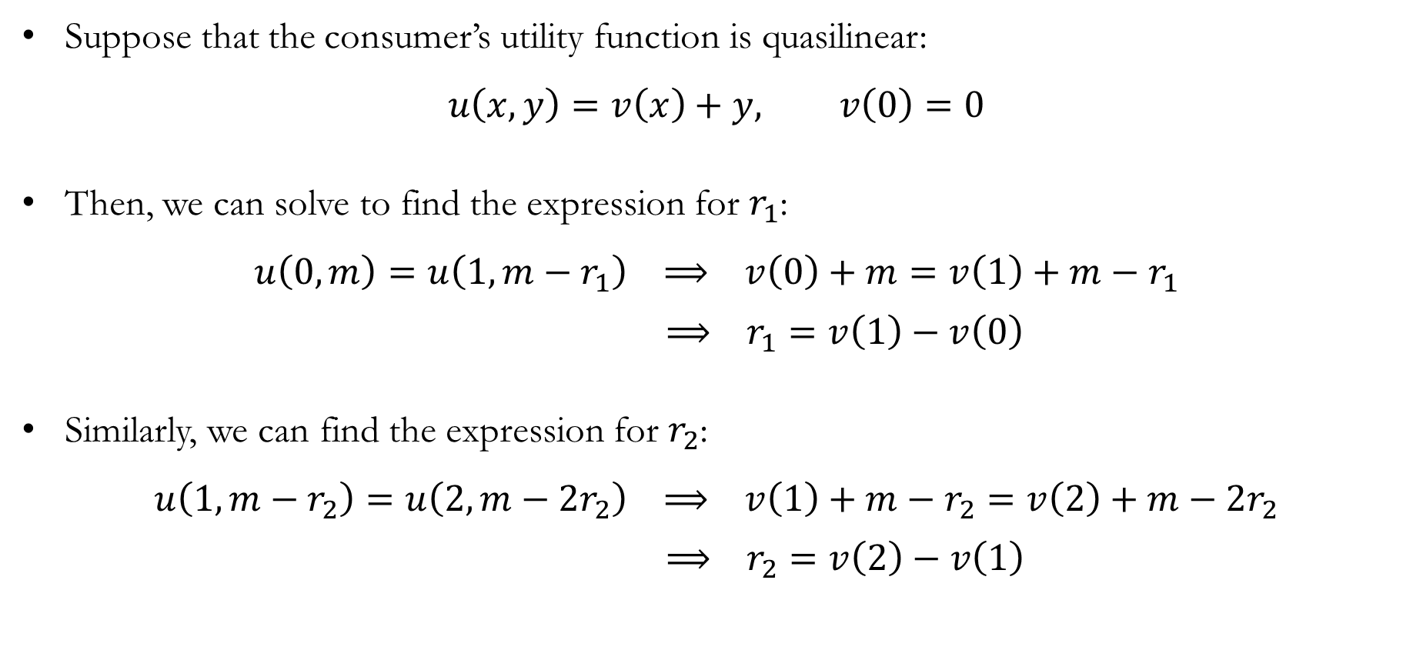
Quasilinear Utility and Reservation Prices
Suppose that the consumer’s utility function is quasilinear:
$$u\left(x,y\right)=v\left(x\right)+y, v\left(0\right)=0$$
Then, we can solve to find the expression for $r_{1}$:
$$u\left(0,m\right)=u\left(1,m−r_{1}\right) ⟹ v\left(0\right)+m=v\left(1\right)+m−r_{1}$$
$⟹ r_{1}=v\left(1\right)−v\left(0\right)$
Similarly, we can find the expression for $r_{2}$:
$$u\left(1,m−r_{2}\right)=u\left(2,m−2r_{2}\right) ⟹ v\left(1\right)+m−r_{2}=v\left(2\right)+m−2r_{2}$$
$⟹ r_{2}=v\left(2\right)−v\left(1\right)$

Slide 12
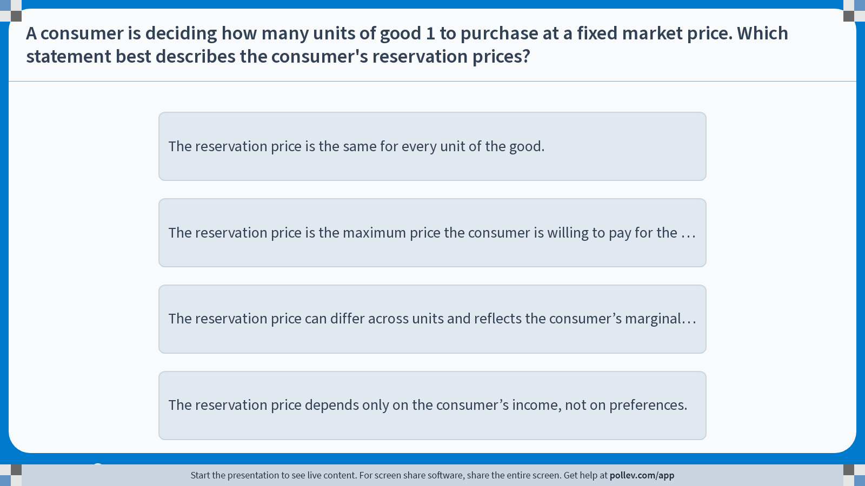
Poll Everywhere multiple choice poll instructions screen Activity Title: A consumer is deciding how many units of good 1 to purchase at a fixed market price. Which statement best describes the consumer's reservation prices? Slide 12
Notes:
Do not modify the notes in this section to avoid tampering with the Poll Everywhere activity. More info at polleverywhere.com/support A consumer is deciding how many units of good 1 to purchase at a fixed market price. Which statement best describes the consumer's reservation prices? https://www.polleverywhere.com/multiple_choice_polls/484yzgFCWECLNrv8v5lxq?display_state=instructions&activity_state=opened&state=opened&flow=Engagement&onscreen=persist

Slide 13
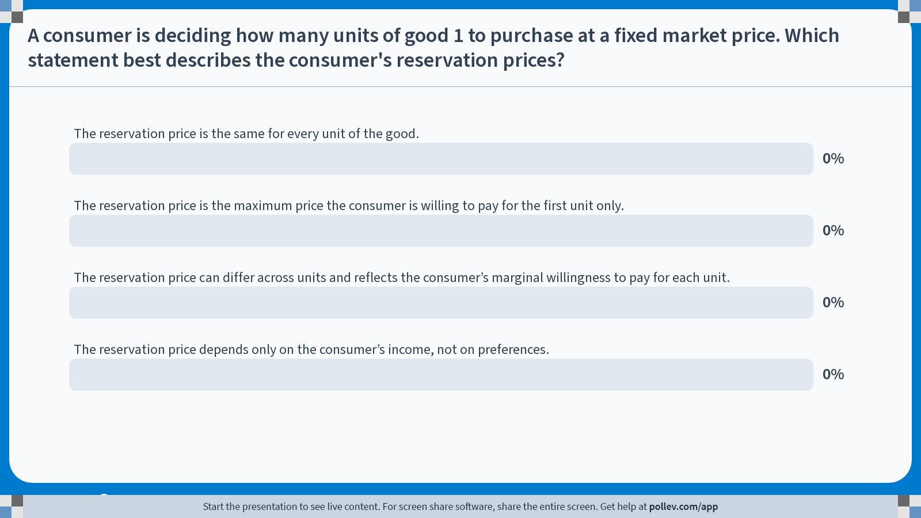
Poll Everywhere multiple choice poll chart screen Activity Title: A consumer is deciding how many units of good 1 to purchase at a fixed market price. Which statement best describes the consumer's reservation prices? Slide 14
Notes:
Do not modify the notes in this section to avoid tampering with the Poll Everywhere activity. More info at polleverywhere.com/support A consumer is deciding how many units of good 1 to purchase at a fixed market price. Which statement best describes the consumer's reservation prices? https://www.polleverywhere.com/multiple_choice_polls/484yzgFCWECLNrv8v5lxq?display_state=chart&activity_state=closed&state=closed&flow=Engagement&onscreen=persist

Slide 14
In-class Poll #1
The reservation price can differ across units and reflects the consumer’s marginal willingness to pay for each unit.
A reservation price is defined unit by unit.
It represents the maximum price the consumer is willing to pay for that specific unit.
As consumption increases, marginal willingness to pay typically falls, implying lower reservation prices for additional units.
Incorrect Answers:
A: Reservation prices are generally not the same across units, since they reflect marginal willingness to pay.
B: The first unit does not uniquely define willingness to pay for all units.
D: Reservation prices depend on preferences and marginal utility, not income alone.

Slide 15
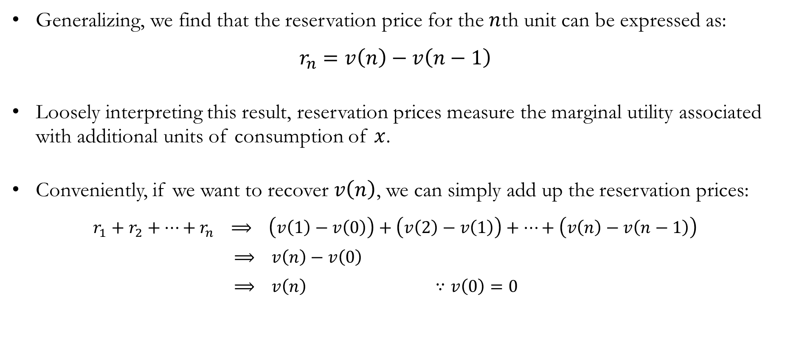
Reservation Prices and Utility
Generalizing, we find that the reservation price for the $n$th unit can be expressed as:
$$r_{n}=v\left(n\right)−v\left(n−1\right)$$
Loosely interpreting this result, reservation prices measure the marginal utility associated with additional units of consumption of $x$.
Conveniently, if we want to recover $v\left(n\right)$, we can simply add up the reservation prices:
$$r_{1}+r_{2}+⋯+r_{n} ⟹ \left(v\left(1\right)−v\left(0\right)\right)+\left(v\left(2\right)−v\left(1\right)\right)+⋯+\left(v\left(n\right)−v\left(n−1\right)\right)$$
$⟹ v\left(n\right)−v\left(0\right)$
$⟹ v\left(n\right) ∵v\left(0\right)=0$

Slide 16
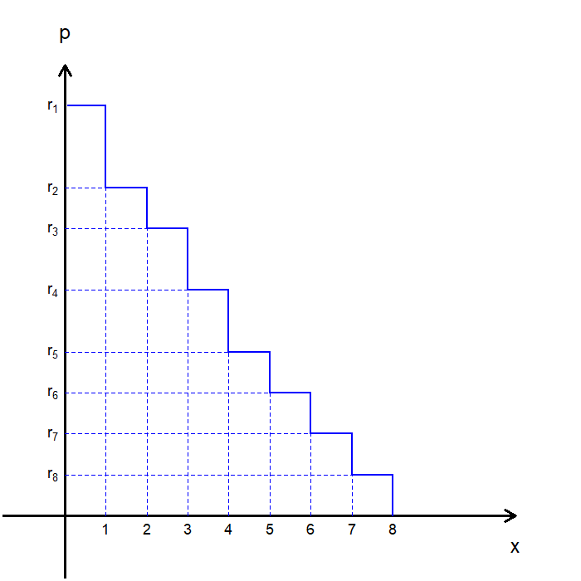
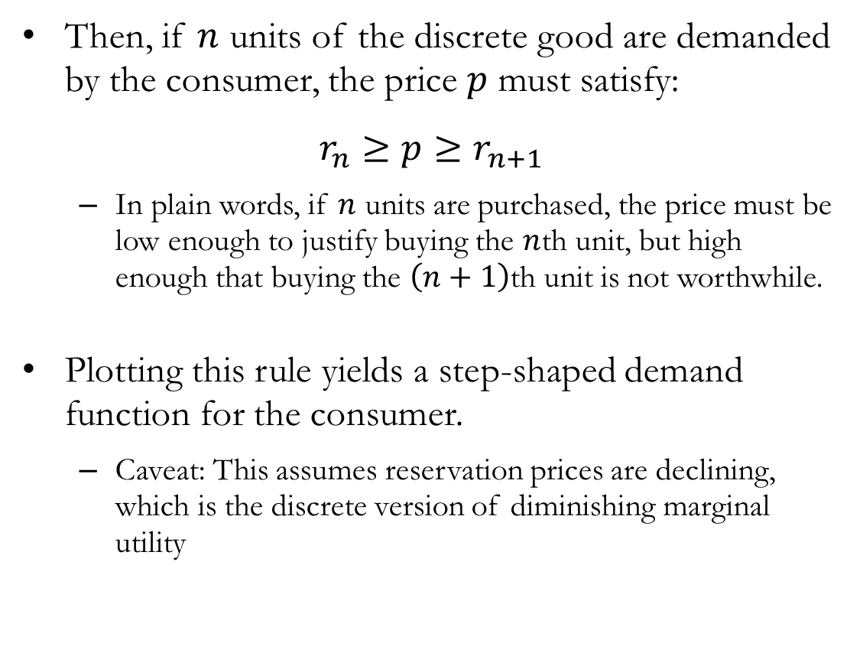
Quasilinear Utility: Demand Functions
Then, if $n$ units of the discrete good are demanded by the consumer, the price $p$ must satisfy:
$$r_{n}≥p≥r_{n+1}$$
In plain words, if $n$ units are purchased, the price must be low enough to justify buying the $n$th unit, but high enough that buying the $\left(n+1\right)$th unit is not worthwhile.
Plotting this rule yields a step-shaped demand function for the consumer.
Caveat: This assumes reservation prices are declining, which is the discrete version of diminishing marginal utility

Slide 17
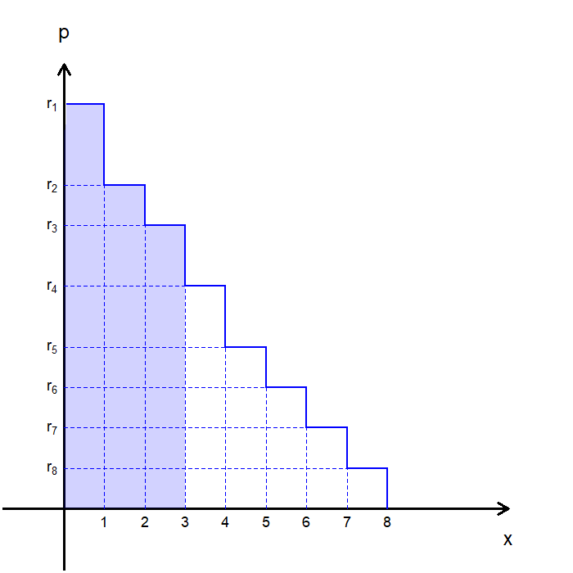
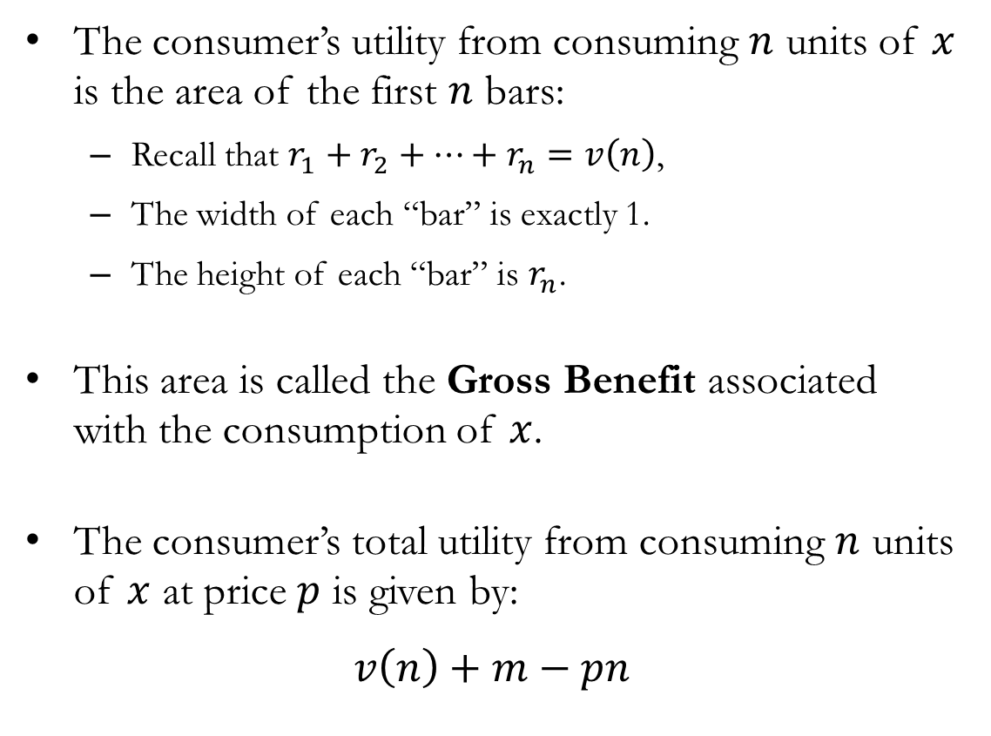
Gross Benefit
The consumer’s utility from consuming $n$ units of $x$ is the area of the first $n$ bars:
Recall that $r_{1}+r_{2}+⋯+r_{n}=v\left(n\right)$,
The width of each “bar” is exactly 1.
The height of each “bar” is $r_{n}$.
This area is called the Gross Benefit associated with the consumption of $x$.
The consumer’s total utility from consuming $n$ units of $x$ at price $p$ is given by:
$$v\left(n\right)+m−pn$$

Slide 18
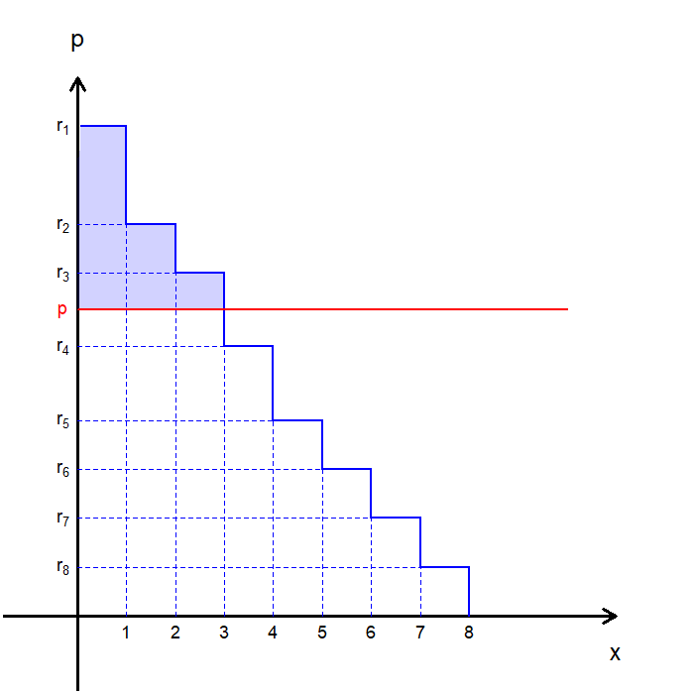
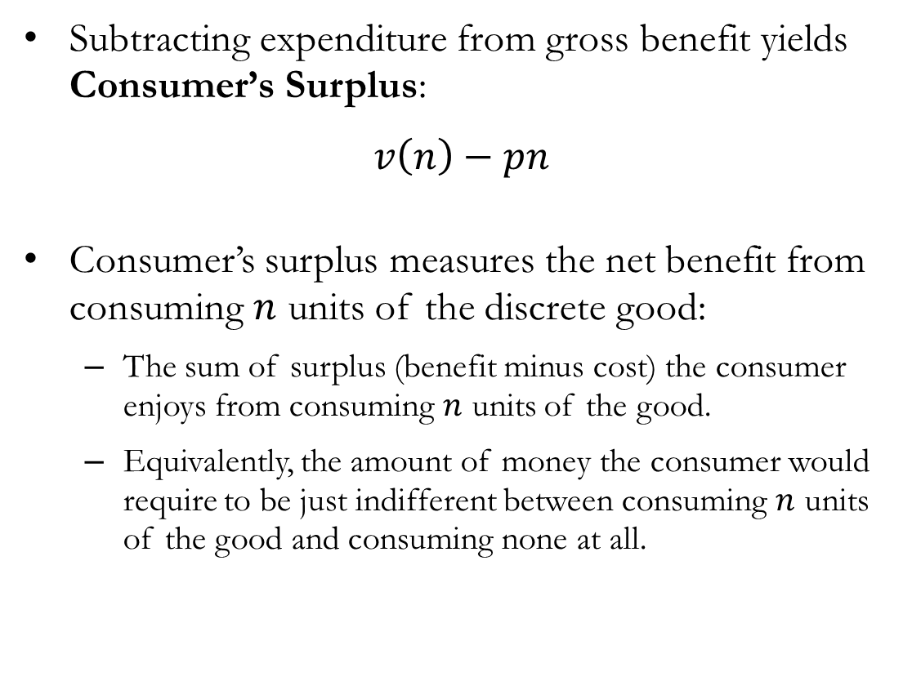
Consumer’s Surplus
Subtracting expenditure from gross benefit yields Consumer’s Surplus:
$$v\left(n\right)−pn$$
Consumer’s surplus measures the net benefit from consuming $n$ units of the discrete good:
The sum of surplus (benefit minus cost) the consumer enjoys from consuming $n$ units of the good.
Equivalently, the amount of money the consumer would require to be just indifferent between consuming $n$ units of the good and consuming none at all.

Slide 19
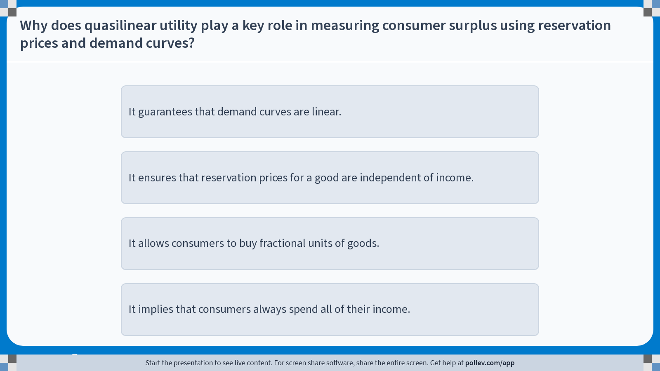
Poll Everywhere multiple choice poll instructions screen Activity Title: Why does quasilinear utility play a key role in measuring consumer surplus using reservation prices and demand curves? Slide 19
Notes:
Do not modify the notes in this section to avoid tampering with the Poll Everywhere activity. More info at polleverywhere.com/support Why does quasilinear utility play a key role in measuring consumer surplus using reservation prices and demand curves? https://www.polleverywhere.com/multiple_choice_polls/WRcAbWNXFTg3EkYDXI3io?display_state=instructions&activity_state=opened&state=opened&flow=Engagement&onscreen=persist

Slide 20
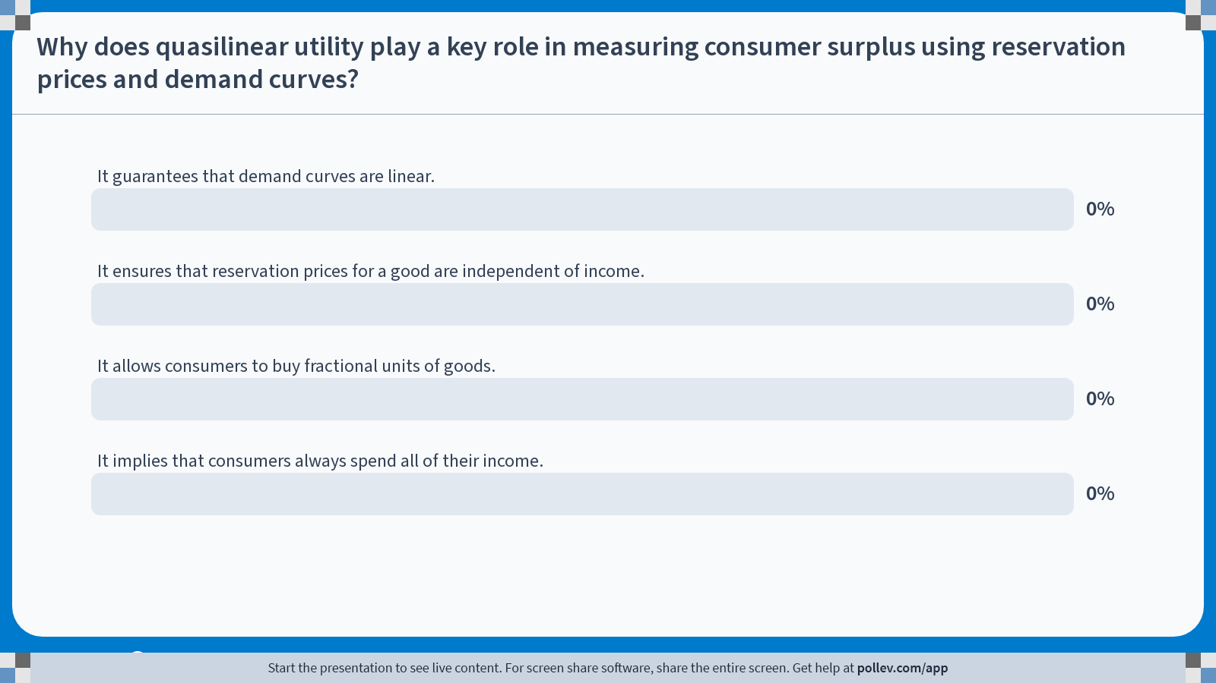
Poll Everywhere multiple choice poll chart screen Activity Title: Why does quasilinear utility play a key role in measuring consumer surplus using reservation prices and demand curves? Slide 21
Notes:
Do not modify the notes in this section to avoid tampering with the Poll Everywhere activity. More info at polleverywhere.com/support Why does quasilinear utility play a key role in measuring consumer surplus using reservation prices and demand curves? https://www.polleverywhere.com/multiple_choice_polls/WRcAbWNXFTg3EkYDXI3io?display_state=chart&activity_state=closed&state=closed&flow=Engagement&onscreen=persist

Slide 21
In-class Poll #2
It ensures that reservation prices for a good are independent of income.
Under quasilinear utility, changes in income affect consumption of the numeraire good only.
Marginal utility of the non-numeraire good does not depend on income.
As a result, reservation prices remain fixed as income changes.
This allows consumer surplus to be measured using reservation prices and demand curves.
Incorrect Answers:
A: Quasilinear utility does not imply linear demand.
C: Fractional units are unrelated to quasilinear preferences.
D: Monotonicity, not quasilinearity, is the reason consumers spend all of their income.

Slide 22
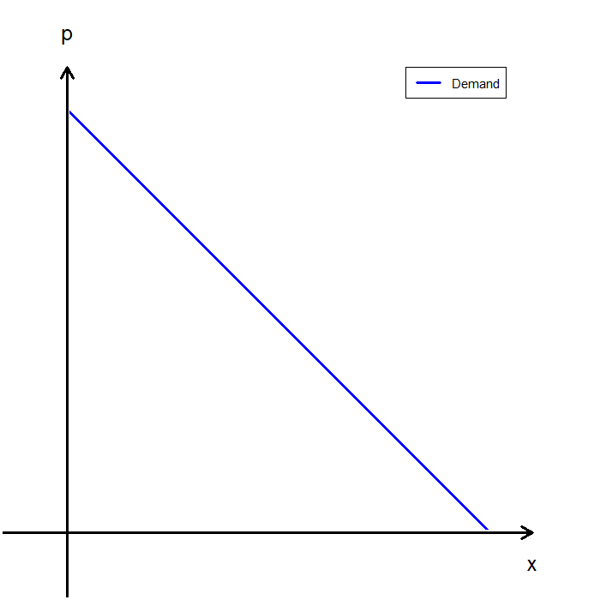
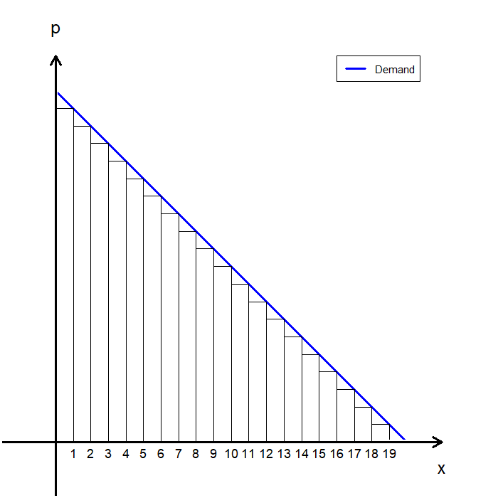
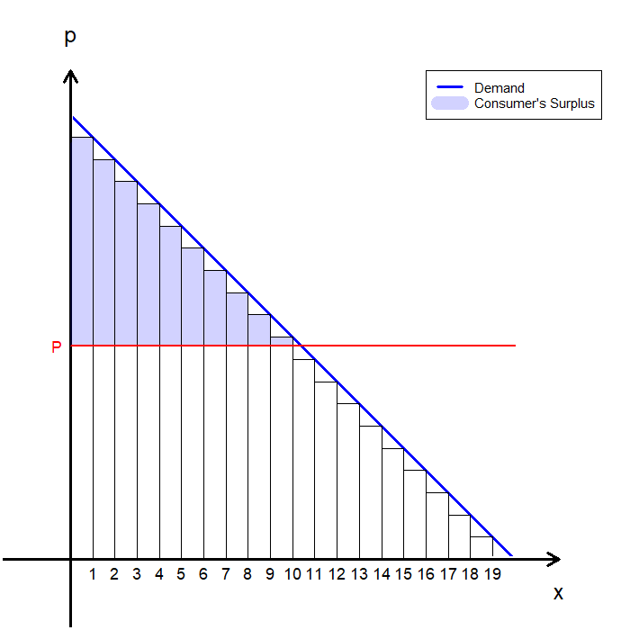
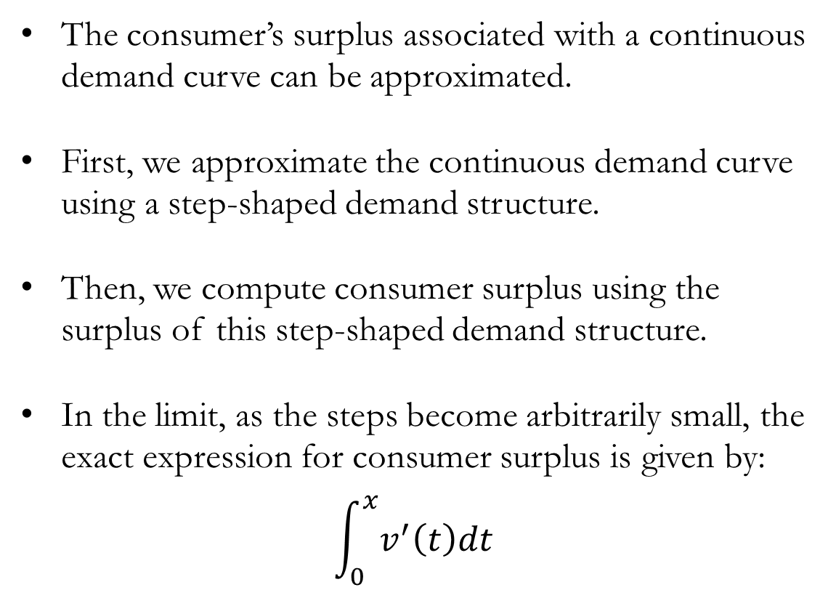
Consumer’s Surplus and Continuous Demand
The consumer’s surplus associated with a continuous demand curve can be approximated.
First, we approximate the continuous demand curve using a step-shaped demand structure.
Then, we compute consumer surplus using the surplus of this step-shaped demand structure.
In the limit, as the steps become arbitrarily small, the exact expression for consumer surplus is given by:
$$\int_{0}^{x}{v^{′}\left(t\right)dt}$$

Slide 23
Caveat: Quasilinear Utility
All analysis up to this point hinges on one key assumption: the consumer’s utility function can be represented by a quasilinear utility function.
In general, the price at which a consumer is willing to purchase units of good 1 depends on how much income they have available for consuming other goods.
Only when the consumer’s utility is quasilinear, the consumer’s reservation price is independent of the amount of income available for consumption of other goods.
Although the area under the demand curve is not an exact measure of consumer surplus in general, it is often a sufficiently accurate approximation.
This approximation works best when the income effect is small.

Slide 24
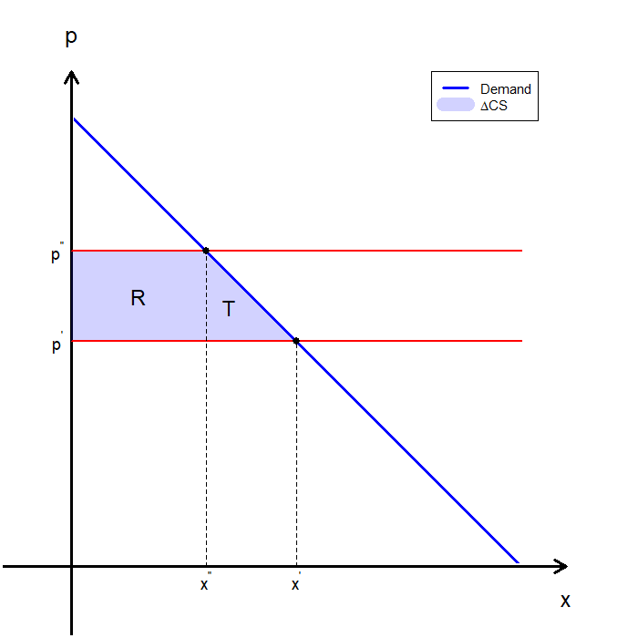
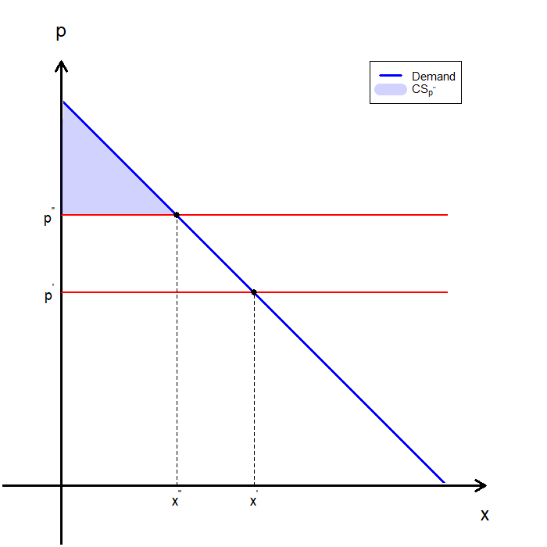
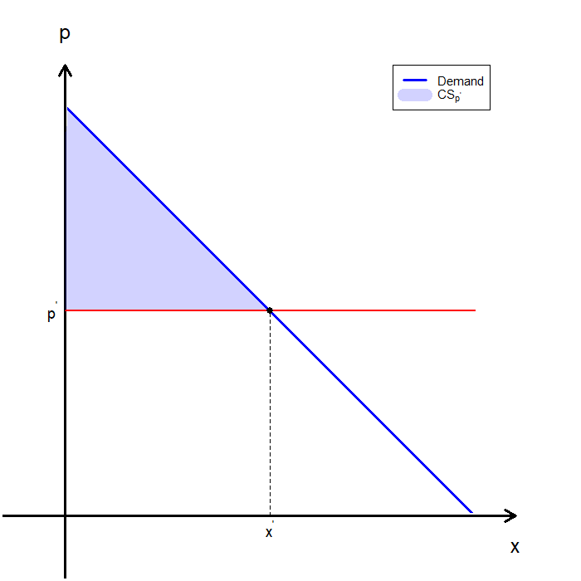
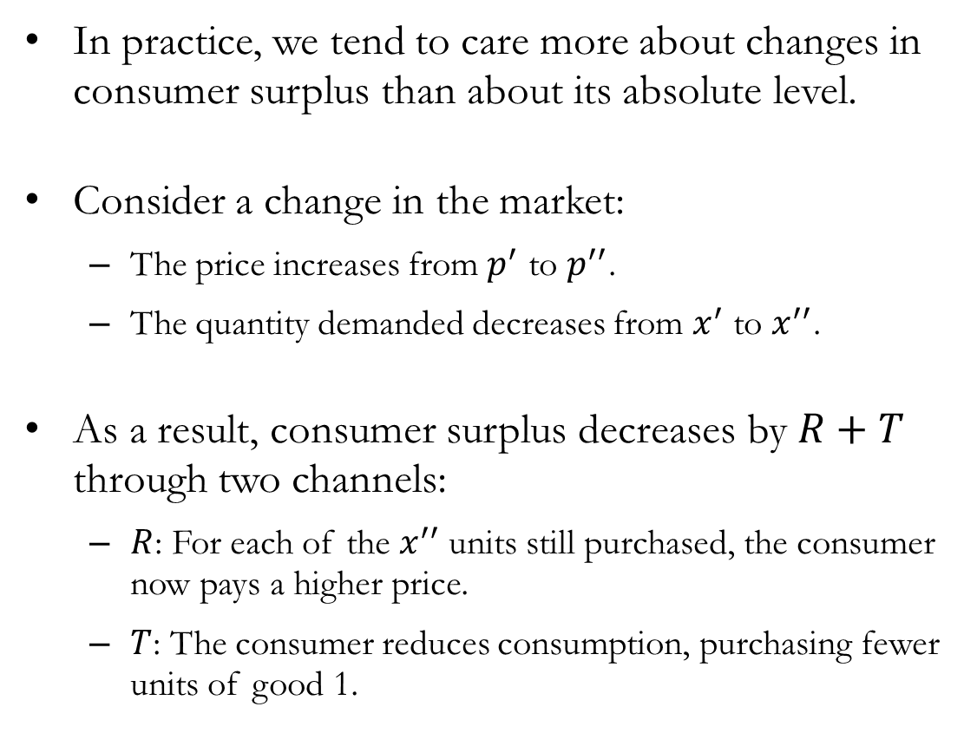
Changes to the Consumer’s Surplus
In practice, we tend to care more about changes in consumer surplus than about its absolute level.
Consider a change in the market:
The price increases from $p^{′}$ to $p^{′′}$.
The quantity demanded decreases from $x^{′}$ to $x^{′′}$.
As a result, consumer surplus decreases by $R+T$ through two channels:
$R$: For each of the $x^{′′}$ units still purchased, the consumer now pays a higher price.
$T$: The consumer reduces consumption, purchasing fewer units of good 1.

Slide 25
Producer’s Surplus

Slide 26
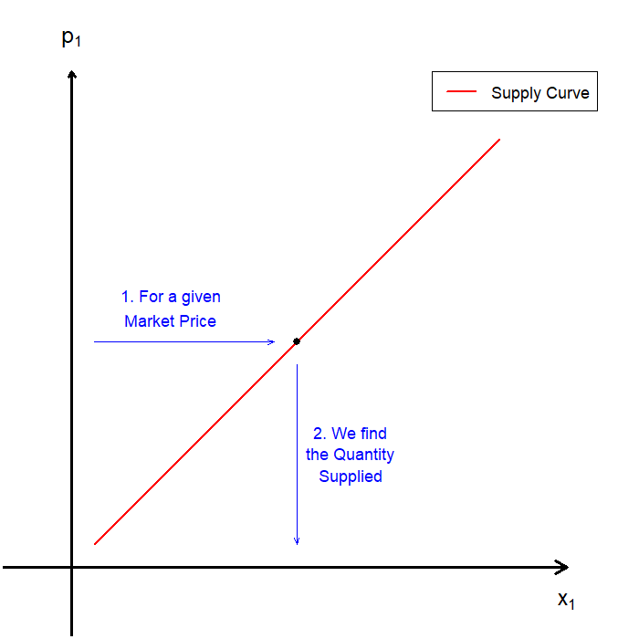
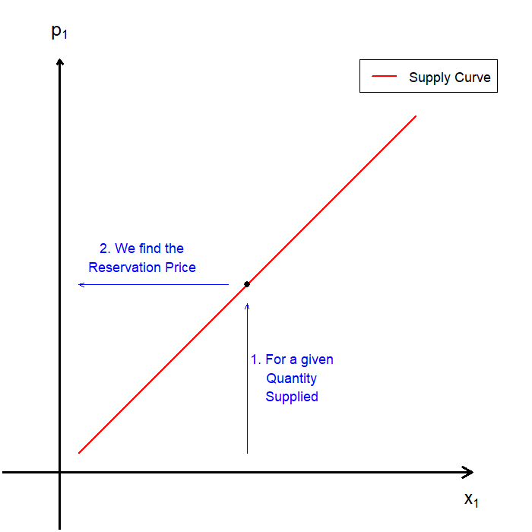
Supply and Inverse Supply Functions
The supply function gives the quantity a firm (or market) is willing to supply at each price.
The inverse supply function gives the minimum price at which the supplier is willing to supply a given quantity of the good.
The inverse supply function gives the reservation price for supplying each unit of the good.
Producer surplus arises when the market price exceeds the reservation price for units supplied.

Slide 27
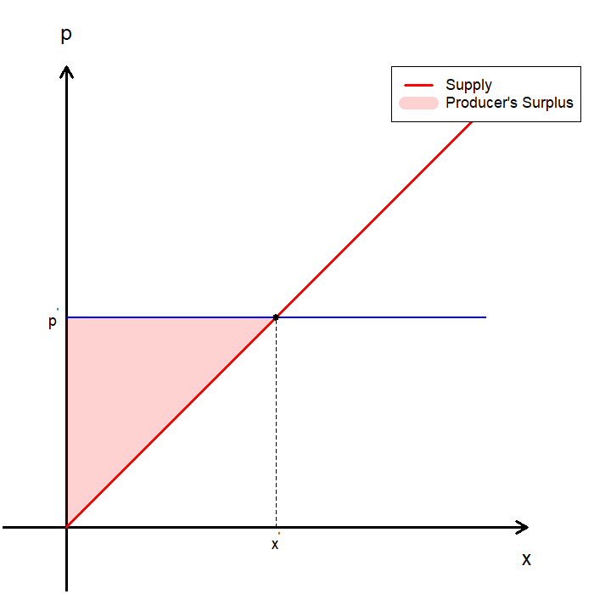
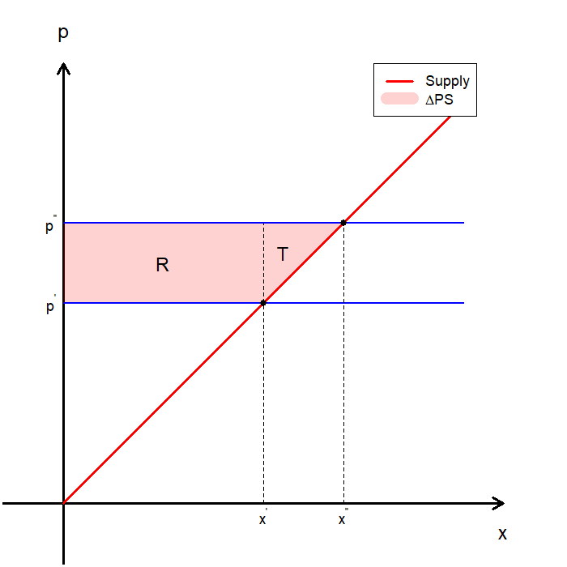
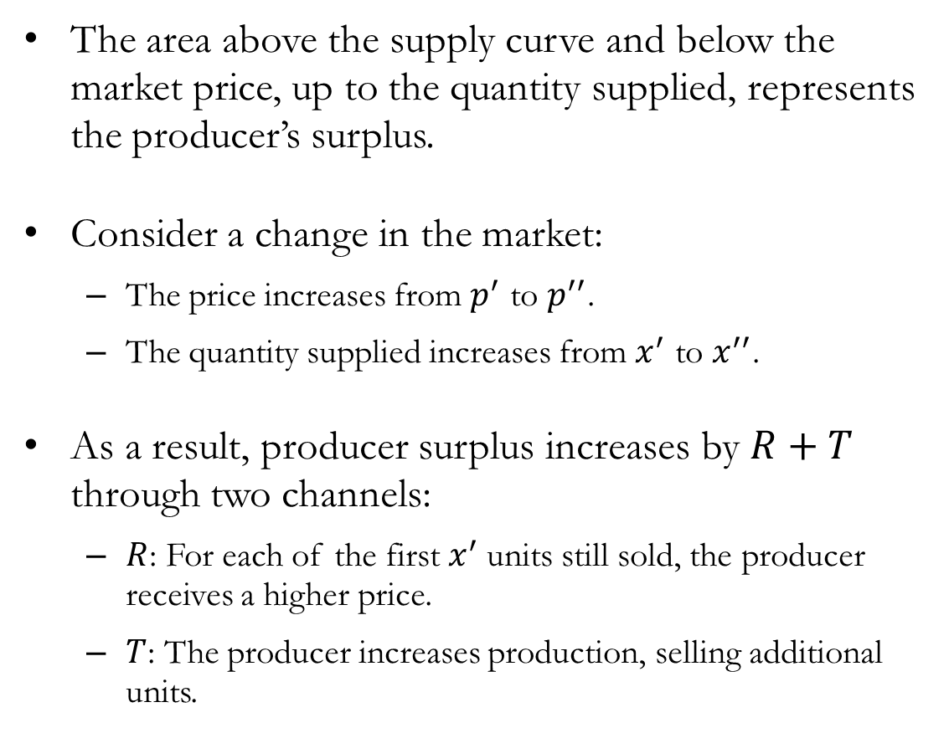
Producer’s Surplus
The area above the supply curve and below the market price, up to the quantity supplied, represents the producer’s surplus.
Consider a change in the market:
The price increases from $p^{′}$ to $p^{′′}$.
The quantity supplied increases from $x^{′}$ to $x^{′′}$.
As a result, producer surplus increases by $R+T$ through two channels:
$R$: For each of the first $x^{′}$ units still sold, the producer receives a higher price.
$T$: The producer increases production, selling additional units.

Slide 28
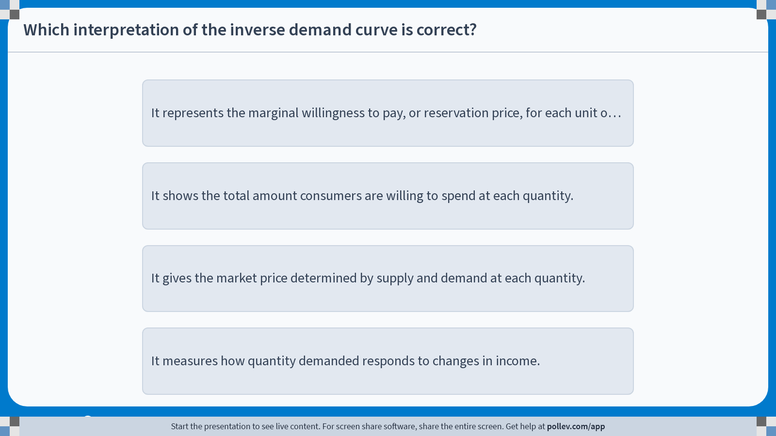
Poll Everywhere multiple choice poll instructions screen Activity Title: Which interpretation of the inverse demand curve is correct? Slide 26
Notes:
Do not modify the notes in this section to avoid tampering with the Poll Everywhere activity. More info at polleverywhere.com/support Which interpretation of the inverse demand curve is correct? https://www.polleverywhere.com/multiple_choice_polls/p98dhnNeqKHxxDhqFXIK3?display_state=instructions&activity_state=opened&state=opened&flow=Engagement&onscreen=persist

Slide 29
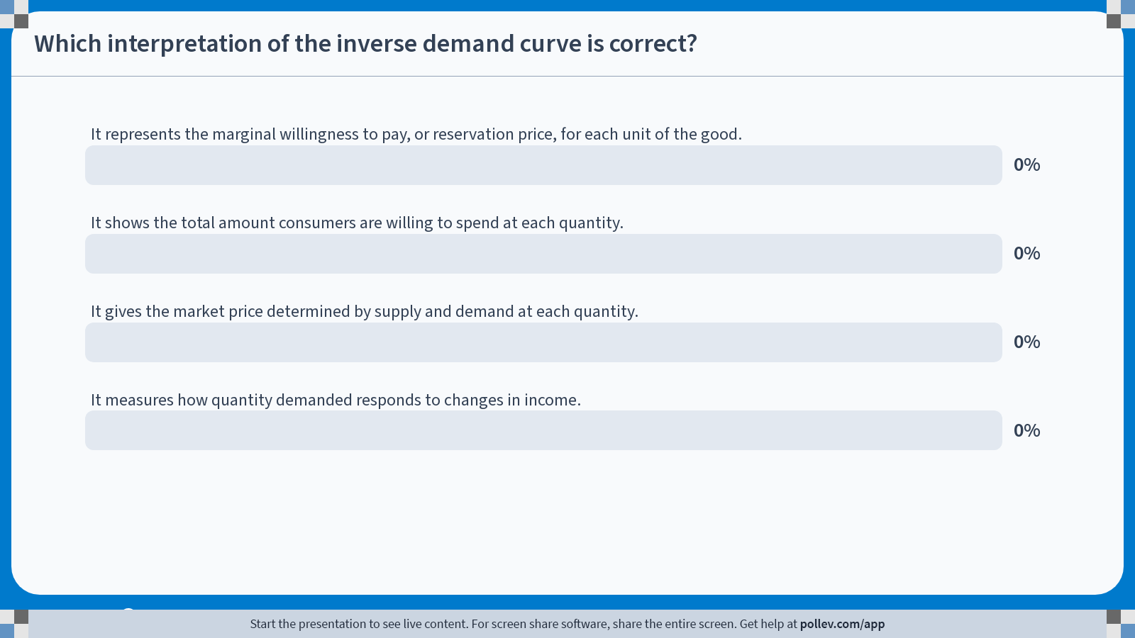
Poll Everywhere multiple choice poll chart screen Activity Title: Which interpretation of the inverse demand curve is correct? Slide 28
Notes:
Do not modify the notes in this section to avoid tampering with the Poll Everywhere activity. More info at polleverywhere.com/support Which interpretation of the inverse demand curve is correct? https://www.polleverywhere.com/multiple_choice_polls/p98dhnNeqKHxxDhqFXIK3?display_state=chart&activity_state=closed&state=closed&flow=Engagement&onscreen=persist

Slide 30
In-class Poll #3
It represents the marginal willingness to pay, or reservation price, for each unit of the good.
The inverse demand curve tells us the price at which a consumer is just willing to purchase a given unit.
Each point on the inverse demand curve corresponds to a reservation price.
This interpretation is what allows the area under the demand curve (above the market price) to represent consumer surplus.
Incorrect Answers:
B: Inverse demand reflects marginal, not total, willingness to pay.
C: Market price is determined by both supply and demand, not demand alone.
D: Income responsiveness is not shown by inverse demand.

Slide 31
Recap & Preview

Slide 32
Recap: Consumer’s Surplus
Reservation prices describe the maximum price a consumer is willing to pay for each unit of a good.
Consumer surplus measures the difference between:
The consumer’s gross benefit, and
Total expenditure at the market price.
For discrete goods, consumer surplus is computed by summing reservation prices net of expenditure.
For continuous goods, consumer surplus is represented by the area:
Under the individual demand curve,
Above the market price.

Slide 33
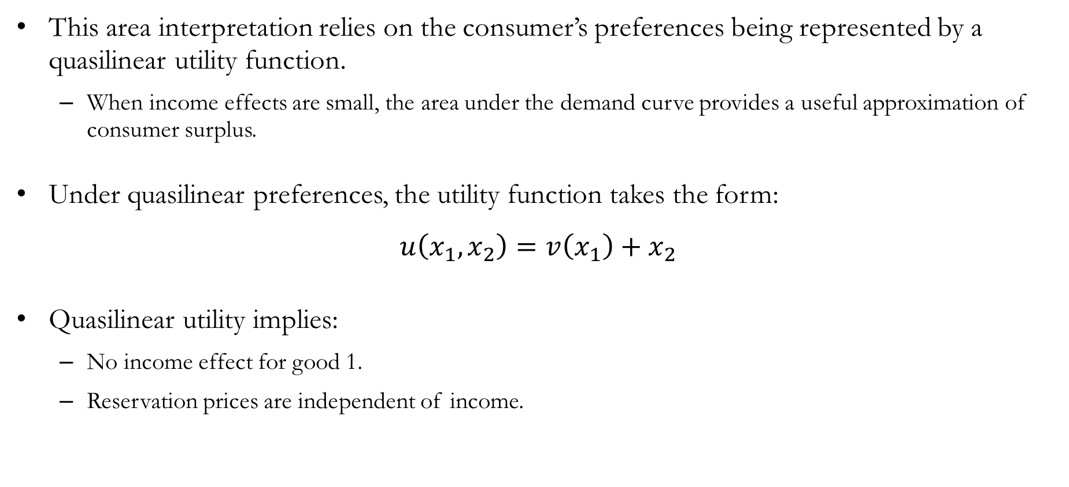
Recap: Consumer’s Surplus
This area interpretation relies on the consumer’s preferences being represented by a quasilinear utility function.
When income effects are small, the area under the demand curve provides a useful approximation of consumer surplus.
Under quasilinear preferences, the utility function takes the form:
$$u\left(x_{1},x_{2}\right)=v\left(x_{1}\right)+x_{2}$$
Quasilinear utility implies:
No income effect for good 1.
Reservation prices are independent of income.

Slide 34
Preview: Market Demand
So far, we have focused on individual demand derived from utility maximization.
In practice, economists often observe market demand, which aggregates the behavior of many individual consumers.
Next, we study how individual demand curves combine to form market demand.
We examine how market demand responds to price changes.
A key concept will be price elasticity of demand, which measures how sensitive quantity demanded is to price changes.

